Slide 1
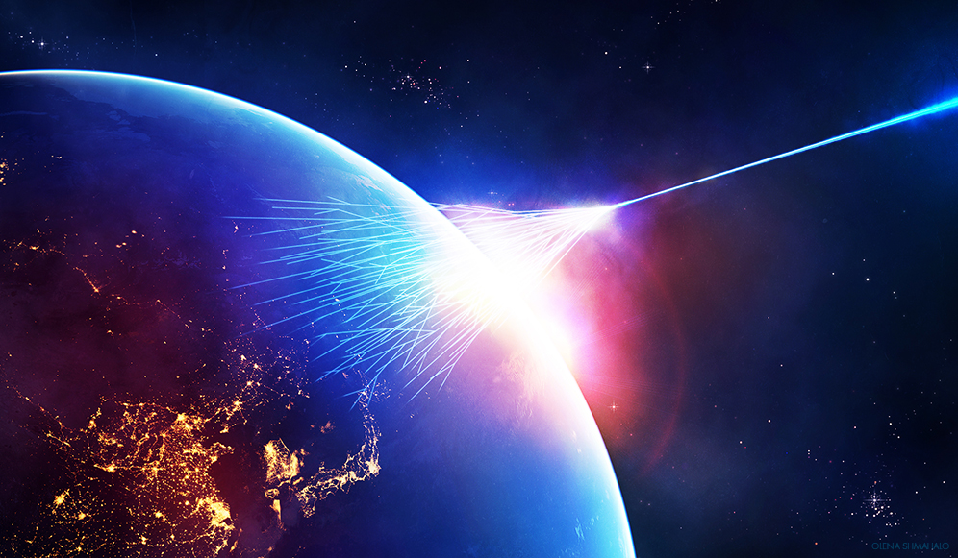
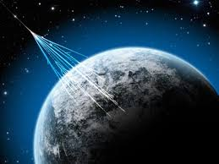
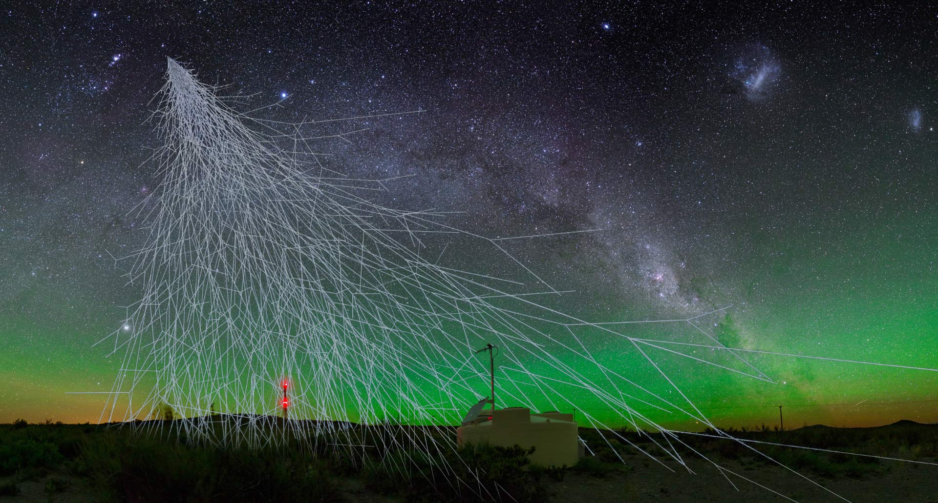
Ultra high energy cosmic rays
.
Notes:
Motivaciou pre skumanie LIVu su viacere teorie aspirujuce na QGT. S volny
Planck-scale Lorentz violation constrained by Ultra-High-Energy Cosmic Rays
Lorentz symmetry breaking is certainly not a necessary feature of QG, but any Planck-scale induced LV effects could provide an observational window into QG phenomena. Moreover, the absence of LV phenomena provides by itself constraints on viable QG theories and more firmly establishes the validity of special relativity.

Slide 2
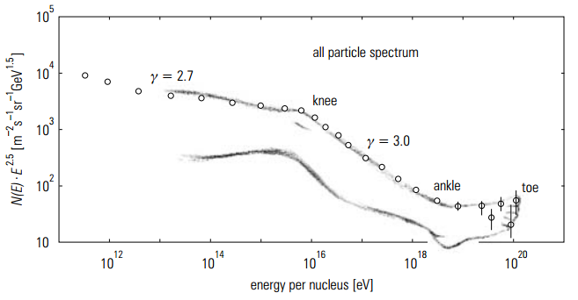
Cosmic ray spectrum
.
Notes:
Za kozmicke ziarenie sa povazuje nabite ziarenie dopadajuce s kozmu na zem s energiami vacsimi ako 10na13 eV. Spektrum toku tohto ziarenia je vidiet na lavo. Na prvy pohlad na nom nie je vidiet ziadnu detailnejsiu strukturu. Tu je vidiet az po vynasobeni tohto toku energiou na3. Potom mozme vidiet jednotlive casti tohto spektra, ktore sa nazyvaju koleno, clenok, prsty. Ziarenie do 10na15eV je galaktickeho povodu a jeho tok predtavuje 1casticu na 1m2 za sekundu, ziarenie nad 10na15eV je extragalaktickeho povodu a jeho tok je 1castica na 1m2 za rok. UHECR, podla je to kozmicke ziarenie a ma energiu vacsiu ako 10na19 s tokom 1 castica na 1km2 za storocie.
Je tomu tak ze magneticke galakticke pole dokaze udrzat len castice s energiami do 10na15eV 10na13 je 1cas na 1m2/s 10na15 je 1cas/1km2 a 10na19 je 1cas/km2 za storocie

Slide 3
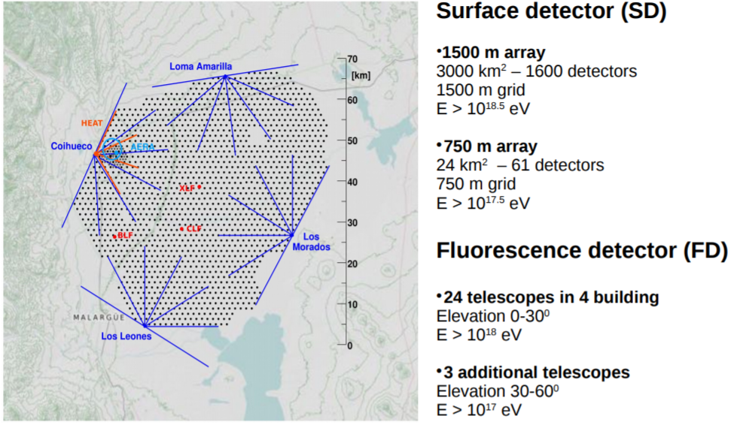
Pierre Auger Observatory
.
Notes:
Na meranie UHECR sa pouzivaju specialne observatoria. Jednym z nich je Observatoř Pierra Augera. Je to mezinárodní observatoř kosmického záření nacházející se v Argentině. Je určena k detekci ultra-vysoce energetického kosmického záření. Toto observatorium pozostava zakladne z povrchovych detektorov SD ktore su v podstate cerenkovymi detektormi v poli 1500 kde je ich 1600 na celkovej rozlohe 3000km2 a ich ucelkom je meranie zlozky spektra s najvyssimi enrgiami a 61 750. kde je ich 61. FD dektorv tvoria 24 teleskopov v 4budovach, ktore su rozmiestnene po obvode polia.

Slide 4
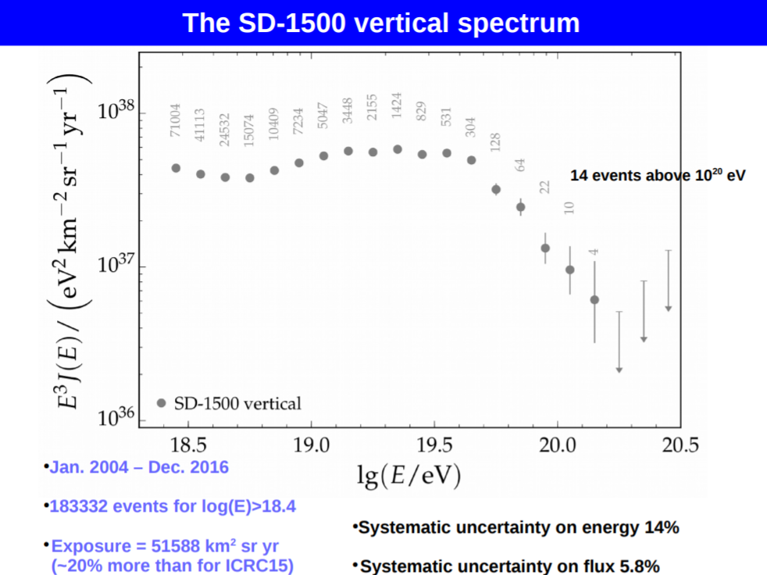
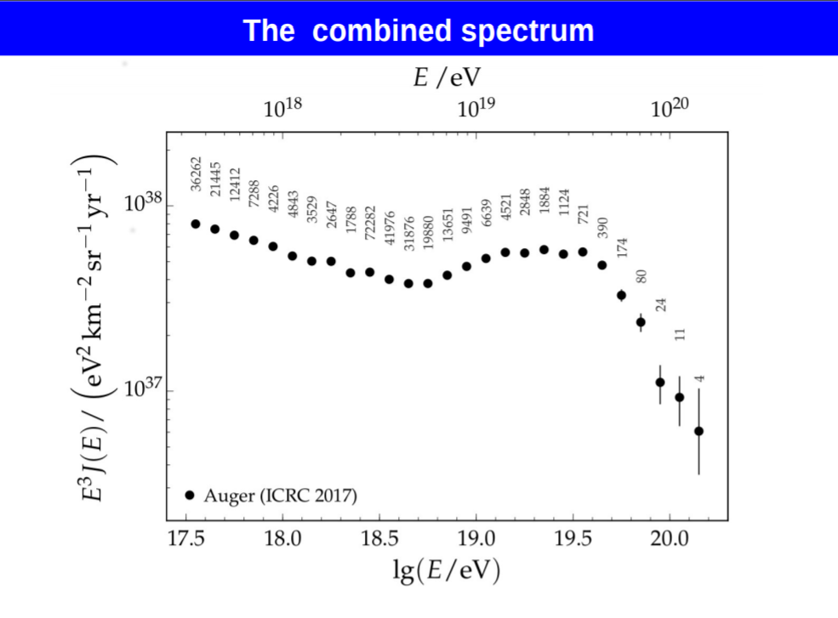
Spektrum UHECR namerané
Pierre Auger Observatory
.
Notes:
Vysledkom merani PAO je okrem ineho, aj spektrum UHECR. Na lavo je vertikalne spektrum namerane iba SD detektormi a na pravo je spektrum vytvorene kombinovanim nameranych udajov z SD1500 SD750 a FD detektorov, ktore sa spracuvavaju komplikovanym sposobom. Podla gzk by malo kozmicke ziarenie s energiami vyssimi ako 5*10na19 reagovat s CMB za produkcie pionu a fotonu. Tomu zodpovedajuca stredna volna draha je 10Mpc. Na to aby k nam mohlo dojst taketo energeticke ziarenie vacsie ako 5*10na19 tak by sa jeho zdroje museli nachadzat vo vzdialenosti niekolkych strednych dlzok podla coho je priblizne 30Mpc. Avsak doteraz neboli spolahlivo najdene taketo zdroje. Dalsou nejasnostou je zlozenie tychto castic. Povod vysokoenergetickeho ziarenia z nasej galaxie sa vylucuje z toho dovodu ze magneticke pole nasej galaxie nie je schopne udrzat taketo silne castice alebo ich aj tak urychlit. by toto kozmicke ziarenie bolo extragalaktickeho povud a jeho zdroje by sa nachadzali vo vzidialenosti vacsej ako horizonte 50Mpc tak by sme toto ziarenie nemohli vidiet. Potom
pri udalostiach v ramci tohto horizontu by sme mali vediet tieto zdroje najst avsak ziadne doteraz spolahlivo najdene neboli identifikovane. Existuju rozne vysvetlenia tohto tzv. gzk paradoxu jedn zni ch je ako uz bolo spomenute zdroje takeho vysokych energii by sa museli nachadzat mimo nasej galaie. naprikla ze zdroje tohto ziarenia sa nachadzaju v ramci nasej galaxi a su nimi rozpady TD SHMU atd
It is, however, possible to shift the effect of the Greisen–Zatsepin–Kuzmin cutoff to higher energies by assuming thatprimary particles are nuclei. Since the threshold energy mustbe available per nucleon, the corresponding threshold energy, for example, for carbon nuclei (Z = 6, A = 12) would be correspondingly higher,
GZK sphere
E = Ep
cutoff A = 7.2 × 1020 eV , (7.26)
so that the observed events would not be in conflict with the heavy nuclei
Greisen–Zatsepin–Kuzmin cutoff.
. Ako je vidiet na spektre je mozne rozoznat jeho jednotlive vacsti, koleno clenok, prsty.
What is GZK paradox? GZK limit is a theoretical upper limit on the energy of cosmic rays from distance. This limit was computed by Greisen, Zatsepin and Kuzmin in 1966, based on the interactions between the cosmic ray and the cosmic microwave background (CMB) radiation. They predicted that cosmic rays with energies over the threshold energy of 5 x10^19 eV would interact with CMB photons to produce pions. Therefore, extragalactic cosmic rays with energies greater than this threshold energy should never be observed on Earth. Nevertheless, a number of observations appear to show cosmic rays from distant (i.e., extragalactic) sources with energies above this limit.
Podla Greizena, Zatsepina a Kuzmina by sa vsak pri energiach 5*10na19 mal nachadzat cutoff v dosledku interakcie kozmickeho ziarenia s CMB co je cosmic microwave background co je mikrovlne ziarenie nachdzajuce sa vsade okolo nas a jeho povod je z rannych stadii vesmiru, Toto je jedna z kozmologickych otazok na ktoru dosial neexistuje jednoznacna odpoved. Nie je nam jasne preco vidime tieto castice a navyse castice s takouto velkou energiou by nemali byt deflektovane mag. Polom galaxie a mali by sme byt potom schopony urcit smer tohto ziarenia tym padom aj jeho zdroj.
Vysledkom je je namerane spektrum uhecr castic dopadajucich na zem. Vlavo je spektrum merane len prostrednictvom SD detectorov a napravo je kombinovane spektrum z oboch detektorov.
Ako je možné vidieť častice s energiou väčšou ako je GZK mez?
Aký je zdroj tak silného žiarenia E?
Kde sú tieto zdroje?
Klasické
Exotické
LIV
Kozmologické defekty
Rozpad tmavej hmoty

Slide 5
Upper limits for UHE photons
.
Notes:
Z nameranych dat je mozne odvodit dalej horne limiti pre toky vysokoenergeticke fotony pochadzajuce z rozpadu pionu vzniknuteho interakciou uhecr s cmb. Tieto horne limity pre toky fotonov je mozne potom pouzit na potvrdenie resp. vyvratenie roznych scenarov povodu UHECR ako napriklam rozpad tmavej hmoty, rozpad TD Z bursty. Ako je vidiet tak viacero zo scenarov na obrazku uz bolo vylucenych. Shdm i a td su daleko nad hornymi limitmi. Shdm model ii je sice blizsie k limitam ale aj tak je stale nad nimi. Z tychto teorii je vidiet ze plati len gzk 1 a 2. Jednou z dalsich scenarov
Ultra-high energy (UHE) photons are among the possible particles contributing to the flux of cosmic rays. A flux of UHE photons is expected from the decay of π 0 particles produced by protons interacting with the cosmic microwave background (CMB) in the so-called GreisenZatsepin-Kuz’min (GZK) effect [1, 2]. The energy threshold of the process is about 10na19.5 eV and photons are produced on average with around 10% of the energy of the primary incident proton.

Slide 6
Motivácia
Lorentz Invariance Violation - LIV
string theory,
Loop QG,
non-commutative geometry,
space-time foam,
some braneworld backgrounds,
condensed matter analogues of “emergent gravity”.
Notes:
Motivaciou pre LIV su rozne teoria aspirujuce na kvantovu gravitacnu teoriu. Kedze tieto teorie pracuju na velmi malych skalach tak sucasne contraints pre nich nie su dostatocne na to aby brali LI za fakt.
Lorentz symmetry breaking is certainly not a necessary feature of QG, but any Planck-scale induced LV effects could provide an observational window into QG phenomena. Moreover, the absence of LV phenomena provides by itself constraints on viable QG theories and more firmly establishes the validity of special relativity.
Jednym z dalsich moznych scenarov na vysvetlenie otazok okolo UHECR je porušenie LI pri vysokych energiach. V ramci diplomovej prace sa planujem pozriet ako sedi model LIVu aplikovany na UHECR s sucasnymi Augerovske data a hornymi limitmi pre toky fotonov a neutrin. Zakladna myslienka je taka ze pri LI predstavuje limtu v LIVu v energii podobne ako galileovska transformacia je limitiou rychlosti LT. Existuju rozne teoreticke prace zdovodnujuce preco by mal LIV existovat. Pre moje potreby mi staci len vediet vysledy efekt LIVu a tym je modifikacia vztahu e = p+m na e=p+m+3 cim sa dalej v konecnom dosledku upravia trasholdy pre jednotlive rozpady ako napriklad prave pre GZK.

Slide 7


Modification of the dispersion relations
Dôsledok
A pre
Nemá riešenie, protóny sa propagujú voľne
Notes:
K dispozicii su rozne pristupy ku modifikovaniu kinematiky
Most phenomenological frameworks for LIV converge into a perturbative theory
around Lorentz invariance suppressed by the Planck scale.
where p = j-! p j, m is a function of momenta and energy, MP ≈ 1:2 × 1028 eV, the Planck mass,
is the possible scale where QG effects become important and fi, which can be either positive or
negative, parametrizes the strength of LIV for particle i.
The last equality reflects the fact that LI is
an exceedingly good approximation of the physics we know, so that modifications are expected to
be quite small, making an expansion of the LIV dispersion relation in terms of E=MP appropriate.
Here we make the simplifying assumption that all possible terms at the same order have the same
form, which amounts to neglect higher order corrections to Eq. 2.1. Also, we consider only the
lowest correction term in E=MP present (higher orders are totally negligible at UH energies). In
practical terms, only n = 1;2 will be relevant [1].
The right hand side of Eq. 2.1 is invariant when fi = 0.
The case we are interested in is for fi ≤ 0. As soon as fi moves from zero towards negative
values the threshold energy at first slightly increases, but for fi < -2:5 × 10-14 (n = 1) [ fi <
-4×10-7 (n = 2)], Eq. 2.2 has no longer real solutions [1]: the photo-pion production reaction is
no longer kinematically allowed and protons propagate freely in the Universe, if only interactions
on the CMB are taken into account. Interaction on the EGBL are affected for larger values of - fi.2
For nuclei, for which the relevant process of interaction on the universal backgrounds is photodisintegration, an equation corresponding to Eq. 2.2, with MP ! AMP, can be written. The modification of the thresholds is similar to that for protons.

Slide 8
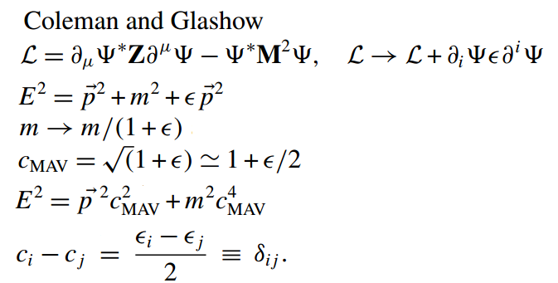
Coleman and Glashow

Slide 9
Tests of LIV and Auger
Future prospects of testing Lorentz invariance with UHECRs - Denise Boncioli
Searching for new physics with ultrahigh energy cosmic rays – Stecker & Scully
Astroparticle Physics Tests of Lorentz Invariance
Violation – Lang
New test of Lorentz symmetry using ultrahigh-energy cosmic rays
Luis A. Anchordoqui and Jorge F. Soriano
Phys. Rev. D 97, 043010 – Published 12 February 2018
Notes:
Testy livu uz boli robene napriklad clanok 1 2 3 a posledny clanok vysiel dokonca teraz vo february.

Slide 10
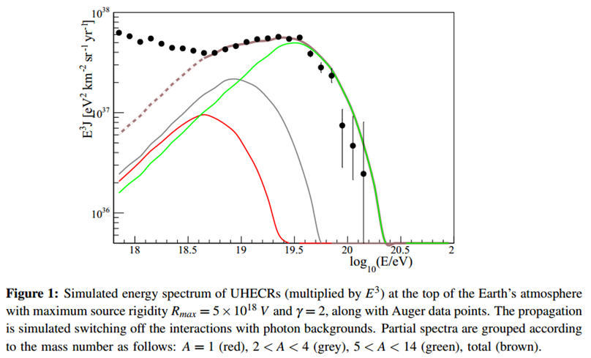
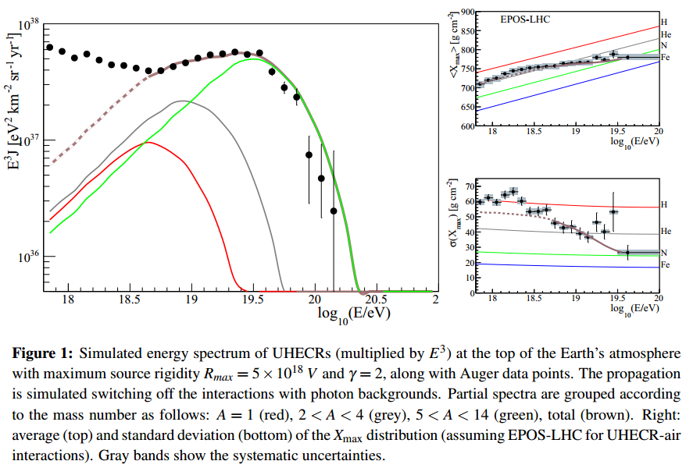
Future prospects of testing Lorentz invariance with UHECRs - Denise Boncioli
Notes:
Tu autorka simulovala pomocou MC propagaciu CR pre rozne kompozicie sprsok. Motivaciou
im bol vyskusat ci LIV scenario zapada aj do predstavy ze koniec kozmickeho spektra je
sposobenho zdrojmi a nie GZK medzou. Cervena predstavuje scenar ze propagujuca sa castica je tvorena jednzm nukleonom, seda 2-4, zelena 5-14 a hneda je kombinaciou
Ziadny constraint sa nepodarilo najst, jej modif. Spektrum plne zapada stale, avsak neda sa to povazovat za dokaz livu ale iba za to ze nedokazala urcite bound
simplifications made and does not allow us
to exclude LIV in the propagation of nuclei.
It is however obvious that the above statement cannot be taken as evidence of LIV, since many
other astrophysical/particle physics explanations can be considered
Simulated energy spectrum of UHECRs (multiplied by E3) at the top of the Earth’s atmosphere
with maximum source rigidity Rmax = 5×1018 V and g = 2, along with Auger data points. The propagation
is simulated switching off the interactions with photon backgrounds. Partial spectra are grouped according
to the mass number as follows: A = 1 (red), 2 < A < 4 (grey), 5 < A < 14 (green), total (brown). Right:
average (top) and standard deviation (bottom) of the Xmax distribution (assuming EPOS-LHC for UHECR-air
interactions). Gray bands show the systematic uncertainties

Slide 11
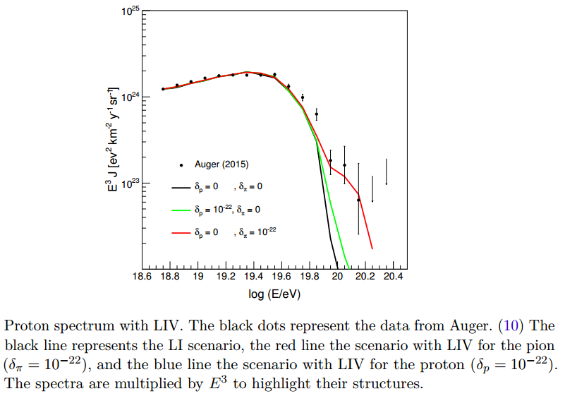
Astroparticle Physics Tests of Lorentz Invariance Violation – Lang
Notes:
Dalsie autor analytickym sposobom vypocital tvar spektra s liv clenmi. Cierne body su augerovske data. Cierne spektrum je spektrum bez liv clenov. Zelena je ze iba interagujuci proton ma liv clen, a pion nema, a cervena je opacne. Je vidiet vyraznu zmenu spektra v druhom pripade, pricom je koniec spektra posunuty tak ze je v suhlase s augerovskymi datami
As shown before, the
source evolution has almost no influence in the spectrum. Its value, therefore, was fixed at
ξ = 3.6, which corresponds to the star formation rate. A maximum redshift of zmax = 2.5
was used

Slide 12
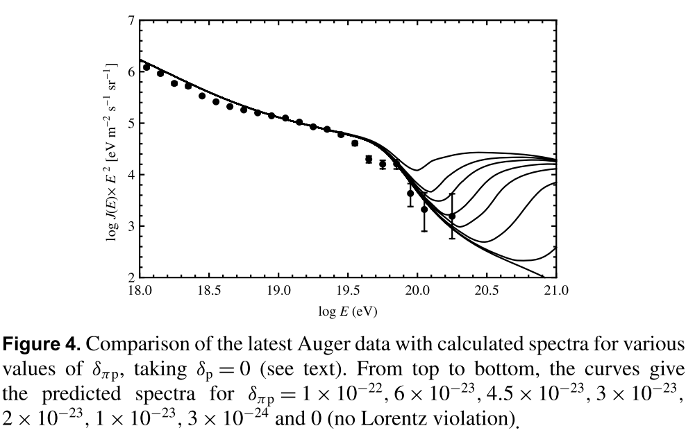
Searching for new physics with ultrahigh energy cosmic rays – Stecker & Scully
.
Notes:
Tu mame vysledok z dalsieho clanku, taktiez pocitaneho analyticky, delta piP znaci rozdiel vo velkosti liv clenov pre pion a proton naspodnejsie spoektrum je pre nulove liv a spektra smerom na hor maju postupne 10na-24 na -23 na -23 sa zvysuje, je vidiet ze spektrum by sa podla tejto prace, malo od vyssi energii regenerovat,

Slide 13
END
Pokračovanie o rok...
Notes:
Hodlam skumat jestli by modifkace pre neutrina a fotony ja by zmenila dovolena predvpodene tak aby to suhlasilo z datami

Slide 14
Frameworks for Lorentz violation
Systematic modified dispersion
Robertson-Mansouri-Sexl framework
c2 framework
“Doubly special” relativity
Non-systematic dispersion
Effective field theory
Non-commutative spacetime
Symmetry and relevant/irrelevant Lorentz violating operators
Lorentz violation with gravity in EFT
Notes:
Tu je vidiet mnozstvo teoreticky frameworkov zaoberajucich sa livom. Je ich vela
Most phenomenological frameworks for LIV converge into a perturbative theory
around Lorentz invariance suppressed by the Planck scale.

Slide 15
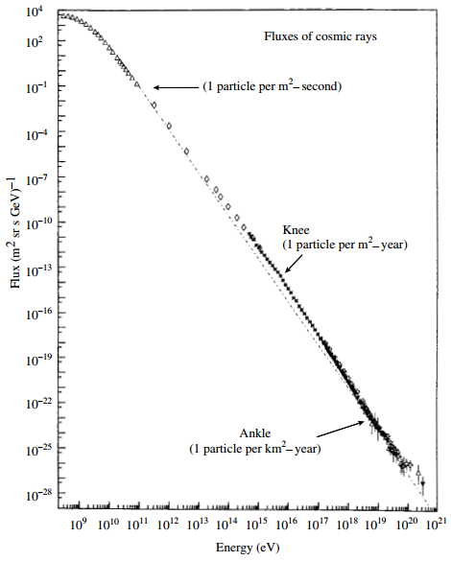
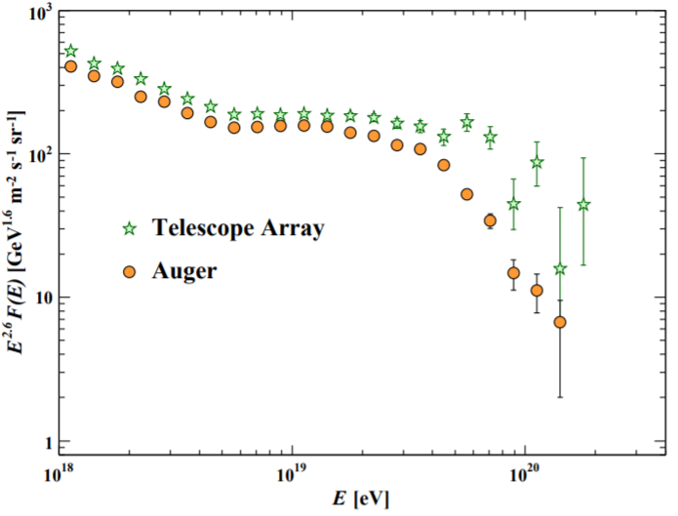

Slide 16
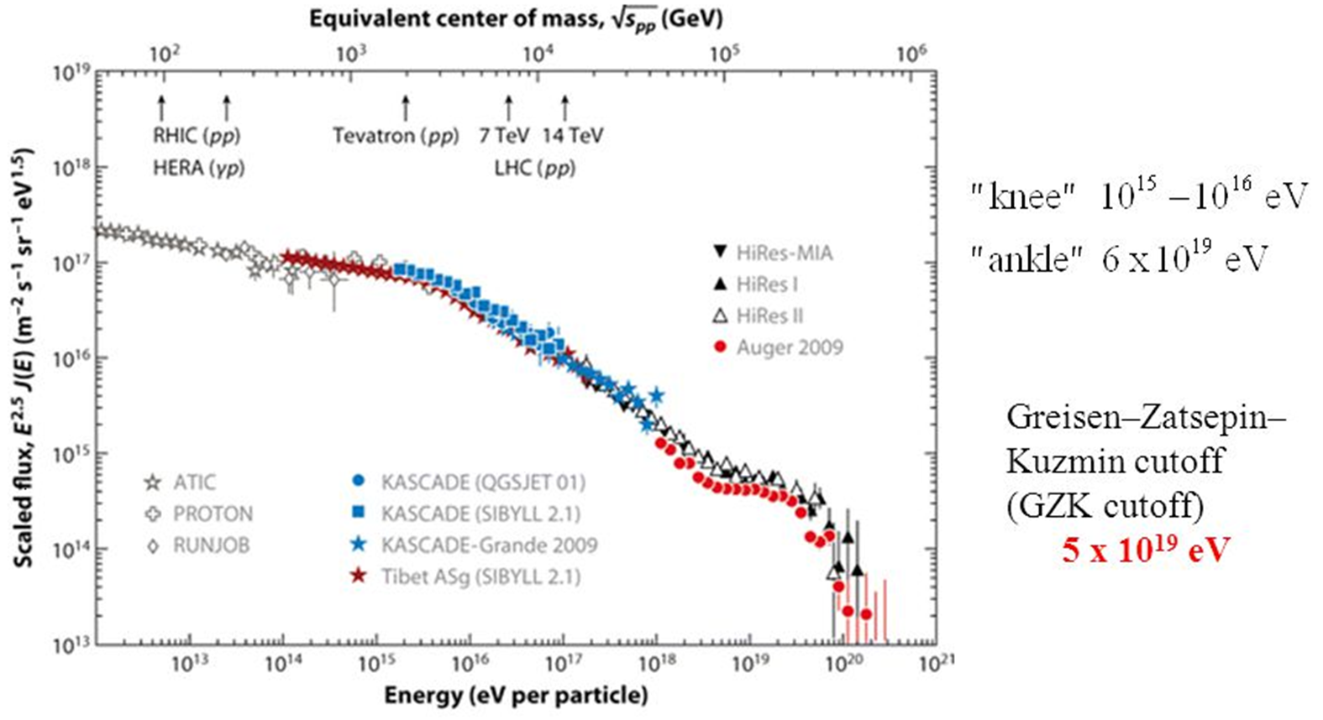
Cosmic ray spectrum
.

Slide 17

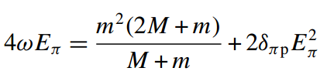
Model UHECR s LIVom
Motivácia - skúmanie alternatívnych hypotéz v súvislosti s propagáciou kozmického žiarenia.
Notes:
Jednym z dalsich moznych scenarov na vysvetlenie otazok okolo UHECR je porušenie LI pri vysokych energiach. V ramci diplomovej prace sa planujem pozriet ako sedi model LIVu aplikovany na UHECR s sucasnymi Augerovske data a hornymi limitmi pre toky fotonov a neutrin. Zakladna myslienka je taka ze pri LI predstavuje limtu v LIVu v energii podobne ako galileovska transformacia je limitiou rychlosti LT. Existuju rozne teoreticke prace zdovodnujuce preco by mal LIV existovat. Pre moje potreby mi staci len vediet vysledy efekt LIVu a tym je modifikacia vztahu e = p+m na e=p+m+3 cim sa dalej v konecnom dosledku upravia trasholdy pre jednotlive rozpady ako napriklad prave pre GZK.

Slide 18
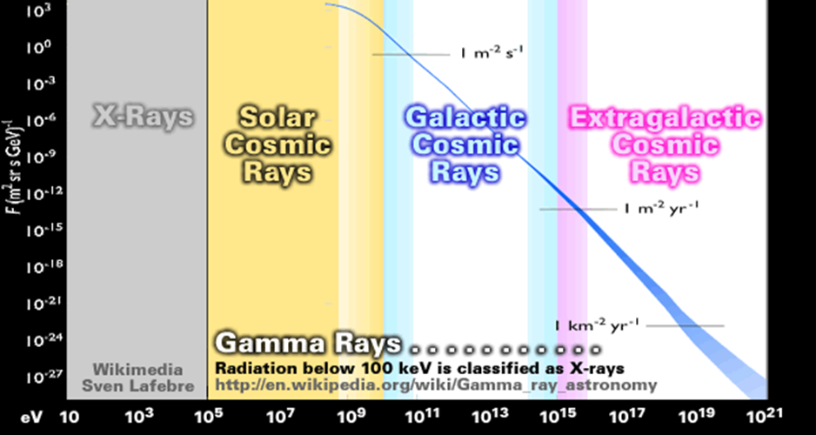
Cosmic ray spectrum
.

Slide 19
Otvorené otázky o UHECR
Ako je možné vidieť častice s energiou väčšou ako je GZK mez?
Aký je zdroj tak silného žiarenia E?
Kde sú tieto zdroje?
Notes:
Keby koniec spektra bol jasna zalezitost tak by sme nevideli castice s E viac ako GZK a vedeli by sme stanovit umiestnenie zdroja tohto ziarenia. Kedze vsak vidime castice aj s 10na20ev a nevieme urcite ani smer.

Slide 20
Odpovede na tieto otázky
Klasické
Exotické
  LIV
  Kozmologické defekty
  Rozpad tmavej hmoty
Notes:
Castice su zelezo ale potom by sme mali vediet povod, ale dalej fitovane spektra zelezom MC nesedia dobre na spektrum
Pri vysokych E dochadza k LIVu
Je dane rozpadom topologickych defektov
Je dane rozpadom tmavej hmoty

Slide 21
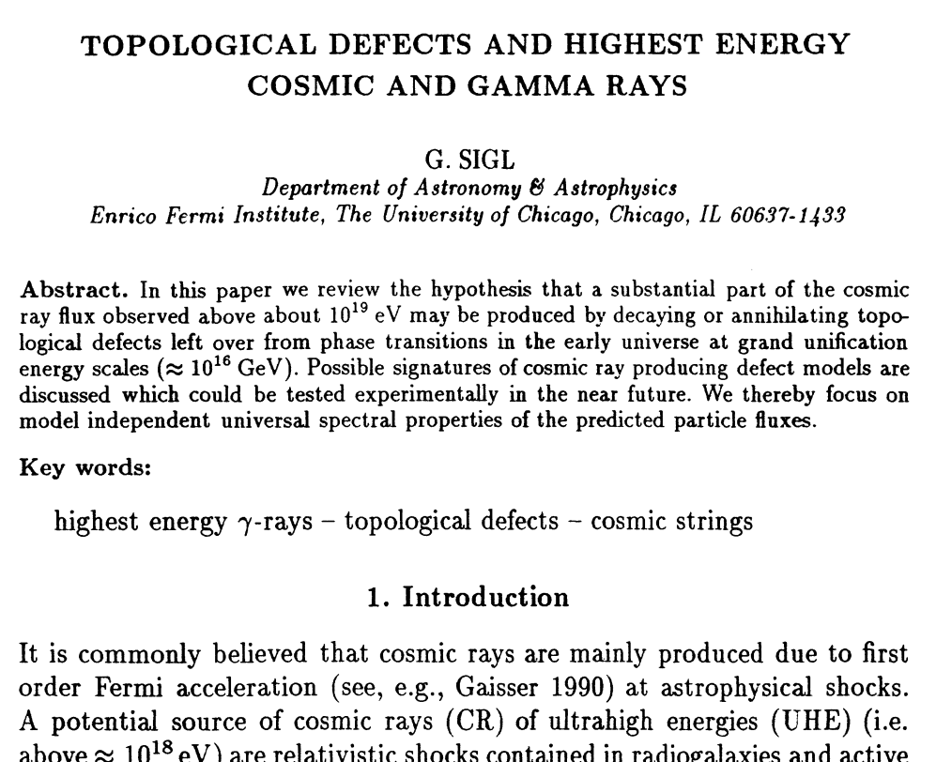
Cosmodefekty
.
Notes:
Cosmologists postulate a universe filled with relics left over from the Big Bang icon info - hypothetical objects, called topological defects, with names like "cosmic strings," "domain walls," and "monopoles." Although these strange objects figure prominently in theories of the evolution of the universe, we have no experimental evidence to show that they really exist. However, if they did exist, and if they sometimes collapsed, their collapse could produce enough energy to create very high-energy cosmic rays.

Slide 22
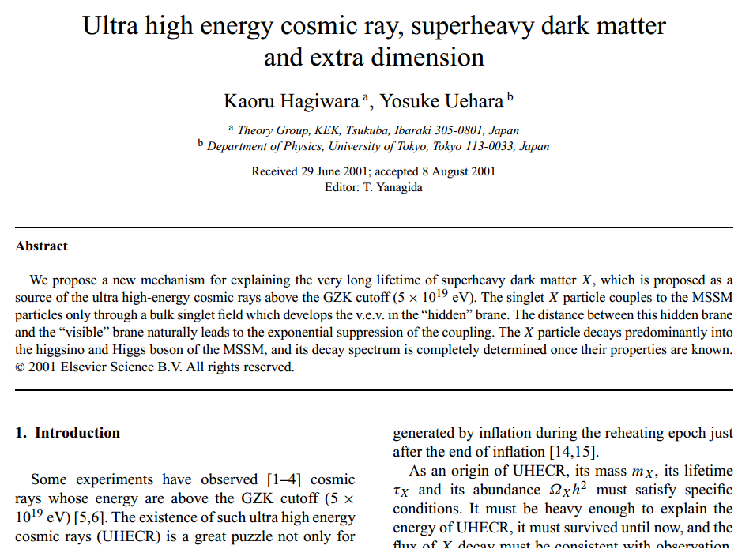
Rozpad tmavej hmoty
.

Slide 23
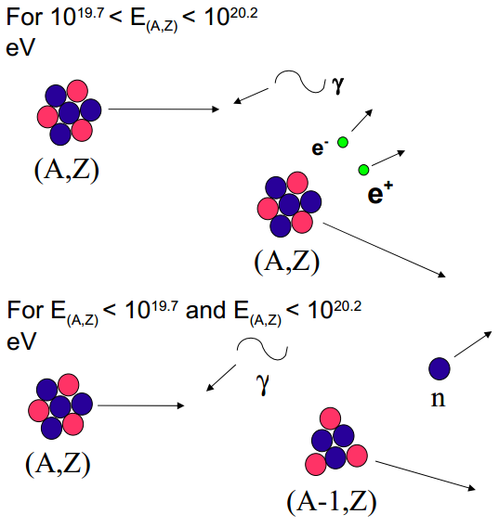
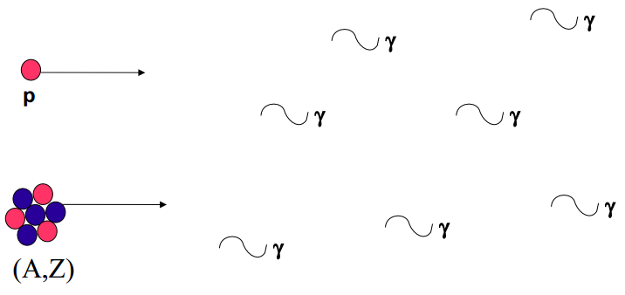
GZK cutoff
.

Slide 24
Motivácia a predpoklady LIV
string theory,
Loop QG,
non-commutative geometry,
space-time foam,
some braneworld backgrounds,
condensed matter analogues of “emergent gravity”.
Notes:
Motivaciou pre skumanie LIVu su viacere teorie aspirujuce na QGT. S volny
Planck-scale Lorentz violation constrained by Ultra-High-Energy Cosmic Rays
Lorentz symmetry breaking is certainly not a necessary feature of QG, but any Planck-scale induced LV effects could provide an observational window into QG phenomena. Moreover, the absence of LV phenomena provides by itself constraints on viable QG theories and more firmly establishes the validity of special relativity.

Slide 25







Forbidden reactions
photon decay
Pair annihilation
Photon splitting
vacuum Čerenkov effect

Slide 26
Inšpirácia
This work can be used to study the effects of LIV on interactions not treated here such as the pair production for protons or the inverse Compton scattering for electrons. It can also be adapted to treat the effects of LIV in the development of extensive air showers (EASs), which would change the measured composition.

Slide 27
Z čoho sa vychádzalo:
modification of the dispersion relations
Dôsledok
A pre
Nemá riešenie, protóny sa propagujú voľne
Notes:
where p = j-! p j, m is a function of momenta and energy, MP ≈ 1:2 × 1028 eV, the Planck mass,
is the possible scale where QG effects become important and fi, which can be either positive or
negative, parametrizes the strength of LIV for particle i.
The last equality reflects the fact that LI is
an exceedingly good approximation of the physics we know, so that modifications are expected to
be quite small, making an expansion of the LIV dispersion relation in terms of E=MP appropriate.
Here we make the simplifying assumption that all possible terms at the same order have the same
form, which amounts to neglect higher order corrections to Eq. 2.1. Also, we consider only the
lowest correction term in E=MP present (higher orders are totally negligible at UH energies). In
practical terms, only n = 1;2 will be relevant [1].
The right hand side of Eq. 2.1 is invariant when fi = 0.
The case we are interested in is for fi ≤ 0. As soon as fi moves from zero towards negative
values the threshold energy at first slightly increases, but for fi < -2:5 × 10-14 (n = 1) [ fi <
-4×10-7 (n = 2)], Eq. 2.2 has no longer real solutions [1]: the photo-pion production reaction is
no longer kinematically allowed and protons propagate freely in the Universe, if only interactions
on the CMB are taken into account. Interaction on the EGBL are affected for larger values of - fi.2
For nuclei, for which the relevant process of interaction on the universal backgrounds is photodisintegration, an equation corresponding to Eq. 2.2, with MP ! AMP, can be written. The modification of the thresholds is similar to that for protons.

Slide 28


Teoretický základ
Nerozpadavajú sa ak:
Notes:
Jednym z najdolezitejsich rozpadov pri hadronovych sprskach je rozpad pionu na dva fotony. Modifikaciou disperzneho vzutahu potom dostavami aj modifikovanu kinematiku rozpadu.

Slide 29
Inšpirácie
These are probably the most important affecting UHECR propagation and interaction, but certainly a general analysis of all aspects of LIV on cosmic ray physics would be very welcome.
In principle, all aspects of UHECR physics can be modified by LIV. For instance, LIV can affect the cosmic ray acceleration processes, and also the energy losses during acceleration.
As an example, consider LI violation with fi > 0. In this case, as soon as the energy of the accelerated nucleus is above some threshold, vacuum Cherenkov process becomes possible and essentially no
further acceleration is possible.
Notes:
Inspiraciami z clanku je najviac tretia odrazka kde citujem,, ze analyza vsekc&h efektov na kozmicke ziarenie bude vitana, cize to znamena ze je tu aj dalsi priestor pre dalsie prace na tuto temu. Dalej v clanku bolo spomenute ze LIV moze mat efekt na akceleracne procesy a na straty energie pri akcelaricii. Ako priklad uvadzaju autori ze pri akcelerovani jadier nad threshold vacuuoveho Cerenka nie je mozne ziadne dalsie zrychlenie

Slide 30
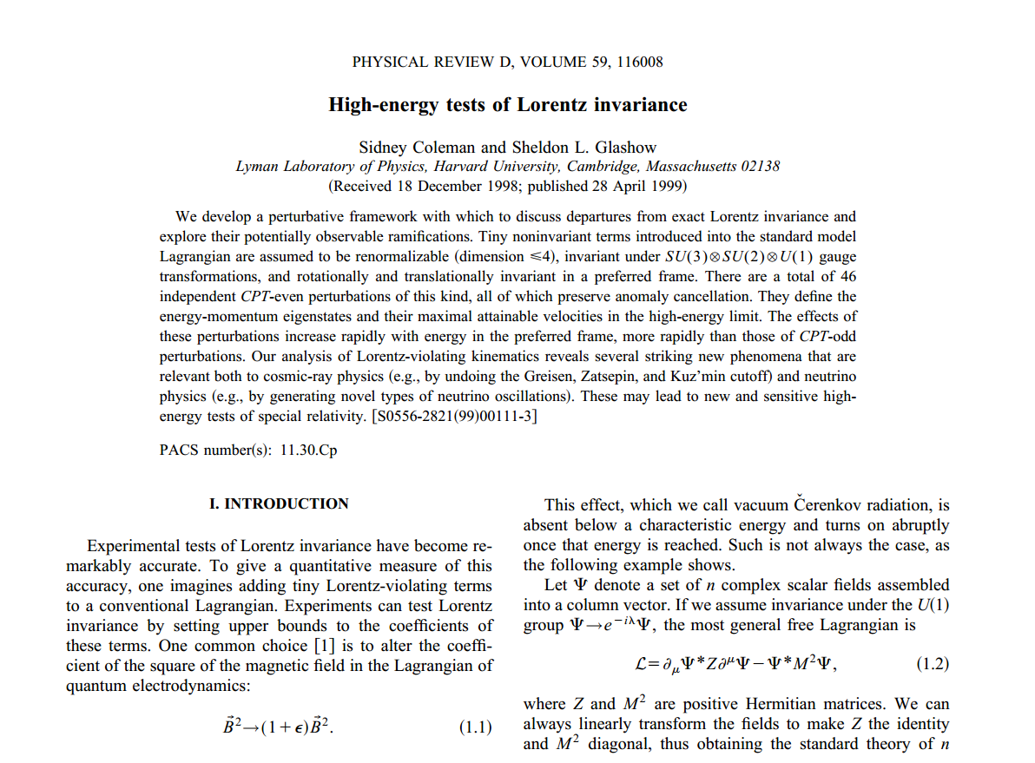
Teoretický základ
.

Slide 31
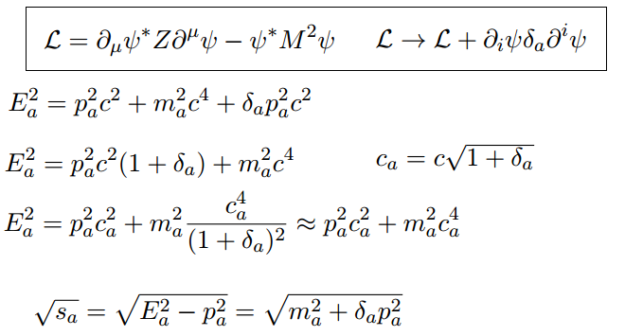
Teoretický základ
.
Notes:
Podobne ako v predchadzajucom clanku aj tu vychdzal auto z teoretickej prace Colemana a Glashova.

Slide 32
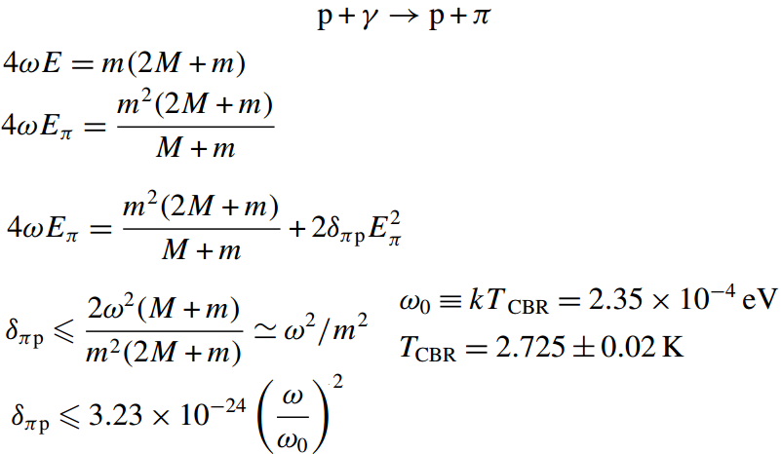

Z čoho sa vychádzalo
          threshold energia proton
          threshold pion
          ak tak
          kvadraticka rovnica ktora ma realne korene pre
Notes:
Podobne ako v prvom clanku aj tu sa skumal efektu LIVu na GZK medz. Vidime tu aky vplyv ma dosadenie modifikovanych disperznych vztahov do rovnice vyjadrujucej threshold energiu protonu a pionu v LAB sustave
This condition, together with equation (10), implies that while photomeson interactions leading to GZK suppression can occur for ‘lower energy’ UHE protons interacting with higher energy CBR photons on the Wien tail of the spectrum, other interactions involving higher energy protons and photons withsmaller values of ω will be forbidden. Thus, the observed UHECR spectrum may exhibit the characteristics of GZK suppression near the normal GZK threshold, but the UHECR spectrum can ‘recover’ at higher energies owing to the possibility that photomeson interactions at higher proton energies may be forbidden.

