Slide 1
Imaging detectors
Zdeněk Doležal
Výjezdní seminář ÚČJF 2018

Slide 2
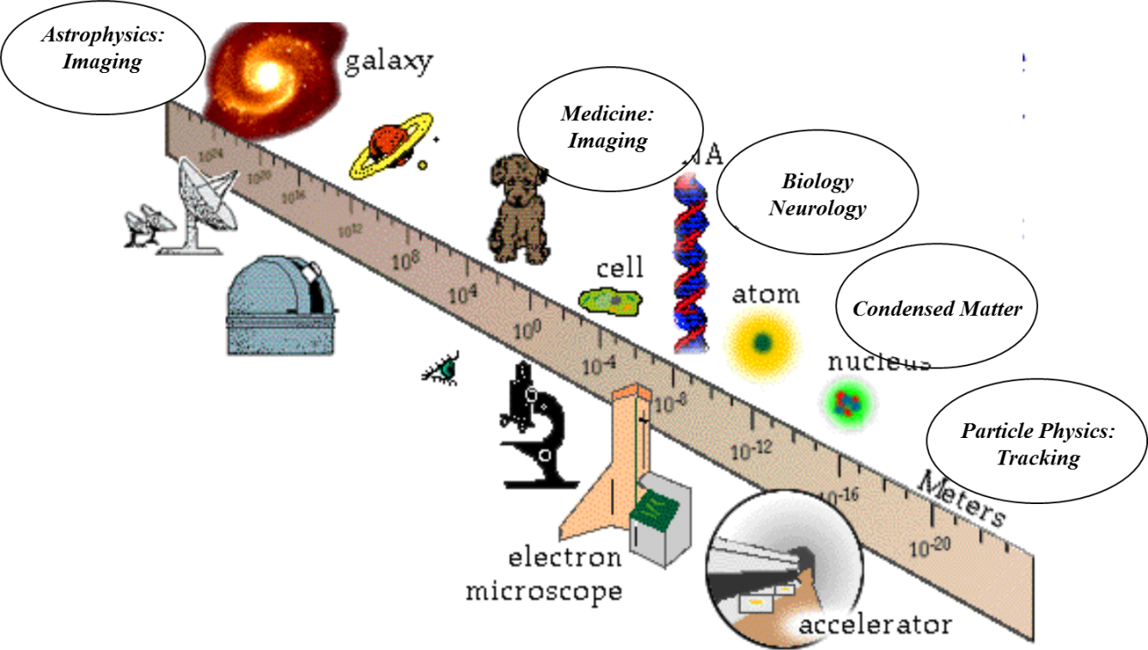
Particle Detector
Applications in Medicine
Hartmut F.-W. Sadrozinski
SCIPP, UC Santa Cruz, CA 95064 USA

Slide 3
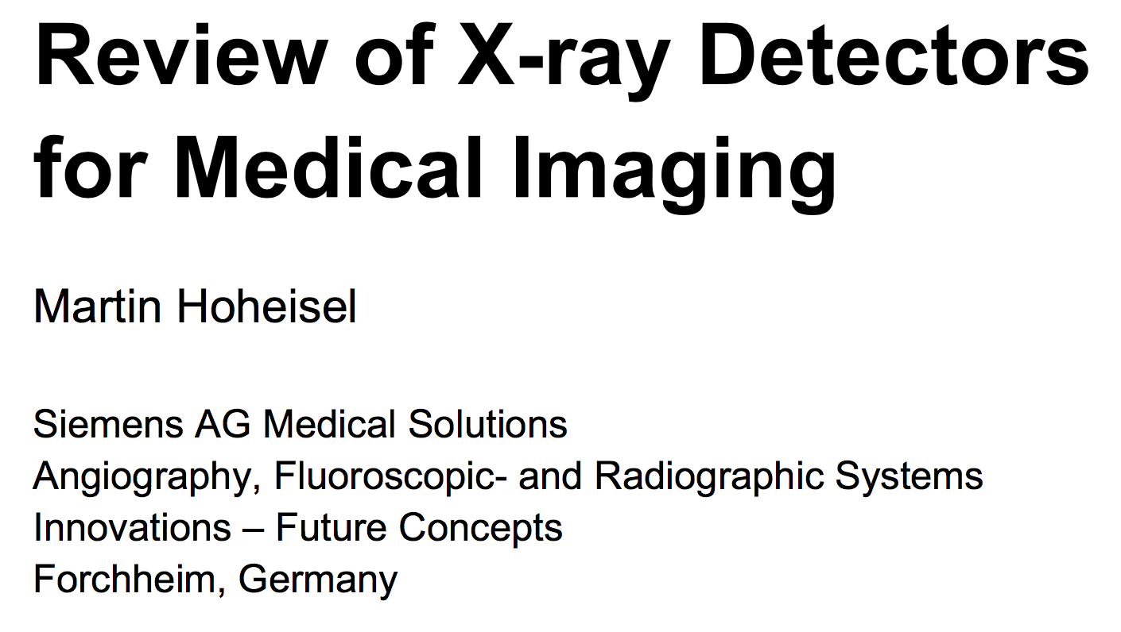

Slide 4
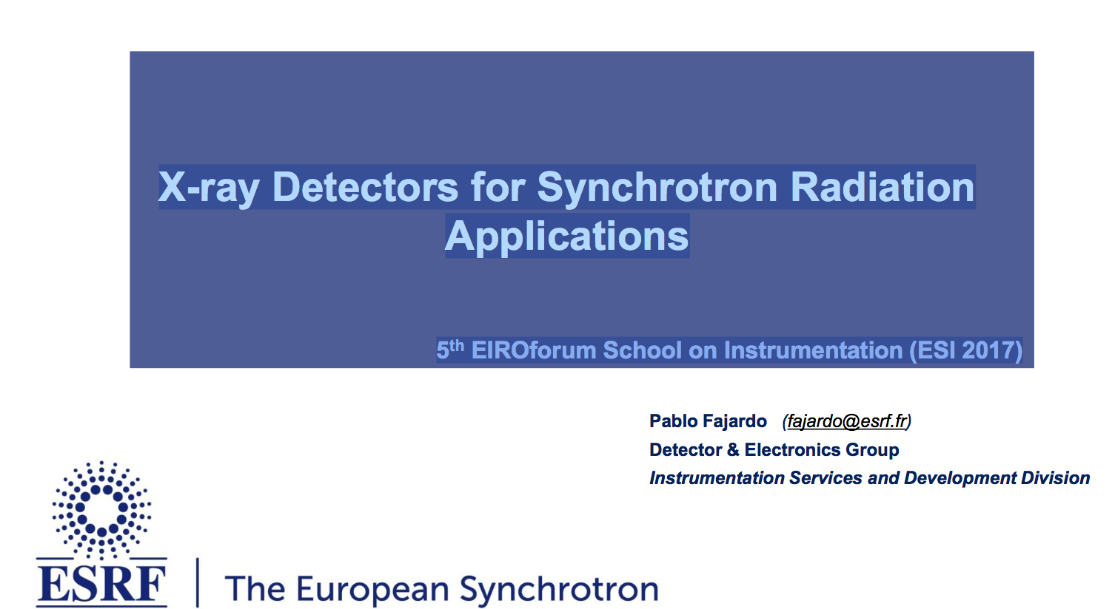

Slide 5
Medical Applications
Low-energy instrumentation,
small systems (until commercialization..) profiting from HEP and (even more so) from Astrophysics heritage
Scintillators & Semiconductors (for WCC heritage: Peskov, Nygren talks)
Dosimetry, EH&S
Imaging: Radiography, Tomography
  Photons
  X-ray CT
  SPECT
  PET & TOF-PET & PET/MRI & PET/CT
  Hadrons (MedAustron)
  Intercation Vertex Imaging IVI
  Proton CT

Slide 6
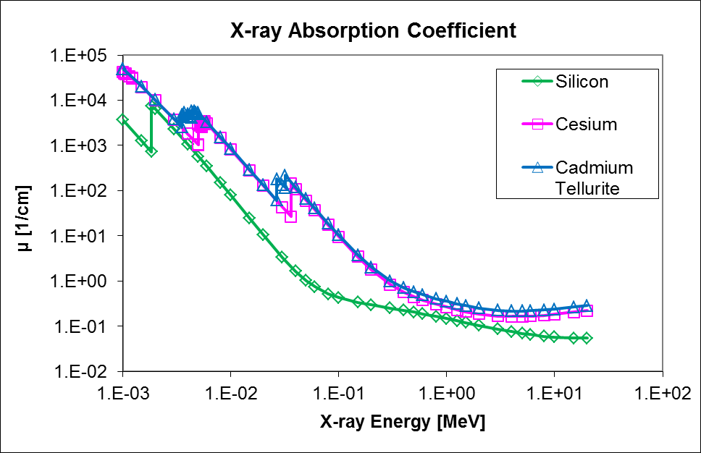
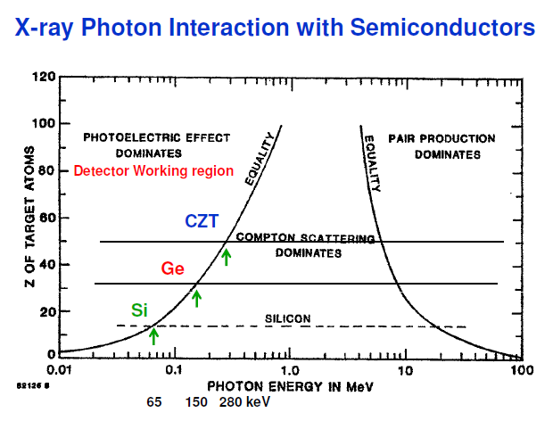
Absorption of Photons N(x) = N_{o}e^{- µ x}
Photons of Medical Interest, Energies & Resolution
µ-waves: MRI (10’s µm)
10-100keV: X-ray radiography and CT (10’s µm)
500 keV: PET and SPECT (mm)
No directional information with exception of Compton
High bone contrast 1-100 keV
Advantage of high-Z detectors:
Shift of Compton region to higher E
reduced range of Compton electrons
reduced range of positron in PET
Larger energy reach (depends on thickness)
300 µm
1 mm
2 cm

Slide 7
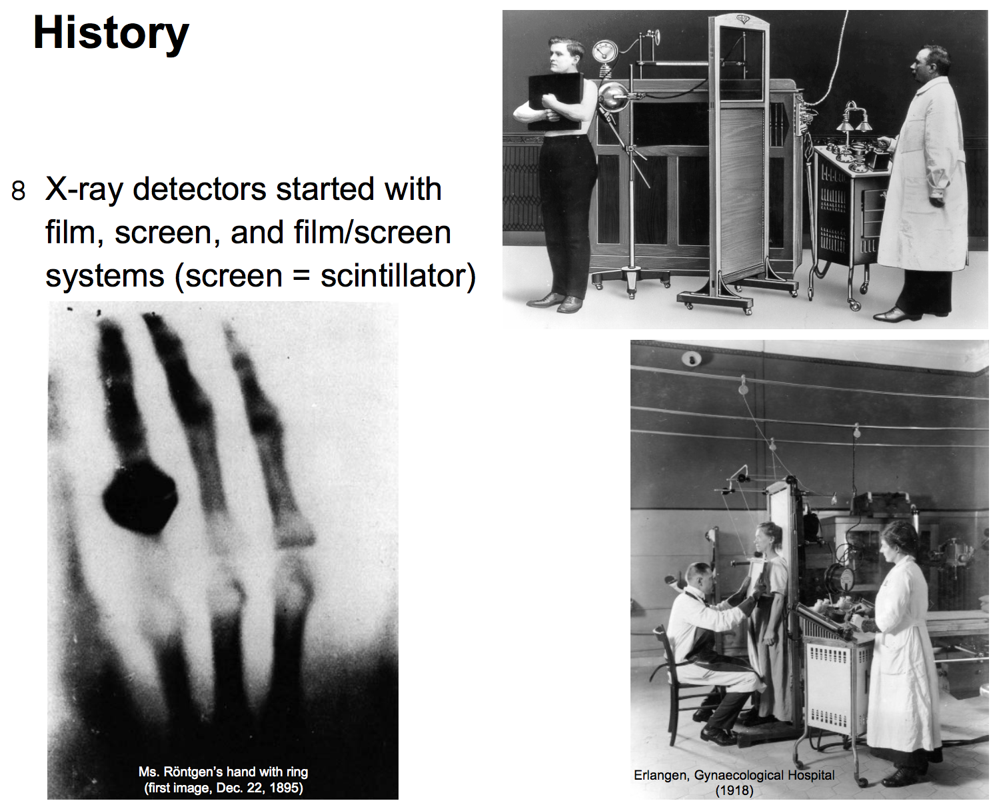

Slide 8
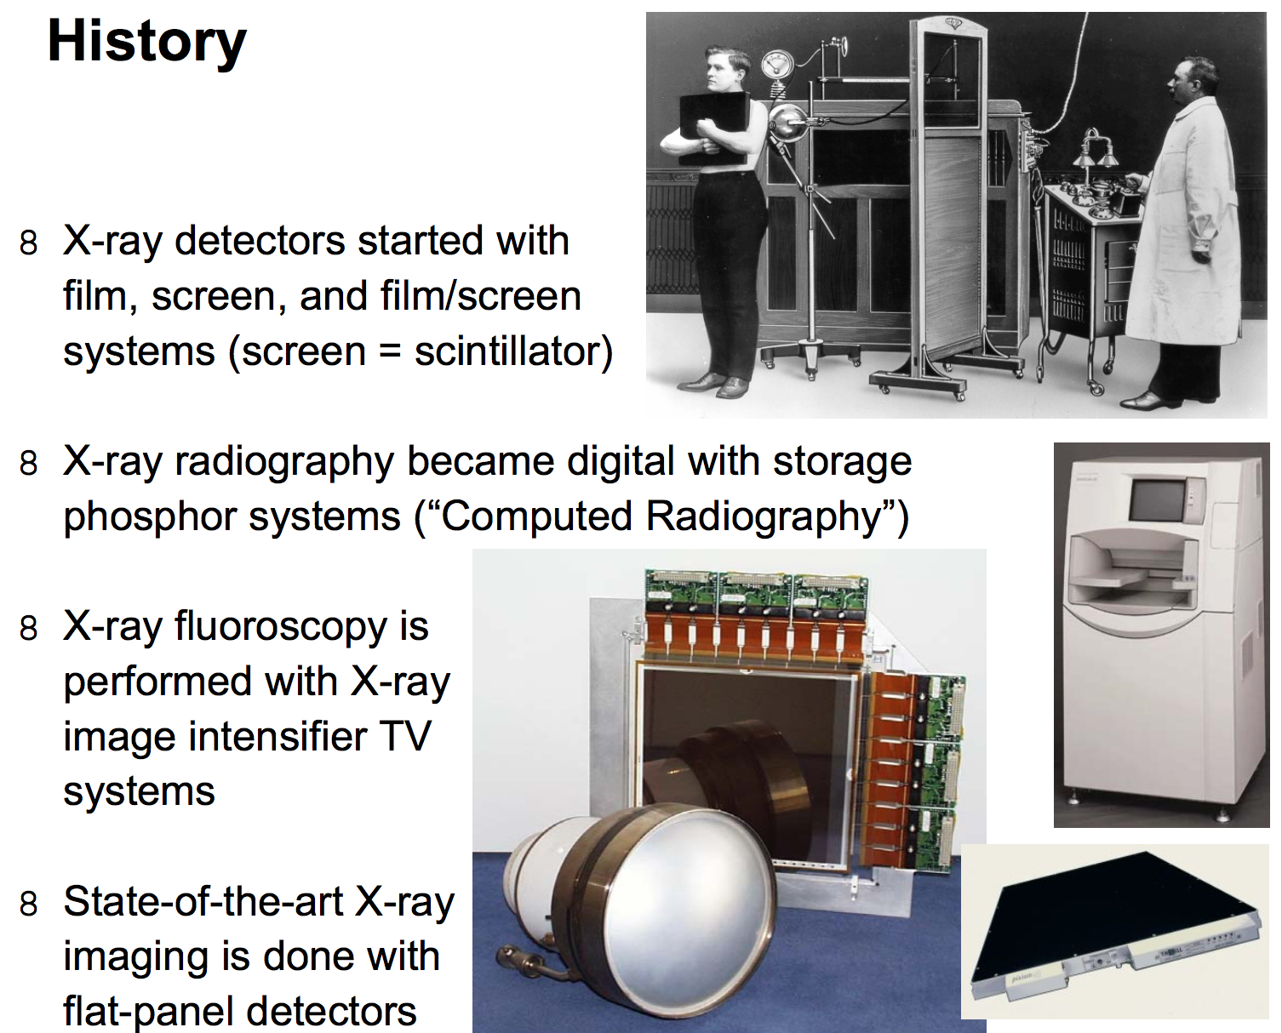

Slide 9
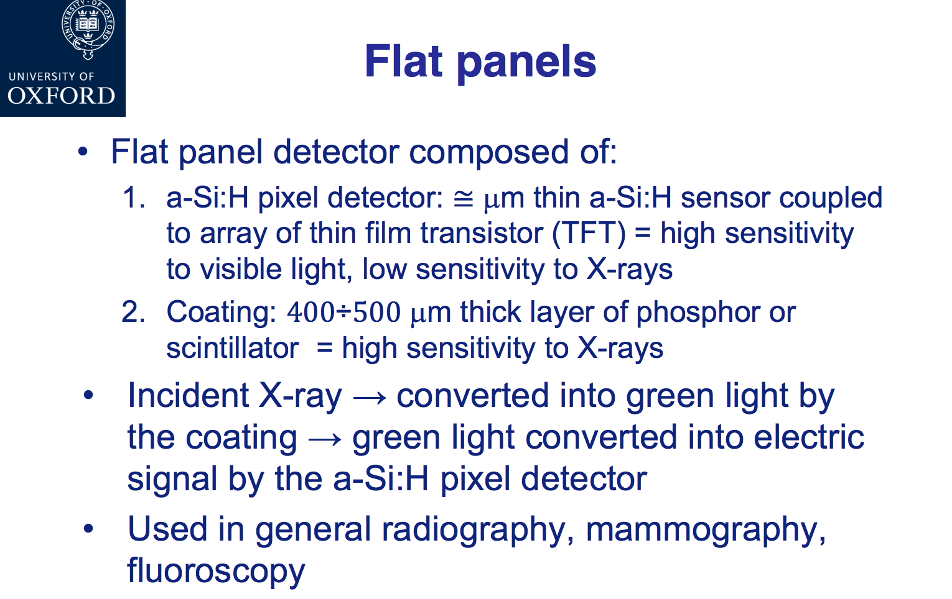

Slide 10
Amorphous Silicon (aSi:H)
Non-crystalline form of Silicon
Worse electrical properties (leakage current, efficiency)
Cheaper than crystalline
Used at solar cells, etc.
Dangling bonds passivated by Hydrogen

Slide 11
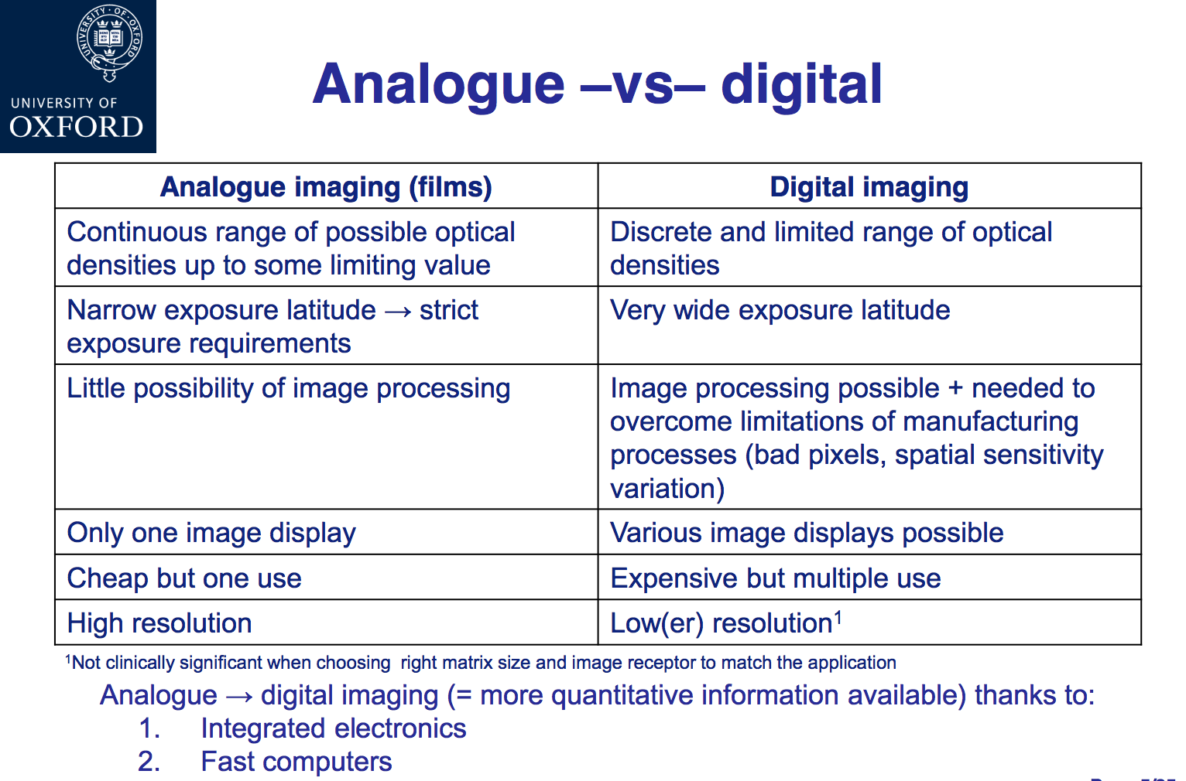

Slide 12
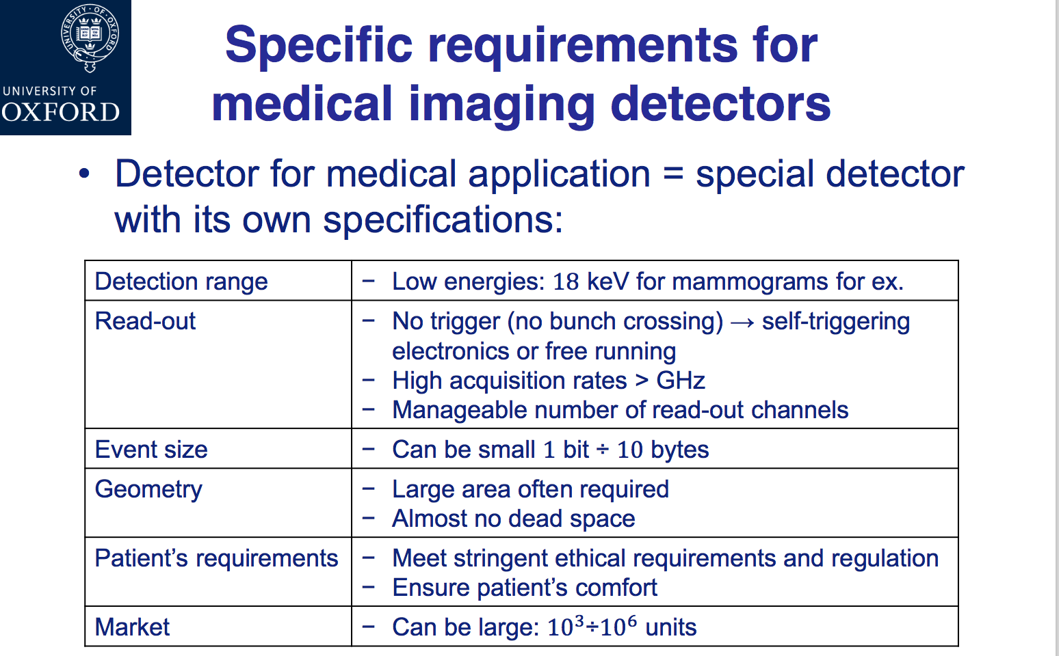

Slide 13
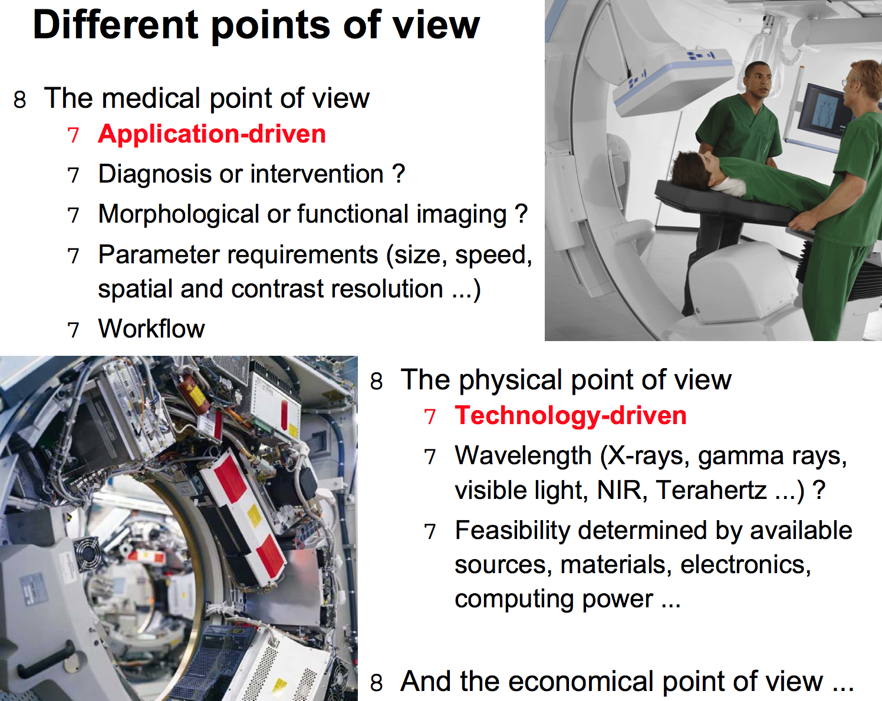

Slide 14
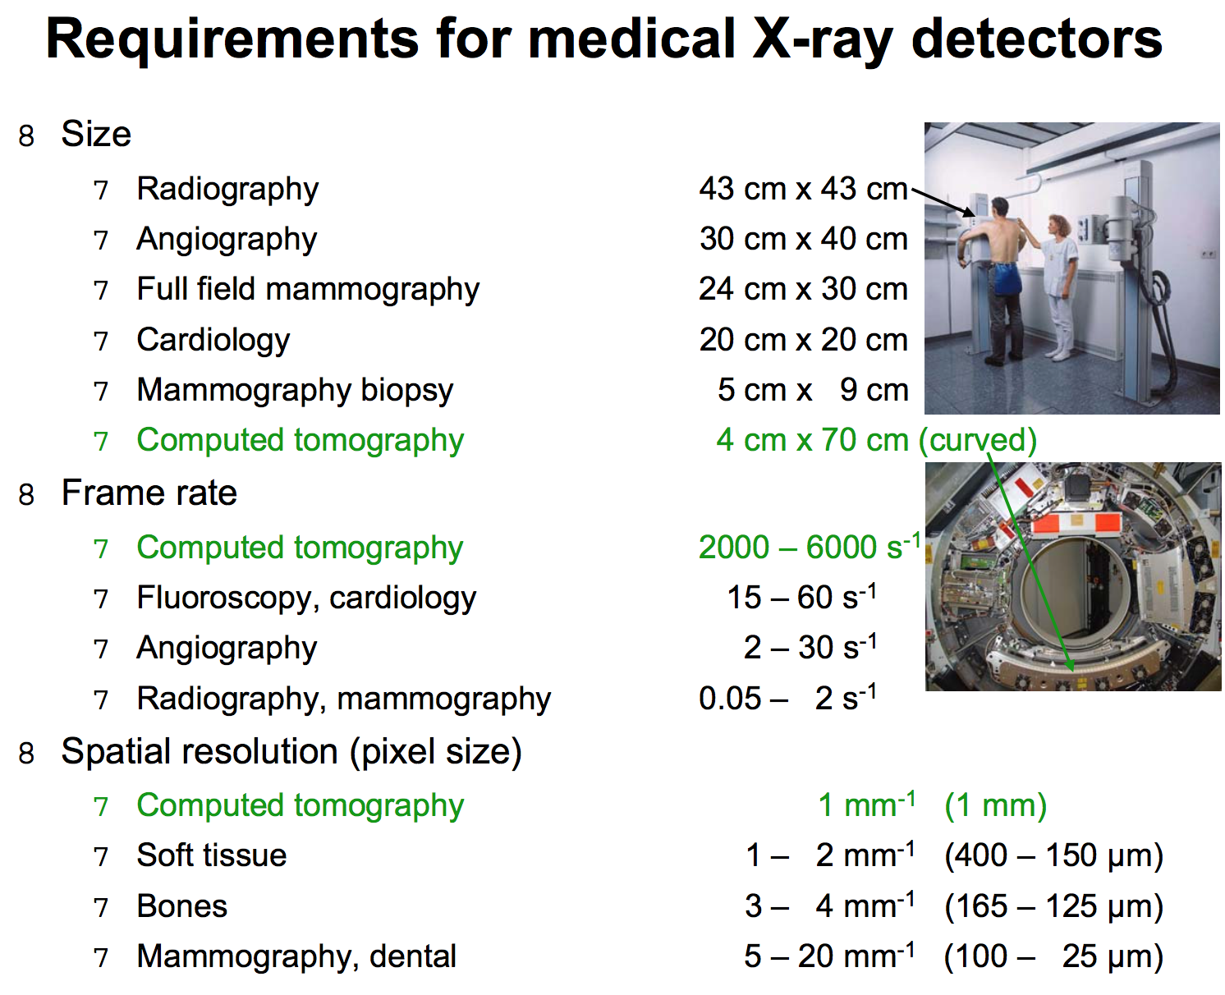

Slide 15
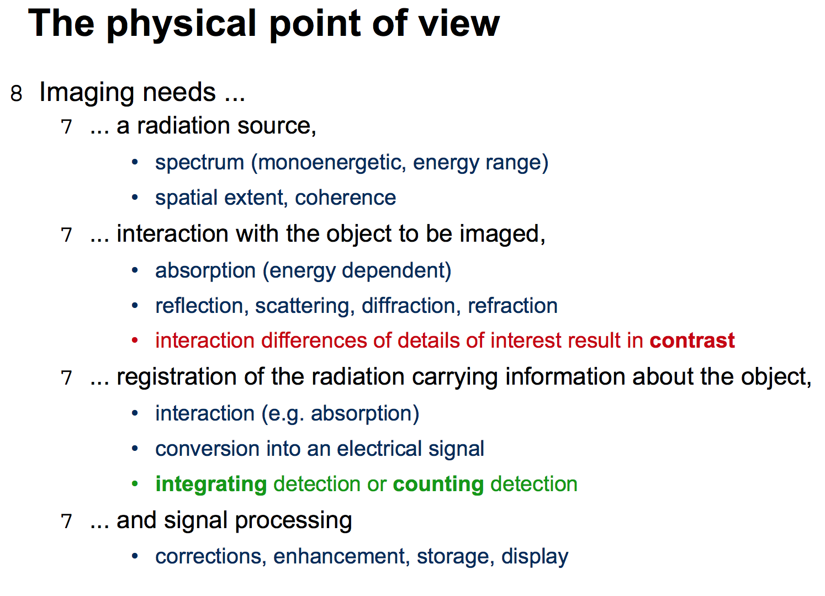

Slide 16
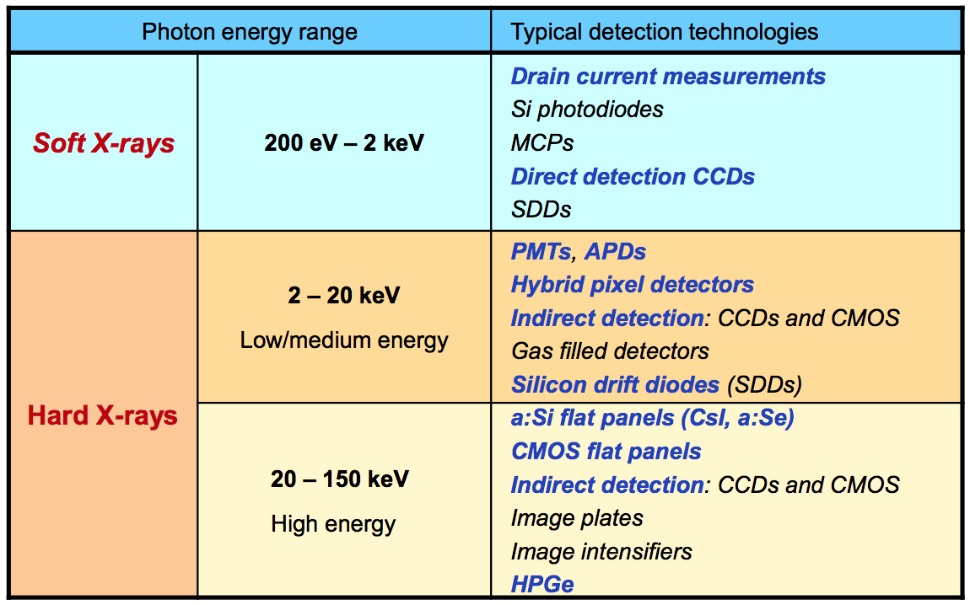
Detection technologies used for photons

Slide 17
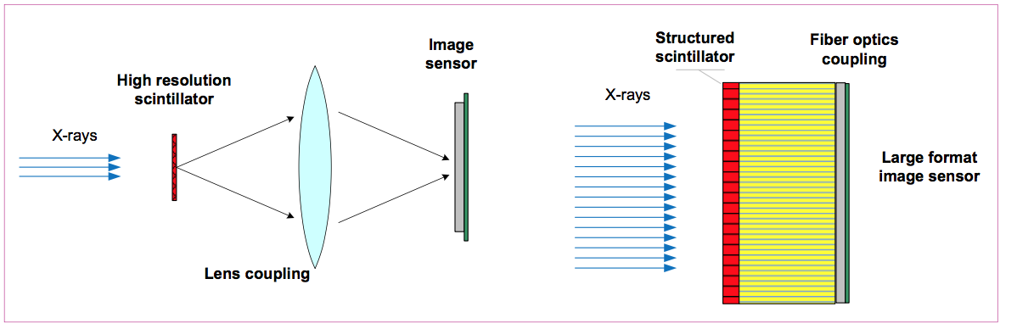
Scintillators: indirect detection

Slide 18
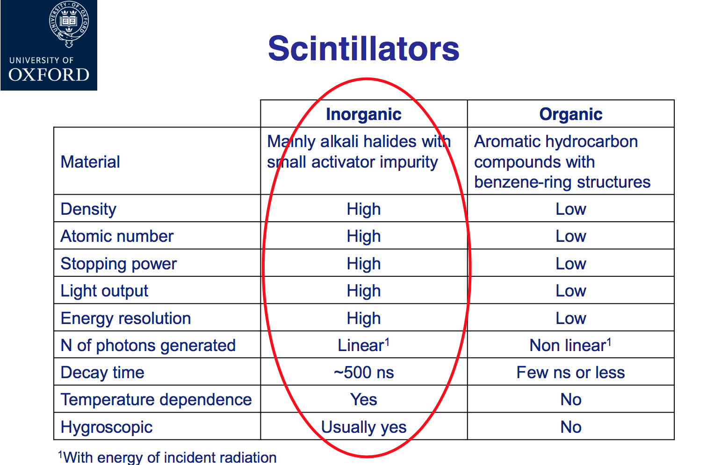

Slide 19
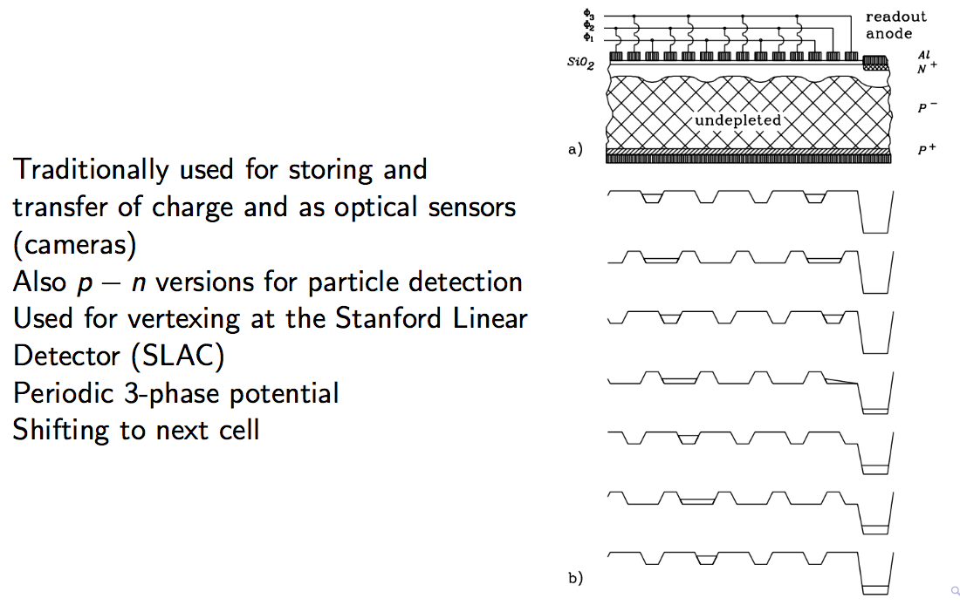
CCDs as detectors

Slide 20
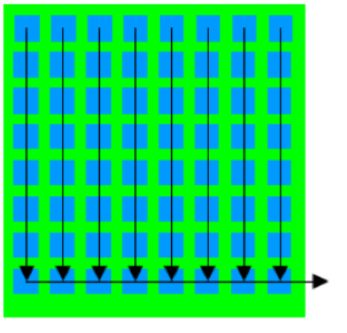
CCDs as detectors
2D structure can be made
Drawback: charge coming during R/O is misidentified

Slide 21
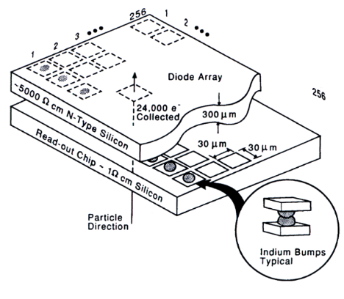
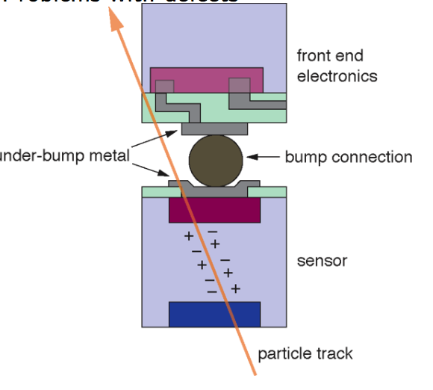
Hybrid Pixels
Signal transferred to special readout chip attached to the pixel chip
Typical pixel size is 50 μm ×50μm
Often digital (binary) resolution
Small pixel area
Low detector capacitance
Large S/N (e.g. 150:1)
Small pixel volume: low leakage current
Drawback: many R/O channels, data, large power consumption

Slide 22
Monolithic Active pixels
Silicon used both in a detector and in processing electronics
Why not integrated?
Using the same wafer/substrate
This is not so easy:
  Electronics needs high conductivity Si
  Detectors need high-resistivity Si (to achieve depletion) Several approaches to match these contradictions:
Monolithic Active Pixels
DEPFET Pixels

Slide 23
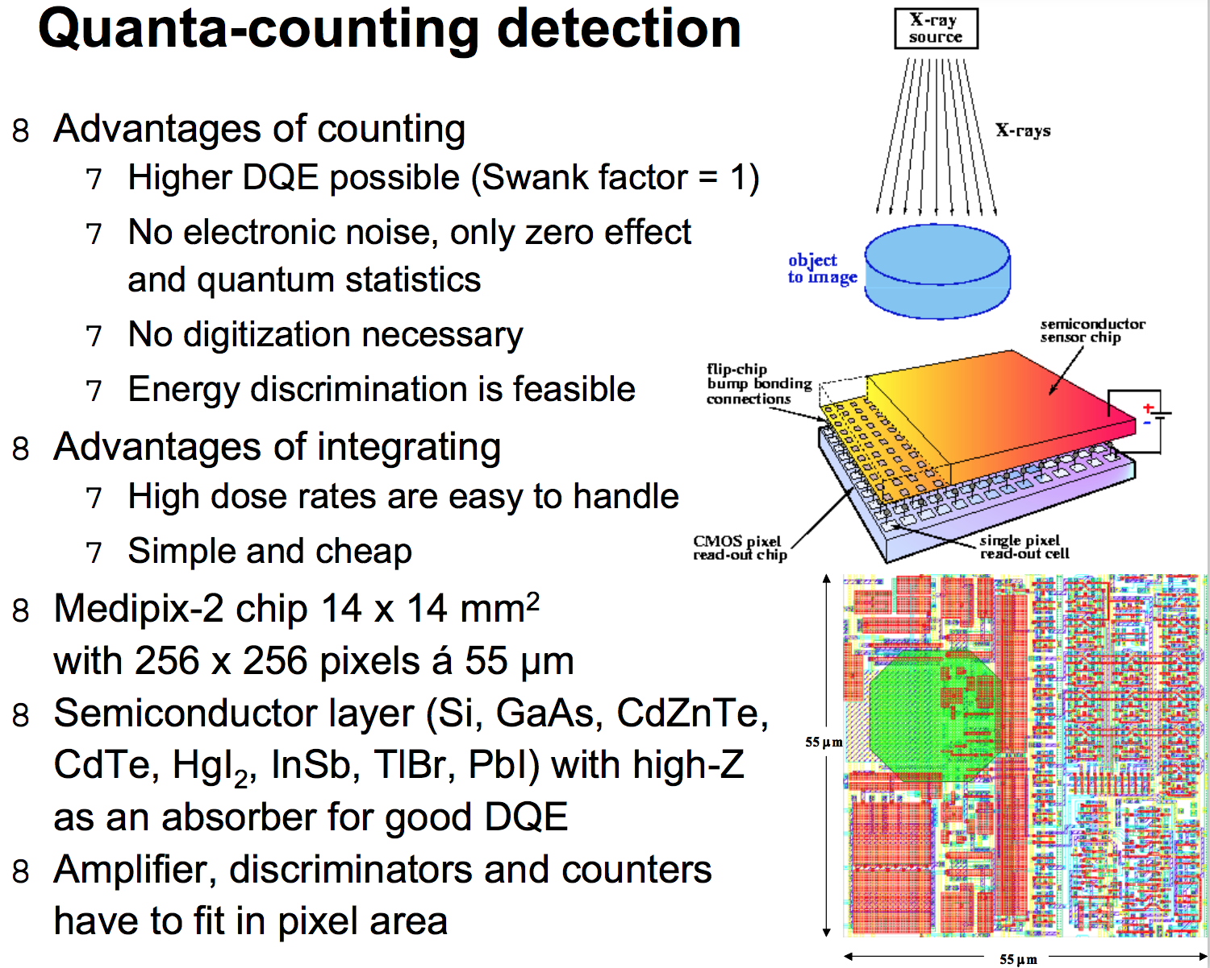

Slide 24
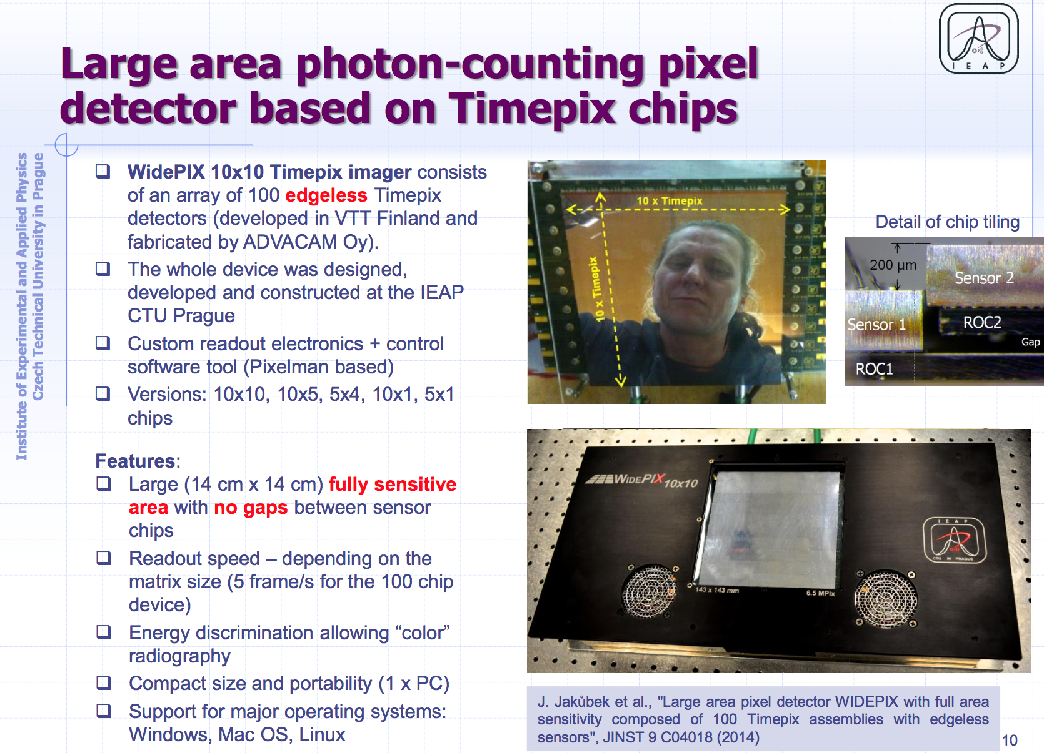

Slide 25
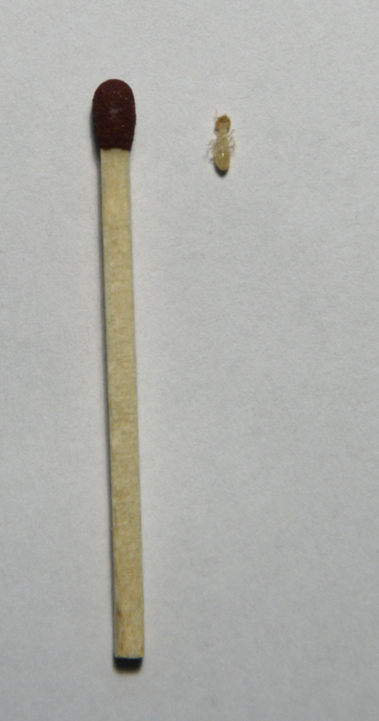
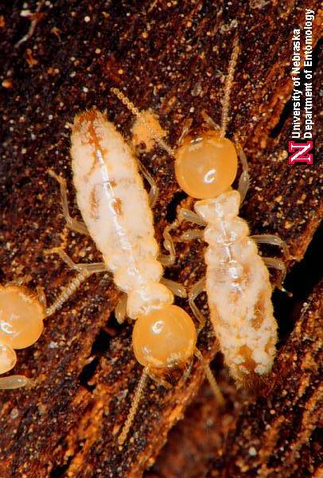
High resolution X-ray radiography:
Imaging of Termites
The imaging of termites as a model soft tissue organism is particularly difficult due to their poorly sclerotized cuticle making difficult to observe the anatomic structures with an optimal contrast.
Moreover, they are vulnerable to damage when they are manipulated or treated during sample preparation.
Thus, the termites represent an ideal model to optimize the accuracy and sensitivity of the developed method.

Slide 26
High resolution X-ray radiography:
Imaging of Termites
X-ray transmission image of termite worker body (left) and detail of its head (bottom). Even fine internal structure of the antennae is recognized.
(Magnified 15x, time=30s, tube at 40kV and 70μA)

Slide 27
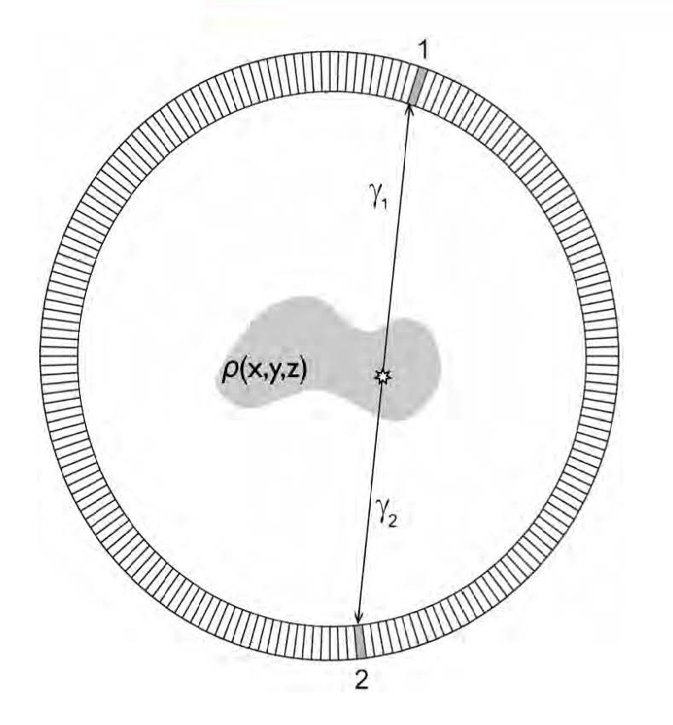
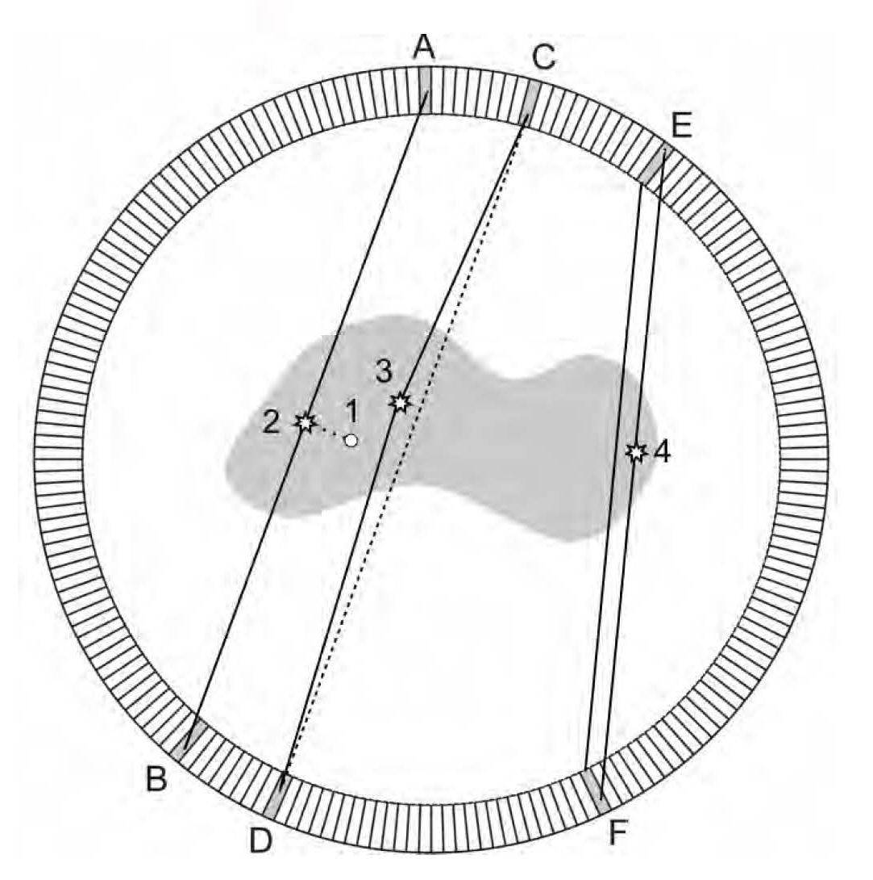
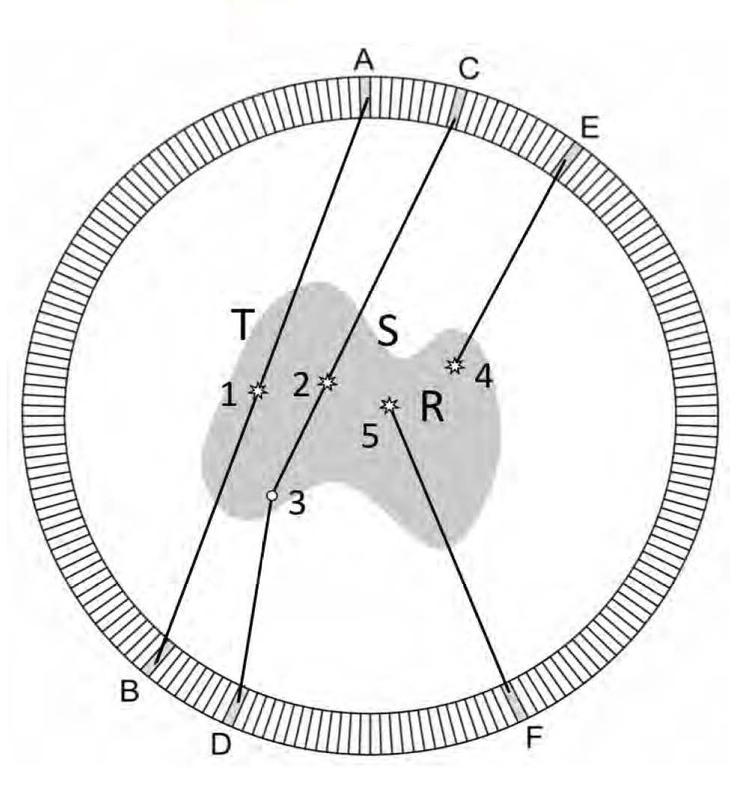
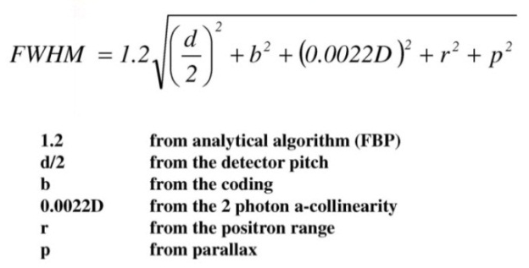
Positron Emission Tomography PET
Study accumulation of radioactive tracers in specific organs.
The tracer has radioactive positron decay, and the positron annihilates within a short
Distance with emission of 511 keV γ pair, which are observed in coincidence.
Perfect Picture:
Resolution and S/N Effects:
Resolution of detector (pitch)
Positron range
A-collinearity
Parallax (depth)
T: true event
S: Compton Scatter
R: Random Coincidence
A. Del Guerra, RESMDD12

Slide 28
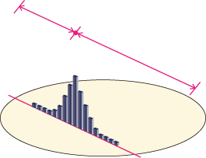
Reduce Accidentals & Improve Image: TOF-PET
PET
t1
t2
TOF-PET
Localization uncertainty:
Δd = c x Δt /2
When Δt = 200 ps
➔ Δd = 3 cm
@ VCI
K. Yamamoto 2012 IEEE NSS-MIC
Notes:
As you know, in Time-Of-Flight Positron Emission Tomography, TOF information provides better localization of the annihilation event and improves the signal-to-noise ratio of the reconstructed image.
For example, when timing resolution is 300ps, position resolution is 4.5cm along the line of response.
In fact, timing resolution depends on the scintillation light yield, detector performance and read out noise.
Multi-Pixel Photon Counter, MPPC is a silicon photomultiplier and expected for use in PET-MR.
Timing resolution required for the MPPC is less than 200ps.

Slide 29
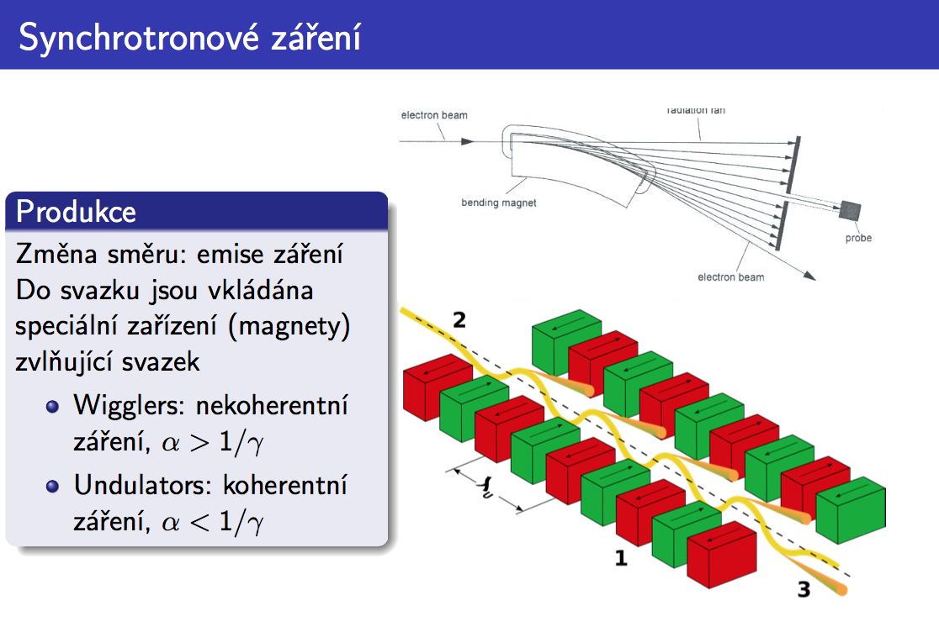

Slide 30
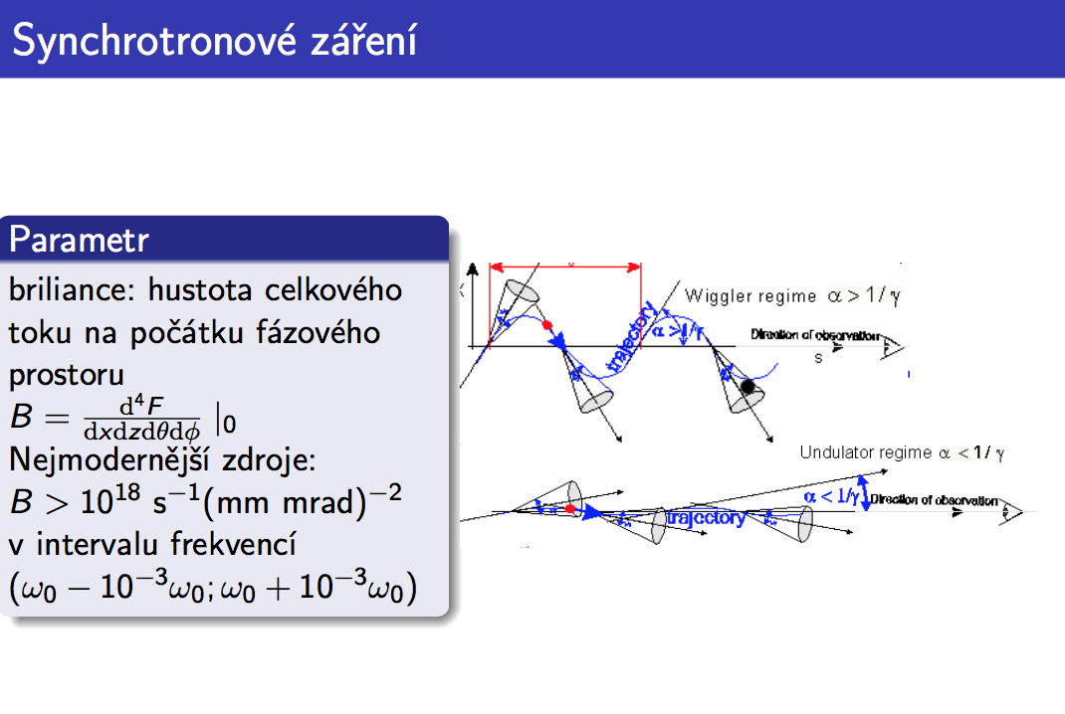

Slide 31
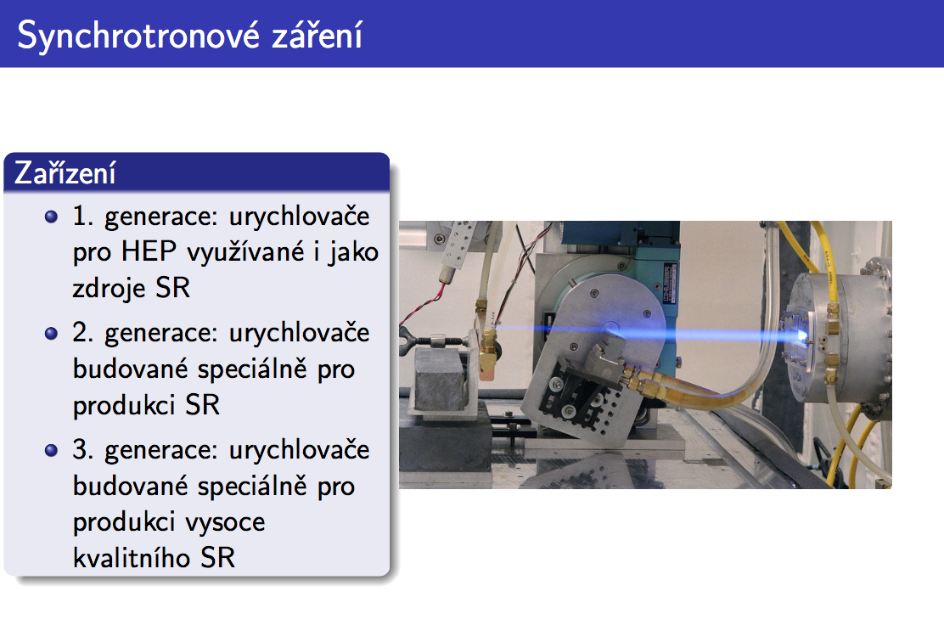

Slide 32
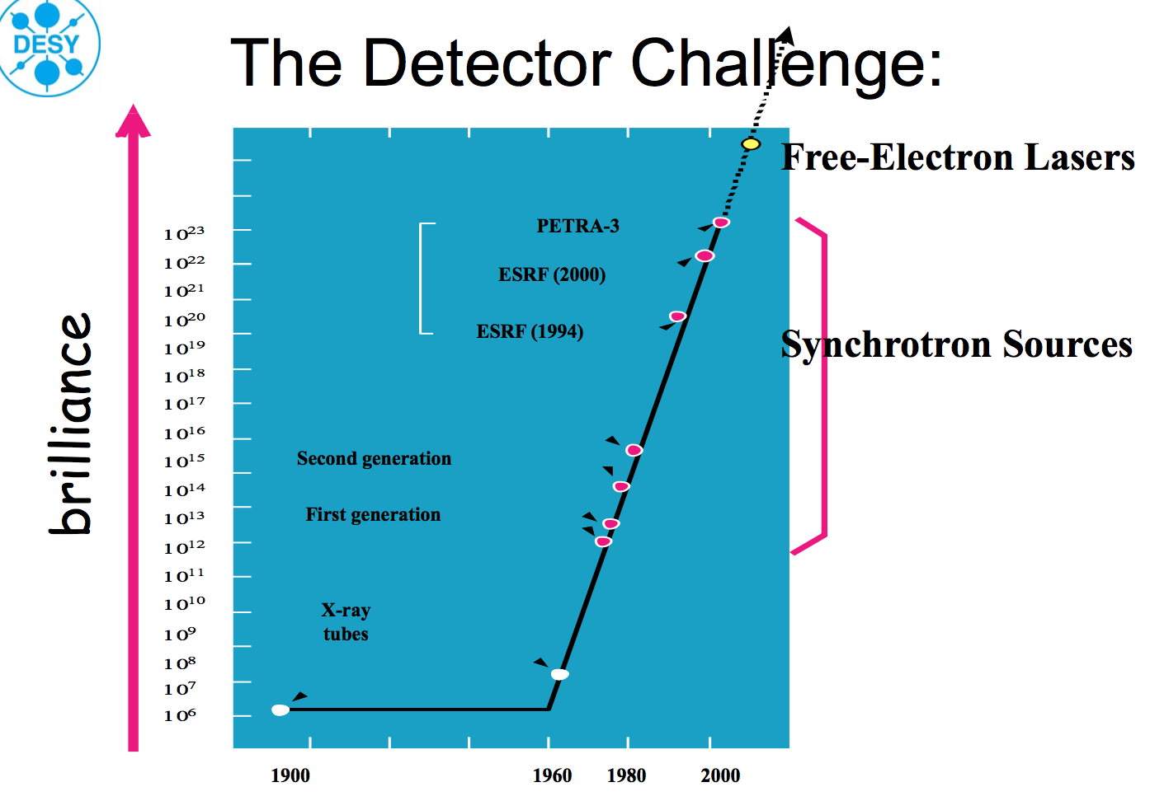

Slide 33
SR imaging
Structural imaging
Short beam time structure allows for dynamic imaging

Slide 34
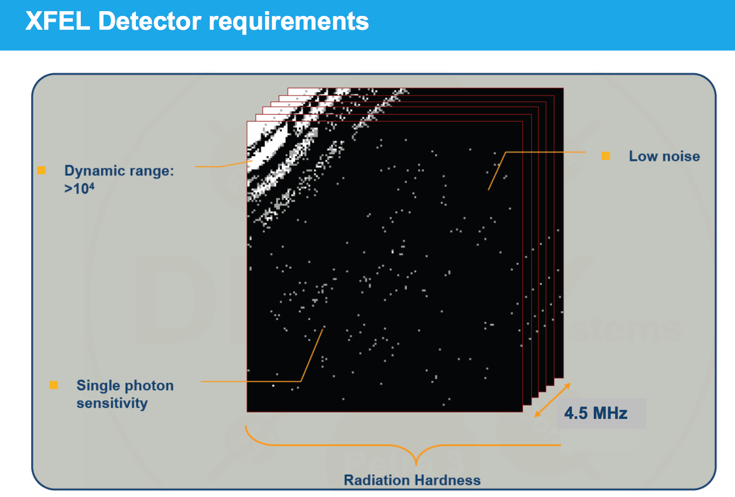

Slide 35
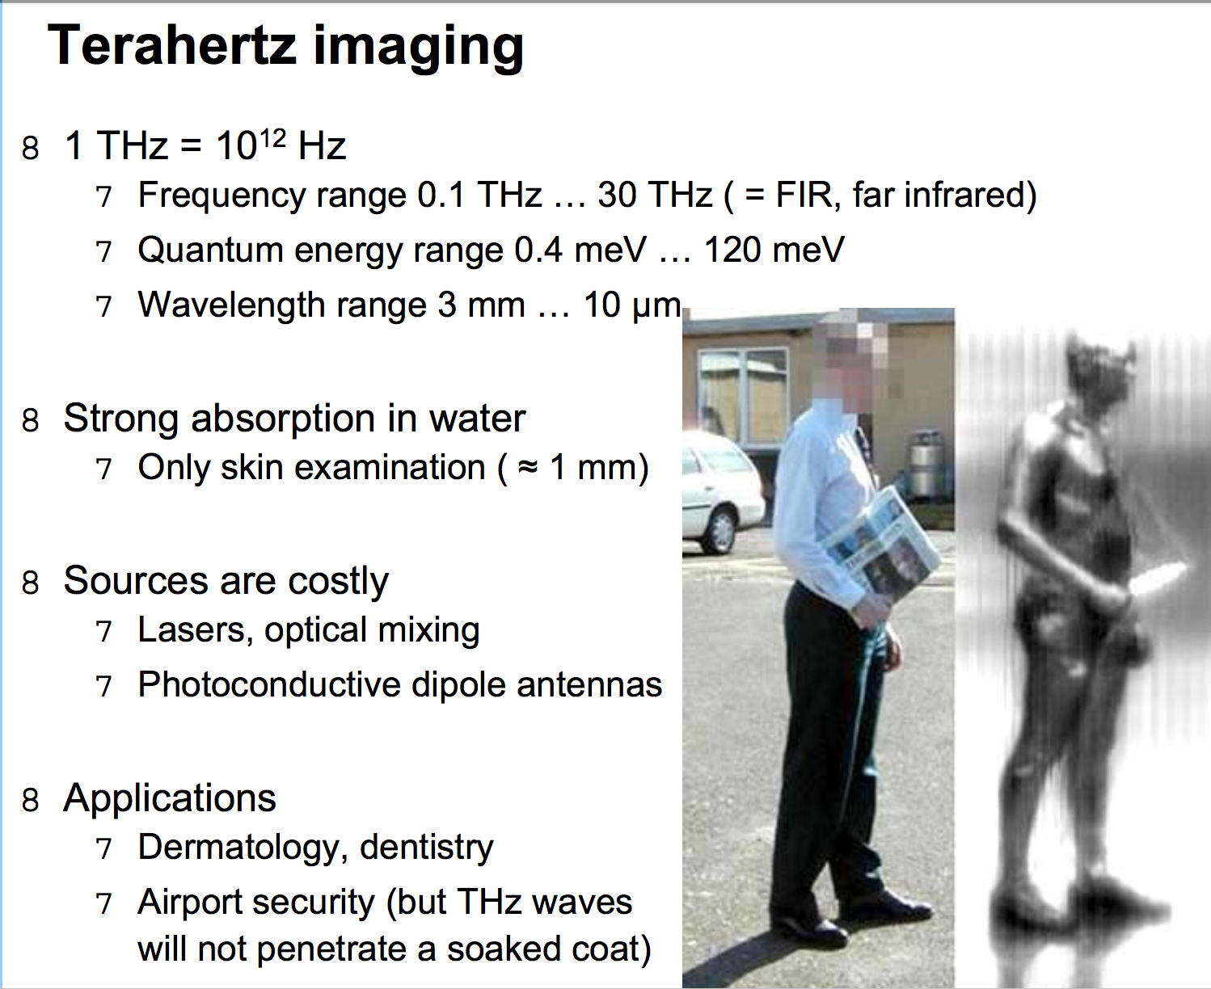

Slide 37

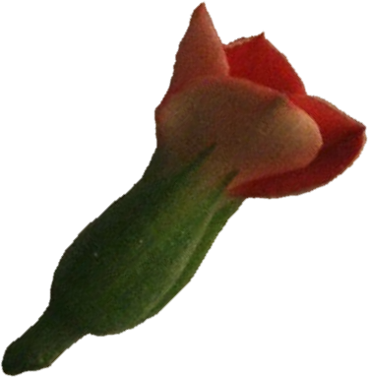
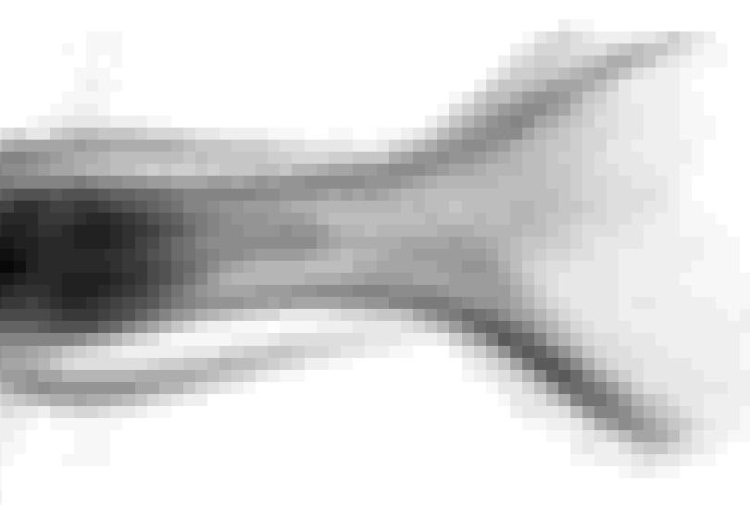
The Neutronography
Parallel beam of thermal neutrons
Specimen attenuating the beam
Shadow on detector
plane
Neutronogram

Slide 38
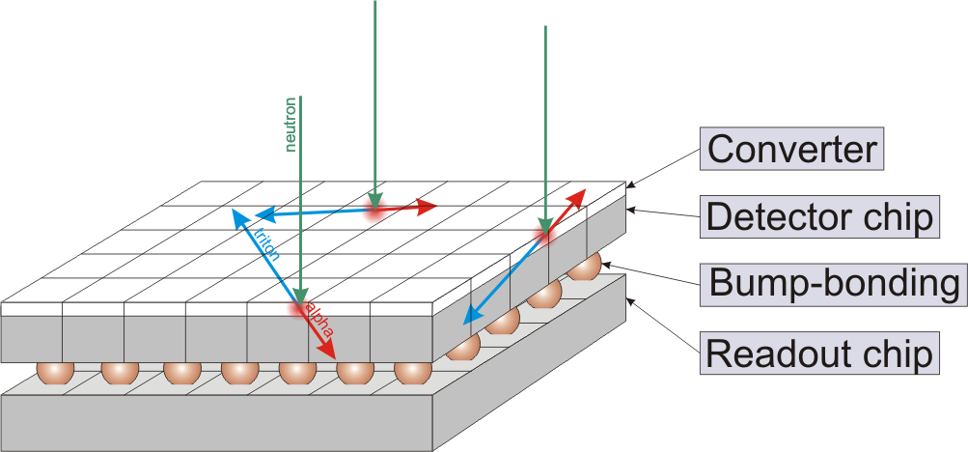
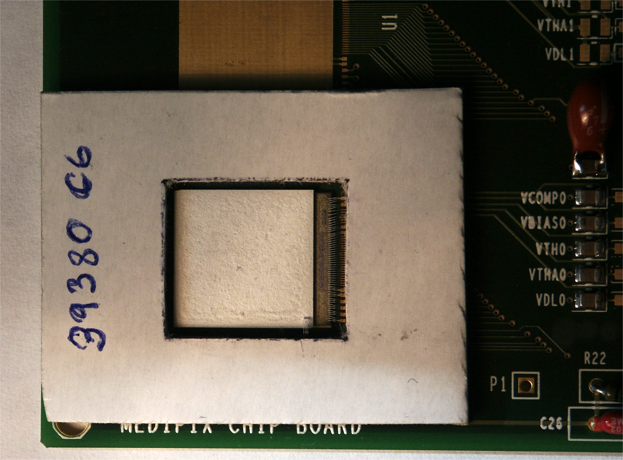
Neutronography with Medipix
Conversion of thermal neutrons to heavy charged particles in ⁶Li or ¹⁰B converter layer.
¹⁰B reaction (Cross section 3840 barns at 0.0253 eV):
¹⁰B+n → a (1.47 MeV) + ⁷Li (0.84 MeV) + γ (0.48MeV) (93.7%)
¹⁰B+n → a (1.78 MeV) + ⁷Li (1.01 MeV) (6.3%)
⁶Li reaction (cross section 940 barns at 0.0253 eV) :
⁶Li + n → α (2.05 MeV) + ³H (2.72 MeV)
⁶LiF layer: 3±1 mg/cm²

Slide 39
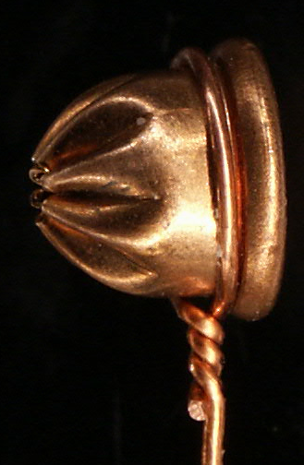
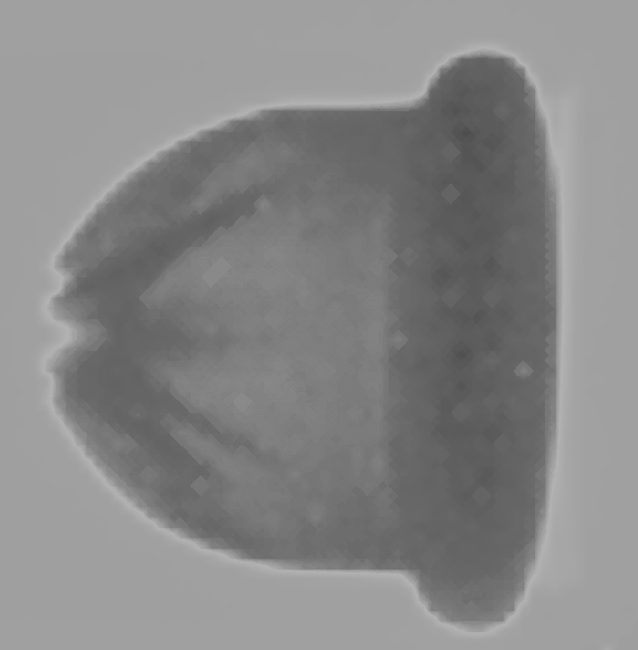
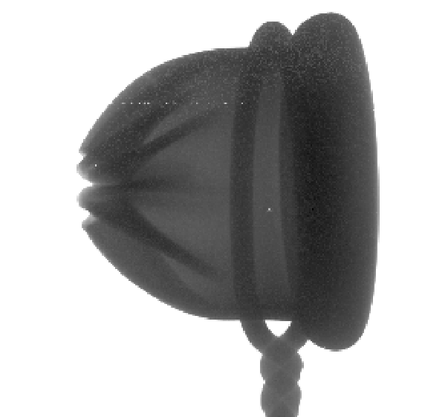
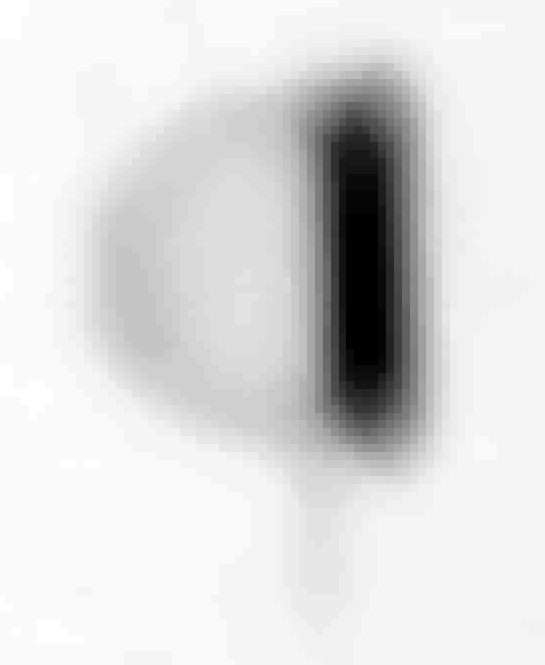
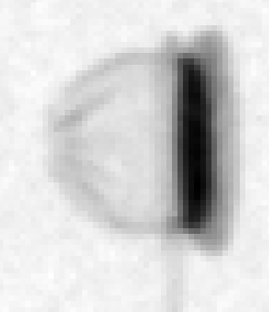
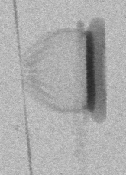
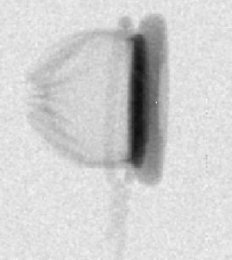
Sample objects – blank cartridge
Roentgenography
Photograph
Medipix-1
Medipix-2
Neutronography
Imaging
plate
CCD
Medipix-1
Medipix-2

Slide 40
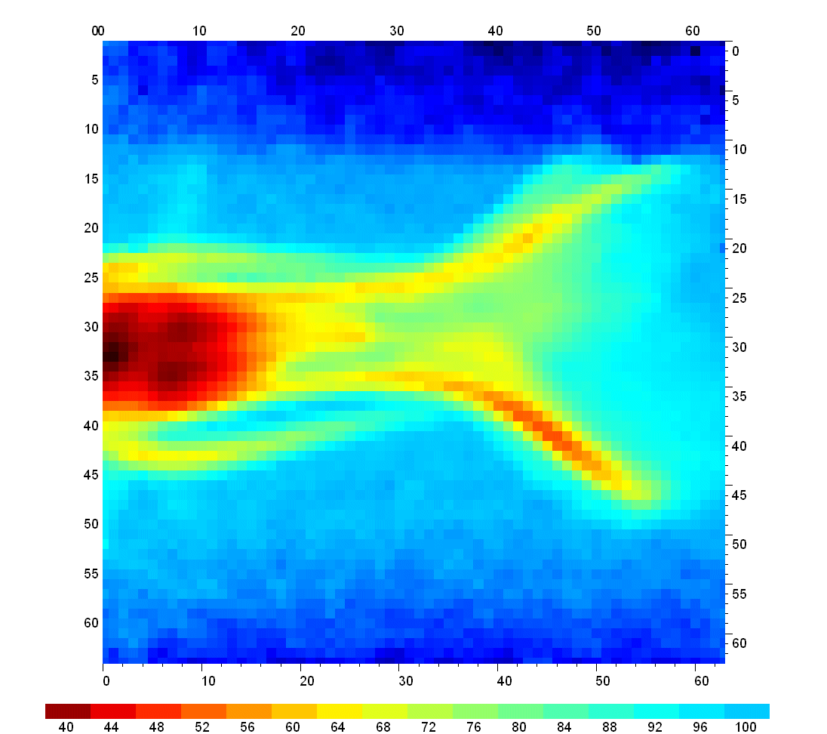
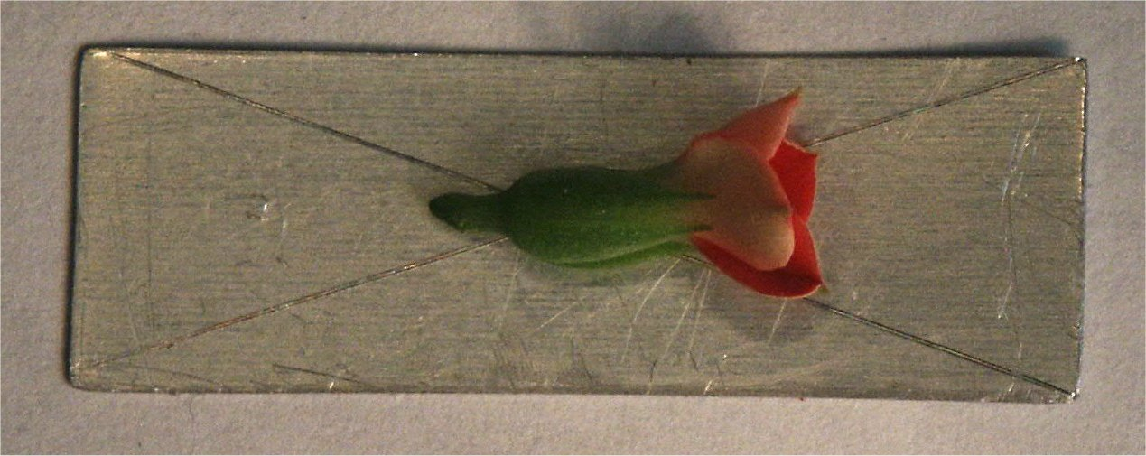
Flower behind Al plate
Seeds

Slide 41
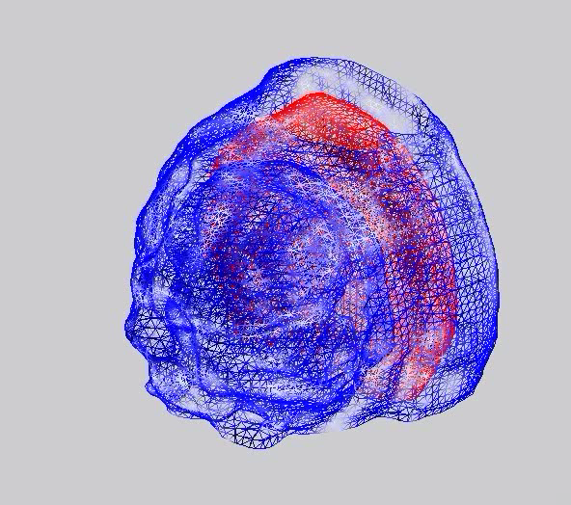
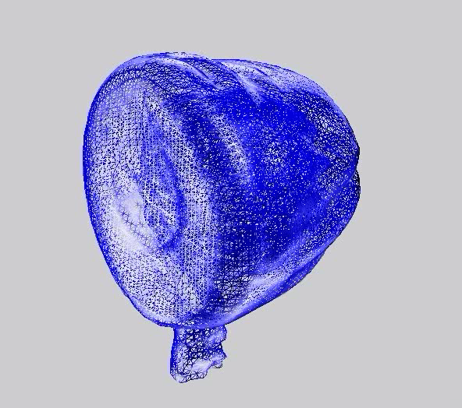
3D reconstructions
3D reconstruction - neutron
3D reconstruction – X-ray

Slide 42


Proton CT Basics
Proton therapy and treatment planning requires the knowledge of the stopping power
in the patient, so that the Bragg peak can be located within the tumor.
X-ray CT has been shown to give insufficiently accurate stopping power (S.P.) maps in
complicated phantoms or from uncertainty in converting Hounsfield values to S.P.
Range Uncertainties
(measured with PTR)
> 5 mm
> 10 mm
> 15 mm
RSP
Schneider U. (1994), “Proton radiography as a tool for quality control in proton therapy,” Med Phys. 22, 353.
Alderson Head Phantom
H
The goal of Proton CT is to reconstruct a 3D map of the stopping power
within the patient with as fine a voxel size as practical at a minimum dose,
using protons (instead of x-rays) in transmission.
In a rotational scan the integrated stopping power is determined for every view
by a measurement of the energy loss.

Slide 43


Proton CT (pCT) Concept
Measure Stopping power distribution directly (instead of converting X-ray CT scans
Design of a Proton CT Scanner rotating with the proton gantry
(R Schulte et al. IEEE Trans. Nucl. Sci., 51(3), 866-872, 2004)
An energetic low intensity cone beam of protons traverses the patient
The position and direction (entry & exit) and energy loss of each proton is measured
Proton histories are taken from multiple projection angles
(angular “CT scan”)
Minimal proton loss and high detection efficiency make this a low-dose imaging modality
Tracking of individual protons
Low intensity proton beam

Slide 44
Low Contrast in Proton CT
High contrast in absorption of Photons
N(x) = N_{o}e^{- μ x}
with the linear absorption coefficient µ differing by a factor 10 between bone and soft tissue.
Bethe-Bloch
Low contrast in energy loss of Protons
with the stopping power dE/dl only 50% larger for bone than for soft tissue.
NIST Data

Slide 45

pCT Challenges
#1: Multiple Coulomb Scattering
The proton path inside the patient/phantom is not straight
→ the path of every proton before and after the phantom
has to be measured and its path inside
the patient reconstructed.
D C Williams Phys. Med. Biol. 49 (2004) 2899–2911
From deflection and displacement, calculate the “Most Likely Path MLP”
#2: Proton Data Rate
Data Flow math:
Assuming 100 protons / 1mm voxel and 180 views requires ~ 7*10⁸ protons.
A scan with a proton rate of 2 MHz takes 6 min with a dose of 1.5 mGy.
Image Reconstruction
To reconstruct images with > 10⁷ voxels using ~10⁹ protons is NOT trivial.
Our reconstruction code is already running on GPU’s in anticipation of the much higher data rates of the future.

Slide 46

Hand Radiography: Something New (?)
Hand Phantom imaged with 200 MeV protons
at the Loma Linda Synchrotron,
using the existing pCT scanner.
Color-coded image
of the summed-up
stopping power
in terms of
water-equivalent
thickness [in mm].
Note the varying thickness of the hand
and clear structural details.

Slide 47


A step forward into Imaging History..
X-Rays
200 MeV Protons
Stopping Power
Multiple Scattering
UCSC-LLU-CSUSB 2012, T. Plautz et al., 2012 IEEE NSS-MIC
Wilhelm Roentgen,
Laboratory Radiology (1895)

Slide 48
Summary
Vivid field
Broad range of applications
Inspired by particle physics, but developing autonomously
Particle physics experience still useful
Companies exist also in the Czech Republic

Slide 49


Slide 50


Slide 52


