Slide 1

Faculty of Mathematics and Physics
Multivariate analysis of decays of the Higgs boson into pairs of tau leptons using the ATLAS detector at the LHC
Tomáš Kello
Supervisor of the master thesis: Mgr. Daniel Scheirich, Ph.D.
Institute of Particle and Nuclear Physics
Výjezdní seminář, Malá Skála, 2018

Slide 2
Content
ATLAS detector subsystems
Higgs boson mechanism
Data & MC – preselection and categorisation
MVA – Boosted Decision Trees
BDT Training
Final BDT score cut

Slide 3
Content
ATLAS detector subsystems
Higgs boson mechanism
Data & MC – preselection and categorisation
MVA – Boosted Decision Trees
BDT Training
Final BDT score cut

Slide 4
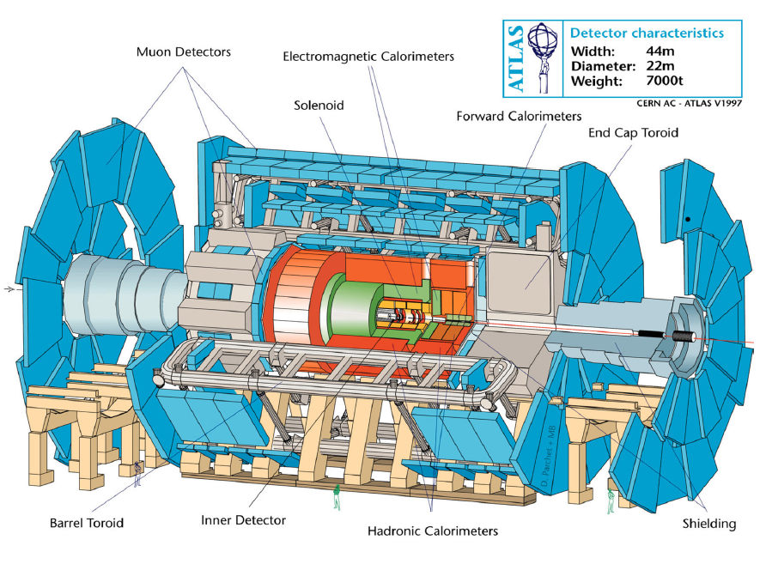
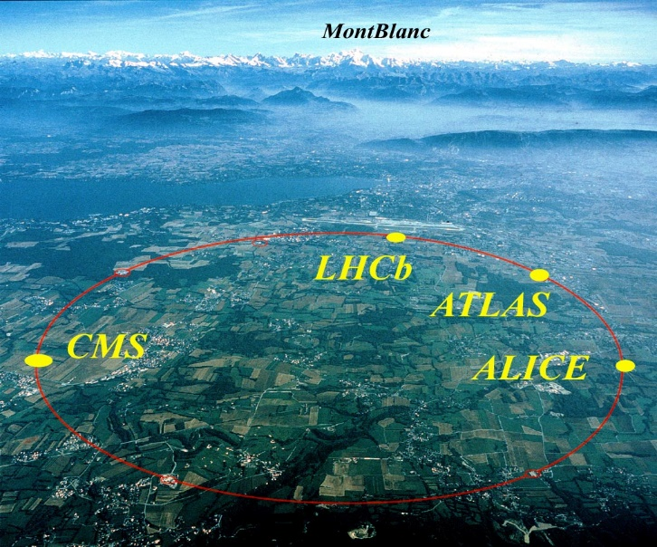
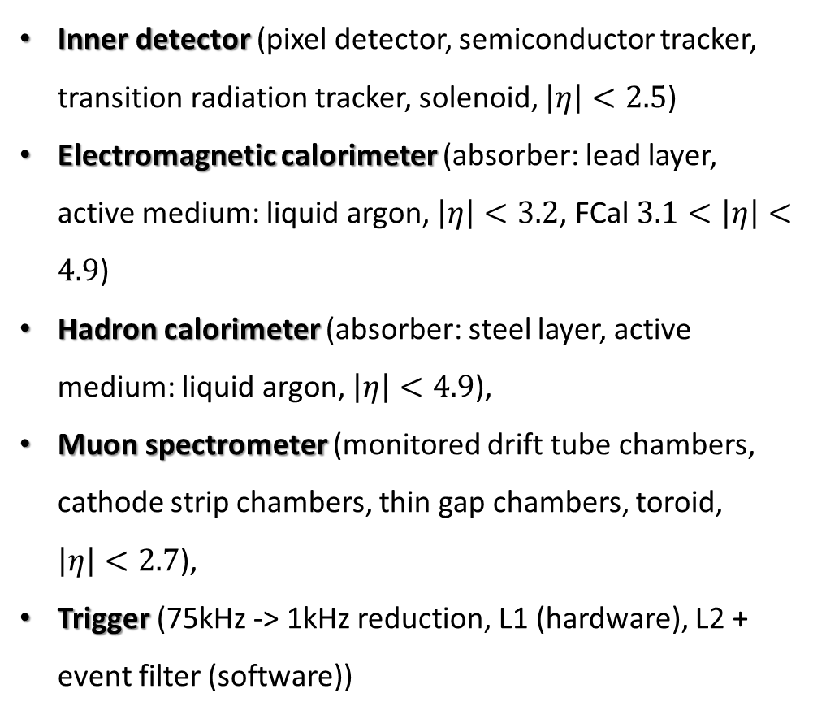
The ATLAS experiment at the LHC
Inner detector (pixel detector, semiconductor tracker, transition radiation tracker, solenoid, $\left|η\right|<2.5$)
Electromagnetic calorimeter (absorber: lead layer, active medium: liquid argon, $\left|η\right|<3.2$, FCal $3.1<\left|η\right|<4.9$)
Hadron calorimeter (absorber: steel layer, active medium: liquid argon, $\left|η\right|<4.9$),
Muon spectrometer (monitored drift tube chambers, cathode strip chambers, thin gap chambers, toroid, $\left|η\right|<2.7$),
Trigger (75kHz -> 1kHz reduction, L1 (hardware), L2 + event filter (software))

Slide 5
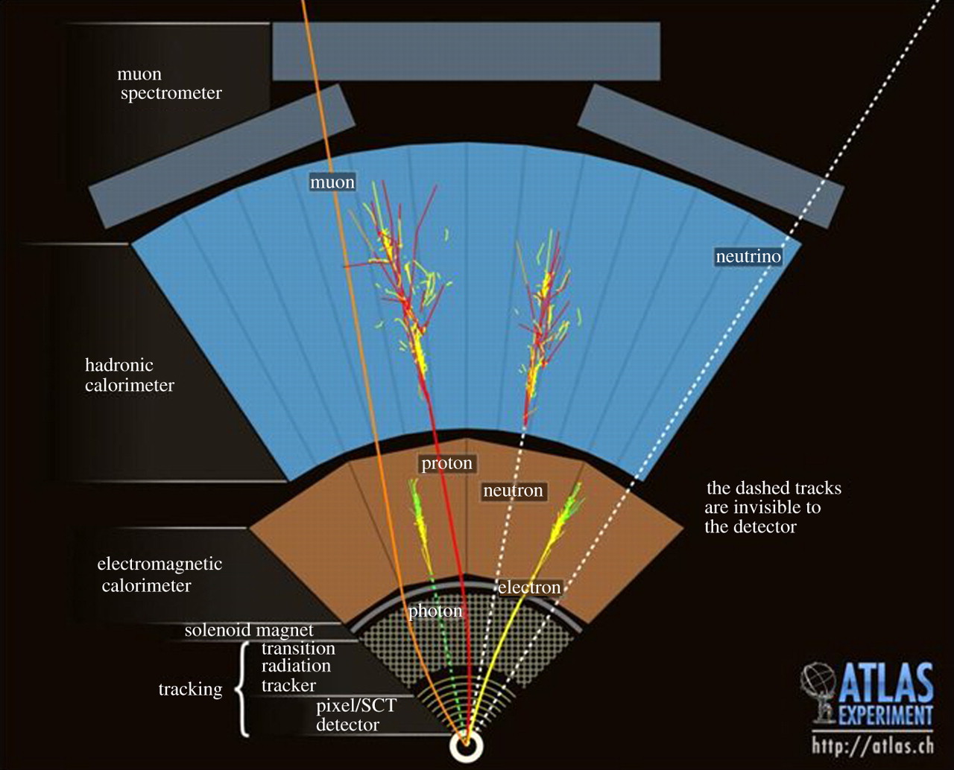
The ATLAS experiment at the LHC
MET
Muon spectrometer
Toroid B=0.5T (barrel)
B=1.0T (end-cup)
System of calorimeters
Inner detector
Solenoid (B=2T)

Slide 6
Content
ATLAS detector subsystems
Higgs boson mechanism
Data & MC – preselection and categorisation
MVA – Boosted Decision Trees
BDT Training
Final BDT score cut

Slide 7
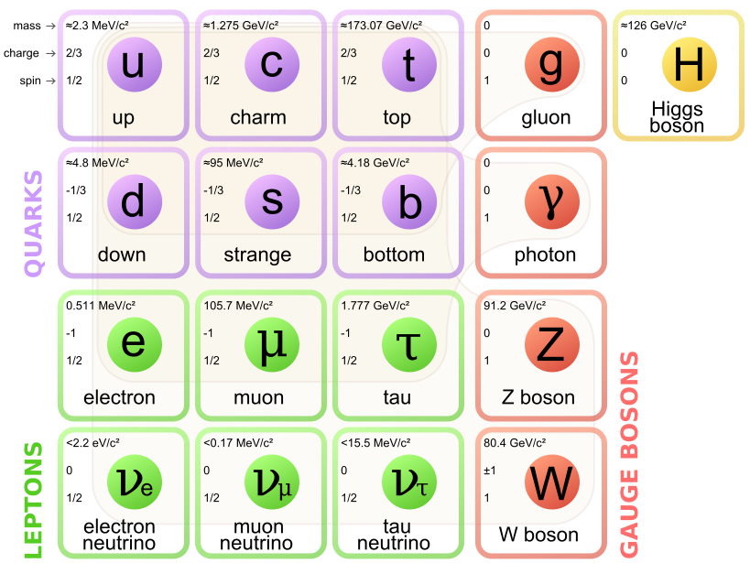
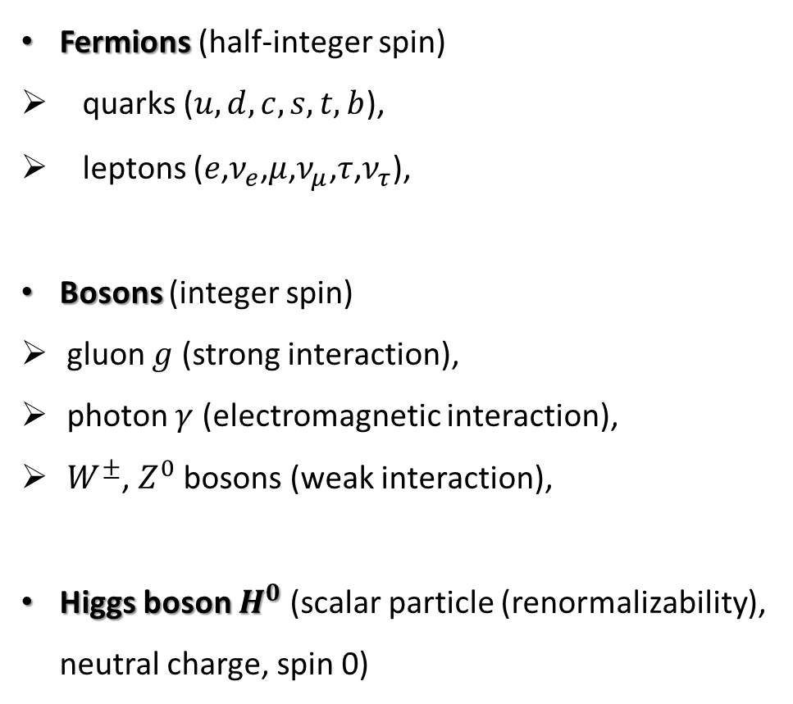
Standard model. Elementary particles
Fermions (half-integer spin)
quarks ($u,d,c,s,t,b$),
leptons ($e$,$ν_{e}$,$μ$,$ν_{μ}$,$τ$,$ν_{τ}$),
Bosons (integer spin)
gluon $g$ (strong interaction),
photon $γ$ (electromagnetic interaction),
$W^{±}$, $Z^{0}$ bosons (weak interaction),
Higgs boson $H^{0}$ (scalar particle (renormalizability), neutral charge, spin 0)
3 fermion generations

Slide 8
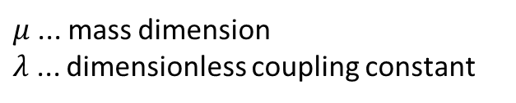
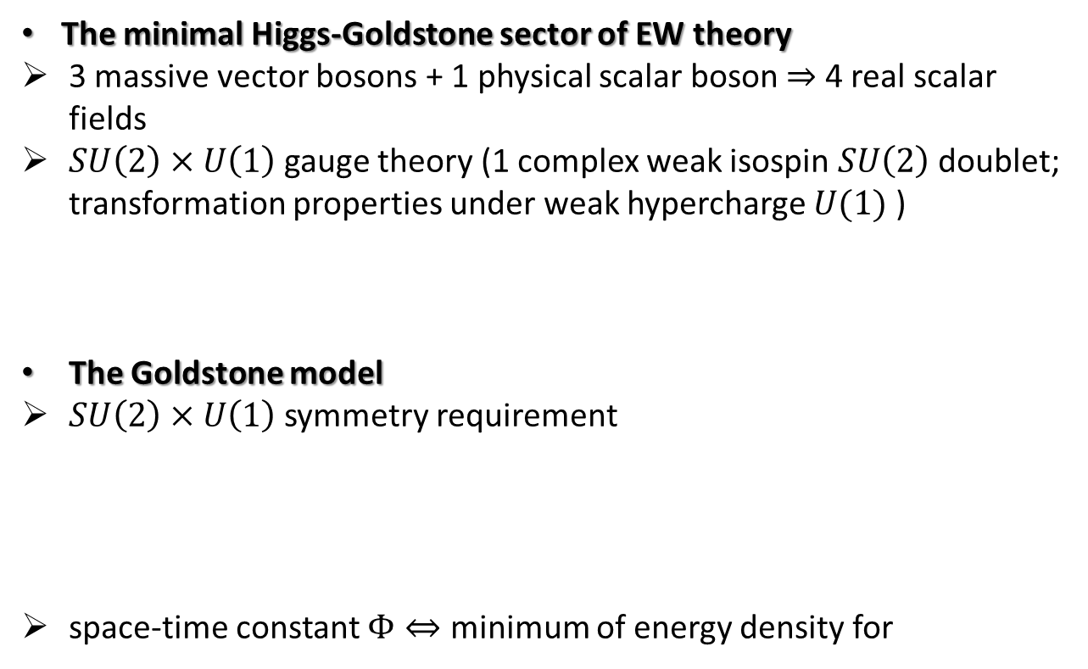


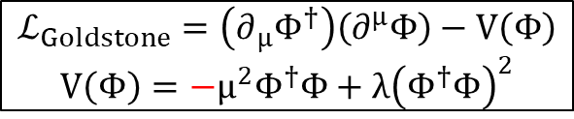
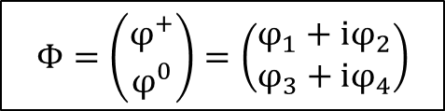

Higgs mechanism
The minimal Higgs-Goldstone sector of EW theory
3 massive vector bosons + 1 physical scalar boson $⇒$ 4 real scalar fields
$SU\left(2\right)×U\left(1\right)$ gauge theory (1 complex weak isospin $SU\left(2\right)$ doublet; transformation properties under weak hypercharge $U(1)$ )
The Goldstone model
$SU\left(2\right)×U\left(1\right)$ symmetry requirement
space-time constant $Φ⇔$ minimum of energy density for
$$Φ=\left(\begin{matrix}φ^{+} \\ φ^{0}\end{matrix}\right)=\left(\begin{matrix}φ_{1}+iφ_{2} \\ φ_{3}+iφ_{4}\end{matrix}\right)$$
$μ$... mass dimension
$λ$ ... dimensionless coupling constant
$$ℒ_{Goldstone}=\left(∂_{μ}Φ^{†}\right)\left(∂^{μ}Φ\right)−V\left(Φ\right)$$
$$V\left(Φ\right)=−μ^{2}Φ^{†}Φ+λ{\left(Φ^{†}Φ\right)}^{2}$$
$$Φ_{0}^{†}Φ_{0}=\frac{v^{2}}{2}$$
$$v=\frac{μ}{\sqrt{λ}}$$
$v$... „vacuum value“

Slide 9

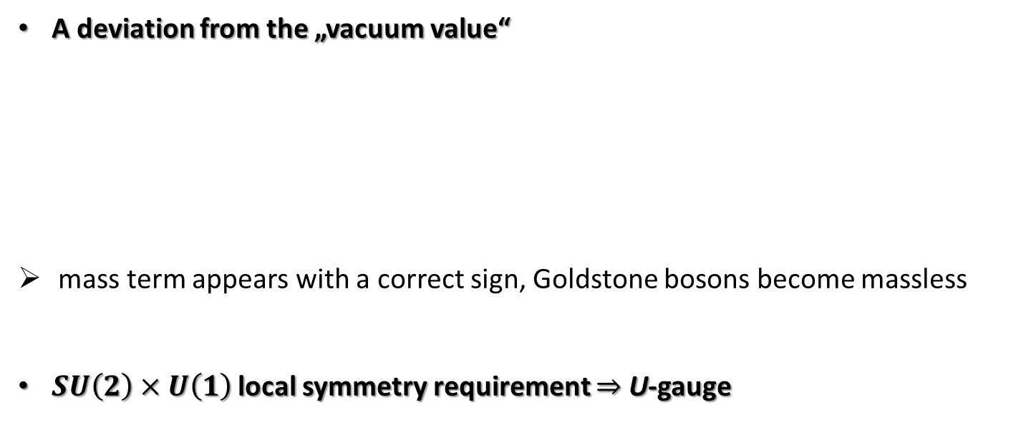

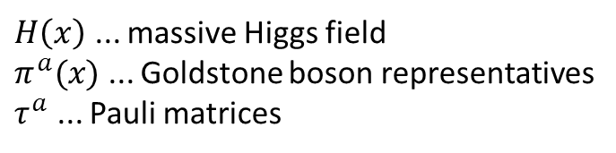
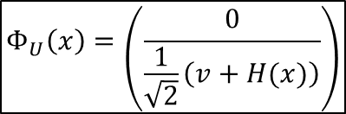
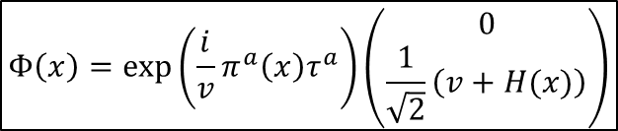

Higgs mechanism
A deviation from the „vacuum value“
mass term appears with a correct sign, Goldstone bosons become massless
$SU\left(2\right)×U\left(1\right)$ local symmetry requirement $⇒$ U-gauge
$$Φ\left(x\right)=exp\left(\frac{i}{v}π^{a}\left(x\right)τ^{a}\right)\left(\begin{matrix}0 \\ \frac{1}{\sqrt{2}}\left(v+H(x)\right)\end{matrix}\right)$$
$H\left(x\right)$ ... massive Higgs field
$π^{a}(x)$ ... Goldstone boson representatives
$τ^{a}$ ... Pauli matrices
„angular“ variable
shifted „radial“ variable
$$ℒ=kin. terms+interactions −λv^{2}H^{2}$$
$$⇔$$
$$m_{H}^{2}=2λv^{2}$$
$$m_{π}=0$$
$$Φ_{U}\left(x\right)=\left(\frac{0}{\frac{1}{\sqrt{2}}\left(v+H(x)\right)}\right)$$

Slide 10


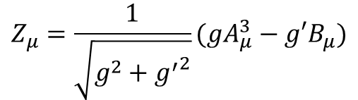
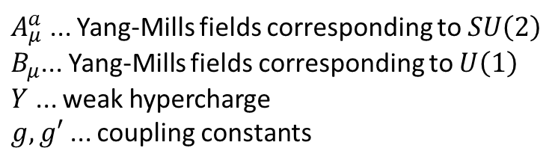


Higgs mechanism
$A_{μ}^{a}$ ... Yang-Mills fields corresponding to $SU\left(2\right)$
$B_{μ}$... Yang-Mills fields corresponding to $U\left(1\right)$
$Y$ ... weak hypercharge
$g,g′$ ... coupling constants
The U-gauge Higgs Lagrangian
$$ℒ_{Higgs}^{(U)}=Φ_{U}^{†}\left({\overset{⃖}{∂}}_{μ}+igA_{μ}^{a}\frac{τ^{a}}{2}+ig^{′}YB_{μ}\right)\left({\vec{∂}}_{μ}−igA^{bμ}\frac{τ^{b}}{2}−ig^{′}YB^{μ}\right)Φ_{U}−λ{\left(Φ_{U}^{†}Φ_{U}−\frac{v^{2}}{2}\right)}^{2}+kin.+selfinter.$$
...
$$ℒ_{Higgs}^{(U)}=\frac{1}{2}∂_{μ}H∂^{μ}H−λv^{2}H^{2}−λvH^{3}−\frac{1}{4}λH^{4}+\frac{1}{8}{\left(v+H\right)}^{2}\left(g^{2}A_{μ}^{a}A^{aμ}−4Ygg^{′}A_{μ}^{3}B^{μ}+4Y^{2}{g′}^{2}B_{μ}B^{μ}\right)$$
$$Z_{μ}=\frac{1}{\sqrt{g^{2}+{g^{′}}^{2}}}(gA_{μ}^{3}−g′B_{μ})$$
$$ℒ_{mass}^{(IVB)}=\frac{1}{4}g^{2}v^{2}W_{μ}^{−}W^{+μ}+\frac{1}{8}(g^{2}+{g′}^{2})v^{2}Z_{μ}Z^{μ}$$
$$Y=\frac{1}{2}$$
$$m_{W}=\frac{1}{2}gv$$
$$m_{Z}=\frac{1}{2}v\sqrt{\left(g^{2}+{g′}^{2}\right)}$$

Slide 11
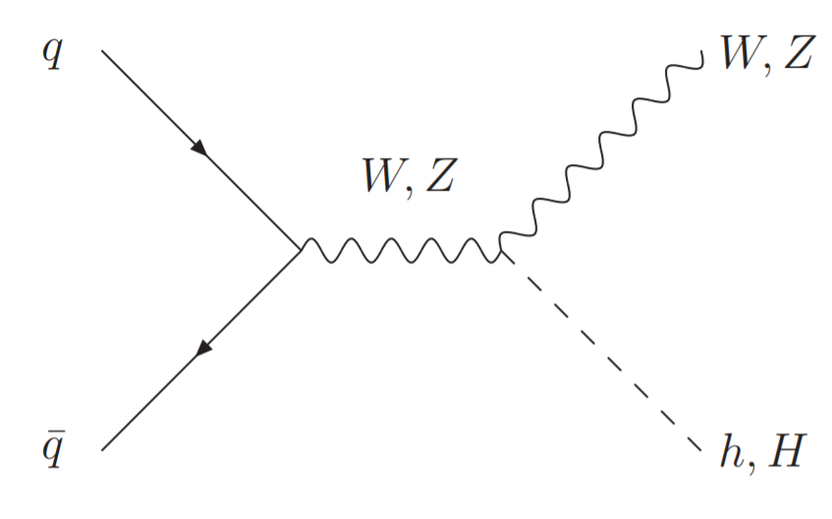
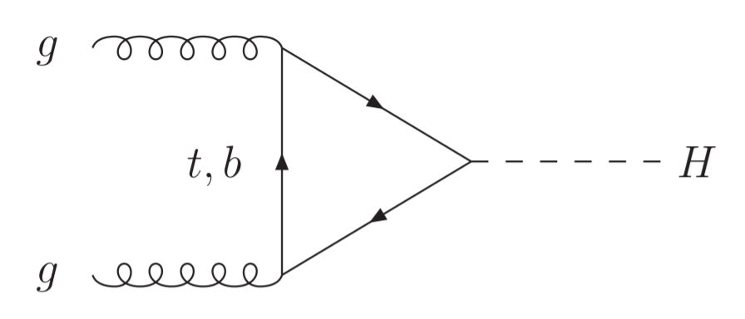
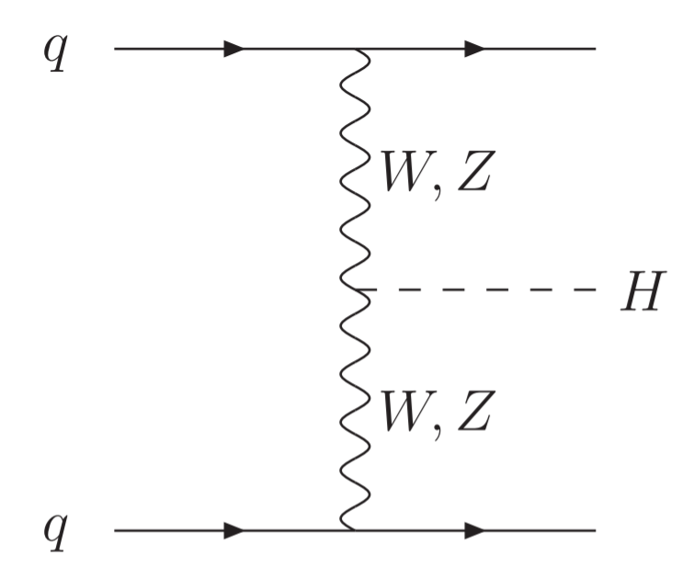
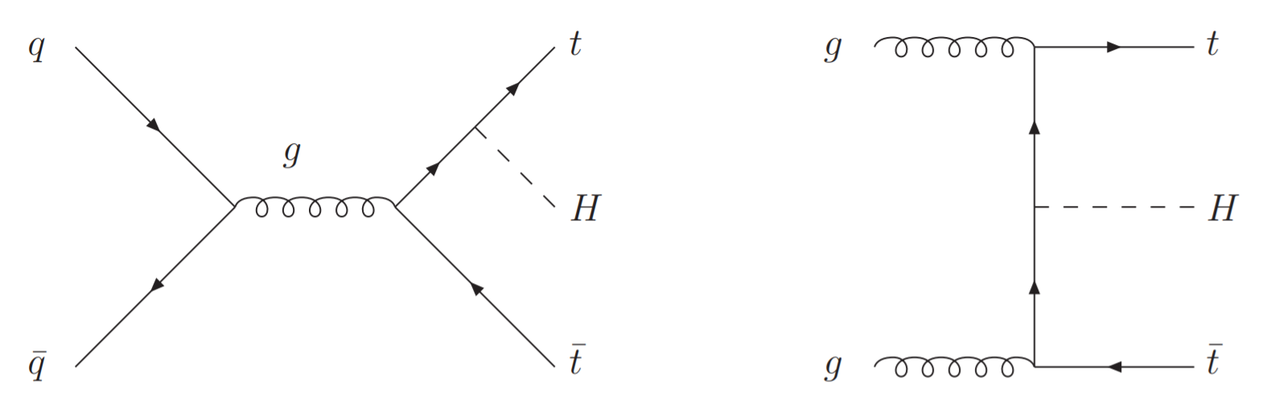

Higgs production
PDG 2016, [9]: $m_{H_{0 }}\dot{=}(125.09 ± 0. 24)GeV$
ggF (gluon-gluon fusion)
Higgs Strahlung VH
Powheg Box2 (NLO)
PowhegNNLOPS
VBF (vector-boson fusion)
MG5_aMC@NLO v2.2.2
$t\overline{t}H$ production
Powheg Box2 (NLO)

Slide 12





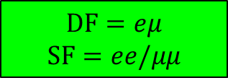







Higgs decay modes
$$H^{0}→f\overline{f}$$
$$H^{0}→b\overline{b}$$
$5.84×{{10}^{−1}}_{−3.2\%}^{+3.3\%}$ [9]
$$H^{0}→τ\overline{τ}$$
$6.27×{{10}^{−2}}_{−5.7\%}^{+5.7\%}$ [9]
$$H^{0}→μ^{+}μ^{−}$$
$$H^{0}→W^{+}W^{−}$$
$$H^{0}→Z^{0}Z^{0}$$
$$H^{0}→γγ$$
$$H^{0}→τ^{+}τ^{−}→l^{+}\overline{ν}νl^{−}\overline{ν}ν$$
...
$$DF=eμ$$
$$SF=ee/μμ$$
$$\sqrt{s}=13 TeV$$
integrated luminosity
$$=36.2 {fb}^{−1}$$
Run 2 (2015 & 2016)

Slide 13
Content
ATLAS detector subsystems
Higgs boson mechanism
Data & MC – preselection and categorisation
MVA – Boosted Decision Trees
BDT Training
Final BDT score cut

Slide 14
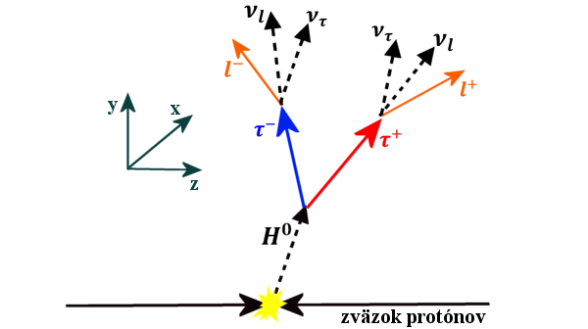
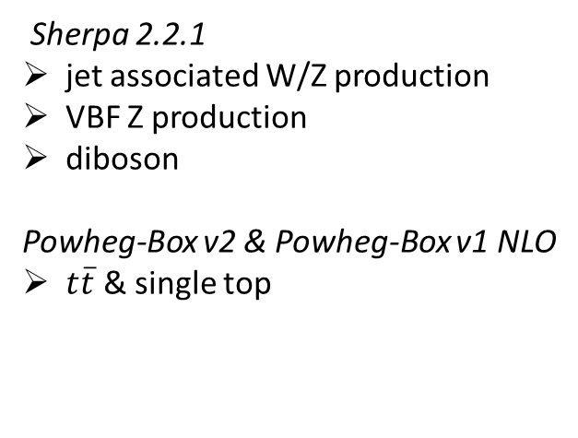
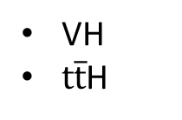
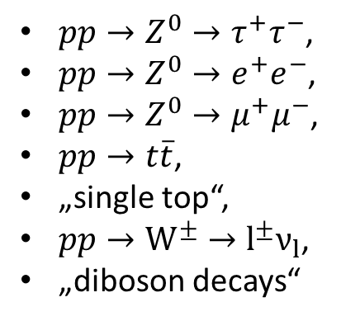

Data&MC
Signal
Background
$pp→Z^{0}→τ^{+}τ^{−}$,
$pp→Z^{0}→e^{+}e^{−}$,
$pp→Z^{0}→μ^{+}μ^{−}$,
$pp→t\overline{t}$,
„single top“,
$pp→W^{±}→l^{±}ν_{l}$,
„diboson decays“
$$H^{0}→τ^{+}τ^{−}→l^{+}\overline{ν}νl^{−}\overline{ν}ν$$
ggF
VBF
VH
$t\overline{t}$H
Sherpa 2.2.1
jet associated W/Z production
VBF Z production
diboson
Powheg-Box v2 & Powheg-Box v1 NLO
$t\overline{t}$ & single top

Slide 15
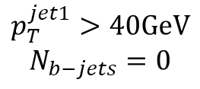

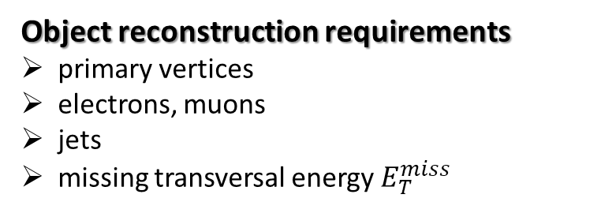
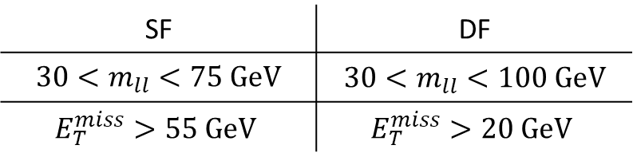





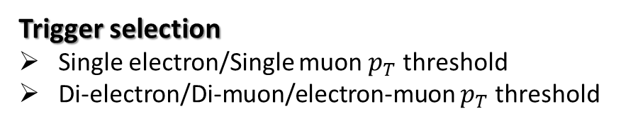

Data&MC
$τ_{lep}τ_{lep}$ preselection criteria
Object reconstruction requirements
primary vertices
electrons, muons
jets
missing transversal energy $E_{T}^{miss}$
$$m_{ττ}^{coll}<m_{Z}−25GeV$$
SF | DF
$30<m_{ll}<75 GeV$ | $30<m_{ll}<100 GeV$
$$E_{T}^{miss}>55 GeV$$ | $$E_{T}^{miss}>20 GeV$$
Trigger selection
Single electron/Single muon $p_{T}$ threshold
Di-electron/Di-muon/electron-muon $p_{T}$ threshold
$$p_{T}^{jet1}>40GeV$$
$$N_{b−jets}=0$$
Preselection requirements
number of leptons
opposite charge
lepton (medium) gradient isolation criteria
...
VBF
Boosted
$$p_{T}^{jet2}>30GeV$$
$$not VBF$$
$$\left|η_{jj}\right|>3$$
$$p_{T}^{ττ}>100GeV$$
$$m_{jj}>400GeV$$

Slide 16
Content
ATLAS detector subsystems
Higgs boson mechanism
Data & MC – preselection and categorisation
MVA – Boosted Decision Trees
BDT Training
Final BDT score cut

Slide 17













Decision Tree
MC
root node
multivariate classification algorithm,
operates within a multi-dimensional observable space,
more sophisticated non sequential approach to observables,
Task: to maximize a figure of merit of signal vs. background selection.
$$X_{1}<C_{1}$$
$$X_{1}>C_{1}$$
1st level split node
$$X_{2}<C_{2}$$
$$X_{2}>C_{2}$$
$$X_{3}<C_{3}$$
$$X_{3}>C_{3}$$
B
...
S
B
...
S
2nd level split node
$$\frac{K−1}{K}$$
TRAINING DATA
TRAINED TREE
TRAINING
v
Final
MC histograms
$$=$$
MC
K-Fold cross validation
Determining the one variable and the corresponding cut value to get the best MC data separation at each node.
$$\frac{1}{K}$$
TESTING DATA
$$X_{j}∈\left\{X_{1},…,X_{n}\right\}$$
$$C_{j}∈\left\{C_{1}(X_{1}),C_{2}(X_{2}),…,C_{n}(X_{n})\right\}$$

Slide 18


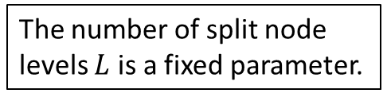






Training algorithm
TRAINED TREES
Final
MC histograms
$$X_{1}<C_{1}$$
Gini index is evaluated AFTER & BEFORE each split node to determine the most contributing selection variable with the corresponding cut value.
$$Gini index=p(1−p)$$
purity ...
$$p=\frac{N_{S}}{N}$$
$$X_{2}<C_{2}$$
$$X_{2}>C_{2}$$
$$X_{j}∈\left\{X_{1},…,X_{n}\right\}$$
the difference of Gini indices is being maximized
$${\left(G_{L}−G_{L−1}\right)}_{max}$$
$$C_{j}∈\left\{C_{1}(X_{1}),C_{2}(X_{2}),…,C_{n}(X_{n})\right\}$$
B
S
The number of split node levels $L$ is a fixed parameter.
Each event from the training data is then classified according to the label of the final leaf node.

Slide 19



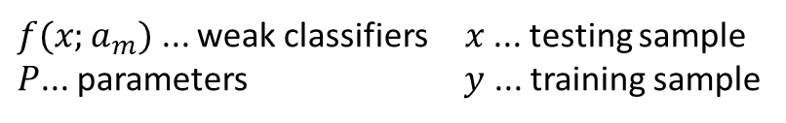
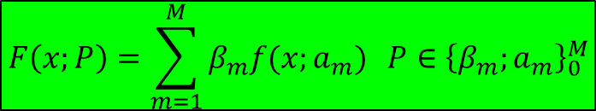




Boosted Decision Tree
...
number of trees in the forest
$$M$$
(Gradient Boost)
sequential method – learning from the mistakes
of previous classifiers
tree ensemble model construction
loss function minimization
executed by loss function gradient calculation
$$m=3$$
$$m=2$$
$$m=1$$
K-Fold cross validation (K=5)
$$F\left(x;P\right)=\sum_{m=1}^{M}{β_{m}f(x;a_{m})} {P∈\left\{β_{m};a_{m}\right\}}_{0}^{M}$$
Training data
Testing data
$f(x;a_{m})$ ... weak classifiers $x$ ... testing sample
$P$... parameters $y$ ... training sample
basic
$$L(F\left(x\right),y)={\left(F(x)−y\right)}^{2}$$
...
gradient
$$L(F\left(x\right),y)=\ln\left(1+e^{−2F\left(x\right)y}\right)$$
a whole MC data sample after BDT selection
$$F\left(x\right)≈F\left(x\right)+k\frac{δL(F\left(x\right),y)}{δF(x)}$$

Slide 20
Content
ATLAS detector subsystems
Higgs boson mechanism
Data & MC – preselection and categorisation
MVA – Boosted Decision Trees
BDT Training
Final BDT score cut

Slide 21
BDT training – splitting data randomly
TRAINING
SIGNAL
TESTING
SIGNAL
v
MC
TRAINING
BKG
TESTING
BKG

Slide 22
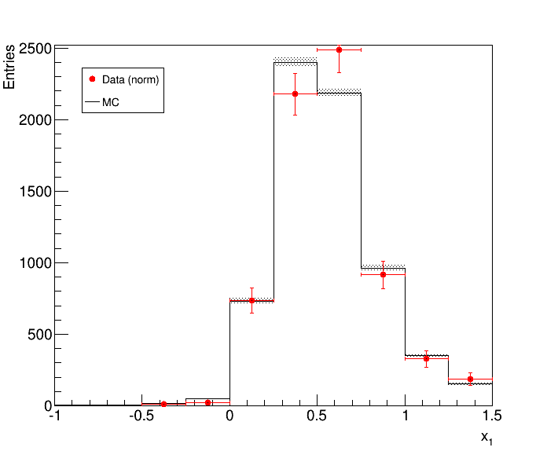
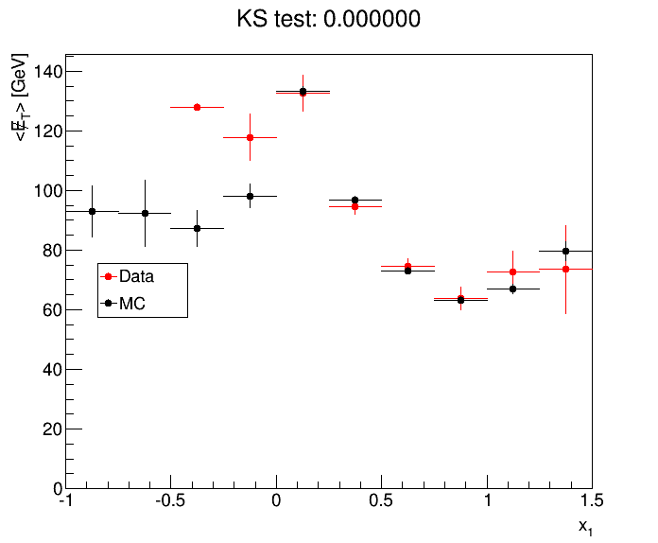
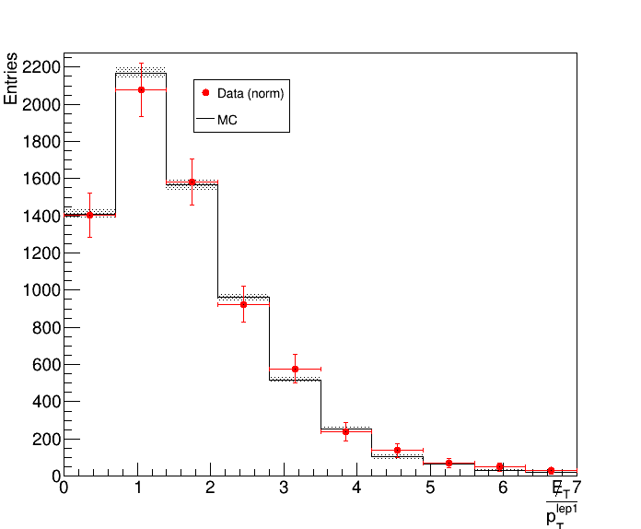
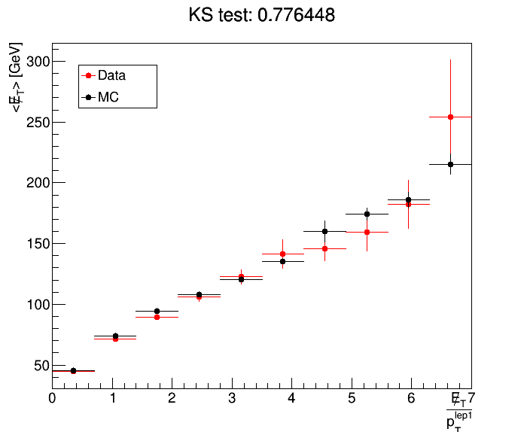

BDT training – DQ and variables selection
Starter Pack Selection
Boosted SF – 34 variables
Boosted DF – 34 variables
VBF SF – 40 variables
VBF DF – 40 variables
$$m_{MMC}^{mlm}$$
NONE was excluded

Slide 23
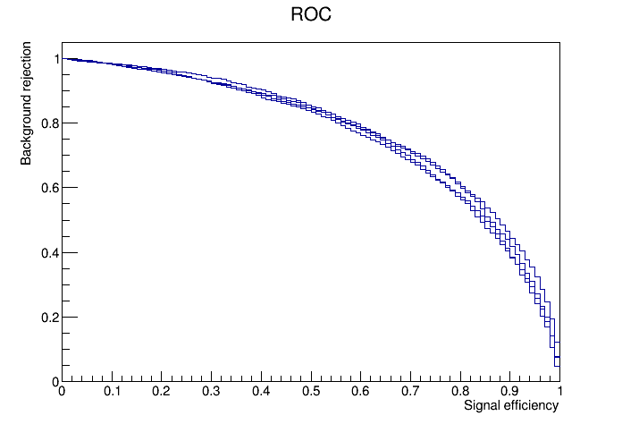
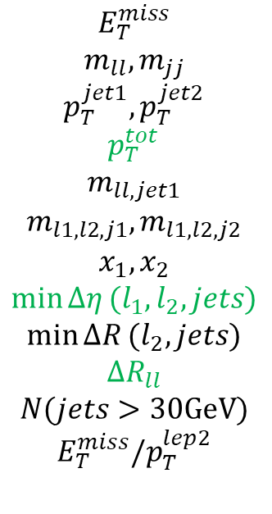
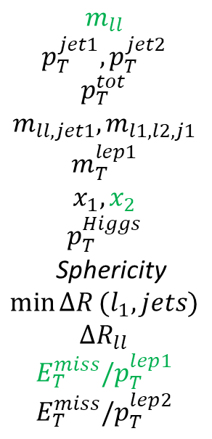
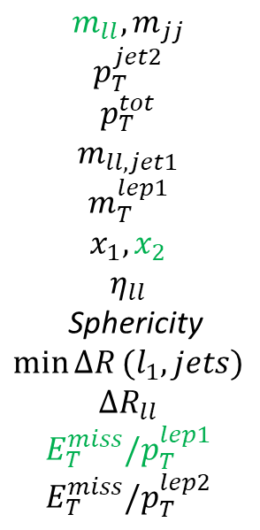
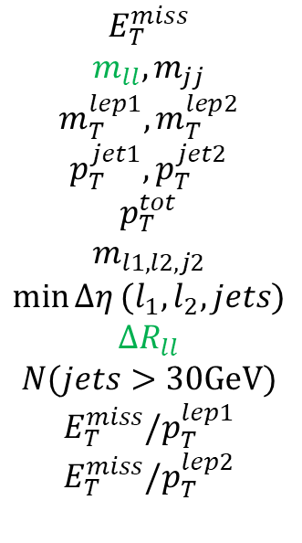
BDT training – DQ and variables selection
Starter Pack Selection
Boosted SF – 34 variables
Boosted DF – 34 variables
VBF SF – 40 variables
VBF DF – 40 variables
Final List of Variables
VBF
Boosted
SF
DF
SF
DF
$$E_{T}^{miss}$$
$$m_{ll},m_{jj}$$
$$p_{T}^{jet1},p_{T}^{jet2}$$
$$p_{T}^{tot}$$
$$m_{ll,jet1}$$
$$m_{l1,l2,j1},m_{l1,l2,j2}$$
$$x_{1},x_{2}$$
$$\min{Δη}(l_{1},l_{2},jets)$$
$$\min{ΔR}(l_{2},jets)$$
$$ΔR_{ll}$$
$$N(jets>30GeV)$$
$$E_{T}^{miss}/p_{T}^{lep2}$$
$$E_{T}^{miss}$$
$$m_{ll},m_{jj}$$
$$m_{T}^{lep1},m_{T}^{lep2}$$
$$p_{T}^{jet1},p_{T}^{jet2}$$
$$p_{T}^{tot}$$
$$m_{l1,l2,j2}$$
$$\min{Δη}(l_{1},l_{2},jets)$$
$$ΔR_{ll}$$
$$N(jets>30GeV)$$
$$E_{T}^{miss}/p_{T}^{lep1}$$
$$E_{T}^{miss}/p_{T}^{lep2}$$
$${m_{ll},m}_{jj}$$
$$p_{T}^{jet2}$$
$$p_{T}^{tot}$$
$$m_{ll,jet1}$$
$$m_{T}^{lep1}$$
$$x_{1},x_{2}$$
$$η_{ll}$$
Sphericity
$$\min{ΔR}(l_{1},jets)$$
$$ΔR_{ll}$$
$$E_{T}^{miss}/p_{T}^{lep1}$$
$$E_{T}^{miss}/p_{T}^{lep2}$$
$$m_{ll}$$
$$p_{T}^{jet1},p_{T}^{jet2}$$
$$p_{T}^{tot}$$
$$m_{ll,jet1},m_{l1,l2,j1}$$
$$m_{T}^{lep1}$$
$$x_{1},x_{2}$$
$$p_{T}^{Higgs}$$
Sphericity
$$\min{ΔR}(l_{1},jets)$$
$$ΔR_{ll}$$
$$E_{T}^{miss}/p_{T}^{lep1}$$
$$E_{T}^{miss}/p_{T}^{lep2}$$

Slide 24
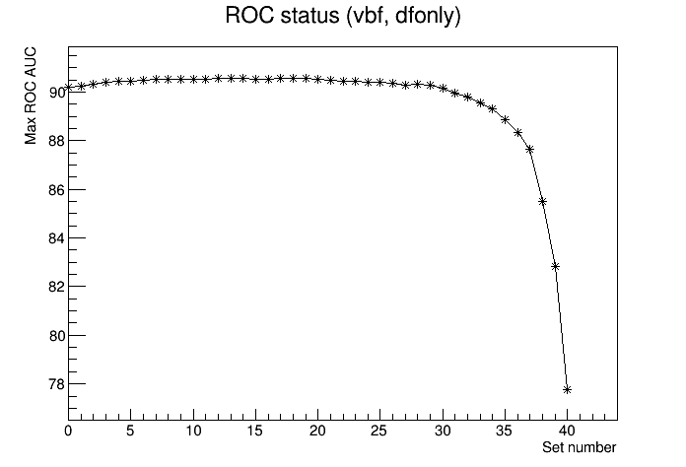
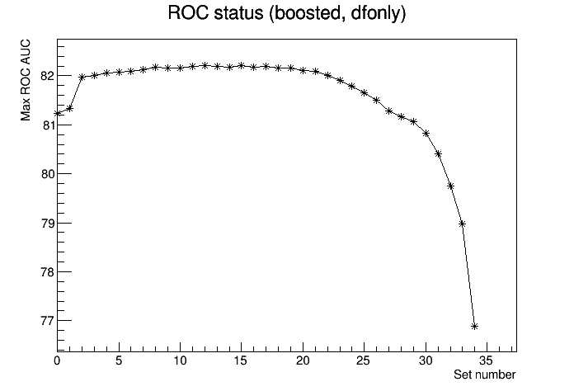
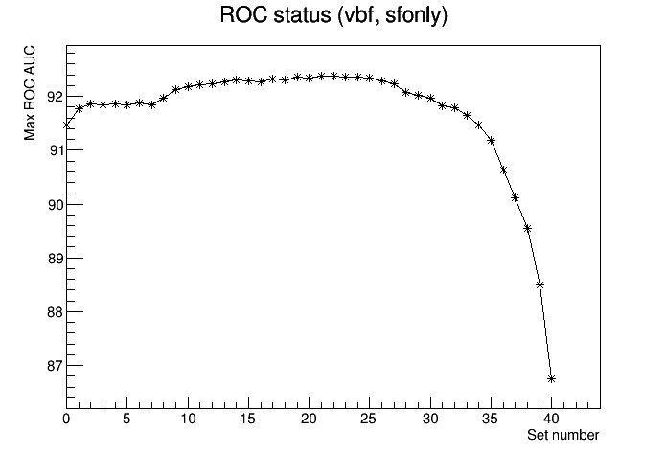
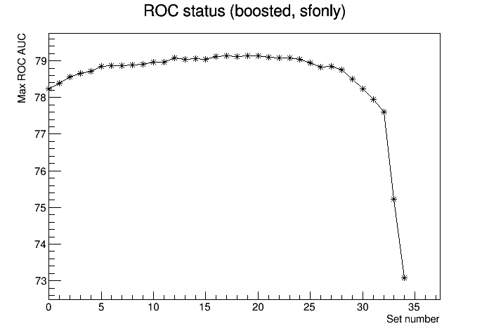
BDT training – DQ and variables selection

Slide 25
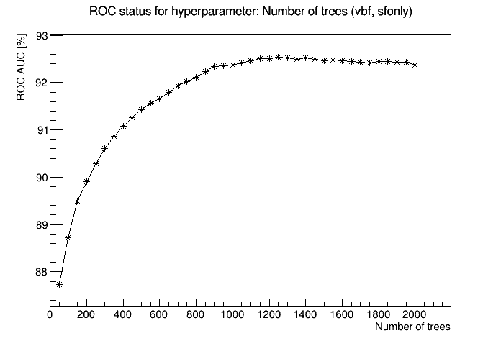
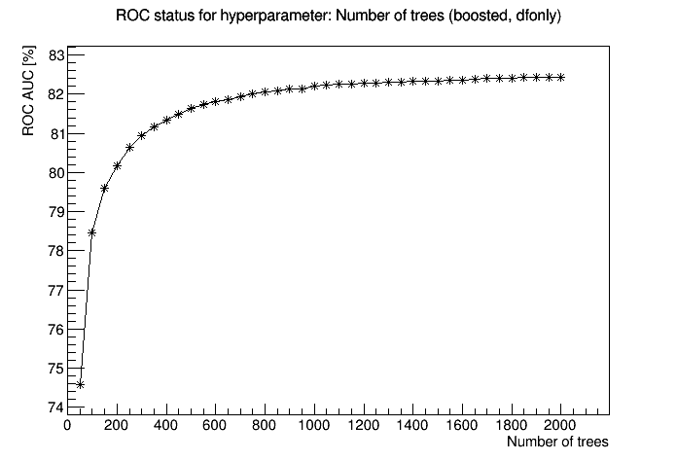
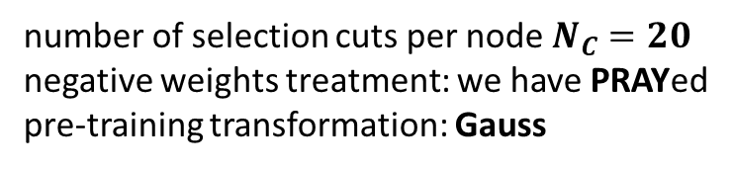
BDT training – Hyperparameters optimization
BOOSTED
VBF
SF
DF
SF
DF
number of trees
tree depth
minimum node size
shrinkage
400 550 1000 250
3 5 3 3
6% 7% 3.5% 6%
0.3 0.2 0.3 0.3
Other parameters
number of selection cuts per node $N_{C}=20$
negative weights treatment: we have PRAYed
pre-training transformation: Gauss

Slide 26
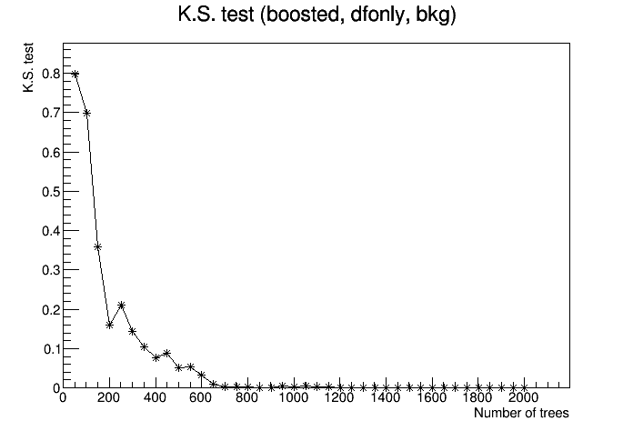
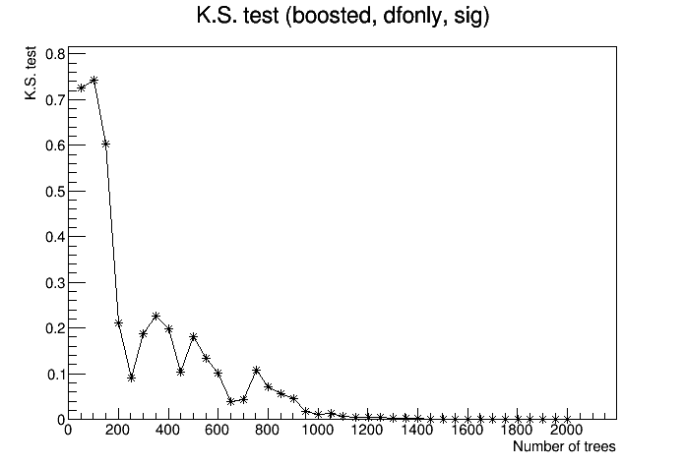


BDT training – Hyperparameters optimization

Slide 27
Content
ATLAS detector subsystems
Higgs boson mechanism
Data & MC – preselection and categorisation
MVA – Boosted Decision Trees
BDT Training
Final BDT score cut

Slide 28


BDT score
Boosted
DF
Workflow
trigger selection and preselection
MC modelling profiles
variables reduction
BDT hyperparameter optimization
overtraining test
BDT score calculation (event by event – testing data)
the best BDT score cut – the best SIG vs. BKG separation
MC only
MC only
Boosted
SF
MC only
MC only

Slide 29


BDT score
VBF DF
Workflow
MC only
MC only
trigger selection and preselection
MC modelling profiles
variables reduction
BDT hyperparameter optimization
overtraining test
BDT score calculation (event by event – testing data)
the best BDT score cut – the best SIG vs. BKG separation
VBF
SF
MC only
MC only

Slide 30

BDT score
+1
-1
Definition: Likelihood estimation of event being signal or background
the better BDT cut – the better SIG/BKG selection
Profile Likelihood Ratio
determined by calculation of Expected significance $Z$
Express how likely it is, that expected signal has outreached background noises only by chance

Slide 31

Significance estimation
Systematic errors
Theoretical systematics
signal cross section uncertainties (higher order corrections)
ggH + 1 or 2 exclusive jets (QCD corrections)
background acceptances (higher order corrections)
PDFs uncertainties
parton shower distribution
Background modelling
$Z→ττ$ control region
shape of the $m_{ττ}^{MMC}$ distribution
Shape and normalization of the fake-lepton background
Experimental systematics
triggering efficiencies
object identification and
reconstruction uncertainties
energy scale
luminosity uncertainties

Slide 32


BDT score
Final BDT selection and Significance (expected)
 | BDT score > | $$Z_{expected}$$
Boosted SF | -0.1 | 0.18
Boosted DF | -1.0 | 0.42
VBF SF | 0.6 | 0.44
VBF DF | 0.8 | 0.88
$$Z_{expected}^{combined}=1.16$$

Slide 33



Summary
Final BDT selection and Significance (expected)
 | BDT score > | $$Z_{expected}$$
Boosted SF | -0.1 | 0.18
Boosted DF | -1.0 | 0.42
VBF SF | 0.6 | 0.44
VBF DF | 0.8 | 0.88
MVA BDT $τ_{lep}τ_{lep}$
$$Z_{expected}^{combined}=1.16$$
Cut based $τ_{lep}τ_{lep}$
$$Z_{expected}^{combined}=1.18$$

Slide 34

Reference
[1] SCHEIRICH, Daniel, 2013. Measurements of $Λ$ and $Λ_{b}$ baryon properties in the ATLAS experiment. Michigan. Dissertation thesis. University of Michigan.
[2] VIRDEE, T. S., 2012. Physics requirements for the design of the ATLAS and CMS experiments at the Large Hadron Collider. Phil. Trans. R. Soc. 370, s. 876-891. ISSN 1364-503X.
[3] DAVÍDEK, Tomáš a LEITNER, Rupert, 2012. Elementární částice od prvních objevů po současné experimenty. Praha: MATFYZPRESS. ISBN 978-80-7378-205-4.
[4] THE ATLAS COLLABORATION, 2008. Expected performance of the ATLAS experiment: detector, trigger and physics [online]. CERN-OPEN-2008-020 [cit. 16.4.2017]. Available: http://cds.cern.ch/record/1125884
[5] HOŘEJŠÍ, Jiří. Historie standardního modelu mikrosvěta [online]. Praha: Ústav částicové a jaderné fyziky MFF UK [cit. 16.4.2017]. Available: http://www-ucjf.troja.mff.cuni.cz/new/wp-content/uploads/2014/02/smodel.pdf

Slide 35
Reference
[6] THE ATLAS COLLABORATION, 2012. Observation of a new particle in the search for the Standard Model Higgs boson with the ATLAS detector at the LHC. Physics Letters B. 716(1), s. 1-29.
[7] CEJNAR, Pavel, 2013. A Condensed Course of Quantum Mechanics. Praha: Karolinum Press. ISBN 978-80-246-2321-4.
[8] Standard Model, 2016 [online]. Wikipedia. Posledná zmena 12.05.2016 10:22 [cit. 16.4.2017]. Available: https://en.wikipedia.org/wiki/Standard_Model
[9] C. Patrignani et al. (Particle Data Group). The Review of Particle Physics, 2016. Chin. Phys. C, 40, 100001.
[10] BARGER, V., MARFATIA, D. a WHISNANT, K. L., 2012. The Physics of Neutrinos. Princeton University Press. ISBN 978-06-9112-853-5.
[11] CONTEMPORARY PHYSICS EDUCATION PROJECT, český preklad KOTRBOVÁ, Olga. Standardní model: Základní částice a interakce [online], [cit. 16.4.2017]. Available:
http://www-ucjf.troja.mff.cuni.cz/dolejsi/outreach/standardni_model_1.pdf

Slide 36
Reference
[12] BELYAEV, Alexander, 2014. Nuclei and Particles [online], [cit. 16.4.2017]. Available: http://www.personal.soton.ac.uk/ab1u06/webpage/phys3002.html
[13] BENTVELSEN, Stan, LAENEN, Eric a MOTYLINSKI, Patrick, 2005. Higgs production through gluon fusion at leading order [online]. Amsterdam: National Institute for Subatomic Physics [cit. 16.4.2017]. Available:
http://www.nikhef.nl/pub/services/biblio/preprints/05-007.pdf
[14] KRÄMER, Michael, 2005. Higgs Production at the LHC [online]. Universität Bielefeld [cit. 16.4.2017]. Available:
https://web.physik.rwth-aachen.de/~mkraemer/Higgs-Production-at-the-LHC.pdf
[15] GRAZZINI, Massimiliano, 2011. Higgs cross sections: a brief overview [online]. Zurich: Institute for Theoretical Physics, University of Zurich [cit. 16.4.2017].
Available: https://indico.in2p3.fr/event/6004/session/8/contribution/111/material/paper/0.pdf
[16] DJOUADI, A., KALINOWSKI, J. a SPIRA, M., 1998. HDECAY: a program for Higgs boson decays in the Standard Model and its supersymmetric extension. Computer Physics Communications. 108(1), s. 56-74. ISSN 0010-4655.
[17] THE ATLAS COLLABORATION, 2015. Evidence for the Higgs-boson Yukawa coupling to tau leptons with the ATLAS detector. JHEP 04, s. 117. ISSN 1029-8479.

Slide 37














Appendices
Monte Carlo simulation
signal + background,
various$processes↔$ various weights,
perturbative method
cross section $σ$
$$\frac{dN}{dt}=σℒ(t)$$
$$N=σℒ_{int}$$
luminosity $ℒ$
integrated luminosity $ℒ_{int}$
$$ℒ_{int}=1411.26 {pb}^{−1}$$
$$σ→σ′$$
branching ratio $Br$
$$σ^{′}=σ(pp→Z)∙Br(Z^{0}→e^{+}e^{−})$$
detector efficiency $ε$
$$ε=\frac{\sum_{rec,i}{{w_{i}}^{MC}}}{\sum_{gen,i}{{w_{i}}^{MC}}}$$
$$N=\sum_{rec,i}{\underset{\begin{aligned}& \\ & MC event \\ &total weight\end{aligned}}{\underbrace{\frac{σ^{′}ℒ_{int}{w_{i}}^{MC}}{\sum_{gen,i}{{w_{i}}^{MC}}}}}}$$

Slide 38







Appendices – Preselection (2016)
Trigger selection
$$η=−\ln\left(\tan{\frac{θ}{2}}\right)$$
pseudorapidity $η$
$p_{T}^{e}>15 GeV$,
$p_{T}^{μ}>10 GeV$,
$\left|η\right|<2,47$,
$θ$ polar angle
Quality of lepton reconstruction
invariant mass
$${m_{ll}}^{2}={\left(E_{1}+E_{2}\right)}^{2}−{\left({\vec{p}}_{1}+{\vec{p}}_{2}\right)}^{2}$$
purity $↔$ reconstruction efficiency
$E_{i},\vec{p_{i}}$ lepton energy and momentum
Lepton isolation
„free isolation“ $ε=\frac{N_{iso, lep}}{N_{lep}}=99\%$,
Invariant mass
$m_{ll}<100 GeV$ ($l_{1}≠l_{2}$),
$m_{ll}<80 GeV$ ($l_{1}=l_{2}$),
Charge conservation, dilepton decays

Slide 39


Appendices – Preselection (2016)
Collinear approximation
$H^{0}→τ^{+}τ^{−}→l^{+}\overline{ν}νl^{−}\overline{ν}ν$
neutrino flight direction $≈$ lepton direction ($m_{H}≫m_{τ}$),
$ν,l,τ$ mass neglected,
azimuthal angle between leptons $\cos{φ}>−1$ ,
$$m_{coll}^{2}={\left(p_{l,1}+p_{ν,1}+p_{l,2}+p_{ν,2}\right)}^{2}−{\left({\vec{p}}_{l,1}+{\vec{p}}_{ν,1}+{\vec{p}}_{l,2}+{\vec{p}}_{ν,2}\right)}^{2}$$
leads to excluding of non physical event reconstruction
$$x_{1}=\frac{p_{T}^{l1}}{p_{T}^{τ1}}$$
$$x_{2}=\frac{p_{T}^{l2}}{p_{T}^{τ2}}$$
$$\left.x_{1,2}∈(0,1\right)$$
$H^{0}$ mass reconstruction with respect to the collinear approx.
MET ... missing energy transversal

