Slide 1
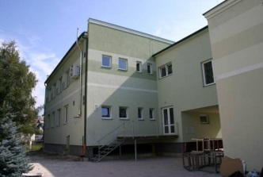
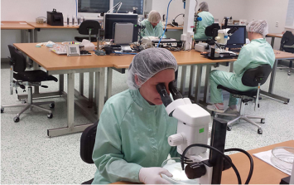
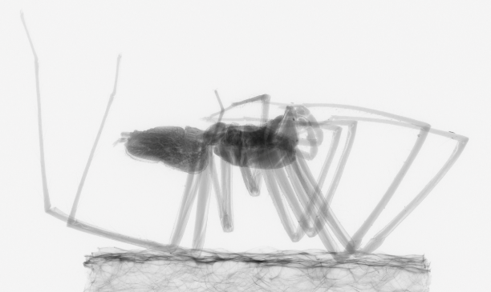
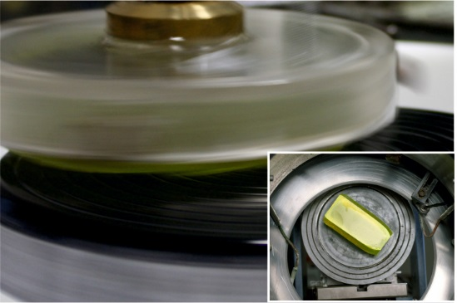
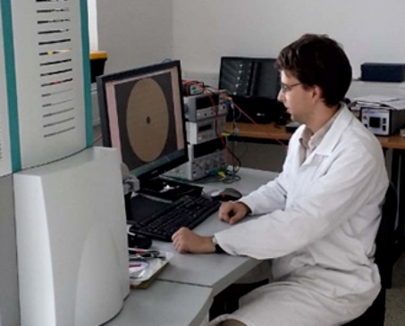
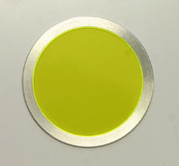
CRYTUR – company profile
Jan Touš
Head of Scintillation Detectors Dpt.
parizek@crytur.cz
Notes:
1

Slide 2
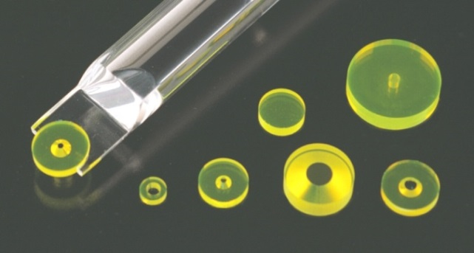
Contents
CRYTUR company profile
Materials and technologies
Scintillating screens for imaging
Detetion units for EM
Lasers
Sapphire
Imaging systems and single photon counting
Summary

Slide 3
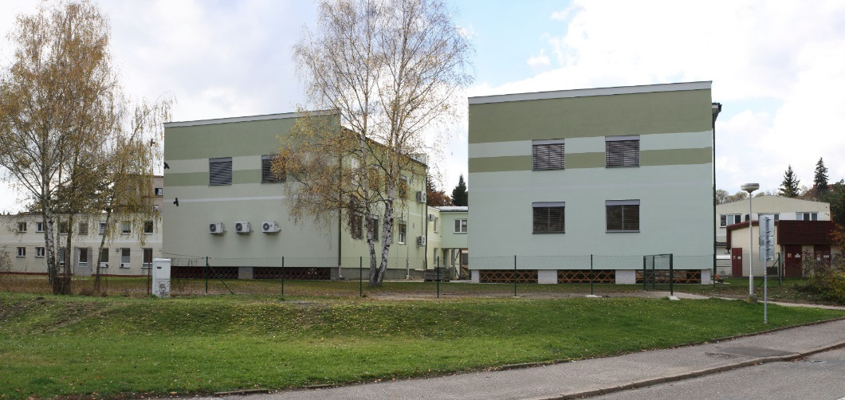
Profile
Tradition in crystal growth back to 1943
142 employees
ISO 9001:2009 certified
  Scintillators and detectors
  Electron microscopy
  Lasers
  Thin-film coating
  Sapphire profiles
Notes:
3
3

Slide 4
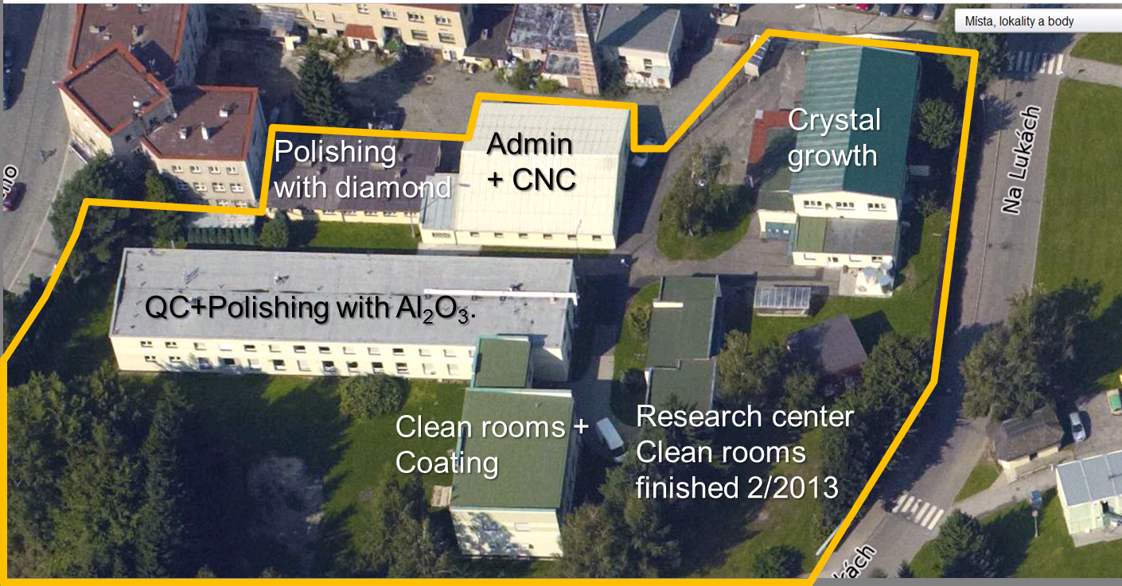
Facility
Modern 4500sqm facility
new
facility
2015
Admin + Polishing
expected in 2017

Slide 5
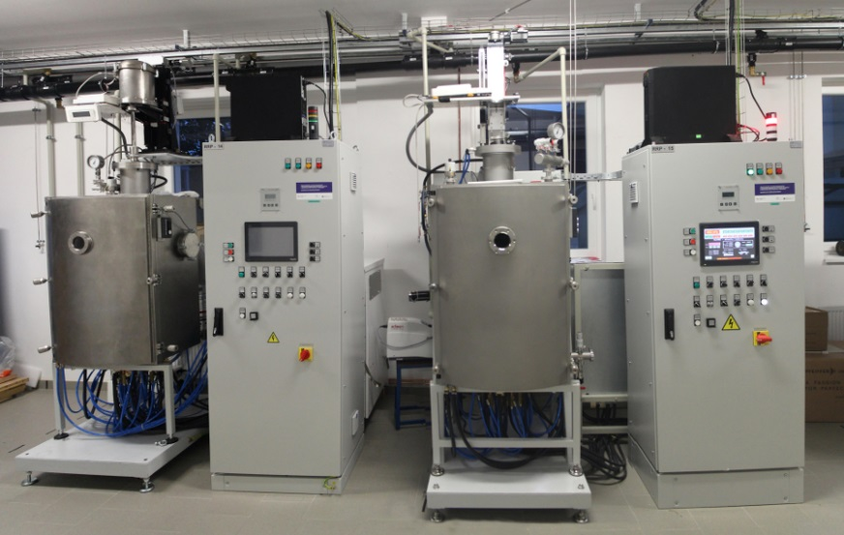
TECHNOLOGIES
– Crystal Growth
CRIG (Crystal Improved Growth)
based on Czochralski method
patent EP 2675944
excellent quality
Stable and flat growth front
Optimal choice of growth conditions
(according to grown material)

Slide 6
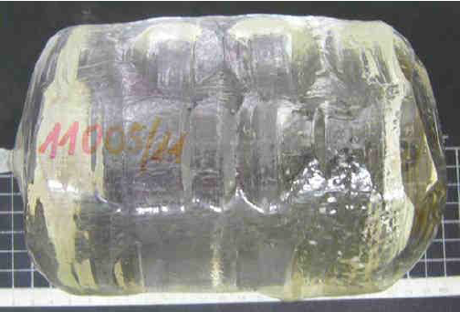
TECHNOLOGIES
– Crystal Growth
„World largest YAG stress-free crystals“
Diameter up to 6 inch
Weight up to 14 kg
Stress-free core

Slide 7
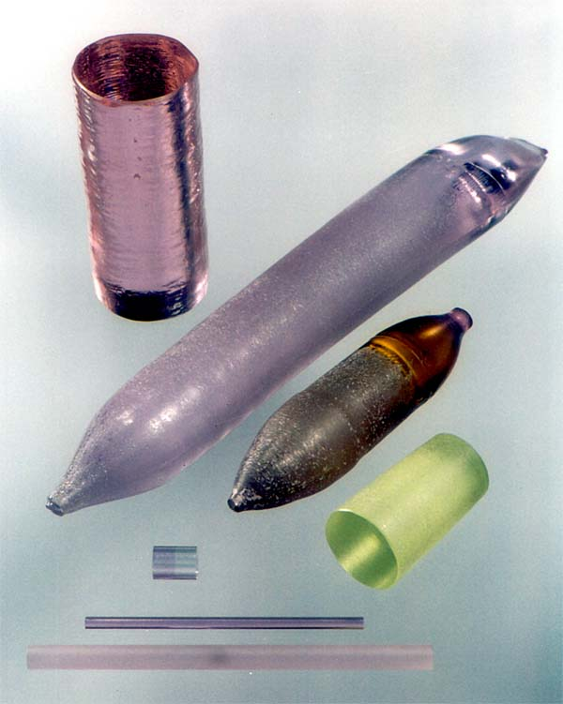
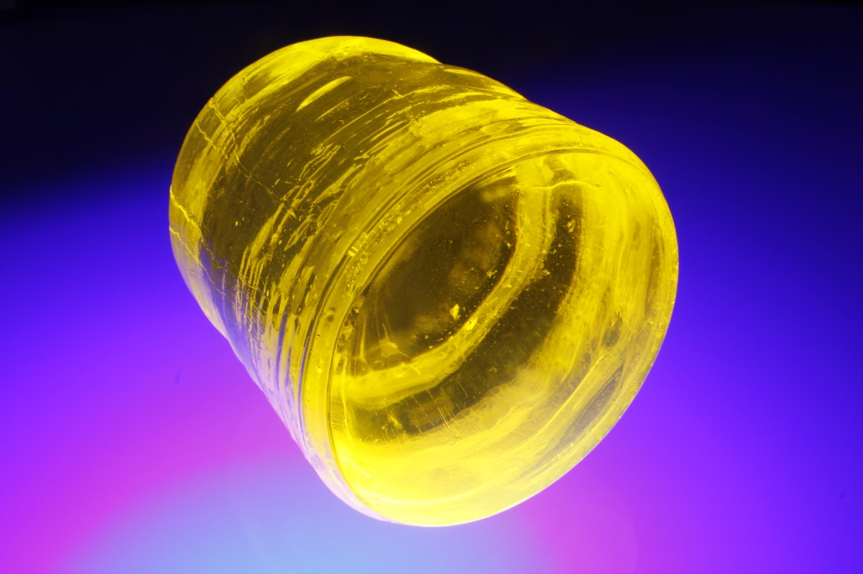
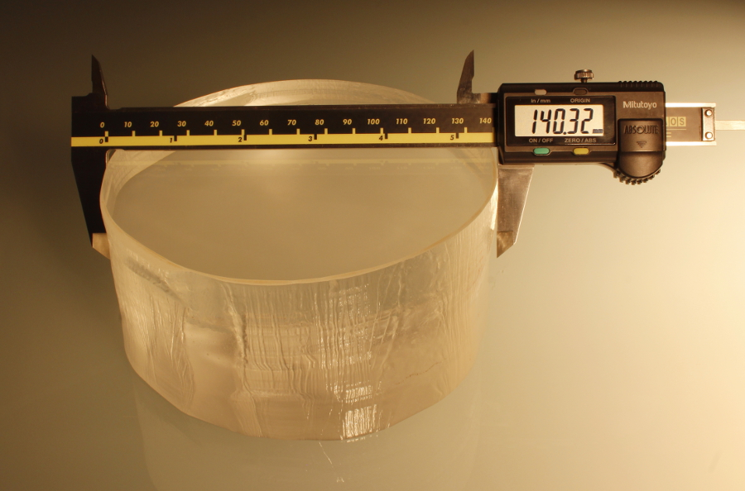
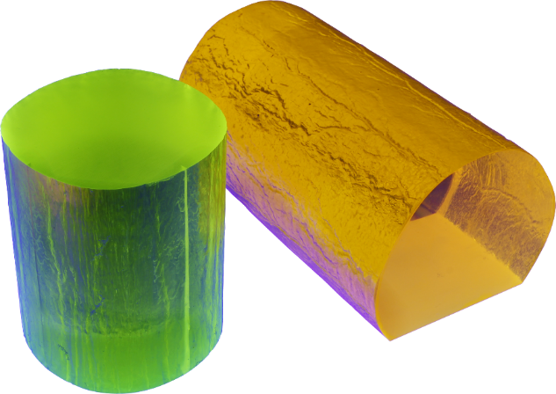
MATERIALS
(grown as single-crystals)
Garnets YAG and LuAG
Perovskites YAP
Silicates, Tungstates (PWO)
Dopants: Ce, Nd, Tm, V, Yb, Pr, Er, Cr
Notes:
7
7

Slide 8
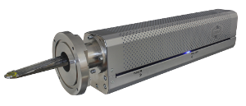
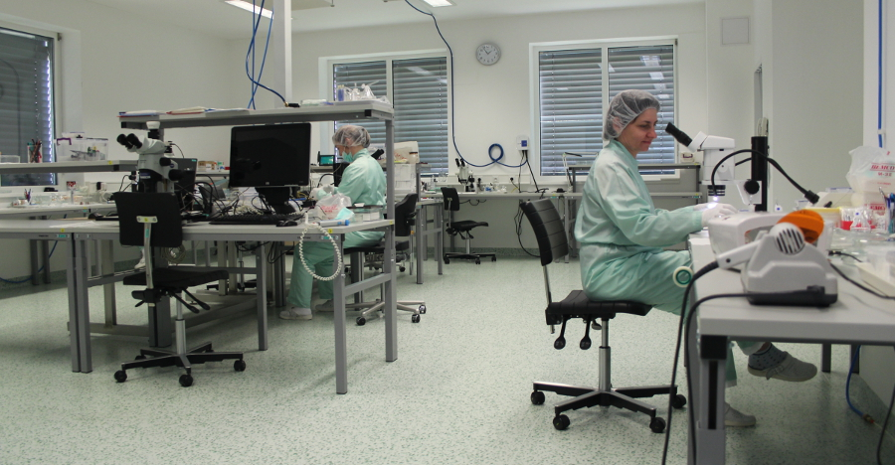
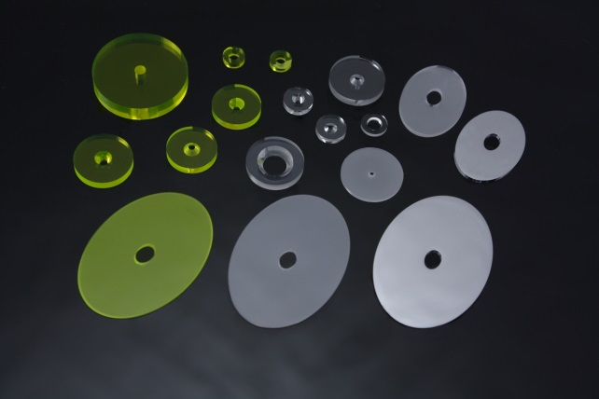
Detection Units for Electron Microscopy
Single crystals for BSE detection in electron microscopy – Crytur has a market majority globally
Complete detection systems
Clean-facilities
Notes:
8
8

Slide 9
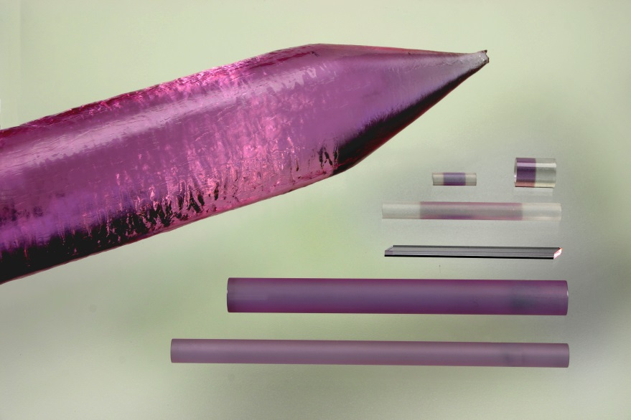
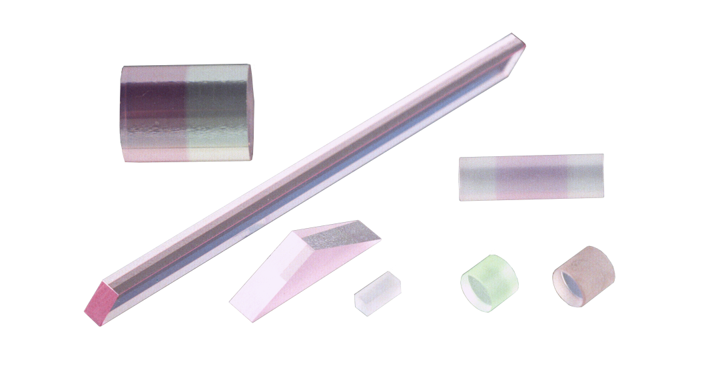
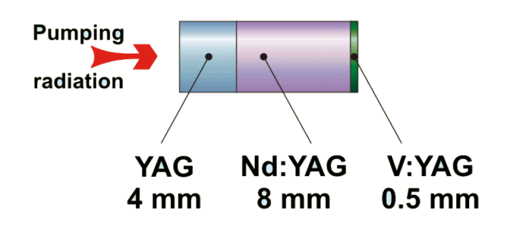
Lasers
Laser rods primarily for medical and defence industries
Specialty materials – YAP, YAG, LuAG, BaWO₄, etc.
Bonding, angles, …
Notes:
9
9

Slide 10
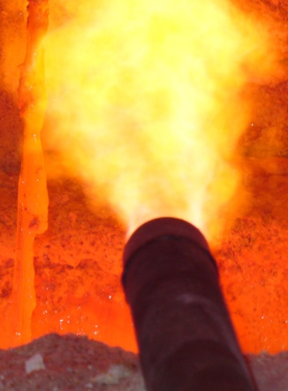
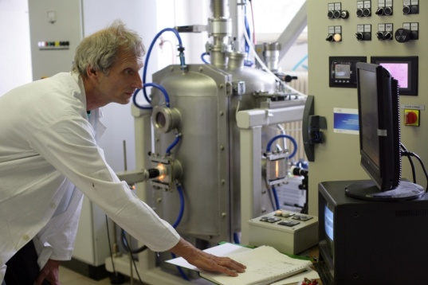
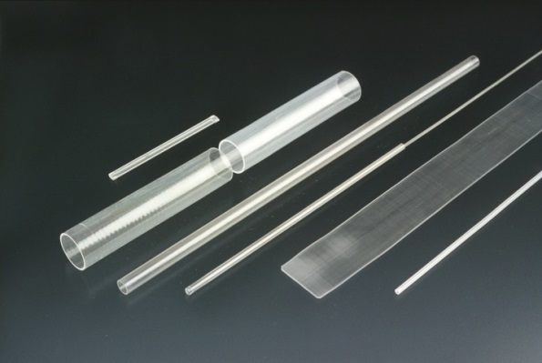
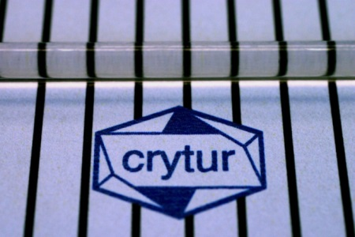
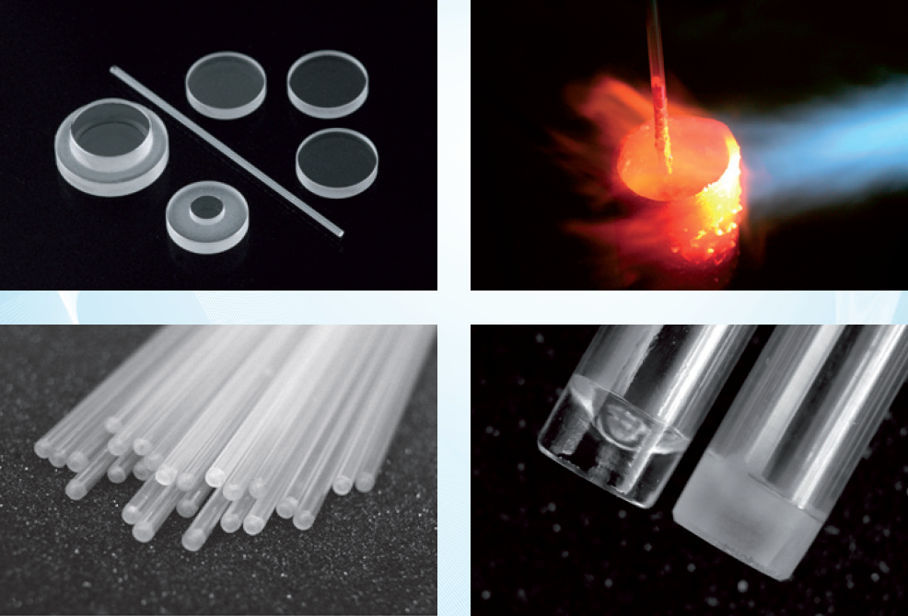
Sapphire profiles
TUBES, RODS
Ø 0,5 mm to 45 mm, length up to 2 m
Applications: Temperature measurement probes, ultra-high pressure probes, high-temperature lightguides, ...
10
Notes:
10
10

Slide 11
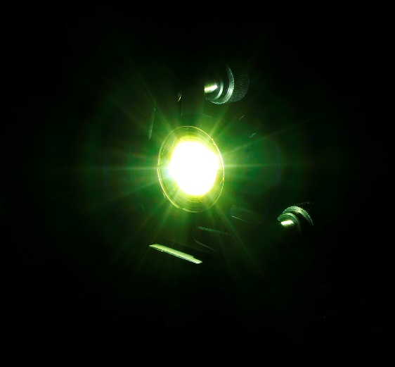
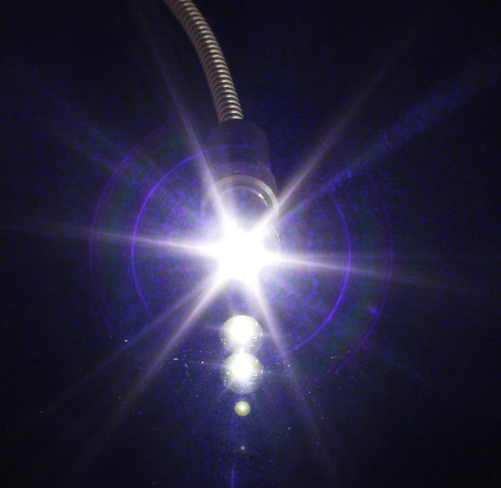
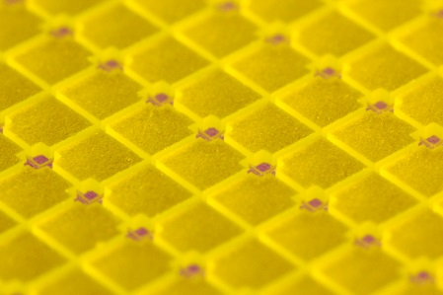
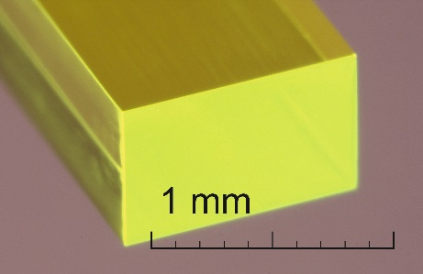
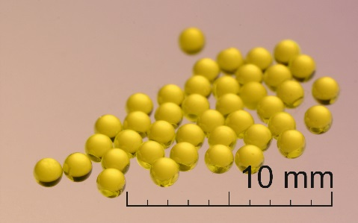
PRODUCTS – LUMINOPHORES
Light conversion elements for LEDs
and laser diodes
White-LED conversion
Full light conversion elements
Optical elements
Remote laser excitaction
Notes:
11
11

Slide 12
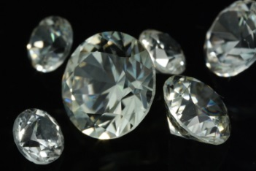
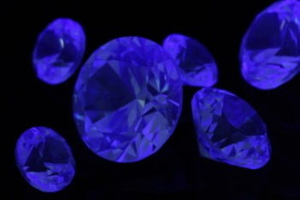
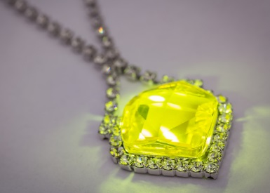
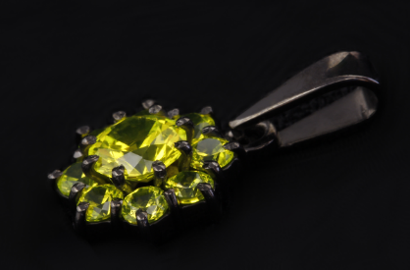
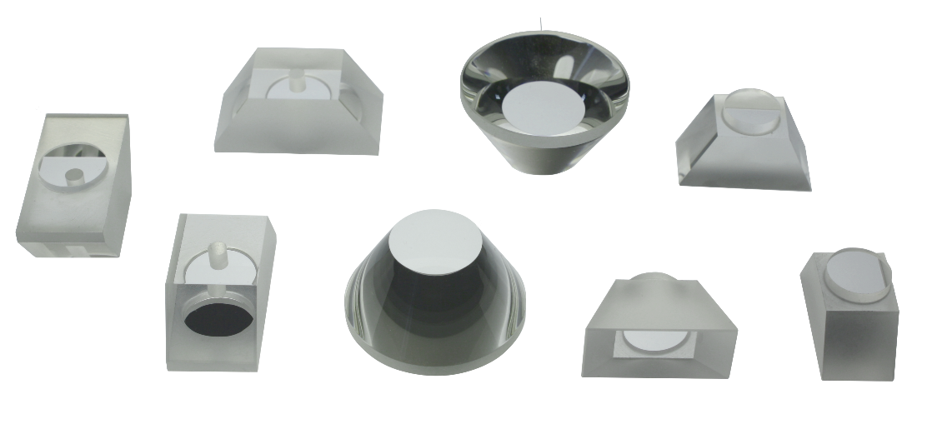
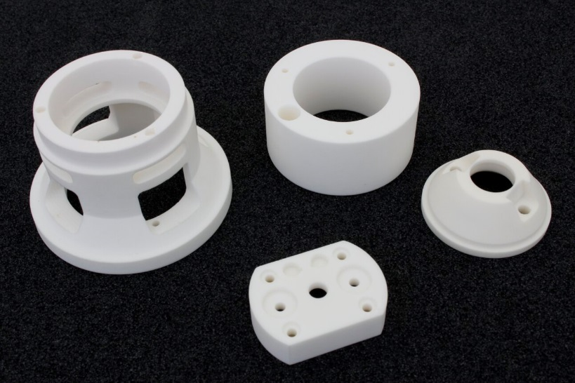
PRODUCTS – PRECISION OPTICS
High precision crystal optics (sapphire, garnet)
High precision ceramics
UV-light gemstone
Complex shapes, high presion,
perfect surfaces
Notes:
12
12

Slide 13
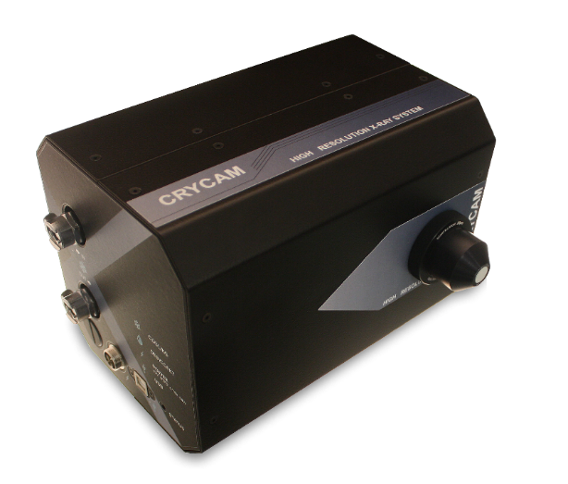
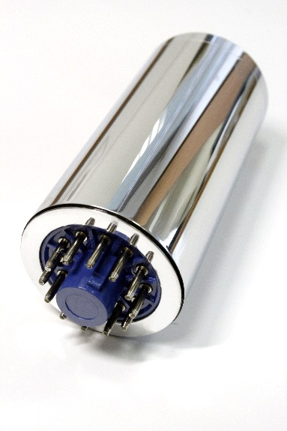
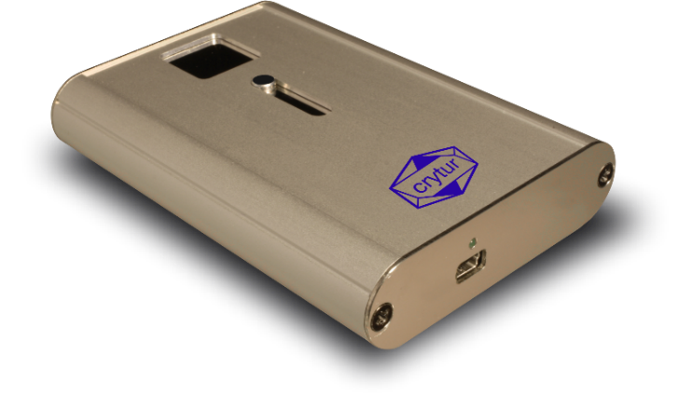
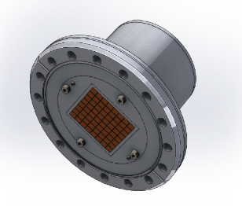
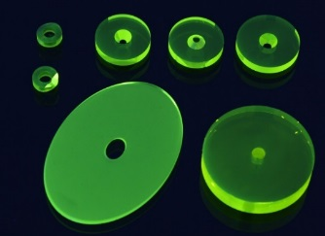
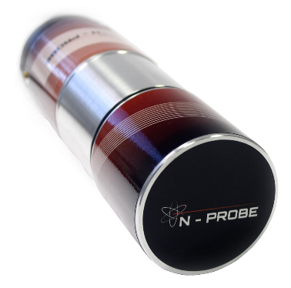
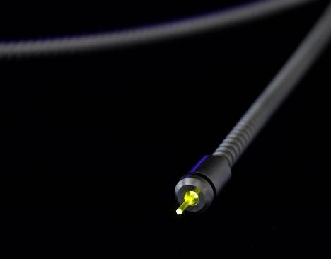
Scintillators & Detectors
X-ray imaging
X-ray / γ-ray
Single photon counting
Integrated solutions
Multipixel detector
Electron detector
Fiber detectors
neutron
Notes:
13
13

Slide 14
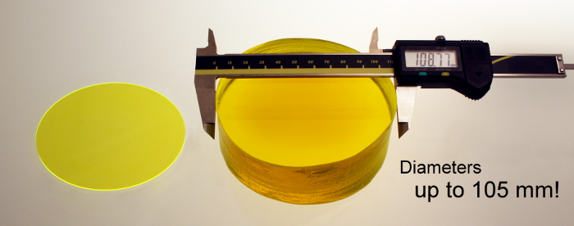
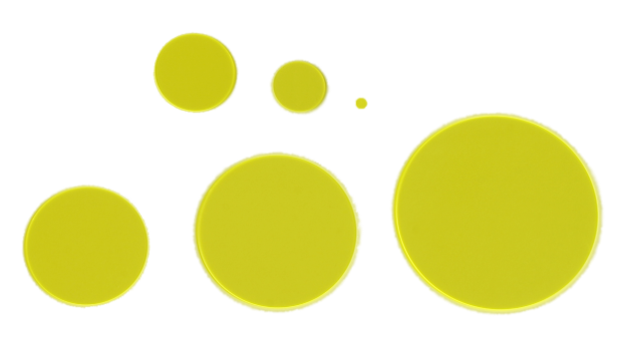
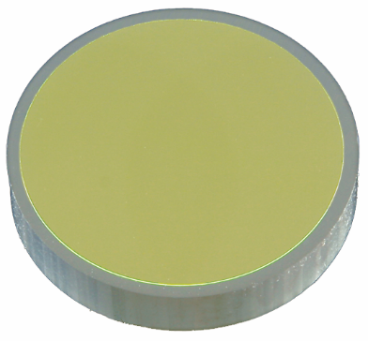
Imaging screens
Optical homogeneity <5 %
Optical quality (S/D 0/0)
High light output
Excellent Radiation Hardness*
Long life-time
Chemical & Mechanical stability
Coatings & lithography
Free-Standing
In Frames
On Substrates
*M. T. Lucchini et al. "Radiation Tolerance of LuAG:Ce and YAG:Ce Crystals Under High Levels of Gamma- and Proton-Irradiation," in IEEE Transactions on Nuclear Science, vol. 63, no. 2, pp. 586-590, April 2016.

Slide 15
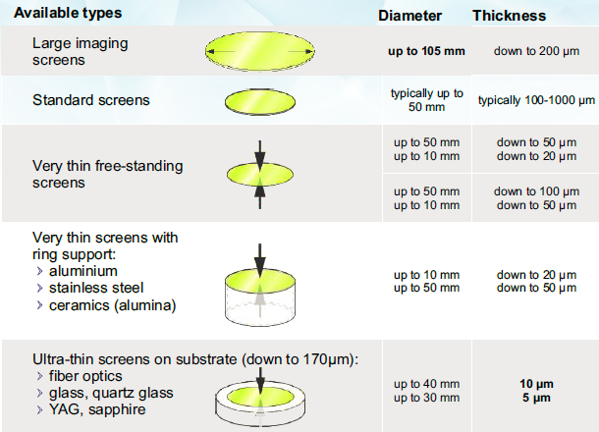
Imaging screens

Slide 16
Scintillation Materials
Imaging screens
Scintillator | Emission wavelength [nm] | Density [g.cm⁻³] | Cleavage/ Hygroscopic | Photon Yield [ph/keV] | Decay [ns]
YAG:Ce | 550 | 4.55 | No/No | 35 | 70
LuAG:Ce | 535 | 6.73 | No/No | 25 | 70
LuAG:Pr | 315 | 6.73 | No/No | 19 | 20
CRY19 | 420 | 7.1 | Yes/No | 32 | 41
YAP:Ce | 370 | 5.37 | No/No | 25 | 25
CRY18 | 425 | 4.5 | Yes/No | 32 | 45
CsI:Tl | 565 | 4.51 | No/Yes | 45 | 900
GOS:Tb | 544 | 7.34 | -/No | 60 | 106
CWO | 475 | 7.9 | Yes/No | 12-15 | 5000
BGO | 480 | 7.13 | No/No | 8-10 | 300

Slide 17
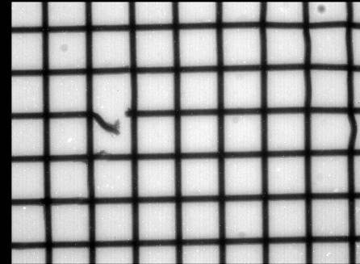
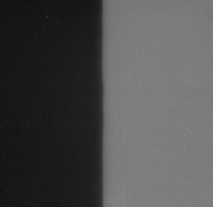




Single crystal vs powder
Intrinsic resolution limited only by optical system!
Single crystal
LuAG:Ce screen
20 um
8 um
100 um
Powder screen
P43 (GOS)
20 um (2um grain)

Slide 18

Imaging Systems
Imaging systems - CRYCAM
Features
  Macro vs Micro system
  Perfect contrast (single crystal screens)
  Outstanding intrinsic resolution (1 µm)
  Highly customized (FOV up to 35 x 35 mm)
  Multiple imaging options
  OEM or end-user solution
Micro system example
Application
  X-ray radiography
  X-ray tomography
  X-ray topography
  Beam viewer

Slide 19

Imaging Systems
Our X-ray cabinet
Features
  Custom designed
  Microfocus X-ray source
  160 Kp, 2W at high power
  Cu, W, Ag targets
X-ray cabinet
Workload
  X-ray test of our scintillator (optional)
  X-ray radiography measuremets (on demand)
  R&D activities

Slide 20

Imaging Systems
CRYCAM examples
Wasp on foam pedestal

Slide 21

Imaging Systems
CRYCAM examples
Sting - detail

Slide 22

Imaging Systems
CRYCAM examples
Hairs clearly visible!
Spider – 10 um resolution

Slide 23


Imaging Systems
CRYCAM examples
Poppy head
Carbon fiber reinforced polymer

Slide 24

Imaging Systems
CRYCAM examples
Carbon Fibers, 7 µm
Phase contrast!
  Microfocus X-ray source
  1 µm spot
  Small focus to
  object distance

Slide 25



Imaging Systems
CRYCAM examples
Cotton Stick – 3D tomography

Slide 26

Imaging Systems
New designs – FOP based cameras
Features
  Medium resolution down to 15-20 µm
  Improved collection efficiency
  High speed acquisition
  Perfect contrast (single crystal screens)
  FOV 32 x 28 mm or 16 x 14 mm
  Multiple scintillator accessories
  OEM or end-user solution
FOP based system example
Related services
  Bonding to CCD
  Custom design

Slide 27


Imaging Systems
FOP based camera example
  Cu target, 40kV, 2 W
LuAG screen
CsI:Tl columnar –HR version

Slide 28


New materials for screens
Ruby & undoped YAG screens
  Alternative to OTR
  Low sensitivity
LuAG:Pr
  Fast (20 ns)
  Heavy (6.7 g.cm⁻³)
  Emission 315 nm
  Photon yield 19 ph/keV
LPE screens
  New development
  Update in Q3/2017

Slide 29



X-ray / γ-ray detector family
X-ray detector
(counting / spectroscopy)
HT – X-ray detector for
high temperature environment
LGD – γ-ray detector

Slide 30
X-ray detector
  Features
  Innovative YAP:Ce technology => Non-toxic substances (e.g. Be)
  Counting and spectroscopy
  Properties
  Energy range of 5 keV to 150 keV (50 % absorption)
  High count rate up to 10⁶ pulses/s
  Detection area: Ø 37 mm (Ø 1.45 inch)
  Magnetic shielding: Mu-metal
  Application
  X-ray diffraction
  X-ray fluorescence
  DXA (double-energy X-ray analysis)

Slide 31

LGD – γ-ray detector
  Features
  Scintillation detector based on YAP:Ce scintillation crystal
  Energy resolution (FWHM) ≤ 5.5 % … ¹³⁷Cs@662 keV
  Energy resolution (FWHM) ≤ 18% … ²⁴¹Am@59.9 keV
  No intrinsic background
  Fast detector for high count rate applications
  Minimal energy non-proportionality (max. 3 %)
  Properties
  Energy range of 20 keV to 800 keV (@ 50 % absorption)
  Detection area: Ø 44 mm (Ø 1.45 inch )
  Typical voltage 700 V
  Magnetic shielding: Mu-metal
  Application
  Spectroscopy with high resolution

Slide 32
X-ray detector for HT
  Features
  High temperature resistivity up to 175 °C
  Ruggedized detector for harsh operating conditions
  Fast response
  All parts of the unit adapted for HT
  Application
  Densitometry at high temperatures
  Geology
  Level gauges

Slide 33




Single photon counting
“Ionizing radiation and neutron imaging has never been easier”
  CRYPIX
  RASPIX
  Art, Archeology
  Biological research
  Forensic science, Geology
  Particle physics
  NDT
  First alarm radiation monitor

Slide 34

RasPIX
Key features
  Precise radiation monitoring (2D)
  Stand-alone data acquisition
  Real-time data analysis
  Easy-to-use
  LAN or Wi-Fi connectivity
  Online web interface
  Implemented battery
Typical application
  First alarm radiation monitor
RasPIX
Sensor | Silicon
Pixel size | 55 x 55 μm
Image resolution | 256 x 256 pixels
Sensitive detection area | 14.1 x 14.1 mm
Frame rate | 15 / 2 fps
PC Interface | LAN/Ethernet
Software | Included
Note: RasPIX is not a certified dosimetric device. Radiation protection of people cannot be based on its measurements

Slide 35

RasPIX
Motivation
  Radiation monitoring is crucial in different industries
  Can we also see and distinguish between particles (2D detection)?
Main Requirements:
  Real-time monitoring
  Radiation recognition
  Count/Dose information
  Reliable operation 24/7
  Fast data access
  Compact Stand-alone version
  User friendly
Warning notice

Slide 36


RasPIX – application
Image
Energy spectrum
Origin of radiation
Time evolution

Slide 37


CRYPIX system
Key features
  Single particle counting in large area
    14 x 14 mm (256 x 256 pixels)
    14 x 70 mm (1280 x 256 pixels)
  High contrast (unlimited dynamic range)
  Silicon or CdTe sensors
  Modular system (optional)
  X-ray, Alpha, Beta, Gamma detection, neutron (optional)
Typical applications
  Art, Archeology
  Biological research
  Forensic science, Geology
  Particle physics
  Non-destructive testing

Slide 38


Biological research
X-ray radiography
Live video: 1000 frames (20 ms each)
Real-time video, 50 fps
Terrestrial isopod
© IEAP Prague

Slide 39




Biological research
High resolution X-ray tomography
1 mm
© IEAP Prague

Slide 40


Art, Archeology
Multi energy X-ray radiography
Full image
Light component
Canvas + putty
Heavy component
Mineral pigments
© IEAP Prague

Slide 41







Non-destructive composition investigation
X-ray fluorescence
Cu: 75%
Zn: 20%
Ni: 5%
Pure Pb
Pb: 40%
Sn: 60%
Cu: 75%
Zn: 0%
Ni: 25%
Color coding:
Cu = Red, Pb = Green, Sn = Blue
Color coding:
Zn content in pink

Slide 42
Non-destructive testing
X-ray defectoscopy
Inspection of fatigue internal crack in multilayer composites
  Crack shielded by rivet head
  Optical observation is impossible
  High dynamic range => crack visible
  (virtually unlimited)
crack
© IEAP Prague

Slide 43

Non-destructive testing
X-ray defectoscopy
Aluminium profile welding quality check
Micro bubbles
  Resolution
  Duplex IQI, 13D clearly resolved

Slide 44
Summary
Reliable partner in scintillation crystals and integrated solution
Niche application with single crystals, crystal growth and precise technologies
Long-term collaboration with international institutes
New opportunities welcome
Notes:
44
44

Slide 45
Staff
Absolventi MFF UK v CRYTUR
11 absolventů
5 ve vedoucích funkcích hlavních vývojových oddělení
1 specialista obchodu
5 vývojáři
Hledáme další schopné členy týmu
Notes:
45
45

Slide 46
Thank you for your attention!
Contacts:
CRYTUR, spol. s r.o.
Palackeho 175
511 01 Turnov
Czech Republic
crytur@crytur.cz
Jan Touš
Head of Scintillation Detectors Dpt.
tous@crytur.cz
Notes:
46

