Slide 1


01/13
Pavel Cejnar
IPNP MFF UK
Superradiance

Slide 2
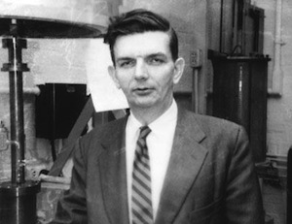
02/13
Legacy of Robert Dicke
1946 – Dicke radiometer
(development of radar)
1953 – Dicke narrowing
(analogous to Mössbauer effect, 1958)
1954 – Dicke superradiance
1956 – infrared laser
(US patent in 1958, same as Townes & Schawlow in US, and Prokhorov in CCCP)
1965 – prediction (with Peebles, Roll & Wilkinson)
of cosmic microwave background
(1965 discovered by Penzias & Wilson using Dicke radiometer)
1957-70 – renaissance of gravitation and cosmology
(alternative theory to general relativity, anthropic principle…)
Robert Henry Dicke (1916-97)

Slide 3
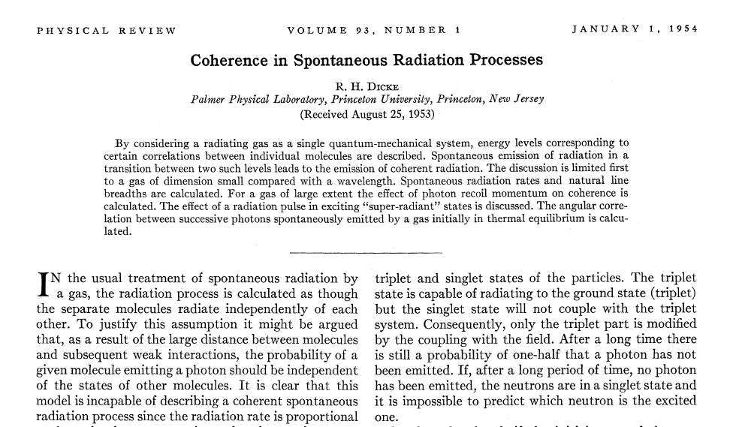
03/13
Dicke Superradiance
WoS April 2017: ~4000 citations
(+2)
Cited in: Quantum optics, Condensed matter + Solid state physics (incl. graphene), Astrophysics, Nuclear physics, Biophysics + Biology (incl. neurosciences), Engineering …

Slide 4

04/13
Dicke Superradiance
A collection of phenomena
named “superradiance”
1) Superradiant flash
enhanced non-exponential irradiation of coherent sources
2) Superradiant phase transitions
thermal/quantum phase transitions from normal to superradiant phase
in interacting matter−field systems
3) Non-hermitian superradiance
separation of long- and short-lived states in systems coupled to continuum
4) Zel’dovich-Misner-Unruh superradiance
amplification of radiation by rotating black holes
……………..
……………..

Slide 5
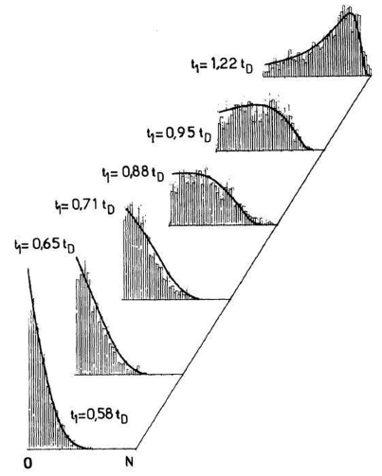
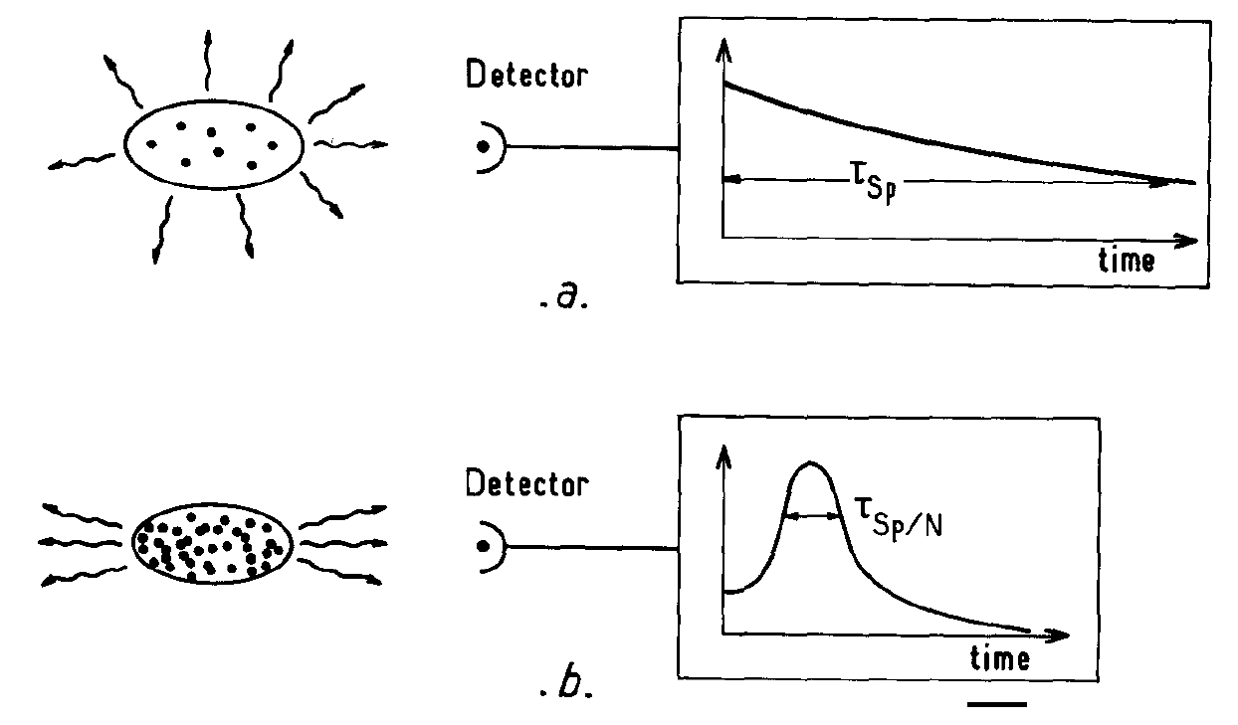
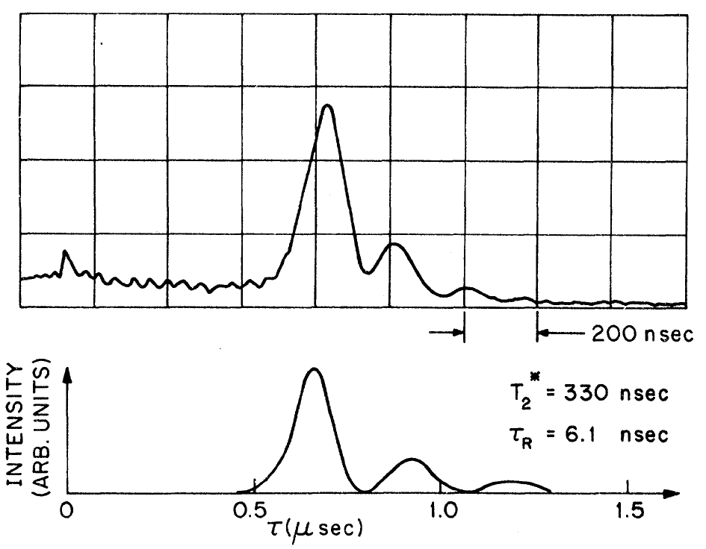
05/13
Superradiant flash
A sample of N
two-level atoms
M. Gross, S. Haroche, Phys. Rep. 93, 301 (1982)
1) Independent radiators
Probability
that n photons
was emitted
from a sample of
N≈3200 atoms
[Raimond et al. 1982]
2) Coherent (collective) radiators
Superradiant pulse in optically pumped HF gas [Skribanowitz et al. 1973]

Slide 6
06/13
cavity
Superradiant flash
volume V
Dicke model
A schematic model for cavity QED: interaction
of single-mode radiation with two-level atoms
N two-level atoms
sample
volume V₀
n
single-ω
photons
dipole approximation
D,d … dipole operator, matrix element
ε … electric field intensity
neglect of the A² term
phase
total quasi-spin operators
Conserved quantity

Slide 7
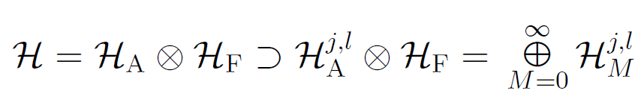
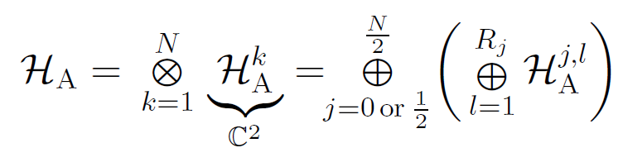
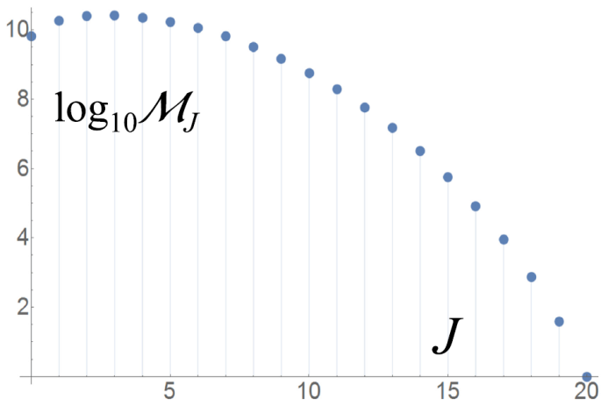
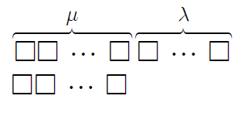
07/13
Superradiant flash
Dicke model
Hilbert space
bases
dim_{A}=2^{N}
dim_{F}=∞
dim_{j}=2j+1
log₁₀ R_{j}
=number of exc.atoms
N=40
j

Slide 8
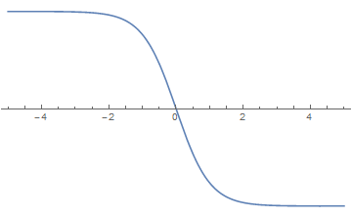
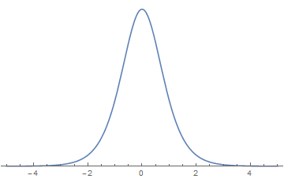
08/13
Superradiant flash
m=+j
n*=2j
Dicke model
decay
m=+j−1
Approximate solution of the decay dynamics:
m=+½
m=−½
+j
t₀
t
n*=2
t₀
t
m=−j+1
n*=1
m=−j
n*=0
−j

Slide 9

09/13
Superradiant phase transitions
Dicke model
m
n
John
Daniel Edward
"Jack" Torrance
(? – ?)
In this approximation, the model conserves the quantity
Assume the resonant case
E
M=0:
M=1:
Quantum Phase
ω
Transition
M=2:
ω
Superradiant
phase
−ωj
Normal phase
λ

Slide 10
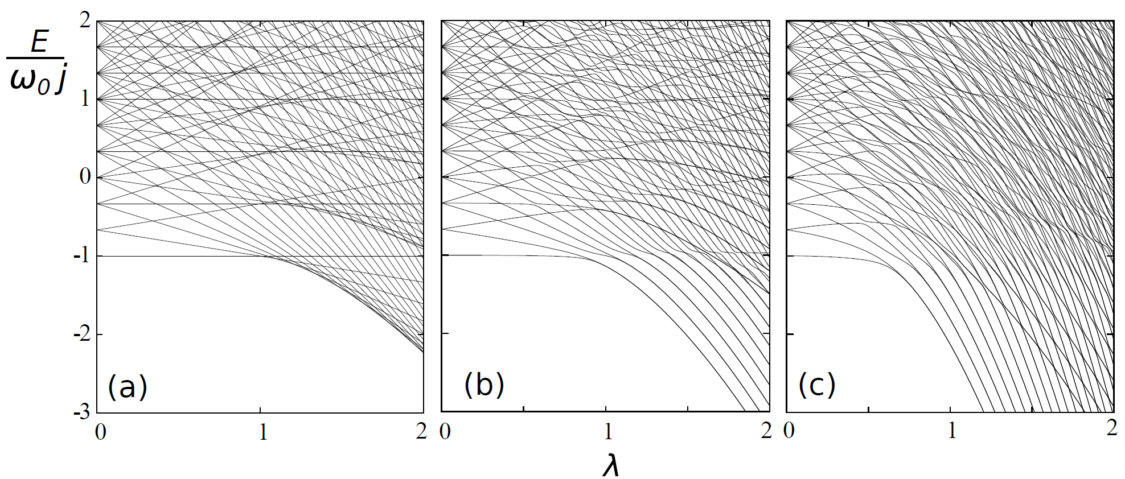
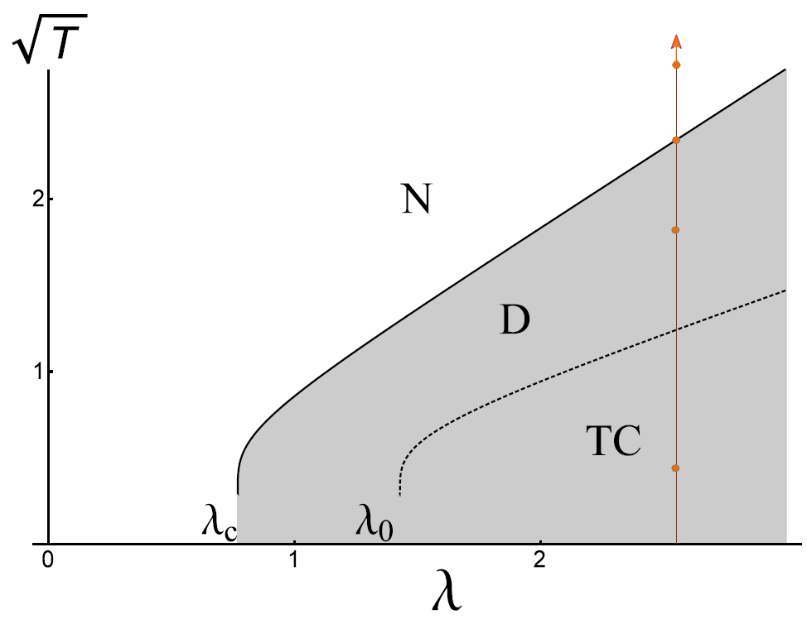
10/13
Superradiant phase transitions
Dicke model
extended
Thermal Phase Transition
QPT
QPT
QPT
normal
superradiant

Slide 11
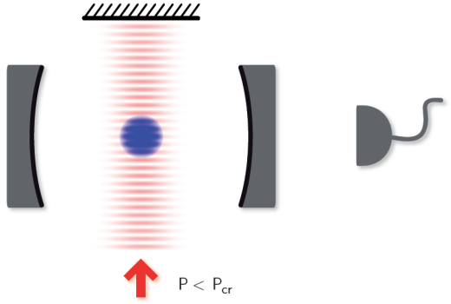
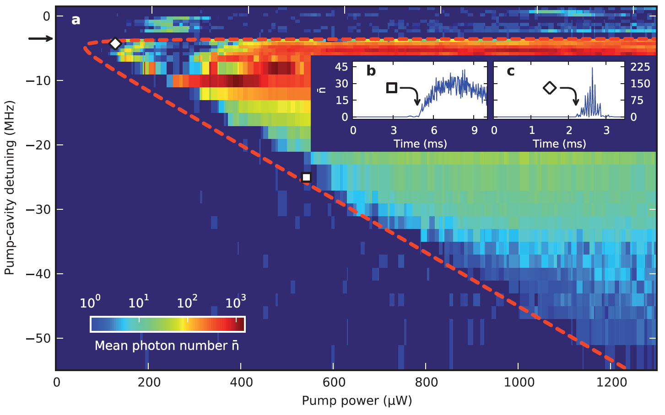
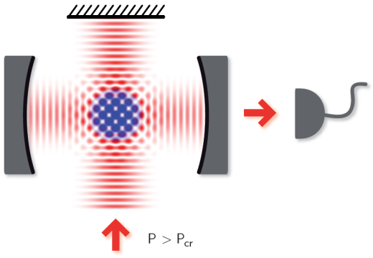
11/13
Superradiant phase transitions
Theory of superradiant phase transitions:
Thermal: Y.K. Wang, F.T. Hioe, Phys. Rev. A 7, 831 (1973)
K. Hepp, E.H. Lieb, Phys. Rev. A 8, 2517 (1973)
Quantum: C. Emary, T. Brandes, Phys. Rev. Lett. 90, 044101 (2003)
Experiment
F. Dimer et al., Phys. Rev. A 75, 013804 (2007) … proposal
K. Baumann et al., Nature 464, 1301 (2010), Phys. Rev. Lett. 107,
140402 (2011)
Realization by means of BEC at T≈50 nK in optical cavity
Spatial redistribution
of BEC leads to constructive interference of reflected waves
undercritical pumping field
pumping field
of overcritical power

Slide 12
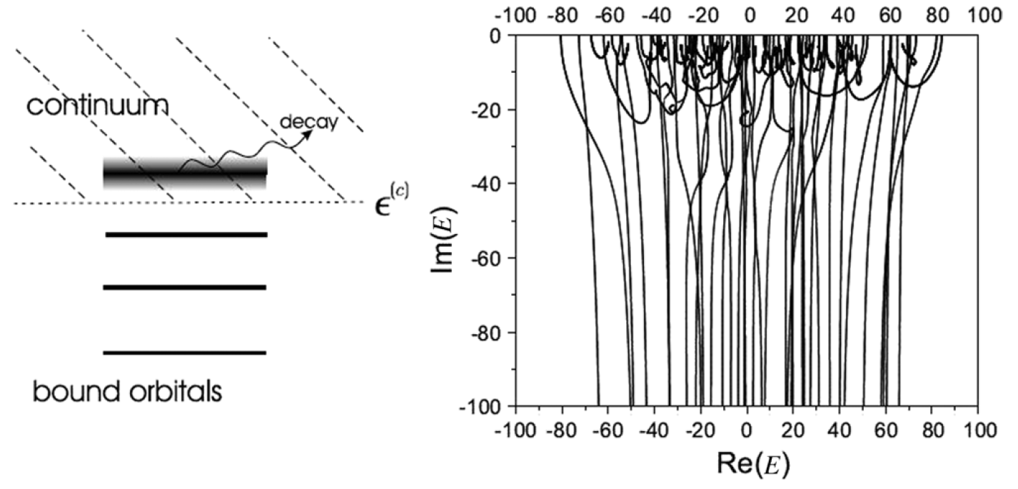
12/13
Non-hermitian superradiance
Quasi-bound quantum system with a common set of decay channels. Increasing coupling to continuum leads to seggregation of long-lived (compound) and short-lived (superradiant) resonance states. Applications in nuclear physics (e.g. giant & pygmy resonances…), particle physics (baryon resonances) biophysics (photosynthesis), graphene… Recent reviews: N. Auerbach, V. Zelevinsky, Rep. Prog. Phys. 74, 106301 (2011), I. Rotter, J.P. Bird, Rep. Prog. Phys. 78, 114001 (2015)
A. Volya, V. Zelevinsky, AIP Conf.Proc. 777, 229 (2004)

Slide 13

D
13/13
ěkuji !
Thank you !

