Slide 1
Validation of cross section on (n,2n) reactions
Nicola Burianová

Slide 2
Reasons of validation
Reactor dosimetry - determining the damage of
the reactor vessel (life expectancy of the
nuclear power plant)
Precision of neutron fission spectrum of 235U
(in region of the higher neutron energies)

Slide 3
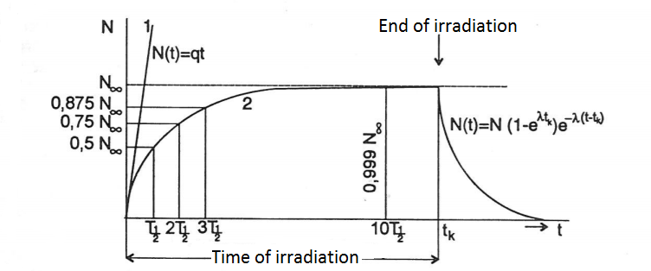
Irradiation
Chosen sample is irradiated in reactor LR-0
Irradiation time is dependent on half-life of generated
radioisotope
Notes:
3

Slide 4
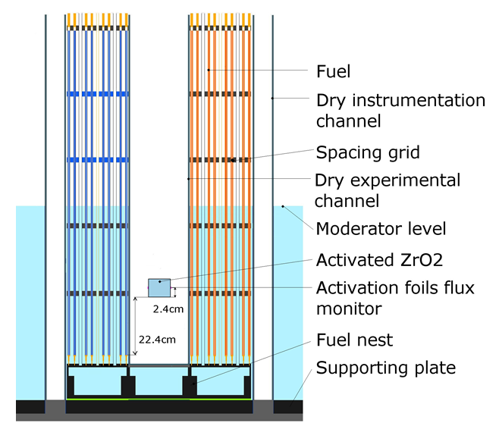
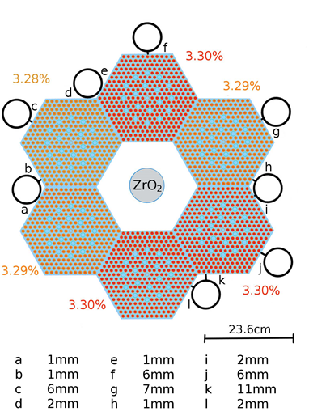
Irradiation
Example of ZrO2 irradiation
Notes:
4

Slide 5
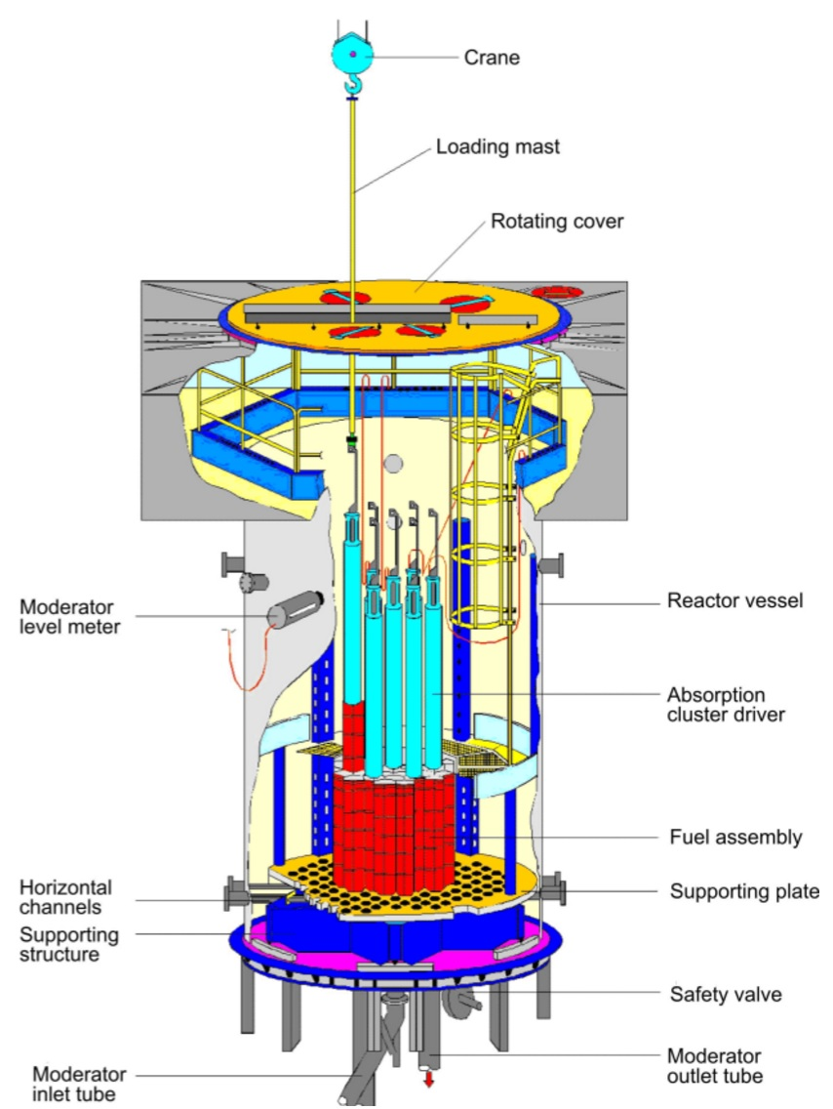
LR-0 reactor
Moderator - De-mineralized water
with boric acid
Fuel - UO2
Enrichment - 1.6 - 4.4% U235
Absorption Clusters - 18 rods -
solid B4C
Maximum output - 1kW
Notes:
5

Slide 6
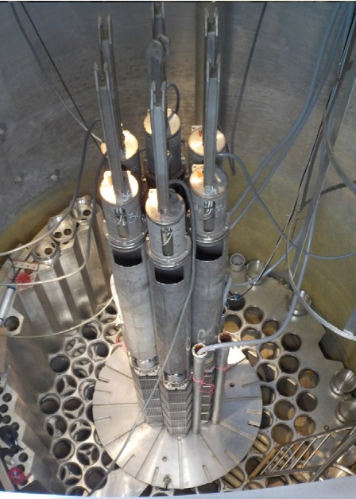
LR-0 reactor
Overhead view inside
the LR-0 reactor with
special core without
moderator
Notes:
6

Slide 7
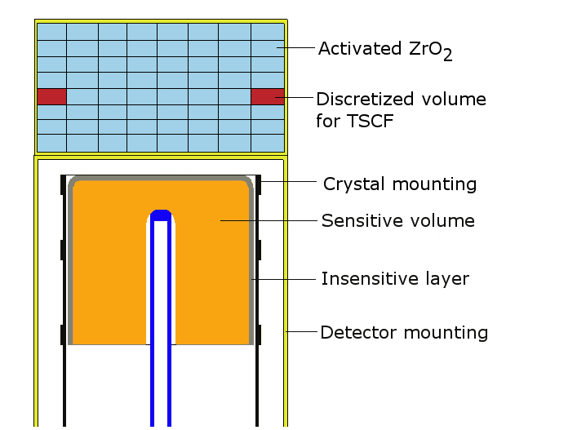
Measurement after irradiation
HPGe spectrometry
Measurement of activation
foils (Au, Ni)
Measurement of irradiated
capsule (ZrO2, …)
Notes:
7

Slide 8
Measurement after irradiation
It is needed to have well-defined detector, because we measure large-volume sample (for efficiency calibration).
Radiograms of detector – pictures of detector geometry
Measurement of insensitive layer

Slide 9

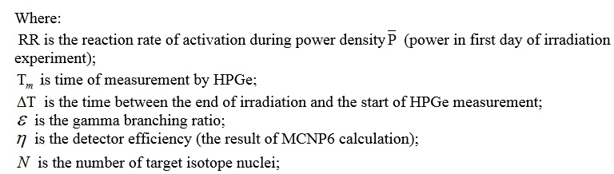
Evaluation of measurement

Slide 10

Evaluation of measurement
RR = Φ*σ
Where Φ is neutron flux and σ is cross-section. Neutron flux is determined from measurement of activation foils (Au for thermal neutrons and Ni for fast neutrons)

Slide 11
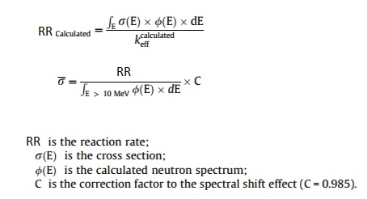
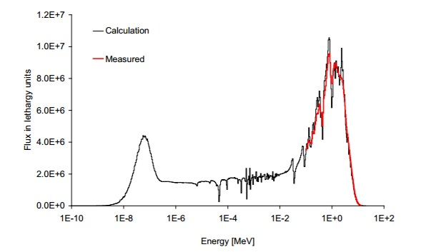
Evaluation of measurement
Neutron spectrum is calculated
by MCNP method
Acquired spectral average cross-section
is compared with spectral average
cross-section in databases.
Notes:
11

Slide 12
Thank you for your attention!

