Slide 1
Photon strength functions in ¹⁶⁸Er from multi-step gamma cascade measurement at DANCE
Ingrid Knapová
Malá Skála, 21. 4. 2017

Slide 2
Outline
Aim of the thesis: study of nuclear gamma decay
Information about the decay obtained by analysis of experimental data from reaction ¹⁶⁷Er(n, γ) ¹⁶⁸Er and their comparison to simulated gamma spectra
Introduction to gamma decay
Neutron capture reaction
Experimental setup
Computer simulations
Results
Conclusion

Slide 3
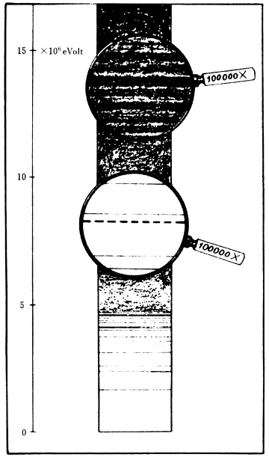
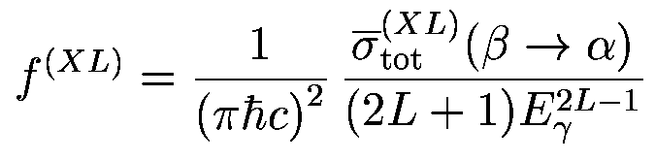
Introduction
Decay of levels at low excitation energies
often known experimentally
  Properties of individual levels can be often predicted in models
Decay of levels in the region of high level density
described by “statistical approach”
two average quantities needed for description of γ decay or γ absorption
  level density (LD) & γ-ray photon strength functions (PSF)
  PSF describes average probability of γ−decay:
fluctuation properties
  Porter-Thomas fluctuations of partial radiation widths
Nuclear levels

Slide 4
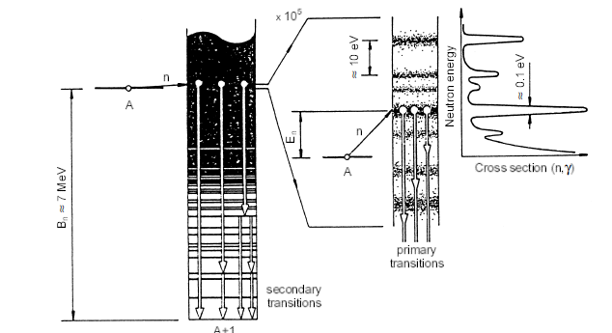
Neutron capture reaction
Reaction ¹⁶⁷Er(n, γ) ¹⁶⁸Er
Neutron separation energy B_{n}= 7.771 MeV
Neutron captured in the nucleus, followed by emission of gamma rays
An illustration of (n, γ) interaction

Slide 5
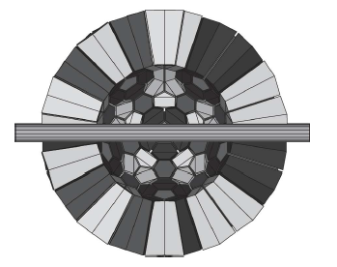
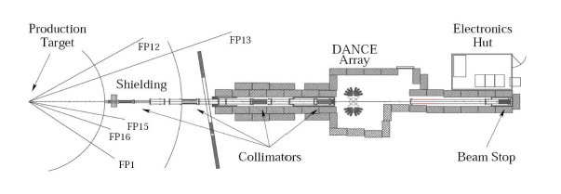
Experimental setup
LANSCE (Los Alamos Neutron Science Center) facility, detector DANCE (Detector for Advanced Neutron Capture Experiments)
High efficiency, high segmented scintillator, 160 BaF2 crystals
Spallation source of neutrons, neutron energies from thermal up to several MeVs
Neutrons strike 167Er sample in the center of the detector, resulting photons detected by scintillation crystals
Flying path in experimental area ER-2 in LANSCE
DANCE detector visualized by Geant4

Slide 6
Experimental output
Experimental output – sum-energy spectra for different multiplicities (number of photons per event)
MSC (multi-step cascades) spectra constructed from sum-energy spectra by choosing well-isolated neutron resonances and a narrow photon energy interval
E_{γ1}
E_{γ3}
E_{γ2}
Sum-energy and MSC spectra
E_{γ4}

Slide 7
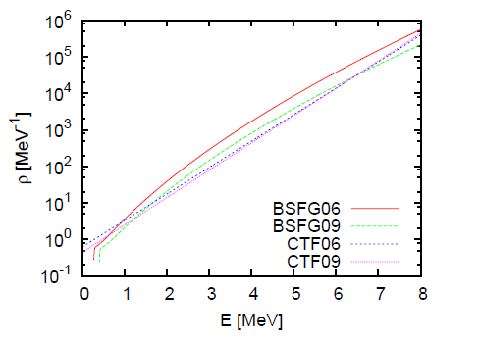
Computer simulations
Simulations of gamma decay – to obtain information on LD and PSF by comparison to experimental data
Algorithm based on validity statistical model
Various models of LD and PSF can be tested
Output: a set of levels and their properties (spin, parity, radiation width, branching intensities) called nuclear realization
Necessary to include also simulation of the detector response (Geant4)
Two mostly used phenomenological models of LD – Back-Shifted Fermi Gas and Constant Temperature Model
The energy dependence of level density

Slide 8
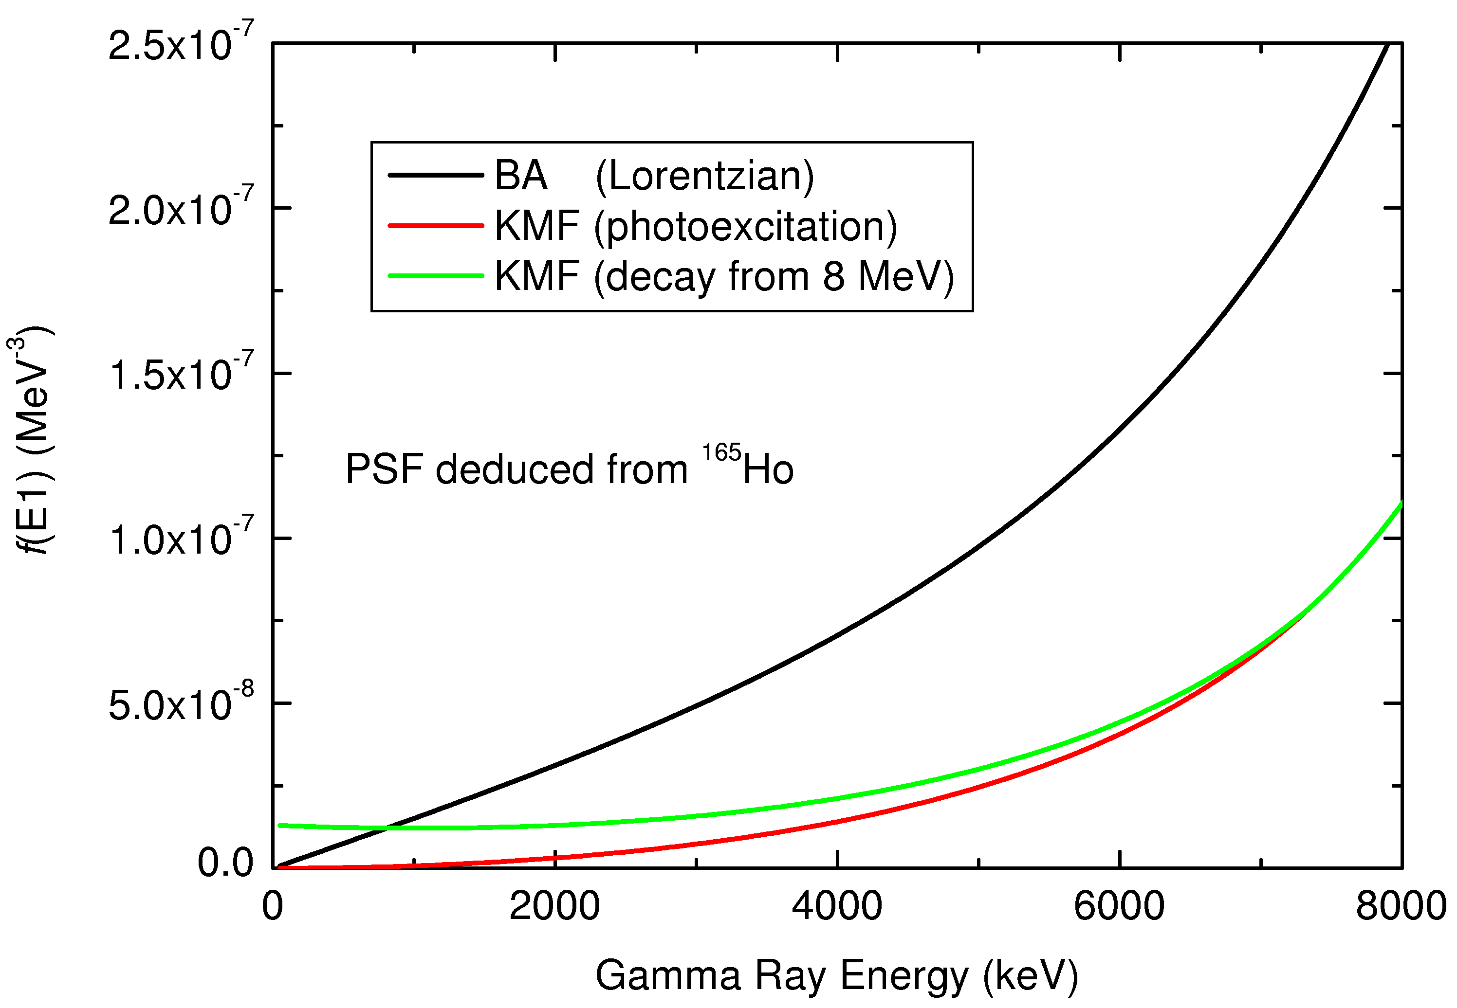
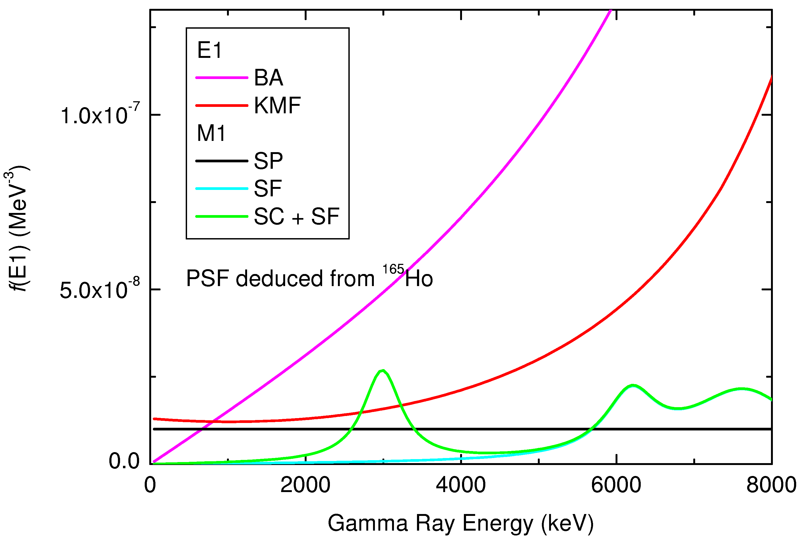
Computer simulations
Electromagnetic transitions -different types (electric and magnetic) and multipolarities (1, 2, 3…)
E1, M1 and E2 transitions give main contribution, higher multipolarities strongly suppressed
Different PSFs for different types of transitions
E1 transitions dominant
Different phenomenological models visualized in the figures below
The models of E1 PSF
The models of M1 PSF

Slide 9
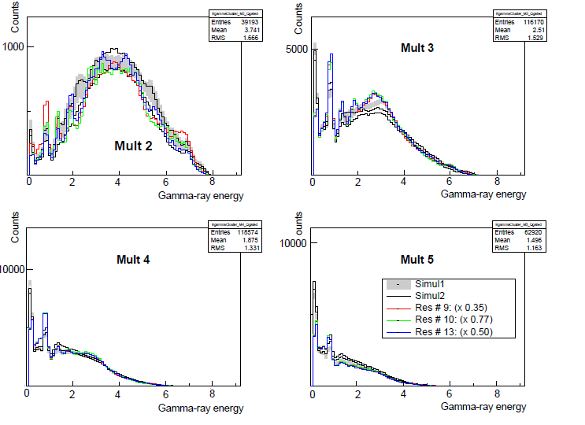
Results
Different models of LD and PSF were used
MSC spectra
MSC spectra for two
different models of LD
and PSF

Slide 10
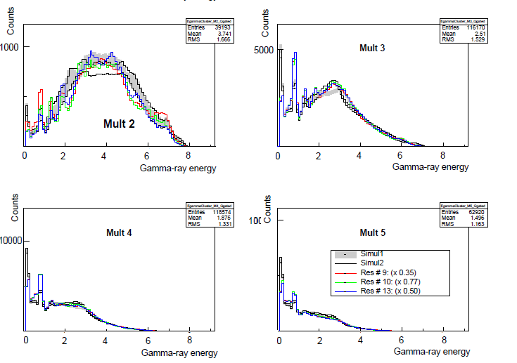
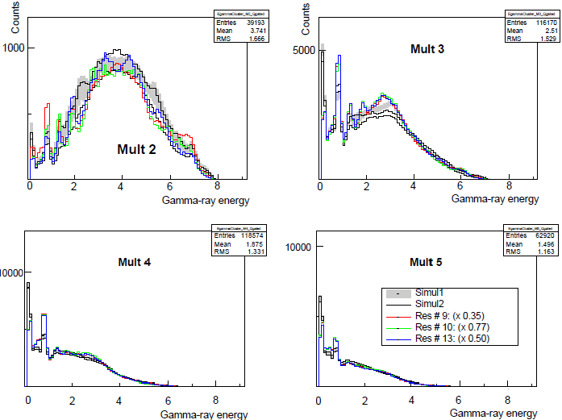
Results
Different parameters of scissor mode in M1 PSF
Resonance structure described by 3 parameters - (E, Γ, σ)
MSC spectra for SC mode E=2.8 MeV
MSC spectra for SC mode E=3.4 MeV

Slide 11
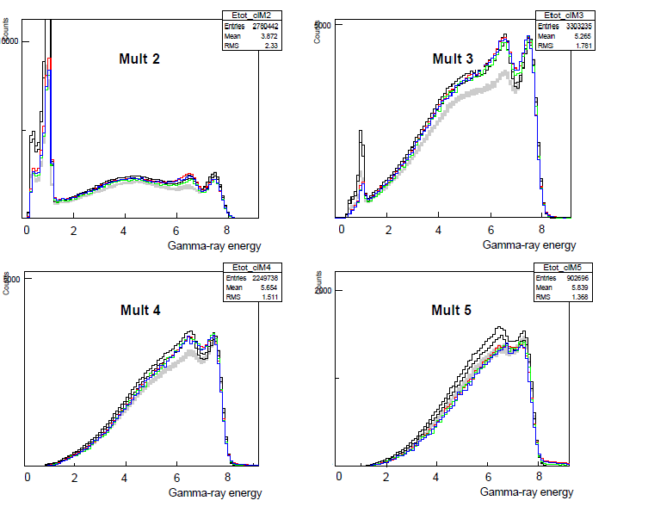
Results
Simulations cannot describe peak at 6.677 MeV
Isomere state at the energy 1.094 MeV, mean lifetime τ too long (109 ns) while coincidence window 20 ns
Quantum number K may play a role in the region of low excitation energies
This phenomenon will be probably studied more
7.771 MeV
6.677 MeV
1.094 MeV
ground state
Sum-energy spectra

Slide 12
Conclusion
Analysis of experimental data from neutron capture on ¹⁶⁷Er was made
Experimental output was compared with computer simulations and information on LD and PSF was obtained
Interesting phenomenon of isomere state in the nucleus can be a subject of future research

