Slide 1


_lecture5
Review and Prospects of Higgs
Physics from CMS
Albert De Roeck
CERN, Geneva, Switzerland
Antwerp University Belgium
UC-Davis California USA
NYT, Singapore
July 4th On-Line Workshop

Slide 2

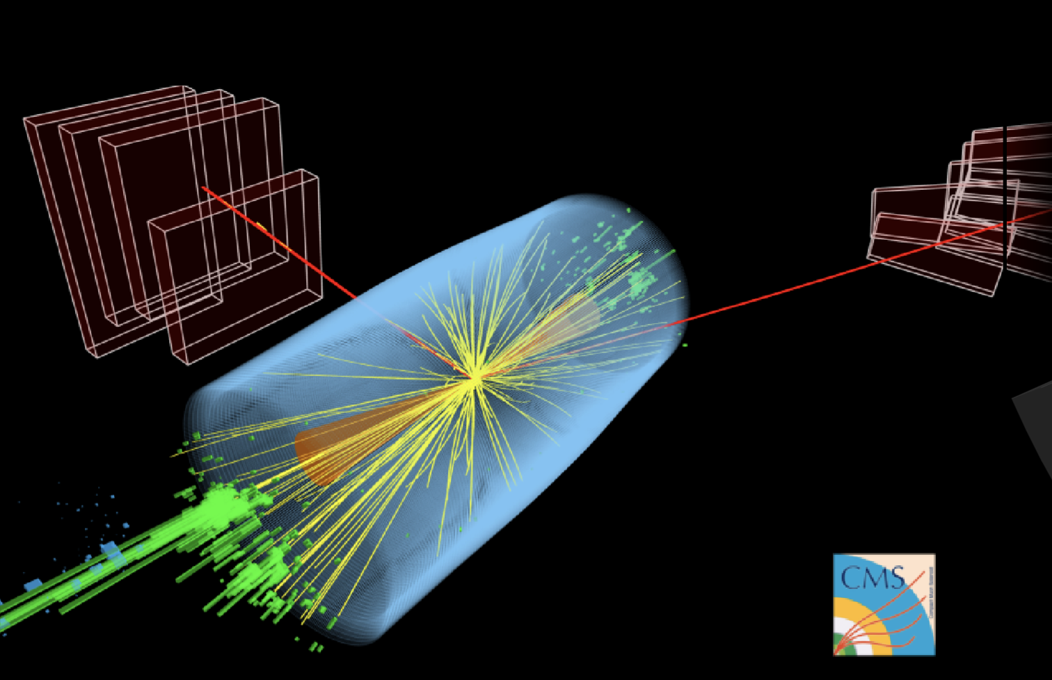
Contents
Introduction: 4th of July 2012
A day to remember
A Higgs particle in Run-1:
First contact with an entirely
new particle
A Higgs particle in Run-2:
Completing the Higgs pattern
The Future:
Quo Vadis Higgs?

Slide 3

The “Standard Model”
Over the last 100 years: combination of
Quantum Mechanics and Special Theory of relativity
along with all new particles discovered has led to the
Standard Model of Particle Physics.
The new (final?) “Periodic Table” of fundamental elements:
Fermions
Bosons
The most basic mechanism of the SM, that of granting mass to particles remained a mystery for a long time
A major step forward was made in July 2012 with the discovery of what could be the long-sought Higgs boson!!
Matter particles
Force particles
Fermions: particles with spin ½
Bosons: particles with integer spin

Slide 4

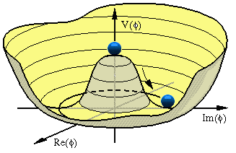



The Hunt for the Higgs
The key question (pre-2012):
Does the Higgs particle exist?
Where
do
the
masses of
elementary particles come from?
If so, where is the Higgs?
Massless particles move at the speed
We do not know the
mass of the Higgs Boson
of light -> no atom formation!!
Scalar field with at least
It could be anywhere
from 114 to ~700 GeV
one scalar particle

Slide 5
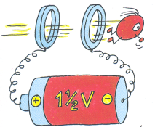

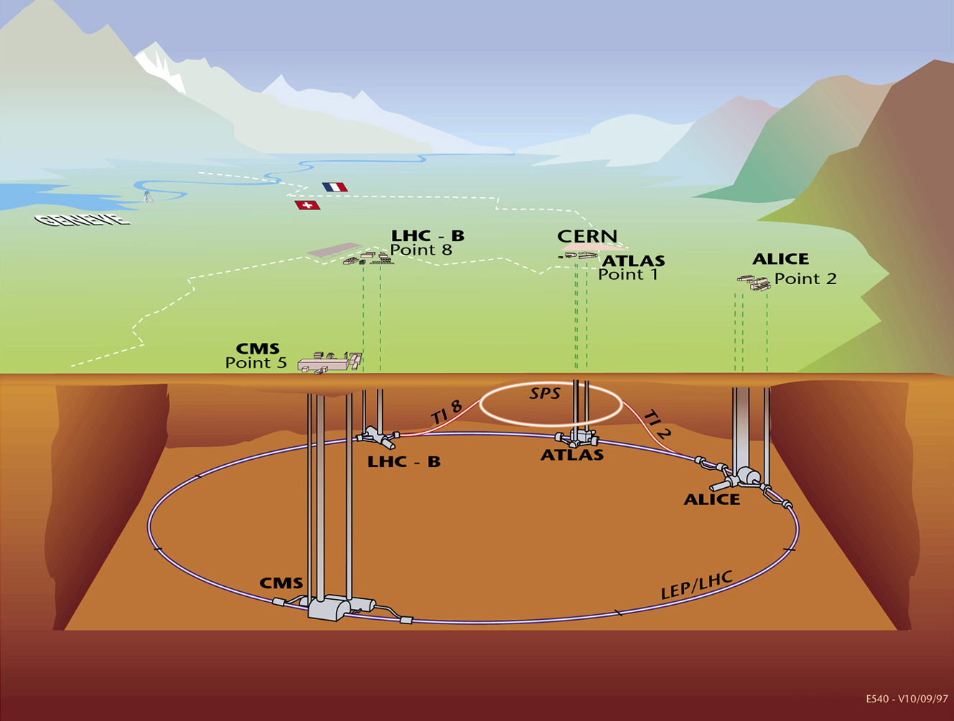
The LHC Machine and Experiments
LHC is 100m underground
LHC is 27 km long
Magnet Temperature is 1.9 Kelvin = -271 Celsius
LHC has ~ 9000 magnets
LHC: 40 million proton-proton collisions per second
moedal
LHCf
FASER
SND@LHC
totem

Slide 6

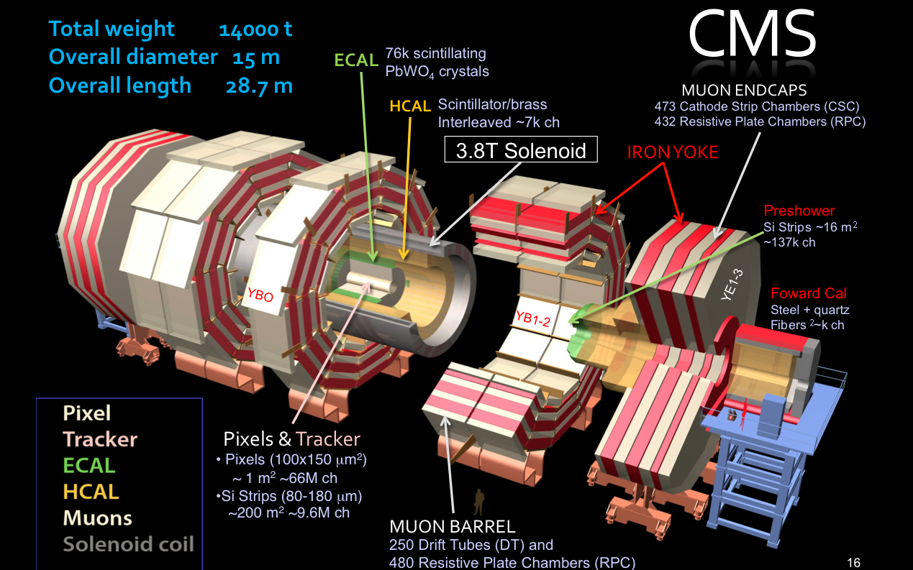
Higgs Hunters @ the LHC
The ATLAS experiment
The CMS experiment

Slide 7
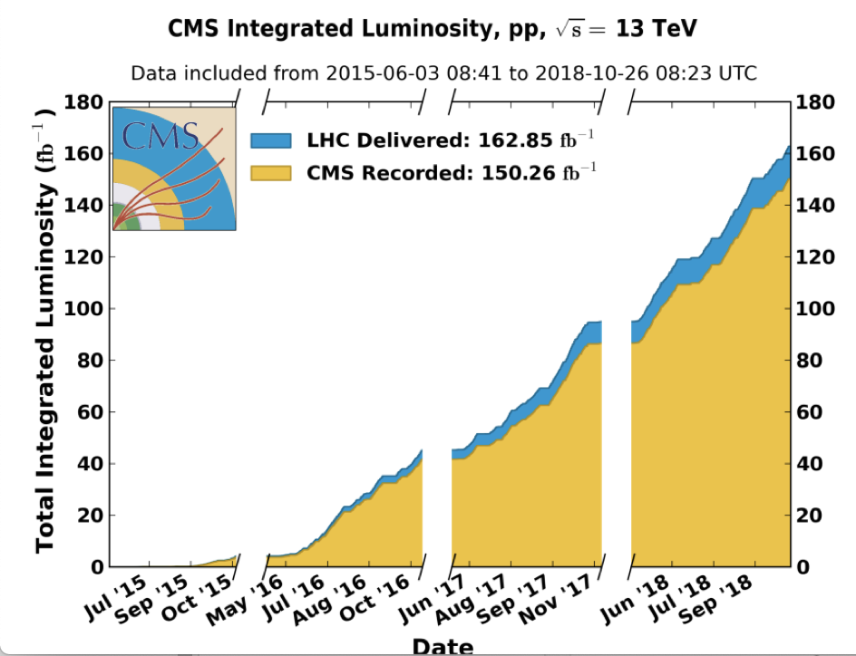
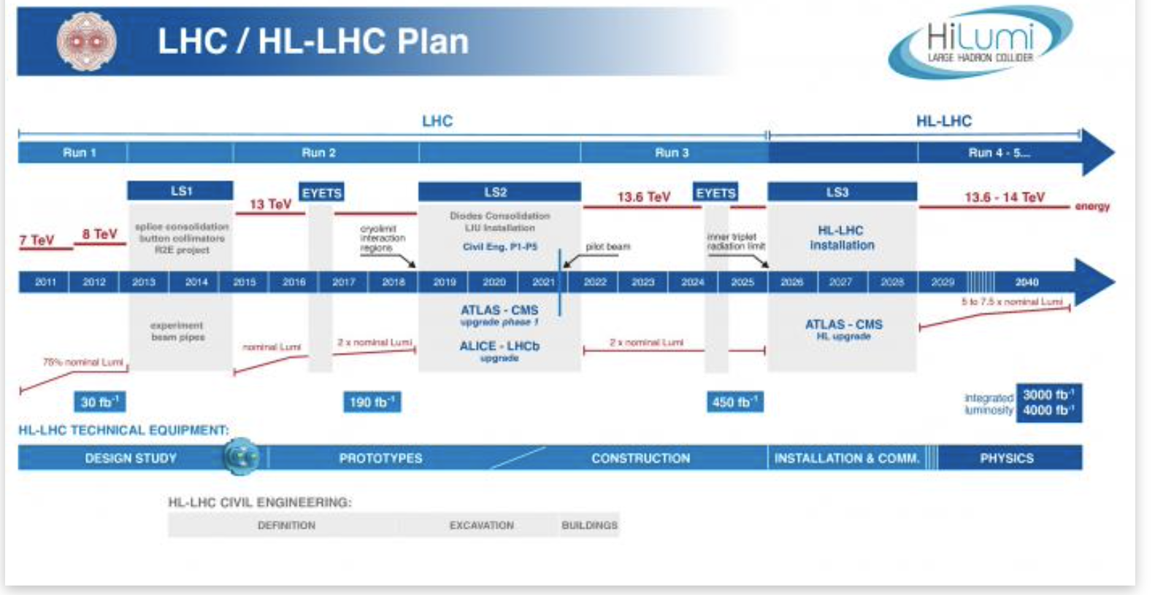
LHC Operations
pp Run-2 was finished on 24/10/18 6:00am
•2010-2012: Run-1 at 7/8 TeV CM energy
•Collected ~ 25 fb⁻¹
•2015-2018: Run-2 at 13 TeV CM energy
•Collected ~ 140 fb⁻¹
You are
here
LHC is restarting after
more than 3 years
Expect >250 fb⁻¹
by 2025 in Run-3 at
13.6 TeV CM energy.
Run-3 starts on 5/7 !!
Followed by HL-LHC:
3000 fb⁻¹ per exp.

Slide 8
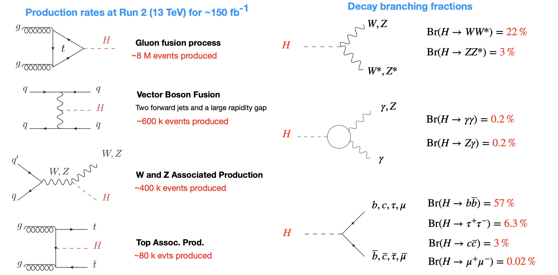
Higgs Production and Decay Processes
M. Kado

Slide 9
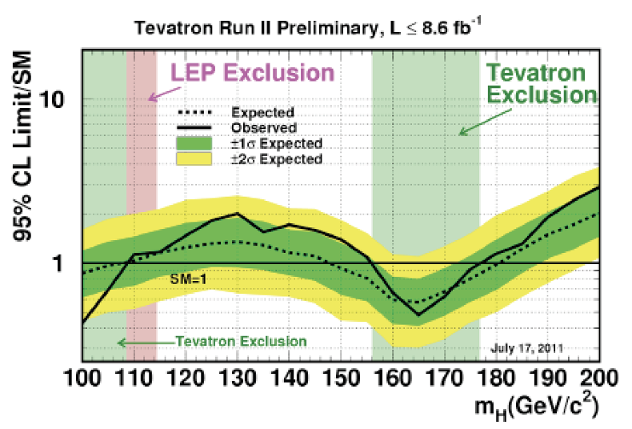
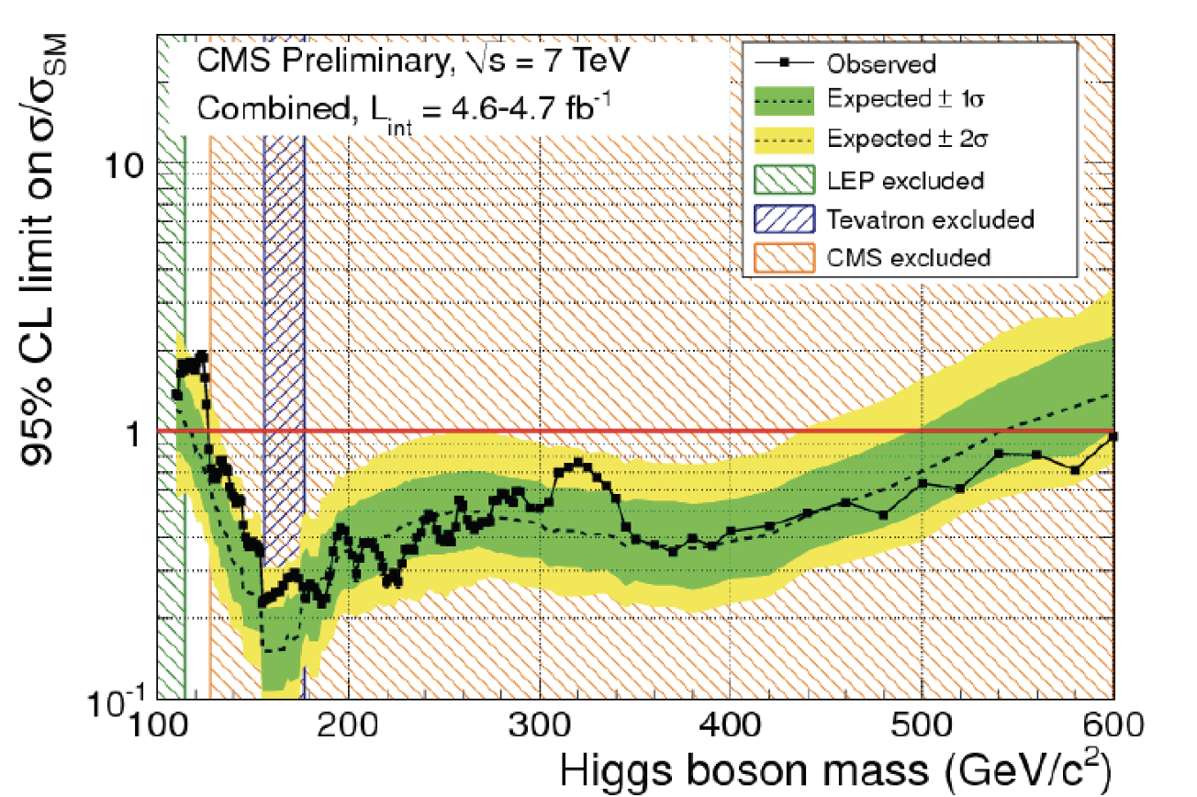
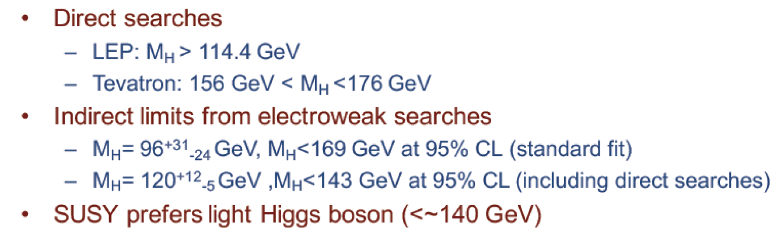
The Search for Higgs in 2011
Before the LHC
The LHC in 2011
Oct 2012
Closed all mass space for a SM Higgs
except for the region 114.5-127 GeV
This region “refuses to be excluded”
with 2011 data and shows a slight
excess. What will 2012 data say?
(SM) Higgs Boson exclusion when full line goes below value of 1

Slide 10
July 4th 2012

Slide 11
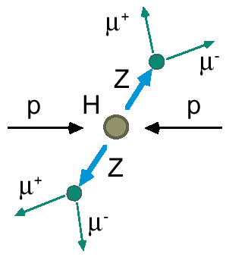
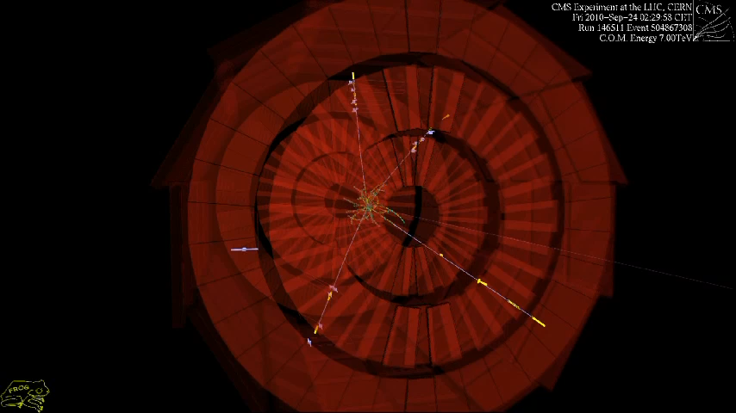
Example: H→ ZZ→ Four Leptons
A Higgs particle will decay immediately, eg in two heavy Z bosons
-> Select Z decays into electron or muon pairs
Eg we look for 4 muons
in the detector
But two Z bosons can also be produced in LHC collisions, without involving a Higgs!
We cannot say for sure on event by event (but we can reconstruct the total mass with the leptons)
Real event from the original sample

Slide 12
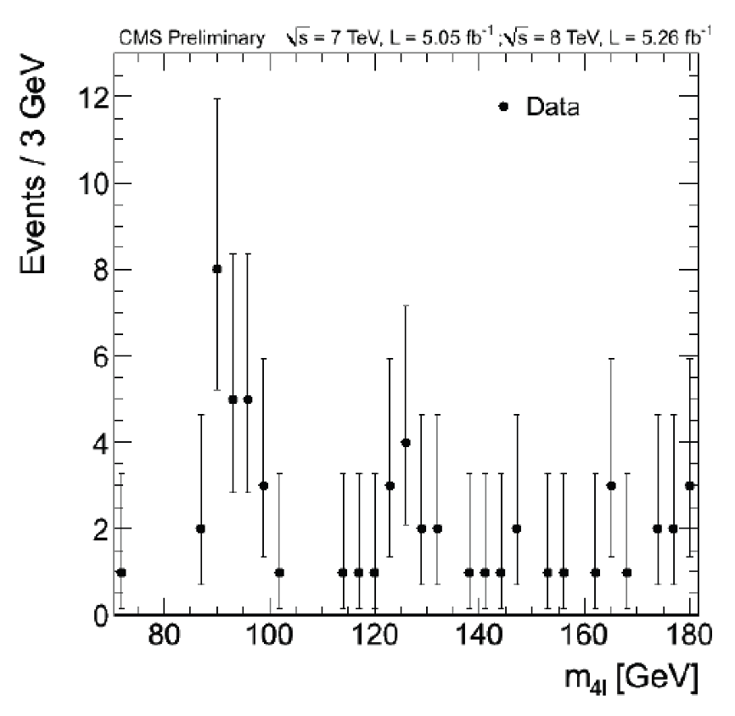
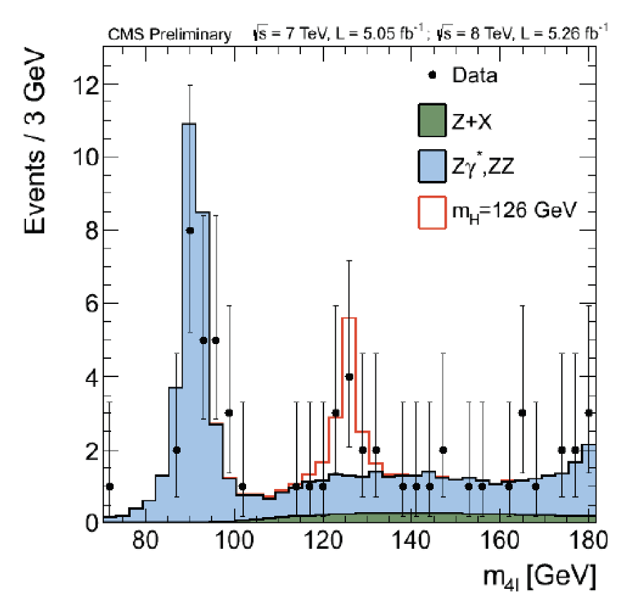
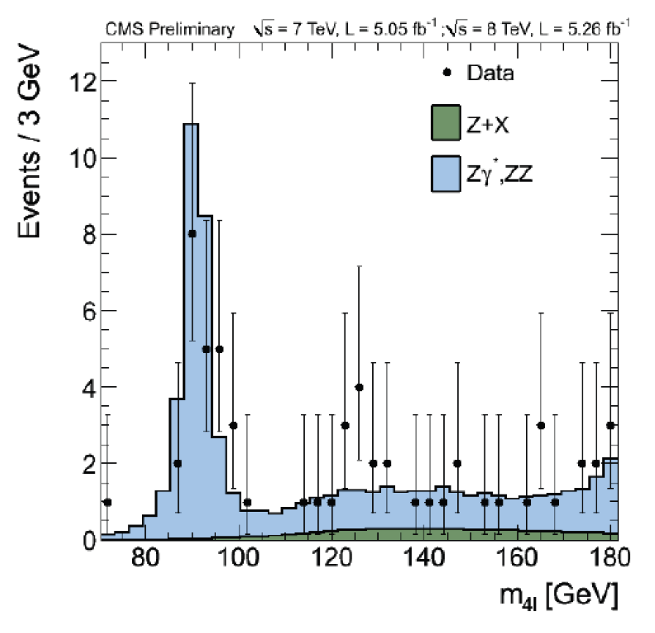
Example: H→ ZZ→ Four Leptons
Data collected and analysed till 4th July 2012.
-> Invariant mass distribution of 4 charged leptons
Any sign of a new particle
here? We need a yardstick
i.e. what do we expect from
the SM on ZZ production?
Add Monte Carlo prediction:
some excess above SM at
125 GeV.
Consistent with a Higgs?
Add 126 GeV SM Higgs
prediction: A nice match…

Slide 13
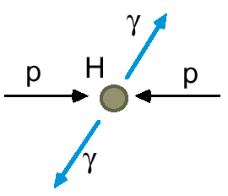
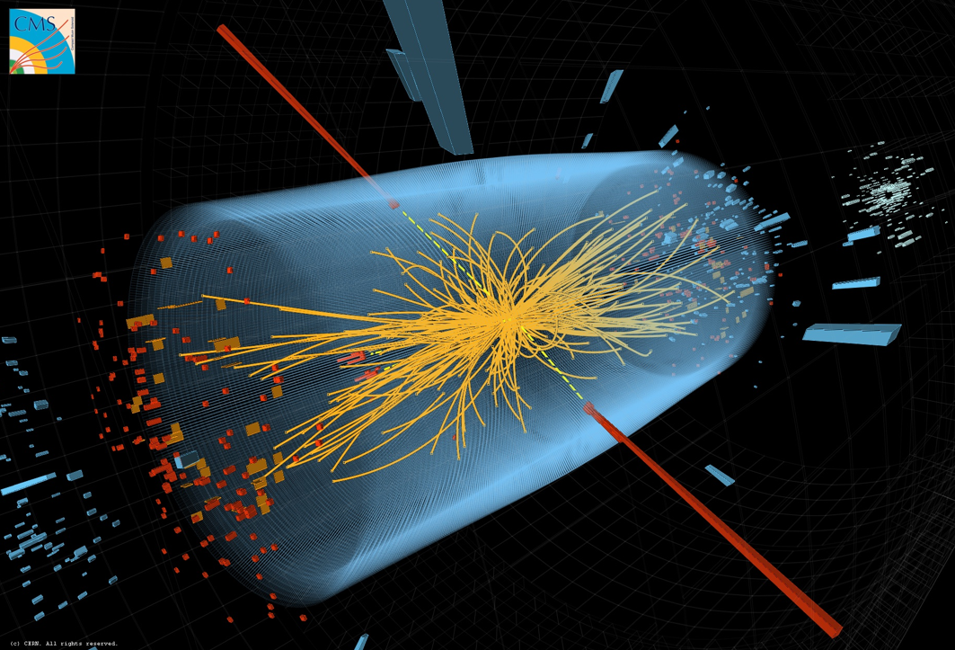
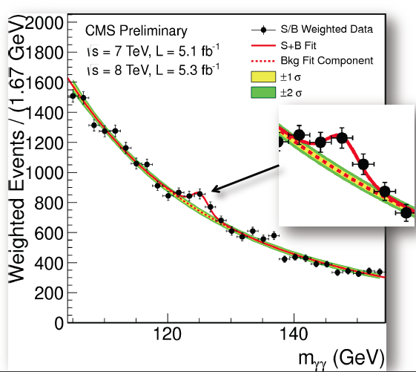
Example: H→ Two Photons
Different Higgs decay channel: decay to two photons
Observe an excess also at around 125 GeV

Slide 14
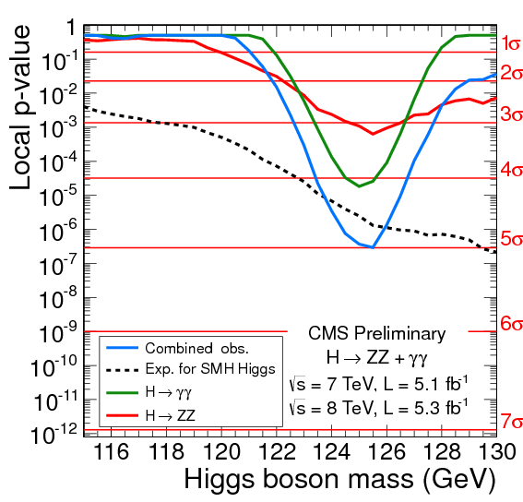
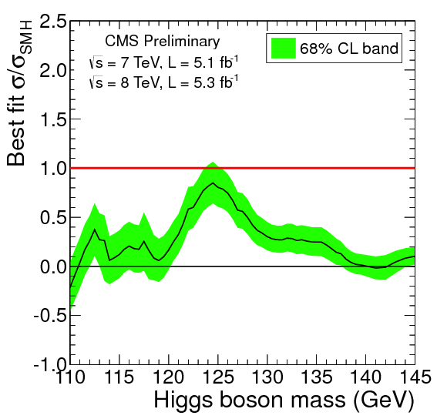
Results from Different Channels
July 4th 2012
Combined statistical strenght
July 4th 2012
Consistency with a SM Higgs
CMS observe a new boson with a significance of
5 sigma. ATLAS announces the same !
The particle is consistent with a Higgs-like boson

Slide 15

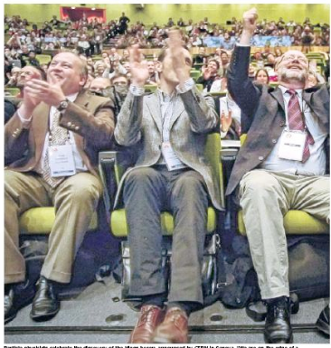

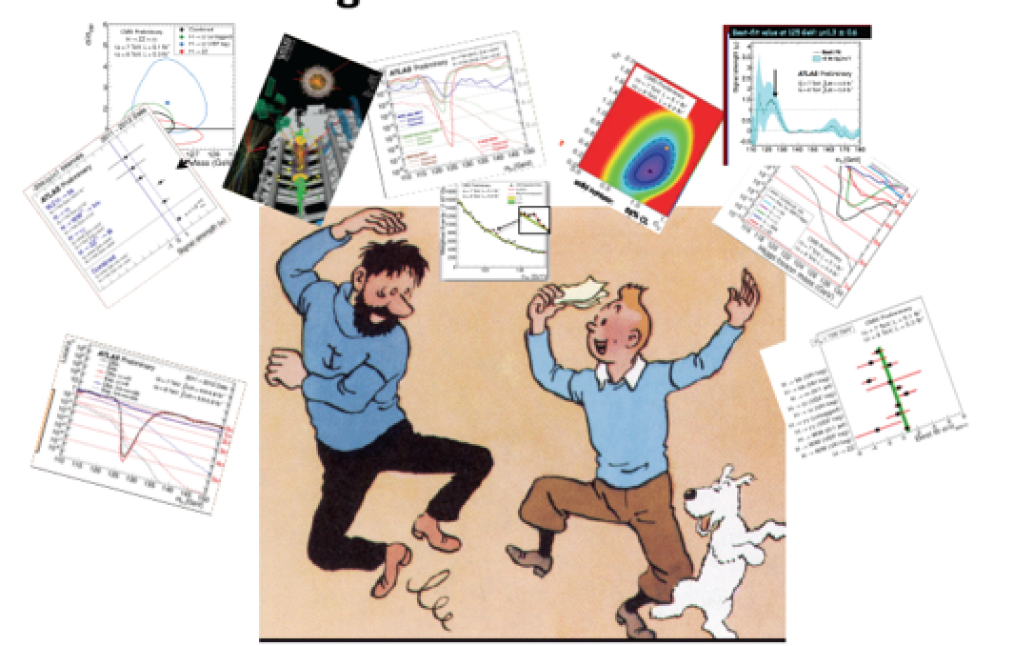
July 4th 2012
Official announcement of the discovery of a Higgs-like particle with mass of 125-126 GeV by CMS and ATLAS.
Historic seminar at CERN with simultaneous transmission and live link at the large particle physics conference of 2012 in Melbourne, Australia
CERN
Melbourne

Slide 16


Now: 10 Years of Higgs Studies
2012: Special Physics Letters B edition with the ATLAS and CMS papers on the Higgs Discovery
2022: Special Nature magazine edition with the ATLAS and CMS papers on 10 years of Higgs
?
More than 13,000 times
cited so far…
Released by Nature and to
arXiv today: 2207.00043

Slide 17
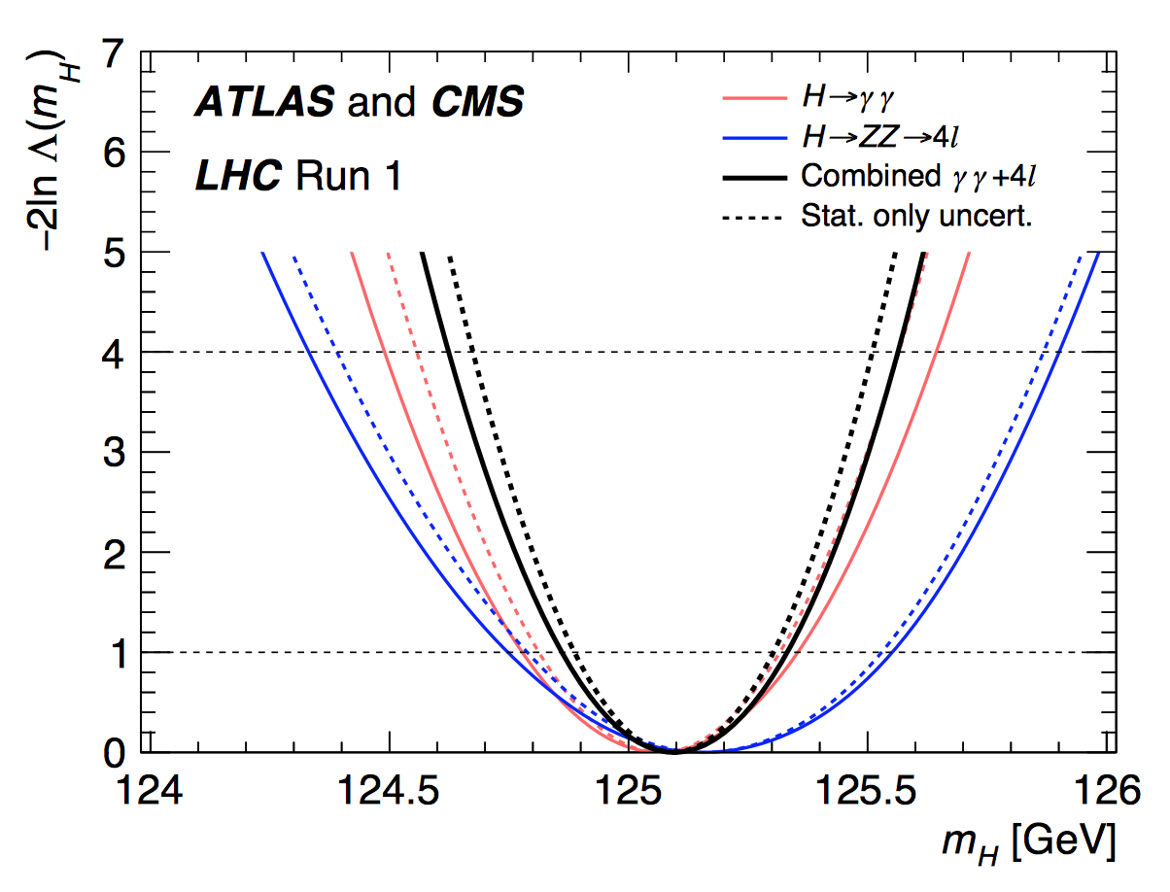
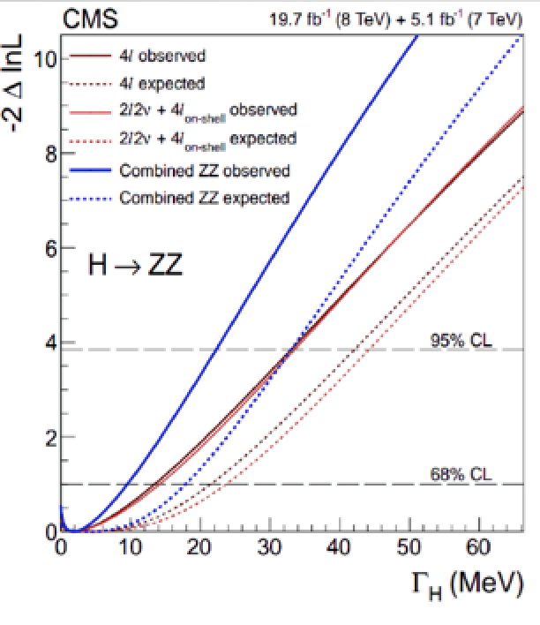
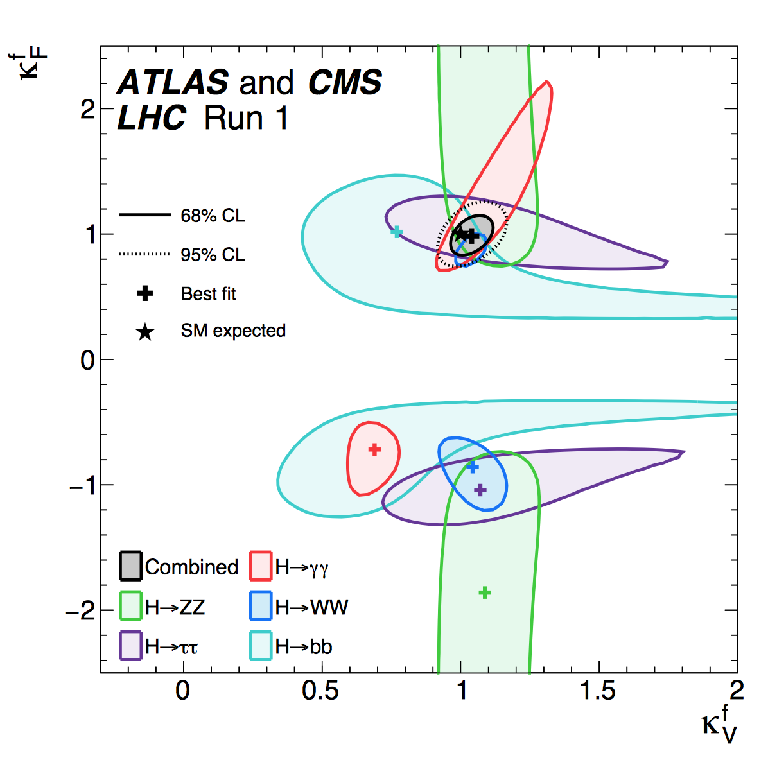
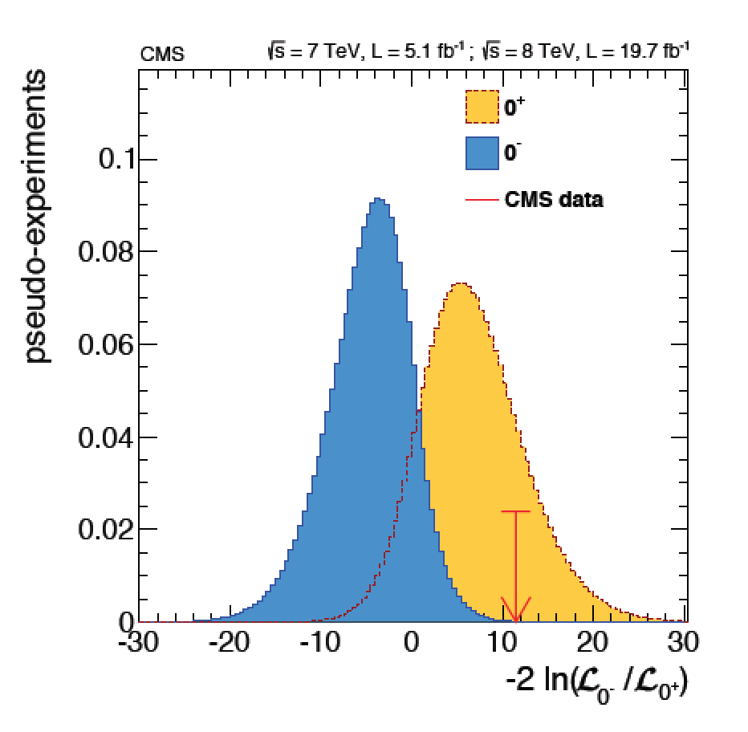

Brief Higgs Summary from Run-1
We knew already a lot on this Brand New Higgs Particle!!
(*)
Mass = CMS+ATLAS
125.09 ±0.21(stat)
±0.11(syst) GeV
Width
< 24 MeV
(95%CL)
Couplings are
within ~15-20%
of the SM values
Spin =
0⁺⁽⁺⁾ preferred
over 0⁻,1,2
SM-like behaviour for most properties, but continue to look for anomalies,
new/unexpected decay modes or couplings, multi-Higgs production…
(*) First ATLAS+CMS paper : > 5000 authors, a new record as noted by Nature!!

Slide 18
The Higgs Today

Slide 19
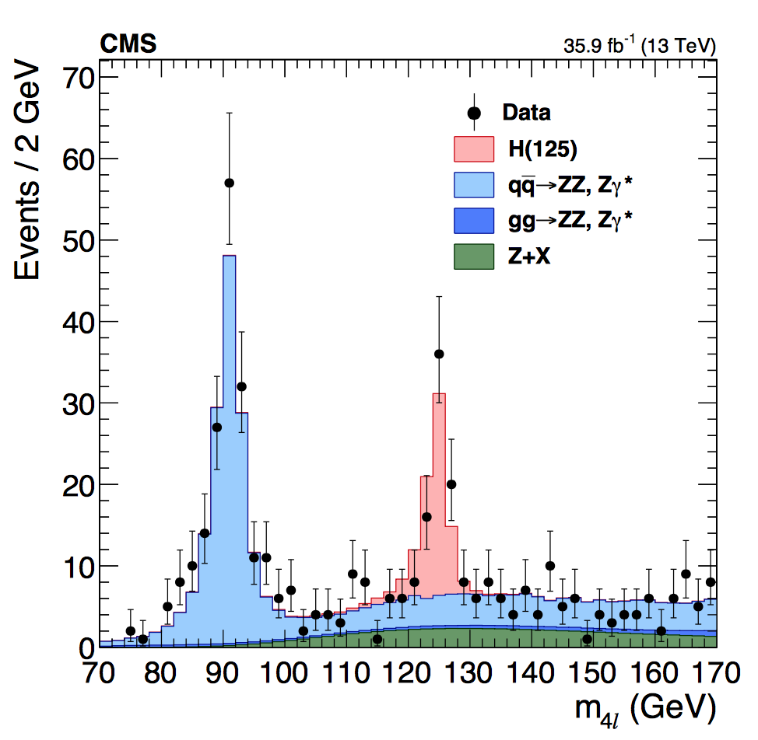
Higgs @ 13 TeV in Run-2
Higgs particle is still there !! ☺
More precision on Higgs properties
New Combined Fits with all data
Observation of H→𝛕𝛕
Direct observation of ttH production
Observation of H→bb
Evidence for H→𝜇 𝜇 (second generation fermions)
Detailed CP analysis eg in H→VV & H→𝛕𝛕
Differential distributions/STXS event classification…
The mild deviations seen in Run-1 seem to be gone ☹
NEW: 10 year Anniversary Paper with Run-2 legacy
H→ ZZ

Slide 20
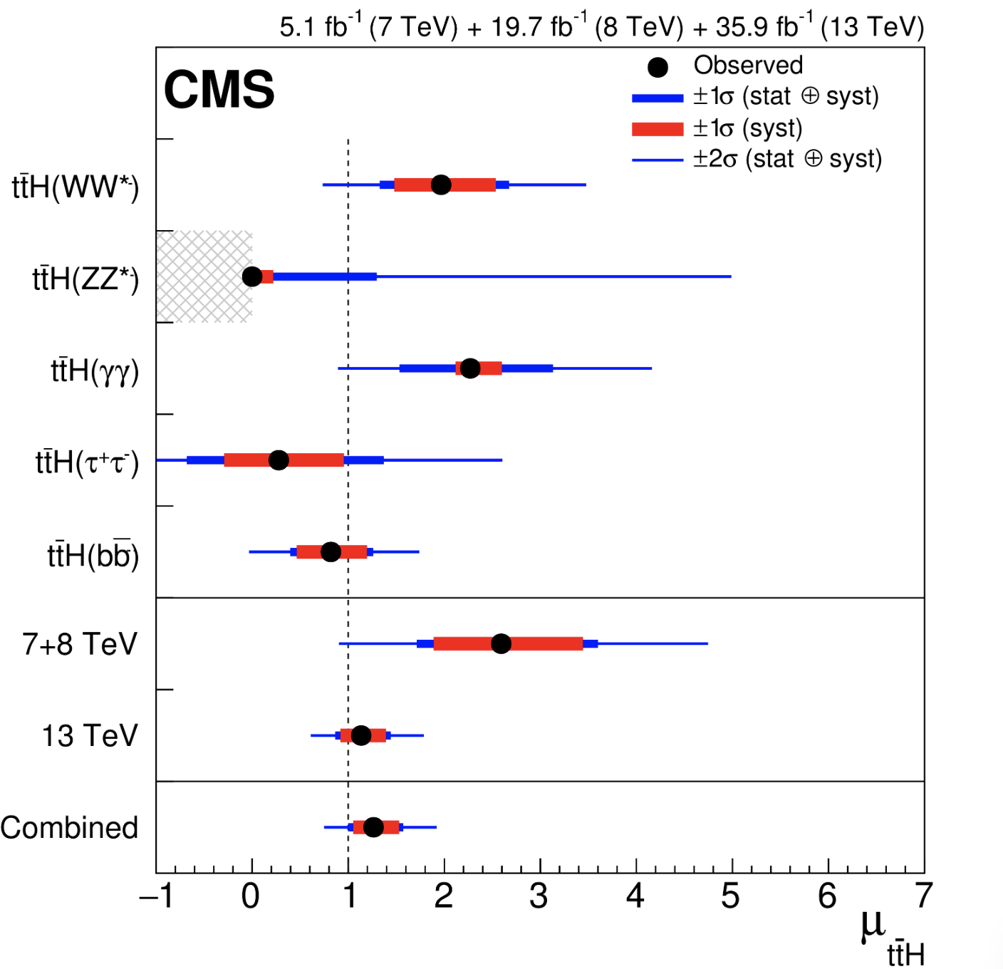
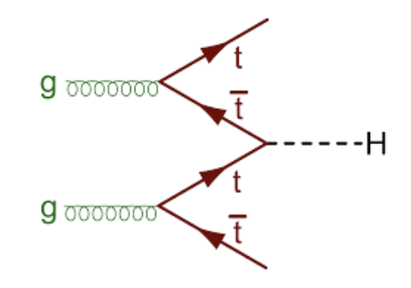
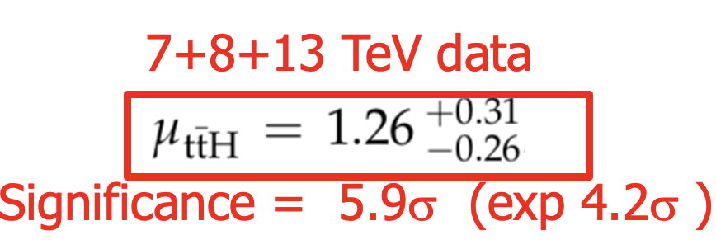
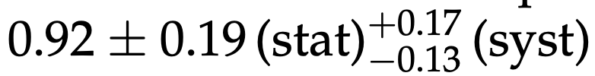

Higgs ttH Production
Observation of ttH production: Combination of all Higgs decay channels and combination with the 7/8 TeV data of Run-1
arXiv:1804.02610
arXiv:2011.03652
NEW: ttH and tH in final states with muons, electrons and hadronic taus
using the full Run-2 data, giving the following 𝞵 values:
ttH: and tH:

Slide 21
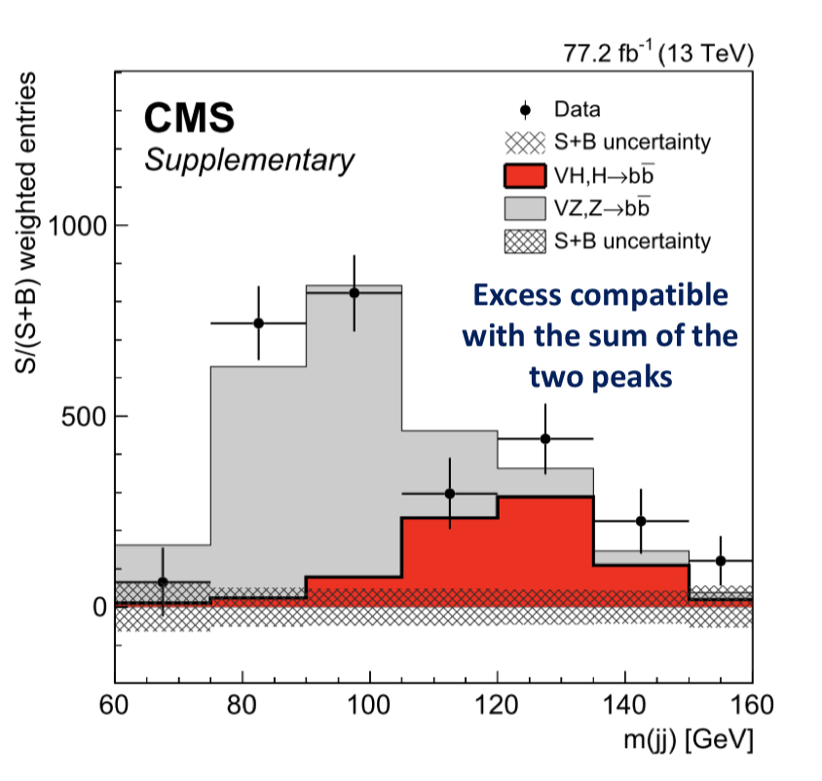
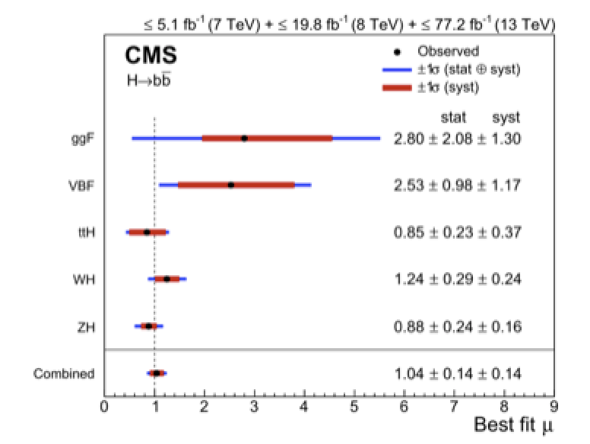

Higgs to bb Decay
H->bb decay: Combination of all Higgs decay channels
and combination with the 7/8 TeV data of Run-1
arXiv:1808.08242
H->bb observed (expected) with 5.6 (5.6)σ significance
Combined best fit

Slide 22
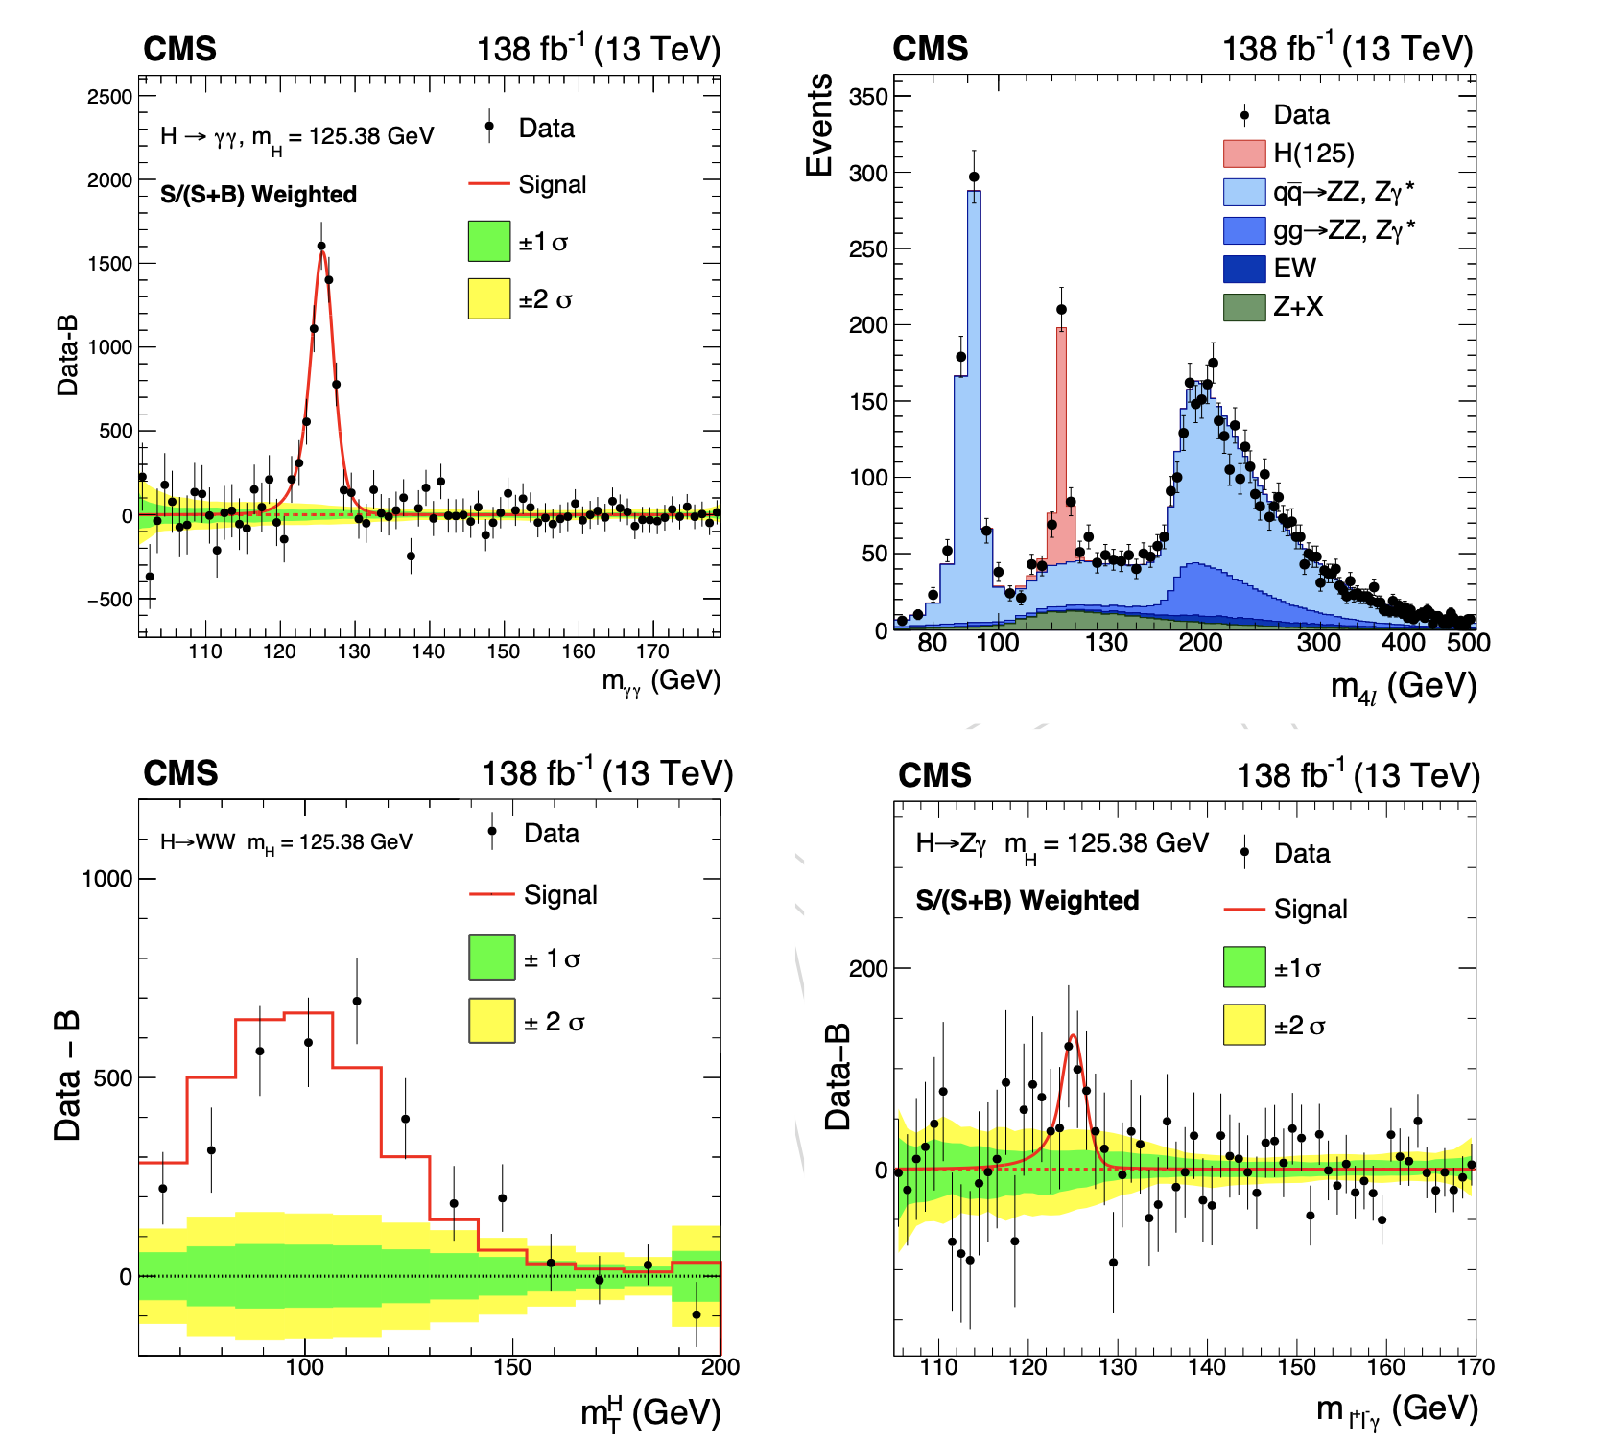
Higgs Decaying to Vector Bosons
2207.00043
H→𝛾𝛾
H→ZZ
These are the
CMS Run-2
legacy results!
Full run-2 data
sample
H→Z𝛾
H→WW

Slide 23
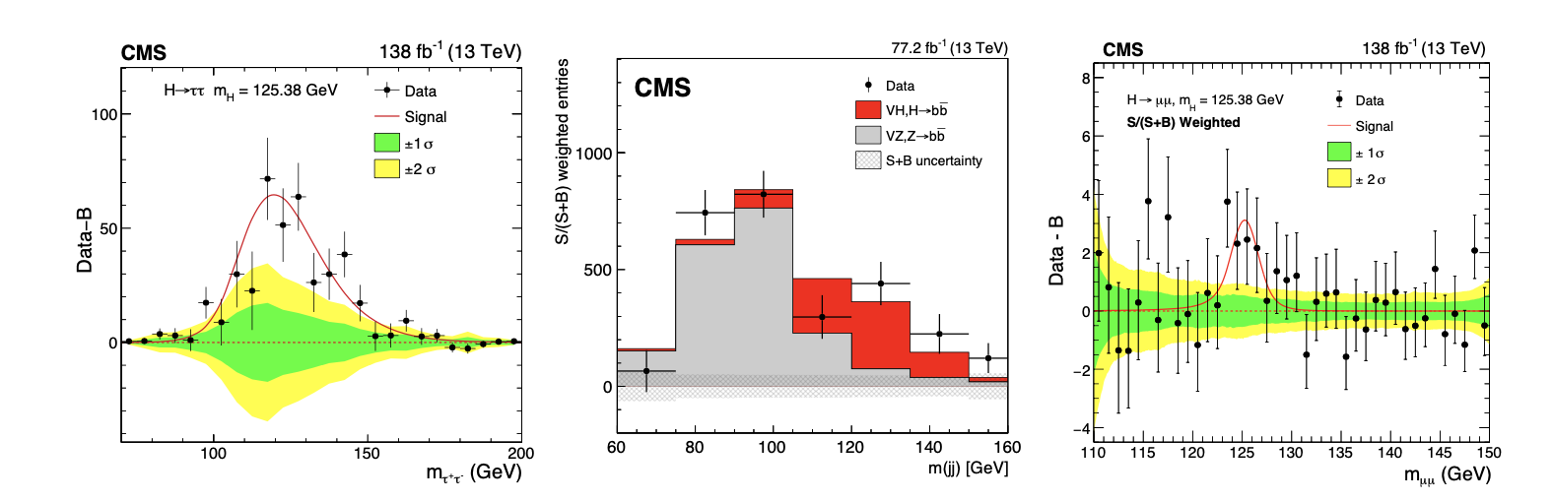
Higgs Decaying to Fermions
2207.00043
Background-subtracted results for H→𝞽𝞽, H→bb and H→𝞵𝞵 channels
H→bb
H→𝞽𝞽
H→𝞵𝞵
CMS Run-2 legacy results!

Slide 24

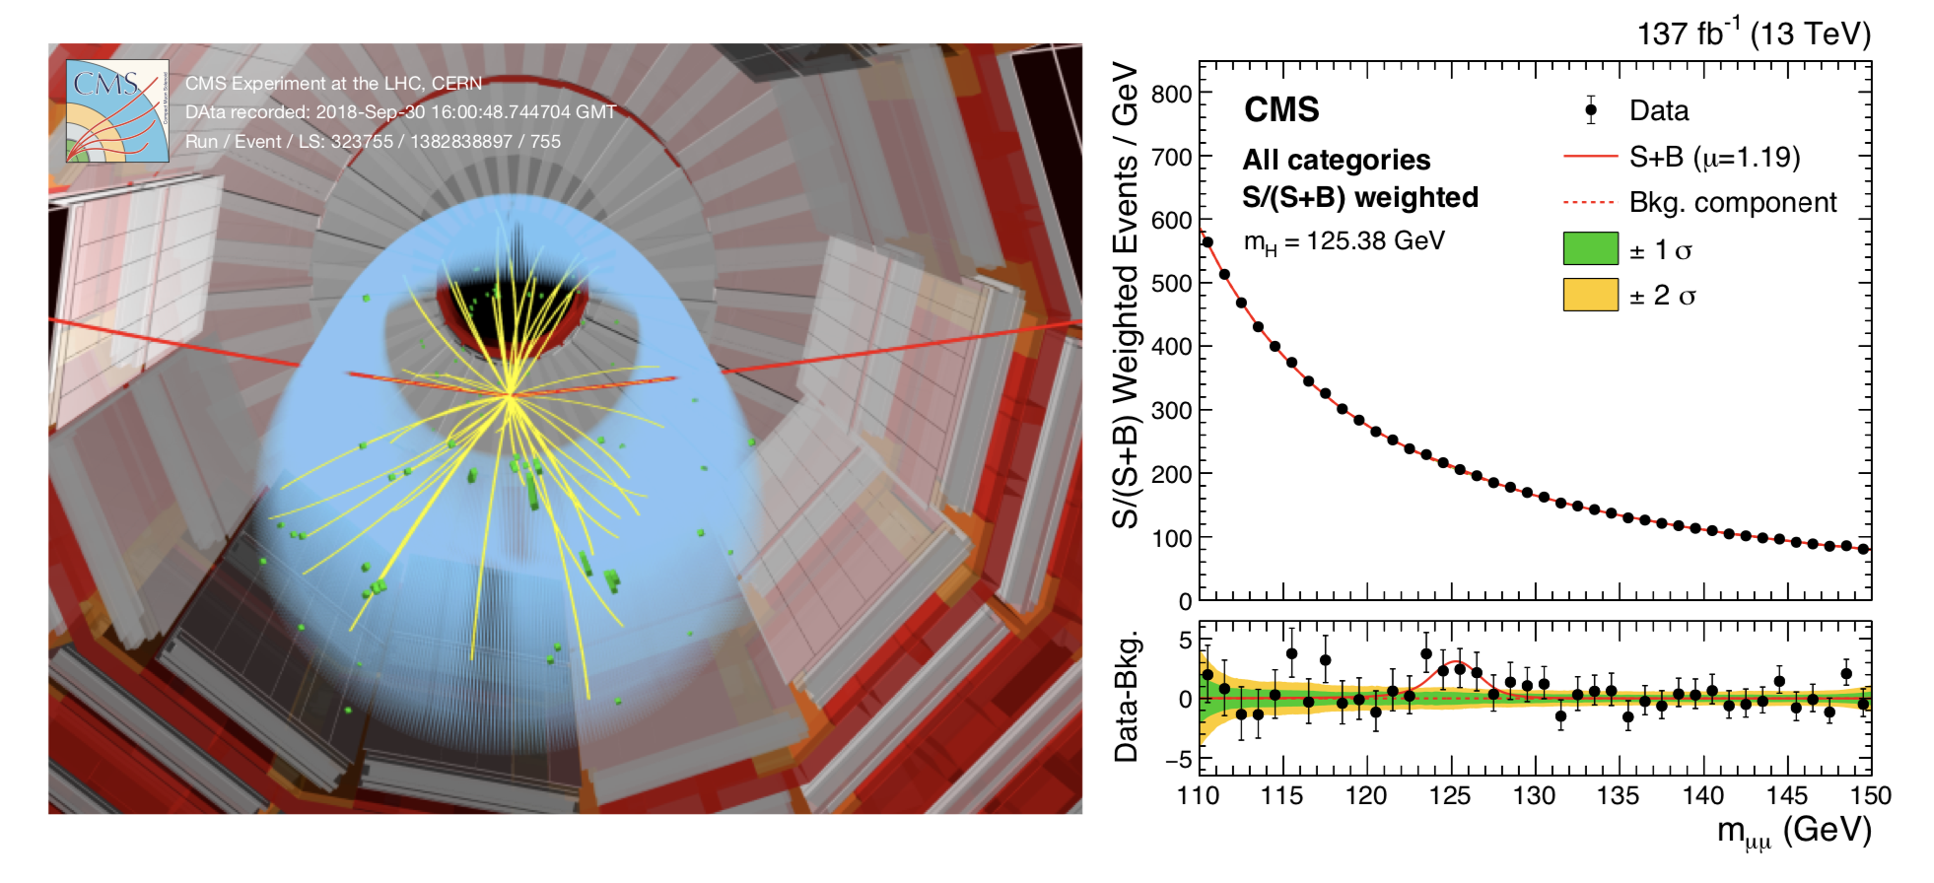
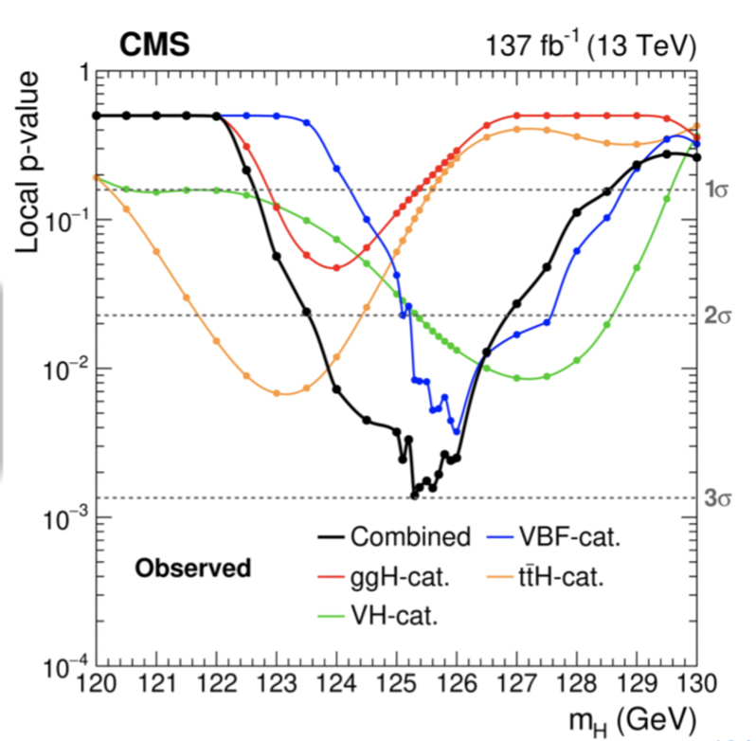
Higgs decaying to Di-Muons
Evidence for H->𝜇𝜇 with full run-2 data sample (3 sigma)
-> Clean signature but small Branching Ratio: 0.02% only
SM coupling strenght 𝞵
2009.04363
First evidence of Higgs coupling to second generation!

Slide 25
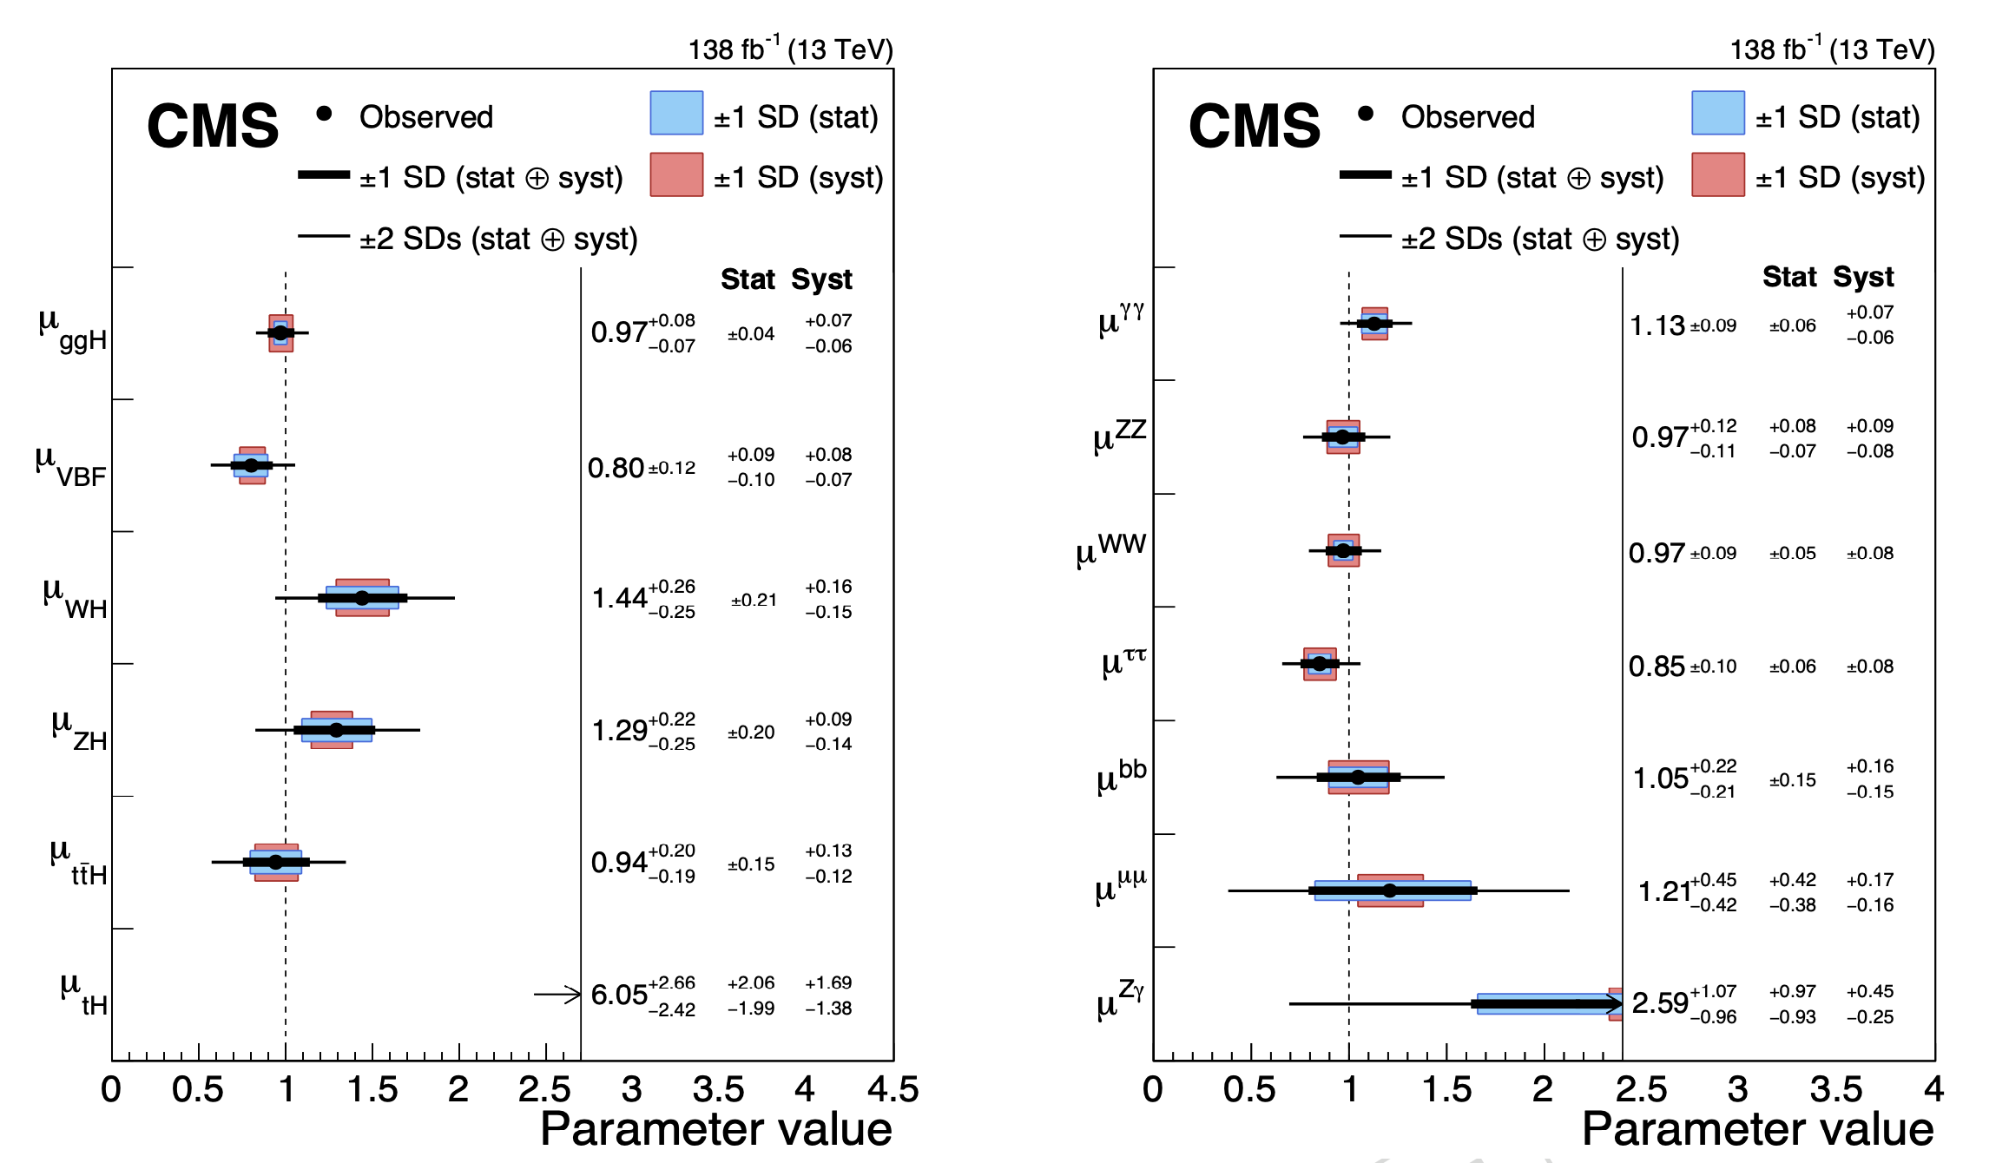

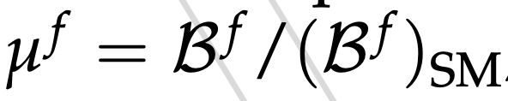

Signal Strenght Parameters
Higgs Production Modes
Higgs Decay Channels
2207.00043
Compare
observed
yield with SM
expectation
Global Higgs Signal Strenght:
The value 𝞵 =1 is the expected value for the Standard Model

Slide 26
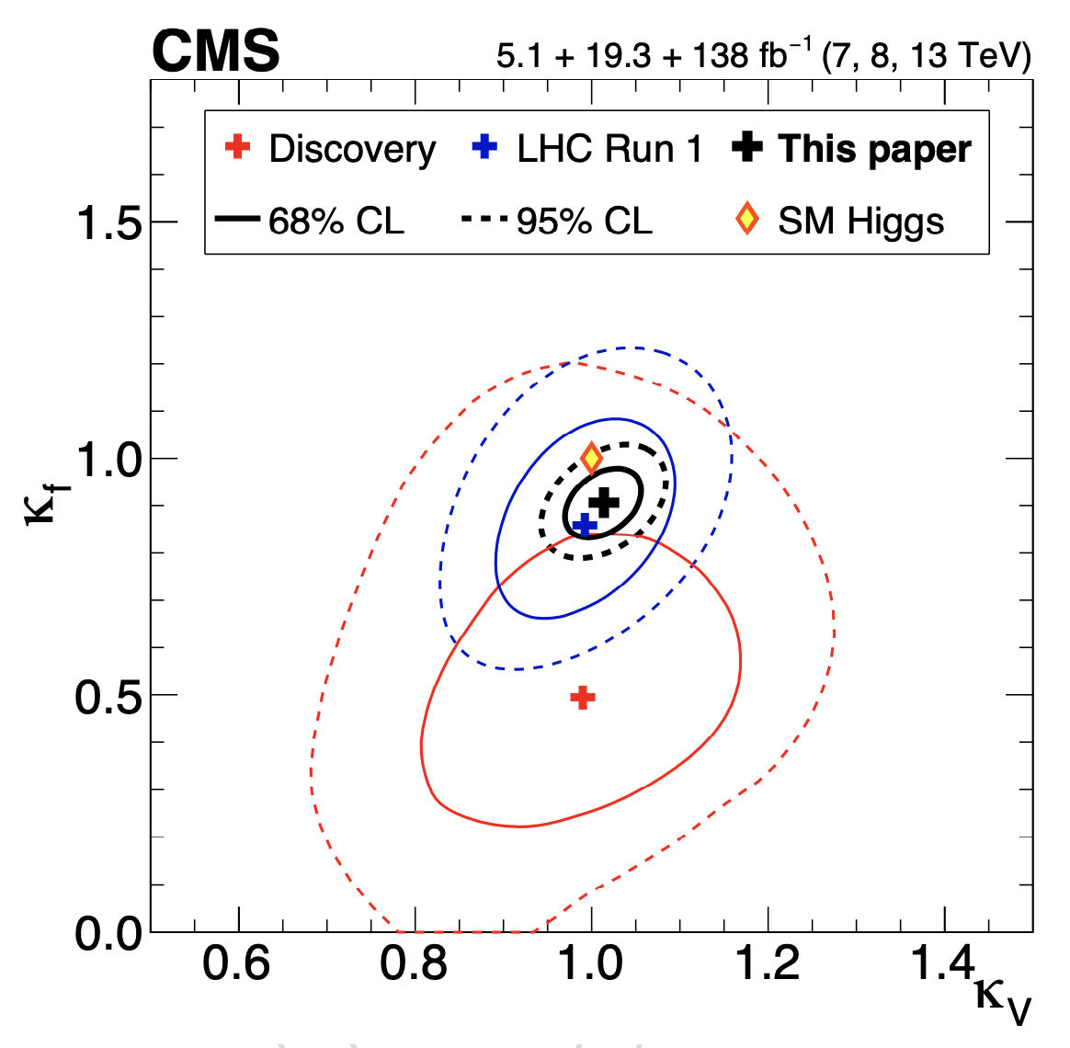
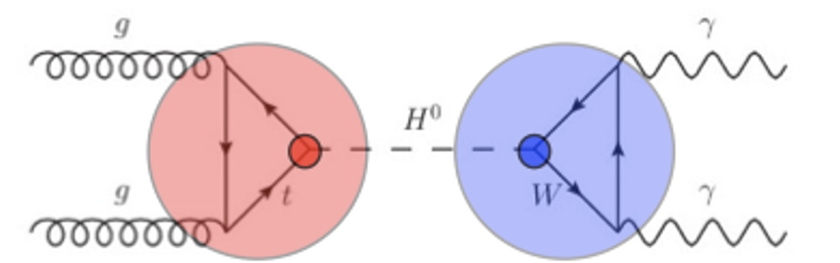
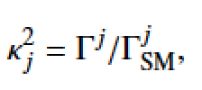
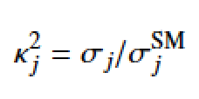
Coupling Modifiers
Constraints on the Higgs coupling modifiers to fermions and heavy
gauge bosons, and the evolution with time from discovery till today
Coupling Modifiers:
In the 𝜅-framework
for cross sections and
branching ratios
In the SM: 𝜅=1
For a single contribution

Slide 27
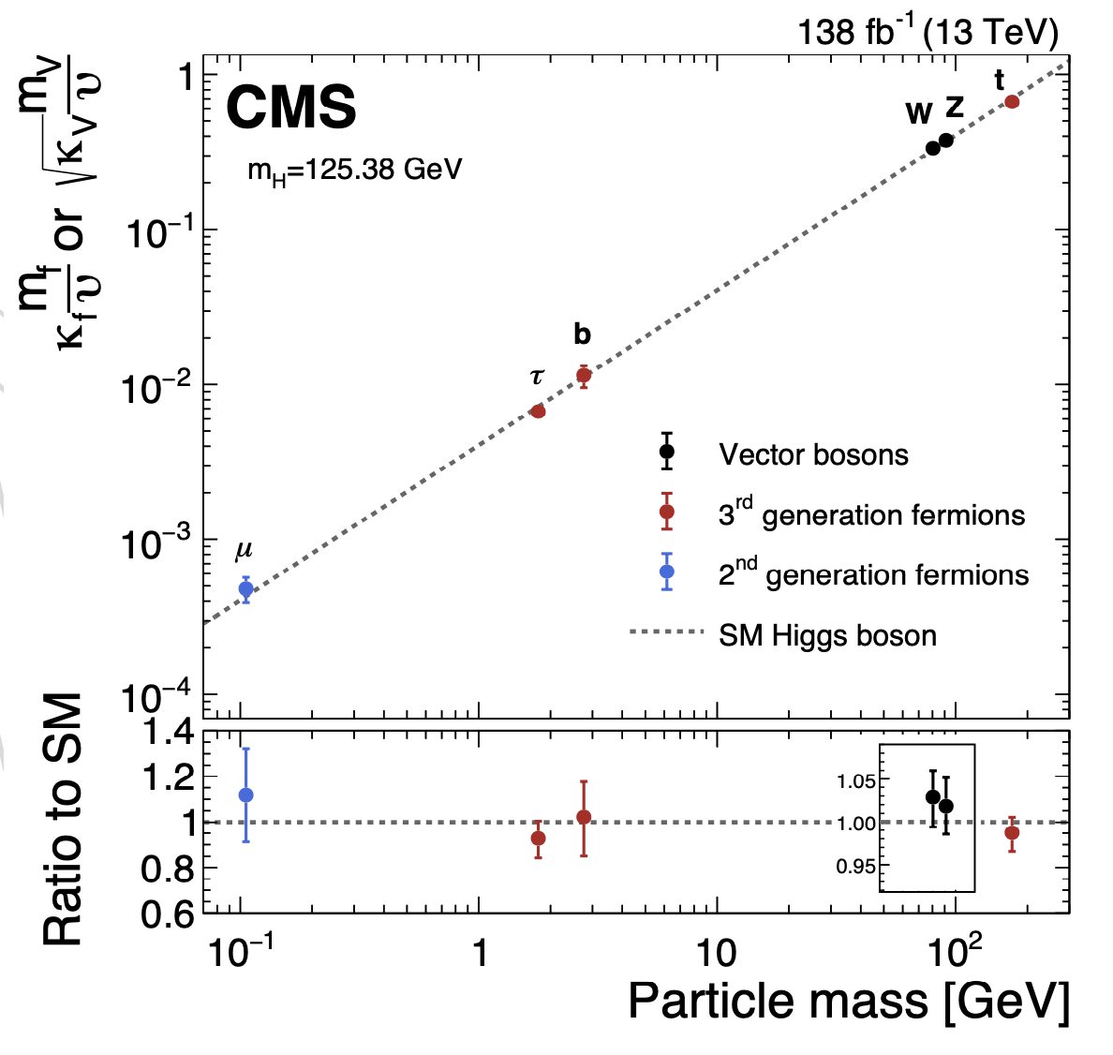
Higgs Coupling to Fermions and Bosons
2207.00043
Scaled coupling
modifiers for bosons
and fermions
𝜐 is the vacuum
expectation (246 GeV)

Slide 28
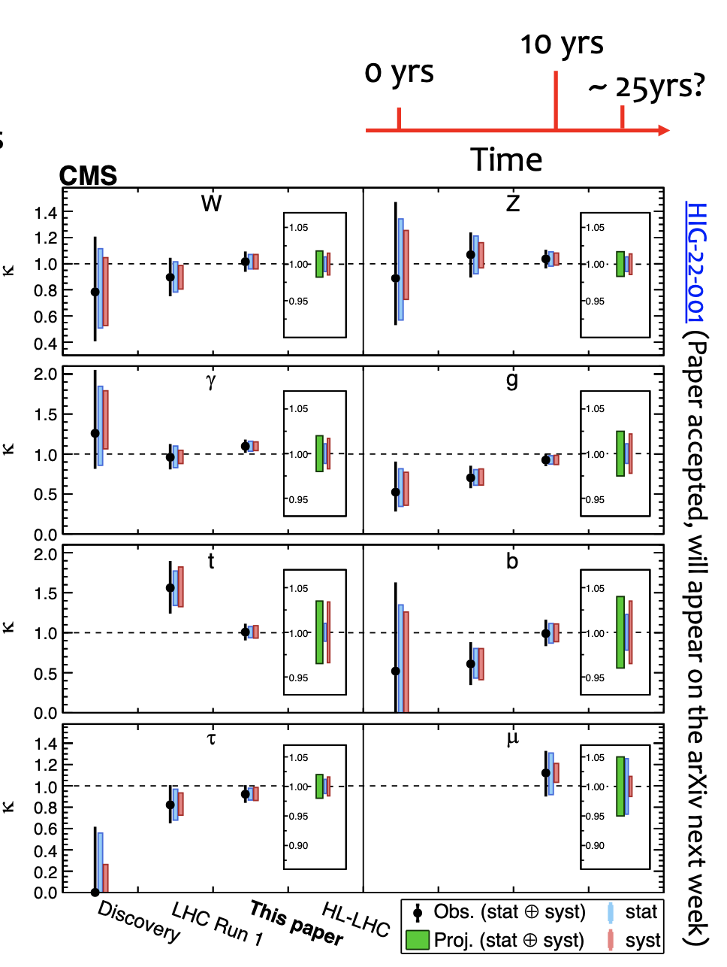
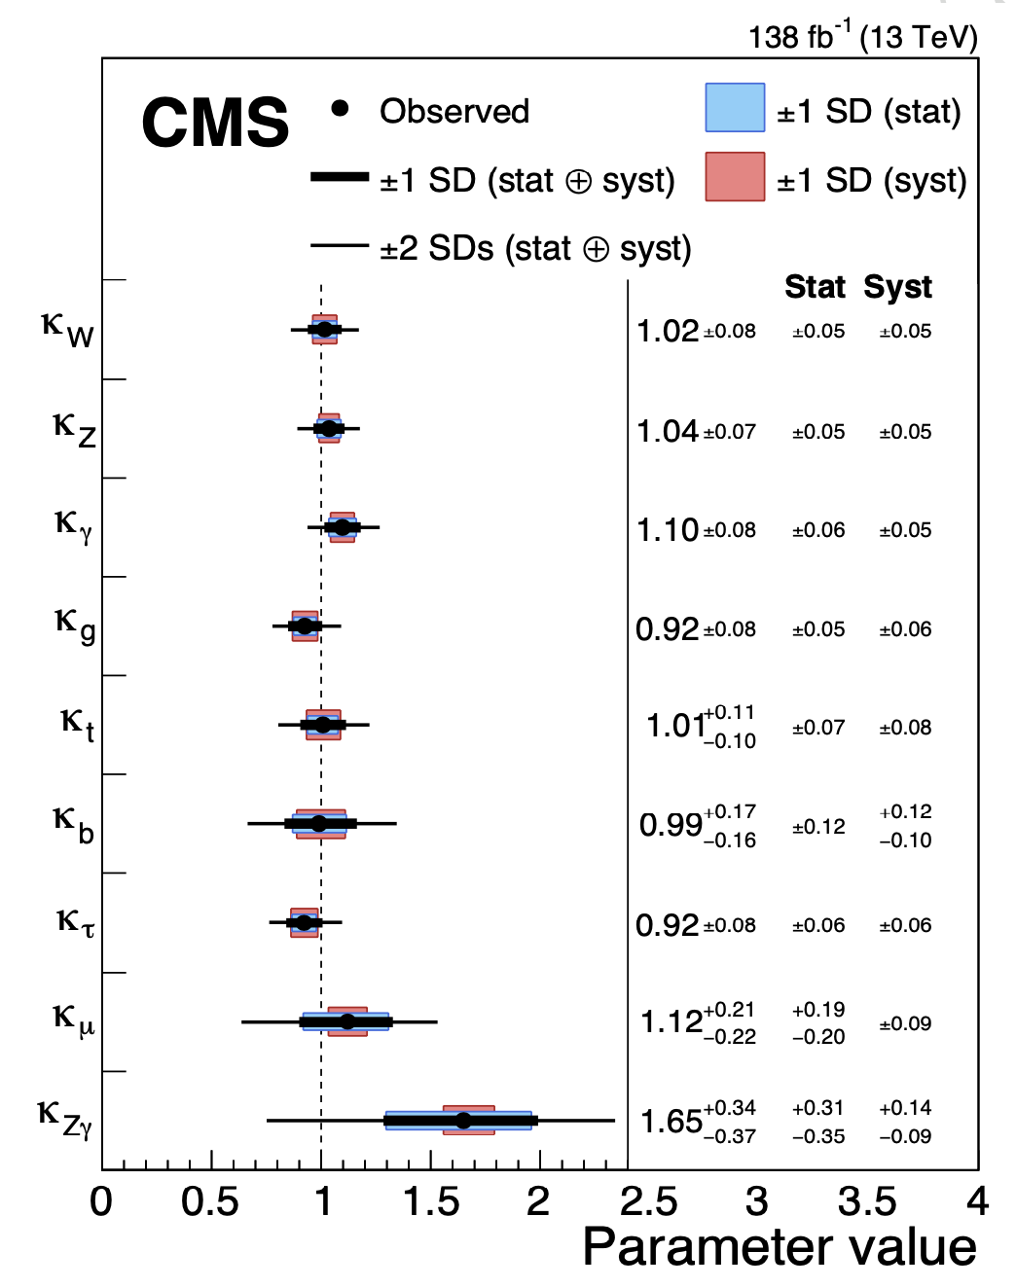
Results from the fit of all channels
Different coupling modifiers and evolution with time from discovery till today

Slide 29
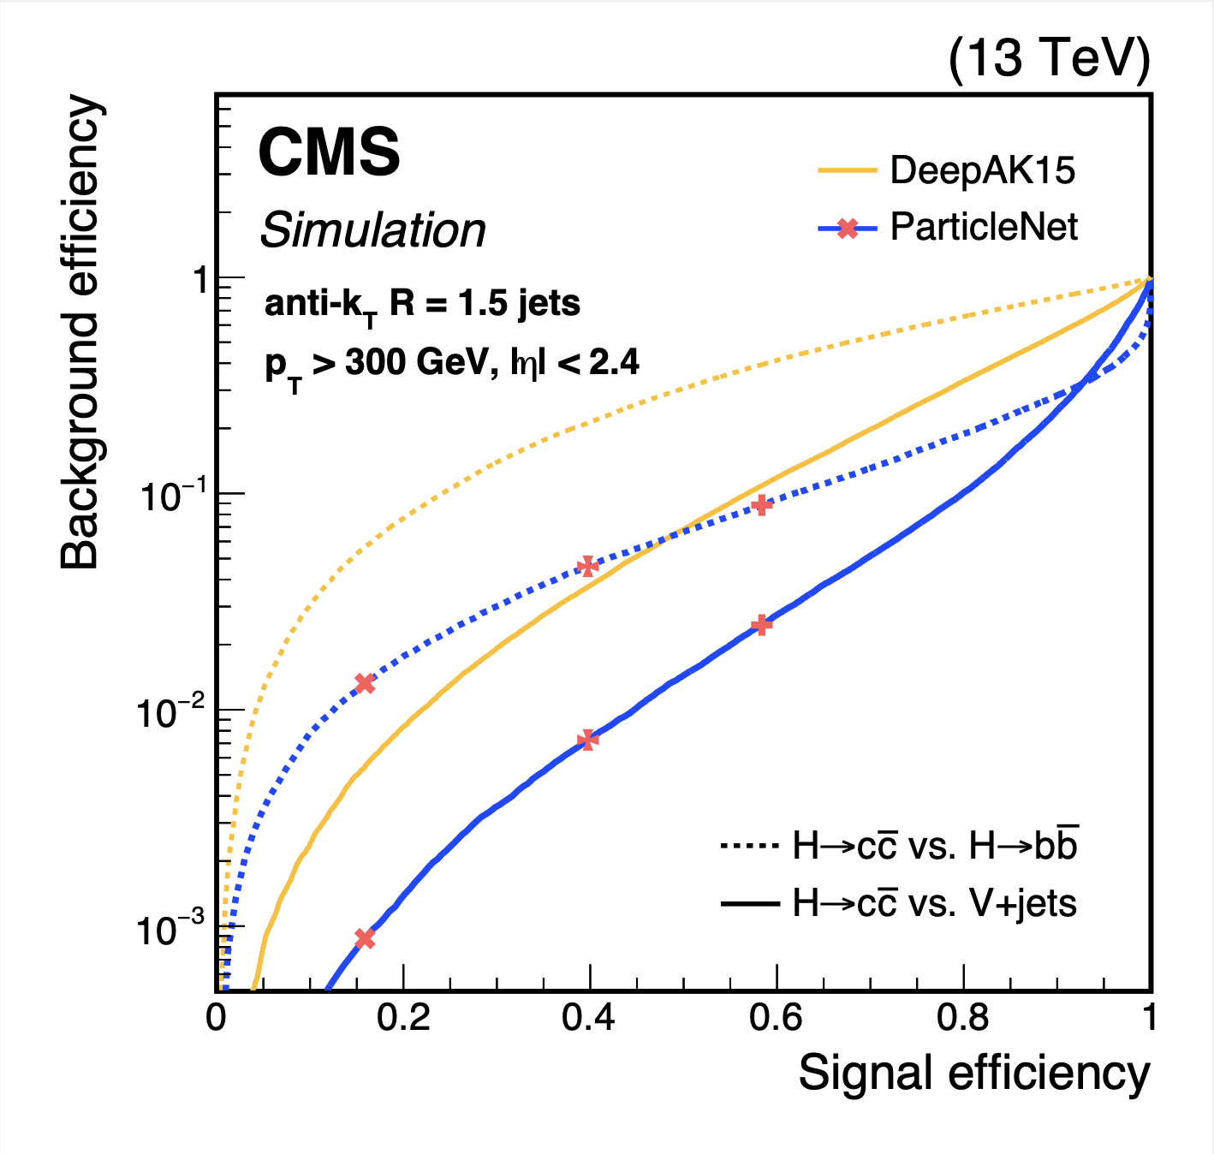
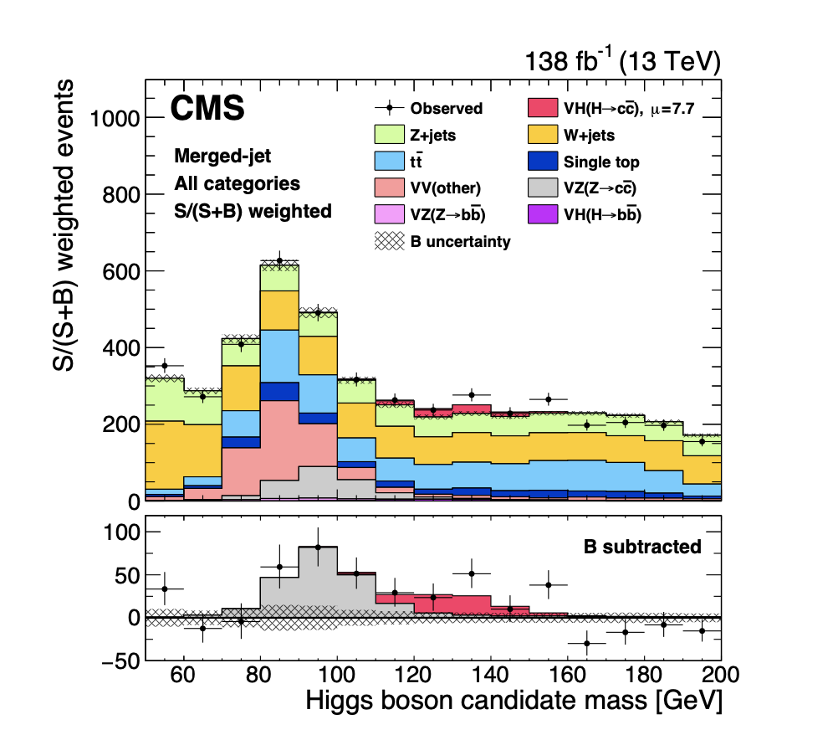
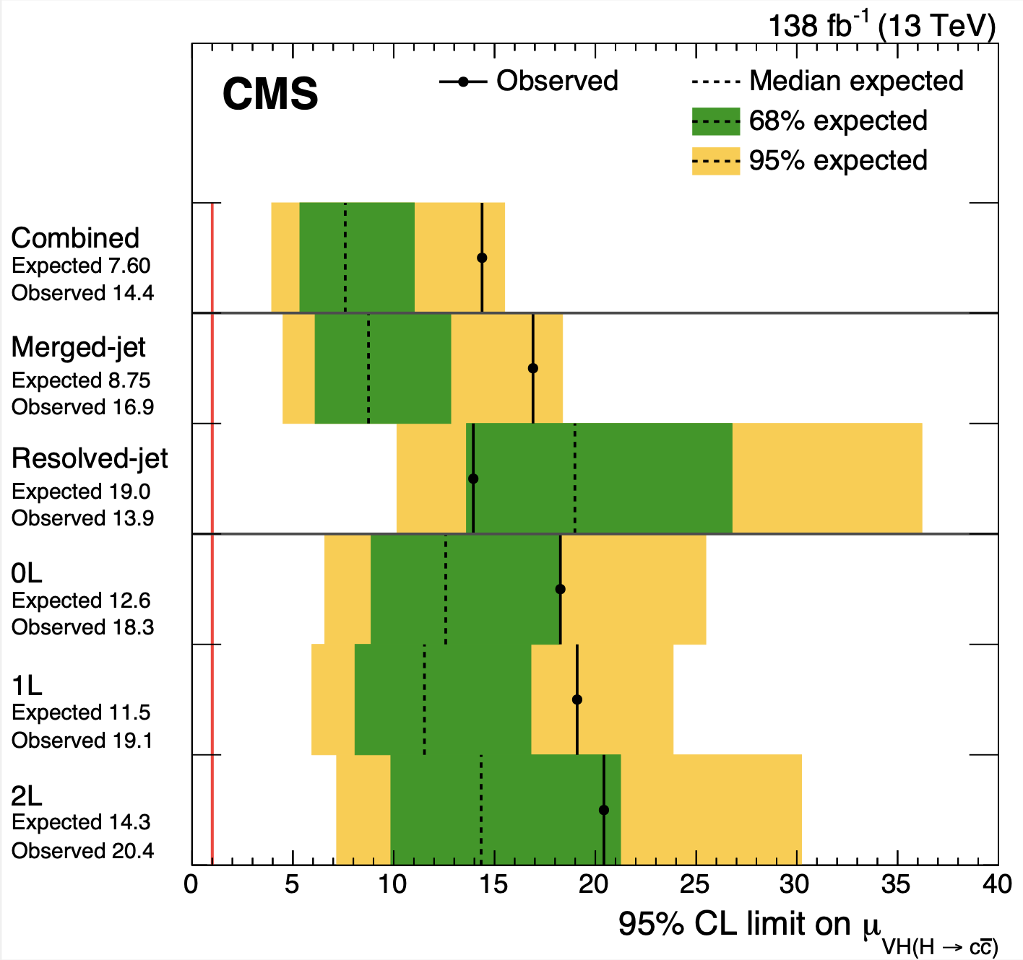

Higgs to Charm?
Search for H→ cc in HV assoc. production mode.
Find c-jets using the PARTICLENET graph neural
network, with jet tagging via particle clouds.
-> Observation of Z→ cc with 5.7σ significance
Observed (95%): 𝛍 upper limit <14 SM prediction, Yukawa coupling

Slide 30



Higgs Self Coupling
● Does the Higgs couple to itself?
● Access the shape of the Higgs
potential…
Main tool at the LHC to measure the Higgs
self-coupling is via Higgs Pair production
● Small cross sections
● Negative interference with background
● Many decay channels to study
->A challenging measurement @ LHC!

Slide 31

Higgs Pair Production
State of the art studies, including bbZZ, bb𝛄𝛄, bb𝛕𝛕, bbbb and multi-leptons
2207.00043
95% upper limits for𝜿_{𝝠} and 𝝹_{2V}
N. Wardle
Result is a few times SM value already! Very promising for Run-3/HL-LHC

Slide 32



Higgs Properties: Higgs Mass
Higgs Mass from H→𝛾𝛾 and H→ZZ →4leptons with run-1 and 2016 data
● Excellent detector performance and lepton/photon energy scale calibration
● Results still dominated by statistical uncertainties
2002.06398
M_{H} is known to a precision
of almost 1 per mille

Slide 33





Higgs Properties: Higgs Width
arXiv:1901.00174
arXiv:2202.06923
Direct resonance width measurement not possible.
Technique used: on-shell to off-shell cross section in H→ZZ
SM Higgs(125)
width = 4.1 MeV
68% | 95% CL 68% | 95% CL
➨
Result:
in addition

Slide 34


Invisible Decays of the Higgs Boson
Direct search for H decaying into invisibles, using VBF channels
● Major challenge is control of backgrounds
● Present limit BR(inv.) < 0.18 @ 95% CL (0.10 expexted)
2201.11585
Dark Matter interpretation in terms of
WIMP-Nucleon cross section limits

Slide 35


Brief Summary
Channels covered with Run-2 data
More rare processes remain to be observed…
Coupling uncertainties in range 5-12%
Mass of the Higgs
Width of the Higgs
Run-2 data is only 5% of the total data sample with HL-LHC!

Slide 36



The Future: Studying the Higgs
The Higgs gets 10 today
We know already a lot on Higgs but:
Many questions are still unanswered:
•What explains a Higgs mass ~ 125 GeV?
•What explains the particle mass pattern?
•What is the connection with Dark Matter?
•Is the boson fundamental or composite?
•Will BSM physics show up in the Higgs ?
•Are there more Higgs bosons?
•etc…
•A program for detailed studies is in place
•More LHC Data 2022-2025 with Run-3
•HL-LHC Data 2029-2040+ with 3000fb⁻¹
•Other/new machines in the future??
•…
Will the Higgs shows us some surprises?
The Future will tell

Slide 37
Backup

Slide 38



Higgs Production and Decay Processes
Processes studied for single and pair Higgs production
production
decay
For pp at 13 TeV
and a Higgs with
mass 125.38 GeV

Slide 39


Higgs Pair production
Limits on the di-Higgs cross section ratios to SM expectation for different
final states and the expected sensitivity evolution up to the HL-LHC data
set of 3000 fb ⁻¹

Slide 40

Signal strenght parameters

Slide 41

Signal Strenght Parameter Evolution

Slide 42


Slide 43


Constraints from Higgs pair production

