Slide 1
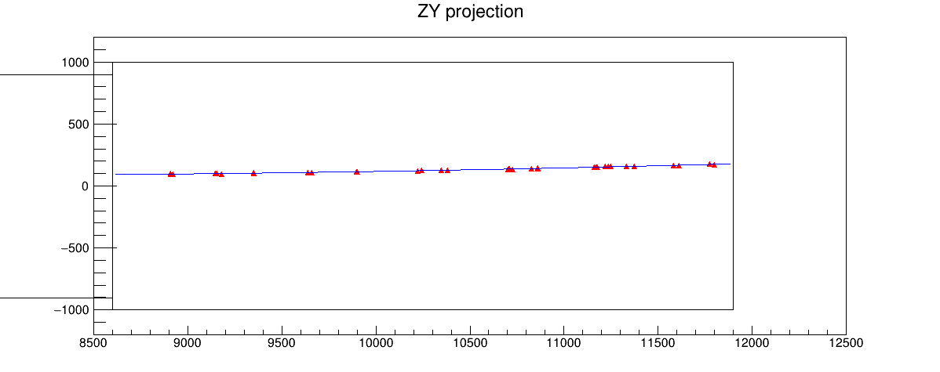
Trying to use BabyMIND to reconstruct momentum …
not very successfully 😅
Using the BabyMIND geometry that Matteo Vicenzi has created, I’ve worked
(modified/corrected) with Matteo’s codes to use “CircleFit” to find momentum in the
BabyMIND volume, in the y-z plane.
E.g. 10 GeV muon in FLArE:
FLArE
BabyMIND
Distances in mm

Slide 2
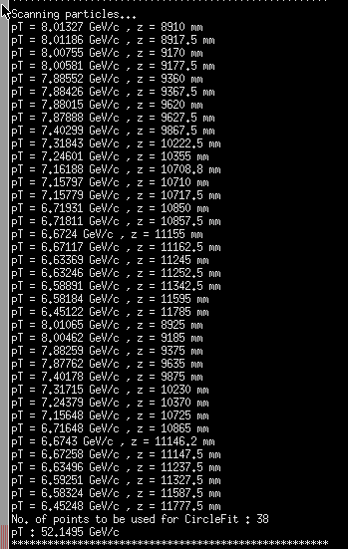
Though the fit seems good, pT ~ 0.3 * B * (r_{c}/1000) gives quite different pT.
It got 52 GeV/c in this case.
Muons tend to lose a couple GeV when
they reach BabyMIND.
The fit assumes a uniform field of
1.5 T is ~inaccurate.

