Slide 1

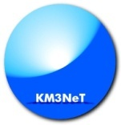


Neutrino telescopes in the Mediterranean Sea: status and perspectives
Annarita Margiotta
INFN & University of Bologna
on behalf of the ANTARES and of the KM3NeT Collaborations
annarita.margiotta@unibo.it

Slide 2
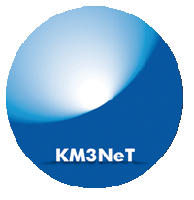
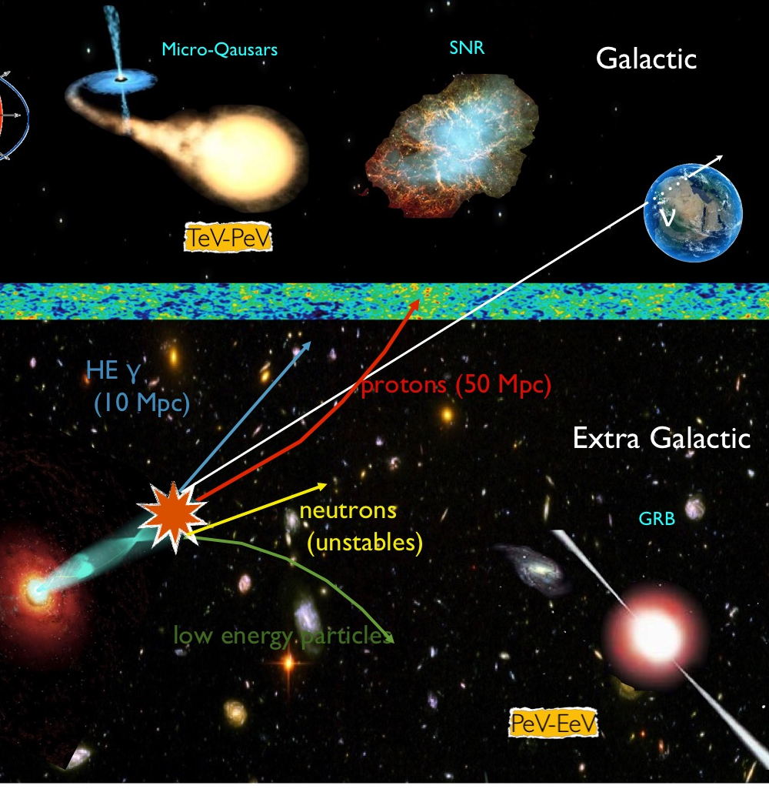
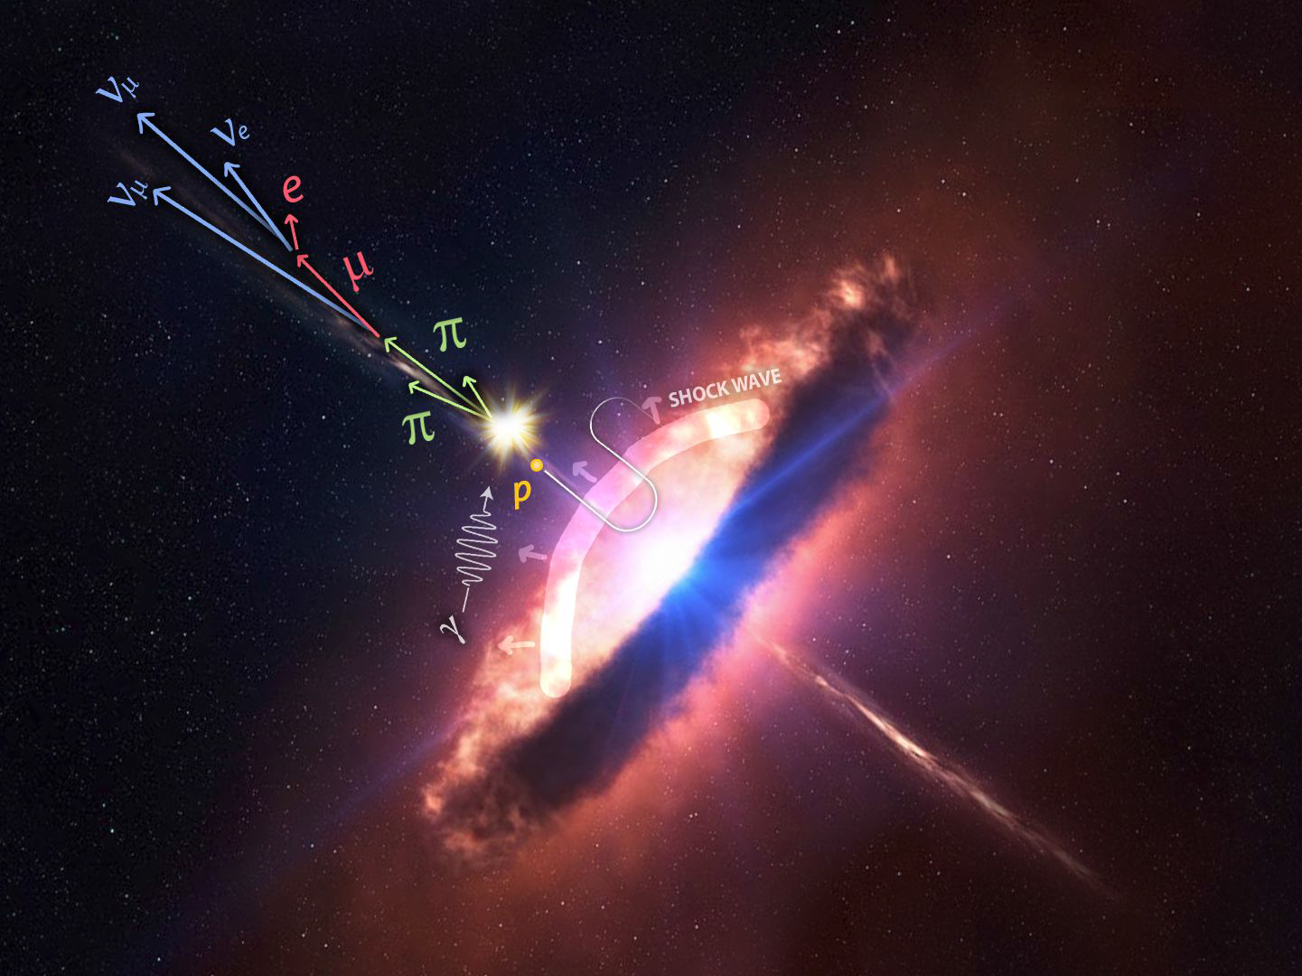
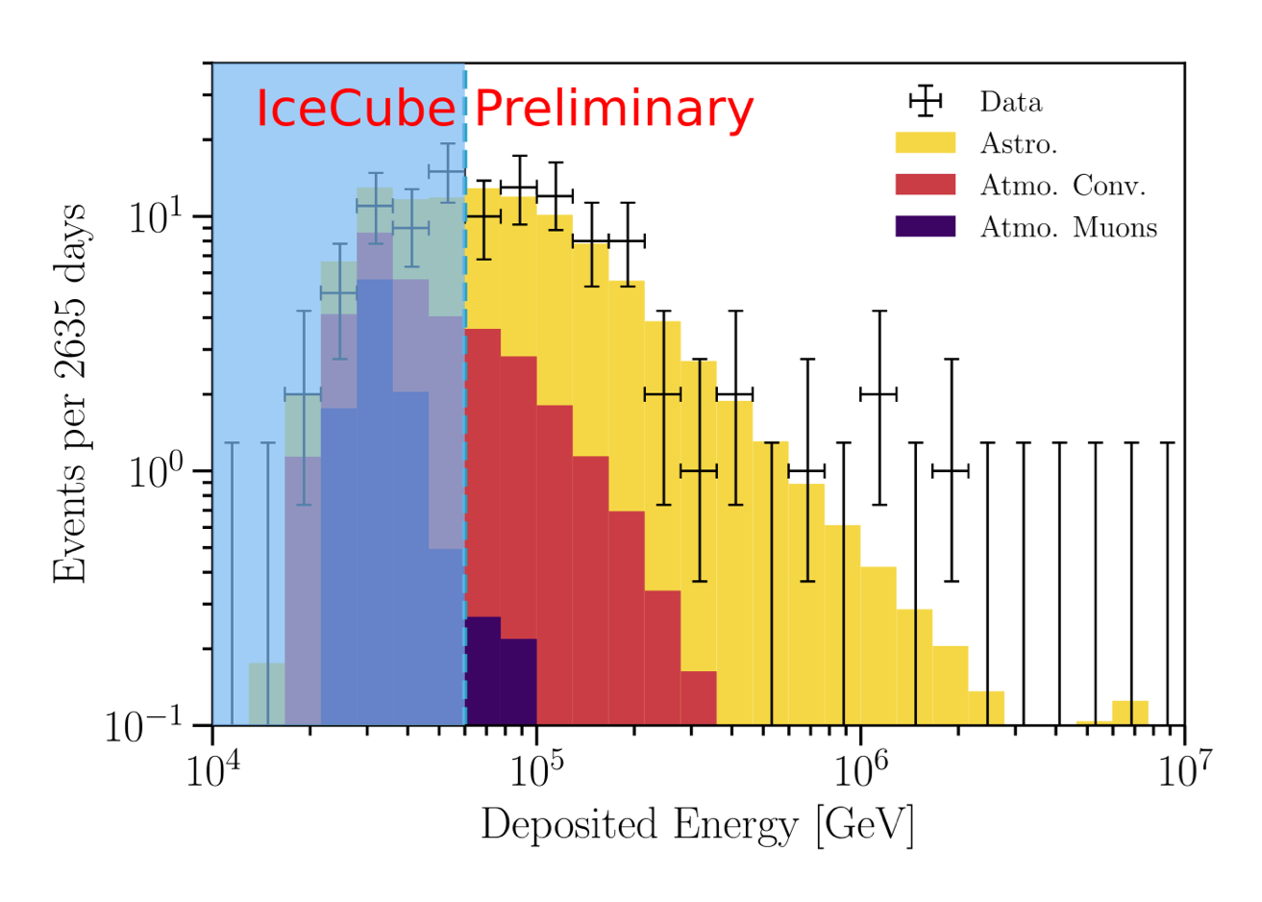
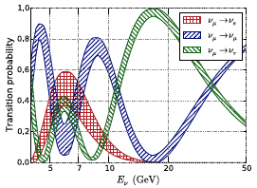
Motivations & Objectives
COSMIC NEUTRINOS
Sources of cosmic ν
Production and acceleration of ultra high-energy cosmic rays
High Energy
E_{ν} > 1 TeV
ASTROPHYSICS
Perfect prob es : undeflected and
unabsorbed
Multimessenger approach
Dark matter
Monopoles, Nuclearites
Medium Energy
10 GeV < E_{ν} < 1 TeV
IceCube diffuse flux
D. Williams – ICRC 2019
ATMOSPHERIC NEUTRINOS
Supernovae
ν oscillations
sterile neutrinos
mass hierarchy
tau appearance
mass hierarchy
Non-standard interactions
Low Energy
MeV < E_{ν} < 100 GeV
PARTICLE PHYSICS

Slide 3
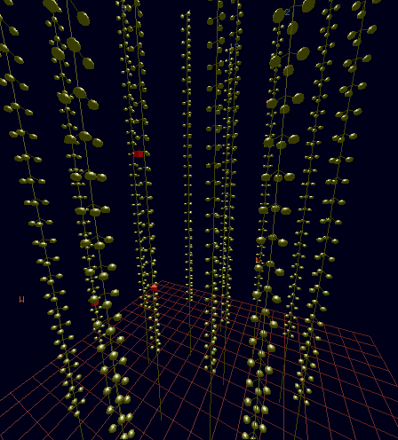
The concept of Cherenkov neutrino telescopes
Photomultipliers (PMTs) collecting Cherenkov photons due to relativistic charged particles from ν interactions
Parent ν direction reconstructed using time & position
Moisej Markov
Bruno Pontecorvo
Moisej Markov
Bruno Pontecorvo
1960, Rochester Conference
ν_{μ}

Slide 4
Events in a neutrino telescope
CC ν_{e}+ all flavours NC
BACKGROUND !!
CC ν_{μ}
track like events
good pointing
shower like events –
good energy reconstruction
CC ν_{τ}
“double bang”
atmospheric muon
neutrino or
charged lepton
μ±
μ±
τ
⁽⁻⁻⁾
^{ν}_{x}
⁽⁻⁻⁾
^{νμ}

Slide 5
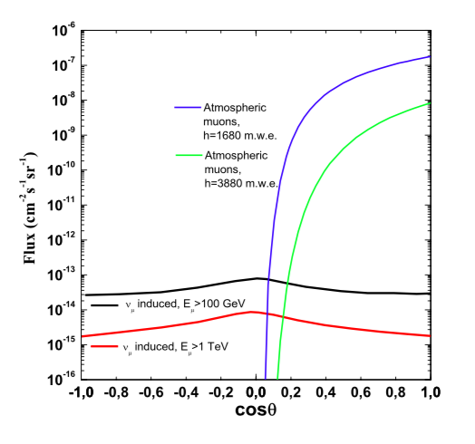
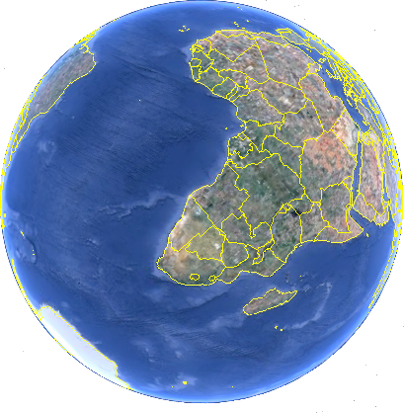

Background
cosmic
rays
atmosphere
p
Atmospheric muons
direction cut → upward going events
useful for detector calibration
Atmospheric neutrinos
irreducible background
neutrino oscillations → mass hierarchy
μ
Atmospheric µ
@1680 m.w.e.
νμ
cosmic
ν
μ
Atmospheric µ
@ 3880 m.w.e.
νμ
cosmic
rays
ν_{μ} induced, Ε_{μ} >100 GeV
ν_{μ} induced, Ε_{μ} >1 TeV
Environmental background
⁴⁰K decay rejection :
bioluminescence causal correlation
of the signals
γ
γ
e⁻ (β decay)
⁴⁰K
⁴⁰Ca

Slide 6
Why the Mediterranean Sea
Optical properties of water ➔ Mapping the Southern sky with unprecedented angular resolution
  tracks: < 0.1 ° (KM3NeT) - 0.4° (ANTARES) @ 10TeV
  (IceCube : 0.3° @ >100 TeV)
  showers: few degrees 2° (KM3NeT )- 4° (ANTARES) @10 TeV
  (IceCube: 10° @ > 100 TeV)
Visibility of the Galactic region ➔ ~ 70 % for the Galactic Centre
Investigation of the IceCube diffuse flux from another point of view
SOUTH POLE
MEDITERRANEAN SEA
KM3NeT - M.Taiuti - Ghent
Visibility for up-going neutrinos

Slide 7
The detectors

Slide 8
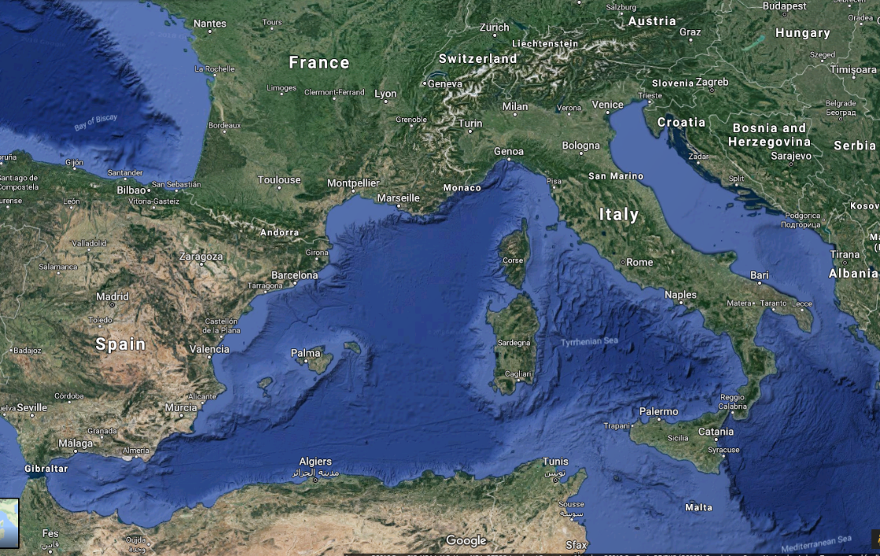
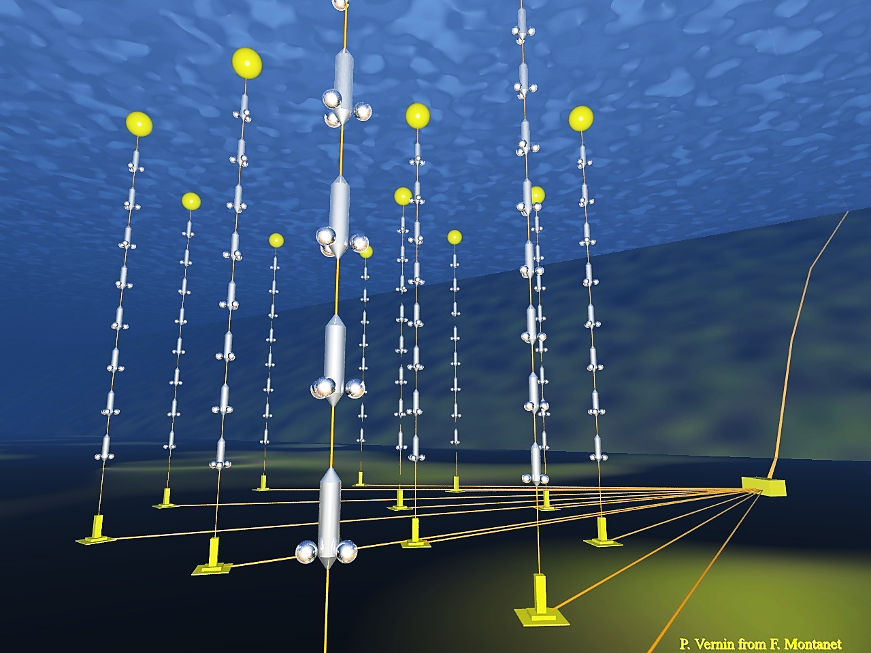
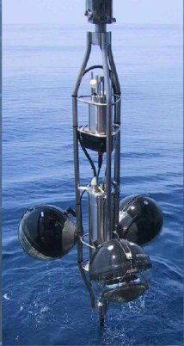
The ANTARES neutrino telescope
ANTARES
In operation since 2007
885 10” PMTs
12 lines
25 storeys/line
3 PMTs / storey
all-data-to-shore
Volume 0.01 km³
depth ~ 2500 m
10” PMT
450 m
Detector completed in 2008
Taking data since 11 years duty cycle ∼95%
40 km to
shore
JunctionBox
70 m
Interlink cables

Slide 9
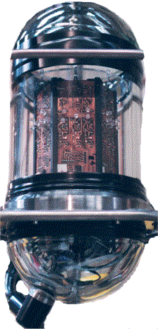
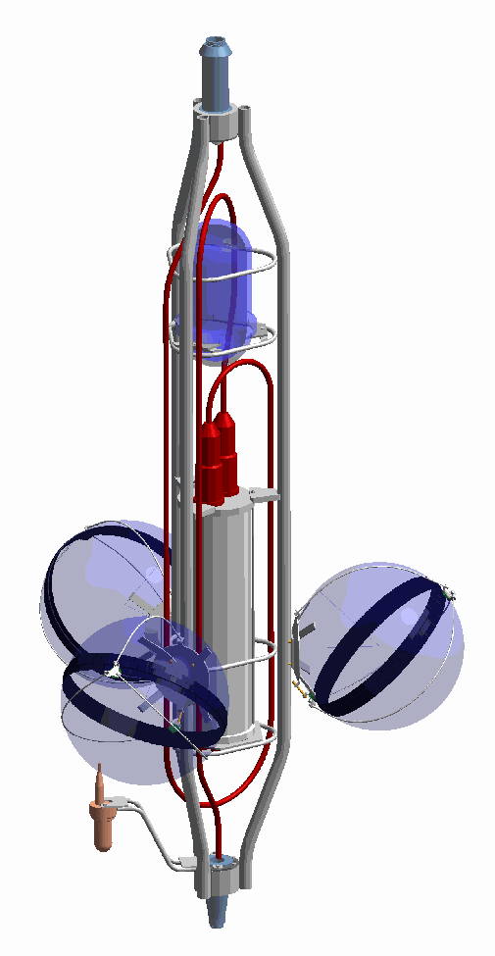
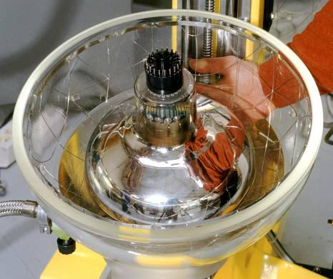
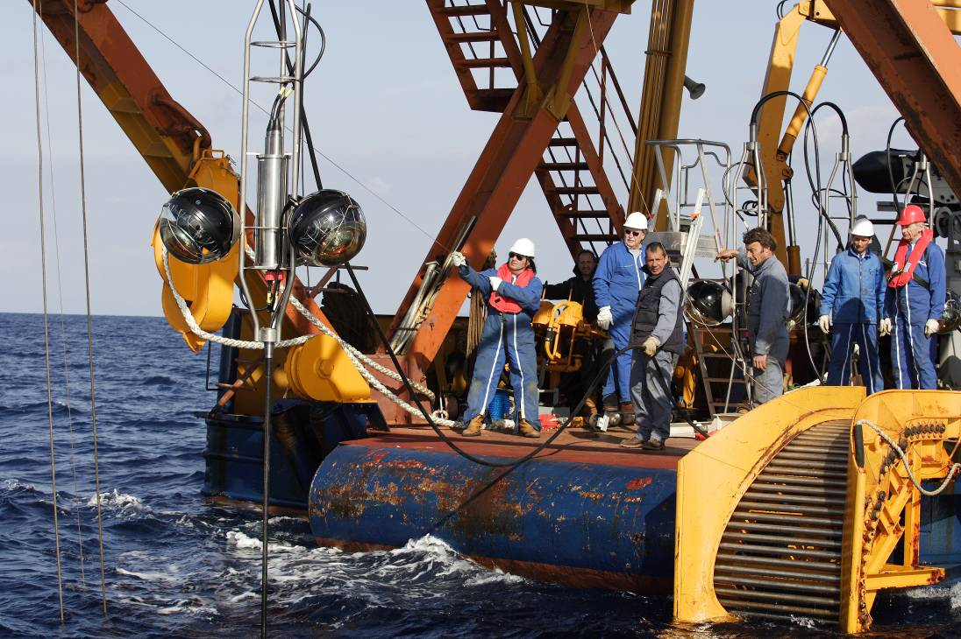
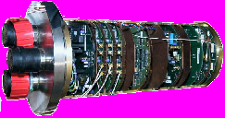
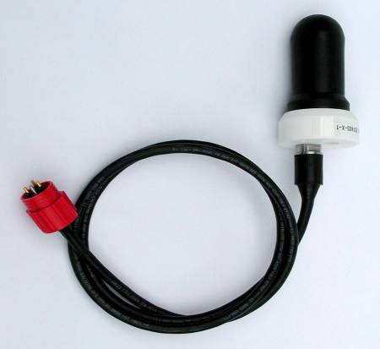
The storey
titanium frame: support structure (2m)
Optical Beacon
with blue LEDs:
timing calibration
Optical Module:
10” Hamamatsu PMT
in 17” glass sphere
(σ_{TTS} ≈1.3 ns)
photon detection
acoustic positioning
Local Control Module
(in Ti cylinder):
Front-end ASIC, DAQ/SC, DWDM,
Clock, tilt/compass, power distribution…

Slide 10

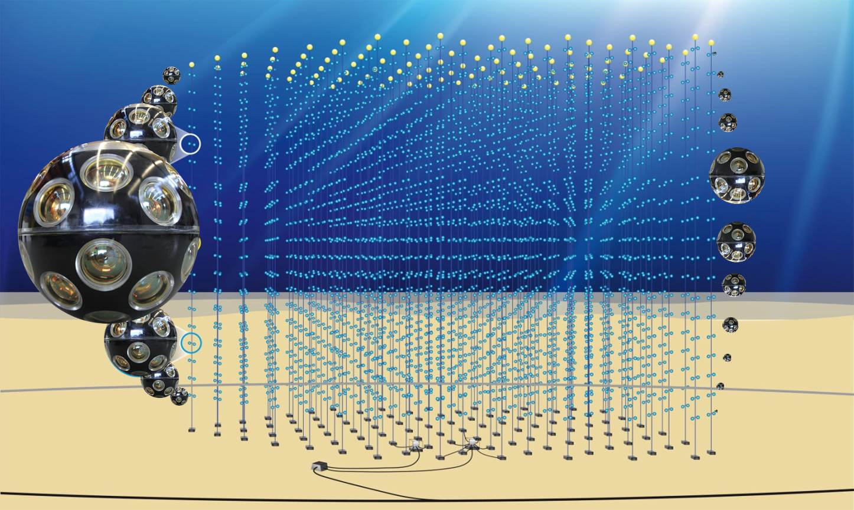
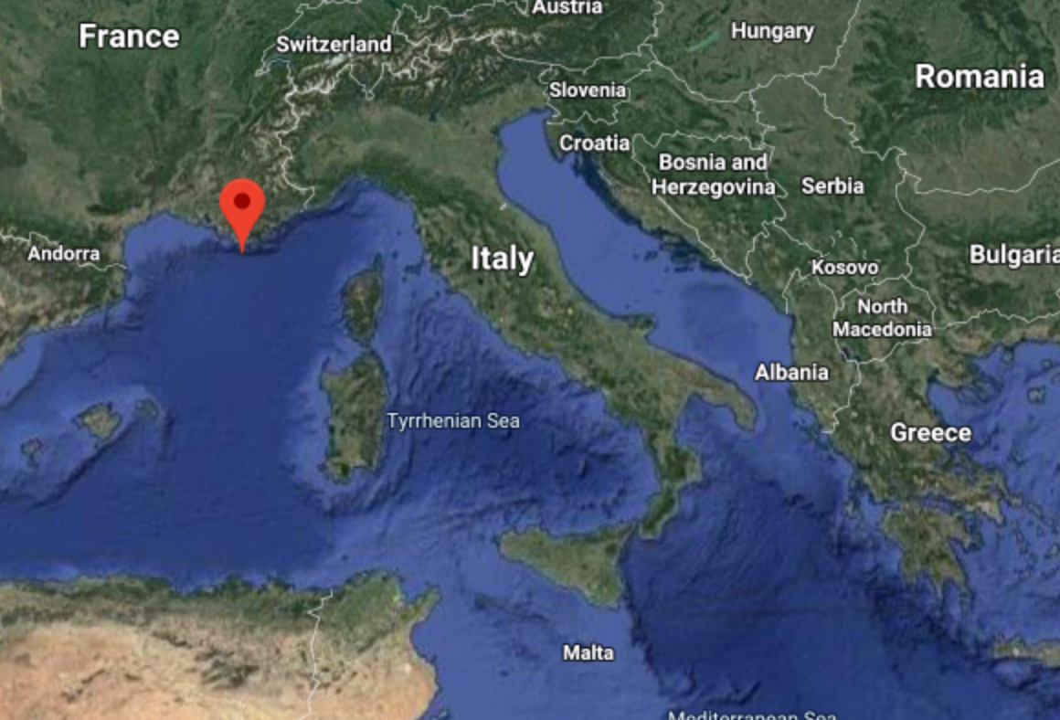

The KM3NeT detectors
KM3NeT/ARCA (Astroparticle Research with Cosmics in the Abyss)
• discovery and observation of high energy neutrino sources of cosmic origin (E_{ν} ~ GeV-PeV)
Depth – 3500 m
KM3NeT/ORCA (Oscillation Research with Cosmics in the Abyss)
• determination of the neutrino mass hierarchy (E_{ν} ~ MeV - GeV)
Depth – 2500 m
KM3NeT 2.0 Letter of Intent:
J.Phys. G43 (2016) 084001
Optical sensor (DOM)
31 PMTs of 3 inches
ORCA
ARCA
Detection Unit (DU)

Slide 11
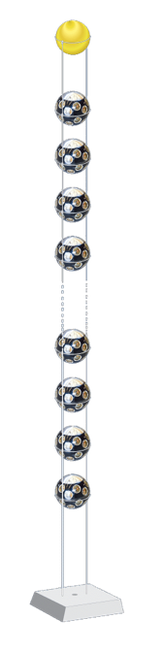
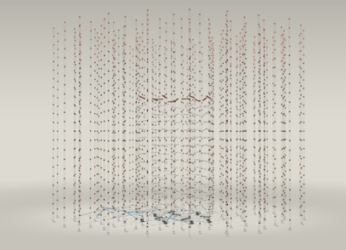
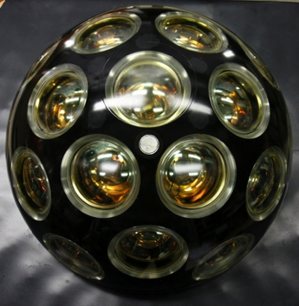
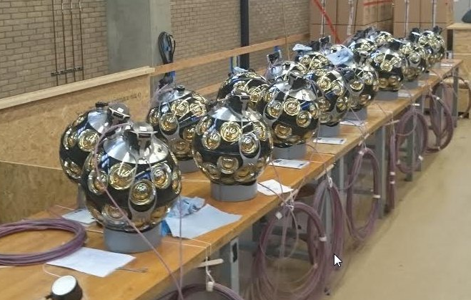
The KM3NeT detectors - Design
The optical sensor:
the Digital Optical Module (DOM)
31 PMTs x 3” PMTs
The Detection Unit (DU)
  String:
  1 Buoy
  2 Dyneema ropes
  18 DOMs
  1 Anchor
  Electro-optical backbone:
  Flexible hose 7mm
  Oil-filled
  18 fibres
  2 copper wires
a 3D array of optical sensors
Seafloor Network
~ 40 cm
Improved background rejection
Compact and cost effective design: photocathode area ≃ 3 x 10” PMTs
1 Building Block (BB) = 115 DUs
ARCA= 2 BB = 230 DUs
ORCA= 1 BB

Slide 12
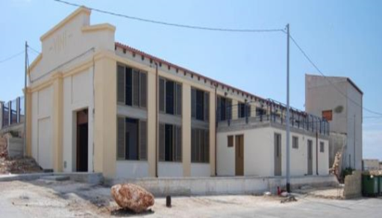
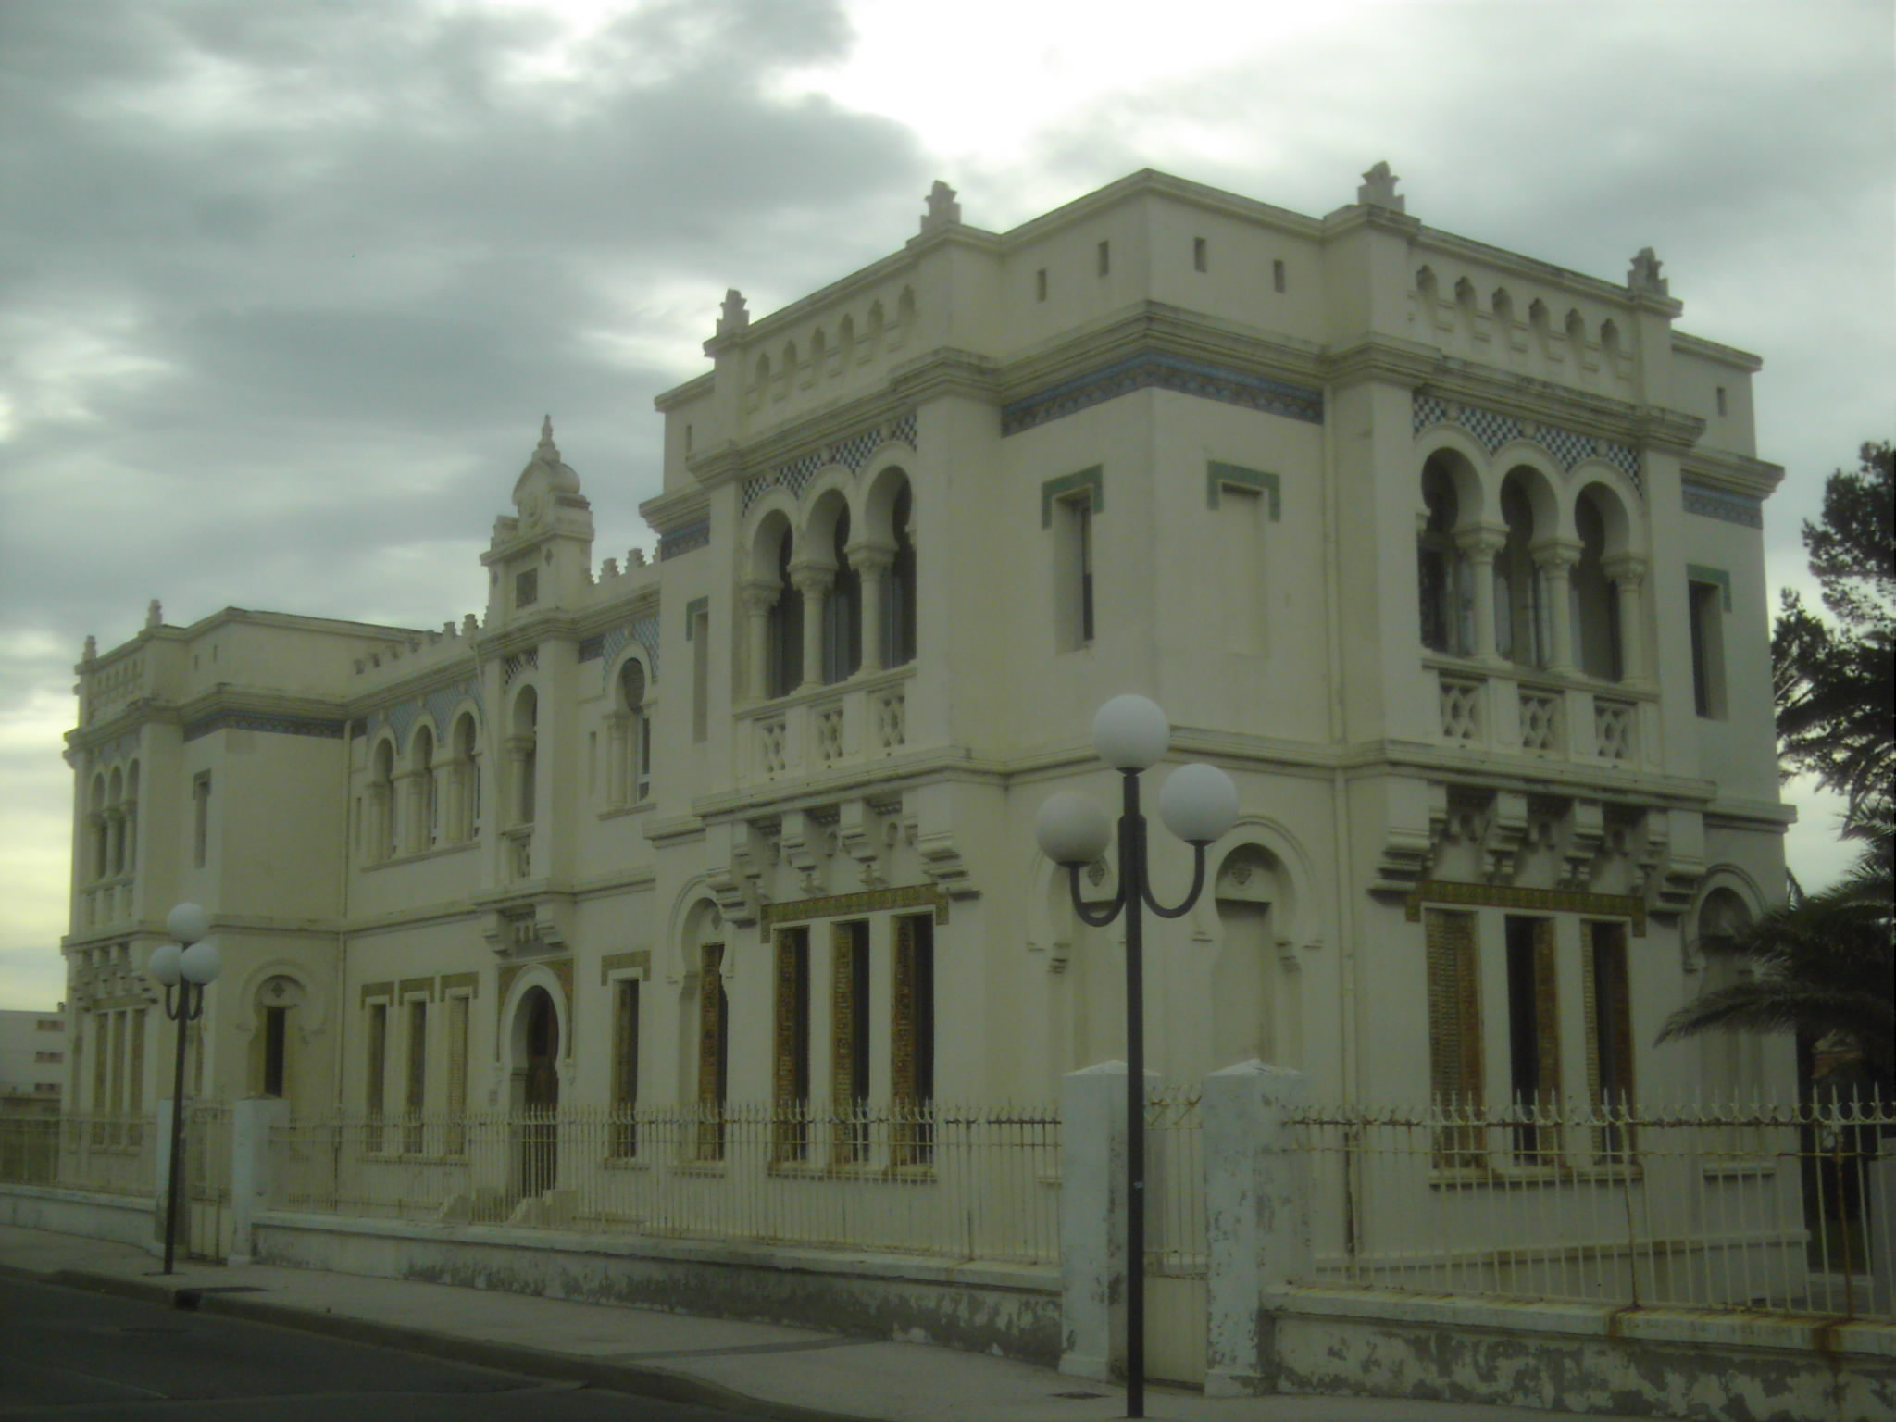
The KM3NeT detectors - Design
The same technology and design – different density of active sensors
Modular design
Power and data distributed by a single backbone cable
with breakouts at DOMs
Sea network of submarine cables and Junction Boxes
connected to shore via a main e/o cable
All-data-to-shore ➔ no trigger off-shore
 | ARCA | ORCA
Location | Italy | France
DU distance | 90 m | 23 m
DOM spacing | 36 m | 9 m
Instrumented mass | 2*500 Mton | 8 Mton
Depth | 3500 m | 2500 m
ARCA shore station @ Portopalo di Capo Passero
ORCA shore station @ La Seyne-sur-mer
12

Slide 13
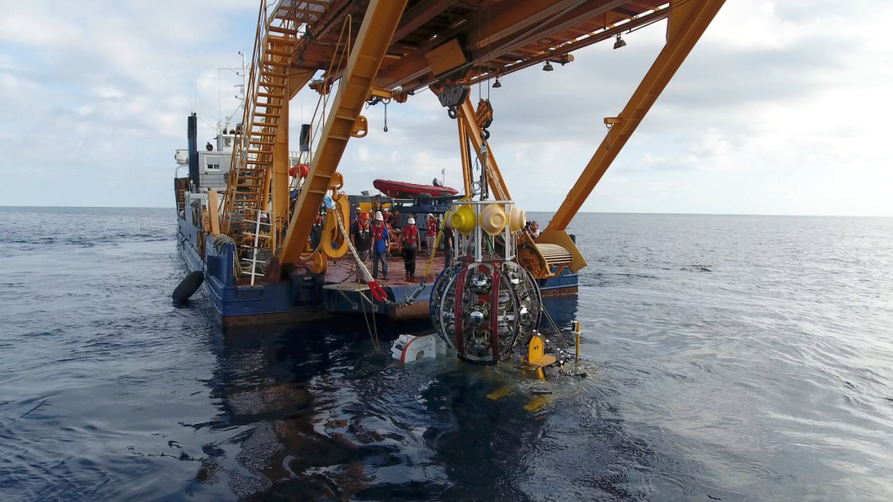
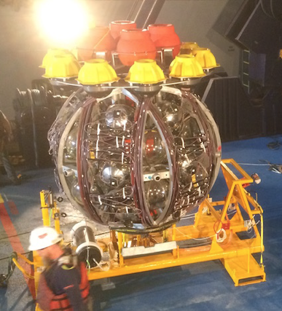
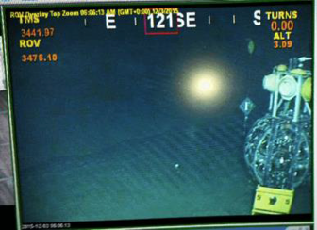
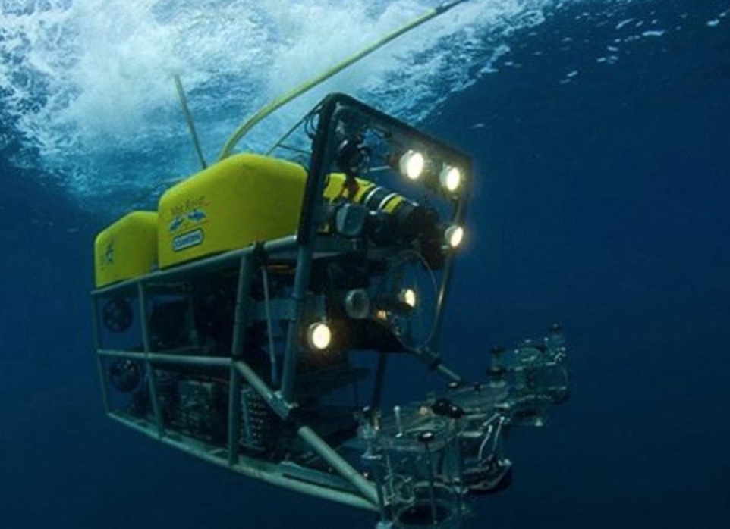
The Detection Unit Deployment
The Launcher of Optical Modules (LoM)
2 m diameter
efficient deployment
several strings per sea operation
at the sea bottom
connection to the JB
with ROV
autonomous unfurling

Slide 14

Physics
Recent results presented at the 36th International Cosmic Ray Conference,
July 2019, Madison WI, USA
https://pos.sissa.it/358/
Summary here:
PoS(ICRC2019)006

Slide 15
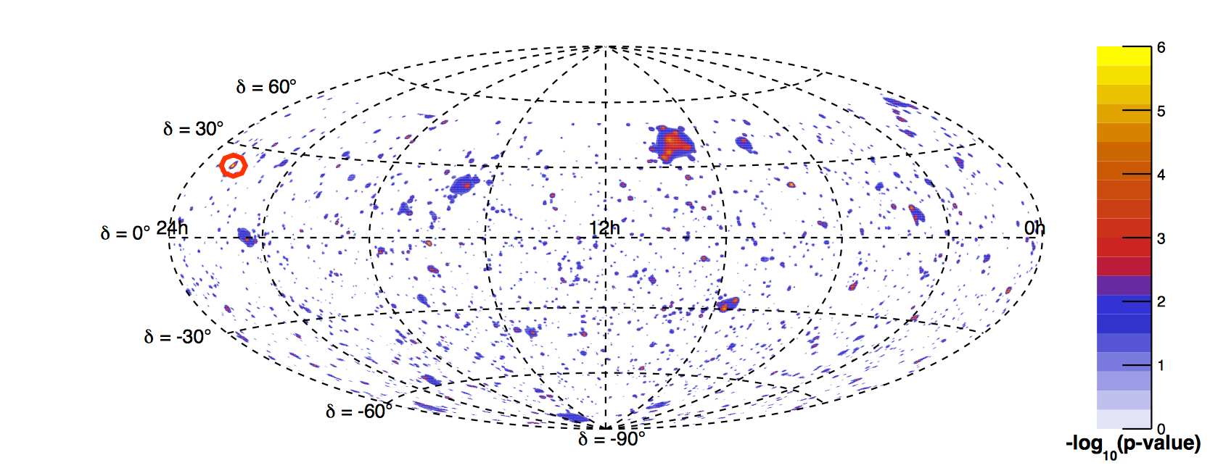
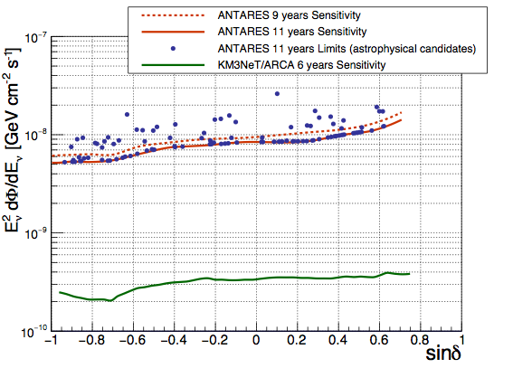
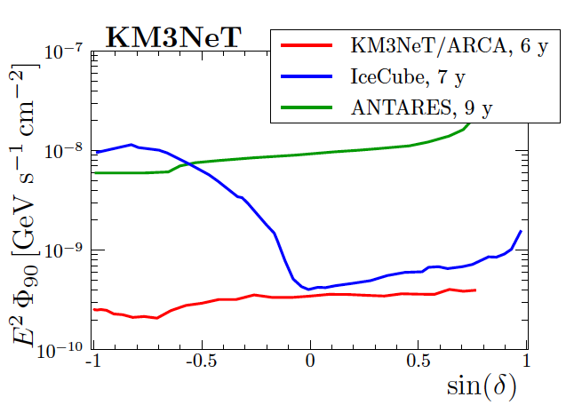
Pointlike sources: search for an excess of events over the expected background
ANTARES 11 years (3136 days of livetime)
track and cascade analysis
G. Illuminati S. Navas - PoS920 ICRC2019
1°x 1° bins
Full sky search
the most significant cluster:
α=343.7° δ=+23.6°
post trial 0.23 (1.2 σ) 3 track events within 1° ;
15 tracks + 1 shower within 5°
Search over a list of astrophysical objects
upper limits and sensitivities
E⁻² spectrum
ANTARES 11 year
KM3NeT/ARCA
sensitivity after 6 years

Slide 16
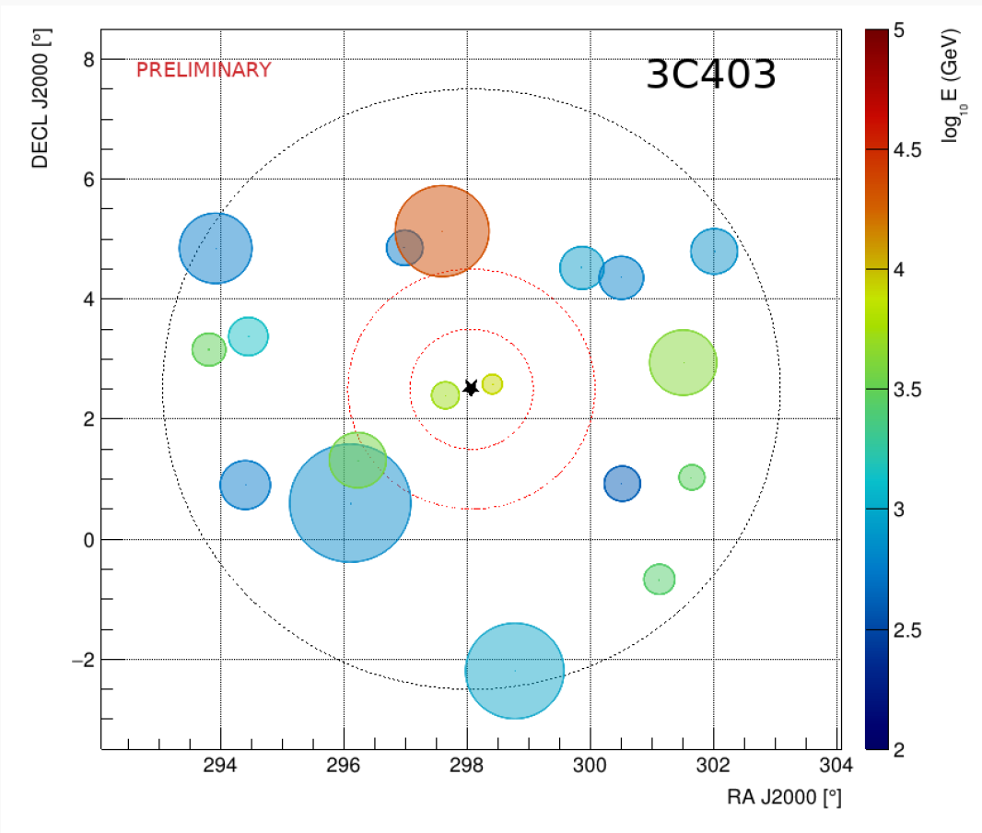
Point like sources – stacking analysis
CATALOG | PRE-TRIAL | POSTTRIAL | DOMINANT SOURCE
Fermi 3LAC All Blazars | 0.19 | 0.83
Fermi 3LAC FSQR | 0.57 | 0.97
Fermi 3LAC BL Lacs | 0.088 | 0.64 | MG3J225517+2409
Radio-galaxies | 4.8 10⁻³ | 0.10 | 3C403
Star Forming Galaxies | 0.37 | 0.93
Obscured AGN | 0.73 | 0.98
IceCube HE tracks | 0.05 | 0.49
1.6 σ
11 years of track events
5°
Radio Galaxies are the most significant category of sources
Two individual sources look particularly interesting:
1°
2°
Radio Galaxy 3C403
Blazar MG3J225517+2409 → same location found in the full sky

Slide 17
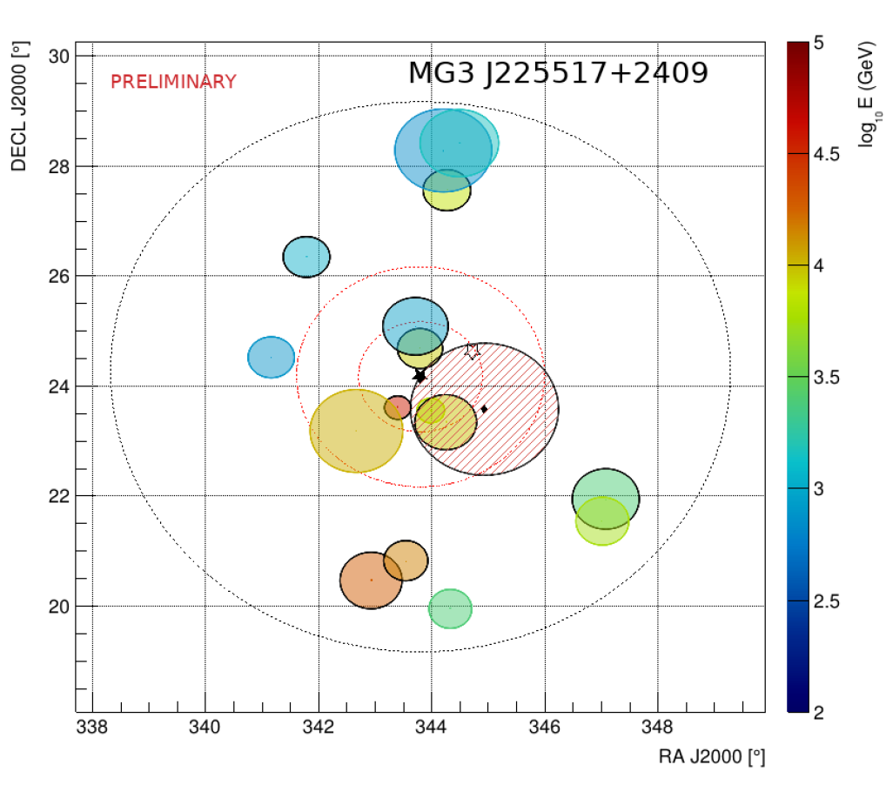
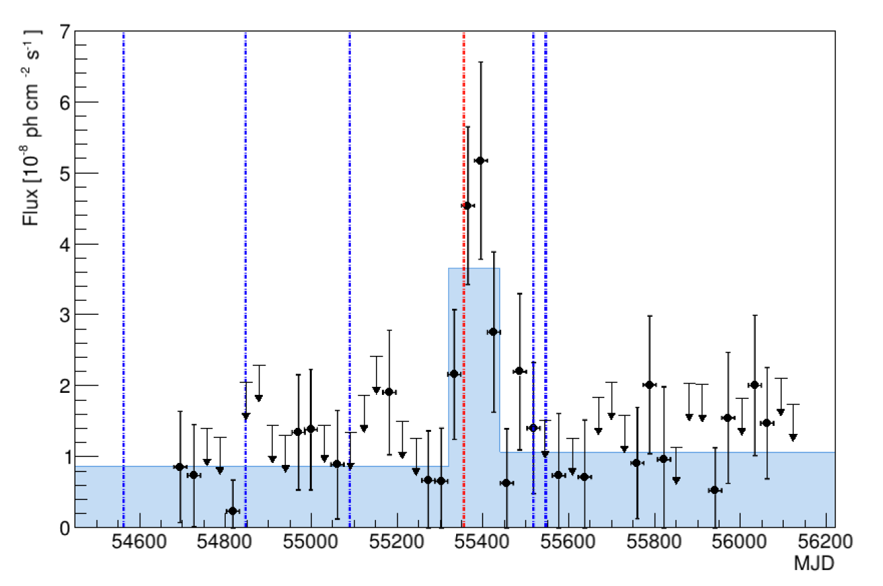
Point like sources – stacking analysis
Blazar MG3J225517+2409
α=343.78° δ=+24.19°
same location found in the full-sky search
EHE IC#3 event
ANTARES
events
July 2010
5°
2°
1°
pre-trial value 3.8 σ
5 ANTARES tracks within 1°
Time analysis & combining the IceCube - ANTARES events
1 EHE IC event during a source flare

Slide 18
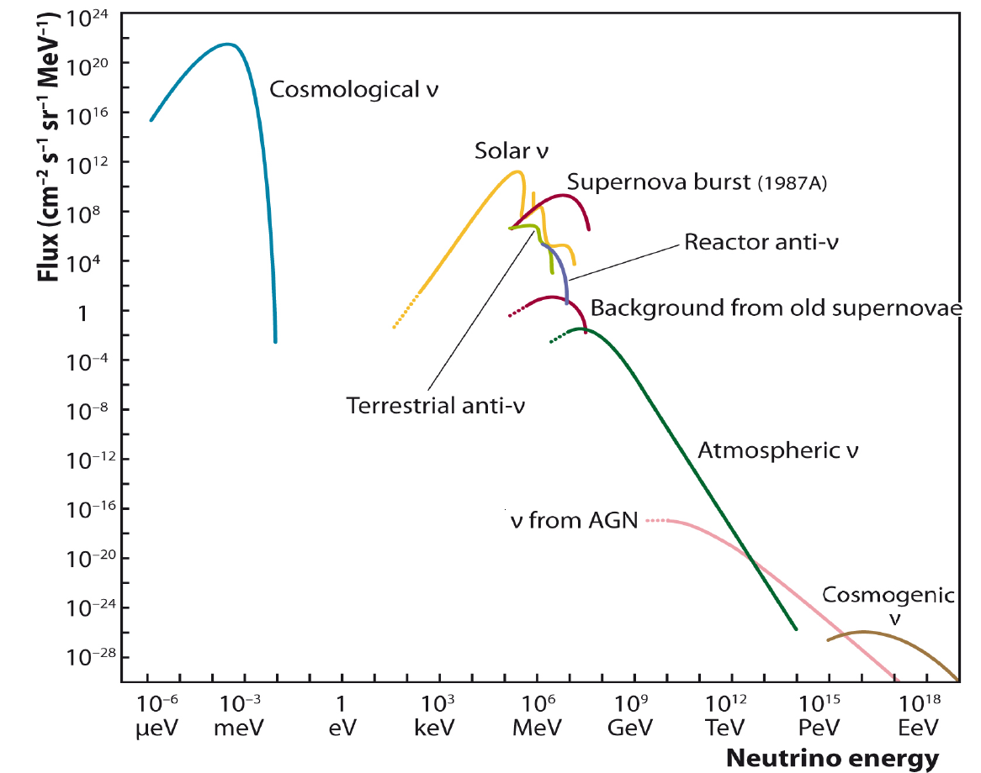
Diffuse fluxes of neutrinos
Kaons and pions in CR showers
E² Φ_{ν}
ν_{μ}
Charmed mesons in CR showers
ν_{e}
conventional
ν_{e}
ν_{μ}
prompt
E_{ν}

Slide 19
Diffuse fluxes of neutrinos
E²Φ_{ν}
Extragalactic?
Local?
Which Sources?
…?
ν_{μ}
ν_{e}
ν_{e} :
ν_{μ}:
ν_{τ}
1 : 1 : 1 (?)
E_{ν}
Atmos-to-Cosmic transition
30-200 TeV

Slide 20
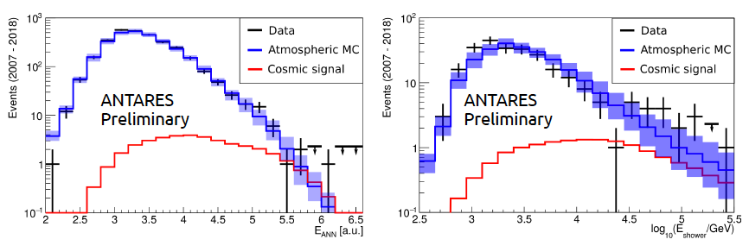
Diffuse flux - ANTARES
Data sample: 2007 – 2018
Livetime: 3380 days
All-flavour events (track+showers)
Event selection chain + energy-related cut
a high-purity neutrino sample
maximise sensitivity
50 events found when 36.1 ±8.7 expected as background
Tracks
1.8σ excess over the (Honda + Enberg) atmospheric flux
increased with increased stat.(ApJL 853 (2018) L7 )
ɸ = 1.5±1 10⁻⁸ GeV ⁻¹cm⁻² sr⁻¹ s⁻¹
Γ=2.3±0.4
Null-cosmic excluded at 90% c.l.
PoS(ICRC2019)891
Showers

Slide 21
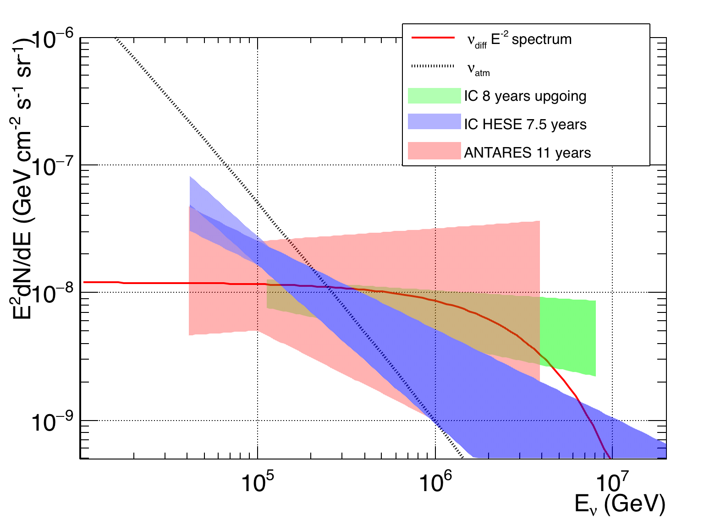
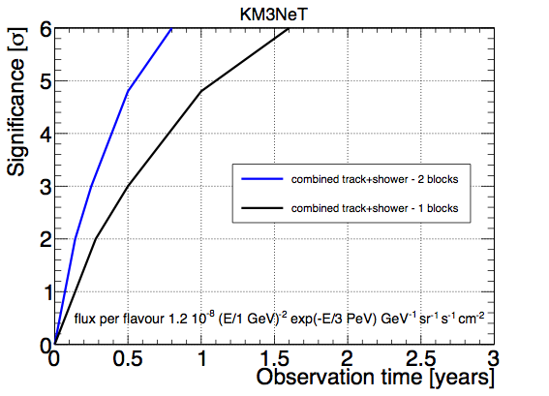
Diffuse flux – KM3NeT
preliminary
one flavour
ANTARES 11 years spectrum
5σ in ∼ 0.5 year for the full detector (230 DUs)
5σ ∼ 1 year for one block detector (115 DUs)

Slide 22
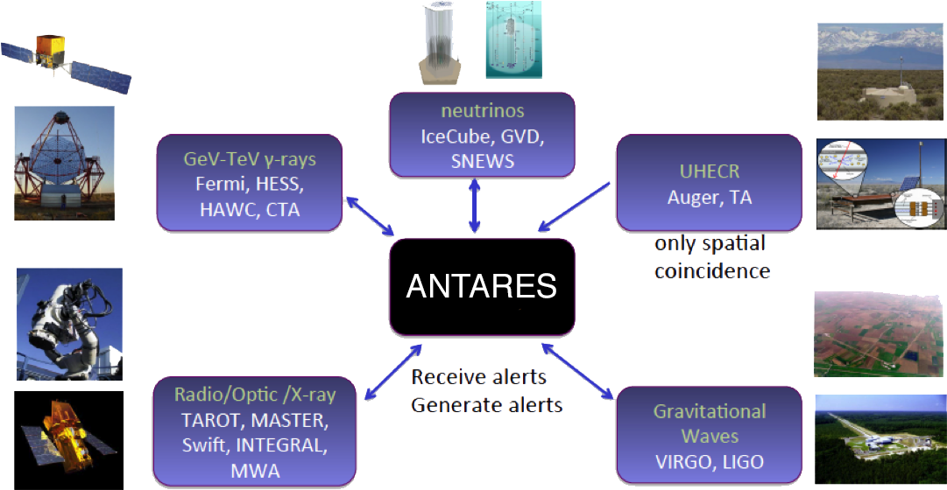
Multimessenger with ANTARES
APP35 (2012)530
JCAP02(2016)062
PoS(ICRC2019)871 PoS(ICRC2019)872
Gamma-ray Coordinates Network (GCN) https://gcn.gsfc.nasa.gov/

Slide 23
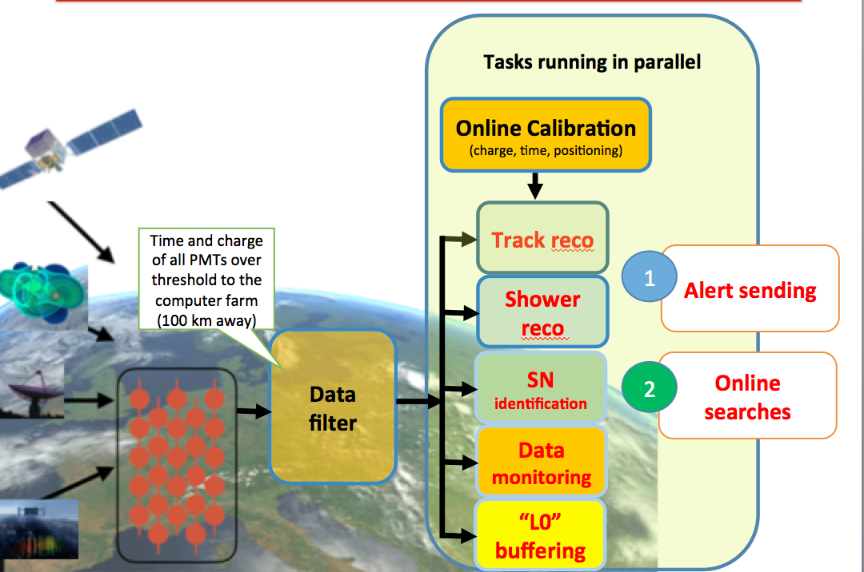
Multimessenger with KM3NeT
on-line track reconstruction and trigger for Core Collapse Supernov already available
Open Public Alert Program is being implemented for both ORCA and ARCA detectors

Slide 24
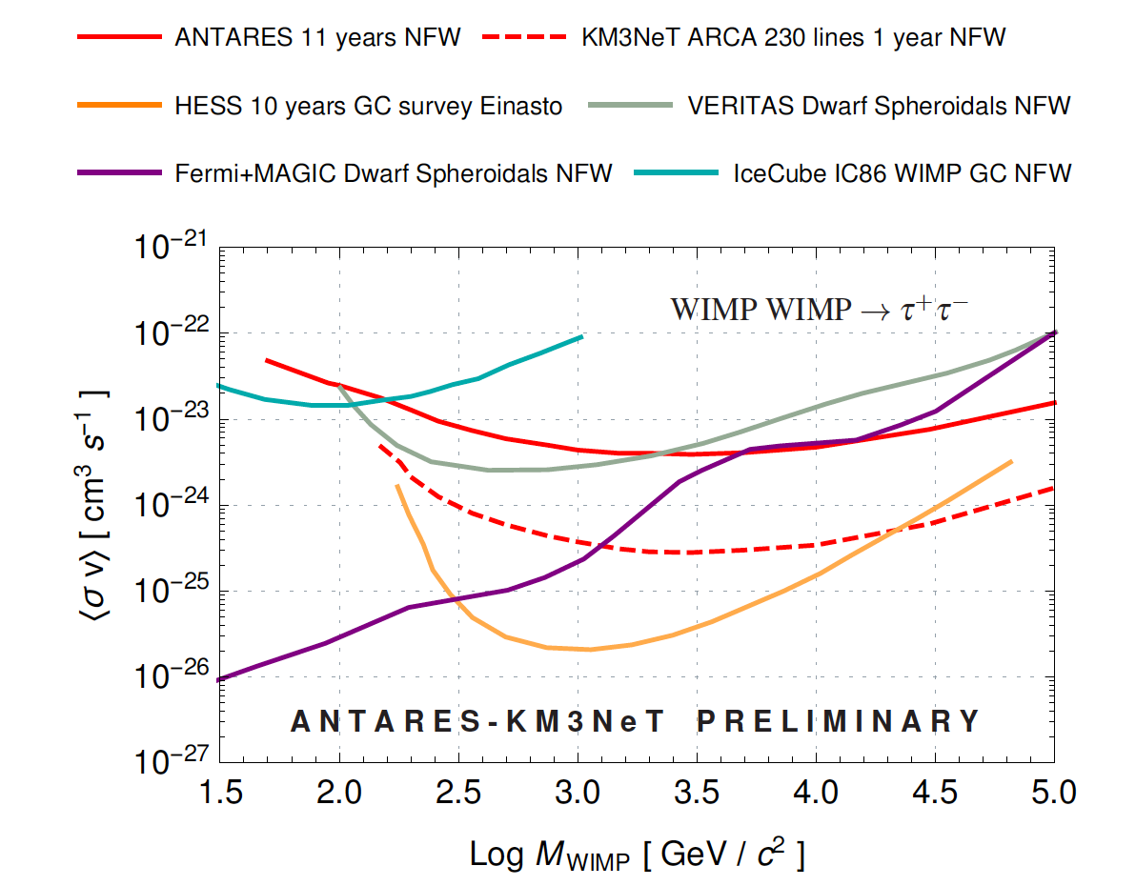
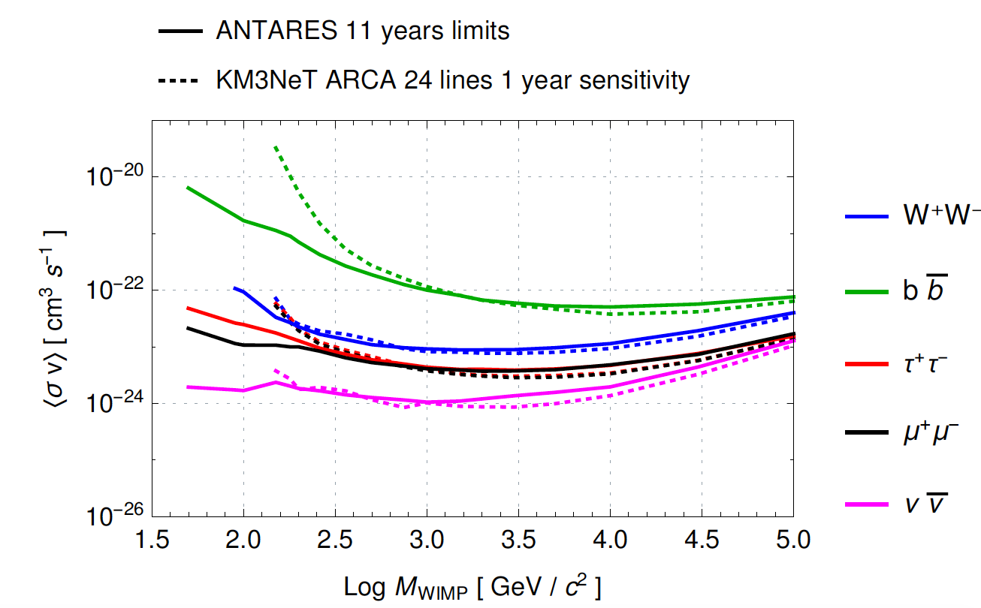
Dark Matter
(Sun) Phys. Lett. B 759 (2016) 69-74
(GC) Phys. Lett. B 769 (2017) 249 (erratum PLB796(2019)253
(Earth) Physics of the Dark Universe 16 (2017) 41
Dark Matter from the Galactic Center
WIMPs accumulate in massive celestial objects (Sun, Galactic Centre, …)
Neutrinos could be produced in WIMP-WIMP annihilation
Clean signal and low expected background
Ingredients used in the analysis:
Signal energy spectra for each considered WIMP mass and annihilation channel:
𝑊𝐼𝑀𝑃 +𝑊𝐼𝑀𝑃 → 𝑏𝑏s,𝑊⁺𝑊⁻,𝜏⁺ 𝜏⁻,𝜇⁺ 𝜇⁻,𝜈𝜈̅
Spatial distribution of dark matter in the source:
  Point-like (Sun)
  NFW, Burkert, McMillan halos (GC)
No excess above background observed;
Upper limits derived, as a function of the WIMP mass and annihilation channel on
  spin-(in)dependent WIMP-nucleon scattering cross-section (Sun)
  thermally averaged annihilation cross-section (Galactic center)
NFW halo model
PoS(ICRC2019)536 PoS(ICRC2019)552

Slide 25
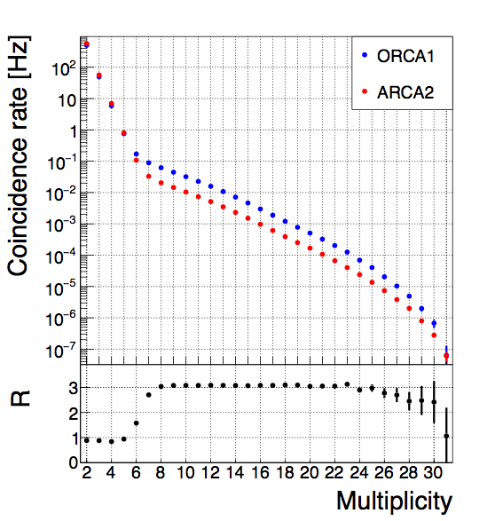
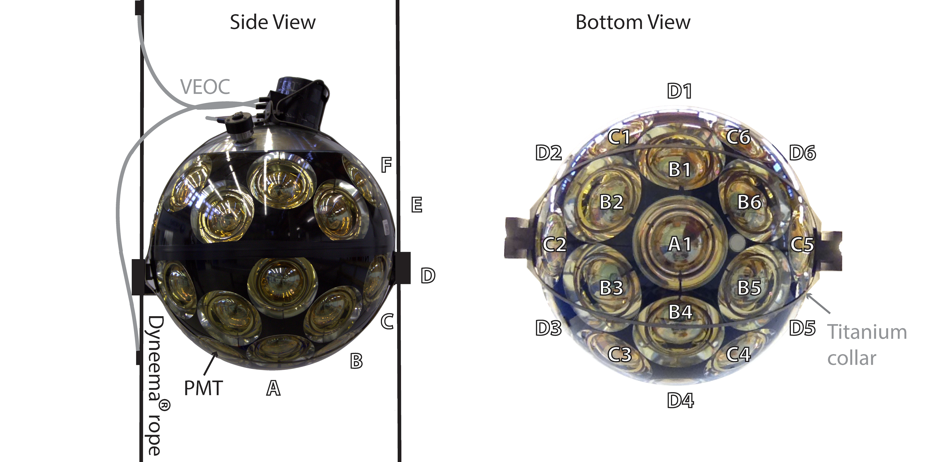
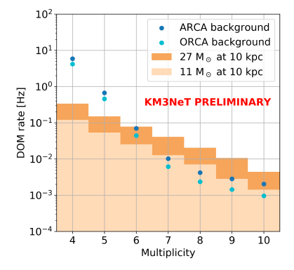
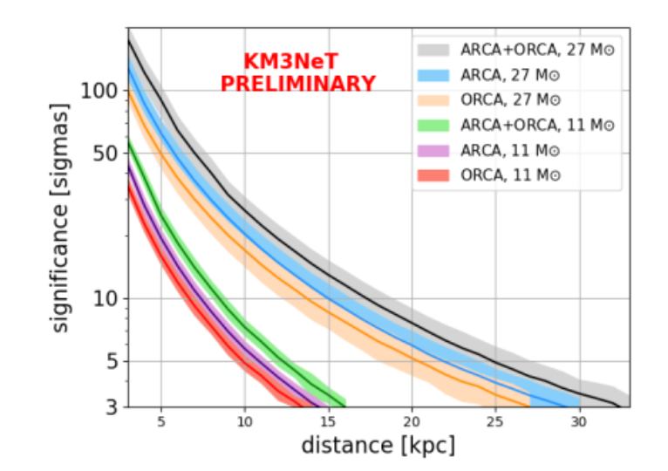
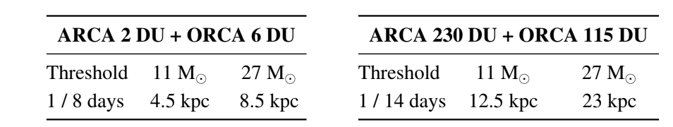
Core Collapse SuperNovae (CCSN)
Increase of the DOM rates due to many MeV neutrinos from the collapse
Atmospheric muons
K40
PoS(ICRC2019)857
Each single DOM can act as a detector
DATA
Muon rejection applied
Number of PMT in coincidence
>5σ for ARCA+ORCA for 27M☉at a distance <25kpc
PoS(ICRC2019)857

Slide 26
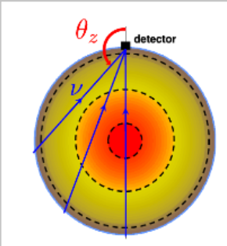

Neutrino oscillation studies with KM3NeT/ORCA
track-cascade discrimination with
Random Decision Forest
Baseline from 50 to 12800 km
Energy resolution ∼25% @ 10GeV
Zenith angular resolution ∼ 5° @ 10GeV
Good track-cascade discrimination
(flavour determination)
Search for deviations from the predictions for standard 3-flavour ν oscillations:
Neutrino Mass Ordering (NMO)
Sterile Neutrinos
Non Standard Interactions (NSI)
PoS(ICRC2019)931
PoS(ICRC2019)1019

Slide 27



Neutrino oscillation studies with KM3NeT/ORCA
Systematics
Neutrino oscillation parameters
Atmospheric neutrino flux parameters
≳ 3σ in 3 years
> 4σ in 3 years for NO and large θ23

Slide 28



Sensitivity to sterile neutrinos
ANTARES
KM3NeT/ORCA
distortion in the ν oscillation pattern
Honda model (2014 @ Gran Sasso site)
PREM for the Earth interior
J. High Energ. Phys. 06 (2019) 113
ORCA: competitive
sensitivity to constrain
low sterile masses
KM3NeT/ORCA - 3 years
PoS(ICRC2019)870

Slide 29



KM3NeT status
DUs in data taking
TODAY
4 DUs
@ORCA site
July 18th
cos(θ)=-0.95
1 DU
@ARCA site

Slide 30


KM3NeT detectors – first results
Up-going atmospheric neutrino selection
ARCA2 = 2 DUs @ ARCA SITE
Dec 23rd 2016 - Mar 2nd 2017
ORCA1 = 1 DU @ ORCA SITE
Sep 28th 2017 – Dec 13th 2017
Mar 13th 2019 – May 15th 2019
Eth ∼100 GeV
trigger rate μatm ∼0.2 Hz ; νatm ∼1/day
Eth ∼ few GeV
trigger rate μatm ∼2 Hz ; νatm ∼10/day
DATA: ∼6 neutrinos cos(θrec)<-0.8
MC: μatm 0 + νatm 3.3
DATA: ∼77 neutrinos cos(θrec)< 0
MC: μatm 4 + νatm 67.5
PoS(ICRC2019)910
Good Data-MC agreement
Detecting neutrinos with 1-2 DUs

Slide 31


KM3NeT detectors – first results
Data collected with 2 DUs of ARCA (Dec 23rd 2016 - Mar 2nd 2017)
and 1 DU of ORCA (Nov 9th 2017 – Dec 13th 2017)
Paper in preparation
https://arxiv.org/pdf/1906.02704.pdf
Measured rate as proxy of the muon flux
Compared a muon depth dependence model (Bugaev et al, Phys. Rev. D 58 1998 054001)
Atmospheric muons
ORCA
DATA
ARCA
RMS <2%
Multiplicities>8
Number of PMT in coincidence
PMT detection efficiency evaluated with K⁴⁰
(run-by-run)
PoS(ICRC2019)943
Calibration procedure and PMT detection efficiency tested

Slide 32
Conclusions
Mediterranean Sea is an excellent location to look at the Southern sky
Water properties allow for good angular resolution
Technological challenges have been successfully overcome
ANTARES paved the way to Mediterranean neutrino telescopes
Promising results:
  Mild excess of a neutrino diffuse flux (~1.8 σ)
  Interesting region identified (α=343.78° δ=+24.19°) in coincidence with the
  Blazar MG3J225517+2409
KM3NeT Collaboration constantly growing, several extra–Europe Institutes (Australia, Morocco, South Africa, Georgia…)
5 DUs in data taking
Analysis of data :
  Calibration procedure tested
  Reliable MC simulations
  SuperNovae alert system already active

Slide 33

Mediterranean collaborations: ANTARES & KM3NeT
Cities and Sites of ANTARES
Saclay
Clermont

Slide 34
Backup slides

Slide 35

How does a ν telescope work?

