Slide 1




Physics Beyond the Standard Model:
What to Look for?
« Empty » space is unstable
Dark matter
Origin of matter
Masses of neutrinos
Hierarchy problem
Inflation
Quantum gravity
…
^{The} Standard Model
John Ellis
Notes:
1

Slide 2
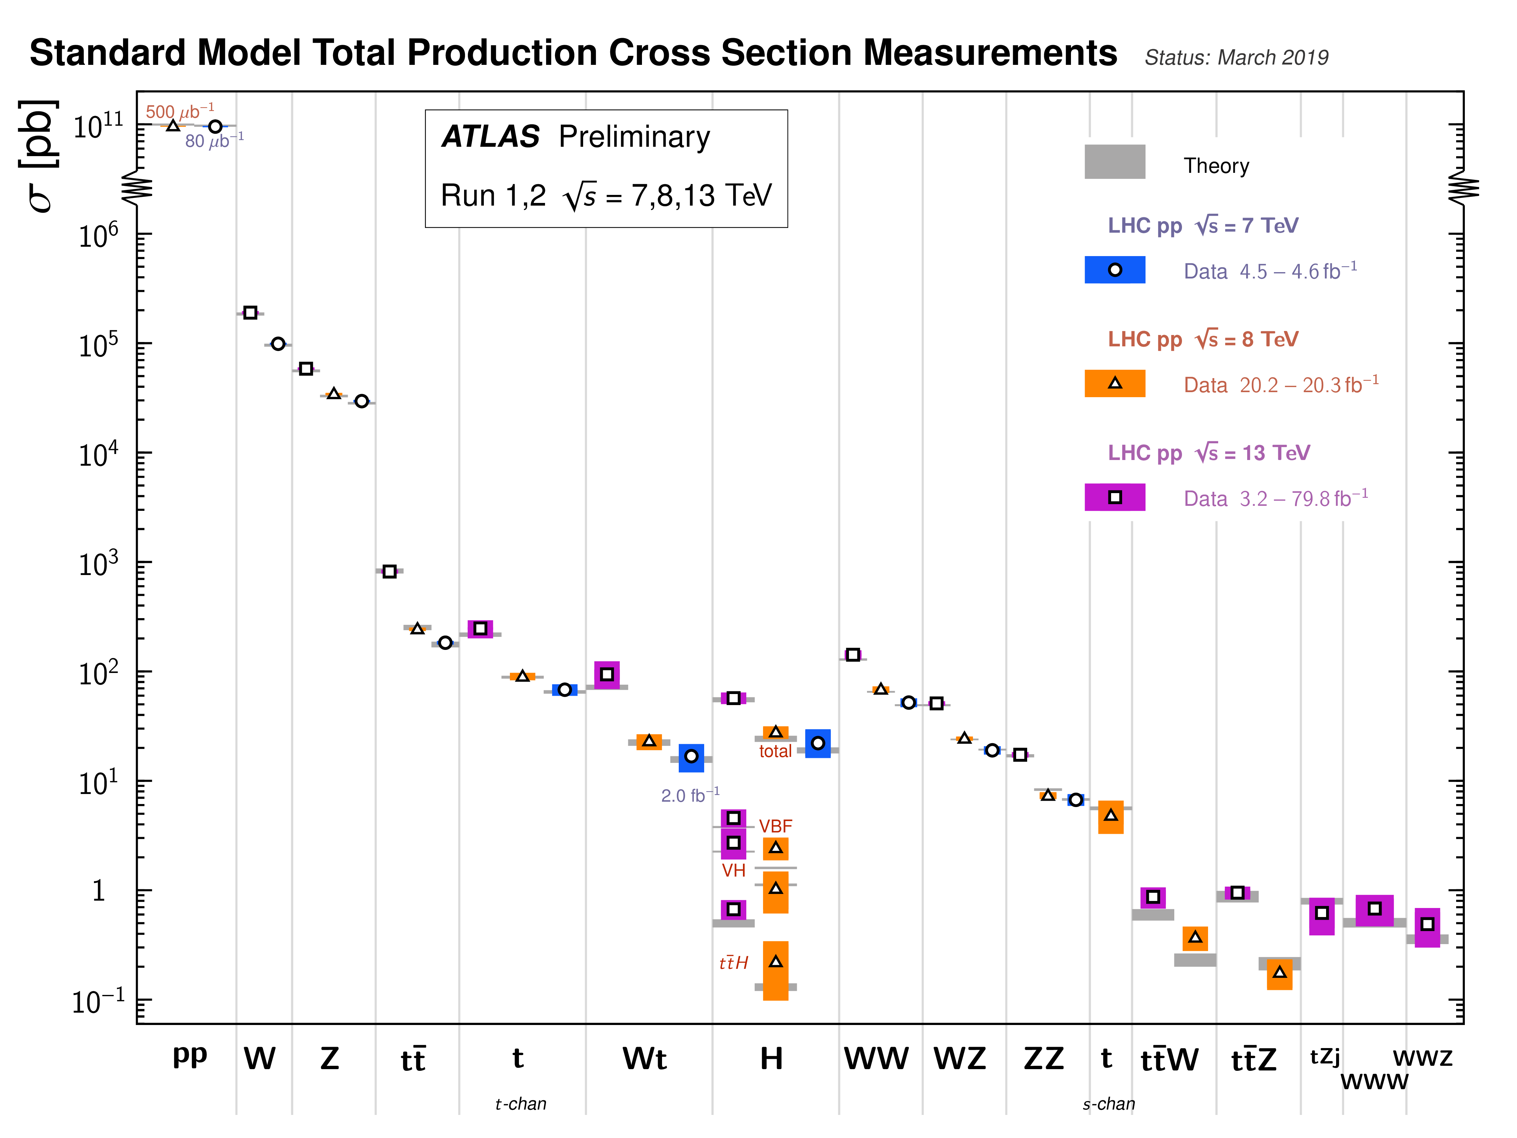
Standard Model Measurements @ LHC
Do these data
offer any hints?

Slide 3
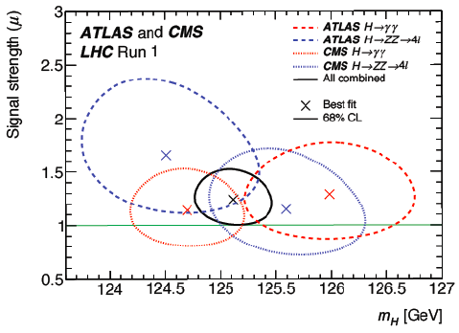

Higgs Mass Measurements
ATLAS + CMS ZZ* and γγ final states
Run 1:
CMS Run 2:
ATLAS Run 2:
Crucial for
stability of
Electroweak
vacuum
Naïve combination 125.13 ± 0.14 GeV

Slide 4


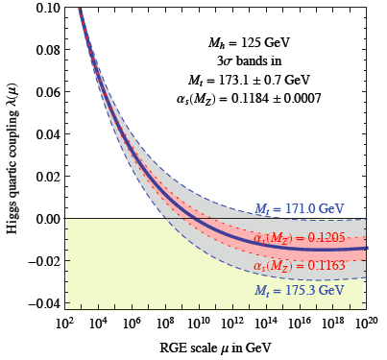
Theoretical Constraints on Higgs Mass
Buttazzo, Degrassi, Giardino, Giudice, Sala, Salvio & Strumia, arXiv:1307.3536
Large M_{h} → large self-coupling → blow up at low-energy scale Λ due to
renormalization
Small: renormalization
due to t quark drives
quartic coupling < 0
at some scale Λ
→ vacuum unstable
Vacuum could be stabilized by Supersymmetry
Instability @
10^{11.4±0.8} GeV

Slide 5
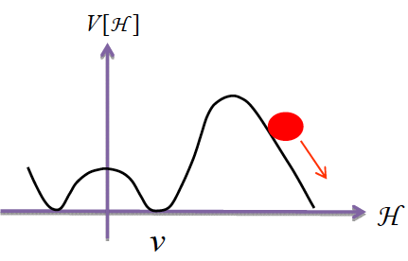
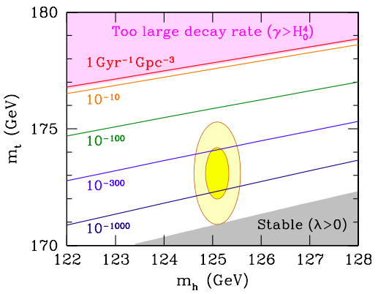
Vacuum Instability in the Standard Model
Andreassen, Frost & Schwartz, arXiv:1707.08124
Sensitive to α_{s} as well as m_{t} and M_{H}
Instability scale:
m_{t} = 172.47±0.35 GeV ➔ log₁₀(Λ/GeV) = 11.4±0.8
Buttazzo, Degrassi, Giardino, Giudice, Sala, Salvio & Strumia, arXiv:1307.3536

Slide 6
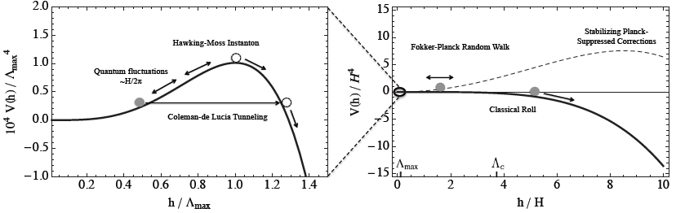
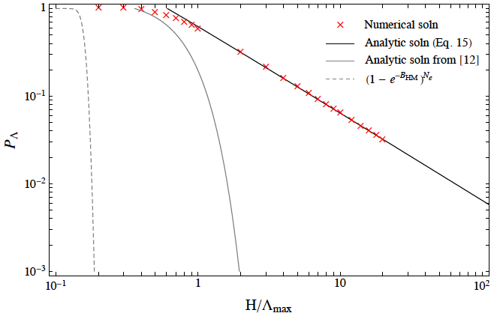
Instability during Inflation?
Hook, Kearney, Shakya & Zurek: arXiv:1404.5953
Do inflation fluctuations drive us over the hill?
Then Fokker-Planck evolution
Do AdS regions eat us?
  Disaster if so
Stabilize vacuum with BSM physics?
“Build a wall” with supersymmetry?

Slide 7

Standard Model as an Effective Field Theory
Supplement Standard Model with higher-dimensional interactions generated by new physics at scale Λ
Leading dimension-6 operators:
Use data to constrain operator coefficients
Look for indirect effects of physics beyond the Standard Model
Buchmueller & Wyler, 1986

Slide 8
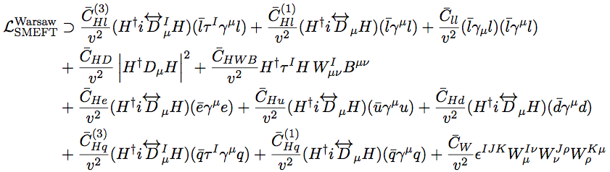

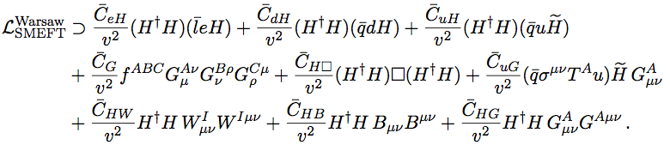
Dimension-6 Operators in Warsaw Basis
Involved in precision electroweak, diboson data
Operators affecting Higgs observables

Slide 9
Updated Global SMEFT Fit
to Higgs, Diboson and Electroweak Data
Global fit to dimension-6 operators using precision electroweak data, W⁺W⁻ at LEP, Higgs and diboson data from LHC Runs 1 and 2
Improvements in the constraints from Run 2
Constraints on BSM models
  Some contribute to operators at tree level
  Stops that contribute at loop level
JE, Murphy, Sanz & You, arXiv:1803.03252

Slide 10
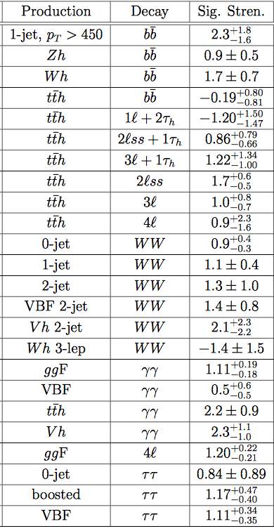
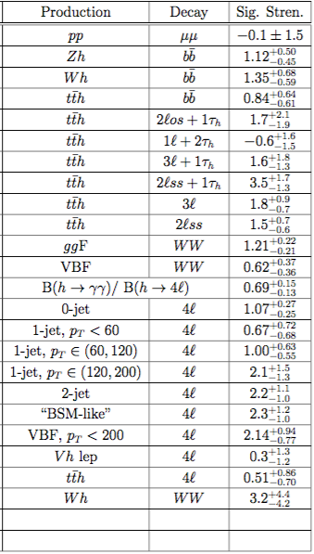
Run 2 Higgs
Measurements used in
SMEFT Fit
CMS
ATLAS
Include all
available
kinematical
information
+ W⁺W⁻
measurement
at high p_{T}
Probe 12 SMEFT directions
JE, Murphy, Sanz & You, arXiv:1803.03252

Slide 11
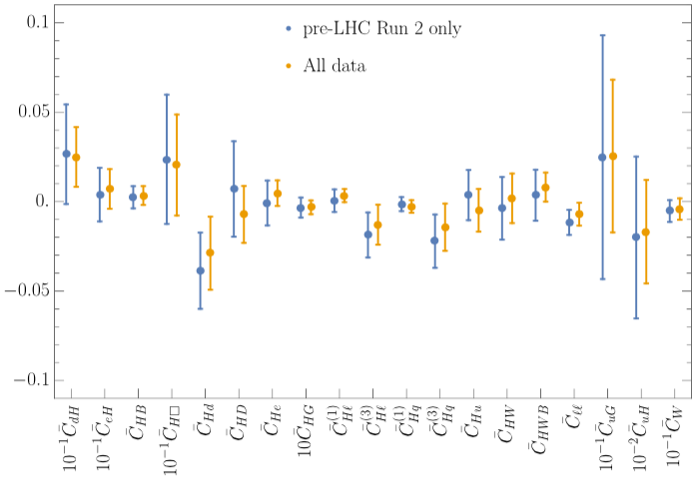
Results of Global Fit in Warsaw Basis
Fit to all operators simultaneously
NB: Different
scale factors
JE, Murphy, Sanz & You, arXiv:1803.03252

Slide 12
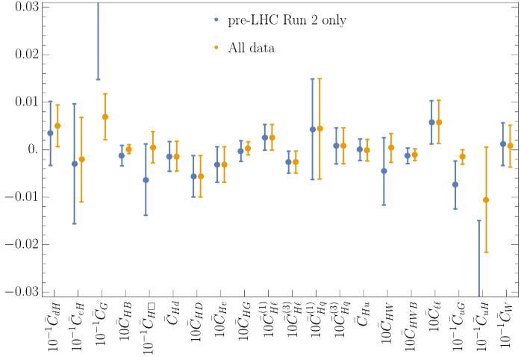
Results of Global Fit in Warsaw Basis
JE, Murphy, Sanz & You, arXiv:1803.03252
Fit to each operator individually
NB: Different
scale factors

Slide 13
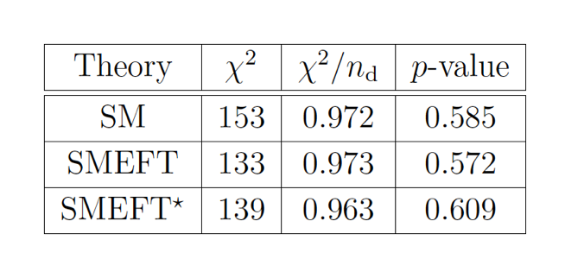
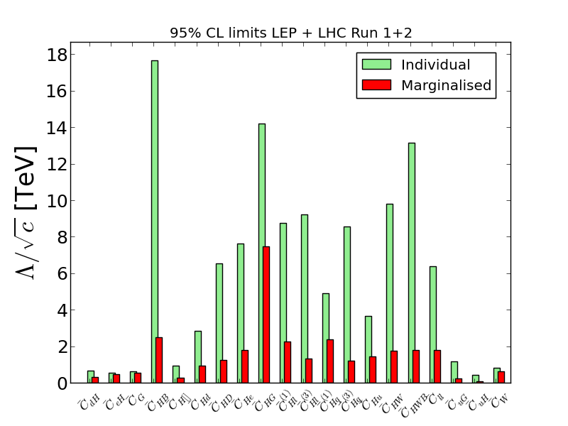
Summary
JE, Murphy, Sanz & You, arXiv:1803.03252
No sign of BSM

Slide 14
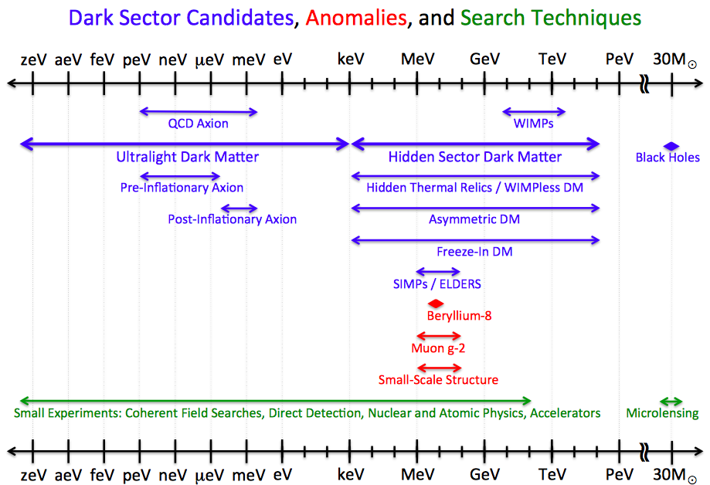
Dark Matter Candidates
Superheavy ‘cryptons’
Black
Holes
→
Log₁₀(mass/proton mass)

Slide 15
WIMP Candidates
Could have right density if weigh 100 to 1000 GeV (accessible to LHC experiments?)
Present in many extensions of Standard Model
Particularly in attempts to understand strength of weak interactions, mass of Higgs boson
Examples:
  Extra dimensions of space
  Supersymmetry

Slide 16

You must be joking!
We still believe in supersymmetry

Slide 17
What lies beyond the Standard Model?
Supersymmetry
New motivations
From LHC Run 1
Stabilize electroweak vacuum
Successful prediction for Higgs mass
  Should be < 130 GeV in simple models
Successful predictions for couplings
  Should be within few % of SM values
Naturalness, GUTs, string, …, dark matter

Slide 18
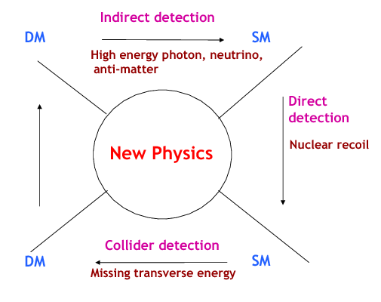
Searches for WIMP Dark Matter
Annihilation
to particles ➔
in cosmic rays
Dark Matter
Standard Model
Annihilation
in the early ➔
Universe
Production
⬅ at particle
colliders
⬆
Direct dark matter detection
Dark Matter
Standard Model

Slide 19
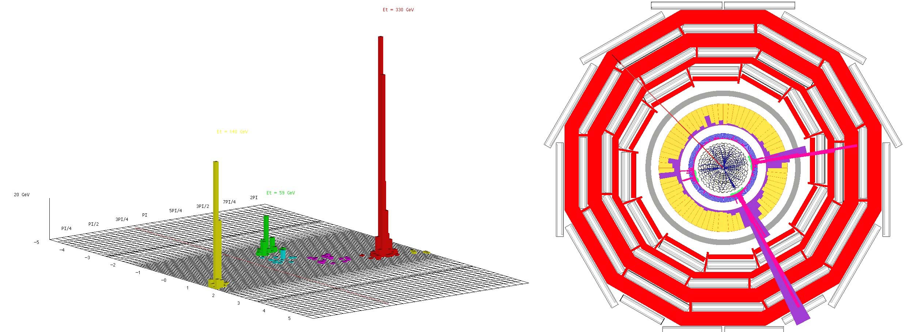
Classic LHC Dark Matter Signature
Missing transverse energy
carried away by dark matter particles

Slide 20
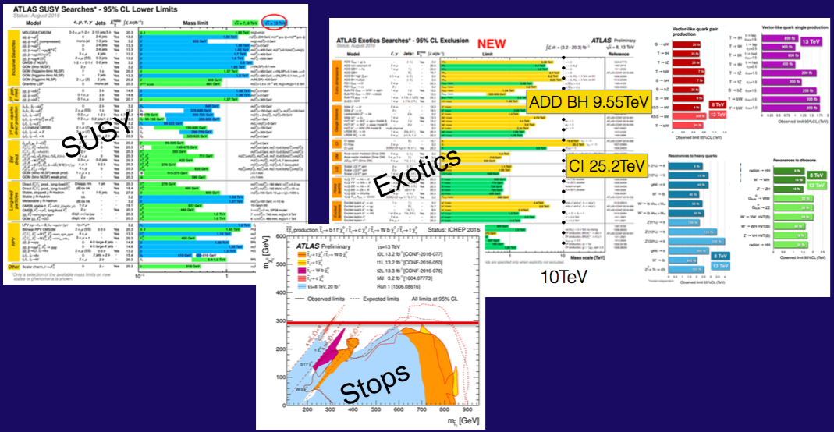
Nothing (yet) at the LHC
No supersymmetry
Nothing else, either
More of same?
Unexplored nooks?
Novel signatures?

Slide 21
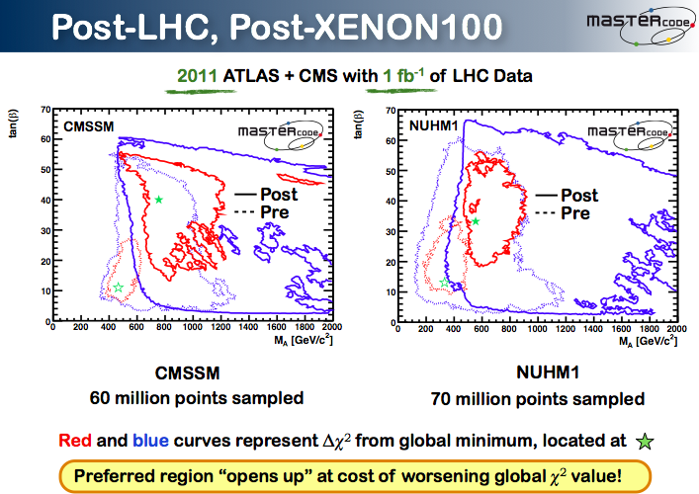

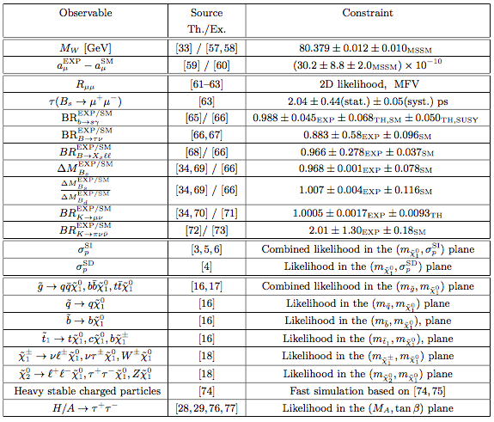
Inputs to Global Fits for New Physics
Electroweak
observables
Flavour
observables:
Interpretation
requires
lattice inputs
Dark Matter
LHC
observables

Slide 22

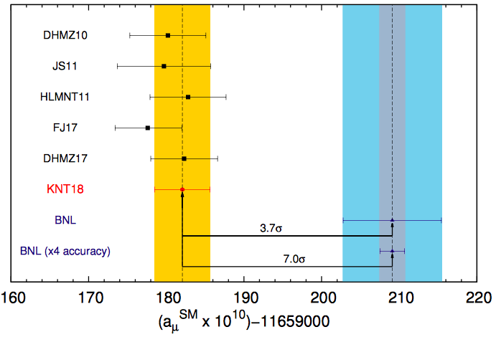
Quo Vadis g_{μ} - 2?
Strong discrepancy between BNL experiment and e⁺e⁻ data now ~ 3.7 σ
New experiment at FNAL (J-PARC)
New physics
at TeV scale?
SUSY?
Keshavarrzi, Nomura & Teubner, arXiv:1802.02995
Notes:
22

Slide 23
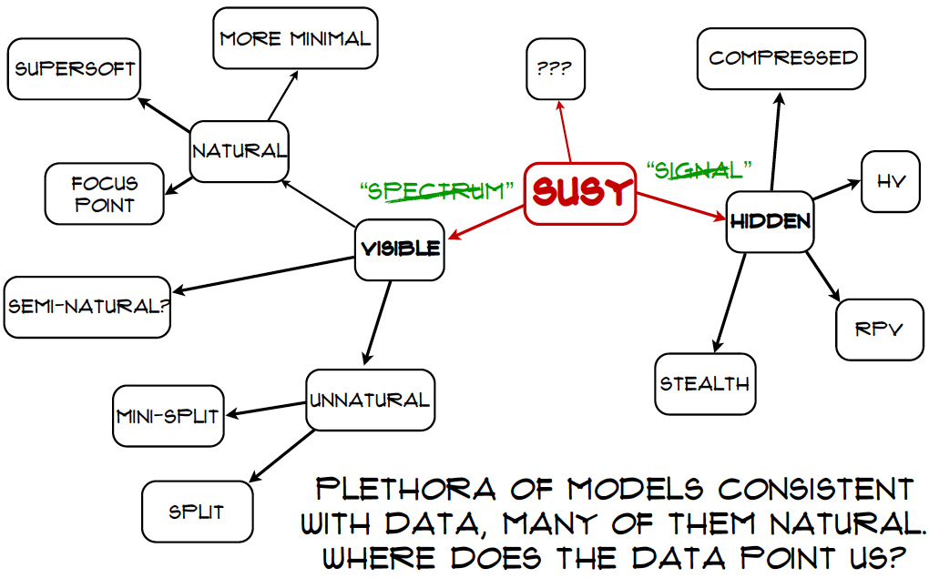

Craig@LHCP

Slide 24
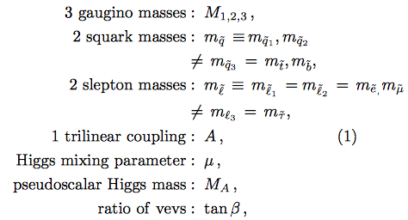
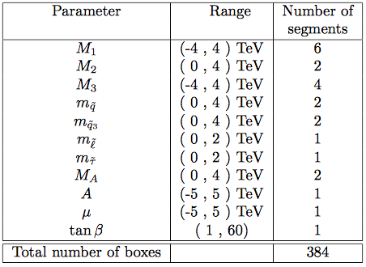
Analysis of pMSSM11
Phenomenological MSSM with 11 parameters
Sample parameter space using Multinest technique
Sampling with/without g-2
Dedicated sampling of Dark Matter regions
Sample 2 × 10⁹ points
Bagnaschi, Sakurai, JE et al, arXiv:1710.11091

Slide 25
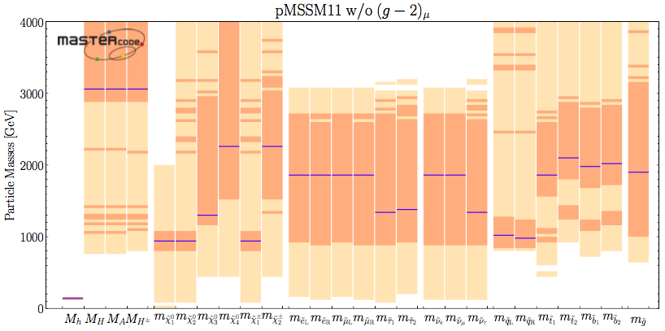
Sparticle Masses in the pMSSM
& production at e+e- colliders
Fit without g_{μ}-2
68 & 95% CL ranges
Best-fit values
Accessible in pair production at ILC500, ILC1000, CLIC
Bagnaschi, Sakurai, JE et al, arXiv:1710.11091

Slide 26
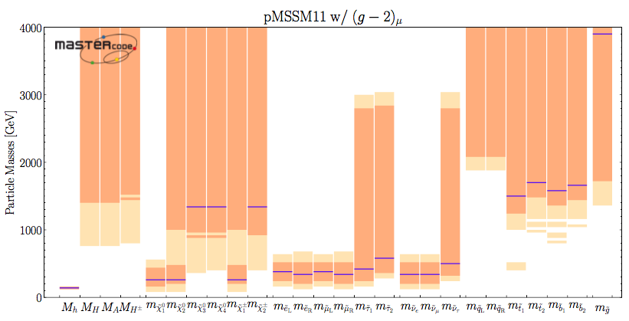
Sparticle Masses in the pMSSM
& production at e+e- colliders
Fit with g_{μ}-2
68 & 95% CL ranges
Best-fit values
Accessible in pair production at ((ILC500)), (ILC1000), CLIC
Bagnaschi, Sakurai, JE et al, arXiv:1710.11091

Slide 27
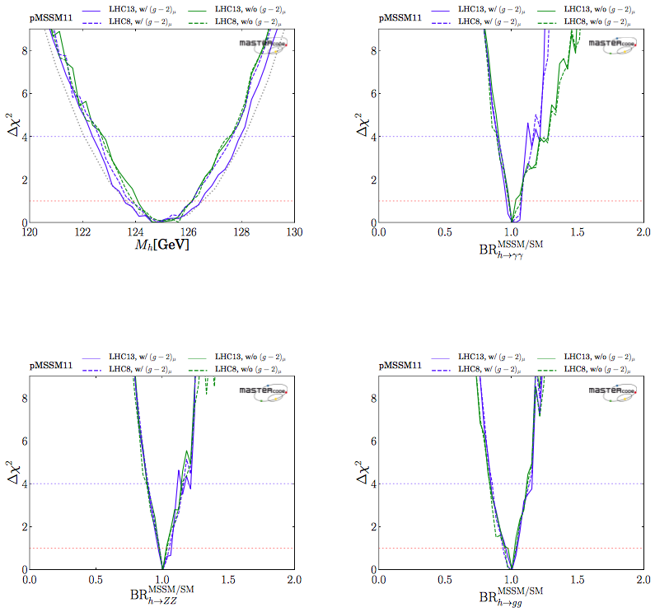
Higgs properties in the pMSSM
Fit with g_{μ}-2
Fit without g_{μ}-2
No issue with
measured Higgs mass
Central values of decay
BRs similar to SM
Substantial deviations
possible
Bagnaschi, Sakurai, JE et al,
arXiv:1710.11091

Slide 28
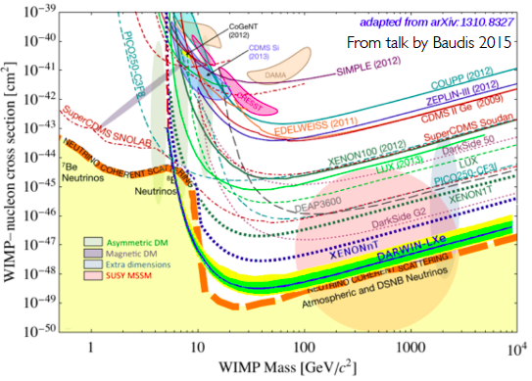
Direct Dark Matter Searches
Compilation of present and future sensitivities
SUSY
models
Neutrino
“floor”

Slide 29
Simplified Dark Matter Models
Dark matter χ + mediator particle of spin 0 or 1
Assume leptophobic gauge boson Y of some U(1)’ with vector and/or axial-vector couplings
Model parameters:
  Coupling of mediator Y to dark matter: g_{DM}
  Coupling of Y to quarks (assumed universal): g_{SM}
  Mediator mass: m_{Y}
  Dark matter particle mass: m_{χ}
Global analysis using MasterCode
Bagnaschi, …, JE et al, arXiv:1905.00892

Slide 30
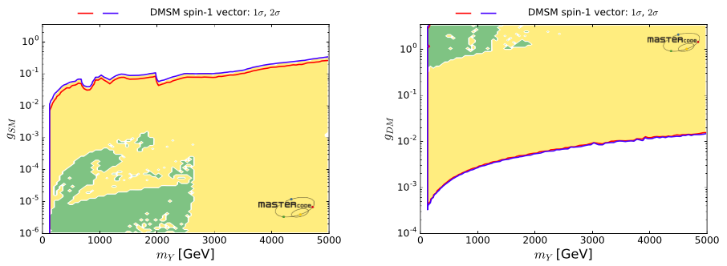
Dark Matter Simplified Models
Leptophobic vector mediator
✔
s-channel annihilation
Coupling to SM particles
Coupling to daark matter
✔
t-channel
Mediator masses between 100 GeV and > 5 TeV allowed
Bagnaschi, …, JE et al, arXiv:1905.00892

Slide 31
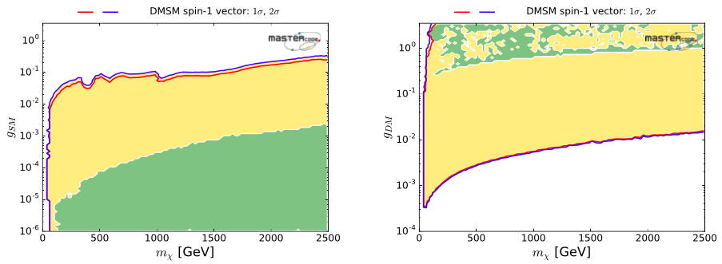
Dark Matter Simplified Models
Leptophobic vector mediator
✔
s-channel annihilation
Coupling to SM particles
Coupling to daark matter
✔
t-channel
DM particle masses between 50 GeV and > 2.5 TeV allowed
Bagnaschi, …, JE et al, arXiv:1905.00892

Slide 32
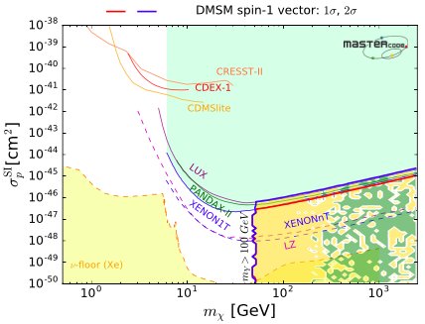
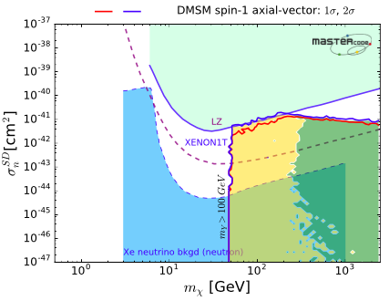
Dark Matter Simplified Models
Leptophobic vector mediator
Leptophobic axial mediator
Spin-independent scattering
Spin-dependent scattering
Scattering could be close to experimental limits
Bagnaschi, …, JE et al, arXiv:1905.00892

Slide 33
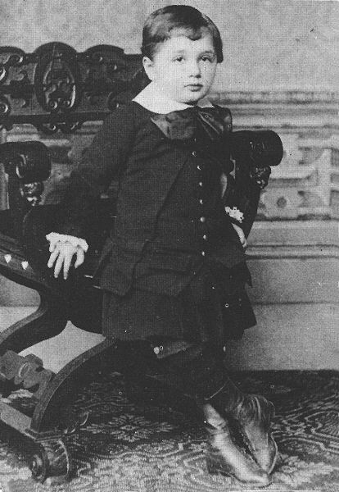
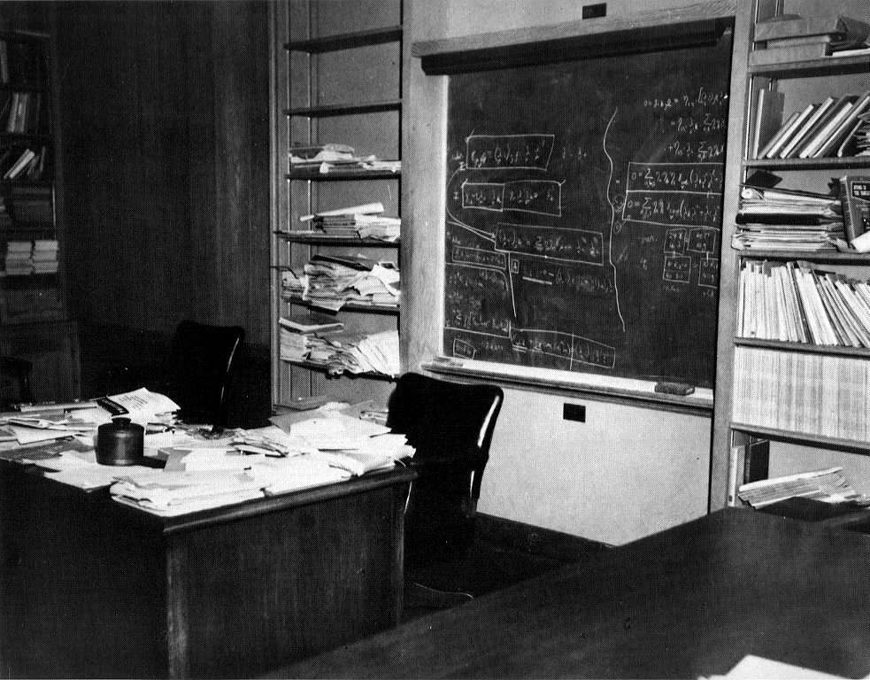
Unify the Fundamental Interactions:
Einstein’s Dream …
← … but he never succeeded
Unification via extra dimensions of space?

Slide 34
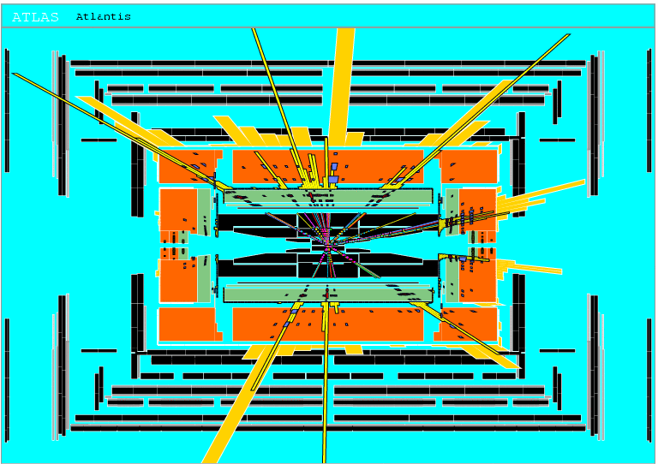
Will LHC experiments create black holes?
Eat up
the entire
Earth?
Would
vanish
instantly
Cosmic rays have not harmed us!

Slide 35
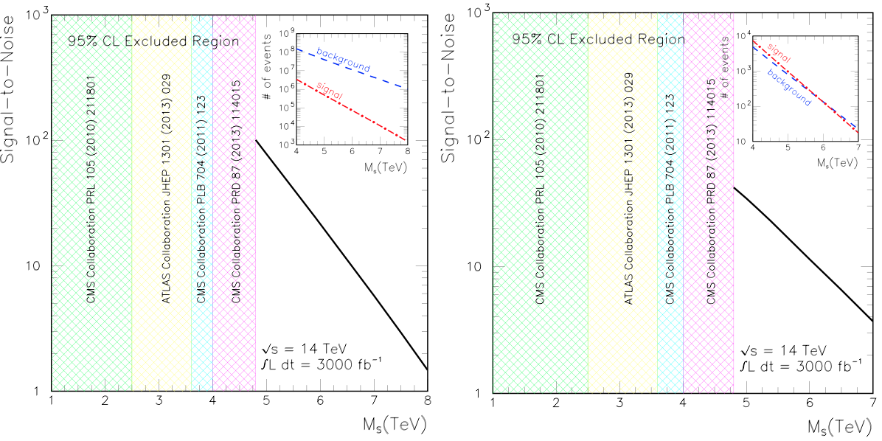
String Bump Hunting @ LHC
Look for string recurrences in jets, γ + jets
Anchordoqui, Antoniadis, Dai, Feng, Goldberg,Huang, Lust, Stojkovic, Taylor, arXiv:1407.8120

Slide 36
How to get there from here?

Slide 37
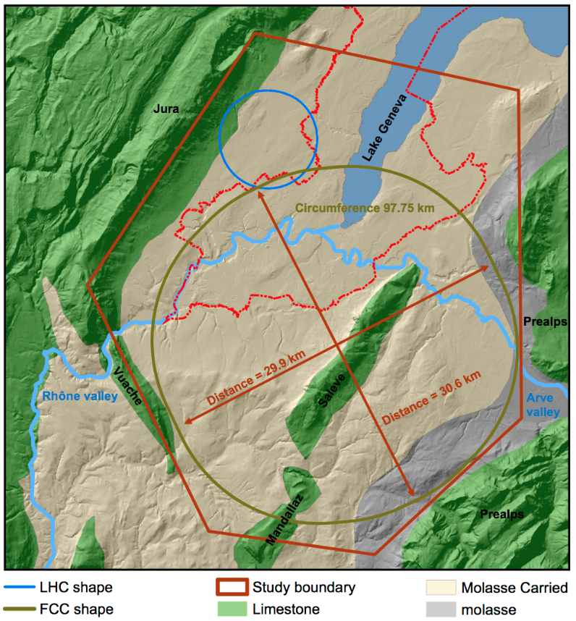


Future Circular Colliders
The vision:
explore 10 TeV scale directly (100 TeV pp) + indirectly (e⁺e⁻)

Slide 38
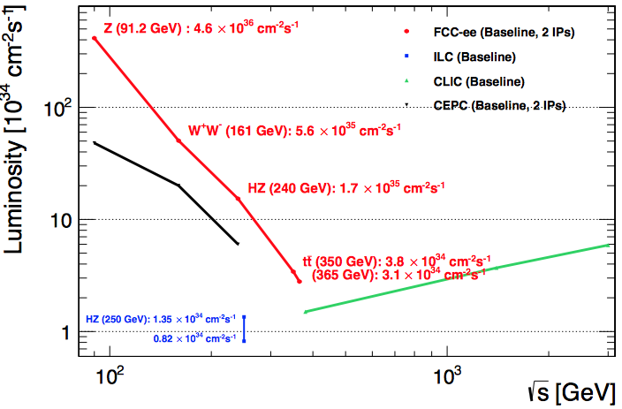
Projected e⁺e⁻ Colliders:
Luminosity vs Energy

Slide 39
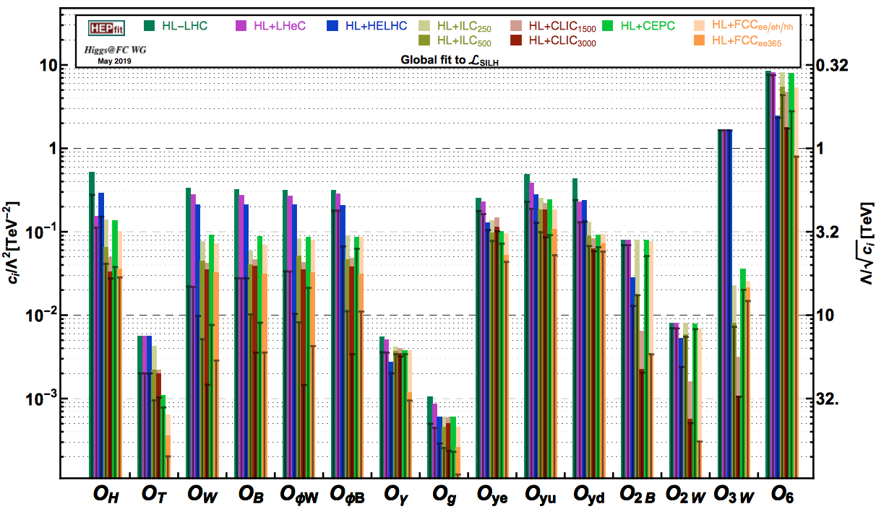
SMEFT Analysis
De Blas et al, arXiv:1905.03764

Slide 40
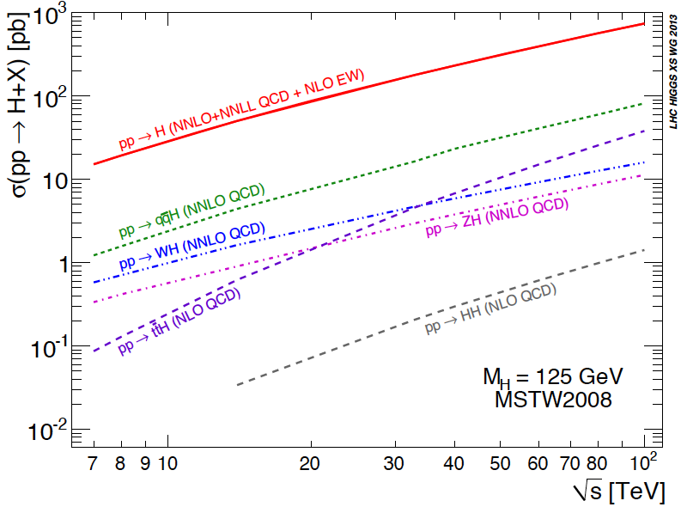
Higgs Cross Sections
At the LHC and beyond:

Slide 41
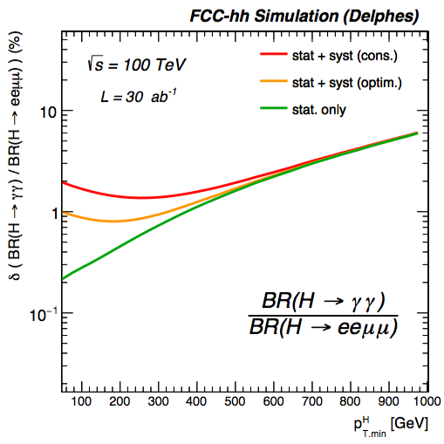
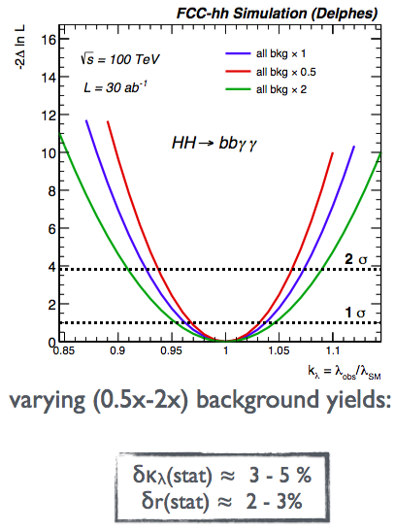
Examples of Higgs Measurements

Slide 42
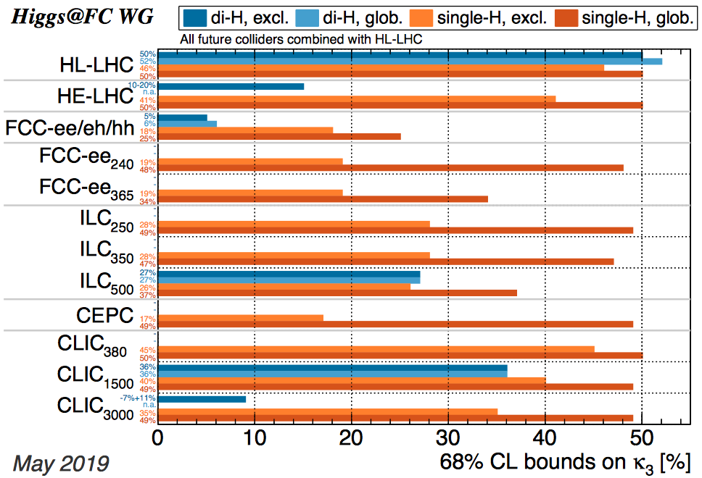
Triple-Higgs Coupling Analysis
De Blas et al, arXiv:1905.03764

Slide 43
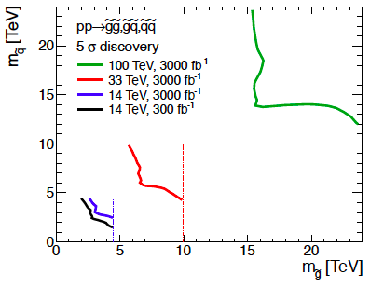
Squark-Gluino Plane
Discover 12 TeV squark,
16 TeV gluino @ 5σ

Slide 44
How to get there from here?
Go around in circles!

Slide 45
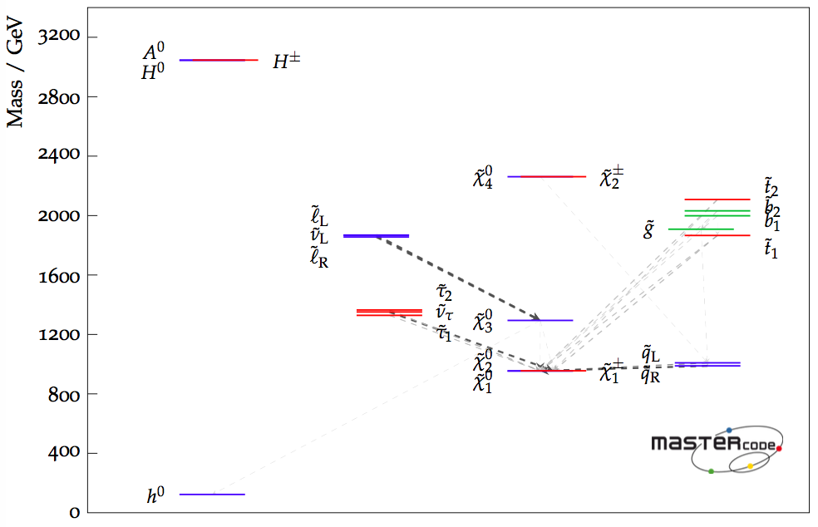
Best-Fit Sparticle Spectrum
Phenomenological MSSM
Fit excluding g_{μ}-2
Accessible to LHC?
Bagnaschi, Sakurai, JE et al, arXiv:1710.11091

Slide 46
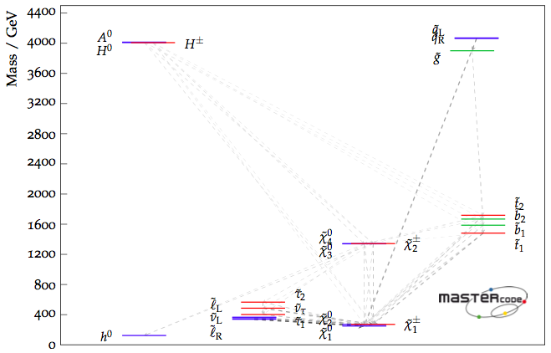
Best-Fit Sparticle Spectrum
Phenomenological MSSM
Fit including g_{μ}-2
Accessible to LHC?
Bagnaschi, Sakurai, JE et al, arXiv:1710.11091

Slide 47
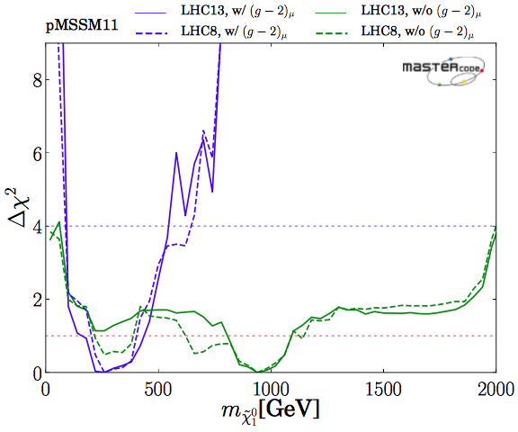
Likelihood for LSP Mass
Phenomenological
MSSM
(no assumptions
on mass parameters)
With g_{μ}-2
Without g_{μ}-2
Bagnaschi et al, arXiv:1710.11091

Slide 48
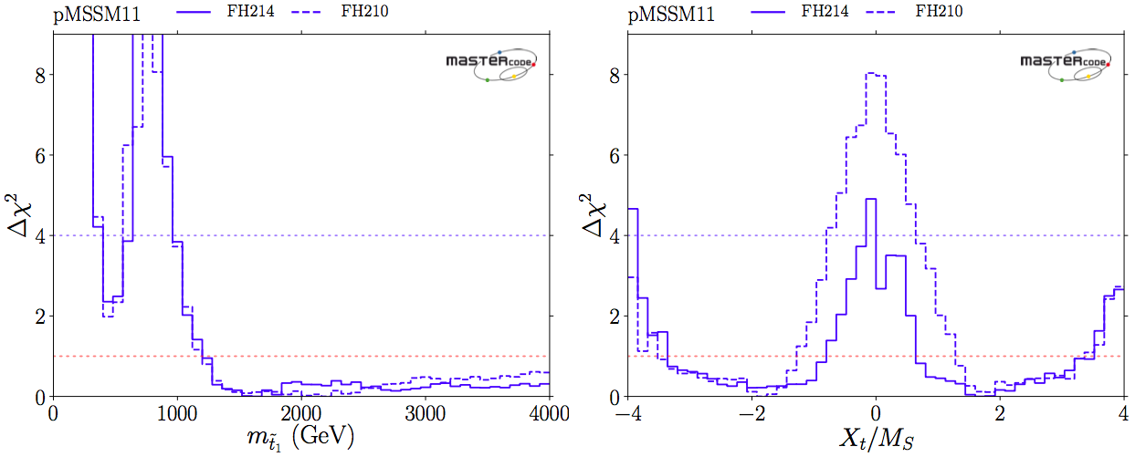
The Lighter Stop may be Light
χ² likelihood functions for m_{stop}, stop mixing
M_{stop} < 500 GeV allowed with Δχ² ~ 2
pMSSM11
Bagnaschi, Bahl, JE et al, arXiv:1810.10905

Slide 49
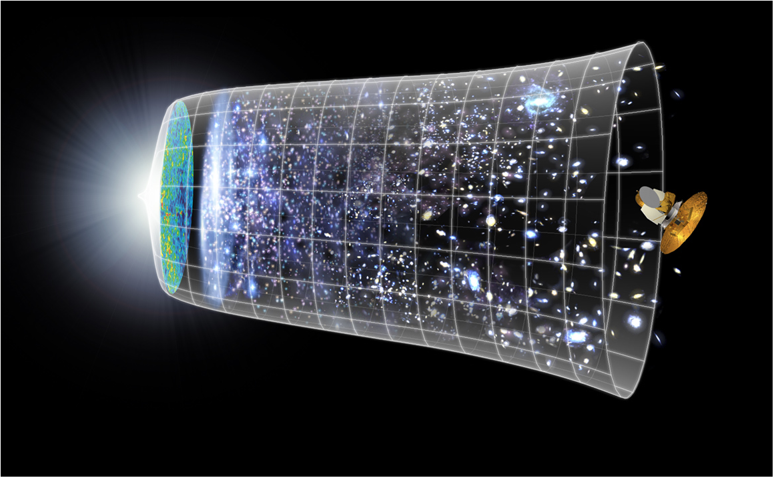
From Little Bangs to the Big Bang
What will
happen in
the future?
Big Bang
10²⁸ cm
What
happened then?
What is
the universe
made of?
13.8 Billion Years
Today
John Ellis

Slide 50

Fusion of two massive black holes
Masses ~ 36, 29 solar masses
Radiated energy ~ 3 solar masses

Slide 51


Remark on Primordial Gravitational Waves
Generated by first-order electroweak phase transition
Observable if |Φ|⁶/Λ², Λ small, also at HL-LHC
Reach of HL-LHC: 625 GeV @ 3σ, 766 GeV 2σ
Reach of LISA: 580 GeV
JE, Lewicki & No, arXiv:1809.08242

Slide 52

The Gravitational Chirp …
… heard around the world
Frequency increases with time during inspiral
Followed by ringdown of combined black hole
Graviton mass < 10⁻²⁷ × mass of electron
GWs of different frequencies have same speed
LIGO
JE, Mavromatos & Nanopoulos, arXiv:1602.04764

Slide 53

Neutron Star Merger
GW170817
Longer chirp, extending to higher frequencies
Masses < 2 solar masses
2 neutron stars!
Constraints on properties
Weak signal in Virgo helps localization
Electromagnetic counterpart seen in detail
LIGO /Virgo, Oct. 2017

Slide 54

Direct Dark Matter Searches
Phenomenological MSSM
Spin-Independent Scattering
With g_{μ}-2
Without g_{μ}-2
Bagnaschi, Sakurai, JE et al, arXiv:1710.11091

Slide 55

Direct Dark Matter Searches
Phenomenological MSSM
Spin-Dependent Scattering
sensitive to quark contributions to nucleon spin
With g_{μ}-2
Without g_{μ}-2
Bagnaschi, Sakurai, JE et al, arXiv:1710.11091

Slide 56
Search for Dark Matter in NS-NS Mergers?
Crazy ideas for dark matter signatures
JE, Hektor, Hütsi, Kannike, Marzola, Raidal & Vaskonen, arXiv:1710.05540
JE, Hütsi, Kannike, Marzola, Raidal & Vaskonen, arXiv:1804.01418

Slide 57


What Happens after the Merger?
NS cores orbit and oscillate radially during ringdown
Characteristic spectrum of frequencies in GW emissions
Frequency peaks at stationary points in oscillations
Weakens
in few ms
Takami, Rezzolla & Baiotti, arXiv:1403.56720, 1412.3240

Slide 58


Toy Mechanical Model
Neutron cores oscillate and rotate inside disc
Captures surprisingly well major features of strain fluctuations
Takami, Rezzolla & Baiotti, arXiv:1403.56720, 1412.3240

Slide 59


Including Dark Matter
DM
Two pairs of oscillating cores
Reproduce results when no DM
Weakens in few ms
2 peaks if unequal DM core masses
EHHKMRV, arXiv:1710.05540

Slide 60
Models for Massive DM Cores
Conversion of neutron to heavier DM particle inside NS: n on Fermi surface ➔ χ
Bremsstrahlung of lighter DM particle:
n + n ➔ n + n + χ
DM mass fraction ~ 5% possible
Merger of DM star with conventional star before/after becoming NS
DM fraction may depend on age, environment
JE, Hütsi, Kannike, Marzola, Raidal & Vaskonen, arXiv:1804.01418

Slide 61
DM Effects on NS Properties for various nuclear equations of state (EOS)
Effects on mass and radius
Effect on tidal deformability
Maximum mass, radius decrease
Potential issue for some EOS
Decrease in tidal deformability
Potential constraint on EOS
JE, Hütsi, Kannike, Marzola, Raidal & Vaskonen, arXiv:1804.01418

Slide 62
Summary
The Big Bang raises many problems needing physics beyond the Standard Model
Address them in smaller bangs:
  LHC TeV
  Direct dark matter searches keV
  Indirect dark matter searches GeV
  CMB 10¹⁵ GeV ?
  Black hole and neutron star mergers M_{Planck} ?
“Per ardua ad astra” - By struggles to the stars

Slide 63

Dark Matter Models for e⁺ Spectrum
Not up-to-date
Illustrates problems
Boudeaud et al., arXiv:1612.03924

Slide 64

Fits to DM Annihilations
Annihilation mainly into bb, some admixture of e⁺e⁻, μ⁺μ⁻
Different cosmic ray models
Different solar potentials
Annihilation σ = 272 ✕ thermal
_
Boudeaud et al., arXiv:1612.03924

Slide 65

Cosmic-Ray Positrons
Dark Matter?

Slide 66

Diffuse γ Emission near Pulsars
HAWC Collaboration, DOI:10.1126/science.aan4880
Absrorption of lower-energy γ

Slide 67

Effect on Pulsar Positron Spectrum
HAWC Collaboration, DOI:10.1126/science.aan4880

Slide 68

A Tough
Neighbourhood
We live in a local bubble
Excavated by many supernovae in ‘recent’ past
Opportunity for AMS?
“16 supernovae have exploded during the past 13 million years within the boundaries of the Local Bubble.”
Breitschwerdt et al, Nature 532, 73 (2016)

Slide 69


Inhomogeneous Diffusion Coefficient?
More similar to AMS-02 spectrum with spatial dependence of diffusion coefficient
Better fit including secondary production
Profumo, ReynosCordova, Kaaz & Silverman, arXiv:1803.09731

Slide 70

Antiprotons Compatible with Cosmic Rays
Giesen et al., arXiv:1504.04276

Slide 71

Cosmological Inflation in Light of Planck
A scalar in the sky? Supersymmetry/supergravity?

Slide 72

The Spectrum of Fluctuations in the Cosmic Microwave Background
The position of the first peak
→ total density Ω_{Tot}
The other peaks
depend on density of
ordinary matter Ω_{atoms}
& dark matter Ω_{Dark}

Slide 73


Inflationary Landscape
Monomial
Single-field
potentials
Planck +
other data
+ BICEP/Keck data
ϕ³
ϕ²
Starobinsky
R + R² model,
Higgs inflation,
No-scale models
ϕ
ϕ^{2/3}
Data start to
be sensitive
to N*

Slide 74
Challenges for Inflationary Models
Links to low-energy physics?
  Only SM candidate for inflaton is Higgs
    BUT negative potential, ….
Link to other physics?
  SUSY partner of RH (singlet) neutrino?
  Some sort of axion?
Links to Planck-scale physics?
  Inflaton candidates in string theory?
  Inflaton candidates in compactified string models?

Slide 75



Starobinsky Model
Non-minimal general relativity (singularity-free cosmology):
No scalar!?
Conformally equivalent to scalar field model:
Inflationary interpretation, calculation of perturbations:
Starobinsky, 1980
Stelle; Whitt, 1984
Mukhanov & Chibisov, 1981

Slide 76




Higgs Inflation: a Single Scalar?
Bezrukov & Shaposhnikov, arXiv:0710.3755
Standard Model with non-minimal coupling to gravity:
Consider case : in Einstein frame
With potential:
  Similar to Starobinsky, but not identical
Successful inflationary potential at

Slide 77
Problem for Higgs Inflation
Buttazzo, Degrassi, Giardino, Giudice, Sala, Salvio & Strumia, arXiv:1307.3536
Large M_{h} → large self-coupling → blow up at low-energy scale Λ due to
renormalization
Small M_{h}: renormalization
due to t quark drives
quartic coupling < 0
at some scale Λ
→ vacuum unstable
Negative potential not suitable for inflation
Problem avoided with supersymmetry
Instability @
~ 10¹¹ GeV

Slide 78
Inflation Cries out for Supersymmetry
Want “elementary” scalar field
(at least looks elementary at energies << M_{P})
To get right magnitude of perturbations
prefer mass << M_{P}
(~ 10¹³ GeV in simple φ² models)
And/or prefer small self-coupling λ << 1
Both technically natural with supersymmetry
JE, Nanopoulos, Olive & Tamvakis 1983

Slide 79
Inflation cries out for Supergravity
Stabilize ‘elementary’ scalar inflaton
(needs mass << m_{P} and/or small coupling)
Supersymmetry
The only good symmetry is a local symmetry
(cf, gauge symmetry in Standard Model)
Local supersymmetry = supergravity
Early Universe cosmology needs gravity
Supersymmetry + gravity = supergravity

Slide 80
No-Scale Supergravity Inflation
Supersymmetry + gravity = Supergravity
Include conventional matter?
Potentials in generic supergravity models have ‘holes’ with depths ~ – M_{P}⁴
Exception: no-scale supergravity
Appears in compactifications of string
Flat directions, scalar potential ~ global model + controlled corrections
Cremmer, Ferrara, Kounnas & Nanopoulos, 1983
Witten, 1985
JE, Enqvist, Nanopoulos, Olive & Srednicki, 1984
JE, Nanopoulos & Olive, arXiv:1305.1247, 1307.3537, …

Slide 81




No-Scale Supergravity Inflation Revived
JE, Nanopoulos & Olive, arXiv:1305.1247
Simplest SU(2,1)/U(1) example:
Kähler potential:
Wess-Zumino superpotential:
Assume modulus T = c/2 fixed by ‘string dynamics’
Effective Lagrangian for inflaton:
:
Modifications to globally supersymmetric case
Good inflation possible …

Slide 82


No-Scale Supergravity Inflation
Inflationary potential for
Special case = Starobinsky
JE, Nanopoulos & Olive, arXiv:1305.1247

Slide 83

If it looks and smells like Starobinsky …
Is there more profound connection?
Starobinsky model:
After conformal transformation:
Effective potential:
Identical with the no-scale Wess-Zumino model for the case
… it actually IS Starobinsky
Cecotti, 1987
JE, Nanopoulos & Olive, arXiv:1305.1247

Slide 84

How many e-Folds of Inflation?
General expression:
In no-scale supergravity models:
Prospective constraint on inflaton models?
JE, García, Nanopoulos & Olive, arXiv:1505.06986
Amplitude of
perturbations
Equation of state
during inflaton decay
Inflaton
decay rate

Slide 85

Planck Constraints on # of e-Folds
Starobinsky-like no-scale models
Starobinsky
JE, García, Nanopoulos & Olive, arXiv:1505.06986

