Slide 1
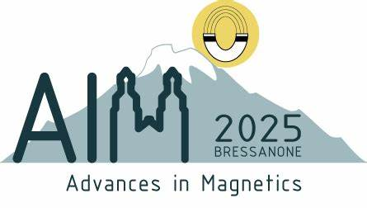


Magneto-Thermoelectrics in Cryogenic, Room, and High-Temperature Regimes
MATERIAL AND DEVICE INNOVATIONS
Darja Gačnik, Katja Klinar, Radel Gimaev, Oumayma Chdil, Andrej Kitanovski

Slide 2
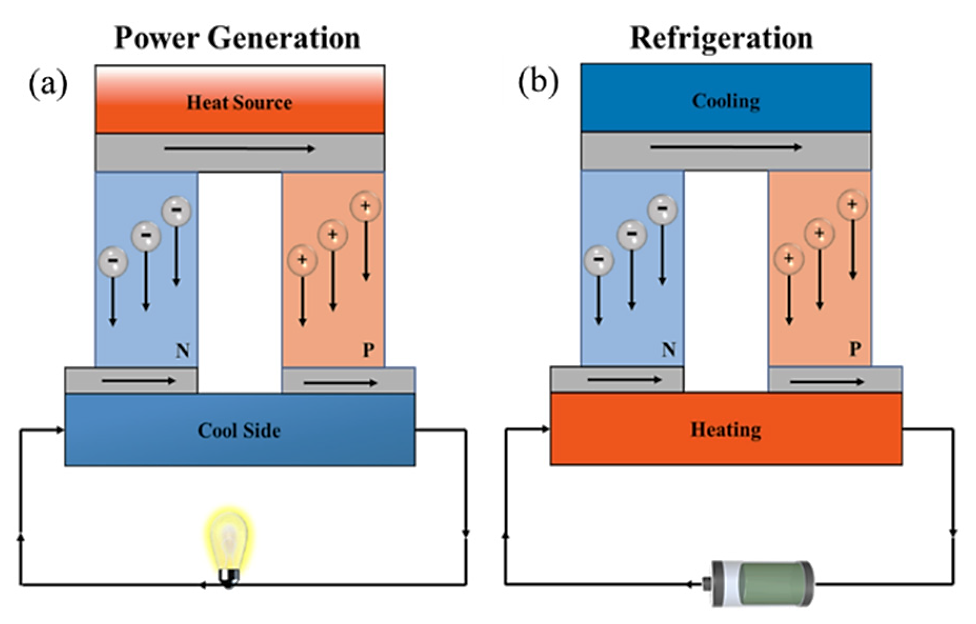



1 Why thermoelectrics?
thermoelectric effect (TE):
$$ZT=\frac{S^{2}σT}{κ}$$
SEEBECK EFFECT
PELTIER EFFECT
$$∆T→∆V$$
$$∆V→∆T$$
[Huo B. and Guo C. Y., Molecules 2022]
2

Slide 3
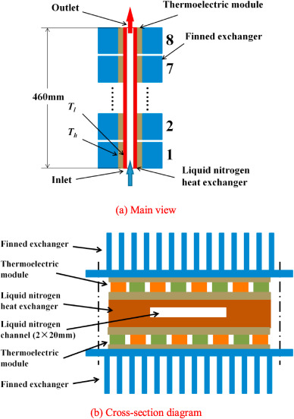
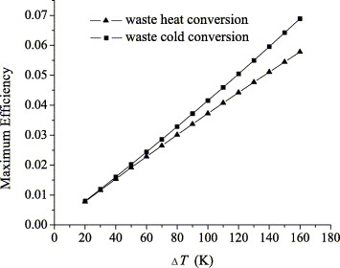
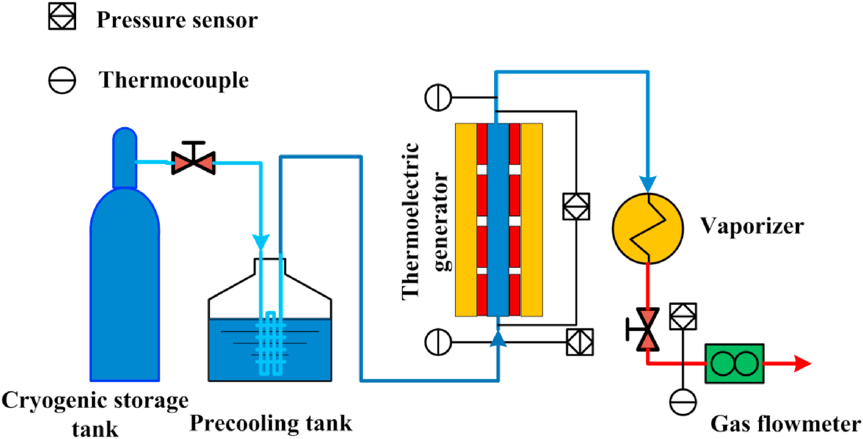

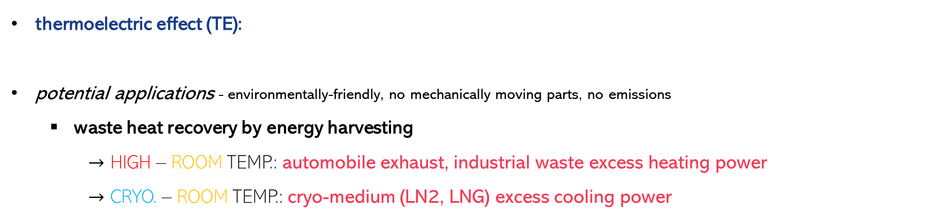

1 Why thermoelectrics?
thermoelectric effect (TE):
potential applications - environmentally-friendly, no mechanically moving parts, no emissions
waste heat recovery by energy harvesting
$→$ HIGH – ROOM TEMP.: automobile exhaust, industrial waste excess heating power
$→$ CRYO. – ROOM TEMP.: cryo-medium (LN2, LNG) excess cooling power
SEEBECK EFFECT
PELTIER EFFECT
$$ZT=\frac{S^{2}σT}{κ}$$
$$∆T→∆V$$
$$∆V→∆T$$
[Sun et al., Energy Conversion and Management 2005]
[Ge et al., Energy 2021]
3

Slide 4
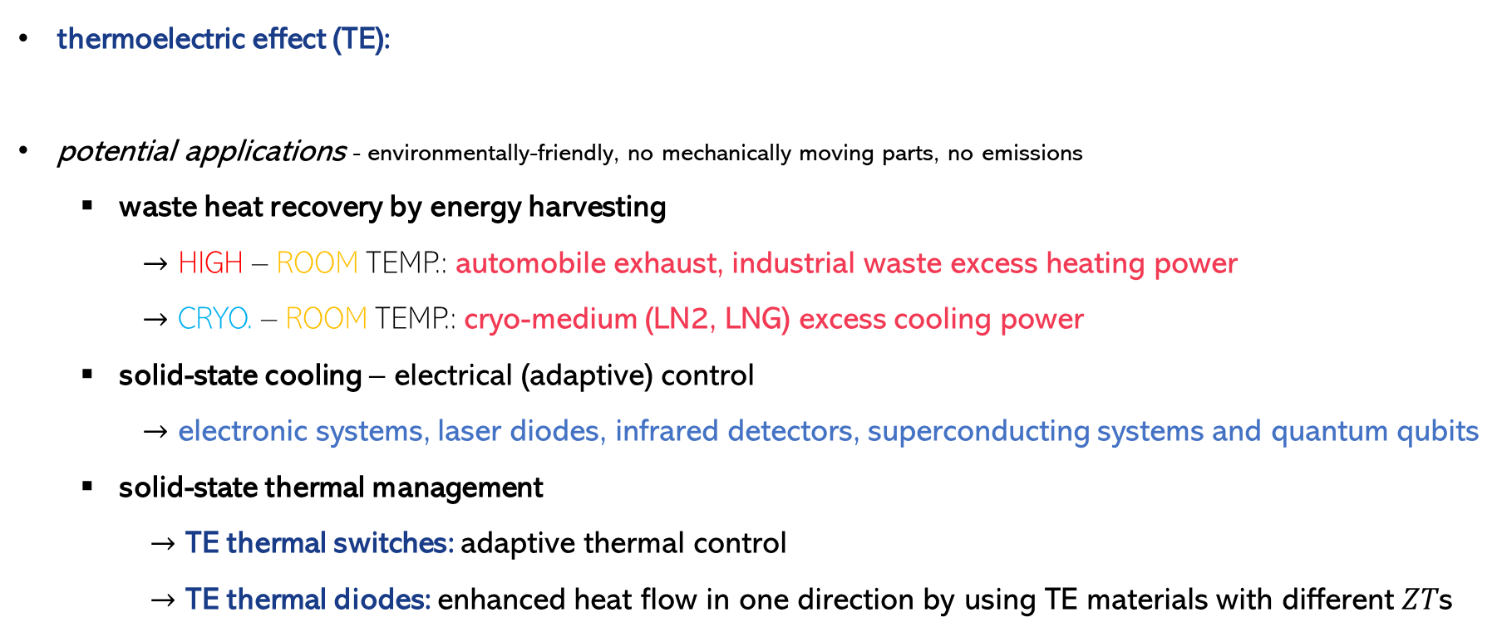
1 Why thermoelectrics?
thermoelectric effect (TE):
potential applications - environmentally-friendly, no mechanically moving parts, no emissions
waste heat recovery by energy harvesting
$→$ HIGH – ROOM TEMP.: automobile exhaust, industrial waste excess heating power
$→$ CRYO. – ROOM TEMP.: cryo-medium (LN2, LNG) excess cooling power
solid-state cooling – electrical (adaptive) control
$→$ electronic systems, laser diodes, infrared detectors, superconducting systems and quantum qubits
solid-state thermal management
$→$ TE thermal switches: adaptive thermal control
$→$ TE thermal diodes: enhanced heat flow in one direction by using TE materials with different $ZT$s
SEEBECK EFFECT
PELTIER EFFECT
$$ZT=\frac{S^{2}σT}{κ}$$
$$∆T→∆V$$
$$∆V→∆T$$
4

Slide 5
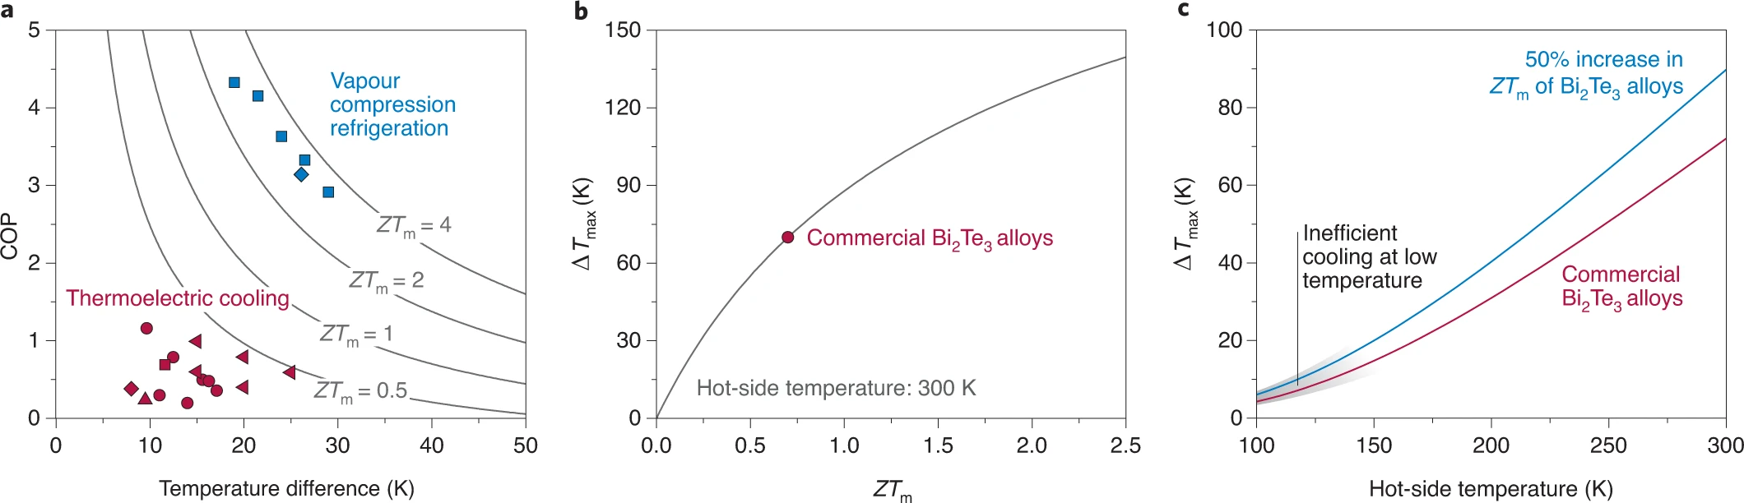




1 Why thermoelectrics?
benefits: lightweight, small, inexpensive
challenges: TE material selection, optimal device performance
difficult to obtain high $ZT$!
$$ZT=\frac{S^{2}σT}{κ}$$
$$− parameters are interlinked!$$
$$κ≈κ_{latt.}+κ_{el.}$$
Minimize by enhancing phonon scattering?
(point defects, dislocations, nanostructures, multiscale defect structures)
DOESN’T WORK FOR CRYOGENICS!
MAGNETIC-FIELD ENHANCEMENT!
[Mao et al., Nature materials 2021]
5

Slide 6

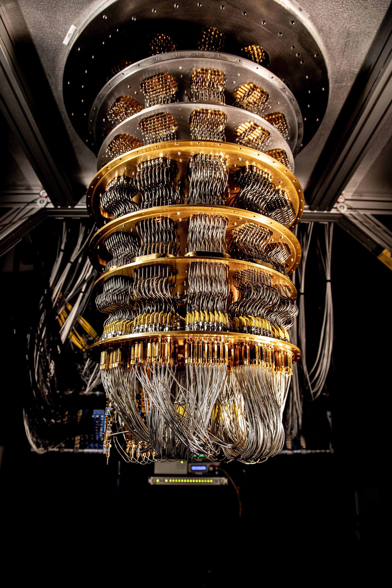
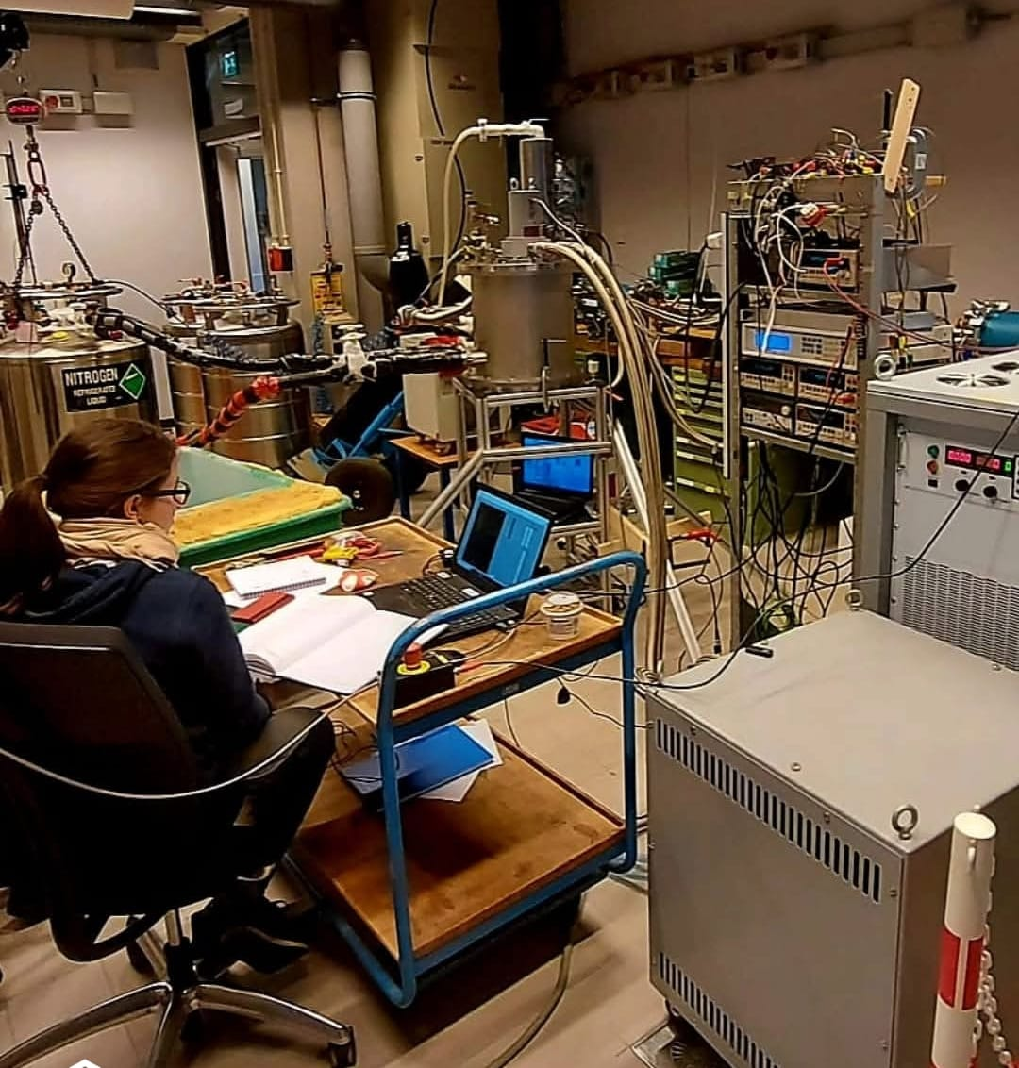
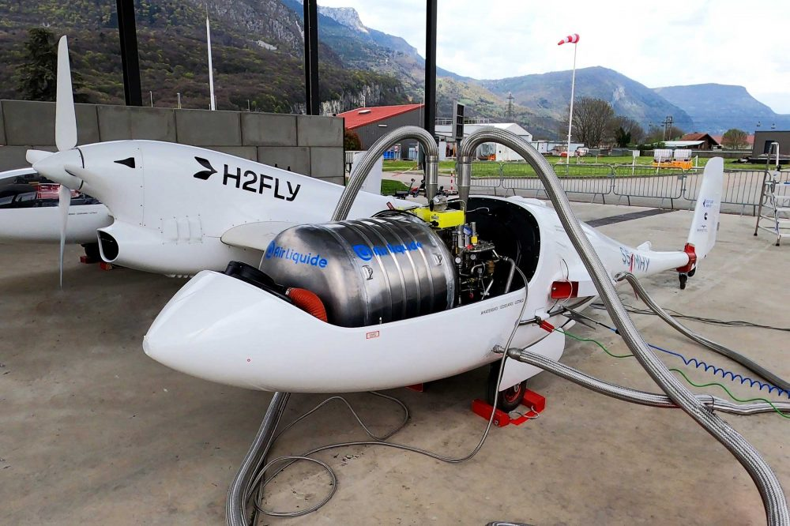
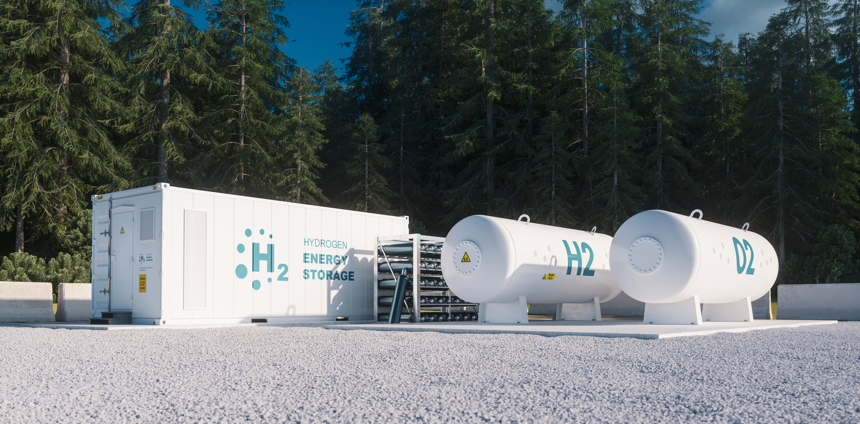



1 Why magneto-thermoelectrics?
enhancing thermoelectric effect by applying external magnetic fields
potential applications:
(adaptive) cryogenic cooling
magnetic field sensing
challenges:
TE material selection
magnetic field generation
optimal device performance
H2FLY - Realizes hydrogen-powered zero-emission aviation.
MTE
DEVICE-LEVEL OPTIMIZATION APPROACH
[Our progress toward quantum error correction]
[D. Gačnik, personal archive, Airbus UpNext’s ASCEND – Advanced Superconducting and Cryogenic Experimental powertraiN Demonstrator]
6

Slide 7
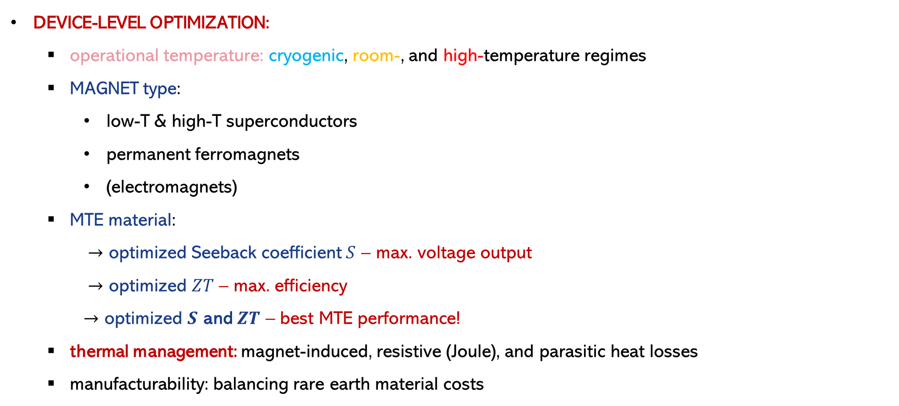
2 Magneto-thermoelectrics device
DEVICE-LEVEL OPTIMIZATION:
operational temperature: cryogenic, room-, and high-temperature regimes
MAGNET type:
low-T & high-T superconductors
permanent ferromagnets
(electromagnets)
MTE material:
$→$ optimized Seeback coefficient $S$ – max. voltage output
$→$ optimized $ZT$ – max. efficiency
$→$ optimized $S$ and $ZT$ – best MTE performance!
thermal management: magnet-induced, resistive (Joule), and parasitic heat losses
manufacturability: balancing rare earth material costs
TEMPERATURE-DEPENDENT!
TEMPERATURE-DEPENDENT!
TEMPERATURE-DEPENDENT!
7

Slide 8
3 Cryogenic magneto-thermoelectrics
MAGNET type:
~ 2 T up to 25 K: low-T superconducting magnets – 4 K: up to 25 T, 20 K: up to 6 T
~ 2 T up to 90 K: high-T superconducting magnets – 4 K: up to 100 T, 20 K: up to 50 T
~1.4 - 2 T in all cryogenic regime: permanent magnets (Nd₂Fe₁₄B, SmCo)
MTE material:
10 – 100 K: Bi & Bi-Sb Alloys
→ under 5-9 T (anisotropic Fermi surface)
90 – 110 K: high-Tc superconductors (YBa₂Cu₃O₇, Bi-2223)
→ under 3-8 T (vortex movement in the vortex-liquid phase)
150 – 300 K: topological insulators (Bi₂Te₃, Sb₂Te₃)
→ under 1-3 T (spin-momentum-locked surface-state disruption)
8

Slide 9
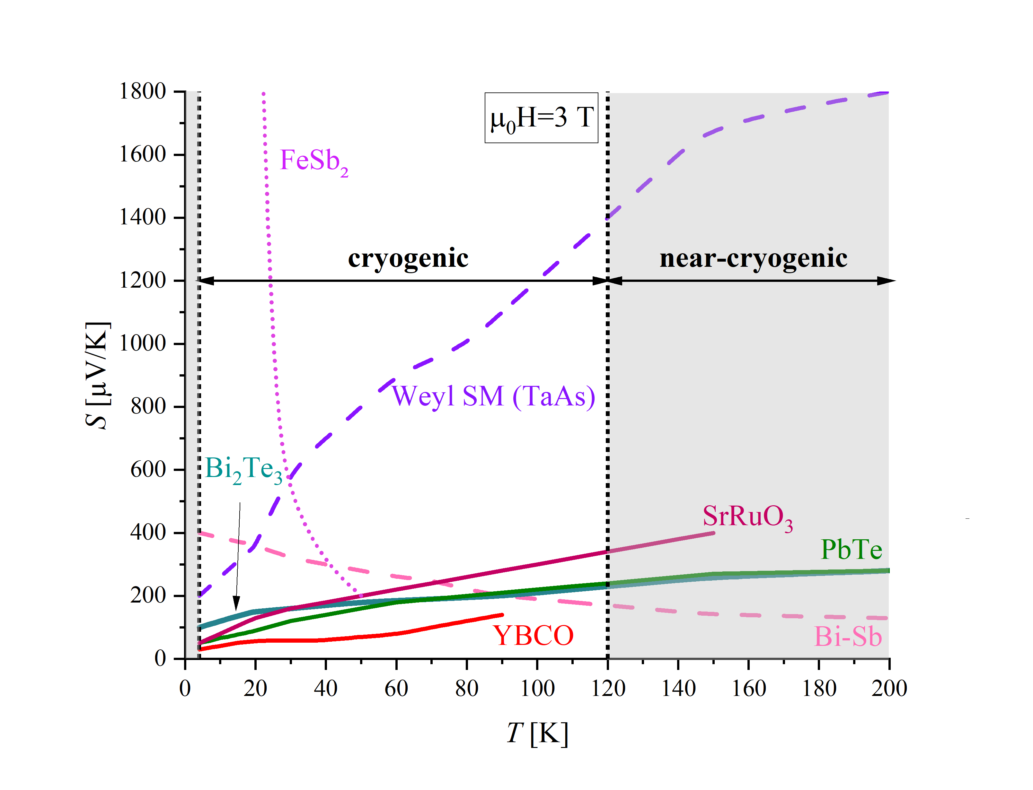
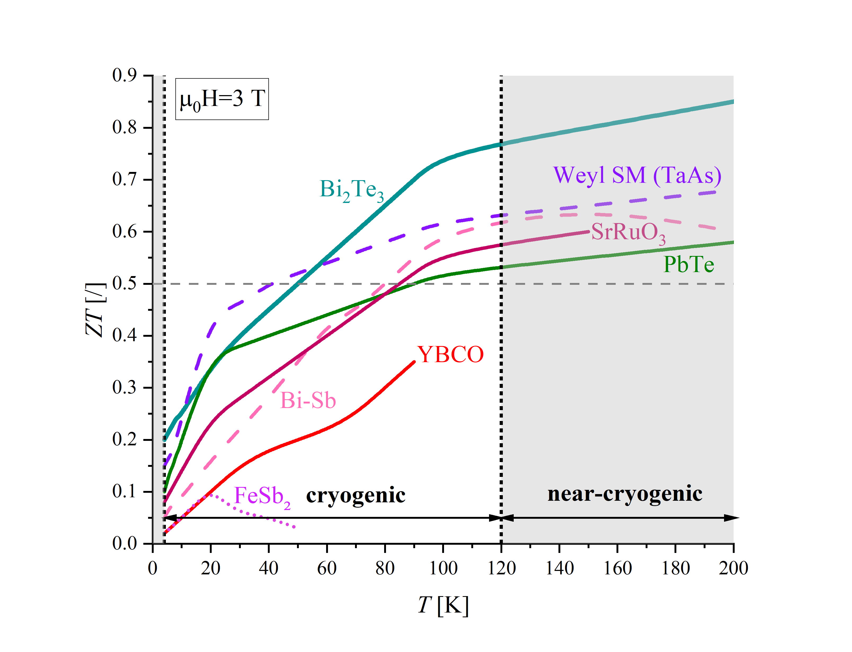
3 Cryogenic magneto-thermoelectrics
MTE material – tailored to temperature range, $S$ and $ZT$ optimization, and applied magnetic field
9

Slide 10
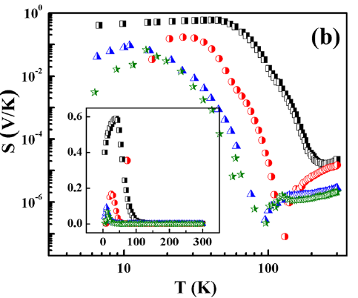
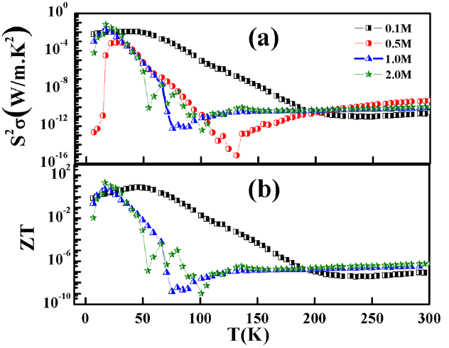
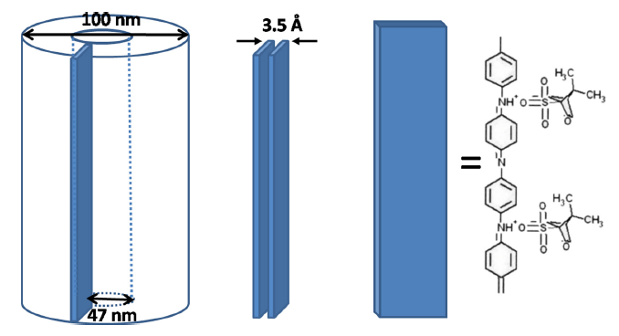

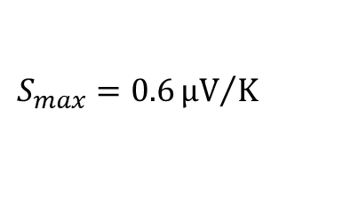
3 Cryogenic magneto-thermoelectrics
MTE material – novel processing techniques $→$ new (M)TE candidates?
$$S_{max}=0.6{μV}/K$$
$${(ZT)}_{max}=2.14 \left[17K\right]$$
conducting polymer polyaniline (Pani) doped with camphor sulfonic acid synthesized in semi-crystalline nanostructures
[Nath et al., Applied Physics Lectures 2014]
10

Slide 11
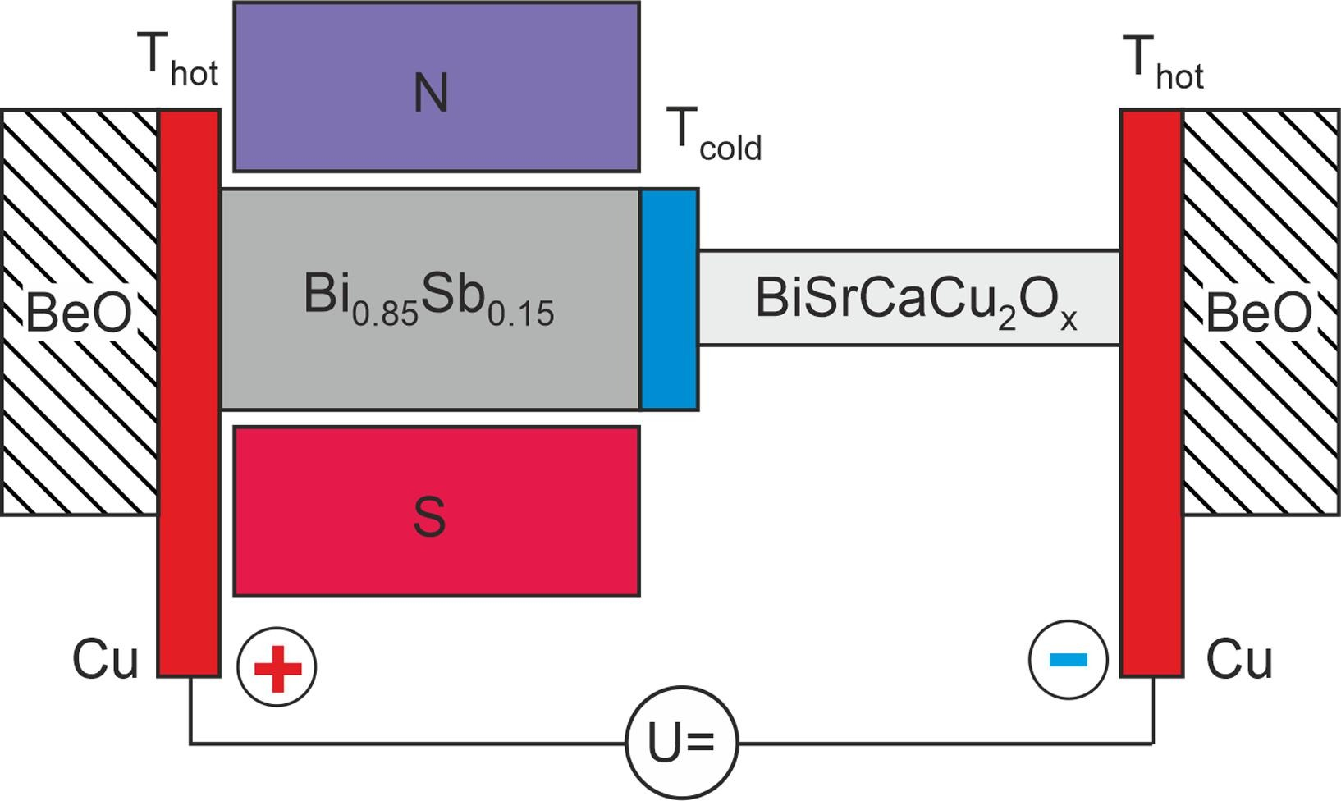
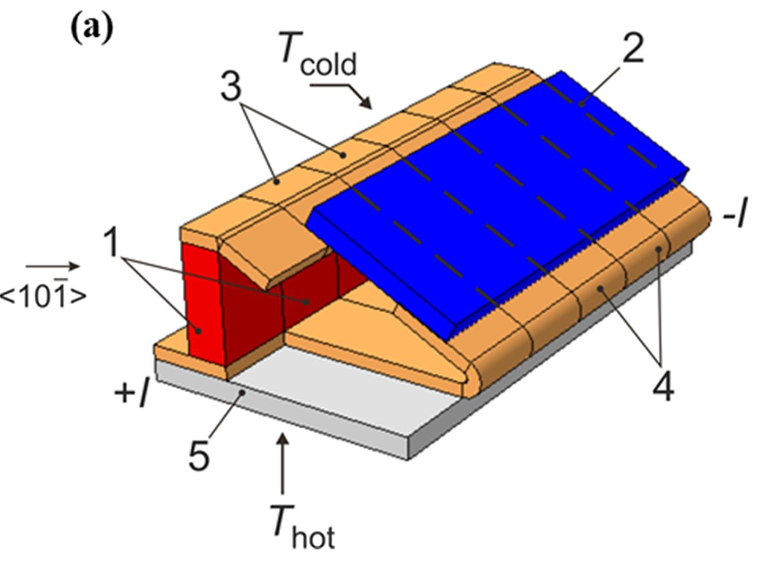





3 Cryogenic magneto-thermoelectrics
CRYOGENIC MAGNETO-THERMOELECTRIC COOLER
$$\max\left(∆T\right)=15 K$$
$$COP=\frac{{\dot{Q}}_{c}}{W}=0.11 −0.15$$
passive legs based on HTSC (YBa₂Cu₃O₇) films
$$=80 K$$
n-legs from Bi_{0.91}Sb_{0.09}
$$\max\left({\dot{Q}}_{c}\right)=0.4 W$$
[Sidorenko et al., Cryogenics 2020]
$$0.10 V$$
11

Slide 12
4 Near-room-temperature magneto-thermoelectrics
MAGNET type:
0.3 - 2 T: permanent magnets (Nd₂Fe₁₄B, SmCo)
0.5 - 5 T: electromagnets – water/air cooling, tunable field strength
5 - 7 T: PM+ EM hybrid magnets – water/air cooling, tunable field strength
3 - 5 T (at 77 K): SC magnets – (local) LN₂ cooling, tunable field strength
Material Class | Example Materials | T Range (K) | S (0T) [µV/K] | S (2T) [µV/K] | ZT (0T) | ZT (2T)
Heusler Alloys | Co₂MnSi, Co₂FeAl, Co₂TiSn | 200 – 400 K | 150 – 250 | 180 – 300 | 0.05 – 0.3 | 0.15 – 0.4
Half-Heusler Alloys | CoTiSb, FeNbSb, NiMnSb | 250 – 400 K | 100 – 200 | 130 – 250 | 0.1 – 0.4 | 0.25 – 0.5
Manganites | La₁₋ₓCaₓMnO₃, LaSrMnO₃ | 200 – 350 K | 150 – 250 | 180 – 280 | 0.08 – 0.3 | 0.2 – 0.45
Topological Materials | Mn₃Sn, Fe₃Sn₂, MnBi₂Te₄ | 200 – 350 K | 200 – 300 | 250 – 350 | 0.15 – 0.5 | 0.35 – 0.75
12

Slide 13
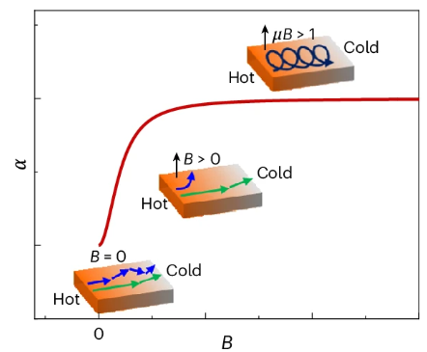
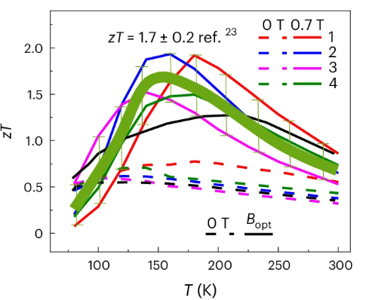
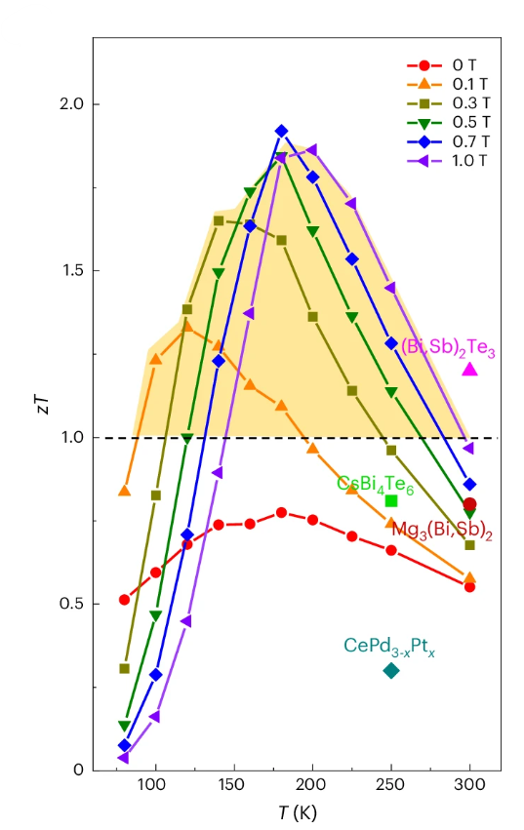
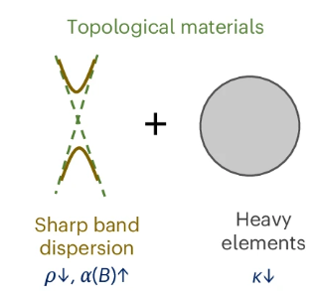
4 Near-room-temperature magneto-thermoelectrics
MTE material:
120 – 350 K: Topological Materials
Bi₈₈Sb₁₂
Potential application:
LOW-TEMPERATURE THERMOELECTRIC COOLER
[Pan et al., Nature Materials 2025]
13

Slide 14
5 High-temperature magneto-thermoelectrics
MAGNET type:
0.3 - 2 T: permanent magnets (Nd₂Fe₁₄B, SmCo)
0.5 - 5 T: electromagnets – water/air cooling, tunable field strength
5 - 7 T: PM+ EM hybrid magnets – water/air cooling, tunable field strength
Material Class | Example Materials | T Range (K) | S (0T) [µV/K] | S (2T) [µV/K] | ZT (0T) | ZT (2T)
Skutterudites | CoSb₃, FeSb₃ | 500 – 800 K | 100 – 150 | 120 – 180 | 0.2 – 0.7 | 0.4 – 1.0
Si-Ge Alloys | Si-Ge (p-type, n-type) | 700 – 1000 K | 80 – 120 | 100 – 150 | 0.5 – 1.0 | 0.8 – 1.5
Antiferromagnetic Compounds | Mn₁₋ₓCrₓSb, MnTe | 600 – 900 K | 150 – 250 | 180 – 300 | 0.3 – 0.9 | 0.6 – 1.3
Ferromagnetic Oxides | La₁₋ₓSrₓMnO₃, SrRuO₃, Fe₂O₃ | 600 – 1000 K | 100 – 200 | 130 – 250 | 0.2 – 0.8 | 0.5 – 1.1
14

Slide 15
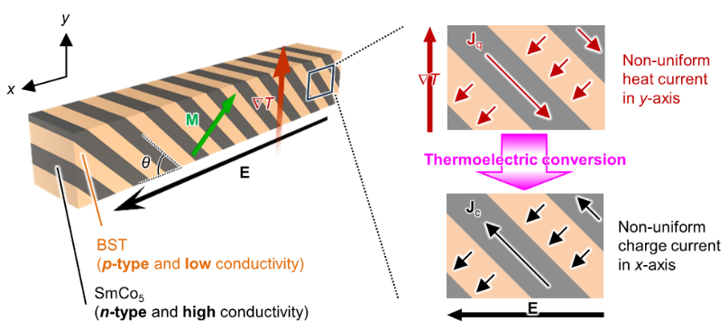
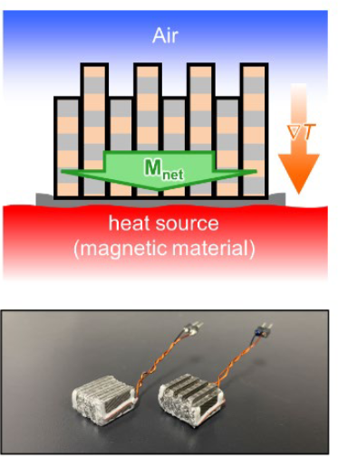
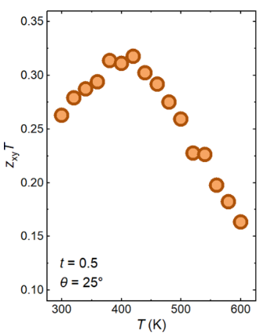
5 High-temperature magneto-thermoelectrics
Potential application:
HIGH-TEMPERATURE MULTIFUNCTIONAL COMPOSITE MAGNET ENABLING GIANT TRANSVERSE THERMOELECTRIC CONVERSION
[Ando et al., preprint 2024]
15

Slide 16
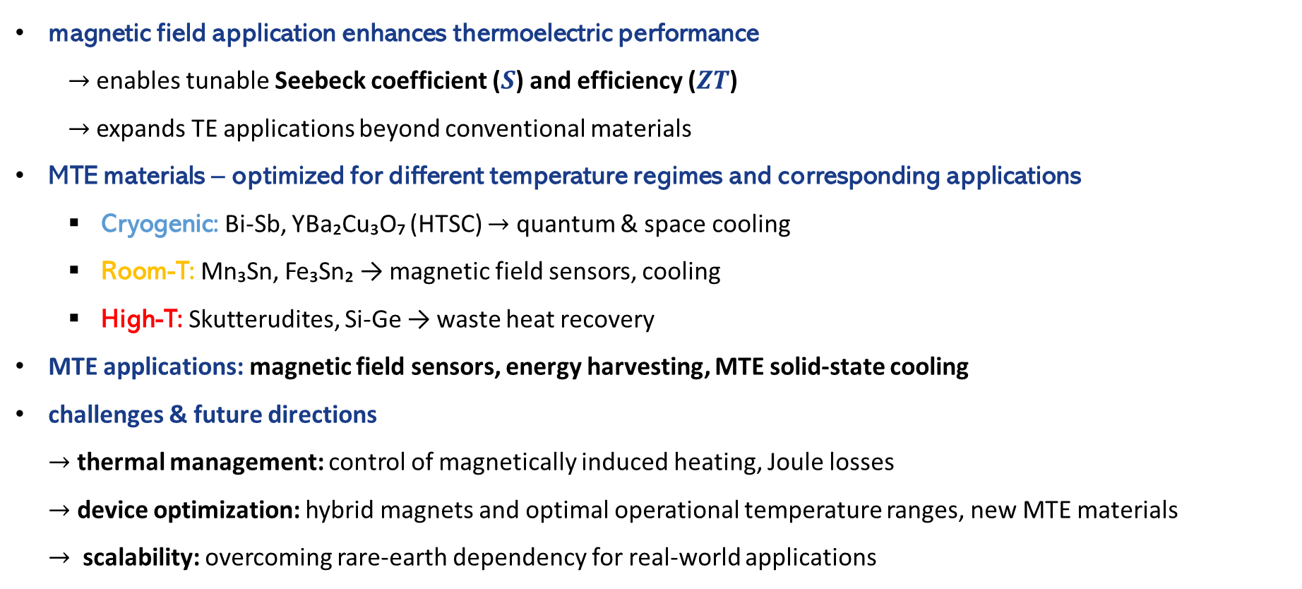
6 Conclusions
magnetic field application enhances thermoelectric performance
$→$enables tunable Seebeck coefficient ($S$) and efficiency ($ZT$)
$→$expands TE applications beyond conventional materials
MTE materials – optimized for different temperature regimes and corresponding applications
Cryogenic: Bi-Sb, YBa₂Cu₃O₇ (HTSC) $→$ quantum & space cooling
Room-T: Mn₃Sn, Fe₃Sn₂ → magnetic field sensors, cooling
High-T: Skutterudites, Si-Ge → waste heat recovery
MTE applications: magnetic field sensors, energy harvesting, MTE solid-state cooling
challenges & future directions $→$ thermal management: control of magnetically induced heating, Joule losses $→$ device optimization: hybrid magnets and optimal operational temperature ranges, new MTE materials $→$ scalability: overcoming rare-earth dependency for real-world applications
16

Slide 17

Thank you.
The authors acknowledge the financial support of the Slovenian Research Agency for the research core funding No. P2-0223 and Magccine project, which has received funding from the EU’s Horizon Europe research and innovation programme through the EIC under the grant agreement No. 101161135.

Slide 18
2 Magneto-thermoelectric device
thermal management:
magnet-induced heating
eddy currents: induced in conductive TE materials when exposed to AC or varying magnetic fields
magnetoresistance: field-dependent resistance in some TE leads to additional Joule heating
vortex dynamics: in type-II SC magnets vortex movement leads to dissipative losses in the vortex-liquid phase
resistive (Joule) heating
MCE material and el. contacts
at metal-TE interfaces electrical contact resistance causes localized heating
resistive stabilizer in SC magnets (and electromagnets)
parasitic heat losses
radiative heat transfer
thermal link to the ambient
TEMPERATURE-DEPENDENT!
18

Slide 19
2 Magneto-thermoelectric device
MTE material:
optimized Seeback coefficient S – max. voltage output
magnetic field sensors: high S ensures a strong voltage response to small B-field variations
TE devices: even small ΔT can generate large voltage
TE cooling systems: high S enables a stronger Peltier effect
optimized ZT – max. efficiency
power generation: waste heat recovery, energy harvesting, space applications
thermal-to-electrical conversion for sustainable energy systems
MTE devices where efficiency is the primary goal
optimized S and ZT – best MTE performance!
thermoelectric-magnetic hybrid systems (high efficiency + strong mag. field tunability)
transverse thermoelectric devices (ANE, Nernst, spin Seebeck effects in MTE devices)
19

