Slide 1
A CFD comparison of interfacial phase change models for boil-off, self-pressurisation and thermal stratification in LH2 storage tanks
S. Fernandes, E. V. Korsukova, C. D. Ellis, S. Ambrose and C. N. Eastwick
Mechanical and Aerospace Systems Research Group
This work was funded by the Engineering and Physical Sciences Research Council (EPSRC) and Airbus UK (EP/Y52778/1).

Slide 2
Motivation
Enabling Net-Zero Transport: Decarbonising hard-to-electrify sectors such as aviation, maritime, and heavy-duty road transport.
Overcoming Storage Challenges: Boil-off, thermal stratification, structural integrity under dynamic conditions
Bridging Knowledge Gaps: Critical need for high-fidelity data and validated models to support the design, optimisation, and certification.

Slide 3
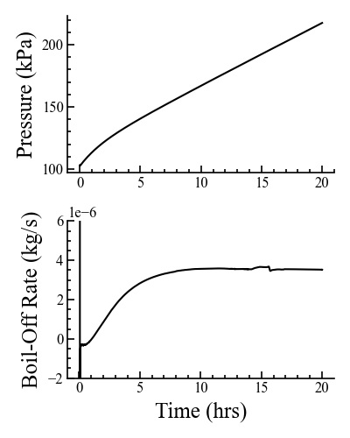






Motivation
Ullage, $α$ = 0
Motivation for LH2 in Aviation
Properties of H2
Physical / Chemical
Hazard / Safety
Impacts to A/C Design
Fuel System / Tank Design
Aero Loads / Airframe Weight
Engine / Propulsion Mods
Certification / Regulations
State of the Art Modelling
LH2 Spills
Tank Modelling
Pipe Modelling
Specific Component Modelling
Boil-off
Spills
Sloshing
Phase Change
Component Failure
Embrittlement
Ignition
$${\dot{q}}_{v}$$
$$\dot{m}$$
Interface, $0<α<1$
$${\dot{q}}_{l}$$
Liquid, $α$ = 1
When a cryogenic liquid e.g. LN2 or LH2, is stored in a tank, ambient heat can cause the liquid to vaporize in a process called boil-off
This raises the internal pressure of the tank, requiring appropriate venting
As well as this many issues are coupled to this e.g.
  Increased complexity in design and storage
  Fuel loss > Direct economic loss
  Operational issues > Refuel duration, Maintenance etc
  Environmental & Safety
A Fundamental Problem Associated with LH2 Storage

Slide 4
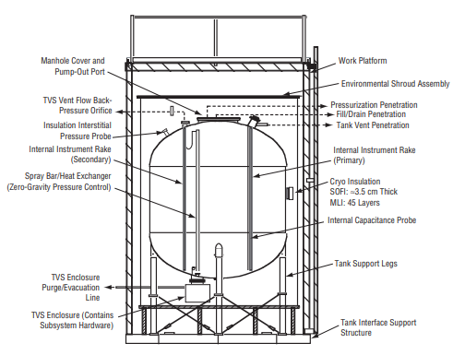
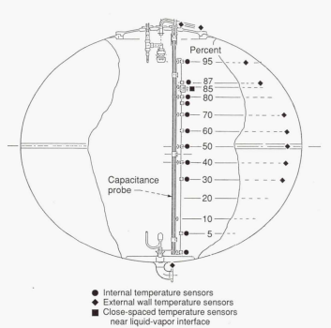
NASA Benchmark Cases
K-Site Tank 1991 [1, 2]
2 Different Experiments at different heats (2.0 and 3.5 W/m2)
(b) MHTB Tank 2000s [3]
3 Different Experiments at 3 different fills (25%, 50% & 90%)

Slide 5
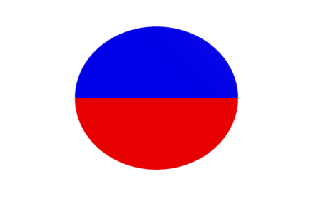
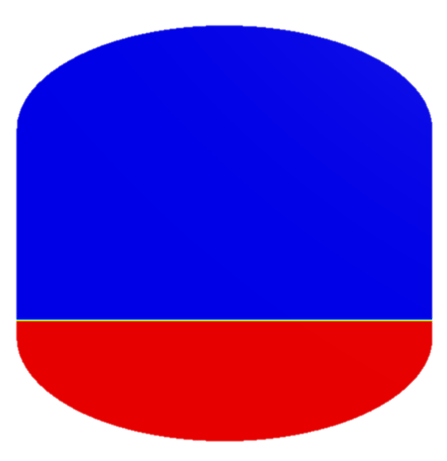
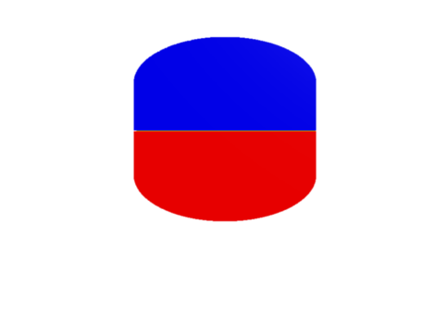
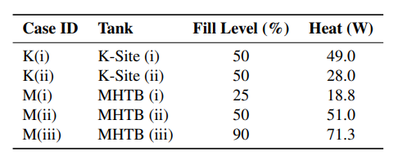


NASA Benchmark Cases
K-Site Tank 1991 [1, 2]
(b) MHTB Tank 2000s [3]
Experimental Procedure:
Store LH2 in a closed tank
Allow to self-pressurise as a result of either ambient or forced heating
K(i) 3.5 W/m2
M(i) 25 % Fill
K(ii) 2.0 W/m2
M(ii) 50 % Fill
5 Experiments for Validation
M(iii) 90 % Fill

Slide 6
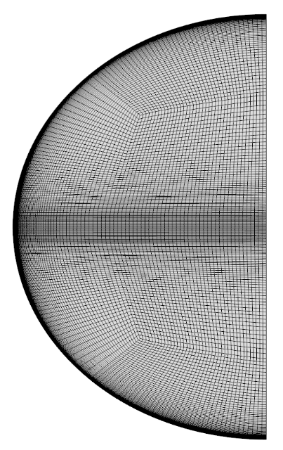
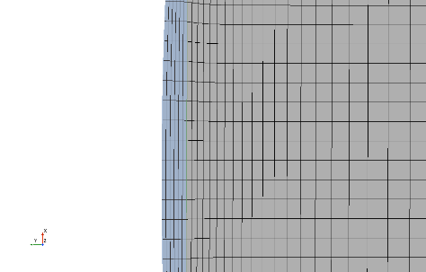
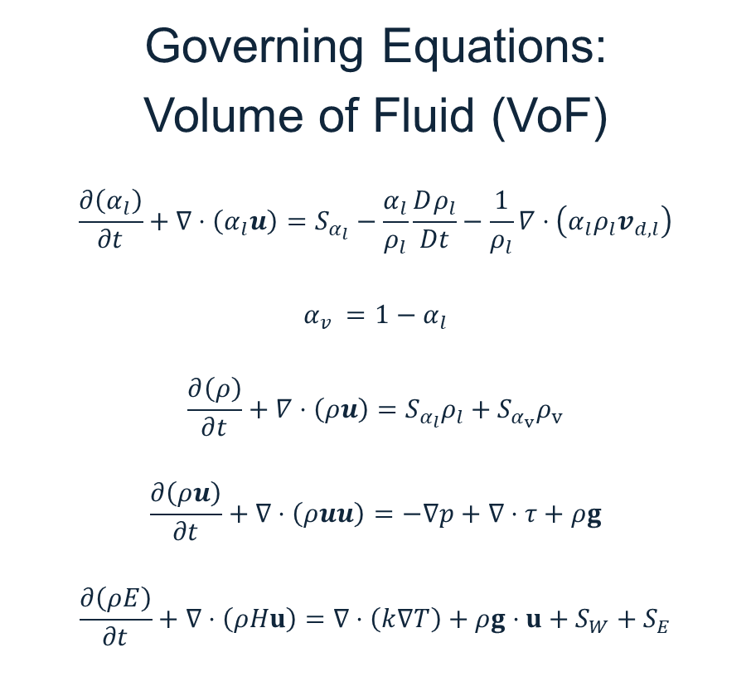
CFD Tank Modelling
Governing Equations:
Volume of Fluid (VoF)
$$\frac{∂\left(α_{l}\right)}{∂t}+∇⋅\left(α_{l}u\right)=S_{α_{l}}−\frac{α_{l}}{ρ_{l}}\frac{Dρ_{l}}{Dt}−\frac{1}{ρ_{l}}∇⋅\left(α_{l}ρ_{l}v_{d,l}\right)$$
$$α_{v} =1−α_{l}$$
$$\frac{∂\left(ρ\right)}{∂t}+∇⋅\left(ρu\right)=S_{α_{l}}ρ_{l}+S_{α_{v}}ρ_{v}$$
$$\frac{∂\left(ρu\right)}{∂t}+∇⋅\left(ρuu\right)=−∇p+∇⋅τ+ρg$$
$$\frac{∂\left(ρE\right)}{∂t}+∇⋅\left(ρHu\right)=∇⋅\left(k∇T\right)+ρg⋅u+S_{W}+S_{E}$$
Mesh Generation
Refined interface
Solid wall meshing for conjugate heat transfer

Slide 7
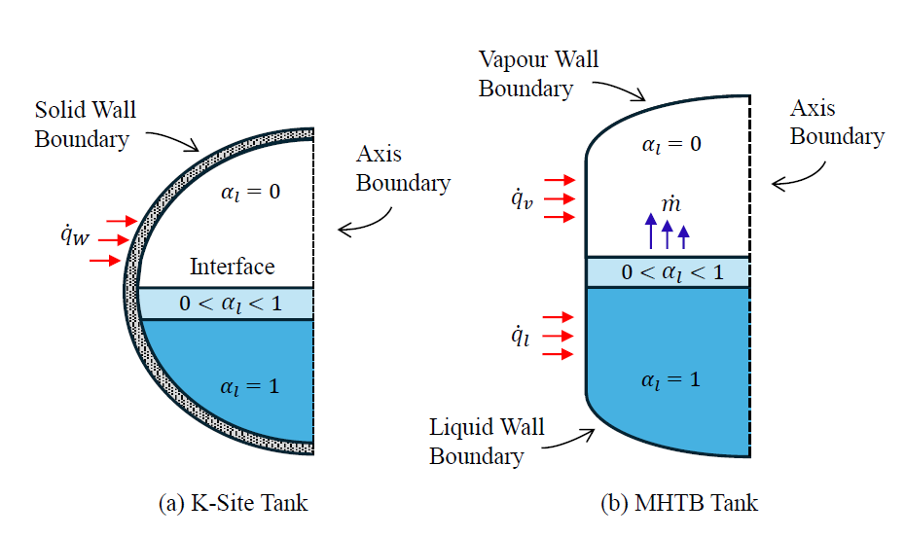



CFD Tank Modelling
Initial Conditions
MHTB tank – Isothermal conditions used – lack of experimental data
K-Site tank – Stratified temperature condition from Hasan and Van-Dresar experiment [1].
Boundary Conditions
$$q_{v}=0.45, 0.90, 0.97 W/m^{2}$$
$$q_{w}=2.00, 3.50 W/m^{2}$$
$$q_{l}=0.85, 2.08, 2.17 W/m^{2}$$
Haoren [7]

Slide 8
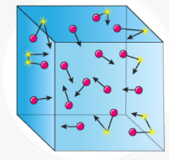
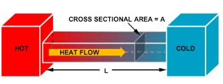
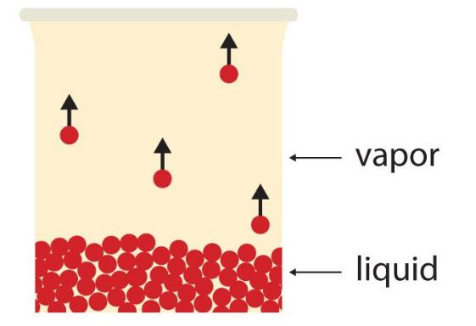

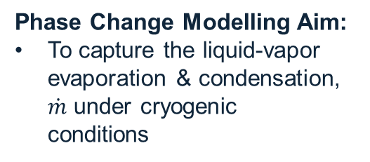
Phase Change Modelling
Two branches of interfacial phase change modelling:
Kinetic Theory of Gas Models
1882 Hertz Model
Energy Transport Models
1950 Knudsen Model
1953 Schrage Model
1991 Tanasawa Model
1985 Lee Model
Energy Jump Model
Modified Energy Jump Model
Phase Change Modelling Aim:
To capture the liquid-vapor evaporation & condensation, $\dot{m}$ under cryogenic conditions
$\dot{m}$
Parametric Study Motivation:
Compare popular phase change models to gain a better understanding in self pressurization applications

Slide 9


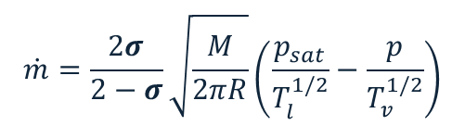

Phase Change Modelling
Kinetic Theory of Gas Models
Energy Transport Models
1953 Schrage Model [4]
1985 Lee Model [5]
Modified Energy Jump (MEJ) Model [6]
We chose to study the following popular phase change models in a parametric study:
Popular for NASA researchers
Ansys Fluent Default
STAR CCM+ Default
$$\dot{m}=\frac{2σ}{2−σ}\sqrt{\frac{M}{2πR}}\left(\frac{p_{sat}}{T_{l}^{1/2}}−\frac{p}{T_{v}^{1/2}}\right)$$
$$\dot{m}=βαρ\frac{({T−T}_{sat})}{T_{sat}}$$
$$\dot{m}=\frac{h ({T−T}_{sat})}{L}$$
Each model has its own characteristic coefficient

Slide 10
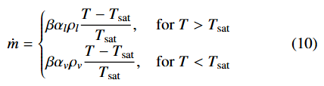




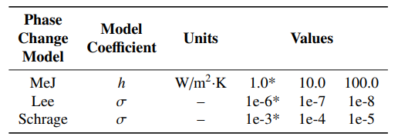
Phase Change Model Comparison
Modified Energy Jump (MeJ) Model
Lee Evaporation/Condensation Model
Schrage Kinetics Model
Each model has its own characteristic coefficient
We conducted a parametric study on each of the model’s coefficients for each experiment
5 experiments, 3 phase change models, 3 coefficient variations = 45 total simulations

Slide 11
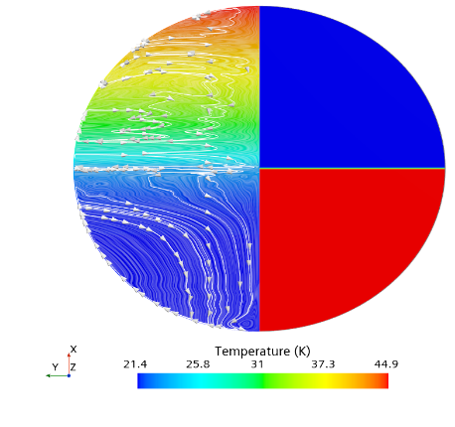
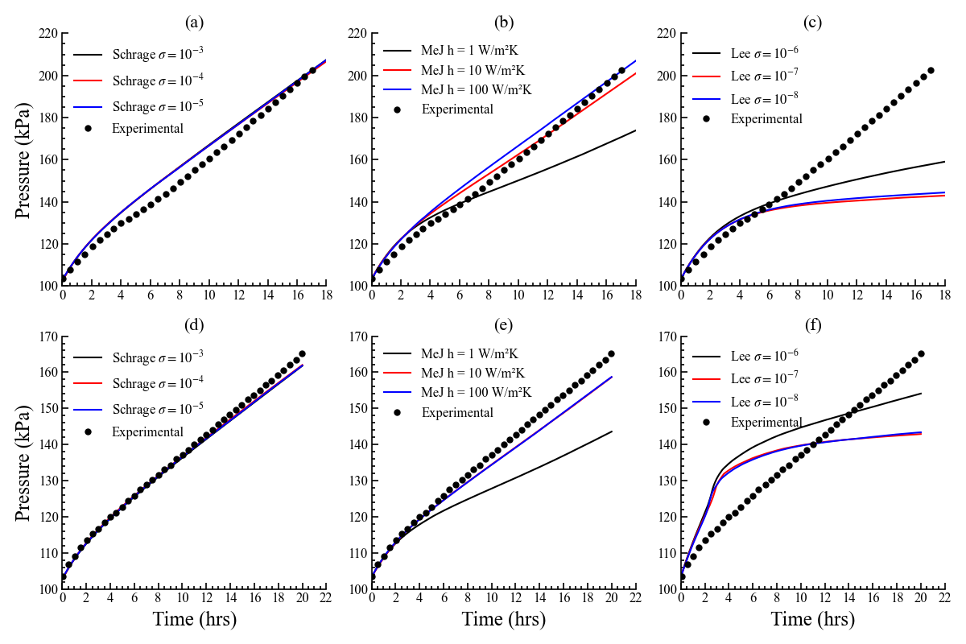

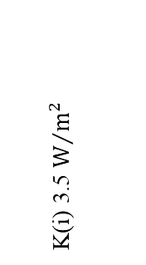
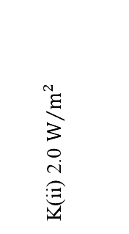
K-Site Pressurisation Results
Schrage Model
MeJ Model
Lee Model
K(i) 3.5 $W/{m^{2}}$
K(ii) 2.0 $W/{m^{2}}$

Slide 12
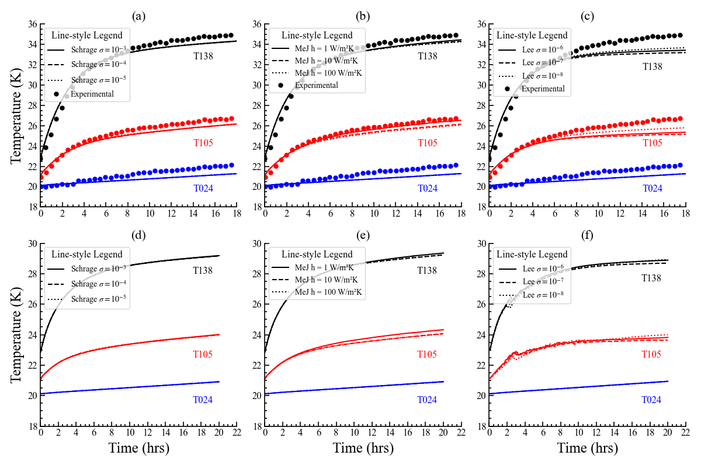
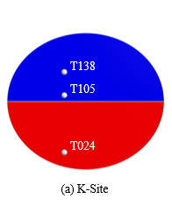
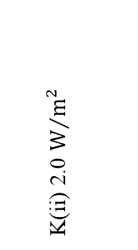
K-Site Thermal Stratification Results
Schrage Model
MeJ Model
Lee Model
K(i) 3.5 $W/{m^{2}}$
K(ii) 2.0 $W/{m^{2}}$

Slide 13
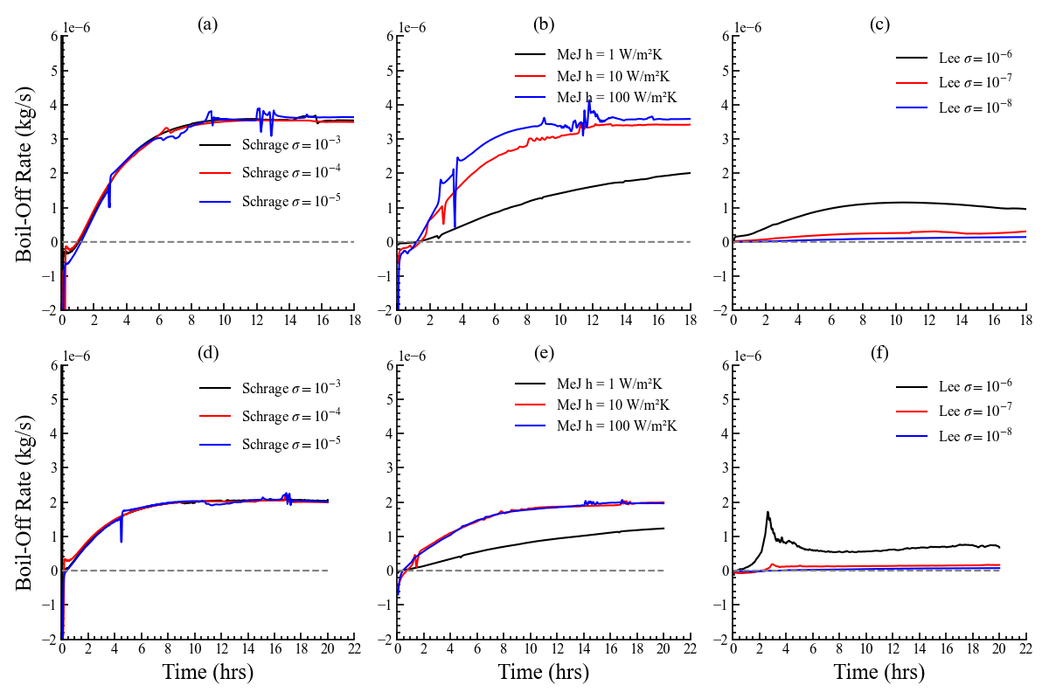
K-Site Boil-Off Analysis
Schrage Model
MeJ Model
Lee Model
K(i) 3.5 $W/{m^{2}}$
K(ii) 2.0 $W/{m^{2}}$

Slide 14
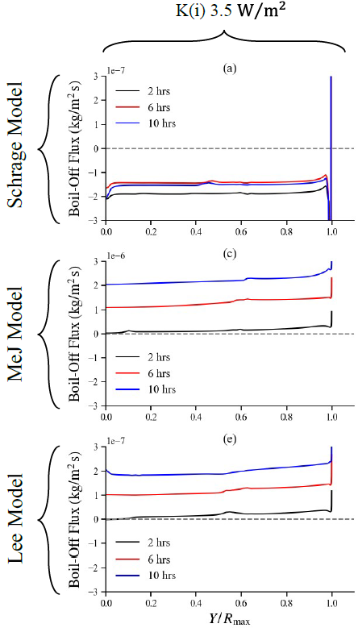




K-Site Boil-Off Analysis
Vapor, $α$ = 0
$$\dot{m}(y,t)$$
$$Y/R_{max}$$
Liquid, $α$ = 1

Slide 15
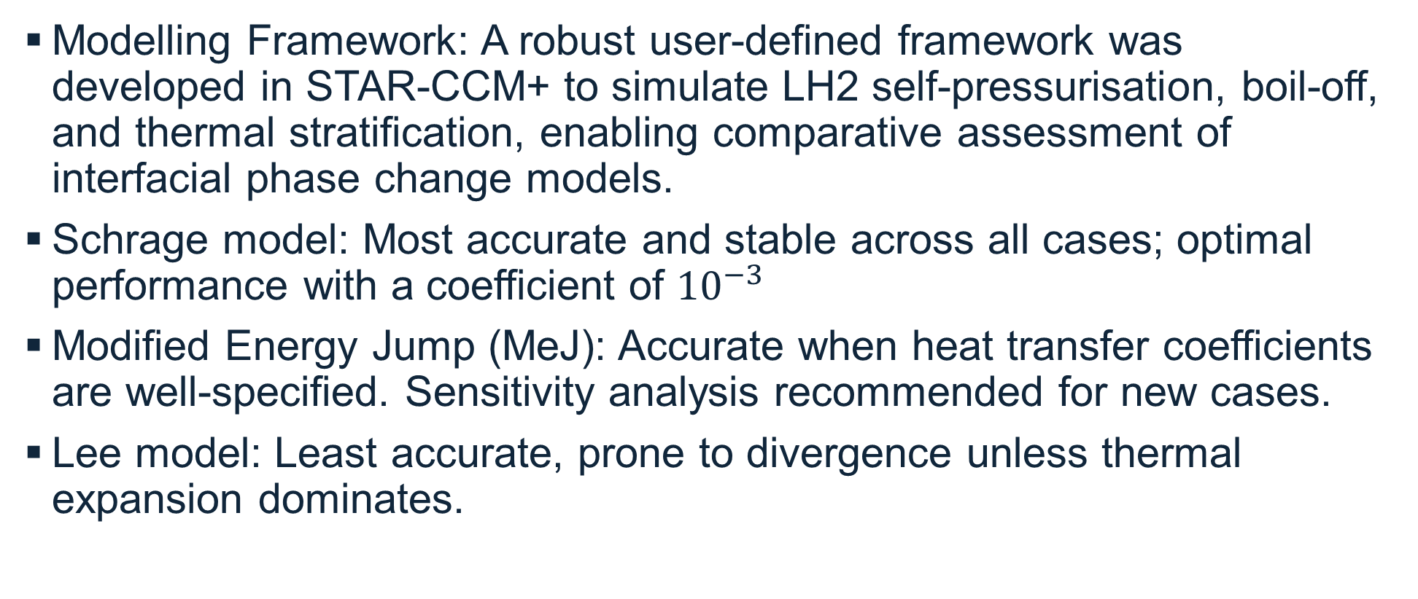
Conclusions
Modelling Framework: A robust user-defined framework was developed in STAR-CCM+ to simulate LH2 self-pressurisation, boil-off, and thermal stratification, enabling comparative assessment of interfacial phase change models.
Schrage model: Most accurate and stable across all cases; optimal performance with a coefficient of ${10}^{−3}$
Modified Energy Jump (MeJ): Accurate when heat transfer coefficients are well-specified. Sensitivity analysis recommended for new cases.
Lee model: Least accurate, prone to divergence unless thermal expansion dominates.
Notes:
Key Conclusions
Modelling Framework: A robust user-defined framework was developed in STAR-CCM+ to simulate LH₂ self-pressurisation, boil-off, and thermal stratification, enabling comparative assessment of interfacial phase change models.
Model Performance:
Schrage model: Most accurate and stable across all cases; optimal performance with a coefficient of $1×{10}^{−3}$.
Modified Energy Jump (MeJ): Accurate when heat transfer coefficients are well-specified; sensitivity analysis recommended for new cases.
Lee model: Least accurate; prone to divergence unless thermal expansion dominates.
Additional Insights:
Conjugate heat transfer improves versatility over fixed heat flux splits.
Local boil-off peaks near walls; global rates similar between Schrage and MeJ.
Flow patterns influenced by fill level and geometry; lower fills promote mixing.
Coarse meshes can suffice if interface resolution is adequate.
Limitations include stationary interface assumption and axisymmetric domain simplifications.

Slide 16
References
[1] M. Hasan, C. S. Lin, N. Vandresar, Self-pressurization of a flightweight liquid hydrogen storage tank subjected to low heat flux, in: 1991 ASME/AIChE National Heat Transfer Conference, no. E-6095, 1991.
[2] N. Van Dresar, C. Lin, M. Hasan, Self-pressurization of a flightweight liquid hydrogen tank effects of fill level at low wall heat flux, in: 30th aerospace sciences meeting and exhibit, 1992, p. 818.
[3] L. Hastings, R. Flachbart, J. Martin, A. Hedayat, M. Fazah, T. Lak, H. Nguyen, J. Bailey, Spray bar zero-gravity vent system for on-orbit liquid hydrogen storage, Tech. rep. (2003).
[4] R. W. Schrage, A theoretical study of interphase mass transfer, Columbia University Press, 1953.
[5] W. H. Lee, A pressure iteration scheme for two-phase flow modeling, Multiphase transport fundamentals, reactor safety, applications 1 (1980) 407–431.
[6] Z. Zuo, W. Zhu, Y. Huang, L. Wang, L. Tong, A review of cryogenic quasi-steady liquid vapor phase change: Theories, models, and state-of-the-art applications, International Journal of Heat and Mass Transfer 205 (2023) 123916.
[7] W. Haoren, W. Bo, L. Ruize, S. Xian, W. Yingzhe, P. Quanwen, H. Yuanxin, Z. Weiming, G. Zhihua, Theoretical investigation on heat leakage distribution between vapor and liquid in liquid hydrogen tanks, International Journal of Hydrogen Energy 48 (45) (2023) 17187– 17201.

