Slide 1
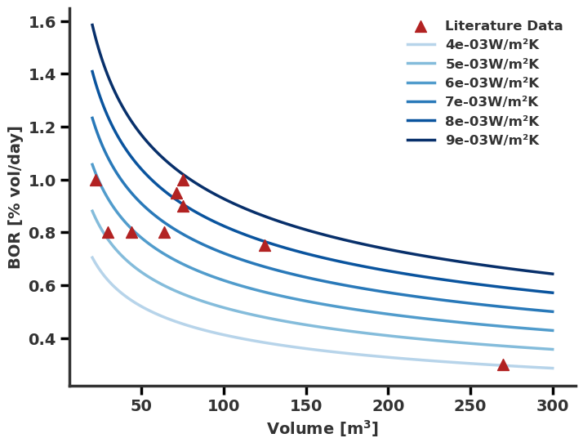
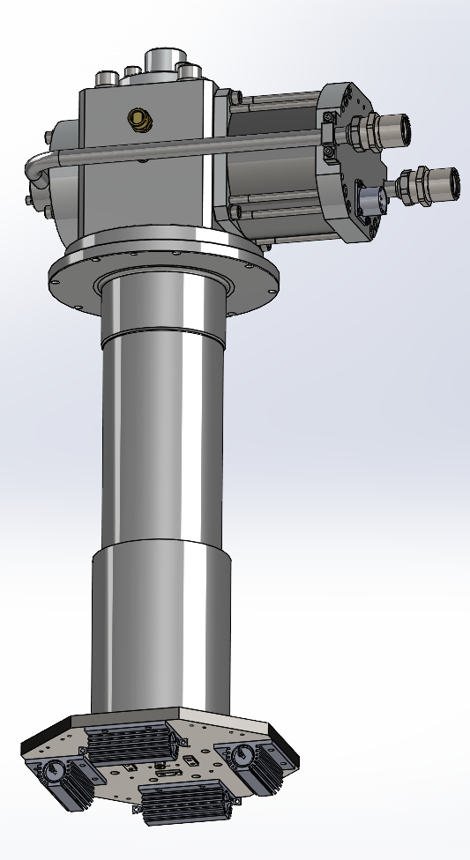
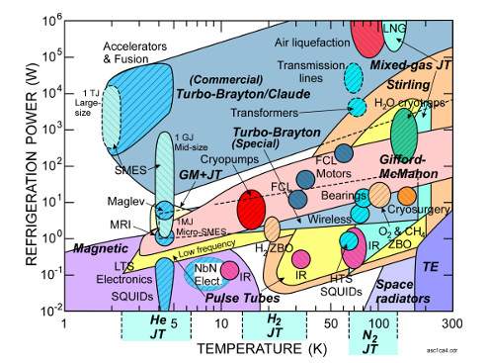
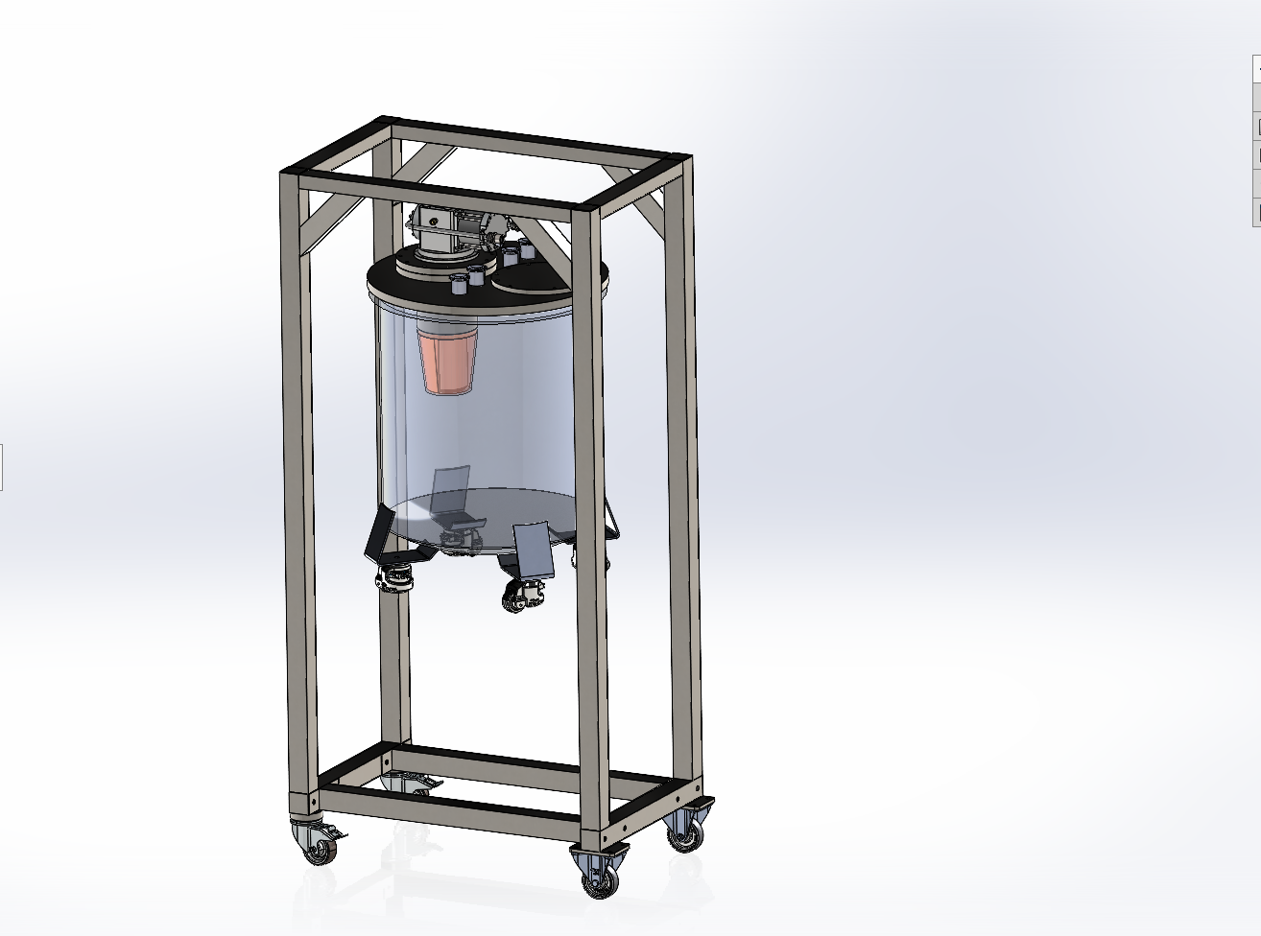
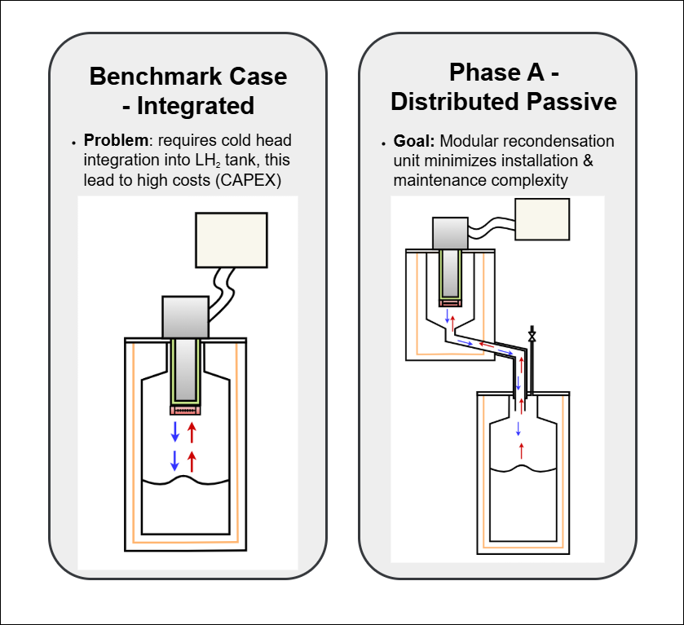



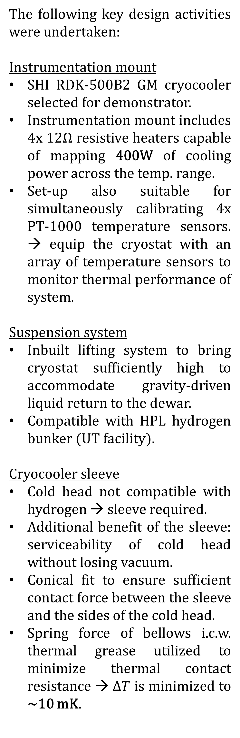
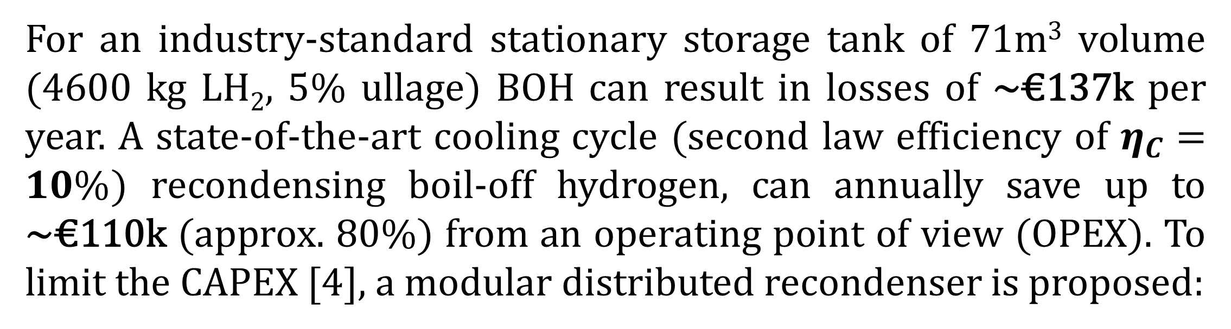
Development of a Recondensing Cryostat for ZBO LH2 Storage in Medium-Scale Tanks
H. Beens, S. Vanapalli
h.beens@utwente.nl
A green infrastructure: hydrogen as an energy carrier in the Netherlands
With conventional energy sources depleting and its impact on the climate increasing, the need for a sustainable energy supply and infrastructure is evident. When it comes to developing such an infrastructure, hydrogen (H₂) is gaining traction as a promising energy carrier. Especially the Netherlands, with its geography, key ports, solar- and wind power, policy and further infrastructure tailored to hydrogen, stands to become a major player [1]. Storing hydrogen in liquefied form (LH2) is attractive for various large-scale and long-term storage and transport scenarios. Amongst the various hydrogen storage methods, it offers a comparatively high energy density (~ 2.3 MWh/m³), high purity, non-toxicity, zero emissions at point-of-use, and low storage pressure. The high boil-off rates typically characterizing LH2 tanks, however, form a major technological and economical hurdle. To address this, one of the focus points the HyTROS project - a consortium of 32 research and industry partners developing hydrogen infrastructure - is the development of an economic boil-off recondenser.
The need for cooling in LH₂ storage
Design of a recondensing hydrogen cryostat
Especially down-stream in the hydrogen distribution chain, for medium sized storage units of 20-100 m³ with state-of-the-art insulation, the BOR is substantial: 0.6-1.0 vol%/ day [2]. The heat leak into these mid-range size of LH₂ tanks is typically on the order of ~10² W. For the smaller-sized vessels in this mid-range, state-of-the-art GM cryocoolers can deliver sufficient cooling capacity. For the larger tanks, new hybrid coolers with high cooling capacity need to be developed [3].
The following key design activities were undertaken:
Instrumentation mount
SHI RDK-500B2 GM cryocooler selected for demonstrator.
Instrumentation mount includes 4x 12Ω resistive heaters capable of mapping 400W of cooling power across the temp. range.
Set-up also suitable for simultaneously calibrating 4x PT-1000 temperature sensors. → equip the cryostat with an array of temperature sensors to monitor thermal performance of system.
Suspension system
Inbuilt lifting system to bring cryostat sufficiently high to accommodate gravity-driven liquid return to the dewar.
Compatible with HPL hydrogen bunker (UT facility).
Cryocooler sleeve
Cold head not compatible with hydrogen → sleeve required.
Additional benefit of the sleeve: serviceability of cold head without losing vacuum.
Conical fit to ensure sufficient contact force between the sleeve and the sides of the cold head.
Spring force of bellows i.c.w. thermal grease utilized to minimize thermal contact resistance → $ΔT$ is minimized to ~10 mK.
Key focus: development of ZBO demonstrator of 50 W at 20 K
For an industry-standard stationary storage tank of 71m³ volume (4600 kg LH₂, 5% ullage) BOH can result in losses of ~€137k per year. A state-of-the-art cooling cycle (second law efficiency of $η_{C}=10\%$) recondensing boil-off hydrogen, can annually save up to ~€110k (approx. 80%) from an operating point of view (OPEX). To limit the CAPEX [4], a modular distributed recondenser is proposed:
Upcoming developments
Experimental campaign: capacity mapping of cryocooler with and without sleeve.
Design of inner recondensation vessel, thermosyphon-based liquid return line and its interfacing with the outer vacuum vessel.
References
[1] Cebolla, Rafael Ortiz, Francesco Dolci, and Evelyn Weidner. "Assessment of hydrogen delivery options: feasibility of transport of green hydrogen within Europe." (2022).
[2] Verfondern, Karl. "Hydrogen fundamentals." Hydrogen safety for energy applications. Butterworth-Heinemann, 2022. 1-23.
[3] Radebaugh, Ray. "Review of refrigeration methods." Handbook of Superconductivity. CRC Press, 2022. 501-518
[4] Karayel, G. Kubilay, and Ibrahim Dincer. "Hydrogen storage and refueling options: A performance evaluation." Process Safety and Environmental Protection 191 (2024): 1847-1858.

