Slide 1

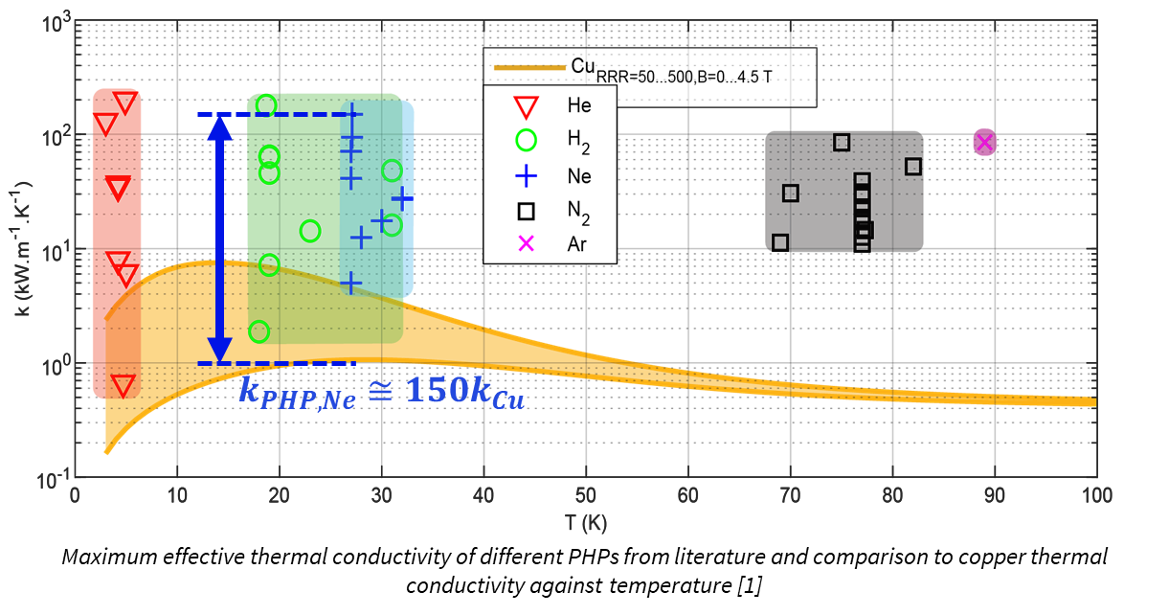
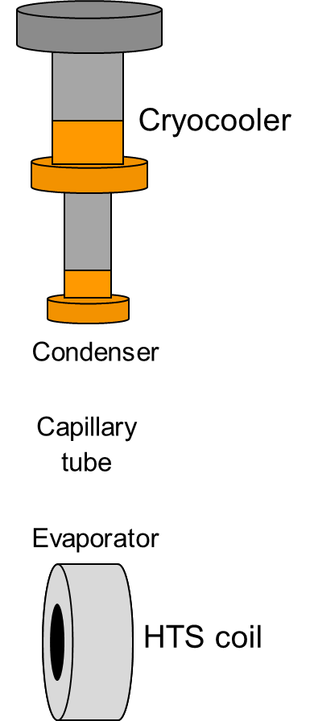
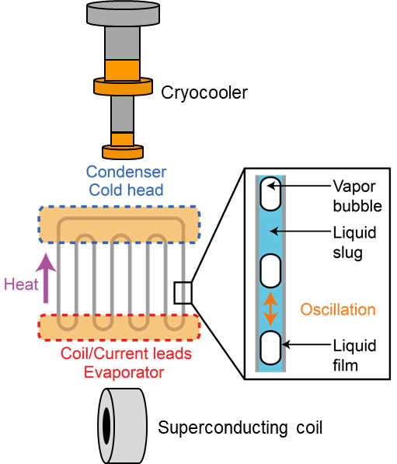
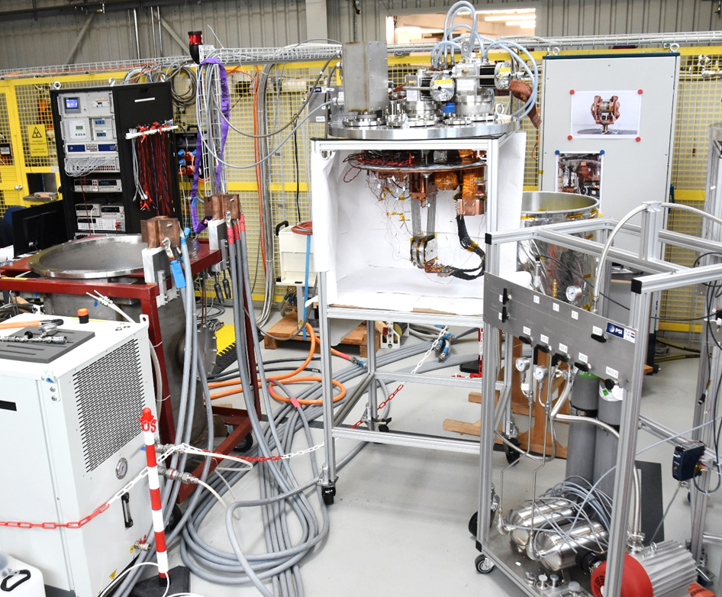
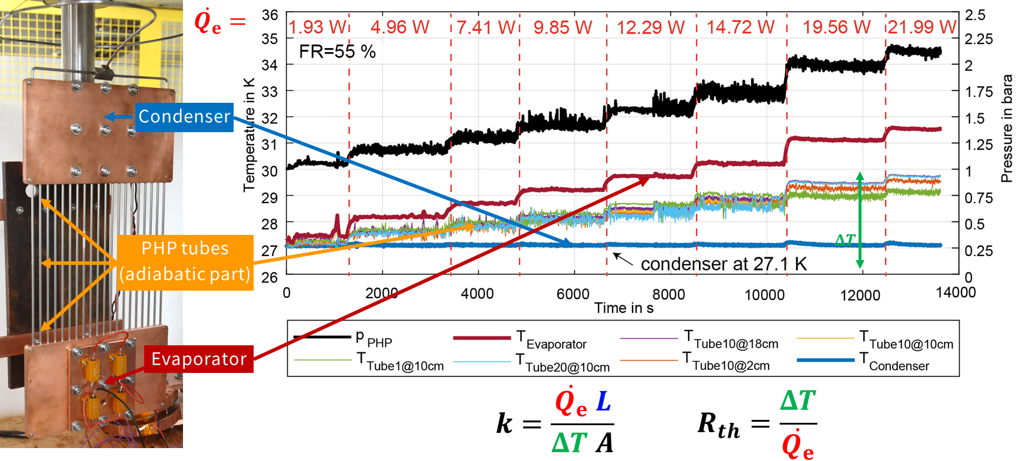

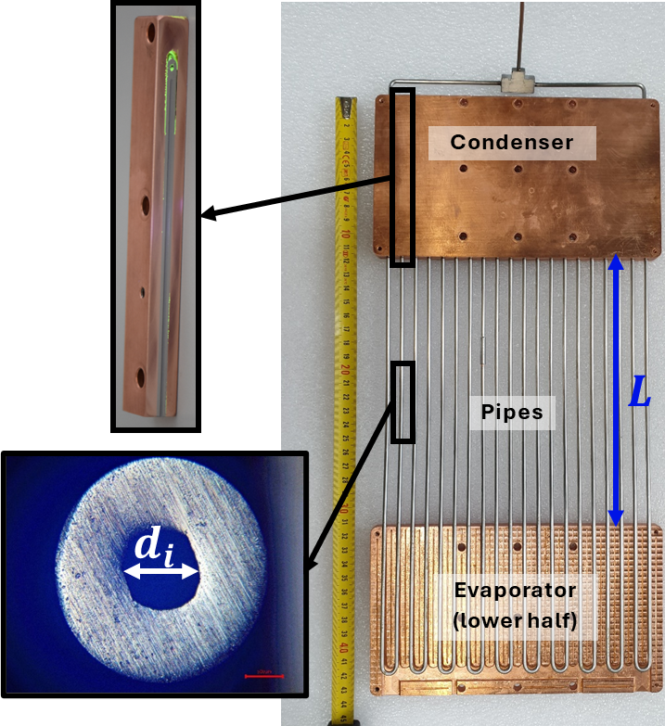
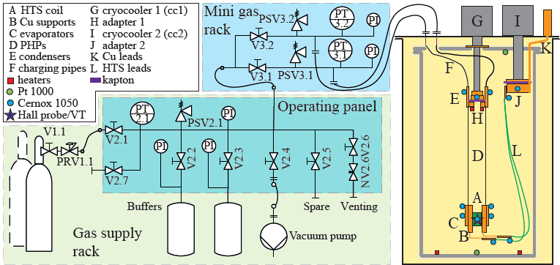
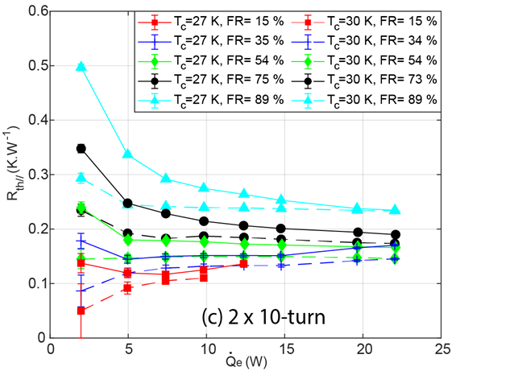
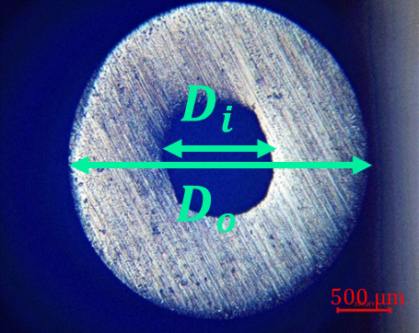
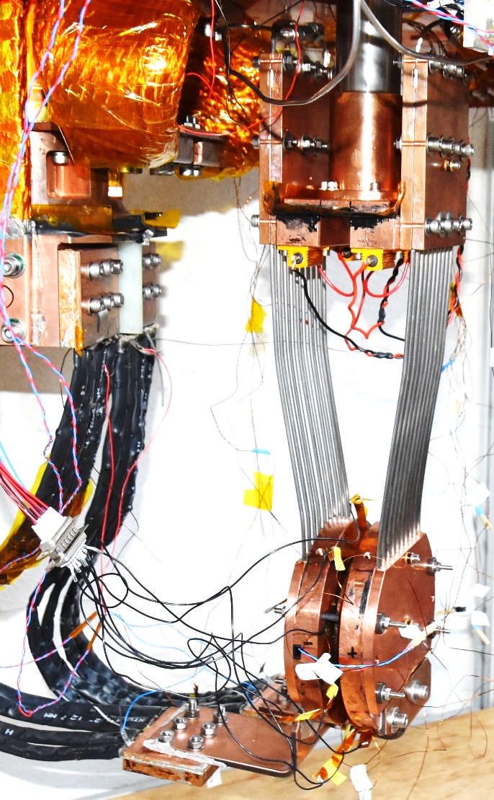
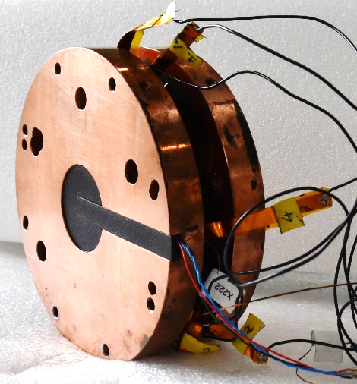
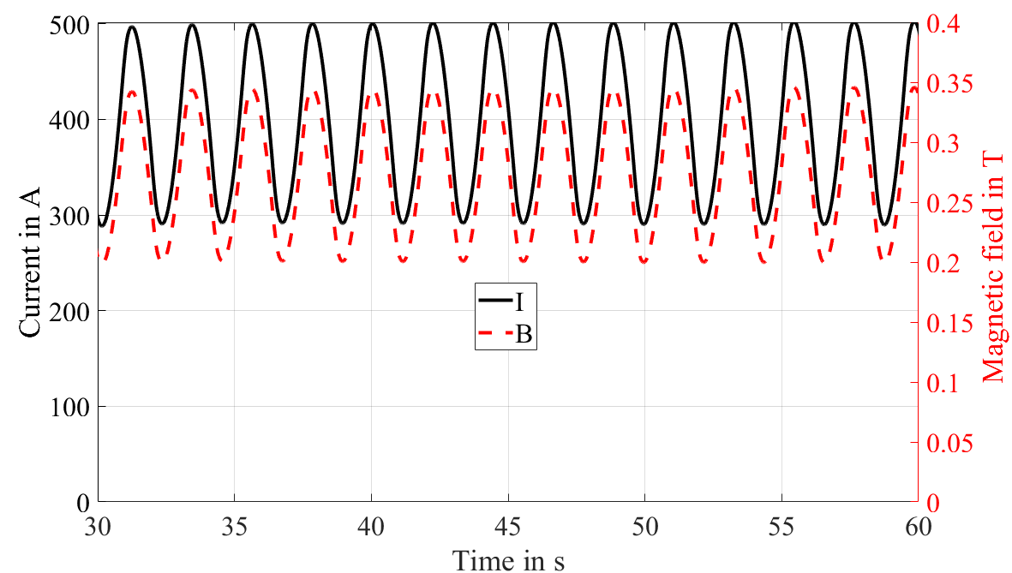
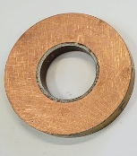
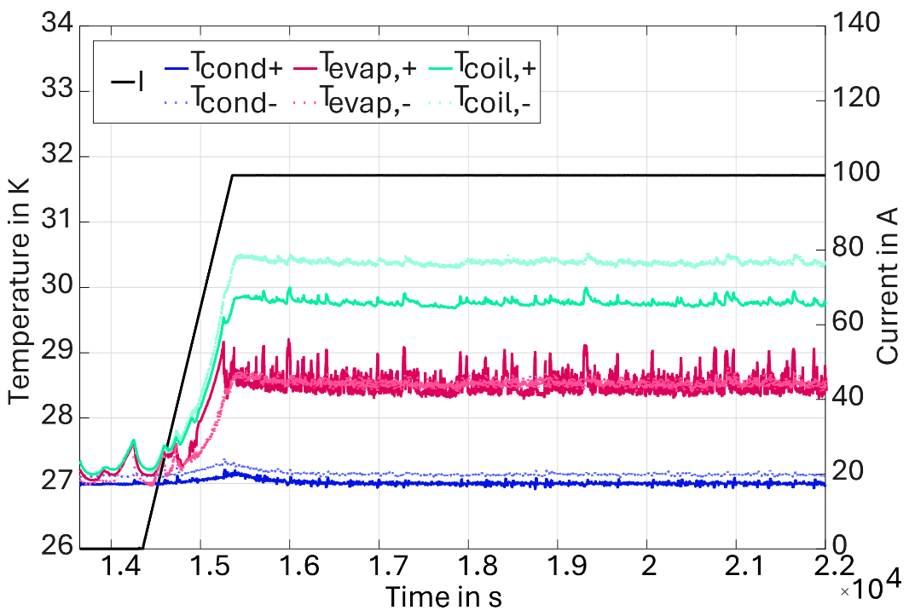
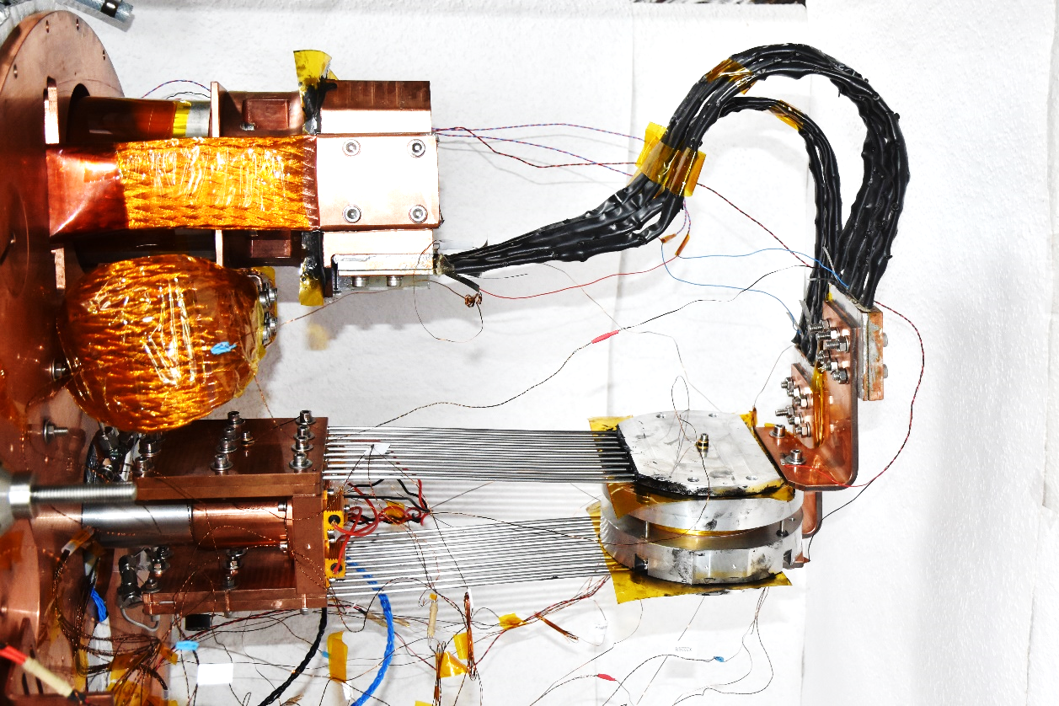
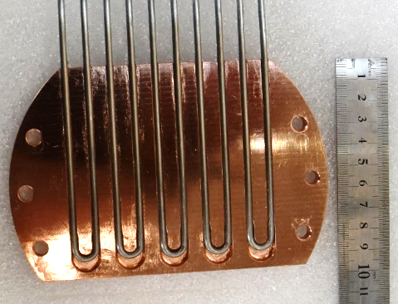
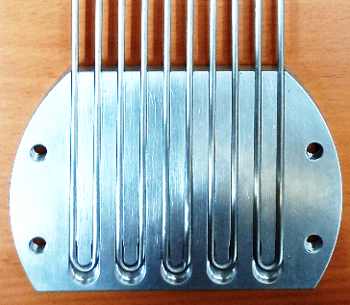
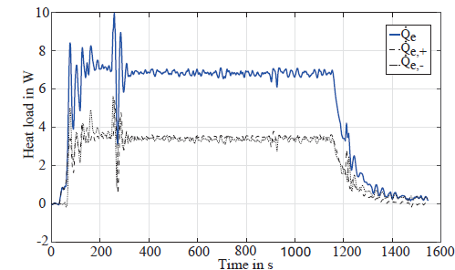

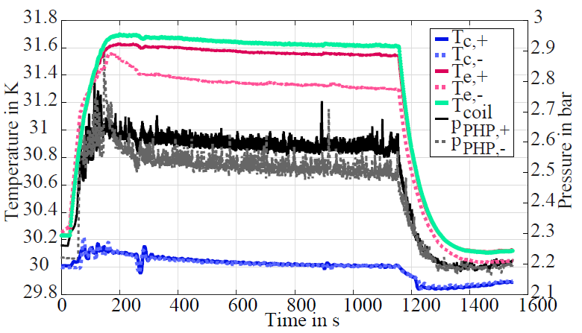
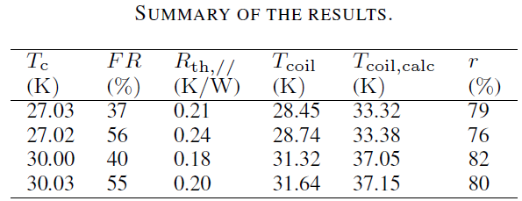
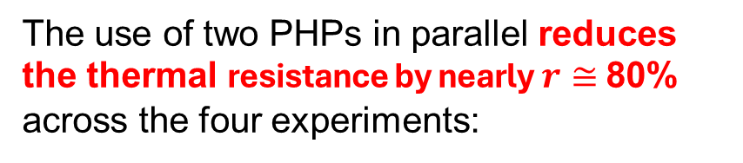
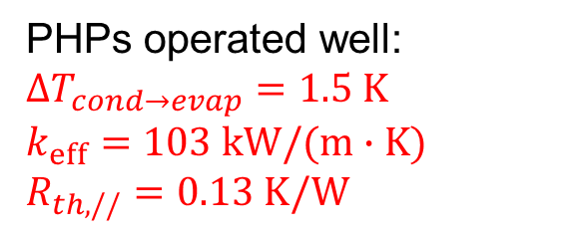
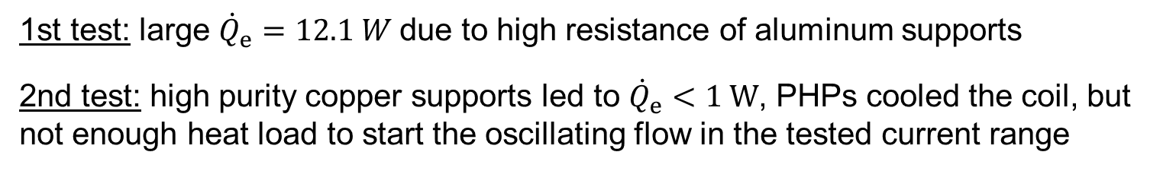
CRYOGENIC PULSATING HEAT PIPES: APPLICATION TO HTS COILS
Q. Gorit^{1,2)}, A. Brem¹⁾, M. Duda¹⁾, H. Garcia Rodriges¹⁾, J. Kosse¹⁾, J. C. Maris^{1,2)}, R. Riccioli¹⁾, S. Sanfillipo¹⁾, Y. M. Studer¹⁾ and C. Zoller¹⁾
¹⁾ Department of Accelerator Technology, Paul Scherrer Institut, 5232 Villigen PSI, Switzerland
²⁾ VDL ETG Technology & Development B.V., De Schakel 22, 5651 GH, Eindhoven, The Netherlands
Context
Cryocoolers are increasingly favored for cooling superconducting components and an efficient heat transfer between both is crucial for ensuring the thermal stability of the superconductor
VDL ETG and PSI develop an efficient and passive thermal link for cryogenic systems used in accelerators, gantries, space, and industrial applications
Aim of the study: Design, model, build, test and apply Pulsating Heat Pipes (PHPs) to cryocooler-based HTS coil
Pulsating Heat Pipes
Experimental Setup
Characterization
Principle: Transfer heat from an evaporator to a condenser using thermally driven two-phase flow
Gain: on thermal resistance, weight and bulk, possibility to operate without gravity and to be used as thermal switch
Testing facility:
Experiments: Step-wise heating mode
Design:
Hydraulic system:
Cryostat:
Parametric study:
Effect of heat load, liquid volume fraction (filling ratio), condenser temperature and number of turns on thermal resistance
Optimal parameters identified
Dry-out conditions identified
Correlations determined
5
Application to an insulated HTS coil
Application to a non-insulated HTS coil
PHPs and HTS coil assembly:
Alternative current (AC) operation:
PHPs and HTS coil assembly:
Direct current (DC) operation:
Heat load from AC losses:
PHPs operated well:
$$ΔT_{cond→evap}=1.5 K$$
$k_{eff}=103 kW/(m∙K)$
$$R_{th,//}=0.13 K/W$$
Comparison to copper rod:
The thermal resistance of the copper rod is calculated to be nearly 1.03 K/W using:
1st test: large ${\dot{Q}}_{e}=12.1 W$due to high resistance of aluminum supports
2nd test: high purity copper supports led to ${\dot{Q}}_{e}<1 W$, PHPs cooled the coil, but not enough heat load to start the oscillating flow in the tested current range
Conclusion
The use of two PHPs in parallel reduces the thermal resistance by nearly $r≅$80% across the four experiments:
Temperatures and pressures:
Neon PHPs designed and manufactured
Experimental setup dedicated to PHP characterizations and applications built at PSI
Characterization campaigns were used to define optimal parameters and correlations for predicting their performance
Two neon PHPs in parallel were operated simultaneously with the evaporators integrated into the coil supports
Thermal resistance reduction of nearly 80% compared to a copper rod of the same adiabatic length and cross-section
First PHP application, to our knowledge, to cool and operate cryocooler-based insulated and non-insulated HTS coils
The authors would like to thank : VDL ETG and the Department of Accelerator Technology at PSI for their ongoing commitment and support.
European Cryogenics Days 2025 and the Cryogenics Heat and Mass Transfer Workshop 2025

