Slide 1
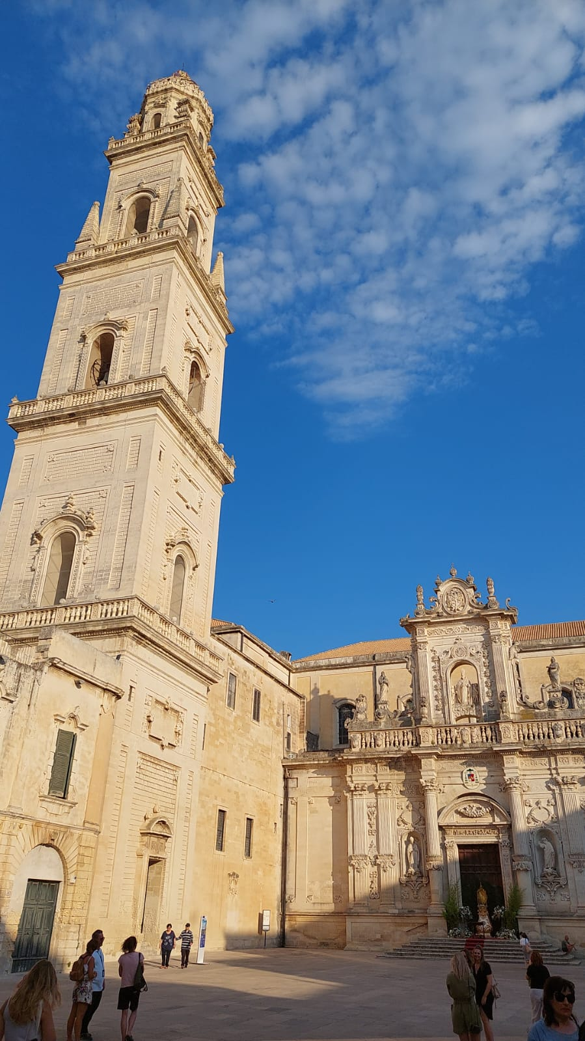
10th Beam Telescopes and Test Beams Workshop
(BTTB) in Lecce, Italy
20-24th June 2022
Alexander Gerbershagen
a.gerbershagen@umcg.nl

Slide 2
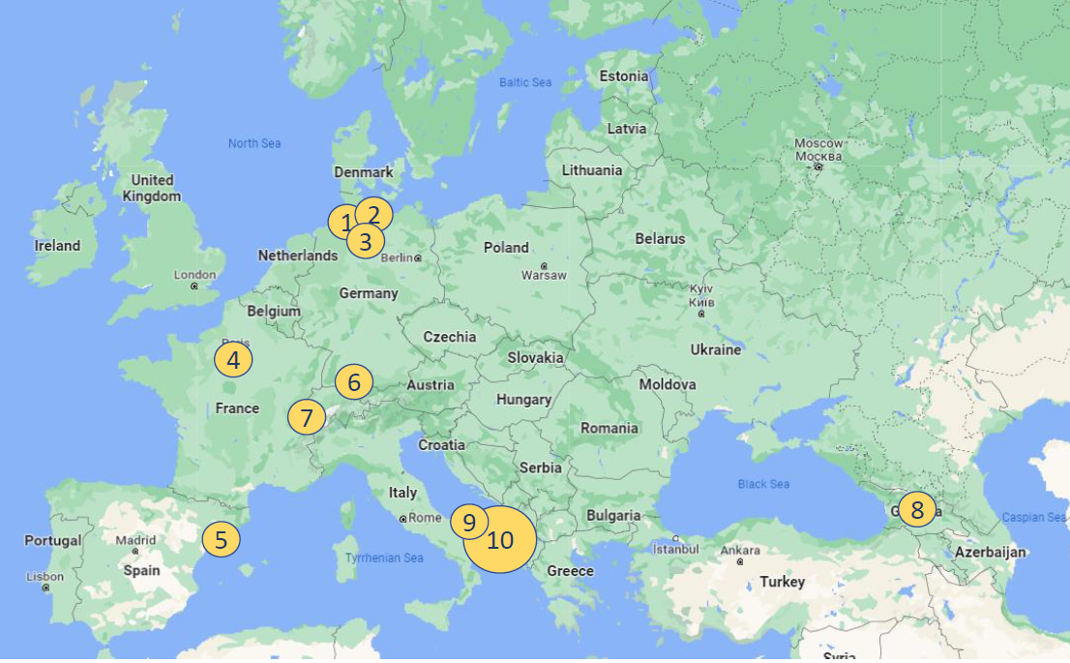
Conference details
BTTB 10
In person after more than two years
Usually in February, due to COVID this year in June
Hybrid event
  121 participants
  60 in person

Slide 3
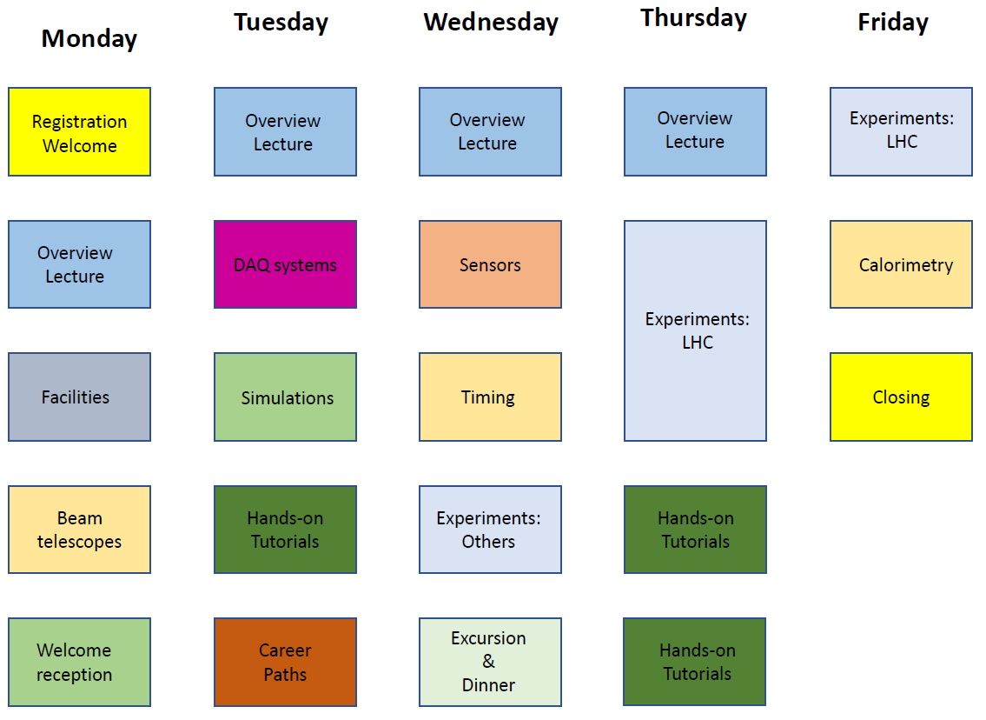
Programme
52 Contributions
4 Lectures
4 Hands-On Tutorials
New session:
Career Paths

Slide 4
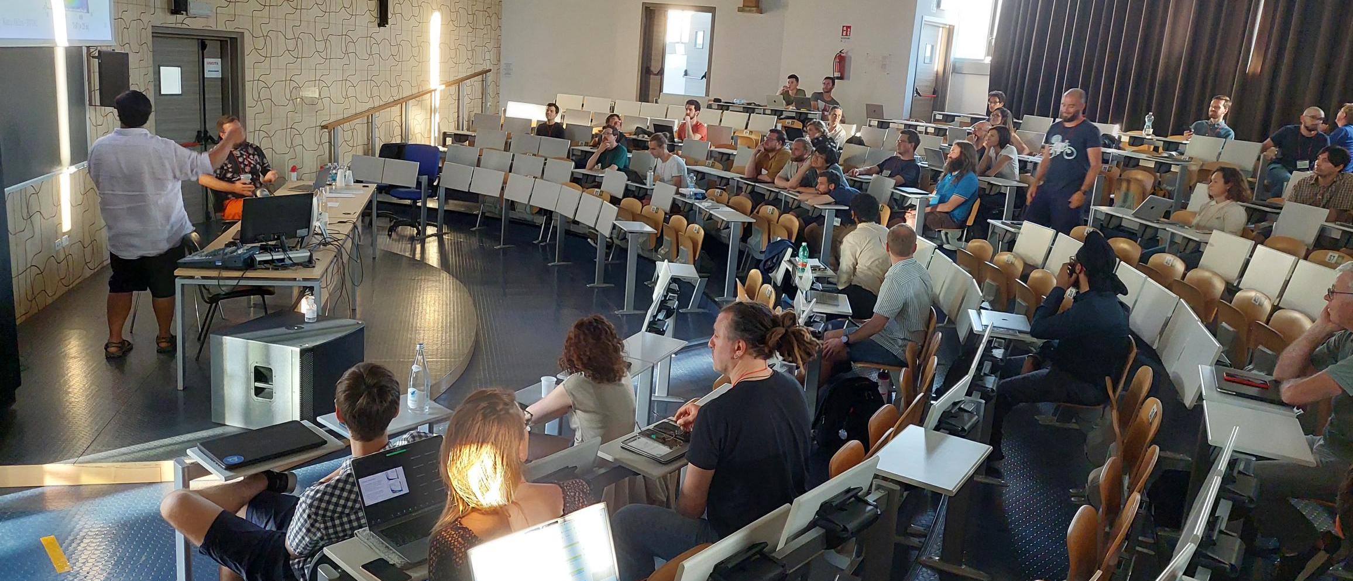
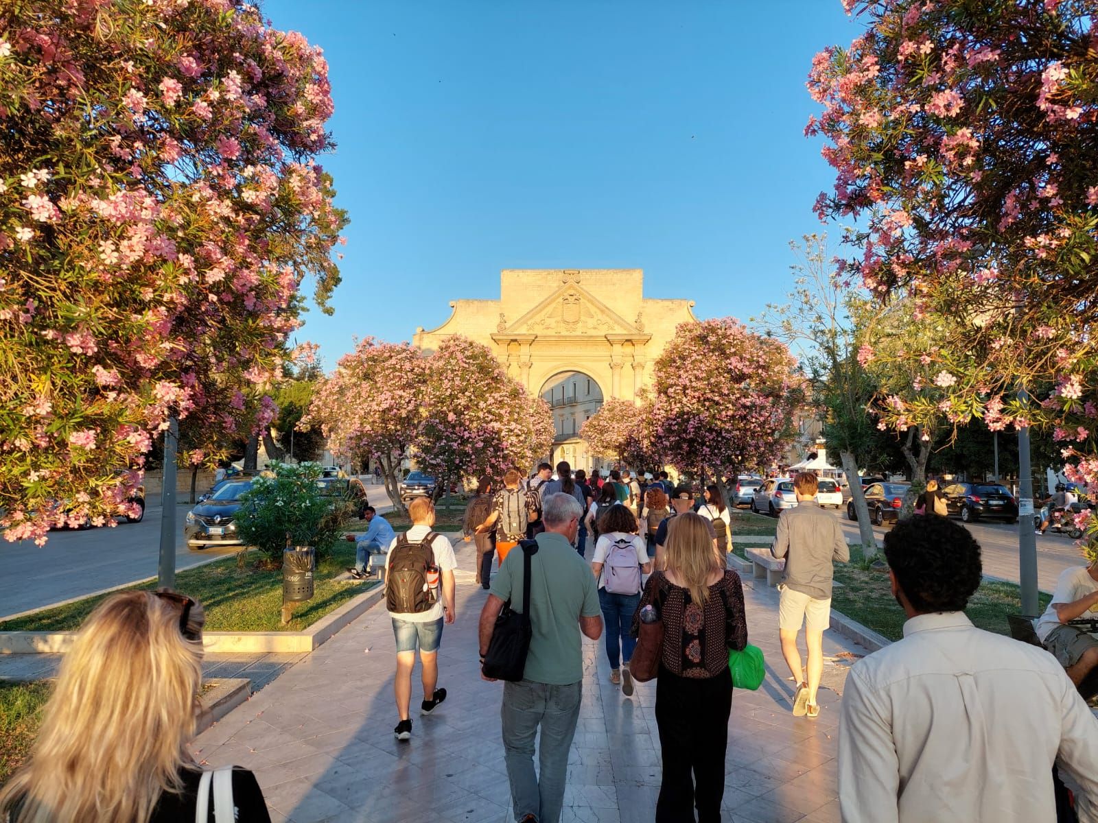
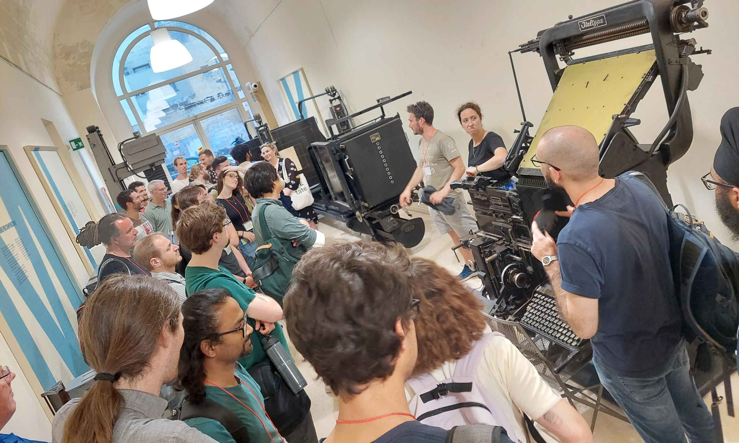
Impressions
Young, enthusiastic audience
Majority from detector development community
Facilities presenting the test beams: CERN, DESY, Fermilab
  Next year we will submit an abstract on PARTREC!
Lecce
  Very hot in summer
  Good food

Slide 5
Thank you for your attention!
Questions?

