Slide 1
Summary of International Conference on
Accelerators for Research and
Sustainable Development
Alexander Gerbershagen
a.gerbershagen@umcg.nl

Slide 2
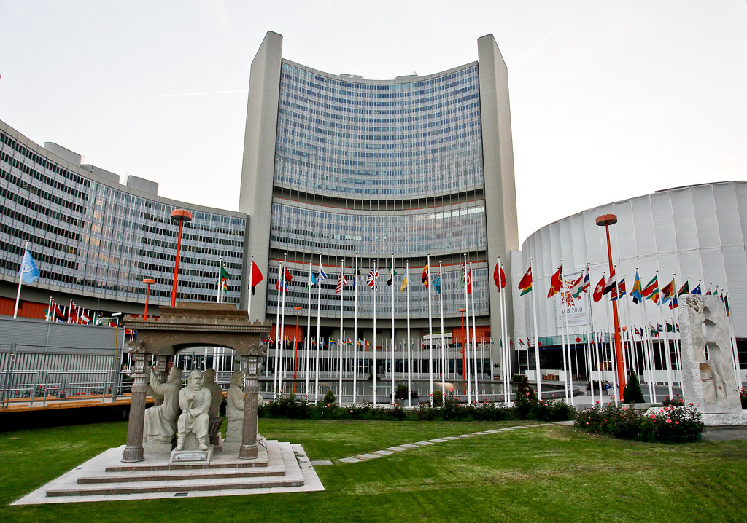
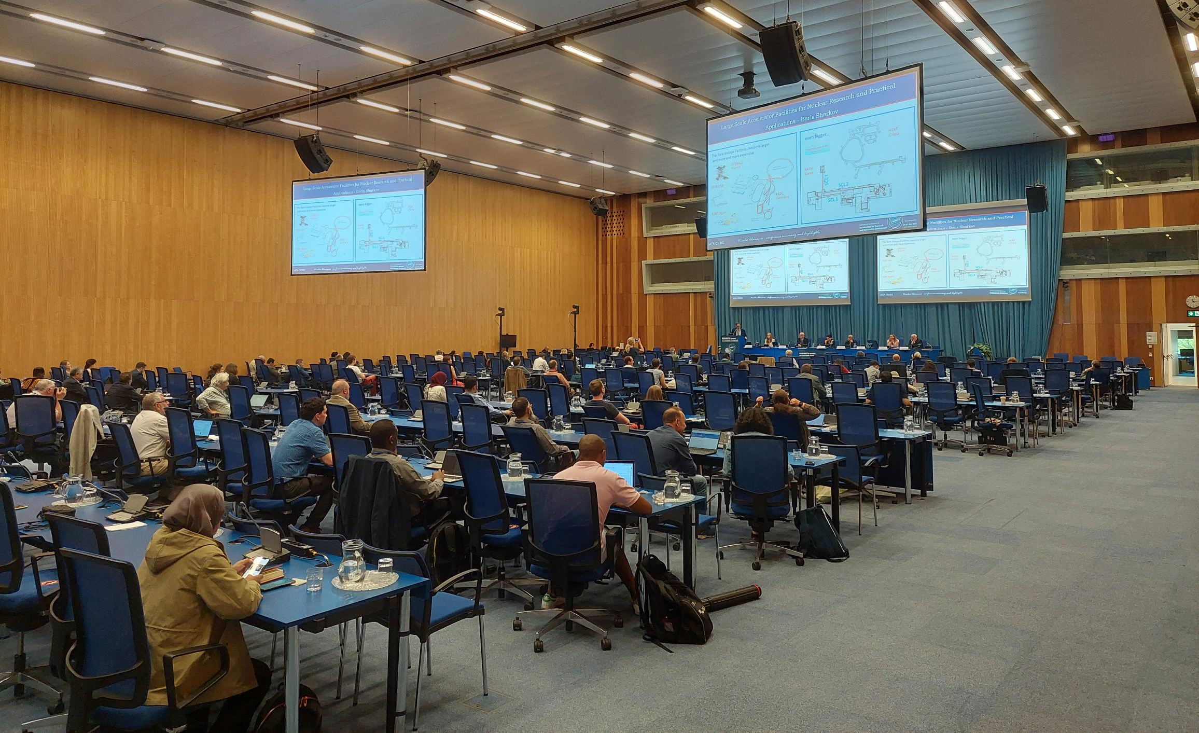
Conference details
Organized by International Atomic Energy Agency (IAEA)
First of its kind, is foreseen take place regularly (bi-annually?)
At IAEA Headquarters Vienna, Austria
Number of participants:
  ~200-300 in person
  More online
Programme over 5 days

Slide 3
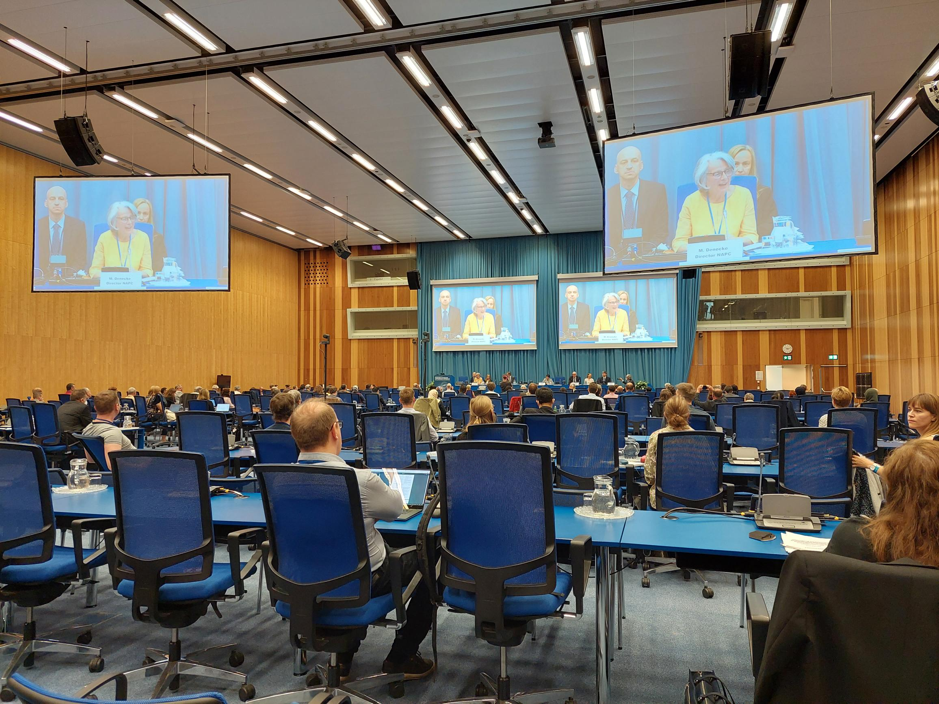
Conference topics
Accelerators for the Environment
Accelerators for Medical Applications (Cancer Therapy, Medical Radioisotopes, Energy Production and Nuclear Research)
Accelerators for Cultural Heritage
Accelerators for Nuclear Data and Materials Research
Best Practices and Education

Slide 4
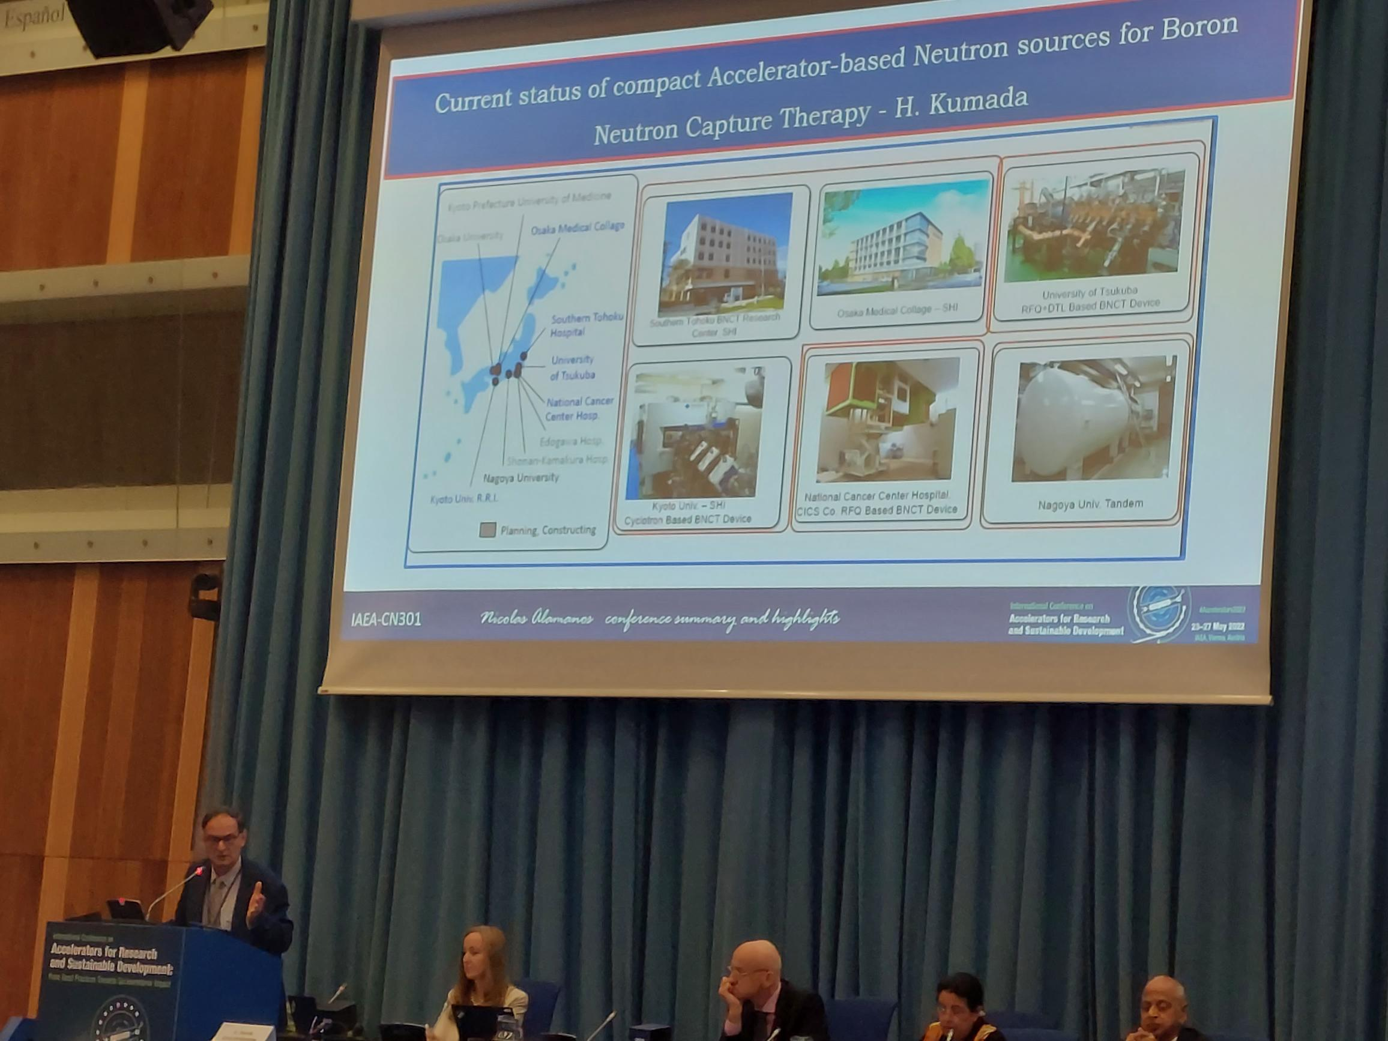
Boron Capture
Large activities in Japan
Covered by insurance

Slide 5
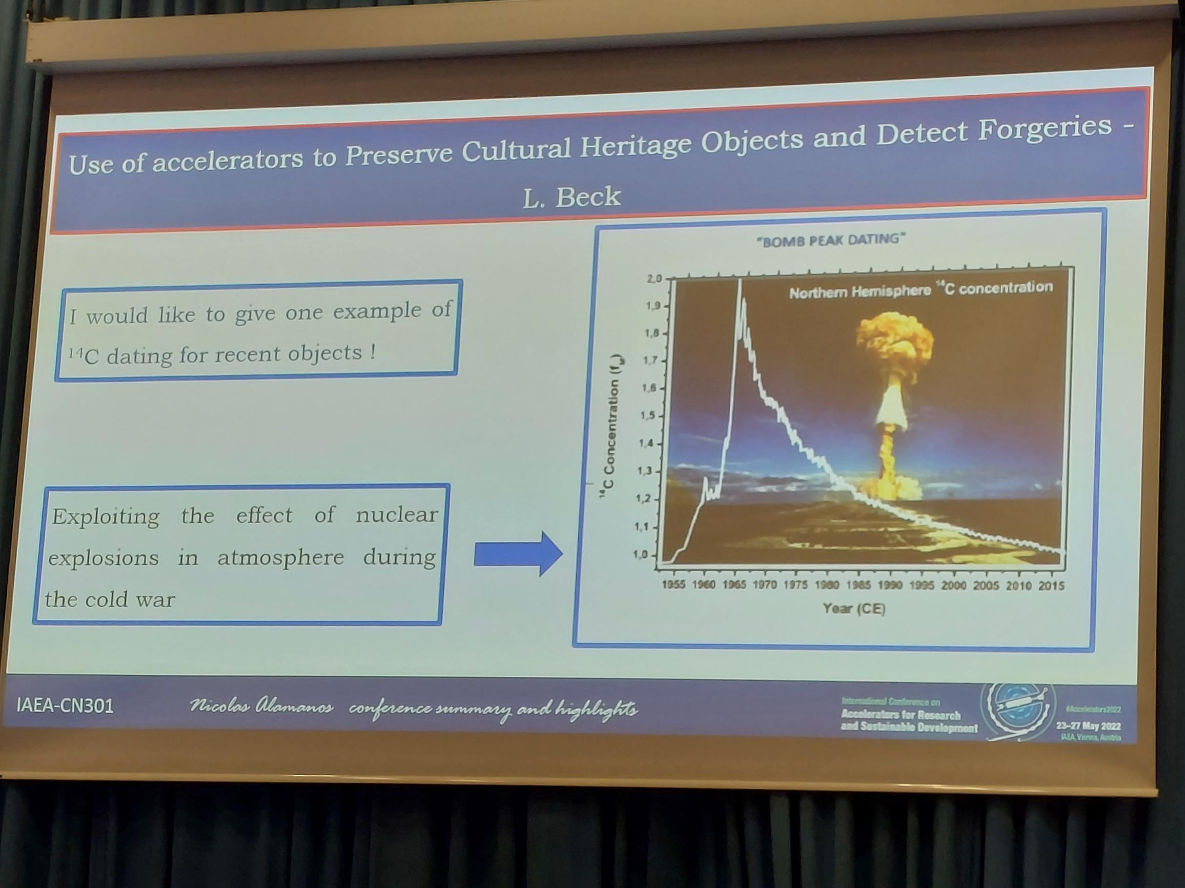
Carbon dating
Previously used for antique dating
More modern analysis possible due to large content of ¹⁴C since the start of nuclear bomb testing

Slide 6
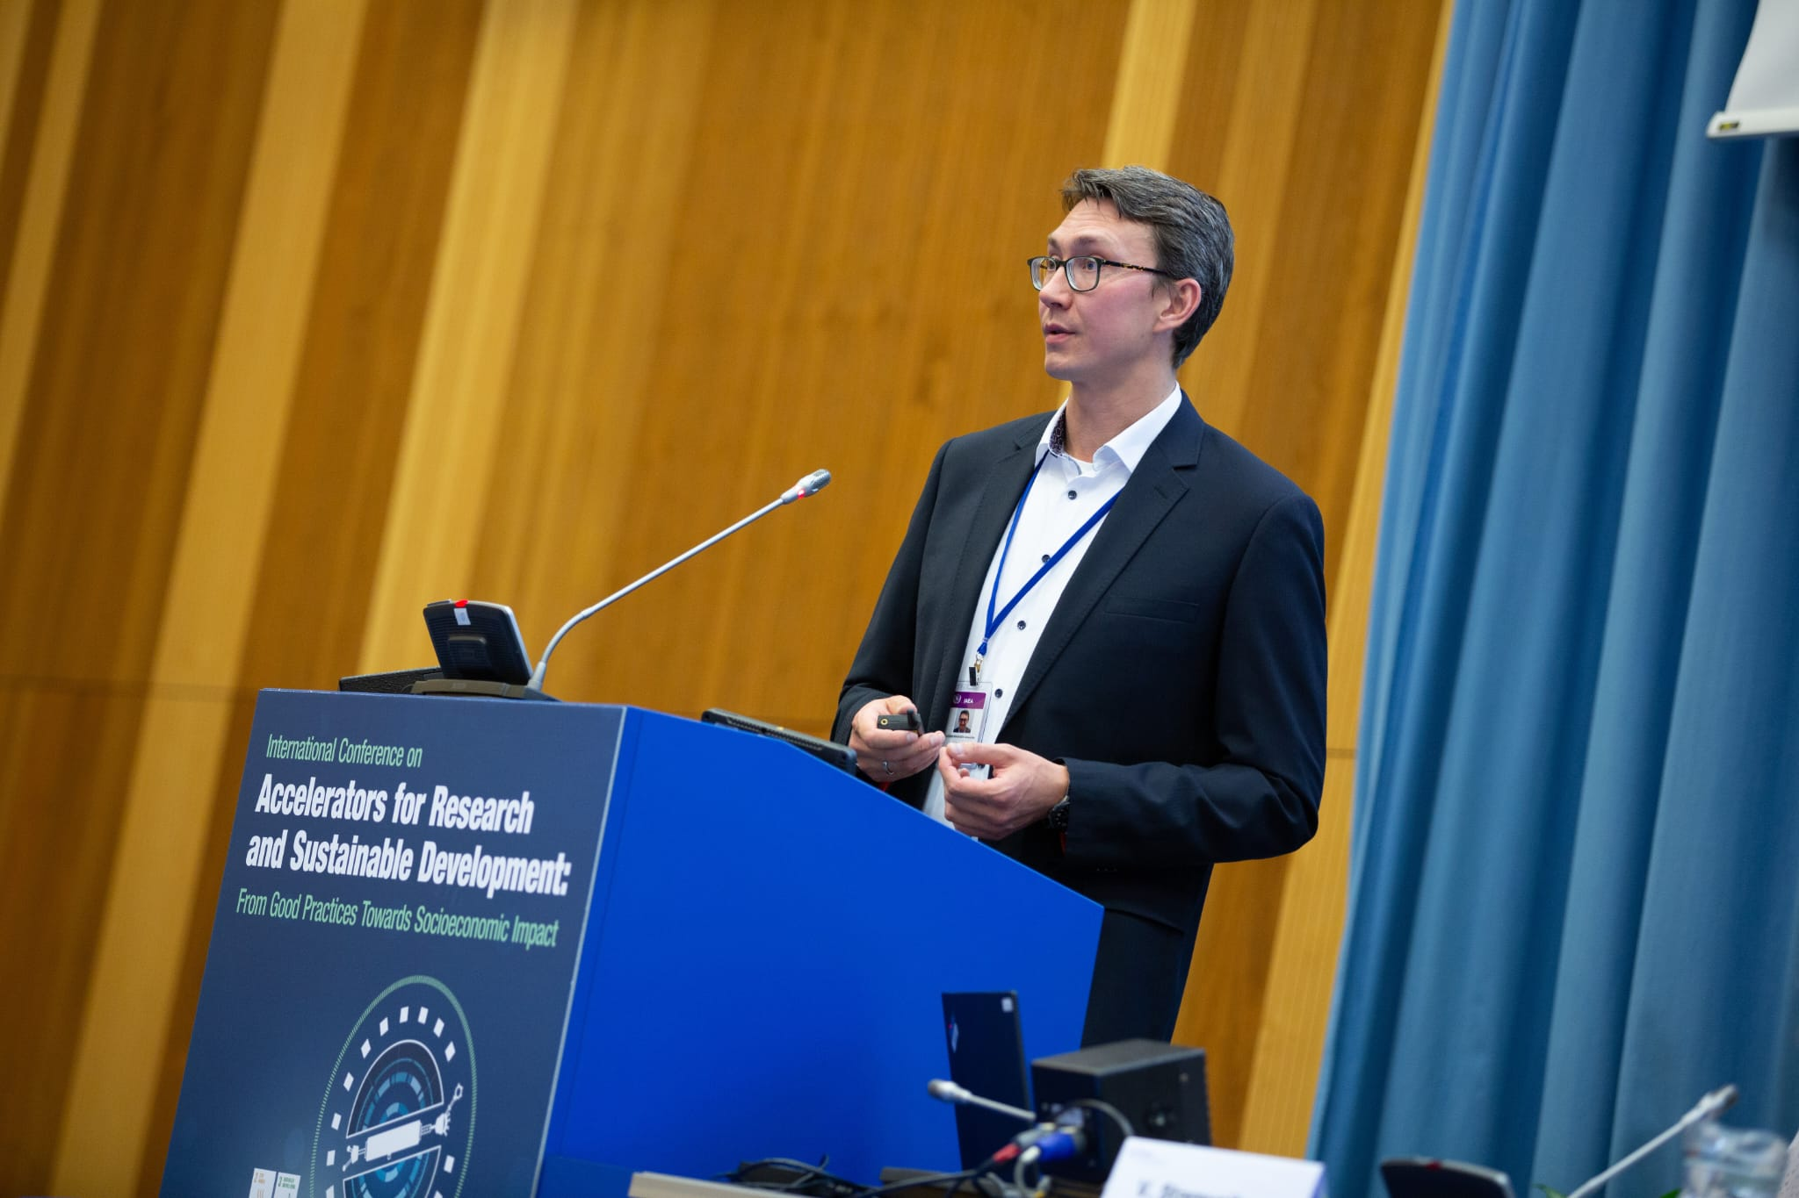
PARTREC talk
Took place on the first day
Well perceived
Many (SEEist in Greece, Melbourne in Australia) expressed interest in collaborating

Slide 7
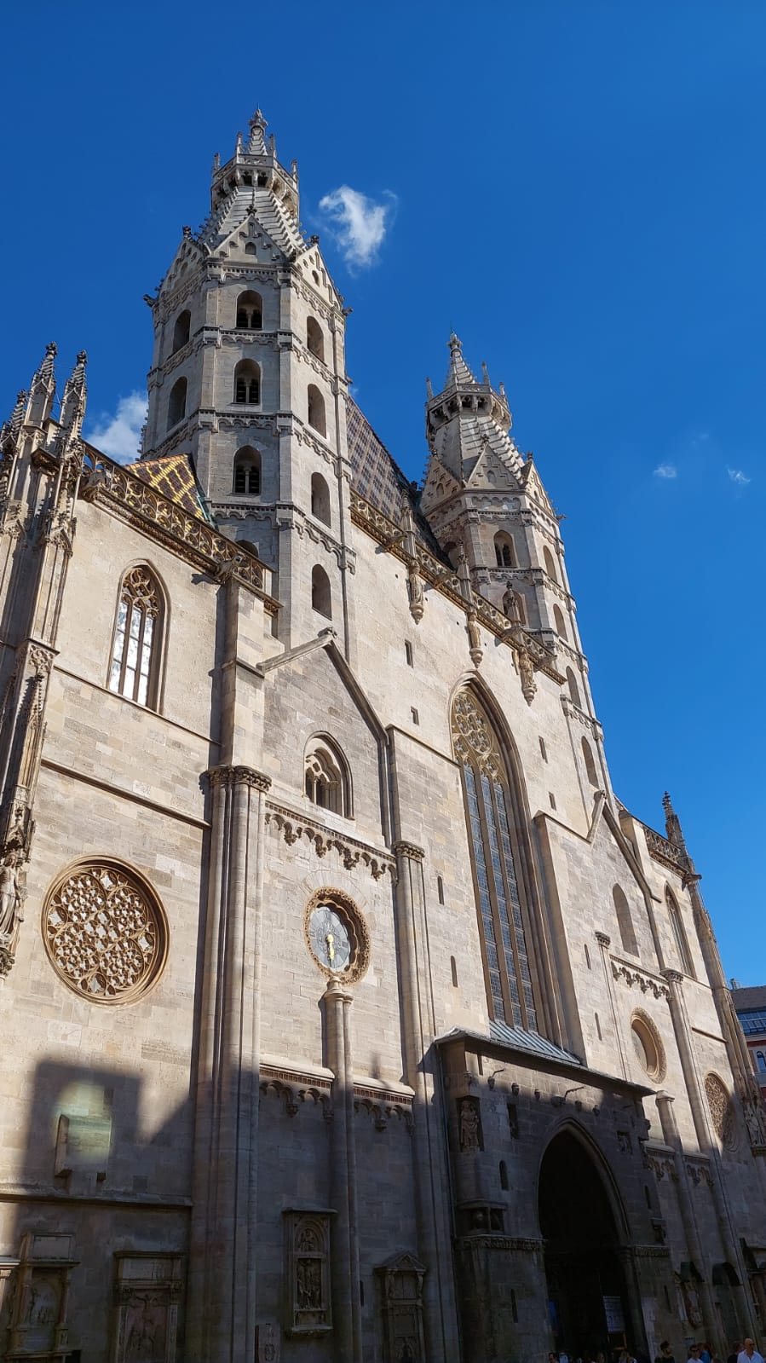
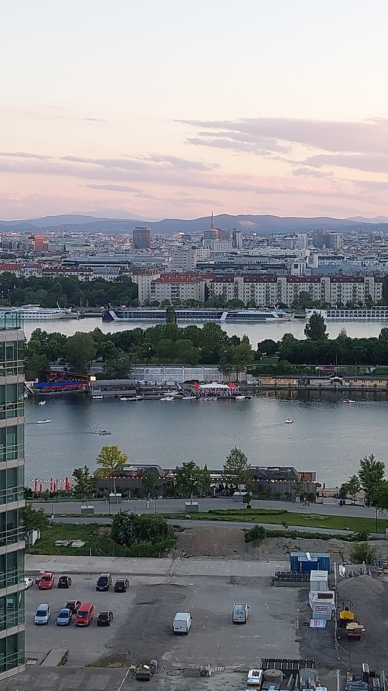
Vienna is pleasant…

Slide 8
Thank you for your attention!
Questions?

