Slide 1
Cosmic Tensions and
Cracks in the Standard Model of Cosmology
Waleed El Hanafy
waleed.elhanafy@bue.edu.eg
Centre for Theoretical Physics, The British University in Egypt
Workshop on Astro-particles and Gravity
Sep 20 – 22, 2022
Cairo University

Slide 2
Abstract
The standard Λ Cold Dark Matter cosmological model amazingly fits a wide range of astrophysical and astronomical data. However, the increase of the experimental sensitivity emerges some cracks in the standard scenario due tensions between different independent cosmological datasets. The Planck mission estimation of Hubble constant H₀ is at 4-6σ tension with its measured value by SH0ES and H0LiCOW collaborations. Also, the tension between Planck data and weak lensing measurements and redshift surveys about the value of the matter energy density Ω_{m}, and the amplitude or rate of growth of structure (σ₈, fσ₈) becomes significant. New physics could be in action to resolve these cosmic tensions. We give an outline of the different approaches to solve these tensions with some interesting models.

Slide 3
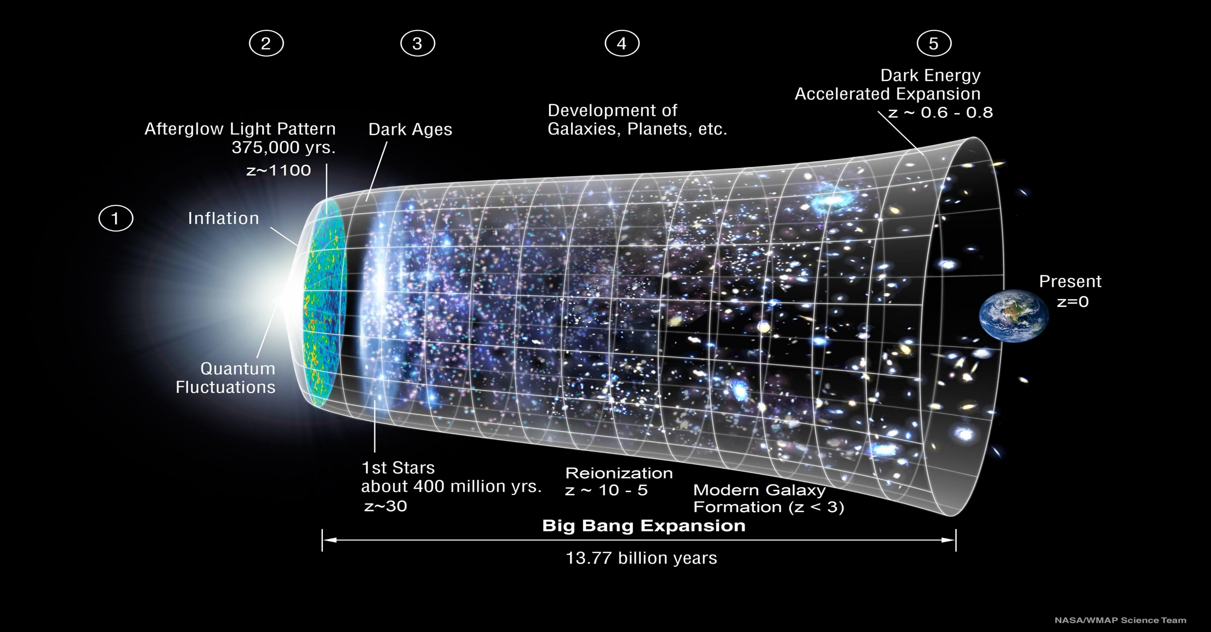
The Standard Model of Cosmology (ΛCDM)

Slide 4
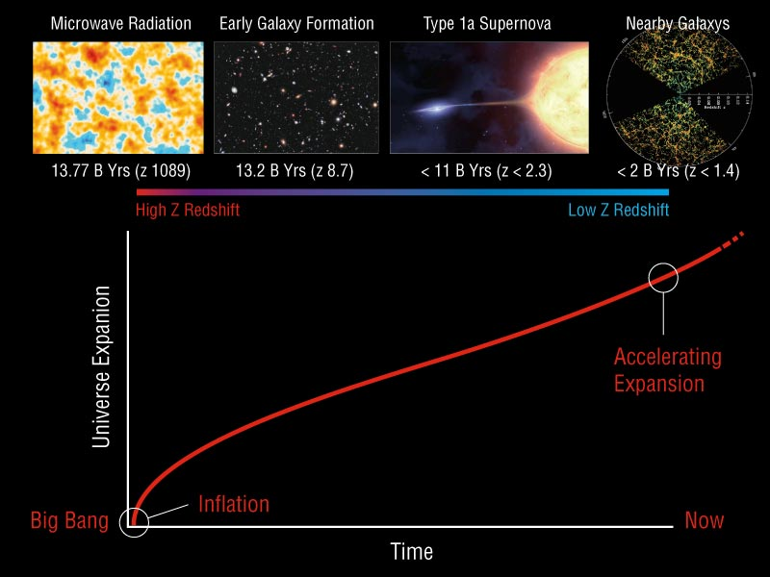
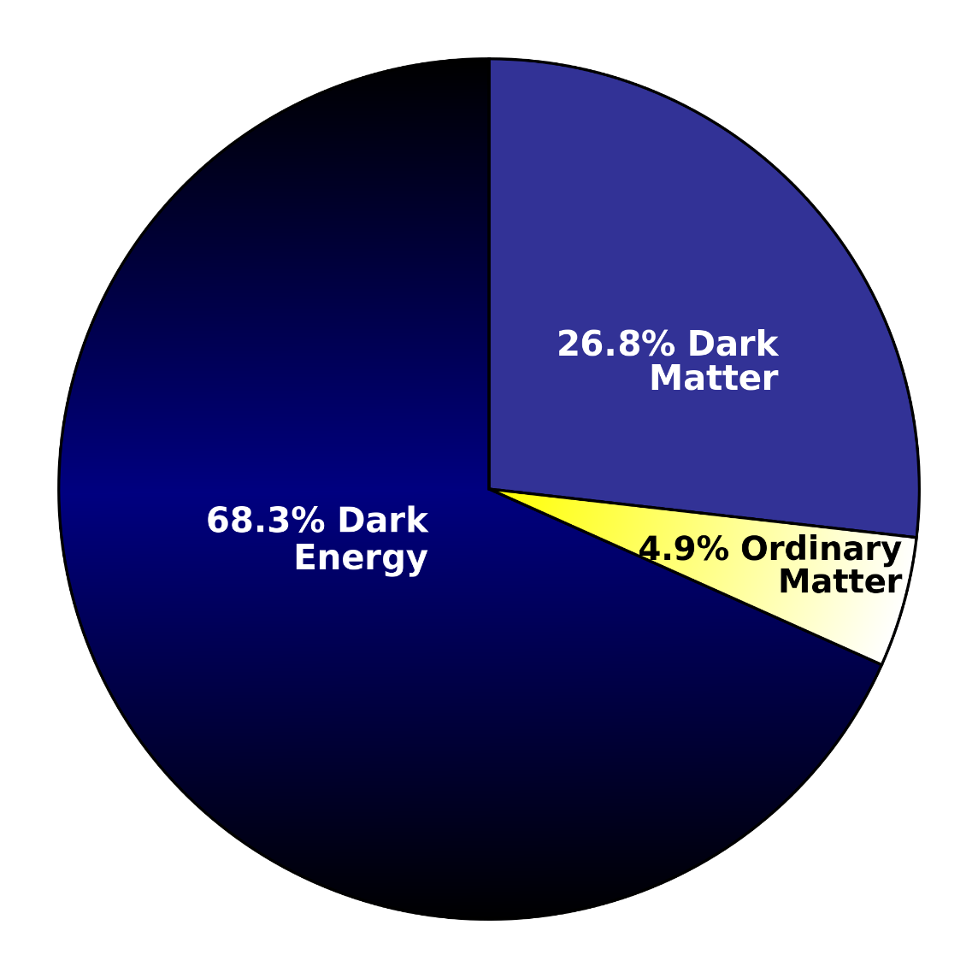
Relevant Cosmological Observations

Slide 5
DISTANCE INDICATORS
Standard Candle
If two sources have the same intrinsic luminosity (“standard candles”), from the ratio of their apparent brightness we can derive the ratio of their luminosity distances.
Standard Ruler
If two sources have the same physical size (“standard rulers”), from the ratio of their apparent angular sizes we can derive the ratio of their angular diameter distances.

Slide 6
SNIa Standard Candle
Distance modulus
Obs
Theor
Luminosity distance

Slide 7
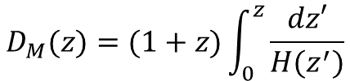



BAO Standard Ruler
Radial BAO
$$r_{d}$$
Intrinsic length BAO
θ_{ΒΑΟ}
Angular BAO
Line-of-sight BAO
$${δθ}_{BAO}=\frac{r_{d}}{D_{M}(z)}$$
$${δz= r}_{d}H(z)$$
Angular BAO
$$D_{M}(z)=(1+z)\int_{0}^{z}{\frac{dz′}{H(z^{′})}}$$

Slide 8
BAO Standard Ruler

Slide 9

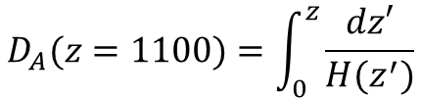
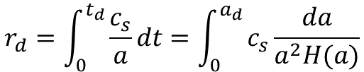
Sound horizon scale
$$r_{d}=\int_{0}^{t_{d}}{\frac{c_{s}}{a}}dt=\int_{0}^{a_{d}}{c_{s}\frac{da}{a^{2}H(a)}}$$
$$D_{A}(z=1100)=\int_{0}^{z}{\frac{dz′}{H(z^{′})}}$$

Slide 10
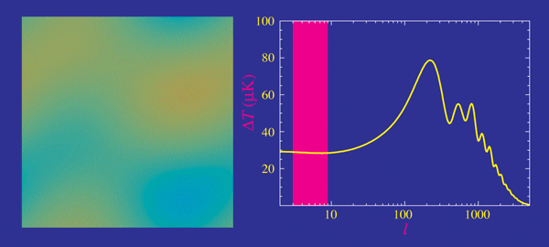
Power Spectra
Decompose the anisotropy (random Gaussian distribution) in spherical harmonics
Power Spectra
Baryons
Matter
Curvature DarkEnergy
Reionization Tensors
Damping Tail
Baryon Fraction
EB Polarization
Scalar
Vector
Tensor
Wayne hu
Professor, Department of Astronomy and Astrophysics, University of Chicago
http://background.uchicago.edu/~whu/metaanim.html

Slide 11
Power Spectra
CMB anisotropies are mainly formed at redshift z ∼ 1000 when either dark energy or modifications to GR appear to be negligible. However, while CMB photons travel to us, they are affected and distorted by other, low redshift, mechanisms, that could help in understanding the nature of the accelerating universe.

Slide 12
Precession Cosmology (Planck 2018)
Precision measurements and maps
– temperature
– polarization
– lensing
– 9 frequencies
Control over systematics
– most recently polarization
Accurate and precise
theoretical predictions
– Gaussian, adiabatic
– LCDM
Planck Legacy

Slide 13
Sound horizon scale
2 < ℓ < 2500
Lots of
peaks & troughs
0.03%
Temperature 7 peaks
Polarization 5 peaks
TE correlation 6 peaks
High
precession measurement

Slide 14
Sound horizon scale
2 < ℓ < 2500
Lots of
peaks & troughs
Temperature 7 peaks
Polarization 5 peaks
TE correlation 6 peaks
High
precession measurement

Slide 15
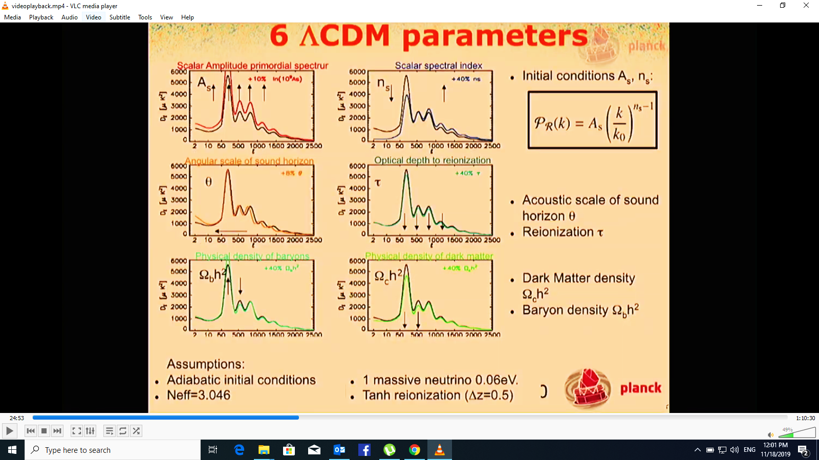
LCDM 6 parameters Space

Slide 16
LCDM 6 parameters Space

Slide 17
Planck + LCDM vs. External Datasets
BAO
RSD
AMAZING
SNIa
BBN

Slide 18

Cracks in Standard Model
H₀-tension
σ₈-tension
No concordance model
Illustration by Sandbox Studio, Chicago with Corinne Mucha

Slide 19
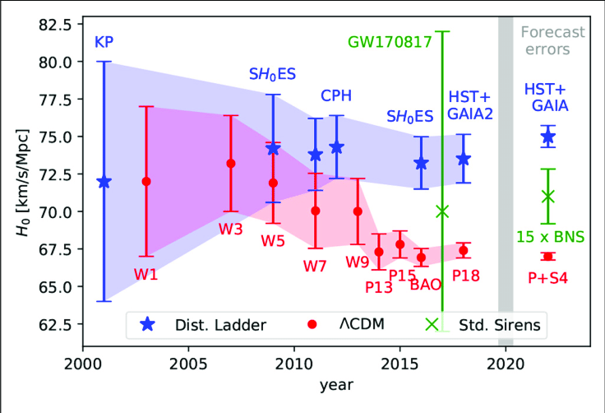
How fast is the universe expanding?

Slide 20
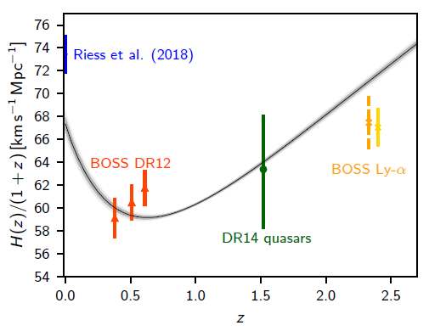
Planck + LCDM vs. External Datasets
cosmic shear by KiDS-450 is at 2σ
disagreement.
H0 by (SH0ES+H0LiCOW) is at ~5σ
disagreement.
Distance ladder
BAO
DES and KiDS

Slide 21
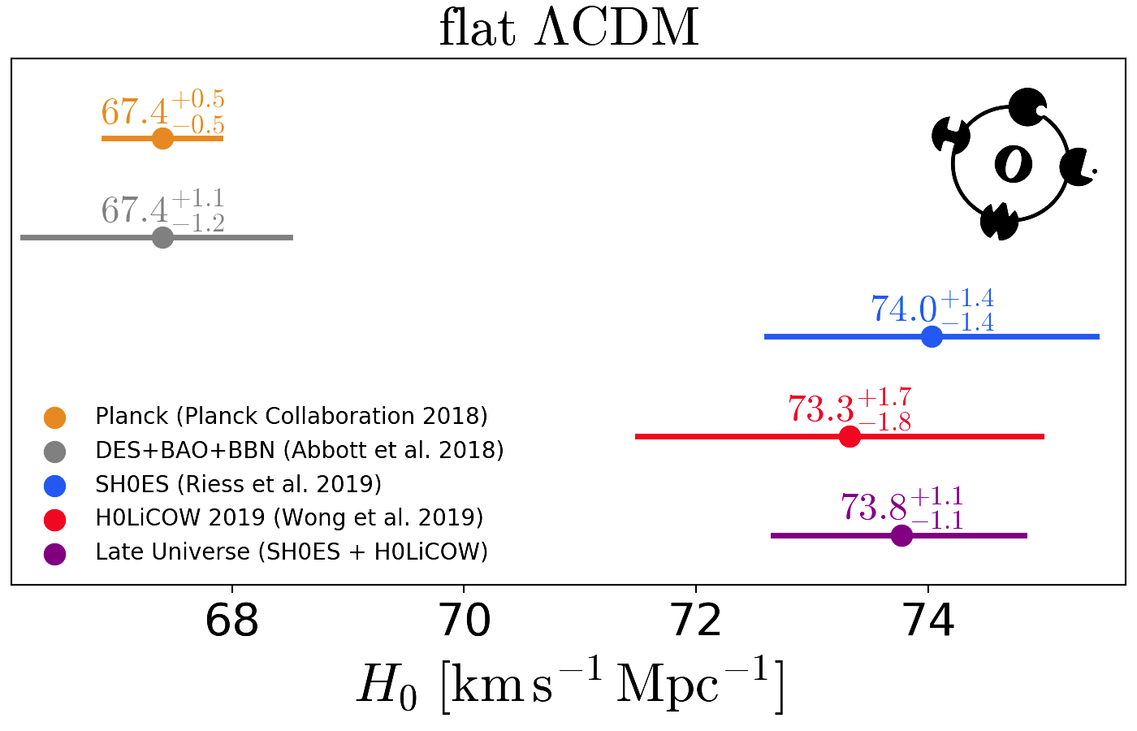
H₀ Tension
Indirect measurement
direct measurement
5.3σ
New Physics?

Slide 22
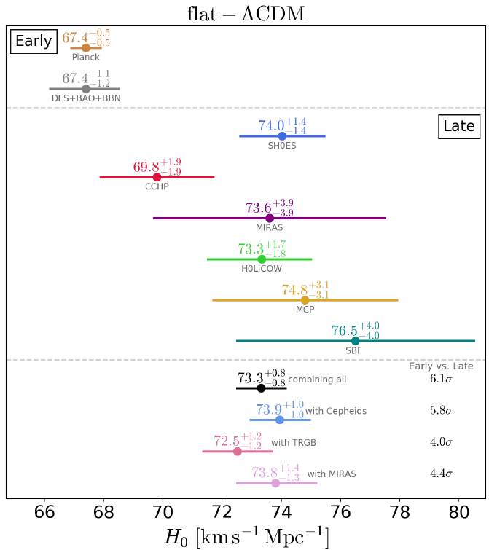
Tensions between the Early and the Late Universe
Discrepancies developing between observations at early and late cosmological time may require an expansion of the standard model, and may lead to the discovery of new physics.
arXiv:1907.10625
L. Verde, T. Treu and A. G.~Riess, Nature Astron. 3, 891

Slide 23
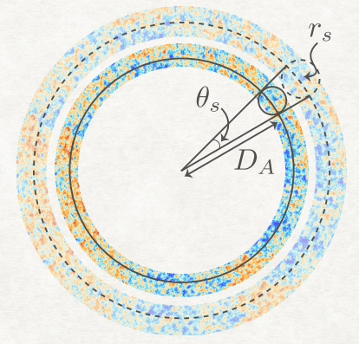
How to solve?
Planck analysis of the CMB power spectra provides a precise measurement of the acoustic angular scale of the sound horizon at last scattering (recombination).
z∗ is the redshift at last scattering (at which the CMB photon optical depth equals unity). Planck measures 100θ∗ = 1.04109±0.00030 (68 %, TT, TE, EE+lowE), with 0.03 % precision.
Any solution should keep this scale fixed.

Slide 24



How to solve?
The sound horizon size at recombination
The sound speed
The angular distance to recombination

Slide 25

How to solve?
Early Universe
Late Universe
(pre-recombination)
Decrease r_{s}(z*) at fixed θ* To decrease D_{A}(z*) and increase H₀.
Late universe observables are unaffected.
(post-recombination)
Keep r_{s}(z*) and D_{A}(z*) fixed and break the relationship between D_{A} and H₀.
Early universe physics is left unaffected.
Hubble rate (LCDM)

Slide 26
Early Universe Solution
One way to solve H₀-tension is to reduce the sound horizon size at recombination rs(z∗) by ∼ 10 Mpc,
The sound speed cs is sensitive to the physical densities of baryon (ωb) and radiation (ωr)
The physical densities are well constrained by BBN, therefore it is not recommended to reduce the
sound horizon via changing cs. On the other hand, the sound horizon can be reduced by increasing the Hubble expansion rate H(z) before recombination

Slide 27
Early Universe Solution
This can be achieved by introducing an early dark energy component which should decay just before recombination when the sound horizon is decreased as required. This keeps post-recombination just as ΛCDM. However, in order to restore θ∗, one expect the angular distance to recombination DA to decrease similar to rs
Since the expansion rate E(z) after recombination is just as in ΛCDM, the H₀ should be increased to
solve the tension.

Slide 28
Early Universe
Early Dark Energy
Energy injection
Extra free streaming neutrinos
Self-interacting neutrino

Slide 29
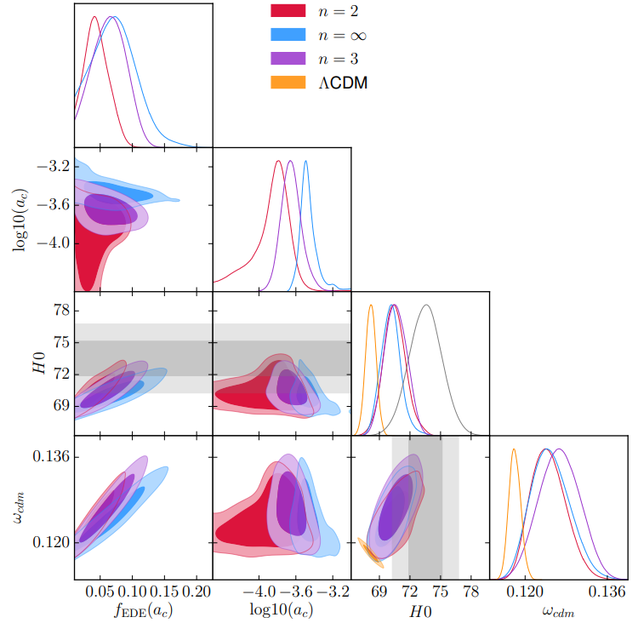
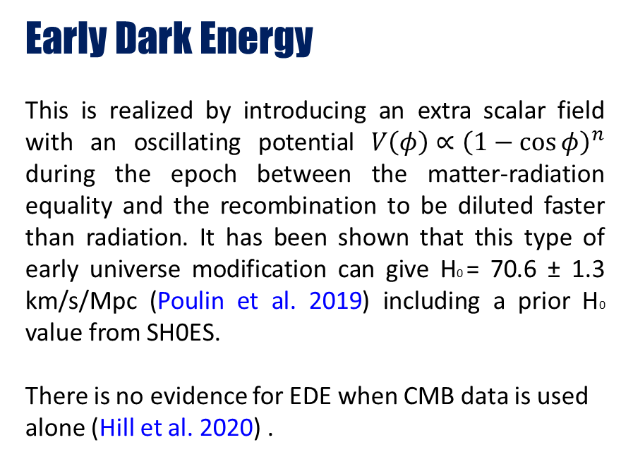
Early Universe
Early Dark Energy
This is realized by introducing an extra scalar field with an oscillating potential $V\left(φ\right)∝{\left(1−\cos{φ}\right)}^{n}$ during the epoch between the matter-radiation equality and the recombination to be diluted faster than radiation. It has been shown that this type of early universe modification can give H0 = 70.6 ± 1.3 km/s/Mpc (Poulin et al. 2019) including a prior H0 value from SH0ES.
There is no evidence for EDE when CMB data is used alone (Hill et al. 2020) .

Slide 30
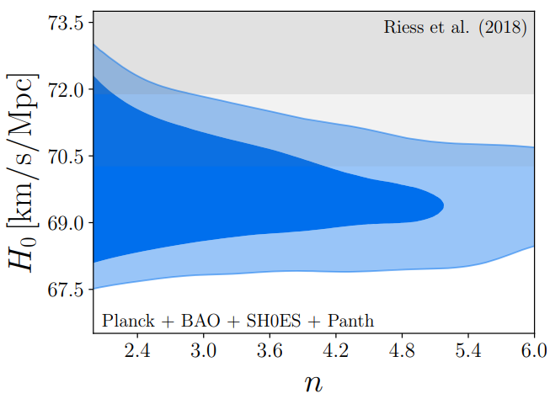
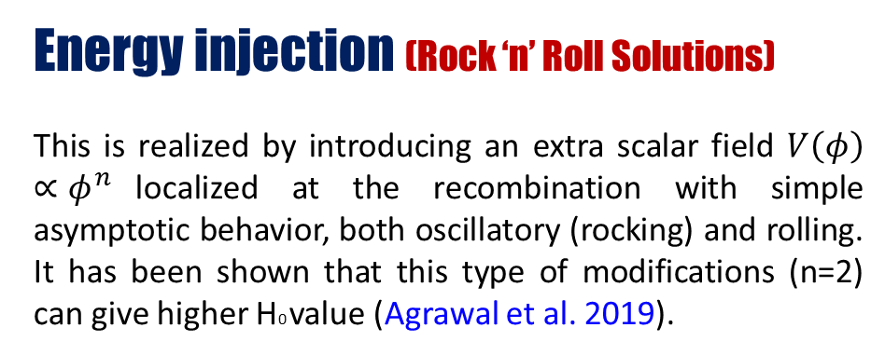
Early Universe Solution
Energy injection (Rock ‘n’ Roll Solutions)
This is realized by introducing an extra scalar field $V\left(φ\right)∝φ^{n}$localized at the recombination with simple asymptotic behavior, both oscillatory (rocking) and rolling. It has been shown that this type of modifications (n=2) can give higher H0 value (Agrawal et al. 2019).

Slide 31
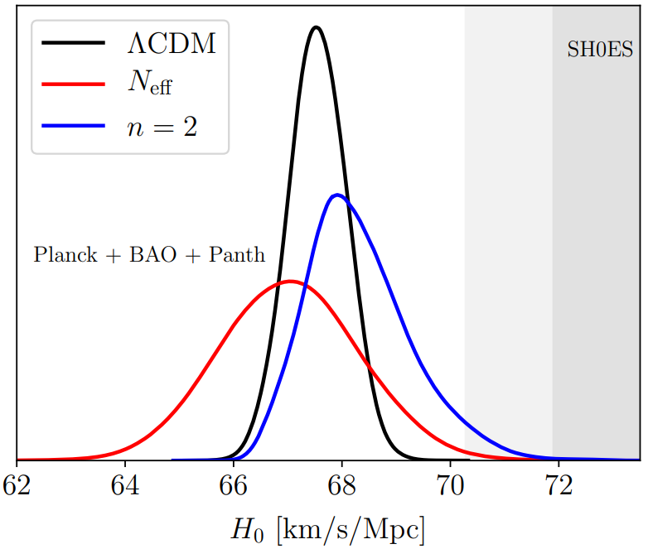
Early Universe Solution
Energy injection (Rock ‘n’ Roll Solutions)
This is realized by introducing an extra scalar field $V\left(φ\right)∝φ^{n}$localized at the recombination with simple asymptotic behavior, both oscillatory (rocking) and rolling. It has been shown that this type of modifications (n=2) can give higher H0 value (Agrawal et al. 2019).
SH0ES

Slide 32
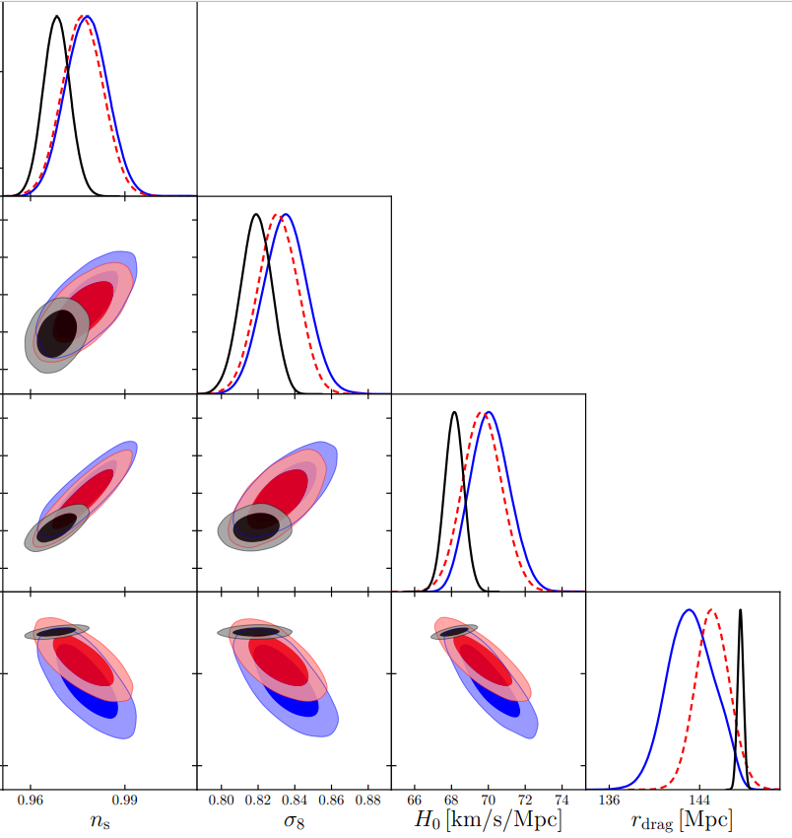
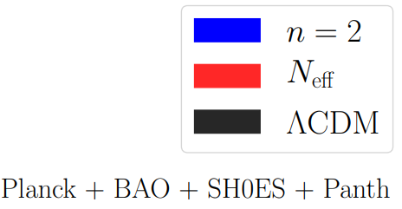
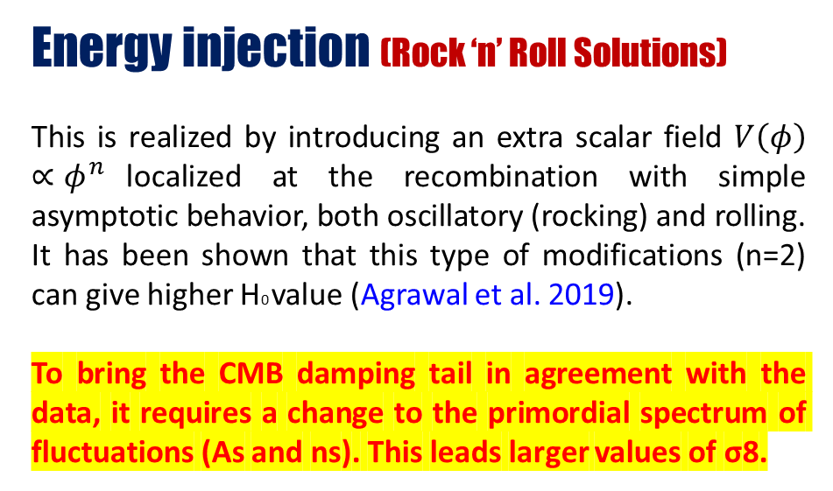
Early Universe
Energy injection (Rock ‘n’ Roll Solutions)
This is realized by introducing an extra scalar field $V\left(φ\right)∝φ^{n}$localized at the recombination with simple asymptotic behavior, both oscillatory (rocking) and rolling. It has been shown that this type of modifications (n=2) can give higher H0 value (Agrawal et al. 2019).
To bring the CMB damping tail in agreement with the data, it requires a change to the primordial spectrum of fluctuations (As and ns). This leads larger values of σ8.

Slide 33
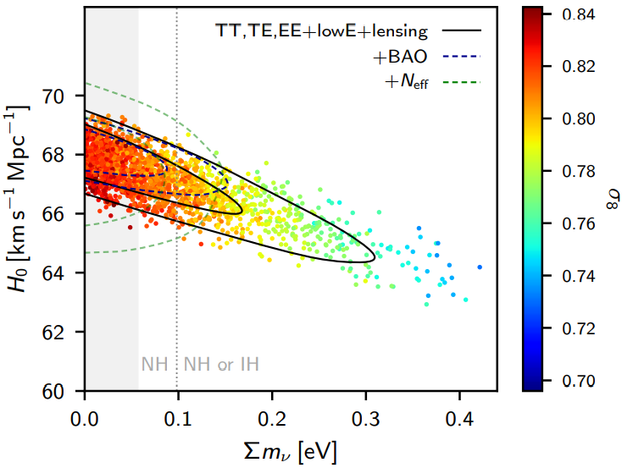
Early Universe
Extra free streaming neutrinos
(dark radiation)
This can be realized by introducing extra free streaming neutrinos with a specific gravitational coupling.
Planck 2018 results
Solid black contours (Planck TT, TE, EE + lowE + lensing + BAO)
Dashed lines the joint constraint also including Riess et al. (2018).

Slide 34
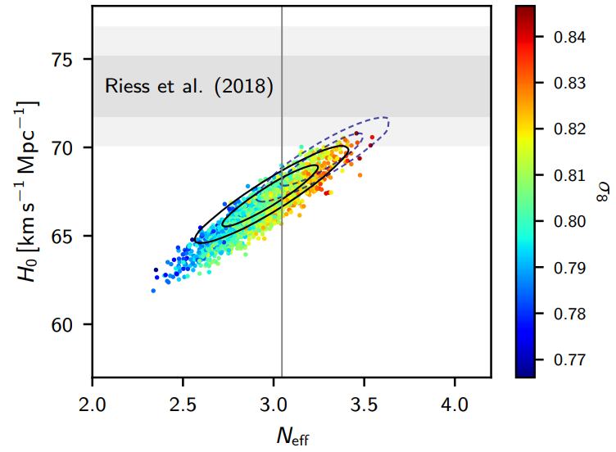
Early Universe
Extra free streaming neutrinos
(dark radiation)
This can be realized by introducing extra free streaming neutrinos with a specific gravitational coupling.
Planck 2018 results
Solid black contours (Planck TT, TE, EE + lowE + lensing + BAO)
Dashed lines the joint constraint also including Riess et al. (2018).

Slide 35
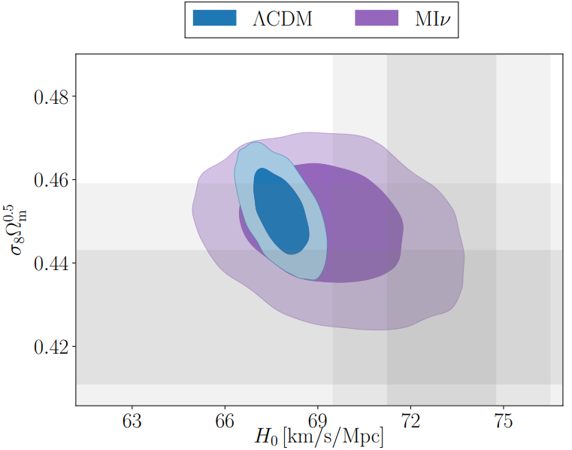
Early Universe
Self-interacting neutrino
This is realized by allowing neutrino to act as tightly coupled radiation instead of free streaming and also by allowing extra species of neutrinos Neff ≈ 4 (Kreisch et al. 2019).This offers a possible solution to the H0 and σ8. We show here that delaying the onset of neutrino free streaming until close to the epoch of matter-radiation equality can naturally accommodate a larger value for the Hubble constant H0 = 72.3 ± 1.4 km s−1Mpc−1 and a lower value of the matter fluctuations σ8 = 0.786 ± 0.020, while not degrading the fit to the cosmic microwave background (CMB) damping tail.

Slide 36
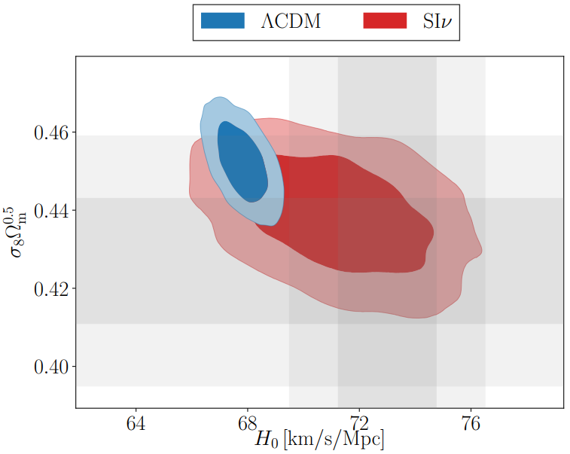
Early Universe
Self-interacting neutrino
This is realized by allowing neutrino to act as tightly coupled radiation instead of free streaming and also by allowing extra species of neutrinos Neff ≈ 4 (Kreisch et al. 2019).This offers a possible solution to the H0 and σ8. We show here that delaying the onset of neutrino free streaming until close to the epoch of matter-radiation equality can naturally accommodate a larger value for the Hubble constant H0 = 72.3 ± 1.4 km s−1Mpc−1 and a lower value of the matter fluctuations σ8 = 0.786 ± 0.020, while not degrading the fit to the cosmic microwave background (CMB) damping tail.

Slide 37
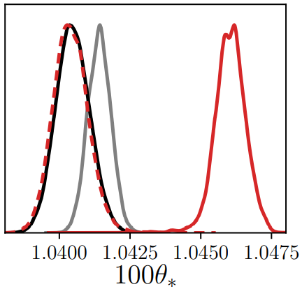
Early Universe
Self-interacting neutrino
Self interacting neutrinos provide a better framework for solving both tensions simultaneously. But the tightly-coupled neutrinos scenario, unlike free streaming, does not phase shift the photon-baryon fluctuations. Hence, the CMB power spectra are slightly displaced towards high-ℓ, and the acoustic scale θ∗ at recombination must take larger values in order to restore the fit with observed CMB. It remains a challenge to construct and verify viable models with requirements beyond standard model physics with very large couplings.

Slide 38
does Early Universe solve?
These models suffer fine tuning problems at eV scales and also lead to severe scale dependent changes in the matter spectrum, which worsen the tension. They also shift some standard CDM parameters, in particular the spectral index n_{s} and the physical baryon density Ω_{b}h² (h = H0=100 km/s/Mpc) (Smith et al. 2020).
However, it has been shown that such modification leads to scale dependent severe changes in the matter spectrum p(k) across a decade in k-space and also to worsen the density fluctuation amplitude tension (Hill et al. 2020). In addition, the same study shows that the there is no evidence for EDE when CMB data is used alone.
In general, any sort of early dark energy slightly affects the growth of perturbations during its acting period. This implies an increase in the CDM density to compensate the loss in the perturbation growth in order to fit the CMB data (Hill et al. 2020).

Slide 39
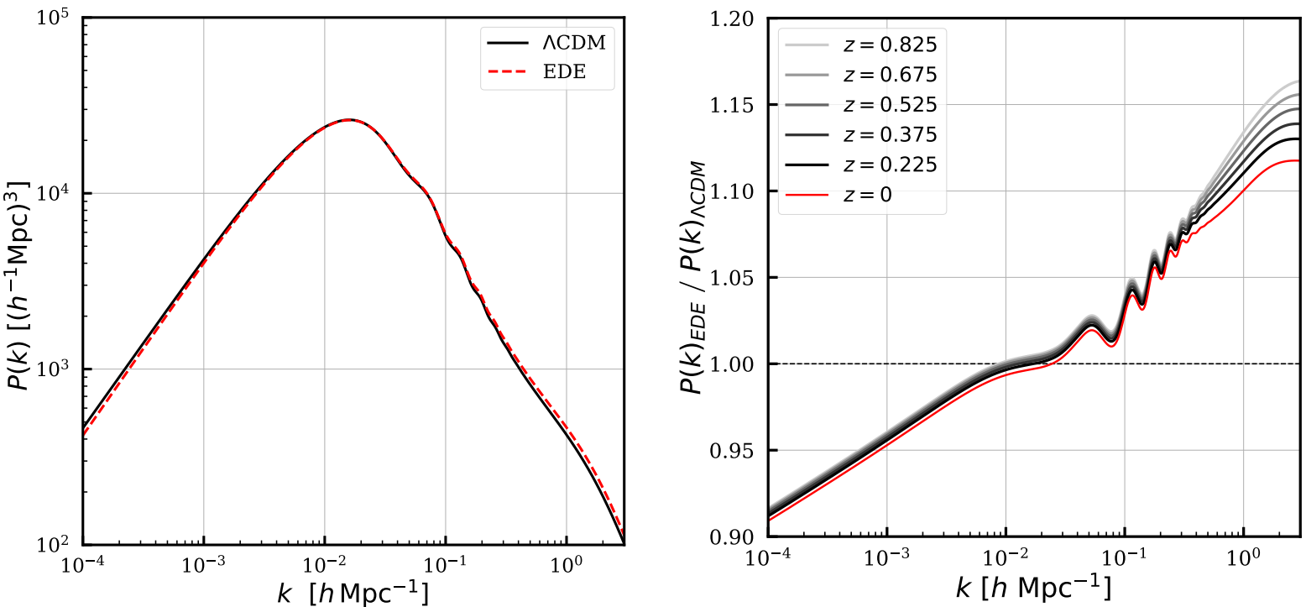
does Early Universe solve?
Hill et al. 2020

Slide 40
How to solve?
Early Universe
Late Universe
(pre-recombination)
Decrease r_{s}(z*) at fixed θ∗ to decrease D_{A}(z*) and increase H₀.
Late universe observables are left unaffected.
(post-recombination)
Keep r_{s}(z*) and D_{A}(z*) fixed and break the relationship between D_{A} and H₀.
Early universe physics is left unaffected.
Hubble rate (LCDM)

Slide 41


Late Universe Solution
Another way to solve the H₀ tension is to change the late universe by considering dark energy different for the cosmological constant.
For ΛCDM model, w_{de} = w_{Λ} = −1, we have y(z) = 1. In order to account for larger H₀ value, the expansion rate E(z) should be lower than the ΛCDM to keep D_{A}(z∗) fixed to Planck measurement. As clear, this can be achieved by considering phantom dark energy w_{de} = w_{ph} < −1 (for simplicity we take w_{ph} fixed). Clearly, one can see that y(z = 0) = 1 while y(z > 0) < 1, which in return finds E(z)_{ph} < E(z)_{ΛCDM} for redshifts z > 0.

Slide 42
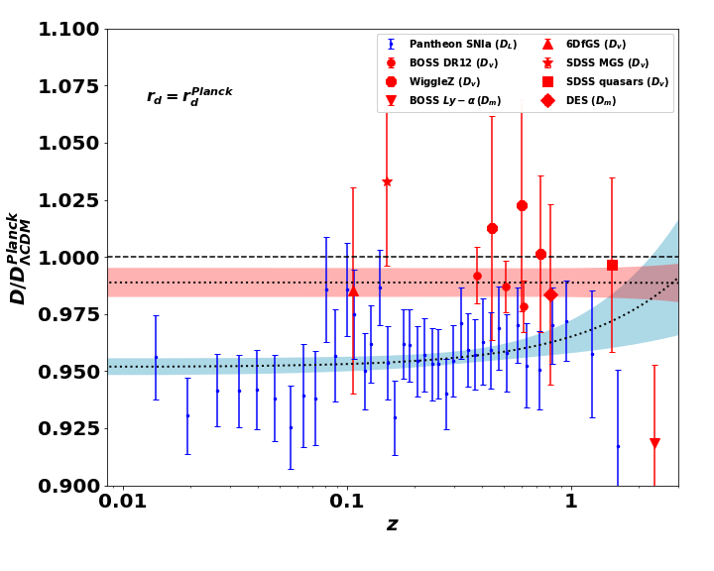
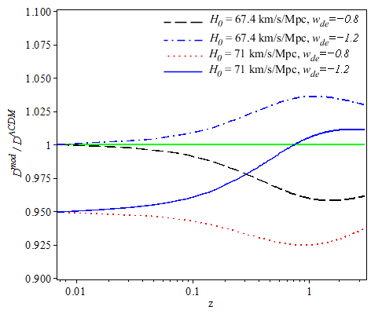
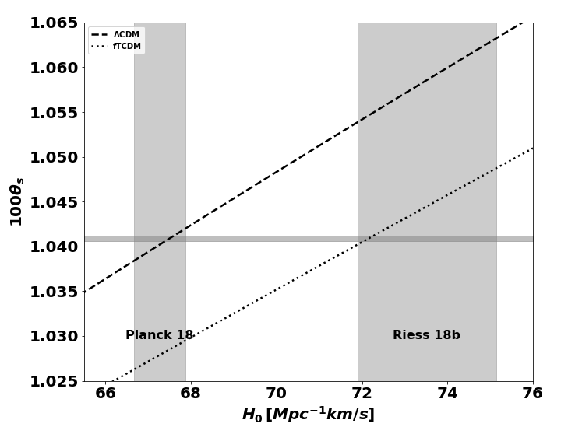
Late Universe Solution
Two distance indicators: (a) The SNIa luminosity distance anchored to the H0 value as inferred by the distance ladder method. (b) The BAO measurements of the angular distance anchored to the rd value as inferred by the inverse distance ladder method.
Distance indicators of four different models according to the choices of H0 and wde . By comparison to the observed distance indicators, it is clear that the phantom dark energy can fit better.
The horizontal grey band shows the CMB 1σ constraints on the angular scale of the sound horizon at recombination θ∗, while the vertical bands show the 1σ constraints on the H0 as derived by CMB and as measured by distance ladder method.

Slide 43
Late Universe Solution
Phenomenological Emergent Dark Energy
Interacting dark energy
Modified Gravity

Slide 44
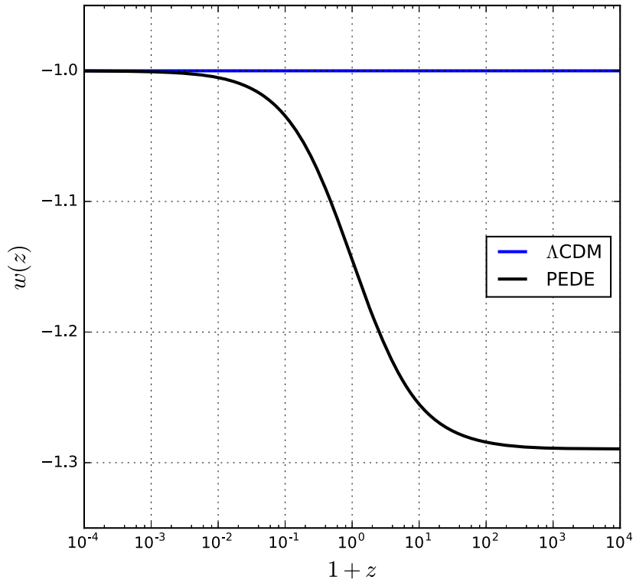
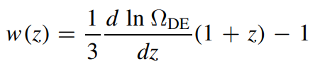
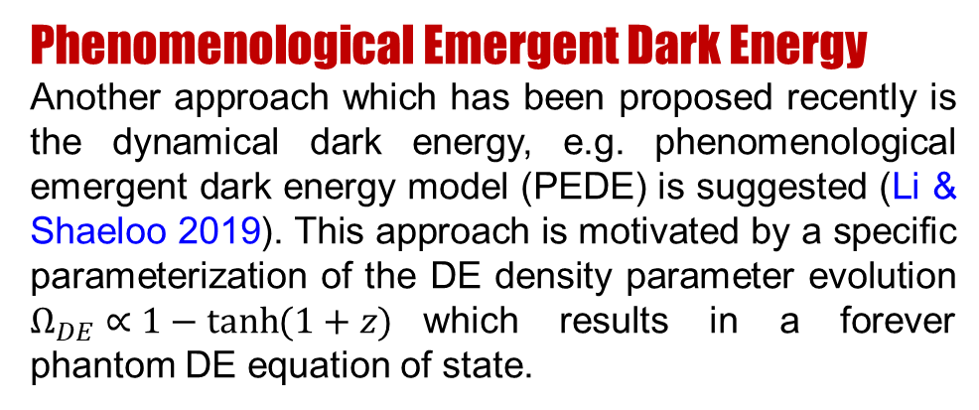
Late Universe Solution
Phenomenological Emergent Dark Energy
Another approach which has been proposed recently is the dynamical dark energy, e.g. phenomenological emergent dark energy model (PEDE) is suggested (Li & Shaeloo 2019). This approach is motivated by a specific parameterization of the DE density parameter evolution $Ω_{DE}∝1−tanh{(1+z)}$which results in a forever phantom DE equation of state.

Slide 45
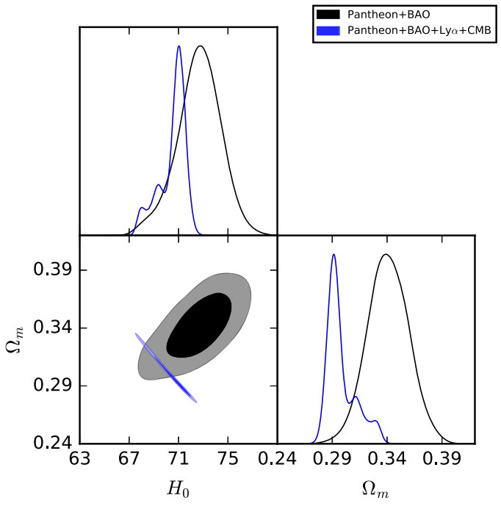

Late Universe Solution
Phenomenological Emergent Dark Energy
Another approach which has been proposed recently is the dynamical dark energy, e.g phenomenological emergent dark energy model (PEDE) is suggested (Li & Shaeloo 2019). This approach is motivated by a specific parameterization of the DE density parameter evolution $Ω_{DE}∝1−tanh{(1+z)}$which results in a forever phantom DE equation of state.

Slide 46
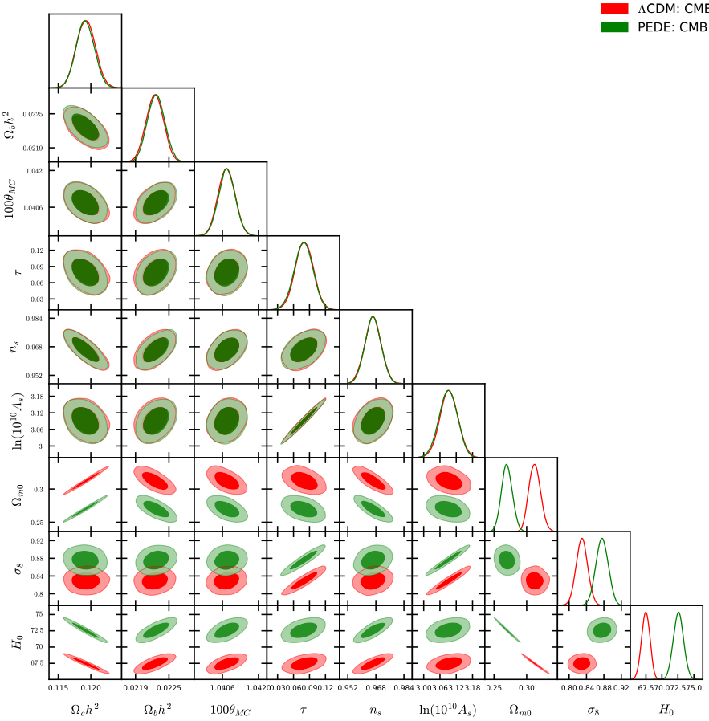
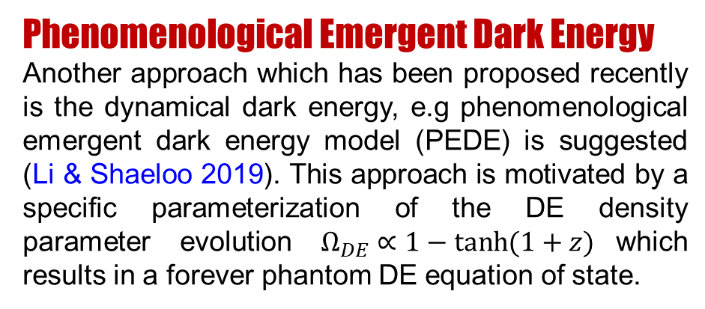
Late Universe
Phenomenological Emergent Dark Energy
Another approach which has been proposed recently is the dynamical dark energy, e.g phenomenological emergent dark energy model (PEDE) is suggested (Li & Shaeloo 2019). This approach is motivated by a specific parameterization of the DE density parameter evolution $Ω_{DE}∝1−tanh{(1+z)}$which results in a forever phantom DE equation of state.

Slide 47
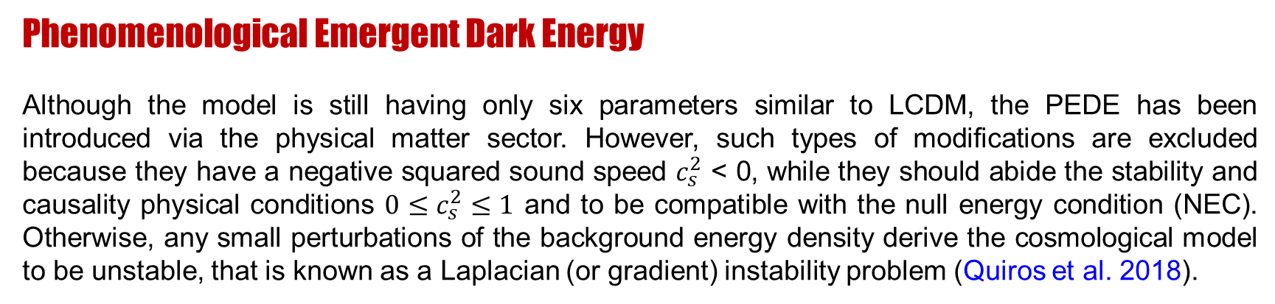
Late Universe Solution
Phenomenological Emergent Dark Energy
Although the model is still having only six parameters similar to LCDM, the PEDE has been introduced via the physical matter sector. However, such types of modifications are excluded because they have a negative squared sound speed $c_{s}^{2}$ < 0, while they should abide the stability and causality physical conditions $0≤c_{s}^{2}≤1$ and to be compatible with the null energy condition (NEC). Otherwise, any small perturbations of the background energy density derive the cosmological model to be unstable, that is known as a Laplacian (or gradient) instability problem (Quiros et al. 2018).

Slide 48
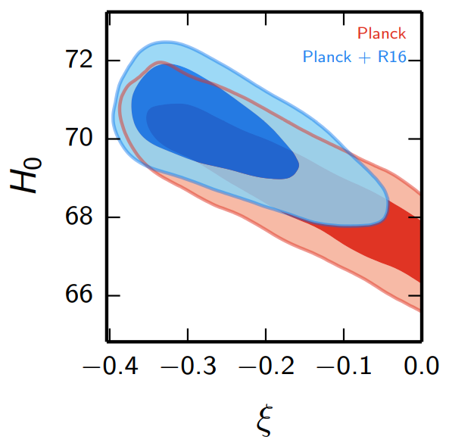

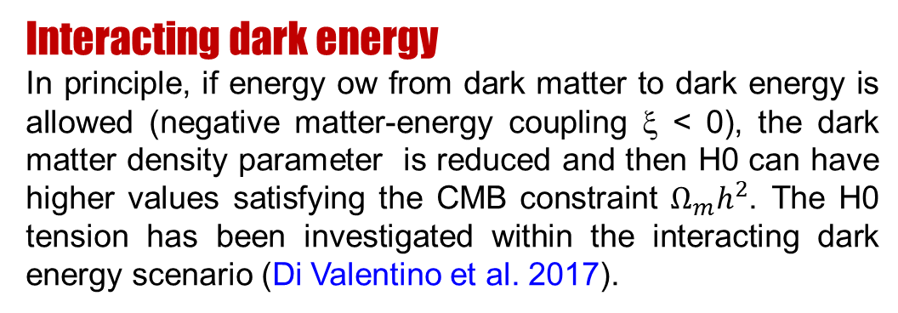
Late Universe Solution
Interacting dark energy
In principle, if energy ow from dark matter to dark energy is allowed (negative matter-energy coupling ξ < 0), the dark matter density parameter is reduced and then H0 can have higher values satisfying the CMB constraint $Ω_{m}h^{2}$. The H0 tension has been investigated within the interacting dark energy scenario (Di Valentino et al. 2017).

Slide 49
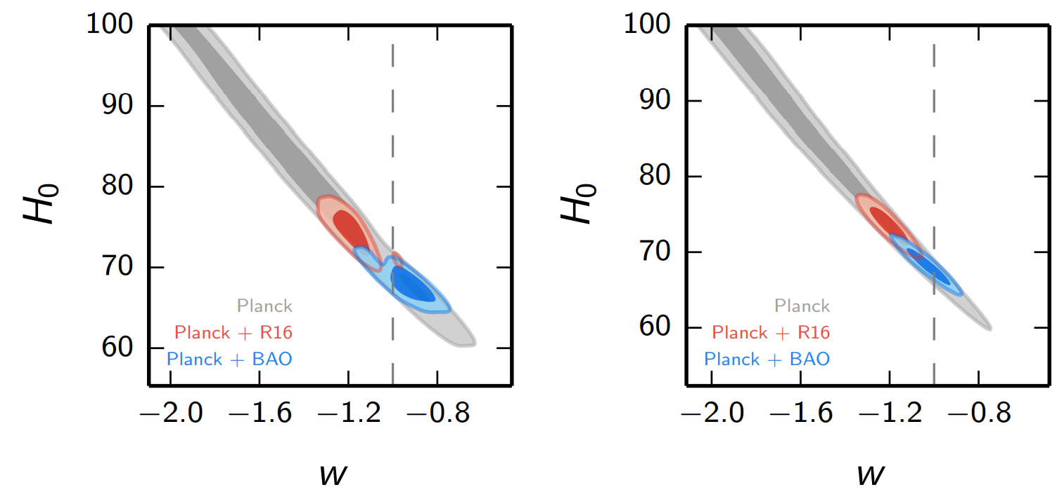


Late Universe Solution
Interacting dark energy
It has been shown that the combination of CMB and R18 gives an evidence for non-zero coupling with ξ < 0 along with phantom DE w_{de} < -1.
$$ξ≠0$$
$$ξ=0$$

Slide 50
Late Universe Solution
Interacting dark energy
Again, the NEC violation is still the main defect in addition to the presence of two extra free parameters and w_{de}.
When BAO datasets are included, the analysis strongly enforces the model to CDM (w_{de}= -1) with no evidence for interacting DE.

Slide 51
Late Universe Solution
Infrared Gravity suggests some corrections by weakening gravity at the infrared scales. These appear only on large distances keeping the GR hold on solar system and below scales. Therefore, it is a reasonable choice of dark energy approach and it needs be investigated.
Infrared gravity effectively acts as a phantom dark energy which is recently favored to resolve the H0-tension between early and late universe. However, in modified gravity we can avoid the major problems which face phantom dark energy (Null Energy Conditions/instability problems) if assumed to be a canonical scalar field.

Slide 52
f(T) Cosmology
The f(T)
Teleparallel Gravity
The Action
The Field Equations
Einstein frame
The torsional
stress-energy tensor
Modified Friedmann equations
FLRW

Slide 53
Phase Portraits of general f(T) Cosmology
The f(T) phase portrait
f(T)= T = − 6H² (TEGR)
one-dimensional autonomous system

Slide 54
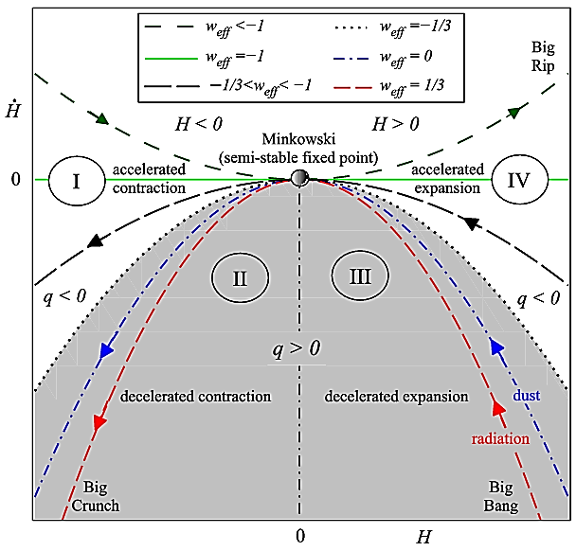
Four dynamical regions of the phase space
(I)-region represents an accelerated contracting universe as q<0 and H<0.
(II)-region represents an decelerated contracting universe as q>0 and H<0.
(III)-region represents an decelerated expanding universe as q>0 and H>0 which characterizes the standard thermal history (BBN).
(IV)-region represents an accelerated expanding universe as q<0 and H>0 which characterizes the so-called inflation (early universe) or dark energy (late universe).
A. Awad, et. al., JCAP 02 (2018), 052 [arXiv:1710.10194]

Slide 55
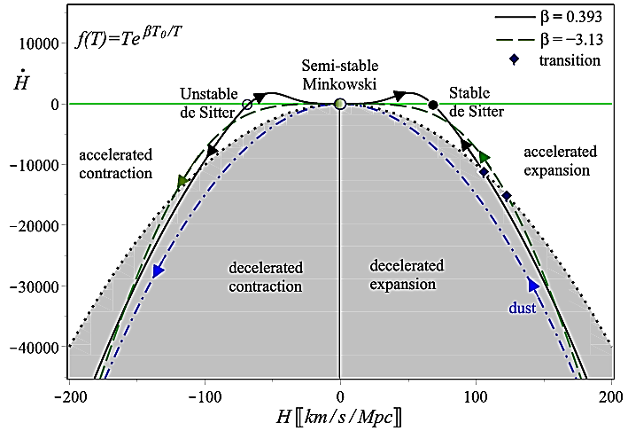


Exponential Infrared f(T) Gravity
New Suggested Model
Exponential Infrared f(T) Gravity
The f(T) phase portrait
The parameter is not independent
No extra free parameter

Slide 56
Exponential Infrared f(T) Gravity
The exponential correction reduces to unity at large T-regimes (early universe/strong gravity), and therefore the model does not change early universe at last scattering (CMB) or at solar system. It affects the evolution at late universe only on cosmic scales.
In infrared gravity models, usually each additional term in the Lagrangian introduces an extra free parameter. Generally these modifications introduce new free parameters which may require further explanation and interpretation. Finally, it favours the LCDM model statistically when confronting with observations. In addition, in our choice, we can describe a complete spectrum of infrared corrections without introducing new parameters which is not an easy task.

Slide 57
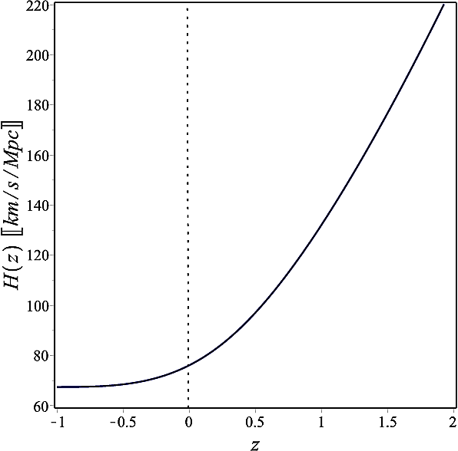
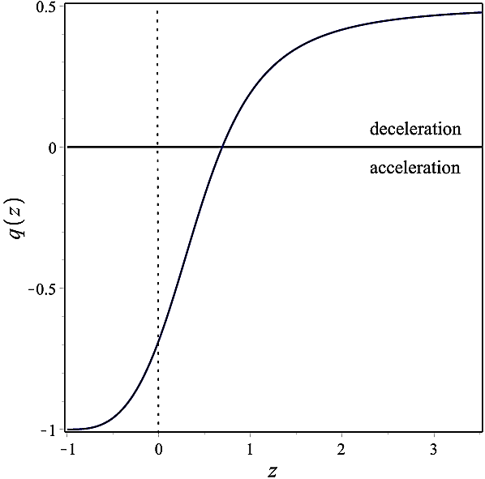
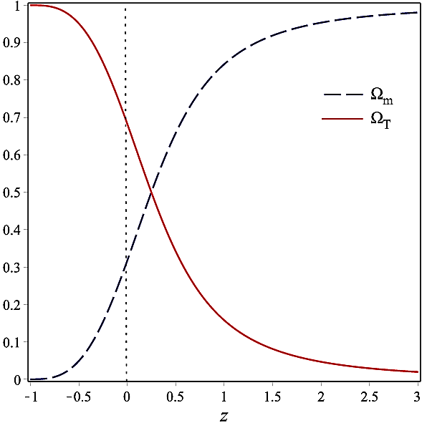
Exponential Infrared f(T) Gravity
Basic requirements
Exponential Infrared f(T) Gravity



Hubble evolution
Deceleration parameter
Density parameters

Slide 58
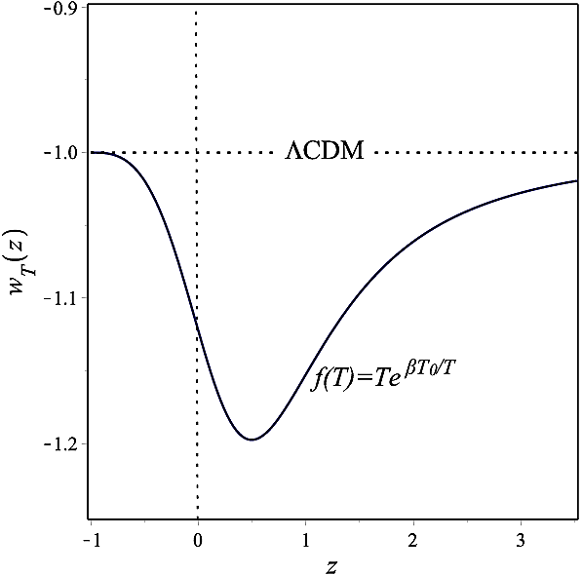
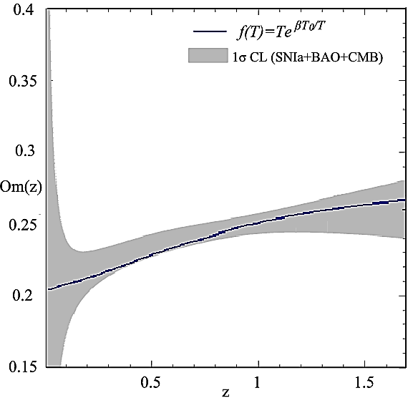
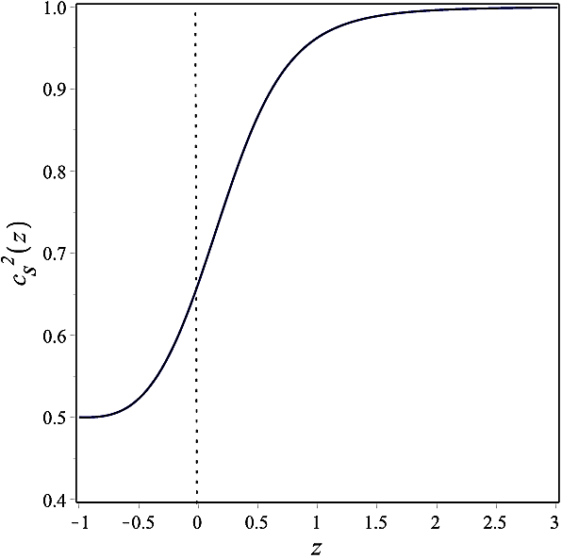
Exponential Infrared f(T) Gravity
Basic requirements
Exponential Infrared f(T) Gravity
Perturbation level



Dark torsion
Om(z) parameter
Sound speed

Slide 59
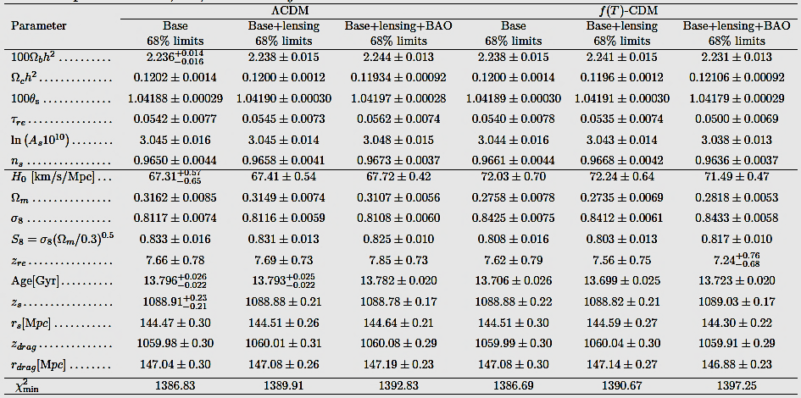
Exponential IR f(T) gravity
Base=TT+TE+EE
M. Hashim, et. al., JCAP 07 (2021), 053 [arXiv:2104.08311]

Slide 60
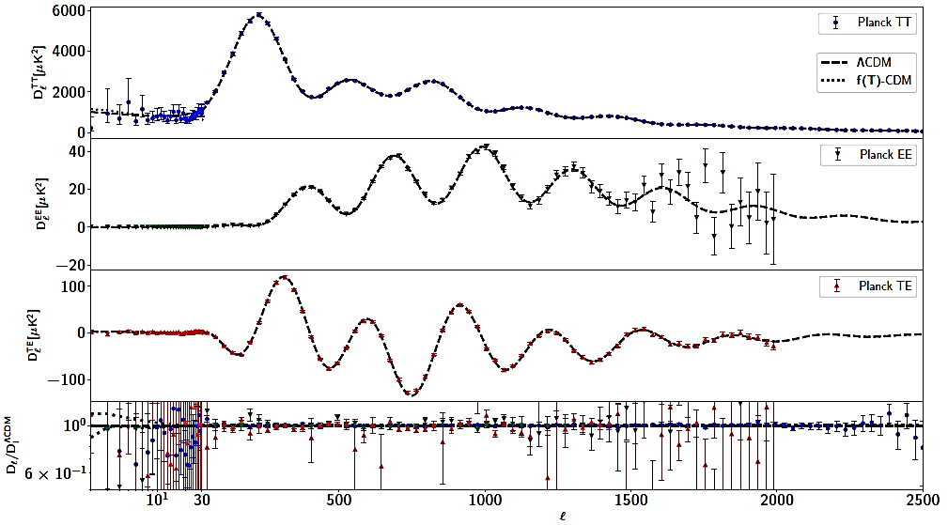
Exponential IR f(T) gravity
CMB power spectra

Slide 61

Exponential IR f(T) gravity
Lensing power spectrum
Matter power spectrum

Slide 62


Exponential IR f(T) gravity
Six parameter space

Slide 63


Exponential IR f(T) gravity
Indeed, using the full CMB spectrum, we find that the Planck (TT+TE+EE+lensing) base-f(T)-CDM alone predicts a Hubble constant of H₀ = 72.24 ± 0.64 km/s/Mpc. This alleviates the H₀ tension with R20+H0LiCOW to the 0.8σ level; in contrast to CDM context, where it reaches 4.8σ.
The cosmic shear measurements of σ₈ using VK-450 dataset is at ~ 0.2σ tension higher with our obtained CMB base-f(T)-CDM value.

Slide 64


Exponential IR f(T) gravity
Indeed, using the full CMB spectrum, we find that the Planck (TT+TE+EE+lensing) base-f(T)-CDM alone predicts a Hubble constant of H₀ = 72.24 ± 0.64 km/s/Mpc. This alleviates the H₀ tension with R20+H0LiCOW to the 0.8σ level; in contrast to CDM context, where it reaches 4.8σ.
The cosmic shear measurements of S₈ using VK-450 dataset is at 2.4σ tension with our obtained CMB base-f(T)-CDM value, which reduces the S₈ tension by 0.2σ.

Slide 65

Exponential IR f(T) gravity
Although the current theory is
viable — in the sense that it fits the data with χ² values comparable to CDM — it shows systematic deviations with not only the BAO but also the SNIa distances and the growth of structure (fσ₈), where it is in more severe tension than the standard model.

Slide 66

Phantom regime
It follows that the Hubble expansion rate H(z)
(i) At some critical redshift z_{c} > 0, H_{ph} = H_{ΛCDM},
(ii) At redshifts 0 ≤ z < z_{c}, Hph > HΛCDM (this includes H_{0,ph} > H_{0,ΛCDM}),
(iii) At redshifts z > z_{c}, H_{ph} < H_{ΛCDM}.
Since the BAO angular distance is sensitive to the sound horizon size (standard ruler), one does not expect changes in their observed values when early universe is kept unaltered. However, the changes in the Hubble expansion rate in phantom regime at late universe as illustrated above leads to a necessarily systematic deviation with BAO angular distances at low redshift if angular distance to CMB is kept fixed to Planck measurement

Slide 67
Thermal History, BAO, matter power spectrum, particle physics SM, …
Sound horizon r_{s}
Once BAO is added,
all go back to LCDM + Planck!
Dark radiation
Neff
Change
early time
physics
5σ
H₀ Tension
Early
DE
Neutrino
Strong interaction
Solar system, BAO, distance indicators, ……..
Extended LCDM
Modified Gravity
Is it
no go Solution?
Change
late time
universe
Dynamical DE
Decaying DM
Interacting DM-DE

Slide 68


How to solve?
Recommendations
Any alternative/extension to LCDM to solve H0 tension should not worsen the S8 tension
Test your model using CMB data alone and CMB+BAO.
Do not add priors on H0 from late universe observations.
Try to keep the model at six parameter space.

