Slide 1
Fuzzy Dark (matter) Imprints in Galaxies
Quantum effects on galactic scales…
Amr El-Zant (Centre for Theoretical Physics, The British University in Egypt)

Slide 2
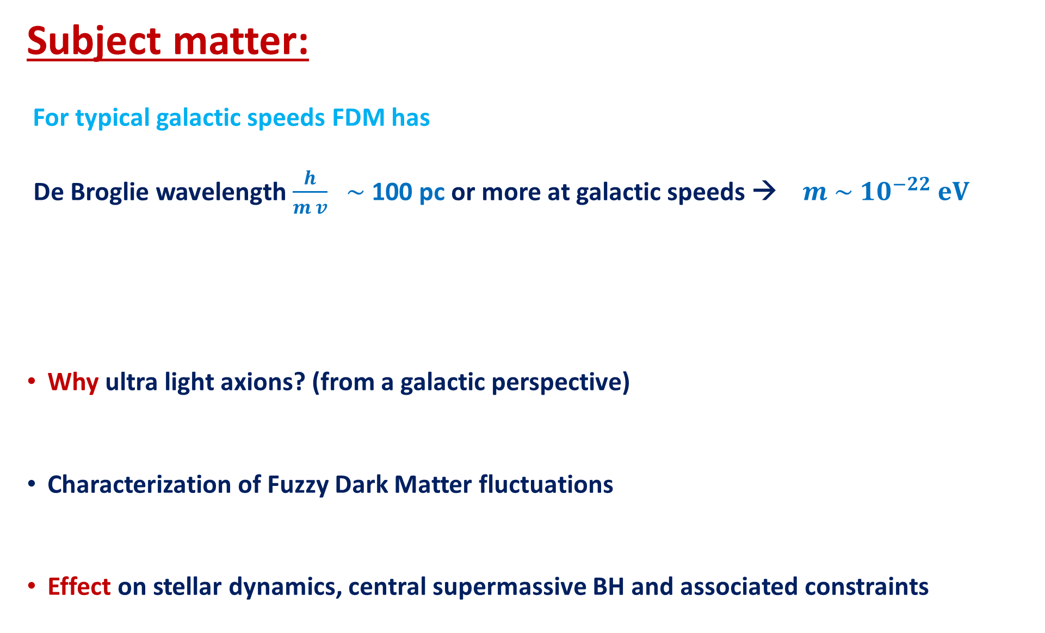
Subject matter:
For typical galactic speeds FDM has
De Broglie wavelength $\frac{h}{m v}$ $\sim$ 100 pc or more at galactic speeds → $m \sim 10^{−22} eV$
Why ultra light axions? (from a galactic perspective)
Characterization of Fuzzy Dark Matter fluctuations
Effect on stellar dynamics, central supermassive BH and associated constraints
Outline:

Slide 3
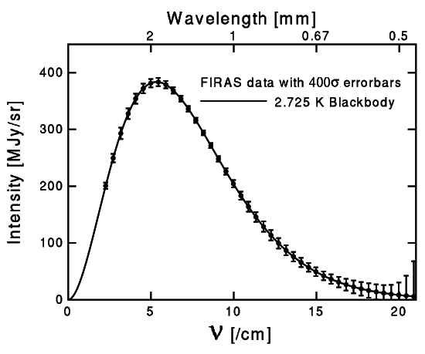
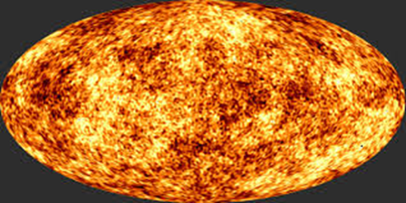
Hot Big Bang and Cold Dark Matter Driven Structure Formation
→ Early thermal equilibrium
Baryons coupled to photon bath → cannot collapse early enough
But weakly interacting, massive particles (WIMPs)
Decouple early with small speed → → Drives galaxy formation
→

Slide 4
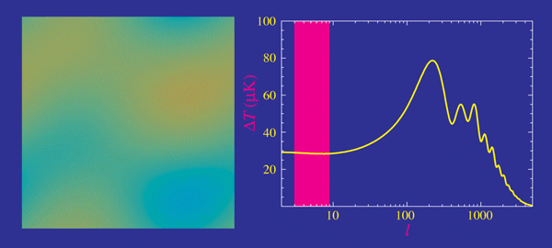
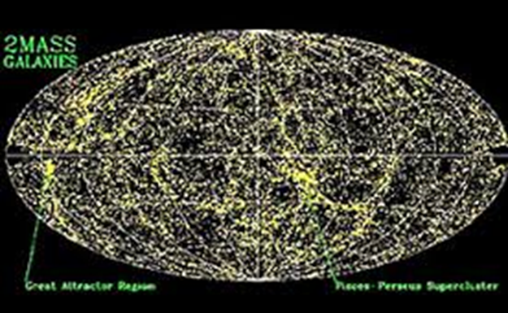
The Case for CDM
DM needed for structure formation and CMB
Not easily explainable by modified gravity
Cold dark matter → Fits cosmological data
Power spectrum of
cosmic structure
Predicted by natural Susy theories (until recently a big plus!)
Right abundance from weak interaction freeze out from thermal equilibrium
CMB. LSS in MOND
(Skordis et. al. 2006)

Slide 5
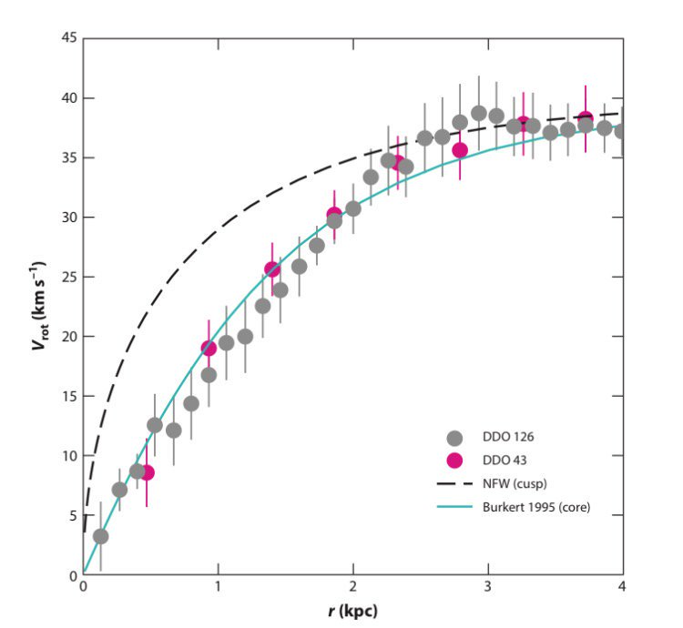
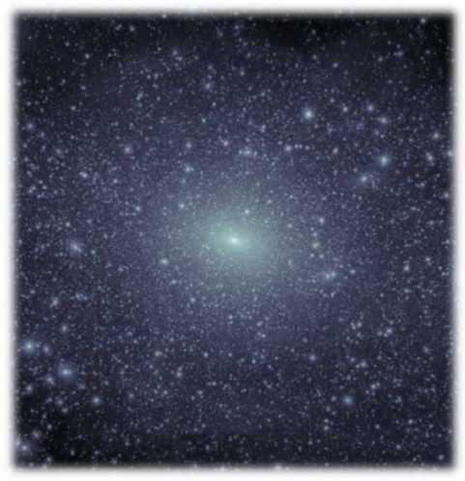
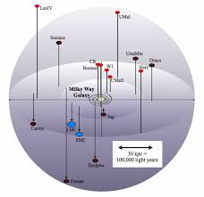
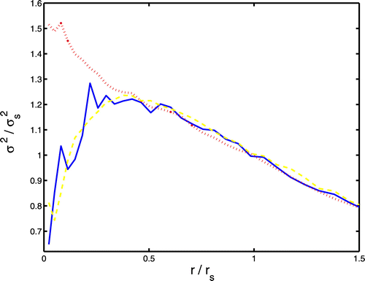
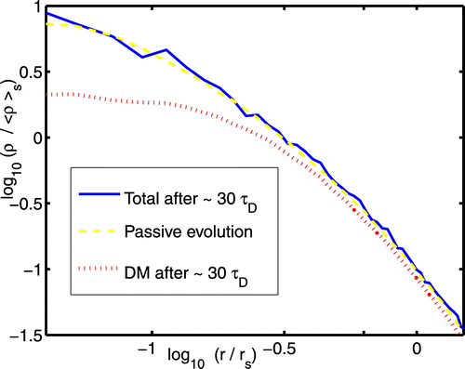
Galactic Scale Problems with CDM
From Bullock & Bolan-Kolchin 2017
DM compensates for mass deficit in outer parts
BUT contributes too much mass to central parts
**Probably related problems: Excess of small haloes and wrong dynamics
Simulation M.Y. size halo .vs. Dwarf galx. pop.
→ constraints
Need smaller density
+ more random motion in centre of halo:
Heating of central cusp by dynamical friction; El-Zant (2008)

Slide 6
Some Proposed Solutions
’Heat’ DM → decrease DM density:
** Baryonic solutions: baryons pump energy into DM
(e.g., El-Zant et. al 2001, 2004; Pontzen & Governato 2014; El-Zant et. al. 2016, Hashim et. al. 2022)
** Self interacting DM → Conduction
** Warm DM → preheat!
** Quantum fluctuations (‘Fuzzy Dark Matter’ of ultra light bosons)
e.g., Hu et al. (2000), Peebles (2000), Hui et. al. (2017), El-Zant et. al. (2019, 2020)

Slide 7
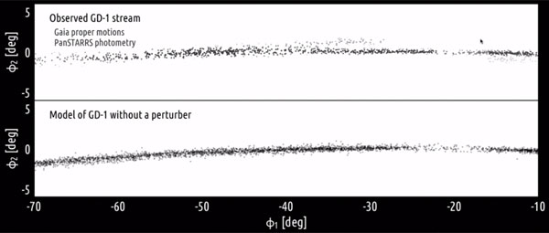
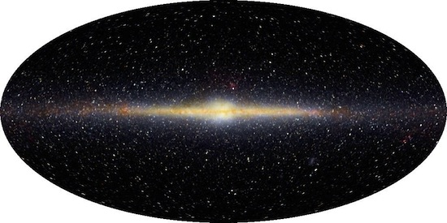

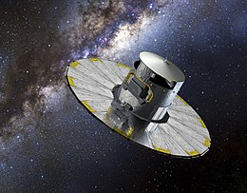
Couple of effects of DM fluctuations
Tidal streams: thickness and gaps (Bonaca et. al. 2019)
Thickness and Dyn. of Galactic Disk
GAIA

Slide 8
Worked Example: Ultra-light Axion → “Fuzzy DM”
Tiny Mass ~ →Astrophysical de Broglie wavelength
Large number of particles in same state and non-relativistic on galactic scales
→ Schrodinger-Poisson system

Slide 9
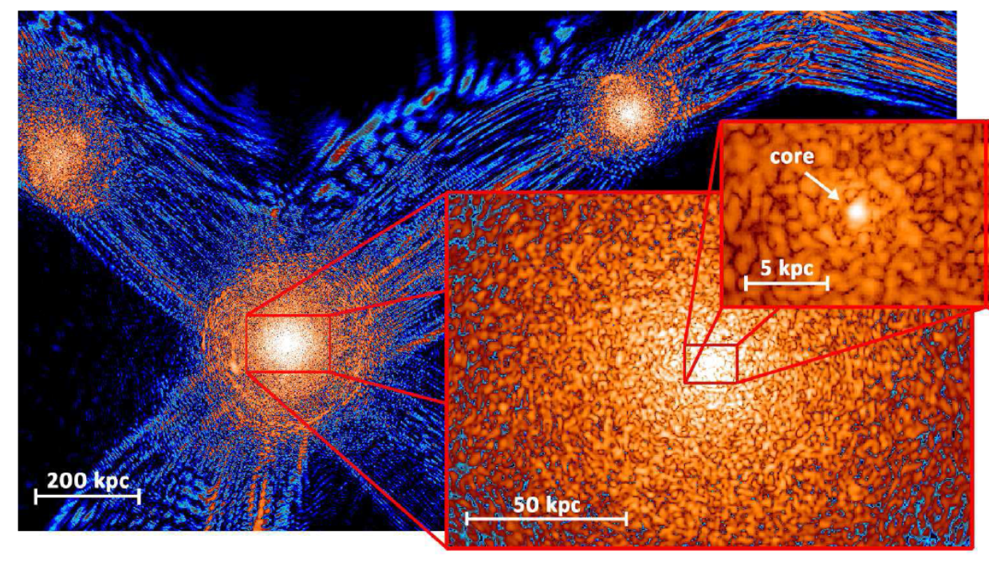
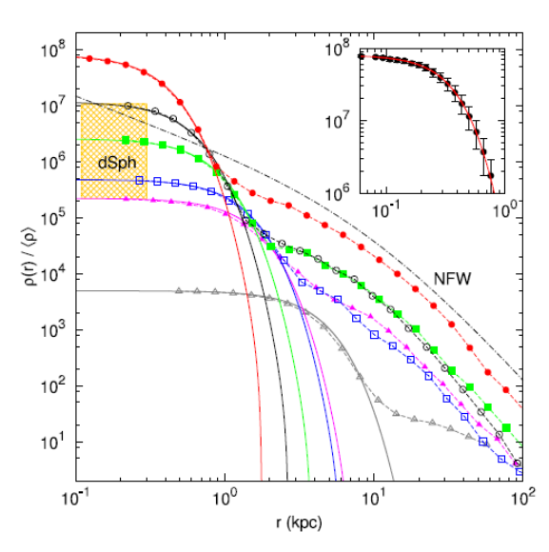
Structure Formation and fluctuations with fuzzy DM (Schive et. al. 2014)
~Constant density cores
Fewer small bound structures (haloes)
~as CDM on large scales
Few smaller halos (note however interference pattern and flcutuations!)

Slide 10

Axion Fluctuations as Random Gaussian Field
Expand fluctuations in modes $ρ_{k}$ moving at phase velocity v such that
This is the case if
and
Wave function power spectrum → k-space density →
Power spectrum of
density fluctuations
interference pattern →

Slide 11

Power Spectrum of Density Fluctuations
Interpretation and Comparison with simulations (of Chan et. al. 2018)
Conservation of probability (number density)
Correspondence of wavenumber and FDM vely distn function
Maxwellian velys
→ Power spectrum
White noise
Effective fluctuation scale
~ Randomly scattered masses ~ $m_{eff}$

Slide 12
From Density to Force fluctuations
Use Poisson equation
Homogeneous process →
Force fluctuation power →

Slide 13
Fourier Transform → Force Correlation Function
Stochastic equation → Random velocity from fluctuations
Maxwellian →

Slide 14
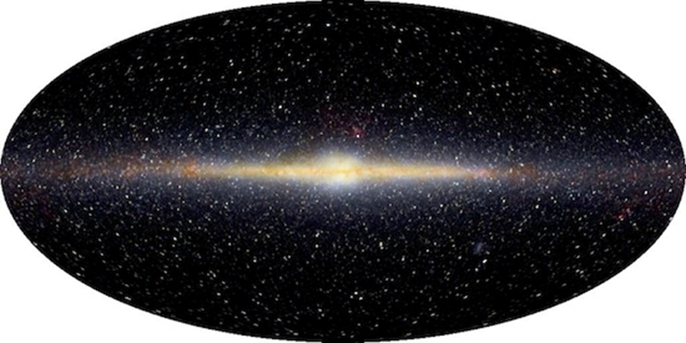
Observable Effect: Galactic Disk Velocity Dispersion
-- Decompose energy input to disk via fluctuations into vertical and radial components
→ Prediction: radial velocity dispersion of disk stars increases as
Observed dispersion does increase BUT as
→ Axion fluctuation contribution
→ Limit on axion mass
Observed radial dispersion increase and power law exponent. From Mackareth et. al. (2019 )

Slide 15
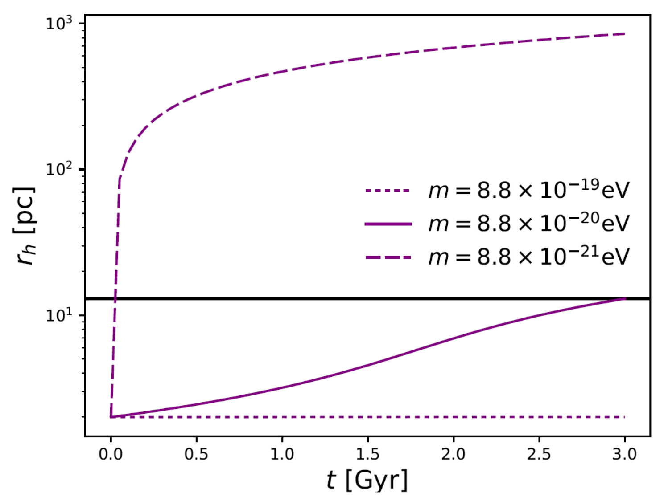
Expansion of the Central Cluster of Dwarf Eridanus II
Basic idea (Marsh & Niemeyer 2019):
-- Fluctuations cause central cluster to expand
-- If axion mass too small → cluster too large
→ quite severe constraints on axion mass
BUT does cluster expand or gets displaced?
Cluster expansion in context of El-Zant et. al. (2019) model

Slide 16
Observable Effect: Central Black Hole Displacement
Equipartition of SMBH KE with FDM heat bath →
Virial theorem at low masses →
Averaging over thermal distribution
Reduction in merger rate

Slide 17
Conclusions and Prospects:
CDM Threatened: small scale problems part of a parcel of problems
Alternatives can have observable consequences on galaxies
FDM Alternative: Fluctuations from uncertainty principle →’hotter’ DM
But are fluctuations needed to solve core-cusp problem etc., too large?
Ongoing and prospective work:
** FDM Simulations of disks with FDM noise
++ Full S-P simulations
Effect on tidal stream (already much work)
FDM self interaction… baryons etc…

Slide 18
Effect of Non-radial Modes and Power Input
Same power input as previous case but evolution on a tenth of the timescale

Slide 19
Space and Time Correlations

