Slide 1
Gauss-Bonnet Gravity:
Singularity Analysis
Adel Awad
Department of Physics, Faculty of Science, Ain Shams University
Centre for Theoretical Physics, British University in Egypt

Slide 2
Outline
Introduction & Motivation
Cosmology with Weyl Anomaly
Strength of a singularity
Extending spacetime and singularity crossing
Gauss-Bonnet Cosmology
Gauss-Bonnet Black Holes
Conclusion

Slide 3
I. Introduction & Motivation
One of the important features of GR is the existence of spacetime singularities.
Singularity theorems (Hawking and Penrose) assured the existence of singularities for any gravitational system starting from generic matter distribution with some energy conditions.
In the absence of a canonical framework for quantum gravity several authors tried to smooth out these singularities through modifying the EoS or Einstein field equations near singularities!
E.g., for cosmological singularities we have several choices and it is very difficult to justify the use of a specific EoS or theory of modified gravity.
Here we constrain the discussion to two modifications of GR, one is produced by Weyl/conformal anomaly and the other is a curvature correction inspired by string theory, or Gauss-Bonnet gravity.
Therefore, it is natural to ask; Can these higher curvature theories change the nature of some known singular solutions, namely, FLRW and Schwarzschild solutions?

Slide 4
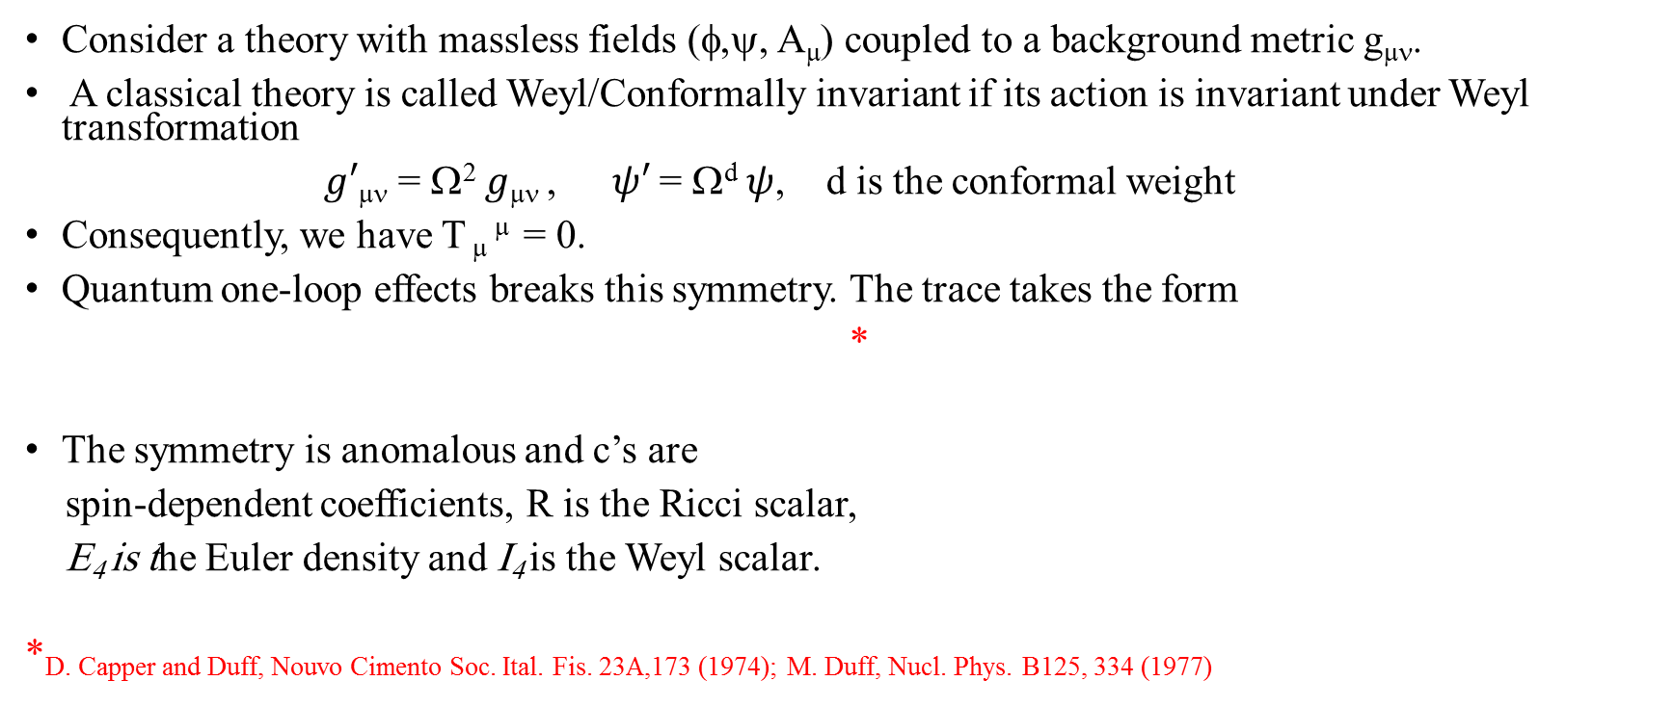
II. Cosmology with Weyl anomaly
Consider a theory with massless fields (φ,ψ, A_{μ}) coupled to a background metric g_{μν}.
A classical theory is called Weyl/Conformally invariant if its action is invariant under Weyl transformation
$g′$_{μν} = Ω² $g$_{μν} , $ψ′$= Ω^{d} $ψ$, d is the conformal weight
Consequently, we have T _{μ} ^{μ} = 0.
Quantum one-loop effects breaks this symmetry. The trace takes the form
*
The symmetry is anomalous and c’s are
spin-dependent coefficients, R is the Ricci scalar,
E₄ is the Euler density and I₄ is the Weyl scalar.
*D. Capper and Duff, Nouvo Cimento Soc. Ital. Fis. 23A,173 (1974); _{M. Duff, Nucl. Phys.} _{B125, 334 (1977)}

Slide 5
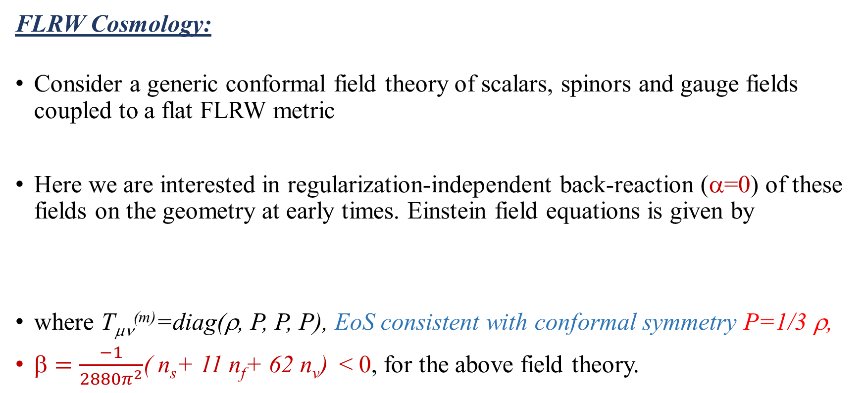
II. Cosmology with Weyl anomaly
FLRW Cosmology:
Consider a generic conformal field theory of scalars, spinors and gauge fields coupled to a flat FLRW metric
Here we are interested in regularization-independent back-reaction (α=0) of these fields on the geometry at early times. Einstein field equations is given by
where T_{μν}^{(m)}=diag(ρ, P, P, P), EoS consistent with conformal symmetry P=1/3 ρ,
$=\frac{−1}{2880π^{2}}$( n_{s}+ 11 n_{f}+ 62 n_{v}) < 0, for the above field theory.

Slide 6

II. Cosmology with Weyl anomaly: FLRW cosmology
Two independent field eqn.’s are
The last eqn. can take the form
Solving the first eqn. for H , we get
$$< 0 implies that density and Hubble rate have max. values and scale factor has a min.

Slide 7


II. Cosmology with Weyl anomaly: Solution
Taking
Soln. of the cosmological eqns is
$ρ \sim 1/η^{4}$
                $R \sim \frac{1}{ \sqrt{t}}$ dh/dt= F with h
  (remember, GR FLRW soln. has R $\sim \frac{1}{t^{2}}$)
III
IV
V
I
II
VI

Slide 8
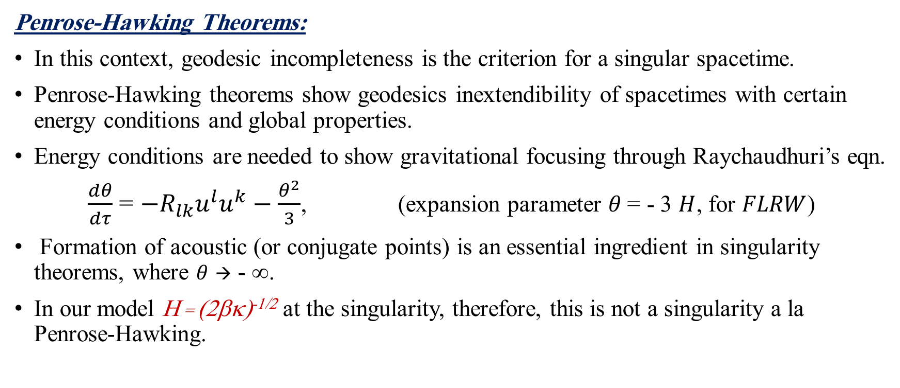
  III. Strength of a singularity
Penrose-Hawking Theorems:
In this context, geodesic incompleteness is the criterion for a singular spacetime.
Penrose-Hawking theorems show geodesics inextendibility of spacetimes with certain energy conditions and global properties.
Energy conditions are needed to show gravitational focusing through Raychaudhuri’s eqn.
$\frac{dθ}{dτ}$ = $−R_{lk}u^{l}u^{k}−\frac{θ^{2}}{3}$, (expansion parameter $θ$= - 3 $H$, for $FLRW$)
Formation of acoustic (or conjugate points) is an essential ingredient in singularity theorems, where $θ$ → - ∞.
In our model H = (2βκ)^{-1/2} at the singularity, therefore, this is not a singularity a la Penrose-Hawking.

Slide 9



  III. Strength of a singularity
u^{μ}
ξ^{μ}
x^{μ}(τ,s)
Tipler’s and Krolak’s criteria for a strong singularity:
Soln. of geodesic deviation eqn. are called Jacobi fields
Tipler’s criterion for a strong singularity; a singularity is called strong if the volume spanned by three orthonormal Jacobi fields shrunk to zero size at the singularity.
Krolak’s criterion for a strong singularity is similar but based on the rate of change of the volume w.r.t. affine parameter instead of the volume at the singularity.
u^{μ} = $\frac{∂\text{x}\text{μ}}{∂\text{τ}}$
, ξ^{μ} = $\frac{∂\text{x}\text{μ}}{∂\text{s}}$
$\frac{D2ξ\text{μ}}{\text{d}\text{τ}2}= R_{αβγ}^{μ}$ $u^{α}u^{β}^{γ}$

Slide 10
III. Strength of a singularity
The singularity is Tipler strong for a null geodesic iff the following integral diverges
But the singularity is Krolark strong iff the following integral diverges
For our spacetime close to t=0, (int. cond. λ₀= 0 at t=0) solving geodesic eqn.’s we get
Now evaluating both integrals in the limit λ→ 0 , we find that both integrals vanishes.

Slide 11
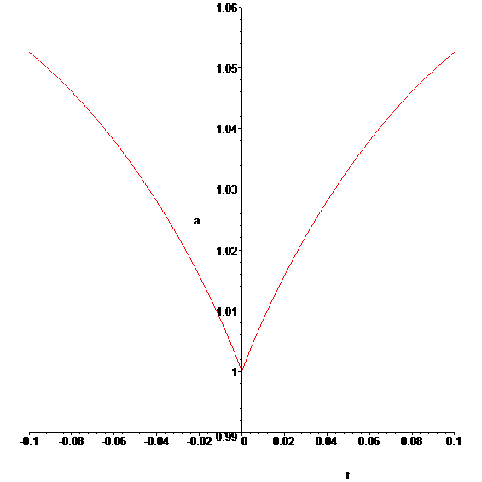
  IV. Extending spacetime and singularity crossing
Geodesic extension:
Geodesic equations for FLRW metric are
where s and v^{i} are integration constants and λ is a non-spacelike
affine parameter. s =1,0 for timelike and null affine parameter.
  Now joining the two branches (soln’s for t ≥ 0 and t < 0) together
  leads to following scale factor
One can show that it is possible to extend geodesics beyond this
singularity, in fact, beyond this type of singularities (Sudden singularities).
III
IV
V
I
II
VI
a(t)
t

Slide 12
  IV. Extending spacetime and singularity crossing:
  geodesic extension
Now integrating geodesic eqn.’s such that t=0 at λ=0, one obtains
Notice:
These geodesics are defined for all values of λ. Therefore, geodesics are complete and nonspacelike test objects does not get destroyed crossing singularity.
To have a consistent gravitational description it is not enough to have a geodesic extension, we have to check the consistency of this extension with the field equations.

Slide 13
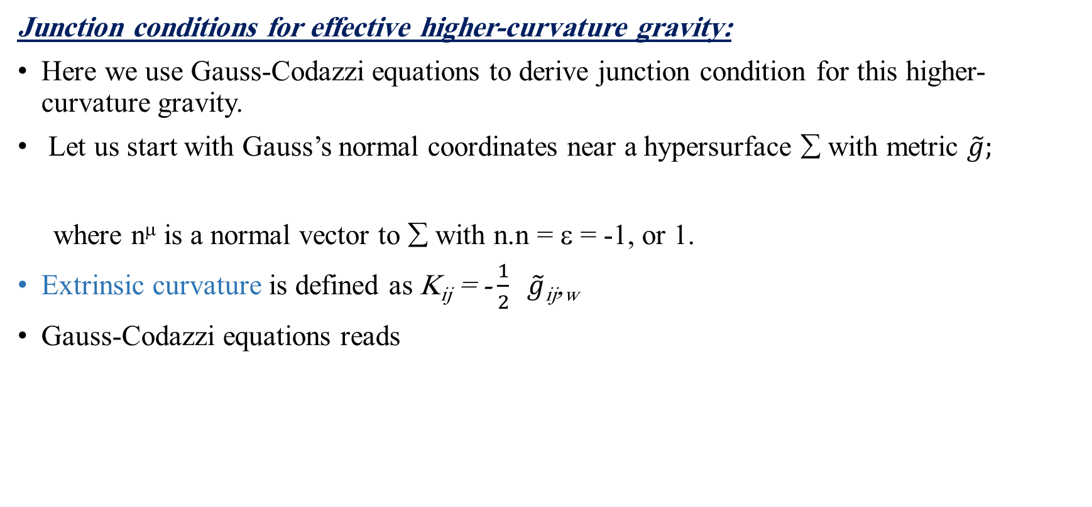
  IV. Extending spacetime and singularity crossing
Junction conditions for effective higher-curvature gravity:
Here we use Gauss-Codazzi equations to derive junction condition for this higher-curvature gravity.
Let us start with Gauss’s normal coordinates near a hypersurface ∑ with metric $\tilde{g};$
where n^{μ} is a normal vector to ∑ with n.n = ε = -1, or 1.
Extrinsic curvature is defined as K_{ij} = -$\frac{1}{2} \tilde{g}$_{ij},_{w}
Gauss-Codazzi equations reads

Slide 14

  IV. Extending spacetime and singularity crossing:
  Junction conditions for effective higher-curvature gravity:
Now we want to express everything in terms of K_{ij} and its derivatives. Field eqn.’s
Let us start with Einstein tensor;
Now for joining two spacetimes at the hypersurface w=0, we must have a continues $\tilde{g}$_{ij}.
Integrating the above eqn.’s one obtains
or [K_{ij}] ≠ 0

Slide 15
  IV. Extending spacetime and singularity crossing:
  Junction conditions for effective higher-curvature gravity:
Now let us express H_{μν} in terms of K_{ij};

Slide 16
  IV. Extending spacetime and singularity crossing:
  Junction conditions for effective higher-curvature gravity:
Since H_{w}^{w} and H_{i}^{w} depends quadratically on K_{ij,w} one might choose [K_{ij}]=0, but this doesn’t allow for surface layer to form.
It is more convenient to split K_{ij} into a trace and traceless part (this splitting is adopted in F(R) theories for junction condition too);
Now the conditions reads
These conditions leads to

Slide 17

  IV. Extending spacetime and singularity crossing:
  Junction conditions for effective higher-derivative gravity:
The extended spacetime scale factor is (for all times)
where, w = t, ε = -1 and $\tilde{g}$_{ij} = a(t)² δ_{ij} and
Calculating S_{ij}
= 0

Slide 18
  V. Gauss-Bonnet Cosmology
Gauss-Bonnet gravity in 5 dimensions has the action
This is the most general two-derivative gravity theory in 5 dimensions. Also, it is ghost-free when expanded about flat space.
Let us start with FLRW cosmology in GB gravity
Einstein field eqns. reduces to

Slide 19
  V. Gauss-Bonnet Cosmology
After rescaling “H” and “t” the system reduces to
Which has the following soln.
Joining two region I&II
III
IV
V
I
II
VI
dh dτ = F versus h & different branches of solutions

Slide 20
  V. Gauss-Bonnet Cosmology
Geodesics equations are
  Solving these eqns. We get
These geodesics are defined for all values of λ. Therefore, geodesics are complete and non-spacelike test objects do not get destroyed upon crossing the singularity.
To have a consistent gravitational description it is not enough to have a geodesic extension, we have to check the consistency of this extension with the field equations.

Slide 21

  V. Gauss-Bonnet Cosmology
Junction conditions for GB gravity, where K_{µν} = -$\frac{1}{2} \tilde{g}\text{µ}\text{ν}$,_{w}*
Junction condition
[K_{µν}] ≠ 0
* N. Deruelle and T. Dolezel, Phys.Rev. D62 (2000) 103502

Slide 22
  V. Gauss-Bonnet Cosmology
The junction conditions are
which are satisfied by the two solutions.

Slide 23
  VI. Gauss-Bonnet Black Hole
GB gravity has a Schwarzschild-like solution that has been introduced by Boulware and Deser in 1985.
Where f (r) has two branches
The “-” soln is stable while the “+” is unstable (this was shown by Boulware and Deser). Furthermore, the “-” sign soln. goes to Schwarzschild solution in large radial distance “r” and in the limit that α → 0

Slide 24
  VI. Gauss-Bonnet Black Hole
We are going to consider the “-” sign soln. for the cases of α > 0 and α < 0.
Black Hole with α > 0 :
In this case the horizon is at
Curvature is blowing up at r*= 0, Ricci Scalar goes as
Black Hole with α < 0:
The horizon is at
Curvature is blowing up at r*= 2(mα)^{1/4} , Ricci Scalar goes as

Slide 25
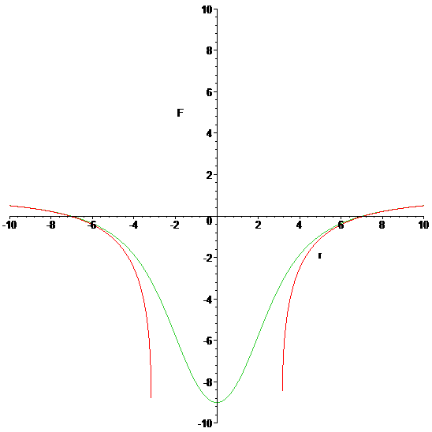
f(r) for α > 0 and α < 0 branches

Slide 26

  VI. Gauss-Bonnet Black Hole
Tipler’s and Krolak’s criteria for a strong singularity:
Krolak’s criterion :
i) For α > 0, singularity at r* = 0, or at λ₀ = 0,
$$\underset{\text{λ}\text{0} →0}{=lim}{\text{c}\text{3 }\text{λ}\text{0}\text{−2}}$$
ii) For α < 0, singularity at r* = 2(α m)^{1/4}, or at λ =λ₀,
                $\underset{\text{λ}→\text{λ}\text{0}}{=lim}{ \text{c}\text{4 }\text{(}\text{λ} \text{−}\text{λ}\text{0}\text{)}\text{−3/2}}$

Slide 27
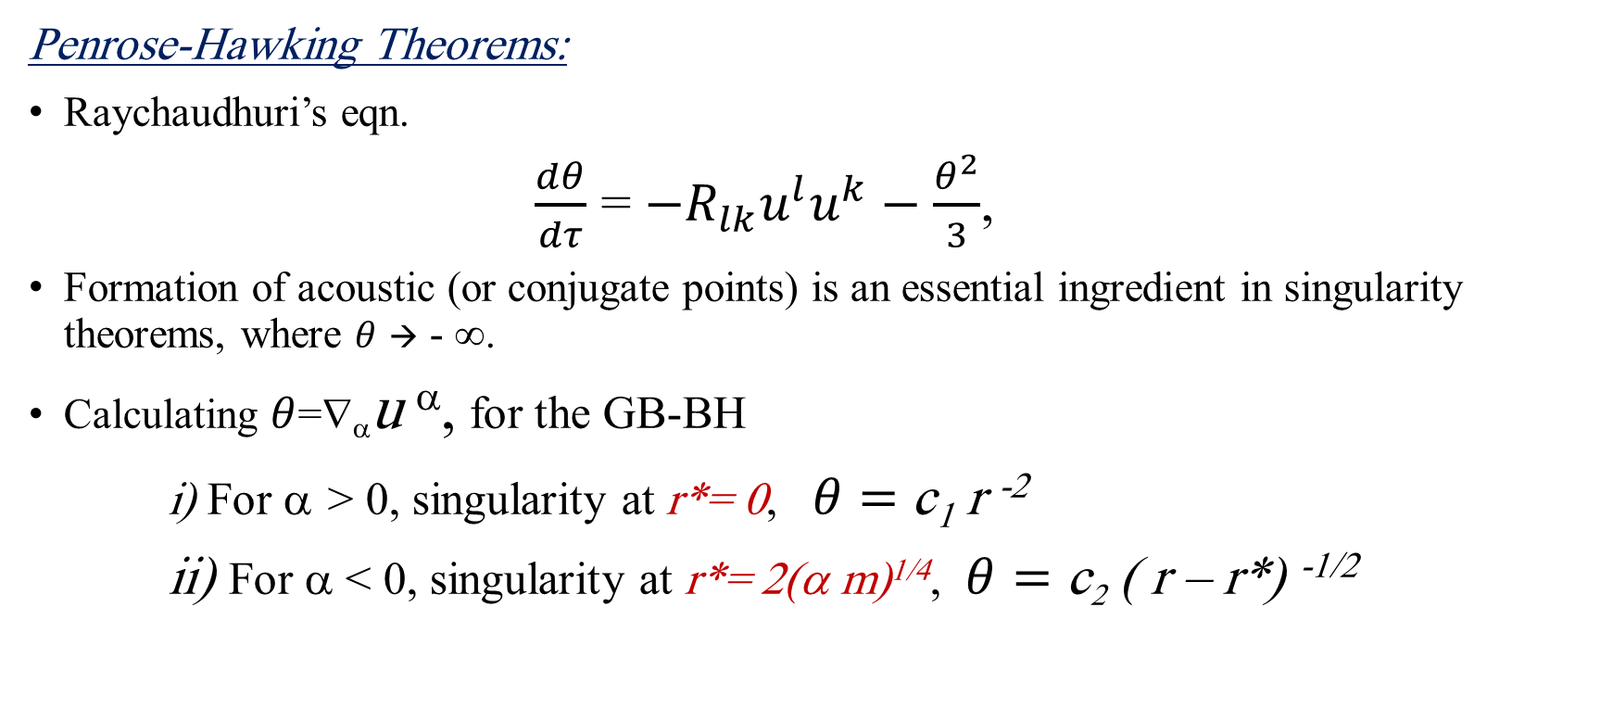
  VI. Gauss-Bonnet Black Hole
Penrose-Hawking Theorems:
Raychaudhuri’s eqn.
$\frac{dθ}{dτ}$ = $−R_{lk}u^{l}u^{k}−\frac{θ^{2}}{3}$,
Formation of acoustic (or conjugate points) is an essential ingredient in singularity theorems, where $θ$ → - ∞.
Calculating $θ$=∇_{α}u ^{α}, for the GB-BH
i) For α > 0, singularity at r*= 0, $θ=$c₁ r ⁻²
ii) For α < 0, singularity at r*= 2(α m)^{1/4}, $θ=$ c₂ ( r – r*) ^{-1/2}

Slide 28

  VI. Gauss-Bonnet Black Hole
Junction Conditions:
Since we have K_{µν} = -$\frac{1}{2} \tilde{g}\text{µ}\text{ν}$,_{w}
The junction conditions are not satisfied since K_{µν} tensor is divergent. For example in the α < 0, case with a singularity at r *= 2(α m)^{1/4},one of the components goes as
K₀₀

Slide 29
  VII. Conclusion
Here we considered GR corrections due to Weyl anomaly and Gauss Bonnet in modifying FLRW cosmology at early times and showed the following;
Curvature corrections changed the nature of the singularity from big bang to sudden singularity.
In is case the singularity is weak, and it admits geodesic extension.
Joining the two disjoint branches of soln.’s provides us with a C² extension to geodesics that leave the spacetime geodesically complete!
Using Gauss-Codazzi eqn.’s one can obtain junction conditions for these higher-curvature gravity which are consistent with the geodesic extension.
For the Gauss-Bonnet theory, the derivative curvature terms were not able to smooth out or modify the singularity Schwarzschild-like solution in a way that enables us to extend geodesics beyond this point.
Higher-curvature gravity theories are important laboratories for understanding singularities more as well as testing our ideas of how to extend geodesics beyond these points.

Slide 32
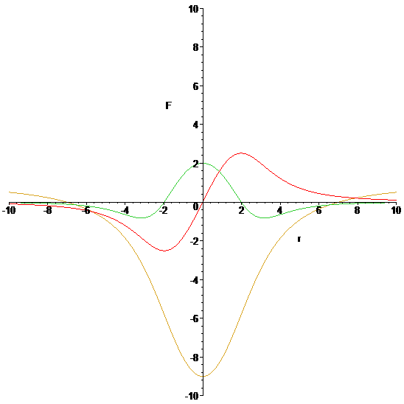

Black Hole with α > 0
  VI. Gauss-Bonnet Black Hole
Geodesics:
Geodesics equations:
Around r = 0, we have
$\dot{r}$ is not continues at r = 0, for L≠ 0, therefore, no extension is possible!

Slide 33
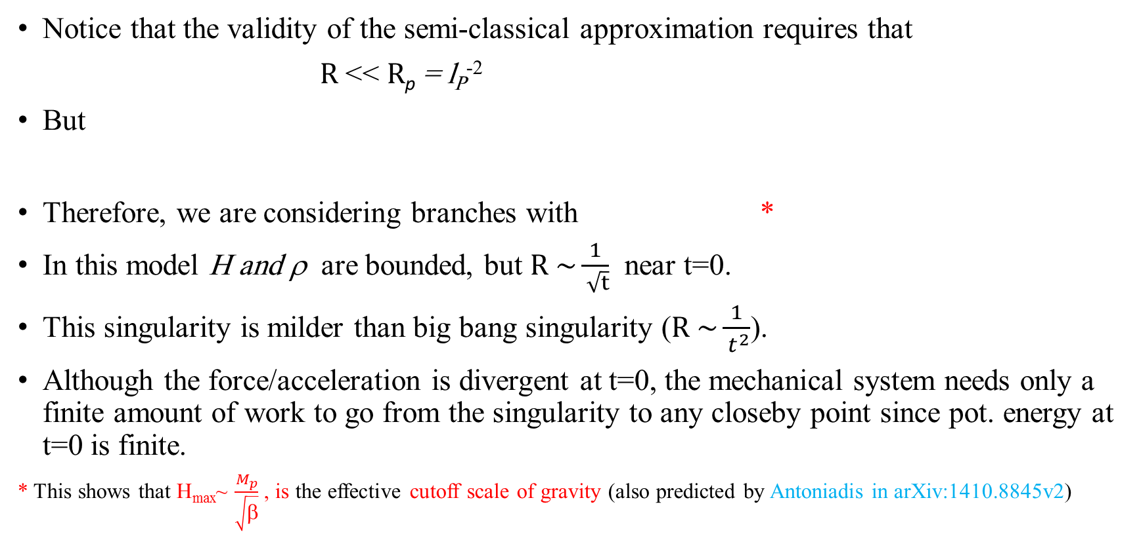
II. Cosmology with Weyl anomaly: a mechanical analogue
Notice that the validity of the semi-classical approximation requires that
$R$<< $R$_{p} = l_{P}⁻²
But
Therefore, we are considering branches with *
In this model H and ρ are bounded, but $R \sim \frac{1}{ \sqrt{t}}$ near t=0.
This singularity is milder than big bang singularity ($R \sim \frac{1}{ t^{2}}$).
Although the force/acceleration is divergent at t=0, the mechanical system needs only a finite amount of work to go from the singularity to any closeby point since pot. energy at t=0 is finite.
* This shows that H_{max}~ $\frac{M_{p}}{\sqrt{β}}$ , is the effective cutoff scale of gravity (also predicted by Antoniadis in arXiv:1410.8845v2)
III
IV
V
I
II
VI

Slide 34
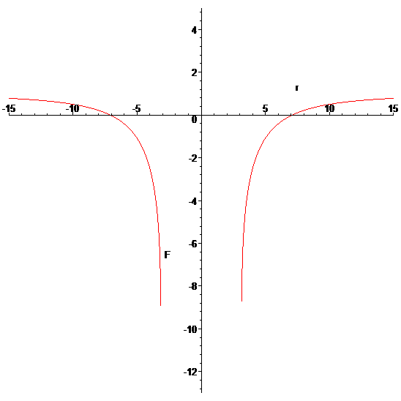
  VI. Gauss-Bonnet Black Hole
Black Hole with α < 0
Geodesics: around r =2(mα)^{1/4}
This fn is continues but not differentiable at r=2(mα)^{1/4 ,} which is saying that one can extend geodesics beyond this point, but the extension is not unique.
Another difference is that geodesic extensions are not going to be C² as in the case for cosmology but at most C¹.

Slide 35
  IV. Extending spacetime and singularity crossing:
  geodesic extension
  For these first-order eqn.’s Picard-Lindelof theorem states that if f^{i} and g are continuous in λ and Lipshitz continuous in t, there exist a unique soln. for the first-order eqn.’s
  Now joining the two branches (soln’s for t ≥ 0 and t < 0) together leads to following scale factor
Notice: First, the above theorem shows the possibility of geodesic extensions for sudden singularities in general.
Furthermore, the invariance of Raychaudhuri eqn. under t → -t, and H → -H leads to existence of time-reflected soln. which works as a natural extension for FLRW for t<0.

Slide 36
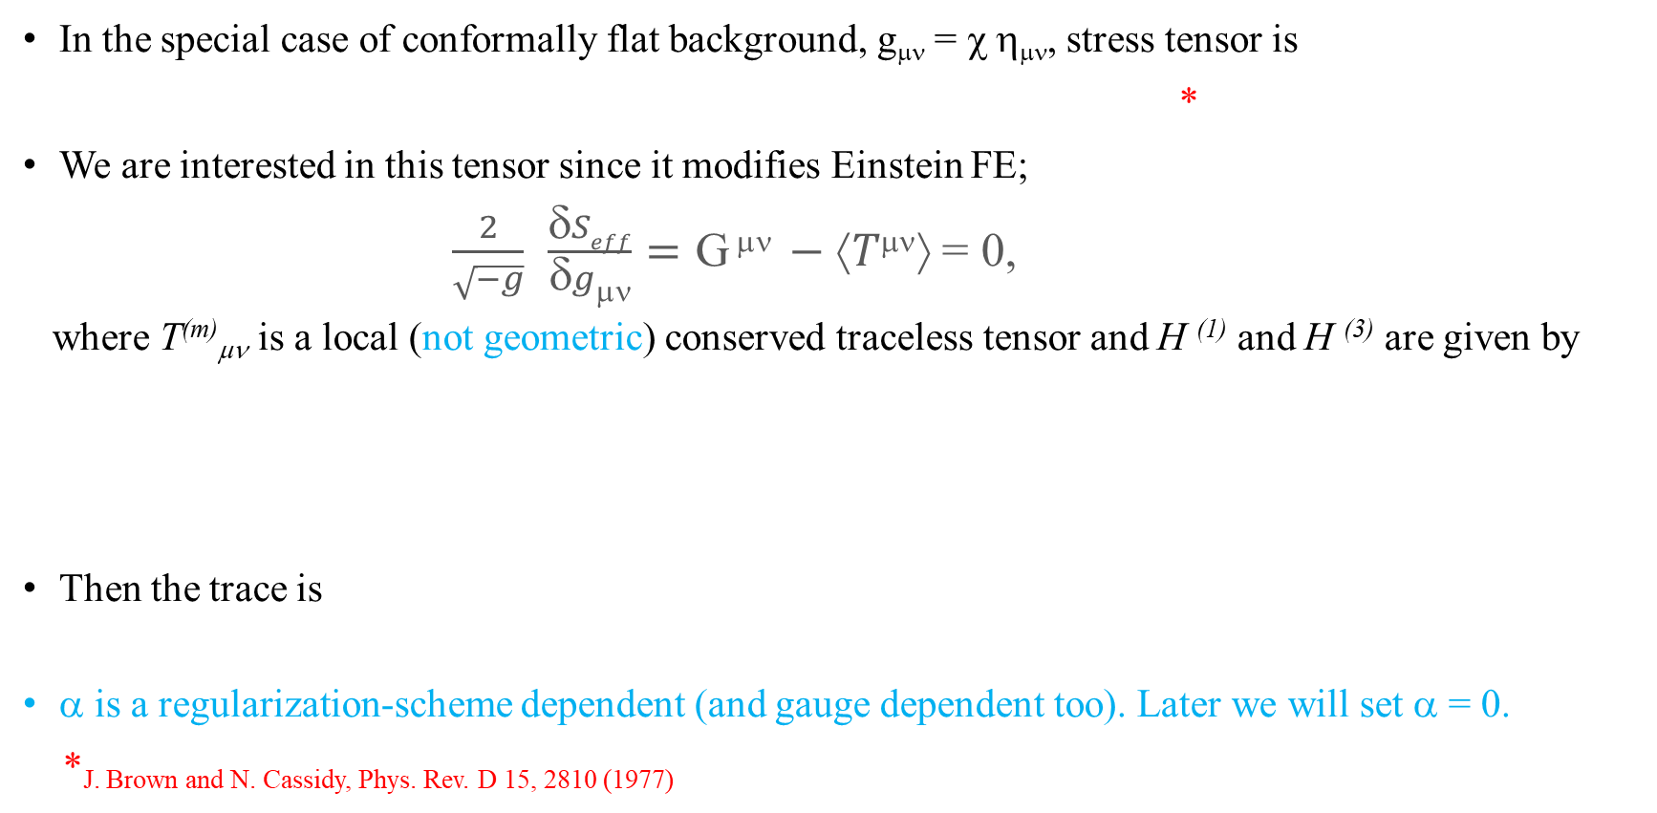
II. Cosmology with Weyl anomaly
In the special case of conformally flat background, g_{μν} = χ η_{μν}, stress tensor is
*
We are interested in this tensor since it modifies Einstein FE;
$\frac{2}{\sqrt{−g}}$ $\frac{δSeff}{δgμν}=\text{G} μν −⟨Tμν⟩$ = 0,
where T^{(m)}_{μν} is a local (not geometric) conserved traceless tensor and H ⁽¹⁾ and H ⁽³⁾ are given by
Then the trace is
α is a regularization-scheme dependent (and gauge dependent too). Later we will set α = 0.
*J. Brown and N. Cassidy, Phys. Rev. D 15, 2810 (1977)

