Slide 1


External-magnetic-field-induced paramagnetic squeezing effect in heavy-ion collisions at the LHC
Ze-Fang Jiang 江泽方
Hubei Engineering University
PHYSICAL REVIEW C 110, 014902 (2024)
Presented at Central China Normal University Oct 24th 2024

Slide 2
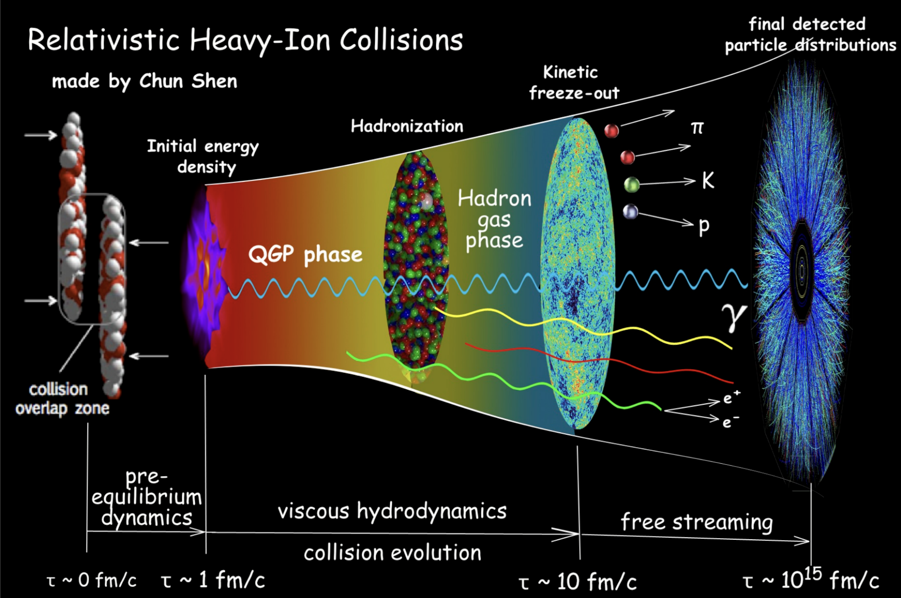
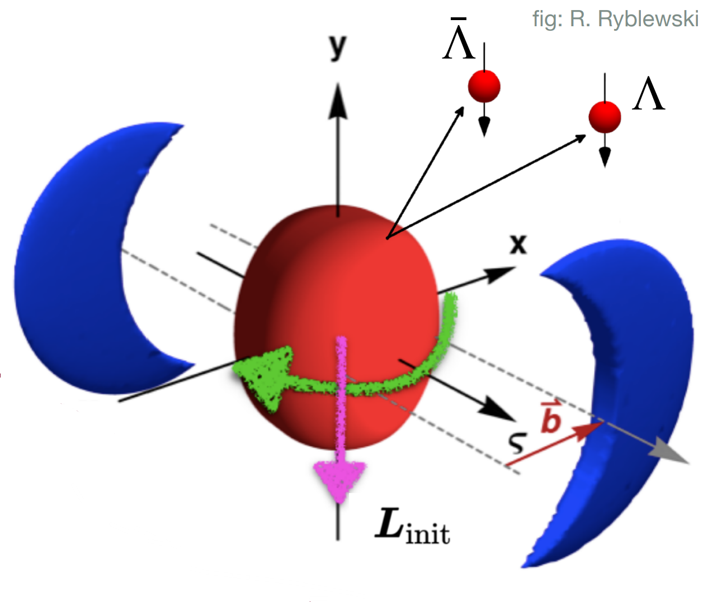

Introduction: HIC
B
EB field
$${10}^{18} −{10}^{19}Gauss$$
CME, CMW,
magnetohydrodynamics..
“ Standard Model ” of heavy ion collision

Slide 3
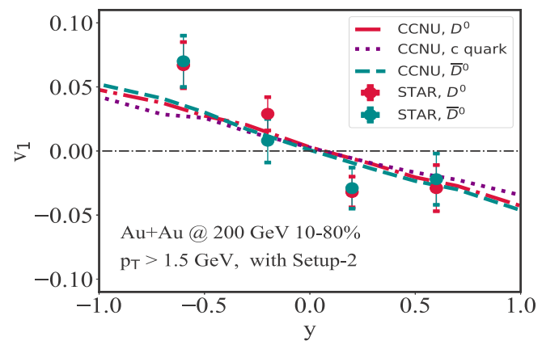
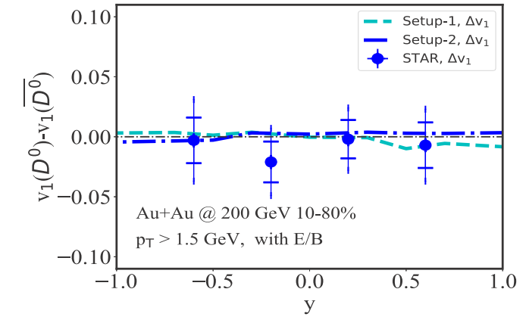
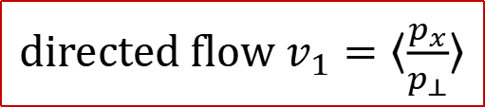



EM field signal: directed flow v₁
STAR, Phys. Rev. Lett. 123, 162301 (2019)
Y. Sun, Phys. Lett. B 816, 136271 (2021)
Jiang et, al. PRC105, 054907 (2022)
Langevin + CLVisc + EM field
STAR
D⁰ meson v₁
B
$$F_{x}=q(E_{x}−v_{z}B_{y})$$
v₁ splitting
weak
c
$$\overline{c}$$
$${−F}_{x}$$
di$rected flow{ v}_{1}=〈\frac{p_{x}}{p_{⊥}}〉$
The v₁ splittings for heavy quark from EMF are small at RHIC.

Slide 4
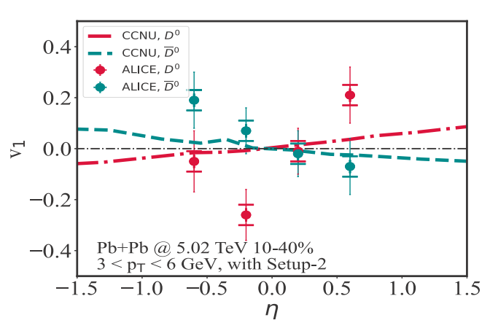
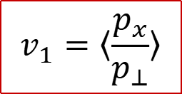
EM field signal: directed flow v₁
ALICE, Phys. Rev. Lett.125, 022301 (2020).
Y. Sun, Phys. Lett. B 816, 136271 (2021)
Jiang et, al. PRC105, 054907 (2022)
Langevin + CLVisc + EM field
ALICE D meson v₁
B
$$F_{x}=q(E_{x}−v_{z}B_{y})$$
$$v_{1}=〈\frac{p_{x}}{p_{⊥}}〉$$
c
v₁ splitting large!
a large and slow decay magnetic Field B at the LHC?
$$\overline{c}$$
$${−F}_{x}$$
The ALICE data favors a big, slow-decaying magnetic field!

Slide 5
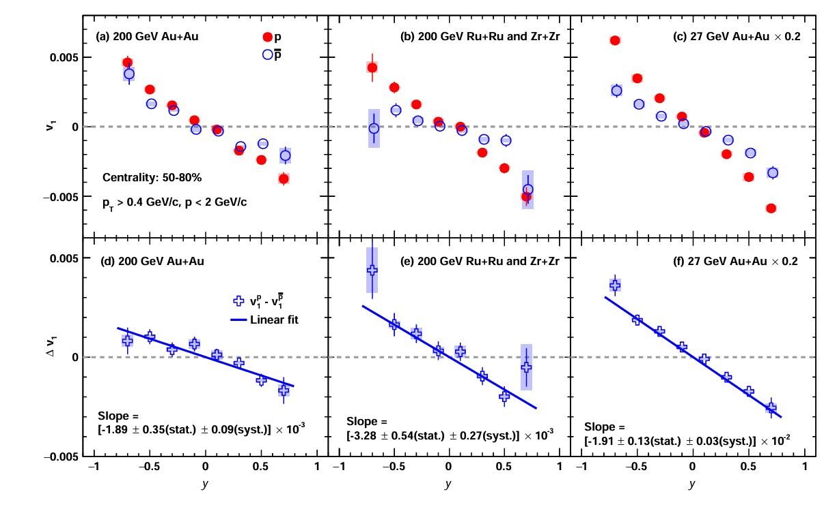
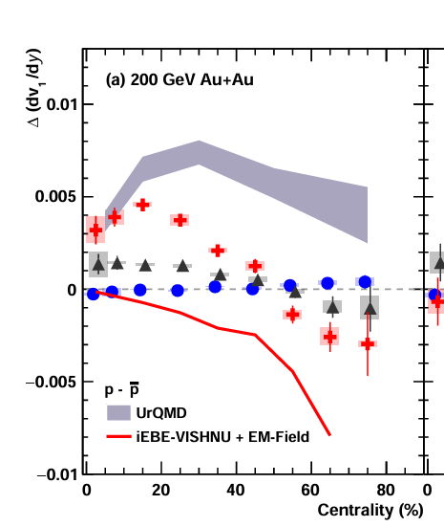
EM field signal: directed flow v₁
STAR, Phys. Rev. X 14 (2024) 1, 011028
$p$/$\overline{p}$ directed flow splitting ∆v₁ : Hall + Faraday + Coulomb effects?
UrQMD
Hydro
$p$/$\overline{p}$ ∆v₁: the impacts of the electromagnetic field on the QGP?

Slide 6
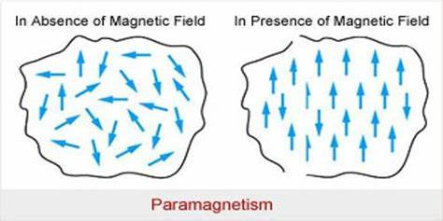
Motivation: paramagnetic squeezing effect
Paramagnetic materials: aligning with external magnetic field B, showing weak magnetism. For examples: Cu, O, Al et al.
B
Lattice QCD show QGP gets paramagnetic at high temperature. Under a strong external magnetic field, the QGP will magnetize, forming a weak internal induced magnetic field, as well as a squeezing force.
G. Endrodi et. al, JHEP 1304 (2013) 023.
G. Bali et. al, JHEP 1304(2013) 130.
G. Bali et. al, Phys. Rev. Lett. 112, 042301 (2014).
H.T. Ding et.al, Int.J.Mod.Phys.E 24 (2015) 10, 1530007
S. Pu et.al, Phys.Rev.D 93 (2016) 7, 074022
L. G. Pang et. al, Phys.Rev.C 93 (2016) 4, 044919
G. Bali et. al, JHEP 07 (2020) 183.
G. Endrodi et. al, Phys. Rev. D 109 (2024) 3, 034506
1. QGP magnetic susceptibility χ.
2. The evolution of external magnetic field B(τ).
3. Final spectra.

Slide 7
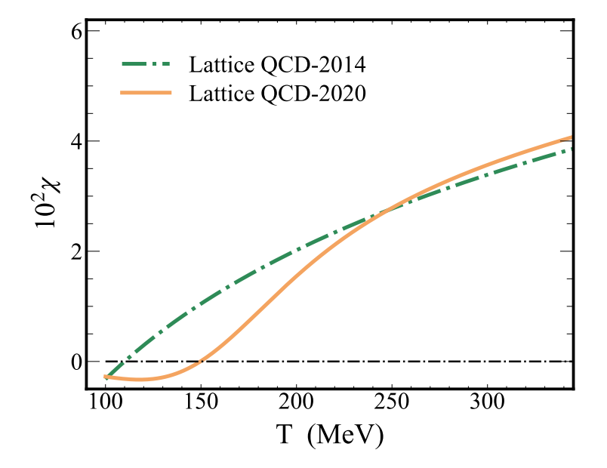

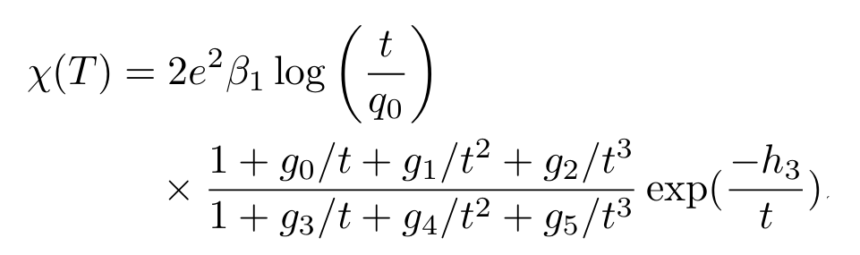
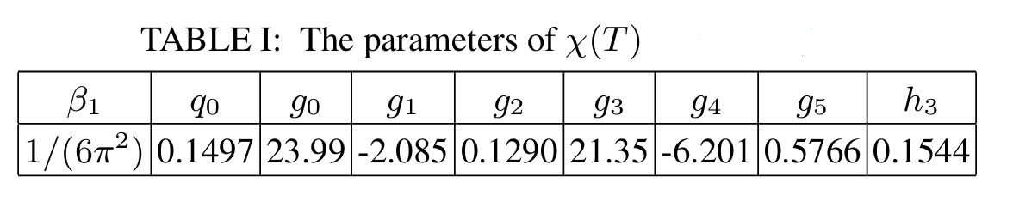
QGP magnetic susceptibility χ
G. Bali et. al, Phys. Rev. Lett. 112, 042301 (2014).
G.S. Bali, G. Endrodi et. al, JHEP 07 (2020) 183.
G. Endrodi et. al, Phys. Rev. D 109 (2024) 3, 034506.
1. A magnetic susceptibility at high temperatures.
2. Lattice QCD-2020: making contact to the Hadron Resonance Gas (HRG) model at low T.
3. In the confined phase, QCD matter show a diamagnetic behavior.

Slide 8
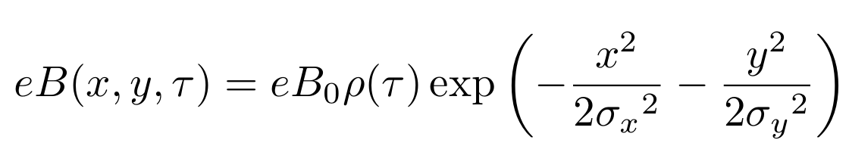
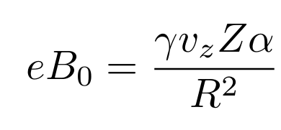
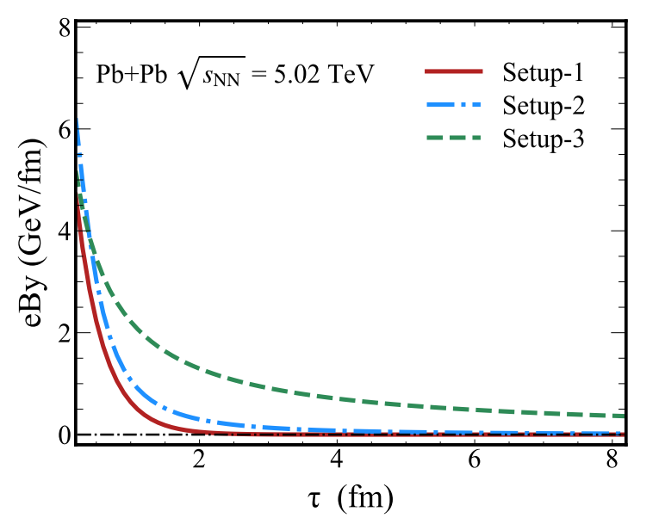
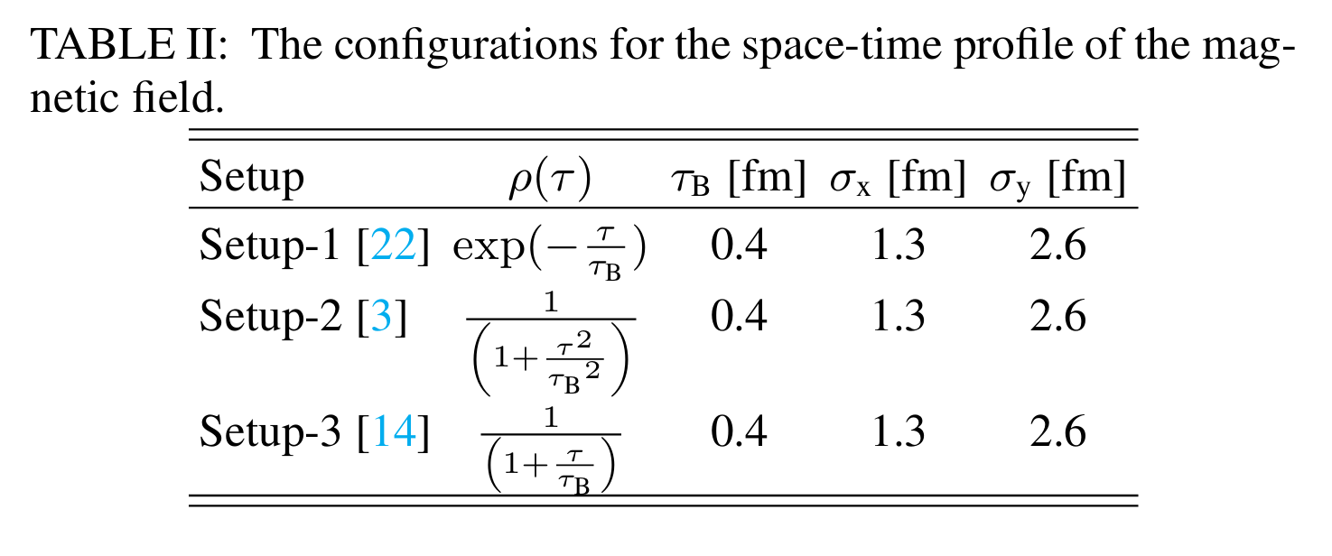

The External Magnetic Field in HIC
W.-T. Deng et.al, Phys. Rev. C 85, 044907.
The evolution of external magnetic field B(τ) is
for Pb+Pb 5.02 TeV
$${eB}_{0}≈7.2 GeV/fm$$
here . Based on the CME and D⁰ directed flow v₁ studies, one has
Key differences in magnetic fields: time evolution, spatial distribution.
Longitudinally: boost-invariance. The QGP formation time: τ_{B} .

Slide 9


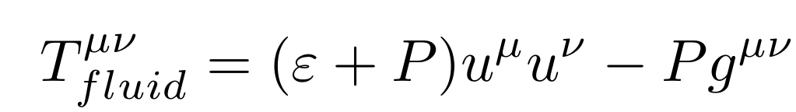
Hydrodynamics
G. Bali et. al, Phys. Rev. Lett. 112, 042301 (2014)
In the presence of the squeezing force, the conservation equations can be written as
The shear and bulk viscosity are zero.
The energy-momentum tensor
Focusing on QGP's paramagnetic response, treating the B field as an external degree of freedom, ignoring QGP’s back reaction on the magnetic field (unlike MHD). F^{v} : the squeezing force density related to B field:
χ: magnetic susceptibility, depends on temperature
CLVisc model, Long-Gang Pang et. al, Phys. Rev. C 93 (2016) 4, 044919

Slide 10
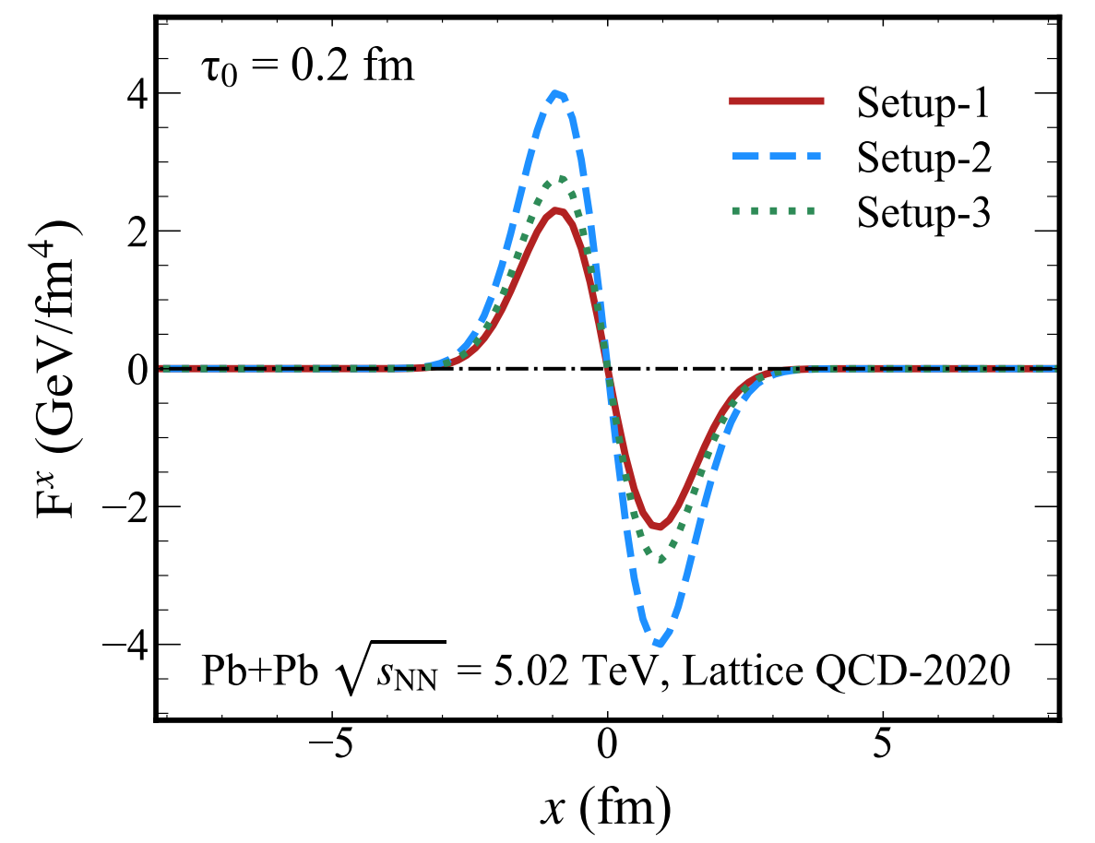
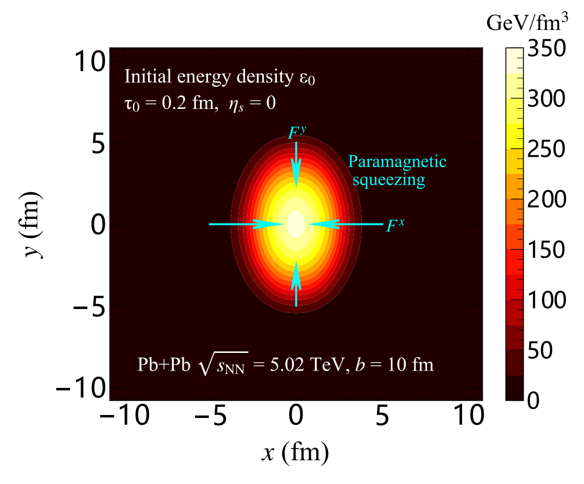
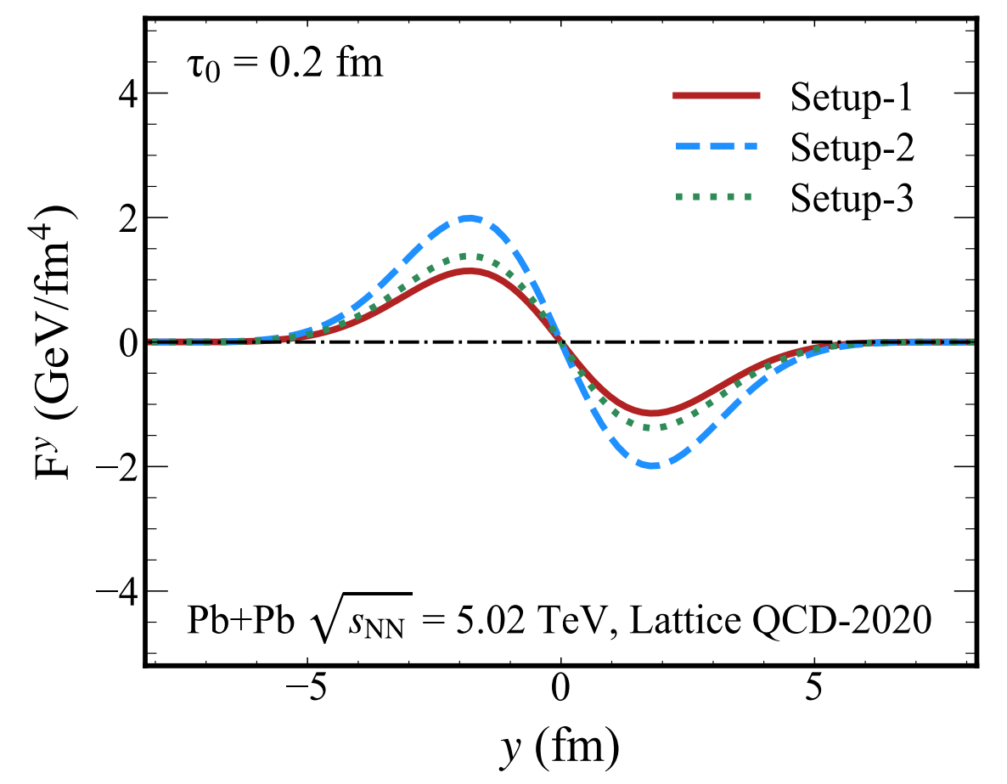




Squeezing force for QGP fireball
$τ_{0}=0.2$ fm
$$F=−∇p$$
Initial state (xy)
$$F^{y}$$
F^{x} > F^{y}
$$F^{x}$$
$$F=−∇p$$
$$F=−∇p$$
With non-zero paramagnetic squeezing force, the eccentricity of the QGP fireball increases.
All three external magnetic fields have: F^{x} > F^{y}.

Slide 11
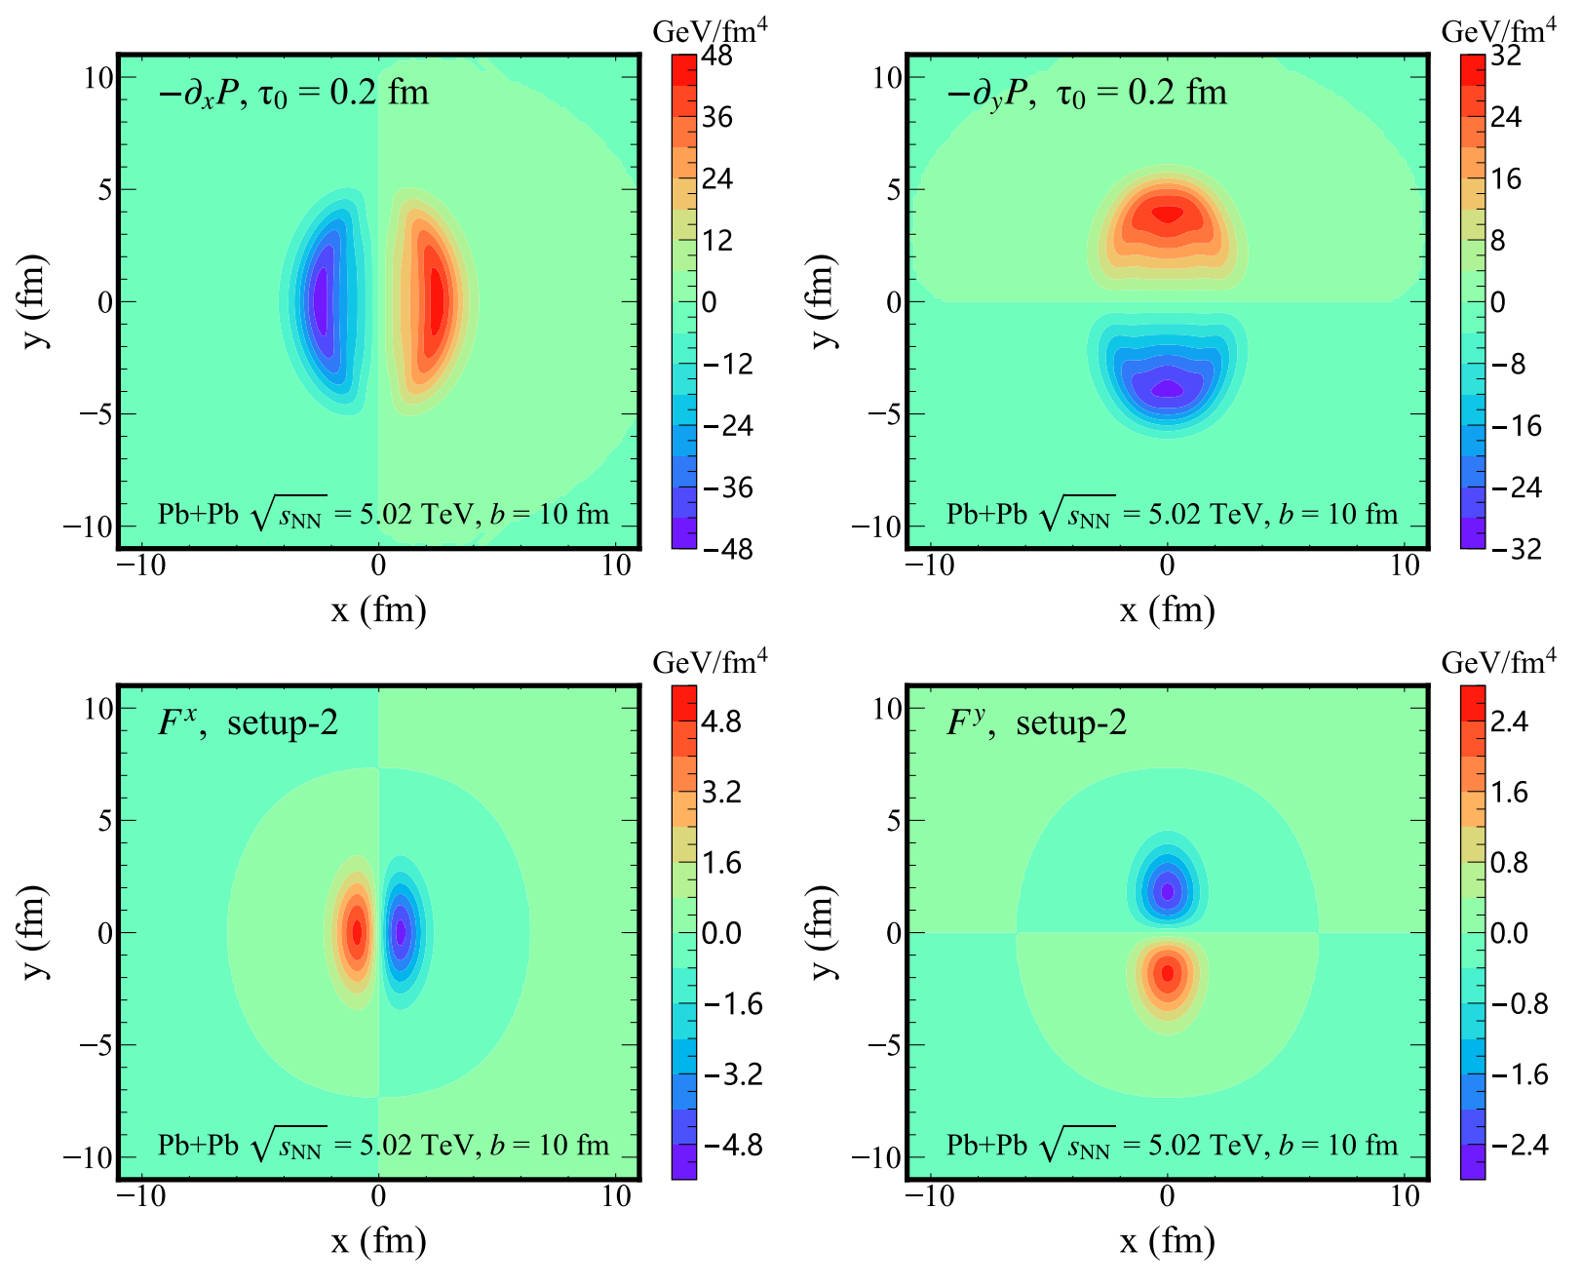
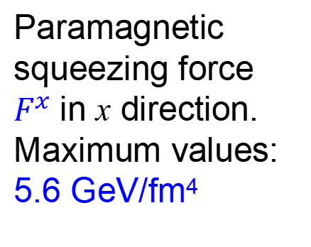
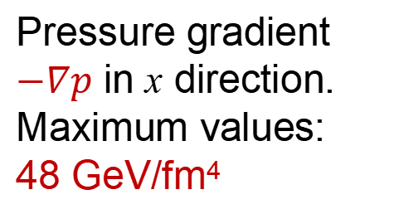
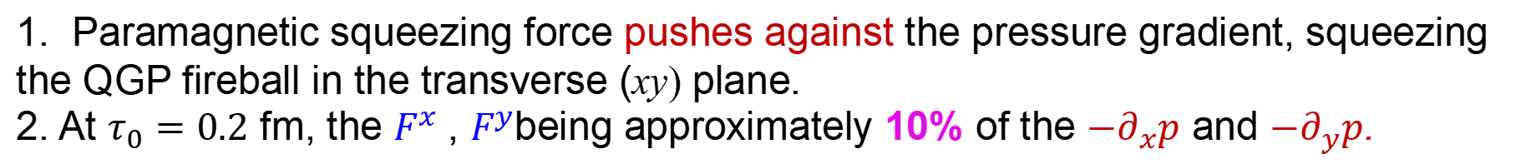
$−∇p$ vs. $F^{x/y}$ in transvers plane
Pressure gradient in x direction
Pressure gradient in y direction
Pressure gradient $−∇p$ in x direction.
Maximum values:
48 GeV/fm⁴
Paramagnetic squeezing force
$F^{x}$ in x direction.
Maximum values:
5.6 GeV/fm⁴
1. Paramagnetic squeezing force pushes against the pressure gradient, squeezing the QGP fireball in the transverse (xy) plane.
2. At $τ_{0}=0.2$ fm, the $F^{x}$ , $F^{y}$being approximately 10% of the ${−∂}_{x}p$ and ${−∂}_{y}p$.

Slide 12
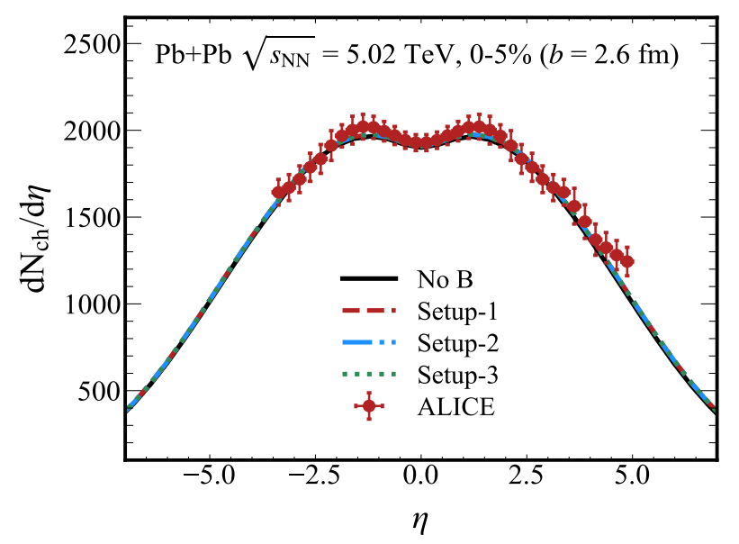
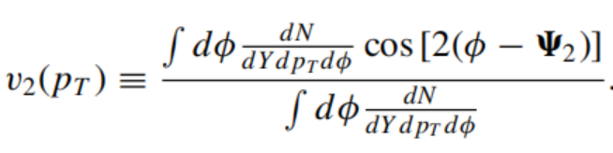
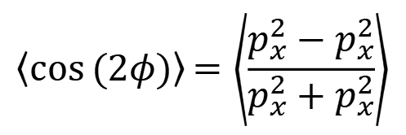
Observables: $\frac{dN_{ch}}{dη}, v_{2}$
Long-Gang Pang et. al, Phys. Rev. C 97, 064918 (2018).
Framework: Optical Glauber model + Squeezing Force + CLVisc + Smooth method.
Initial state (xy)
$$F^{y}$$
F^{x} > F^{y}
F
$$F^{x}$$
the eccentricity of QGP fireball increases.
$$F=−∇p$$
Final state (p)
p_{x} ↓ > p_{y} ↑
$$〈\cos{(2φ)}〉{=\left\langle \frac{p_{x}^{2}−p_{x}^{2}}{p_{x}^{2}+p_{x}^{2}}\right\rangle }$$
Elliptic flow:
Smooth method:
1. Magnetic squeezing force on the yield distribution of charged particles is insignificant.
2. The magnetic fields affect the elliptic flow v₂ of charged particles.

Slide 13
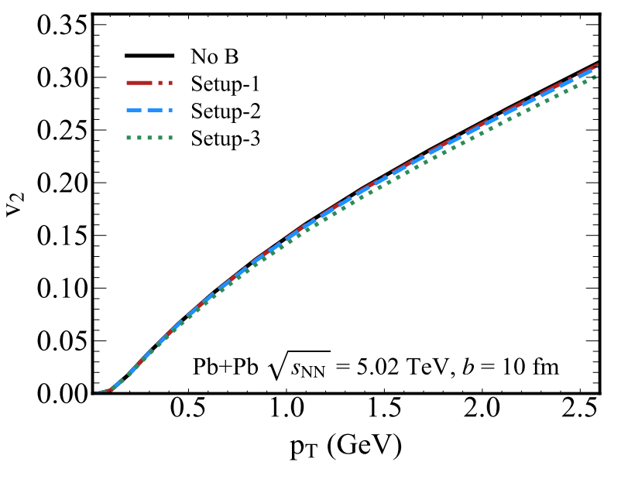

Results: the effect of B field initial value
Long-Gang Pang et. al, Phys. Rev. C 97, 064918 (2018).
Hydrodynamic framework: Optical Glauber model + Squeezing Force + CLVisc + Smooth method.
Elliptic flow v₂, centrality 20-50%, b = 10 fm
Setup-2 has the largest initial paramagnetic squeezing force, but it affects the elliptic flow v₂ insignificant.

Slide 14

Results: the effect of B field lifetime
Setup-3 has the longest lifetime
suppressing v₂ 3-4%
Setup3: a longer-lasting B field reduces the v₂ of the final charged particles.

Slide 15
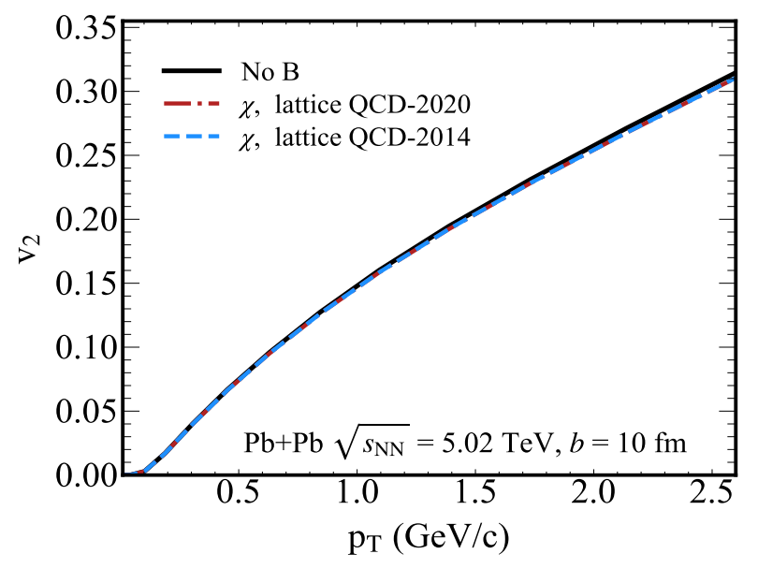
Results: effect of magnetic susceptibility χ
1. The impact of different magnetic susceptibilities χ on the v₂ of is nearly indistinguishable.
2. For two magnetic susceptibility χ , only 2-3% suppression for v₂.

Slide 16
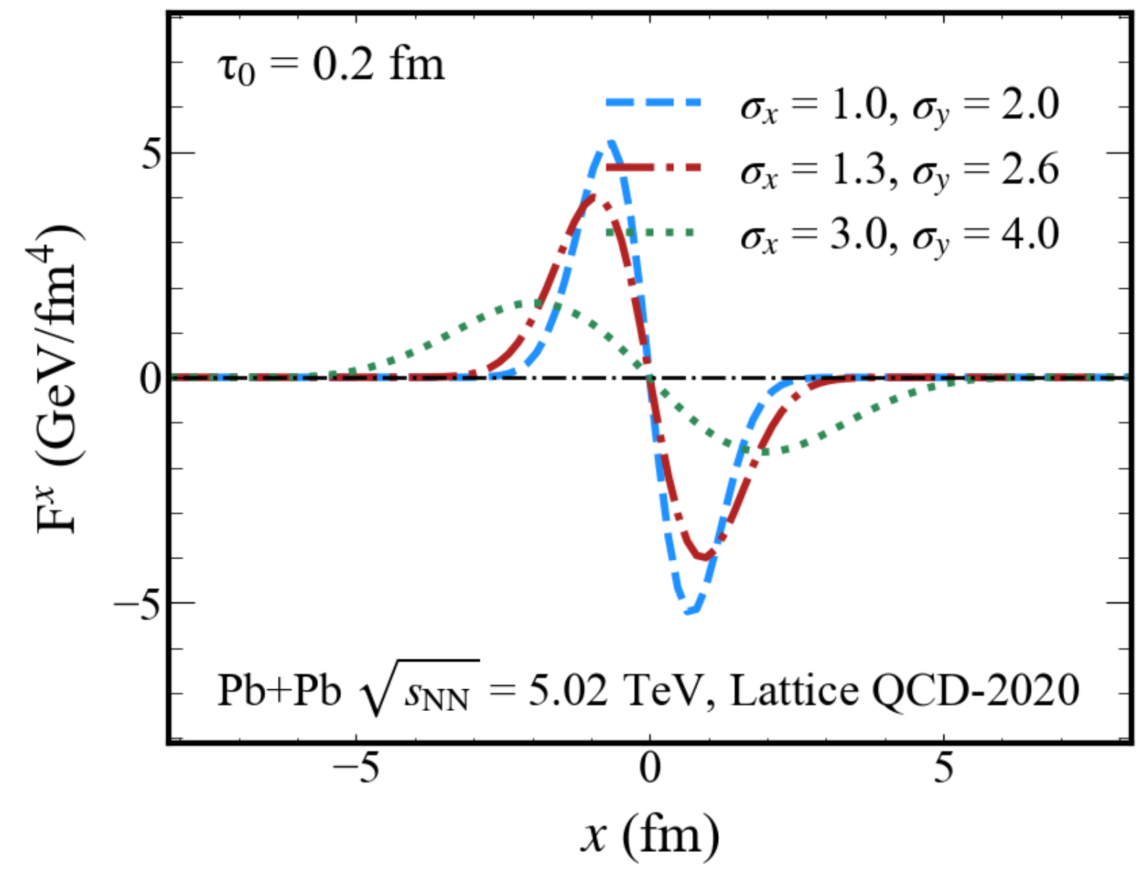
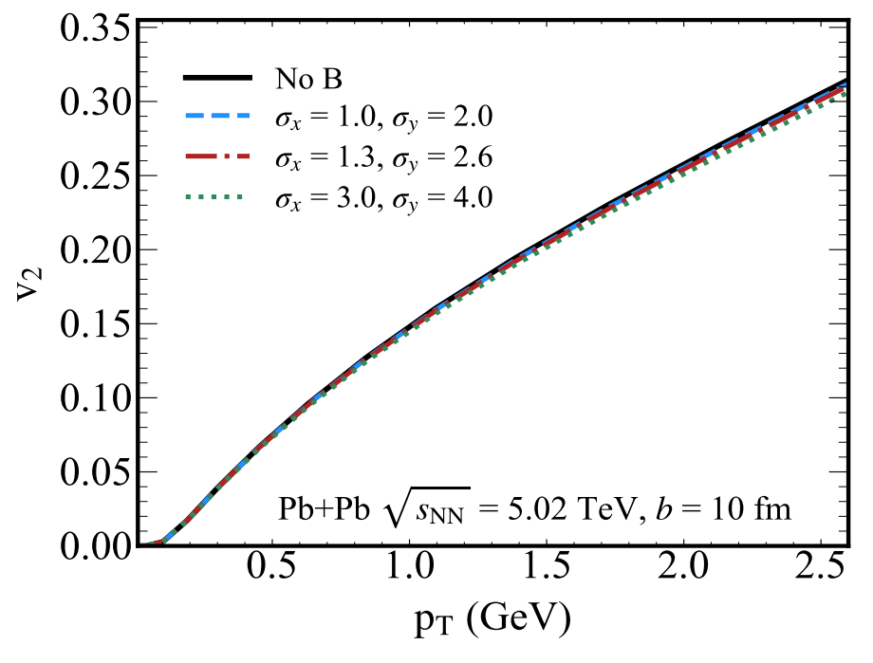
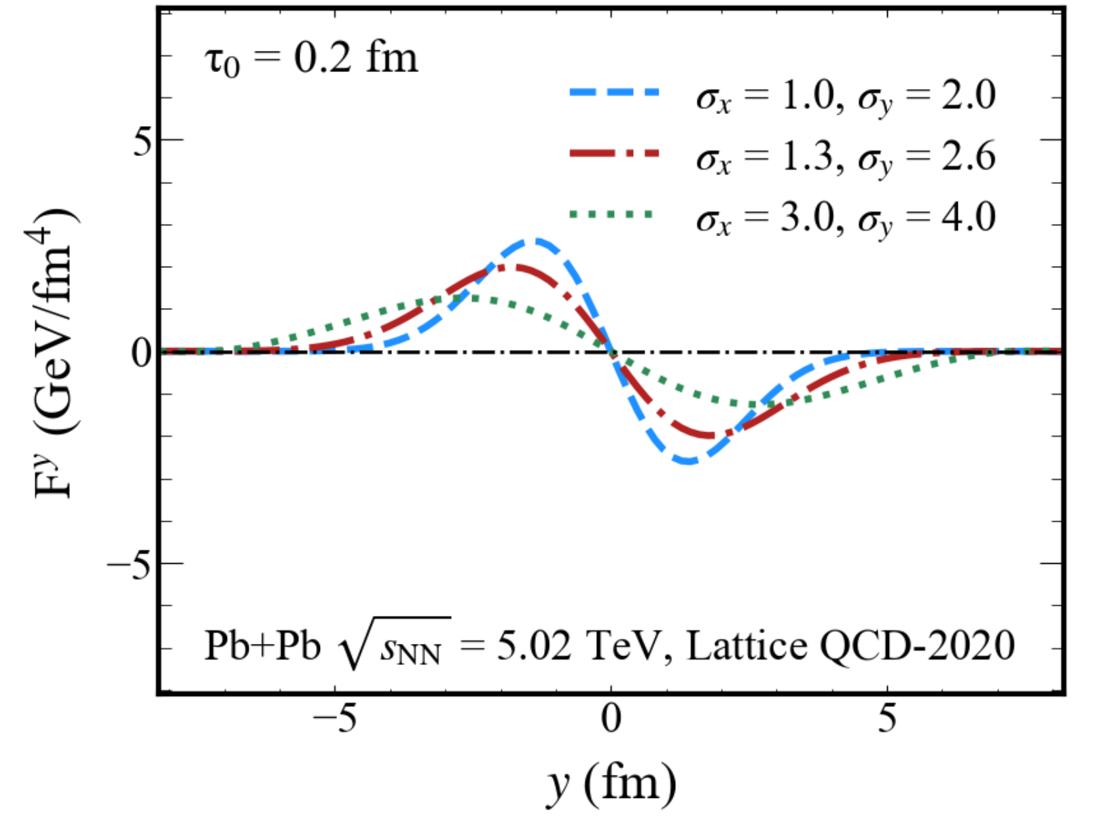




Results: effect of B field overlay space
y
Initial state (xy)
$$σ_{y}↑$$
$σ_{x}$ < $σ_{y}$
x
$σ_{x}$↑
Larger $σ$, larger overlay space.
A larger B field overlay space in the transverse plane gives a stronger paramagnetic squeezing effect.

Slide 17
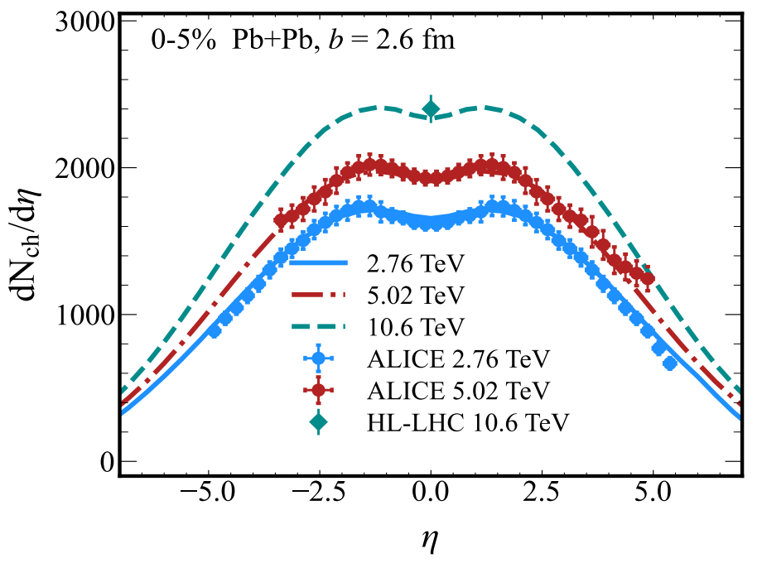
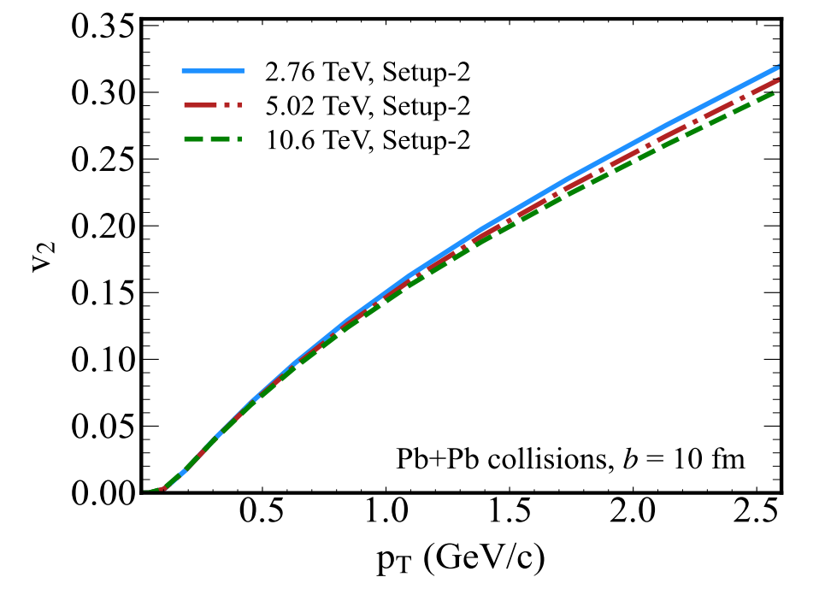
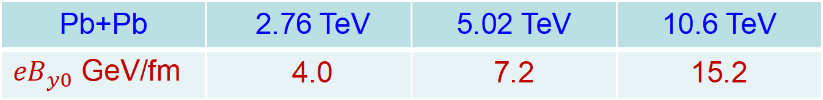
Results: Squeezing effect from LHC to HL-LHC
Pb+Pb | 2.76 TeV | 5.02 TeV | 10.6 TeV
${eB}_{y0}$ GeV/fm | 4.0 | 7.2 | 15.2
CERN Y. R.
1. The v₂ suppression in the HL-LHC for 10.6 TeV Pb+Pb collisions is larger than that at 2.76 and 5.02 TeV.
2. The v₂ suppression ratio is 3-4% at 10.6 TeV.

Slide 18
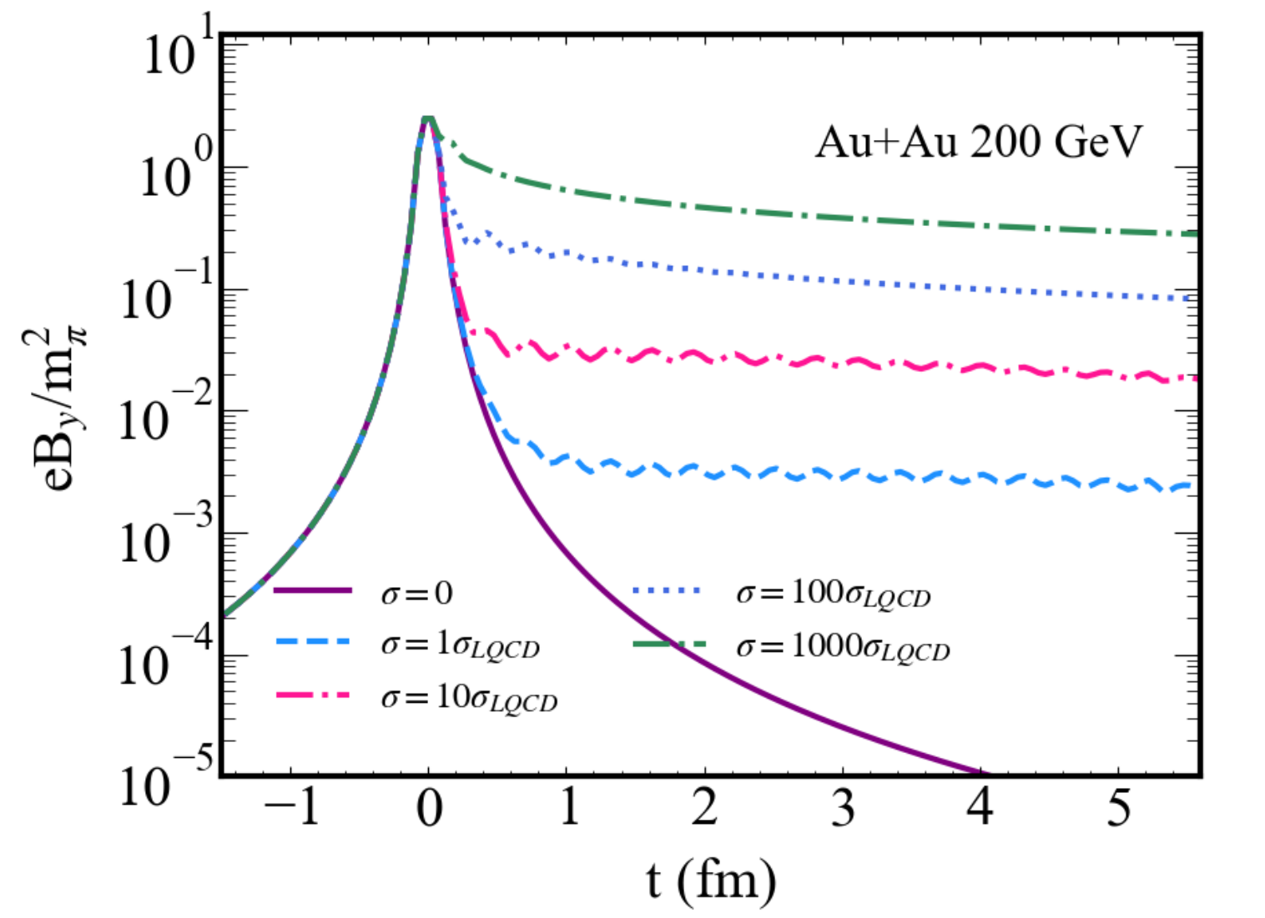
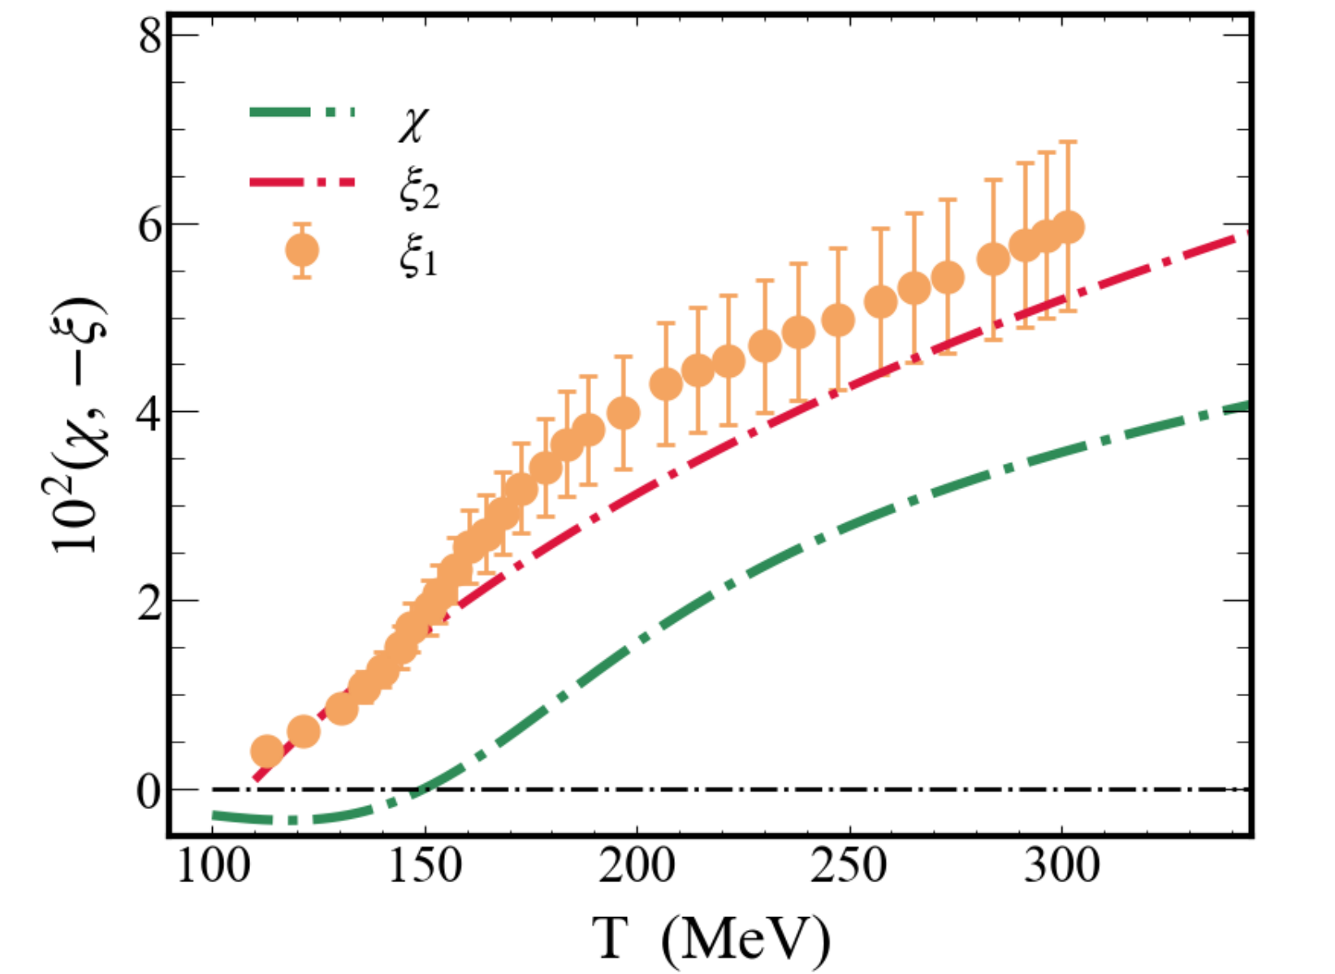
Summary and outlook
Summary
We studied the paramagnetic squeezing effect and its impact in high-energy heavy-ion collisions at the LHC.
Despite an initial squeezing force-to-pressure gradient ratio of up to 10%, the overall squeezing effect induced by external magnetic fields on light charged hadron v₂ is insignificant (<5%).
Outlook
Larry and Anping’s EB work
QGP electric susceptibility

Slide 19
Thank you

Slide 20
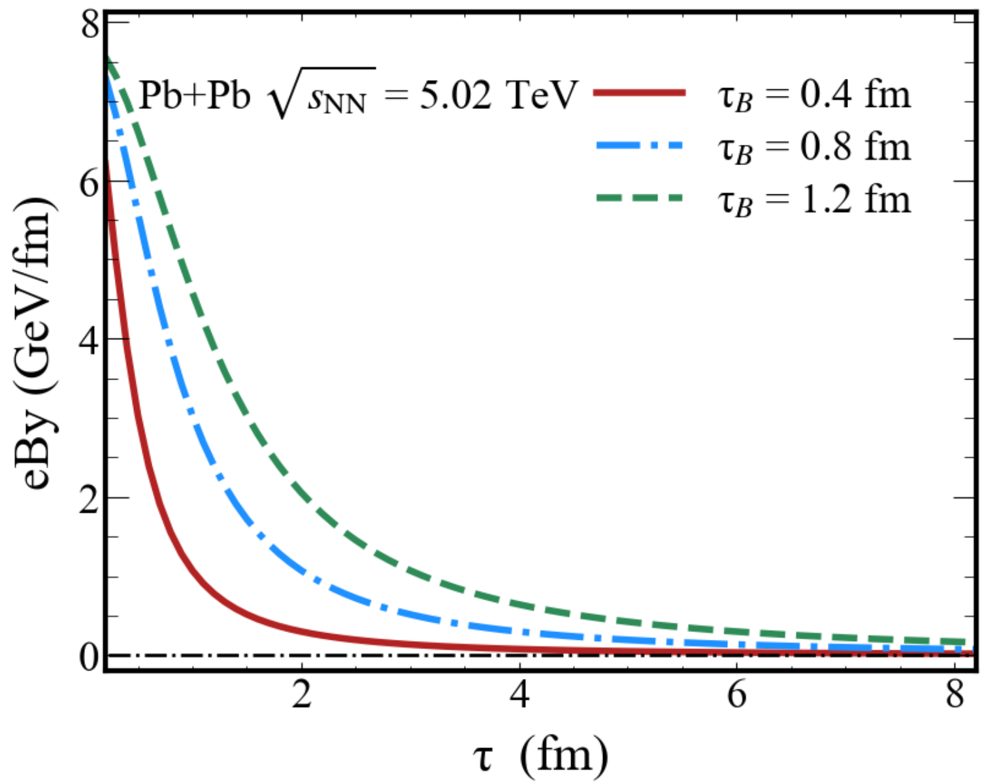
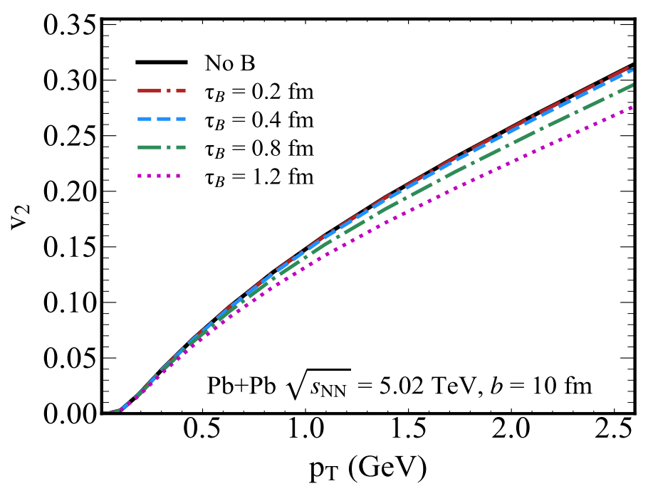
Results: effect of QGP formation time τ_{B}
1. Varying QGP formation times τ_{B} extend the lifetime of the magnetic squeezing effect.
2. Consequently, there is a significant impact on v₂, with a suppression reaching 10%.

