Slide 1
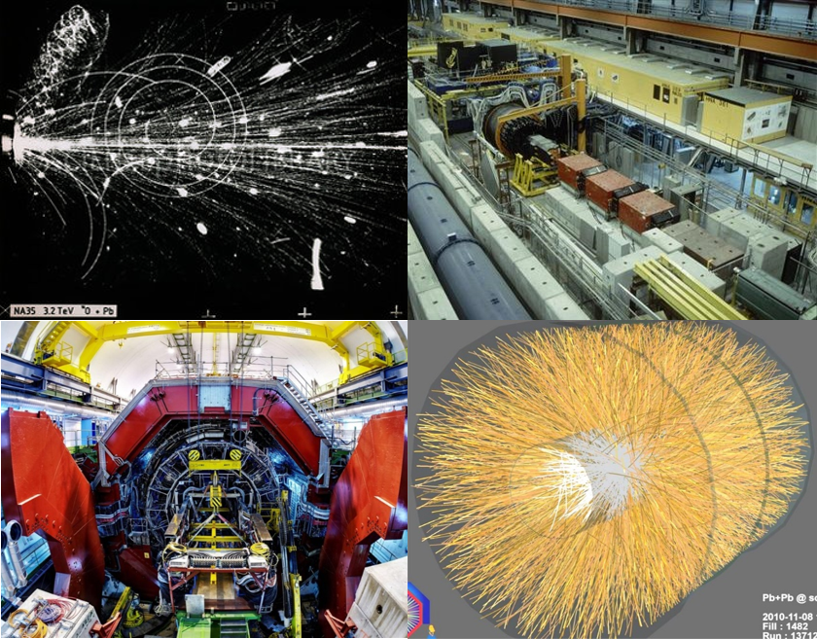

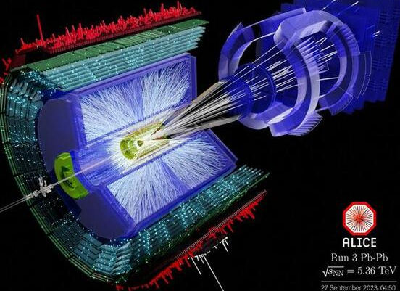
“≈ 40 years of Ultra-Relativistic Heavy Ion Physics:
QCD@work”
CERN
exploratory
Light Ion Program
approved
1984
2024

Slide 2
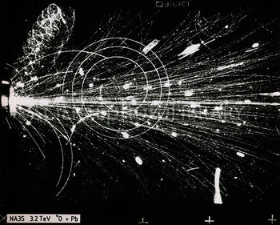

FIRST ultra-relativistic Heavy Ion Collision (fall 1986)
A long time ago in a laboratory far, far away
SPS: Sept ‘86
²⁰⁸Pb
¹⁶O
World Record in Energy … Break new ground
AGS: Nov. ‘86
¹⁹⁷Au
¹⁶O
.. up to 400 particles/collision
..over 300 physicists
..whether the famous
quark-gluon plasma
really has been achieved
CERN SPS
√s = 20 GeV/Nucleon
NA35 streamer chamber picture, ca 1986

Slide 3
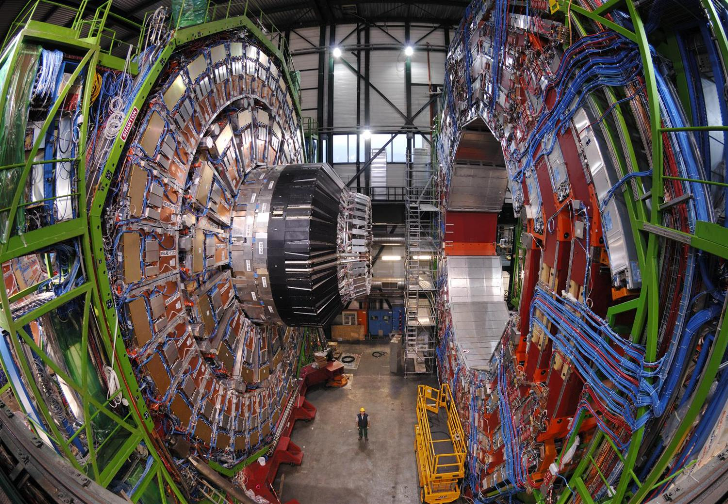
Highlights from 40 Years of URHI Physics
The Questions
  What do we want to learn from HIC
The Tools
  Accelerators, Experiments, Theory
Some Answers
  Highlights from (AGS)/SPS/RHIC/(LHC)
Open Questions
  What's left to do

Slide 4
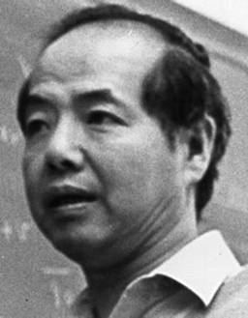

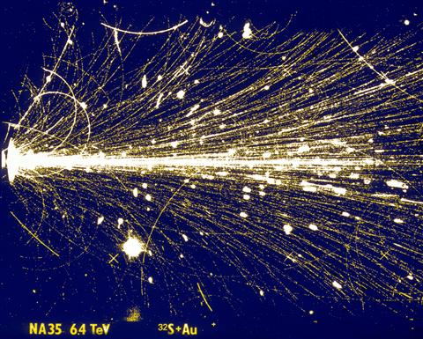
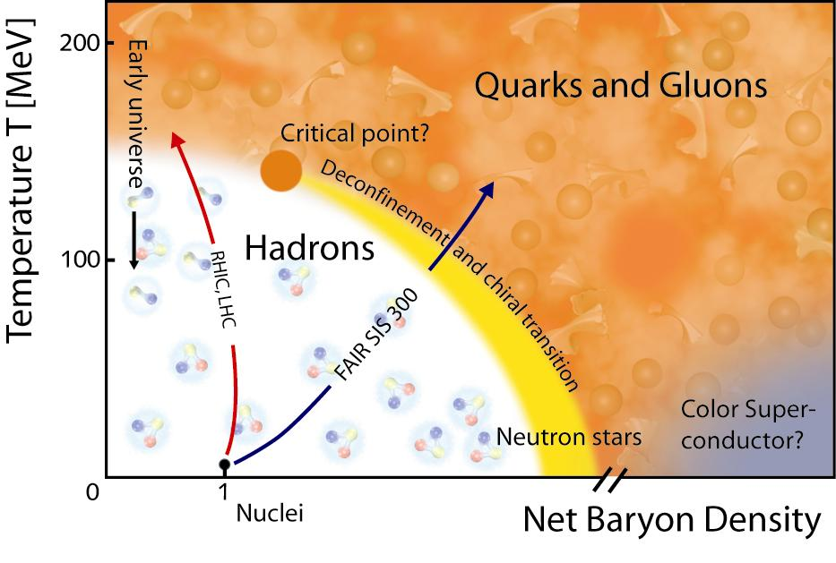
Heavy Ion Physics: Why ? QCD@work !
T.D. Lee 1975*:
  pp, e⁺e⁻: concentrate energy on small volume => high mass, short distance
  AA: distribute high energy over a large volume
to study bulk phenomena and the structure of the vacuum
QCD in the Long Wavelength - Large Volume - ManyBody limit:
i.e. in the regime where the Strong Interaction actually IS strong !
  Properties of strongly interacting ‘matter’ & the QCD phase diagram
QGP: Quark Gluon Plasma
Deconfined (no bound hadrons)
Chirally Symmetric (≈ massless)
1980 QGP Theory Expectation:
Weakly Interacting Plasma
ideal gas of free quarks & gluons
Experimental Expectation:
‘Smash stuff as hard as we can and I’ll be surprised if there is no surprise’
(Bill Willis, ca 1984)
HRG:
Hadron Resonance Gas
* Rev. Mod. Phys., Vol 47 (1975) 267; Nucl. Phys. A553 (1993) 3c

Slide 5
Accelerators
Particle Physics: energy doubling time ≈ 4 years
Heavy Ion Physics: doubling time ≈ 2 years
  starting late 70’s at Bevalac/Berkely & Synchrophasotron/Dubna (E/m ≈ 1)
    energy increase by factor 10⁴ in ≈ 30 years
    from few dozen physicists to > 3000 physicists active worldwide today
Total center-of-mass energy versus time
Field went from the periphery
into a central activity of
contemporary Nuclear Physics
LHC Pb
LHC
x 15
RHIC
RHIC
x 12
TeV
SPS
SppS
LHC
SPS S/Pb
AGS
x5.5
ISR
AGS Si/Au
AGS/PS
Bevalac
FNAL
Livingston plot

Slide 6
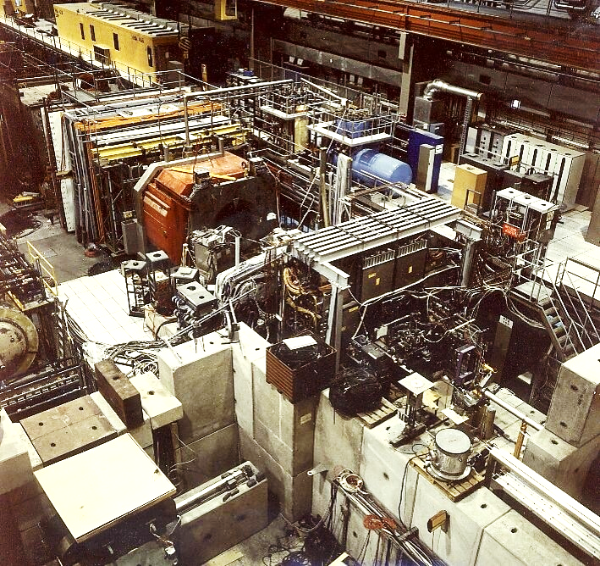
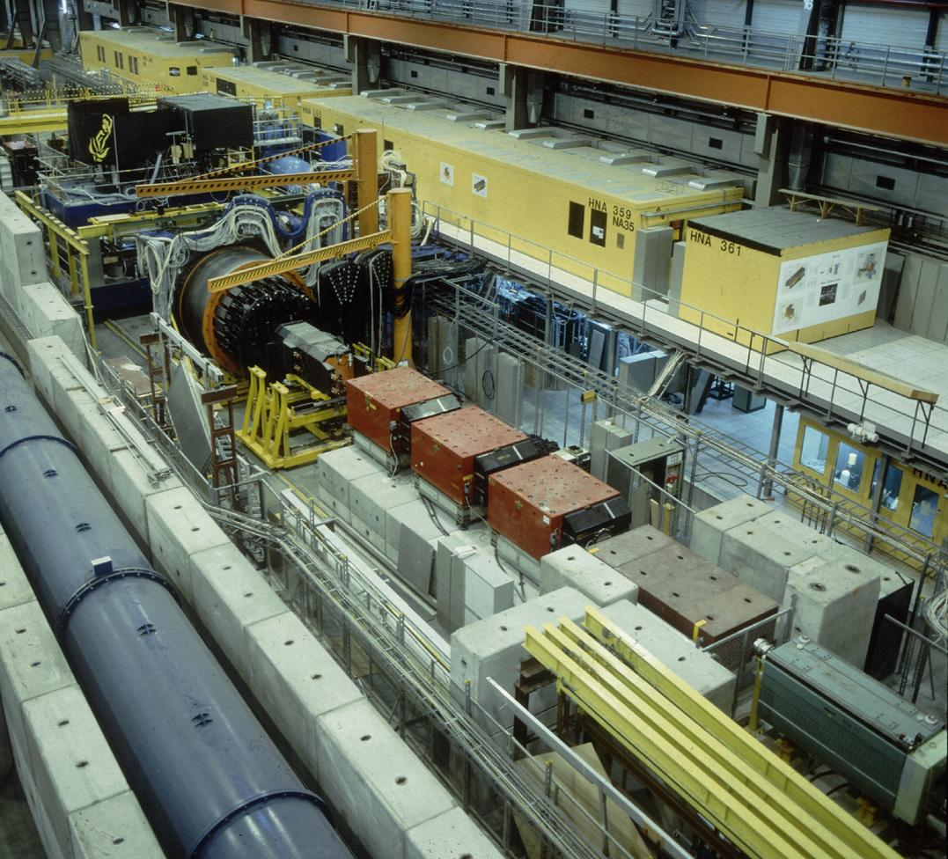
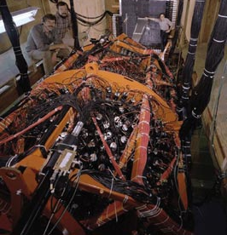
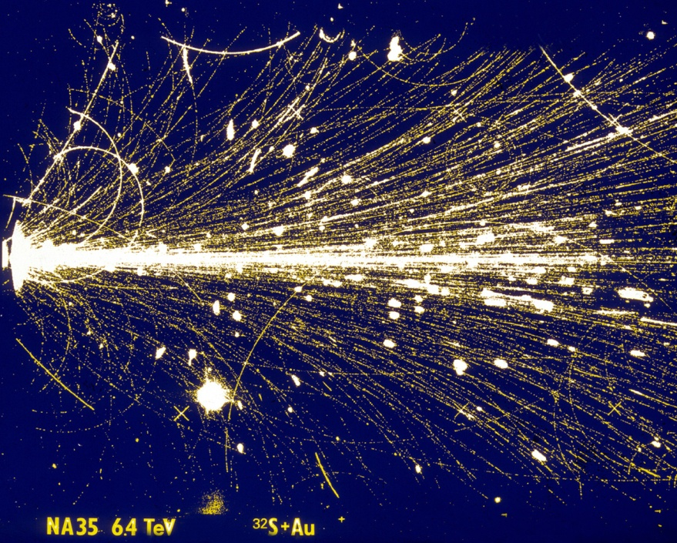
1st Generation Experiments
SPS: NA34-2
1986 - 1992
light ions (¹⁶O, ³²S, ²⁸Si)
SPS: NA35
Reusing existing equipment:
UA5 streamer chamber, LBL Plastic Ball,
UA2 CCD camera, NA3 muon spectrometer,
ISR U-calorimeters, ….
Exploratory Program:
Can we measure these high multiplicity events ?
Can we analyze them ?
Are they interesting ?
UA5 Streamer chamber -> NA35
Plastic Ball-> WA80

Slide 7
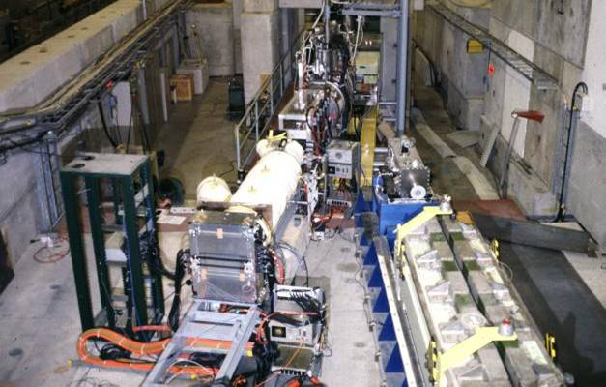
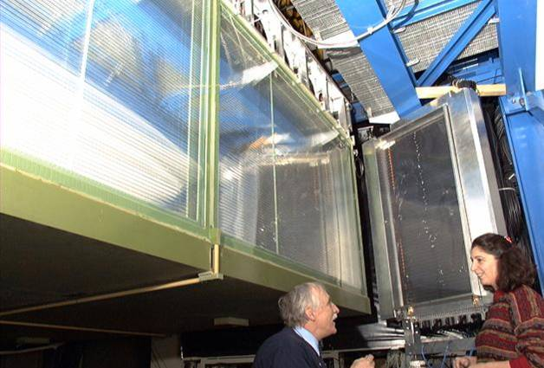

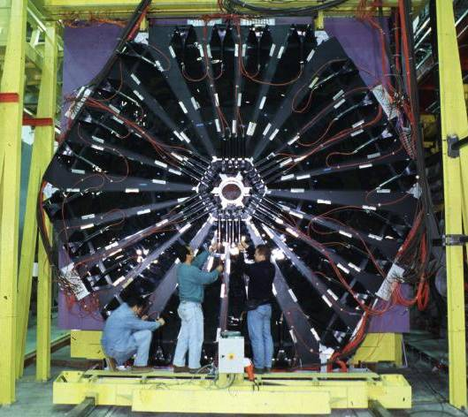
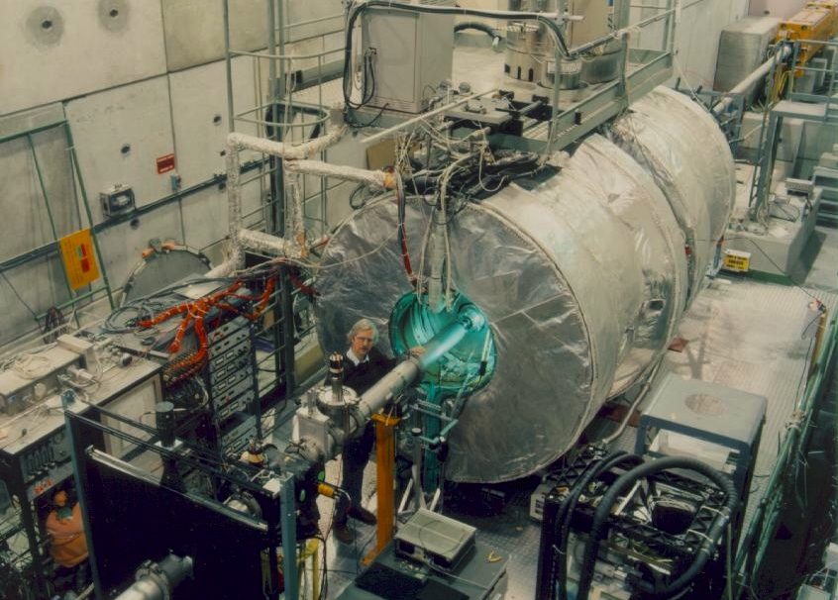
NA44
Small angle hadrons
2nd Generation Experiments
²⁰⁸Pb beams 1994 – 2002 (…NA60, NA61)
NA49
Large acceptance hadrons
Can we measure ?
Can we analyze ?
Are they interesting ?
NA45/Ceres
Low mass e+e-
several dedicated and optimized
'special purpose' experiments
NA50
J/Ψ μμ

Slide 8
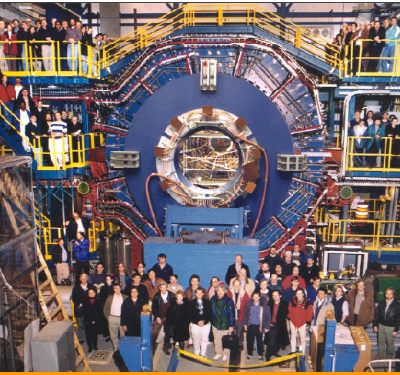
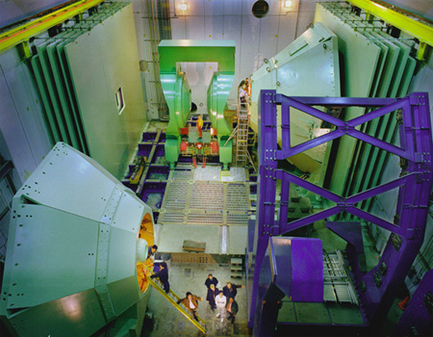
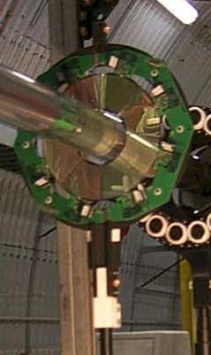
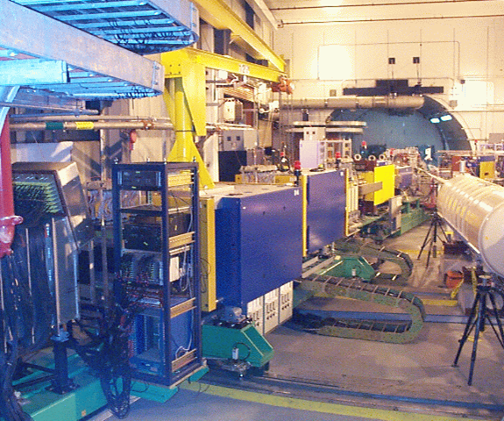
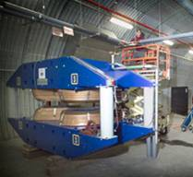
STAR
STAR
PHENIX
3rd Generation: RHIC Experiments
> 2000
first 'general purpose' HI collider detectors
PHOBOS
BRAHMS

Slide 9
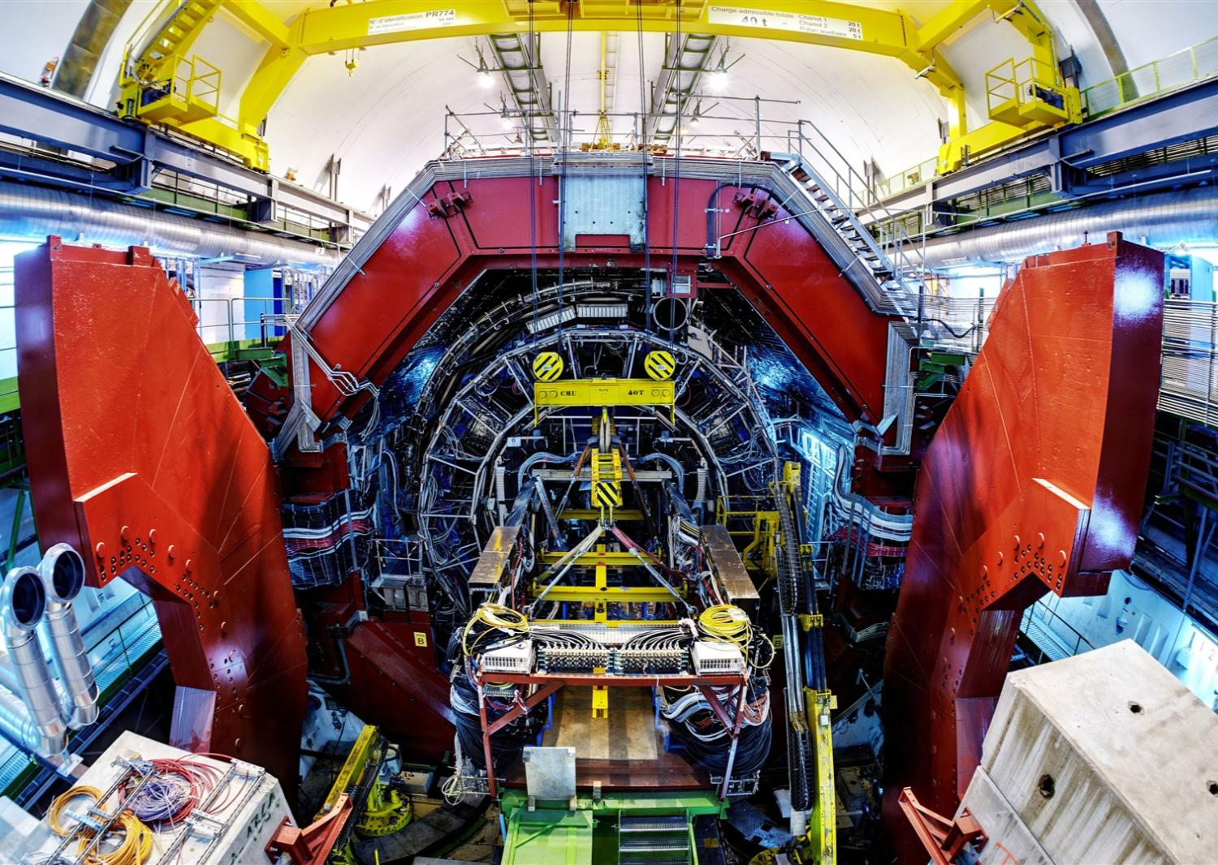
4rd Generation: LHC > 2009
1 dedicated general purpose
heavy ion experiment
Alice

Slide 10
All 4 large LHC experiments
participate in heavy ion physics !
Atlas

Slide 11
All 4 large LHC experiments
participate in heavy ion physics !
CMS

Slide 12
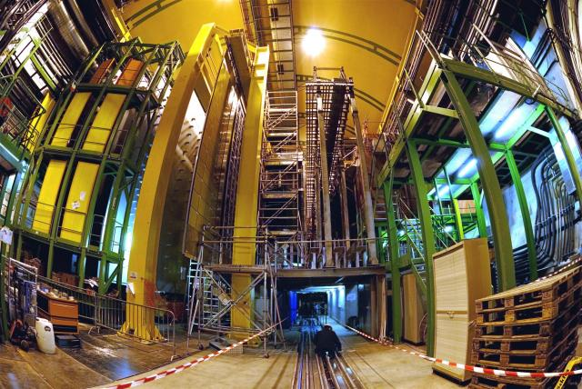
All 4 large LHC experiments
participate in heavy ion physics !
LHCb

Slide 13
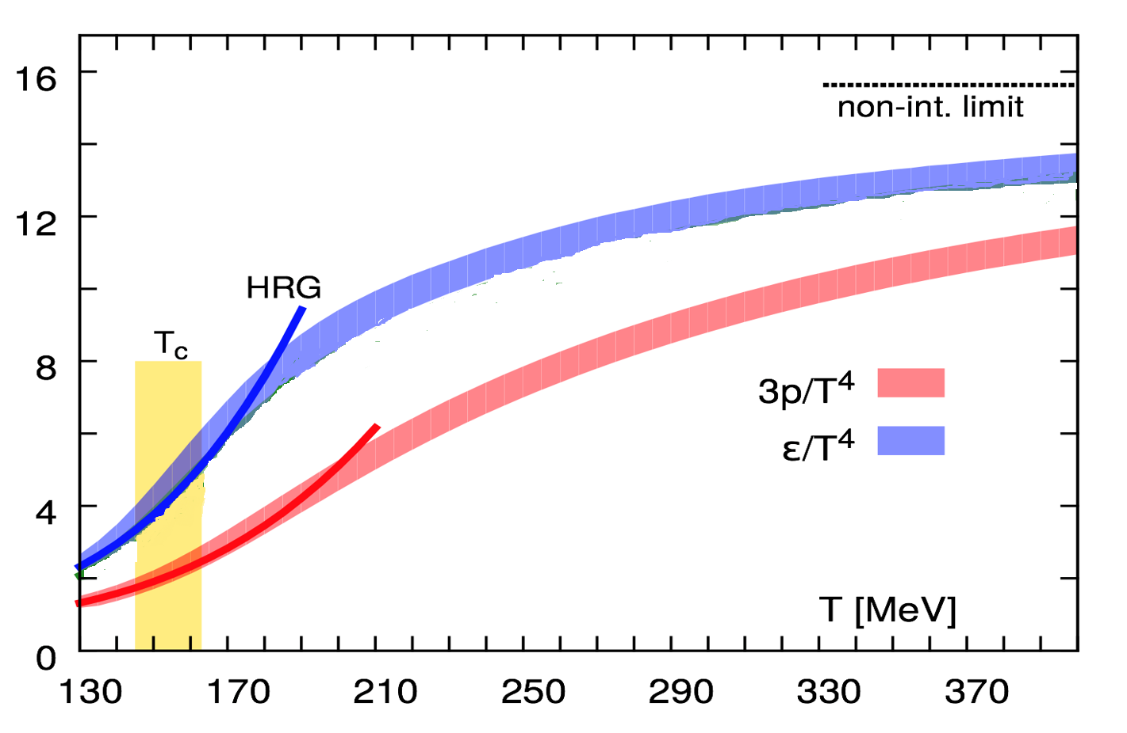
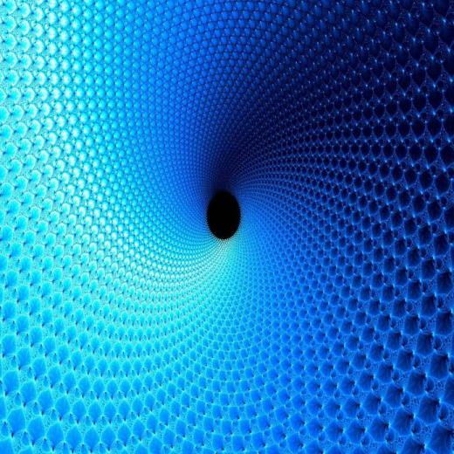
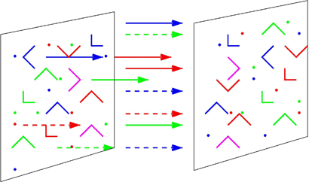
Theory Tools
Lattice QCD
  ideal for thermodynamics(static), EoS, T_{c}
Pert. QCD
  cross sections, high p_{T}
Phenomenology, eff. theory
  event generators (Phytia, Hijing, URQMD, ..)
  hydrodynamics, thermal models
Duality: AdS/CFT
  QCD analogue in strong coupling limit
  remarkable results: η/s = 1/4π; ε(λ∞)/ε(λ₀)=3/4; ..
Color Glass Condensate
  initial state: classsical FT in high density limit
  related to gluon shadowing, saturation, small x physics
Lattice QCD Equation of State
Stefan-Boltzmann
Energy Density
Hadron Resonance Gas
Trace Anomaly
(ε-3P) ≠ 0
Pressure
T_{c} ~ 176 MeV
μ_{c} =41 MeV
Smooth Crossover (μ_{B}=0)
T_{c} ~ 155 ± 10 MeV¹
T_{c} ~ 156.5 ± 1.5 MeV²
ε_{c} ≈ 0.5 GeV/fm³ ≈2ε_{p} ≈3ε_{N}
1)Hot QCD coll., 1407.6387 (2014)
2)Hot QCD coll., 1812.8235 (2018)
Temperature

Slide 14
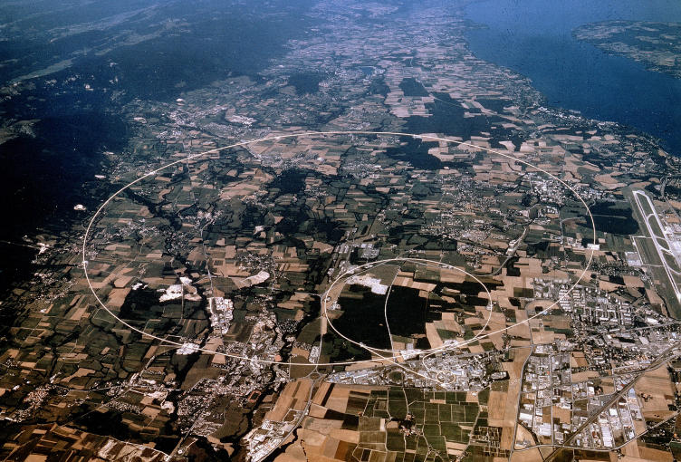

CERN
SPS: 1986 - 2002(4); NA61: >2009
O, S, Pb
√s_{NN =} 6.5 - 20 GeV/A, 3.9 - 17 GeV/A
Users: ~ 600
LHC: 2010 - 2032(41?)
Pb, √s_{NN =} 2.76, 5.5 TeV/A
Users: > 2000
AGS: 1986 - 1996(8)
Si, Au
√s_{NN =} 2.5 - 5.5 GeV/A
Users: ~ 400
RHIC: 2000 – 2025(?)
d, Cu, Au,
√s_{NN =} 7.7-200 GeV/A
Users: ~ 1000
Selected Results*:
QGP: The QCD ‘Ground State’
  Chiral Symmetry Restoration
  Deconfinement
Properties of Hot and Dense Matter
  Transport coefficients (viscosity, opacity,..)
Surprise Discovery
  ‘QGP’ in small and dilute systems (pp, pA) ?
  * concentrate on the first 30 years, up to about 2014
SPS/RHIC/LHC
RHIC/LHC
LHC/RHIC

Slide 15
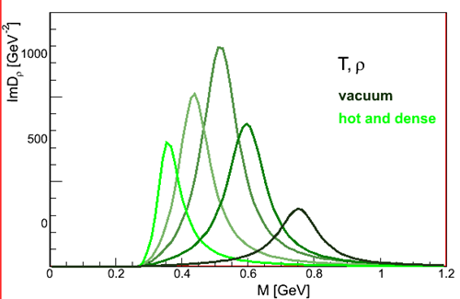
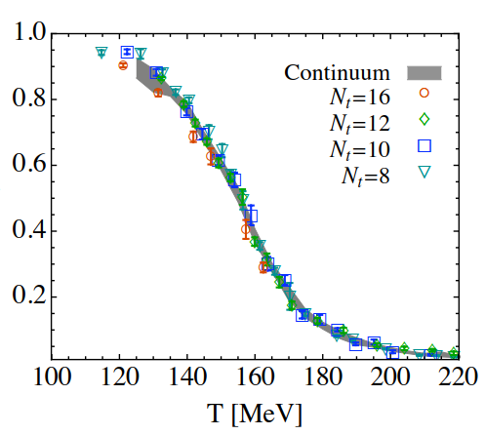
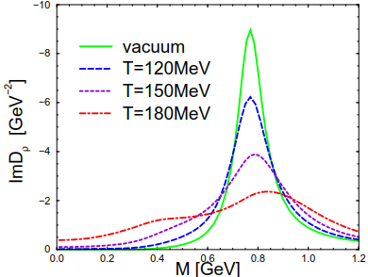
Chiral Symmetry Restoration in the QGP
Chiral Quark Condensate
conjecture
<ΨΨ> → 0 => changing ‘in medium’ hadron masses
ρ mass shifts ?
Quark Condensate <ΨΨ> vs Temperature T
Quark Condensate <ΨΨ>
ρ mass melts ?
JHEP 1009:073,2010
≈ (300 MeV)³
hep-ph/0611339
Lattice QCD
n_{F} = 2+1, m_{π} = 135 MeV

Slide 16
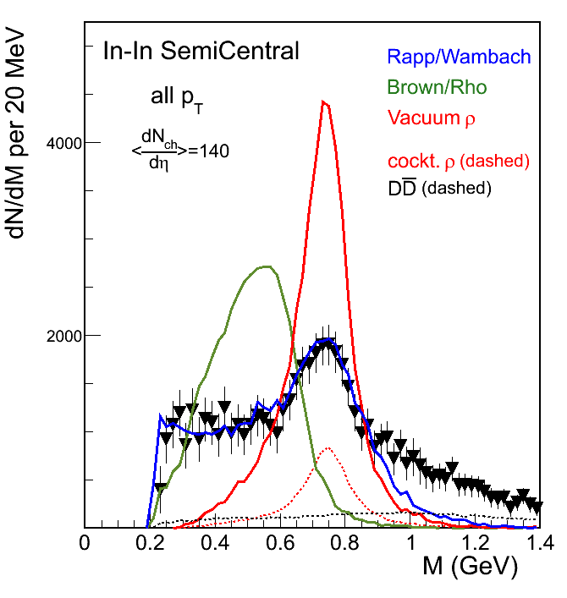
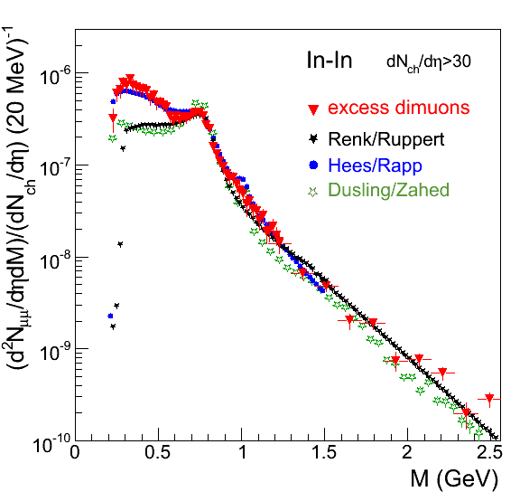

γ*: Chiral Symmetry
and Thermal Radiation
Prompt Low Mass Muon pairs M(μ⁺μ⁻), decay (≠ ρ ) subtracted
Muon pairs M(μ⁺μ⁻)
$$\frac{m∗}{m0}\sim \frac{<qq>∗}{<qq>0}$$
ρ Mass Shift
20 years later,
these results are still
unsurpassed
in terms of relevance and precision
Vacuum
ρ → μ⁺μ⁻
NA60 Phys.Rev.Lett. 96 (2006) 162302
Planck-like spectrum
dΝ/dΜ ∼ Μ^{3/2} x exp(−Μ/Τ)
ρ Broadening
ρ broadens → hadrons ‘melt’ close to T_{c}
Conjecture:
Approach to Chiral Symmetry Restoration
P.M.Hohler and R. Rapp, PLB 731 (2014) 103
Virtual Photon Radiation
Slope → T = 230 ± 10 MeV
(T₀ ≈ 250 MeV)
Yield → τ = 6.5 ± 1 fm/c

Slide 17
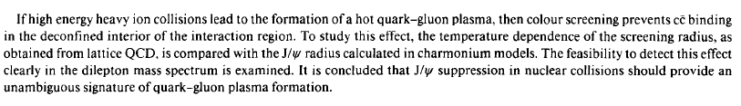
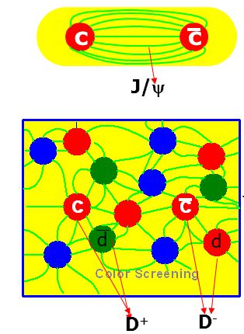
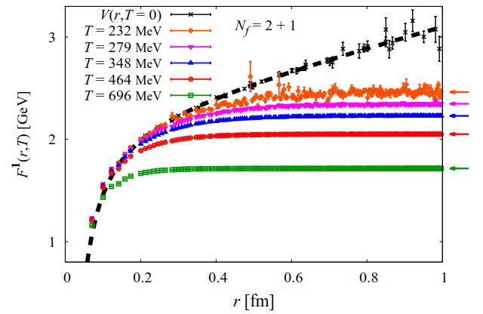

Quarkonium Suppression & Deconfinement
J/Ψ production & suppression: 'well calibrated (pQCD) smoking gun'
Matsui & Satz, 1986:
> 3500 citations
Heavy Quark Potential (Free Energy) vs distance r
T=0 Confinement
Lattice QCD
n_{F} = 2+1, Prog.Theor.Phys. 128 (2012) 955
T>> T_{c}
Deconfinement
https://indico.cern.ch/event/256031/contributions/568121/attachments/449248/622966/talk_wxie_v4.pdf

Slide 18



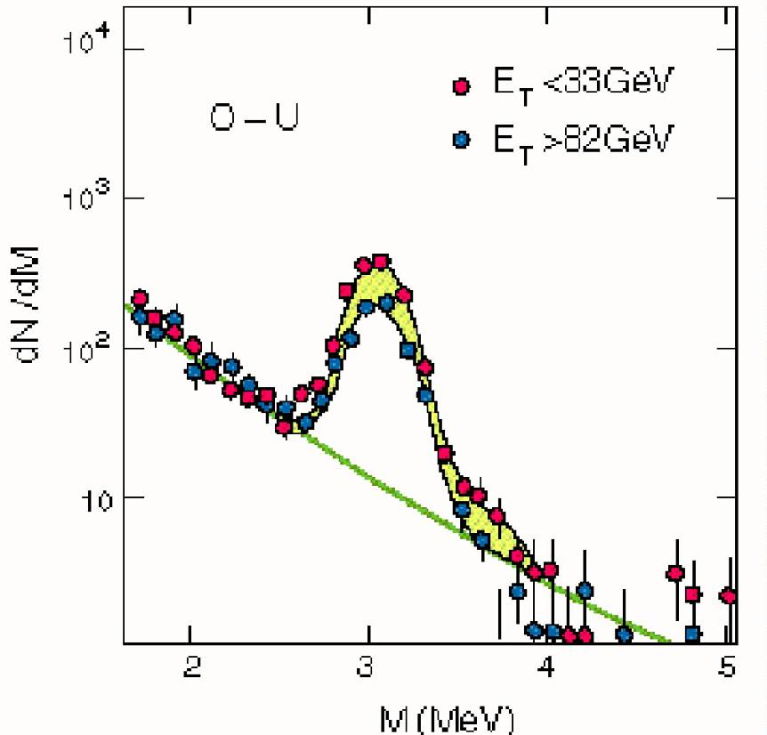
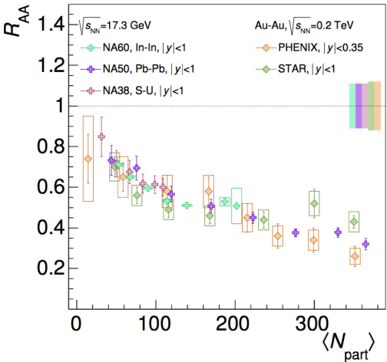
Quarkonium Suppression & Deconfinement
J/Ψ: 'well calibrated (pQCD) smoking gun‘ ???
Re-Un-Dis-cover-up ?
Discovered
normal
suppressed
Un-discovered 1990
SPS
√s=20 GeV
RHIC
√s=200 GeV
NA50
≈ 1996
NA38
≈ 1986
Suppression
light ions (O,S)=
p-Nucleus (CNM)
Nuclear Matter
Effect !!
Phenix
≈ 2006
heavy ions (Pb):
Anomalous (QGP?)
Re-discovered 1996
Centrality

Slide 19
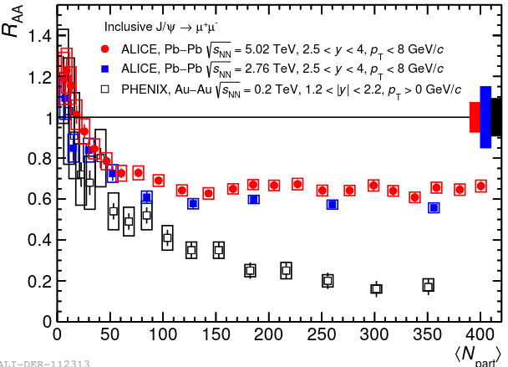
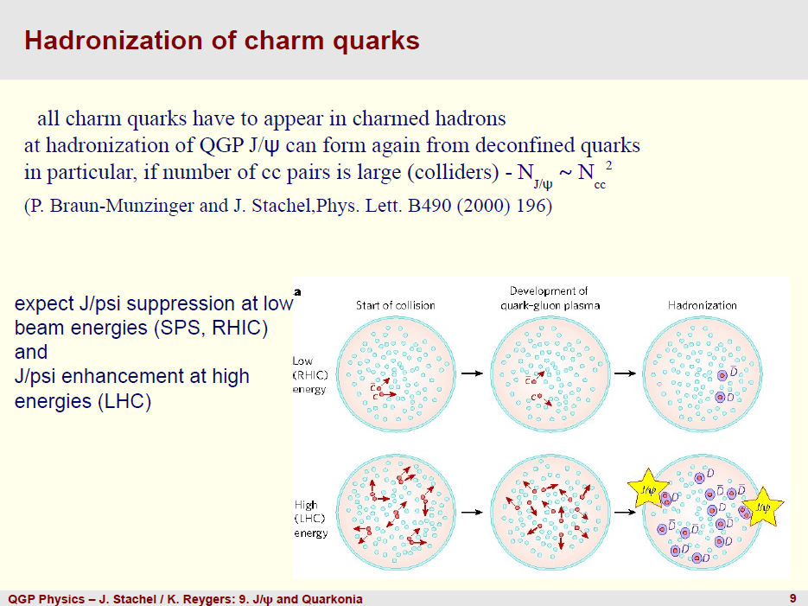
J/Ψ: Melting
+ Regeneration !
J/Ψ suppression (R_{AA}< 1): centrality dependence
Centrality
cc recombination
at hadronisation !
R. Arnaldi 1604.03139
LHC > RHIC
Recombination/Coalesence:
Deconfinement Signal !
Deconfinement ⬄ colour conductivity
'partons roam freely over large distance'
That's what primordial charm quarks do to recombine
cc creation
melting & diffusion

Slide 20

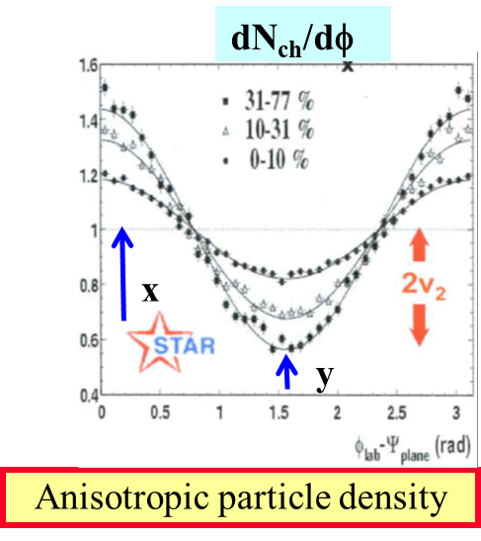
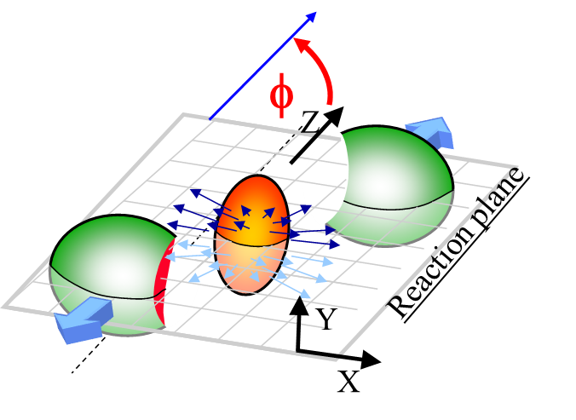
Properties of Matter: Hydrodynamic Flow
Flow: Strong correlation between coordinate and momentum space
  builds up in an interacting medium with pressure gradients => Hydrodynamics
  flow modulation v₂ depends on
    Initial Conditions: geometrical boundary conditions, pressure gradients
      geometrical eccentricity ε = (y²-x²)/(y²+x²) drives flow
    Fluid properties: Equation of State EoS f(P,E,T), viscosity η (internal friction),..
      (shear) viscosity η dissipates flow
azimuthal flow via Fourier analysis: 1 + 2 v₁ cos(φ) + 2 v₂ cos(2φ) + 2 v₃ cos(3φ) +…
radial flow (“v₀ component”) via dN/dp_{t}
Spatial deformation

Slide 21

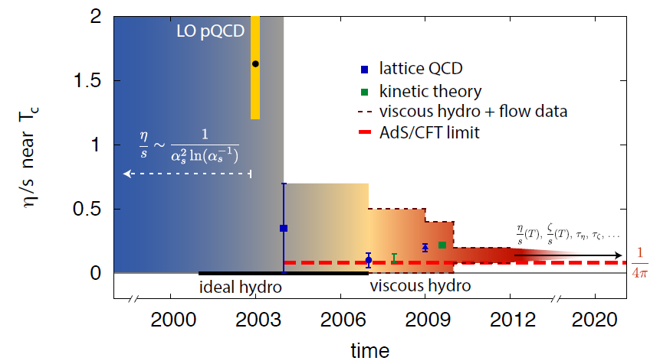
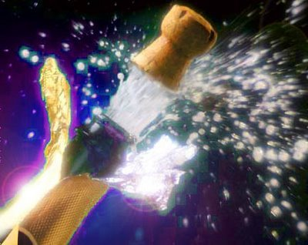
QGP: The 'perfect Liquid'
AdS/CFT conjecture: PRL 94(2005) 111601
η/s = 1/4π (≈ 0.08)
is lower quantum limit for viscosity
mean free path ≈ Compton wavelength
Perfect liquid → Viscosity/Entropy η/S ≈ 0
  large interaction cross section σ in the liquid
How perfect is it ?
Is η/s at the quantum limit 1/4π ?
η/s versus time
2004: η/s < 10 x1/(4π)
2014: η/s ≈ 1 – 2 x1/(4π)
1/4π

Slide 22

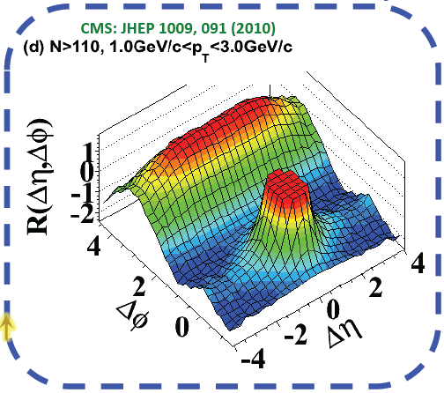
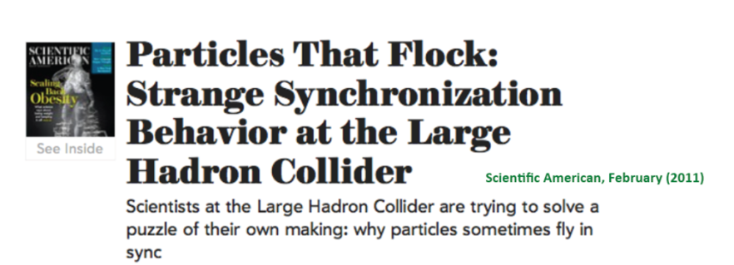

Surprise
The first LHC Discovery (pp 7 TeV, Sept 2010)
  long range rapidity ‘Ridge' in 2-particle correlations
    visible in the highest multiplicity pp collisions
    arguably still the most unexpected LHC discovery
?
'Near Side Ridge
'Away Side JET'
'Near Side JET'

Slide 23
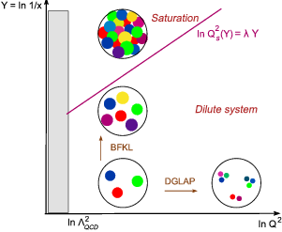
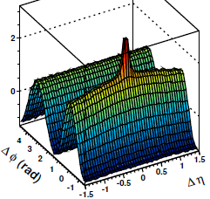




Origin of the pp 'Ridge'
Spawned a large number of different explanations
  mostly rather ad hoc, very speculative, or outright weird
Color Glass Condensate CGC: 'first principles' theory
  Initial State Momentum Anisotropy
  driven by quantum correlations
  'new state of cold & dense parton matter‘
Collective-flow like (Hydro)
  Final State Interactions driven by geometry and density
  same origin but different magnitude in pp and AA
PbPb 10-20%
pp 7 TeV
Flow

Slide 24
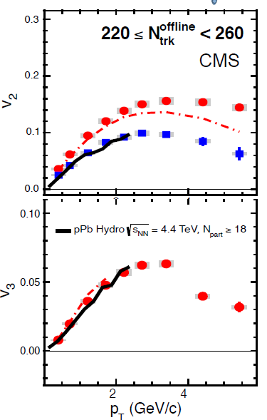
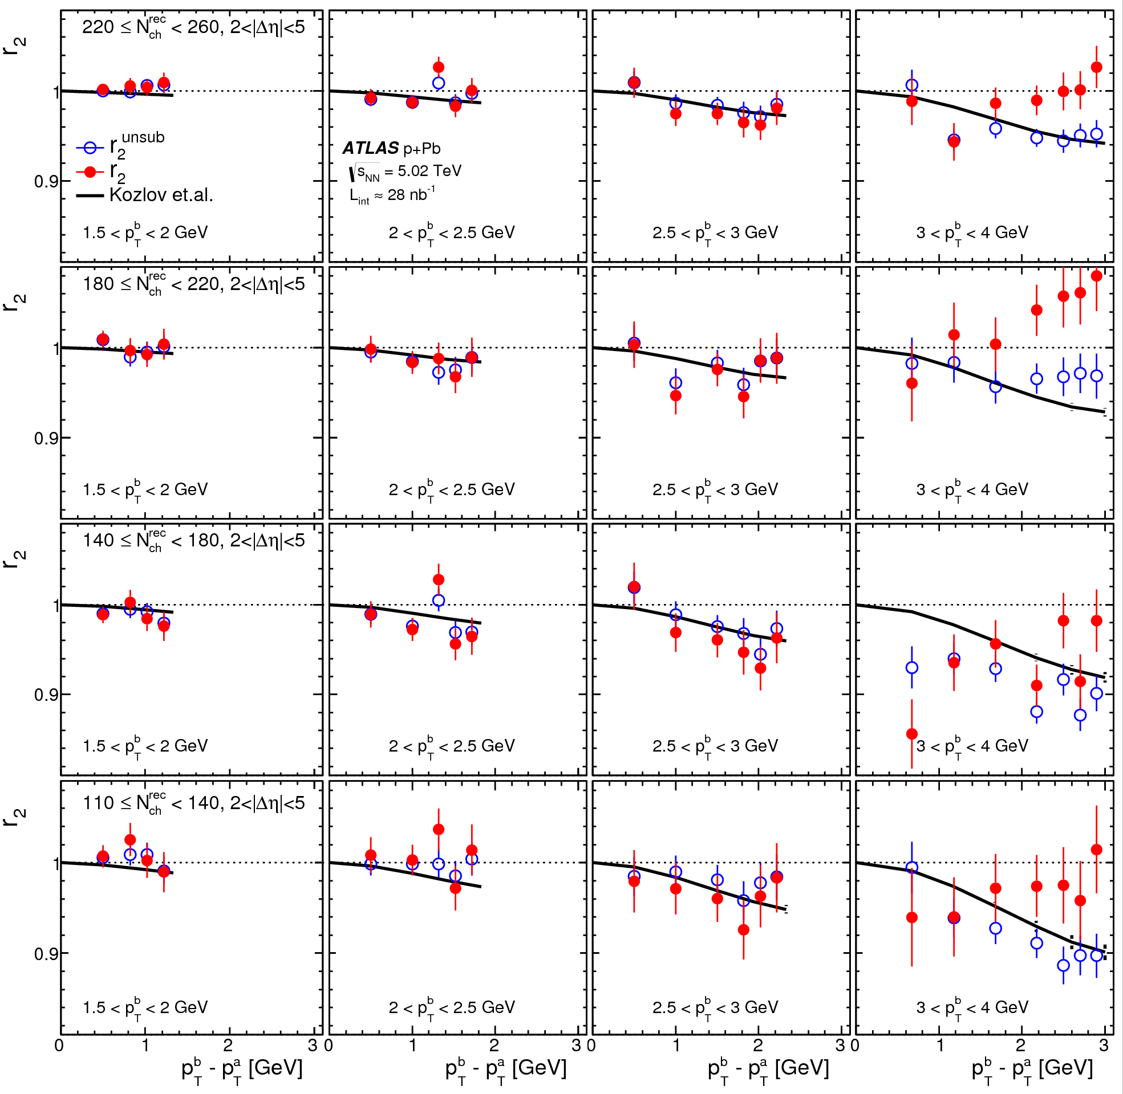

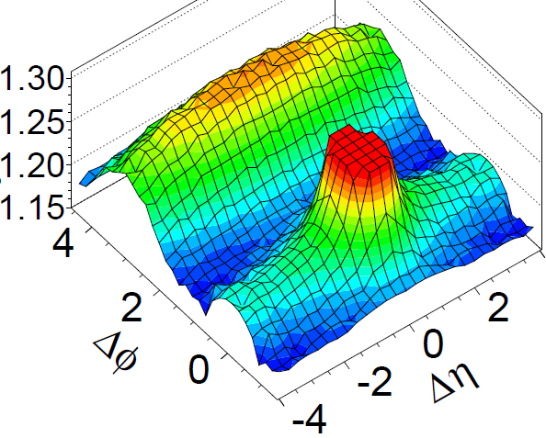
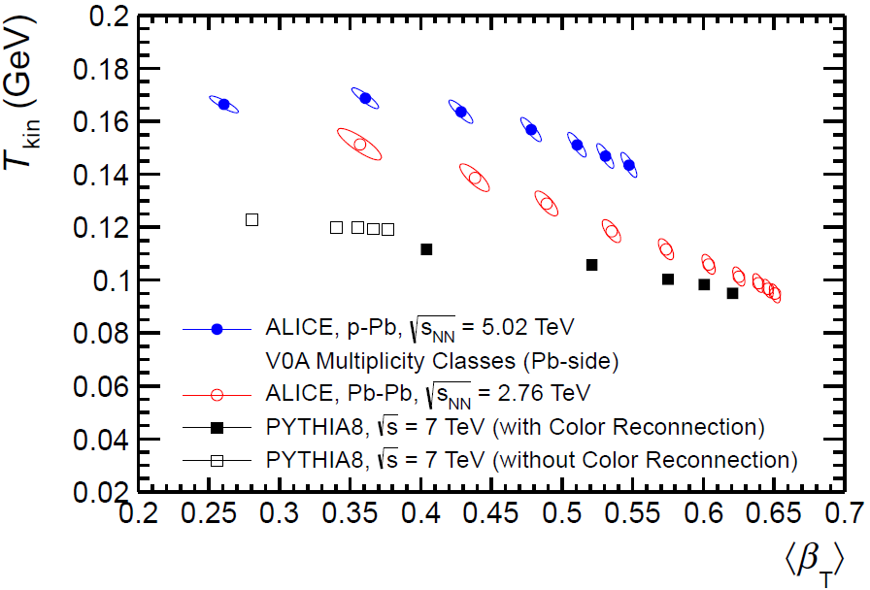



Collective Signals in pp, pA ?
pp 7 TeV
.. All collective flow signatures seen in pp & pA
.. Other ‘QGP’ signals emerge (strangeness, HBT, Ψ(2S),
… continuous & smooth
down to dN/dy ≈ 0 (MinBias pp)
NNLO: Factorization test
pPb
v₂{2}, v₂{4}
right size
right shape
COLLECTIVE
{4}={6}={8}= ∞
ATLAS PRC 90, 044906
CMS PLB 724 (2013) 213
pPb 5 TeV
LO: BW fit: T_{kin} vs β
ALICE PLB
728 (2014) 25
Strangeness enhancement
RHIC v₂:
p, d, ³He + Au
higher harmonics
pPb v₂,v₃
PbPb 10-20%
Flow
NLO: PID v₂
mass dependence
‘Elliptic flow’ v₂
pp 13 TeV
PHENIX 1609.02894
MinBias N_{rec} ~ 15
IS Geometry matters
ATLAS PRL 110, 182302 (2013)
pp -> pPb -> PbPb
ALICE PLB 726 (2013) 164

Slide 25




Heavy Ion Paradigm
1986
Commissioned by TD Lee
AA:
‘Hot Matter’ modifications (“R_{AA}”)
1508.03260
pp:
Comparison Data
QGP everywhere ?
pA:
‘Cold Nuclear Matter’ modifications
(nPDF, shadowing, ..)
p

Slide 26

sQGP: The stuff at high T..
We set out to find a weakly interacting gas of quarks & gluons
'Very strongly interacting, almost perfect liquid' : sQGP
  'Macroscopic' piece of matter with amazing properties
    we can experimentally measure its properties and follow its evolution !
  We see signs of it (almost) everywhere we look
    genuine QCD property of strongly interacting many-body (>2) systems?

Slide 27
Answers …
and new Questions
What we know:
  increasingly precise measurements of macroscopic properties
    η/S, ξ, q^, e^, D(iffusion), EoS, c_{s}, …
  good evidence for deconfinement (J/Ψ, Υ)
    J/Ψ coalescence = color conductivity, Y suppression = resonance melting
  some evidence for chiral symmetry restoration, but indirect
    strangeness ???, low mass l⁺l⁻ (connection between rho melting and chiral sym ?)
  the relevant dof (particles, excitations, ..) may NOT be free quarks&gluons
    the interaction seems much too strong !
What we don't know
  what ARE the relevant dof in the QGP ?
    pseudoparticles, collective excitations (plasmons, ..), 'glueballs', ..
  What is the dynamics ? 'looking under the hood' of the sQGP
    how can it happen so fast, and in very small systems (incl. pp ?)
  Where is the onset ?
    how does collectivity & statistical behavior emerge with size & energy density ?
How is it!
After ≈ 40 Years of URHI
Plenty left to do for the Future
Why is it so?

Slide 28



“Ultra-Relativistic Heavy Ion Physics”
1986
20xx

