Slide 1


Collectivity in small systems based on the AMPT framework: from pp to pA/UPC
Liang Zheng (郑亮)
China University of Geosciences (Wuhan)
EPJC 81 (2021) 8, 755
arXiv:2404.18829
The 4th International Workshop on QCD Collectivity at the Smallest Scales
Qingdao Shandong
Jun 24-28, 2024

Slide 2
Outline
Collectivity in small systems
AMPT with PYTHIA8 initial condition and sub-nucleon structures
Collective flow in pp collisions
Collective flow in pPb and UPC

Slide 3
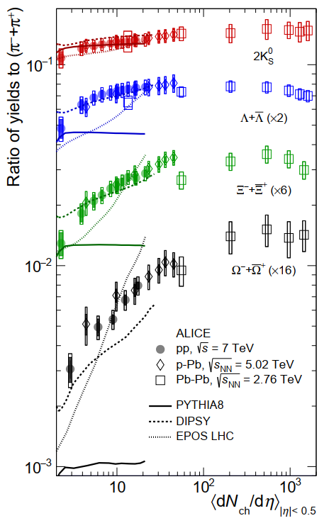
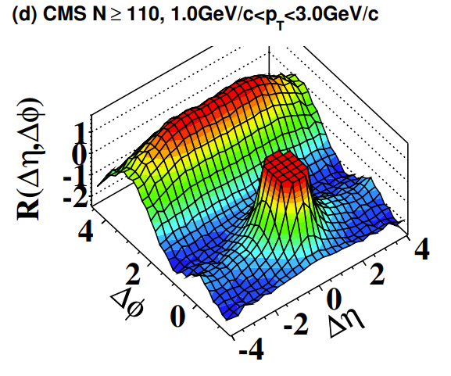
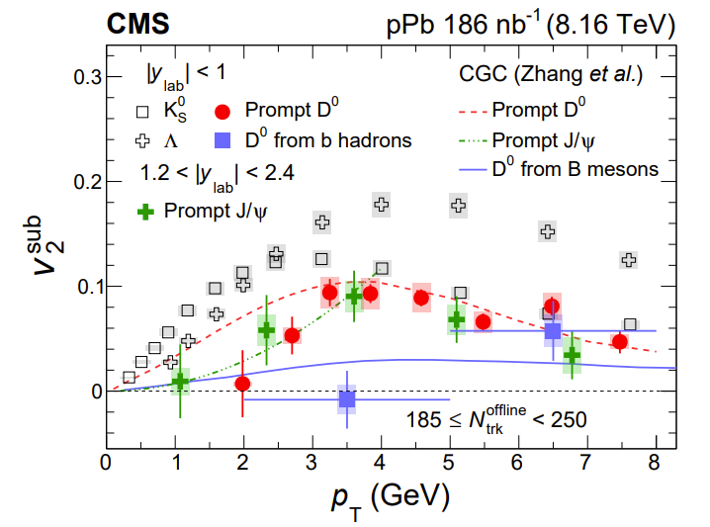
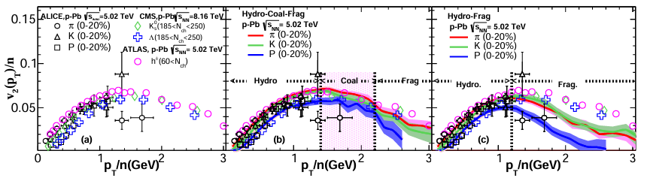
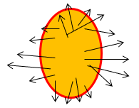
Flow-like signal in small system
Nat. Phys. 13 (2017) 535
Long range correlation: “ridge” structure
Non-zero azimuthal collective flow
Strangeness enhancement
Multiplicity dependent baryon to meson ratio
JHEP 09 (2010) 091
PRL 122, 172302 (2019)
Hydrodynamic final state evolution
EPJC 76 (2016) 7, PLB 774 (2017) 351, PLB 780 (2018) 495, EPJC 80 (2020) 846, PRC 101 (2020) 2
CGC Initial state correlations
PRL 108 (2012) 262001, PRD 87 (2013) 051502, PRL 117 (2016) 162301
Collective string effects
color reconnection: PRL 111 (2013) 042001, PRD 92 (2015) 094010
color rope: JHEP 03 (2015) 148, PLB 779 (2018) 58, JHEP 03 (2021) 270
Parton escape effects
PLB 753 (2016) 506
PRL 125 (2020) 072301

Slide 4
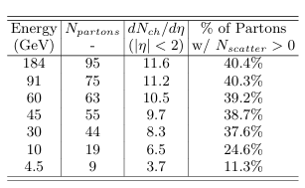
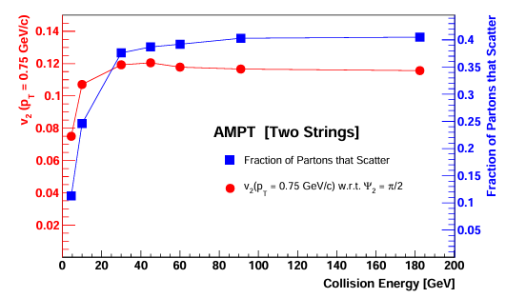
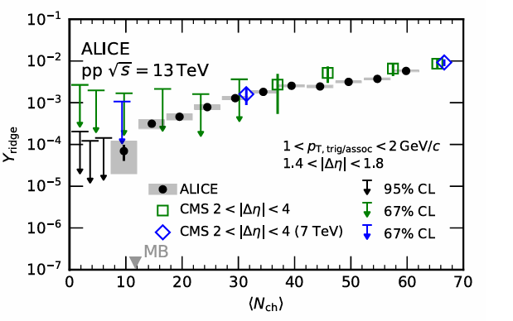
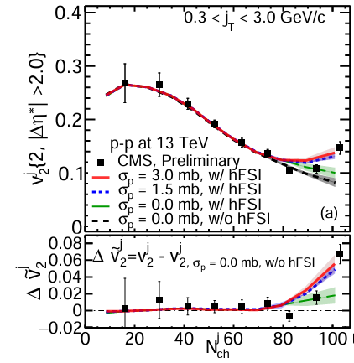
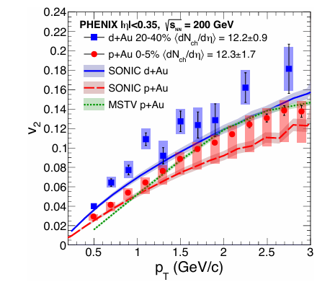
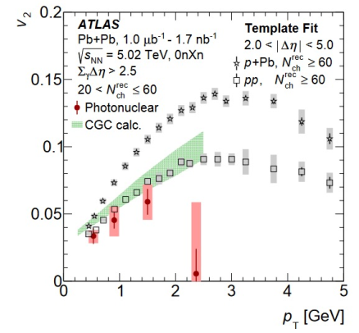
The minimal condition for flow
arXiv:1707.02307
Can be generated with a simple two string system
PRL 132 (2024) 172302
arXiv:1805.02973
arXiv: 2401.13137
PRC 104 (2021) 014903

Slide 5

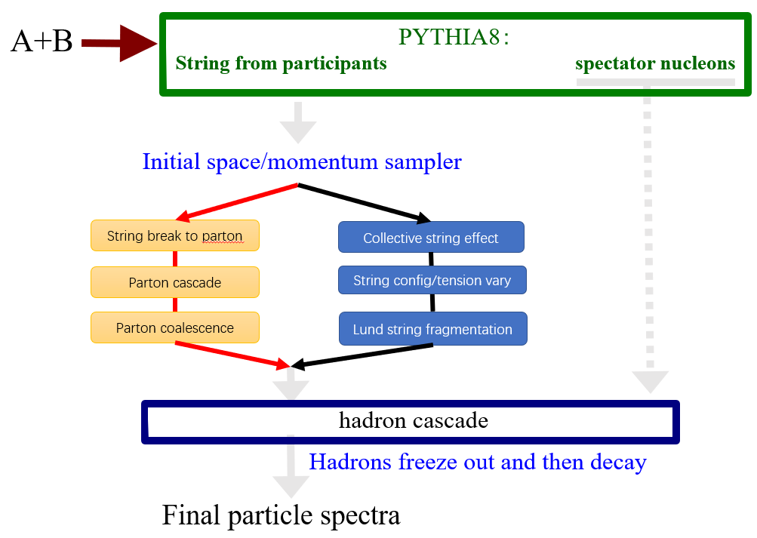
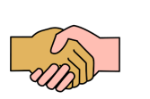
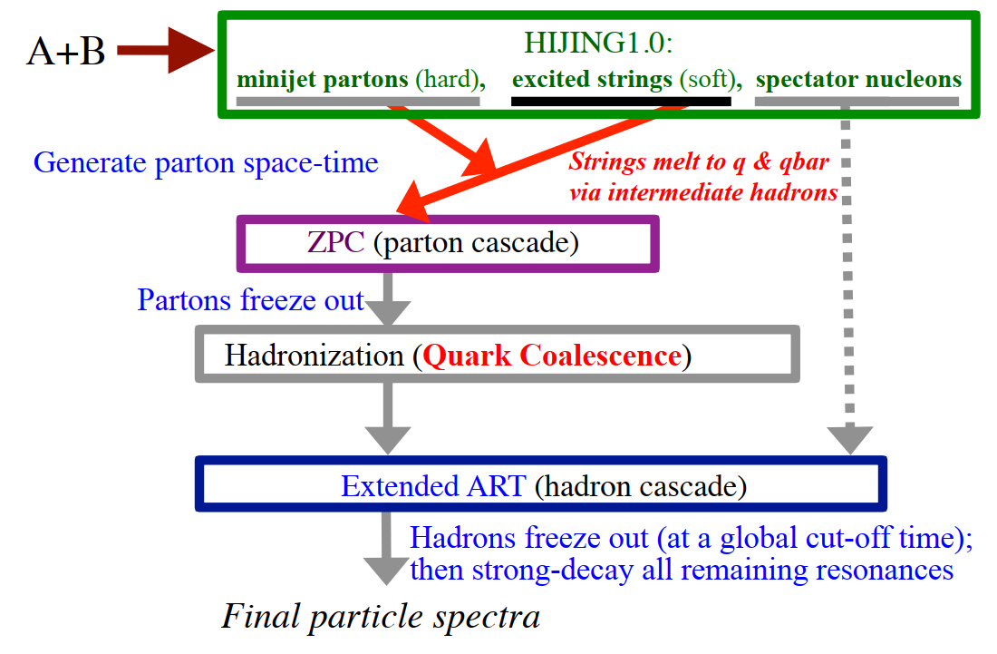
AMPT x PYTHIA8
Impact parameter dependent string system well developed in PYTHIA8/Angantyr framework
Possible to compare parton transport and inter-string effects on the same basis
PRC 72 (2005) 064901
Nucl.Sci.Tech. 32 (2021) 113

Slide 6
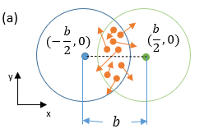
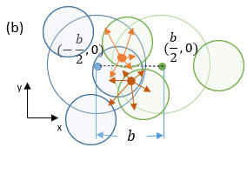
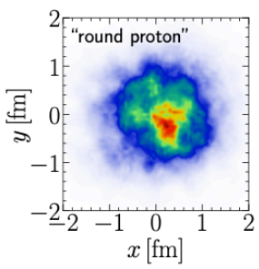
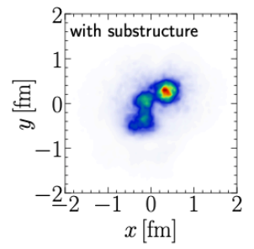
Sub-nucleon structure
PRC 72 (2005) 064901
Nucl.Sci.Tech. 32 (2021) 113
Rept.Prog.Phys. 84 (2021) 082301

Slide 7

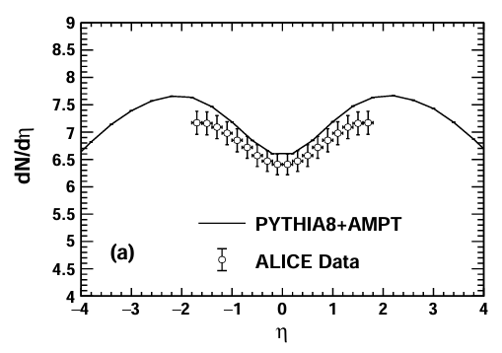
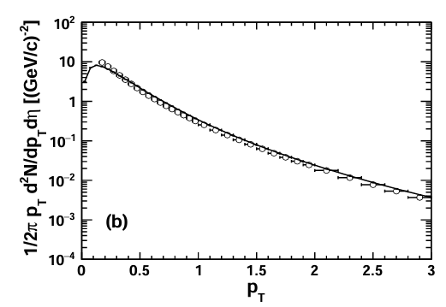
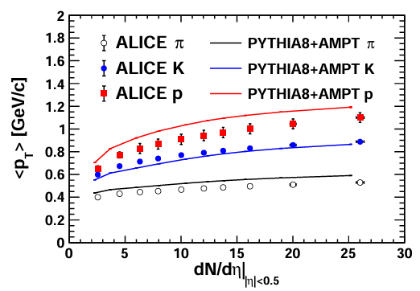
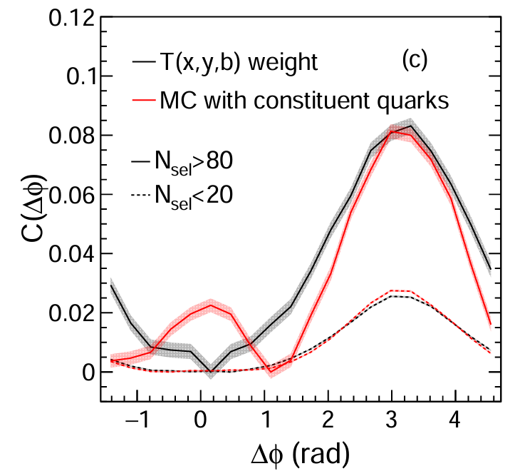

pp collisions
pp 13 TeV
$$σ_{ZPC}=0.15 mb, t_{max}=30 fm/c$$
Hadron production well described
Long range correlation induced with the sub-nucleon spatial fluctuations and partonic rescattering
1<p_{T}<3 GeV/c |△η|>2

Slide 8
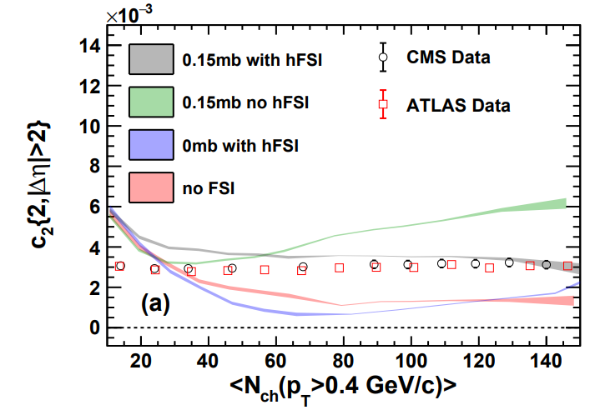
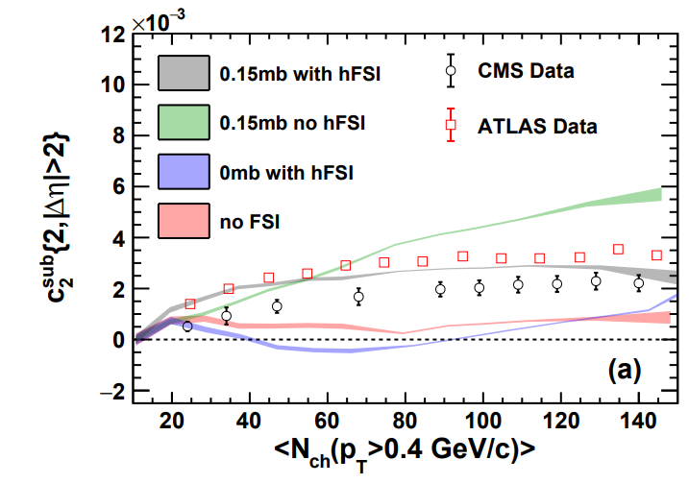




Two-particle cumulants
Low multiplicity dominate by non-flow effects
Final state parton rescattering leads to sizable c₂{2}
Non-flow effectively subtracted with low multiplicity events
With all FSI, data behavior well captured

Slide 9
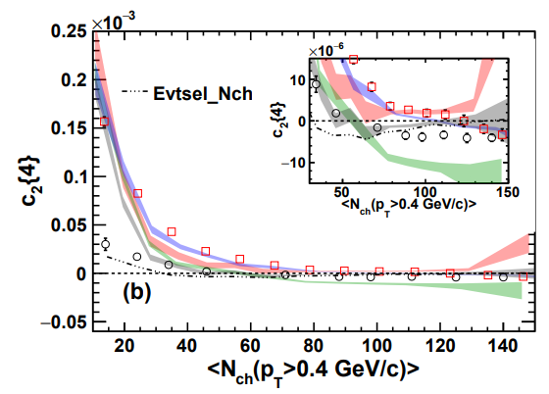
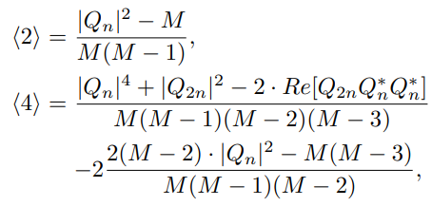

Four-particle cumulants
Parton rescattering leads to the most significant negative c₂{4}
Sign change dependent on multiplicity observed in the model calculations
Data discrepancy due to different event averaging treatment well described in the model

Slide 10
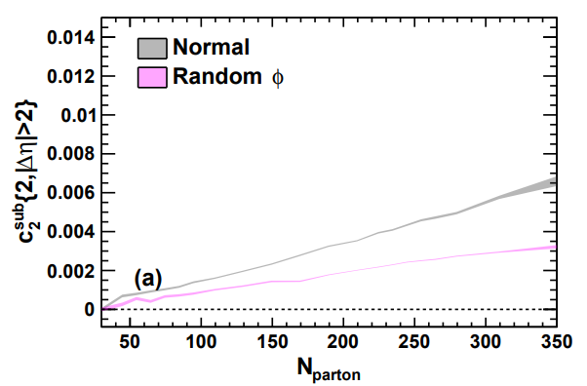
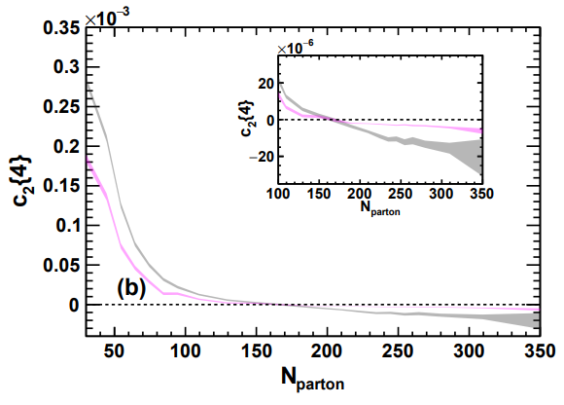
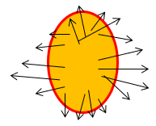
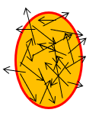

Parton escape effects
Sizable contribution from parton escape, decreases with event multiplicity
Sign change of c₂{4} can be related to the parton escape mechanism
Random $φ$ test

Slide 11
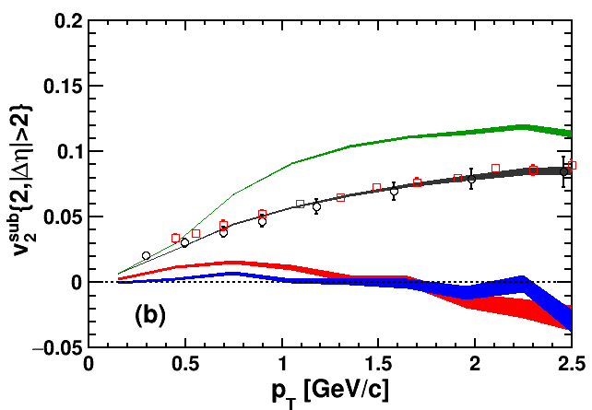



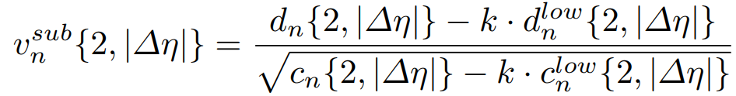
p_{T} differential elliptic flow for charge particle
Sizable elliptic flow induced by parton level evolutions
Hadronic interactions generally reduce the flow magnitude
Negligible flow with only hadronic scattering or no FSI
Elliptic flow in high multiplicity events (M>100)

Slide 12
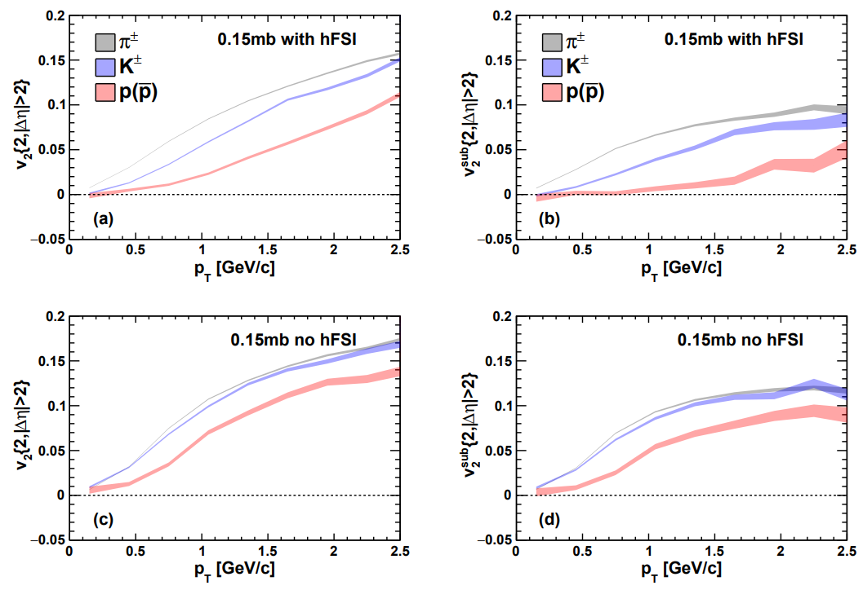
Elliptic flow for identified particles
Elliptic flow in high multiplicity events (M>100)
Significant mass ordering at low p_{T} w/ or w/o low multiplicity subtraction
Hadronic FSI coupled to parton evolutions further enlarge the mass ordering feature

Slide 13
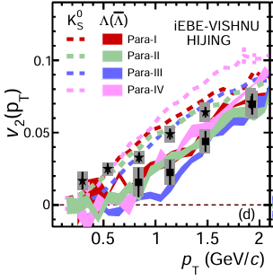
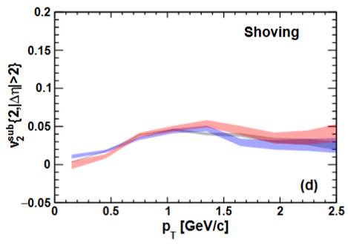
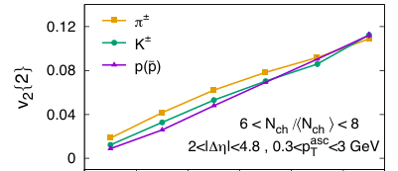

Elliptic flow for identified particles
Elliptic flow in high multiplicity events (M>100)
Significant mass ordering at low p_{T} w/ or w/o low multiplicity subtraction
Hadronic FSI coupled to parton evolutions further enlarge the mass ordering feature
Mass ordering can be unique evidence of deconfined parton matter creation
EPJC 80 (2020) 9
arXiv:1607.02496

Slide 14
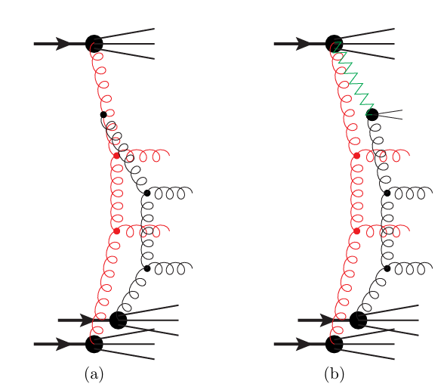
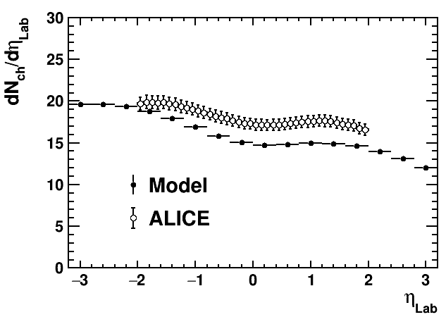
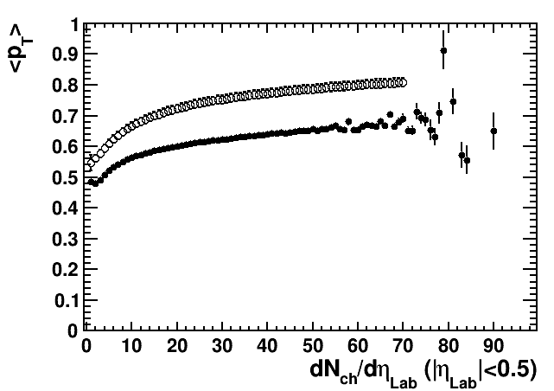
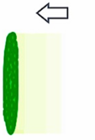
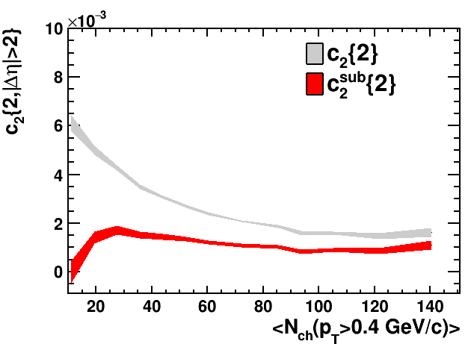
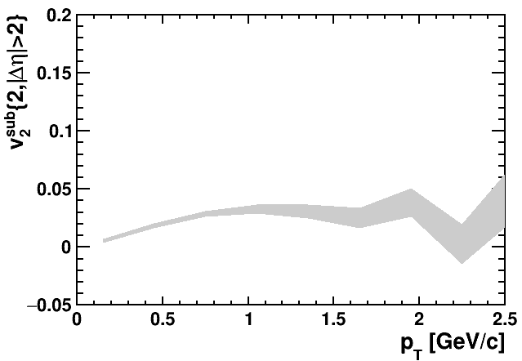
pPb collisions
pPb 5.02 TeV
Extending to pA using the Angantyr framework
Tuning required to reproduce hadron productions
Collective flow can be generated but weaker than pp

Slide 15



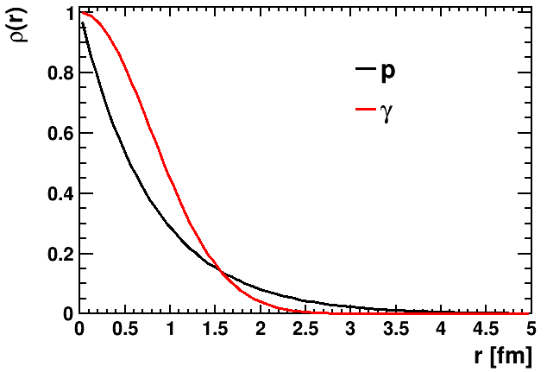
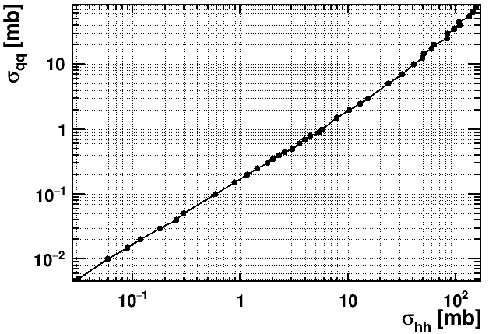
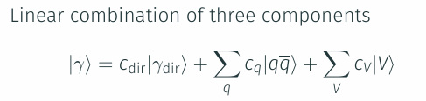
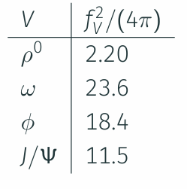

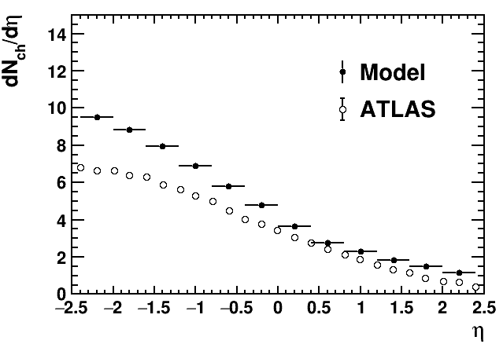
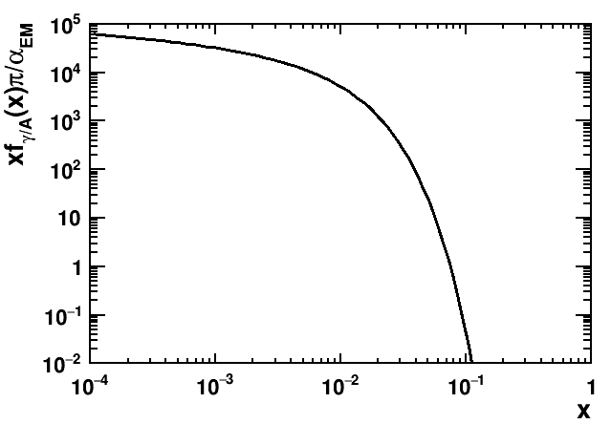

Ultra-peripheral collisions
$$ρ{\left(r\right)}_{γ}=\exp\left(−\frac{r^{2}Q^{2}}{2}\right), Q^{2}=0.0625 GeV^{2}$$
PbPb 5.02 TeV UPC
Modeled via VMD-Pb collisions
Notes:
arXiv:2406.10403

Slide 16
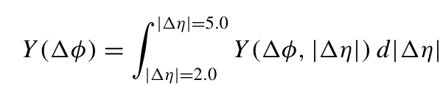

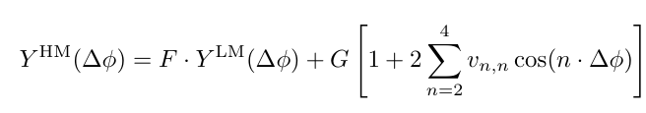



Collectivity in UPC
Collective flow extracted using the same experimental analysis method
Sizable flow signal after template fit
Non-zero higher order flow appears

Slide 17



Collectivity in UPC
Collective flow extracted using the same experimental analysis method
Sizable flow signal after template fit
Non-zero higher order flow appears
Reasonable data agreement
HM using $\sqrt{s_{γN}}=894 GeV ρPb$ collision

Slide 18

Summary
Collectivity in small system has been stimulating for new theoretical and experimental developments in QGP studies.
The AMPT model interfaced to PYTHIA8/Angantyr initial conditions are expected to deal with different collision systems.
Parton evolution is essential for the flow development in pp collisions.
The mass ordering of identified particle v₂ can be regarded as important signature indicating the existence of the deconfined quark matter.
Sub-nucleon fluctuations for both proton and photon are considered in the same framework.
Collectivity in UPC can be potentially explained in this model.

Slide 19
Backup

Slide 20








Charged hadron production
$\sqrt{s_{γN}}=894 GeV ρPb$ collision
$$σ=0.15mb, t_{max}=30 fm/c$$
Multiplicity can be quite large
Asymmetric rapidity structure
$$\left|η\right|<2.4, p_{T}>0.4 GeV/c$$
$$ρ$$
$$Pb$$
$$\left|η\right|<0.5$$

Slide 21





Collectivity in photon nuclear collisions
PRC 104 (2021) 014903
QCD fluctuations in photon
Two particle correlation method
Non-zero v2, v3 in UPC@LHC
Hierarchy of γ- and p-A flow
Search in UPC@RHIC ongoing
Shengli QM23 talk

Slide 22




Collectivity in photon nuclear collisions
PRC 104 (2021) 014903
Longitudinal extension of color domains
Uncorrelated domains randomly oriented
Initial momentum anisotropy
Roughly agree with experimental data
v₂ increases with Q²
PRD 103 (2021) 054017
EPJC 81 (2021) 760

Slide 23



Collectivity in photon nuclear collisions
Hydrodynamic simulation with comprehensive 3+1D framework
v₂ hierarchy explained with longitudinal decorrelations
VMD photon structure with sub-hadronic geometry
Due to photon size dependence, v₂ decreases with Q²
PRL 129 (2022) 252302

Slide 24

A multi-phase transport model (AMPT)
AMPT has been extensively applied in collectivity study for large systems
System size dependence has been improved recently
PRC 104 (2021) 014908
PRC 72 (2005) 064901
Nucl.Sci.Tech. 32 (2021) 113

Slide 25



Dihadron correlations
$\sqrt{s_{γN}}=894 GeV ρPb$ collision
$$σ=0.15mb, t_{max}=30 fm/c$$
1<p_{T}<2 GeV/c, |△η|>2, |η|<2.4
N_{ch} defined with |η|<2.4, p_{T}>0.4 GeV/c
Charged hadron pairs selected within mid-rapidity
Near side ridge appears in high multiplicity events
N_{ch} <20
N_{ch} >40

Slide 26


Elliptic flow coefficient
PRC 104 (2021) 014903
0.3<p_{T}<3 GeV/c, |△η|>2, |η|<2.4
N_{ch} defined with |η|<2.4, p_{T}>0.4 GeV/c
Flow estimated with Q-cumulant method
Low multiplicity subtract using N_{ch}<20 events
Similar to the value seen in ATLAS data

Slide 27


Elliptic flow coefficient
30<N_{ch}<50
Integrated flow with non-flow subtraction N_{ch} dependence consistent with data
High multiplicity events selected with (30,50), data for (20, 60)
p_{T} differential flow with gap and nonflow subtraction using N_{ch}<20 events

Slide 28




Two particle correlation
pp 13 TeV, charged hadron
1<p_{T}<3 GeV/c, |△η|>2
Near side ridge appears with sub-nucleon fluctuation
Significant ridge also shows in AMPT due to its large initial eccentricity
Robust HM ridge developed in parton evolution stage
EPJC 81 (2021) 8, 755

