Slide 1


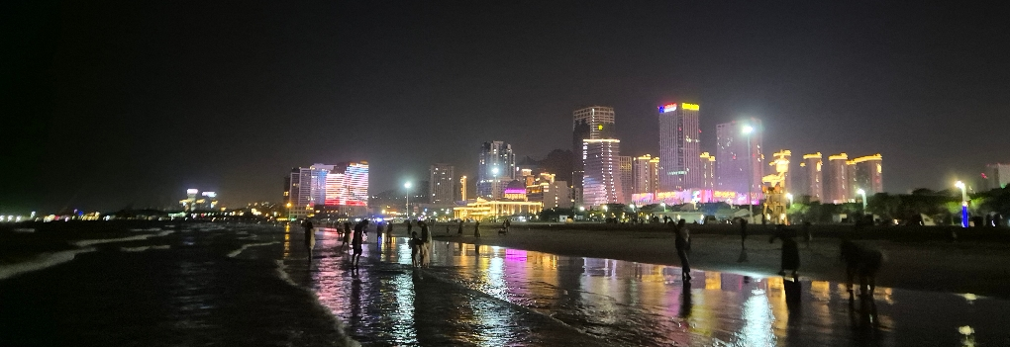

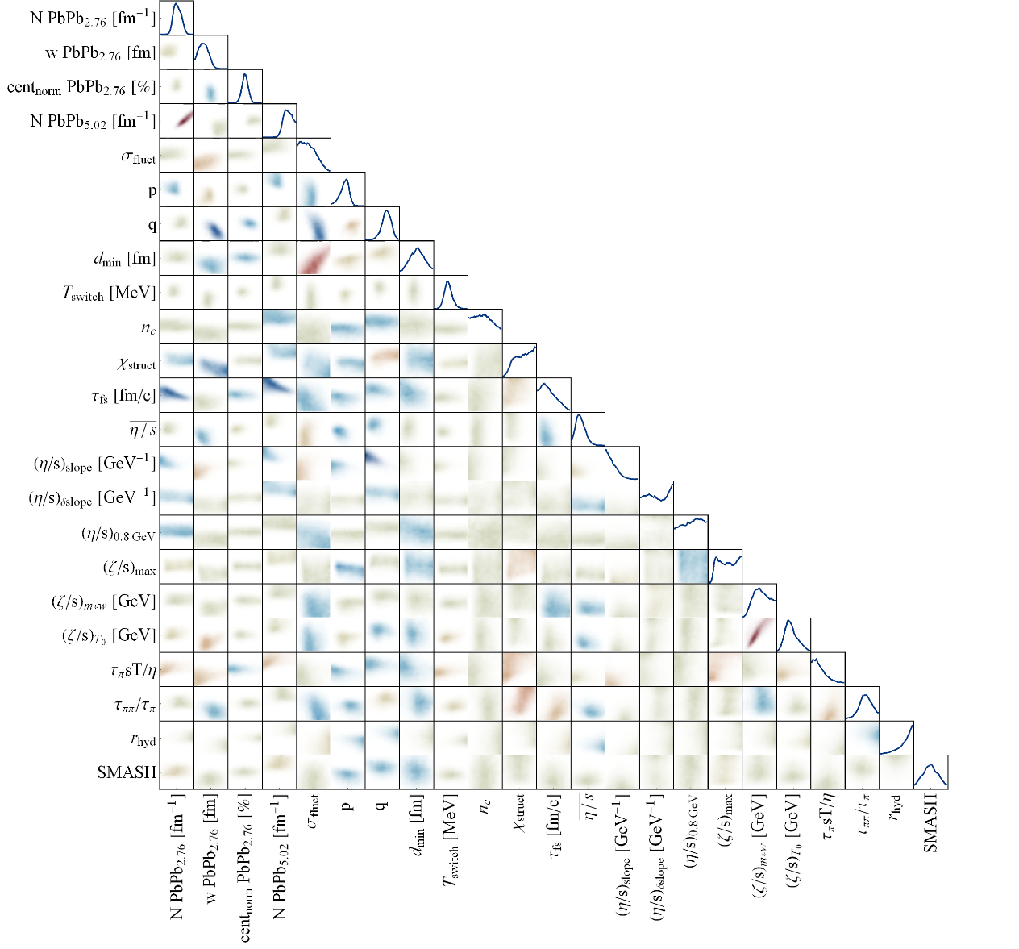
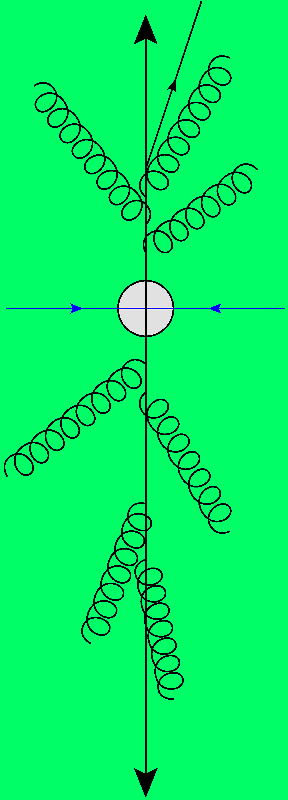
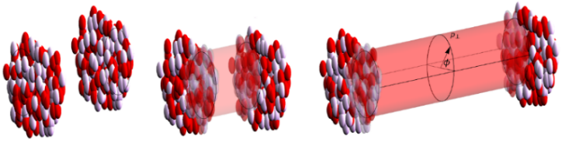
Ultracentral heavy and light ion collisions, transverse momentum and the equation of state
Παντα Ρει
with Govert Nijs;
thanks for discussions with Giuliano Giacalone and Jean-Yves Ollitrault
Wilke van der Schee
QCD Collectivity at the Smallest Scales,
26 June 2024

Slide 2

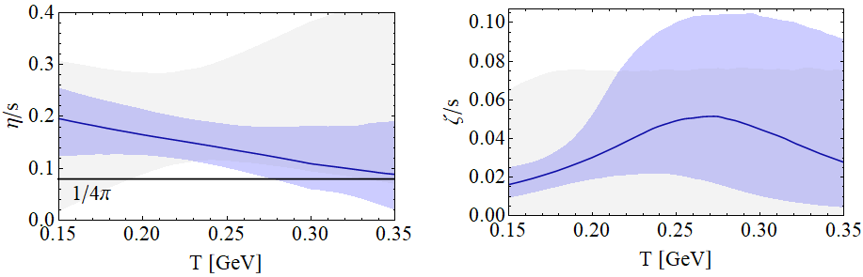

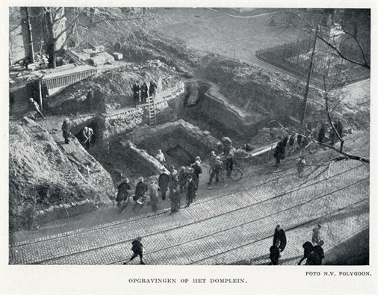
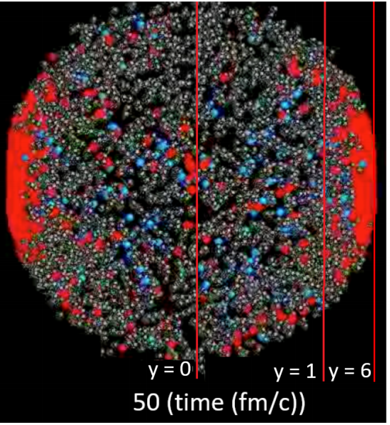
Standard model of heavy ion collisions
Wilke van der Schee, CERN/Utrecht
(# parameters)
Trajectum
New public heavy ion code
Originally Utrecht (now MIT/CERN)
Fast
Precise (all cuts equal to experiment)
Scalable
Initial stage (13)
Viscous hydrodynamics (10)
Subnucleonic structure? (8)
Non-thermal flow? (2)
with hydrodynamised initial stage
Fluctuations? (1)
Shape (2)
Shear viscosity (4)
Bulk viscosity (3)
Second order transports: 2
EOS: 1
Cascade of hadrons (1)
Roman excavations in Utrecht in 1929
Jonah Bernhard, Scott Moreland and Steffen Bass, Bayesian estimation of the specific shear and bulk viscosity of quark–gluon plasma (2019)
Govert Nijs, WS, Umut Gursoy and Raimond Snellings, A Bayesian analysis of Heavy Ion Collisions with Trajectum (2020)

Slide 3
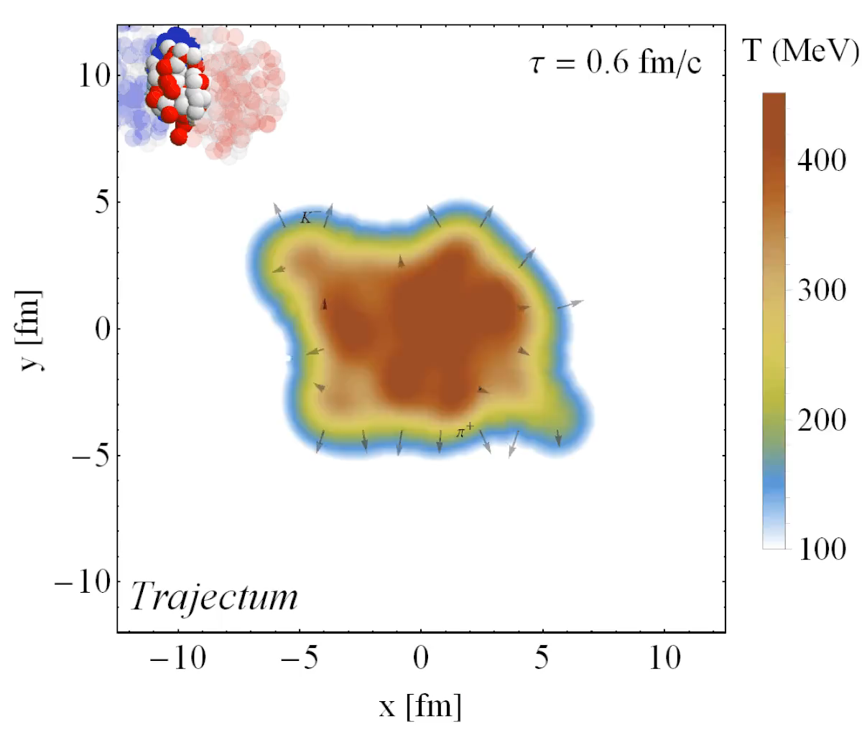
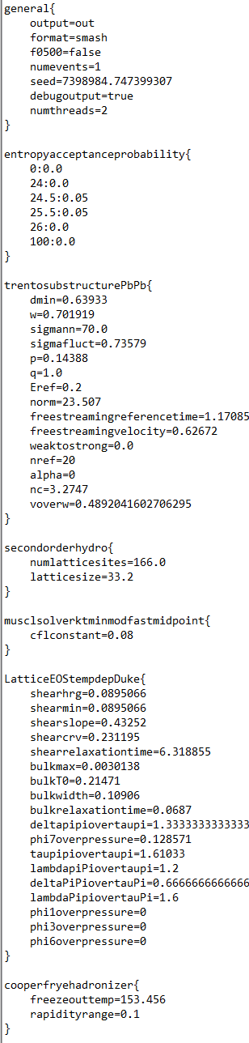
Trajectum
Quite straightforward to use
(see param file, right)
  Events can be weighted according to initial entropy (for ultracentral)
Includes analyse routine
  Parallelised: can analyse unlimited number of events
http://sites.google.com/view/govertnijs/trajectum
http://wilkevanderschee.nl/trajectum

Slide 4
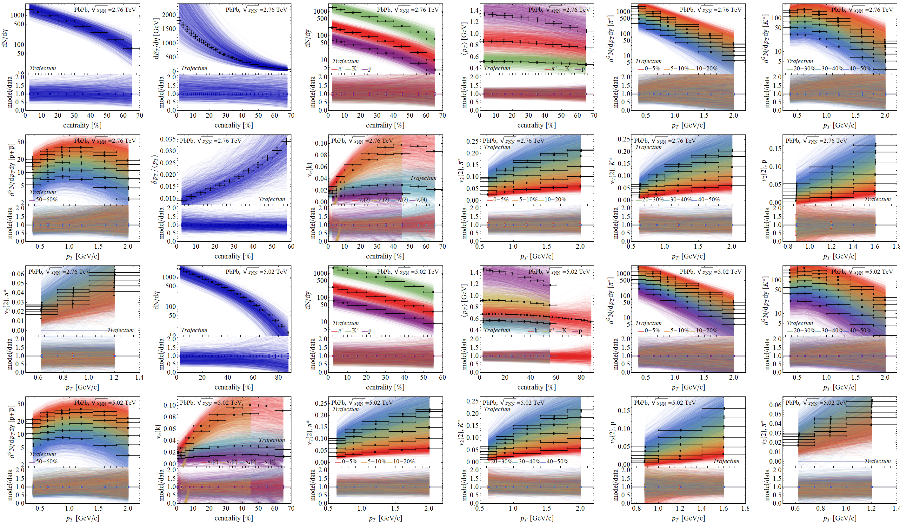
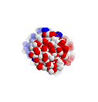
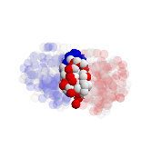
Experimental observables: a wealth of data
Prior

Slide 5
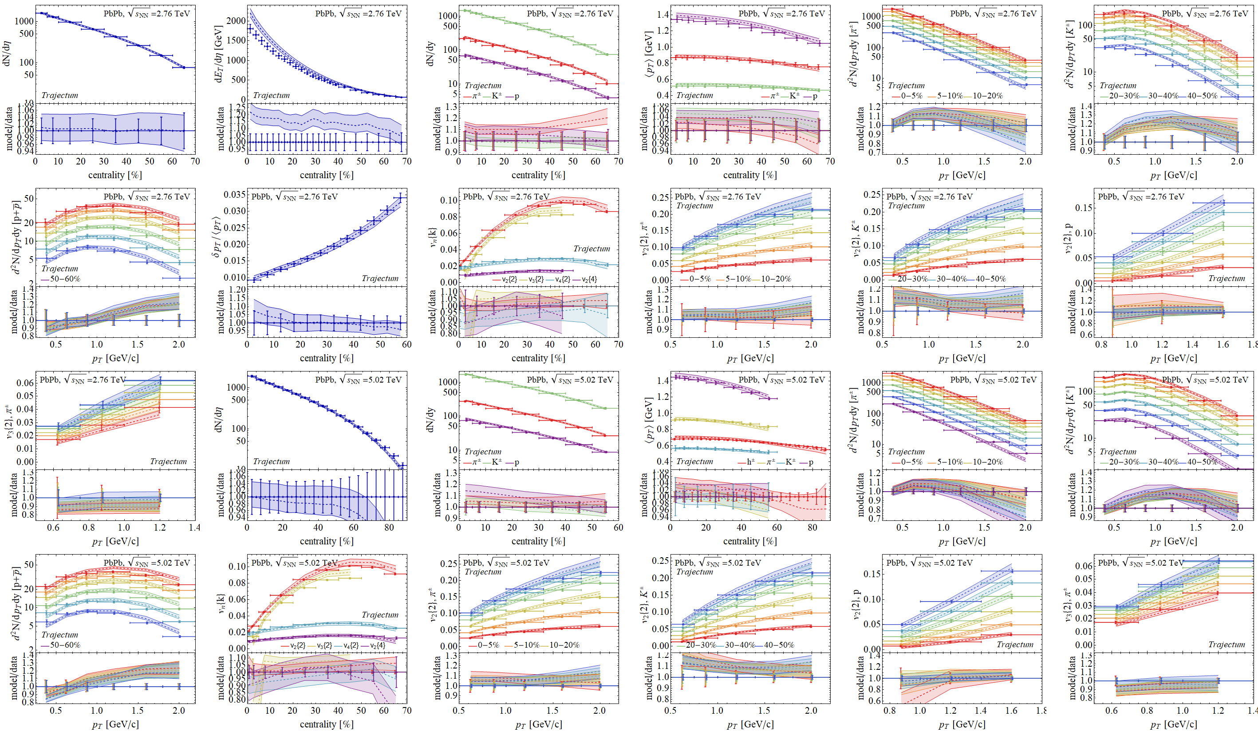
Experimental observables: a wealth of data
Posterior

Slide 6
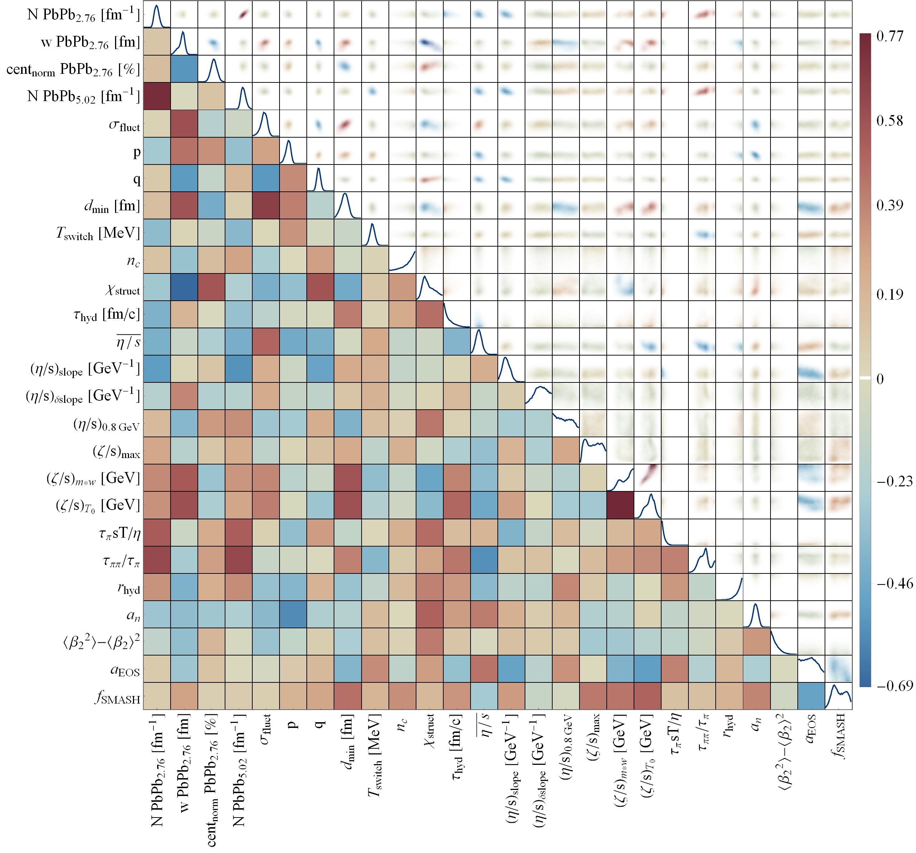
Varying the EOS
As an aside: no (current) sensitivity to the equation of state
  While keeping thermodynamic relations and UV QCD fixed point (excludes `black’ variations)
Perhaps small correlation with specific shear viscosity
Giuliano Giacalone, Govert Nijs and WS,
Determination of the neutron skin of ²⁰⁸ Pb from ultrarelativistic nuclear collisions (2023)

Slide 7
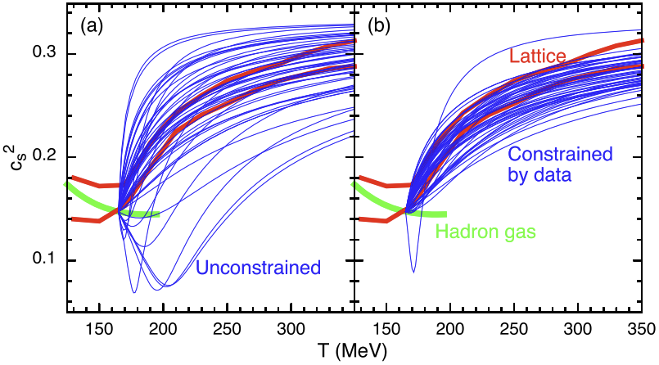
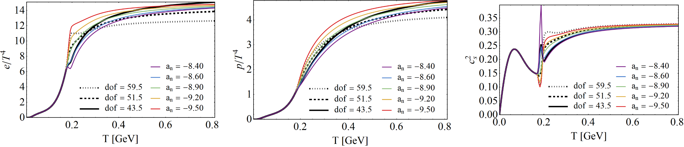
Varying the Equation of State
Not really straightforward to vary the speed of sound alone; thermo + HRG matching
In Trajectum / OSU hydro we can vary (lattice) parameters a_{n} and p_{id}:
We keep UV EOS fixed (coloured, Bayesian as well) or vary just the dof variable p_{id} (black):
Scott Pratt, Evan Sangaline, Paul Sorensen and Hui Wang Constraining the Equation of State of Superhadronic Matter from Heavy-Ion Collisions (2015)
Jonah E. Bernhard, Bayesian parameter estimation for relativistic heavy-ion collisions (2018)

Slide 8
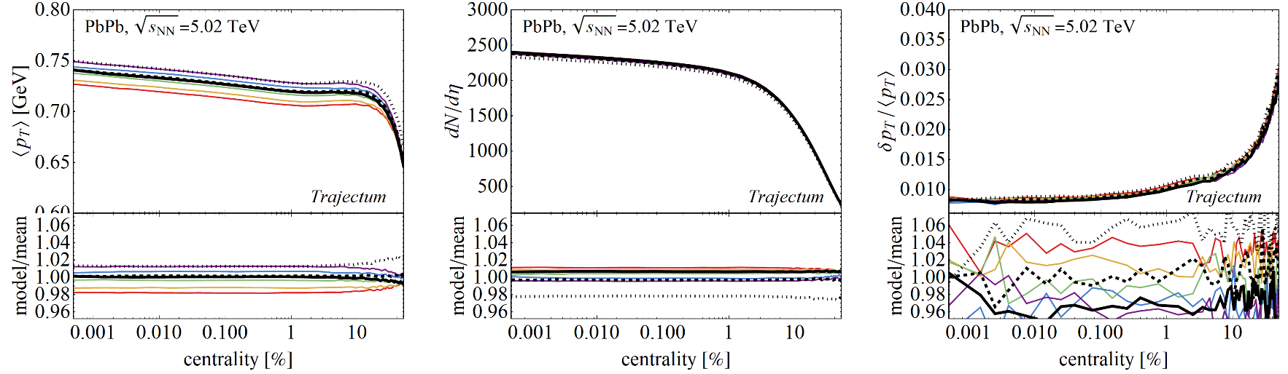
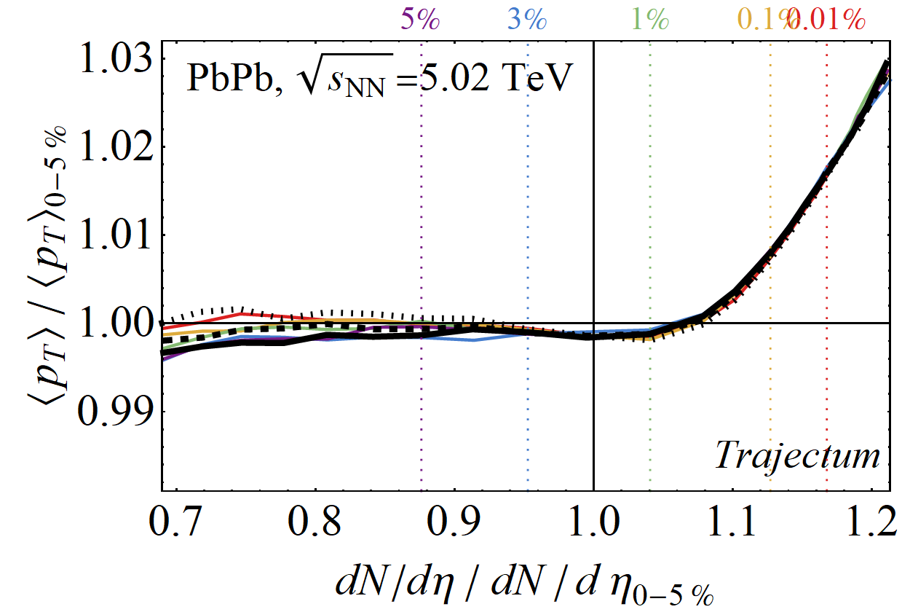
Varying the Equation of State
Observables change:
But the `speed of sound’
slope doesn’t…:

Slide 9
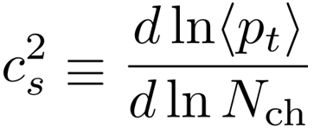
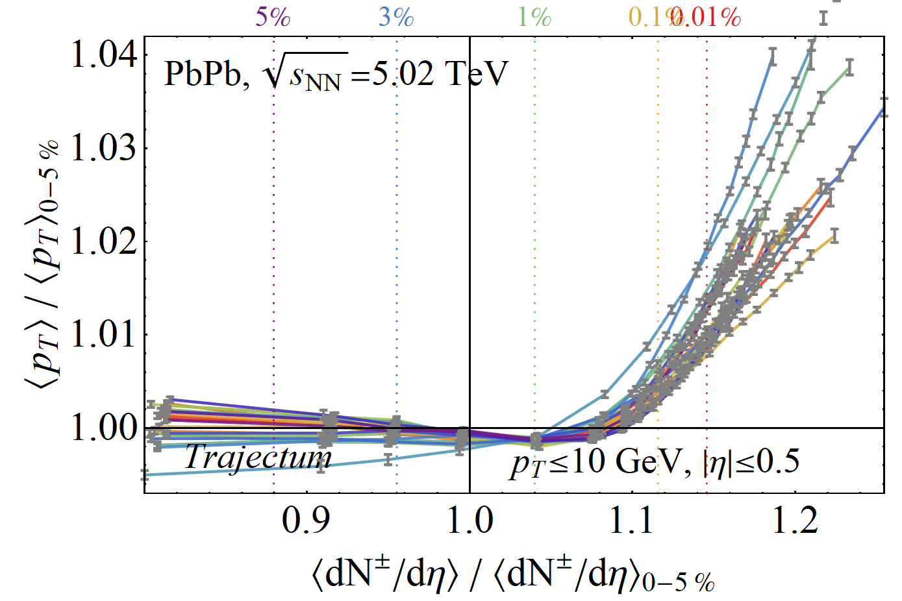
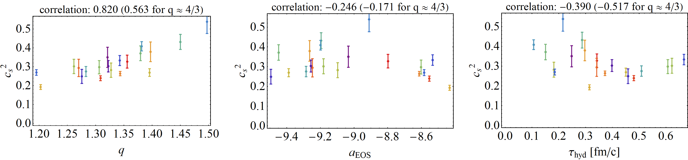
What then determines the slope?
Small abuse of notation:
Alternative; look at the 20 likely settings varying all parameters and fit the speed of sound:
Strong evidence for correlation with q,
perhaps residual correlation with τ_{hyd}:

Slide 10
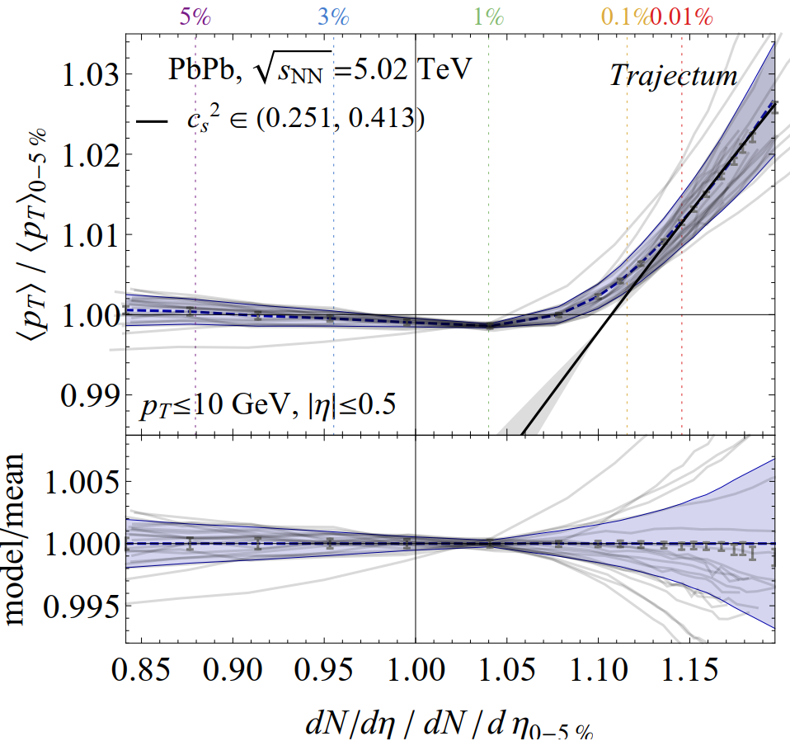
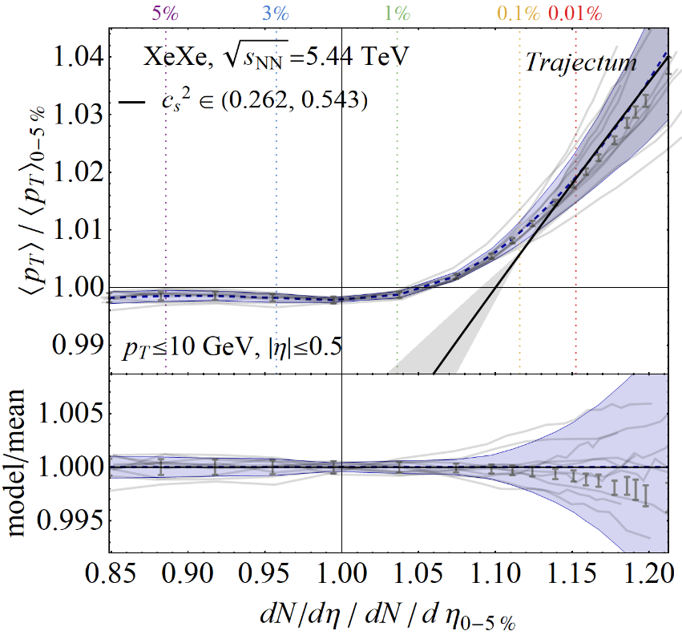
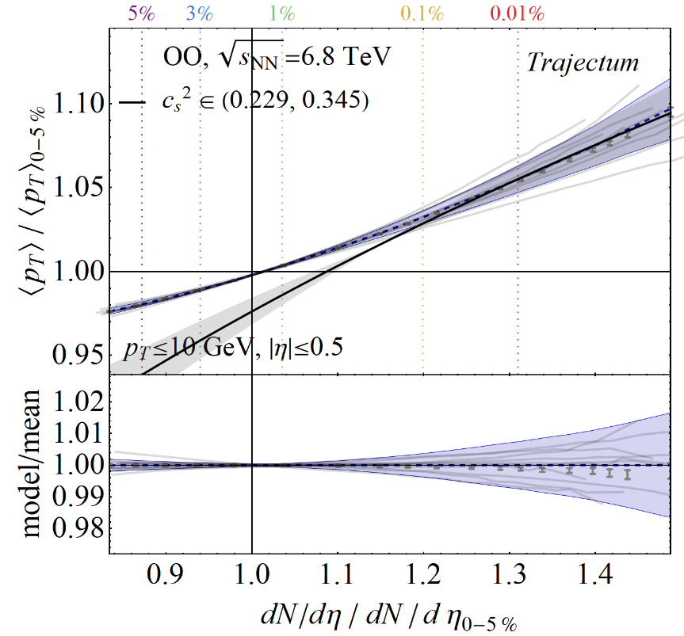
PbPb, Xenon, OO and smaller
Note cancellation of systematic uncertainty in theoretical calculation

Slide 11
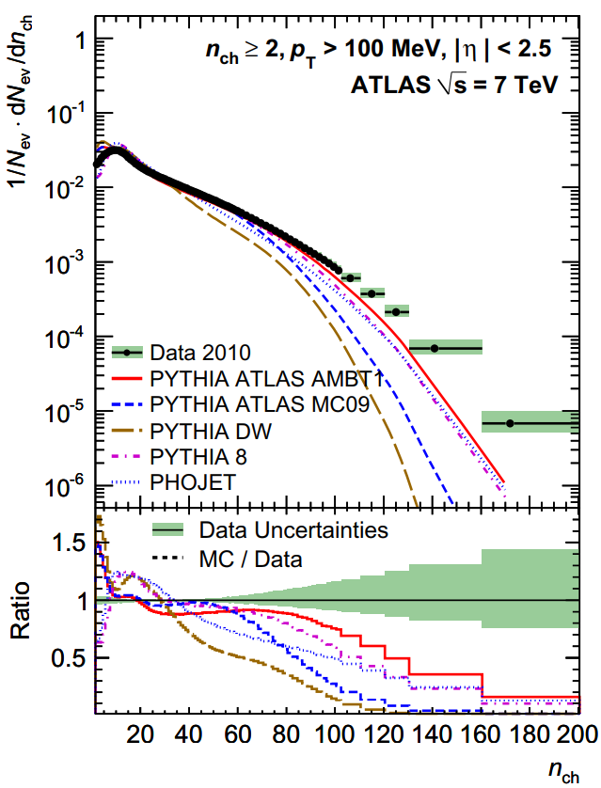
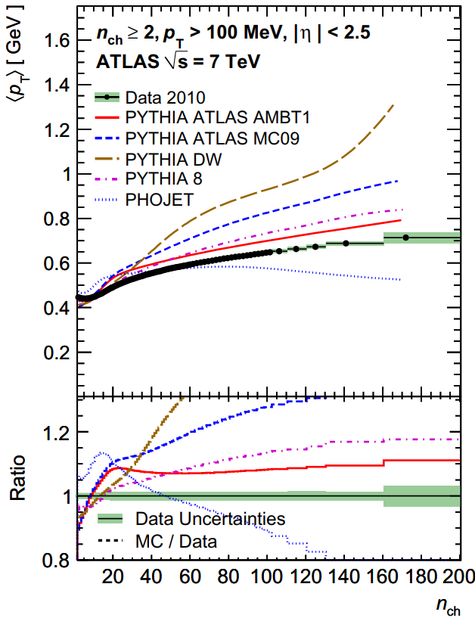
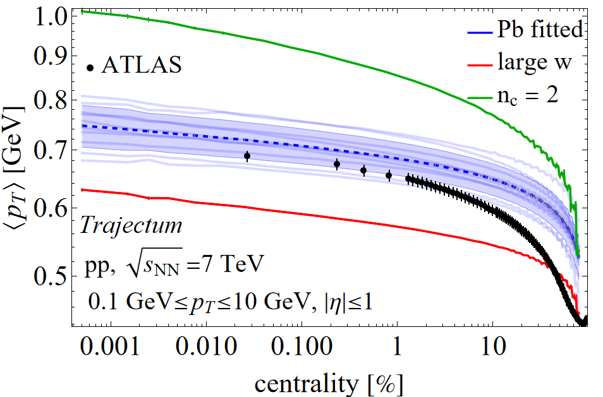
Small systems: pp @ 7 TeV
Trajectum sees a bit off (mostly around 20% centrality), but large uncertainty in parameters (width + # constituents)
Pythia works, but depending on tune
ATLAS, Charged-particle multiplicities in pp interactions
measured with the ATLAS detector at the LHC (2011)

Slide 12
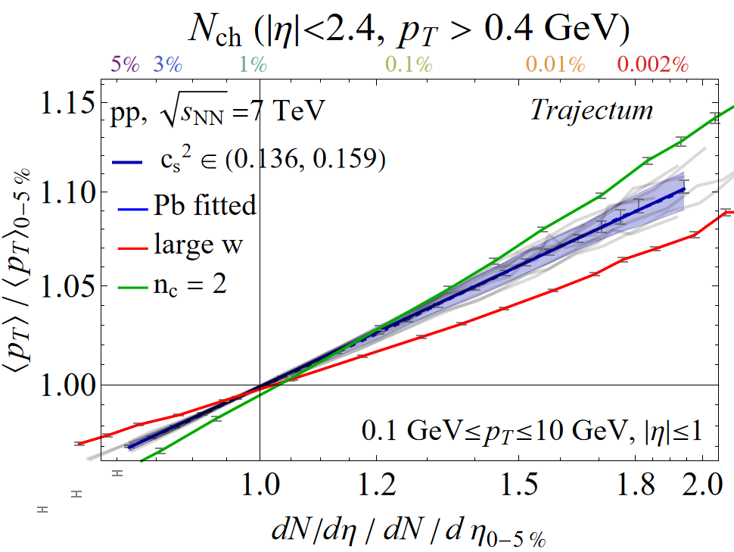
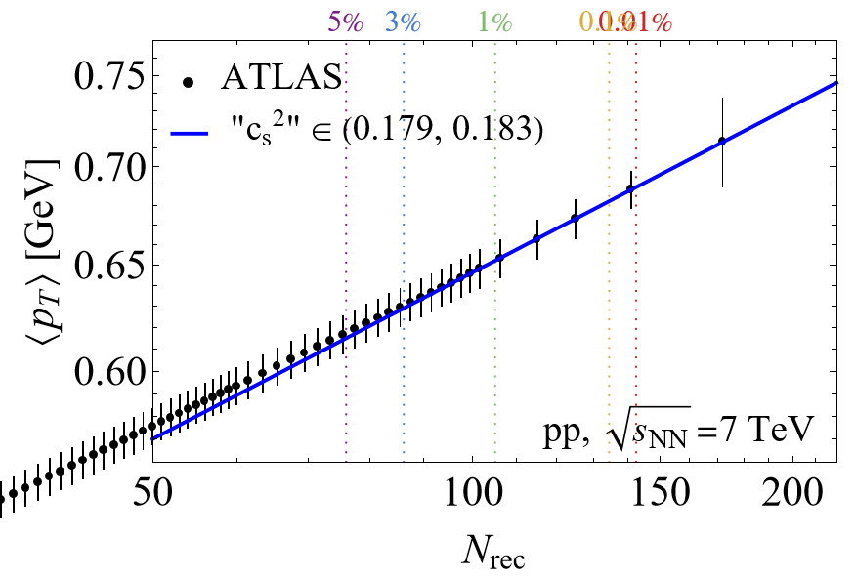
Small systems: pp @ 7 TeV
We can look at slope also for proton collisions; NB quotation marks ☺
Much larger fluctuations: log-log scale

Slide 13
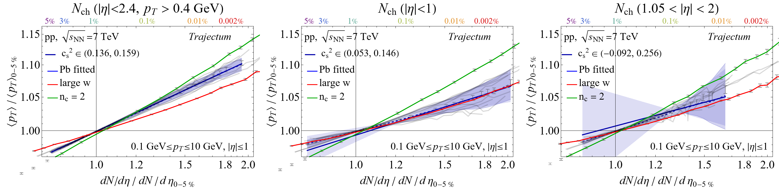
Small systems: pp @ 7 TeV
Similar to PbPb: important dependence on “centrality” selection

Slide 14
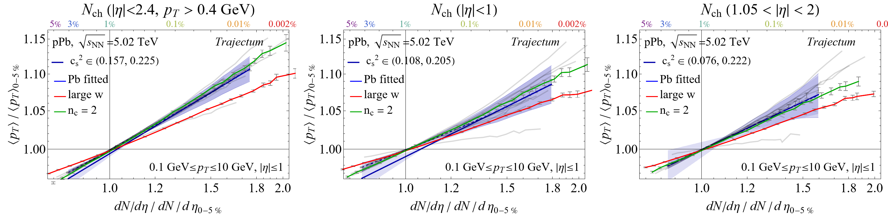
Small systems: pPb @ 5.02 TeV
Similar to pp: slope seems a bit larger and more robust
Origin of slope is still hydro (by construction); can we still see the speed of sound?

Slide 15
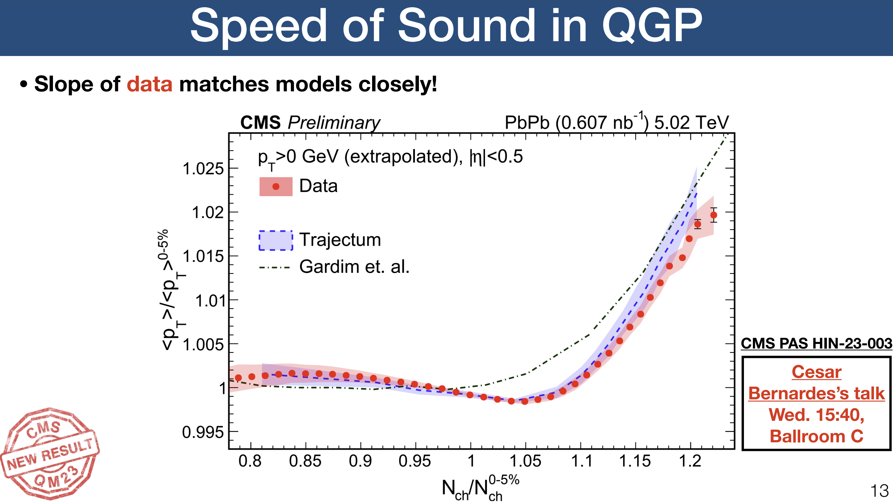
Discussion
Everything should be made as simple as possible, but not simpler
A focus on (extremely) ultracentral collisions
  Interesting interplay of physics not necessarily seen elsewhere
Shows the strength of a model like Trajectum
  Interplay of physics requires a (relatively) complete, precise and accurate model
  Can do predictions (!) ☺
The origin of the slope
  The link with the speed of sound is clear but not sufficient
  Initial conditions important: in particular q parameter (rules out binary scaling (?))
  Centrality selection is crucial, as are p_{T} cuts
Also particularly interesting observable in small systems

Slide 16
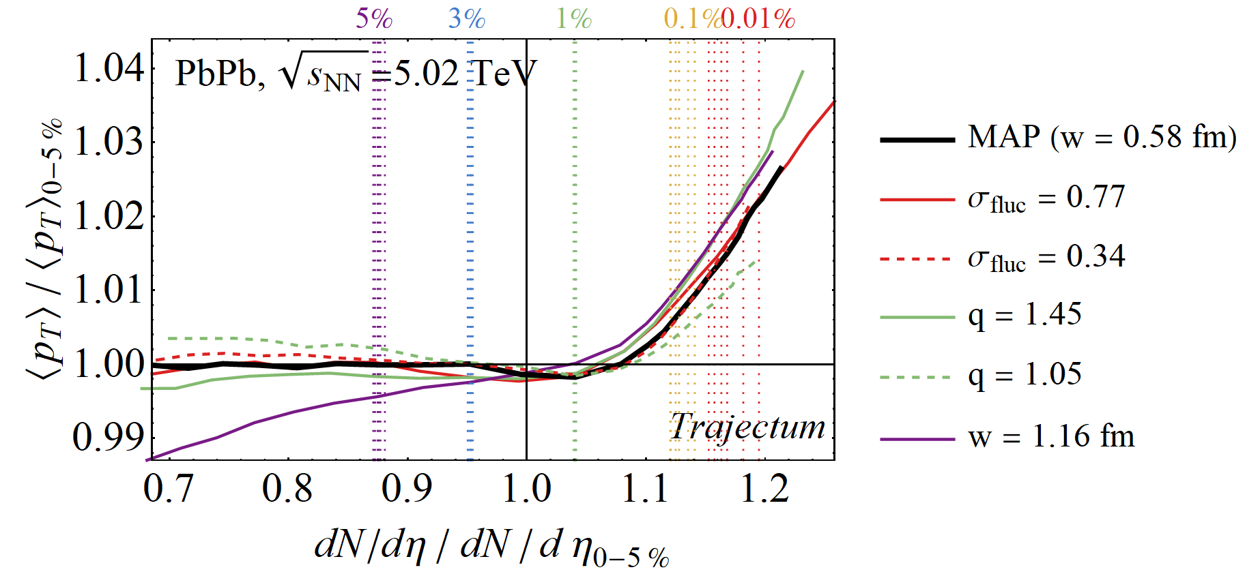

What then/else determines the slope?
Vary parameters: shear viscosity, bulk viscosity, nucleon width, p, q, fluctuations, τ_{hyd}, neutron skin up and down:
Fluctuations only extend curve (fixed centralities shown), but not the slope.
Significant effect mostly from q parameter:
Fluctuations increase entropy more
in the centre for larger q
→ also makes QGP smaller

Slide 17
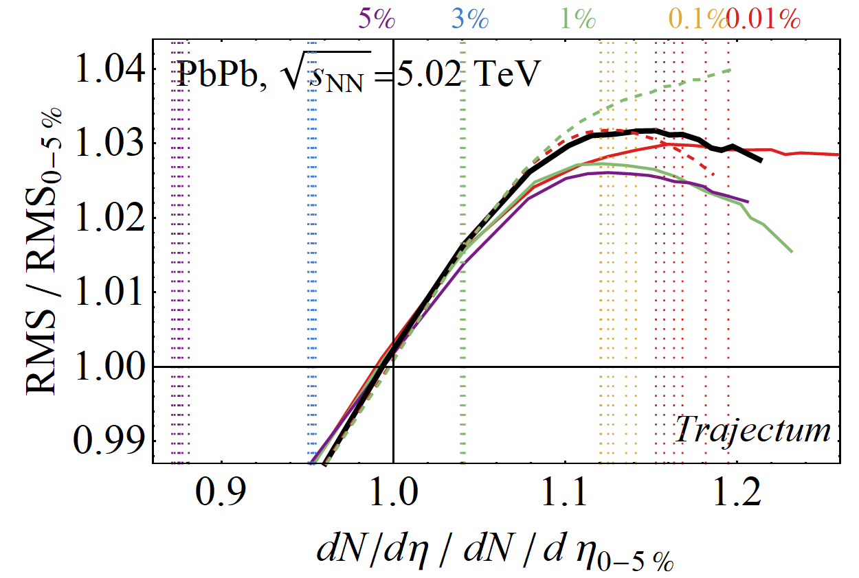
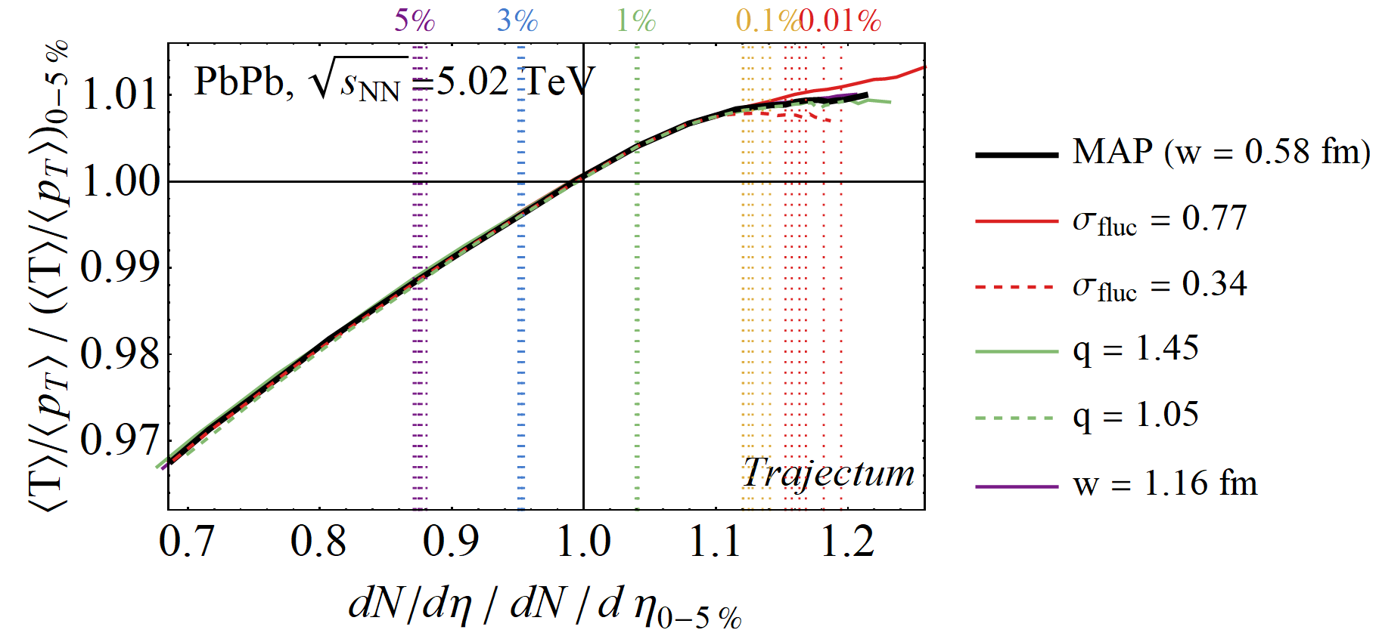
What then determines the slope?
Size fluctuations are a bit non-trivial:
Crucial assumption p_{T} ~ initial T seems validated:
(except for fluct? Compensated by size?)

Slide 18
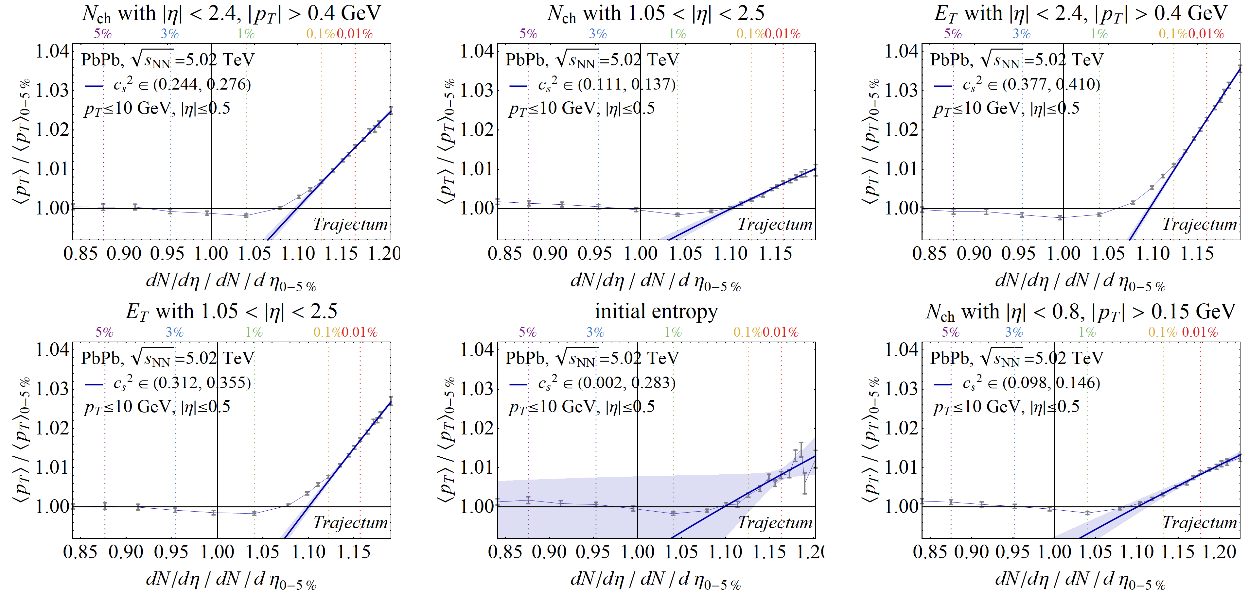
What then determines the slope?
Centrality cuts are very important..;
boost invariant, self-correlation, computationally expensive for |η|>1.5
`Trajectum’
`V0’
`CMS FCAL’
`other theory’
‘ITS’

Slide 19
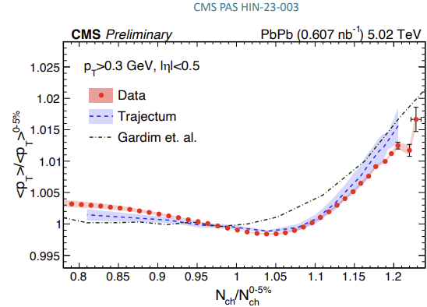
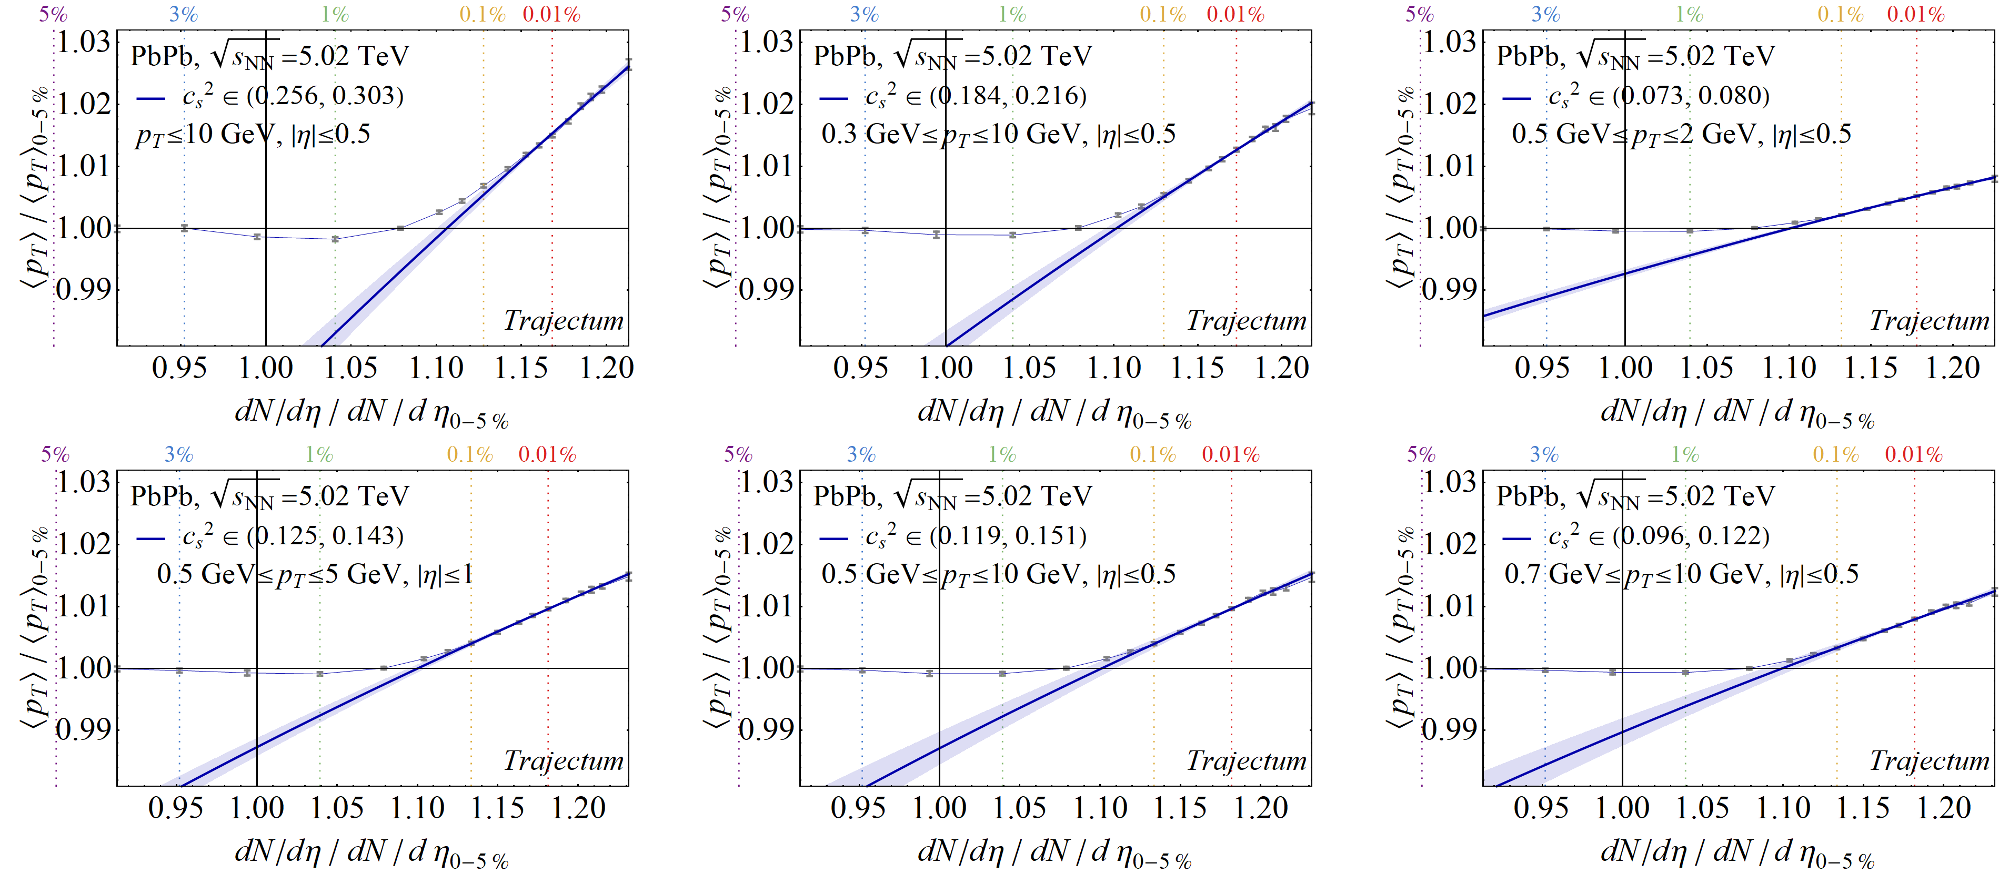
What then determines the slope?
p_{T} cuts and extrapolations are very important…

Slide 20
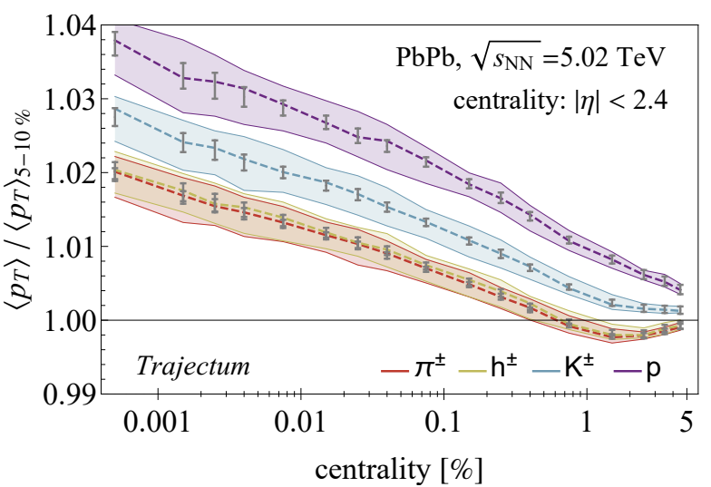
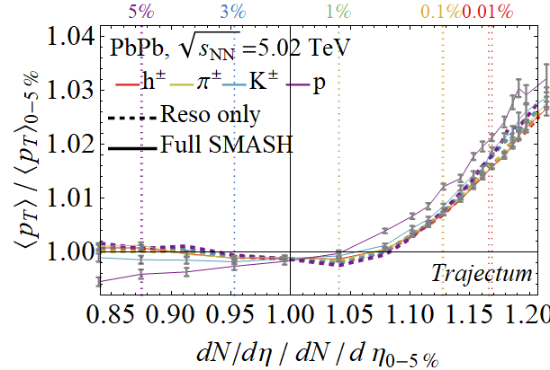
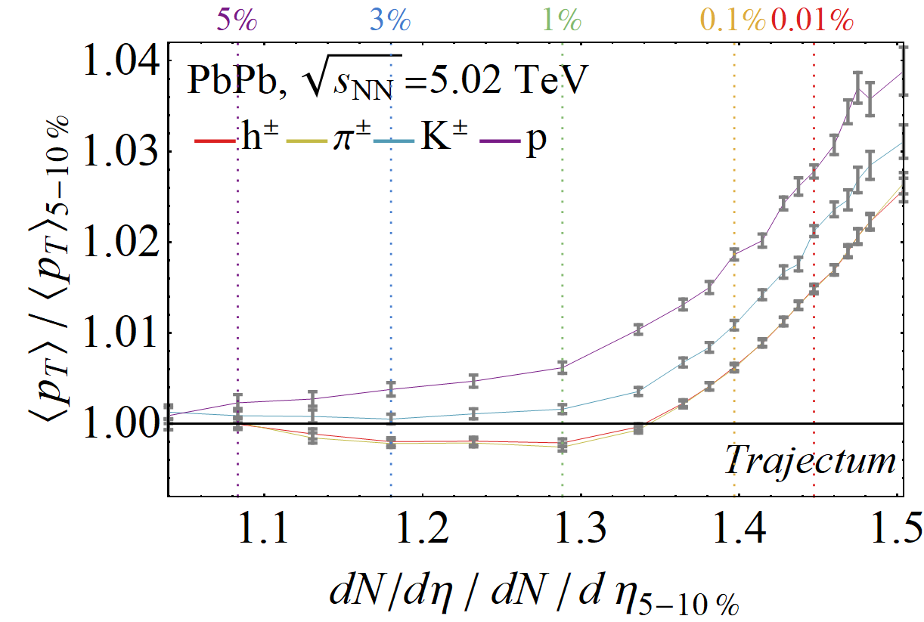
On identified particles
Previous predictions showed relatively strong dependence on PID
  Less influence on the slope
Updated computations show much less dependence:
  Biggest difference came from normalisation by 5-10% class instead of 0-5%
  SMASH collisions influence proton mean p_{T} (not included in rest of presentation)
Govert Nijs and WS, Predictions and postdictions for relativistic lead and oxygen collisions with the computational simulation code Trajectum (2021)

Slide 21
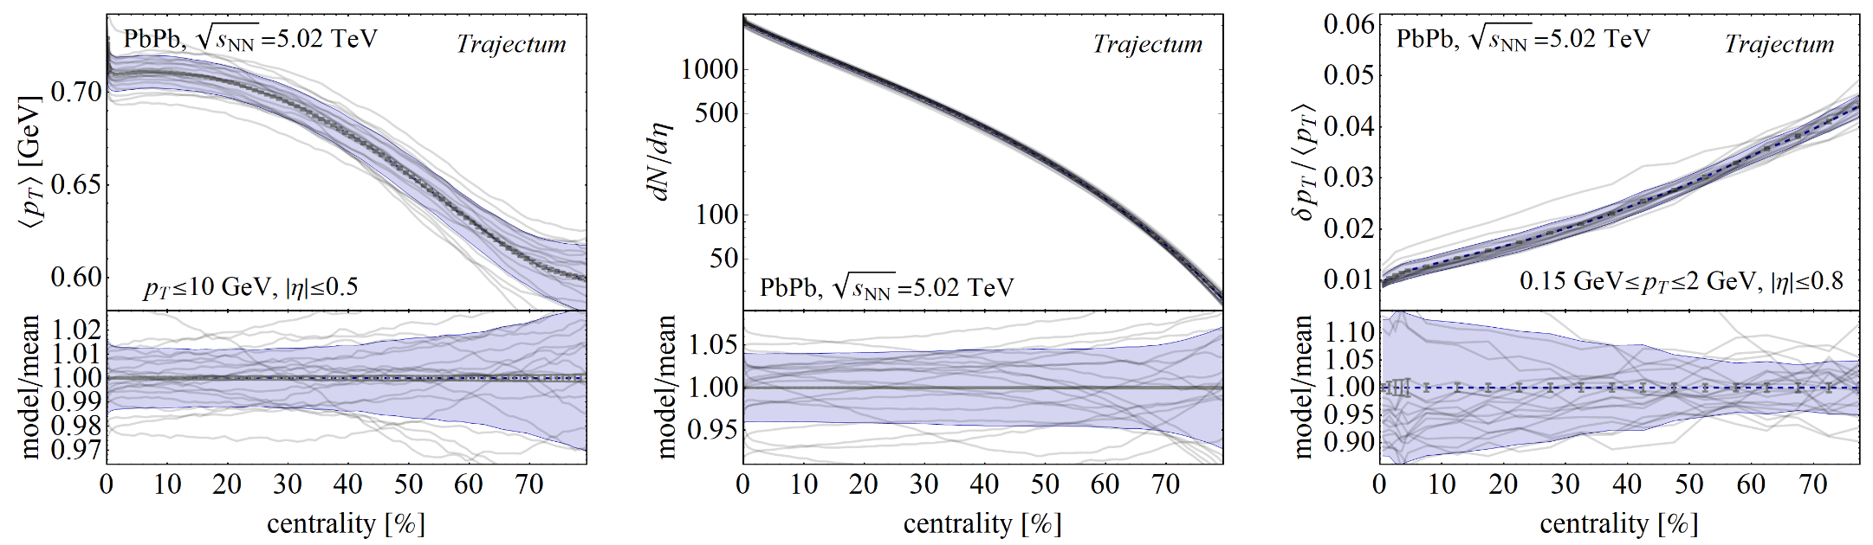
Charged particle yields and momenta
Inclusive charged particle yields and their momenta
  Relatively `cheap’ observables: 10M initial state (Trento), 80k hydro events, 4M hadronic decay; (2k CPU hours)
  Somewhat `smart’ weighting of events to increase statistics with finite # hydro events
  Statistical uncertainty hard to see for `normal’ centralities (pt fluctuations more expensive)
Lines are 20 individual simulations from MCMC; determines systematic uncertainty

Slide 22
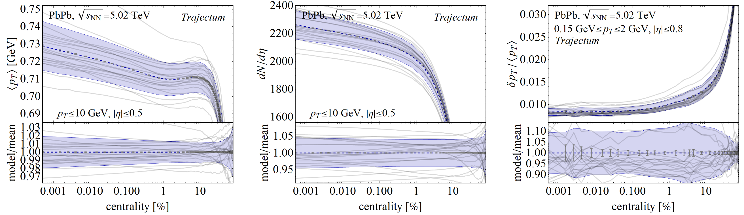
Zooming to ultracentral
Non-trivial dynamics all the way till 0.001% collisions (10 in a million events)

Slide 23
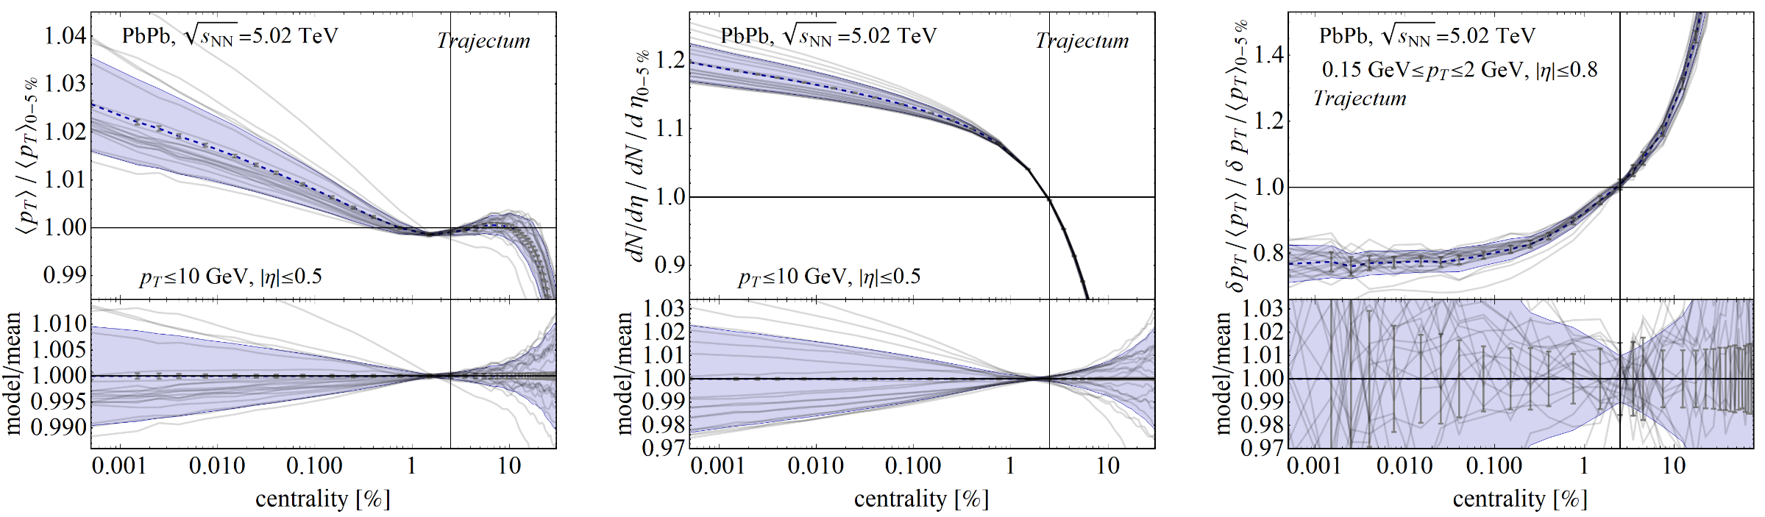
Zooming to ultracentral - systematics
Non-trivial dynamics all the way till 0.001% collisions (10 in a million events)
  Systematics is obtained from varying parameters (viscosities, initial state, etc) within `allowed’ posterior space (experiment)
  Clear correlation: can cancel systematic uncertainty by ratio with 0 – 5% result

Slide 24
The PLB insight
Temperature fluctuations drive both multiplicity and mean p_{T}
  Even more cancellation for multiplicity than for centrality:
Fernando G. Gardim, Giuliano Giacalone and Jean-Yves Ollitrault,
The mean transverse momentum of ultracentral heavy-ion collisions:
A new probe of hydrodynamics (2019)

Slide 25
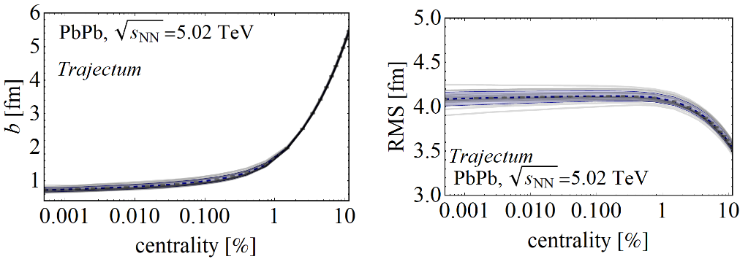
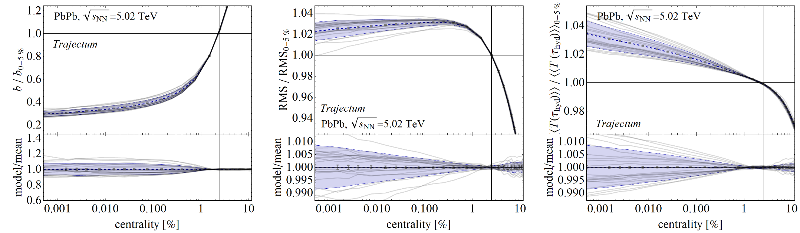
On the initial geometry
Unless otherwise stated centrality is defined by mid-rapidity charged particle tracks
Ultracentral collisions have constant impact parameter (~ 0.8 fm)
The size is also constant (about 4 fm) (slowly decreasing?)
The temperature keeps on increasing because of fluctuations

Slide 26
A true prediction using hydrodynamics (rare these days…)
  Non-trivial curve; non-monotonicity was unexpected
  Extremely precise (<0.1%) due to uncertainty cancellations in the ratio (theory & experiment (!))
Fernando G. Gardim, Giuliano Giacalone and Jean-Yves Ollitrault, The mean transverse momentum of ultracentral heavy-ion collisions: A new probe of hydrodynamics (2019)
Govert Nijs and WS, Predictions and postdictions for relativistic lead and oxygen collisions with the computational simulation code Trajectum (2021)
Austin Baty, Overview of Recent CMS results, https://indico.cern.ch/event/1139644/contributions/5343932/ (see also Cesar Bernardes)

Slide 27
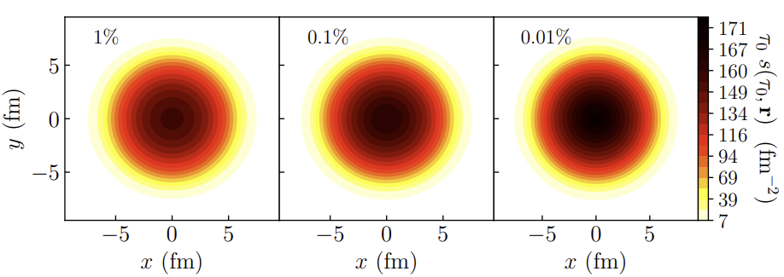
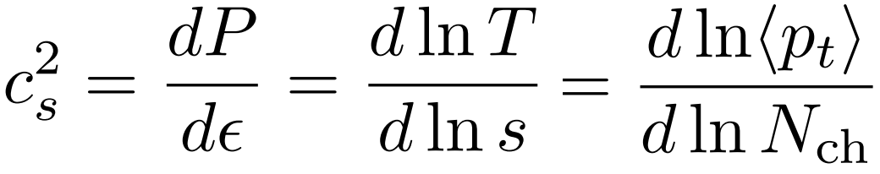
What is happening?
(Extremely) ultracentral collisions are not driven by impact parameter
  Size does not extend beyond radius Lead nucleus
  (Local) fluctuations drive up multiplicity
  Average temperature can still increase
A simplified picture:
  Entropy increase → multiplicity increases
  Temperature increases → mean pt increases (assuming ideal hydro + constant `work’ done in rapidity direction)
  Slope: sensitive to speed of sound (solely ?!):
Fernando G. Gardim, Giuliano Giacalone and Jean-Yves Ollitrault, The mean transverse momentum of ultracentral heavy-ion collisions: A new probe of hydrodynamics (2019)

