Slide 1


Heavy Flavor Production, Collectivity and Hadronization in Small Systems
W. Xie
(Purdue University, West Lafayette)

Slide 2
Essential to understand Open Heavy Flavor Production
One of the most important probes for sQGP
  Interactions between heavy quark and medium are quite different from the ones for light quarks
    gluon radiation, collisional energy loss, collisional disassociation, etc

Slide 3
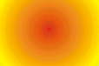
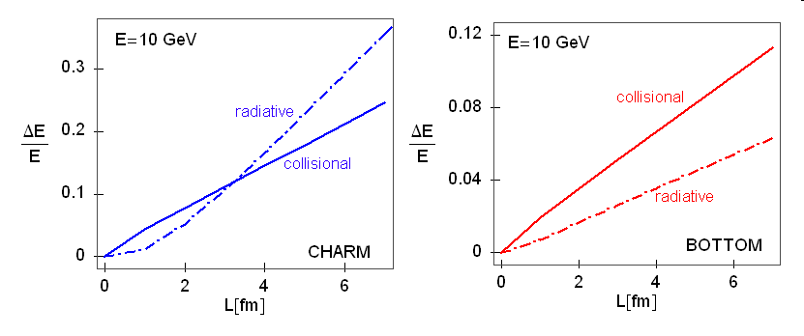
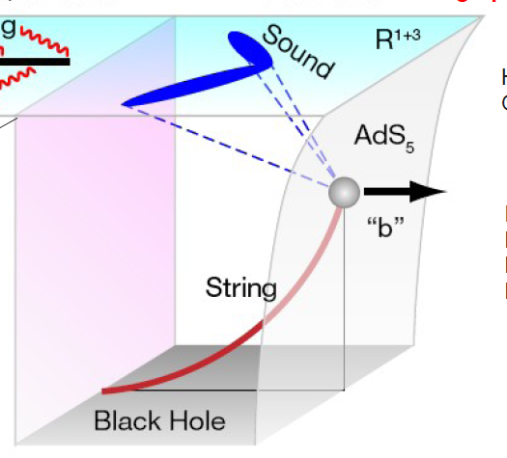
The Large Suppression of Non-photonic Electron Production was a Surprise
Hot/Dense Medium
K⁺
u
“dead cone effect”:
gluon radiation suppressed at θ < m_{Q}/E_{Q}
c quark
e⁻/μ⁻
c
ν_{l}
D⁰
radiative energy loss
(Baier et al, Kharzeev et al, Djordjevic et al, Wiedemann et al . )
Hot/Dense Medium
K⁺
c quark
u
e⁻/μ⁻
c
ν_{l}
D⁰
collision energy loss
(Teaney et al, Rapp et al, Molnar et al, Gossiaux et al.)
Hot/Dense Medium
K⁺
c quark
u
e⁻/μ⁻
c
ν_{l}
D⁰
D⁰
meson energy loss
(Gubser et al., Herzog et al., Horowiz, Gyulassy et al.)
Vitev, et al

Slide 4
Essential to understand Open Heavy Flavor Production
One of the most important probes for sQGP
  Interactions between heavy quark and medium are quite different from the ones for light quarks
    gluon radiation, collisional energy loss, collisional disassociation, etc
  allow further understanding of the medium properties.
  A “Gold Mine” being fully explored.
A good reference to quarkonia production
  Similar initial state effects
    CGC, Shadowing, initial state energy loss, etc.
  Large cross section (compared to J/ψ).
    Accurate reference measurements.

Slide 5
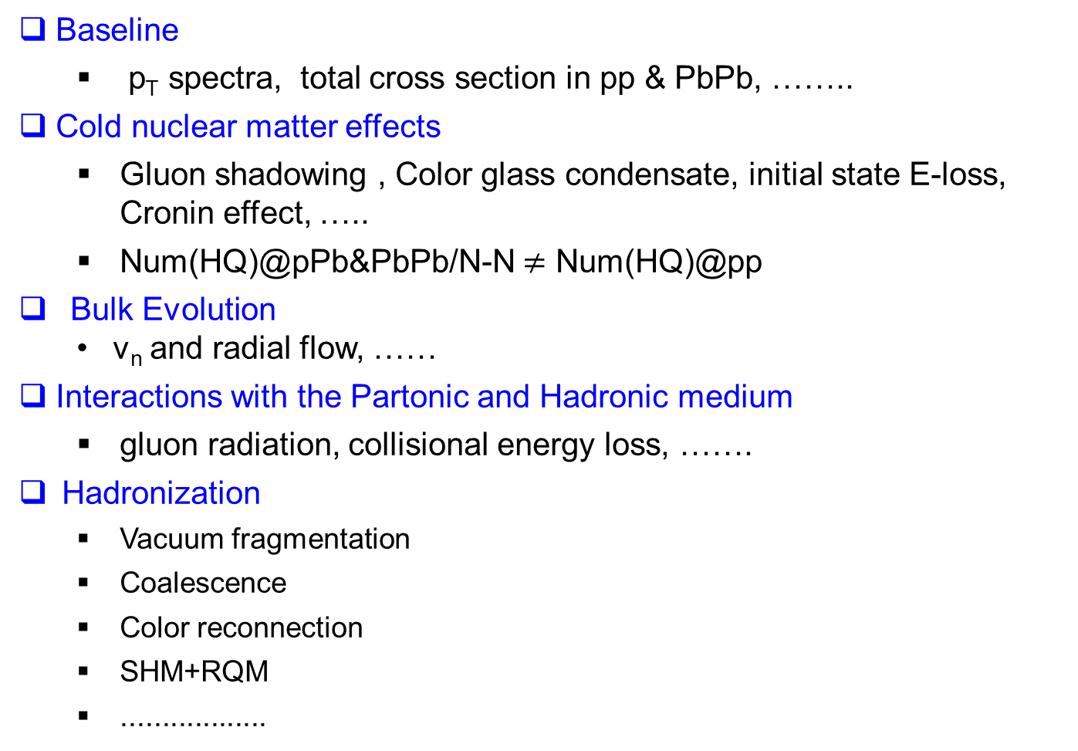
Key Ingredients to study HQ in QGP
Baseline
  p_{T} spectra, total cross section in pp & PbPb, ……..
Cold nuclear matter effects
  Gluon shadowing , Color glass condensate, initial state E-loss, Cronin effect, …..
  Num(HQ)@pPb&PbPb/N-N $≠$ Num(HQ)@pp
Bulk Evolution
  v_{n} and radial flow, ……
Interactions with the Partonic and Hadronic medium
  gluon radiation, collisional energy loss, …….
Hadronization
  Vacuum fragmentation
  Coalescence
  Color reconnection
  SHM+RQM
  ..................
Notes:
The evolution of the bulk medium in HICs, characterized by the space-time dependence of temperature and local ow velocity, provide the link between the interactions of HF particles with the medium and the time evolution of their spectra
SHM+RQM-> statistical hadronization model + relativistic quark model:

Slide 6
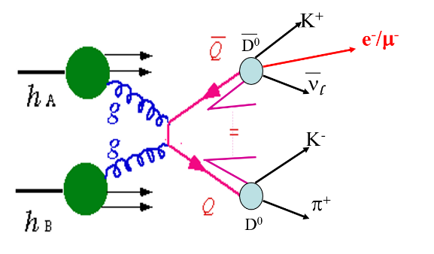
How to study Heavy Quarks
Heavy quark proxies:
  Jet associated with the heavy quark
  HF hadron via direct reconstruction
  HF-decay, i.e. electrons, muons
Production of each individual proxies, e.g. R_{AA} and V₂
Correlation among proxies

Slide 7
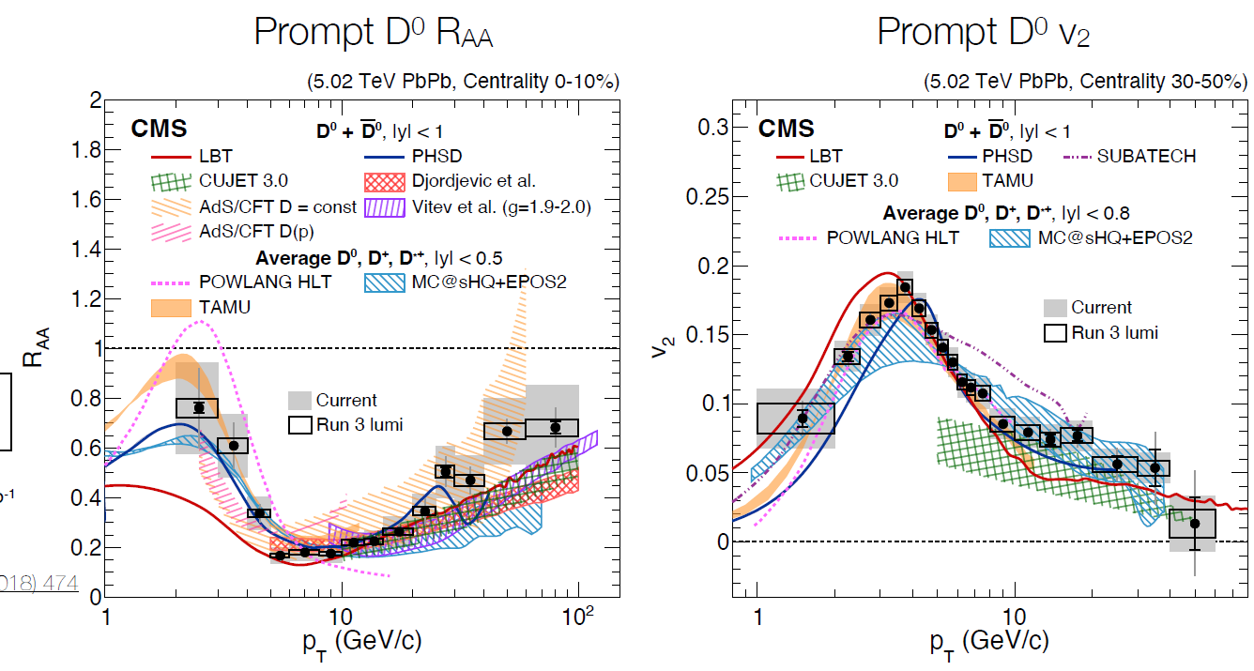

Modeling of HQ-Medium interaction not converged yet
Various models qualitatively described the RAA and v2
PLB 782 (2018) 474
PLB 816 (2021) 136253

Slide 8
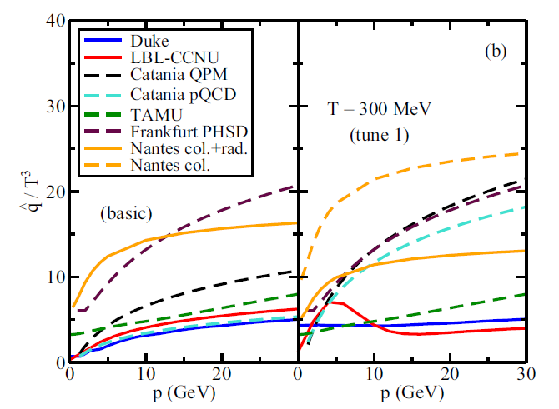
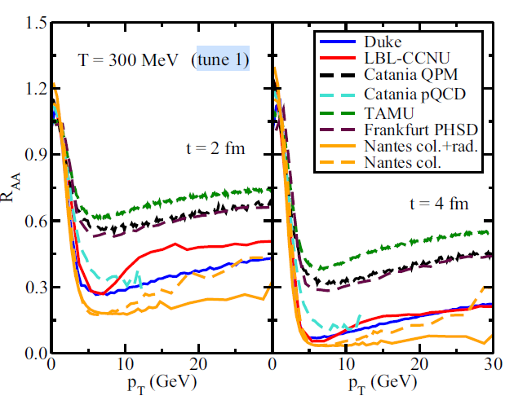
Modeling of HQ-Medium interaction not converged yet
PRC (2019) 054907
Various models qualitatively described the R_{AA} and v₂
Large differences in modeling
  Transport coefficients
  hadronization
  medium evolution
  ……..

Slide 9

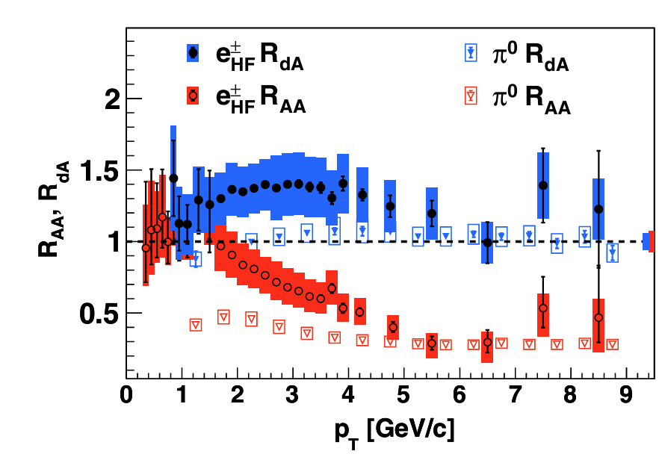
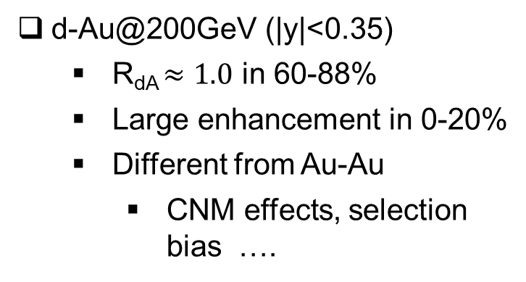
Suppression & enhancement in small system
|y|<0.35
HF→e
d-Au@200GeV (|y|<0.35)
  R_{dA} $≈1.0$ in 60-88%
  Large enhancement in 0-20%
  Different from Au-Au
    CNM effects, selection bias ….
PRL109, 242301 (2012)
Notes:
For midrapidity: Cronin effect and/or radial flow in small QGP system?
For forward region: Cronin effect and/or anti-shadowing in small QGP system?

Slide 10
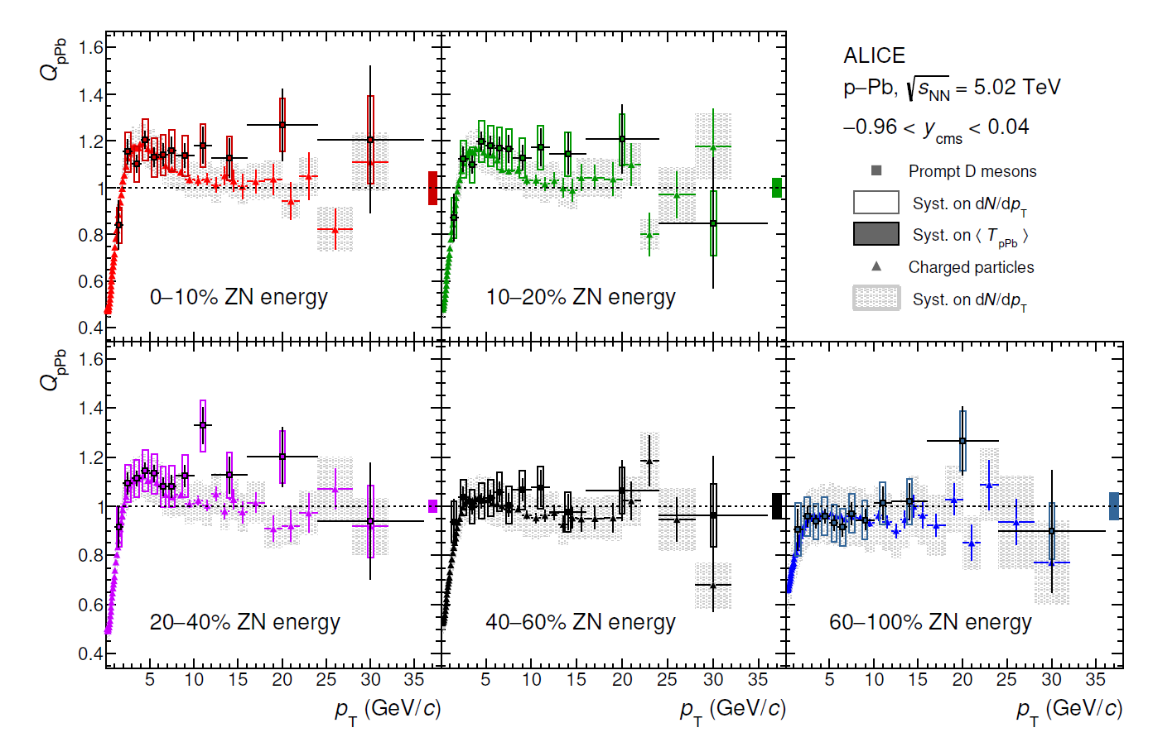
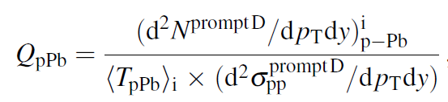
Suppression & enhancement in small system
Similar trend as RHIC
JHEP 12 (2019) 092
Notes:
ALICE RpA is just the minimum-bias QpA where QpA is just the regular definition of RpA.

Slide 11
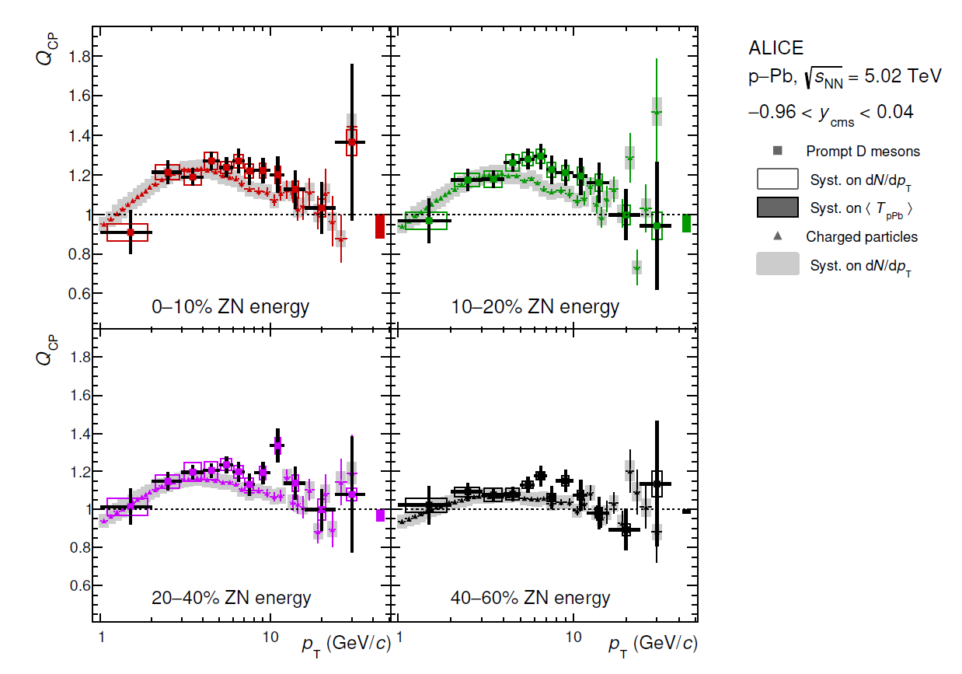
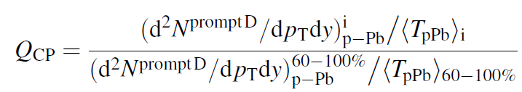
Suppression & enhancement in small system
Similar trend as RHIC
Significant enhancement in p_{T}~2-10 GeV/c
JHEP 12 (2019) 092
Notes:
Qcp cancelled lots of systematics

Slide 12
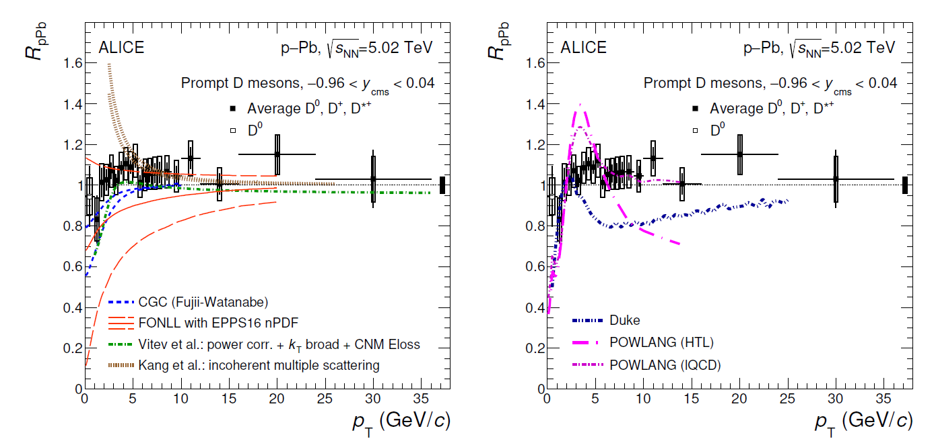
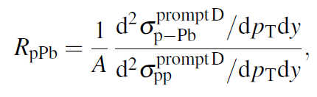
Suppression & enhancement in small system
Models with CNM only describe the data
Models with QGP formation can’t described the data
  Duke: radiative + collisional E-loss
  POWLANG: collisional E-loss
JHEP 12 (2019) 092
Notes:
ALICE RpA is just the minimum-bias QpA where QpA is just the regular definition of RpA.
The peak on the right plot is due to radial flow

Slide 13
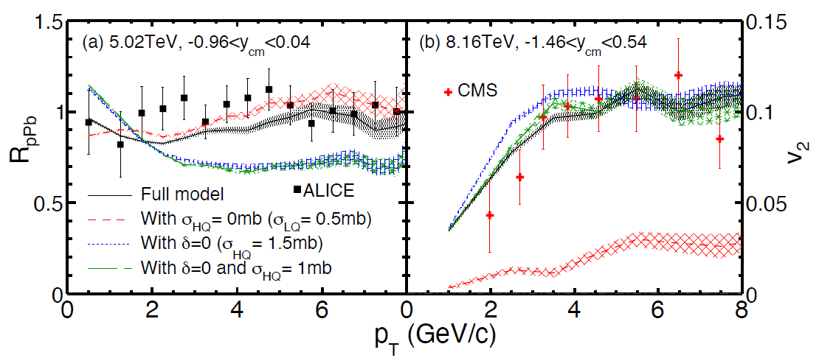
Suppression & enhancement in small system
Models with CNM only describe the data
Models with QGP formation can’t described the data
  Duke: radiative + collisional E-loss
  POWLANG: collisional E-loss
AMPT describes the data with E-loss+Cronin
Notes:
ALICE RpA is just the minimum-bias QpA where QpA is just the regular definition of RpA.
The peak on the right plot is due to radial flow

Slide 14
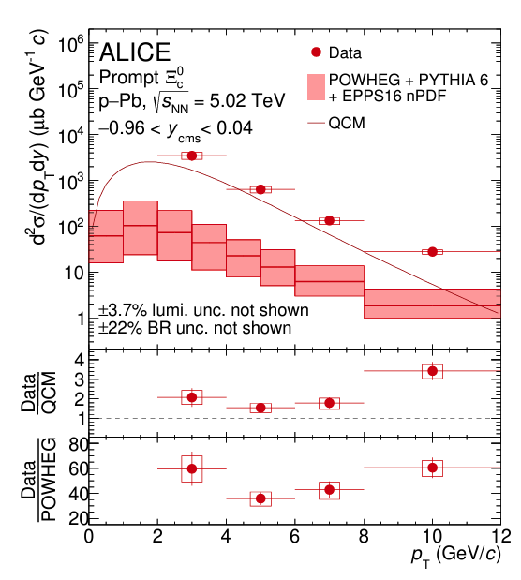
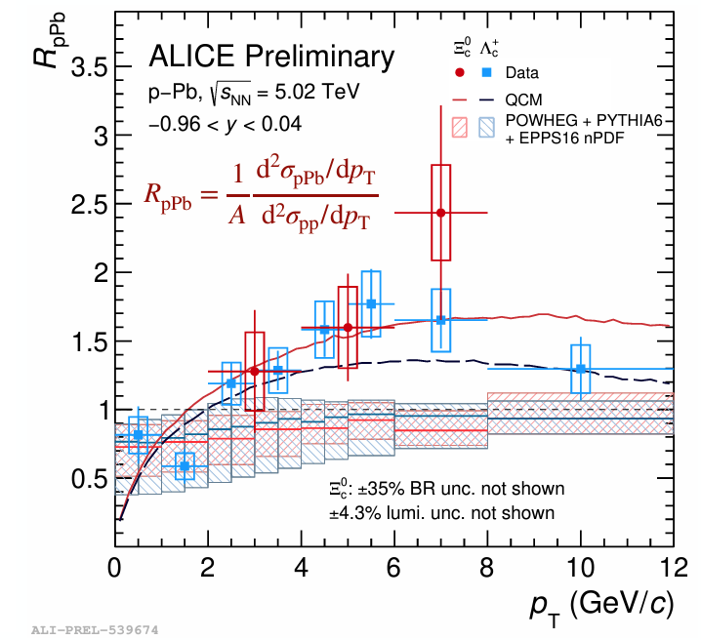
Suppression & enhancement in small system
nPDF underestimated the charm baryon R_{pb}.
QCM model agrees with the data
  QGP formation in pPb w/coalescence
More on charm baryons layer when discussing hadronizations.
JHEP 12 (2023) 086
arXiv:2405.14538
Notes:
ALICE RpA is just the minimum-bias QpA where QpA is just the regular definition of RpA.
The peak on the right plot is due to radial flow

Slide 15
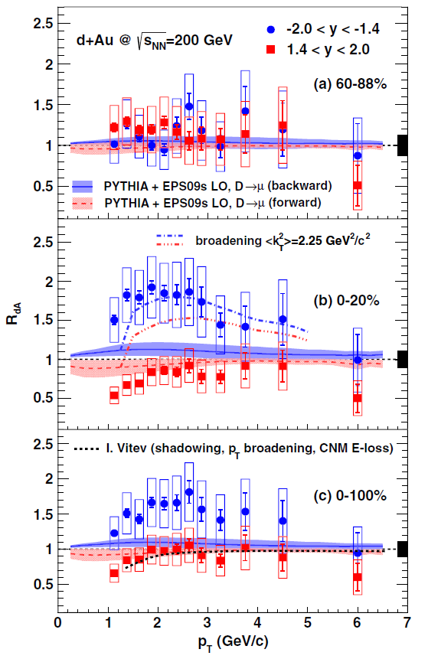
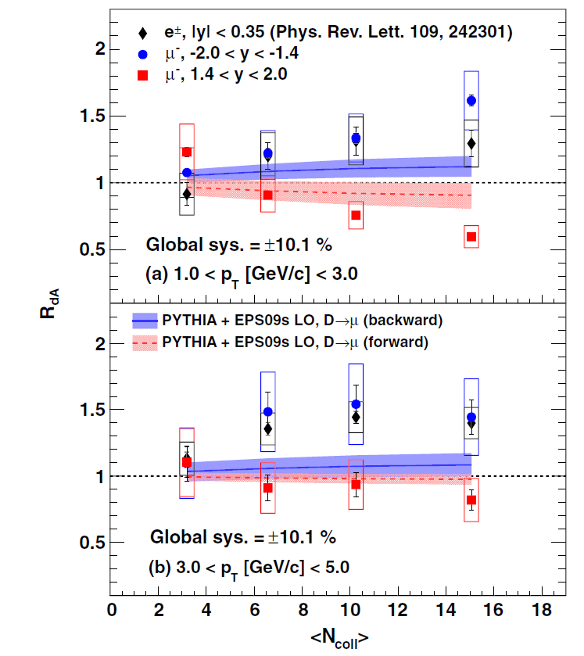
Suppression & enhancement in small system
  enhancement: -2.0<y<-1.4 (Au-going)
  Suppression: 1.4 < y< 2.0 (d-going)
  nPDF+k_{T} broadening can’t describe data in all centralities
PRL 112, 252301(2014)
Notes:
For midrapidity: Cronin effect and/or radial flow in small QGP system?
For forward region: Cronin effect and/or anti-shadowing in small QGP system?
The lead-going is consistent with an additional nuclear-pT broading
However, in p-going, same broadening overshoot the data.
The red dashed (blue solid) lines in each panel are
calculations at forward (backward) rapidity based on the EPS09s
nPDF set [14]. Dot-dashed curves in (b) are the same calculations
plus an additional nuclear-pT broadening.
The dotted line in Fig. 2(c) is a prediction of RdA for
muons from D and B mesons at forward rapidity, y ¼ 1.7
[16,27]. This prediction, including CNM effects such as
shadowing, initial-state energy loss, and nuclear-pT broadening,
is consistent with the data at forward rapidity for
the 0%–100% centrality class. The same model, with
additional energy loss in deconfined hot nuclear matter,
also describes the forward heavy-flavor muon results in
central Cu þ Cu collisions within uncertainties [8].
The same EPS09snPDF-
based calculations with a nuclear-multiple-scattering
broadening hk2
T
i ¼ 2.25 GeV2=c2 (dot-dashed lines), when
selected to match the backward rapidity data, overshoot the
data at forward rapidity. There is no consistent combination
of nuclear-pT broadening and modified nPDF that can
describe the entire rapidity dependence of the data

Slide 16
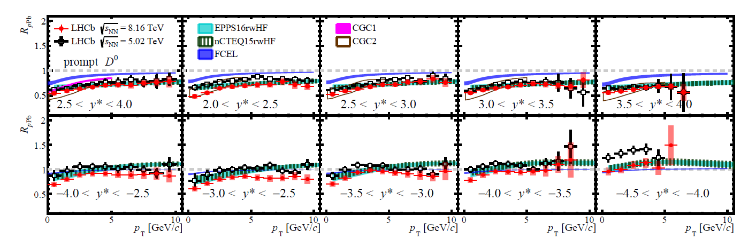
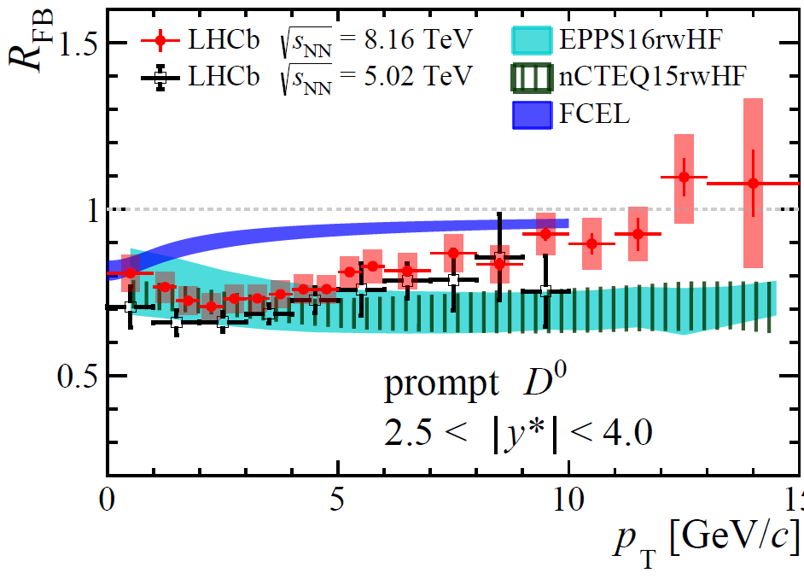
Suppression & enhancement in small system
PRL 131 (2023) 102301
  enhancement: -4.0<y*<-2.5 (Pb-going)
  Suppression: 2.5 < y*< 4.0 (p-going)
  Model w/nPDF only differ from data
    Other CNM effects
  CGC describe the data
    No applicable in Pb going, i.e. large x
  CNM E-loss (FCEL) alone can’t describe the data
  Sqrt(s) dependence ← difference in x distribution.
Notes:
Y*: rapidity in center-of-mass system

Slide 17
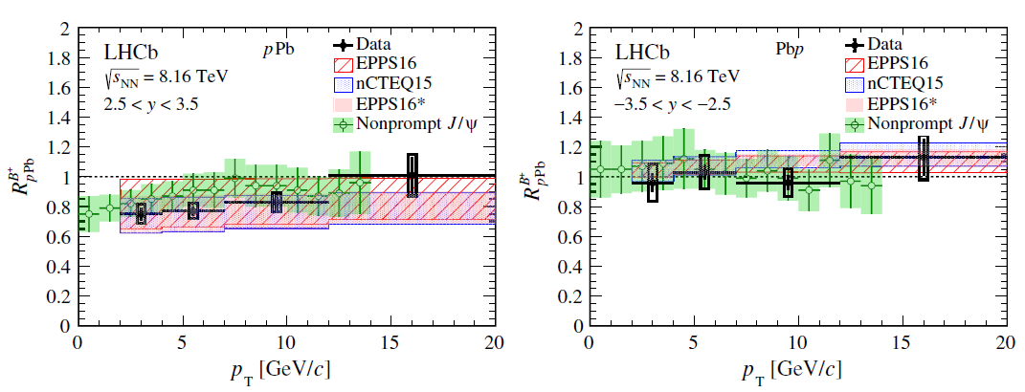
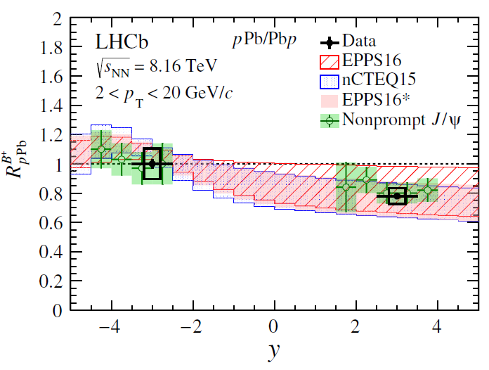
Suppression & enhancement in small system
  No enhancement: -3.5<y*<-2.5 (Pb-going)
  Suppression: 2.5 < y*< 3.5 (p-going)
  nPDF described the data
    Larger error than data
PRD 99 (2019) 052011
Notes:
Y*: rapidity in center-of-mass system

Slide 18
Can we quantify QGP E-loss from the suppression & enhancement of heavy flavor measurements?
  QGP E-loss in small system should be relatively small
    trend from central to peripheral AA collisions.
  Impacts from CNM effects are large:
    nPDF, CNM E-loss, Cronin effect, shadowing, CGC….
  All models so far can qualitatively describe the HF meson data w/o QGP.
    Models w/QGP rejected by data.
  Charm baryon may provide more clues on this
  Will be a “big challenge” to extract QGP E-loss from the suppression/enhancement of HF production.
    Need to quantify all CNM effects in high precision first.
    but all effects are entangled,
    maybe fitting high precision data with templates of different contributors to reproduce subtle pT dependence of the measurements.

Slide 19
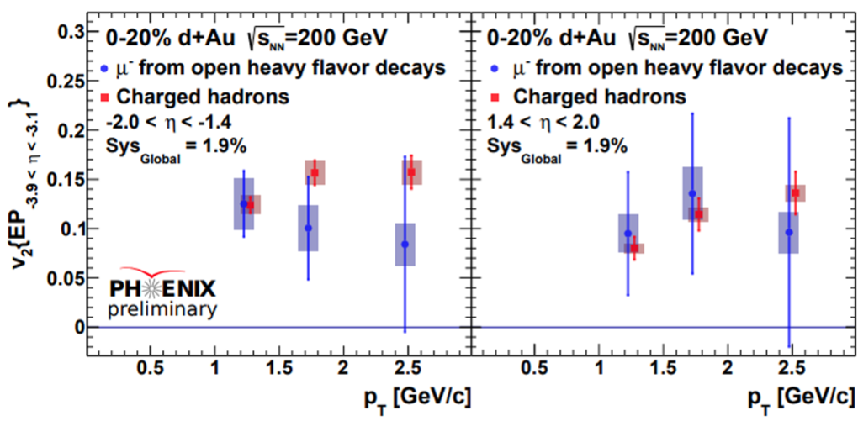
Significant HF→$μ$ v₂ in d-Au at 200 GeV
Significant HF→e/$μ$ v₂ observed
T. Hachiya (PHENIX)@QM18

Slide 20
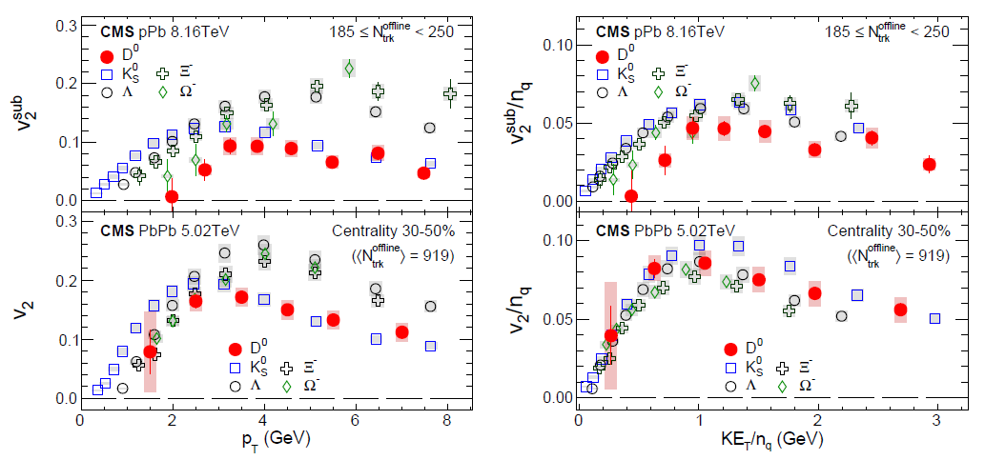
Significant D⁰ v₂ in p-Pb at 8.16 TeV
  Similar mass ordering in pPb and PbPb.
  NCQ scaling doesn’t quite work for D⁰ in pPb.
PRL 121 (2018) 082301
Notes:
M(ks(ds)→pi+pi)=500 MeV
M(omega(sss)→lambda+K) ~1.7 GeV
M(lambda(uds)→p+pi) ~ 1.1 GeV
M(kasket(dss)→lambda+pi) ~1.3 GeV
For-1.46 < ycm < 0.54 in pPb collisions

Slide 21
Significant D⁰ v₂ in p-Pb at 8.16 TeV
  AMPT described both RAA and v2 with charm scattering and Cronin.

Slide 22
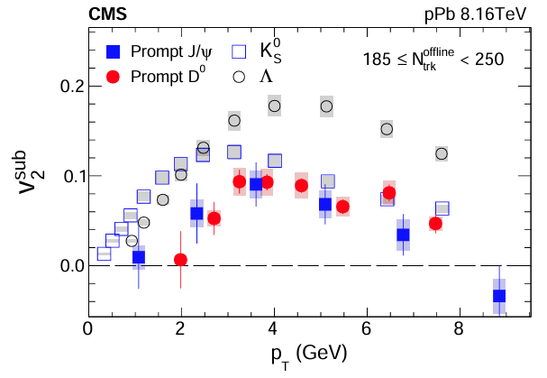
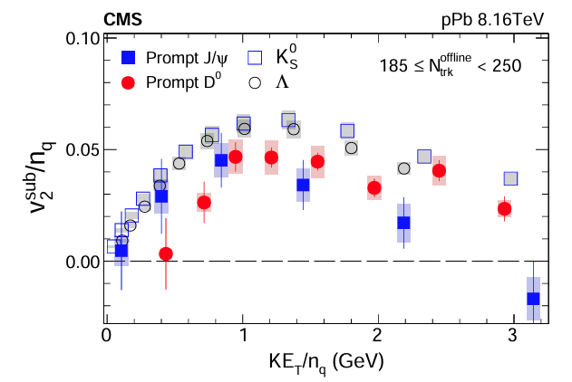
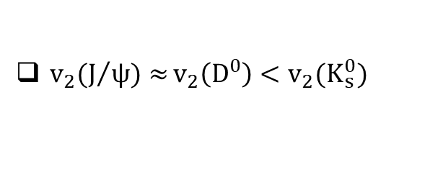
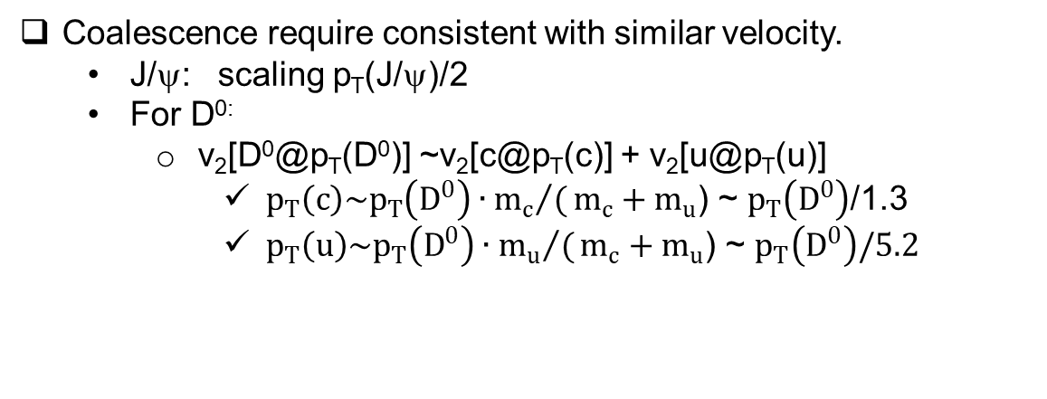
Significant J/ψ v₂ in p-Pb at 8.16 TeV
$v_{2}(J/{ψ)≈}v_{2}\left(D^{0}\right)<v_{2}(K_{s}^{0})$
Coalescence require consistent with similar velocity.
  J/ψ: scaling p_{T}(J/ψ)/2
  For D^{0:}
    v₂[D⁰@p_{T}(D⁰)] ~v₂[c@p_{T}(c)] + v₂[u@p_{T}(u)]
      $p_{T}\left(c\right)\sim p_{T}\left(D^{0}\right)∙{m_{c}}/(m_{c}+m_{u}$) ~ $p_{T}\left(D^{0}\right)$/1.3
      $p_{T}\left(u\right)\sim p_{T}\left(D^{0}\right)∙{m_{u}}/(m_{c}+m_{u}$) ~ $p_{T}\left(D^{0}\right)/5.2$
PLB 791 (2019) 172; Z.W Ling, D. Monlar, PRC68, 044901 (2003)

Slide 23
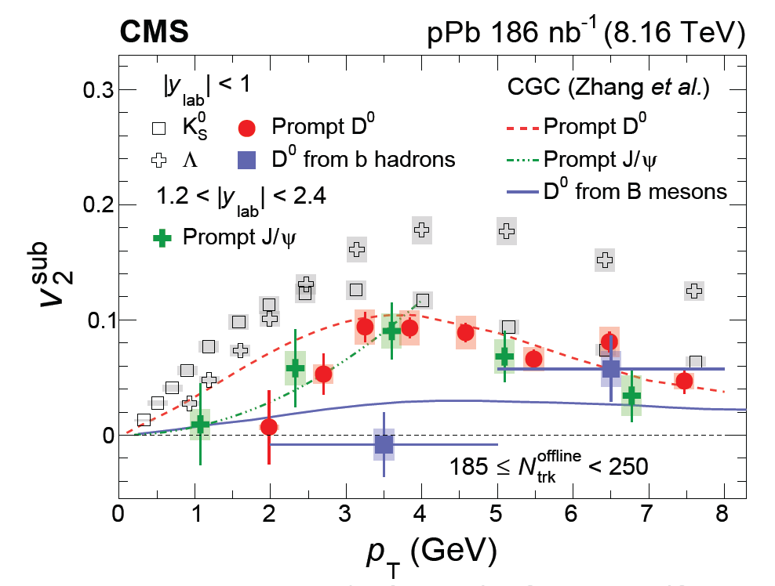
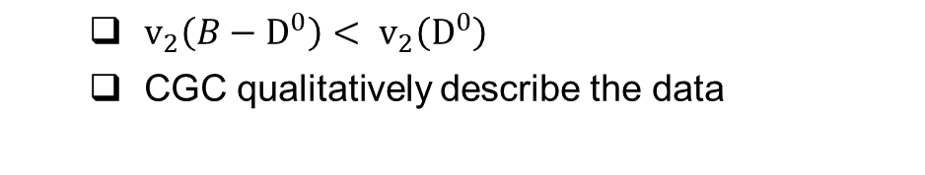
B→D⁰ v₂ in p-Pb at 8.16 TeV
  $v_{2}\left(B−D^{0}\right)< v_{2}\left(D^{0}\right)$
  CGC qualitatively describe the data
PLB 813 (2021) 136036
Notes:
correlations between partons originating from the projectile proton and dense gluons inside the target nucleus.
Usually this is regarded as the initial state effect prior to the onset of hydrodynamic evolution.

Slide 24
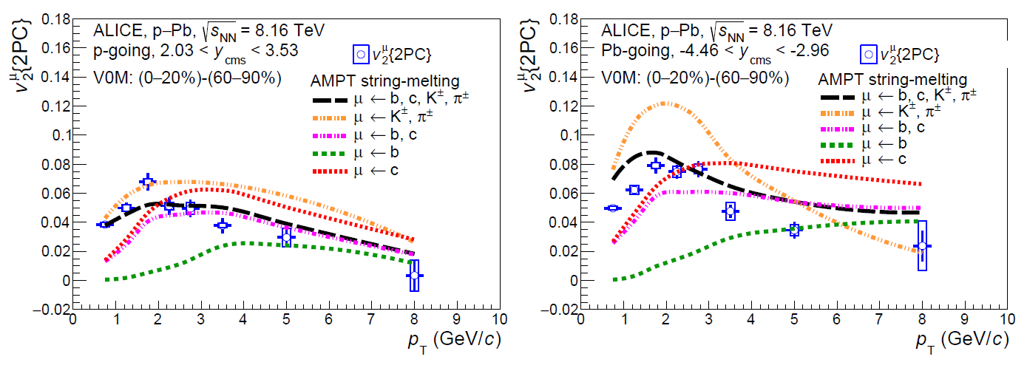
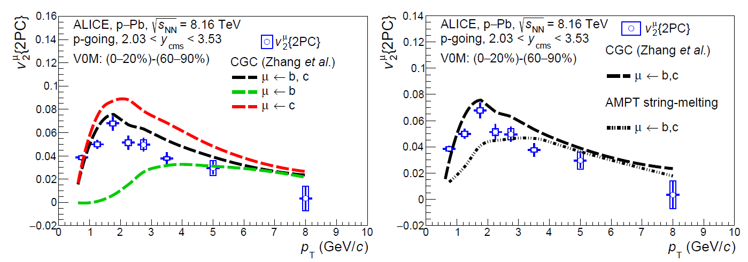
B→D⁰ v₂ in p-Pb at 8.16 TeV
  AMPT described the inclusive muon v₂, hinting finite v₂ from c/b→muon
  CGC b/c->muon > AMPT b/c muon v₂
PLB 846 (2023) 137782
Notes:
This is inclusive muon measurements. AMPT has the escape mechanism

Slide 25
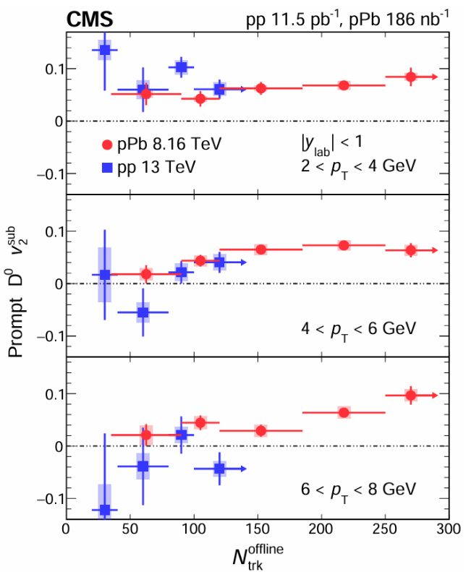
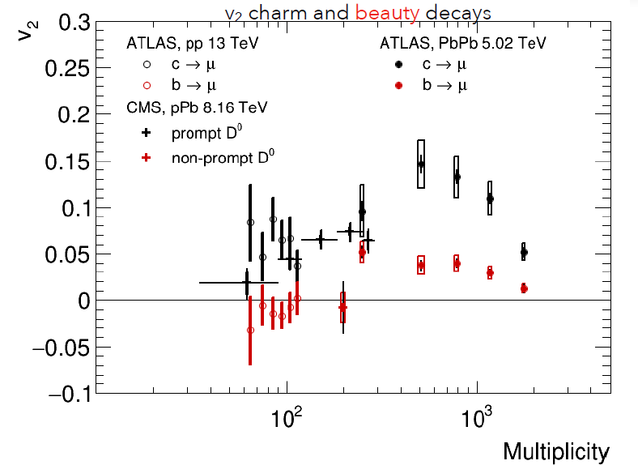
System size dependence of charm and bottom v₂
v₂ increase with multiplicity (<~500)
Decrease towards higher multiplicity
  Less eccentricity@more central PbPb
PLB 813 (2021) 136036;
PRL 124 (2020) 082301;
PLB 807 (2020)135595

Slide 26
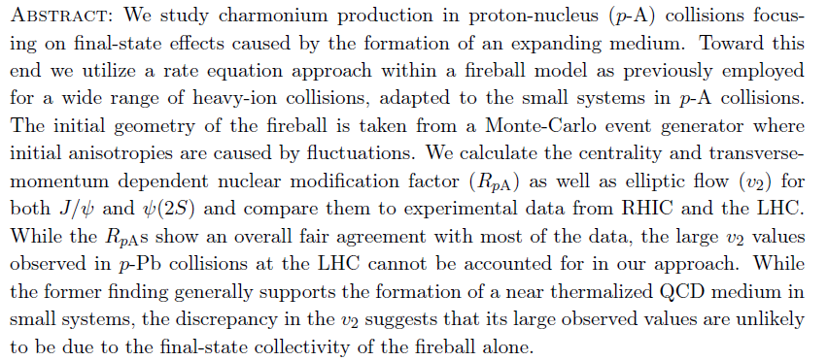
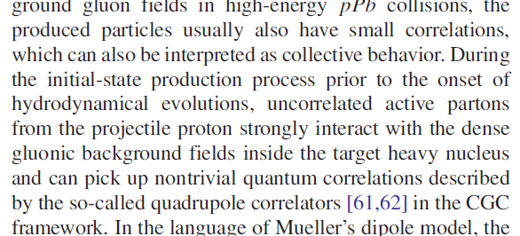
Can we quantify QGP effects from flow measurements of heavy flavor?
JHEP03(2019)015
From the limited selection of models:
final state collectivity in QGP droplet can’t describe data
Correlation from projectile parton interaction with the dense gluon field before onset of QGP.
Parton cascade@AMPT
➔ interaction in unthermalized partonic medium?
AMPT
PRD 102 (2020) 034010

Slide 27
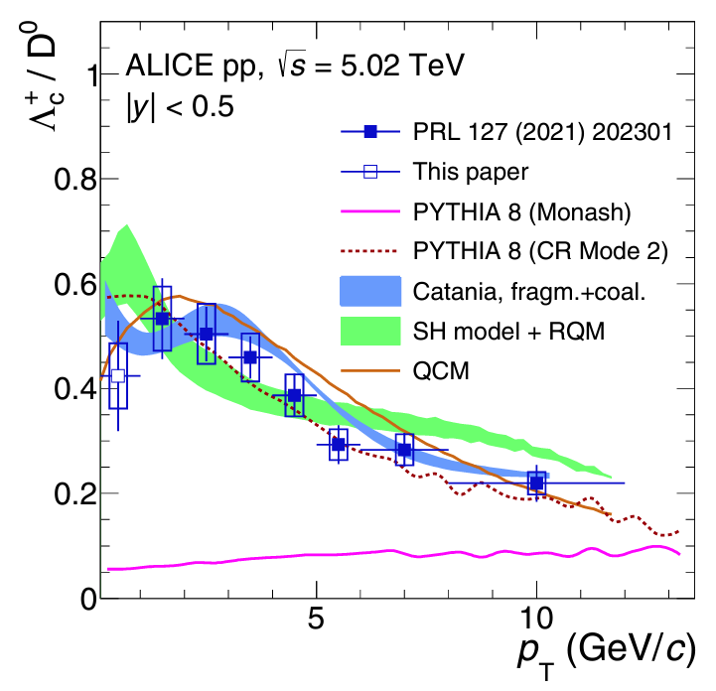
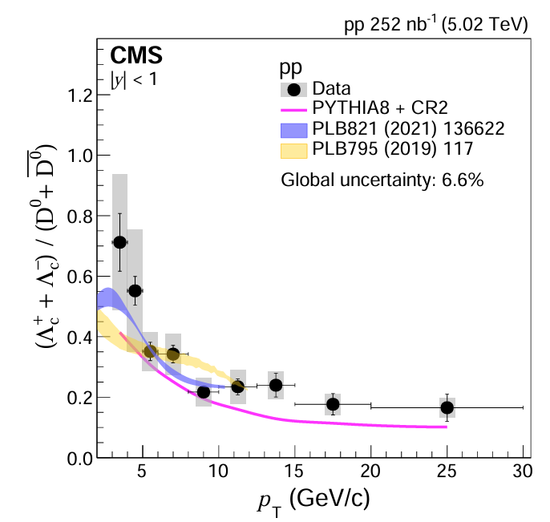
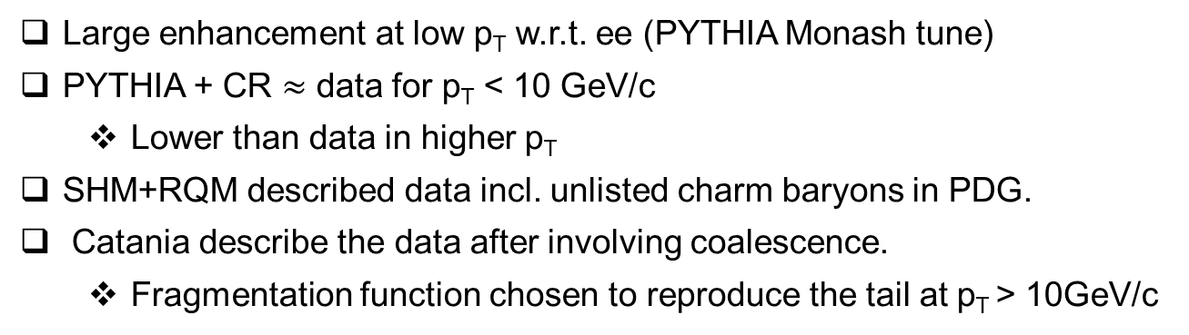
Enhanced Λ_{c}(udc)/D⁰ ratio in small systems
Large enhancement at low p_{T} w.r.t. ee (PYTHIA Monash tune)
PYTHIA + CR $≈$ data for p_{T} < 10 GeV/c
  Lower than data in higher p_{T}
SHM+RQM described data incl. unlisted charm baryons in PDG.
Catania describe the data after involving coalescence.
  Fragmentation function chosen to reproduce the tail at p_{T} > 10GeV/c
JHEP 01 (2024) 128
PRC 107 (2023) 064901

Slide 28
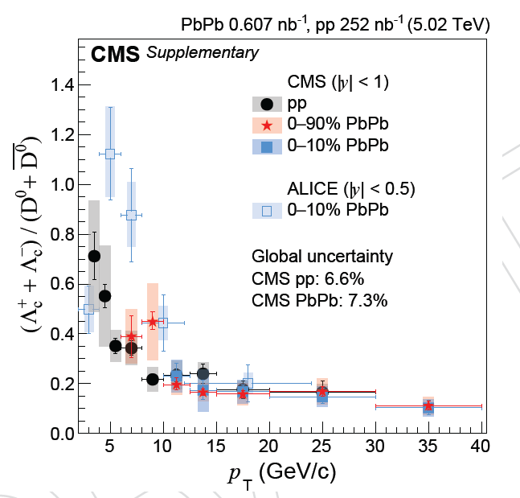
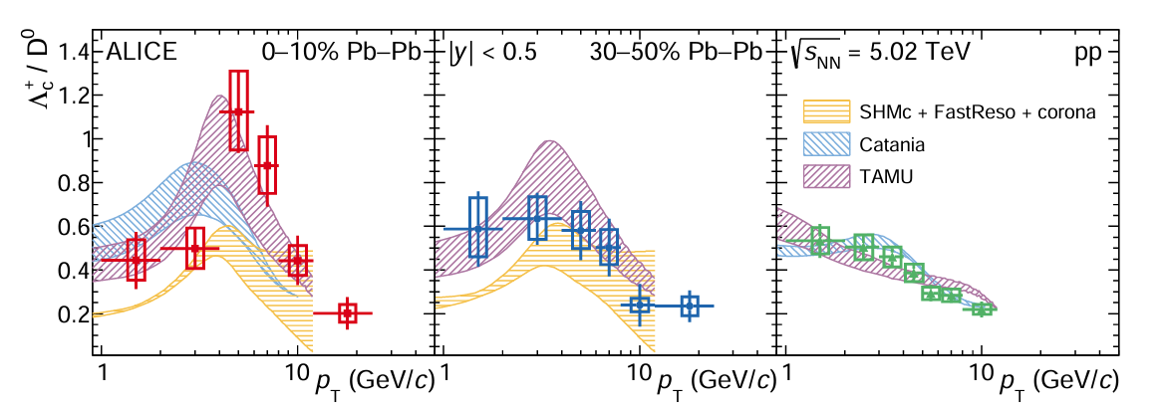
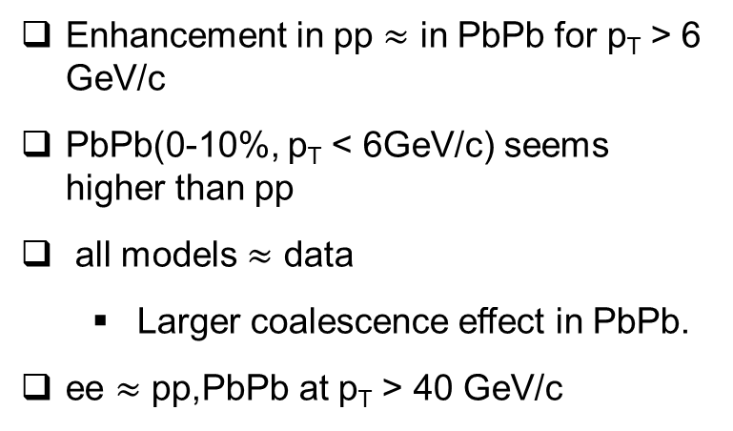
p_{T} dependence of the enhanced Λ_{c}(udc)/D⁰ ratio
Enhancement in pp $≈$ in PbPb for p_{T} > 6 GeV/c
PbPb(0-10%, p_{T} < 6GeV/c) seems higher than pp
all models $≈$ data
  Larger coalescence effect in PbPb.
ee $≈$ pp,PbPb at p_{T} > 40 GeV/c
JHEP 01 (2024) 128
PLB 839 (2023) 137796

Slide 29
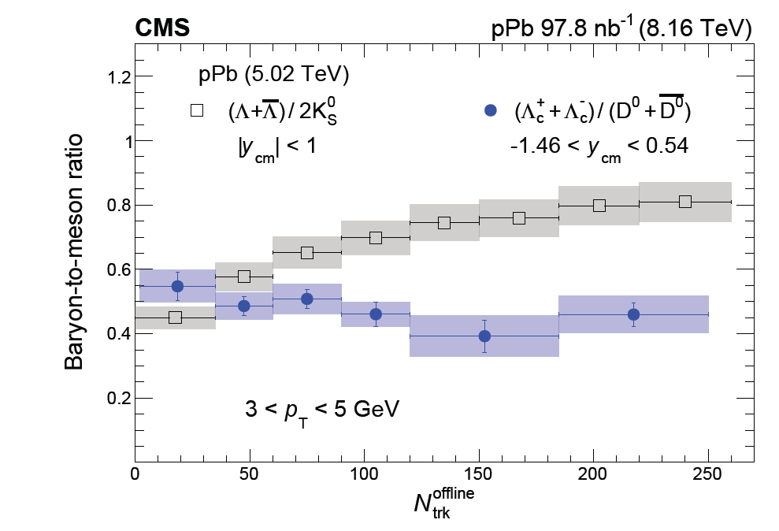
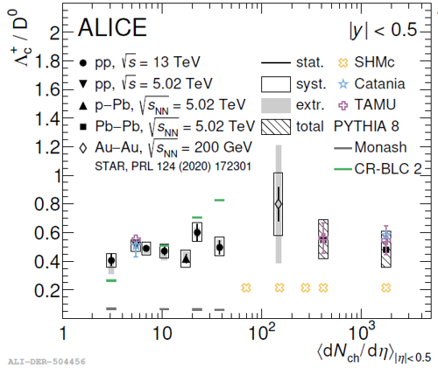
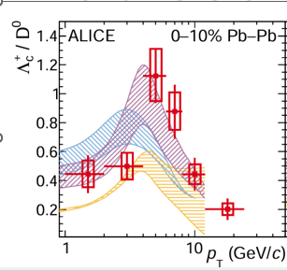
System size dependence of the enhanced Λ_{c}(udc)/D⁰ ratio
No significant dependence on multiplicity
  different from the strange hadrons.
Trend differs from PYTHIA+CR
Large enhancement in PbPb (0-10%)@ p_{T} =4-8 GeV/c may be a fluctuation
  More precision is needed.
CMS PAS HIN-21-016
PLB 829 (2022) 137065
PLB 839 (2023) 137796
Notes:
CMS Lc in pPb is from Lc->Ks^0+p

Slide 30
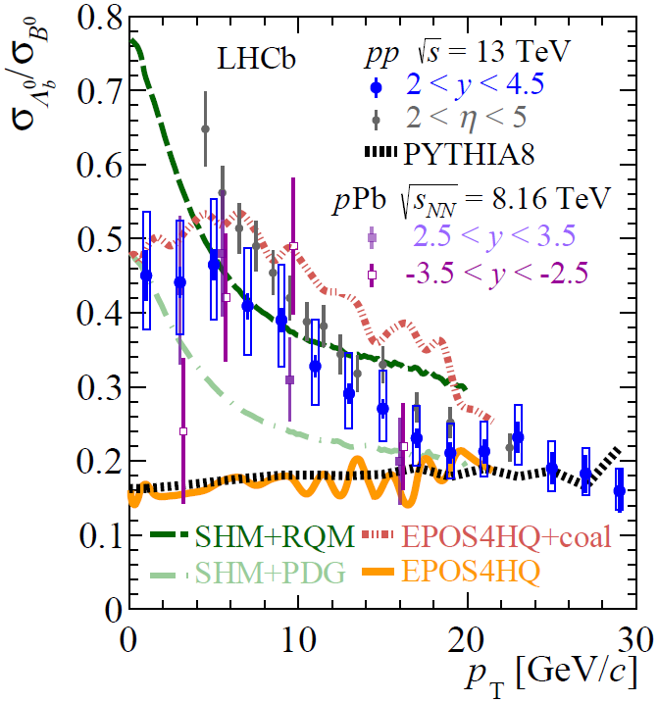
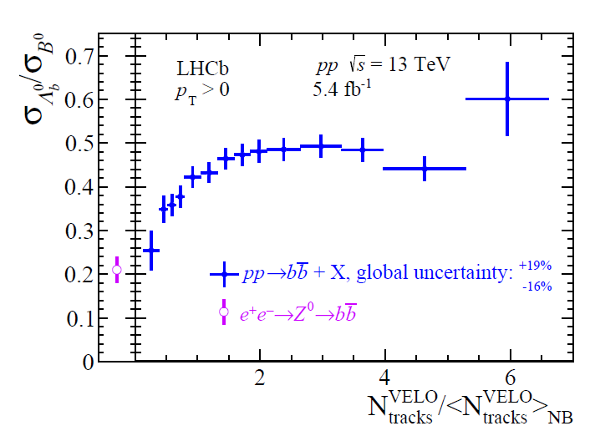

Enhanced Λ_{B}(udb)/B⁰ ratio in small systems
Large enhancement in pp & pPb w.r.t. ee
p-going $≈$ Pb-doing
SHM(RQM/PDG) $≈$ data in different p_{T}
EPOS4HQ+coal > data
Λ_{B}/B⁰ increase towards higher multiplicity
  Differ from multiplicity dependence of Λ_{c}/D⁰
PRL 132 (2024) 081901
CMS PAS HIN-21-016

Slide 31


Enhanced Ξc(dsc) production in small systems
All models underestimate the Ξc/D⁰ and Ξc/Λc in pp
QCM described Ξc R_{pPb} but underestimate the Ξc/D⁰ ratio
JHEP 12 (2023) 086
arXiv:2405.14538

Slide 32


Excited Σ_{c} production in p-Pb
Ratio in pp ~ in ee
SHMc described the data
SHM+RQM systematically below data
PYTHIA8
  Monash tune overpredict the ratio
  CR tune underpredict the ratio
    Described data after suppressing spin-1 w.r.t. spin-0 charm-light diquark
arXiv:2405.19137
ALICE@SQM2024
Notes:
Sigma_c(2455) is the ground state. Sigma_c is a mixture of sigma_c^0(ddc), sigma_c^+(cud) and sigma_c^++(cuu)
SHM+RQM: Ralf model. Unlisted charm baryon states estimated from Relativistic Quark Model(RQM) and lattice QCD.
SHMC: SHM for charmed hadron

Slide 33


Excited Ω_{c}(ssc) production in p-Pb
Large error due to unknow BR.
Different model ratio prediction differ by large amount
Need BR measurements.
PLB 846 (2023) 137625

Slide 34

Strangeness enhancement with charm meson in small systems
D_{s}/D⁺ enhanced towards high multiplicity
  In both p-going and Pb-going direction
  Similar dependence on multiplicity for all p_{T}
EPOS4HQ & PYTHIA8 w/ or w/o CR < data
EPOS4HQ +coal: Ds/D+ vs. multiplicity differ in different p_{T}
  Different trend from data
arXiv:2311.08490

Slide 35

Strangeness enhancement with bottom meson in small systems
  B_{s}/B⁰ increase vs. multiplicity at low p_{T} & systematically above PYTHIA w/ or w/o CR (large uncertainty though)
  No significant dependence on multiplicity in higher p_{T} & consistent with PYTHIA.
  B_{s}/B⁰ in pp consistent with ee (large uncertainty).
PRL 131 (2023) 061901
Notes:
ee->upsilon(5s)->BB mean the BB production at Upsilon(5s) energy, which include light-quark (u, d, s, c) continuum events, bb continuum events, and Υ(5S) events. The latter two cannot be distinguished and will be called bb events in the following. Same meaning for ee->Z0->bb

Slide 36
Can we quantify QGP effects from heavy flavor hadronization?
The current hotspot is baryon enhancement
  PYTHIA: Color Reconnection
  SHM+RQM: feed down from charm baryon states unlisted in PDG.
  Catana: include coalescence to describe the data
  POWLANG: include coalescence and diquark excitations.
  EPOS4HQ: w/ and w/o coalescence
  ……
All require interactions beyond the baseline string fragmentations, but no model can describe all data

Slide 37
Summary & comments
For both charm and bottom hadron in small systems, data shows:
  Significant enhancement or suppression in production
  Significant elliptic flow
  Significant enhancement of baryons production w.r.t. ee
  Significant enhancement of charm, bottom mesons with strangeness
All models requires physics processes beyond baseline string fragmentation.
  Thermalized QGP droplets or unthermalized partonic matter??
  None can explain all the data
More precise and more differential measurements may be needed to gain further insight
  For both small and large systems
Notes:
Mutiparticle vN involving HF hadrons with high luminosity

Slide 38
Backup

Slide 39


Slide 40

arXiv:2405.19137 [hep-ph]

Slide 41

arXiv:2405.14538 [nucl-ex]

Slide 42

Kinematical correlation between B-decay daughters and B meson

