Slide 1

Searching for jet quenching in small systems: experiment
Peter Jacobs
Lawrence Berkeley National Laboratory
University of California, Berkeley

Slide 2
Jet quenching is a necessary consequence of the presence of Quark-Gluon Plasma in hadronic collisions at RHIC and the LHC.
Jet quenching effects in small systems appear to be small. There is little quantitative theoretical guidance about their magnitude.
“There is no jet quenching in small systems” is not a scientifically meaningful statement. We can never determine experimentally that a process literally does not occur.
All we can do experimentally is either:
measure a significant signal - i.e. difference of central value + uncertainties w.r.t. null hypothesis is large; or
set a limit on its rate
This is a quantitative issue

Slide 3
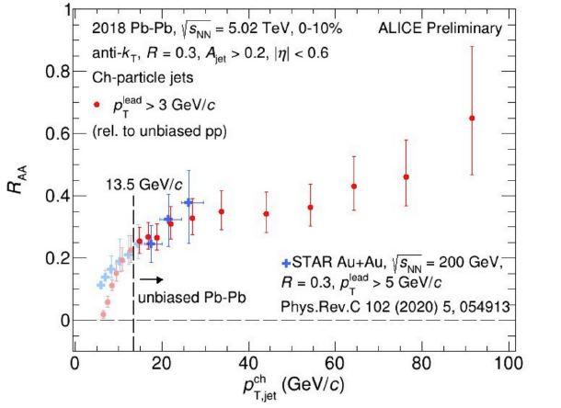
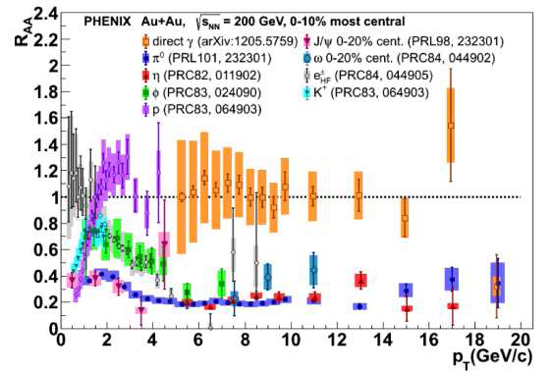
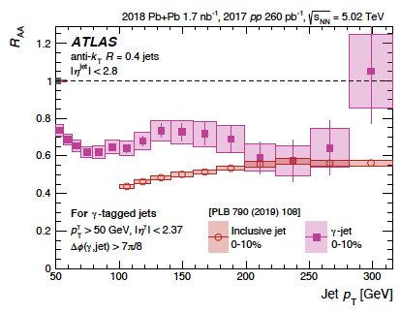
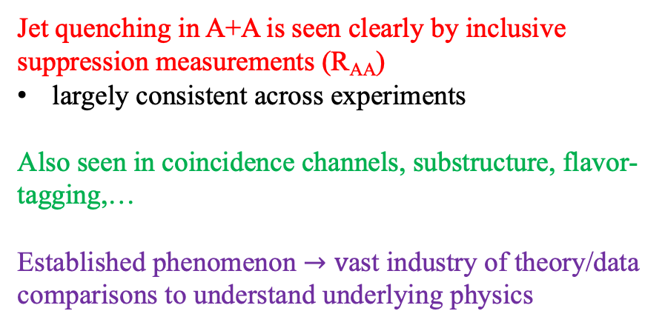
Jet quenching in A+A: inclusive production (R_{AA})
Jets
Hadrons
Jet quenching in A+A is seen clearly by inclusive suppression measurements (R_{AA})
largely consistent across experiments
Also seen in coincidence channels, substructure, flavor-tagging,…
Established phenomenon $→v$ast industry of theory/data comparisons to understand underlying physics

Slide 4
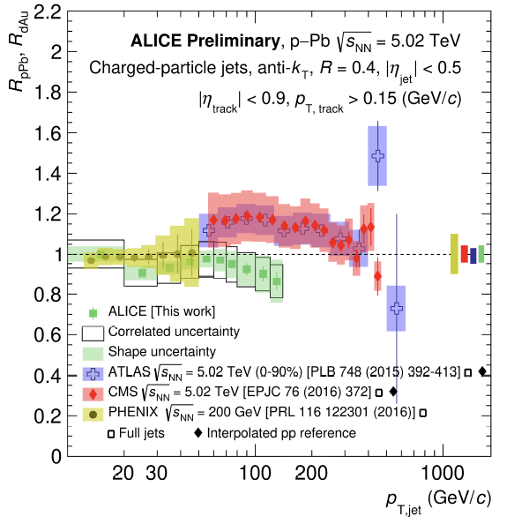
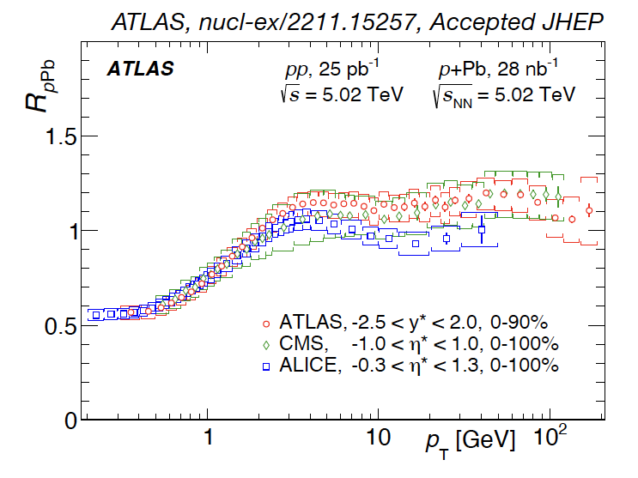
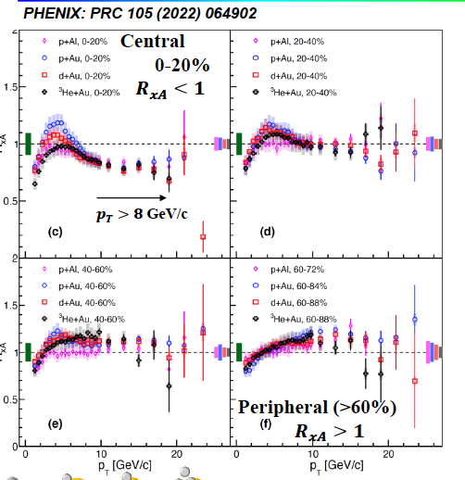
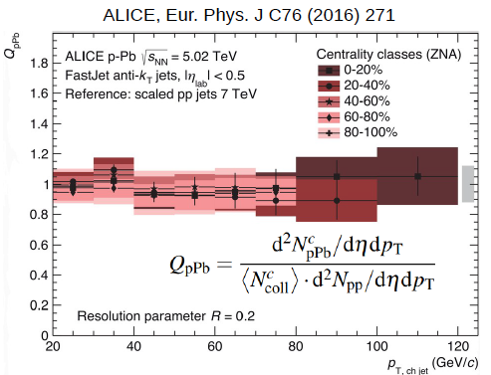

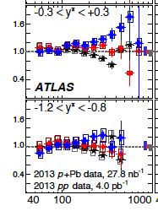
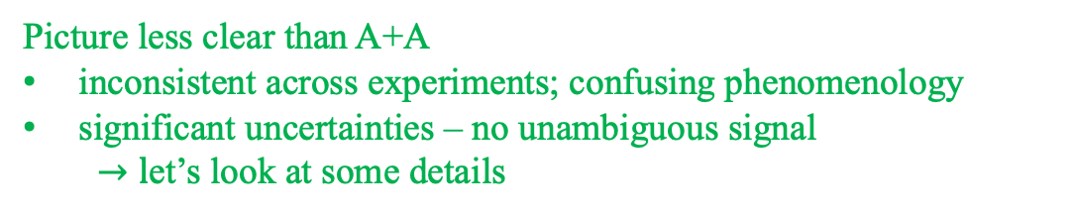
Jet quenching in small systems? Inclusive jet production (R_{pA})
Minimum bias p+A
p+A selected on “Event Activity” (EA)
Picture less clear than A+A
inconsistent across experiments; confusing phenomenology
significant uncertainties – no unambiguous signal
  $→l$et’s look at some details

Slide 5
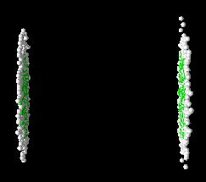
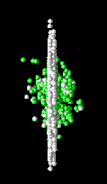
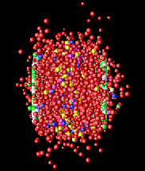
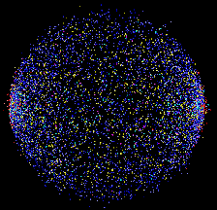
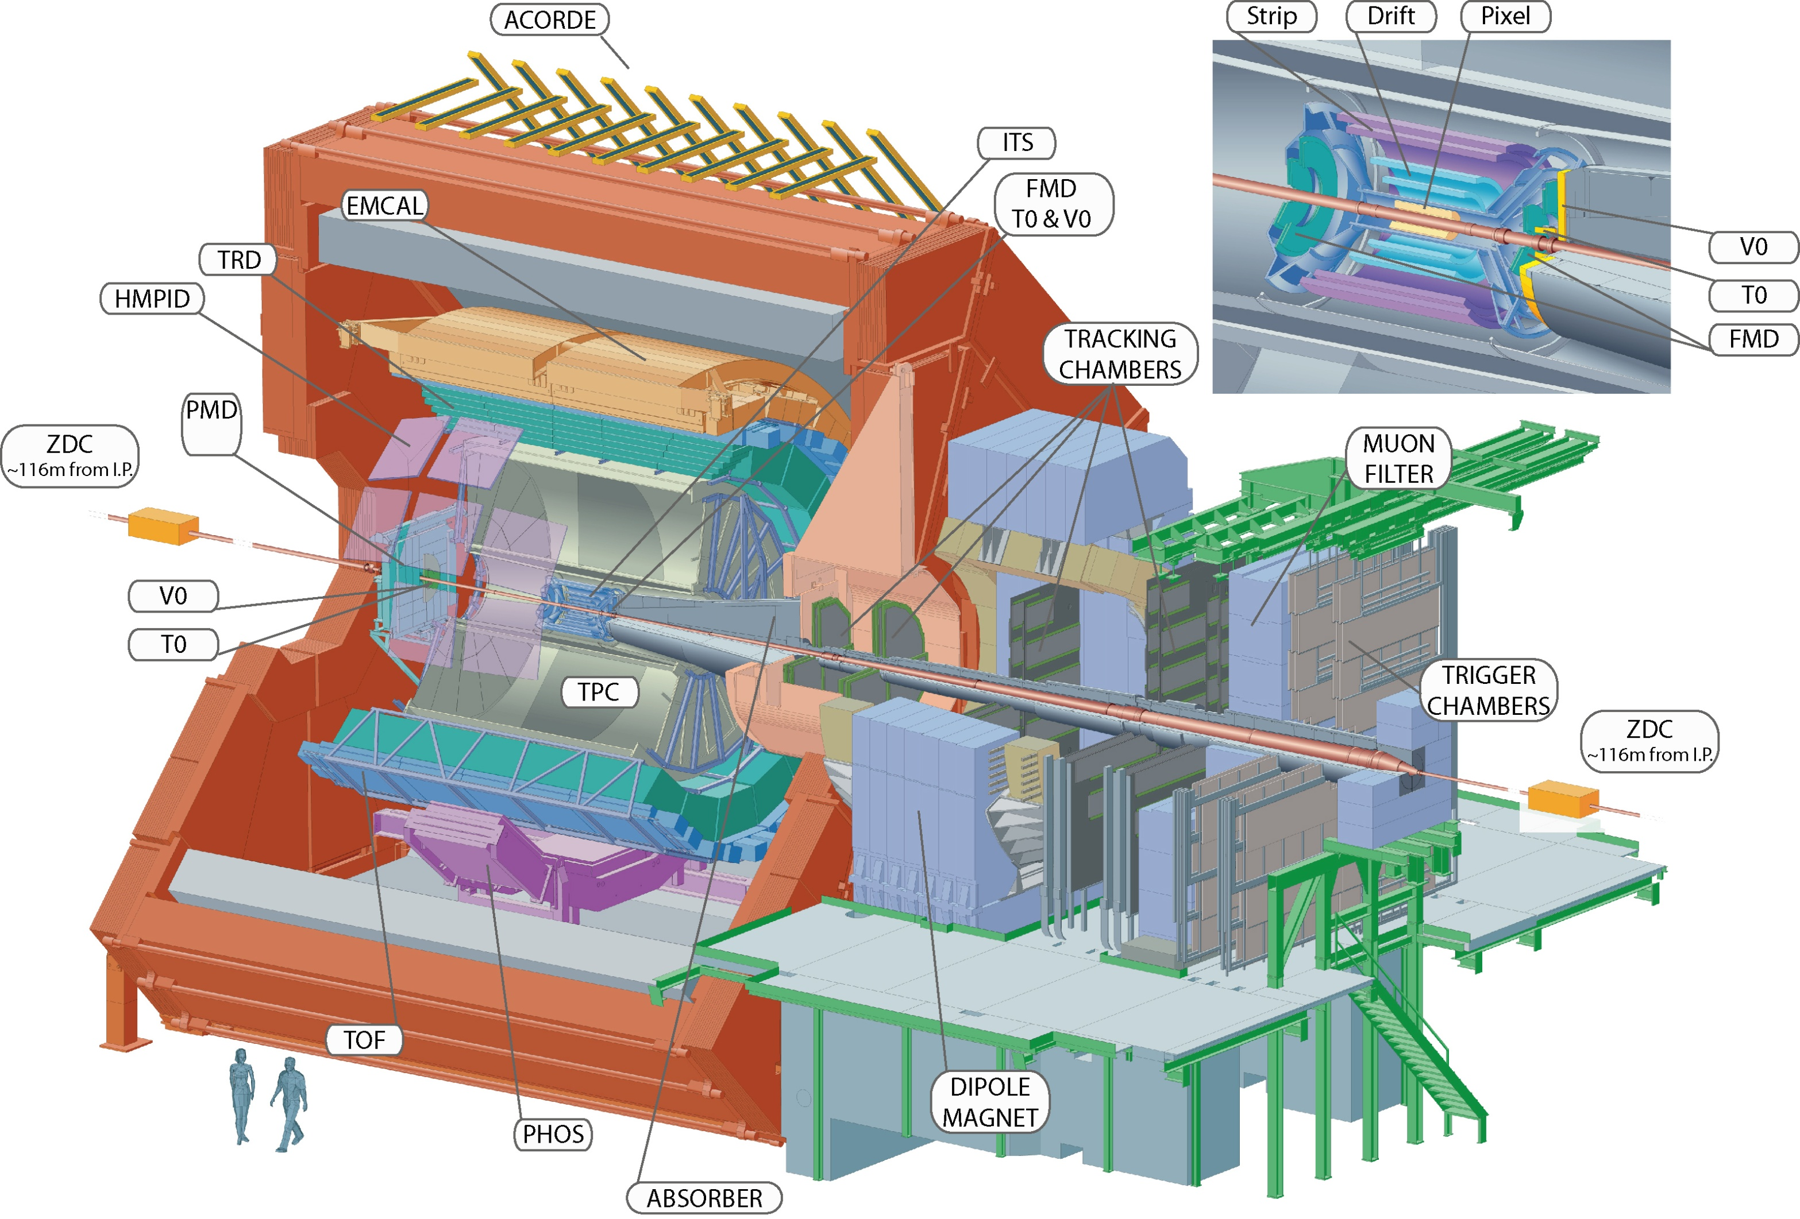



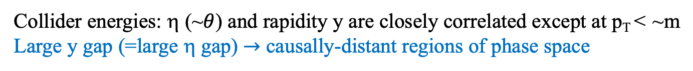
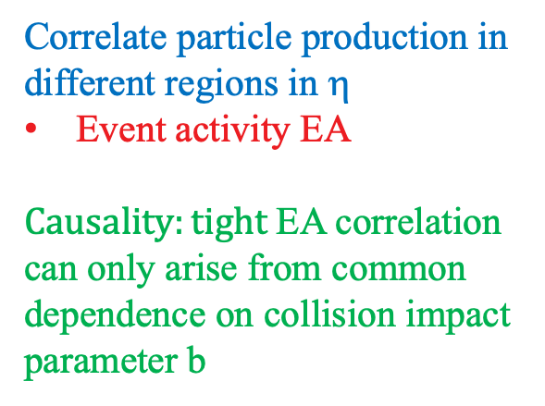
Collision geometry: experiment
Collider energies: η (~$θ$) and rapidity y are closely correlated except at p_{T} < ~m
Large y gap (=large η gap) $→$ causally-distant regions of phase space
Correlate particle production in different regions in η
Event activity EA
$Causality:tight$EA correlation can only arise from common dependence on collision impact parameter b

Slide 6
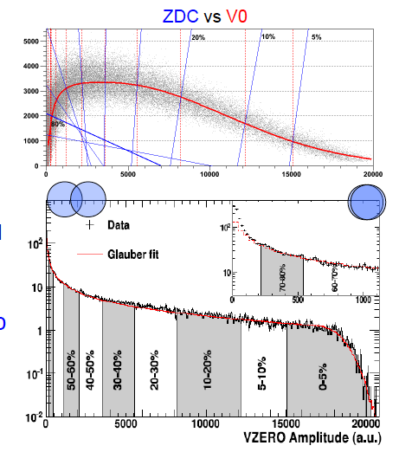
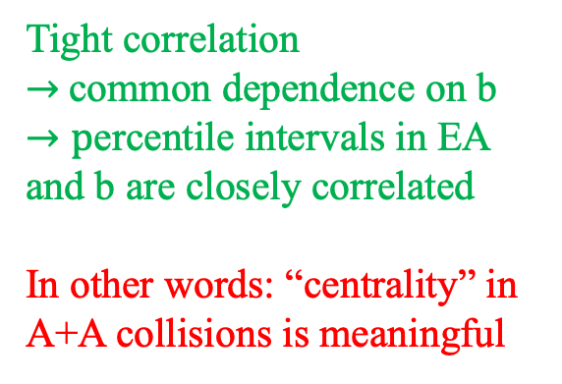
Collision geometry experiment: A+A
Forward neutrons
Tight correlation
$→$common dependence on b
$→p$ercentile intervals in EA and b are closely correlated
In other words: “centrality” in A+A collisions is meaningful
Charged hadrons η~3

Slide 7
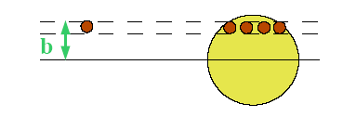
Collision geometry: Glauber modeling
Glauber scaling for hard processes with large momentum transfer
  short coherence length ⇒ successive NN collisions independent
  Assume p+A is incoherent superposition of N+N collisions
Normalized nuclear density ρ(b,z):
Nuclear thickness function
We will need this later
Inelastic cross section for
p+A collisions:
Hard processes are rare:

Slide 8
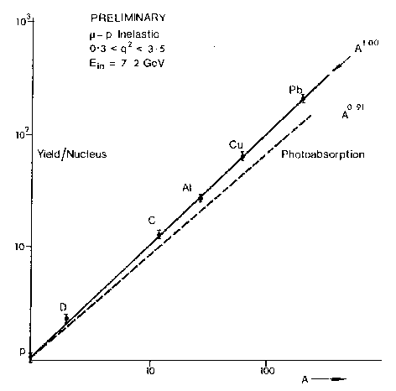
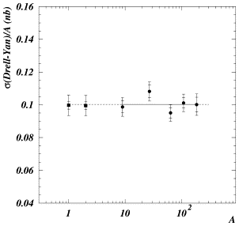
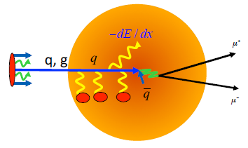
Experimental tests of Glauber scaling
Glauber scaling expectation:
σ_{inel} for 7 GeV muons on nuclei
σ_{Drell-Yan}/A in p+A at SPS
A^{1.00}
NA50 Phys Lett B553, 167
M.May et al, Phys Rev Lett 35, 407 (1975)
A
Hard cross sections in p+A scale as A^{1.0}

Slide 9

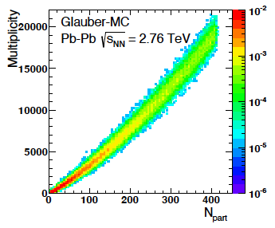
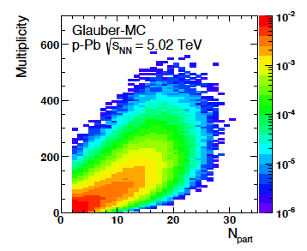
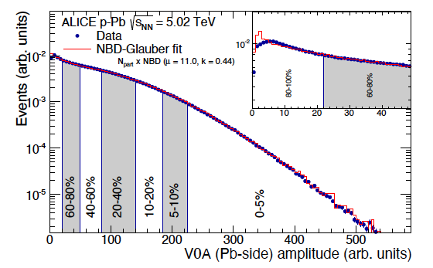

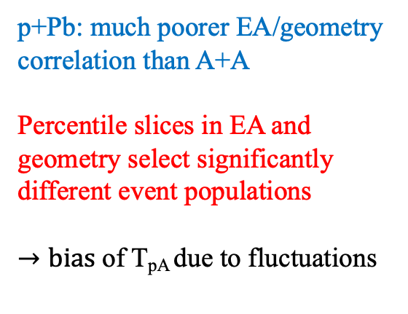
Collision geometry: experiment + modeling
EA $⟷$geometry: Glauber modeling
Phys.Rev.C 91 (2015) 064905
Pb+Pb
Glauber modeling ~ multiplicity
p+Pb: much poorer EA/geometry correlation than A+A
Percentile slices in EA and geometry select significantly different event populations
$→bias$of T_{pA} due to fluctuations
p+Pb
This is already a point of concern about T_{pA}

Slide 10
EA and hard probes I
How does a hard process in the central region affect forward EA?
Phys.Lett. B783 (2018) 95
High p_{T} hadron or jet
Tilt in EA distribution due to hard process
<Ncoll> bias?
Something else?
p_{T,hadron}>6,12 GeV/c
High EA
Low EA

Slide 11

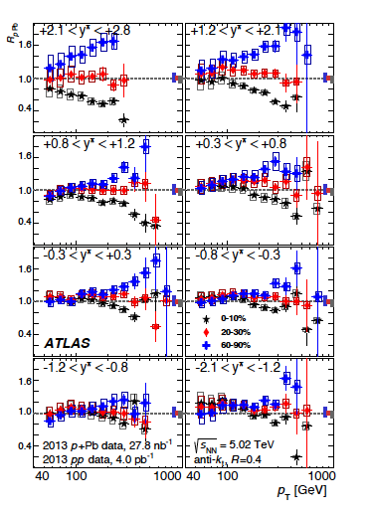
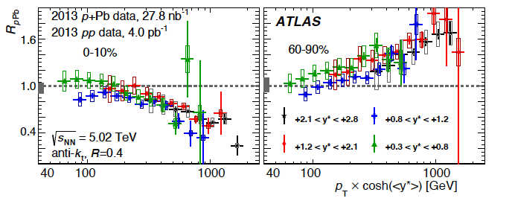
EA and hard probes II
Inclusive jet production in p+Pb
EA: forward E_{T}
T_{pPb} : “standard” Glauber
Jets in proton direction
Phys.Lett. B748 (2015) 392
R_{pPb}
Forward (proton-going): striking scaling with proton momentum fraction x_{p}
Consistent with Glauber-Gribov f$luctuations in σ_{NN}^{inel}$ :
MB: no yield modification
High-x has small size: color transparency
“These effects imply that the factorisation between hard and soft processes is violated at an unexpected level in proton-nucleus collisions.”

Slide 12
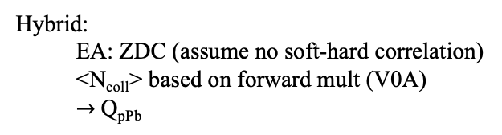
R_{pA} with different EA observables
EA: ZDC
EA: forward E_{T}
Q_{pPb}
ATLAS: Phys. Lett. B748 (2015) 392
R_{pPb}
Hybrid:
  EA: ZDC (assume no soft-hard correlation)
  <N_{coll}> based on forward mult (V0A)
  $→$Q_{pPb}
EA-selected inclusive production: limited precision, complex phenomenology
  unclear how to improve systematic precision
Consider a different approach for precise jet measurements small systems

Slide 13
Solution I: MB O+O
(Huss et al., 2007.13754,2007.13758)
Vary A by large factor
Why interesting? Glauber scaling of hard cross section for Minimum Bias (MB) event selection:
Hadron R_{AA}
A is fixed
no Glauber scaling uncertainty
small uncertainty due to MB trigger bias: 1-2% at ALICE/ATLAS/CMS
Need pp reference at 6.37 TeV: solvable
ALICE projection: quenching signal may be large relative to experimental uncertainties
But is this the complete story?
What really is the question we are asking about jet quenching in small systems?

Slide 14
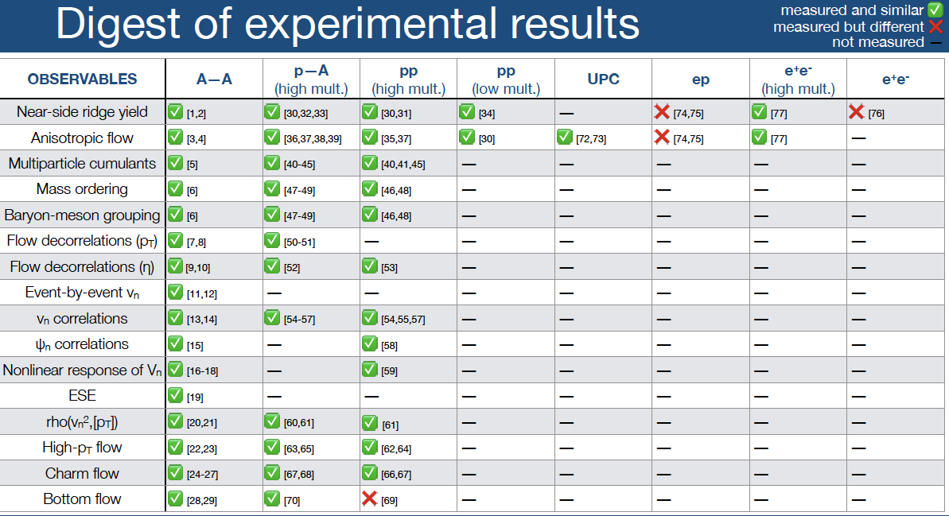
Where do we see evidence of collective effects in small systems?
Katarina Gajdosova
IS2023
Vast majority of signatures are seen in EA-selected p+A and pp (not MB!)
We cannot ignore this: jet quenching with EA-selection is the main question…

Slide 15
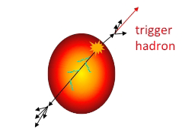
Solution II: cross-section ratios
Example: semi-inclusive observable
  select events based on presence of a trigger
  count recoil jets
  normalize number per trigger
→ ratio of absolutely normalized hard cross sections
No nuclear effects:
Geometric factor T_{AA} cancels
  → no need to interpret Event Activity in terms of collision geometry
  → avoids bias and interpretational confusion of R_{pA} (Q_{pA})

Slide 16
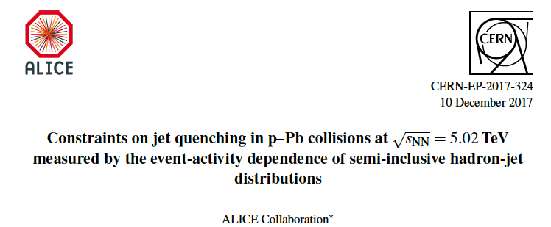
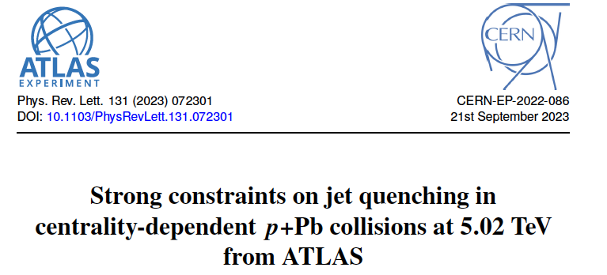
Searching for jet quenching in small systems: cross-section ratios
Phys. Lett. B 783, 95 (2018)
arXiv:1712.05603
PHENIX, arXiv:2303.12899
(not semi-incl.)

Slide 17
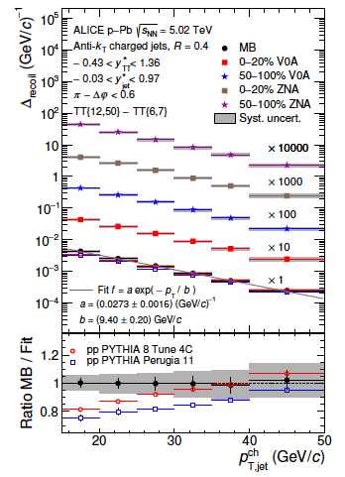
Phys. Lett. B 783 (2018) 95
trigger
hadron
recoil
jet

Slide 18
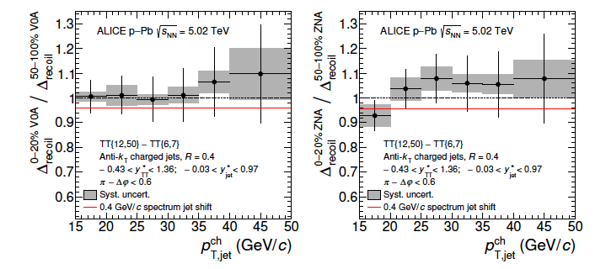
Phys. Lett. B 783 (2018) 95
trigger
hadron
ΔE
Yield suppression
recoil
jet
Recoil yield Ratio high-EA/low-EA
consistent with unity
uncertainty is statistics-dominated
Energy loss = spectrum shift
Limit: out-of-cone (R>0.4) energy loss in high-EA events < 400 MeV/c (90% CL)

Slide 19
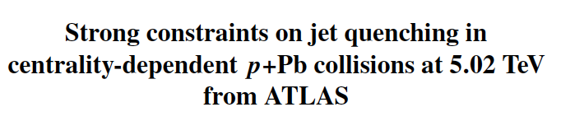
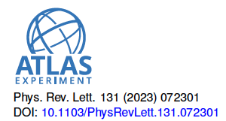
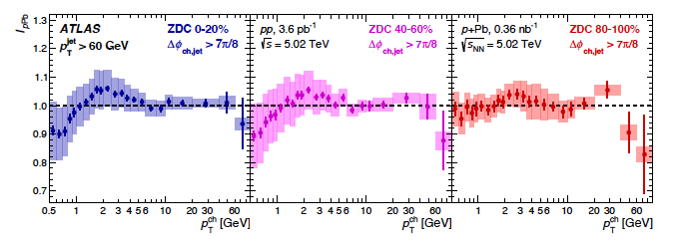
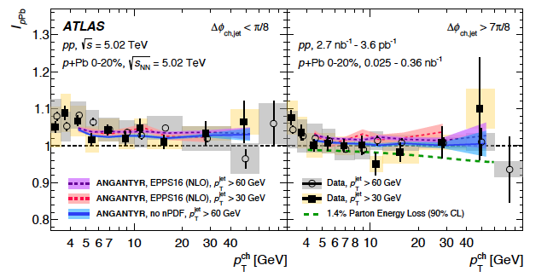
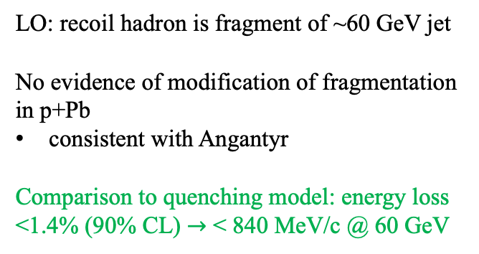
Semi-inclusive distribution of hadrons recoiling from a trigger jet
I_{pPb} = hadron yield/jet yield
recoil
hadron
trigger
jet
EA selection: ZDC
uncorrelated with hard production
LO: recoil hadron is fragment of ~60 GeV jet
No evidence of modification of fragmentation in p+Pb
consistent with Angantyr
Comparison to quenching model: energy loss <1.4% (90% CL) $→$ < 840 MeV/c @ 60 GeV

Slide 20

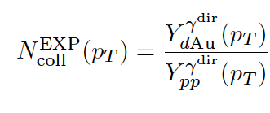
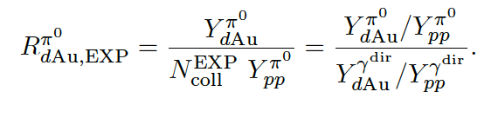
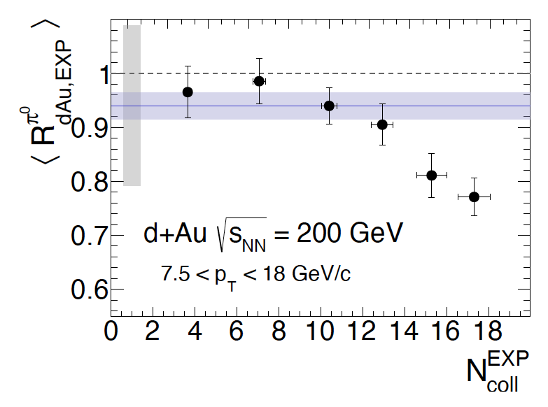
EA selection: forward charged multiplicity
Use direct photon yield to measure <Ncoll>
no Glauber modeling needed
arXiv:2303.12899
Significant suppression in π⁰ yield:
      4.5σ
EA-integrated

Slide 21
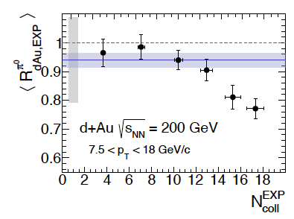
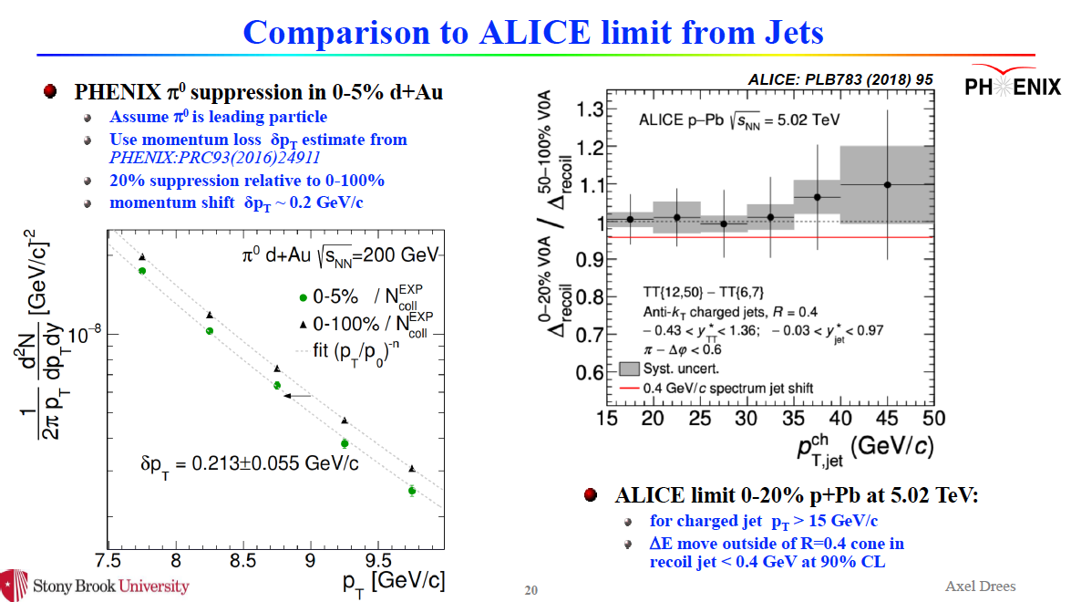
Alex Drees, IS2023

Slide 22
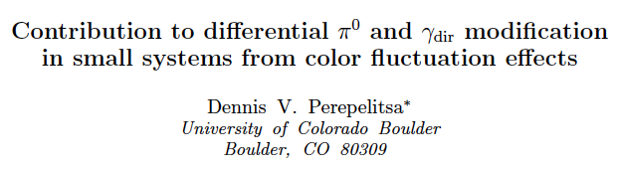
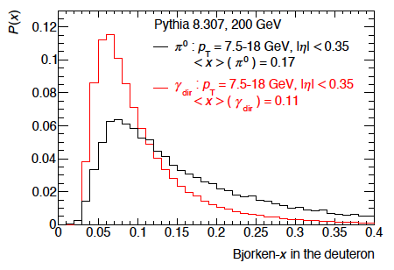
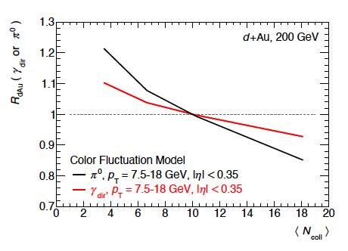
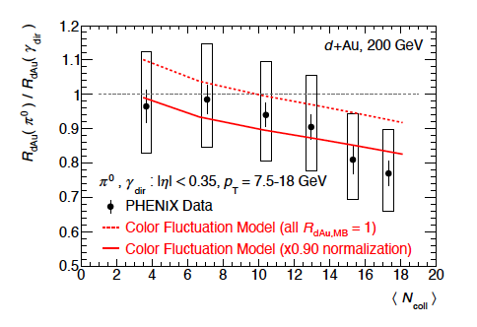

arXiv:2404.17660
Glauber-Gribov fluctuations:
high x has small size $→$color transparency
affects hard/soft correlations
PHENIX kinematics:
π⁰ and γ both probe x > 0.1
π⁰ probes higher x
Color fluctuation model can describe the EA-dependence of π⁰/γ suppression

Slide 23

Cross section ratios in small systems: comparison of jet quenching measurements
EA: ZDC, forward mult.
< 400 MeV/c (90% CL) out-of-cone (R>0.4)
EA: ZDC
< 840 MeV/c (90% CL) for p_{T}^{jet} ~ 60 GeV
Requires energy loss modeling
EA: forward mult
π⁰ suppression: 4.5σ
  $→$δp_{T} ~ 200 MeV
May be due to color fluctuations

Slide 24



JHEP 05 (2024) 229
arXiv:2309.03788
Take the small-systems question to the extreme:
can we find evidence of jet quenching in high multiplicity (HM) pp collisions at 13 TeV?
What observable?
Inclusive suppression not usable: Glauber scaling ill-defined
Alternative: acoplanarity broadening due to in-medium scattering
Characterize pp collisions by forward multiplicity: V0M=V0A+V0C
Definition of HM: V0M/<V0M> > 5

Slide 25

JHEP 05 (2024) 229
arXiv:2309.03788
Marked suppression of back-to-back configuration in HM population
broadening of acoplanarity distribution
Signature of jet quenching?
  No: same effect observed in PYTHIA!
What’s going on? Both ALICE data and PYTHIA show that HM selection biases towards multi-jet final states
Q: When you ask for a central hard process and forward high multiplicity in small systems, what do you get?
A: Preferentially, multi-jet configurations.
    This is a key issue for all small-systems jet analyses, not just this one.

Slide 26

Summary and outlook
Jet quenching signals in small systems are small
EA-selected inclusive suppression measurements (R_{pPb}) systematically limited
no clear path to improve precision
Better precision: ratio of two hard cross sections.
current implementations: semi-inclusive correlations (h+jet, jet+h), π⁰/γ
current limits: energy loss in p+A is less that a few hundred MeV/c
Challenges to theory:
compatible with energy loss in A+A?
quantitative predictions or postdictions?
Challenges to experiment:
yet better precision: find a significant signal
high-EA bias towards multi-jet configurations
Future:
O+O or similar smallish system: amplify signal, improve Glauber resolution
    $→$ sweet spot to balance systematics, signal size, and “small”?
Run 3&4 p+Pb : improved correlation measurements, e.g. semi-incl. γ+jet

Slide 27
Extra slides

Slide 28


JHEP 05 (2024) 229
arXiv:2309.03788
HM generated preferentially by jets
VOA
VOC
HM biases towards multi-jet configurations

Slide 29


Precise d+Au geometry with forward neutrons
STAR Phys.Rev.Lett. 91 (2003) 072304
“Peripheral” d+Au collisions: trigger on beam-energy neutron in ZDC
Deuteron wavefn well-known (Huelthen) $→$well-controlled Glauber calculation

