Slide 1


Dynamical core-corona initialization in small colliding systems
-- DCCI2 overview --
SOPHIA
HADRON
PHYSICS
GROUP
The 4th International Workshop on QCD Collectivity at the Smallest Scales
Qingdao, China, 2024/6/24
Tetsufumi Hirano (Sophia Univ)
References:
M. Okai et al., Phys. Rev. C95, 054914 (2017); Y. Kanakubo et al., PTEP 2018, 121D01 (2018); PRC 101, 024912 (2020); PRC 105, 024905 (2022); PRC 106, 054908 (2022); Y. Kanakubo, Ph.D thesis (Sophia University, 2022).
hirano@sophia.ac.jp
https://tetsufumi-hirano.github.io/

Slide 2
Outline
Introduction
Dynamical Modeling
Dynamical Core-Corona Initialization Model
Results
Summary

Slide 3
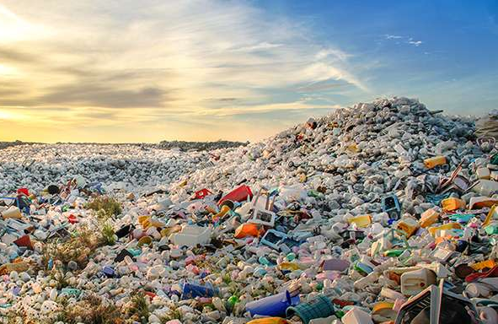

High multiplicity pp events
https://phys.org/news/2017-05-plasticsnot-simply-garbage.html
https://www.journalism.co.uk/news/why-openspending-data-is-a-treasure-trove-for-journalists/s2/a552805/
High Energy Physicist
→ Garbage dump for
Beyond-Standard-Model particle?
(Find a needle in a haystack?)
Heavy Ion Physicist
Treasure trove(?)

Slide 4
To be (QGP) or not to be?
That is THE question!
RHIC
LHC
p+Au
d+Au
³He+Au
p+p
p+Pb
2003~2010: Control experiment
  → Understanding of initial state (cold nuclear matter) effects
2010: Discovery of “ridge” structure in pp by CMS Collaboration
2010~today: Discussion of possibility to create QGP
The smallest fluid on earth ← How small can it be?
B. Schenke, Rep. Prog. Phys. 84, 082301 (2021)

Slide 5
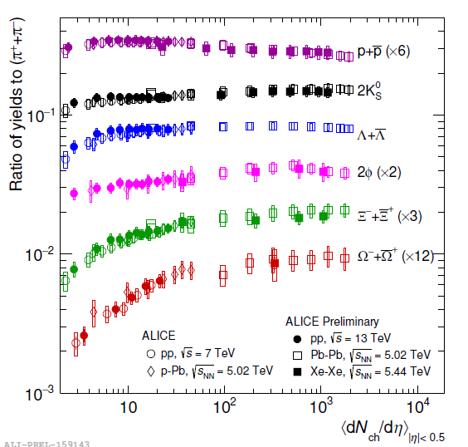

Strangeness enhancement
Hadron yield ratios at LHC
Almost no
collision system dependence
collision energy dependence
Strangeness enhancement as a signal of QGP
ALICE overview, talk at QM2018
$$R_{i/π} vs. {dN_{ch}}/{dη}$$
How to interpret?

Slide 6







Continuous change of production mechanism
$$P∝exp\left(−π\frac{{m_{q}}^{2}}{κ}\right)$$
Chemical equilibrium
$$m_{q}$$
: Constituent
quark mass
$$κ$$
: String tension
$$P∝d_{i}exp\left(−\frac{m_{i}}{T_{ch}}\right)$$
String fragmentation
$$m_{i}$$
: Mass of hadron
$$T_{ch}$$
: Chemical
freezeout
temperature
$$d_{i}$$
: degeneracy
How to deal with these mechanisms in a single framework?

Slide 7
Outline
Introduction
Dynamical Modeling
Dynamical Core-Corona Initialization Model
Results
Summary

Slide 8
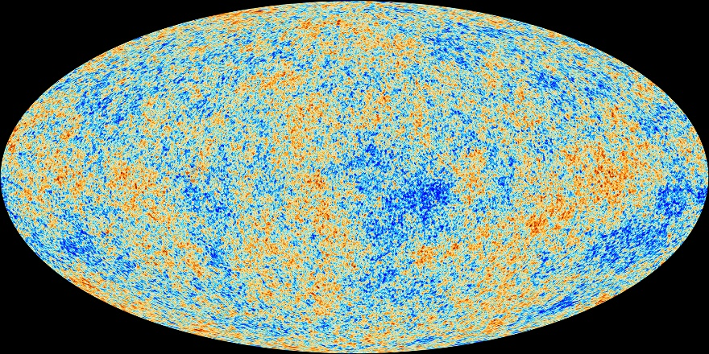
Analysis tool in observational cosmology
Cosmological parameters
Energy budget
Hubble constant (lifetime)
Curvature (flatness)
Information about inflation
…
CAMB, CMBFAST,
CosmoMC,…
Cosmic Microwave Background
Fluctuations of temperature (Planck)
http://www.esa.int/spaceinimages/Images
/2013/04/Planck_CMB_black_background

Slide 9
Analysis tool in high-energy nuclear collisions
Bottom-up approach in high-energy nuclear collisions
Physics properties of the QGP
Equation of state
Shear viscosity
Bulk viscosity
Stopping power
…
?
Y.Zhou, talk at QM2018
Need Standard model/Analysis tool/Event generator
for high-energy nuclear collisions

Slide 10
Dynamical modeling of high-energy nuclear collisions
hadronic
observables
Hadronic transport
time
jet
jet
hadron gas
string
fragmentation
Recombination
model
QGP fluid
Hydro-
dynamics
Modification of
jet structure
hydro+jet
model
Glasma
collision axis
Classical Yang-Mills
0
Gluon
saturation
CGC theory
pQCD
Soft sector
energy scale
Hard sector

Slide 11
Purpose of present study
Develop a unified framework of high-energy nuclear collisions from small to large colliding systems, from low to high collision energies and from low to high p_{T}
Investigate the effects of non-equilibrium components on bulk and flow observables
To answer a question:
How large/small multiplicity to create the QGP

Slide 12
Outline
Introduction
Dynamical Modeling
Dynamical Core-Corona Initialization Model
Results
Summary

Slide 13
Core-corona picture
Bozek (2005,2009), Aichelin, Werner (2009), Becattini, Manninen (2009),
Pierog et al. (2015), Akamatsu et al. (2018), Kanakubo et al. (2018)
Core:
Equilibrated matter ~
QGP fluids
Corona:
Non-equilibrium partons
Multiplicity
(The number of particles)
Low
High
Figures: Courtesy of Y.Kanakubo
Key to describe dynamics
from small (low) to large (high) systems (multiplicity)

Slide 14









Dynamical Core Corona Initialization (DCCI2) model
$$t$$
Hadronic afterburner
JAM
Y. Nara et al.,Phys. Rev. C61, 024901 (2000)
Hadronization
PYTHIA8 (string fragmentation)
iS3D (thermal hadron sampling)
M. McNelis et al., Comput. Phys.Commun. 258, 107604 (2021)
Dynamical initialization
+ QGP dynamics
(3+1)-D hydro with source terms
$$z$$
Y. Tachibana et al., Phys. Rev. C 90, 021902 (2014)
Initial parton production
PYTHIA8/PYTHIA8 Angantyr
T. Sjöstrand et al., Comput. Phys. Commun. 191, 159 (2015)
Figures: Courtesy of Y.Kanakubo
C. Bierlich et al., JHEP 1610 139 (2016)

Slide 15

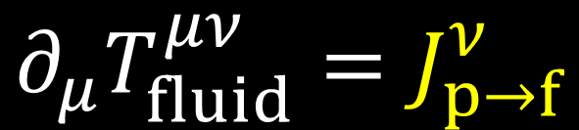





Dynamical initialization
M.Okai et al. (2018)
Conservation of the whole system
$$∂_{μ}T_{fluid}^{μν}=J_{p→f}^{ν}$$
$$∂_{μ}\left(T_{fluid}^{μν}+T_{parton}^{μν}\right)=0$$
$$∂_{μ}T_{parton}^{μν}=−J_{p→f}^{ν}$$
Hydrodynamic equations with source terms
Step 1 Generate
initial partons
Step 2
Model source term
Step 3
Solve hydro eqs. with vacuum initial condition
$$T_{parton}^{μν}\left(0^{+}\right)$$
$J_{p→f}^{ν}=−∂_{μ}T_{parton}^{μν}(t)$
$$∂_{μ}T_{fluid}^{μν}=J_{p→f}^{ν}$$
with
$$T_{fluid}^{μν}\left(t_{0}\right)=0$$

Slide 16
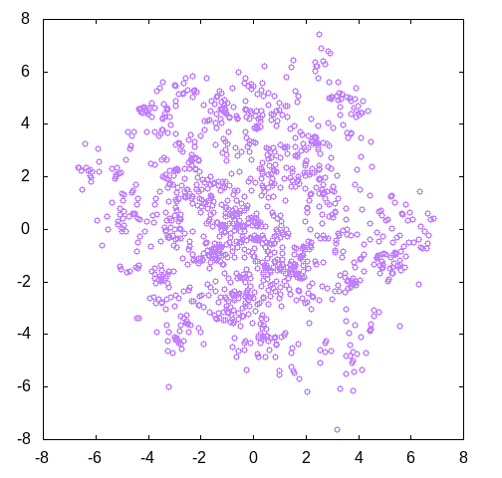


Step 1: Generation of initial partons
PYTHIA 8/PYTHIA 8 Angantyr
General purpose event generator
Meaningful after tuning
Heavy-ion mode available as Angantyr model (Note: no hydro evolution)
(“Almost” default) setting:
  HadronLevel:all = off
  PartonVertex:setVertex = on
  MultipartonInteractions:pT0Ref
  SpaceShower:pT0Ref
T. Sjöstrand et al., Comput. Phys. Commun. 191, 159 (2015)
C. Bierlich et al., JHEP 1610 139 (2016)
Parton distribution
$$y (fm)$$
DCCI2 as “hydrodynamic
afterburner for PYTHIA”
Pb+Pb (2.76 TeV)
$$x (fm)$$

Slide 17














Step 2: Modeling of source terms
Source term from kinetic approach
Y.Kanakubo et al. (2020).
$$J_{p→f}^{μ}=−\sum_{i}{\frac{d{p_{i}}^{μ}}{dt}}G(x−x_{i}(t))$$
$$G$$
: Gaussian smearing of $δ^{(3)}(x−x_{i}\left(t\right))$
$$p_{i}$$
: Four momentum of $i$th parton
$$x_{i}$$
: Position of $i$th parton
Phenomenological fluidization rate per particle in core-corona picture
Y.Kanakubo et al. (2022).
$$\frac{d{p_{i}}^{μ}}{dτ}=−\sum_{j}^{N_{scat}}{ρ_{i,j}σ_{i,j}\left|v_{rel,i,j}\right|}{p_{i}}^{μ}$$
$$ρ_{i,j}$$
: Profile of $j$th parton
$$σ_{i,j}$$
: Cross section btwn. $i$th and $j$th
$$v_{rel,i,j}$$
: Rel. velocity btwn. $i$th and $j$th
soft and hard
core and corona
Dynamical separation between

Slide 18
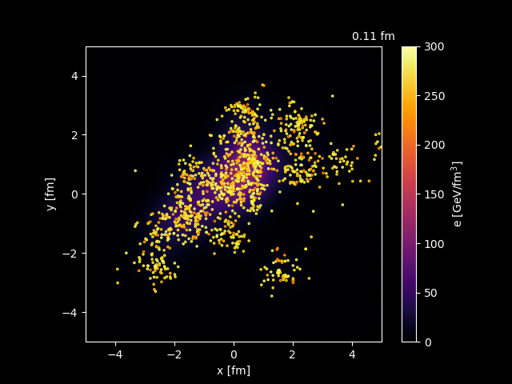
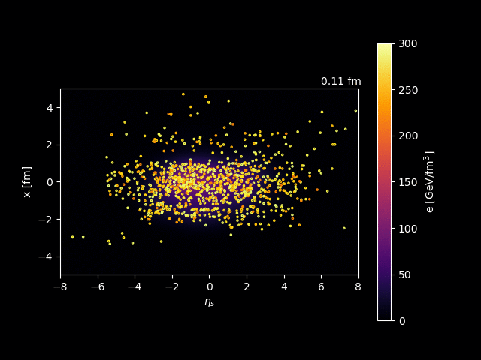


Step 3: Solving hydro eqs. with source terms
Pb+Pb 2.76 TeV
Transverse plane ($\left|η_{s}\right|<0.5$)
$x−η_{s}$ plane ($\left|y\right|<0.5$)
Movies: Courtesy of Y.Kanakubo

Slide 19
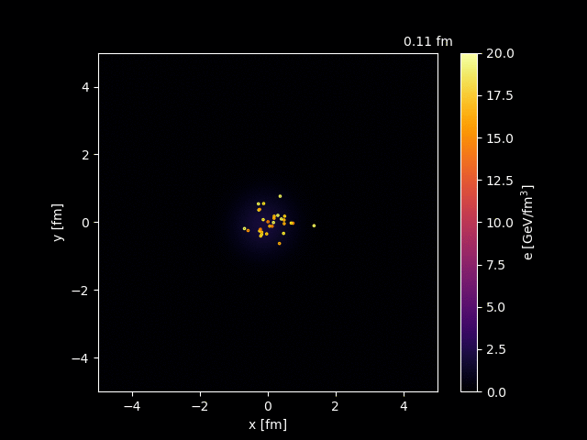
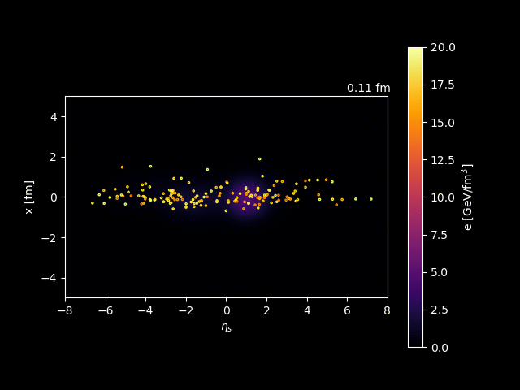
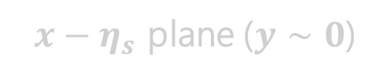
Step 3: Solving hydro eqs. with source terms
p+p 7 TeV
Transverse plane ($\left|η_{s}\right|<0.5$)
$x−η_{s}$ plane ($\left|y\right|<0.5$)
$x−η_{s}$ plane ($y∼0$)
Movies: Courtesy of Y.Kanakubo

Slide 20
Outline
Introduction
Dynamical Modeling
Dynamical Core-Corona Initialization Model
Results
Summary

Slide 21
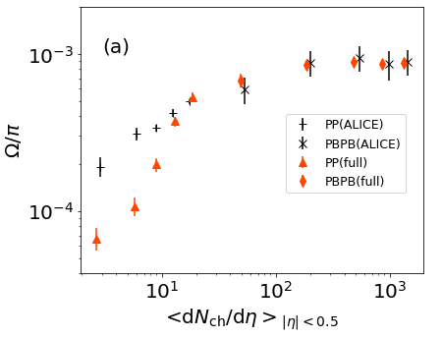


$Ω/π$ ratio from p+p to Pb+Pb
Fixing parameters to control fraction of core/corona
Smooth enhancement of $Ω/π$
← smooth increase of core contribution
B. Abelev et al. (ALICE Collaboration), Phys. Lett. B 728, 216-227 (2014); erratum 734, 409-410 (2014)
J. Adam et al., (ALICE Collaboration), Nature Phys. 13 535-539 (2017)
Deviation from data at low multiplicity can be attributed to PYTHIA default tuning
A promising interpretation of strangeness enhancement based on core-corona picture

Slide 22
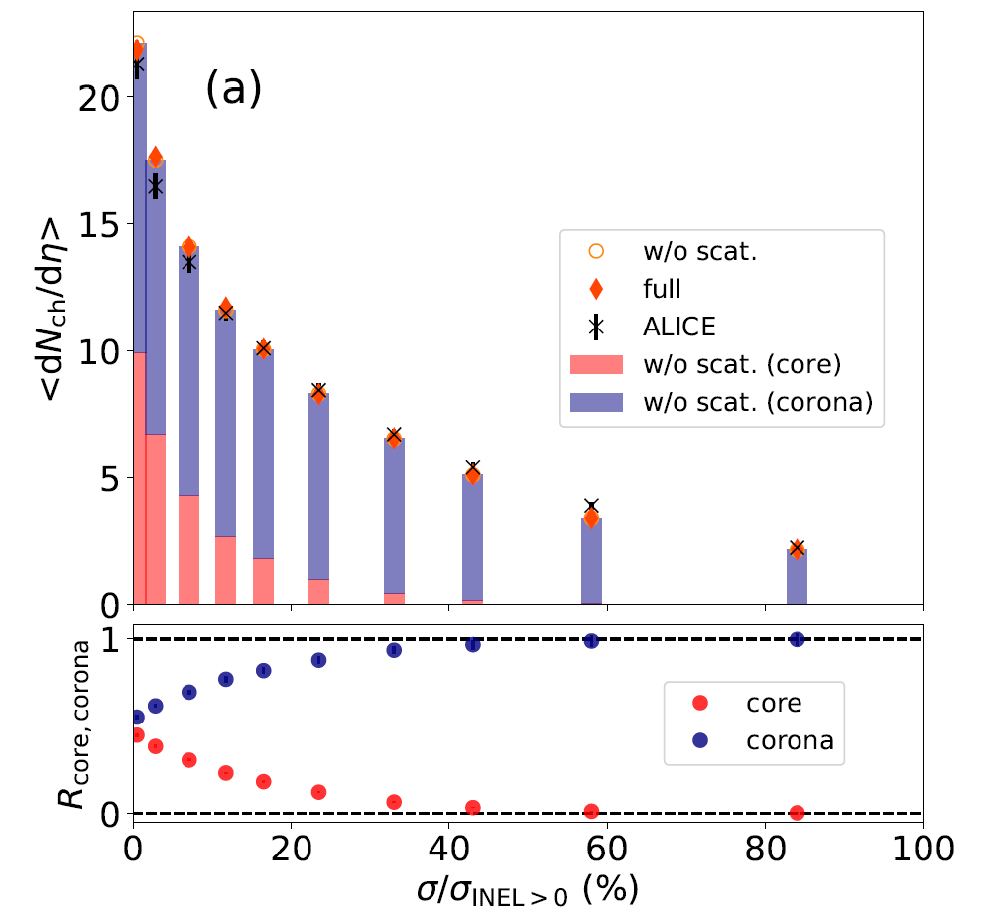
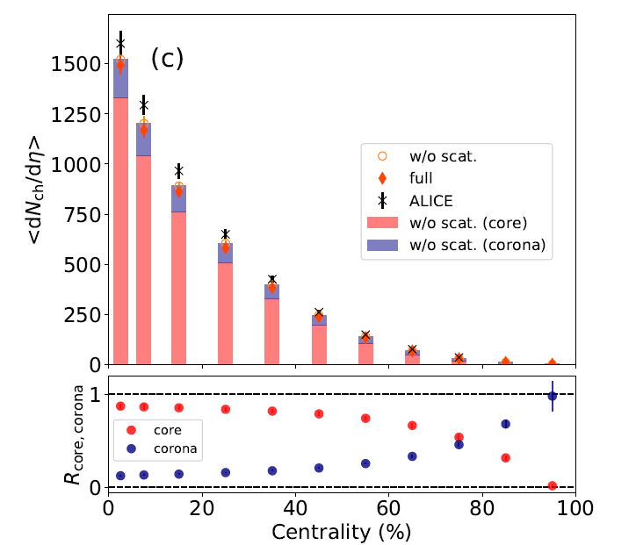
Fraction of core and corona components
p+p 7 TeV
Pb+Pb 2.76 TeV
Corona
J. Adam et al., (ALICE Collaboration), Nature Phys. 13, 535-539 (2017)
K. Aamodt et al., (ALICE Collaboration), Phys. Rev. Lett. 106, 032301 (2011)
Core
pp: core/corona $∼50\%$ at the highest multiplicity class (0-0.95%)
PbPb: corona $∼20\%$ at intermediate centralities (40-60%)

Slide 23
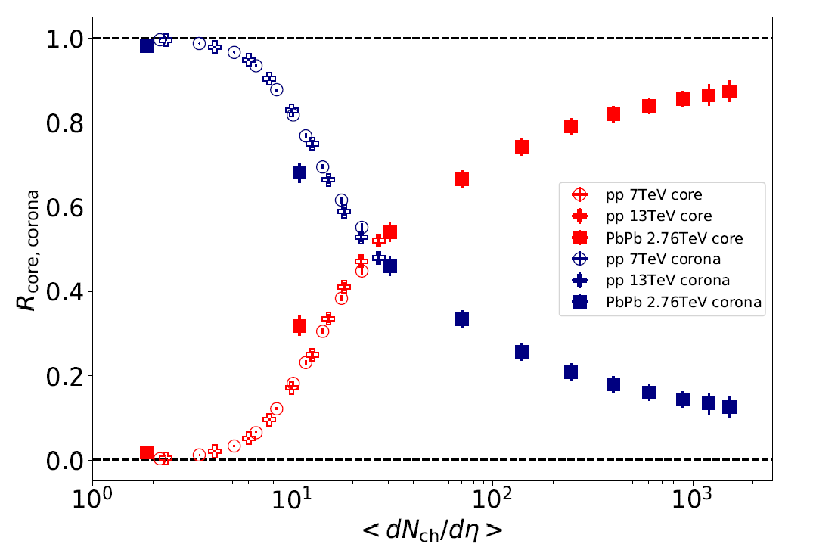
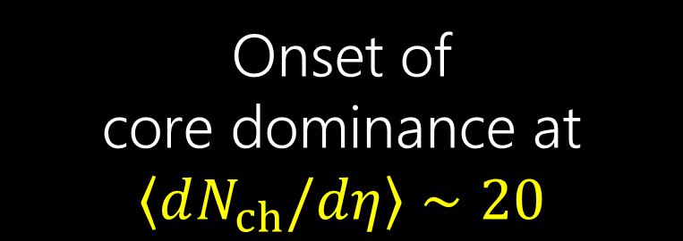
How small can it be for core dominance?
Clear scaling with multiplicity
Core
Onset of
core dominance at $\left\langle dN_{ch}/dη\right\rangle ∼20$
Corona

Slide 24
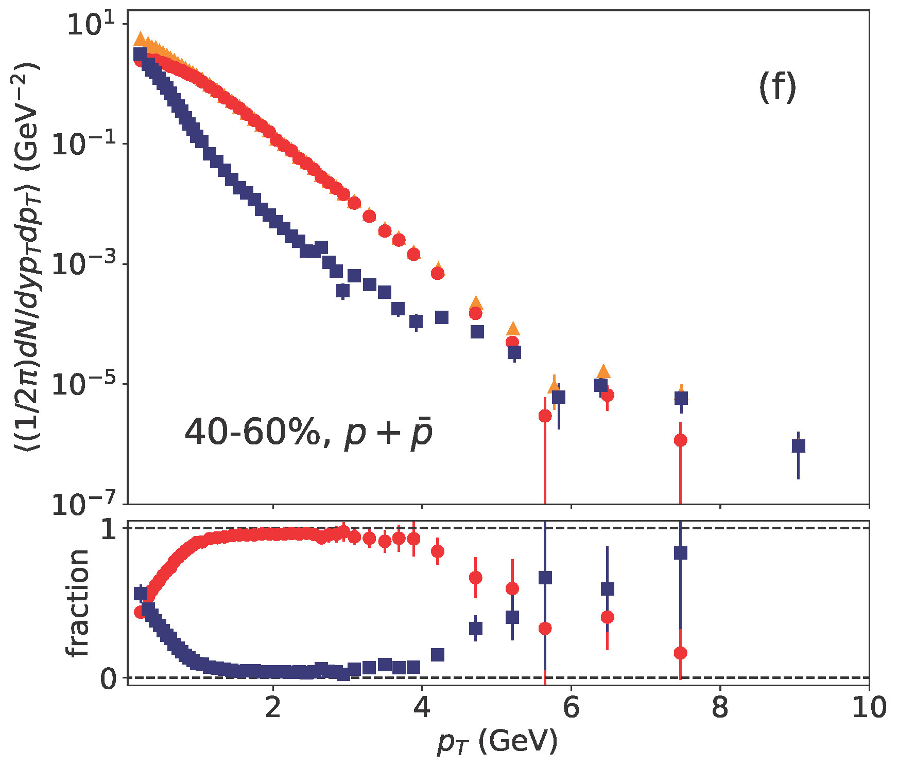
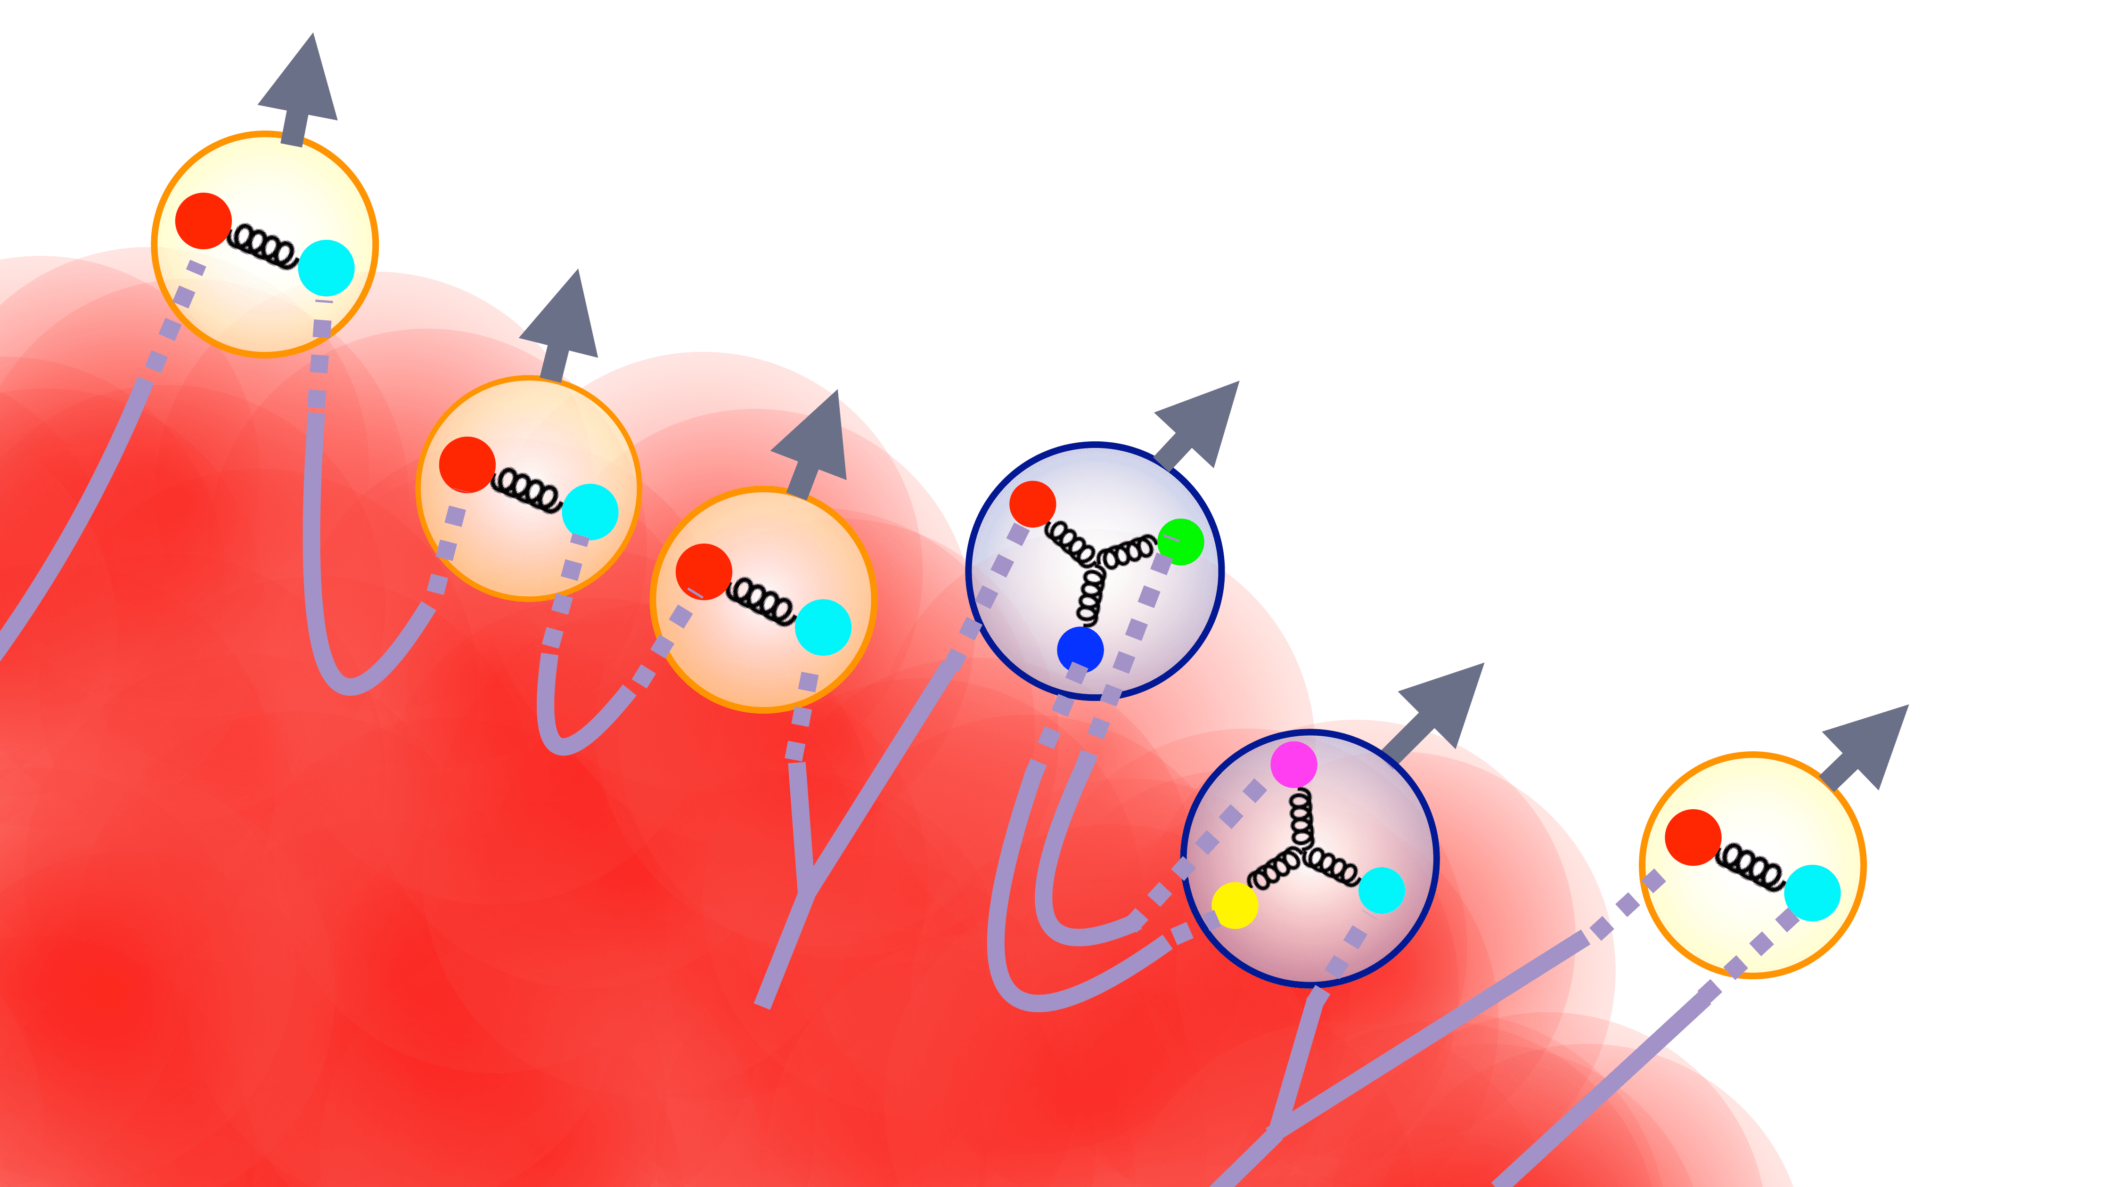
“Soft-from-corona” components
“hard strings” in DCCI2
Total
PbPb 2.76 TeV
Courtesy of Y. Tachibana
Core
https://www.sophia.ac.jp/eng/article/news/release/press20230213/
Corona
Y. Kanakubo et al., Phys. Rev. C 106, 054908 (2022).
Traversing hard partons
String formation
R_{corona} ~ 50%
Fragment into soft hadrons
← Power-law shape

Slide 25
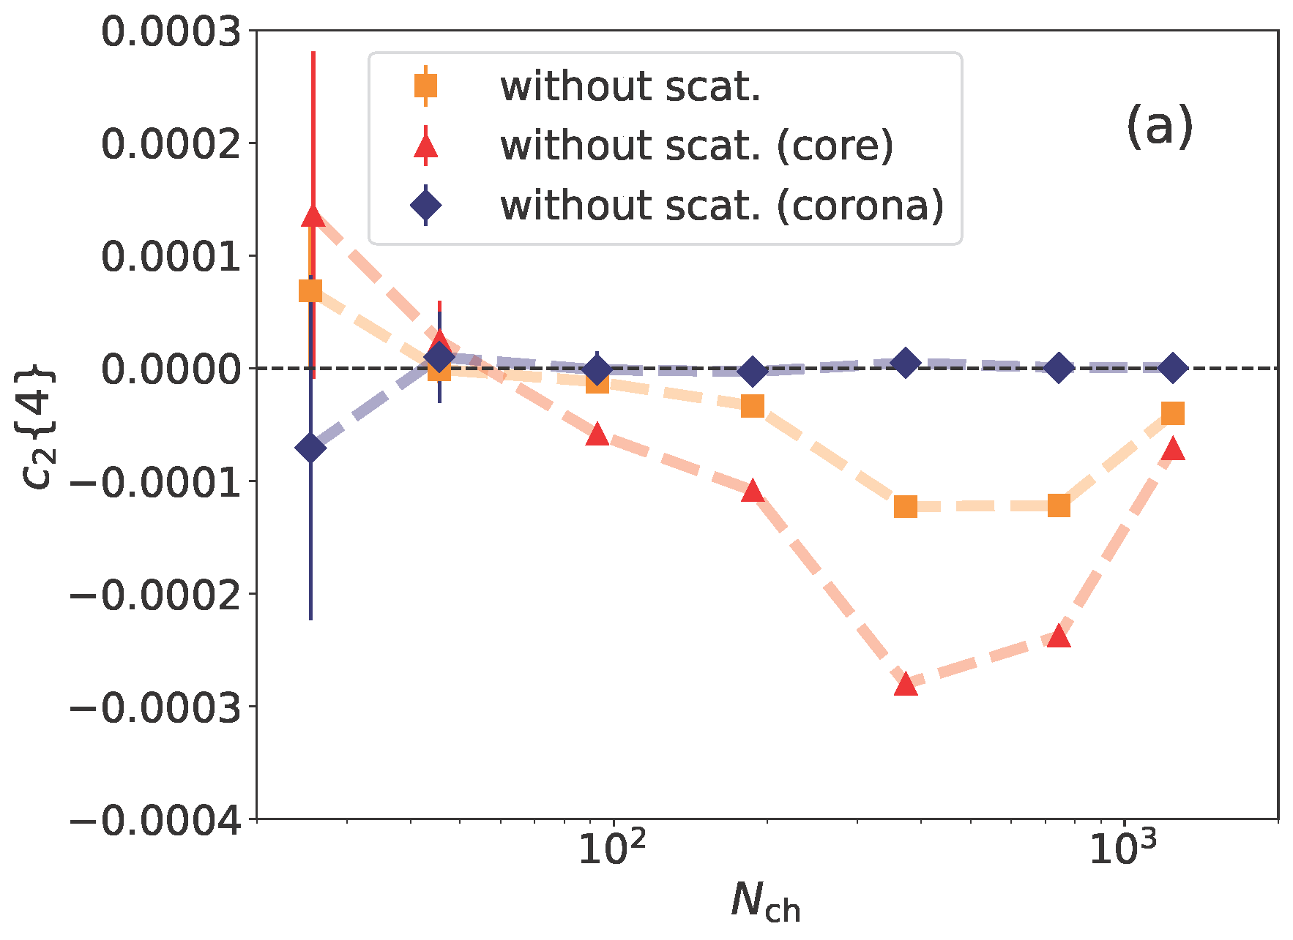
Corona dilutes c₂{4}
Dilution effect even after non-flow subtraction
PbPb
2.76 TeV
Importance in mean p_{T}, v_{n}, dN/deta, etc.
Y. Kanakubo et al., Phys. Rev. C 106, 054908 (2022).
Lesson for experimental people
→ Avoid very low p_{T}
0.2<p_{T}<3.0 GeV, |η|<0.8 (ALICE)
Lesson for theory people
→ Do not ignore corona

Slide 26
Transverse energy evolution
Thermalization
DCCI2
pdV work
Transverse energy
Free streaming
Exp
data
Free streaming
hadronization
PYTHIA/Angantyr
Parton production
Y. Kanakubo et al., Phys. Rev. C 105, 024905 (2022).
Time
How much matter thermalized is highly correlated
with initial production under constraint from exp data.

Slide 27
Outline
Introduction
Dynamical Modeling
Dynamical Core-Corona Initialization Model
Results
Summary

Slide 28

Summary
Development of a unified framework to describe dynamics of high-energy nuclear collisions
  Core (fluids) and corona (non-equilibrium partons)
  Thermal production and string fragmentation
Fraction of core/corona in small and large colliding systems extracted from experimental data
  ~ 50% in the highest multiplicity class in p+p
  ~ 20% in semi-central events in Pb+Pb
  Key number $\left\langle dN_{ch}/dη\right\rangle ∼20$
Soft from core → Soft from both core and corona
  Core-corona picture towards precise extraction of properties of the QGP

Slide 29
Backups

Slide 30

HEP vs HIC physicists’ view
p+p physics
A+A physics
High multiplicity
p+p physics as
interdisciplinary
research area
HEP (Generic purpose MC)
Jet universality
  Fragmentation from $e^{+}+e^{−}$
    Applied to p+p collisions
  No multiplicity dependence
  of particle ratios
Need non-perturbative, new mechanisms to interpret data
HIC (Dynamical modeling)
Successful modeling in A+A collisions
  → Paradigm of QGP fluidity
Testing understanding of the QGP in p+p collisions
QGP-based modeling applicable in small colliding systems???

Slide 31
Standard picture of high-energy nuclear collisions
Measurement
Leptons, photons
W/Z bosons
Radiation
Leptons, phosons
Hadrons
Probe
time
Hadron gas
Recombination
Fragmentation
Bulk
QGP
fluids
Jets
Quarkonia
Interaction
collision axis
0
Glasma
Colliding nuclei
Gluon saturation
Parton gas

Slide 32
Marriage of hydrodynamic model and
QCD-based phenomenological model
Dynamical Core Corona Initialization
Hydro (and hadronic) afterburner on PYTHIA
Corona (non-equilibrium) correction on hydro
From high-energy physics community’s point of view
From HIC community’s point of view

Slide 33
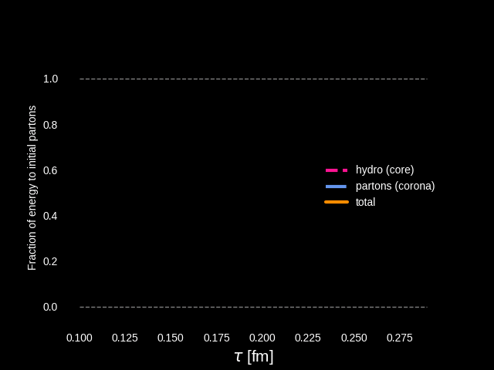
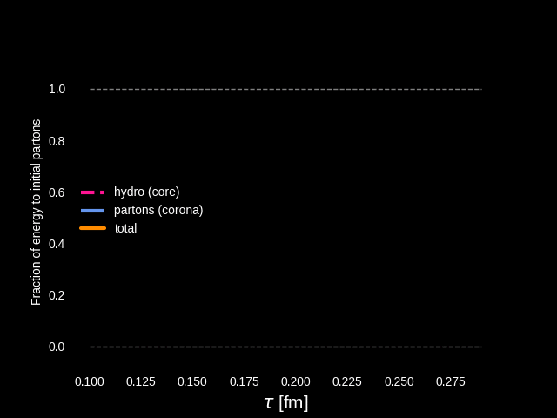

Evolution of energy budget
Dynamical energy conversion from initial partons (corona) to fluids (core)
p+p
Pb+Pb
Starting from vacuum $T_{fluid}^{μν}=0$ for fluids (core)
Incoming beam energy & momentum conservation as total system
Movies: Courtesy of Y.Kanakubo

Slide 34
Outline
1. Introduction
2. Dynamical Modeling
3. Small Colliding Systems
4. Dynamical Core-Corona Initialization Model
5. Results
6. Summary

Slide 35

Dynamical initialization in hydro models
M.Okai, K.Kawaguchi, Y.Tachibana, TH (2017)
Conventional
hydro simulations
Vacuum
$$τ$$
$$0$$
Formation time
of partons
hydro
initial time
Fluids
$$∂_{μ}T_{fluid}^{μν}=J_{p→f}^{ν}$$
Partons
“Fluidization” through source terms
→ Energy-momentum conservation as a whole

Slide 36
Aside: Initialization in low energy collisions
Time
Insufficient Lorentz-contraction of colliding nuclei
→Space-time dependent particle production
Dynamical initialization
→ Resolve these issues phenomenologically?
Collision axis
0
String picture: C.Shen, B.Schenke (2017)
Particle picture (JAM, UrQMD): Y.Akamatsu et al. (2018), L.Du, U.Heinz, G.Vujanovic (2018)

Slide 37
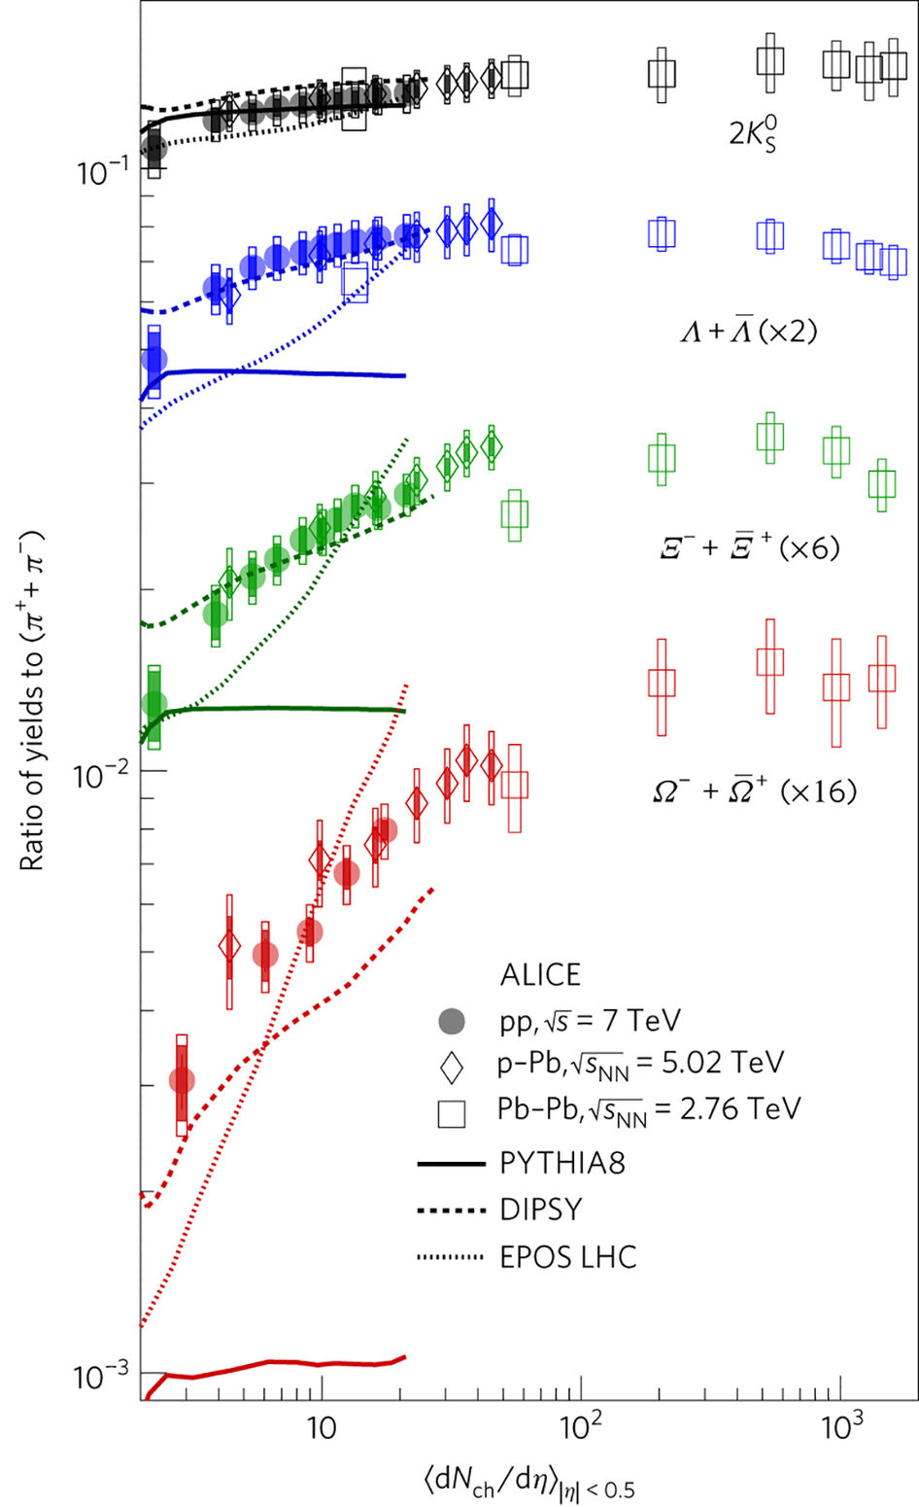
Violation of “jet universality”
Multi-strange hadrons increase more rapidly than charged pions
Unable to reproduce from Lund string fragmentation
Additional final state dynamics needed?
ALICE, Nature Physics (2017)
PYTHIA8: Lund string fragmentation
EPOS LHC: Core-corona QGP formation
DIPSY: Rope hadronization

Slide 38
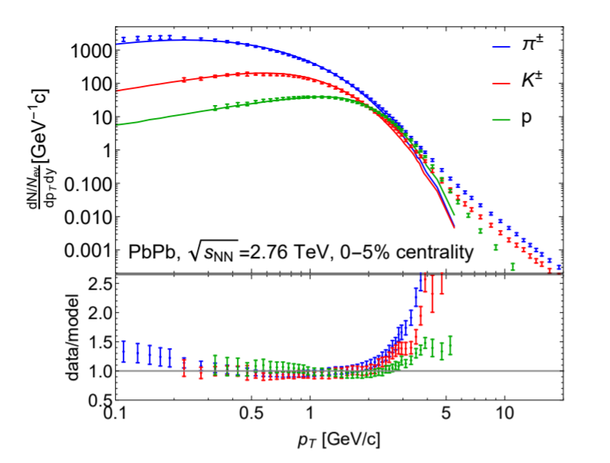
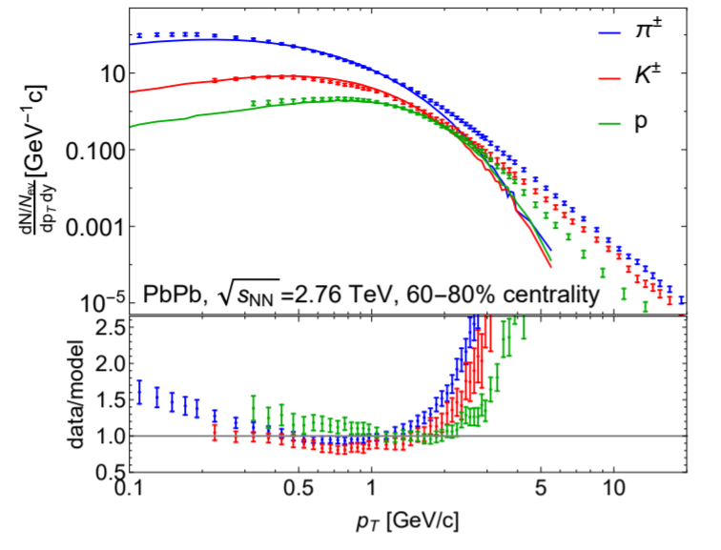
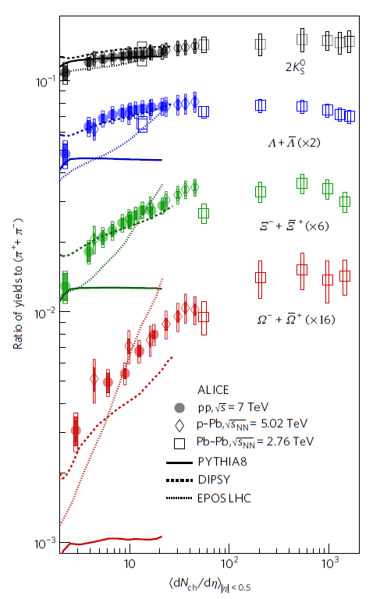

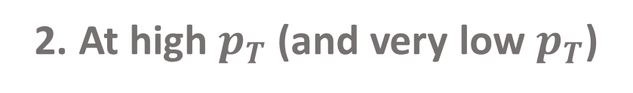
Where doesn’t hydro work?
1. In peripheral AA, small systems
2. At high $p_{T}$ (and very low $p_{T}$)
Trajectum
Nature Phys. 13 535-539 (2017)
Phys. Rev. C 103 (2021) 5, 054909
hydro
Collapse of the hydro myth!
Need to extend applicability of dynamical frameworks

Slide 39
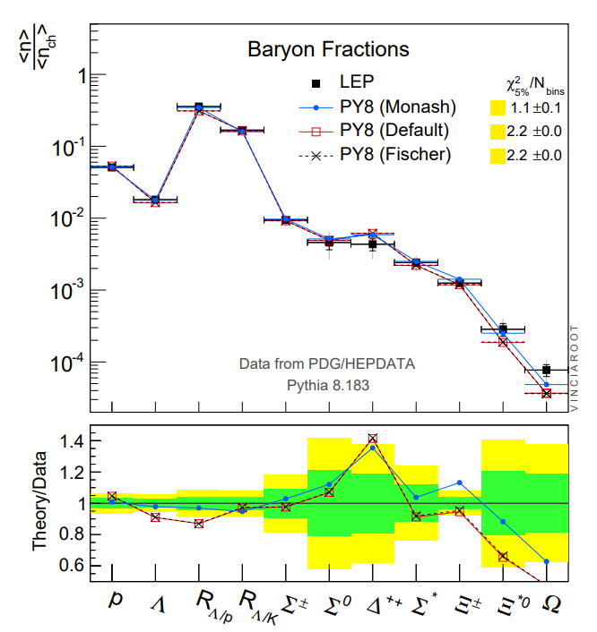
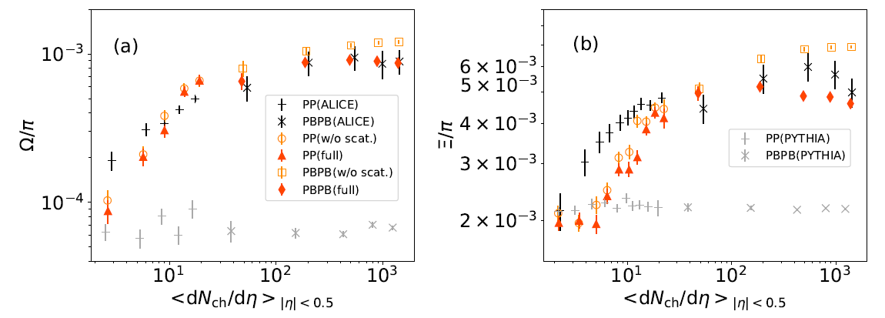

$Ω$ yields from $e^{+}e^{−}$ with Monash Tune
P. Skands et al., Eur.Phys.J.C 74 (2014) 8, 3024

Slide 40
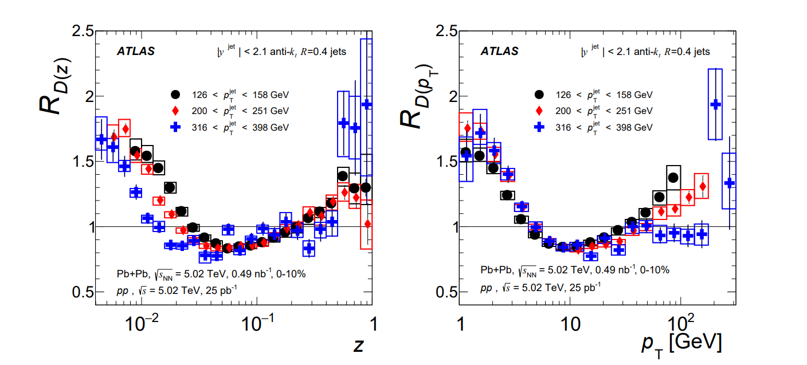
Low $z$/$p_{T}$ enhancement in AA
Phys. Rev. C 98, 024908

Slide 41

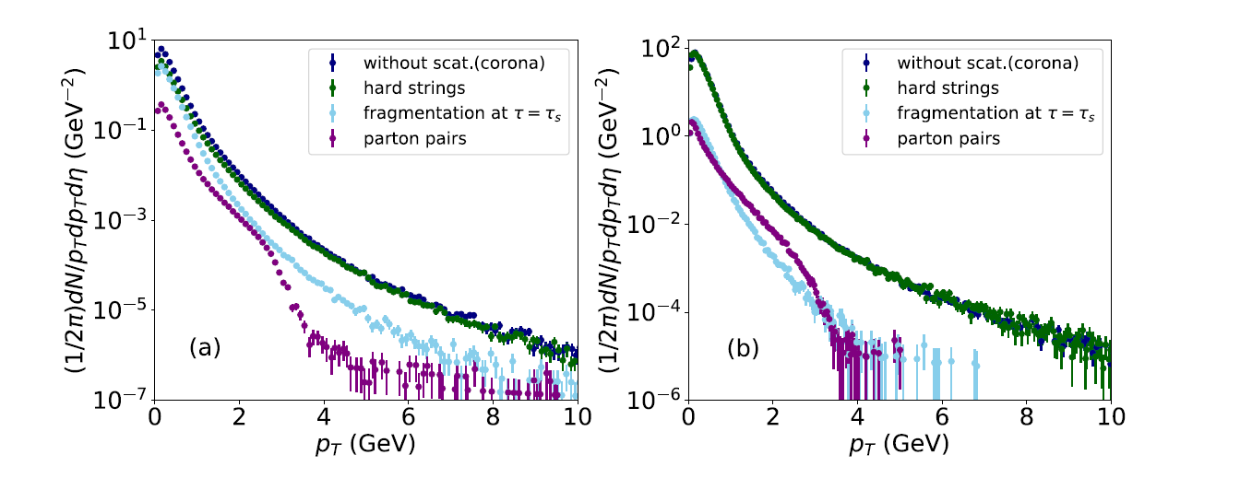
Where can we find corona?
A. in very low $p_{T}$
PbPb 2.76 TeV

Slide 42
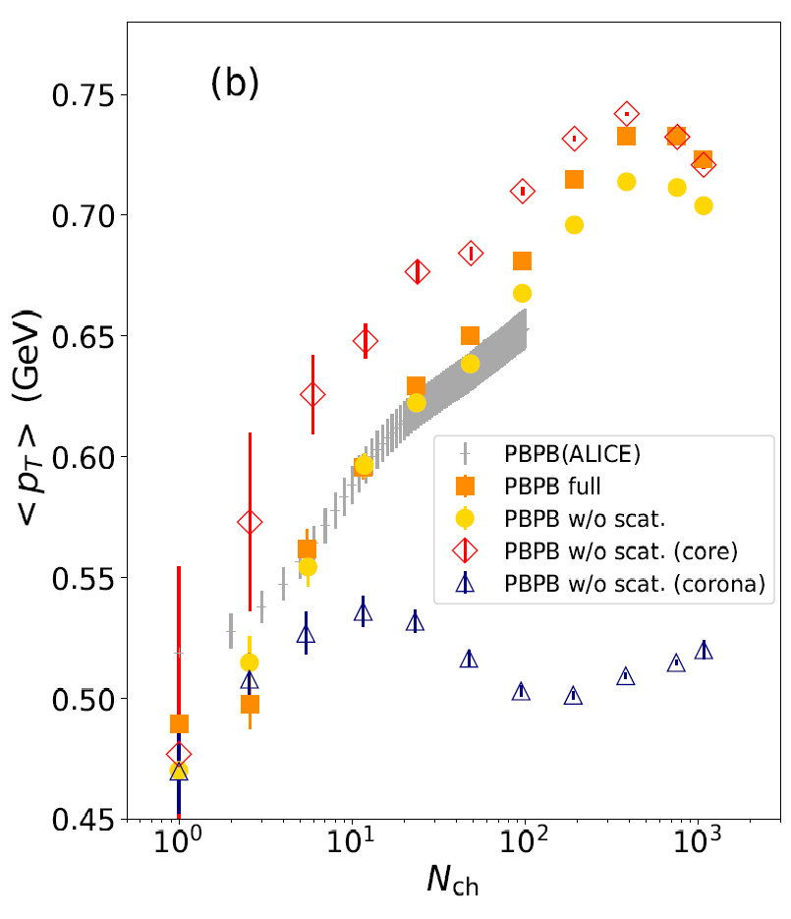
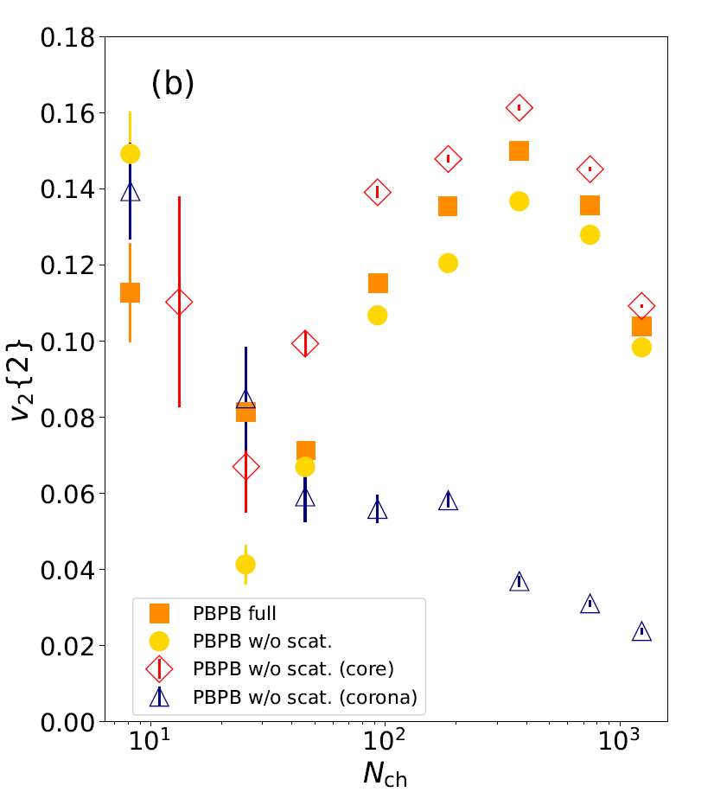
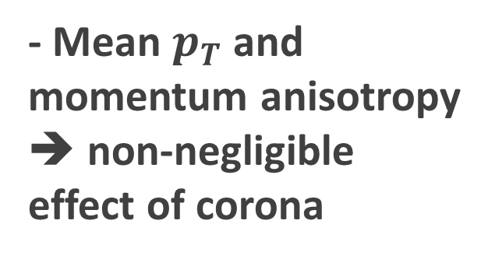


Corona correction in PbPb
$$∼5−11 \%$$
$$∼15−38 \%$$
- Mean $p_{T}$ and momentum anisotropy
➔ non-negligible effect of corona
- Pure hydro calculation can bring misinterpretation of exp. data even in PBPB

Slide 43
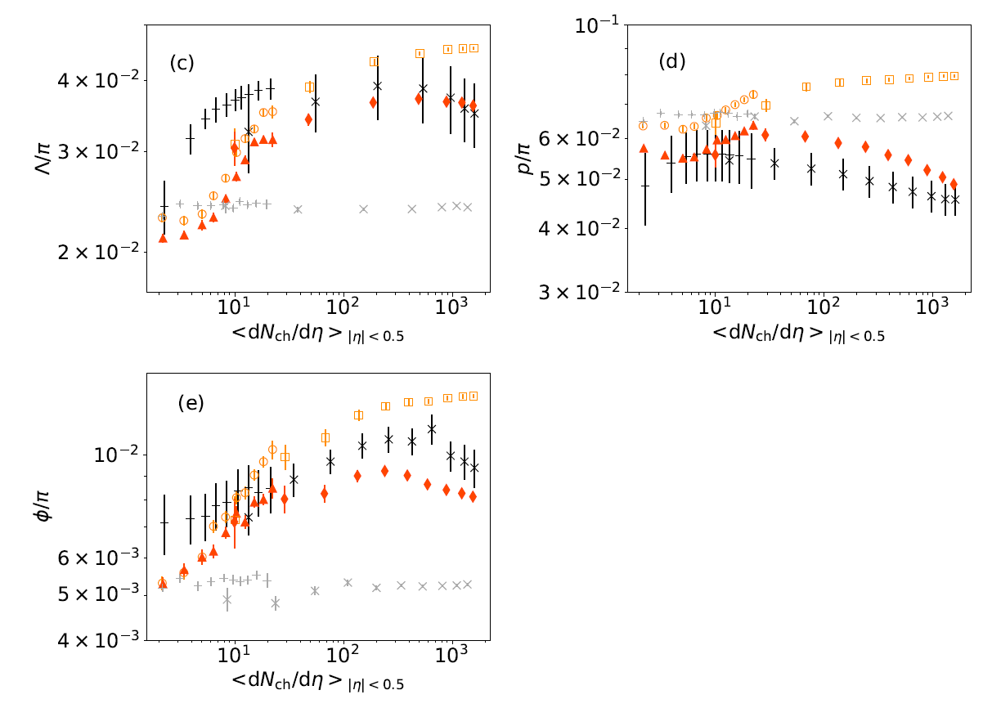
Effects of hadronic rescatterings
Significant suppression of yield ratios at central PbPb
✓Captured with dissociation/annihilation of hadrons in late stage
Visible hadronic rescattering effects even in pp collisions

Slide 44
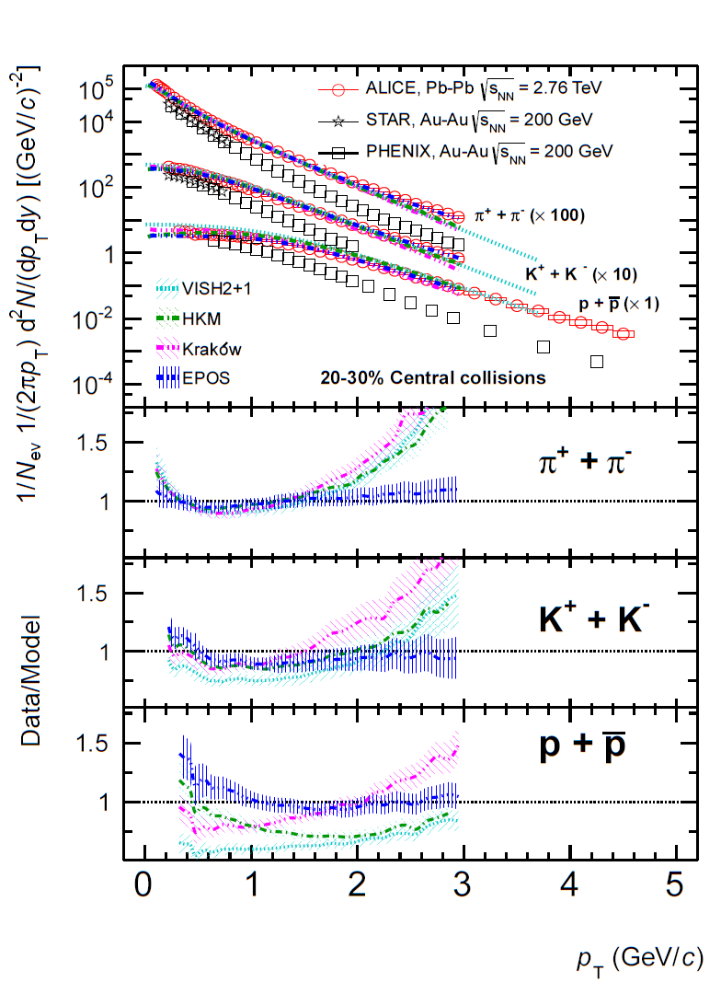
Lack of low $p_{T}$ yield from Hydro
ALICE Collaboration, Phys.Rev.C 88 (2013) 044910
Comparisons between exp. data and hydro models
➔ Lack of (very) low $p_{T}$ yield in hydro models
Be careful with semi-log plot!
Other sources to compensate the low $p_{T}$ yield?
Phys.Rev.C 103 (2021) 5, 054909

Slide 45
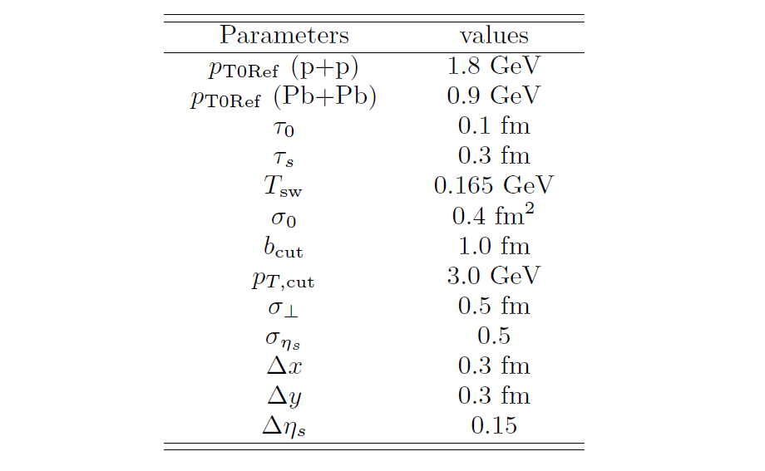

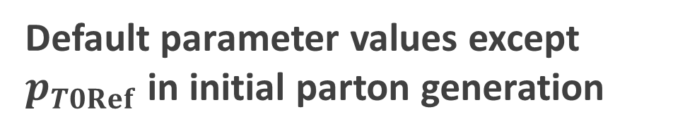
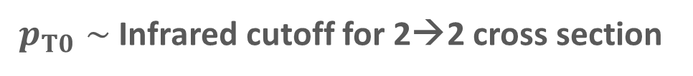

Parameter set for PYTHIA part: almost Monash Tune
How far can we go as a naive combination of hydro and PYTHIA
PYTHIA
…with simple starting point
Default parameter values except $p_{T0Ref}$ in initial parton generation
Hydro with dynamical core-corona
$$\frac{dσ_{2→2}}{dp_{T}^{2}}∝\frac{α_{s}^{2}\left(p_{T}^{2}\right)}{p_{T}^{4}}→\frac{α_{s}^{2}\left(p_{T}^{2}+p_{T,0}^{2}\right)}{{\left(p_{T}^{2}+p_{T,0}^{2}\right)}^{2}}$$
$p_{T0}∼$ Infrared cutoff for 2→2 cross section

Slide 46
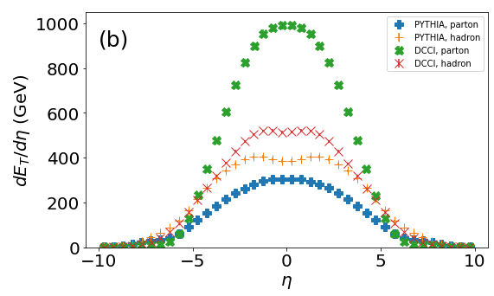
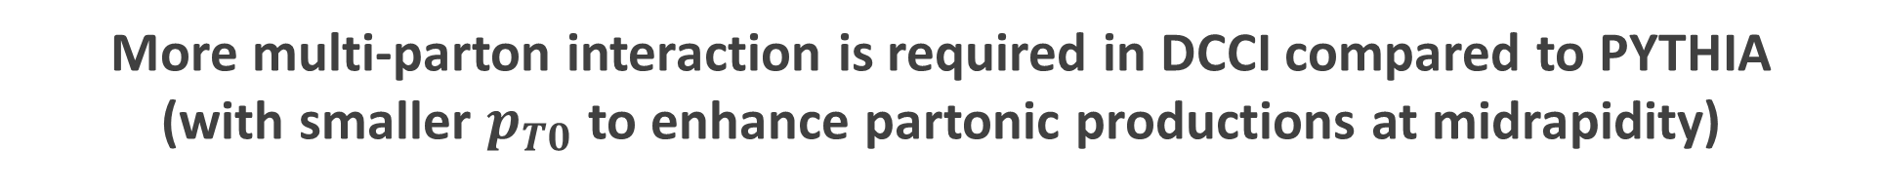

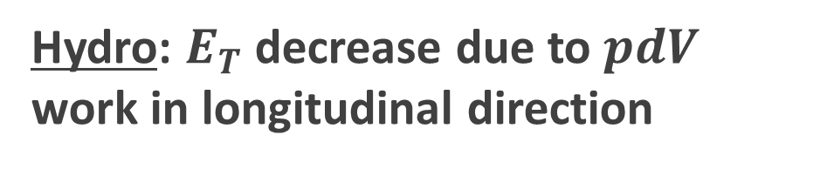
Difference of $E_{T}$ evolution between hydro and string frag.
PbPb (MB)
Hydro: $E_{T}$ decrease due to $pdV$ work in longitudinal direction
String fragmentation:
$E_{T}$ enhance
More multi-parton interaction is required in DCCI compared to PYTHIA
(with smaller $p_{T0}$ to enhance partonic productions at midrapidity)
Different dynamics in later stage
➔ Require different initial energy profile

Slide 47

Corona components from string modification
$$τ_{s}=0.3 fm$$
$$τ_{s}<τ<τ_{fo}$$
String cutting
Parton-pairing
String modification caused by ..
Discard dead partons
Find hypersurface boundaries $T_{sw}$
Sample partons & boost with $v_{fluid}$ at the boundary (recreation of color singlet )
・Spatial overlap of strings and medium
・Completely fluidized partons

Slide 48
Corona components from string modification (cont’d)
$$τ_{s}=0.3 fm$$
$$τ_{s}<τ<τ_{fo}$$
String cutting
Parton-pairing
4. Surviving partons traverse medium
5. Make a pair for a parton coming out from medium
Non-thermal & thermal
➔ Contributes as corona components
*$p_{T, cut}$: threshold to/not to modify a string

Slide 49


Toward “Standard Model” in high-energy nuclear collisions
$${ p}_{T}$$
high
Fragmentation
from
hard particles
High $p_{T}$
suppression
small
large
Multiplicity
Collective
flow from
hydrodynamics
Collectivity in
small systems
low

