Slide 1
Experimental Overview – RHIC
Fuqiang Wang (王福强)
湖州师范学院
Purdue University

Slide 2
Experimental Overview – RHIC
DISCLAIMER
  This is not an overview of all RHIC data
  Emphasis on small-system phenomena – theme of the workshop
  Possibly biased views and perspectives
TALK PLAN
  Overall science from RHIC – the 2000’s
  To understand details and specific physics (LHC insights) – 2010’s
  Why are small systems interesting?
  Likely new physics where things cannot be easily explained, push the envelope, beyond the limit…
  NONFLOW, NONFLOW, NONFLOW
  Not to lose our sight – we want to learn/discover new physics

Slide 3
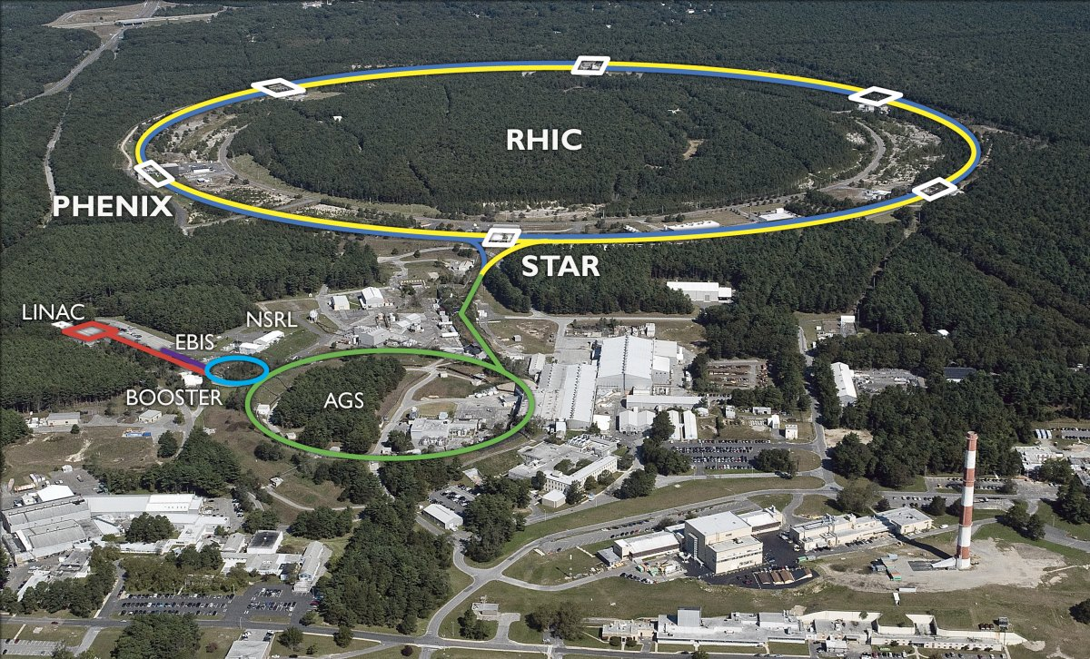
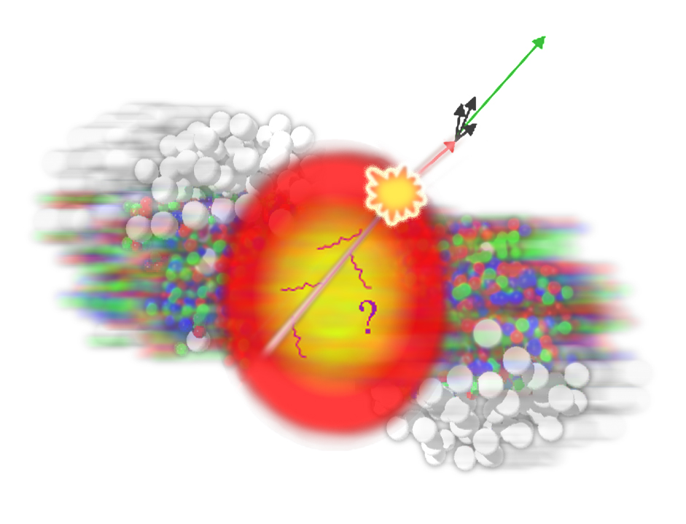
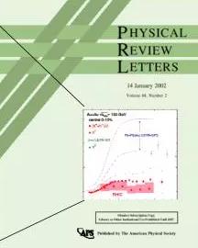
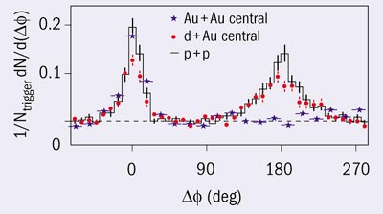
THE RHIC STORY 2000’s – Strong Jet Quenching

Slide 4
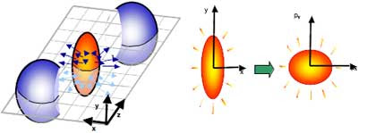
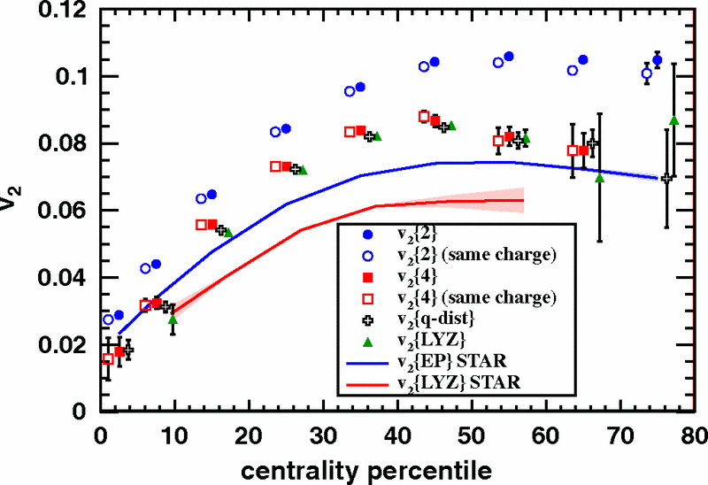
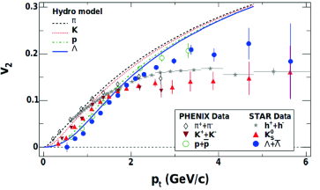
THE RHIC STORY 2000’s – Strong Elliptic Flow

Slide 5
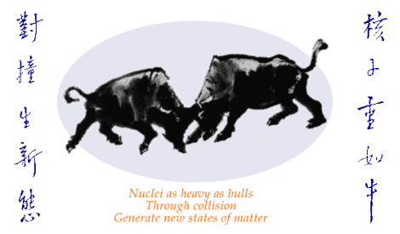
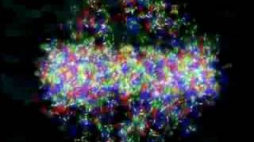

THE RHIC STORY 2000’s – The Perfect Fluid
Low η/s ≈ 1-2/4π

Slide 6
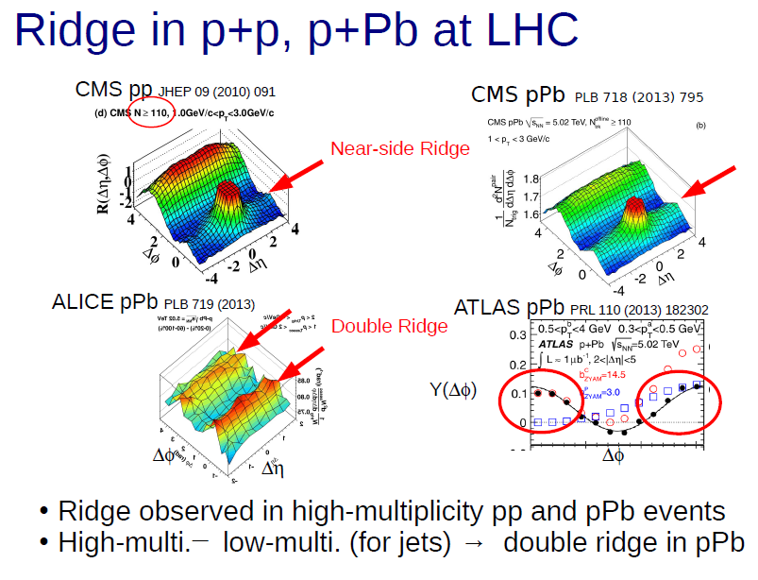
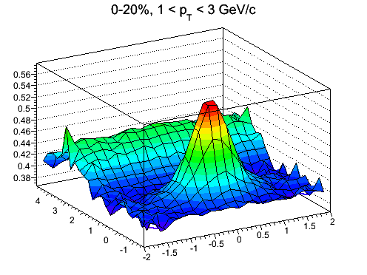
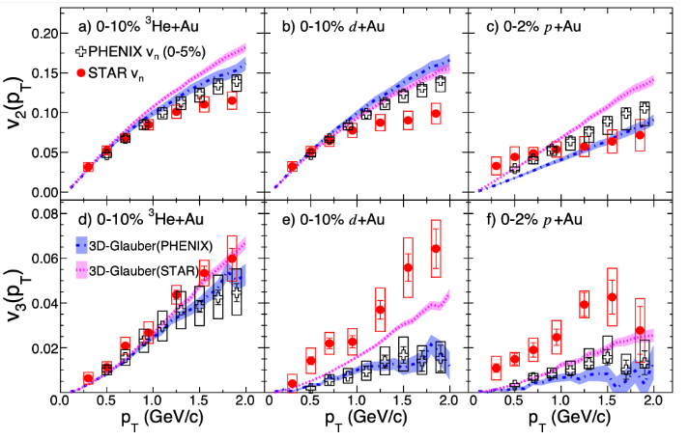
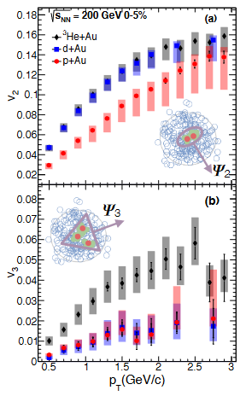
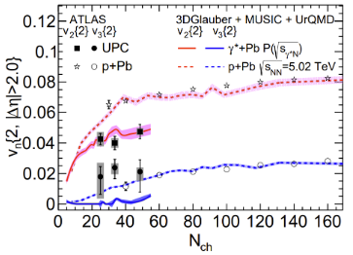
“A FLY IN THE OINTMENT” 2010’s
STAR
STAR dAu
PHENIX

Slide 7
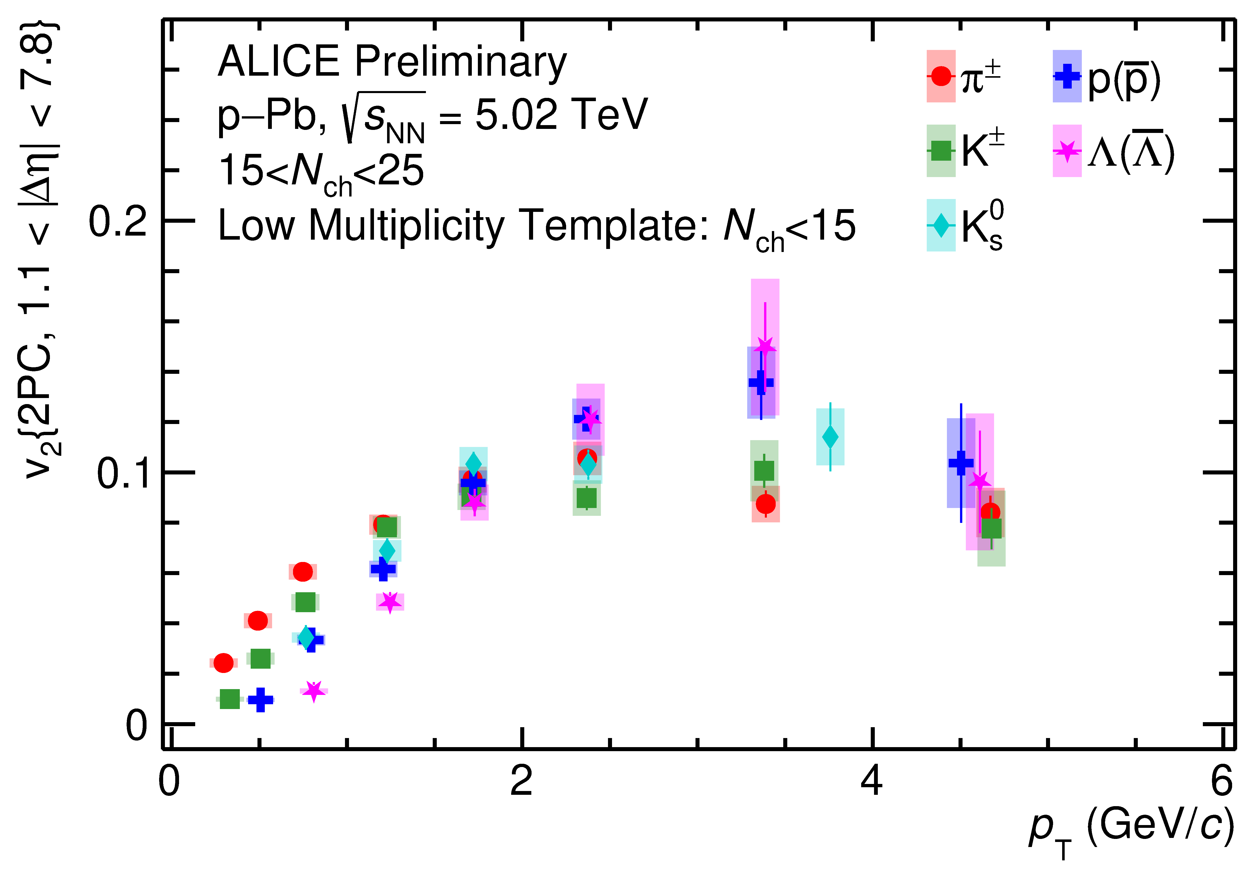
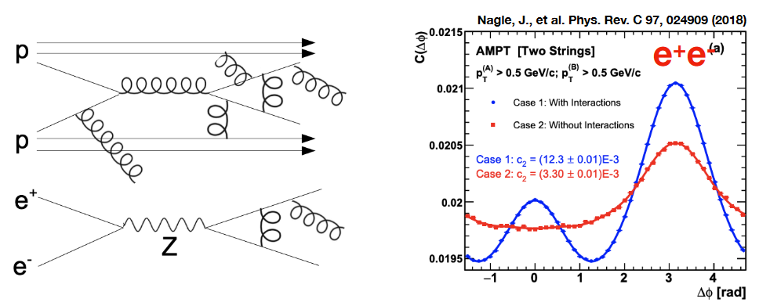
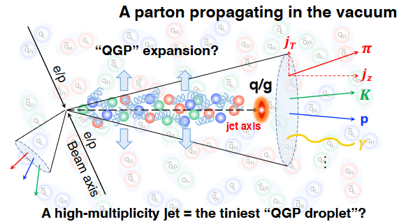
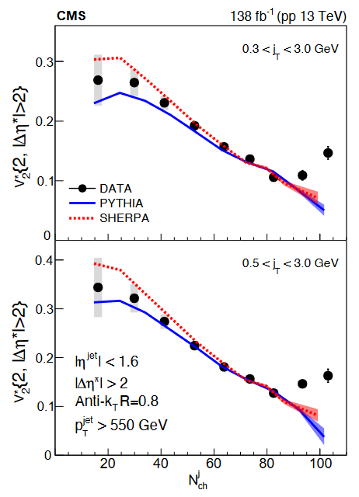
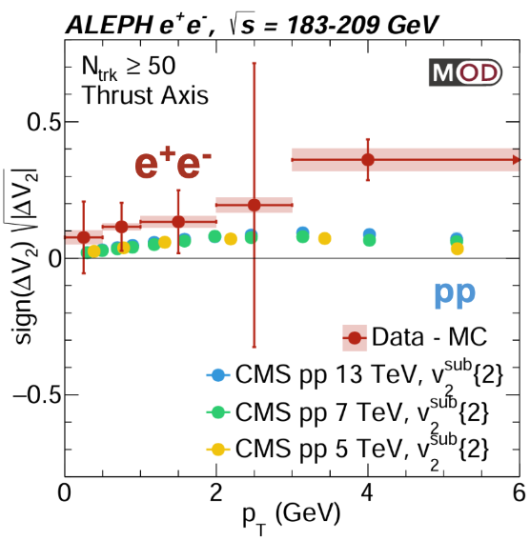
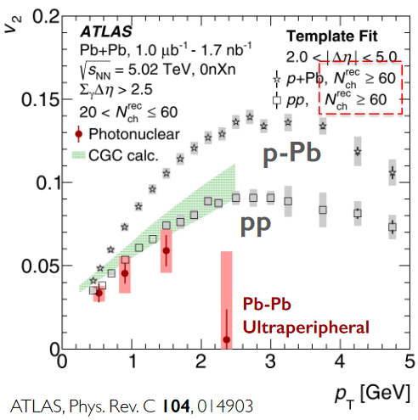
ULTIMATE SMALL SYSTEMS
CMS
arXiv:2312.17103
Baty, Gardner, and Li, PRC107 (2023) 064908, arXiv:2104.11735
Zhao, Lin, XN Wang, arXiv:2401.13137: particle scattering is essential for collectivity in jets
Two-particle long-range correlations
Austin Baty

Slide 8


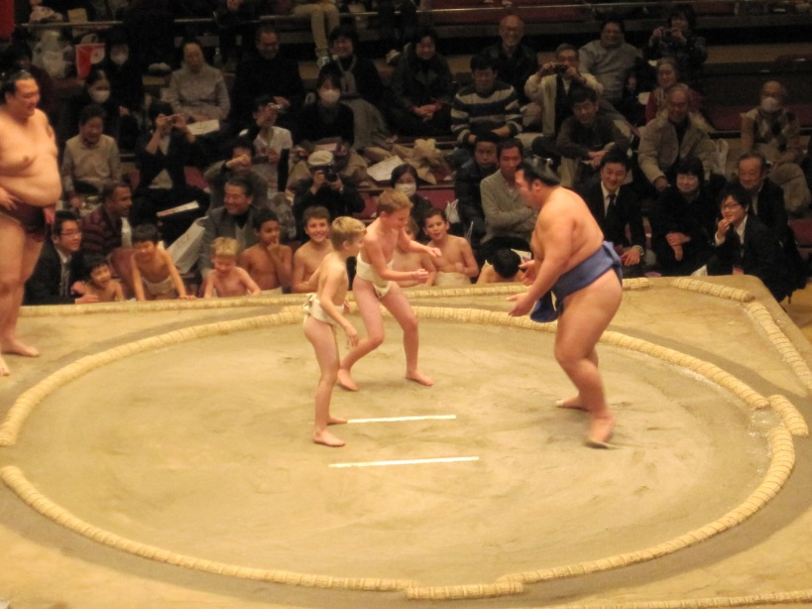
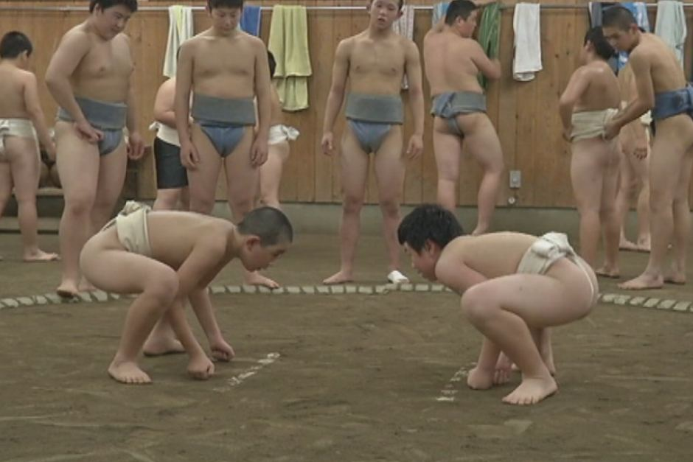

FLOW EVERYWHERE
AA
pA
dA
tA
pp

Slide 9
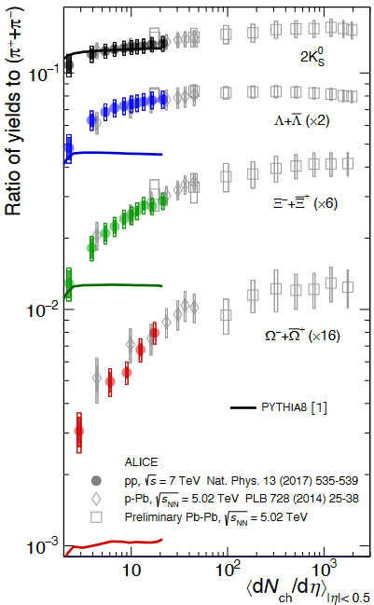
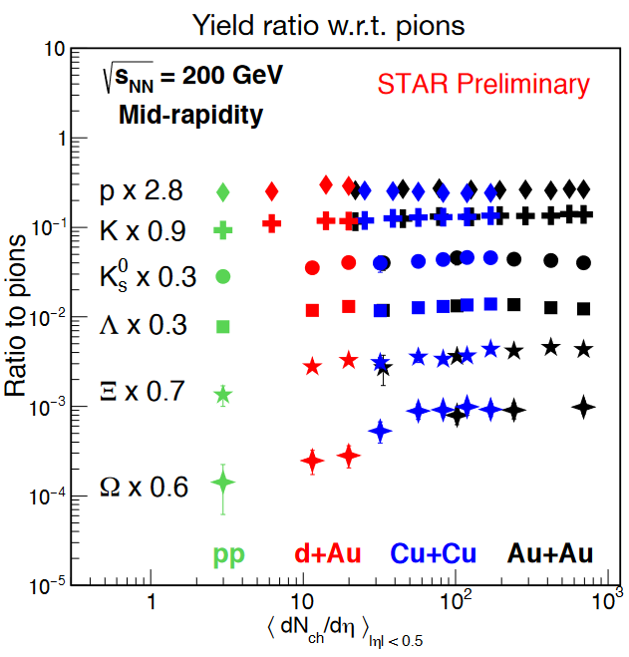
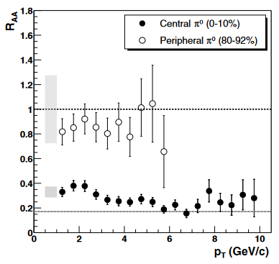
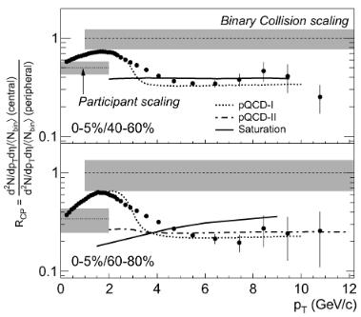
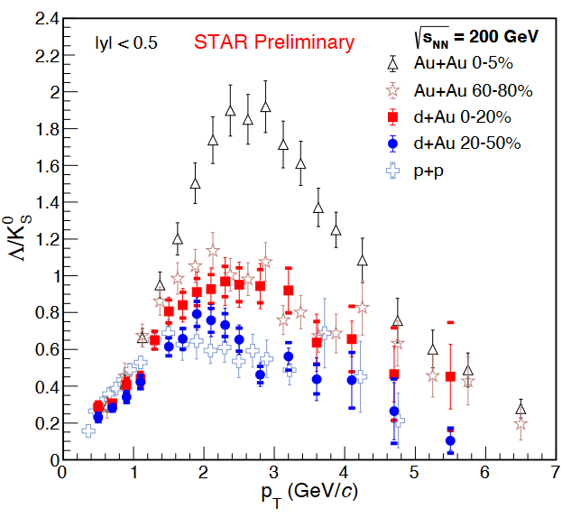
BUT… SMALL SYSTEM HAS BEEN THE BASELINE
Strangeness enhancement, large x-section process, ∼ Npart
Nuclear modification RAA, small x-section process, ∼ Ncoll
Chinellato, SQM
STAR, SQM
Cold nuclear effect
Nuclear shadowing
Jet quenching in hot QGP
PHENIX, PRL 91 (2003) 072301
STAR, PRL 91 (2003) 072302
I. Aggarwal
SQM

Slide 10
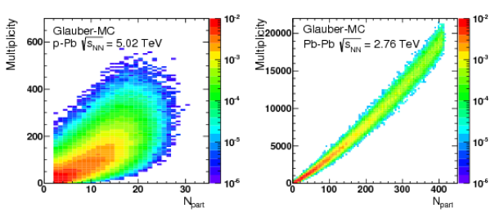
NO MUCH ENERGY LOSS IN SMALL SYSTEMS
No strong jet suppression is observed in high-mult. small systems
PHENIX, PRC 90, 034902 (2014)
PHENIX, 2303.12899. Maya SHIMOMURA, SQM
Centrality tricky in small systems
centrality ≠ geometry (b,N_{part}, ε,..)
R_{pA} measurements difficult and tricky
strong R_{AA} bias in peripheral (> 60%)
N_{ch} vs N_{part}
Clear suppression can be seen in central d+Au
while it’s consistent to 1 at peripheral

Slide 11
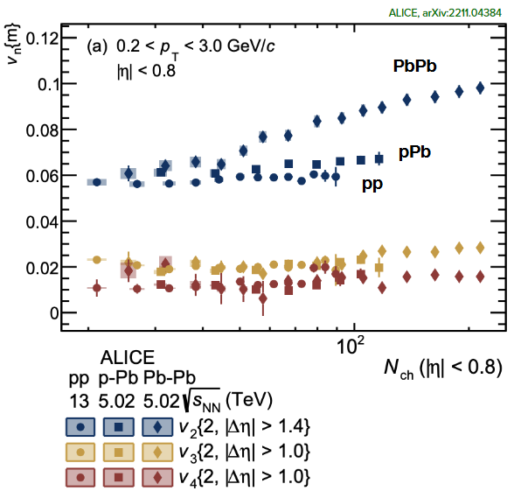
SO, NOW WHAT?
High pt suppression is very large -> no doubt about jet quenching ☺
Flow in small system is quite large, ∼AA ☹
  Small system QGP droplets? (Tevatron pbar-p, PHENIX He3 droplets)
  Large system not yet quite hydrodynamic?
ALICE, 2211.04384
STAR, PLB 747 (2015) 265
Nonfow?
Flow?
Nonfow?
Flow?
Reminder:
High mult. pp & low mult. pp can be very different
Central AA are very different from high mult. pp, not quite the same physics

Slide 12
THE NONFLOW ISSUE
Small system collisions have a geometry as well because of fluctuations
Flow/collectivity is a global correlation to the collision geometry
  Unnecessarily hydrodynamic
  Final-state interactions (however, initial-state effect can be important)
  Long-ranged but can be η dependent
Nonflow is few-body correlations
  Resonance decays, jets, etc.
  Mainly short-ranged, but can also be long-ranged (e.g. dijets)
Jet v_{n}, because of jet quenching, is flow.
Intra-jet and dijet correlations are nonflow.

Slide 13
NONFLOW ESTIMATE
1) Δη gap
  Pros: easy, straightforward
  Cons:
    not clean: how far does near-side nonflow extend
    dijet correlation is long range (largely dipole, but how much contamination to higher v_{n}?)
    flow/plane decorrelation -> result is Δη-gap dependent
2) Data-driven isolation
  Pros: minimal assumption
  Cons:
    diligent effort, careful decomposition
    large uncertainties
Kai Xiao et al, PRC 87, 011901(R) (2013)
Piotr Bozek, et al., PRC 83, 034911 (2011)
STAR, PLB 745 (2015) 40

Slide 14


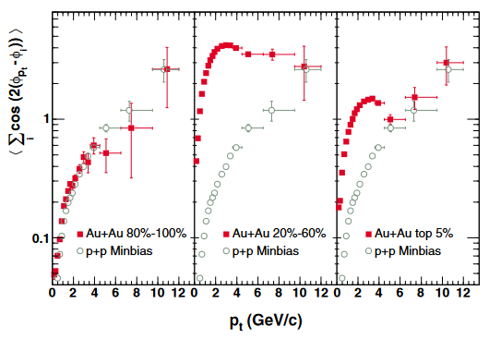
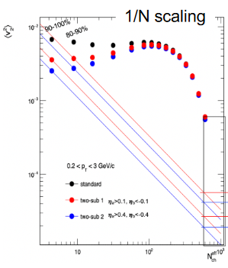
NONFLOW MULTIPLICITY SCALING
STAR, 2210.11352
Shengli Huang
3) Low-multiplicity subtraction
  Pros: easy
  Cons:
    assumes all is nonflow in low multiplicity
    assumes no change in nonflow from low to high multiplicity, or AA=pp:
    multiplicity dilution 1/N: what low multiplicity to choose?
c₀ method
High multiplicity pp events are strongly biased towards jet events. Low-mult. pp strongly biased toward other way.
Very peripheral AA is biased. Central AA are not so much biased (combination of MB pp events), even ultra-central and extreme high multiplicity.
Jiangyong Jia
Nonflow 15%
Lowest mult. (AA or pp) is unnecessarily the best to use for subtraction
Take MB pp for subtraction is probably most appropriate for central AA (note same nonflow assumed). Small system high mult – low mult is dangerous.

Slide 15
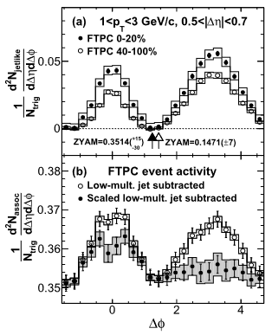
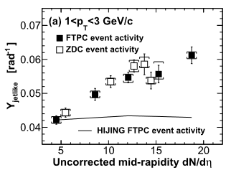
TRIGGER/MULTIPLICITY BIASES
Jet modifications -> nonflow changes
Resonance pt broadening -> nonflow changes
STAR, PLB 743 (2015) 333
Even without changes in physics, there are trigger/multiplicity/centrality selection biases
STAR, PLB 747 (2015) 265
Low-multiplicity subtraction in small system: high multiplicity pp events are strongly biased towards jet events.
Low multiplicity subtraction should be taken as a grain of salt.

Slide 16
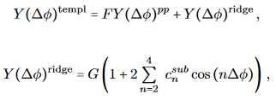
NONFLOW SUBTRACTION
4) Near-side jet yield scaled subtraction (assuming nonflow scales by near-side jet correlated yield):
  Pros: partially take care trigger bias and jet modifications
  Cons:
    assumes how jet modification scales: near-side scaling may be an overestimate (surface trigger bias)
    more difficult, esp. at low pt
5) Template fit (assuming nonflow in AA to have same shape as pp but scaled by factor F)
  Pros: partially take care trigger bias and jet modifications
  Cons:
    assumes jet modification is an overall scale F, not shape (doesn’t make sense at all, to me at least)
    F is a fit parameter, no priori constraint on its magnitude
c₁ method: assumes nonflow is v1
Same as template fit, except no corresponding
change in the normalization factor (the
subtracted pp is effectively first averaged to zero)
CMS
ATLAS, PRL 116, 172301 (2016)

Slide 17
MULTIPLICITY SCALING OF NONFLOW
Template fit extended further into small system itself
high-mult. = F * low-mult. + “flow”
Fourier coefficients of correlations are more or less independent of mult.
Same c_{n} in low- and high-mult. events
Template fit will give the same c_{n}
for “flow” as well
Implication:
low mult. is nonflow,
high mult. is flow
Nonfow?
Flow?
Nonfow?
Flow?

Slide 18
NONFLOW ESTIMATE BY 2D/1D FITS
7) 2D/1D fit decomposition: Yicheng Feng talk
STAR, arXiv.2308.16846, 2310.13096
Feng et al. PRC 105, 024913 (2022)
40%
10%
20%
30%
20%
60%

Slide 19
FLOW MEASUREMENTS IN SMALL SYSTEMS ARE DIFFICULT
PHENIX, Nat. Phys. 15 (2019) 214
Shengli Huang
v₃ longitudinal decorrelation,
nonflow, acceptance differences
PHENIX/STAR discrepancy not fully settled

Slide 20
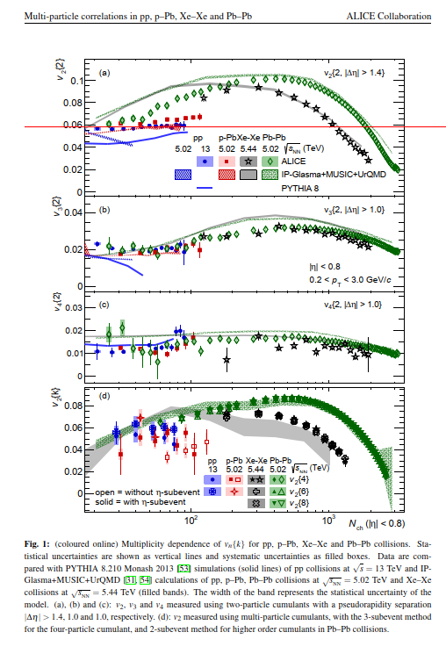
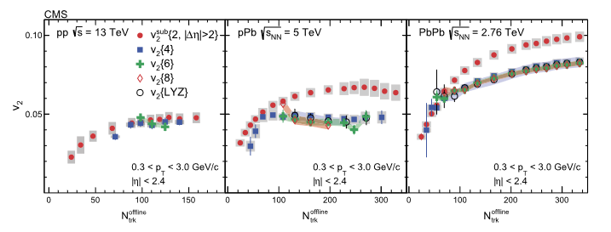
PECULIAR MULTIPLICITY INDEPENDENCE
ALICE, PRL 123 (2019) 142301
Vn is independent of multiplicity in small systems
Juergen Schukraft:
Initial- to final-state conversion should increase with N
Geometry fluctuation anisotropy decreases: 1/N
Accidental cancellation?
STAR, PLB 747 (2015) 265
CMS, PLB 765 (2017) 193

Slide 21
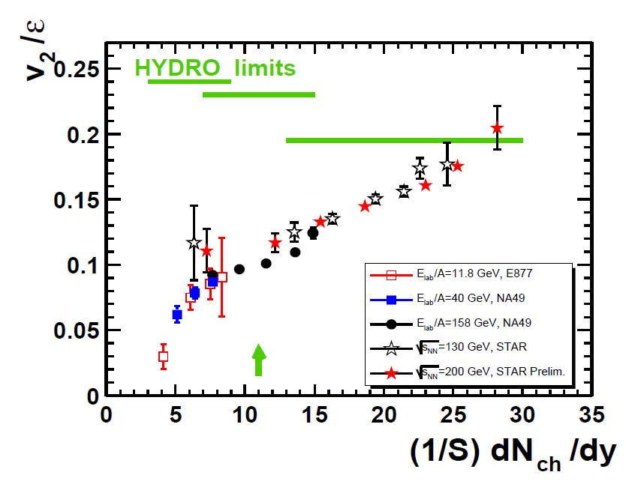
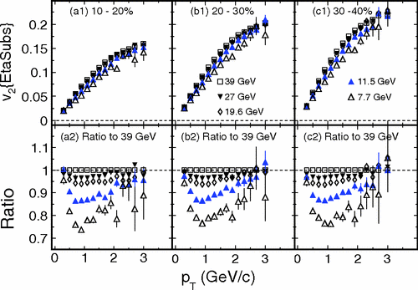
VERY LITTLE ENERGY DEPENDENCE
circa 2005
STAR, circa 2013
PHENIX, PRL98, 162301 (2007)

Slide 22
ANISOTROPY MECHANISMS
No expansion, escape
Expansion, flow

Slide 23
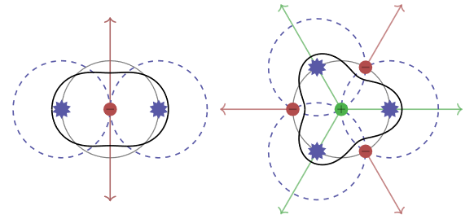
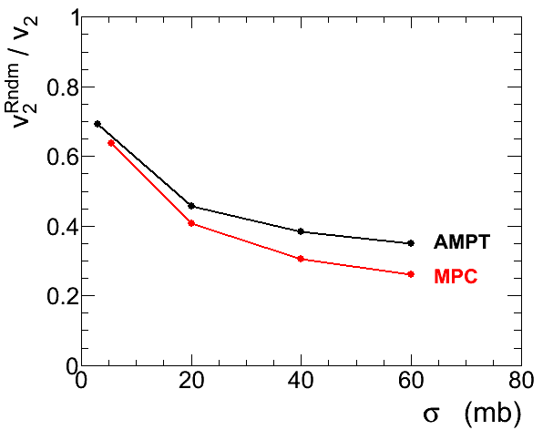
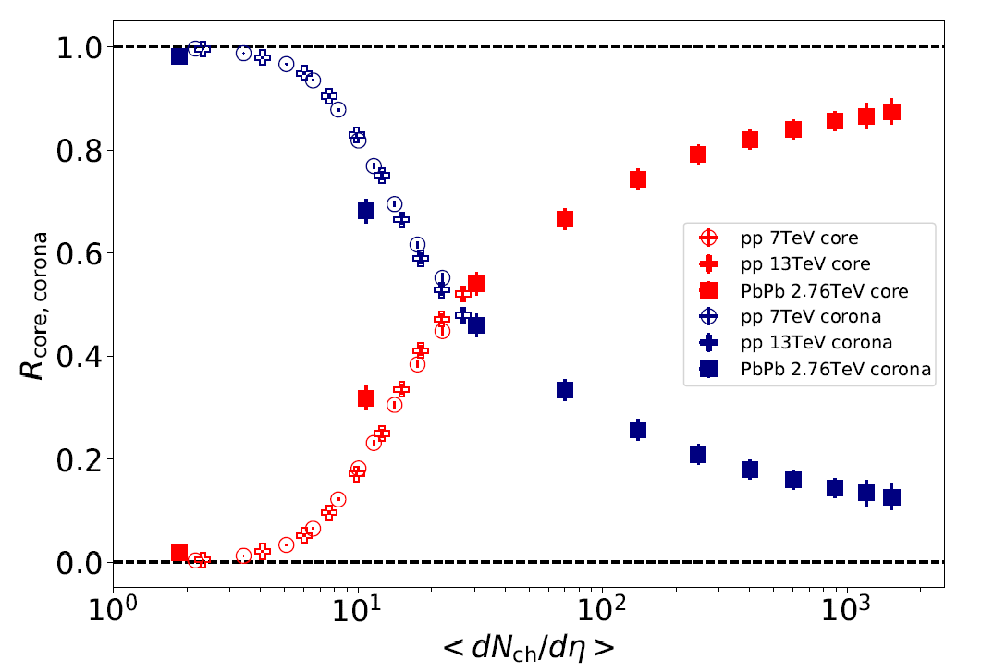
ESCAPE MECHANISM
L. He et al., PLB753 (2016) 506, arXiv:1502.05572
Kurkela et al. JHEP11(2021)216, single-hit anisotropies
Partons freeze out with large positive v₂, even when they do not interact at all.
Remaining partons start off with negative v₂, and become ∼isotropic (v₂∼0) after one more collision.
Romatschke, EPJC 75 (2015) 429, arXiv:1504.02529
Collective flow without hydrodynamics, free-streaming
Escape still sizeable even at x10 larger σ
Kanakubo et al., Phys. Rev. C 105, 024905 (2022)
Au+Au, b=7-8 fm
Core
N_{coll} ≈
5 20 35 50
Corona

Slide 24
CAN WE EXPERIMENTALLY TEST IT?
Central heavy ion collisions are probably dominated by hydro-type collective motion, but anisotropies seem energy independent (BES-II to top RHIC energy)
Problematic to push hydro to small systems (mean free path, core/corona, nonflow and jets…)
Multiplicity independent anisotropies
R_{AA} basically consistent with unity, no clear evidence of jet quenching in small systems
(note: recent PHENIX d+Au indicate energy loss effects)
Unsatisfactory to have to rely on models to interpret data measurements
Can we experimentally demonstrate collectivity at work (or the lack of)?
tunable interaction strengths
manufacturable initial conditions
controllable system size and particle density
Cold atom systems:

Slide 25
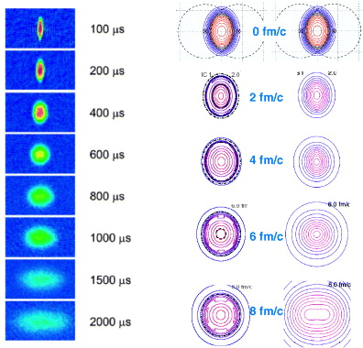
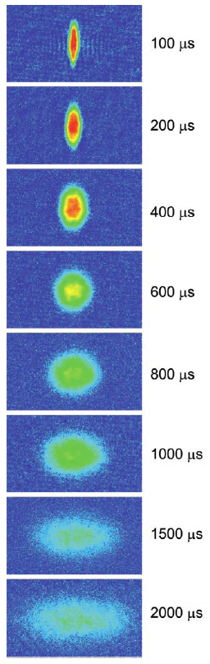

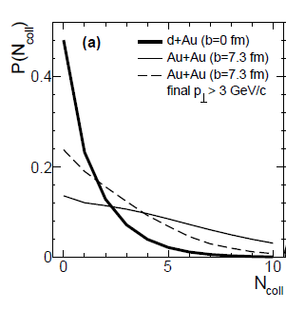
STRONG ELLIPTIC ANISOTROPY
Hot QGP
Cold atoms
?
Hydro?
Hydro!
Mean free path?
L_{mfp} = 1/ρσ , Prob. = exp(−L/L_{mfp})
= opacity
= 1/Knudsen
K. M. O’Hara et al., Science 298, 2179 (2002)
Kolb, Heinz, nucl-th/0305084; Lisa et al. New J. Phys. 13 (2011) 065006
a ≈ −0.5 μm
σ_{int} ≈ 0.1 μm²
ρ ≈ 50 /μm³
L_{mfp} ≈ 0.2 μm
L ≈ 20 μm
L/L_{mfp} ≈ 100
AMPT
N_{coll} ≈ O(1)
Low opacity in QGP modeled by AMPT
Very high opacity for the cold atom system

Slide 26
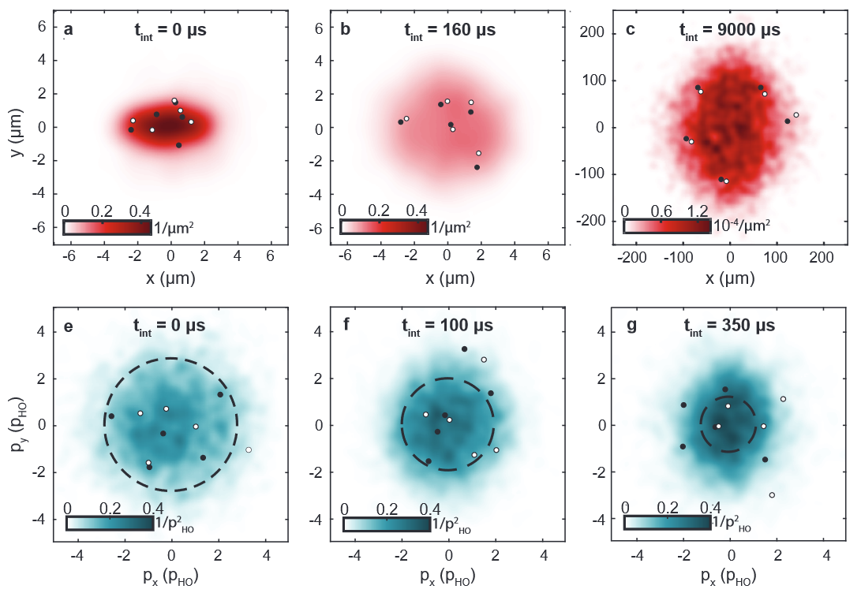
VERY FEW ATOMS ONLY
Brandstetter et al., arXiv:2308.09699
Emergent hydrodynamic behaviour of few strongly interacting fermions

Slide 27
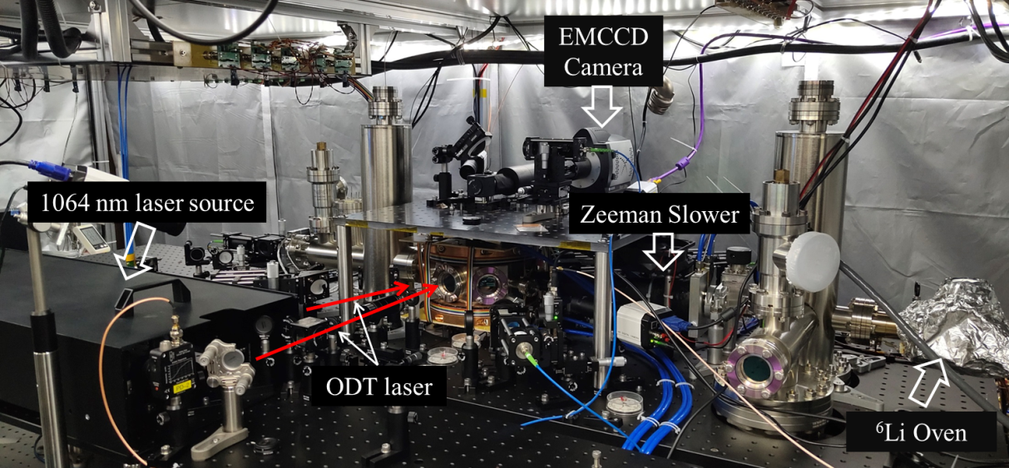
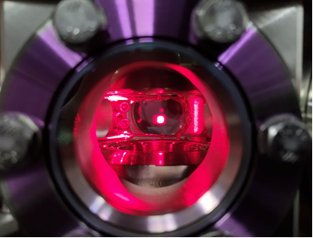
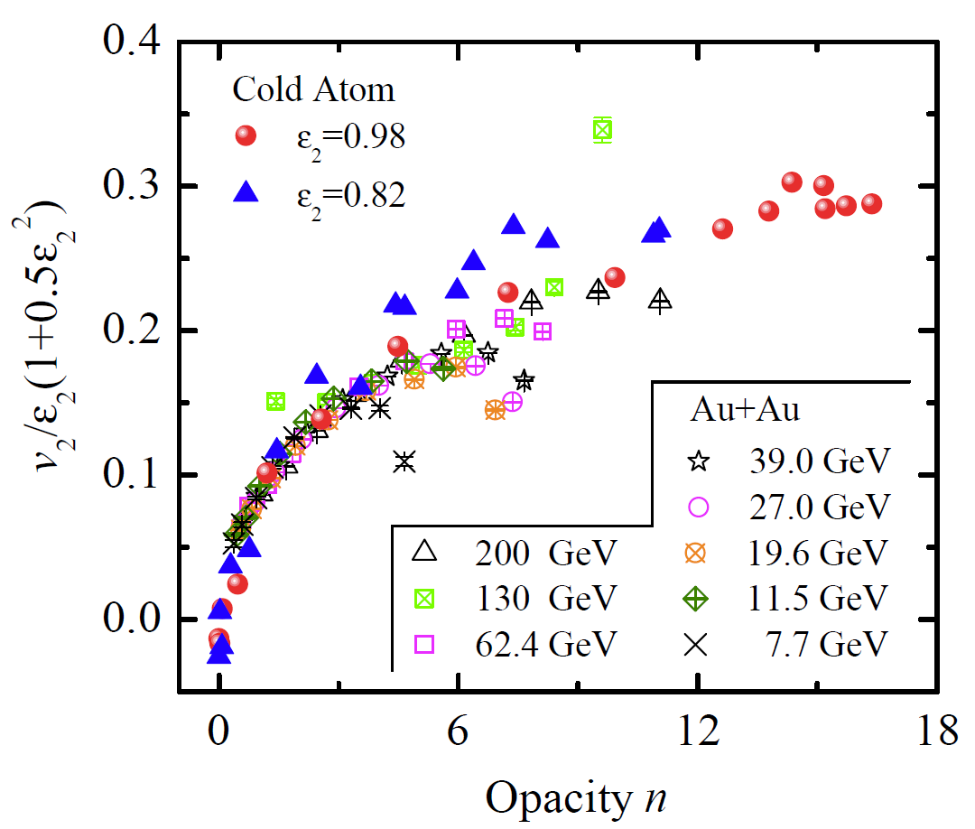
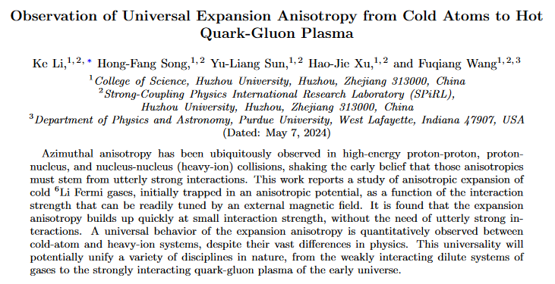
EXPERIMENTAL RESULTS
Trapped Cold ⁶Li Cloud
Ke Li et al., arXiv:2405.02847 [cond-mat.quant-gas]

Slide 28
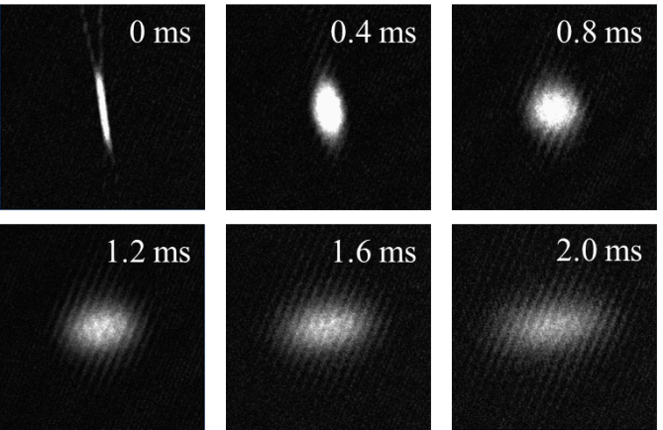




ANISOTROPIC EXPANSION OF FERMI GASES
1/11.4
831 G
B = 831G, a_{s} = 1.86 μm
B = 527 G, a_{s} ~ 0 μm
Ballistic expansion
0.94 mm
1/3.17
757 G
$$σ_{i}{(t)}^{2}=σ_{i}{(0)}^{2}+〈{v_{i}}^{2}〉t^{2}$$
$$v_{2}=\frac{〈{v_{x}}^{2}〉−〈{v_{z}}^{2}〉}{〈{v_{x}}^{2}〉+〈{v_{z}}^{2}〉}$$
0.63 mm
Notes:
我们通常在845G进行蒸发冷却（其时散射长度为负，as = -1.8 um)，这样可以比较快。我们实现了在两个不同光阱中的蒸发冷却。这个表格是将光阱功率降低到 1 W时，在两个版本光阱中制备6Li原子气体的基本性质。因为原子气体被冷却到接近一倍的费米温度处，是非简并状态的，密度分布还是可以用高斯密度分布来拟合。这种正常相的费米气体（冷原子气体）很容易表现出各向异性膨胀特点，其强弱可以外磁场来改变。（右上图）是在831G时观测到各向异性膨胀，（右下图）是757G外磁场条件下的观测到各向异性膨胀。它们的差别在于初始各向异性，分别是1/11.4和1/3.17.
（时序图中的磁场调节范围并不是我们实验中最大的范围。实际上磁场最大可调到 1230 G）

Slide 29



v₂ vs. INTERACTION STRENGTH
Ke Li et al., arXiv:2405.02847 [cond-mat.quant-gas]
Normalize by initial eccentricity v₂/ε ₂
L. He et al., PLB753 (2016) 506
Opacity
Calculate n for test particle traversing from origin:
a ≈ −0.5 μm
σ_{int} ≈ 0.1 μm²
ρ ≈ 10 /μm³
L_{mfp} ≈ 1 μm
L ≈ 20 μm
L/L_{mfp} ≈ 20

Slide 30



COMPARE TO HEAVY-ION DATA
Nonlinearity:
Important at large ε₂
1+ ε₂²/2, insensitive to centrality
Noronha-Hostler, PRC 93, 014909 (2016)

Slide 31
UNIVERSAL EXPANSION ANISOTROPY
Ke Li et al., arXiv:2405.02847 [cond-mat.quant-gas]
Smooth, but apparently two distinct regions:
  Anisotropy builds up quickly,
  within ∼1 collision
  After ∼3 collisions, the system appears already ∼hydrodynamic
However, can be described by a single universal curve: ∼ √n
  Random walk
Universal trend, but vastly different systems:
  Electromagnetic vs strong interaction
  Temperature 10⁻⁶ vs 10¹² K, 18 orders
  Density 1 μm⁻³ vs 1 fm⁻³, 27 orders
3

Slide 32
TO UNDERSTAND MULTIPLICITY INDEPENDENCE
ALICE, 2211.04384
ALICE, PHYSICAL REVIEW LETTERS 123, 142301 (2019)
Juergen Schukraft:
v/e ~ √n
e ~ 1/ √n
v ~ constant

Slide 33


EMERGING PICTURE

Slide 34

SUMMARY – PERSONAL VIEWS
Collectivity: a universal behavior of interactions in finite size.
Quickly turns on, couple of interactions are enough for equilibration.
Continuous physics evolution from small to large systems.
No need to invoke new physics mechanisms.
Generic property of interactions;
May have different labels in different
regions: escape…single hit…hydrodynamics.
Low- or high-density system?
Small systems: low density; Large AA systems: unclear
Does it matter? Maybe…More is different!
Not sufficient for strong (collisional) energy loss effect so no strong quenching in small systems?

Slide 35


RHIC creates a nearly perfect fluid QGP
Anisotropy is as large as hydrodynamics predict
Ideal hydro: zero mean free path, infinite interaction strength
Viscous hydro: large but finite interaction strength, quantum limit on
shear viscosity over entropy density ratio η/s > 1/4π
Song et al. PRL 106 (2011) 192301
Low η/s ≈ 1-2/4π
Very low viscosity, very strong interaction
Notes:
Phys.Rev.Lett. 106 (2011) 192301,
Phys.Rev.Lett. 109 (2012) 139904 (erratum)

Slide 36






But anisotropies are ubiquitous, and in small systems
ALICE
PHENIX
ALICE
PHENIX dAu
STAR dAu
ATLAS
Δη ∼ 3
PHENIX dAu
STAR

Slide 37


