Slide 1
QCD Medium modification of jets in heavy-ion collisions
Guo-Liang Ma (马国亮)
复旦大学
现代物理研究所

Slide 2
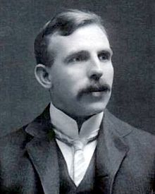
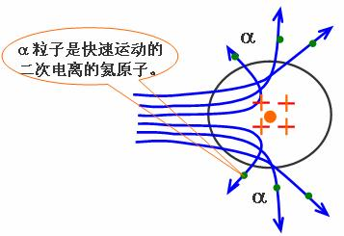

Hard probe of Atom
Target
Basic idea: shoot a probe into medium to learn about the properties of the medium
Probe

Slide 3
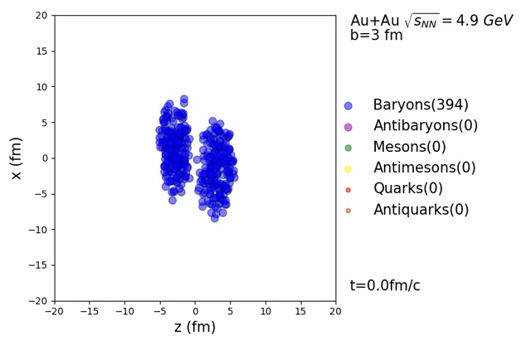
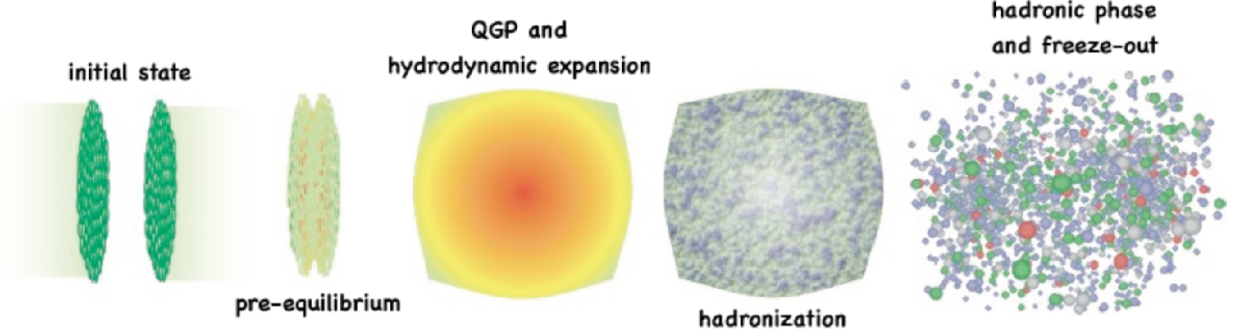
QGP && Relativistic heavy-ion collisions
Au+Au collision
王瀚生制作

Slide 4
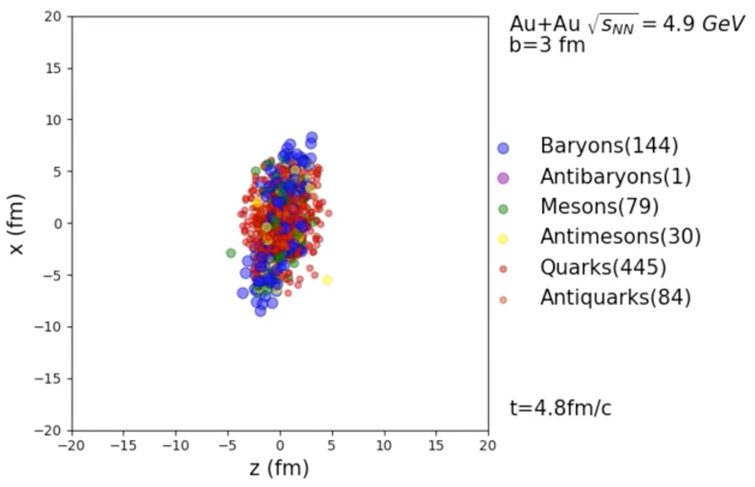

Hard probe of QGP?
Au+Au collision

Slide 5
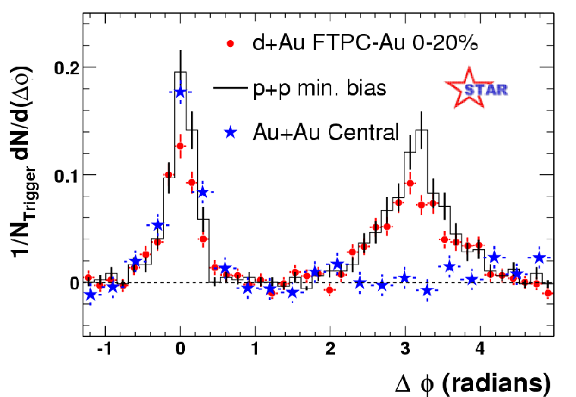
Hard probe of QGP: Jet quenching
Jet quenching:
X.-N.Wang and M.Gyulassy, Phys.Rev.Lett.68,1480(1992)
The hard jet loses a significant amount of its energy via gluon radiation induced by multiple scattering.
Leading particle suppressed
leading
particle
hadrons
hadrons
q
q
PRL 96, 202301 (2006)
q
q
hadrons
hadrons
leading
particle suppressed
leading particle
N-N collision
A-A collision
5

Slide 6
Chronicle of jet quenching
1982, Bjorken (unpublished): elastic dE/dx too small
1990,Gyulassy, Pluemer: Evoking inelastic dE/dx
1992, Gyulassy, XNW: Suppression of leading hadrons due to jet quenching
1994, Gyulassy, XNW: First calculation of radiative parton energy loss with LPM
1995, Gyulassy, Pluemer, XNW: Estimate of mono-jet rate in AA at RHIC
1996, Huang, Sarcevic, XNW: Medium modified fragmentation function & gamma tagged jet quenching
1996, Zakharov: Path integral formulation of dE/dx
1997, Baier et al: non-abelian LPM in QCD- interaction with gluonic clouds
2000, XNW: First estimate of Cronin at RHIC
2000, Gyulassy, Levai, Vitev: Opacity expansion I.
2001, Wiedemann: Opacity expansion II
2001, Guo, XNW: Higher-Twist expansion and calculation of modified frag. function.
2001, XNW, GVW: high p_{T} v₂ due to jet quenching
2002: RHIC: Suppression of high p_{T} hadron in Au+Au
2003: RHIC: v₂ at high pt observed
2003: RHIC: Suppression of back-side jet
……

Slide 8
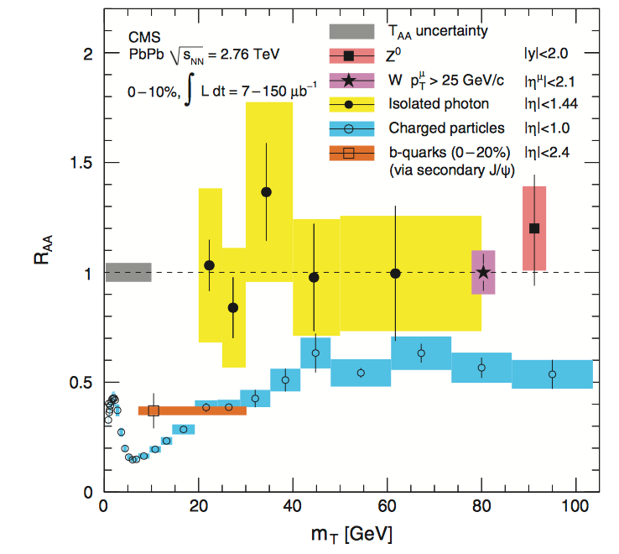
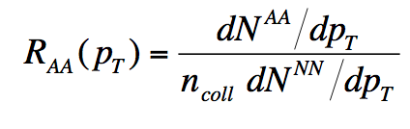
Nuclear modification factor
Suppression of leading hadron production compared to pp baseline
Uncolored particles are not quenched: Photons, Z, W

Slide 9
Disappearance of away side in dihadron correlation

Slide 10
Disappearance of btob jet

Slide 11
Jet Algorithms

Slide 12
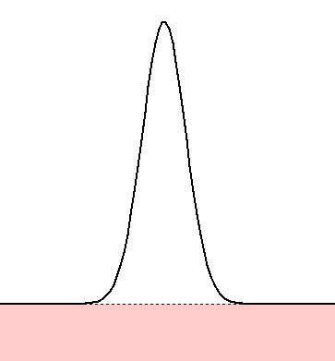
jet reconstruction in A+A
correction
Raw jet energy
Background
subtraction
Jet energy
correction
Jet energy
Remove underlying
events contribution
MC Simulation
PYTHIA

Slide 13
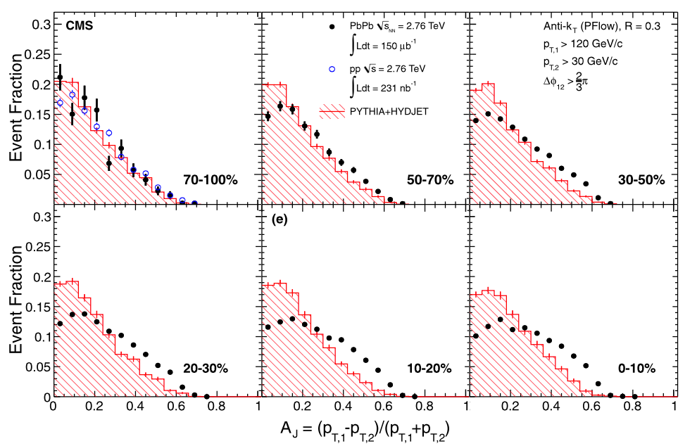
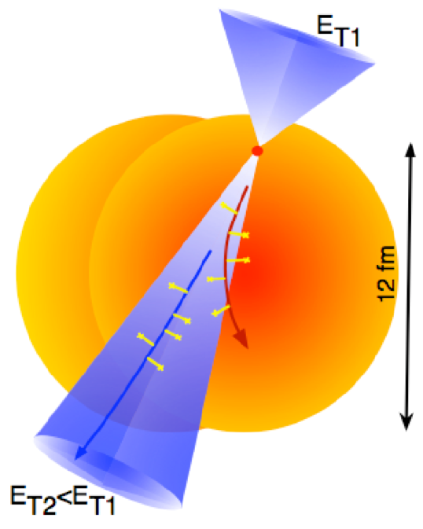
Dijet asymmetry
Body Level One
  Body Level Two
    Body Level Three
      Body Level Four
        Body Level Five
Periphreral events have an unmodified AJ
In pp, asymmetry arises from 3-jet events
Asymmetry much enhanced in central AA

Slide 14


Problem of jet trigger: surface bias
Selection on a high p_{T} leading jet (charged particle) may bias the position of the hard scattering in the QGP
All hard collisions
Can happen in any place in the QGP
High p_{T} leading jet
Triggered sample

Slide 15
How about correlate photons and jets?
Hadrons
photon+jet
Surface bias is removed!
Jet
Gluon
“quark-gluon
compton scattering”
Quark
pT^{photon} ~ pT^{Jet}
Photon

Slide 16
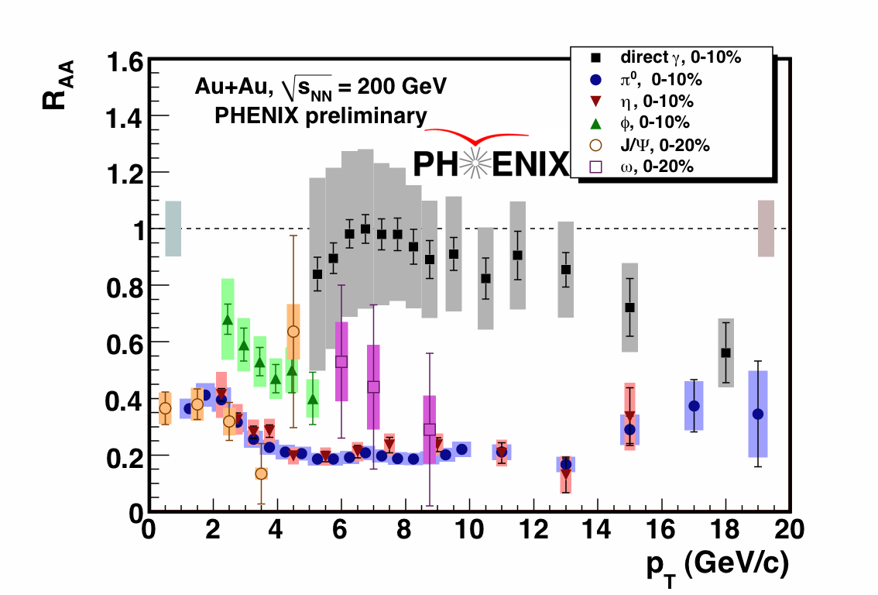

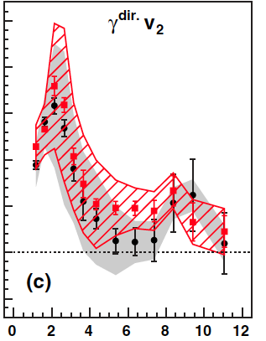

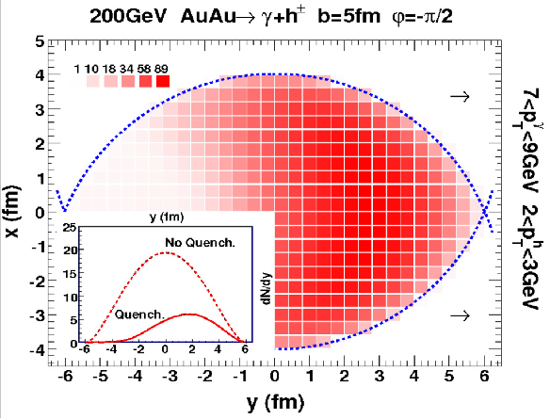
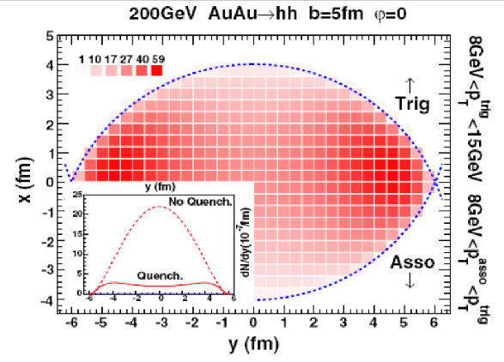
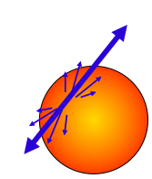
A golden probe: γ-jet (@ RHIC)
direct photon
q
q
quark/gluon jet
suppressed
PHENIX, PRL 109, 122302 (2012)
Hanzhong Zhang, Jeseph F.Owens,
EnkeWang & Xin-Nian Wang (2009)
thermal
Prompt γ has no energy loss and does not flow.
γ-hadron probes medium differently from dihadron.

Slide 17
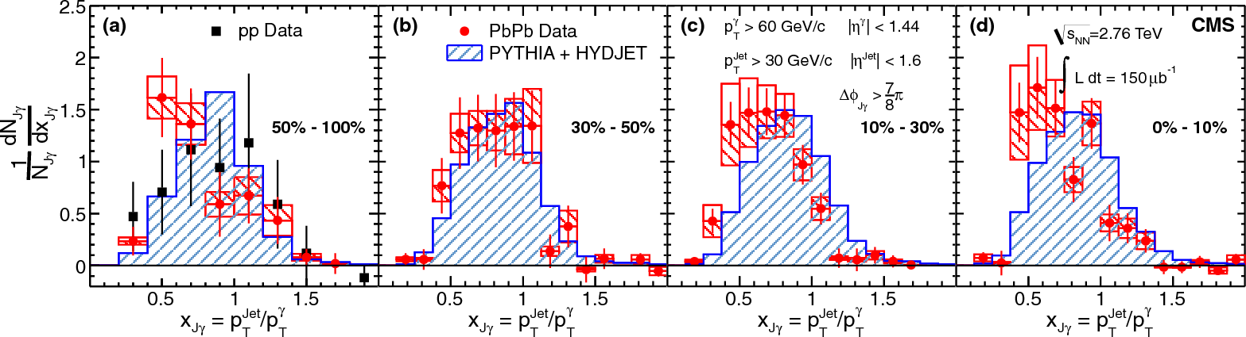
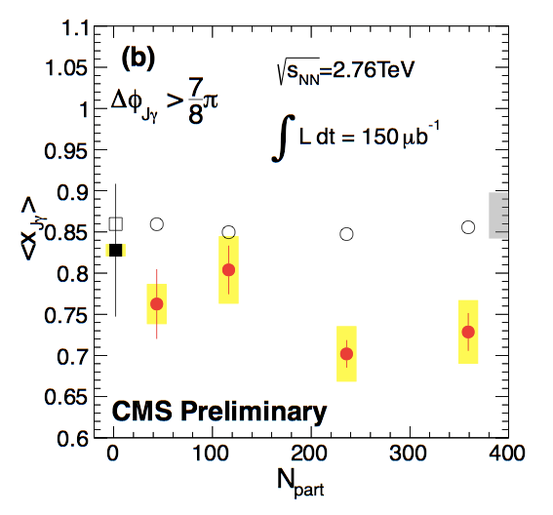
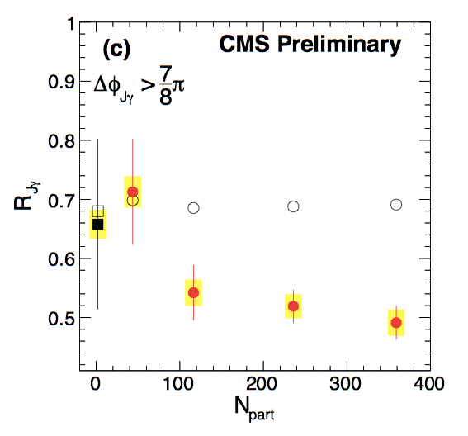
γ-jet momentum imbalance at LHC
γ-jet momentum imbalance @ LHC
arXiv: 1205.0206
Ɣ-jet momentum balance fraction:
xjƔ = pT^{Jet}/pT^{Ɣ}
PbPb
Vacuum (pp collision)
vs. QGP (PbPb collision)
PbPb
Quark/gluon jets lose about 15% of their initial energy.
20% of photons lose their jet partner.

Slide 18
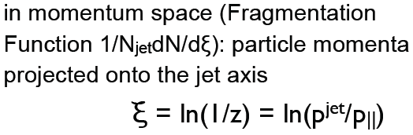
Jet fragmentation function

Slide 19
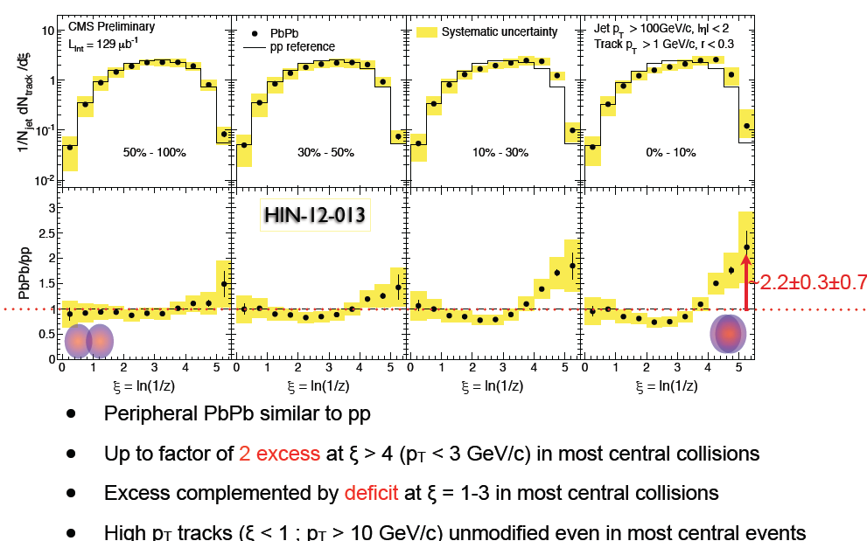
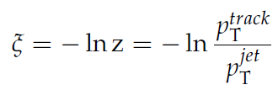
Jet fragmentation function
Select Tracks in ΔR=0.3 cone p_{T}> 1 GeV/c

Slide 20
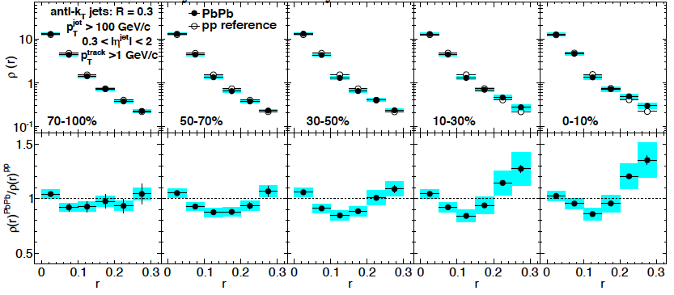
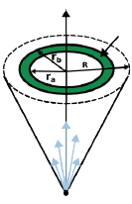
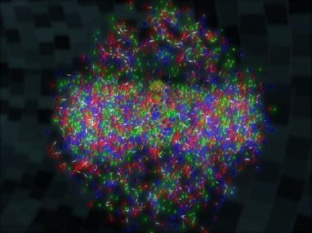
Jet shape @ LHC
CMS, arXiv: 1310.0878
No modification in peripheral Pb+Pb collisions
No modification at small r, suppression at intermediate r and enhancement at large r in central Pb+Pb collisions

Slide 21
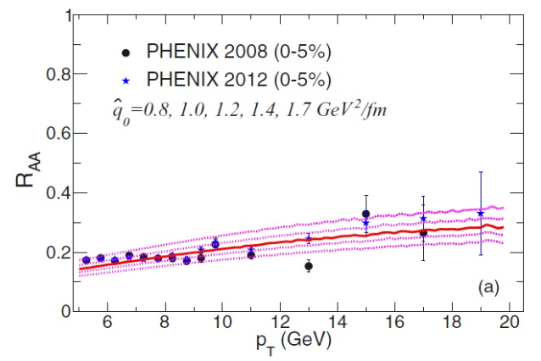
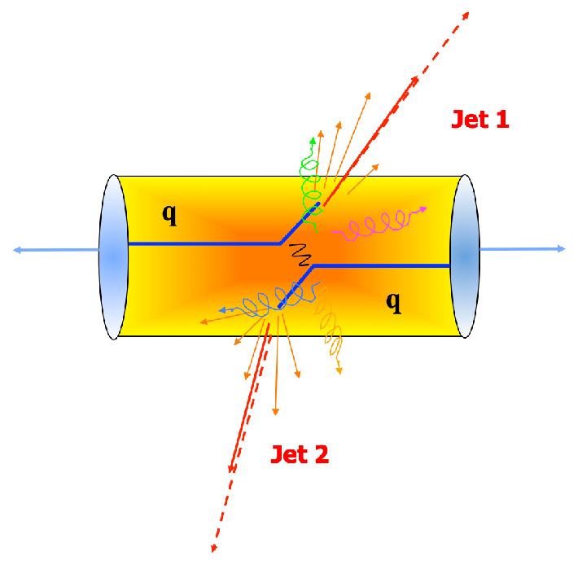
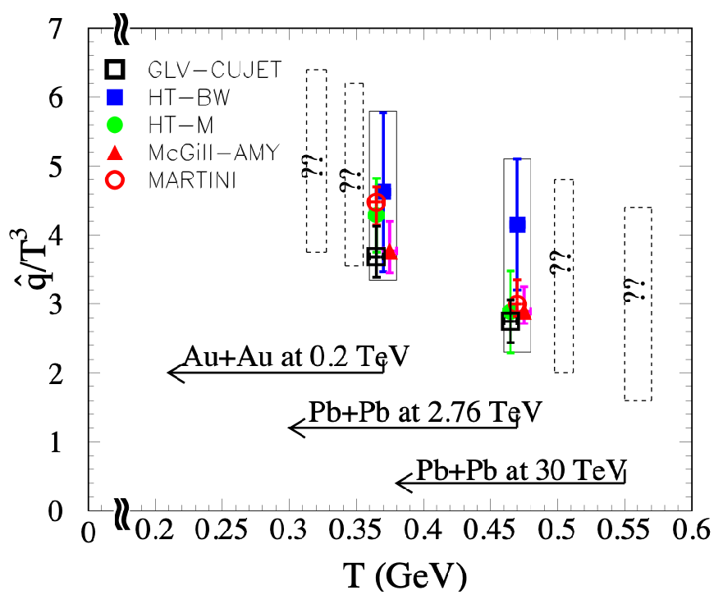
Jet quenching parameter q^
qˆ = d⟨∆p²_{T} ⟩/dL
the mean of the transverse momentum squared exchanged between the propagating parton and the colored medium per unit path length.
JET Collaboration: Phys.Rev. C90 (2014) 1, 014909
Exp. observable based on single leading hadron: RAA, IAA, dihadron…
Jet transport parameter q^: for an initial quark jet with energy E=10 GeV:
(HTL)

Slide 22
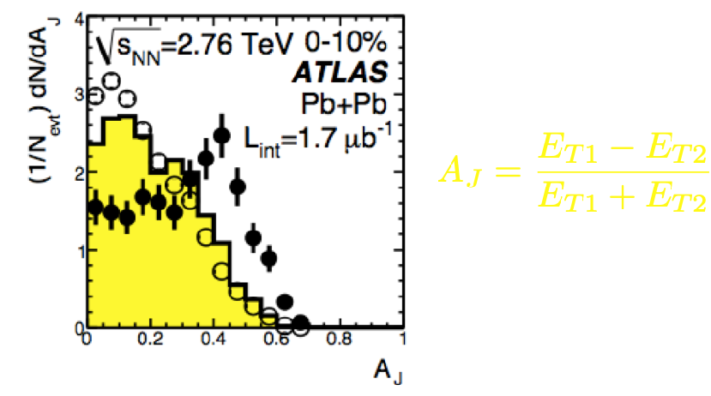
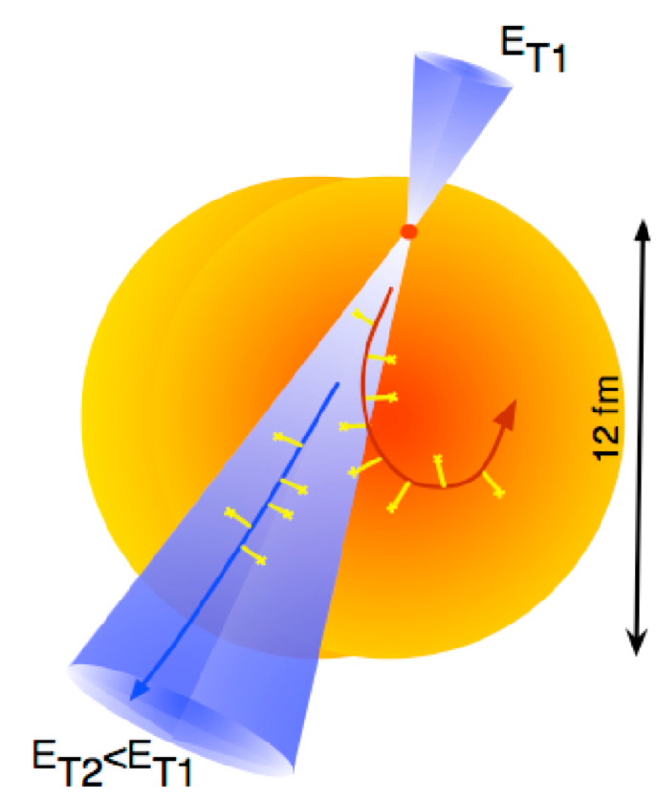
Jet energy loss (full jet)
ET1-ET2
AJ=
ET1+ET2
JET Collaboration: Phys.Rev. C90 (2014) 1, 014909
From reconstructing full jets, can we know jet transport coefficient q^?

Slide 23
Outline
AMPT model introduction
Results about reconstructed jets
  Dijet asymmetry
  γ-jet imbalance
  Jet shape
  Jet fragmentation function
  Jet vn
  Jet q^

Slide 24
Models of jet quenching
•LBT [HT] : recoiled partonstransported. (shower + transport)
Recoil-medium interaction
•CoLBT-hydro [HT] : Transport + Hydro parallel simulation. (shower + transport)
Recoil-medium interaction
•MARTINI [AMY] : recoiled partonstransported. (shower + transport)
Recoil-medium interaction
•JEWEL [BDMPS-Z] : recoiled partonsfree-stream. (modified partonshower)
No recoil-medium interaction
•Hybrid [AdS/CFT]: fully thermalized wake. (modified partonshower)
Recoil-medium interaction (simplified)
•Coupled Jet-Fluid [HT] : solve Boltzmann equation semi analytically + Hydro simulation
Recoil-medium interaction
•AMPT, BAMPS, etc

Slide 25
Boltzmann equation: evolution of particle phase space distribution

Slide 26
Boltzmann equation: evolution of particle phase space distribution

Slide 27

string-melting AMPT model
A+B
HIJING (PDFs, nuclear shadowing):
minijet partons, excited strings, spectators
Melt to q & qbar via intermediate hadrons
玻尔兹曼部分子输运
ZPC (Zhang's Parton Cascade)
[2<->2 elastic collisions]
Partons freeze out
Hadronization (Quark Coalescence)
玻尔兹曼强子输运
ART (A Relativistic Transport model for hadrons)
Hadrons freeze out (at a global cut-off time);
strong-decay all remaining resonances
Final particle spectra
Z. W. Lin, C. M. Ko et al. PRC 72, 064901 (2005)

Slide 28
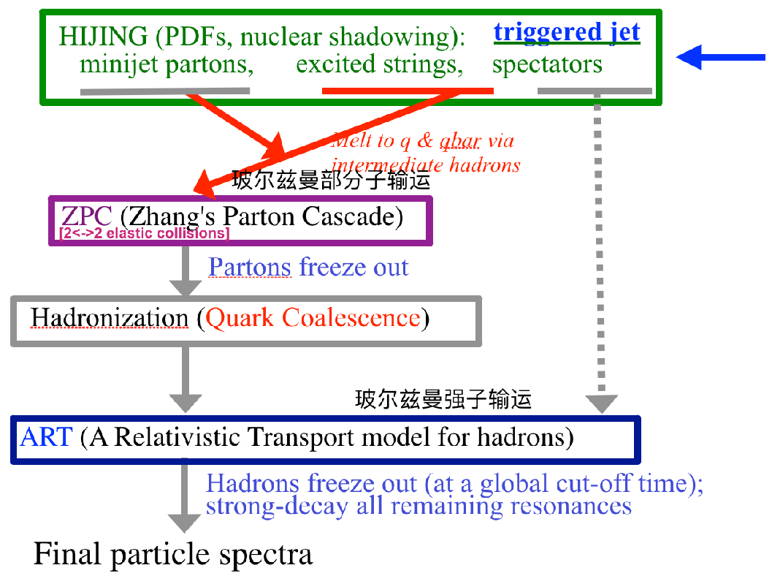
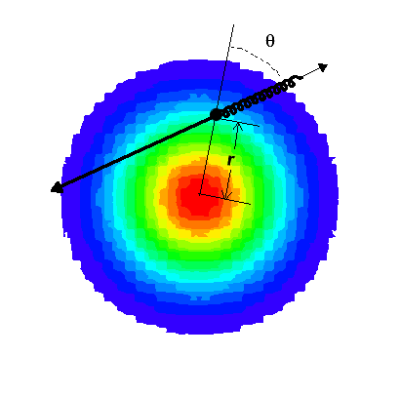
AMPT model with triggered jet
=
+
QGP
jet
a triggered dijet/γ-jet with known momentum and production position (r,θ)
Dijet and γ-jet events for Pb+Pb 2.76-TeV collisions.
String-melting AMPT simulations: 1.5 mb / 0 mb to turn on/off jet-QGP interactions.

Slide 29

Jet reconstruction
q
q
jet
  Jet reconstruction: anti-kt algorithm, [Fastjet package, background subtraction, jet energy scale correction, jet efficiency correction]
  Dijet asymmetry: R=0.5, pT,1>120 GeV/c, pT,2>50 GeV/c, |η1,2|<2, Δɸ12>2π/3
  γ-jet imbalance: R=0.3, pT^{jet}>30 GeV/c, |η^{jet}|<1.6; pT^{Ɣ}>60 GeV/c, |η^{Ɣ}|<1.44, ΔɸjƔ>7π/8
  Jet fragmentation function and shape: R=0.3, pT^{jet}>100 GeV/c, 0.3<|η^{jet}|<2, pT^{ch}>1 GeV/c
  Jet vn: R=0.2, pT^{jet}>45 GeV/c, |η^{jet}|<2

Slide 30
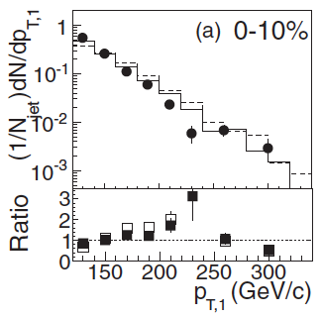
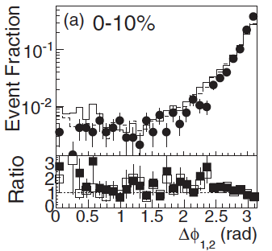
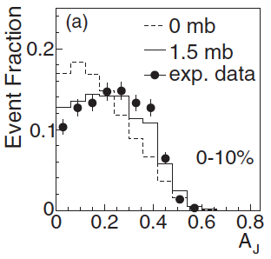
Dijet characters
  G.L. Ma, PRC 87, 064901 (2013)
A_{J}=(p_{T,1}-p_{T,2})/(p_{T,1}+P_{T,2})
Dijet pT spectra and back-to-back azimuthal correlation are not sensitive to the existence of partonic phase.
Dijet asymmetry is enchanced due to strong parton cascade.

Slide 31
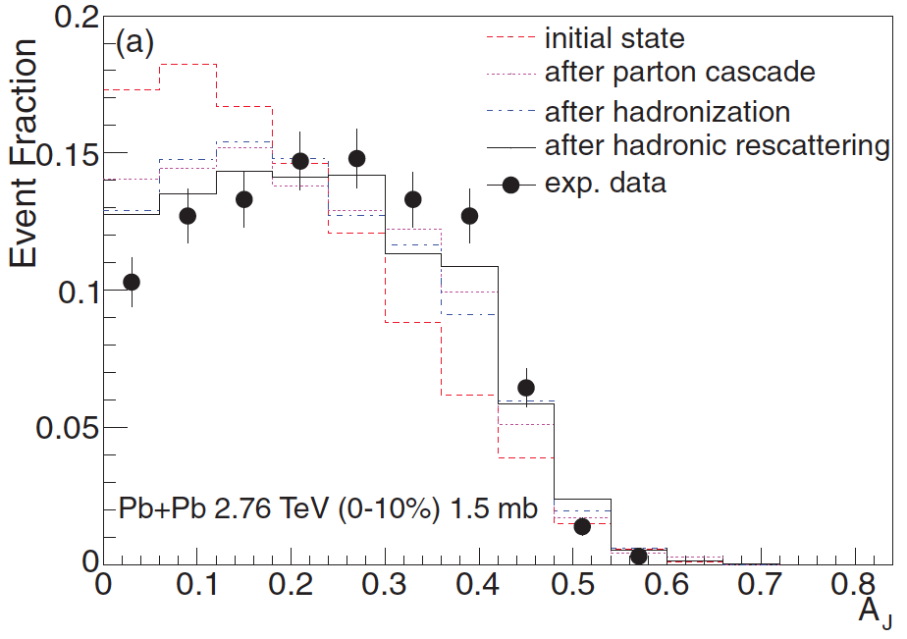
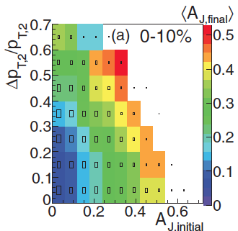
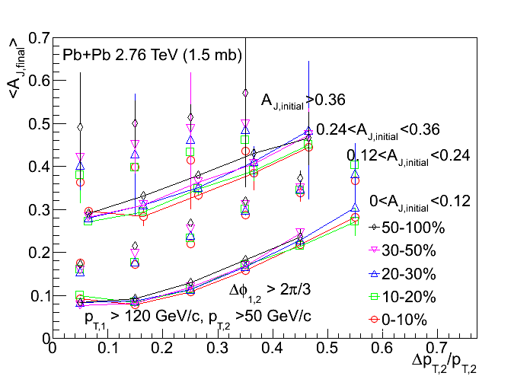
Dijet asymmetry
  G.L. Ma, PRC 87, 064901 (2013)
AJ evolution function:
AJ,final (AJ,initial, ΔpT/pT)
A large dijet asymmetry (AJ) is produced by strong interactions between jets and partonic matter.
The final AJ is driven by both initial AJ and partonic jet energy loss.

Slide 32
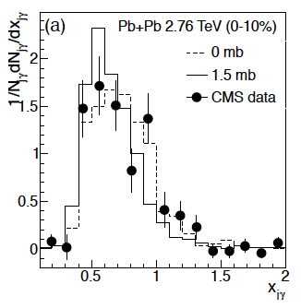
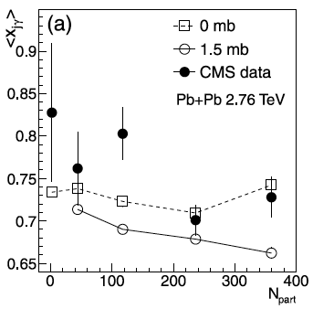
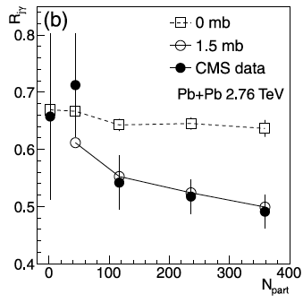


γ-jet imbalance
G.L. Ma, PLB 724,278 (2013)
ΔɸjƔ>7/8 π
xjƔ = pT^{Jet}/pT^{Ɣ}
Jet
Jet losses more energy by strong partonic interactions than by hadronic interactions only.
Rjγ favors a partonic jet energy loss scenario.
Photon

Slide 33
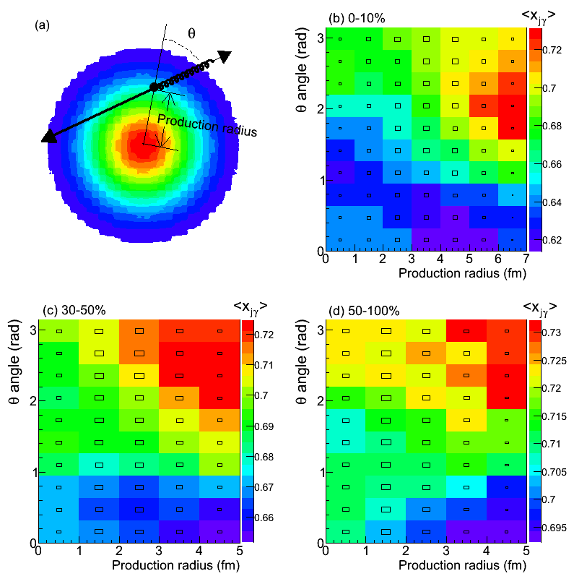
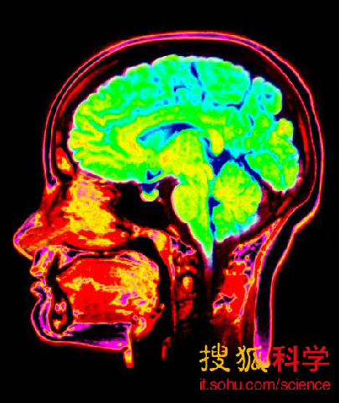
γ-jet tomography of QGP
G.L. Ma, PLB 724,278 (2013)
0-10%
30-50%
50-100%
xjƔ = pT^{Jet}/pT^{Ɣ}
Pb+Pb 2.76 TeV
ΔɸjƔ>7/8 π
xjγ is sensitive to the birth information (r,θ) of γ-jet.

Slide 34
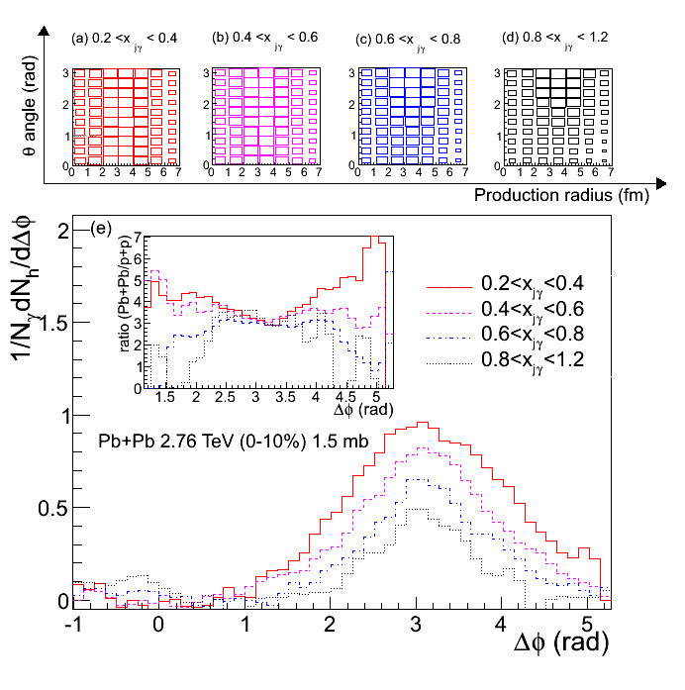
A tomography tool: γ-hadron + γ-jet
G.L. Ma, PLB 724,278 (2013)
(γ-hadron correlation) + (selected xjγ) is proposed as a good tool to do detail tomography of QGP.

Slide 35
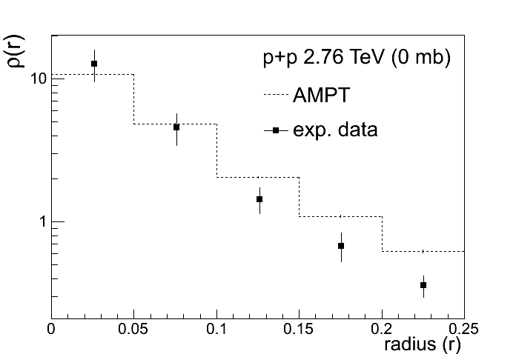
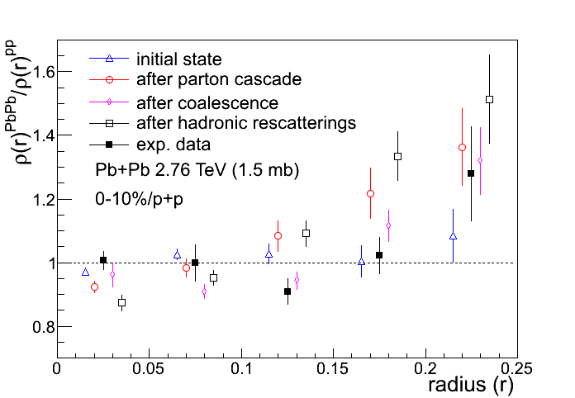
Medium modifications of jet shape
  G.L. Ma, PRC 89, 024902 (2014)
Agreement of jet shape between AMPT and p+p data
Dynamical evolution of modifications of jet shape:
Jet energy is redistributed towards larger radius via the strong interactions between jet and partonic medium.
Coalescence reduces the modifications of jet shape and gives qualitative features.
Hadron scatterings and resonance decays push the jet energy outwards further.

Slide 36
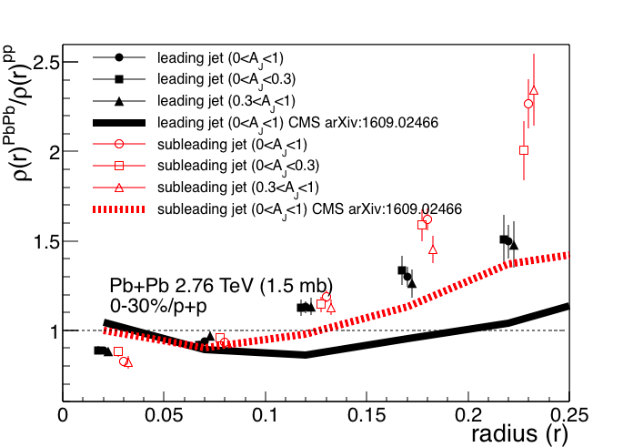
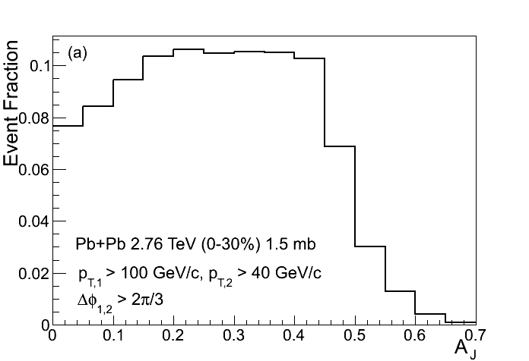
Leading vs subleading jet shapes
  G.L. Ma, PRC 89, 024902 (2014)
Subleading jet has a larger medium modification than leading jet. This ordering is consistent with the new CMS measurement.
The jet shape slightly depends on the dijet asymmetry Aj, consistent with the new CMS data.

Slide 37
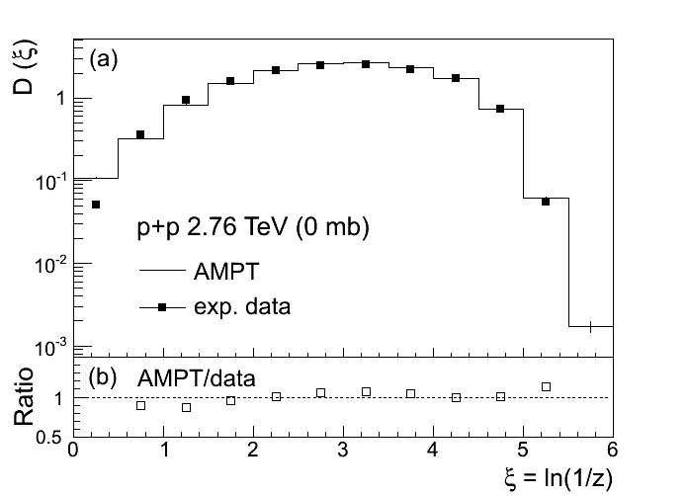
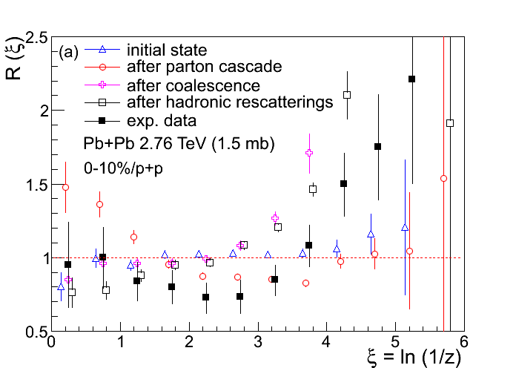
Jet fragmentation function
G.L. Ma, PRC 88, 021902(R) (2013)
D(ξ)=1/NjetdNch/dξ
R(ξ)= D(ξ)Pb+Pb/D(ξ)p+p
Good agreement of jet fragmentation function between AMPT results and p+p data
Jet fragmentation function evolves, but none of them can describe the data in Pb+Pb.

Slide 38


Coalescence && NCQ scaling of v2
Quark coalescence:
v₂^{hadron}(p_{T}) ≈ n v₂^{quark}(p_{T}/n)
Flow follows NCQ scaling: deconfined QGP && a new hadronization mechanism of coalescence

Slide 39



Decomposition of JFF
G.L. Ma, PRC 88, 021902(R) (2013)
Fragmentation
part
Coalescence
part
Frag. part [λf Rf(ξ)]: more important for low-ξ range in more peripheral collisions.
Coal. part [λcRc(ξ)]: more dominant for high- ξ range in more central collisions.

Slide 40




Baryon vs meson in JFF
STAR, PRL 97, 152301 (2006)
G.L. Ma, PRC 88, 021902(R) (2013)
Large high-ξ enhancement of R(ξ) for protons compared to for pions, due to the relative increase of coalescence part in central Pb+Pb collisions.

Slide 41




Jet v2 vs v3
  M. -W. Nie and G.-L. Ma, PRC 90, 014907 (2014)
y
Jet v2{ѱ2=0} is consistent with jet v2{ѱ2}.
Jet v3 is smaller than jet v2 for 45<pT<60 GeV/c.
Jet v3 is consistent with zero for 60<pT<80 GeV/c.
x

Slide 42


Jet energy loss fraction
  M. -W. Nie and G.-L. Ma, PRC 90, 014907 (2014)
Jet energy loss fraction is dependent of the azimuthal angles with respect to ѱn, which shows a path-length dependence of jet energy loss.

Slide 43


Jet vn vs εn
  M. -W. Nie and G.-L. Ma, PRC 90, 014907 (2014)
y
y
The ratio vn/ϵn increases with Npart in non-central Pb+Pb collisions.
Jet vn is sensitive to initial spatial asymmetry ϵn of partonic density for a given centrality bin.
x

Slide 44
extract jet transport parameter q^
t2
t2
t1
t1
After ZPC(ART)

Slide 45
Full jet transport parameter q^
F.C. Zhou, G.L. Ma, Y.G. Ma, EPJA 56,70 (2020)
qˆ increases with full jet energy (from 30 to 90 GeV) for partonic evolution

Slide 46
Full jet transport parameter q^
F.C. Zhou, G.L. Ma, Y.G. Ma, EPJA 56,70 (2020)
10
20
2
q^ (10GeV)@LHC
Jet collaboration:
1.5
q^(10 GeV) @RHIC
1.0
qˆ increases with jet energy for partonic evolution, consistent with the results from jet collaboration.

Slide 47

Jet in a box of thermal partons
段香盼制作
Jet interacts and excites the surrounding medium by elastic collisions.

Slide 48
Summary
By studying jet observables to show jet quenching effect:
Dijet asymmetries: driven by both initial asymmetries and partonic jet energy loss
γ-jet imbalance: sensitive to birth information of γ-jet
Jet Shape: subleading jet has larger medium modifications than leading jet
Jet fragmentation function: decomposed into fragmentation and coalescence parts, a high-ξ enhancement for baryons
Jet vn: path-length dependence of jet energy loss
Jet q^: consistent with jet collaboration’s q^
On-going work(PhD: Xiangpan Duan):
Jet mass: can jet-QGP interactions change jet mass?
Jet in small systems: will jet lose significant energy and change its JFF in small systems?

Slide 49


Jet in vacuum

Slide 50

Hard processes in QCD
Cross section calculation can be split into
Hard part: perturbative matrix element
Soft part: parton density (PDF), fragmentation (FF)
parton density
matrix element
FF
Hard process: scale Q >> Λ_{QCD}
Hard scattering High-p_{T} parton(photon) Q ~ p_{T}
Heavy flavour production m >> Λ_{QCD}
Soft parts, PDF, FF are universal: independent of hard process
This is likely to break down in a QGP, but still a good starting point

Slide 51
triggered jet
HIJING (PDFs, nuclear shadowing):
minijet partons, excited strings, spectators
Melt to q & qbar via intermediate hadrons
玻尔兹曼部分子输运
ZPC (Zhang's Parton Cascade)
[2<->2 elastic collisions]
Partons freeze out
Hadronization (Quark Coalescence)
玻尔兹曼强子输运
ART (A Relativistic Transport model for hadrons)
Hadrons freeze out (at a global cut-off time);
strong-decay all remaining resonances
Final particle spectra

Slide 52
Full jet q^ for different phases
F.C. Zhou, G.L. Ma, Y.G. Ma, EPJA 56,70 (2020)
qˆ(whole)≠qˆ(partonic)+qˆ(hadronic)
qˆ(partonic): RHIC≈LHC
qˆ(hadronic): RHIC>LHC
qˆ(whole): LHC>RHIC

Slide 53
Correlation between q^ and AJ
F.C. Zhou, G.L. Ma, Y.G. Ma, EPJA 56,70 (2020)
qˆ increases with AJ
Ones could measure dijet AJ distributions with different q^ ranges to study jet quenching

Slide 54



Mach cone and dihadron correlation
?
Chesler & Yaffe arXiv:0712.0050
Notes:
(1) Mach cone origin->angle and Cs ->EOS
(2) strong-coupling theory (Ads/CFT)->How strong is the strong-coupling of the matter.
Cs, EOS, Poynting Vector, and strong coupling and viscosity

Slide 55





Mach cone and dihadron correlation
H. Li, F. M. Liu, G.-L. Ma, X.-N. Wang, Y. Zhu
PRL 106, 012301 (2011)
uniform medium
(T=300 MeV, Ejet=20 GeV, αs=0.5, μ=1 GeV)
single quark jet
Mach-cone-like medium excitation and diffusion wake behind the jet are formed by jet-medium interactions in a linear transport model.

Slide 56


dihadron and γ-hadron
G. L. Ma and X.-N. Wang, PRL 106, 162301 (2011)
σ=10mb
γ-hadron correlation is comparable but different from dihadron correlation, which reflects the information about jet-medium interactions.

Slide 57



different components in dihadron correlation
(A) full: jets + hot spots
(A) jet; (B) hot spot; (C) no jet and hot spot
(B) hot spots
(C) soft hot spots
(D) smoothed condition
We use different initial conditions (A)-(D) to study jet and (soft) hot spots effects on dihadron correlation.

Slide 58

dihadron from different initial conditions
G. L. Ma and X.-N. Wang, PRL 106, 162301 (2011)
|Δη|<2
(v1-v5 BG removed)
σ=10mb
Hot spots form a double hump on away side, but the magnitude is less than that of full jet.
Soft hot spots present a weak double hump (a broadening single peak).
The dihadron correlation from smoothed initial condition becomes almost flat.
It is difficult to extract dihadron correlation from dijets alone.

Slide 59
A Linear Boltzmann Transport (LBT) Model

Slide 60
A coupled LBT Hydro (CoLBT-hydro) Model

