Slide 1
Measuring Relic Neutrino Effects Against Galaxy Cluster Formation Simulations
Au Wang To Anthony (HKUST)
Prof. Kirill Prokofiev (HKUST) Prof. Tom Broadhurst (University of the Basque Country)

Slide 2
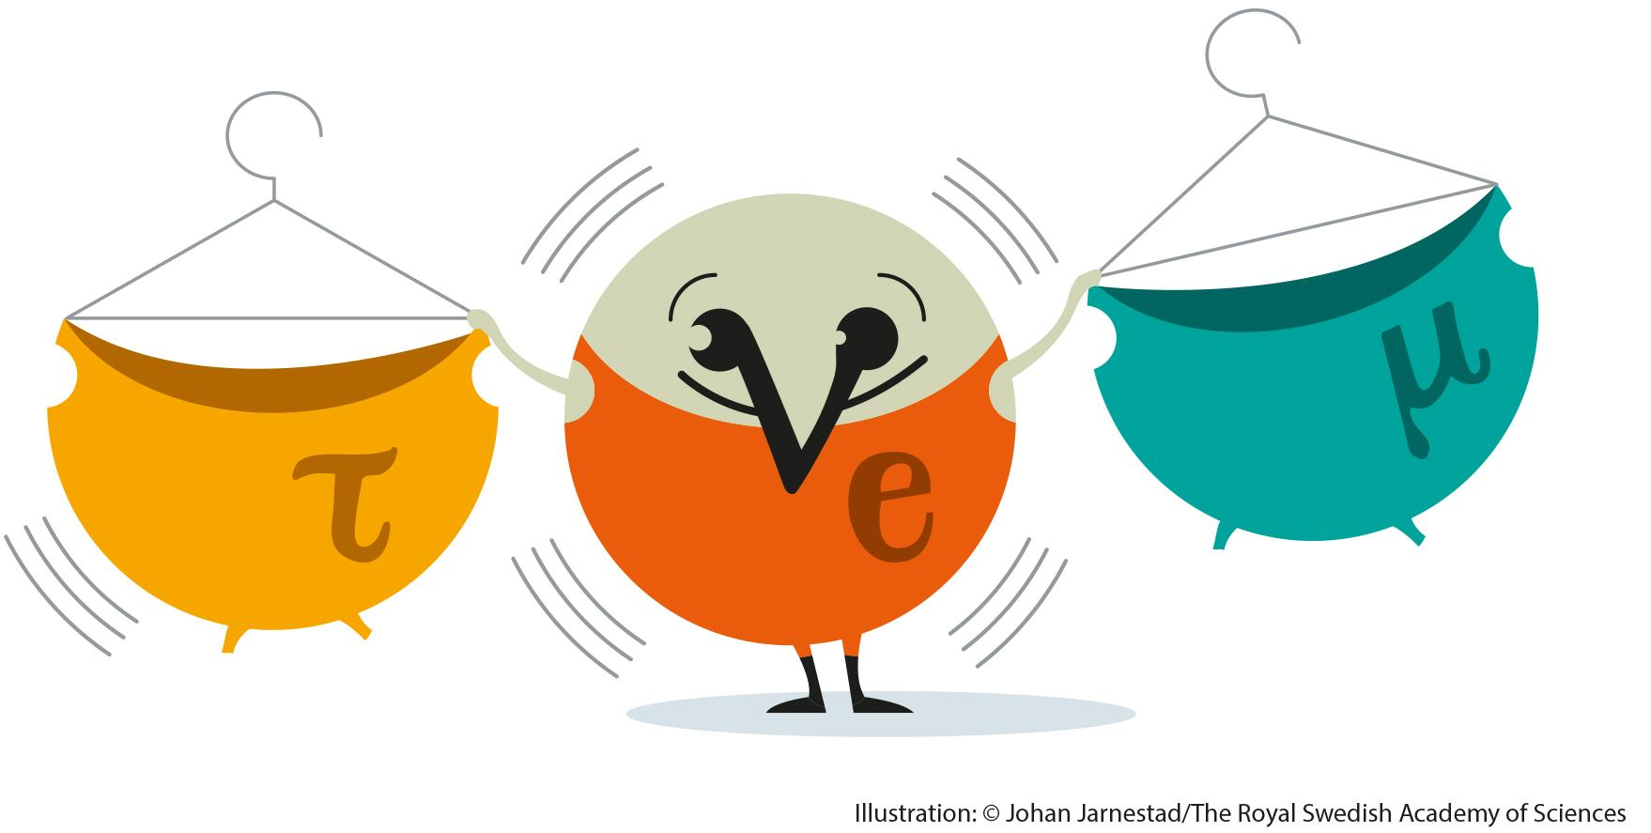
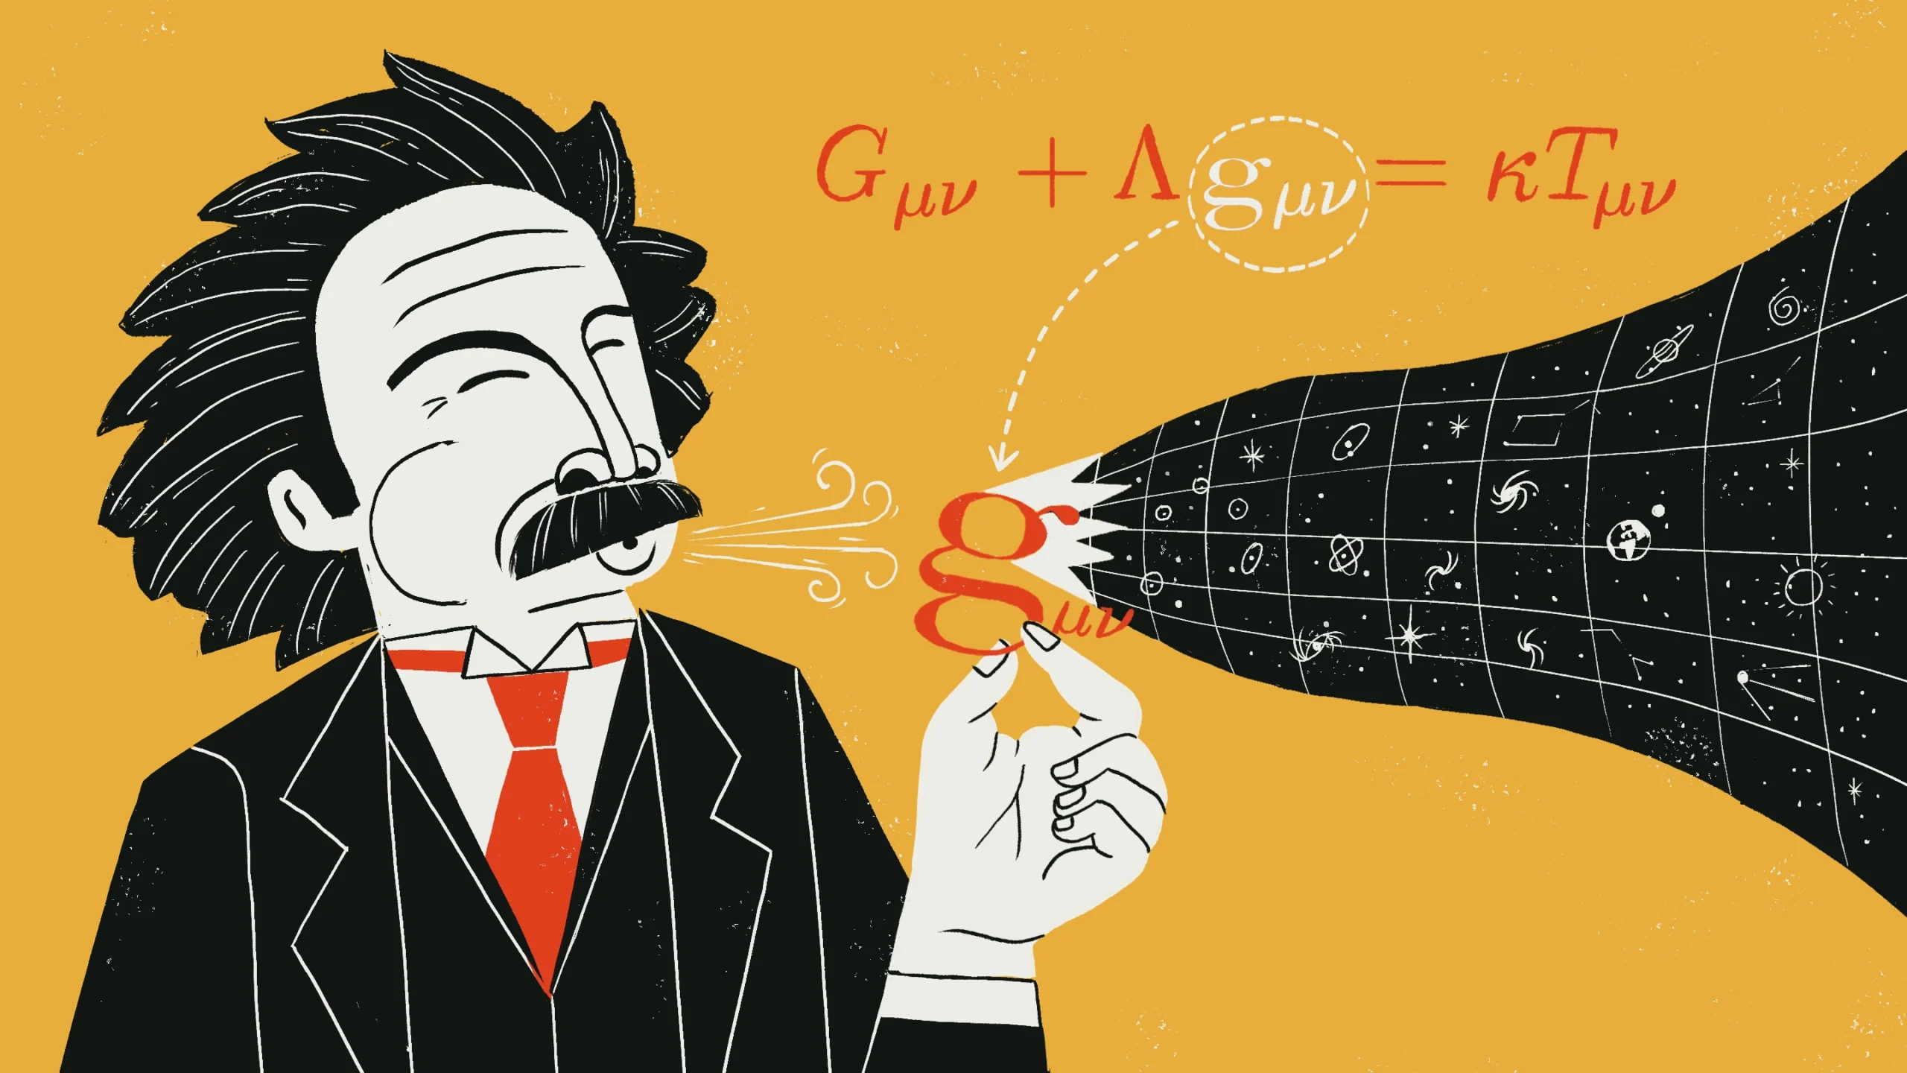

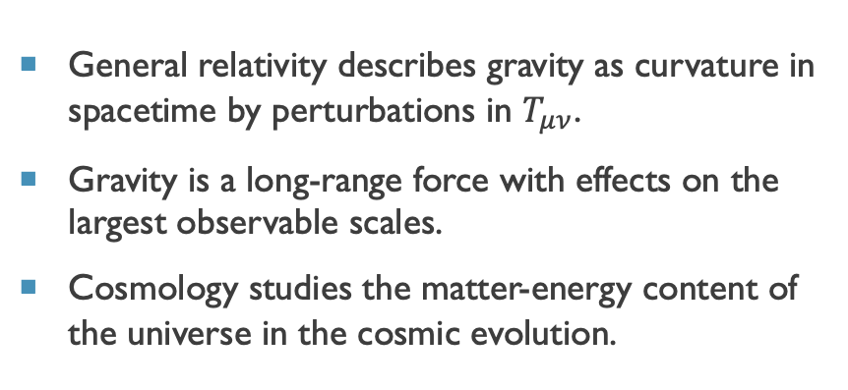
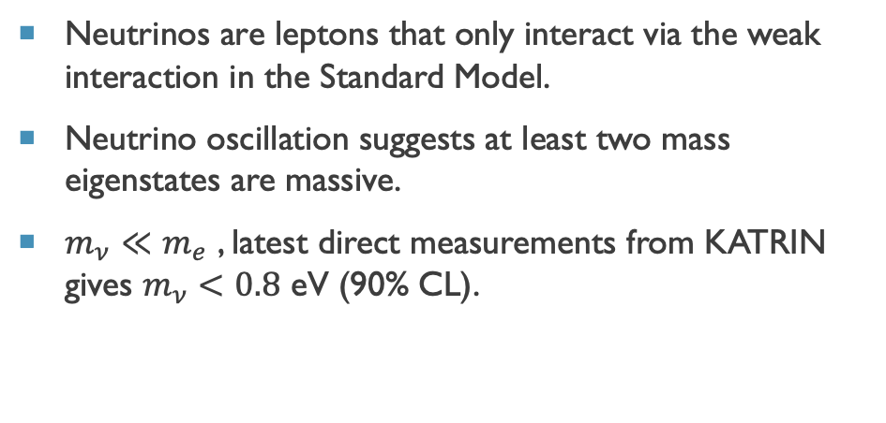
General relativity describes gravity as curvature in spacetime by perturbations in $T_{μν}$.
Gravity is a long-range force with effects on the largest observable scales.
Cosmology studies the matter-energy content of the universe in the cosmic evolution.
Neutrinos are leptons that only interact via the weak interaction in the Standard Model.
Neutrino oscillation suggests at least two mass eigenstates are massive.
$m_{ν}≪m_{e}$ , latest direct measurements from KATRIN gives $m_{ν}<0.8$ eV (90% CL).
C$ν$B
KATRIN. Nat. Phys. 18, 160–166 (2022).

Slide 3
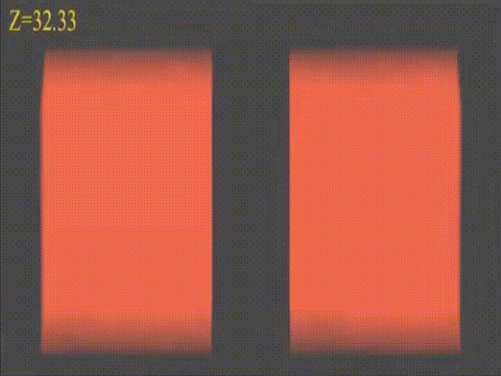
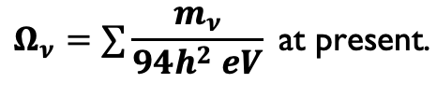

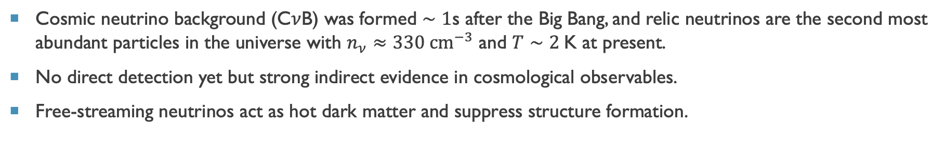
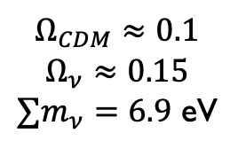

Cosmic neutrino background (C$ν$B) was formed $∼1$s after the Big Bang, and relic neutrinos are the second most abundant particles in the universe with $n_{ν}≈330 {cm}^{−3}$ and $T∼2$K at present.
No direct detection yet but strong indirect evidence in cosmological observables.
Free-streaming neutrinos act as hot dark matter and suppress structure formation.
$$Ω_{CDM}≈0.1$$
$$Ω_{ν}≈0.15$$
$∑m_{ν}=6.9$ eV
$$Ω_{CDM}≈0.25$$
Simulations by Troels Haugbølle
Box size: 256 $h^{−1}$Mpc
$$Ω_{ν}=∑\frac{m_{ν}}{94h^{2} eV} \text{at} \text{present}\text{.}$$

Slide 4
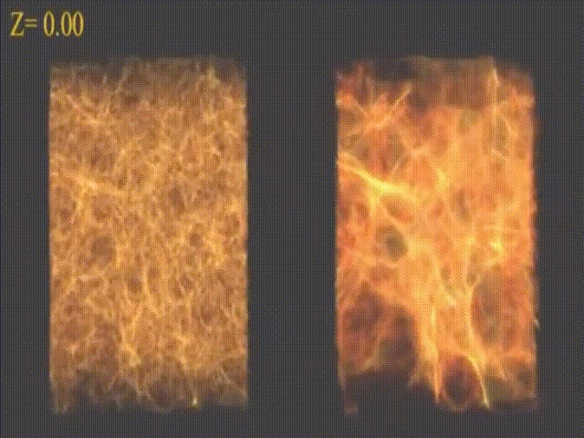
Cosmic neutrino background (C$ν$B) was formed $∼1$s after the Big Bang, and relic neutrinos are the second most abundant particles in the universe with $n_{ν}≈330 {cm}^{−3}$ and $T∼2$K at present.
No direct detection yet but strong indirect evidence in cosmological observables.
Free-streaming neutrinos act as hot dark matter and suppress structure formation.
$$Ω_{CDM}≈0.1$$
$$Ω_{ν}≈0.15$$
$∑m_{ν}=6.9$ eV
$$Ω_{CDM}≈0.25$$
Simulations by Troels Haugbølle
Box size: 256 $h^{−1}$Mpc
$$Ω_{ν}=∑\frac{m_{ν}}{94h^{2} eV} \text{at} \text{present}\text{.}$$

Slide 5
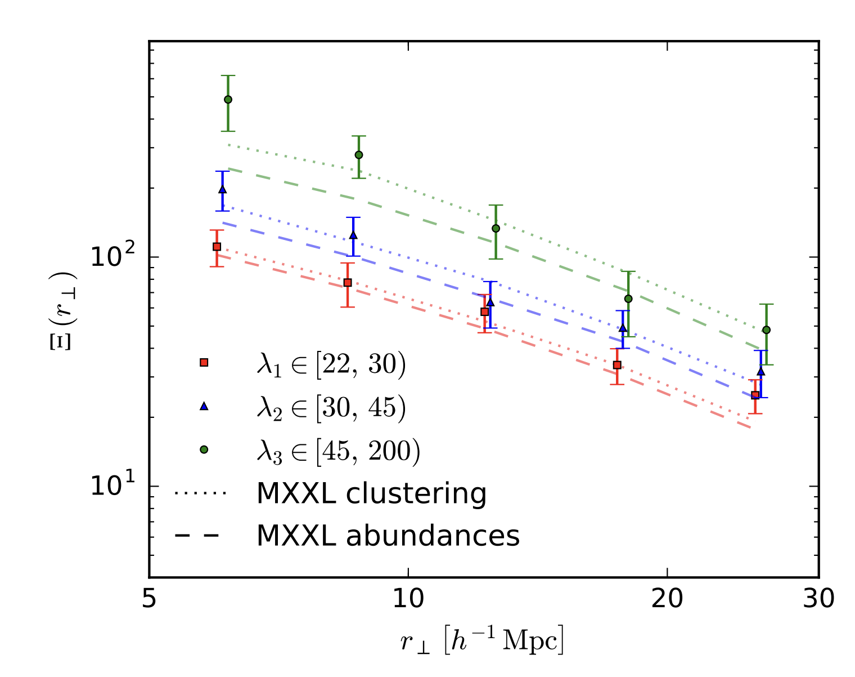
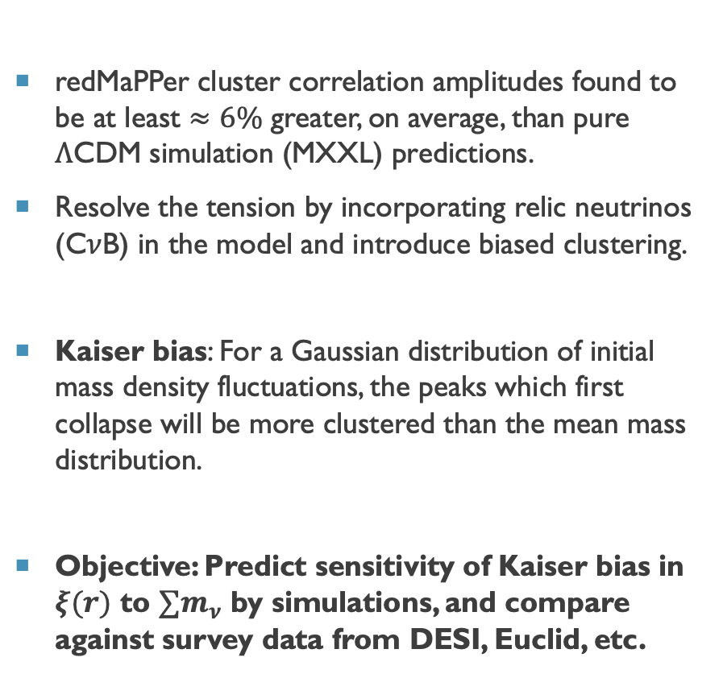

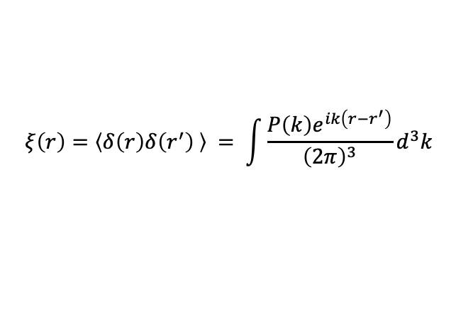
Project Motivation
redMaPPer cluster correlation amplitudes found to be at least $≈6\%$ greater, on average, than pure $Λ$CDM simulation (MXXL) predictions.
Resolve the tension by incorporating relic neutrinos (C$ν$B) in the model and introduce biased clustering.
Kaiser bias: For a Gaussian distribution of initial mass density fluctuations, the peaks which first collapse will be more clustered than the mean mass distribution.
Objective: Predict sensitivity of Kaiser bias in $ξ(r)$ to $∑m_{ν}$ by simulations, and compare against survey data from DESI, Euclid, etc.
$$ξ\left(r\right)=〈δ\left(r\right)δ\left(r^{′}\right) 〉 = \int{\frac{P\left(k\right)e^{ik\left(r−r^{′}\right)}}{{\left(2π\right)}^{3}}d^{3}k}$$
$$ξ(r_{⊥})$$
R. Emami,T. Broadhurst, P. Jimeno, et al. (2019)
[arXiv:1711.05210.]
Notes:
Observed amplitude scales with mass at almost the same rate predicted by simulations, supporting the primordial Gaussian field hypothesis

Slide 6
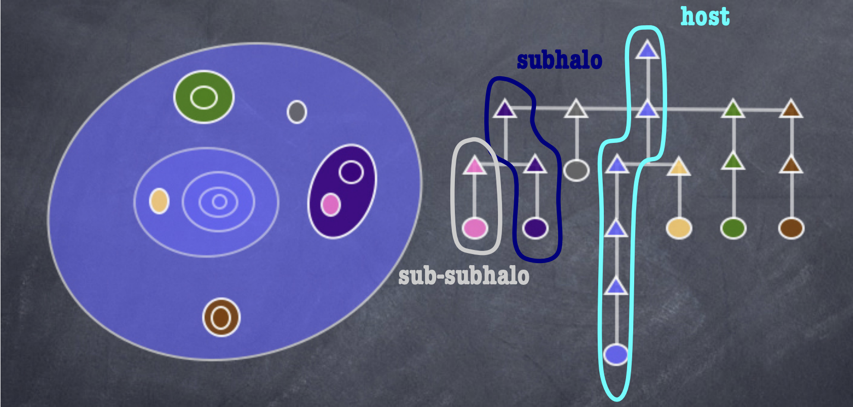
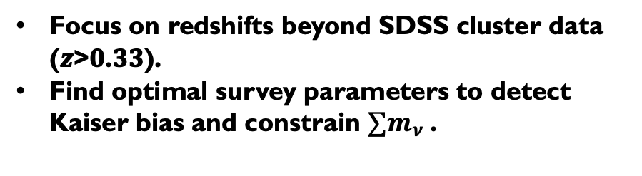
NuGrid: Modified Gadget-2 N-body simulation code with C$ν$B modelled as a grid-based density field.
Gravitational potential by $δ_{m}=f_{ν}δ_{ν}+\left(1−f_{ν}\right)δ_{CDM+b}$ and linearly perturbing $δ_{ν}$.
Z. Zeng, S. Yeung and M. C. Chu. JCAP 1903, 015 (2019).
AMIGA Halo Finder: Identifies halos and subhalos by virial overdensity criterion. (not Friends-of-Friends)
Knollmann, S. R. & Knebe,. ApJS 182, 608–624 (2009).
Landy-Szalay Estimator: $ξ\left(r\right)=\frac{DD\left(r\right)−2DR\left(r\right)+RR(r)}{RR(r)}$ to calculate 2-point correlation function of halos.
Focus on redshifts beyond SDSS cluster data (𝒛>𝟎.𝟑𝟑).
Find optimal survey parameters to detect Kaiser bias and constrain $∑m_{ν}$ .

Slide 7
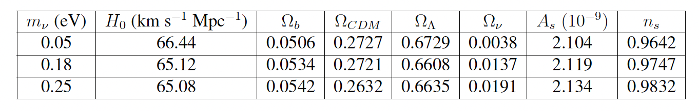
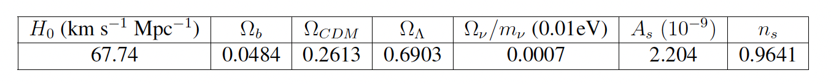
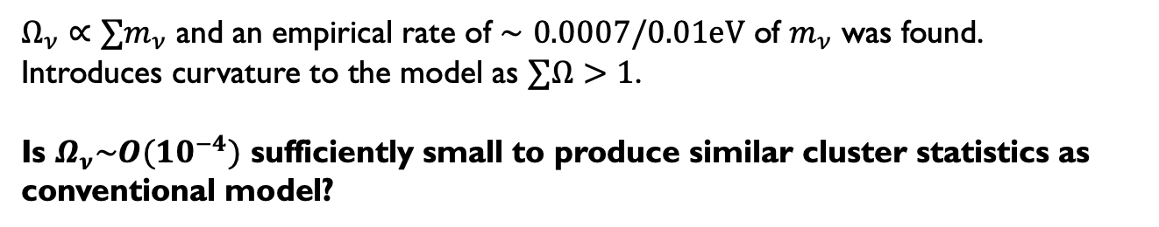
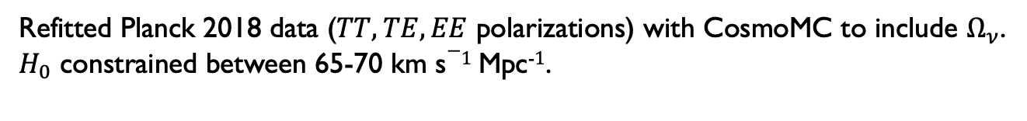
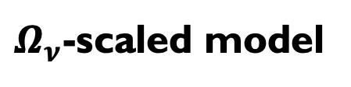
Conventional model
Refitted Planck 2018 data ($TT, TE, EE$ polarizations) with CosmoMC to include $Ω_{ν}$.
$H_{0}$ constrained between 65-70 km s$−1$Mpc⁻$1$.
$Ω_{ν}$-scaled model
$Ω_{ν}∝∑m_{ν}$ and an empirical rate of $∼0.0007/0.01eV$ of $m_{ν}$ was found.
Introduces curvature to the model as $∑Ω>1$.
Is $Ω_{ν}\sim O({10}^{−4})$ sufficiently small to produce similar cluster statistics as conventional model?
Assume all neutrinos have the same mass i.e. $m_{ν}=\frac{∑m_{ν}}{3}$
Z. Zeng, S. Yeung and M. C. Chu. JCAP 1903, 015 (2019).
Notes:
Marginalized best-fit parameters shown.
Treat $Ω_{ν}$ as a perturbation in the fiducial (neutrino-less $Λ$CDM) model
Attempt to remove degeneracies with other cosmological parameters and isolate $m_{ν}$ effects

Slide 8
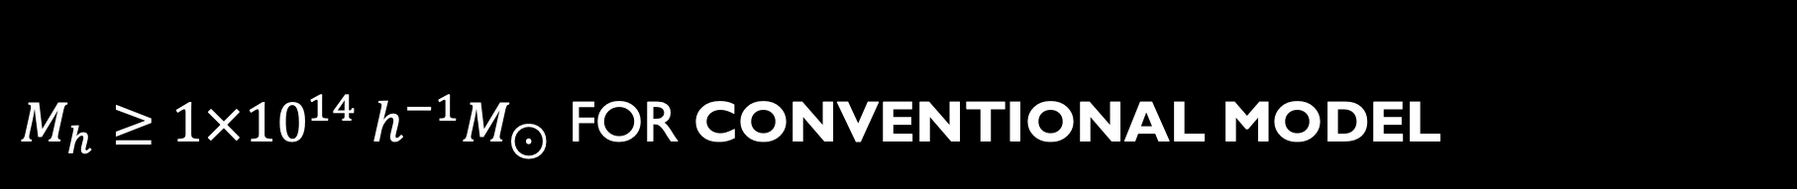
$M_{h}≥1×{10}^{14}{ h}^{−1}M_{⊙}$ for conventional model
z=0.25
z=0.5
z=0.75
CM
CM
$ξ(r)$ fitted to power law ${\left(\frac{r}{r_{0}}\right)}^{−γ}$with $γ$ fixed at 2 based on previous fittings.

Slide 9
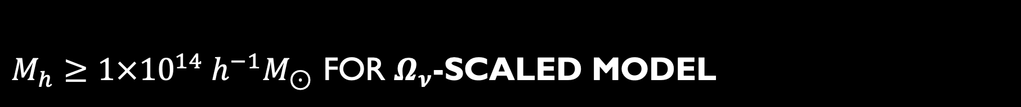
$M_{h}≥1×{10}^{14}{ h}^{−1}M_{⊙}$ for $Ω_{ν}$-scaled model
z=0.25
z=0.5
z=0.75
CM
CM
$ξ(r)$ fitted to power law ${\left(\frac{r}{r_{0}}\right)}^{−γ}$with $γ$ fixed at 2 based on previous fittings.

Slide 10



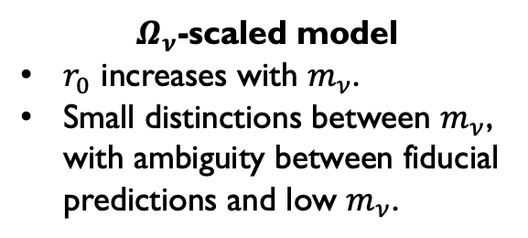
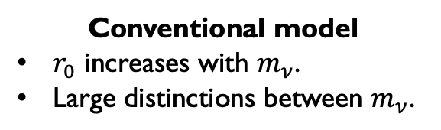
Conventional model
$r_{0}$ increases with $m_{ν}$.
Large distinctions between $m_{ν}$.
$$M_{h}≥1×{10}^{14}{ h}^{−1}M_{⊙}$$
$$M_{h}≥1.4×{10}^{14}{ h}^{−1}M_{⊙}$$
$Ω_{ν}$-scaled model
$r_{0}$ increases with $m_{ν}$.
Small distinctions between $m_{ν}$, with ambiguity between fiducial predictions and low $m_{ν}$.
$$M_{h}≥1×{10}^{14}{ h}^{−1}M_{⊙}$$
$$M_{h}≥1.4×{10}^{14}{ h}^{−1}M_{⊙}$$

Slide 11



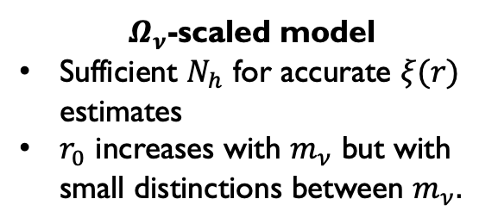
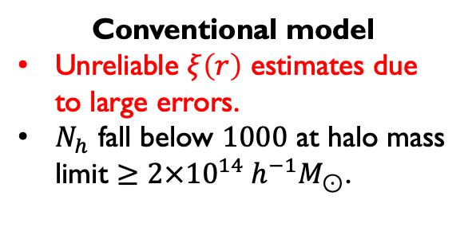
Conventional model
Unreliable $ξ\left(r\right)$ estimates due to large errors.
$N_{h}$ fall below $1000$ at halo mass limit $≥2×{10}^{14}{ h}^{−1}M_{⊙}$.
$$M_{h}≥2.5×{10}^{14}{ h}^{−1}M_{⊙}$$
$$M_{h}≥2×{10}^{14}{ h}^{−1}M_{⊙}$$
$$M_{h}≥2.5×{10}^{14}{ h}^{−1}M_{⊙}$$
$Ω_{ν}$-scaled model
Sufficient $N_{h}$ for accurate $ξ(r)$ estimates
$r_{0}$ increases with $m_{ν}$ but with small distinctions between $m_{ν}.$
$$M_{h}≥2×{10}^{14}{ h}^{−1}M_{⊙}$$

Slide 12
Conventional model
Correlation length $r_{0}$ increases with $m_{ν}$ despite a decrease in number of halos $N_{h}$, characteristic of the Kaiser bias effect.

Slide 13
$Ω_{ν}$-scaled model
Correlation length $r_{0}$ increases with $m_{ν}$ despite a decrease in number of halos $N_{h}$, characteristic of the Kaiser bias effect.

Slide 14

Conventional model
$Ω_{ν}$-scaled model
Observation data from extraction of cluster richness function from redMaPPer sample, and CAMIRA S21A sample.
Jimeno et al. (2017) MNRAS 466 (3): 2658-2674
Chen et al. (2024) [arXiv:2401.10322.]

Slide 15
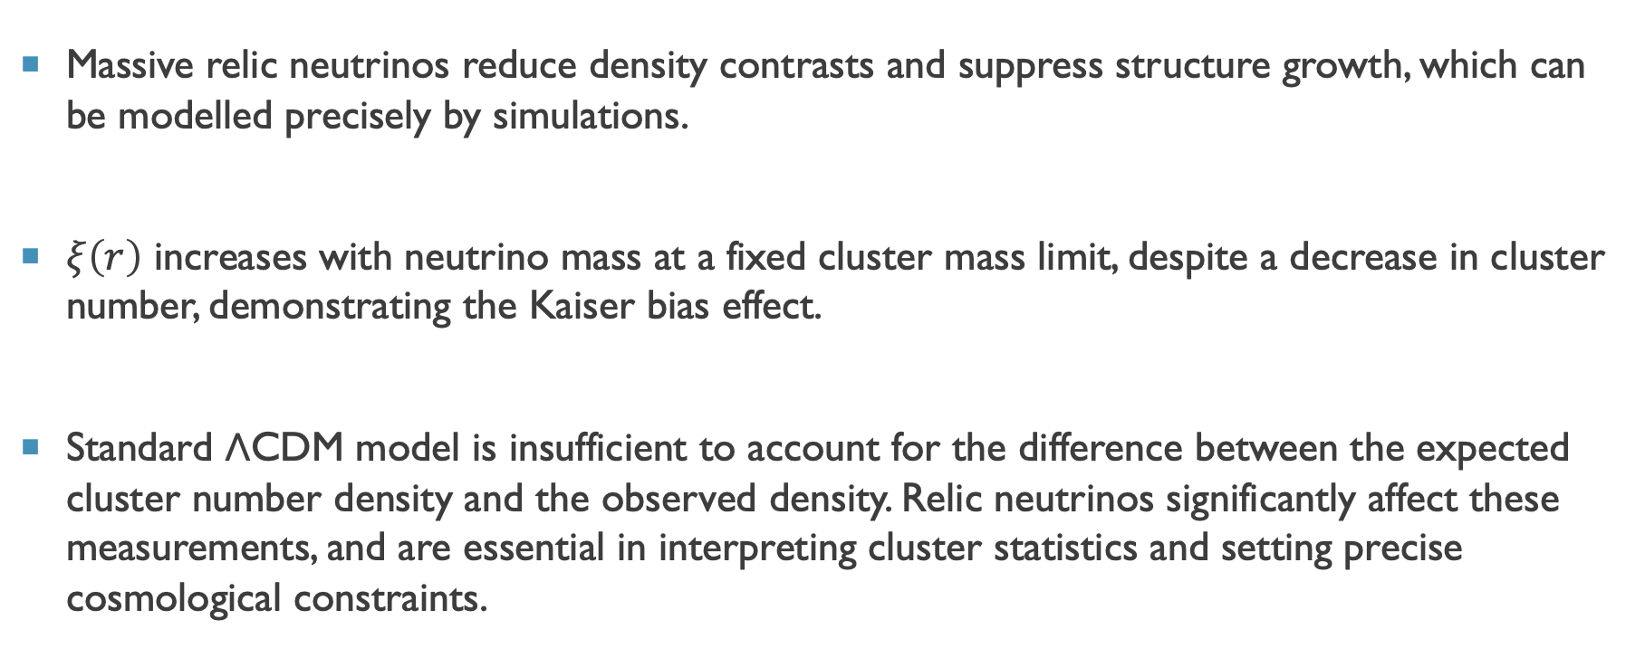
Conclusion
Massive relic neutrinos reduce density contrasts and suppress structure growth, which can be modelled precisely by simulations.
$ξ\left(r\right)$ increases with neutrino mass at a fixed cluster mass limit, despite a decrease in cluster number, demonstrating the Kaiser bias effect.
Standard ΛCDM model is insufficient to account for the difference between the expected cluster number density and the observed density. Relic neutrinos significantly affect these measurements, and are essential in interpreting cluster statistics and setting precise cosmological constraints.

Slide 16
Supplementary
Materials

Slide 17
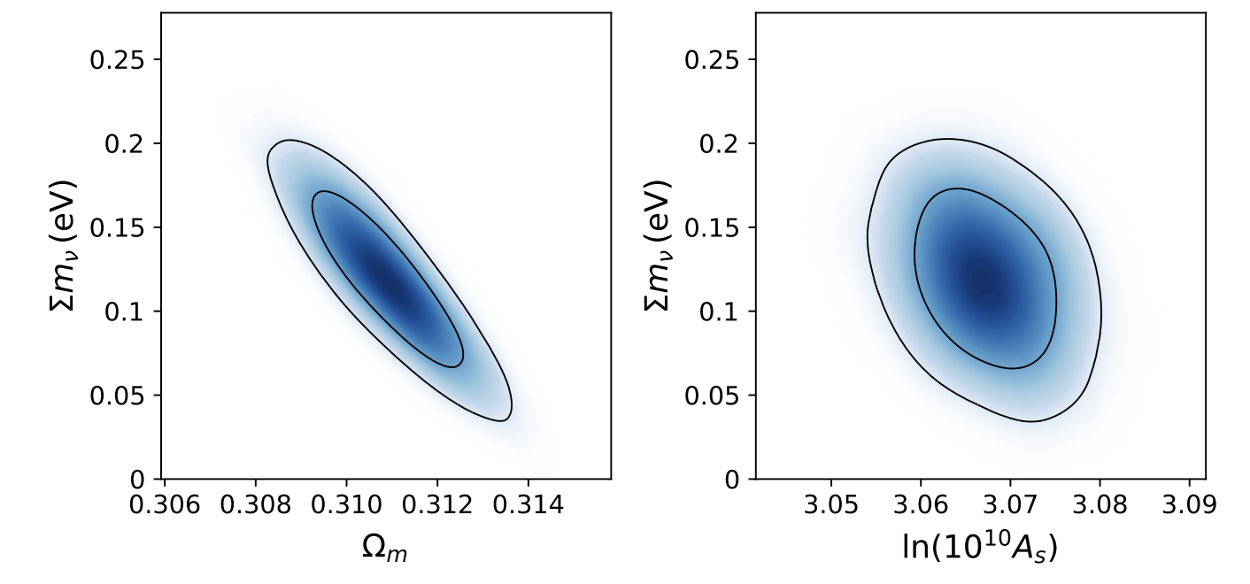
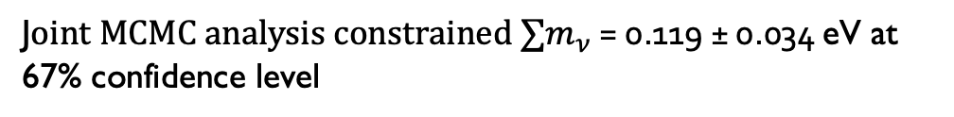
J$oint MCMC analysis constrained ∑m_{ν}$ = 0.119 ± 0.034 eV at 67% confidence level
R. Emami,T. Broadhurst, P. Jimeno, et al. (2019)
[arXiv:1711.05210.]

Slide 18


Conventional model CosmoMC contours
$m_{ν}=0.05$ eV
$m_{ν}=0.25$ eV

Slide 19
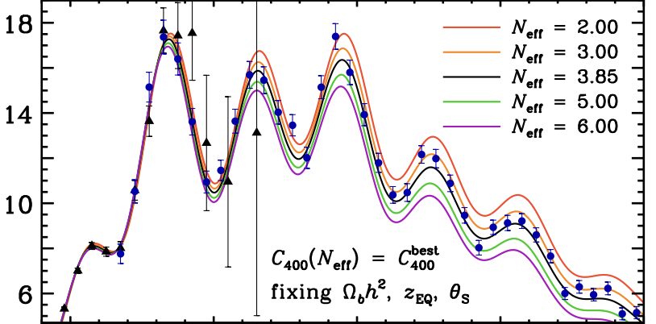

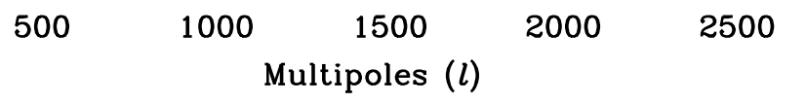
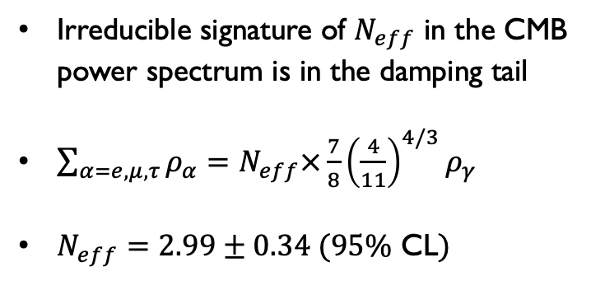
Irreducible signature of $N_{eff}$ in the CMB power spectrum is in the damping tail
$\sum_{α=e,μ,τ}{ρ_{α}}=N_{eff}×\frac{7}{8}{\left(\frac{4}{11}\right)}^{4/3}ρ_{γ}$
$N_{eff}=2.99±0.34 (95\%$ CL$)$
Hou et al. (2013). Phys. Rev. D, 87 (8), 083008.

Slide 20
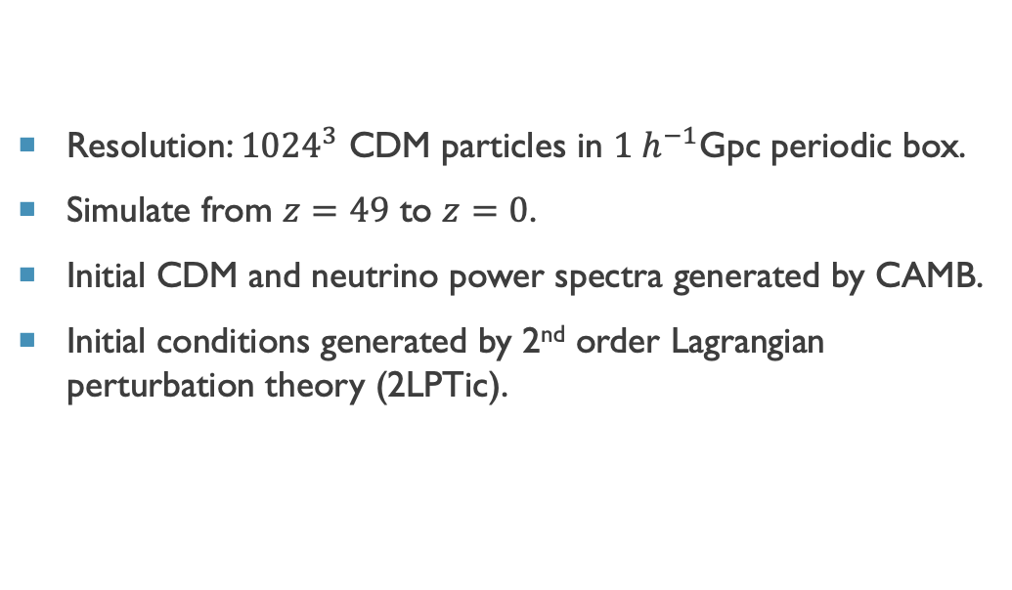
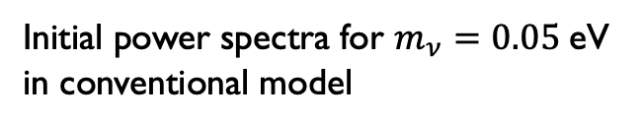
Simulation technicalities
Resolution: ${1024}^{3}$ CDM particles in $1 h^{−1}$Gpc periodic box.
Simulate from $z=49$ to $z=0$.
Initial CDM and neutrino power spectra generated by CAMB.
Initial conditions generated by 2nd order Lagrangian perturbation theory (2LPTic).
Initial power spectra for $m_{ν}=0.05$eV in conventional model

Slide 21
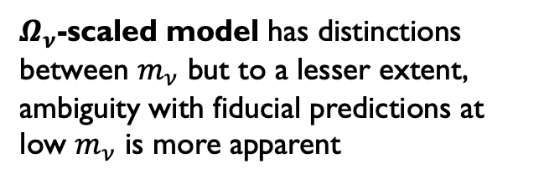
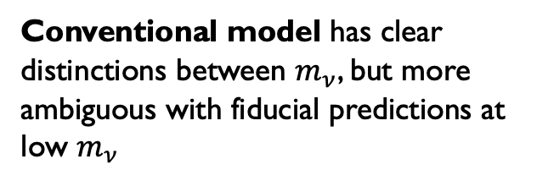
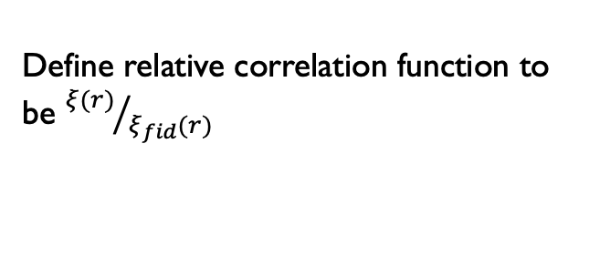
Define relative correlation function to be ${ξ(r)}/{ξ_{fid}(r)}$
Conventional model has clear distinctions between $m_{ν}$, but more ambiguous with fiducial predictions at low $m_{ν}$
$Ω_{ν}$-scaled model has distinctions between $m_{ν}$ but to a lesser extent, ambiguity with fiducial predictions at low $m_{ν}$ is more apparent
Reduce statistical uncertainties by Monte-Carlo or re-binning

Slide 22
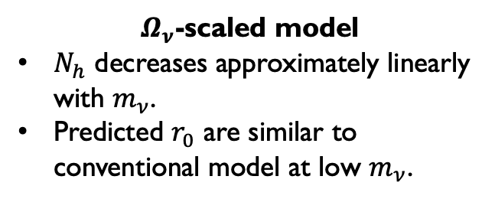
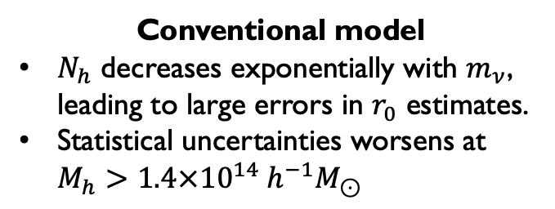
Conventional model
$N_{h}$ decreases exponentially with $m_{ν}$, leading to large errors in $r_{0}$ estimates.
Statistical uncertainties worsens at $M_{h}>1.4×{10}^{14}{ h}^{−1}M_{⊙}$
$Ω_{ν}$-scaled model
$N_{h}$ decreases approximately linearly with $m_{ν}$.
Predicted $r_{0}$ are similar to conventional model at low $m_{ν}$.

Slide 23
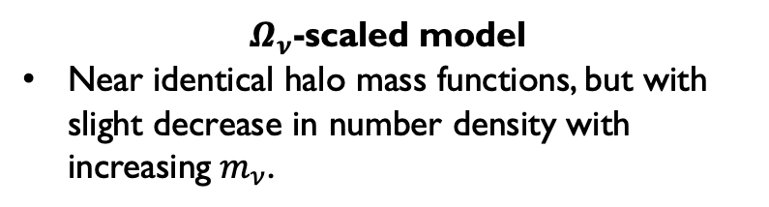
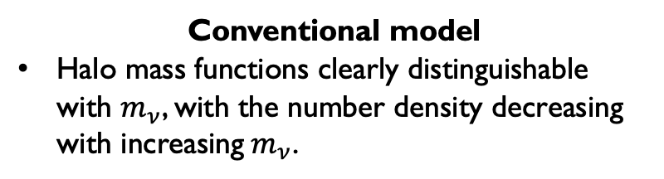
Conventional model
Halo mass functions clearly distinguishable with $m_{ν}$, with the number density decreasing with increasing${ m}_{ν}$.
$Ω_{ν}$-scaled model
Near identical halo mass functions, but with slight decrease in number density with increasing${ m}_{ν}$.

