Slide 1
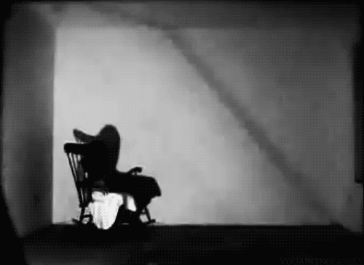

Does it rock?
Time-dependent Measurement
of B_{s} > ϕ(KK)µµ Decay at FCC-ee
Jason Aebischer, Valeriia Lukashenko,
Ben Kilminster, Anson Kwok, Zach Polonshy
15/01/25 hkust ias program fp2025

Slide 2
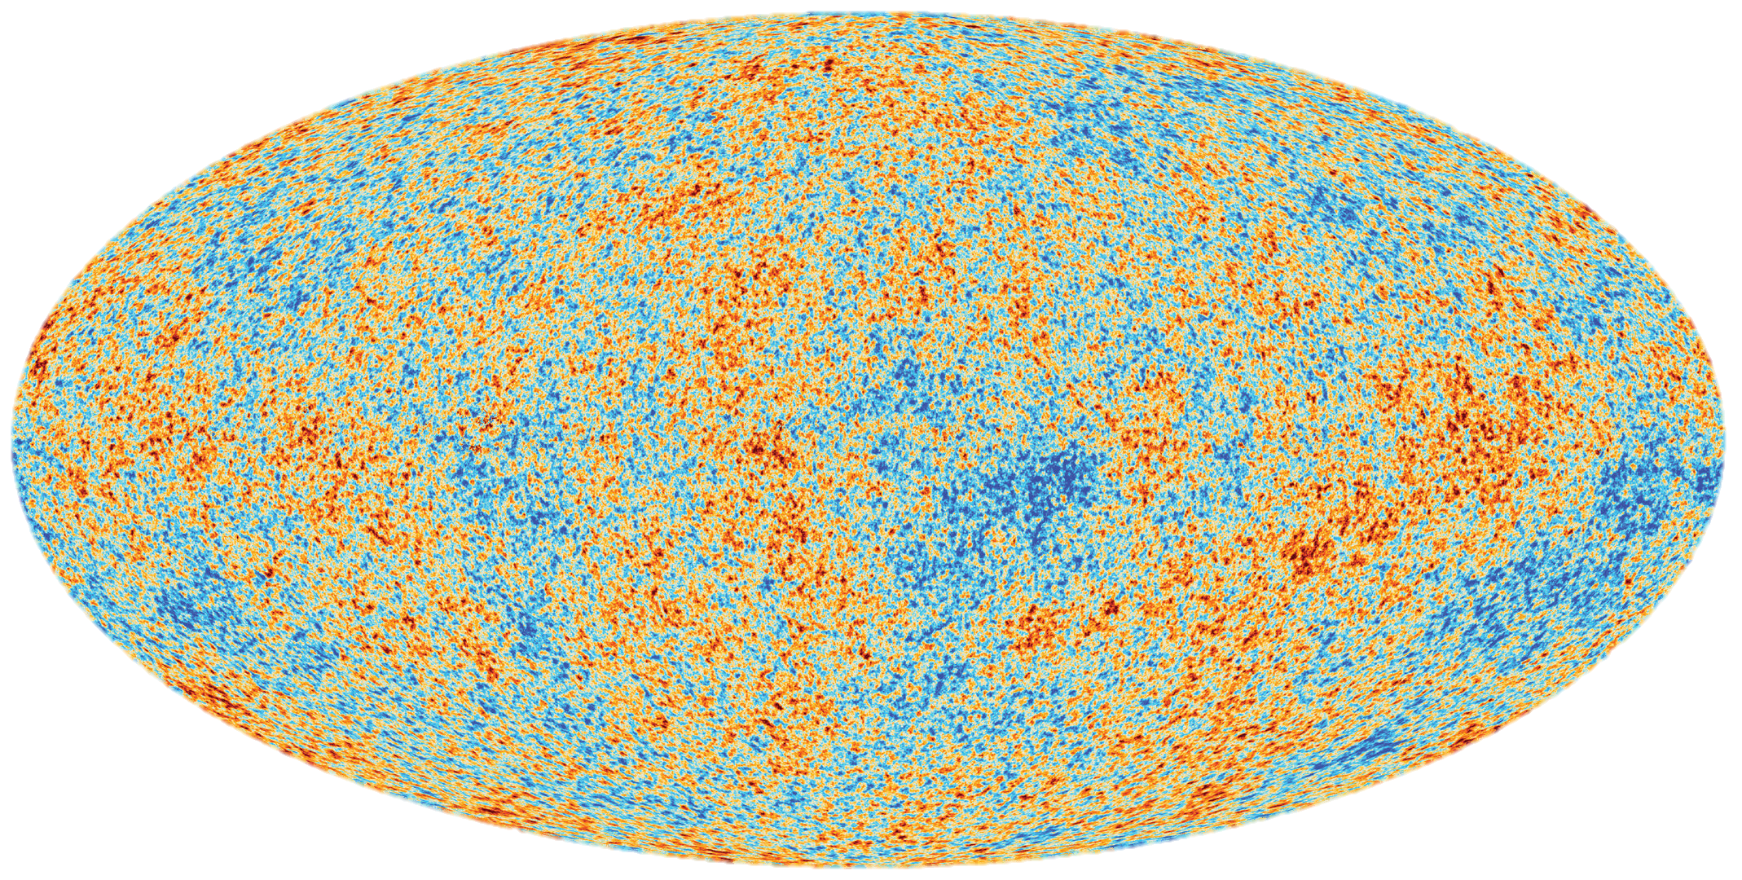
Once upon a time. . . . . . . . .

Slide 3
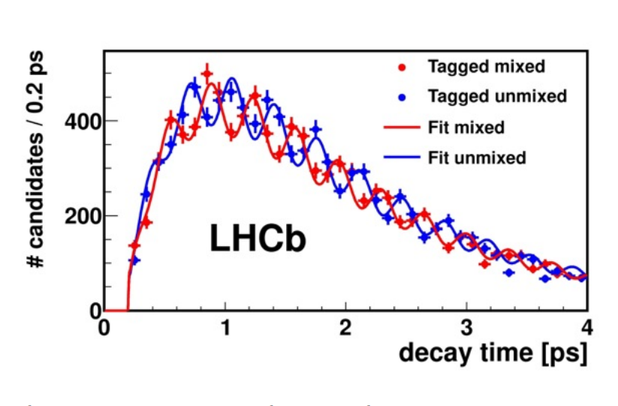
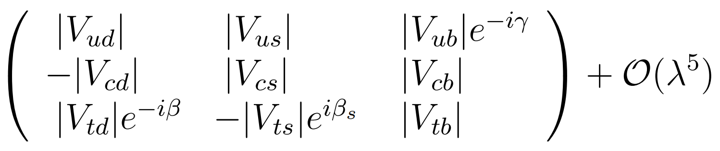
Once upon a time. . . . . . . . .
Cosmological measurement shows: (n_{baryon}-n_{anti-baryon})/n_{photon} ~ 10⁻⁹
[Matter >> Anti-matter]
Sakharov Condition (within Baryogenesis):
Baryon number violation
Interactions out of thermal equilibrium
C, CP violation
We have CPV in SM!
But not enough
[Mostly CPV in non-leptonic decay]
1

Slide 4
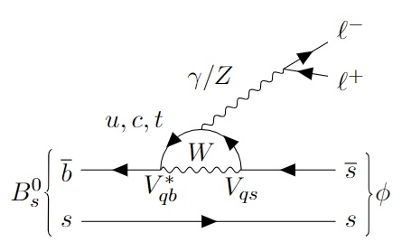
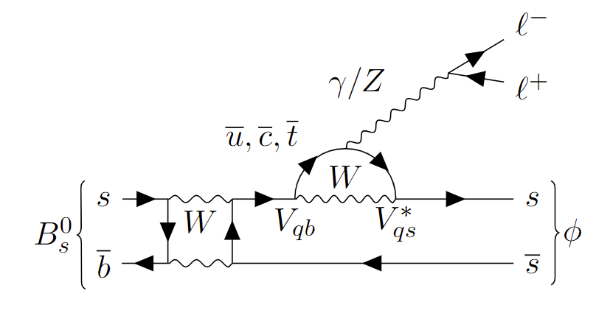


We look at. . . . . . . . . (CPV from NP?)
It is FCNC!!! Loop suppressed: BR~8x10⁻⁷
(BR measurement done by LHCb in 2021 [arXiv:2105.14007])
Just an example, there are more diagrams
2

Slide 5
We look at. . . . . . . . . (CPV from NP?)
It is FCNC!!! Loop suppressed: BR~8x10⁻⁷
(BR measurement done by LHCb in 2021 [arXiv:2105.14007])
[Leptonic CPV is not yet fully explored]
Just an example, there are more diagrams
2

Slide 6
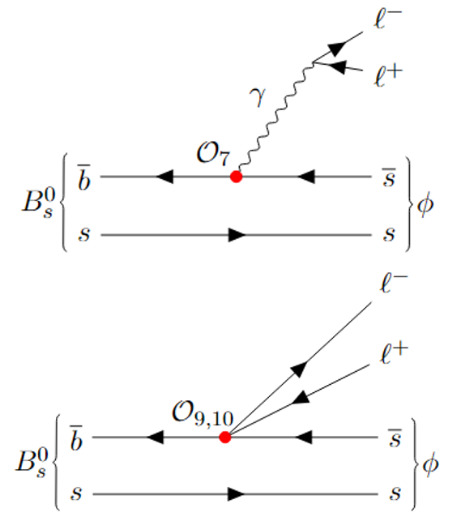
We look at. . . . . . . . . (CPV from NP?)
BSM could introduce CPV in FCNC operators:
time-dependent measurements are sensitive to Im[C_{7,9,10}]
Just an example, there are more diagrams
3

Slide 7
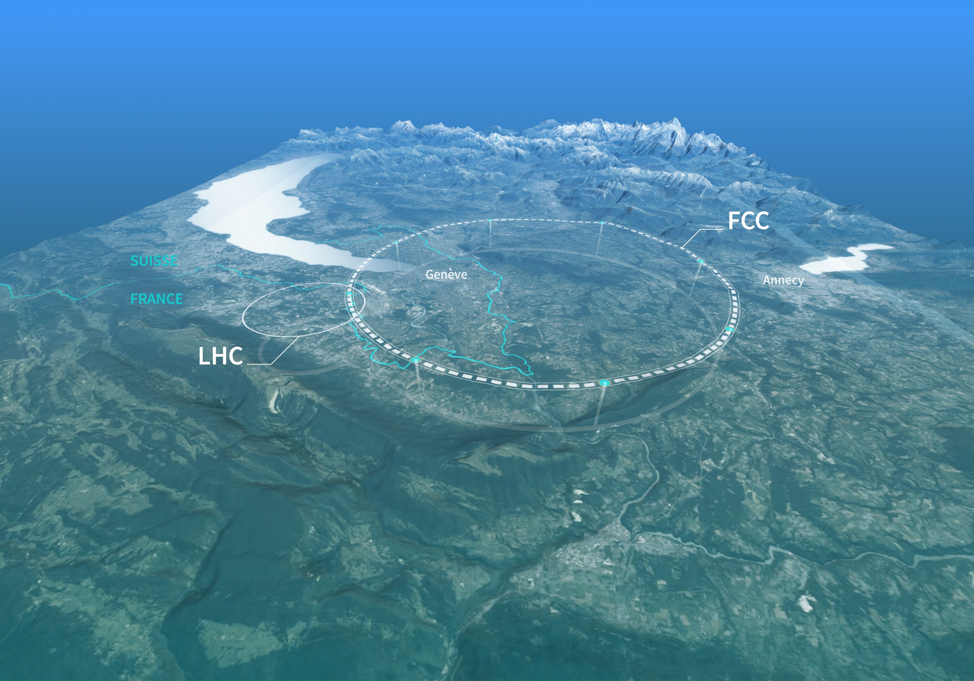
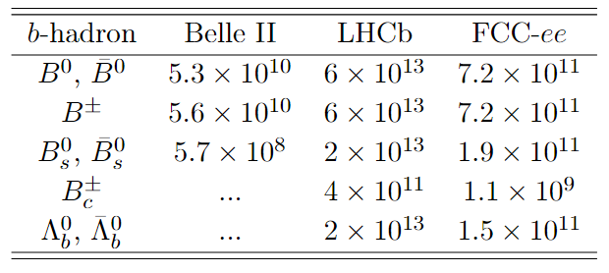
Why FCC-ee . . . . . . . . ?
FCC-ee at Z-pole
In general (you all know better than I do):
Clean (vs LHCb)
Good Flavor Tagging (vs LHCb)
Large Stat. (vs Belle II)
Good Vertexing (vs Belle II)
…
4

Slide 8
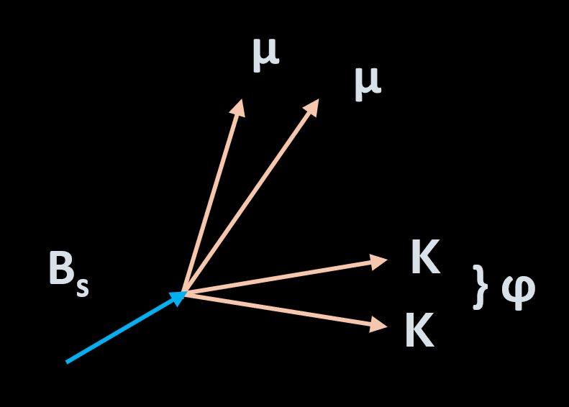
Cartoon Diagram of Signal. . . . . . . .
We use Pythia + Delphes (IDEA) for simulating signal & backgrounds
5

Slide 9
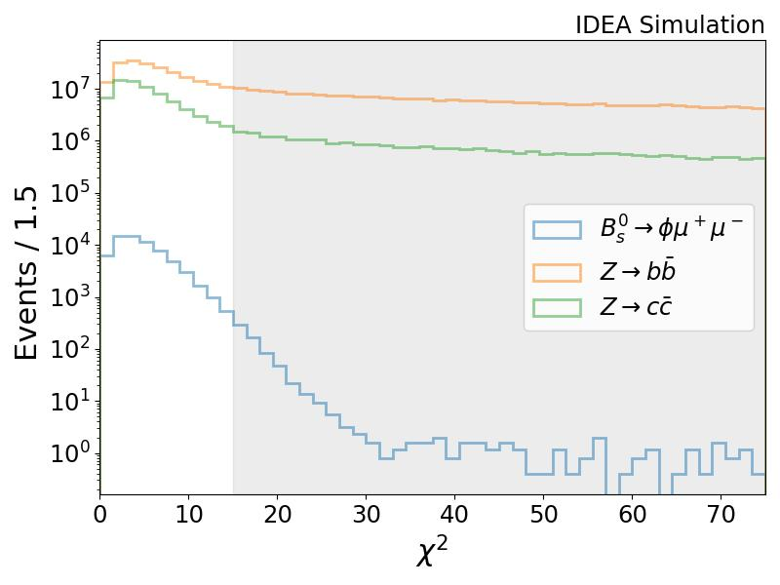
Some Physics of Signal. . . . . . . .
Vertex Fit
Preliminary
6

Slide 10
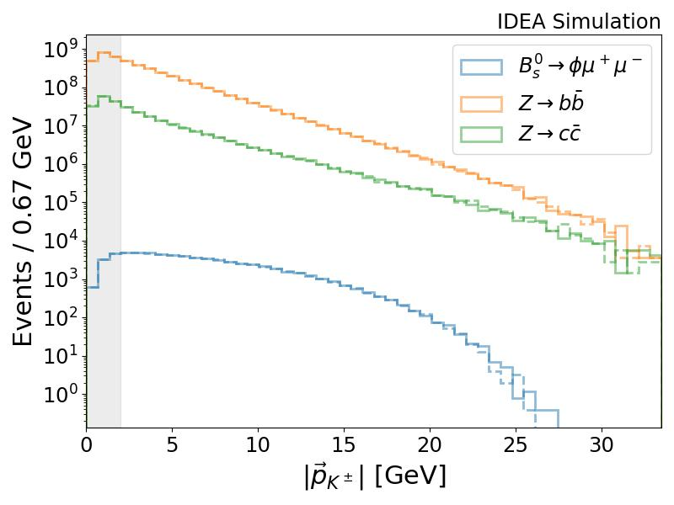
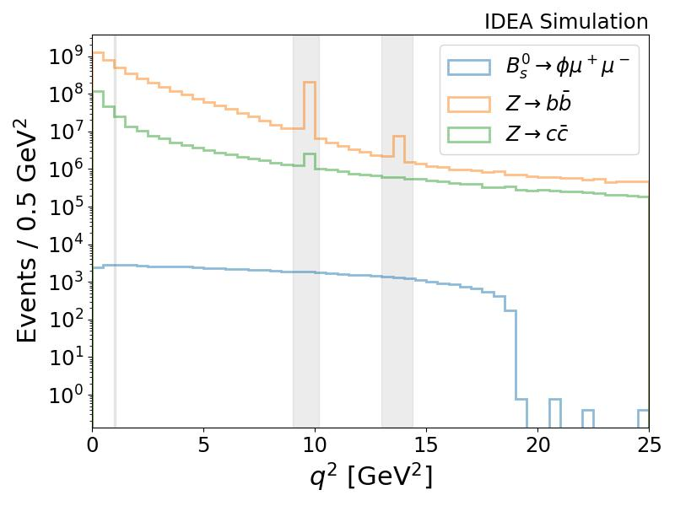
Some Physics of Signal. . . . . . . .
} q²
Resonances
(momentum transferred to dimuon system)
Kinematics
Preliminary
Preliminary
7

Slide 11
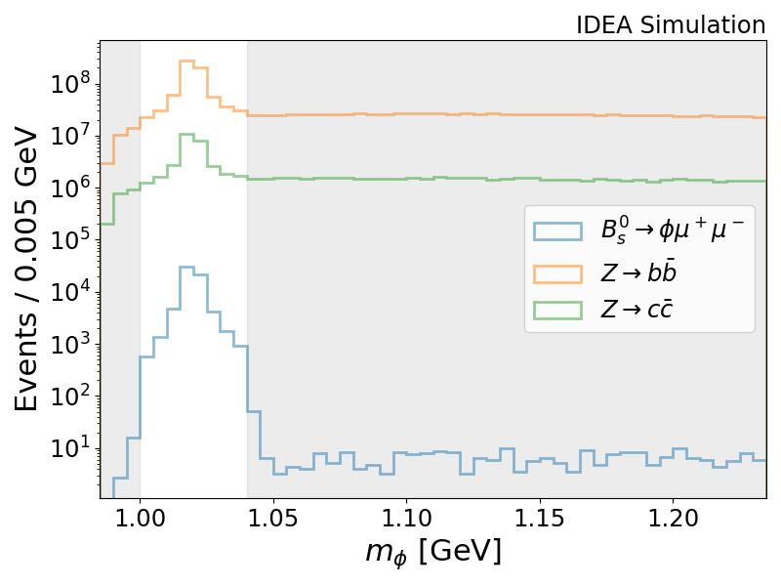
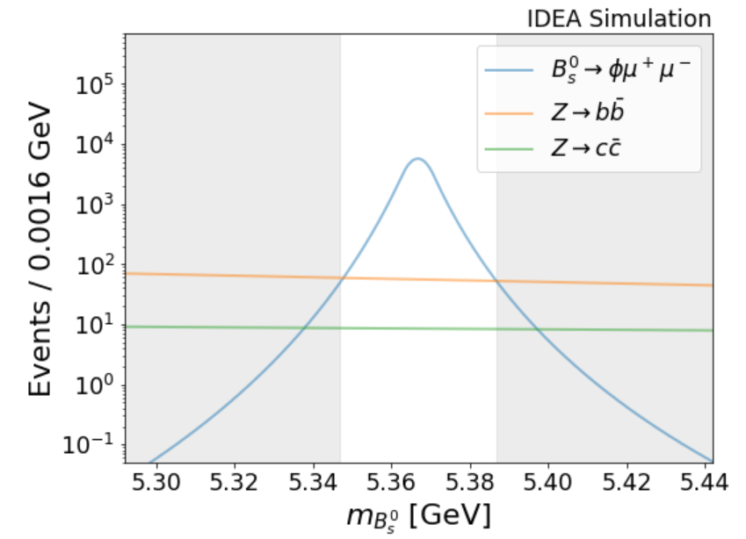
Some Physics of Signal. . . . . . . .
Inv. mass (Dikaon)
Inv. Mass (Dikaon + Dimuon)
Preliminary
Preliminary
8

Slide 12

Cut Flow. . . . . . . .
9

Slide 13
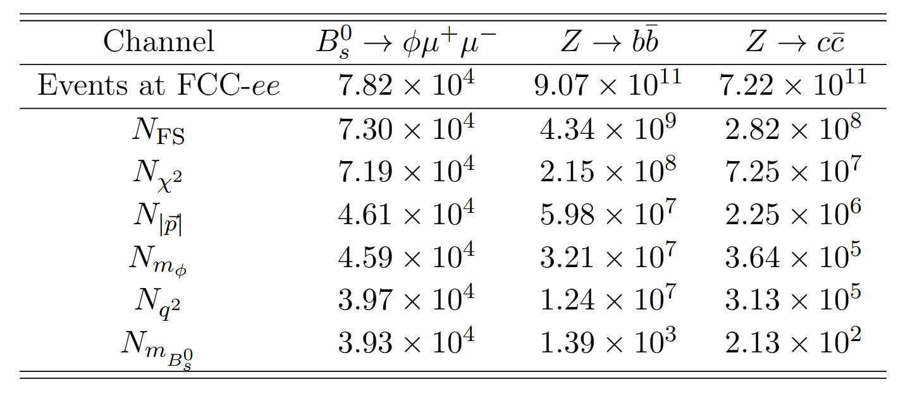






Cut Flow. . . . . . . .
Precision: ~0.5% (vs LHCb: ~2.6%)
9

Slide 14
What Can We Measure. . . . . . . . ?
Untagged Tagged
Time-independent
Time-dependent
10

Slide 15

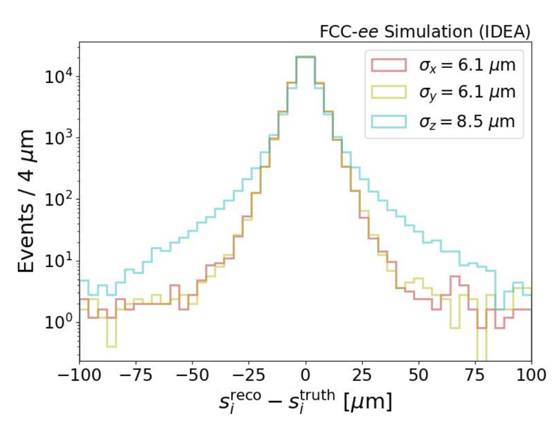
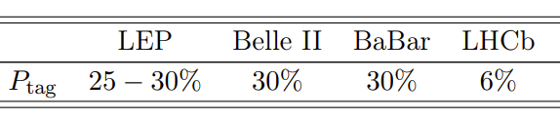




What Can We Measure. . . . . . . . ?
Fact Sheet: “Tagging”
Tell they’re from B or anti-B
Tag eff.: How often we can tell something
Tag Rate: How often we get it right
Uncert. ~ 1/sqrt{Tag Power}
Fact Sheet: “Timing”
Time resolution effect: dilution factor (~0.995)
Function of: PV, SV, Boost
[Dominated by SV resolution]
Untagged Tagged
Time-independent
Time-dependent
10

Slide 16
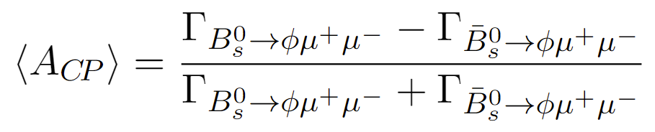
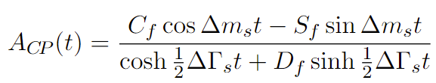
What Can We Measure. . . . . . . . ?
Untagged Tagged
Time-independent
Time-dependent
Time-integrated
CP-asymmetry
Branching Ratio
Time-dependent
Decay Rate
Time-dependent
CP-asymmetry
10

Slide 17
What Can We Measure. . . . . . . . ?
Fact Sheet: “Tagging”
Tell they’re from B or anti-B
Tag eff.: How often we can tell something
Tag Rate: How often we get it right
Uncert. ~ 1/sqrt{Tag Power}
Fact Sheet: “Timing”
Time resolution effect: dilution factor (~0.995)
Function of: PV, SV, Boost
[Dominated by SV resolution]
Untagged Tagged
Time-independent
Time-dependent
Time-integrated
CP-asymmetry
Branching Ratio
Time-dependent
Decay Rate
Time-dependent
CP-asymmetry
10

Slide 18
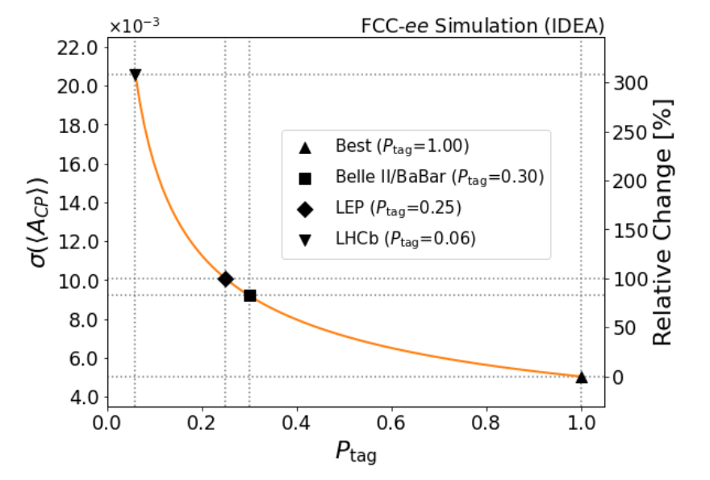
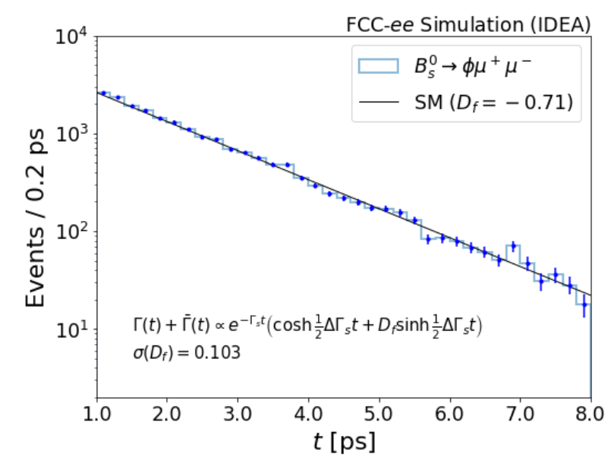
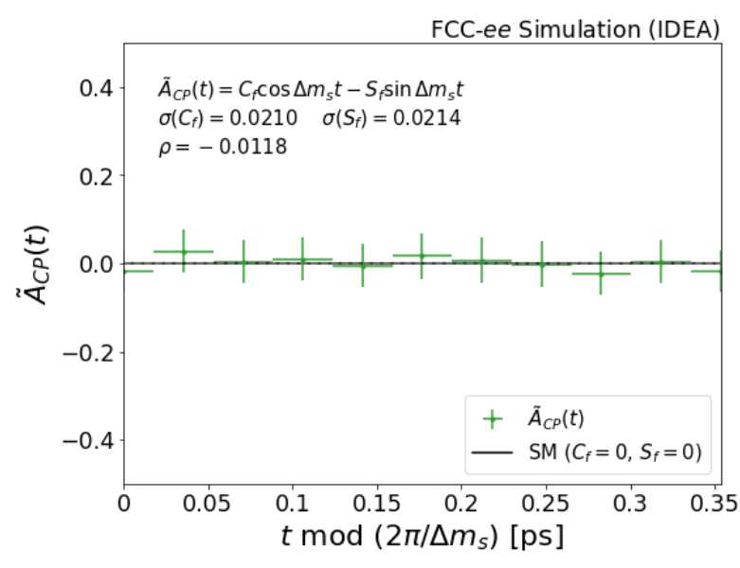



What Can We Measure. . . . . . . . ?
Untagged Tagged
Time-independent
Time-dependent
Preliminary
Precision: ~0.5%
Preliminary
Preliminary
10

Slide 19
What Can We Measure. . . . . . . . ?
Untagged Tagged
LHCb may measure untagged time-dependent
BUT
FCC-ee is really (almost) the only one can measure tagged time-dependent
Time-independent
Time-dependent
Preliminary
Precision: ~0.5%
Preliminary
Preliminary
10

Slide 20
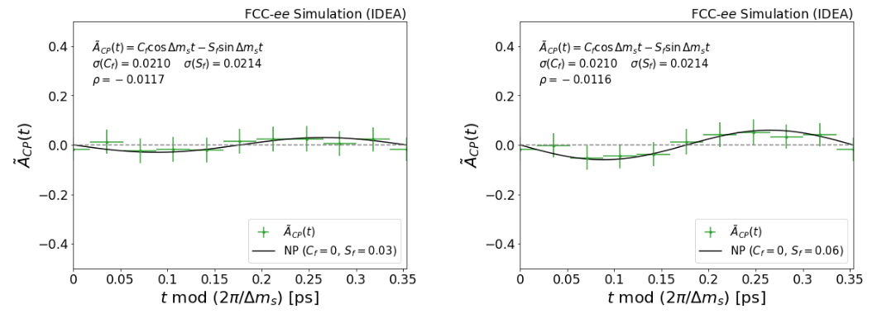


If NP exists. . . . . . . . ?
FYI: SM is like:
Preliminary
If there are Im[C_{NP}]
Preliminary
Preliminary
11

Slide 21
Conclusion (Analysis Part):
Now (we think) we know what we can measure. . . . . . . .
12

Slide 22

Here’s
Theory

Slide 23
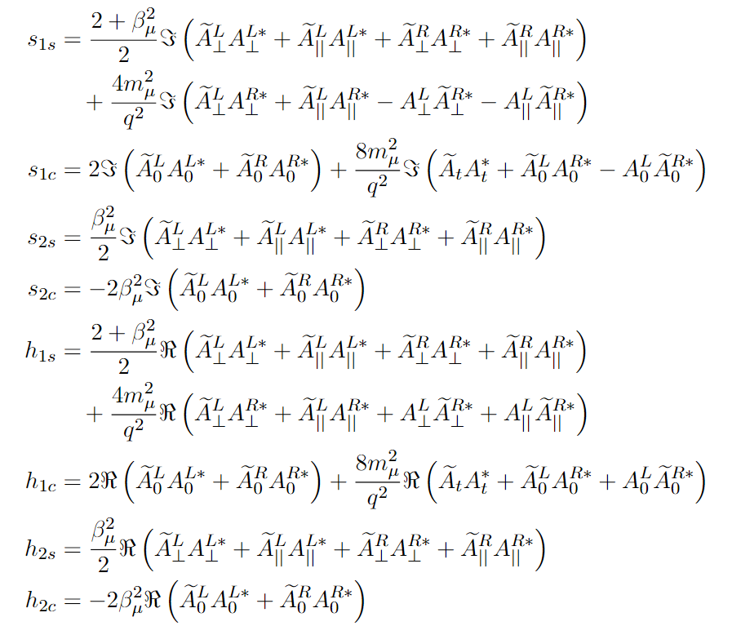
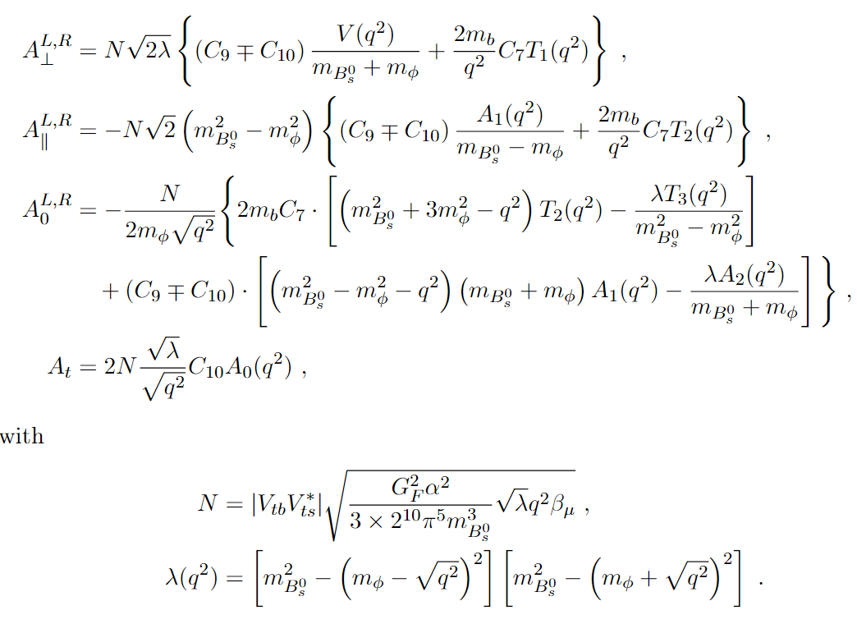
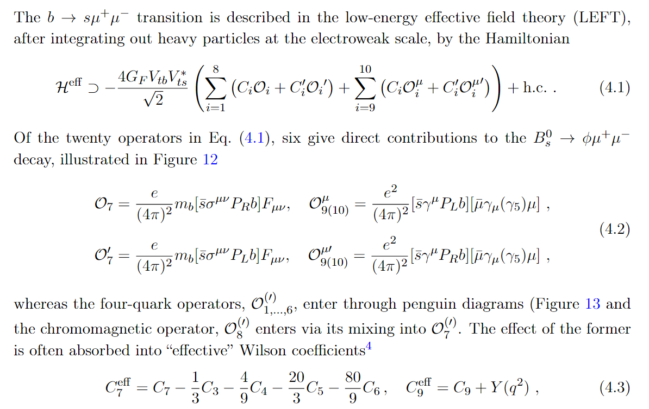
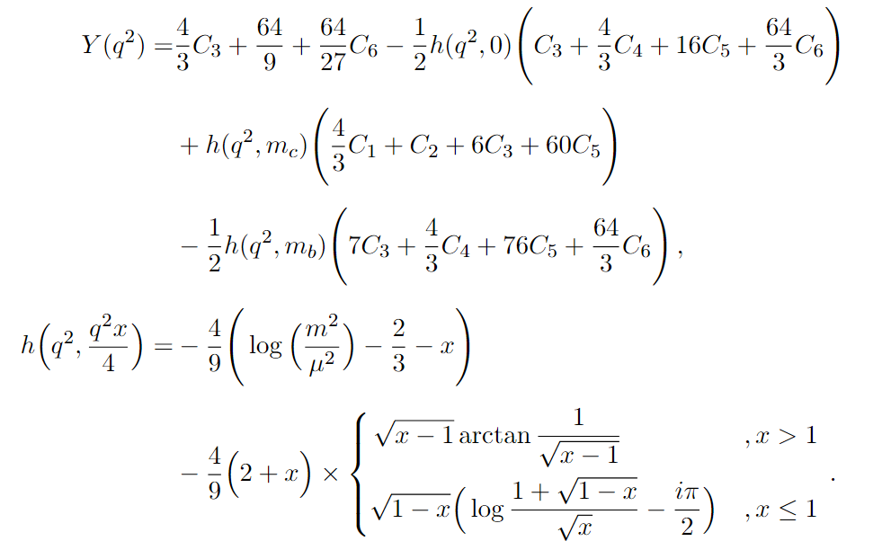
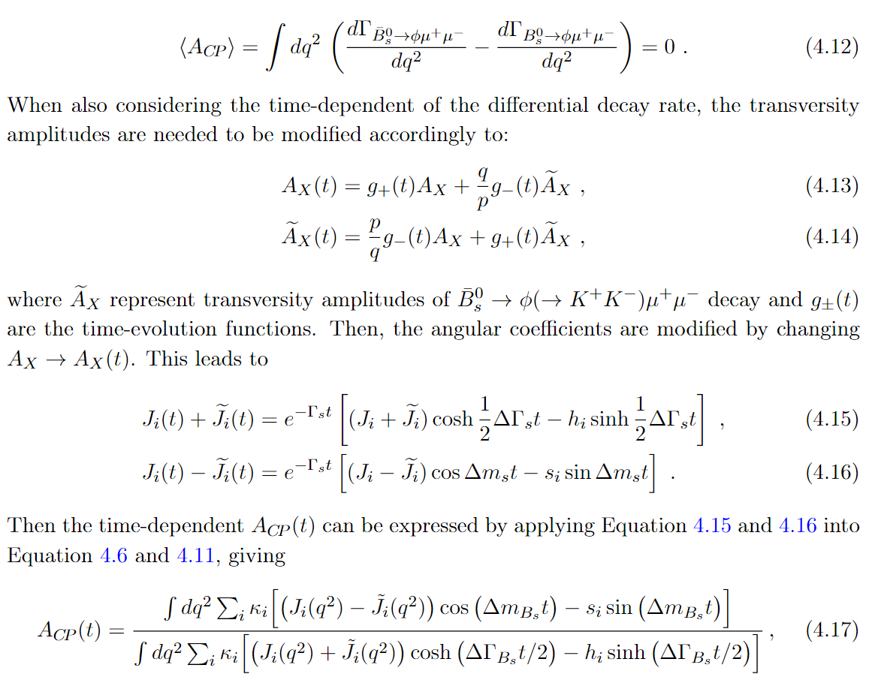
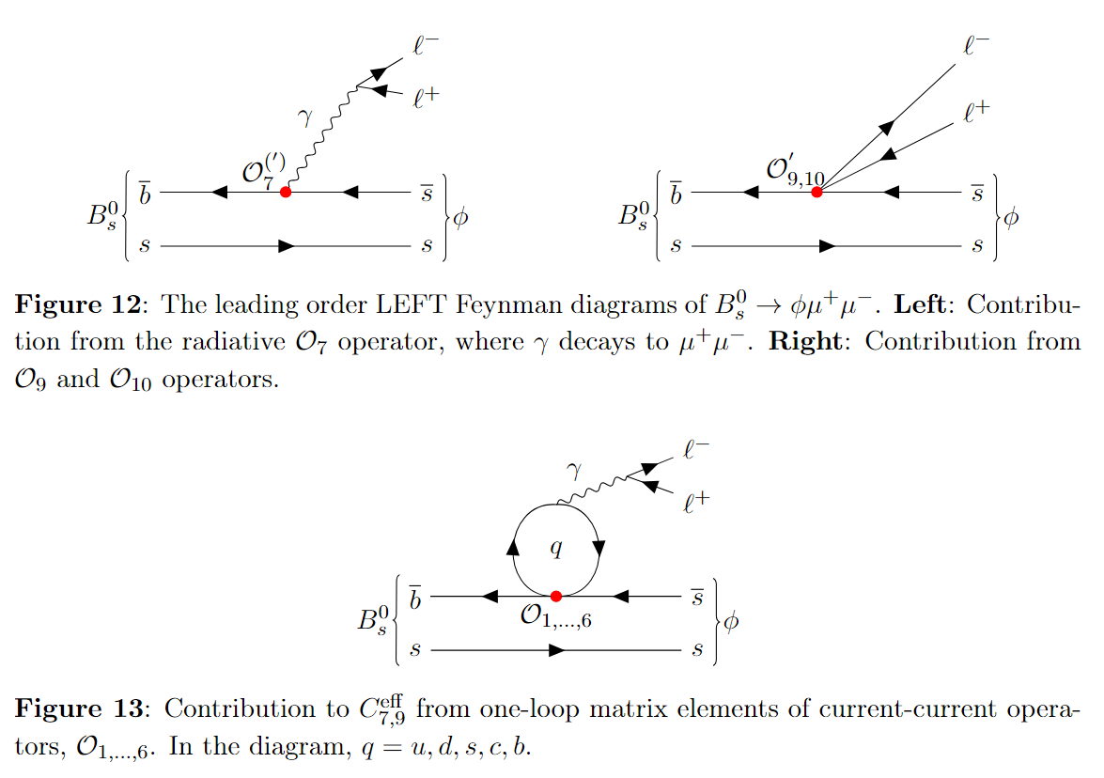
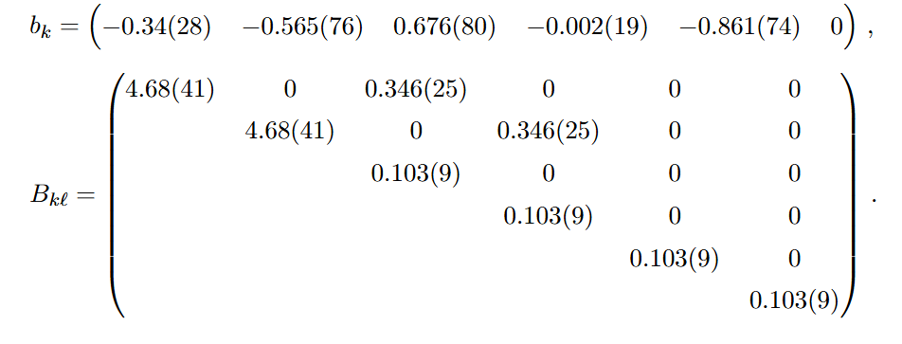
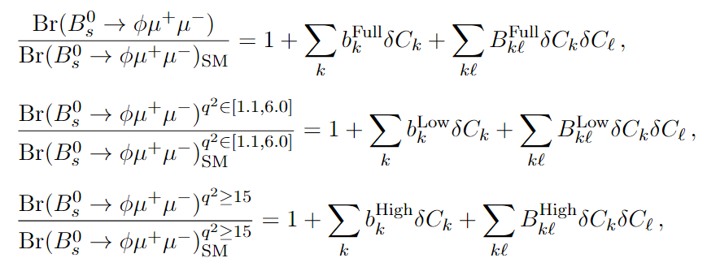
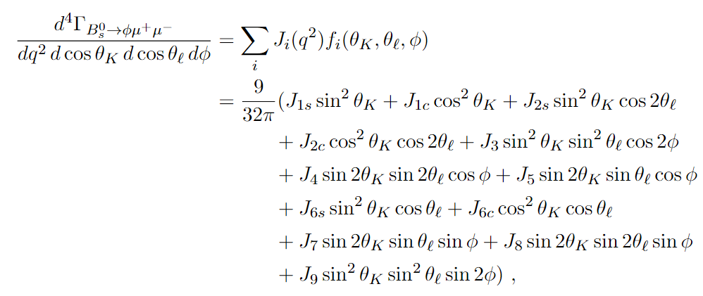
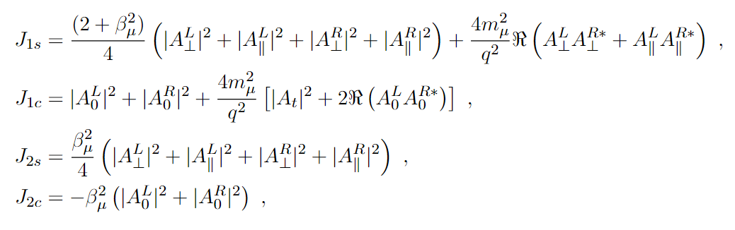
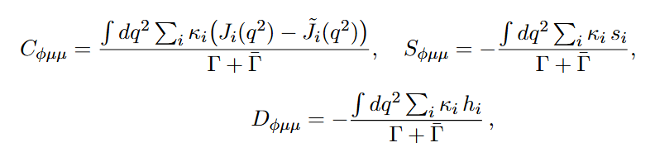
Interpretation In A Nutshell. . . . . . . .

Slide 24
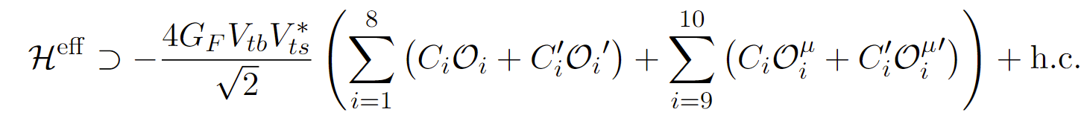
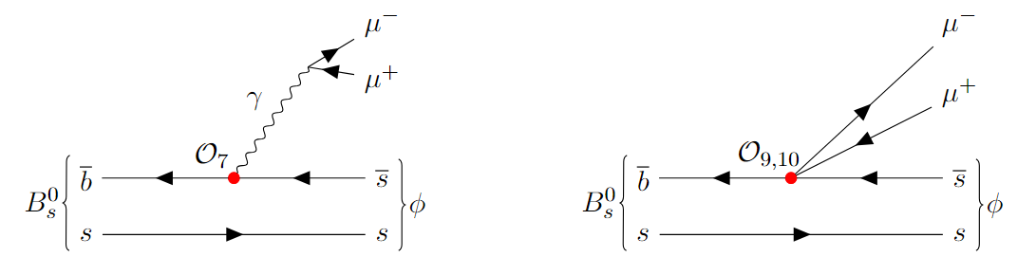
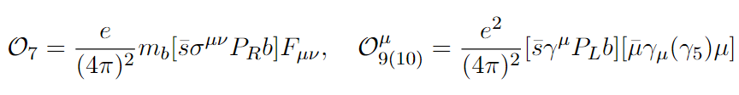




Model-independent Way (EFT). . . . . . . .
Want to see how Wilson Coefficients (C_{i}) deviate from SM value
13

Slide 25
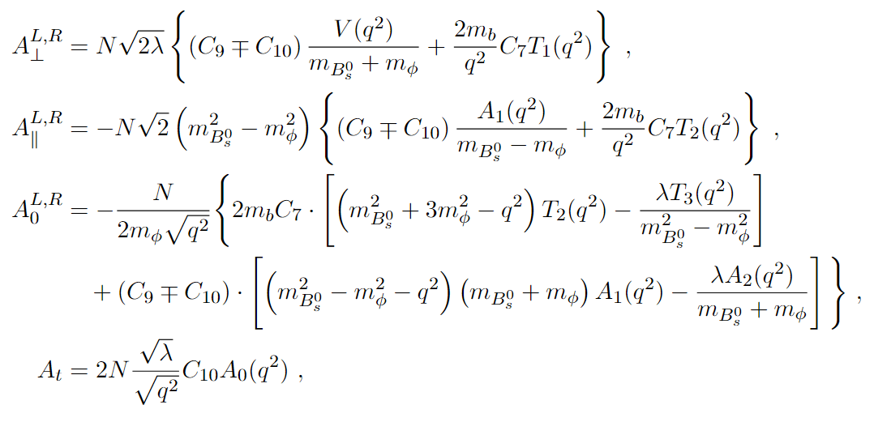
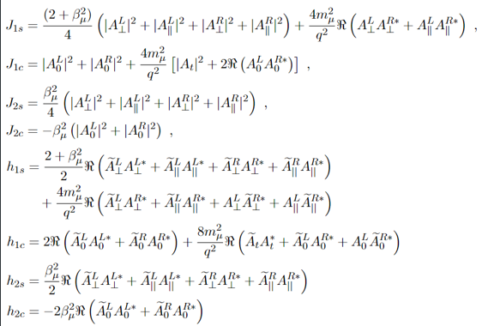










Connecting EXP-TH (An Example). . . . . . .
Observable as function of C’s
Link observables to J’s, h’s, s’s
J’s, h’s, s’s functions of Amplitudes
14

Slide 26

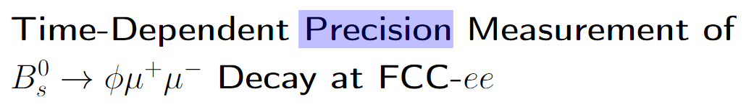
Our projection is pushing theory limit
Should also apply to SM prediction
15

Slide 27
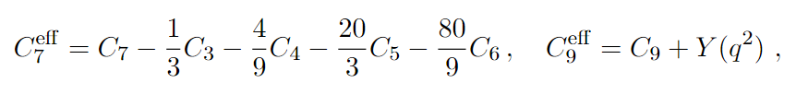
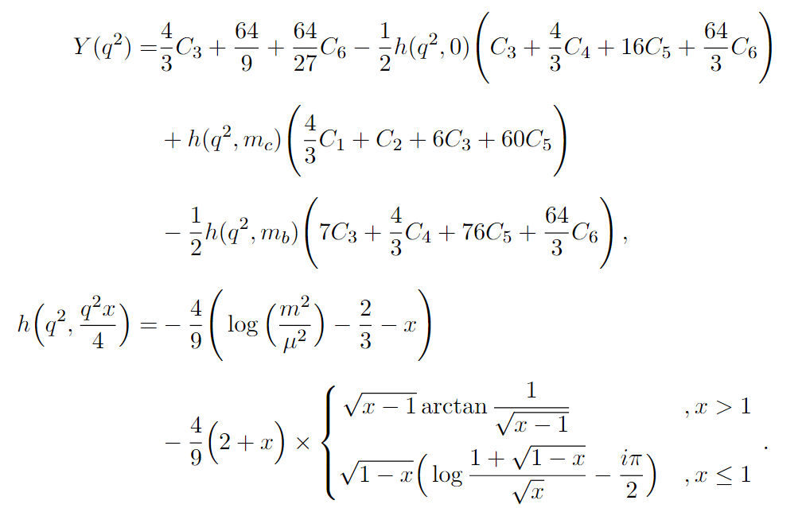
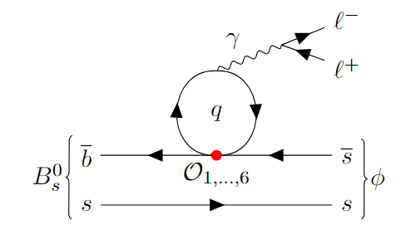






Long-distance Effects. . . . . . . .
16

Slide 28
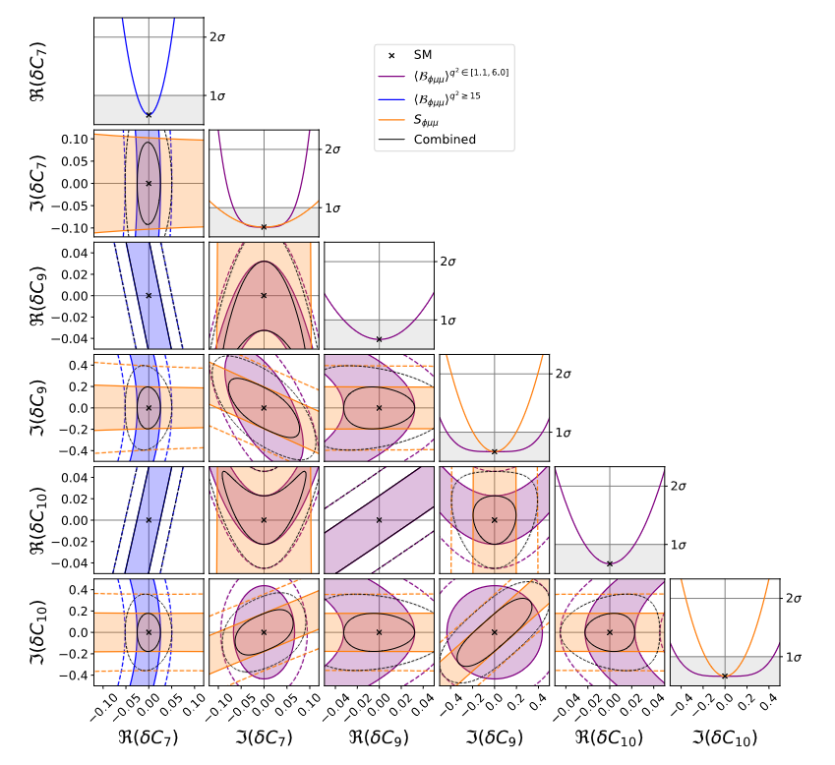
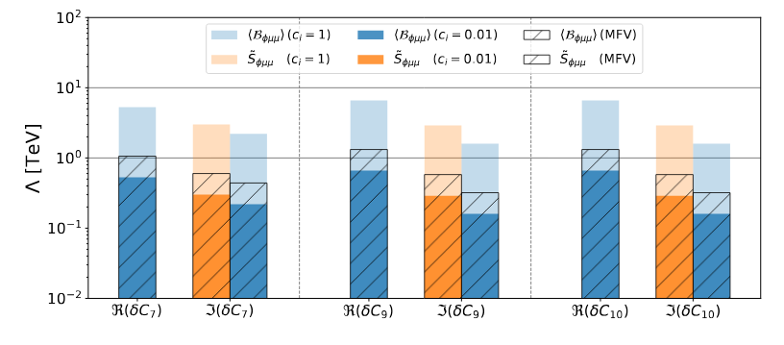
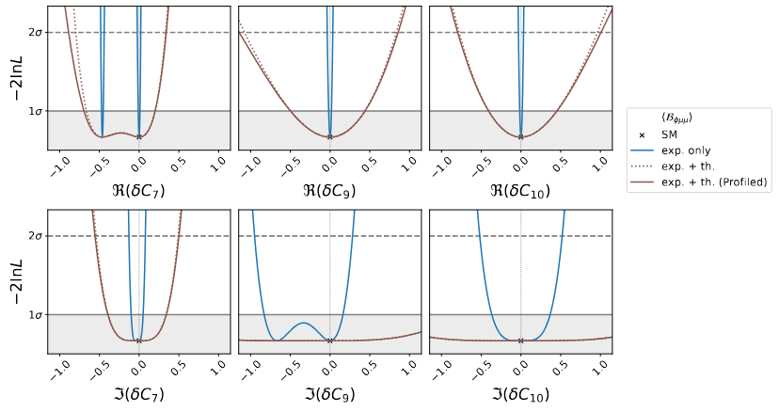
Money Plot (In Construction). . . . . . .
Complementary: Re and Im parts
Can learn NP up to O(10 TeV) [Stat. only]
Very Preliminary
Very Preliminary
With Th. Uncert.: Th. Uncert. >> Exp. Uncert.
Very Preliminary
e.g.
17

Slide 29
Money Plot (In Construction). . . . . . .
Complementary: Re and Im parts
Can learn NP up to O(10 TeV) [Stat. only]
Very Preliminary
Not only we can tell there is NP
We can also tell what kind
(If we see deviation)
Very Preliminary
With Th. Uncert.: Th. Uncert. >> Exp. Uncert.
Very Preliminary
e.g.
17

Slide 30

Conclusion
Big Question
Exact Problem
Where do we test it
How to Interpret it
What can we learn
Why matter >> antimatter?
Do we have CPV from NP
(in leptonic rare, FCNC, decay)?
FCC-ee : Ideal to test rare process! [Clean, Good Vertexing, …]
EFT: Tell how (NP) complex phase affects experimental measurements
Can probe NP up to O(10 TeV)
Crew
--- alphabetical ---
Theoretical Part
Experimental Part (Boss)
Experimental Part
Experimental Part
Theoretical Part
Jason Aebischer
Ben Kilminster
Anson Kwok
Valeriia Lukashenko
Zach Polonsky
Special Thank
Useful Discussions and Feedbacks
Armin Ilg

Slide 31
Conclusion
Big Question
Exact Problem
Where do we test it
How to Interpret it
What can we learn
Why matter >> antimatter?
Do we have CPV from NP
(in leptonic rare, FCNC, decay)?
FCC-ee : Ideal to test rare process! [Clean, Good Vertexing, …]
EFT: Tell how (NP) complex phase affects experimental measurements
Can probe NP up to O(10 TeV)
[If th. uncert. suppressed to similar order of magnitude]
We should push th. calculation

Slide 32
Conclusion
Big Question
Exact Problem
Where do we test it
How to Interpret it
What can we learn
Why matter >> antimatter?
Do we have CPV from NP
(in leptonic rare, FCNC, decay)?
FCC-ee : Ideal to test rare process! [Clean, Good Vertexing, …]
EFT: Tell how (NP) complex phase affects experimental measurements
Can probe NP up to O(10 TeV)
[If th. uncert. suppressed to similar order of magnitude]
We should push th. calculation
There is only one way to find out if it oscillates!
MEASURE IT!

Slide 33
Crew
--- alphabetical ---
Theoretical Part
Experimental Part (Boss)
Experimental Part
Experimental Part
Theoretical Part
Jason Aebischer
Ben Kilminster
Anson Kwok
Valeriia Lukashenko
Zach Polonsky
Special Thank
Useful Discussions and Feedbacks
Franco Grancagnolo
Armin Ilg
Gino Isidori
Lingfeng Li
Margherita Primavera

Slide 36
Backups. . . . . . .

Slide 37
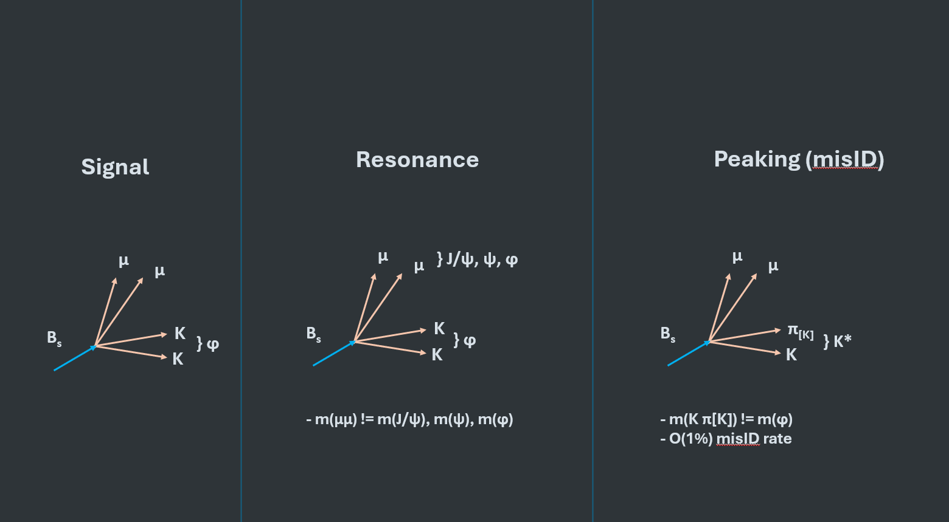
What background types do we have?

Slide 38
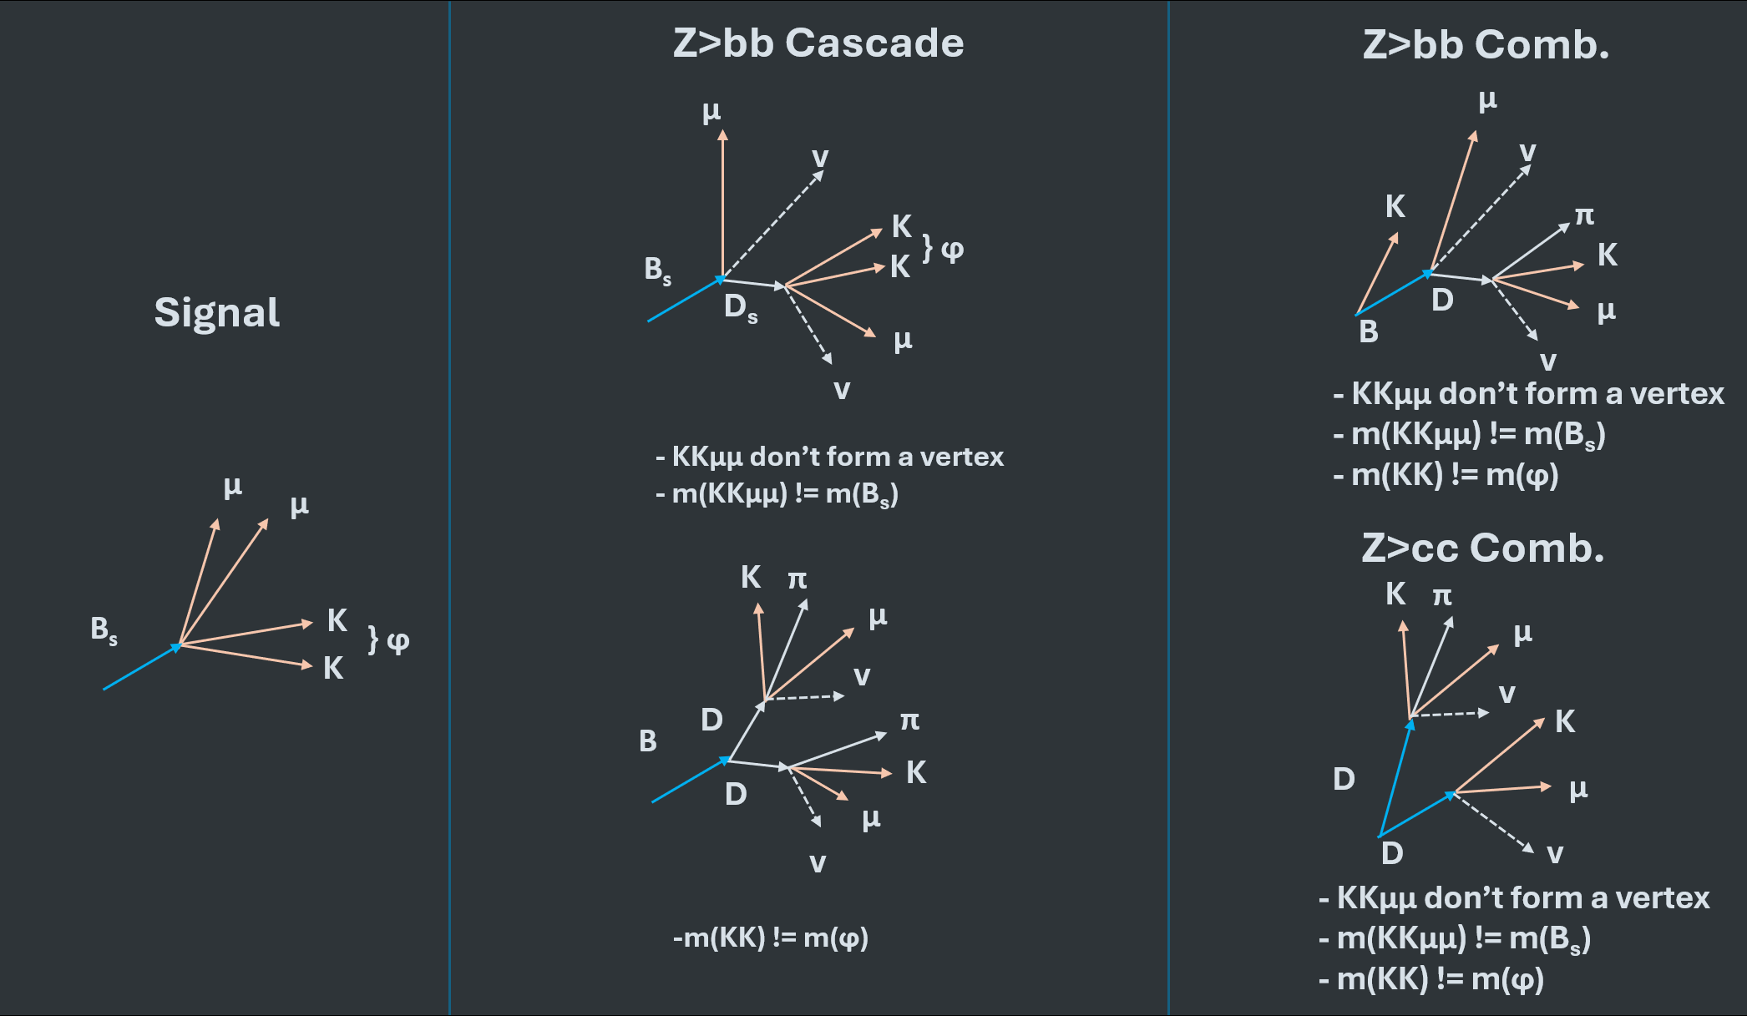
What background types do we have?

Slide 39
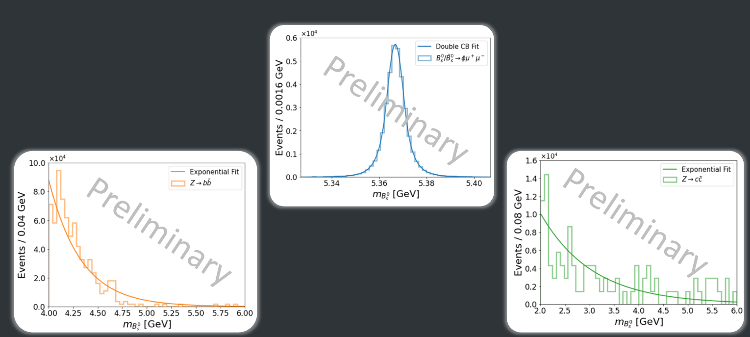
Why doing a fit in m(B_{s})? Leak of simulation samples

Slide 40

Why D_{f,} C_{f} measurement is
not included?
Not so sensitive compared to S_{f}
Extra argument vs LHCb:
They can measure D_{f} but not much physics can be told from D_{f} along.

Slide 41

Binned measurements

