Slide 1


Can blue-tilted primordial power spectrum save the small scale crisis in MW?
From the perspective of Zoom-In simulation for MW host size dark matter halo
Jianhao WU
2nd year MPhil student @ CUHK Physics, Prof. T. K. Chan’s AstroSim Group
IAS Program on Fundamental Physics (FP 2025), HKUST
Paper: Cosmological Zoom-In Simulations of Milky Way Host Size Dark Matter Halos with a Blue-Tilted Primordial Power Spectrum
https://arxiv.org/abs/2412.16072 Under Review by PRD
Jianhao Wu(CUHK), Tsang Keung Chan(CUHK), Victor J. Forouhar Moreno(Leiden).

Slide 2
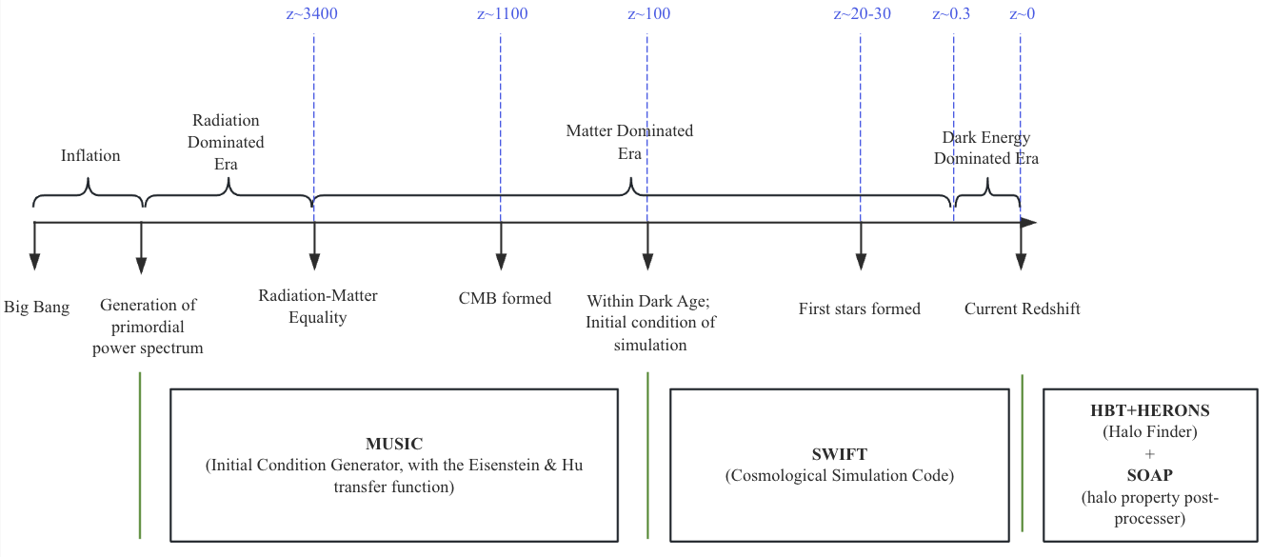
Standard Cosmology Model
The standard cosmology model consists of:
  The single-field slow-roll inflationary model, which would generate a power law primordial power spectrum at very early universe
  The LCDM model, which dominates the later evolution of the universe

Slide 3
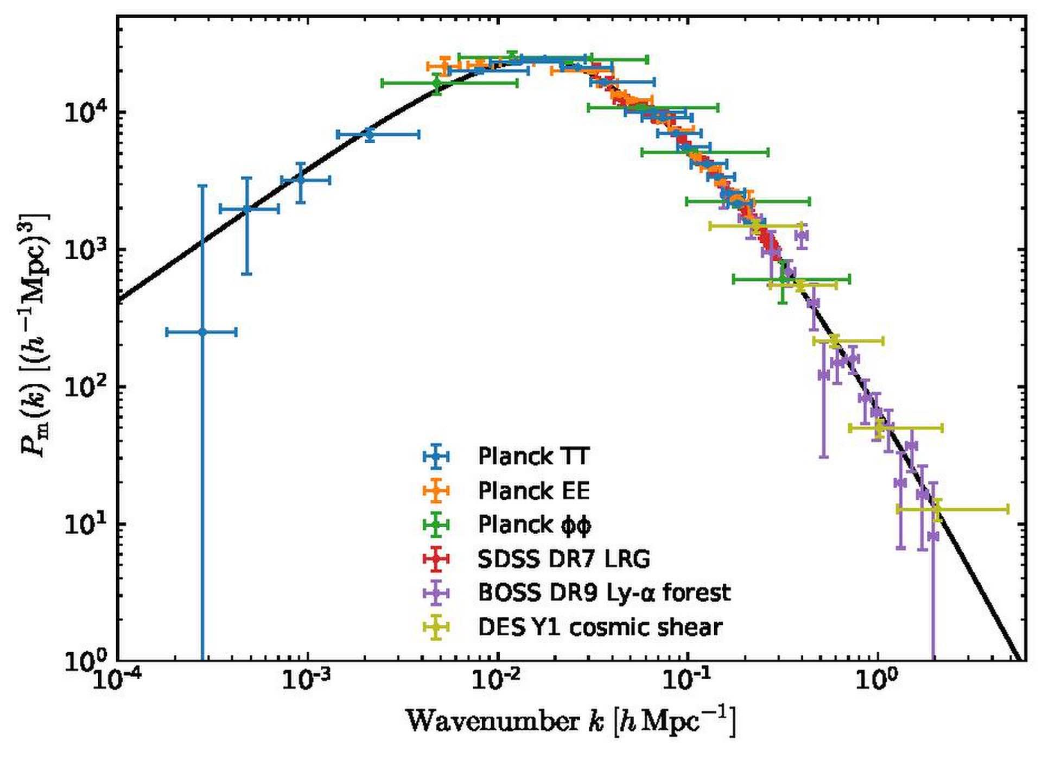
Uncertain at small scales
Standard cosmology model has achieved
great success during the past several
decades, on large scale of universe
However on small scales the primordial power
spectrum is loosely constrained
MW host dark matter halo’s size corresponds to ~2.5 h/Mpc

Slide 4
A small-scale enhanced or suppressed?
Besides, multiple observations are in favor of a small scale enhanced cosmological model:
  JWST has observed early formation of massive galaxies (arxiv [2306.11993])
  Even CDM model could not solve the “anomalous” flux ratio problem in strong lensing: a larger fraction mass of substructure is required (arxiv [0903.4559])
  A too-many-satellite-galaxies problem appeared in nearby galaxy observation (arxiv [1711.06267] [2403.08717])

Slide 5
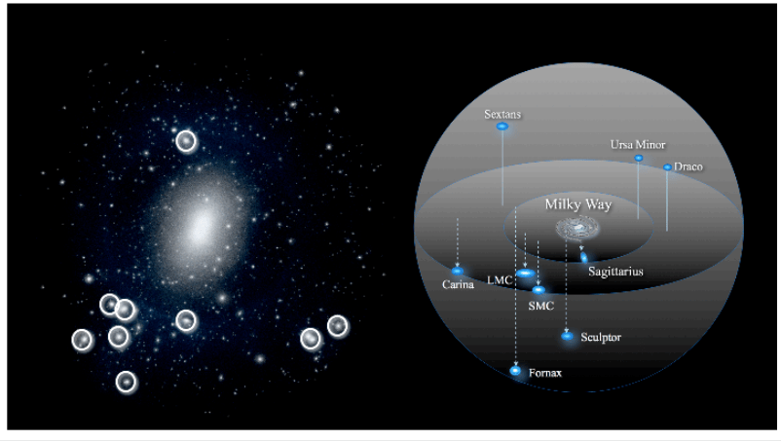
MW satellite galaxies can help constrain small scale！
A satellite galaxy is a smaller galaxy that orbits around a larger galaxy due to gravitational forces
Milky-Way has ≳50 satellite galaxies!

Slide 6
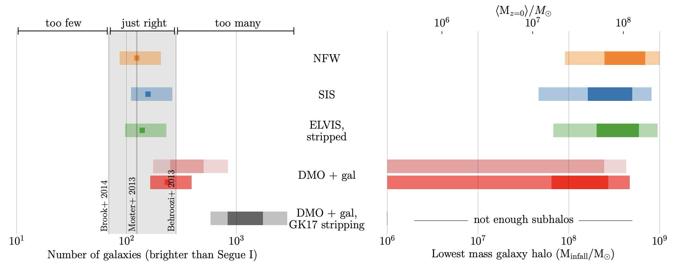
(Recently )Missing Satellite Problem->Too Many Satellites problem!
Faintest known galaxy
When considering the central baryonic disk of MW, the satellites would be too many!
source: arxiv [1711.06267]

Slide 7
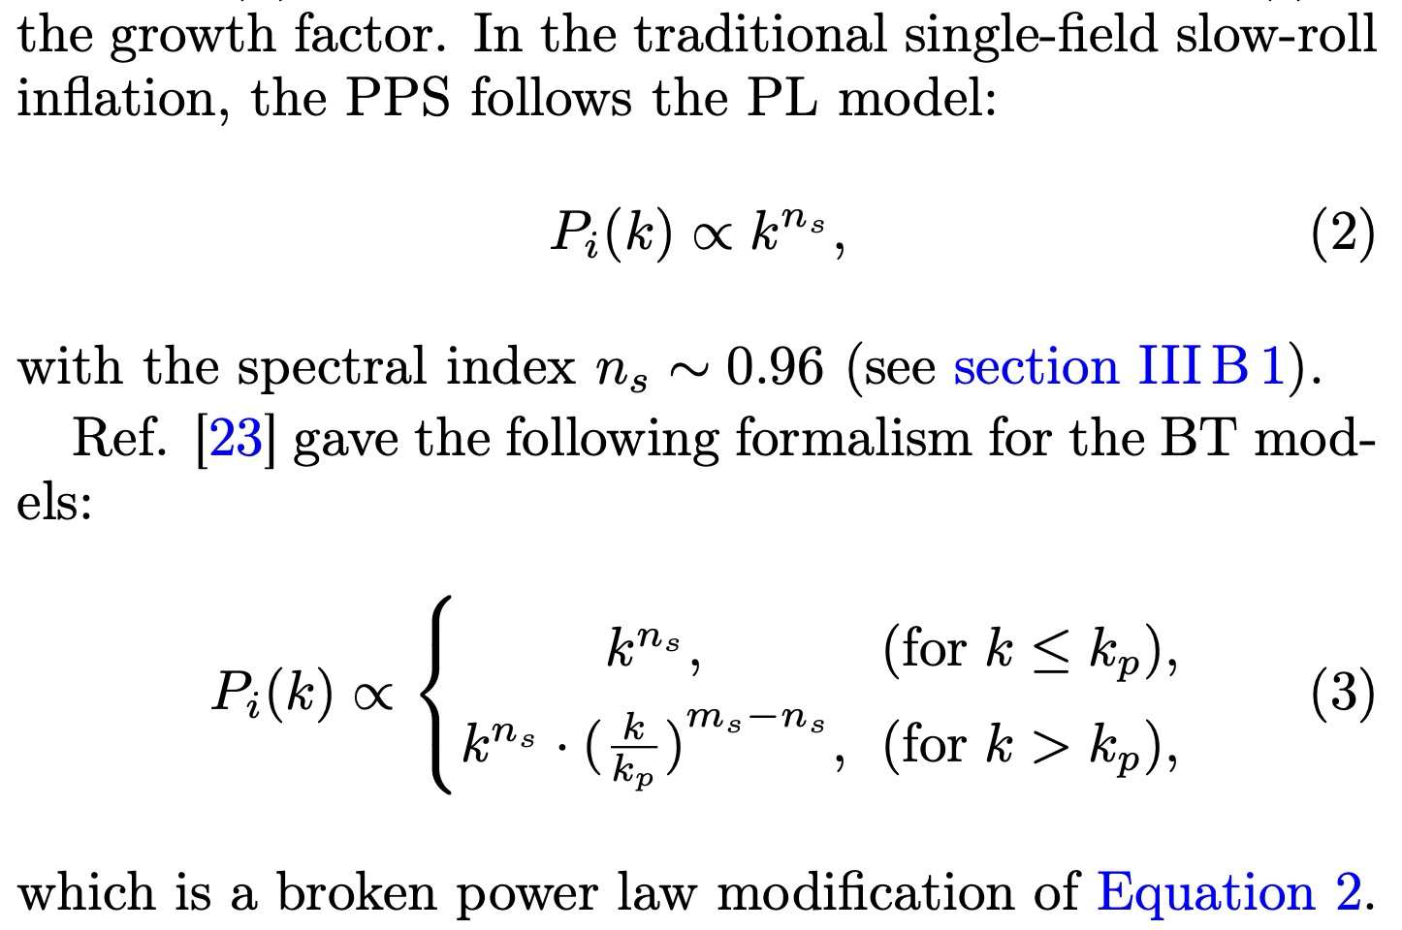
Change Power Law Primordial Power Spectrum->Broken Power Law!
Larger spectral index at small scale end (large k), to give small scale enhancement!
old model
blue-tilted model

Slide 8
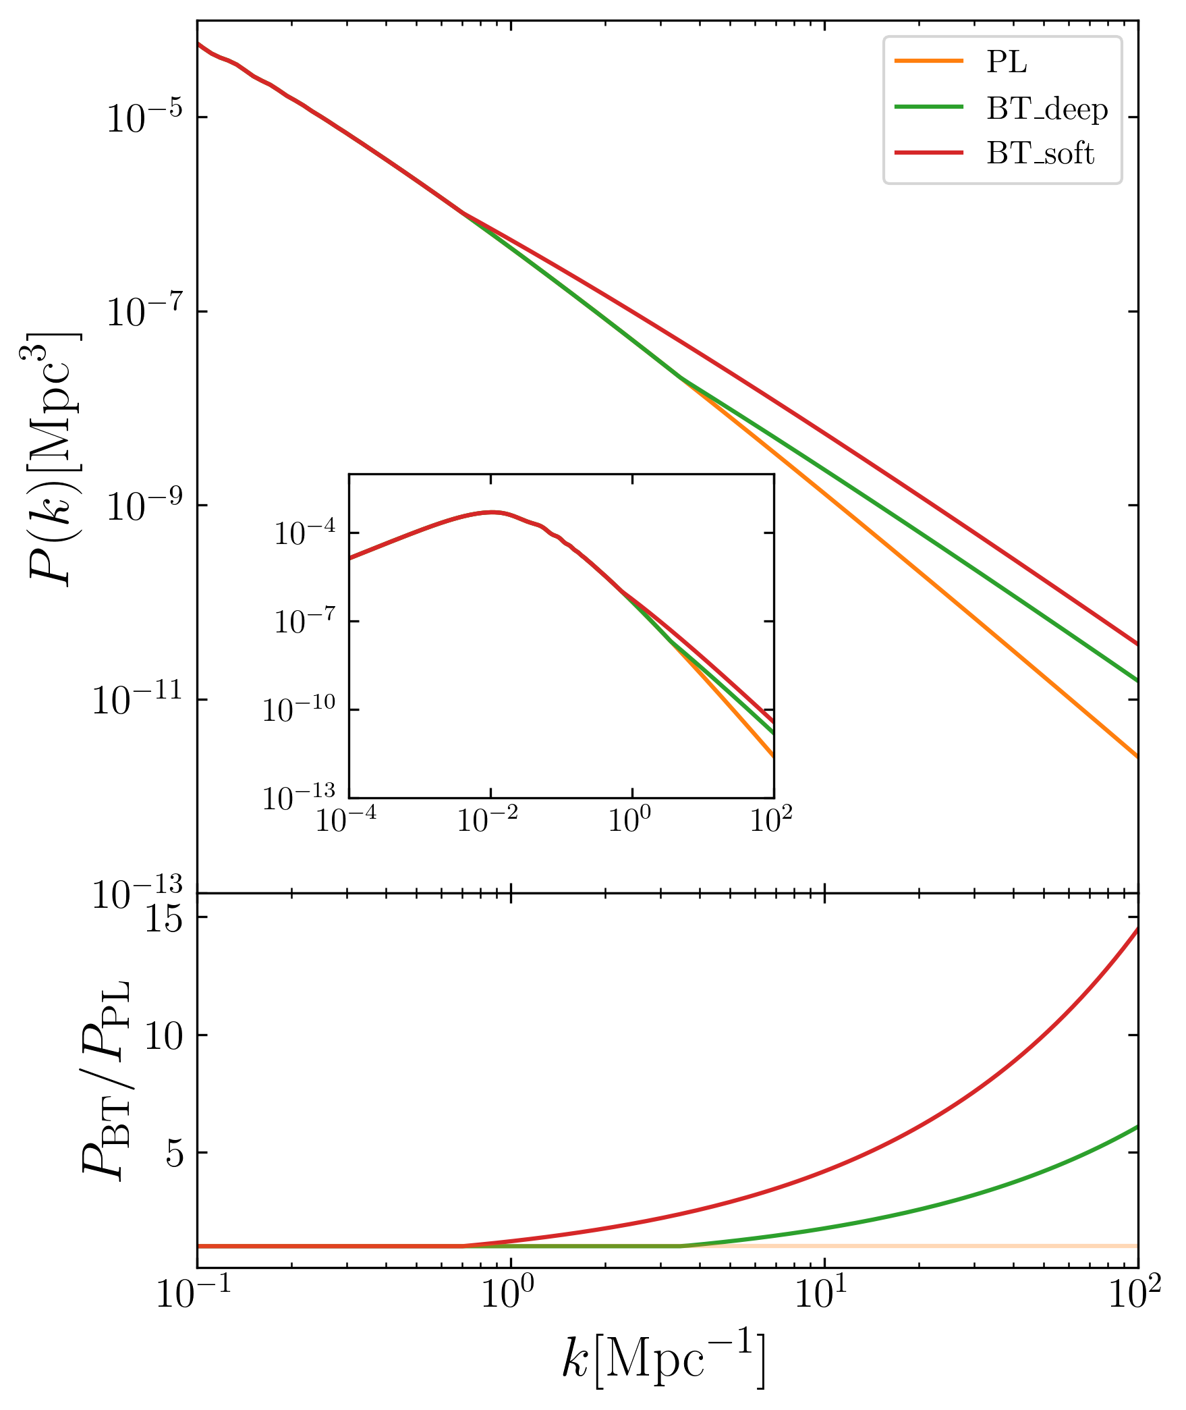
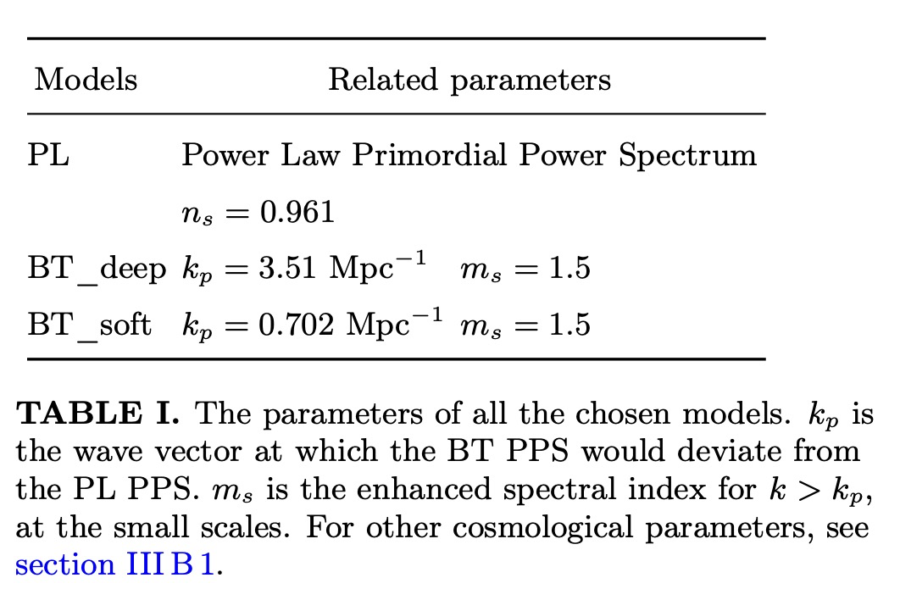
Two blue-tilted models for instance
We chose two sets of parameters for blue-tilted
model (BT model), along with the standard model
(power-law model aka PL model here)

Slide 9
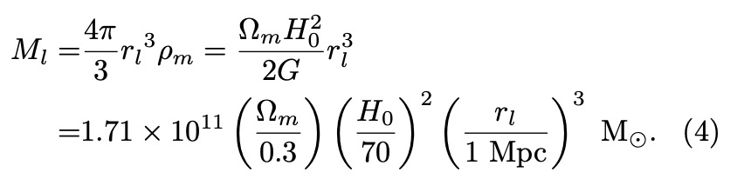



Broken point’s scale corresponds to a cosmic structure mass scale
$k_{p}$ should correspond to a mass scale for cosmic structure, only below which blue-tilted model could affect.
How to get it?
  wave number $k_{p}$ ->
  wave length λ->
  A sphere whose radius $r_{l}=\frac{1}{2}$λ
For BT_deep: $1.1×{10}^{11}M_{⨀}$
For BT_soft: $1.4×{10}^{13}M_{⨀}$
Both could cover the mass scale for most dark matter subhalos in MW host (${10}^{12}M_{⨀}$)!

Slide 10
Numerical pipeline we used
After changing the primordial power spectrum, then use cosmological simulation to evolve to current redshift!
Upper panel: universe history
Bottom panel: numerical codes

Slide 11
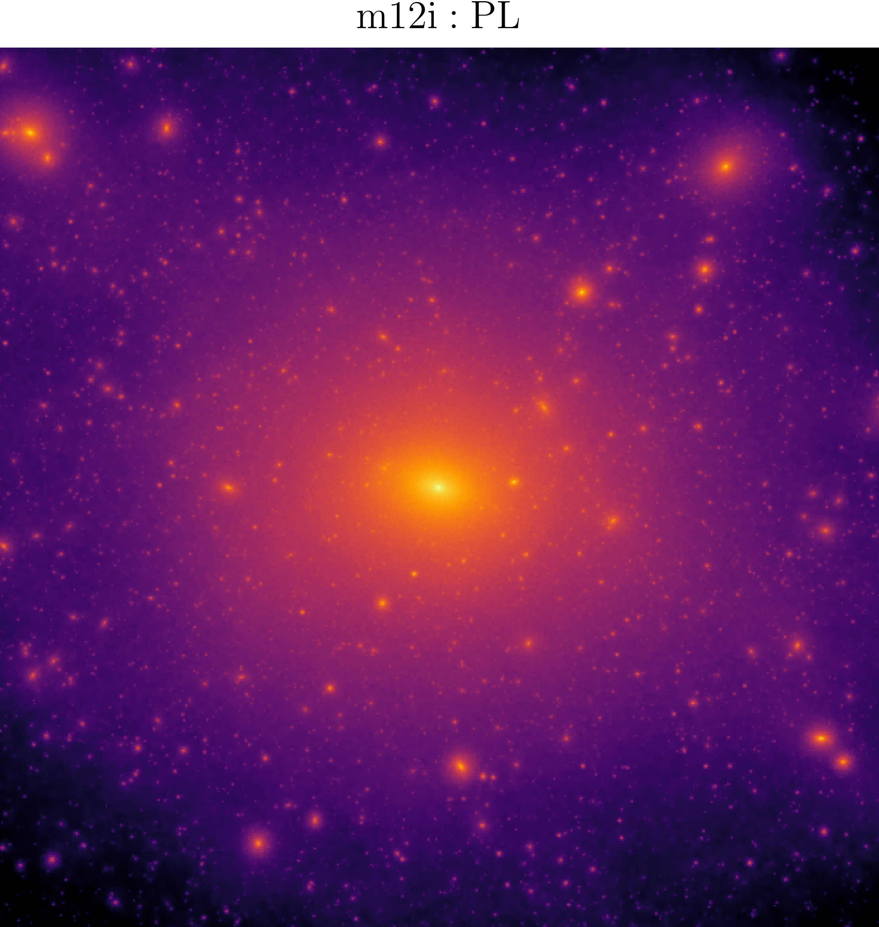
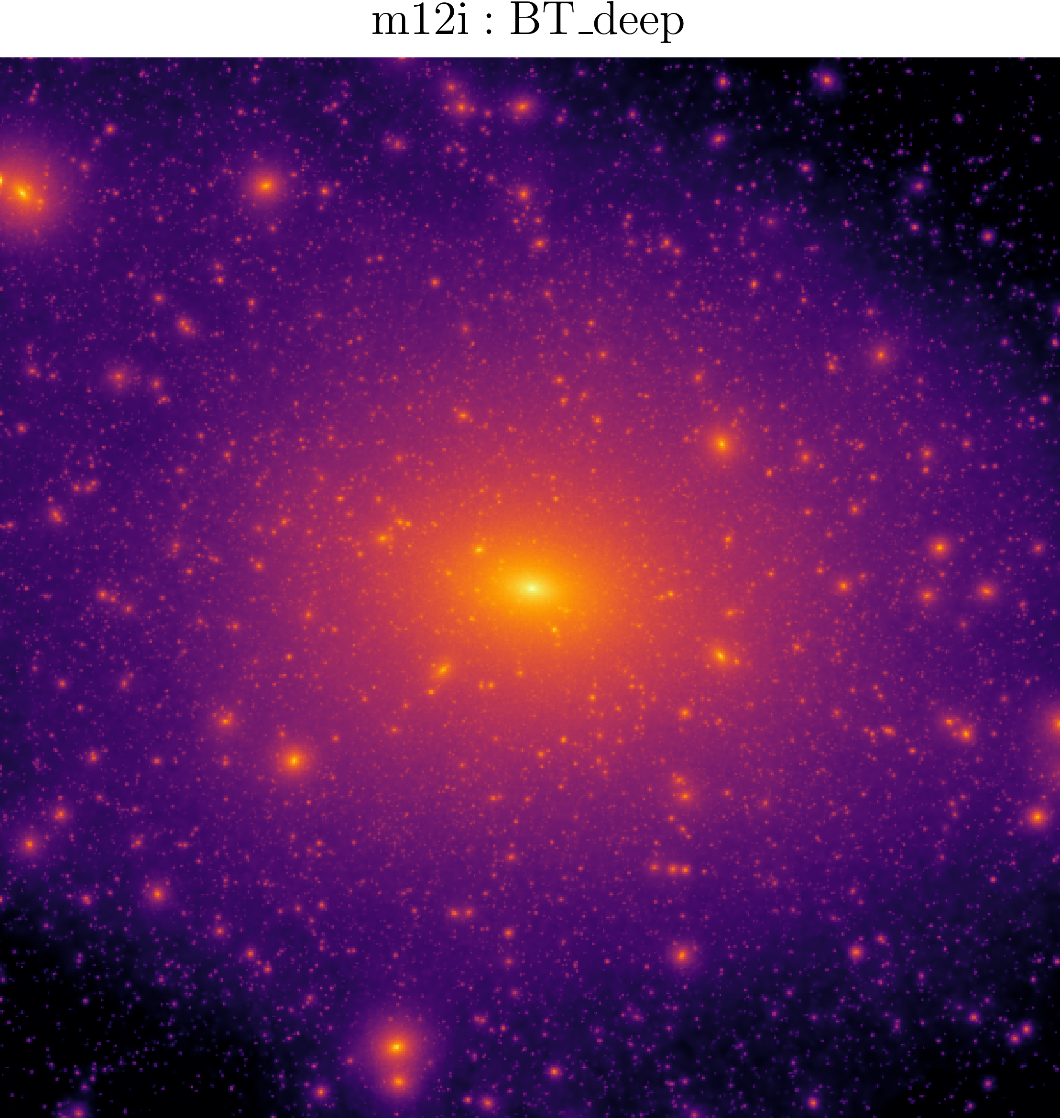
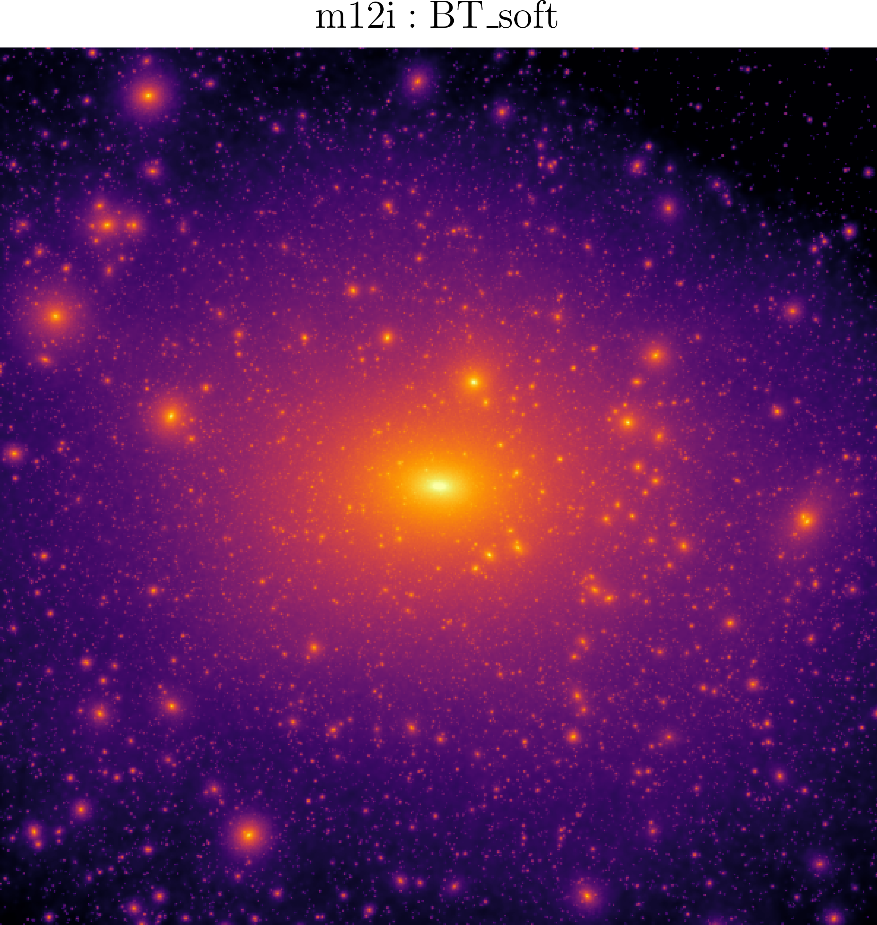
Intuitive way: projection map showing more subhalos
dark matter 2D projection map, with side length 400 kpc
Both BT models give more subhalos than power-law!

Slide 12
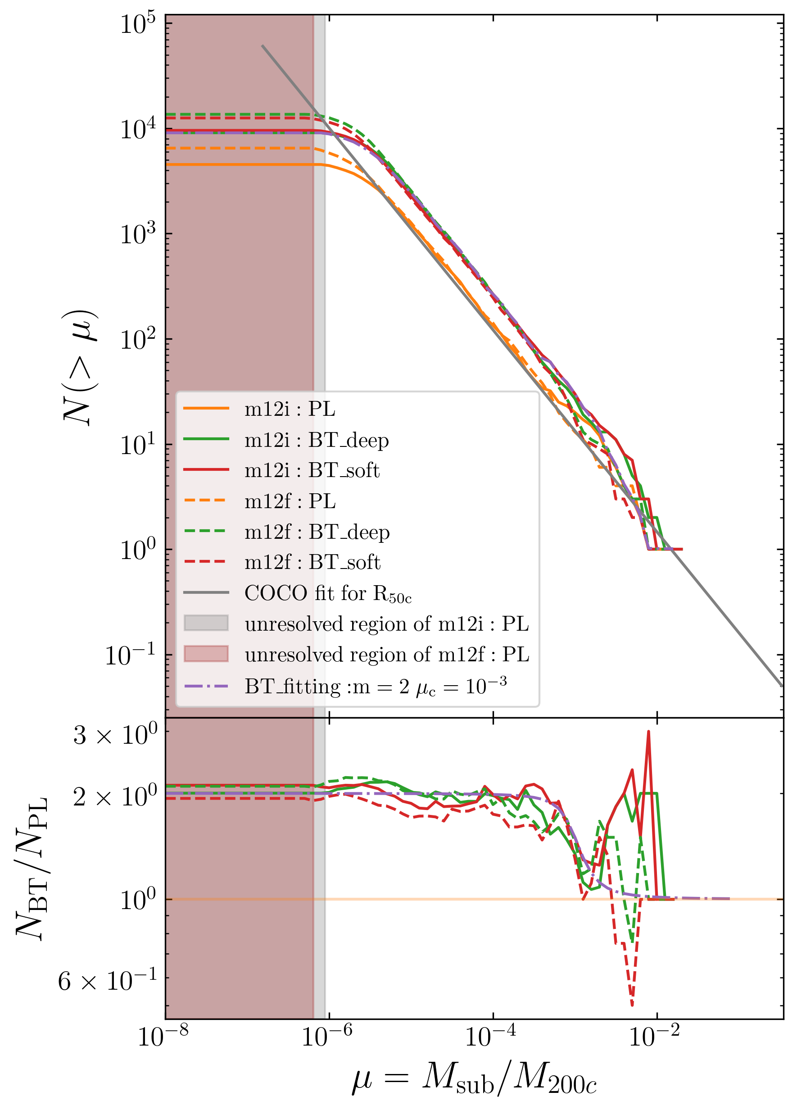
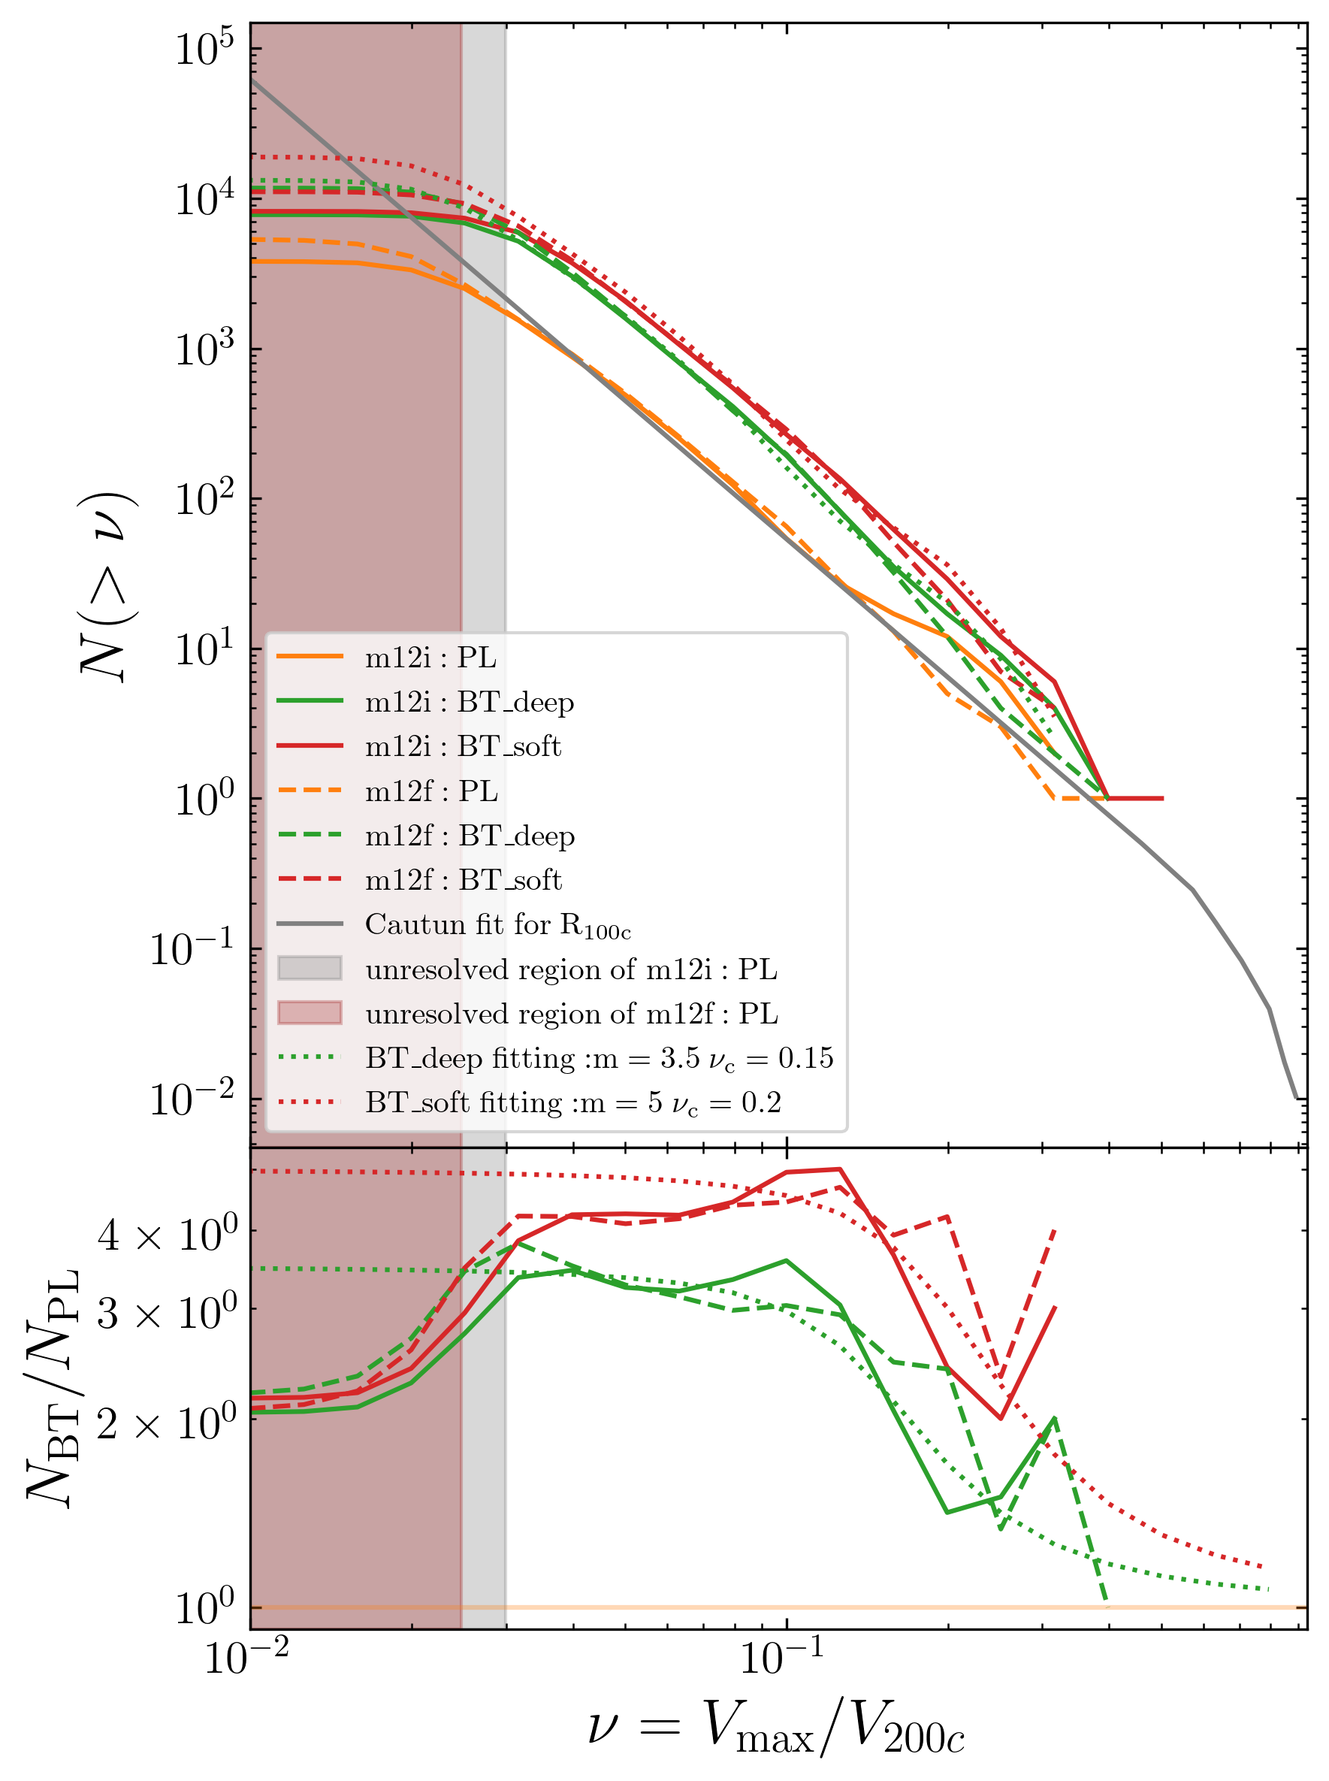
In terms of mass and maximum circular velocity(Vmax)
subhalo function(aka subhalo number distribution) by mass or Vmax
  subhalo mass function could
  be enhanced by a factor of two
  at low mass end
  subhalo Vmax function could
  be enhanced by more than 3
  times at low Vmax end
scaled mass
scaled Vmax
Number of subhalos
Ratios between numbers
The ratio for both functions, observes an inverse S shape function!

Slide 13
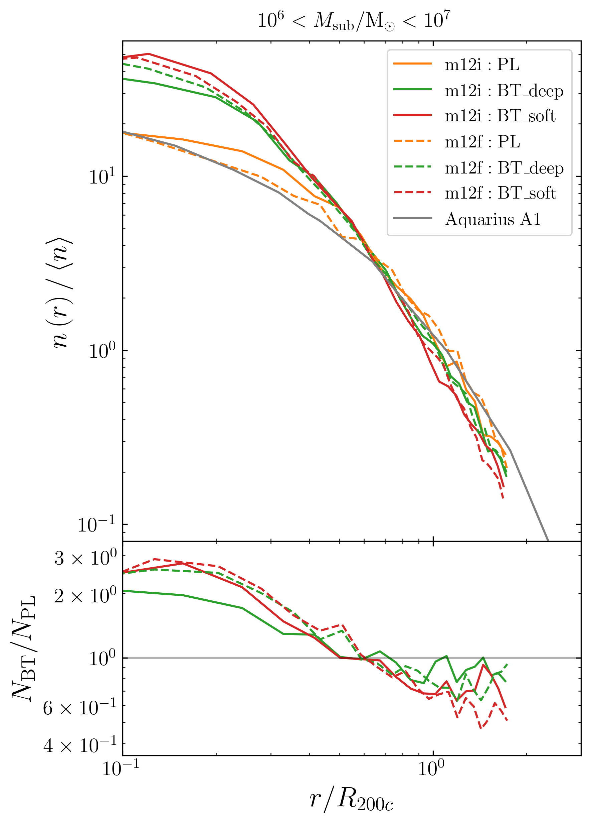
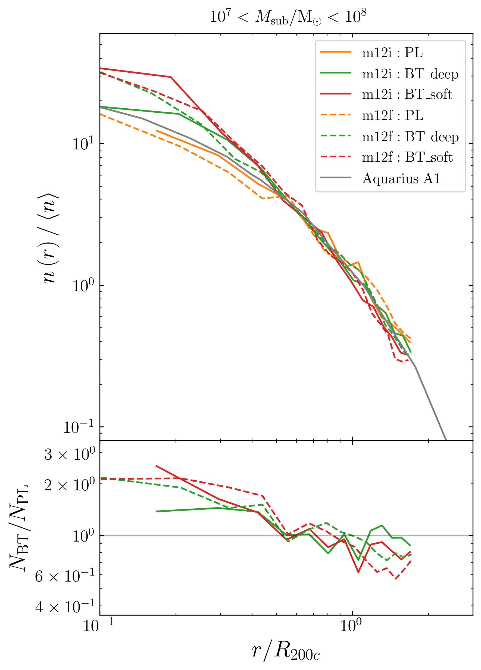
In terms of radial distance
Grey lines are the same for different mass!
(Found by Aquarius simulation [arxiv0809.0898])
radial distance from the center of main halo
  At inner region of main halo,
  normalized number density nearly
  doubled
scaled radial distance
scaled radial distance
Normalized number density
Ratio(BT over PL)

Slide 14
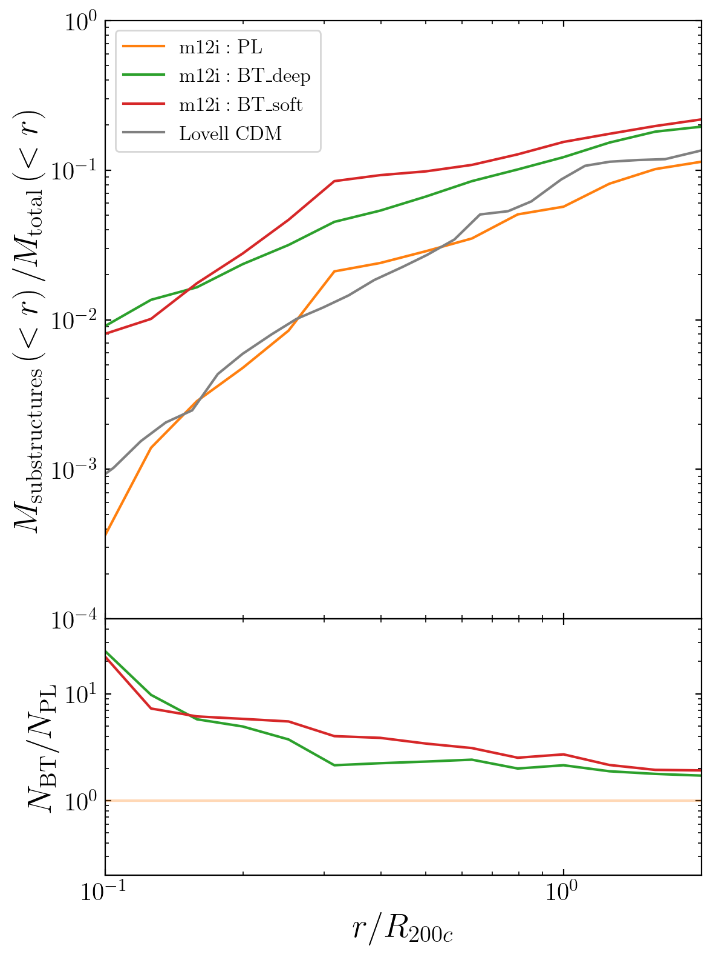
Larger substructure mass fraction!
scaled radial distance
substructure mass fraction:
  Defined as mass of particles belonging to substructures(within radius r)/total mass(within radius r)
  CDMO simulation is insufficient to explain strong lensing result (arxiv [0903.4559])
  Blue-tilted model could reach an order of magnitude enhancement compared to traditional model
Substructure Mass Fraction
Ratio(BT over PL)

Slide 15
Conclusion
We use cosmological simulation to show that a small scale enhanced early universe model could indeed generate more substructure, potentially help to the small scale debate in cosmology:
  More subhalos in terms of mass, Vmax and distance
  Larger fraction of substructure mass
Now we are working on a follow-up project of the first: introducing baryonic disk potential, and then use observed satellite galaxies to constrain the early universe cosmology.

