Slide 1
Status of CLIC and C3
Nuria Catalan Lasheras– CERN
IAS program in Fundamental Physics 14.1.2025

Slide 2
OUTLINE
(Re)introduction to the CLIC machine
CLIC technology
CLIC Recent work on three main pillars
The ESPP update
C3 introduction
C3 newest R&D

Slide 3
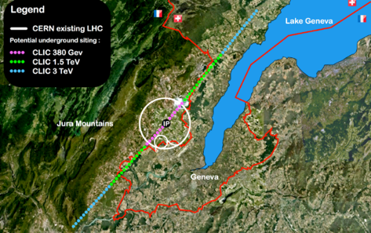
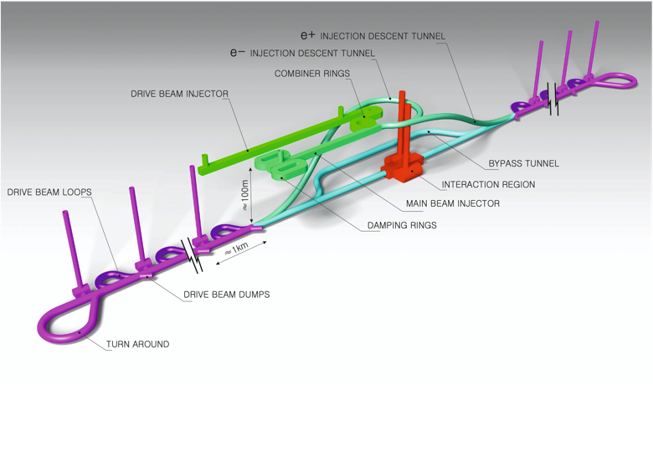
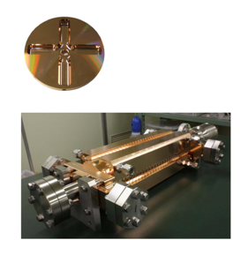
The Compact Linear Collider (CLIC)
  Timeline: Electron-positron linear collider at CERN for the era beyond HL-LHC
  Compact: Novel and unique two-beam accelerating technique with high-gradient room temperature RF cavities (~20’500 structures at 380 GeV), ~11km in its initial phase
  Expandable: Staged programme with collision energies from 380 GeV (Higgs/top) up to 3 TeV (Energy Frontier)
  CDR in 2012 with focus on 3 TeV.
  Project Implementation Plan in 2018 with focus on 380 GeV for Higgs and top.
Accelerating structure prototype for CLIC: 12 GHz (L~25 cm), 100 MV/m

Slide 4
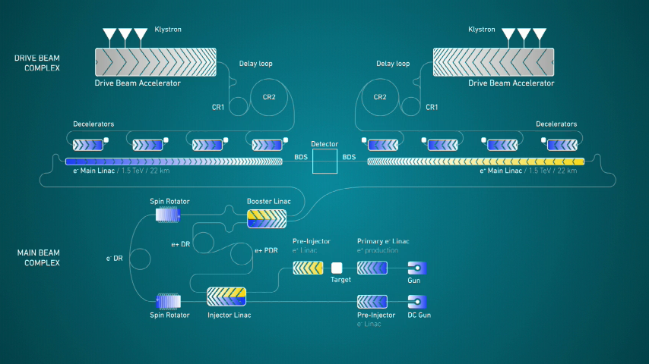

Slide 5
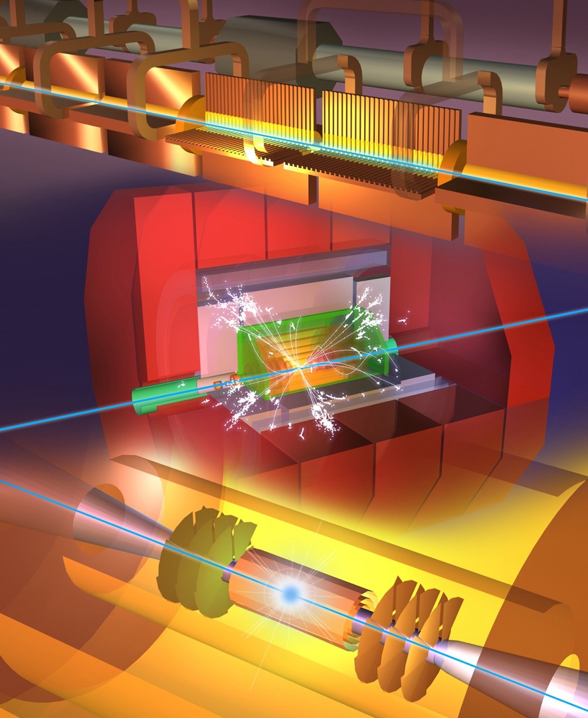
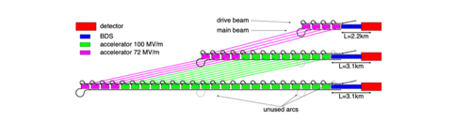
A Multi-TeV Linear Collider Based on CLIC Technology : CLIC Conceptual Design Report. CERN-2012-007
Physics and Detectors at CLIC : CLIC Conceptual Design Report. CERN-2012-003
The CLIC programme: Towards a staged e+e−e+e− linear collider exploring the terascale : CLIC conceptual design report. CERN-2012-005
Updated baseline for a staged Compact Linear Collider. CERN-2016-004 ; CERN-2016-004
Extend by extending main linacs, increase drivebeam pulse-length and power, and a second drivebeam to get to 3 TeV

Slide 6
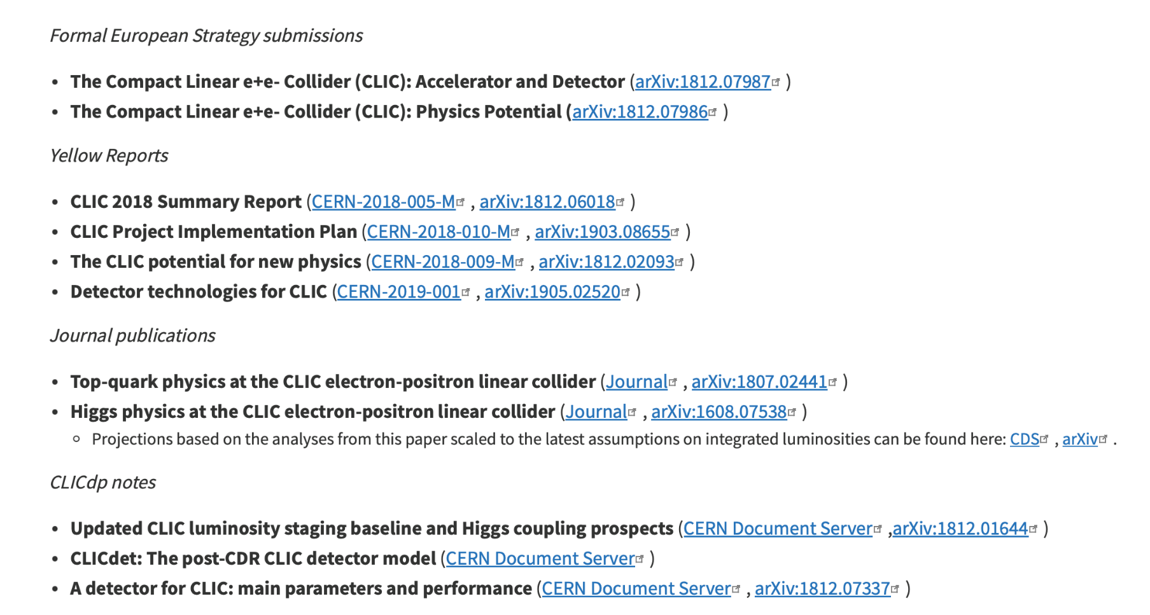
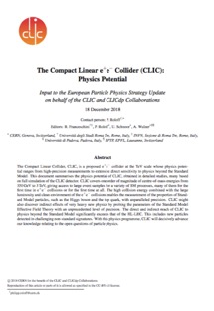
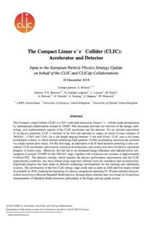
CLIC input to the European Strategy for Particle Physics Update 2018-2020

Slide 8
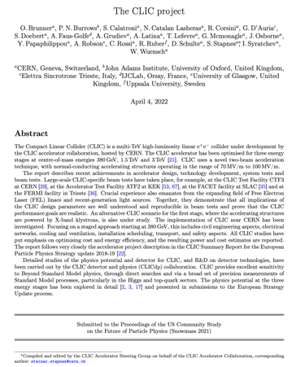
Several LoIs were submitted on behalf of CLIC and CLICdp to the Snowmass process:
The CLIC accelerator study: Link
Beam-dynamics focused on very high energies: Link
The physics potential: Link
The detector: Link
Snowmass white paper (most
recent overview):
https://arxiv.org/abs/2203.09186
Broadly speaking: “Updated accelerator part of 2018 Summary Report”

Slide 9
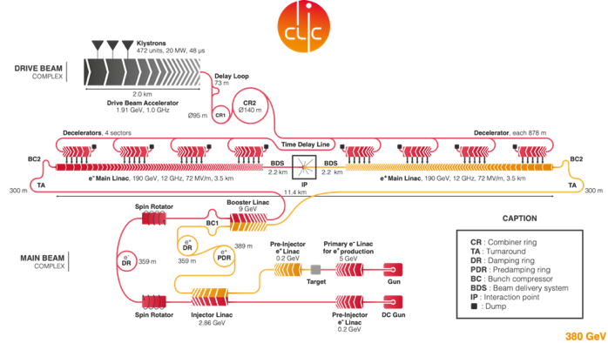
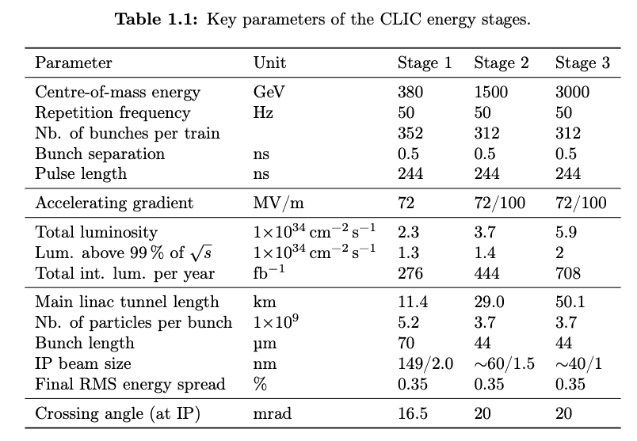
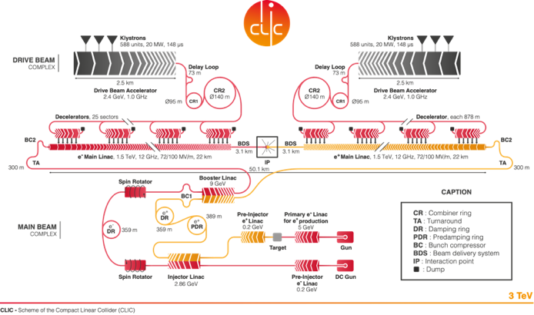
CLIC from 380 GeV to 3 TeV

Slide 10
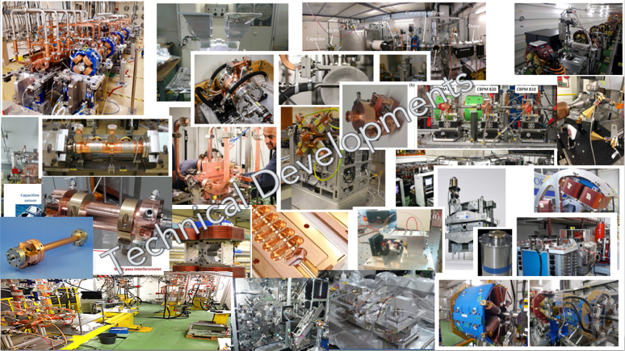

Slide 11
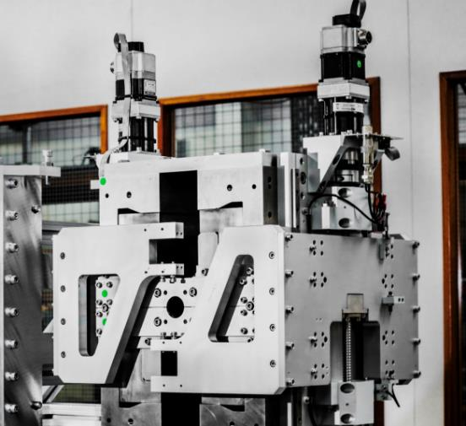
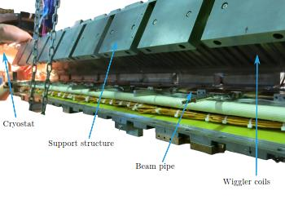
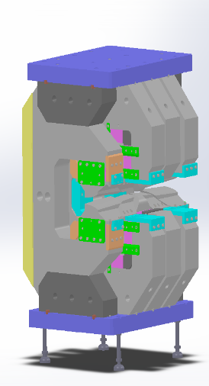
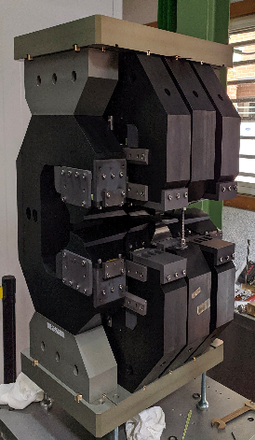
Further magnet developments
Longitudinal variable magnet for CLIC damping rings. CIEMAT
Longitudinal variable bend prototype for the CLIC damping rings
Testing of a ZEPTO tuneable permanent magnet quadrupole at Diamond Light Source
Systematic studies of the beam dynamics with a superconducting damping wiggler at KARA
Zepto magnet for Diamond light source. STFC
Superconducting wiggler installed in KARA. KIT

Slide 12
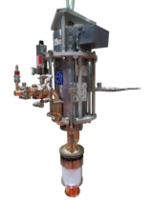
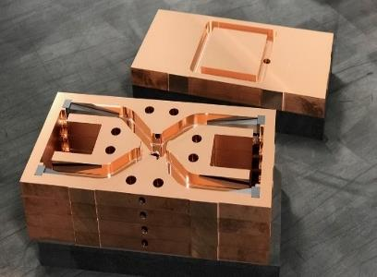
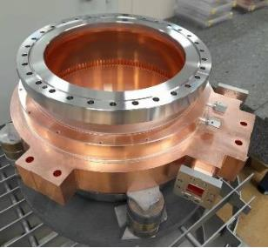
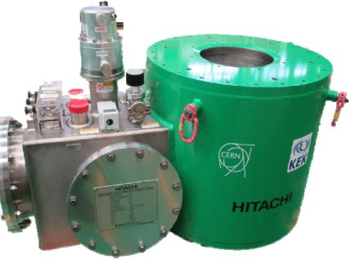
New RF prototypes
New High efficiency Klystrons.
  Demonstrated at 12 Ghz
  Designed for L-band.
New components
  Pulse compressor, correction cavities, magic tee.
New structure prototype using Integrated disks
Sustainable solenoids
    SC and permanent magnets

Slide 13
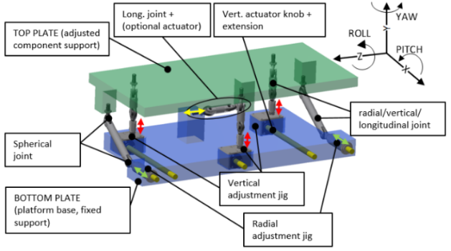
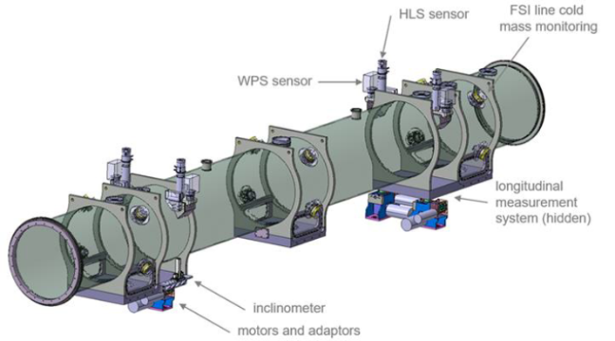
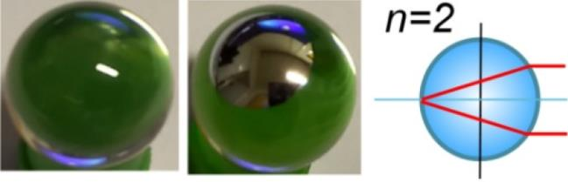
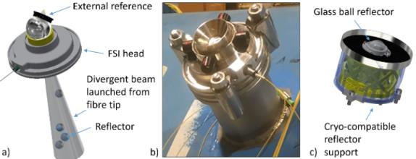
Status on alignment technologies
FULL REMOTE ALIGNMENT SYSTEM FOR THE HIGH-LUMINOSITY LARGE HADRON COLLIDER HL-LHC
New reflectors and supports for FSI and cryogenics
DESIGN AND STUDY OF A 6 DEGREE-OF-FREEDOM UNIVERSAL ADJUSTMENT PLATFORM FOR HL-LHC COMPONENTS
Adjustment platform for HL-LHC
Solution for an HL-LHC criostat
ROBUST OPTICAL INSTRUMENTATION FOR ACCELERATOR ALIGNMENT USING FREQUENCY SCANNING INTERFEROMETRY

Slide 14
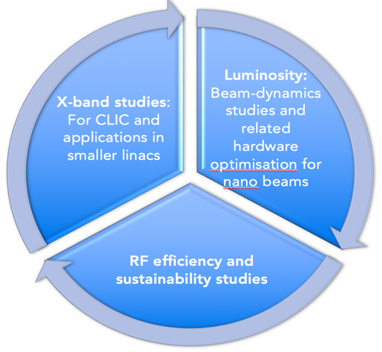
On-going and recent CLIC studies
The X-band technology readiness for the 380 GeV CLIC initial phase - manufacturability and developments driven by use in small compact accelerators for industrial experience (see examples in the following slides)
Beam dynamics and design. Optimizing luminosity at 380 GeV at 2.3 x 10³⁴ cm⁻² s⁻¹– Reoptimizing Injectors. Two interaction points. Study at 250 GeV
Improving the power efficiency for both the initial phase (already in Snowmass report) and at high energies, including more general sustainability studies (in many cases done together with ILC – see later)

Slide 15
On-going and recent CLIC studies
The X-band technology readiness for the 380 GeV CLIC initial phase - manufacturability and developments driven by use in small compact accelerators for industrial experience (see examples in the following slides)

Slide 16
X-band RF technology readiness
Compact Linacs have many uses:
As part of research accelerators (e.g. in FELs as main technology or special elements), or in medical or industrial linacs
Many/most of these developments are driven by CLIC collaborators, for their ”local” applications
Main benefits for CLIC: much strengthened industrial base and strong increase in research/experience on/with X-band technology and associated components

Slide 17
X-band RF technology readiness

Slide 18
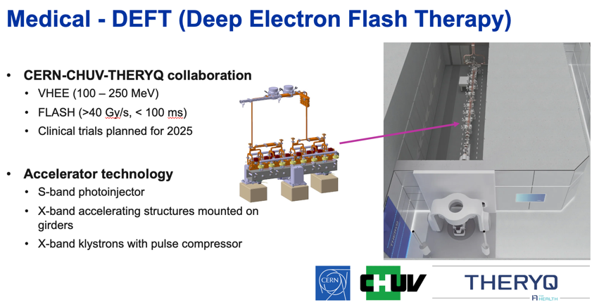
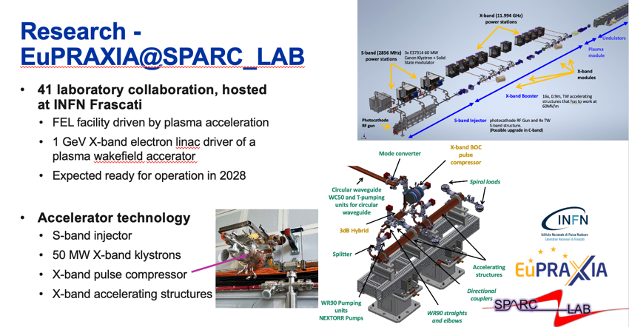
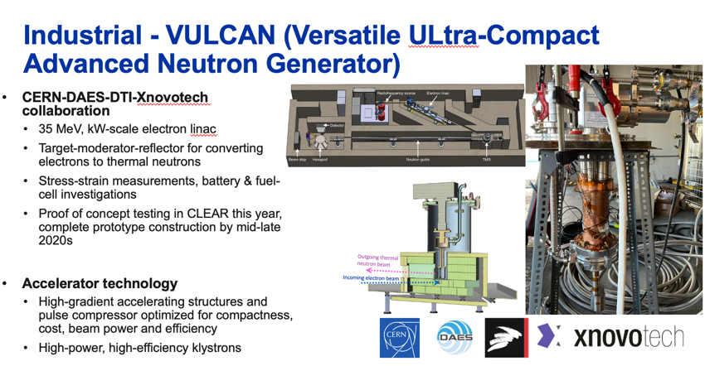
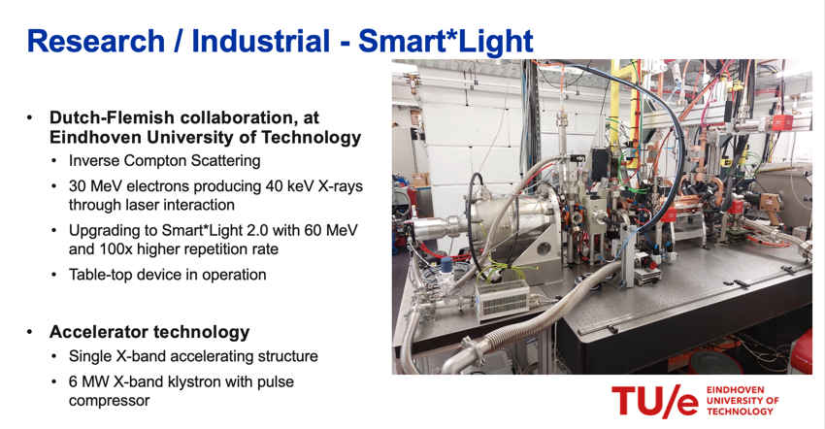

Slide 19
On-going and recent CLIC studies
Beam dynamics and design. Optimizing luminosity at 380 GeV at 2.3 x 10³⁴ cm⁻² s⁻¹– Reoptimizing Injectors. Two interaction points. Study at 250 GeV

Slide 20
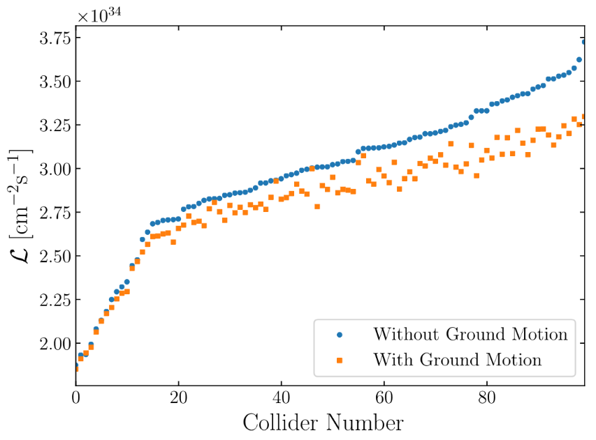
Improved Luminosity. D. Schulte
Could increase luminosity at 380 by 50%
Old target: L=1.5x10³⁴ cm⁻²s⁻¹
Achieved in perfect machine: L=4.3x10³⁴ cm⁻²s⁻¹
Average with static imperfections: L=3x10³⁴ cm⁻²s⁻¹
90% are better than L=2.35x10³⁴ cm⁻²s⁻¹
Average also with ground motion: L=2.8x10³⁴ cm⁻²s⁻¹
90% achieve L>2.3x10³⁴ cm⁻²s⁻¹
Adjust horizontal beam size for each case (differs from Chet’s presentation, but in published paper)
Very small impact of other imperfections
In addition, reduced emittance growth in RTML and ML
L=2.25x10³⁴ cm⁻²s⁻¹ is realistic
Documented for Snowmass, Explained in chapter 2
C. Gohil, P.N. Burrows, N. Blaskovic, A. Latina, J. Ogren, D. Schulte

Slide 21
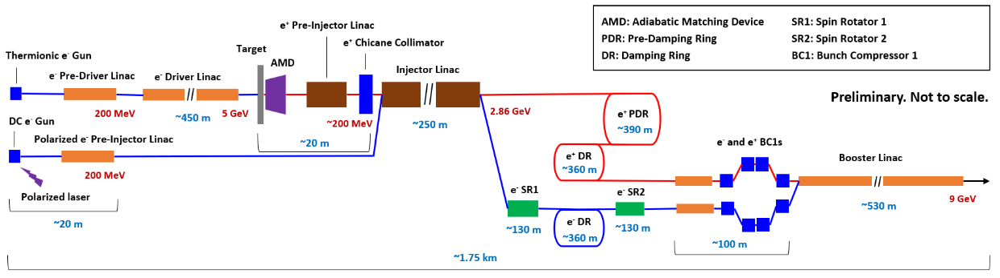
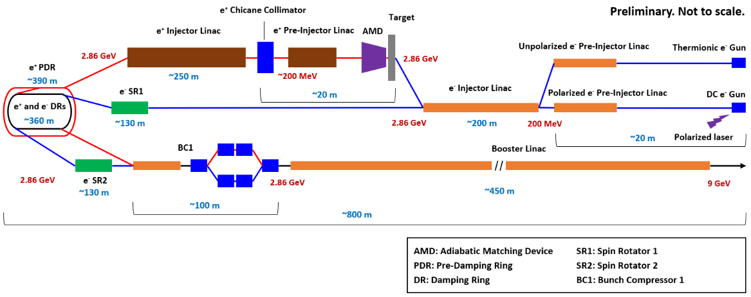
Proposal for a new Optimised Layout
Old (baseline)
New (alternative)
Y. Zhao, A. Kurtulus, A. Latina, A. Grudiev, S. Doebert

Slide 22
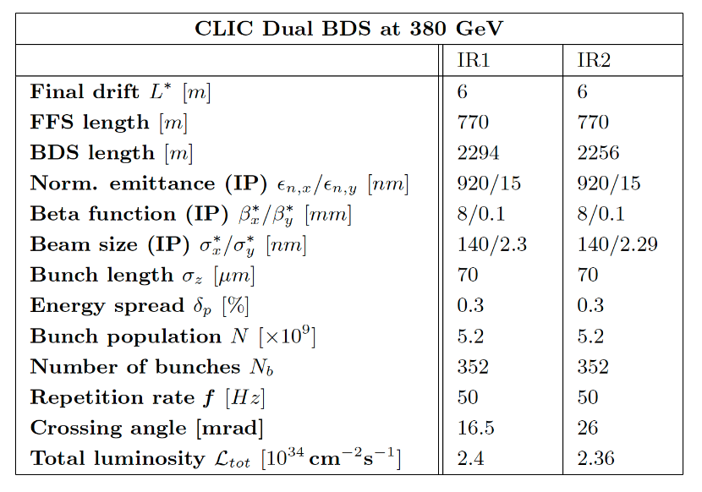
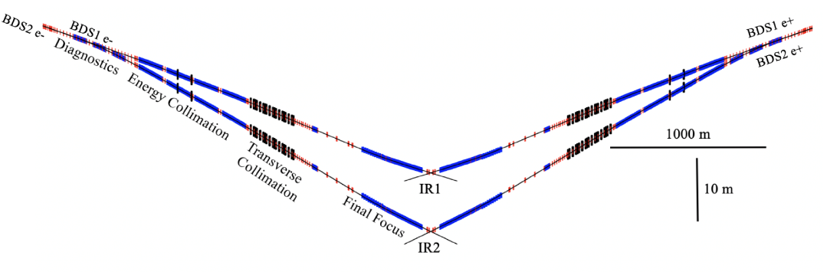
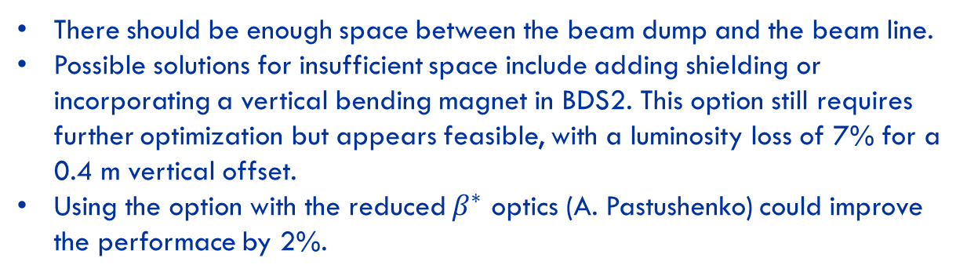
Two IR Design
Vera Cilento
There should be enough space between the beam dump and the beam line.
Possible solutions for insufficient space include adding shielding or incorporating a vertical bending magnet in BDS2. This option still requires further optimization but appears feasible, with a luminosity loss of 7% for a 0.4 m vertical offset.
Using the option with the reduced $β^{∗}$ optics (A. Pastushenko) could improve the performace by 2%.

Slide 23
On-going and recent CLIC studies
Improving the power efficiency for both the initial phase (already in Snowmass report) and at high energies, including more general sustainability studies (in many cases done together with ILC – see later)

Slide 24
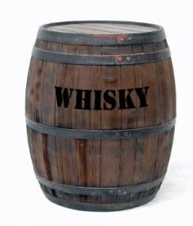
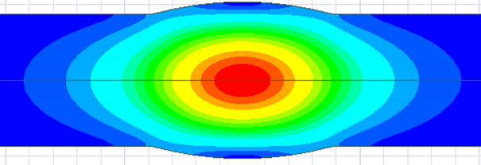
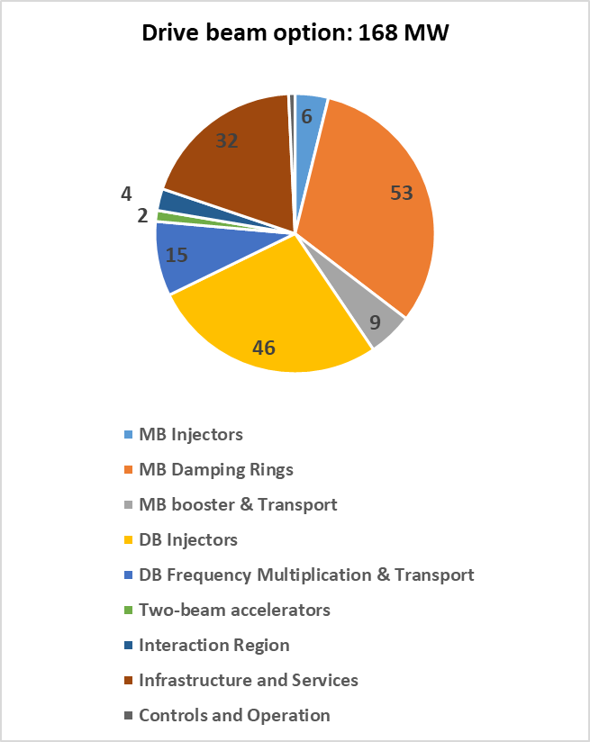
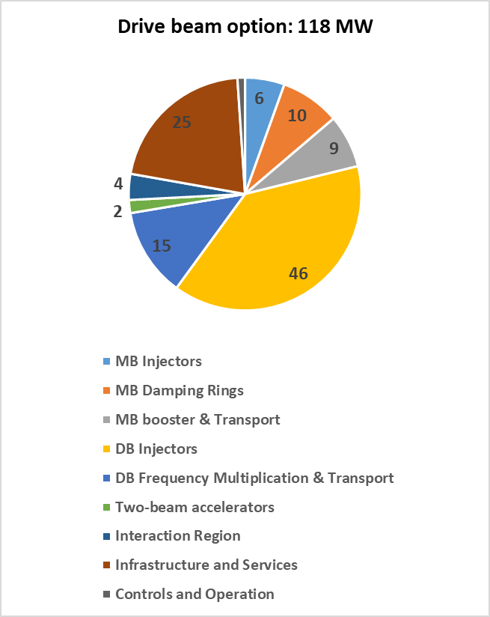
Power savings I.
a
Rarc
Rcav
Improved design for heavily beam loaded regime in the damping rings
  Large aperture => low R/Q
  Long cell: ~λ => low transit time factor
  Low field on the cavity wall
Already presented in Snowmass
Prototype in preparation
Beam axis
E-field
- 50 MW

Slide 25
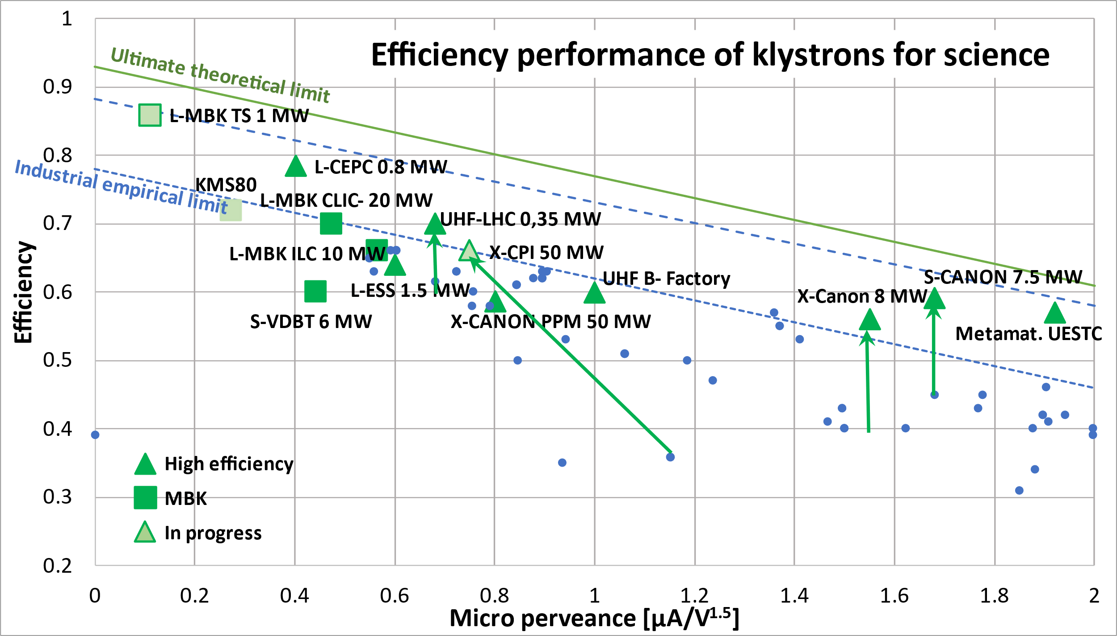
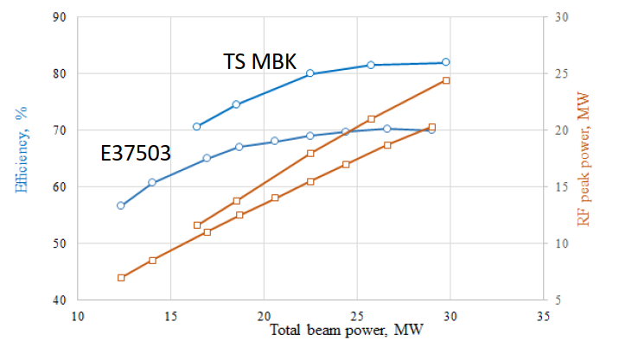
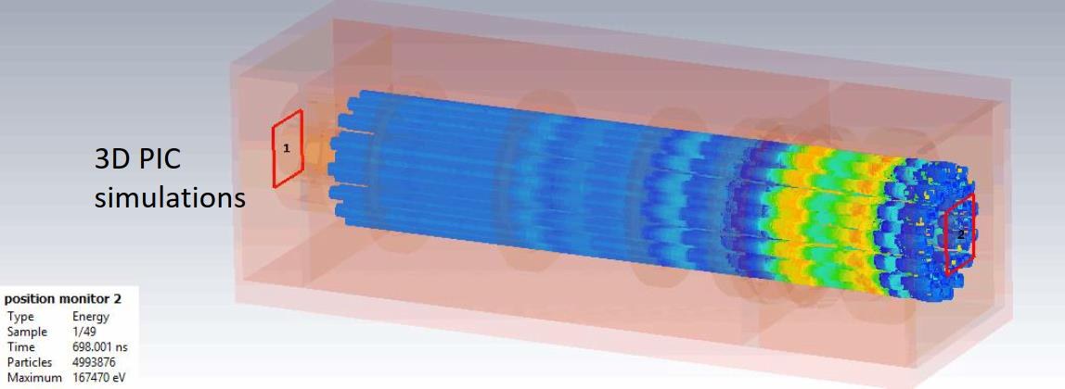
Power savings I
Improved power sources
New design for L-band klystron for drive beam
High efficiency demonstrated for band and UHF
Large synergies with ILC, FCC and CEPC
No prototyping foreseen for the moment

Slide 26
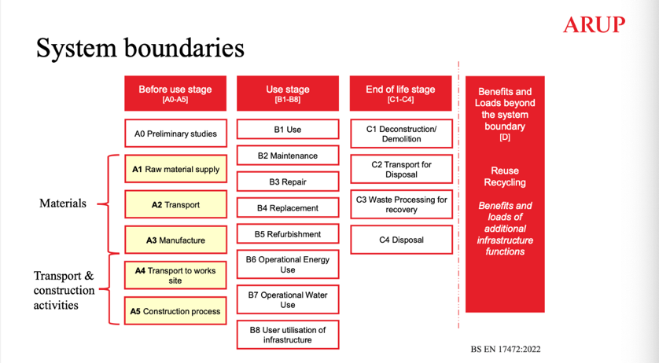
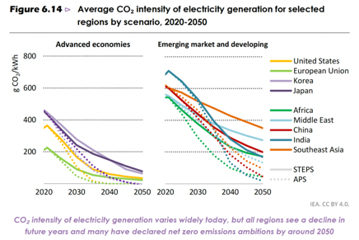
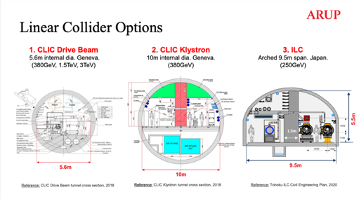
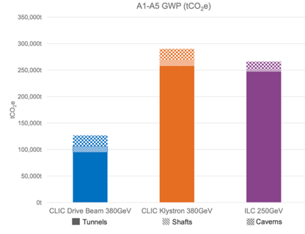
Sustainability: Life Cycle Assessment (LCA)
What is the carbon intensity of energy in ~2050 (operation):
50% nuclear and 50% renewable give ~10-15g/kWh, to optimistic ?
France summer-months are today ~40g/kWh
Reductions predicted (LINK)
Next working on the machine parts, on top of the CE estimate
LCA report for Civil Engineering: LINK
Addressing the Civil Engineering impact
Around 11-12 kton/km main linac (CLIC DB and ILC)

Slide 27
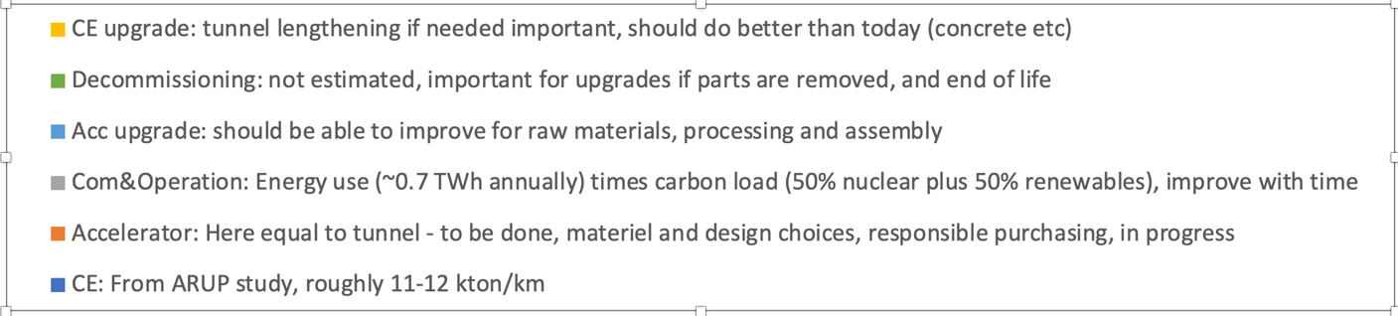
Towards Carbon Accounting with LCA
- example for CLIC, also (being) done for ILC, C3, HALHF, FCC -
Work in progress – this example is closest to the CLIC drive-beam parameters, detectors and computing (and travels) not considered
This plot (blue part) is for 11 km of tunnel, scales with length, injectors will add to this
Next working on machine parts (orange), here assumed hardware and infrastructure = equal civil engineering impact.
Most likely this is optimistic, i.e. orange and light blue parts will be higher
More power (here 0.7 TWh) or more carbon (here assumed 12g/kWh) will increase this quickly

Slide 28
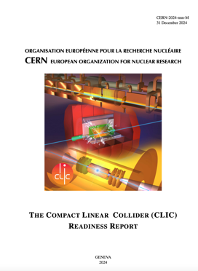
The CLIC ESPP update – I
Guidelines:
Preparing “Project Readiness Report” as a step toward a TDR
Assuming ESPP in ~ 2025-6, Project Approval ~ 2028, Project (tunnel) construction can start in ~ 2030.
However, several important changes:
Energy scales: 380 GeV and 1.5 TeV with one drivebeam
Present 100 Hz running at 250 GeV and 380 GeV (i.e. two parallel experiments, two BDSs) – some increased cost and increased power wrt to one IP
New run plan, 10+10 year for two stages (380 -> 1500 GeV) – with ramp-ups
Several updates on parameters (injectors, damping rings, drive-beam) based on new designs, results and prototyping (e.g. klystrons, magnets) - however no fundamental changes beyond staying at one drivebeam
Technology use examples, including more on use of them in other projects (e.g. alignment, instrumentation, X-band RF is small linacs)
Update costing and power – interplay between inflation and CHF
Life Cycle Assessments
More detailed prep phase planning (next 5-7 years)
Project summary for Snowmass already include some of these changes, i.e. luminosity improvements, 100 Hz study is mentioned, the power is updated for 380 GeV: LINK

Slide 29






The CLIC ESPP update - II
Add:
250 GeV parameters
100 Hz running for both 250 and 380 GeV
3 TeV: refer to earlier reports

Slide 30
CLIC will be presented for ESPP update
Preparing “Project Readiness Report” as a step toward a TDR
However several important changes compared earlier versions:
Energy scales: 380 GeV and 1.5 TeV with one drive-beam, 100 Hz running with two IPs
Several updates on parameters (injectors, damping rings, drive-beam) based on new designs, results and prototyping (e.g. klystrons, magnets) - however no major changes
Technology results updates, including more on use of them in other projects (e.g. alignment, instrumentation, X-band RF is small linacs)
Update costing and power – for costing interplay between inflation and CHF exchanges – and for example power at 1.5 TeV
Life Cycle Assesements
More on next steps (prep phase)

Slide 31

RF Power for
Emilio Nanni
2nd Workshop on Efficient RF Sources
9/23/2024
Notes:
A lepton-collider Higgs factory, to precisely measure the couplings of the Higgs boson to other particles, followed by a higher energy run to measure the Higgs self-coupling, is widely recognized as a primary focus of modern particle physics. In this talk, we will present the study of a new concept for a high gradient, high power accelerator with beam characteristics suitable to study the Higgs boson, the Cool Copper Collider (C3), with the goal of minimizing the capital and operating costs. C3 is based on the latest advances in rf accelerator technology and utilizes optimized cavity geometries, novel rf distribution, and operation at cryogenic temperatures to allow the linear accelerator to achieve high accelerating gradients while maintaining the overall system efficiency. We will present the latest demonstrated performance of prototype accelerators and highlight the future development path for C3.

Slide 32





Breakthrough in the Performance of RF Accelerators
RF power coupled to each cell – no on-axis coupling
Full system design requires modern virtual prototyping
Vacuum space for rf cavities and manifold
Optimization of cell for efficiency (shunt impedance)
Control peak surface electric and magnetic fields
Key to high gradient operation
arXiv:1807.10195 (2018)
PRAB 23.9 (2020): 092001

Slide 33



Cryo-Copper: Enabling Efficient High-Gradient Operation
Cryogenic temperature elevates performance in gradient
Material strength is key factor
Impact of high fields for a high brightness injector may eliminate need for one damping ring
Operation at 77 K with liquid nitrogen is simple and practical
Large-scale production, large heat capacity, simple handling
Small impact on electrical efficiency
Cryogenic temperature elevates performance in gradient
Material strength is key factor
Impact of high fields for a high brightness injector may eliminate need for one damping ring
Cahill, A. D., et al. PRAB 21.10 (2018): 102002.
2nd Workshop on Efficient RF Sources

Slide 34




Accelerator Complex
8 km footprint for 250/550 GeV CoM ⟹ 70/120 MeV/m
7 km footprint at 155 MeV/m for 550 GeV CoM – present Fermilab site
Large portions of accelerator complex are compatible between LC technologies
Beam delivery and IP modified from ILC (1.5 km for 550 GeV CoM)
Damping rings and injectors to be optimized with CLIC as baseline
Costing studies use LC estimates as inputs
C³ - Investigation of Beam Delivery (Adapted from ILC/NLC)
C³ - 8 km Footprint for 250/550 GeV
2nd Workshop on Efficient RF Sources

Slide 35

Table of Parameters
Updated parameters from LCWS 2024
2nd Workshop on Efficient RF Sources

Slide 36

The Complete C³ Demonstrator
QCM
Stage 2:
Injector + Cryomodule
Demonstrate fully engineered cryomodule
~50 m scale facility
3 GeV energy reach
Answer technical questions needed for CDR

Slide 37
Ongoing R&D

Slide 38













Alignment and Vibrations
Two-Phase Fluid Simulations
System level optimization essential for achieving performance
RF Structure Optimization
Vibration Measurements and Analysis
3.55 mm iris radius
2.0=E_{max}/E_{acc}
1.23=H_{coup}/H_{wall}
K. Shoele
Electric Field
Precision Short and Long Range Alignment
Magnetic Field
Z. George, V. Borzenets, A. Dhar, D. Palmer
H. Van Der Graaf
M. Shumail, Z. Li
Main Linac Beam Dynamics
Alignment Parameters | Units | Value
Raft Components | μm | 5
Short Range (~10m) | μm | 30
Long Range (>200m) | μm | 1000
Structure Vert. Vibration | μm | 9
Quad Vert. Vibration | nm | 15
BPM Resolution | μm | 0.1
BPM-Quad Alignment | μm | 2
100 nm resolution
Approved effort to test cold
White (C³), Schulte (CLIC)
https://arxiv.org/pdf/2307.07981.pdf
2nd Workshop on Efficient RF Sources

Slide 39





Beam Dynamics and Luminosity Studies
Compatible with ILC-like Detector
Studies ongoing towards ensuring target luminosity
Emittance Preservation with HOM Suppression
Ntounis, Gray, Vernieri
Damped / Damped-Detuned Spectrum
H. Xu et al., LANL
Wei-Hou Tan, Zenghai Li
See C3 talks at ECFA Workshop on e+e- Higgs/EW/Top Factories
https://agenda.infn.it/event/34841/
Opportunities to Collaborate: DR, Bunch Compressor, BDS, …
2nd Workshop on Efficient RF Sources

Slide 40



Single Cell Cryogenic High Gradient Tests
High power tested up to 5 MW per cavity with Cu and CuAg
CuAg proven to give higher gradient
  First demonstration of Cu and CuAg at C-band in cryo
    Corresponding to fields >200 MeV/m
2nd Workshop on Efficient RF Sources

Slide 41

75XP Series Klystrons as RF sources for C³
The SLAC 75XP is a PPM-focused, X-band klystron designed for 75 MW peak power
Motivated/funded by the Next Linear Collider (NLC) program
Years of engineering effort → attractive candidate for a potential C³ demonstrator
Specification | Target
Beam Voltage | 490 kV
Beam Current | 257 A
RF Output Power | 75 MW
Frequency | 11.424 GHz
RF Pulses | 1.5 µs @ 60 Hz
Saturated Gain | 55 dB
Bandwidth | 75 MHz
Efficiency | 55%
Design Features:
Large “DESY” HV gun insulator
7-cavity gain circuit
5-cell extended-interaction output
Isolated collector

Slide 42





First prototype 75XP4 is under construction now

Slide 43
Conclusion
C³ can provide a rapid route to precision Higgs physics with a compact 8 km footprint
Higgs physics run by 2040
C³ time structure is compatible with SiD-like detector overall design and ongoing optimizations.
C³ can be quickly be upgraded to 550 GeV
C³ can be extended to a 3 TeV e+e- collider
With new ideas, the C³ lab can provide physics at 10 TeV and beyond
May be possible to do physics at an intermediate stage in the construction at 91 GeV
We do not consider this a part of our baseline, but we mention the possibility in case there is community interest for a Giga-Z (2 yrs) program
More Details Here (Follow, Endorse, Collaborate):
https://indico.slac.stanford.edu/event/7155/
2nd Workshop on Efficient RF Sources

