Slide 1
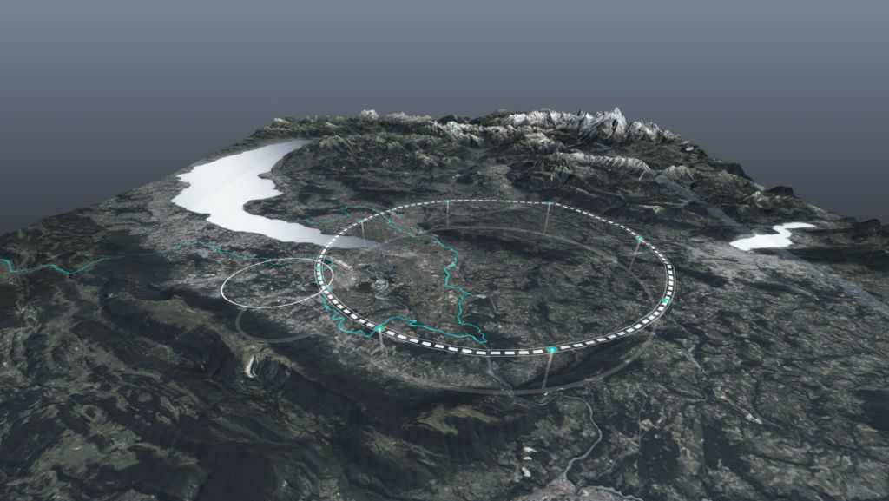











The FCC Integrated Program
IAS Program on Fundamental Physics 2025
Angeles Faus Golfe
on behalf of FCC collaboration & FCCIS DS team
http://cern.ch/fcc
Work supported by the European Commission under the HORIZON 2020 projects EuroCirCol, grant agreement 654305; EASITrain, grant agreement no. 764879; iFAST, grant agreement 101004730, FCCIS, grant agreement 951754; E-JADE, contract no. 645479; EAJADE, contract number 101086276; and by the Swiss CHART program
photo: J. Wenninger
Notes:
I am doing this talk on behalf of the FCC collaboration and the FCC Innovation Design Study team.
Last year Michelangelo present the FCC project including the physics aspects, this year I will present the accelerator and engineering aspects only.
I will introduce the current framework and the ESPPU, after I will present the civil engineering aspects, followed by accelerator and accelerator technologies and finally the collaboration aspects.

Slide 2

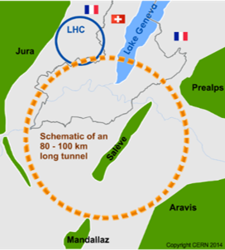
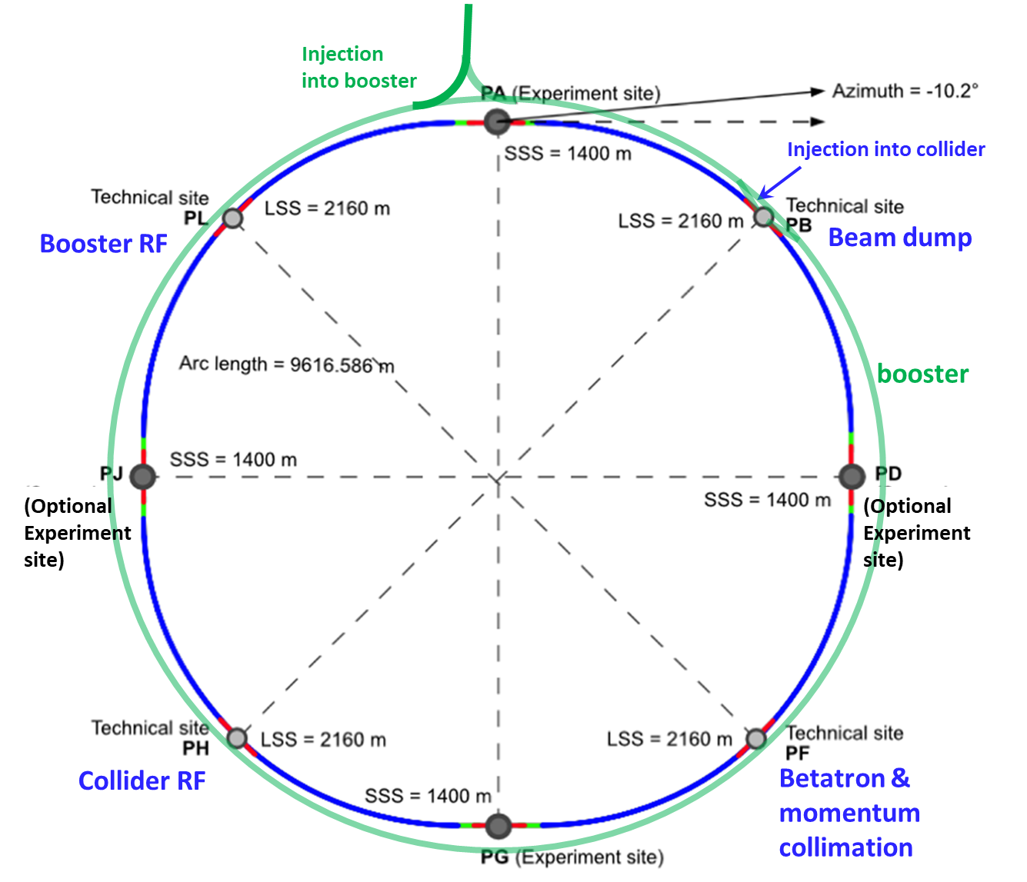
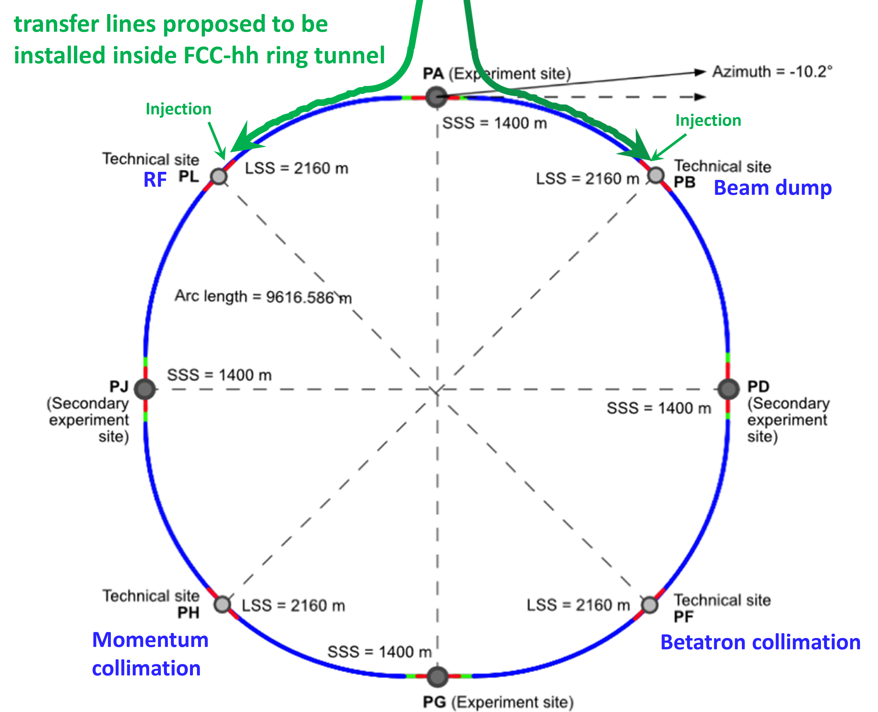
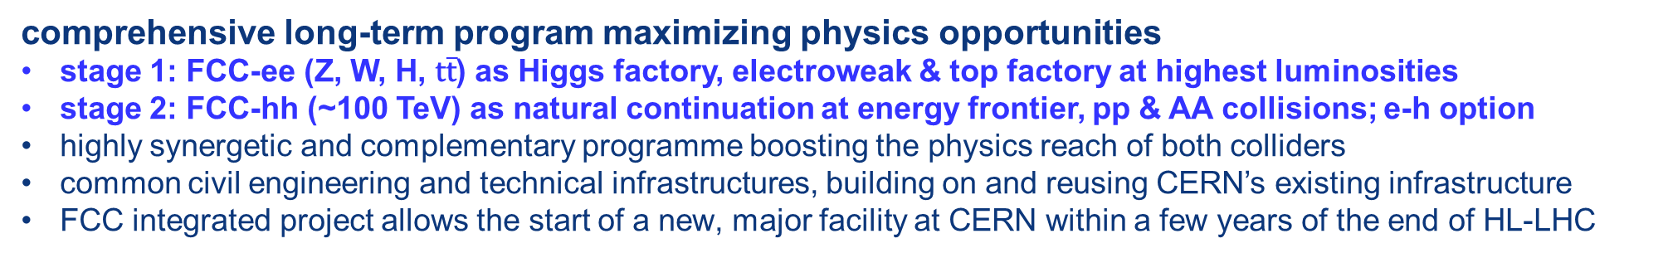
FCC integrated program
comprehensive long-term program maximizing physics opportunities
stage 1: FCC-ee (Z, W, H, $\text{t}\overline{\text{t}}$) as Higgs factory, electroweak & top factory at highest luminosities
stage 2: FCC-hh (~100 TeV) as natural continuation at energy frontier, pp & AA collisions; e-h option
highly synergetic and complementary programme boosting the physics reach of both colliders
common civil engineering and technical infrastructures, building on and reusing CERN’s existing infrastructure
FCC integrated project allows the start of a new, major facility at CERN within a few years of the end of HL-LHC
FCC-ee
FCC-hh
2020 - 2045
2045 - 2065
2070 -
FCC Integrated Program
IAS 2025
Notes:
The FCC Integrated program is a long-term program for the CERN future with a first phase with an EW-Higgs anf top factory at high luminosities followed by a second phase wit a hadronic machine FCChh at the energy frontier starting with pp to be followed by hadrons and with an option for electron-hadron machine.
Following the successful model of LEP-LHC

Slide 3
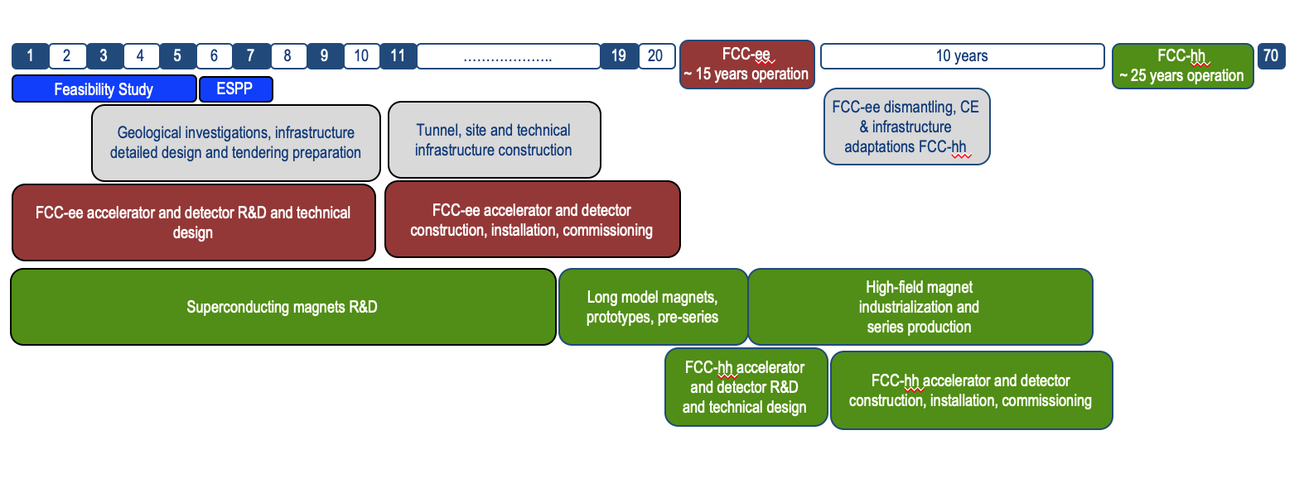
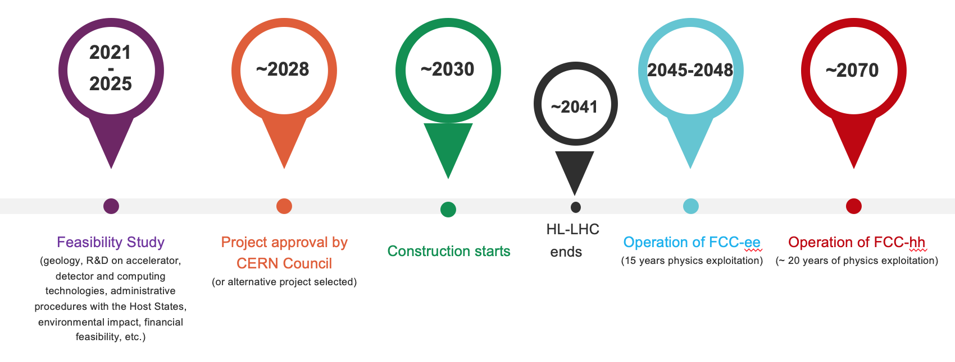
FCC integrated program - timeline
Note: FCC Conceptual Design Study
started in 2014 leading to CDR
in 2018
Ambitious schedule taking into account:
past experience in building colliders at CERN
approval timeline: ESPP, Council decision
that HL-LHC will run until 2041
project preparatory phase with adequate
resources immediately after Feasibility Study
2027/28
~2033
~2046
~2070
Notes:
This integrated program extends from now 50 years until 2070 with the start of the FCC-hh operation.

Slide 4

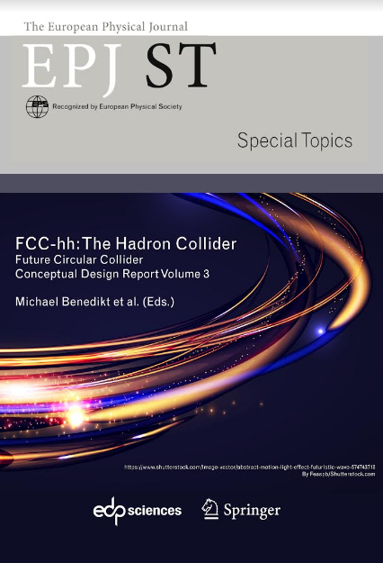
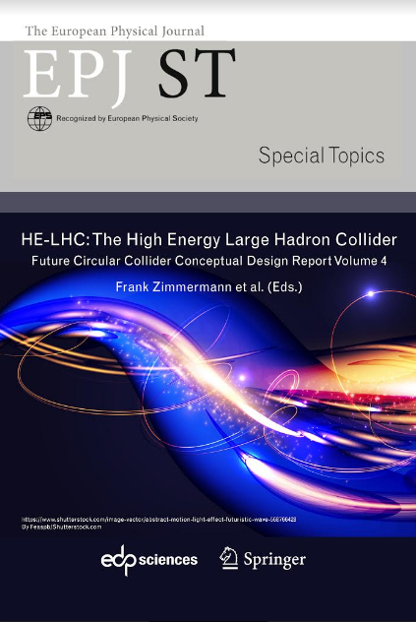
European Strategy for Particle Physics
2013 Update of European Strategy for Particle Physics:
“CERN should undertake design studies for accelerator projects in a global context, with emphasis on proton-proton and electron-positron high-energy frontier machines.”
→ FCC Conceptual Design Reports (2018/19)
2020 Update of European Strategy for Particle Physics:
“Europe, together with its international partners, should investigate technical and financial feasibility of a future hadron collider at CERN with a centre-of-mass energy of at least 100 TeV and with an electron-positron Higgs and electroweak factory as a possible first stage.”
  Vol 1 Physics, Vol 2 FCC-ee, Vol 3 FCC-hh, Vol 4 HE-LHC
  CDRs published in European Physical Journal C (Vol 1) and ST (Vol 2 – 4)
  EPJ C 79, 6 (2019) 474 , EPJ ST 228, 2 (2019) 261-623 , EPJ ST 228, 4 (2019) 755-1107 , EPJ ST 228, 5 (2019) 1109-1382
FCC Integrated Program
IAS 2025
Notes:
We are currently involved in the update of the next European Strategy for Particle Physics that will have to decide which will be the next collider to be build at CERN.
Let remind you about the past EPPSU:
in 2013 the emphasis was on pp and ep high-energy frontier machine
In 2020 on the contrary the focus was the EW and Higgs factory, in this sense the work was organized ...

Slide 5
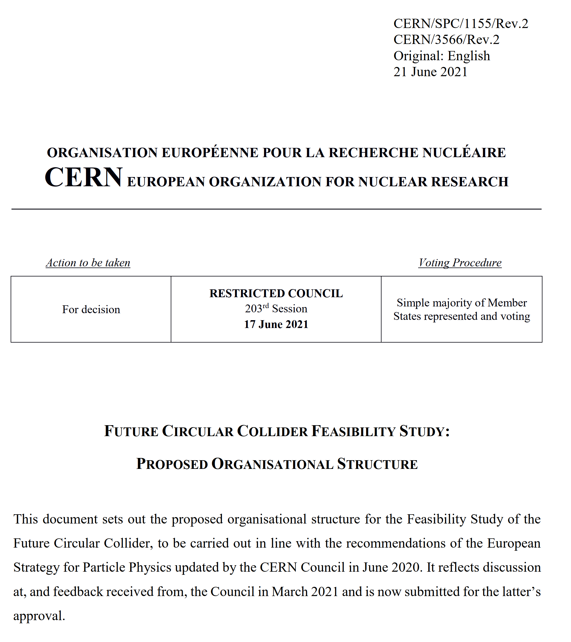
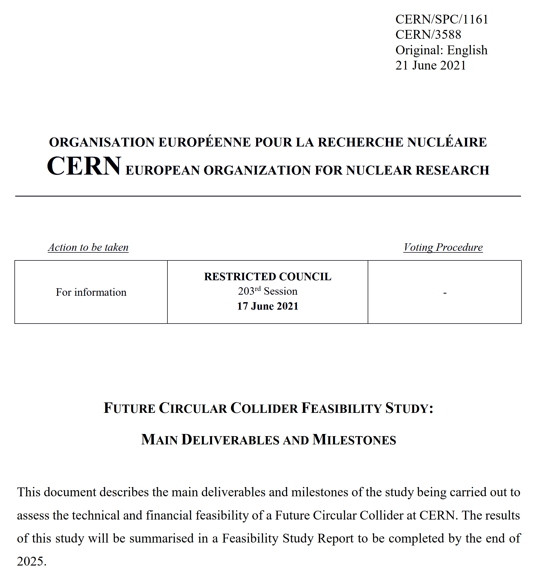
FCC FS Council Documents, June ‘21
Organisational Structure of the FCC Feasibility Study
http://cds.cern.ch/record/2774006/files/English.pdf
Main Deliverables and Timeline of the FCC Feasibility Study
http://cds.cern.ch/record/2774007/files/English.pdf
Notes:
The FCC Feasibility study was launched with the support of the EU (FCC Innovation Study project), a organization as well as main objectives and deliverables have been identified.

Slide 6
FCC Feasibility Study (2021-2025): high-level objectives
demonstration of the geological, technical, environmental and administrative feasibility of the tunnel and surface areas and optimisation of placement and layout of the ring and related infrastructure;
pursuit, together with the Host States, of the preparatory administrative processes required for a potential project approval to identify and remove any showstopper;
optimisation of the design of the colliders and their injector chains, supported by R&D to develop the needed key technologies;
consolidation of the physics case and detector concepts for both colliders
elaboration of a sustainable operational model for the colliders and experiments in terms of human and financial resource needs, as well as environmental aspects and energy efficiency;
development of a consolidated cost estimate, as well as the funding and organisational models needed to enable the project’s technical design completion, implementation and operation;
identification of substantial resources from outside CERN’s budget for the implementation of the first stage of a possible future project (tunnel and FCC-ee);
Results will be summarised in a Feasibility Study Report to be released in March 2025
F. Gianotti
FCC Integrated Program
IAS 2025
Notes:
The main objectives will be delivered in March 2025 on time to be evaluated by the ESPPU.
In the following I will show the status of each of these aspects.

Slide 7
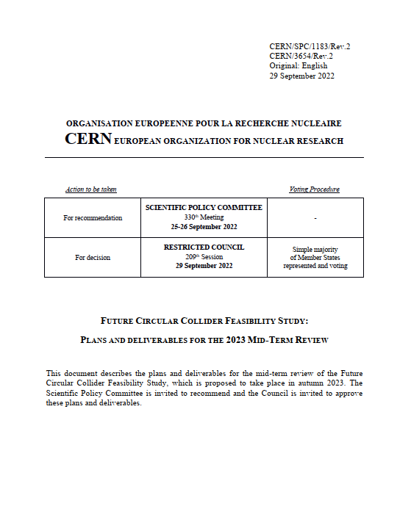
FCC FS mid-term review
Mid-term review setup and deliverables are defined in CERN/SPC/1183/Rev.2:
the scientific and technical results be reviewed by the FCC FS Scientific Advisory Committee, augmented by additional experts as needed;
the cost and financial feasibility, which will focus on the first-stage project (tunnel, technical infrastructure, FCC-ee machine and injectors), be reviewed by a committee including external experts, as proposed in CERN/3588;
FCC Scientific Advisory Committee
Riccardo Bartolini (DESY), Alain Chabert (Société Française du Tunnel Routier Fréjus),
Heinz Ehrbar (HEP), Brigitte Fargevieille (Électricité de France), Belen Gavela Legazpi (UAM), Gudrun Hiller (Dortmund), Srinivas Krishnagopal (BARC), Peter Krizan (Ljubljana), Philippe Lebrun (CERN, retired), Peter McIntosh (STFC), Michiko Minty (BNL),
Andrew Parker (Chair, Cambridge), Kyo Shibata (KEK), Roberto Tenchini (Pisa)
FCC Cost Review Panel
Carlos Alejaldre (Fusion for Energy), Austin Ball (CERN, retired), Umberto Dosselli (INFN), Heinz Ehrbar (HEP)
Vincent Gorgues (CEA), Norbert Holtkamp (Chair, Stanford), Christa Laurila (National Audit Office, Finland), Ursula Weyrich (German Cancer Research Centre), Jim Yeck (BNL), Thomas Zurbuchen (ETH Zürich)
Notes:
To monitor and asses the project a mid-term review has been organized at the end of 2022, to evaluate from the scientific and cost point of view.

Slide 8
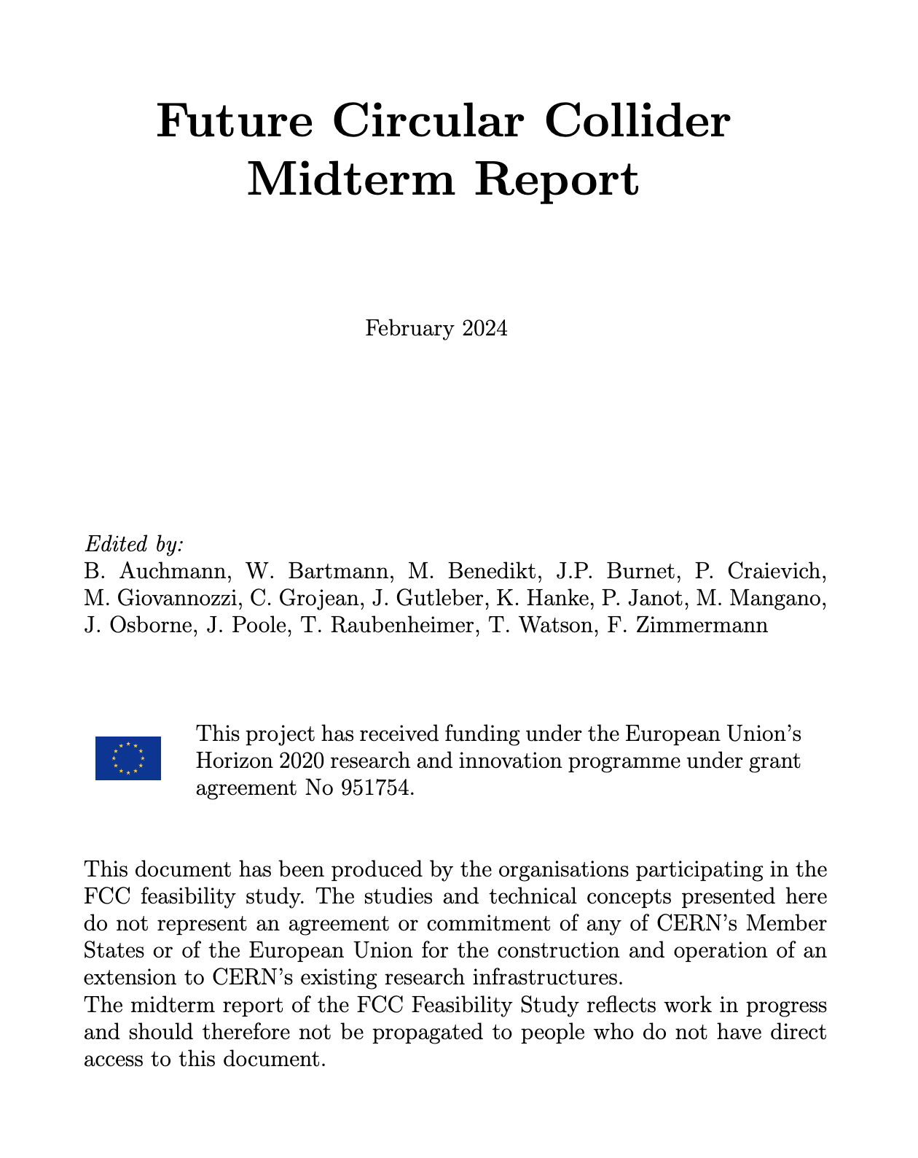
Feasibility Study Mid-Term Review passed !
The goal of the FCC FS mid-term review is to assess the progress of the Study towards the final report.
Deliverables approved by the Council in September 2022:
https://indico.cern.ch/event/1197445/contributions/5034859/attachments/2510649/4315140/spc-e-1183-Rev2-c-e-3654-Rev2_FCC_Mid_Term_Review.pdf
Full Report
8 Chapters/Deliverables
~ 700pp document
~ 16 editors
~ 500 contributors
Deliverables:
D1 : Definition of the baseline scenario
D2 : Civil engineering
D3 : Processes and implementation studies with the Host States
D4 : Technical infrastructure
D5 : FCC-ee accelerator
D6: FCC-hh accelerator
D7: Project cost and financial feasibility
D8: Physics, experiments and detectors
Many thanks to the SAC, CRP, SPC, FC and the Council for the very useful reviews!
Documents:
Mid-term report (all deliverables except D7)
Executive Summary of mid-term report
Updated cost assessment (D7)
Funding model (D7)
Review process:
Oct 2023: Scientific Advisory Committee (scientific and technical aspects)
and Cost Review Panel (ad hoc committee; cost and financial aspects)
Nov 2023: SPC and FC
2 Feb 2024: Council
All deliverables met, no technical showstoppers
→70-80 recommendations
Notes:
The FS mid-term review has not found any show stoppers and a lot of recommendations has been given. These recommendations are being implemented and the final report will be ready for march 2025.

Slide 9




Feasibility Study Report for March 2025
Structure:Three Volumes
Vol. 1: Physics, Experiments and Detectors (~200 pages)
Vol. 2: Accelerators, Technical Infrastructures, Safety Concepts (~400 pages)
Vol. 3: Civil Engineering, Implementation & Sustainability (~200 pages)
- Executive Summary of the FCC Feasibility Study: ~40 pages
In addition:
a. Documentation on Cost Estimate – Funding Models
b. Environmental Report
Input for Update of European Strategy for Particle Physics
to be prepared with Overleaf & published by EPJ (Springer-Nature) – FCCIS members

Slide 10
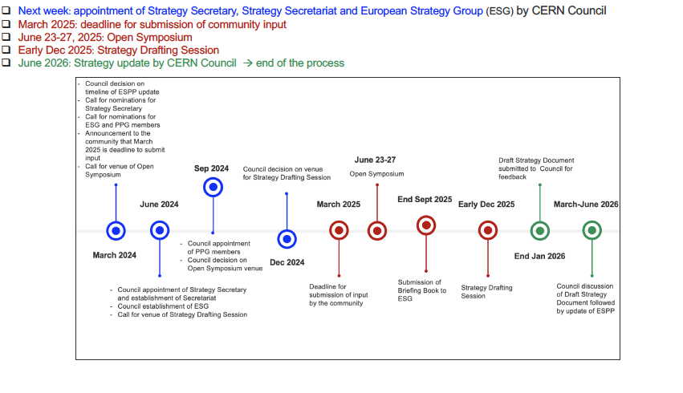
Timeline for European Strategy Update 2026
June 2024: appointment of Strategy Secretary, Strategy Secretariat and European Strategy Group (ESG) by CERN Council
F. Gianotti
Notes:
A reminder of the timeline for the next update of the ESPPU.

Slide 11
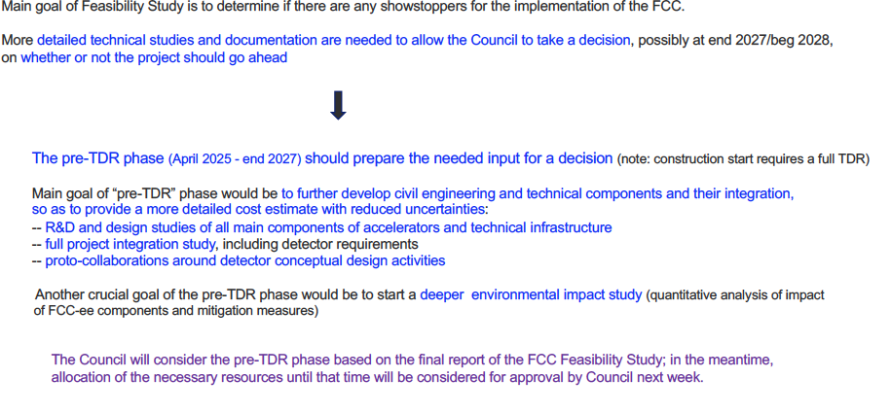
Preparing for next step: pre-TDR phase (April 2025 - end 2027)
F. Gianotti
Notes:
In the next 2 years the plan is to complete the main detailed technical studies (pre-TDR) to prepare the input for a final decision.
This pre-TDR has to developed the civil engineering as well as the technical components.

Slide 12
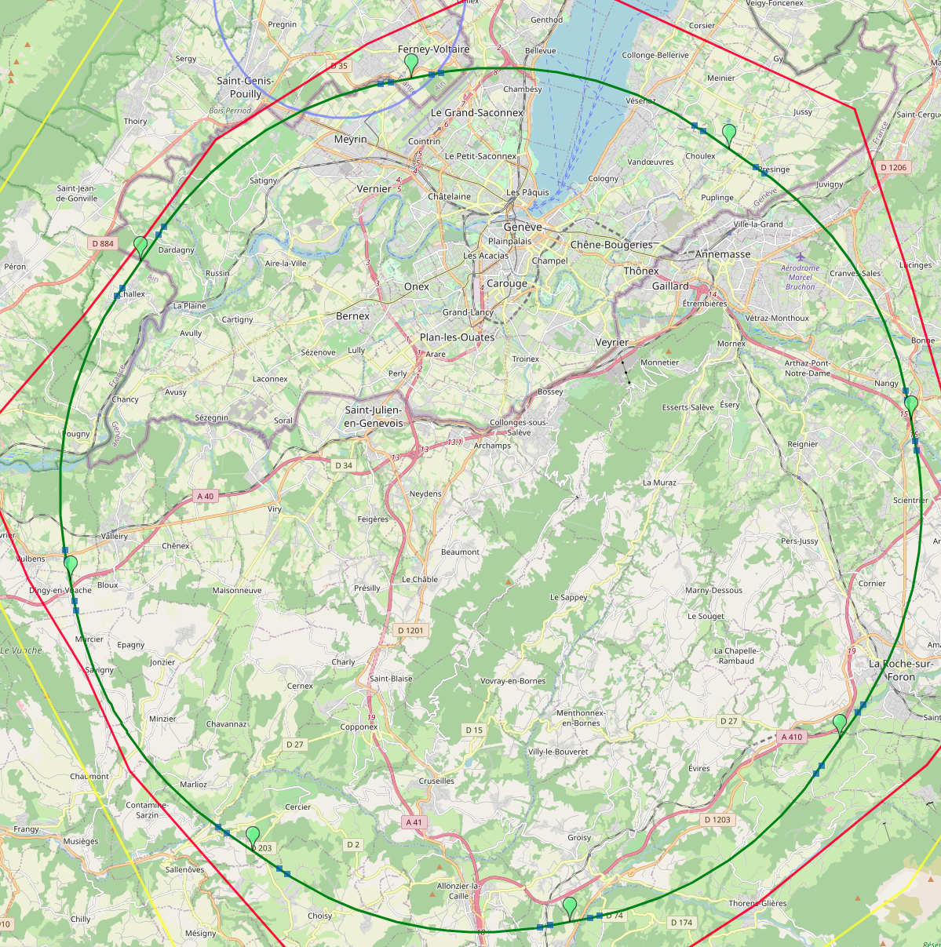
Reference layout and implementation: PA31 - 90.7 km
V. Mertens,
J. Gutleber
Layout chosen out of ~ 100 initial variants, based on geology and
surface constraints (land availability, access to roads, etc.), environment, (protected zones), infrastructure (water, electricity, transport), machine performance etc.
“Avoid-reduce-compensate” principle of EU and French regulations
PA: Experiment
PB: technical
PL: technical
Overall lowest-risk baseline: 90.7 km ring, 8 surface points,
4-fold symmetry
Number of surface sites | 8
Surface requirements | ~40 ha
LSS@IP (PA, PD, PG, PJ) | 1400 m
LSS@TECH (PB, PF, PH, PL) | 2032 m
Arc length | 9.6 km
Sum of arc lengths | 76.9 m
Total length | 90.7 km
PD: experiment
PJ: experiment
4 experiments
PF: technical
PH: technical
12
PG: experiment
Notes:
From civil engineering point of view the layout has been optimized between more that 100 possibilities, taken into account different factors as: geology, surface constrains, environment, infrastructure, machine performance,....
The PA31 has been chosen.

Slide 13
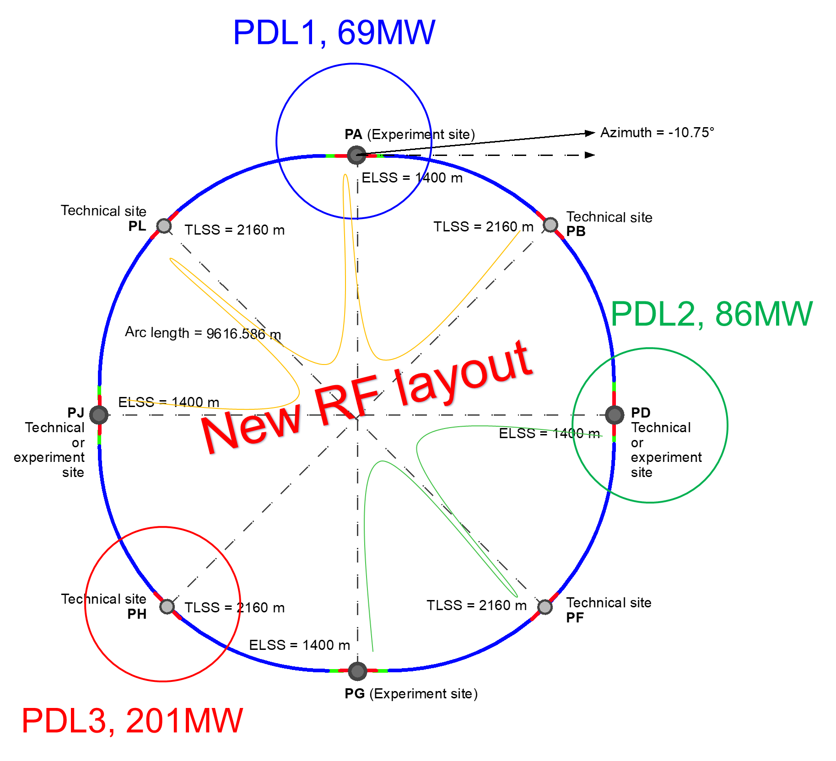
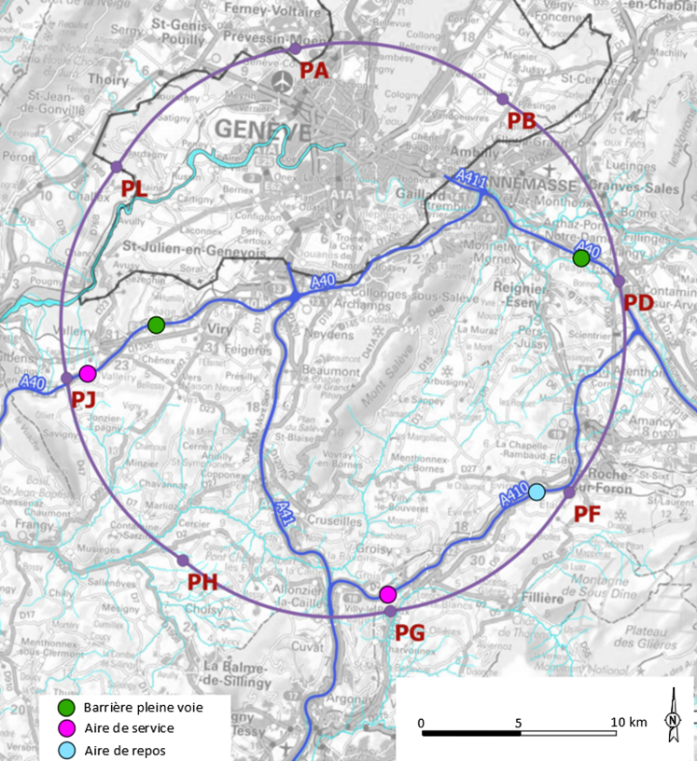
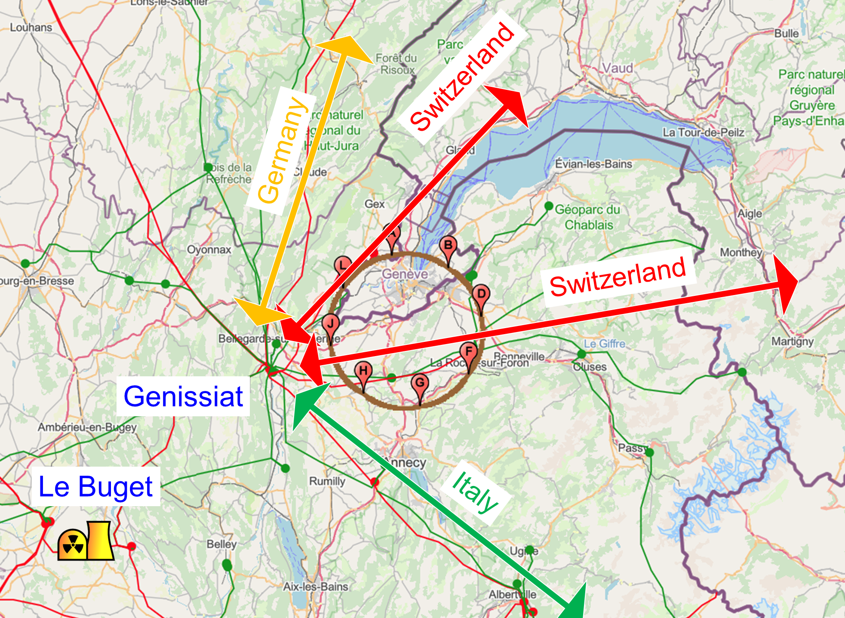
Integration with regional infrastructures
Road accesses developed for all 8 surface sites
Four possible highway connections defined
Less than 4 km of new roads required
Connections to
French electricity grid
connections with
highway network
Electrical connection concept developed with RTE (French electricity grid operator)
Three HV supply points, two new stations & CERN Prevessin
➔ requested loads have no significant impact on grid
R&D efforts aiming at reduction of the energy consumption of FCC-ee and FCC-hh
Notes:
Infrastructires as road and power supplies has been checked and needs evaluated.

Slide 14
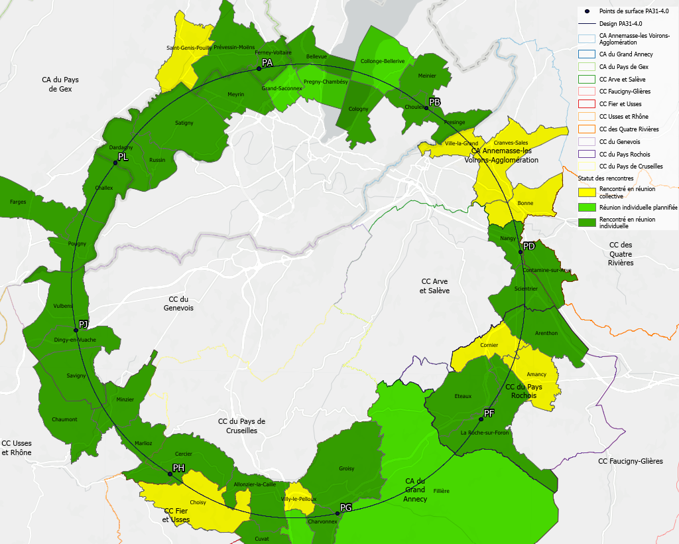
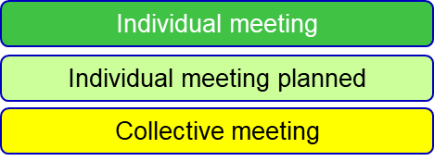
Regional implementation activities
Meetings with municipalities concerned
in France (31) and Switzerland (10)
PA – Ferney Voltaire (FR) – experiment site
PB – Présinge/Choulex (CH) – technical site
PD – Nangy (FR) – experiment site
PF – Roche sur Foron/Etaux (FR) – technical site
PG – Charvonnex/Groisy (FR) – experiment site
PH – Cercier (FR) – technical site
PJ – Vulbens/Dingy en Vuache (FR) experiment site
PL – Challex (FR) – technical site
Detailed work with municipalities and host states
identify land plots for surface sites
understand specific aspects for design
identify opportunities (waste heat, tec.)
reserve land plots until project decision
Status 1 June 2024
The support of the host states is greatly appreciated and essential for the study progress!
Notes:
Meeting with the different municipilaties concerned in France and Switzerland has been realized.
In summary the project is well received and the work is ongoing.

Slide 15

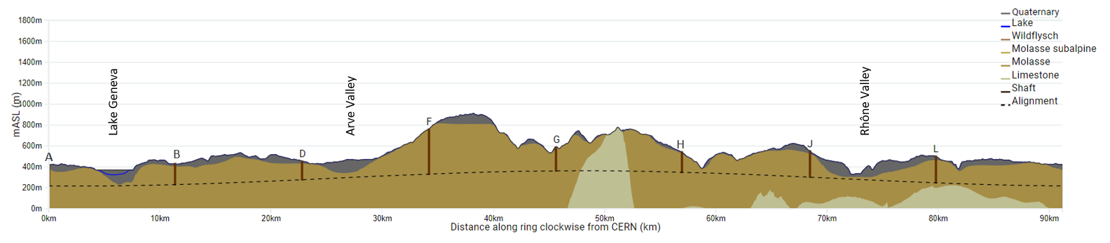
FCC tunnel implementation- geological conditions
FCC inclined at 0.5% gradient to minimise depth of point F
Limestone unavoidable between G-H
FCC passes below Lake Geneva moraines
FCC above limestone
  Tunneling mainly in moraine layer (soft rock), well suited for fast, low-risk TBM construction.
  6 million m³ excavated volume → 8.5 million m³ excavation material on surface
  CE Designs of all underground structures developed
  To fix the vertical position of the tunnel, interfaces between geological layers have to be known
Notes:
Geological studies has been pursued to identify the issues, the PA31 chosen is well suited for low risk construction tunnel

Slide 16
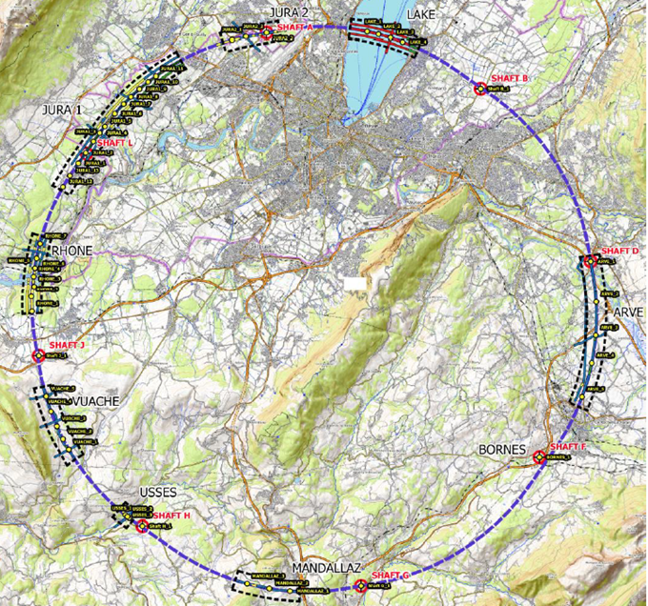
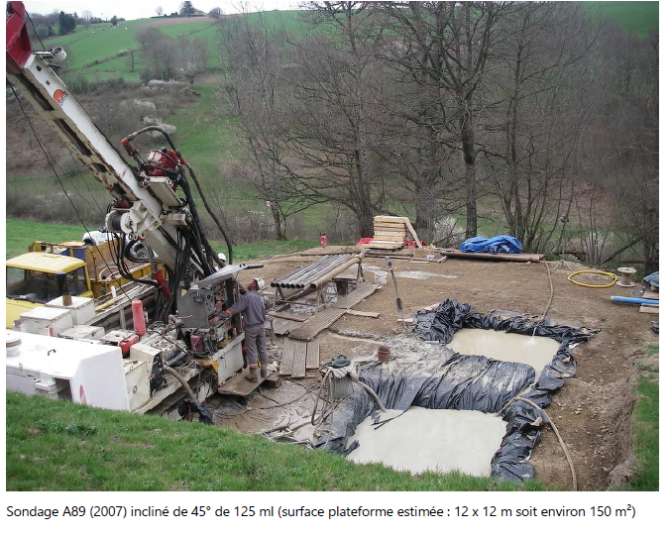
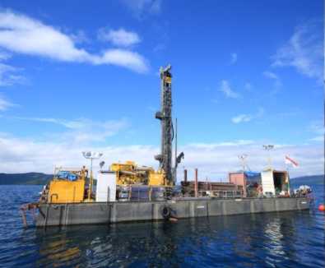
First series of site investigations
Site investigations to identify exact location of geological interfaces:
Molasse layer vs moraines/limestone
~30 drillings and ~90 km seismic lines
→ Vertical position and inclination of tunnel
example of drilling works on a lake the lake
Notes:
Some drilling and seismic lines are been realized.

Slide 17
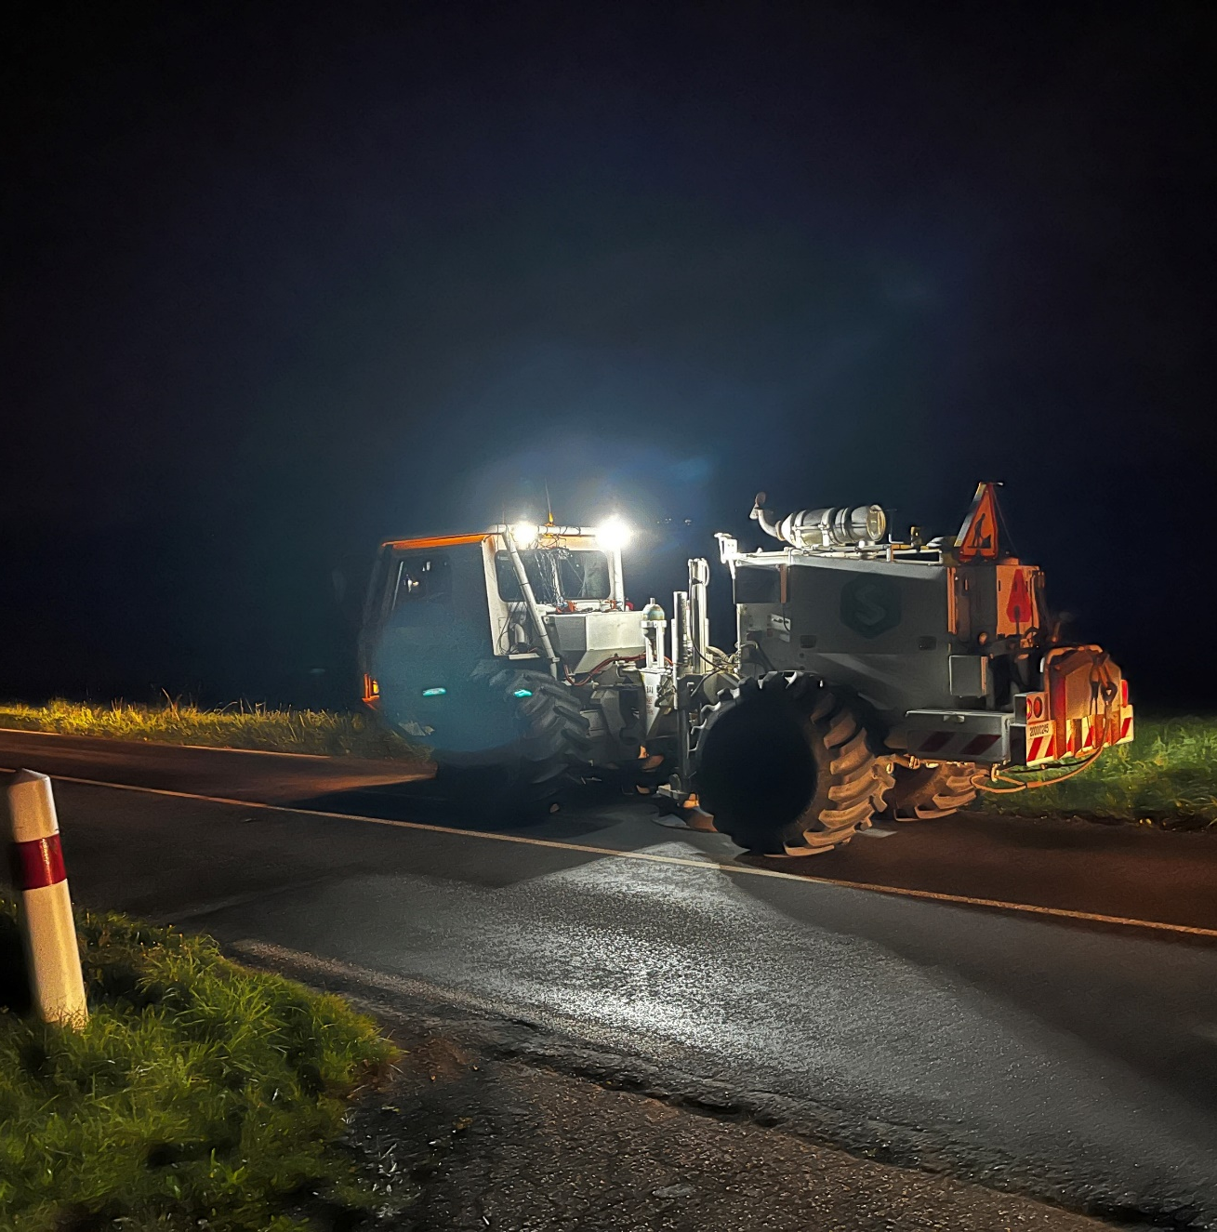
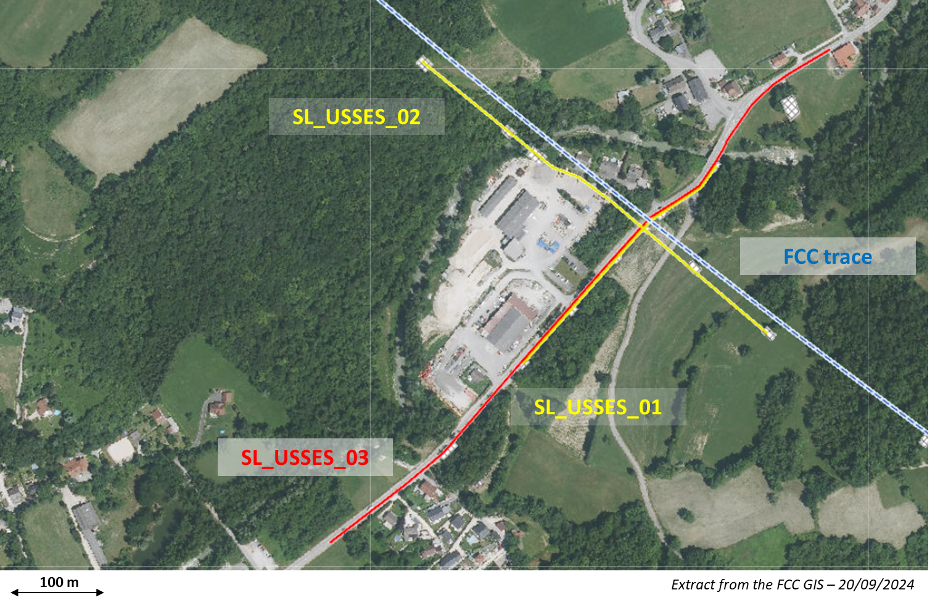
Start of site investigations – seismic investigations
First seismic line :
Second seismic line :
Seismic line SL_USSES_02 :
Acquisition date : 01/10/2024
Length : 480 meters
Method(s) : Explosive and Seismic gun
Geophones : 96 units (5 meters of spacing)
Shot points : 13 shot points in total
Seismic line SL_USSES_01 :
Acquisition date : 02/10/2024
Length : 300 meters
Method(s) : Weight drop
Geophones : 60 units (5 meters of spacing)
Shot points : 15 shot points in total
Notes:
2 Seismic lines are being invetigated

Slide 18
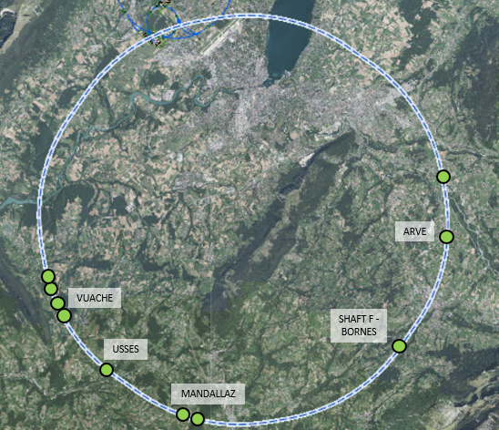
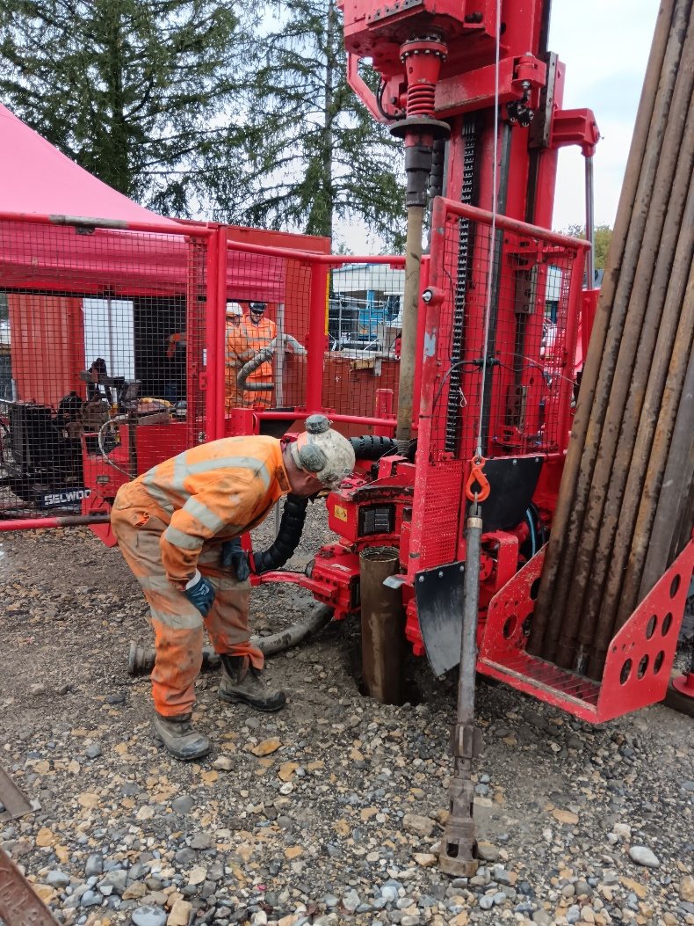
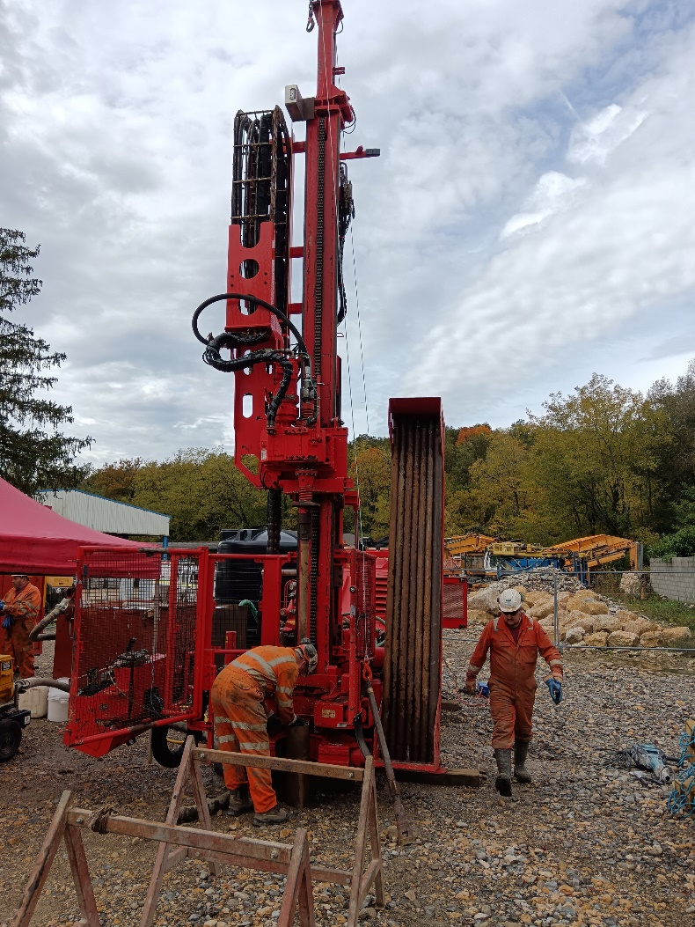
Status of site investigations – drilings
  Drilling for first borehole has commenced on 14/10/2024
  The drilling (USSES 2) is within the commune of Marlioz
  The drill site is located within the storage yard of a private construction company (Besson).
  Drilling Depth = 70m
  Fully cored recovery
  Drill time should be about 2 weeks
  Equipped with Piezometer

Slide 19
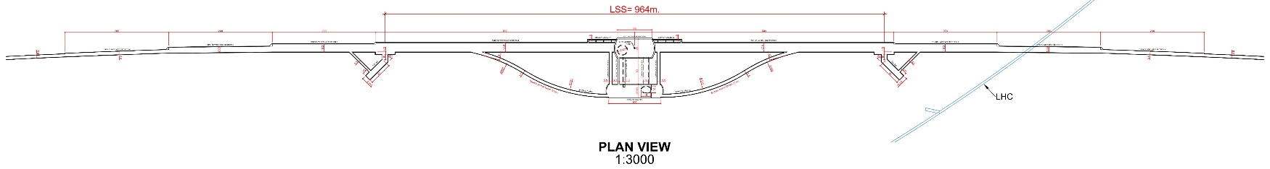
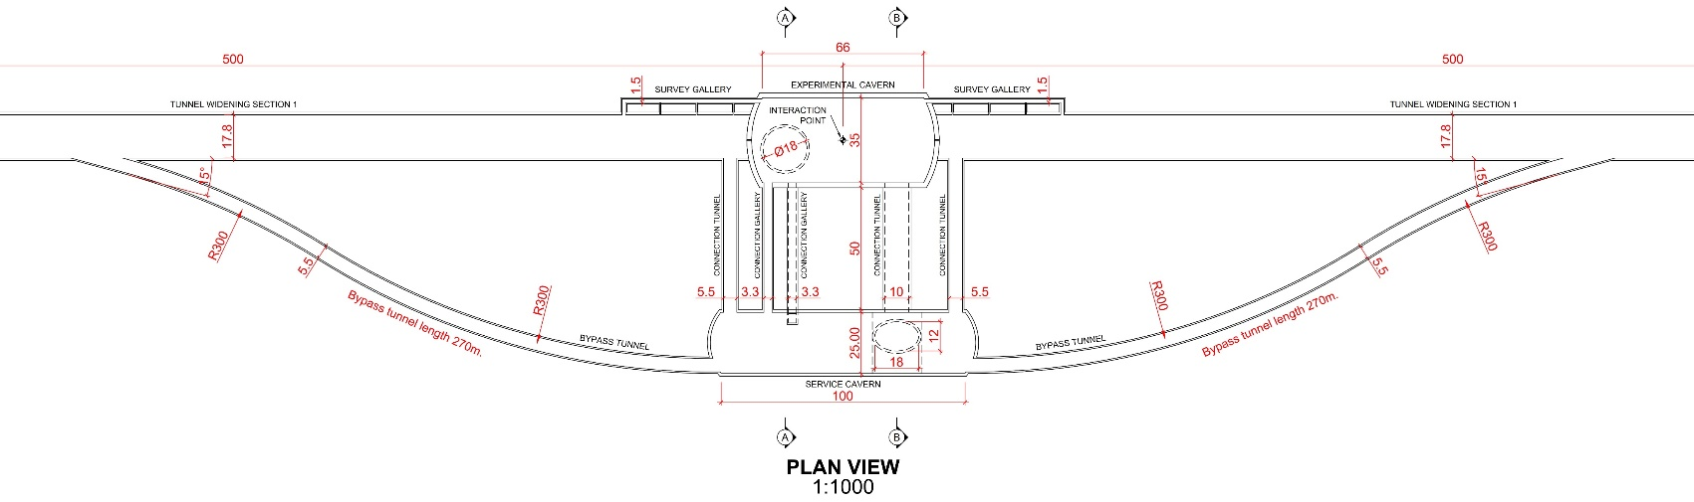
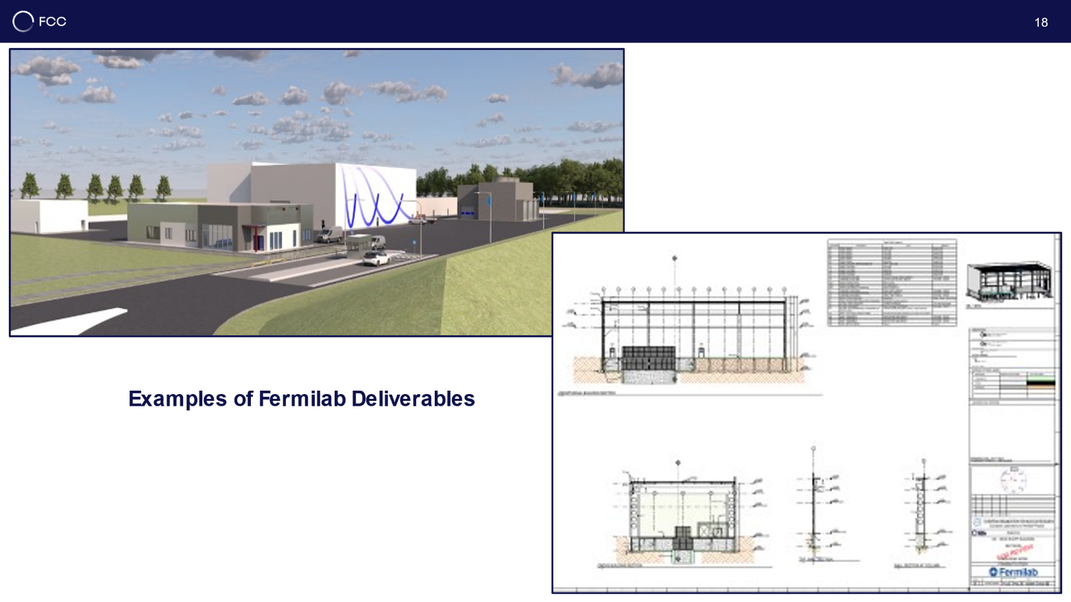
CE underground and surface progress
Full 3D model of all underground structures as basis for costing and scheduling exercises with external consultant.
Experiment Site (PA)
Generic study of experiment site and technical site done by FNAL
bills of quantities extracted from FNAL designs
basis for cost estimate by consultant with experience on industrial constructions in CH-FR area.
Notes:
A full 3D model of the underground structures made by external company and generic study of the 8 experiment and technical sites.

Slide 20
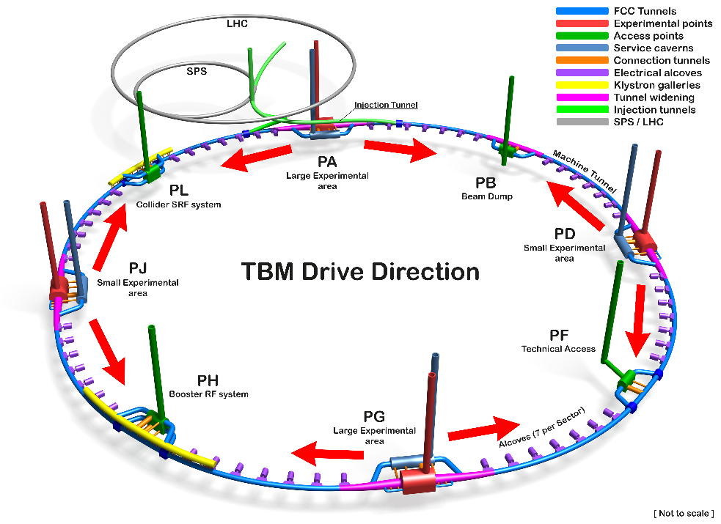
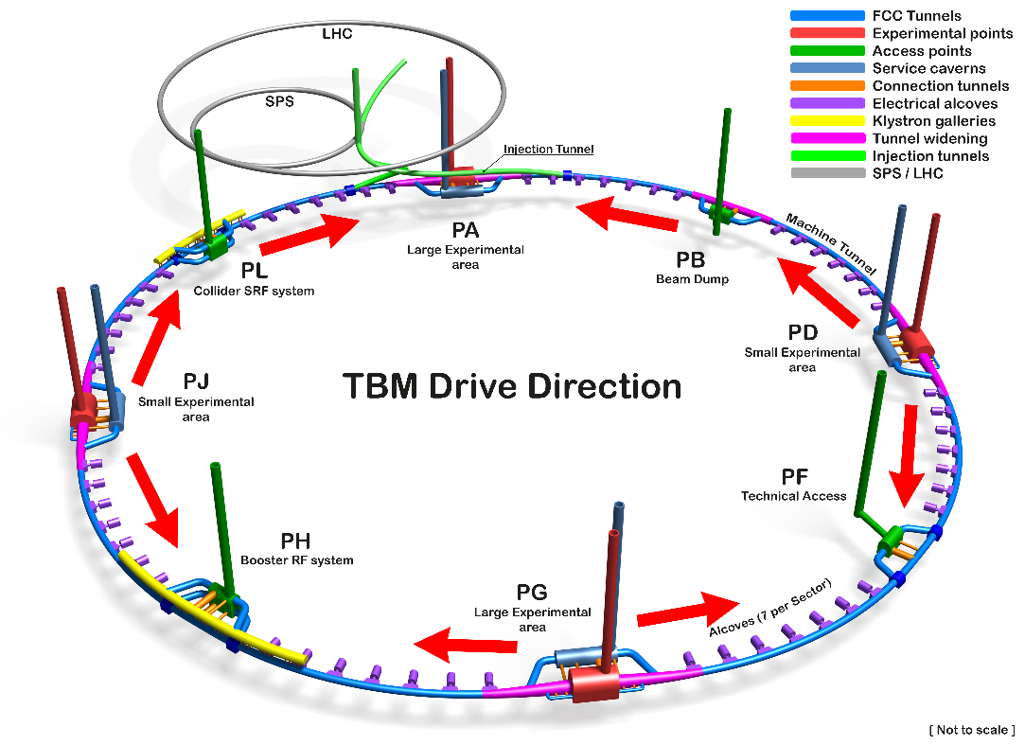
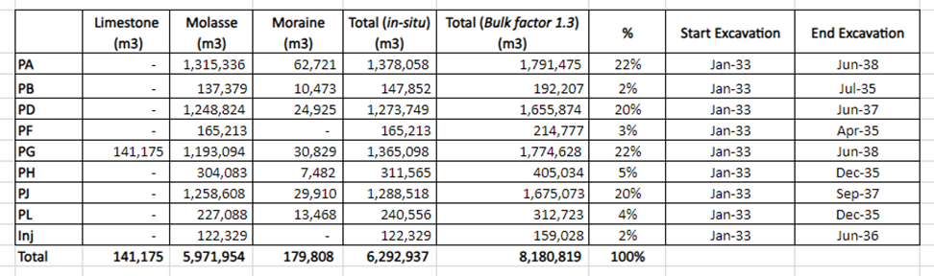
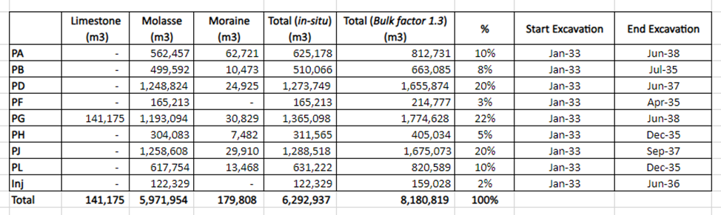
Studies on excavation strategy and material quantities
2 TBMs from each experimental point Alternative with no TBMs from PA
Notes:
A project about the kind of excavation material and the way to use is also ongoing.

Slide 21
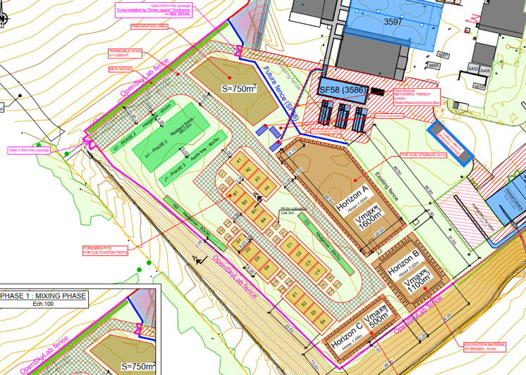









Development of excavation material re-use opportunities
OpenSkyLab: academic and industrial collaboration @LHC P5 CMS
Transformation of Molasse (FCC ~8 Mm³ volume) into fertile soil for agricultural and other uses
Materials: Molasse from the HL-LHC construction
Duration: 4+ years (2024 - )
Trials with 5 000 t molasse
  Soil fertilisation process (micro-organisms, mixing with fertile soil, etc.)
  Development of ferilisation mix products
  Development of quality managed processes
  Experimental phase with scientific protocol and field monitoring and control system support
Notes:
A project called OpenSkyLab has been launched in collaboration with the academies and industry.

Slide 22
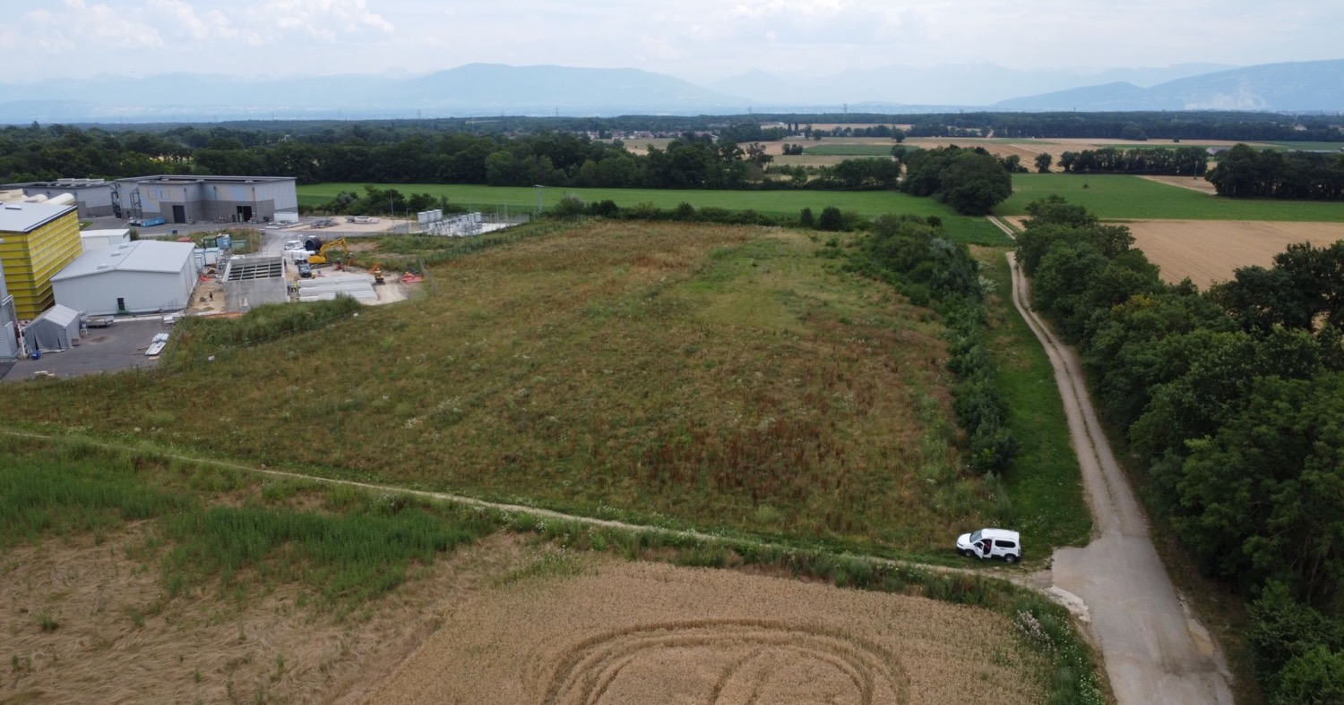
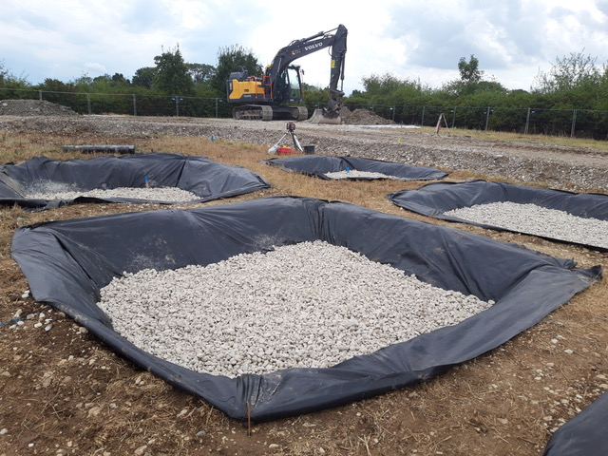
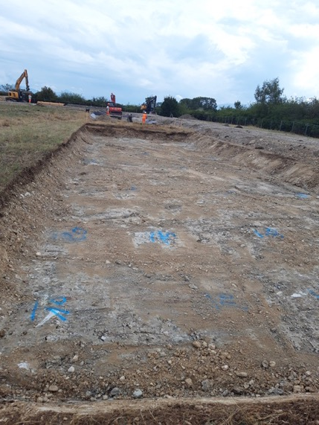
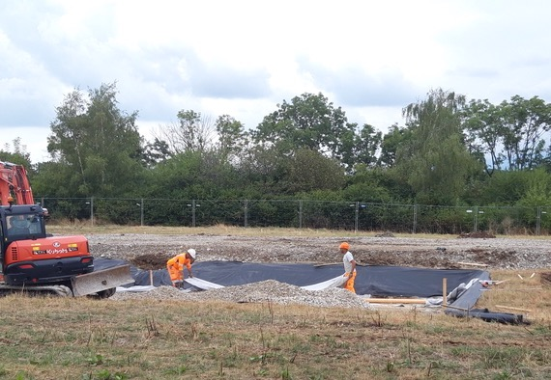
OpenSkyLab status and progress
Notes:
How this molase is transformed in soil for agriculture use.

Slide 23
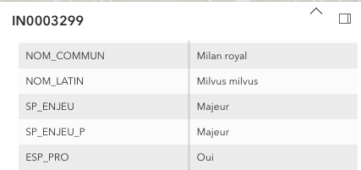
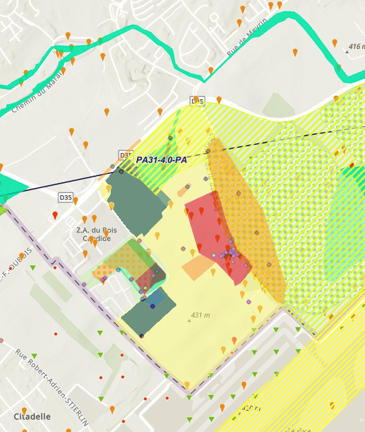
Environmental studies to document
present status of potential FCC surface site areas
Short term goals for FCC Feasibility Study:
Establish a state of the current environmental conditions at the surface site locations based on the actual situation, complementing the map and database investigations.
Confirm the territorial feasibility in principle.
Support the environmental impact studies for the geotechnical and geophysical investigations (i.e. boreholes and seismic lines).
Long term goals anticipating impact assessment works:
Comply with the regulatory reporting requirements in the frame of the authorisation process.
Identify and document the environmental stakes exhaustively.
Definition of environmental strategy and guiding principles for Ecodesign to be considered by infrastructure and equipment designers in technical design phase.
Notes:
An important criteria to be included in all the FCC design is the environmental one.

Slide 24
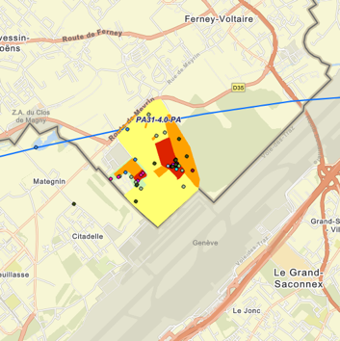
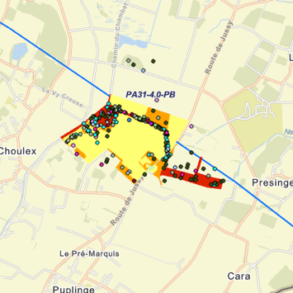
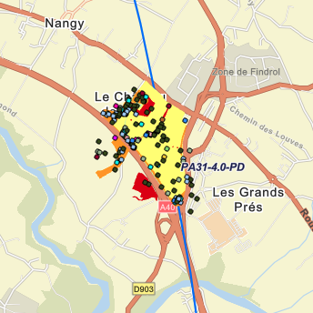
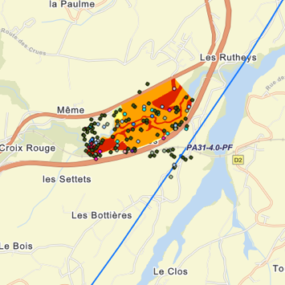
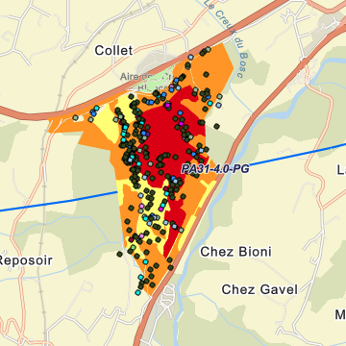
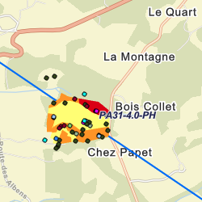


Environmental studies around surface areas
PA
PB
PD
PF
Total area investigated in 2023/24: 585 ha over 4 seasons
PG
PH
PJ
PL
Notes:
In this sense environmental studies has been started in 2023 in all the technical areas nad covering the 4 seasons.

Slide 25



Start of public information & engagement sessions
First public information and discussion meeting at the Science Gateway on the 24th April at CERN.
The meeting was organised for the local community of our Host States, France and Switzerland, in the Science Gateway.
The "Progress of the feasibility study of the Future FCC circular collider" was followed by a discussion with the participants.
La Roche-sur-Foron - Haute Savoie international fare April 27 to May 6
CERN’s participation in the International Fair of Haute-Savoie/Mont Blanc, enhanced by the valuable help of volunteers from the FCC team, resulted in meaningful discussions with more than 2000 members of the local community on topics ranging from the required technological advancements to sustainability measures.
On 15 May, RTS (Radio Télévision Suisse) broadcasted a special program celebrating CERN’s 70th anniversary and hosted at CERN’s Science Gateway.
The event featured a comprehensive look at CERN's illustrious history, groundbreaking achievements, and future ambitions, including the prominently featured Future Circular Collider (FCC) project with study experts interacting with the audience.
Notes:
Public events and outreach activities has been made at CERN and in the communities around CERN France and Swiss ones to inform about the progress of the project.

Slide 26

Commission Nationale de Debat Public (CNDP)
mission and public information meetings
The CNDP, created in 1995, is an independent French authority that ensures public participation in the definition and decision process of major projects in France, impacting the environment by providing a neutral and transparent framework for discussions between decision-makers and citizens.
On July 2, 2024, the CERN DG requested the CNDP to undertake an advisory mission on public participation for the FCC. On July 3, the president of the CNDP appointed two guarantors to:
Assist CERN in preparing the first information meetings on the ongoing studies in the region.
Provide non-binding advice to CERN on the next steps for public participation regarding the FCC.
CNDP decision for the Advisory Mission
Notes:
We have also presented the project to the CNDP in France, as other big project to be developed in France.
After this, I start the second part of the talk on the progress in the accelerator design and accelerator technologies for FCCee and FCChh

Slide 27

FCC-ee basic design choices
K. Oide,
J. Gutleber
et al.
Double ring e+e- collider
Common footprint with FCC-hh,
Asymmetric IR layout and optics to limit synchrotron radiation towards the detector
Perfect 4-fold superperiodicity allowing 2 or 4 IPs; large horizontal crossing angle 30 mrad, crab-waist collision optics
Synchrotron radiation power 50 MW/beam at all beam energies.
Top-up injection scheme for high luminosity Requires booster synchrotron in collider tunnel
FCC Integrated Program
IAS 2025
Notes:
The basic design characteristics:

Slide 28
FCC-ee main machine parameters
Parameter | Z | WW | H (ZH) | ttbar
beam energy [GeV] | 45.6 | 80 | 120 | 182.5
beam current [mA] | 1283 | 135 | 26.8 | 5.0
number bunches/beam | 11200 | 1852 | 300 | 64
bunch intensity [10¹¹] | 2.16 | 1.38 | 1.69 | 1.48
SR energy loss / turn [GeV] | 0.0390 | 0.369 | 1.86 | 9.94
total RF voltage 400/800 MHz [GV] | 0.079/0 | 1.0/0 | 2.09/0 | 2.1/9.2
long. damping time [turns] | 1171 | 218 | 65.4 | 19.4
horizontal beta* [m] | 0.11 | 0.22 | 0.24 | 0.9
vertical beta* [mm] | 0.7 | 1.0 | 1.0 | 1.4
horizontal geometric emittance [nm] | 0.7 | 2.16 | 0.66 | 1.51
vertical geom. emittance [pm] | 1.9 | 2.0 | 1.0 | 1.36
vertical rms IP spot size [nm] | 36 | 47 | 40 | 51
beam-beam parameter ξ_{x} / ξ_{y} | 0.0022/0.0977 | 0.013/0.129 | 0.0108/0.130 | 0.065/0.136
rms bunch length with SR / BS [mm] | 5.57 / 15.6 | 3.46 / 5.28 | 3.26 / 5.59 | 1.91 / 2.32
luminosity per IP [10³⁴ cm⁻²s⁻¹] | 143 | 20 | 7.5 | 1.38
total integrated luminosity / IP / year [ab⁻¹/yr] | 17 | 2.4 | 0.9 | 0.17
beam lifetime rad Bhabha + BS [min] | 15 | 12 | 12 | 11
Design and parameters to maximise luminosity at all working points:
allow for 50 MW synchrotron radiation per beam.
Independent vacuum systems for electrons and positrons
full energy booster ring with top-up injection, collider permanent in collision mode
4 years
5 x 10¹² Z
LEP x 10⁵
2 years
> 10⁸ WW
LEP x 10⁴
3 years
> 2 x 10⁶ H
5 years
2 x 10⁶ tt pairs
x 100 improvements on all EW observables
up to x 10 improvement on Higgs coupling (model-indep.) measurements over HL-LHC
x10 Belle II statistics for b, c, τ
indirect discovery potential up to ~ 100 TeV
direct discovery potential for feebly-interacting particles over 5-100 GeV mass range
Up to 4 interaction points → robustness,
statistics, possibility of specialised detectors
to maximise physics output
F. Gianotti

Slide 29
FCC-ee optics baseline & further evolution(s)
Baseline Lattice GHC (K. Oide)
  Local correction of chromatic effects from IP in vertical plane only
  Same X-poles for crab waist and local correction of vertical
  Many incremental improvements over the last months
  Chromaticity correction in arcs with X-pole pairs (many different strengths) with p phase advance
Local Chromaticity Correction LCC Lattice (P. Raimondi)
  Local correction of perturbations (chromatic effects, anharmonicities …)
  Local correction of chromatic effects from IP in both planes
  Dedicated crab-waist X-poles
  Arc cells with with nested X-poles and no multiple of p phase advance between
Nested Magnet Lattice (L. van Riesen-Haupt)
  Combined function magnets to reduce dipolar field and synchrotron radiation loss
  HTS coils for flexibility – very different optics at low and high energy
  Change of geometry between high and low energy settings
Combination of different approaches to converge on lattice?
  Speculation: arc cells proposed by P. Raimondi and GHC IR design? …
Notes:
Different lattice optics has been developed, being the GHC the baseline. The LCC is being studied also in detail.

Slide 30






FCC-ee optics baseline & further evolution(s)
FCC-ee optics baseline & further evolution(s)
LCC https://indico.cern.ch/event/1326738/timetable/#45-alternative-optics-and-vari
Global Hybrid Correction (GHC)
Local Chromatic Correction (LCC)
GHC https://journals.aps.org/prab/abstract/10.1103/PhysRevAccelBeams.19.111005
.
Average betas ~ 105m
Peak betas ~ 175m
Average betas ~ 85m
Peak betas ~ 120m
K. Oide, UNIGE; P. Raimondi, FNAL; S. Liuzzo, S. White, ESRF; K. Andre, M. Hofer, G. Roy, CERN
Notes:
GHC is the baseline and the LCC is being studied in detail by different teams.

Slide 31







FCC-ee optics baseline & further evolution(s)
regular arc
K. Oide
interaction region
K. Oide
optimisation goals:
reduced power consumption
lower SR energy loss
increased momentum acceptance
relaxed tolerances
larger dynamic aperture
simplified powering schemes
FODO lattice, many -I sext pairs; periodic unit cell length $\sim$260 m
“1.5” sext.s per final focus,
asymmetric
P. Raimondi
P. Raimondi
hybrid FODO lattice,
with few sext. families,
periodic unit cell length$\sim$300 m
5 sext.s per final focus, modular
C. Garcia,
R. Tomas, et al.

Slide 32



FCC-ee optics alternatives
A. Faus Golfe, Z. Zhang IJCLab
Talk by Z. Zhang
Parallel Sessions (Accelerator): Tu3-AP02
Notes:
Some alternatives exotic operation modes as the monochromatization are also being studied in some detail. More info in the talk of Zhandong this afternoon.

Slide 33






FCC-ee corrections & tunning
Notes:
Other complimentary aspects are being studied for these 2 lattices and comparison are also being made. For instance, the sensitivity to magnet misalignments, or the DA with magnets errors, with and without beam-beam...between others.

Slide 34




FCC-ee corrections & tunning
Notes:
Other correction studies are for instance: the BBA based in the parallel method developed by SLAC, preliminary results are obtained, misalignments and correction and impact in for instance the polarization...

Slide 35





FCC-ee Injectors and Injection
Notes:
Top-up injection procedure is being investigated on and off axis, and the baseline is an hybrid on-off axis scheme
Aa a result of the comments and recommendation in the mid-term review the injector design has been re-optimized the process is ongoing.

Slide 36



Optimised injector implementation at Prevessin site
Good integration with existing CERN Prevessin Site and strongly reduced visibility from outside.
Ideal connection to existing experimental halls.
Good conditions for construction.
High Energy LINAC
Damping
Ring
CERN Fenced Area
Entrance CERN Prevessin Site
Notes:
The injector has also been studied from civil engineering aspects implementation inside the CERN area.

Slide 37




FCC-ee Intensity dependence effects
Notes:
Another kind of studies are the one related to the intensity as the beam-beam, the TMCI instabilities (wakefield) and (BB & wakefield) instabilities with a semi analytical fast tool known as the Circular Matrix Model (CMM) and with Xsuite or the e- cloud (problematic foir intermediate regimes)

Slide 38



FCC-ee code developments
Xsuite (G. Iadarola)
  Synchrotron Radiation, Beam-Beam
  Interfaces for Beam-Matter Interaction, Electron Cloud, Wake Fields
  Can now model SuperKEKB IR
BLAST-WarpX (A. Formenti)
  Beam-beam Studies
  PIC, different Geometries
  Fast and flexible, first FCC-ee Simulations
Bmad-Julia (G.Hoffstaetter)
  Open Source Toolkits and Programs
  Digital Twins
  Machine Learning
VACI Suite (A. Rajabi)
  Resistive-wall wake field for arbitrary chamber geometries
  FCC-ee detuning wake field cancelled by deforming circular chamber
Notes:
Another important development is the one of the simulation codes. A lot of effort is being made to modernize and adapt the codes to the FCCee parameters.

Slide 39




FCC-ee sustainability
Notes:
We start here the part dedicated to the FCCee accelerator technologies. As we have stated in the ESPPU on 2020 all the new accelerator designs have to take into account the sustainability aspects, in this sense all the R&D in the SRF will be centered in this crucial aspect.
There is a lot of developments in this area but I will describe in detail only the SRF ones.

Slide 40




FCC-ee SRF
Notes:
400 MHz basis is being developed at CERN or in Europe and the 800 MHz is carried out in FNAL.
In order to simplify the SRF cavities types and switching for the different modes an alternative with 2 cell 400 MHz cavities for all energies is being studied.

Slide 41

FCC-ee SRF R&D activities
Notes:
For pursuing this important R&D effort and assuring the operation of FCCee in 2044, CERN is constructing a dedicated new SRF facility.

Slide 42






FCCee SRF R&D activities
RF system R&D is key for increasing energy efficiency of FCC-ee
Nb on Cu 400 MHz cavities (KEK as R&D partner), seamless cavity production, coating techniques
Bulk Nb 800 MHz cavities and cryomodule, surface treatment techniques (JLAB, FNAL as R&D partners)
RF power source R&D in synergy with HL-LHC.
5-cell 800 MHz cavity development collaboration with JLAB
high-efficiency klystron R&D
400 MHz
monoblock prototype

Slide 43















FCC-ee Accelerator Technical Design
Notes:
Any other aspects that I don’t have time to show today.

Slide 44
FCC-hh main machine parameters
parameter | FCC-hh | HL-LHC | LHC
collision energy cms [TeV] | 81 - 115 | 14
dipole field [T] | 14 - 20 | 8.33
circumference [km] | 90.7 | 26.7
arc length [km] | 76.9 | 22.5
beam current [A] | 0.5 | 1.1 | 0.58
bunch intensity [10¹¹] | 1 | 2.2 | 1.15
bunch spacing [ns] | 25 | 25
synchr. rad. power / ring [kW] | 1020 - 4250 | 7.3 | 3.6
SR power / length [W/m/ap.] | 13 - 54 | 0.33 | 0.17
long. emit. damping time [h] | 0.77 – 0.26 | 12.9
peak luminosity [10³⁴ cm⁻²s⁻¹] | ~30 | 5 (lev.) | 1
events/bunch crossing | ~1000 | 132 | 27
stored energy/beam [GJ] | 6.1 - 8.9 | 0.7 | 0.36
Integrated luminosity/main IP [fb⁻¹] | 20000 | 3000 | 300
With FCC-hh after FCC-ee: significant amount of time for high-field magnet R&D,
aiming at highest possible collision energies
Target field range for cryo-magnet R&D
Formidable challenges:
high-field superconducting magnets: 14 - 20 T
power load in arcs from synchrotron radiation: 4 MW → cryogenics, vacuum
stored beam energy: ~ 9 GJ → machine protection
pile-up in the detectors: ~1000 events/xing
optimization of energy consumption: → R&D on cryo, HTS, beam current, …
Formidable physics reach, including:
Direct discovery potential up to ~ 40 TeV
Measurement of Higgs self to ~ 5% and ttH to ~ 1%
High-precision and model-indep (with FCC-ee input)
measurements of rare Higgs decays (𝛄𝛄, Z𝛄, µµ)
Final word about WIMP dark matter
F. Gianotti

Slide 45



FCC-hh: cryo magnet system, optics design
Notes:
Since 2020 there has been a more reduced effort on the optics design, the main effort has been the HFM

Slide 46






FCC-hh: HFM R&D program
Notes:
The HFM program has been revised in June 2024 with a new target of 14 TeVs based on Nb3Tn. Starting with a short model 1.9K and extendable to 4,2 K. For scaling after at 15m.
HTS with a target of 15-20 Tesla range will be use in simple and short magnets as the correctors. Concerning the energy reach with 14 Tesla the target is now 85 TeV.
With this new 14 T objective the nergy reach has also been re-scoped and now is 85 TeV.

Slide 47









Some HFM updated news
FCC-hh: HFM R&D program
Nb3Sn magnets
First R2D2 coil in CEA (E. Rochepault, et al.)
Manufacturing of SSSMCC in PSI (D. Araujo, B Auchmann, et al.)
Large Magnet facility at CERN (S. Izquierdo , et al)
Delivery of first REBCO tape made in KIT to CERN
HTS magnets
Notes:
If we put the magnets in a historical perspective, for accelerators we have to follow the line of 400 A/mm² (compact and high-current)
Some news in the prototypes side:
For the Nb3Sn: R2D2 at CEA or the SSSMC in PSI and others prototypes at the Large Magnet Facility at CERN
For the HTS; the REBCO cable for KIT arrived at CERN

Slide 48



FCC-hh new scenarios
FCC-hh: new scenarios
Notes:
All of this motivates that FCC-hh new scenarios have been started to be studied. A working group has been settled, first meeting 3 September. The idea in principle, is not to have an alternative plan A but a plan B. But the risk is high in this sense.
Based in the new target of the HFM program, 6 scenarios have been proposed and a working group has been created to discuss the possible Physics cases.
Luminosity is limited by the maximum power to be removed from the cold magnets.

Slide 49


FCC-hh new scenarios
FCC-hh: new scenarios
Notes:
All details are summarized in this table and a document.
Discussion forum on going.

Slide 50




Key activities on FCC-hh: cryo magnet system, optics design

Slide 51




Possible timeline till start of construction
2024 |  |  |  | 2025 |  |  |  | 2026 |  |  |  | 2027 |  |  |  | 2028 |  |  |  | 2029 |  |  |  | 2030 |  |  |  | 2031 |  |  |  | 2032 |  |  |  | 2033
Q1 | Q2 | Q3 | Q4 | Q1 | Q2 | Q3 | Q4 | Q1 | Q2 | Q3 | Q4 | Q1 | Q2 | Q3 | Q4 | Q1 | Q2 | Q3 | Q4
Feasibility Study
Pre-TDR Phase
TDR Phase
Construction →→→
FS Report
cost update
ESPPU
2025/26
pre TDR
cost update
TDR
cost update
Project Decision
accelerator design, technical infrastructure design, R&D, towards TDR
engineering design →
Environmental Impact study & Authorization Process
Phase 1 Site Investigations
Phase 2 Site Investigations
CE Concept Design update
CE Tender Design
Construction Design
Start construction
Detector EOI submissions
FC³ formation, call for CDRs
Detector CDRs submitted to FC³
Notes:
The timelines until 2033

Slide 52

Construction and installation planning stage 1
Baseline stage 1 FCC-ee schedule
Q1 2033, Start of CE construction work
Q2 2041, Completion of last lot of CE construction
Q2 2043, Overall completion of TI installation
Q4 2044, Accelerator installation completed
Q4 2045, HW commissioning completed
Q1 2046, First beams
Q1 2048, Start of nominal operation
Q3 2041 – Q3 2044, Experiment installation
Q1 2046, Start beam commissioning
Civil eng. works
Experiment. install.
Accelerator HWC
Shaft works
Geodetic install.
TI HWC
TI installation
Machine install.
Shaft release
First alcove release
FCC Integrated Program
IAS 2025

Slide 53



Status of FCC global collaboration
Increasing international collaboration as a prerequisite for success:
→links with science, research & development and high-tech industry will be essential to further advance and prepare the implementation of FCC
FCC Feasibility Study:
Aim is to increase further the collaboration,
on all aspects, in particular on
Accelerator and Particle/Experiments/Detectors
141 Institutes
32 countries
+
CERN
Notes:
Finally the collaboration aspects...

Slide 54


FCC Week 2024 - San Francisco – 10 to 14 June
449 participants, 50 public sessions, 216 oral presentations, 32 posters
US efforts getting organized, towards completing the FS by March 2025

Slide 55



Progress on international collaboration
26 April 2024
White House Office of Science and Technology Policy Principal Deputy U.S. Chief Technology Officer Deirdre Mulligan signed for the United States while Director-General Fabiola Gianotti signed for CERN.

Slide 56

EU Competitiveness Report
edited by Mario Draghi, and officially handed over to Ursula von der Leyen in September 2024
“One of CERN’s most promising current projects, with significant scientific potential, is the construction of the Future Circular Collider (FCC): a 90-km ring designed initially for an electron collider and later for a hadron collider..
Refinancing CERN and ensuring its continued global leadership in frontier research should be regarded as a top EU priority, given the objective of maintaining European prominence in this critical area of fundamental research, which is expected to generate significant business spillovers in the coming years.”
https://commission.europa.eu/topics/strengthening-european-competitiveness/eu-competitiveness-looking-ahead_en

Slide 57

Supporting statements at CERN’s 70 anniversary
“….No European country alone could have built the world’s largest particle collider. CERN has become a global hub because it rallied Europe and this is even more crucial today.
I am proud that we have financed the feasibility study for CERN’s Future Circular Collider (FCC). This could preserve Europe's scientific edge and could push the boundaries of human knowledge even further. And as the global science race is on, I want Europe to switch gears. To do so, European unity is our greatest asset. ….”
Ursula von der Leyen, President of the European Commission

Slide 58
Summary from Feasibility Study
CERN Council launched in 2021 the feasibility study for FCC FS to provide input by 2025, required for further discussion, and in view of a potential project decision by end 2027/begin 2028.
Focus on implementation scenario developed with host state authorities
  Surface site areas identified and individual landplots reserved
  Electrical supply concept developed with FR and CH grid operators
  Road and highway connections identified and designs established
  Environmental initial state analysis for all surface sites completed
Colliders and technical infrastructures
  Two collider lattice variants established, optimization ongoing
  R&D activites started on main technologies (RF for FCC-ee, HFM for FCC-hh)
  Injector design optimized and implementation at CERN Prevessin site developed
  Technical infrastructures (EL, CV) system layouts developed
Cost estimate (by FCC FS) and funding model (CERN Council and Directorate)

Slide 59
FCC Main Goals for Coming Years
Upcoming milestone for FCC is the completion of the Feasibility Study by March 2025 as input for the Update of the ESPP.
The following pre-TDR phase should prepare for a possible project approval by 2027-2028 and enable the subsequent start of CE design contract:
  Updated cost and schedule studies
  specifications to enable CE tender design by mid 2027
  refined input for environmental evaluation and project authorisation process
  requires overall integration study and designs based on technical pre-design of accelerators, technical infrastructure and detectors
Possible start of CE construction would then be 2032-33:
  CE groundbreaking
  TDR to enable prototyping, industrialization towards component production
Strong international collaboration is essential for success!

Slide 60

FCC Week 2025 - Vienna
Venue: Hofburg Palace, a historical and cultural landmark in Vienna, Austria.
Dates: Monday 19 to Friday 23 May 2025
Presentation of the Feasibility Study Report and review of its findings and opportunities for future R&D projects
Please save the date and join us in Vienna

