Slide 1



Sustainability technologies development and Cold copper accelerator R&D
Yuhui Li
Institute of High Energy Physics
Sep. 21, 2023
Yuhui Li
On behalf of CEPC accelerator team
IAS Program on Fundamental Physics (IAS-FP 2025)
Hong Kong, China, Jan. 13-17 (2024)

Slide 2
Sustainability technology development
CO2 footprint in operation
Improving the key technology energy efficiency
Clean energy implement and utility
Energy/non-renewable resource recovery

Slide 3
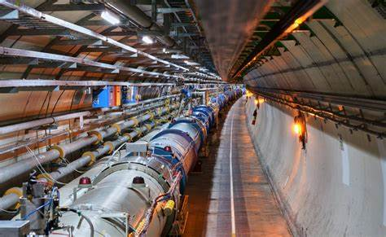
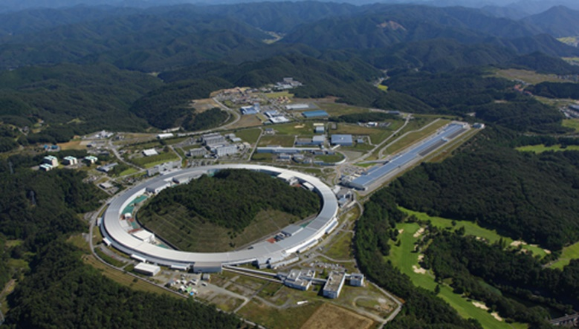
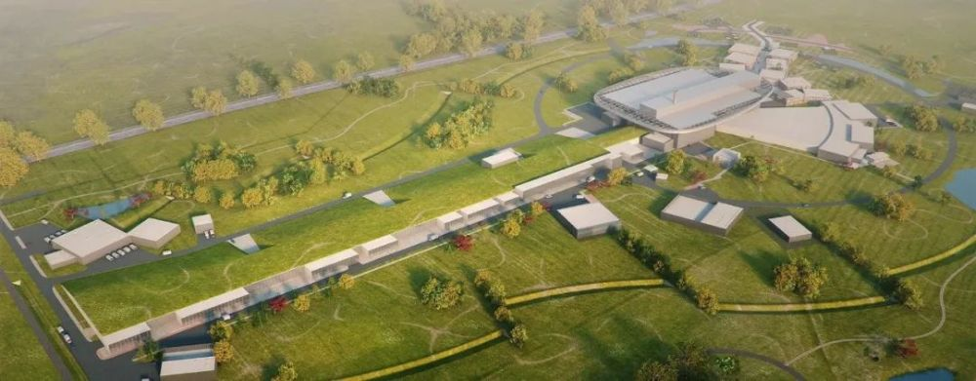
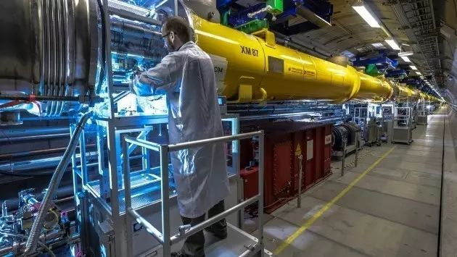
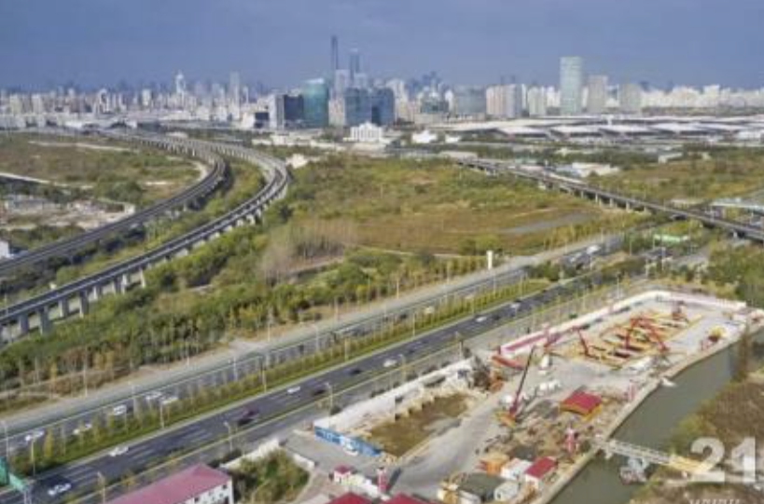
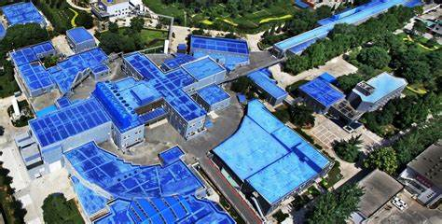
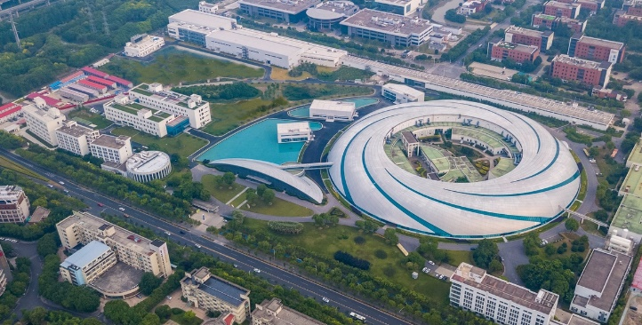
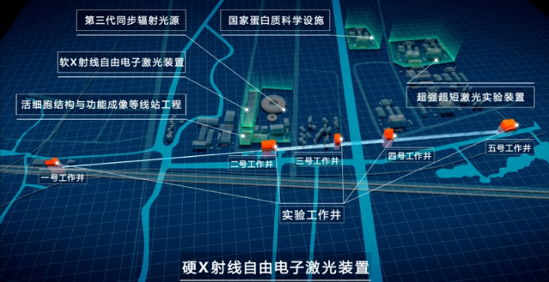
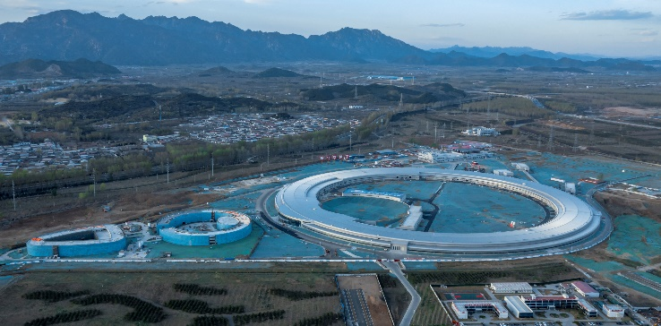
Motivation and obligations to pursue a green machine
China national dual-carbon strategy: CO2 emission peak before 2030 and carbon neutrality before 2060)
The modern high-performance accelerator complex consumes a significant amount of energy: LHC, ILC, CEPC…
LHC 照片
功率 200MW
LHC
200MW
Spring 8
25MW
ESS
33.75MW
EuropeanXFEL
17.76MW
BEPCII 照片
功率 ？MW
上海光源 照片
功率 ？？W
SSRF
10MW
SHINE
20MW
HEPS 照片
功率 ？MW
BEPCII
7MW
HEPS
30MW

Slide 4
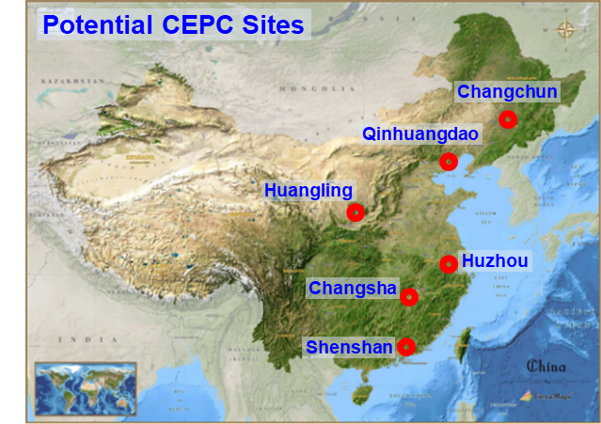
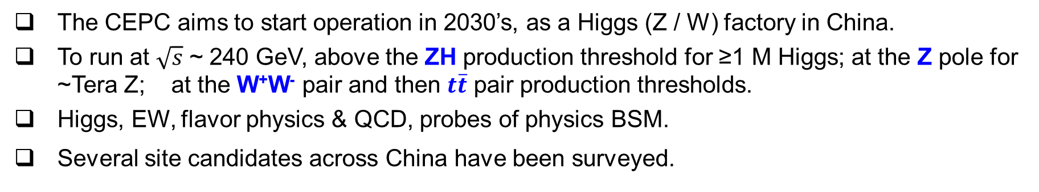

A brief introduction to CEPC
The CEPC aims to start operation in 2030’s, as a Higgs (Z / W) factory in China.
To run at $\sqrt{s}$ ~ 240 GeV, above the ZH production threshold for ≥1 M Higgs; at the Z pole for ~Tera Z; at the W⁺W⁻ pair and then $t\overline{t}$ pair production thresholds.
Higgs, EW, flavor physics & QCD, probes of physics BSM.
Several site candidates across China have been surveyed.
IP 2
$e^{+}e^{−}$ Higgs (Z) factory
Ring length ~ 100 km
IP 1

Slide 5
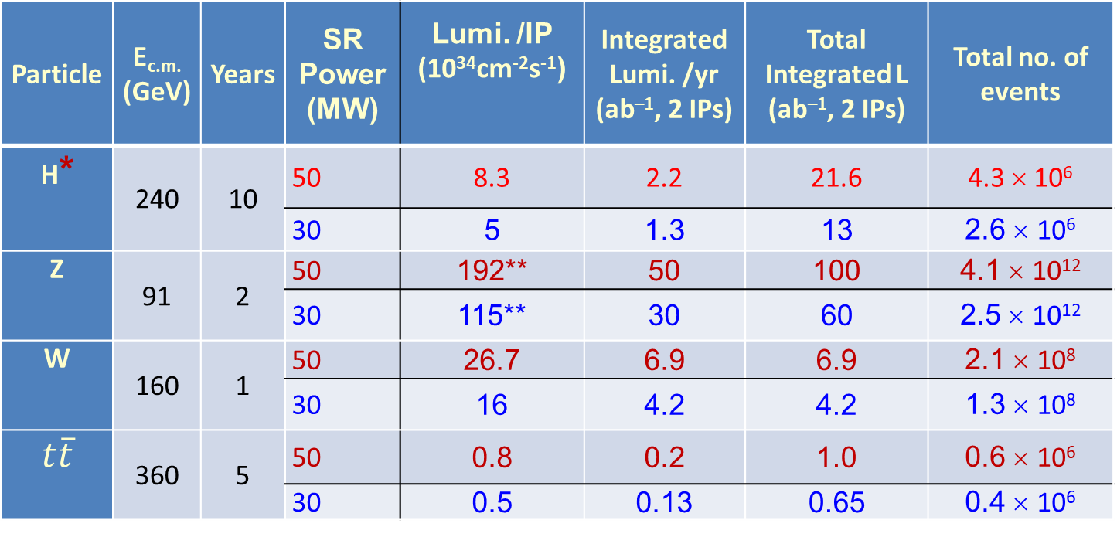
CEPC operation plan
Particle | E_{c.m.} (GeV) | Years | SR Power (MW) | Lumi. /IP (10³⁴cm⁻²s⁻¹) | Integrated Lumi. /yr (ab^{–1}, 2 IPs) | Total Integrated L (ab^{–1}, 2 IPs) | Total no. of events
H* | 240 | 10 | 50 | 8.3 | 2.2 | 21.6 | 4.3 × 10⁶
 |  |  | 30 | 5 | 1.3 | 13 | 2.6 × 10⁶
Z | 91 | 2 | 50 | 192** | 50 | 100 | 4.1 × 10¹²
 |  |  | 30 | 115** | 30 | 60 | 2.5 × 10¹²
W | 160 | 1 | 50 | 26.7 | 6.9 | 6.9 | 2.1 × 10⁸
 |  |  | 30 | 16 | 4.2 | 4.2 | 1.3 × 10⁸
$$t\overline{t}$$ | 360 | 5 | 50 | 0.8 | 0.2 | 1.0 | 0.6 × 10⁶
 |  |  | 30 | 0.5 | 0.13 | 0.65 | 0.4 × 10⁶
* Higgs is the top priority. The CEPC will commence its operation with a focus on Higgs.
** Detector solenoid field is 2 Tesla during Z operation, 3Tesla for all other energies.
*** Calculated using 3,600 hours per year for data collection.

Slide 6
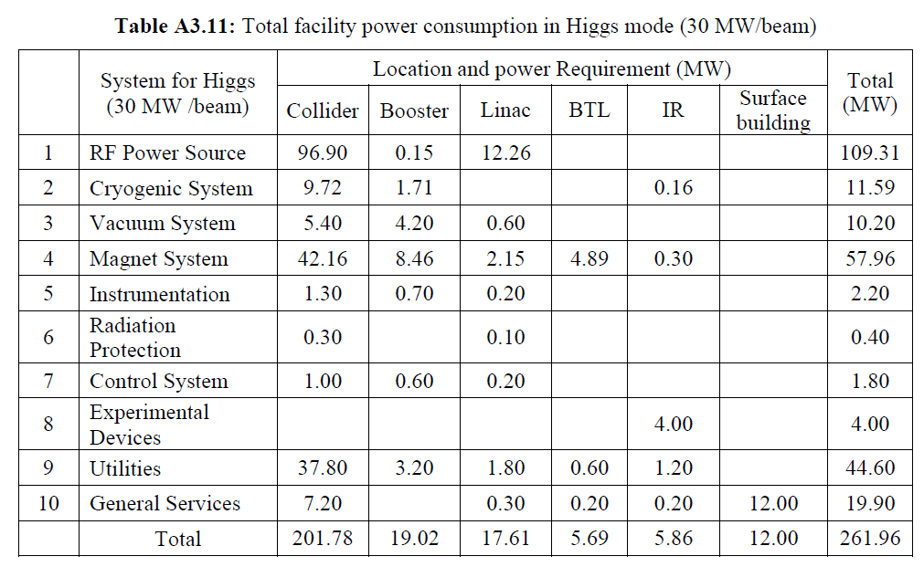
Energy consumption breakdown @ 30MW SR power
CEPC-TDR p965
The total electricity consumption is 262MW for the operation of SR power 30MW
The major energy consumer systems:
  RF power (109 MW) ➢Magnet (58 MW) ➢ Cryogenics (11.6 MW)
  Auxiliary power:
    Instrumentation(2.2) + Radiation Protection (0.4) + Control (1.8) + Experimental device (4) +Utility(44.6) +General Service(19.9) = 73 MW

Slide 7
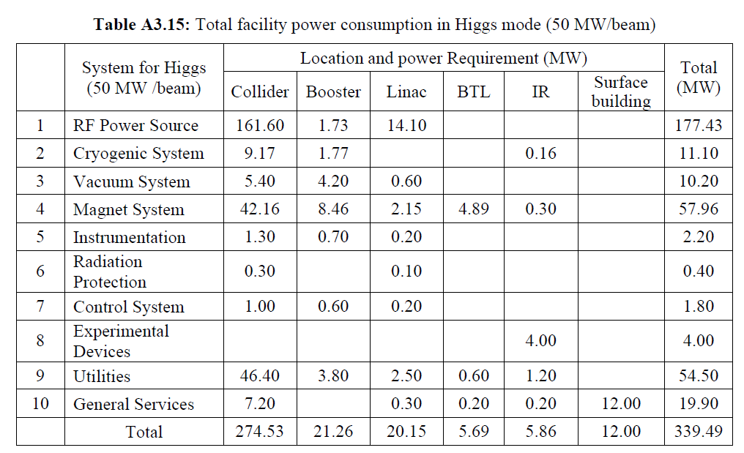
Energy consumption breakdown @ 50MW SR power
CEPC-TDR p967
The total power at other operation modes are listed in TDR
The total electricity consumption is 340MW for the operation of Higgs, SR power 50MW
The major energy consumer systems:
  RF power (177MW) ➢Magnet (58MW) ➢ Cryogenics (11 MW)
  Auxiliary power:
    Instrumentation(2.2) + Radiation Protection(0.4) + Control(1.8) + Experimental device (4) + Utility(54.5) + General Service(19.9) = 78 MW

Slide 8
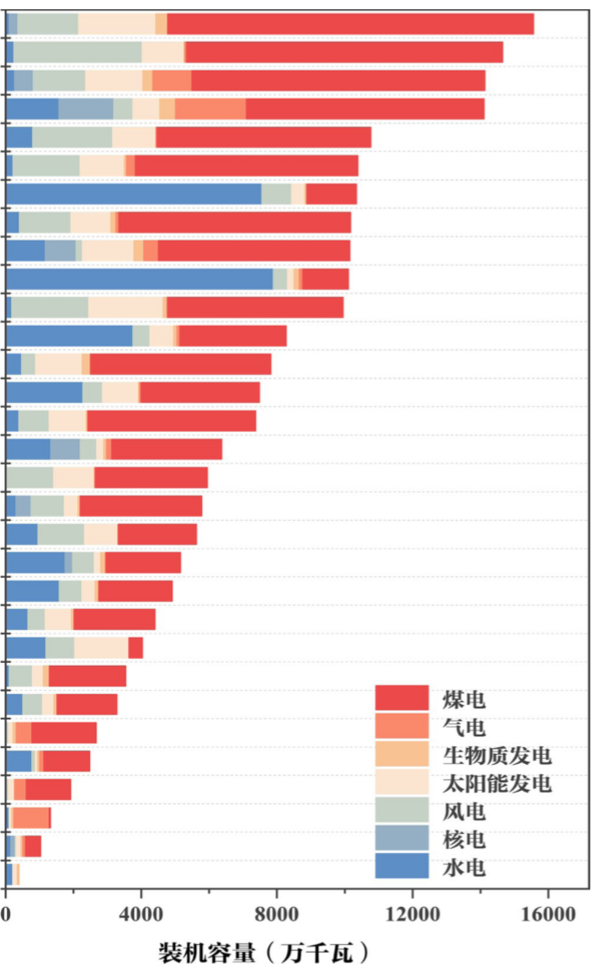
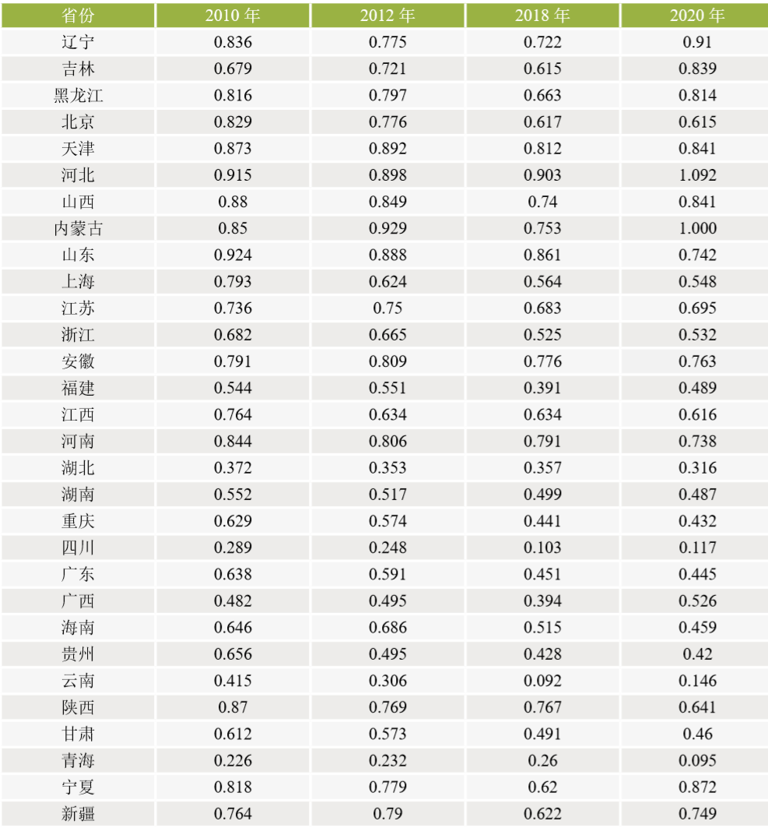
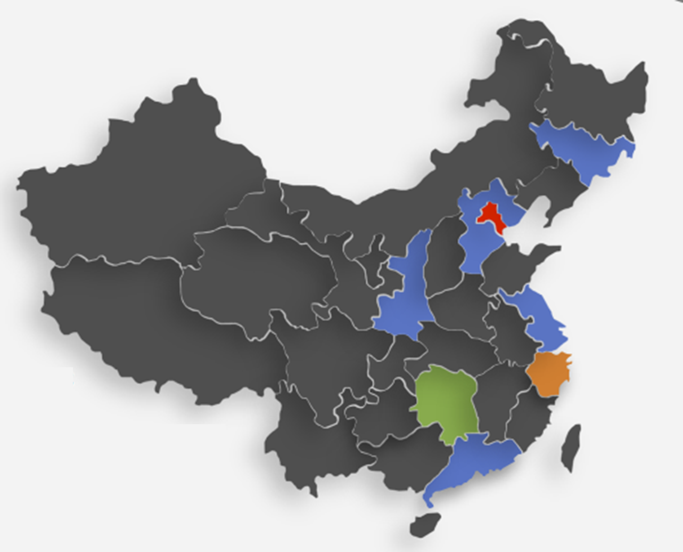
Electricity carbon intensity map
Carbon intensity (kgCO2/kWh)
Shandong
Neimenggu
Jiangsu
Guangdong
Xinjiang
Shanxi
Yunnan
Henan
Zhejiang
Sichuan
Hebei
Hubei
Anhui
Guizhou
Shanxi
Fujian
Ningxia
Liaoning
Gansu
Guangxi
Hunan
Jiangxi
Qinghai
Heilongjiang
Jilin
Shanghai
Chongqing
Tianjing
Beijing
Hainan
Xizzang
Liaoning
Jilin
Heilongjiang
Beijing
Tianjin
Hebei
Shanxi
Neimenggu
Shandong
Shanghai
Jiangsu
Zhejiang
Anhui
Fujian
Jiangxi
Henan
Hubei
Hunan
Chongqing
Sichuan
Guangdong
Guangxi
Hainan
Guizhou
Yunnan
Shanxi
Gansu
Qinghai
Ningxia
Xinjiang
Qinhuangdao
Huzhou
Changsha
Electricity Transport:
North-to-South
West-to-East
Coal
Gas
Biomass
Solar
Wind
Nuclear
Hydraulic
Shenshan
Electricity Generating Capacity in China 2020 (10000 kW)

Slide 9
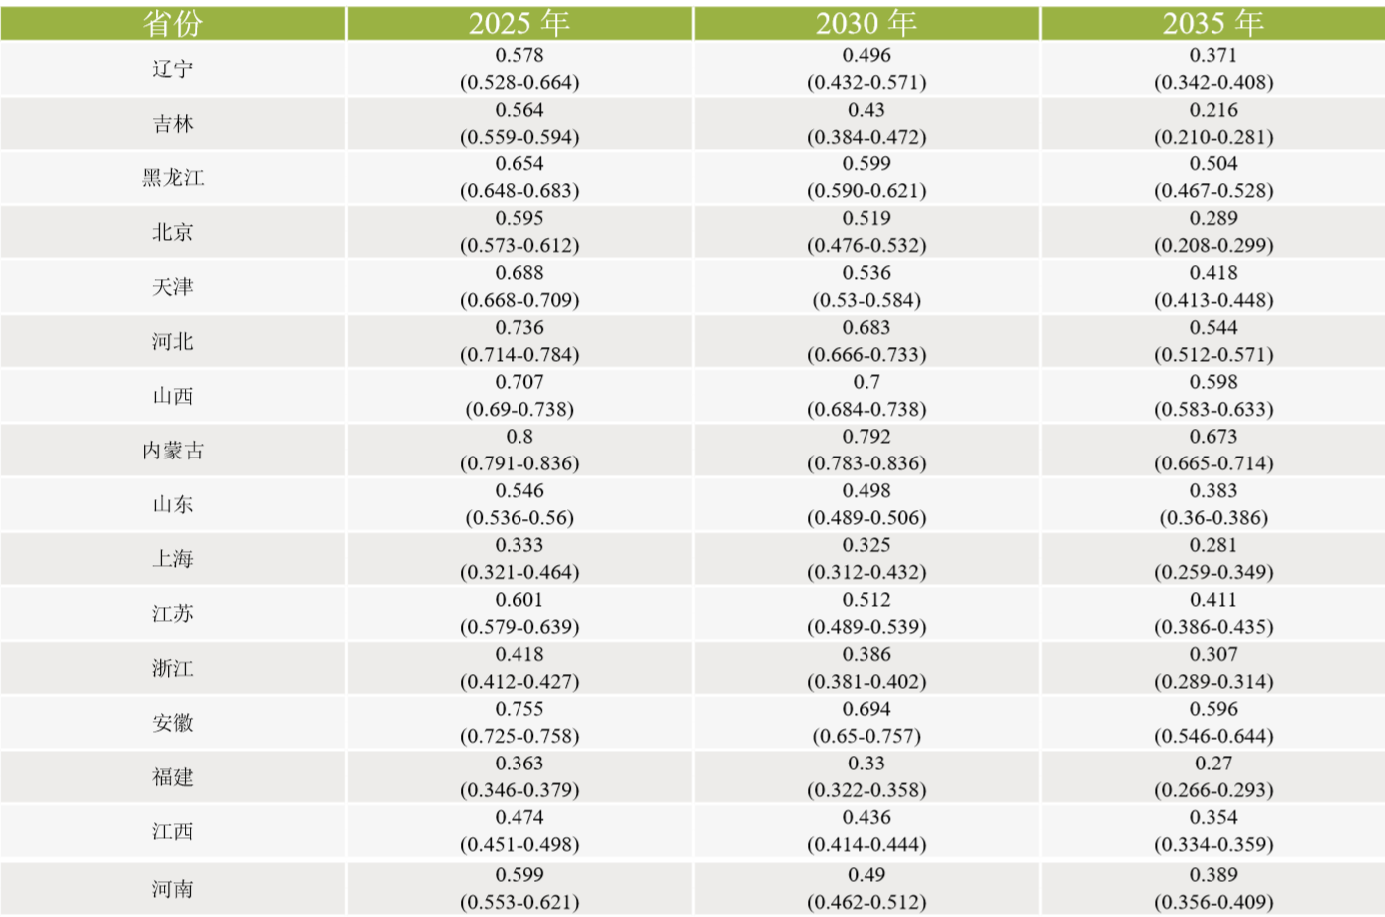
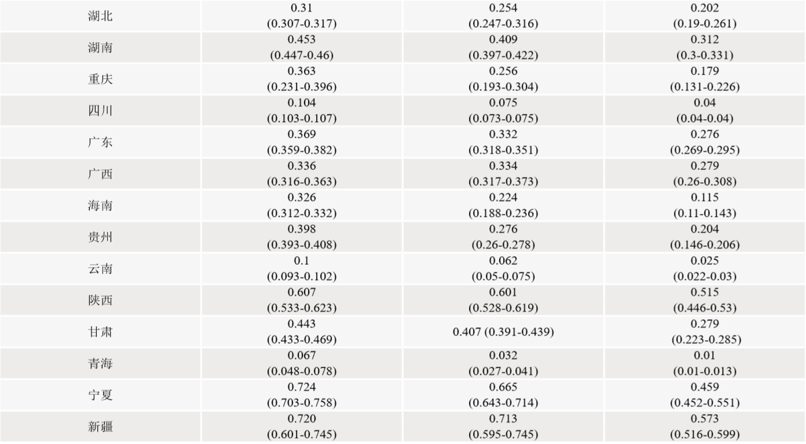
Carbon intensity expectation (2025-2035)
Liaoning
Jilin
Heilongjiang
Beijing
Tianjin
Hebei
Shanxi
Neimenggu
Shandong
Shanghai
Jiangsu
Zhejiang
Anhui
Fujian
Jiangxi
Henan
Hubei
Hunan
Chongqing
Sichuan
Guangdong
Guangxi
Hainan
Guizhou
Yunnan
Shanxi
Gansu
Qinghai
Ningxia
Xinjiang
The carbon intensity will be reduced rapidly until 2035 in China.
Qing Hai: 0.01 kgCO2/kWh (hydroelectric, wind and photovoltaic dominate)
Hu Nan: 0.312 kgCO2/kWh (hydroelectric and coal dominate)

Slide 10
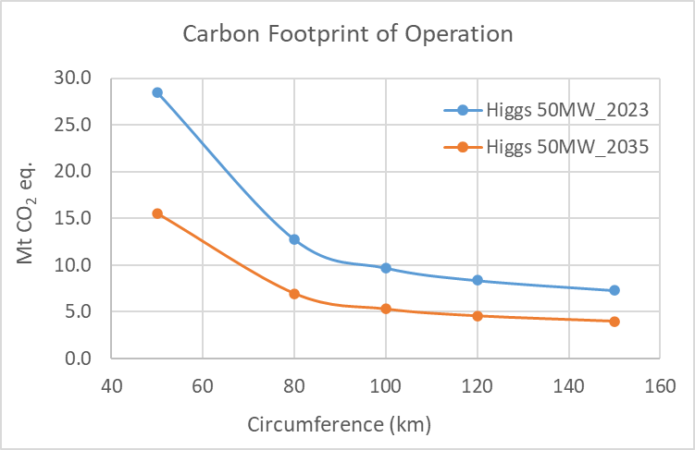
CEPC Higgs CO2 footprint (preliminary)
Grid average carbon intensity in 2023: 550 ton CO₂ e /GWh
Grid average carbon intensity by 2035: 300 ton CO₂ e /GWh
Table: CEPC parameters*
Circumference(km) | 50 | 80 | 100 | 120 | 150
L /IP (50MW) (10³⁴ cm⁻²s⁻¹) | 2.83 | 6.33 | 8.33 | 9.7 | 11.1
Total Higgs particle (million) | 4
Collision time/year (month) | 5 |  |  |  | 5
Running time (years) | 30 | 14 | 10 | 9 | 8
Instantaneous power (MW) | 340 |  |  |  | 340
*Dou Wang, et al., “CEPC cost model study and circumference optimization”, Journal of Instrumentation，(2022)17 P10018.

Slide 11
According to the electricity breakdown, 1. RF power source, 2. Magnet, 3. Cryogenics, 4. Utility (cooling water etc.) are crucial to reduce the energy consumption
The major energy consumer systems:
  RF power (109 MW) ➢Magnet (58 MW) ➢ Cryogenics (11.6 MW)
  Auxiliary power:
    Utility(44.6) +General Service(19.9) + Instrumentation(2.2) + Radiation Protection (0.4) + Control (1.8) + Experimental device (4) = 73 MW

Slide 12
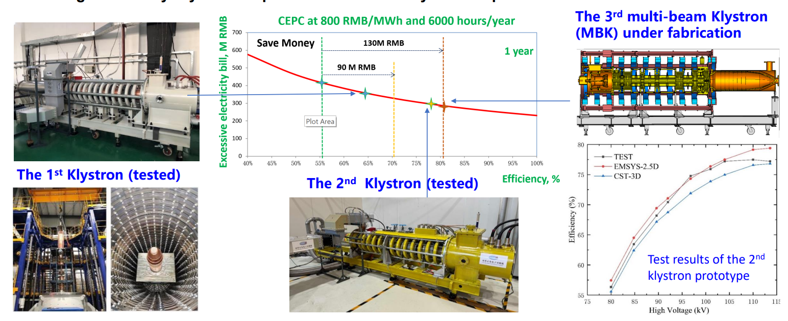
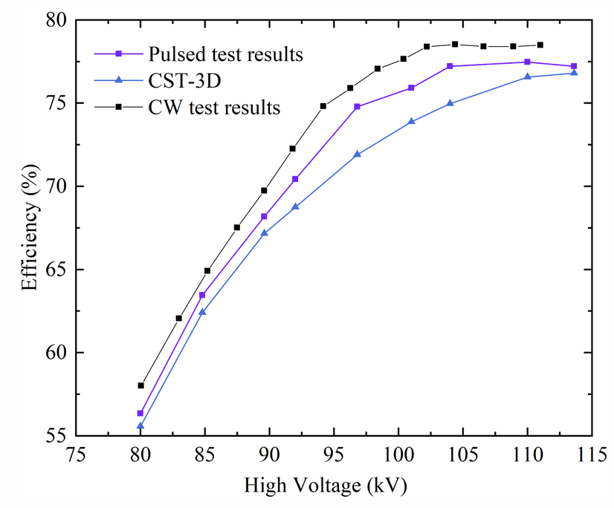
High efficiency klystron and significance
❑ The 1st Klystron prototype, achieved efficiency of 62%
❑ The 2nd Klystron prototype was tested in Aug. 2024, achieved efficiency ~ 78% @ 800kW
❑ The 3rd Klystron prototype (MBK) with manufacture underway, design efficiency is 80%
❑ High efficiency Klystron helps to enormously reduce electricity consumption
Test of the 2nd klystron in CW mode

Slide 13
EDR goal for klystron
Continue the 650MHz high-efficiency klystron R&D: More klystrons will be produced and tested. The klystron design will be further refined based on the insights gained from the TDR prototype. A high level of efficiency and increased stability are goals.
Develop a high-power 80 MW C-band klystron with a wide pulse. The CEPC linac will extensively use C-band klystrons. High power and stable operation are crucial.
The electric field distribution inside the three-stage depressed collector

Slide 14
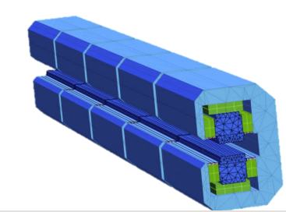
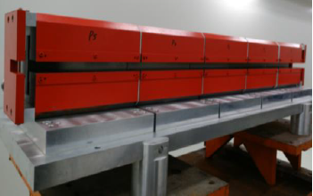
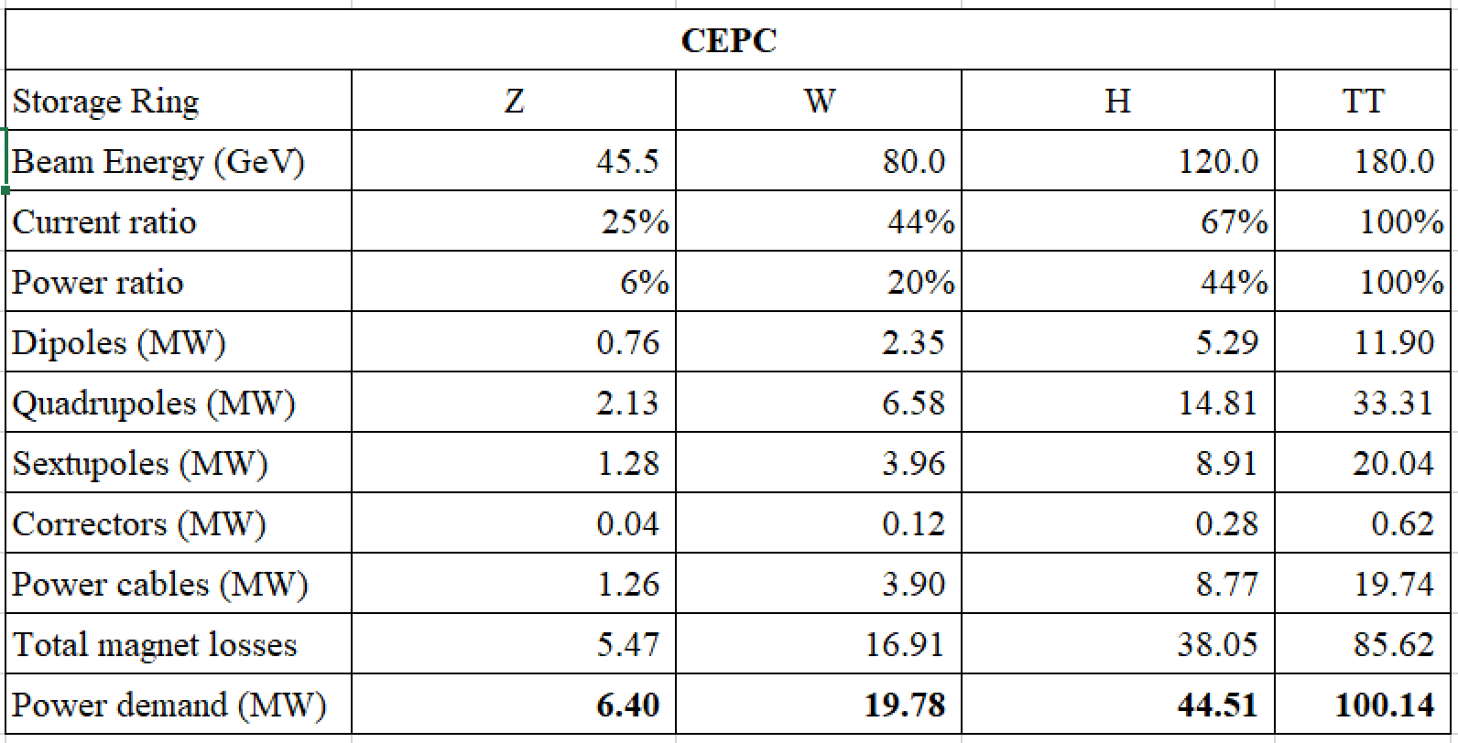
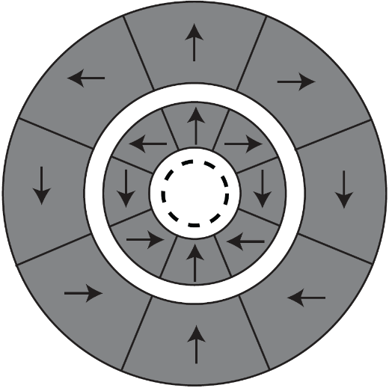
Green machine: Permanent magnet
Inspiration from the permanent magnet utility in HEPS
Equivalent single excitation energy consumption of about 1.62kW.
Equivalent cooling, power efficiency additional energy consumption of about 1.3kW
240 magnets in the whole ring
Annual running time of 8000 hours
Annual saving electricity about 5.6 million kWh
The CEPC uses permanent magnets (dipole, quadruple) for
  Damping ring • Transport line
350mm
Explore novel ideas for collider QUAD
100mm

Slide 15
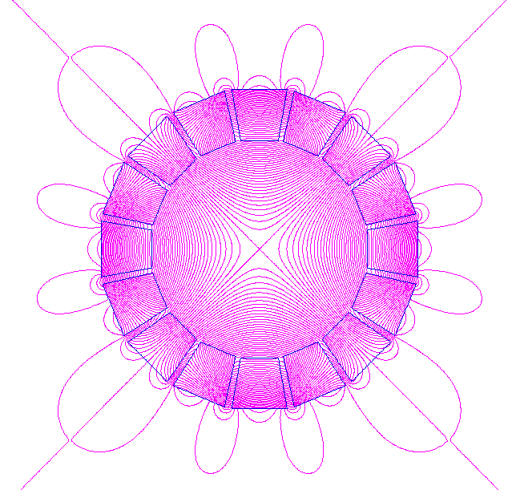
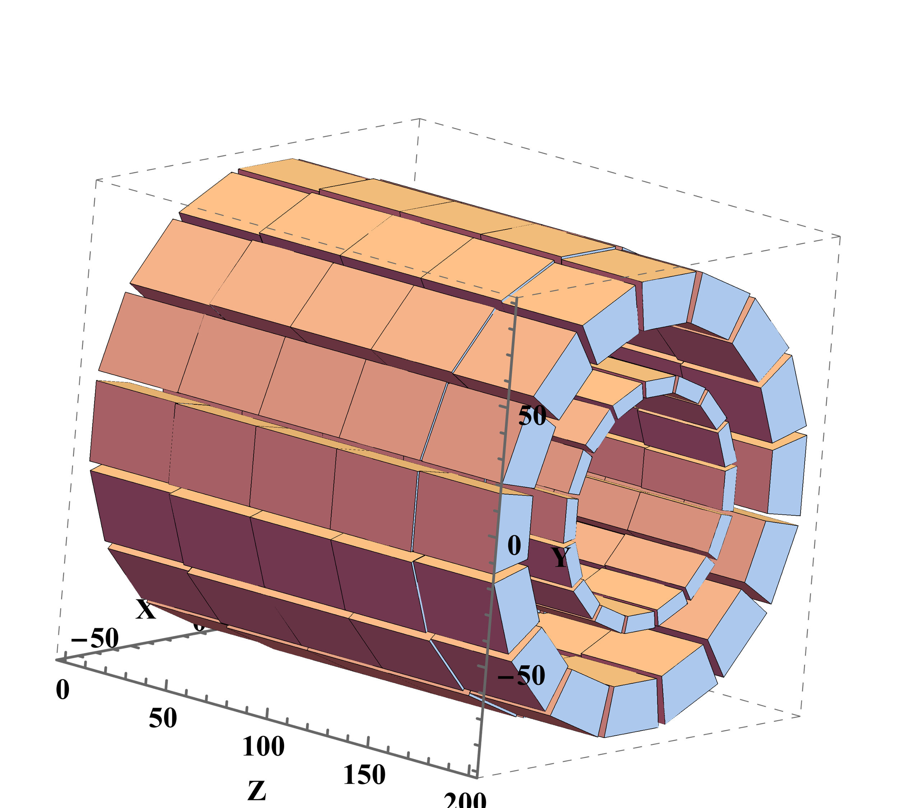
Green machine: Field adjustable PM quadrupole
Two codes (RADIA and OPERA-3d) used for field simulation: field strength satisfies CEPC specification
Halbach array is effective for shielding magnet field leakage, preventing cross-talk in a dual aperture magnet
Adjust field strength by rotating two rings in opposite directions.
Compensate harmonics by moving wedges along radial direction.
Magnet shift for harmonic field error correction

Slide 16
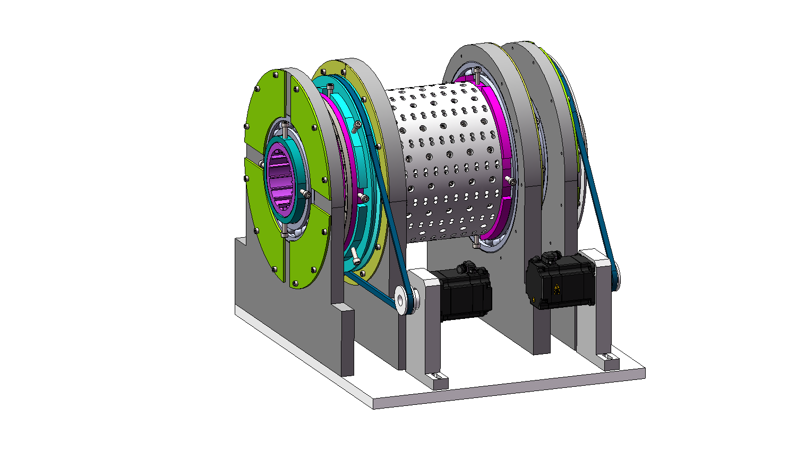
PM quadrupole: specification
All design parameters are already confirmed
The prototype is currently undergoing fabrication, with field tuning and measurements scheduled for 2025.
Aperture | φ | mm | ≥66
Magnetic length | L_{eff} | mm | ≥200
Max Gradient | G_{max} | T/m | ≥10.6
Adjustment range |  | T/m | 1.8 ~ 10.6
Adjustment precision | ΔG | T/m | ≤0.002
Rotating precision | Δθ | mrad | ≤0.08
Good field region | R_{GFR} | mm | 12
Harmonics@G_{max} | B_{n}/B₂ | 10⁻⁴ | <5

Slide 17
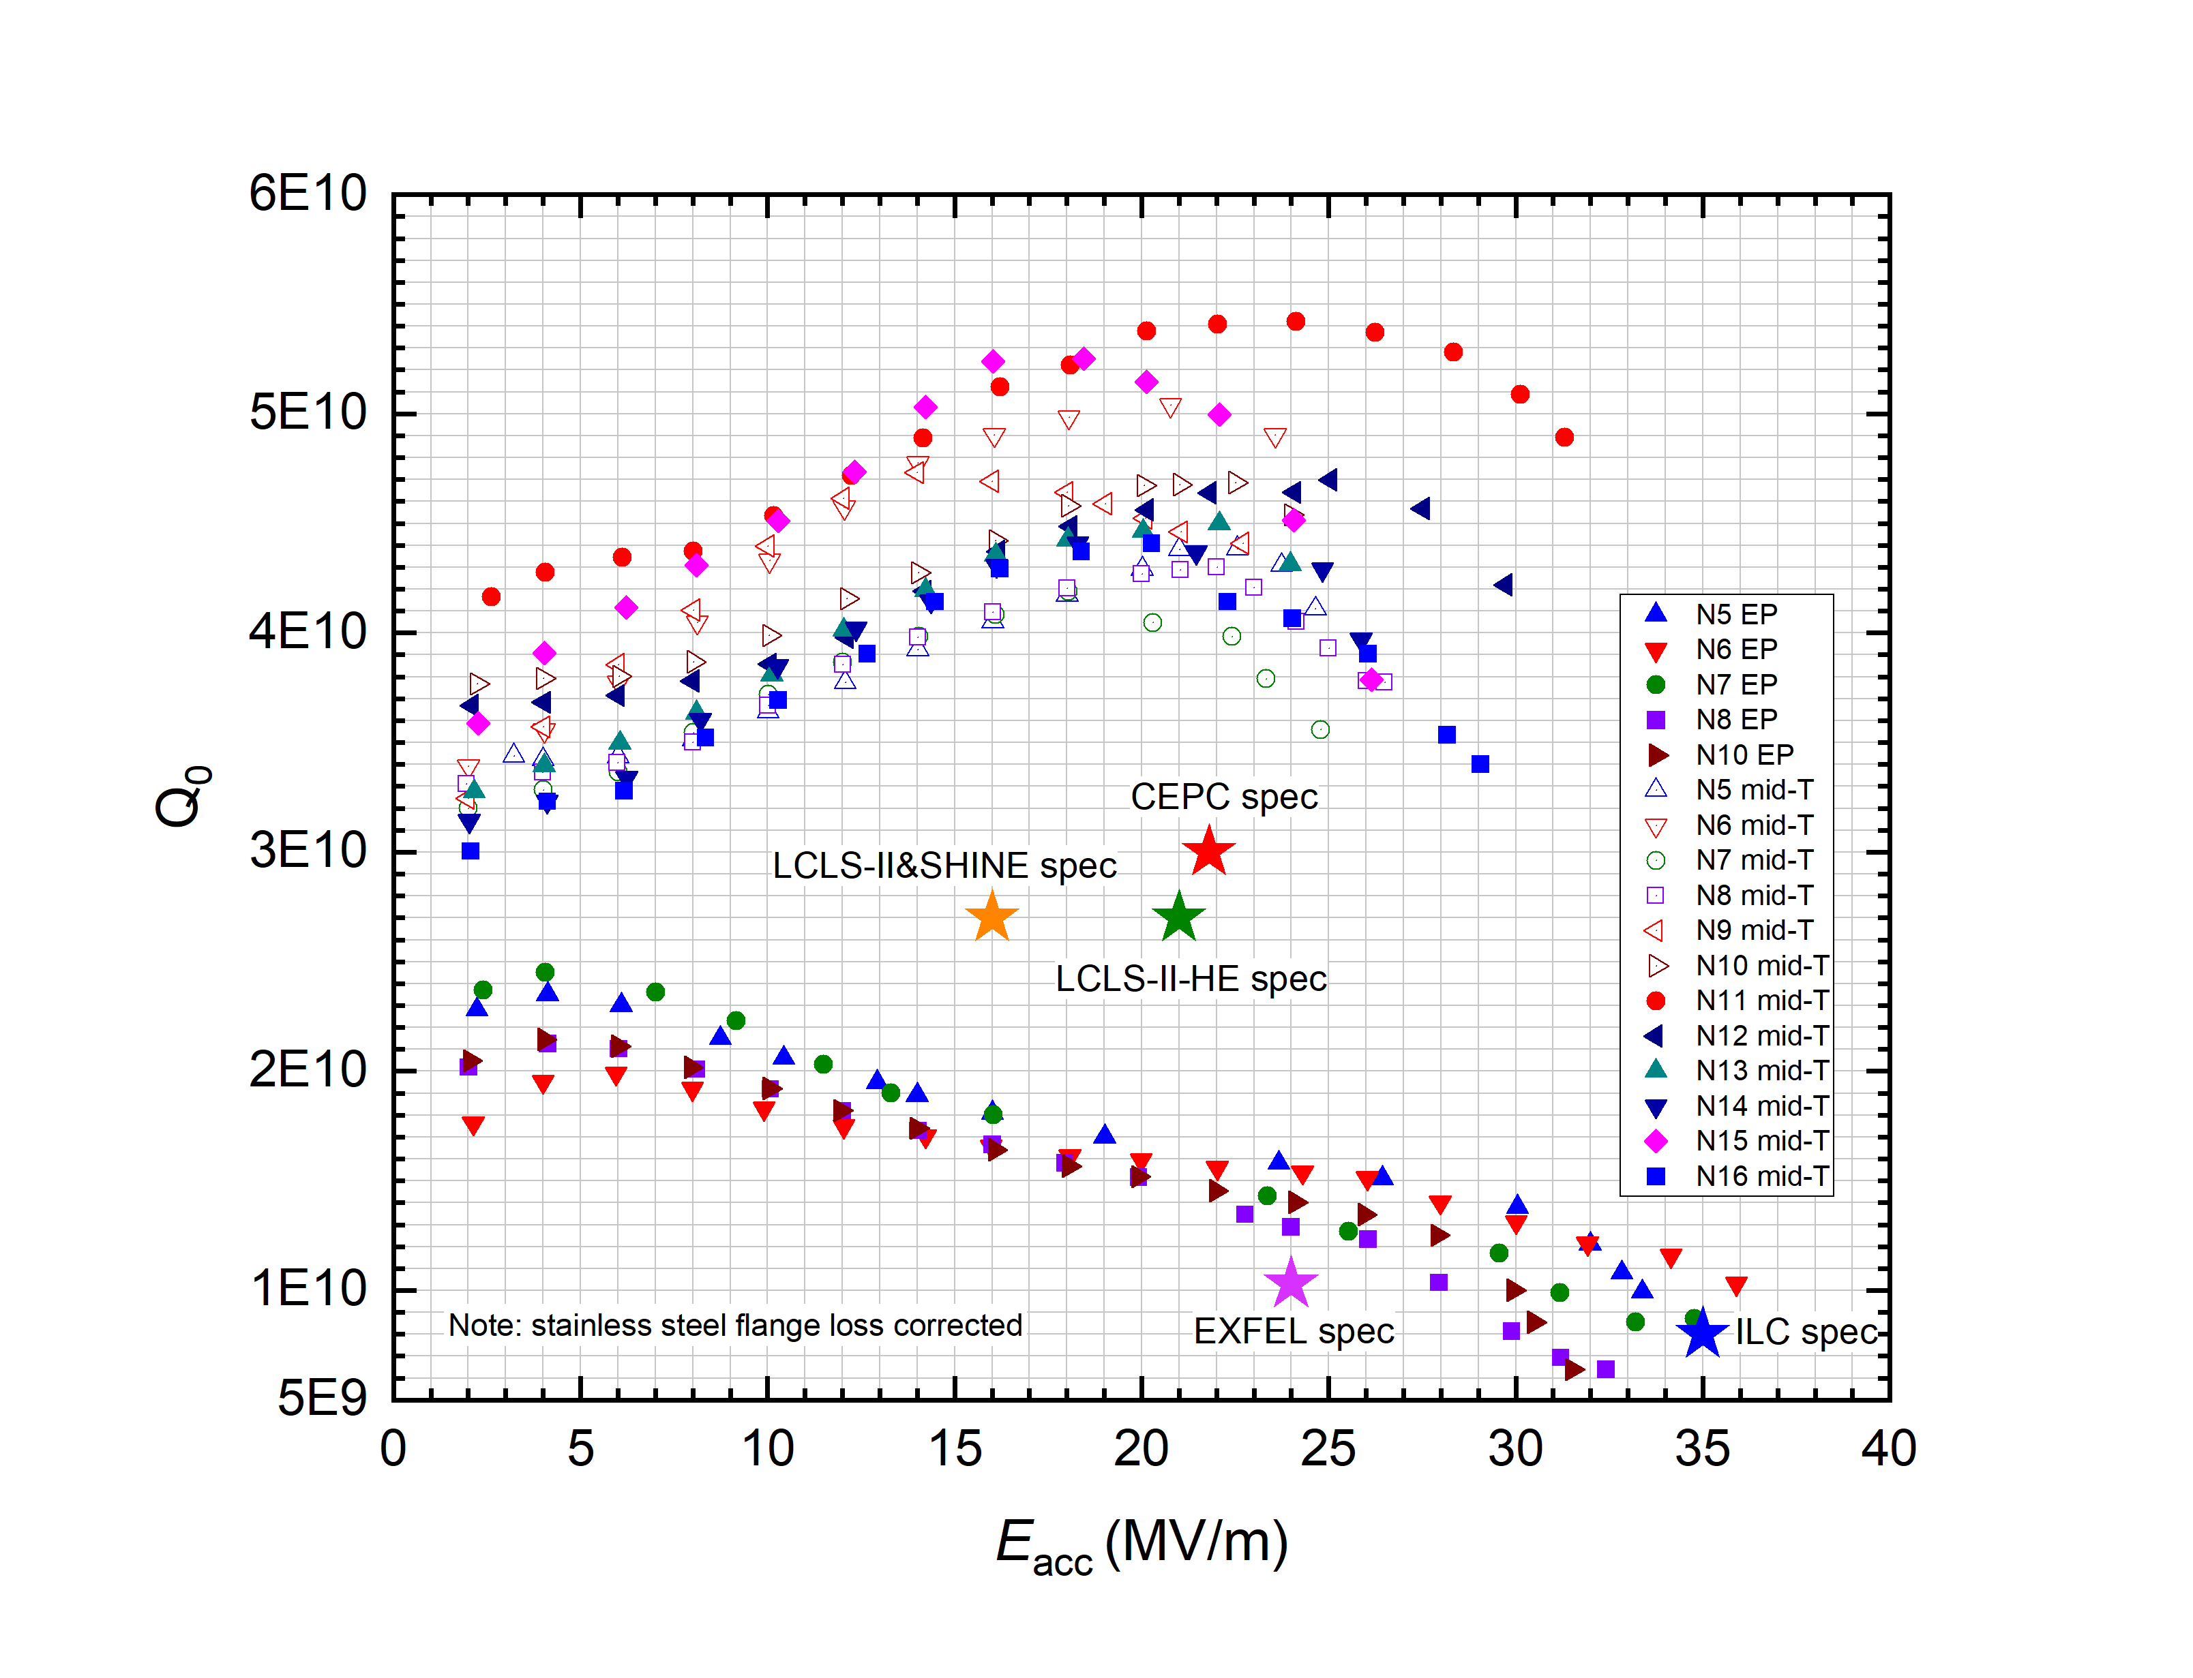
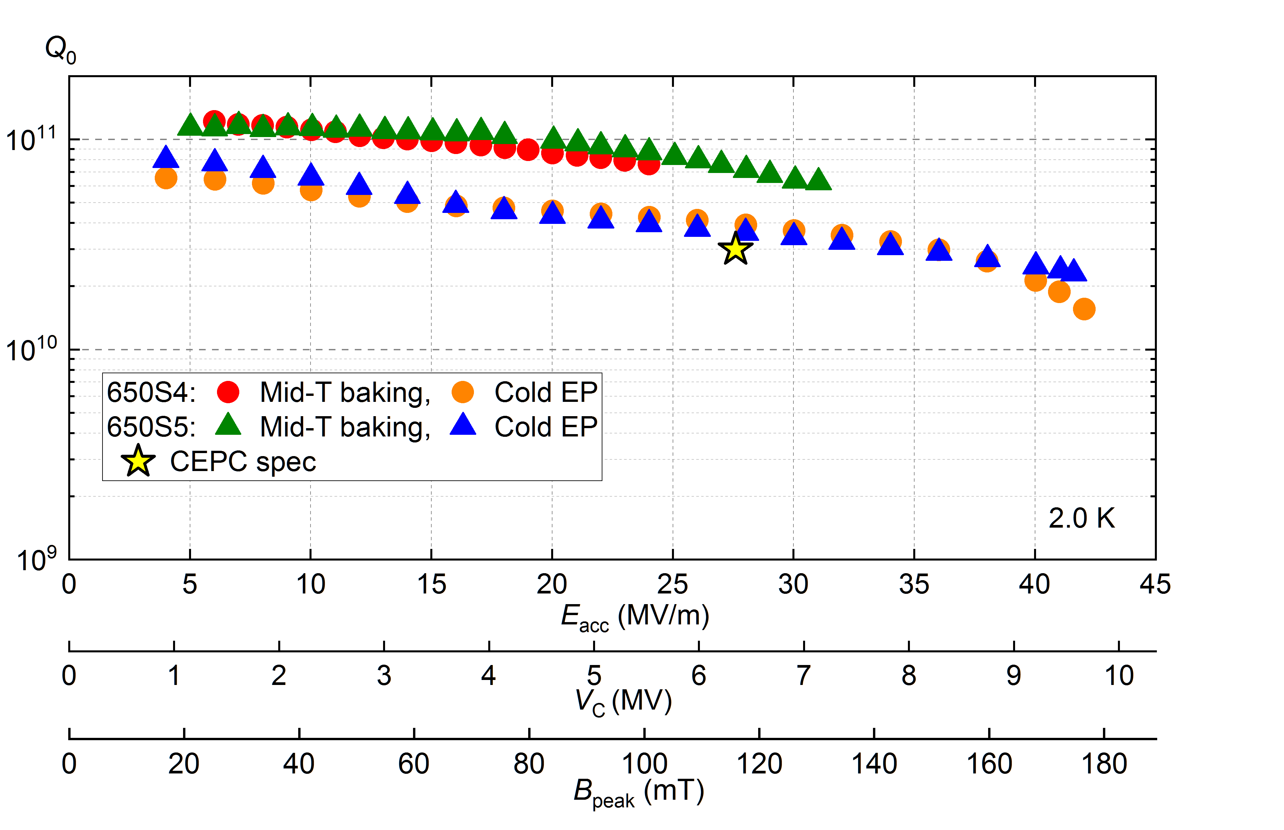
Mid-temp baking SRF cavity test results
1.3GHz 9-cell cavity VT
650 MHz 1-cell cavity VT
Mid-T baking applied to 1.3GHz/650MHz cavities, resulting in High Q SRF cavity that meets the CEPC specification;
Completed SRF modules for both 1.3GHz and 650MHz cavities were assembled;

Slide 18
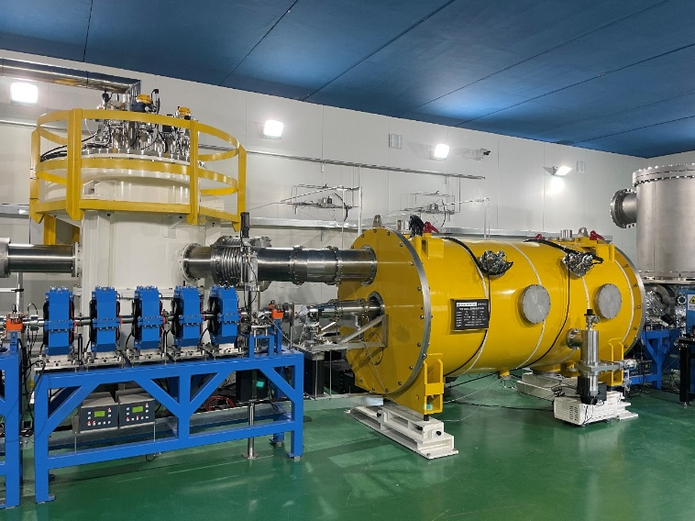
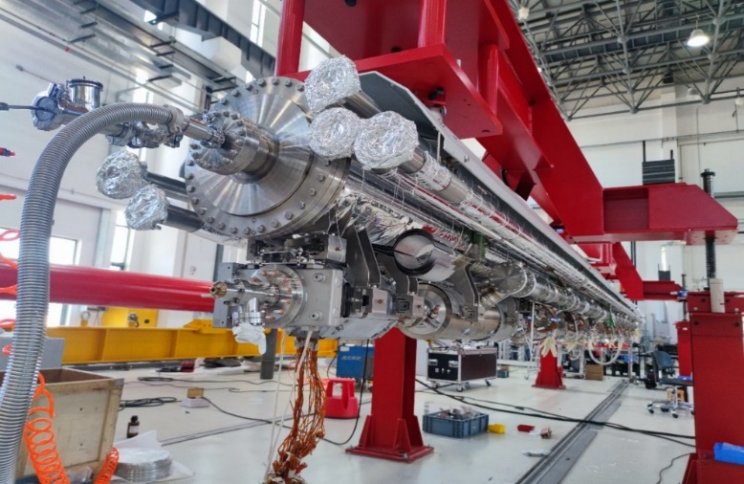
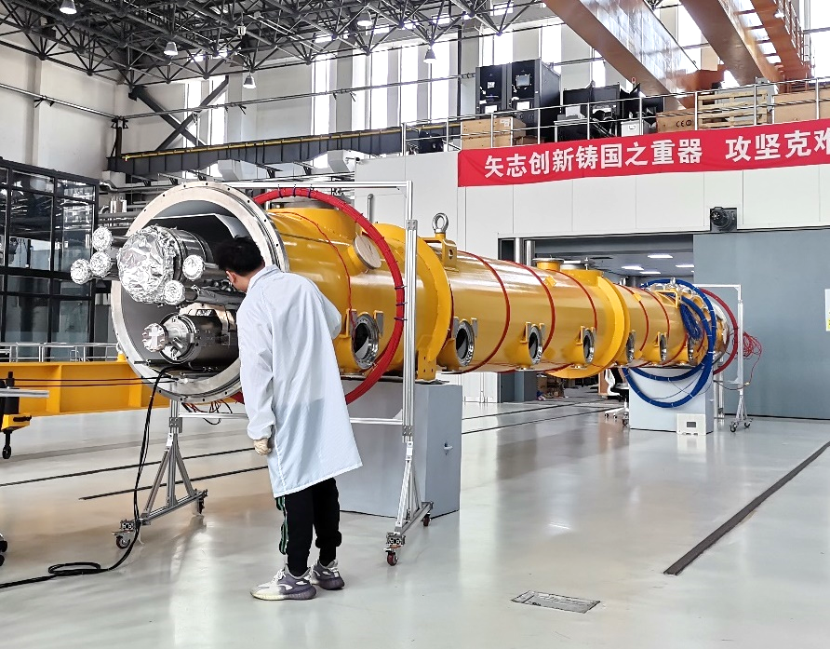
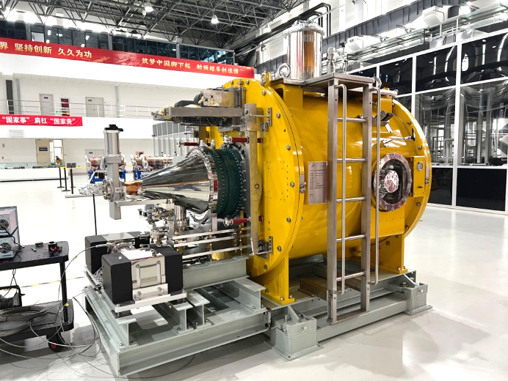
SRF cryo-module horizontal test results
650 MHz test cryomodules including cavities, couplers, HOM absorbers, tuners..., was built and tested OK
A full eight 1.3 GHz 9-cell cavities with input couplers, tuners, SC magnet, BPM, cryostat, module cart, feed/end-cap, volve-box … was built and tested OK
Parameters | Horizontal test results | CEPC Booster Higgs | LCLS-II, SHINE | LCLS-II-HE
Average Q₀ @ 21.8 MV/m | 3.6×10¹⁰ | 3.0×10¹⁰ @ 21.8 MV/m | 2.7×10¹⁰ @ 16 MV/m | 2.7×10¹⁰ @ 20.8 MV/m
Average CW E_{acc} (MV/m) | 23.1
650MHz 2-cell
1.3GHz 9-cell
1.3GHz 9-cell
166MHz QW

Slide 19
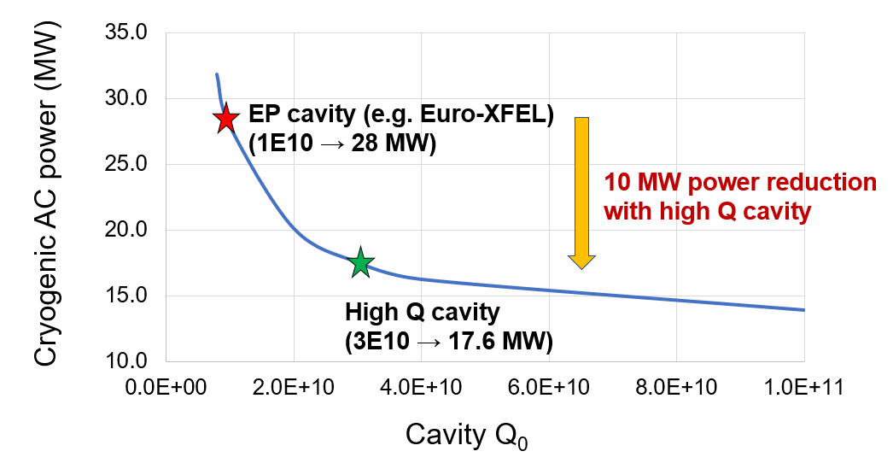
High Q SRF significance for a green machine
The SRF system, along with its cryogenic auxiliaries, is one of the major electricity consumers. High Q-factor SRF cryo-modules effectively reduce the heat load, resulting in lower energy consumption
The CEPC 1.3GHz SRF cavities adopt the mid-temp baking technology, which enhances the Q factor by 5 times compared to the EP technique.
Using the high-Q SRF in CEPC may reduce the operational power by 10MW, which could result in an electricity savings of approximately 60M kWh per year.
Power consumption with respect to the cavity Q-factor
CEPC 50MW Higgs operation

Slide 20
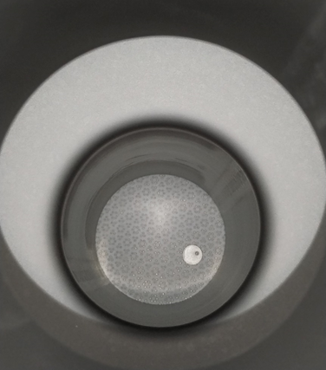
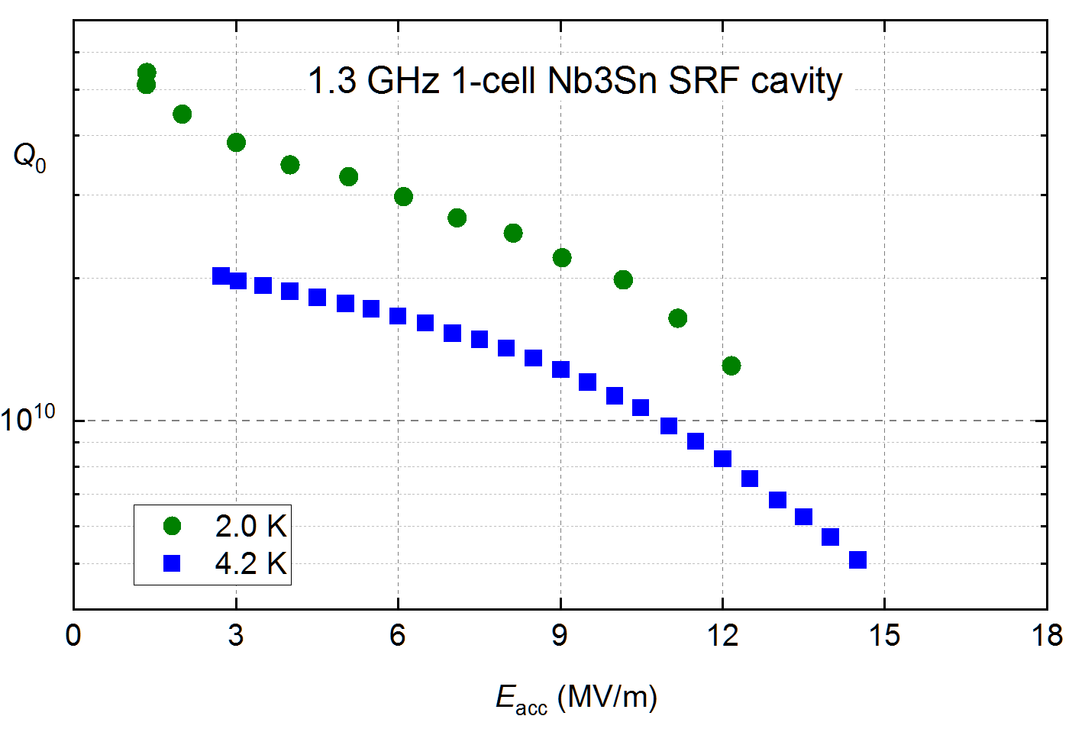
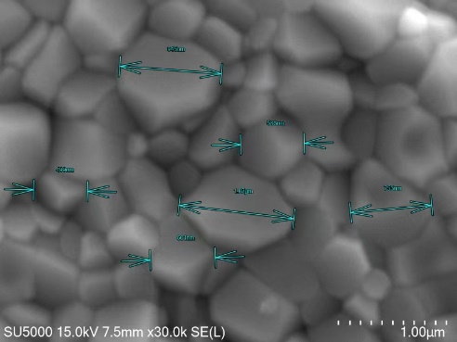
Vapor-diffused Nb3Sn Cavity for Industrial Application
Cryogenic power decrease with high Q SRF Nb₃Sn cavities
  ~ 20 MV/ m Nb₃Sn 4.2 K cryo efficiency similar to Nb at 2 K, lower than high Q Nb at 2 K (unless mitigate Q-slope Q₀ > 2.7E10 at higher gradient), assume Coefficient Of Performance (4.2 K / 2 K) = 3.6
  650 MHz Nb cavity at 4.2 K Q₀ ~ 2E9. If use cryocooler at 4.2 K for industry application (~ 10 MV/m), Nb₃Sn is the only choice. COP of cryocooler not efficient for large accelerators.
Results in June 2024

Slide 21
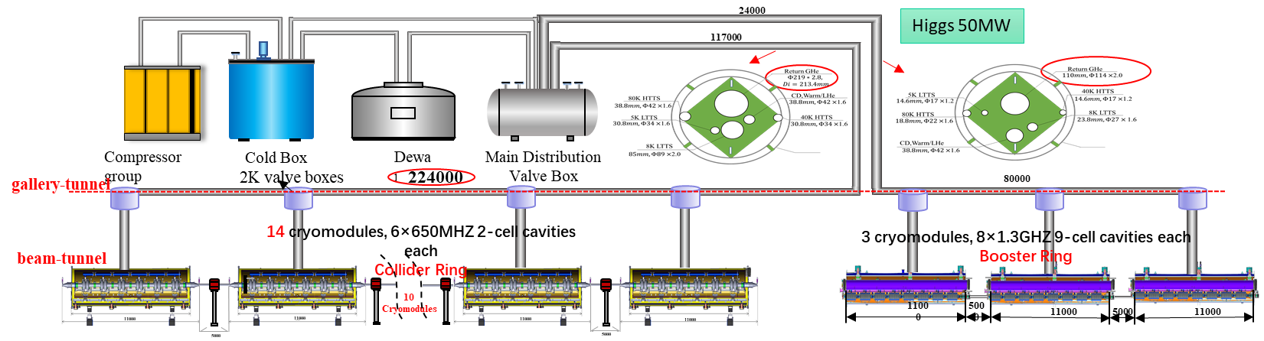
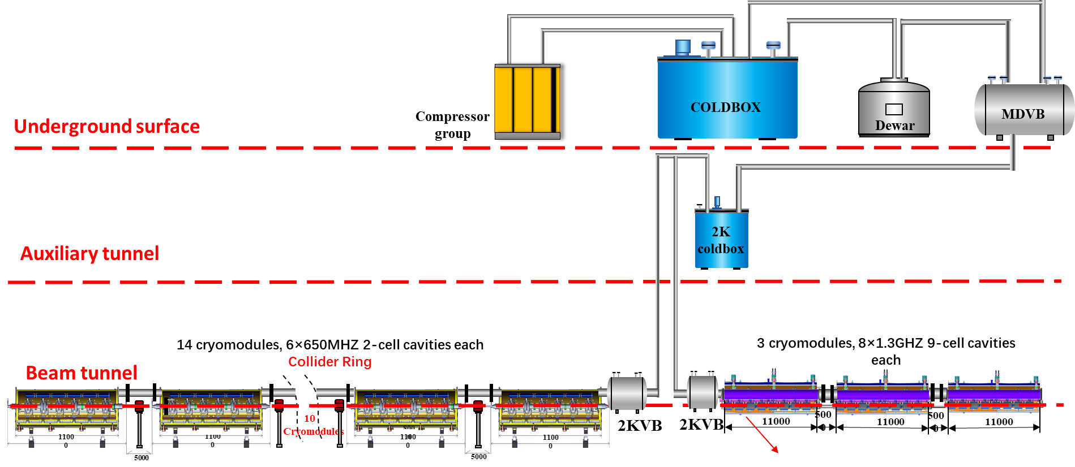
Optimization to the cryogenic system
CDR
TDR
Eliminate many small valve boxes;
Helium flow looks more easier;
Reduce the cryogenic cost;
Potential for saving electricity

Slide 22
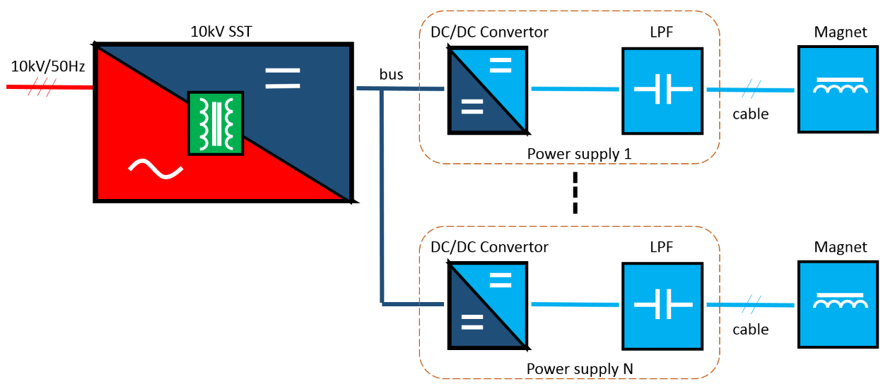
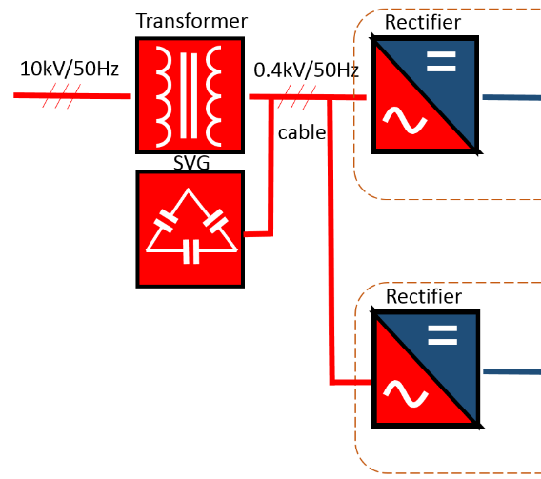
Novel concept of power supply based on 10kV SST
Numerous media/small magnet power supplies are needed: Quadrupole, Sextupole, corrector, … Lots of cables are needed, resulting in energy lost
SST can eliminate the need for 10kV transformer and SVG, which directly converts the AC power from 10kV to DC 200V – 1000V DC200V~1kV, with voltage tenability
Rectifier is not needed in the power supplies, reducing the cost, space occupation and power consumption

Slide 23
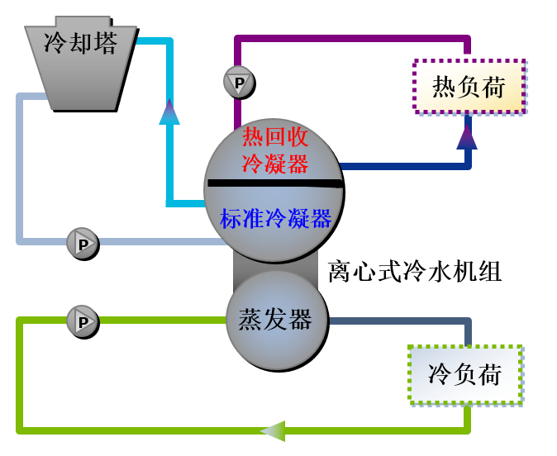
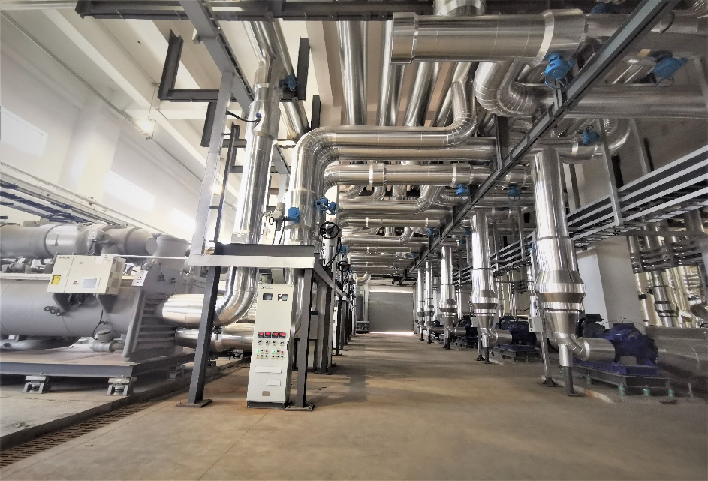
HEPS Waste Heat Sources Utilization
Installation the heat recovery condenser
A heat recovery chiller unit is used to recover waste heat.
HEPS installs four heat recovery chiller units: 2 * 5500 kW and 2 * 2800 kW. In the normal operation, maximum of about 13 MW waste heat can be recovered in the form of 42°C water
The heat load of HEPS is about 10.4 MW in winter and 0.4 MW in summer. When the system is running, the recovered heat source can fully replace municipal heat sources

Slide 24
Advanced heat-pump technology applications for CEPC
As the rapid development of photovoltaic and heat storage technology, AHP can be served the new possible scheme to recover the waste heat.

Slide 25
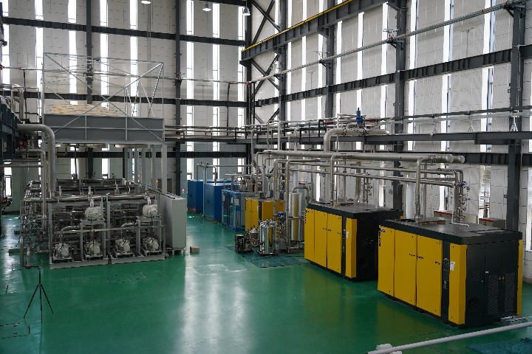
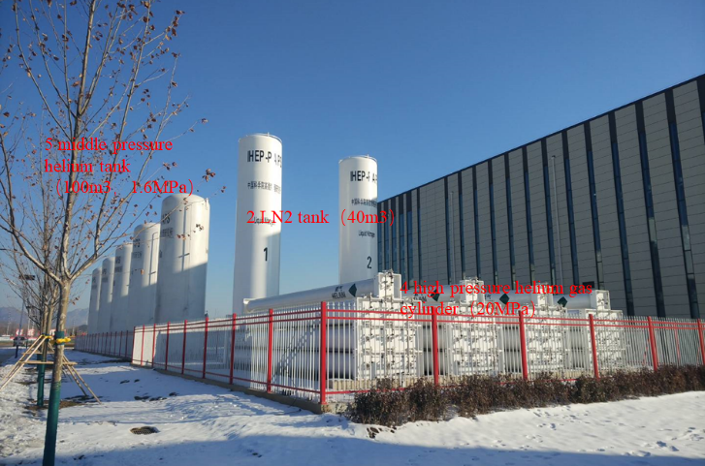
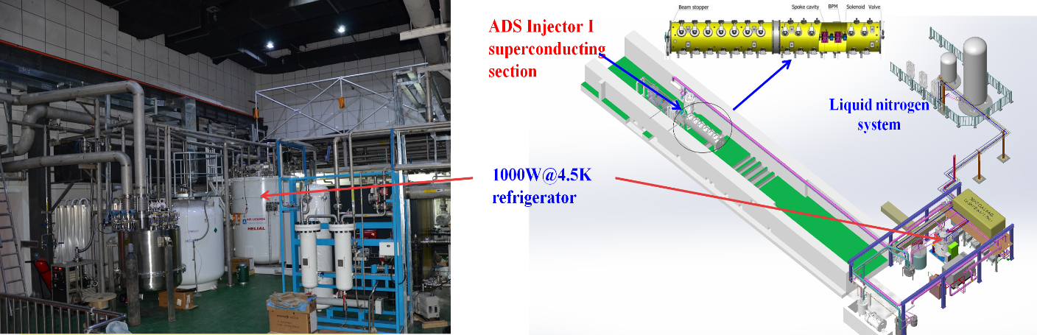
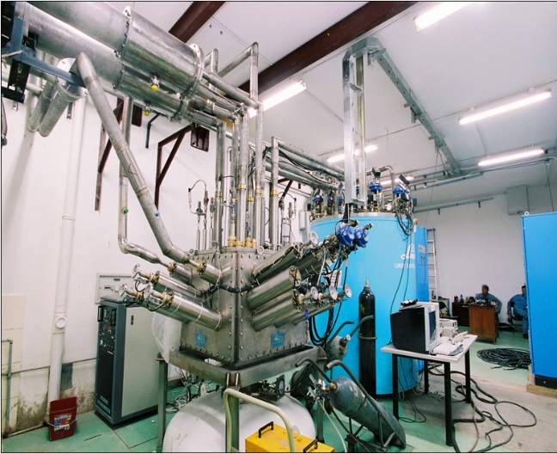
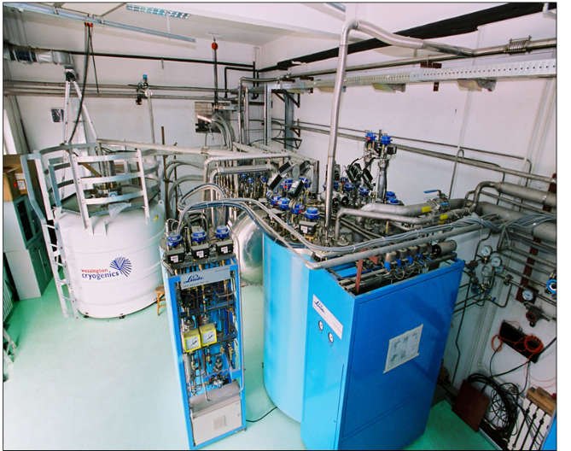

Full recovery/recycling of helium for sustainability operation
Helium gas is a non-renewable resource. Therefore, helium recycling is essential for sustainable operations.
IHEP has implemented a helium gas recovery system, specifically the liquid helium recovery and purification system of BEPCII(ADS)/PAPS, many years ago. This system has been operating stably.
Recovery capacity ≥210NM³/h; purification capacity ≥105NM³/h;
PAPS helium purification
and recycling system
ADS helium purification
and recycling system
BEPCII cryogenic system

Slide 26




Accumulate solar panels experience from HEPS
Photovoltaic (PV) power generation systems are installed on the roofs of HEPS building complex
Adopting 465Wp/550Wp monocrystalline silicon photovoltaic modules, the first phase has a total installed capacity of 9,950.92 kWp. The average annual power generation is expected to be 10.30766 million kWh, and the equivalent average annual utilization hours will be 1035.85h.
Phase I was connected to the grid on 2023.10.30.
The second phase is planned to lay PV modules on the ground inside the storage ring with an installed capacity of 7314.45kWp.
Implement flexible regulation between source-storage-load through the time and spatial complementarity of load power usage

Slide 27
Cold copper technology R&D
20 cell structure
40 cell structure

Slide 28



Cold copper technology
The maximum of copper cavity acceleration gradient is constrained by RF breakdown rate
X-band high power test results (CLIC cooperation group) shows that the cryogenic copper cavity possessing a higher gradient at the same RF breakdown rate
  Temperatures lower than 77K benefit copper cavity due to the anomalous skin effect
    The surface impedance and thermal expansion coefficient decrease
    The Yield strength and thermal conductivity increase

Slide 29






The 20 cells C-band cold copper parallel coupling structure design
RF design is accomplished, which includes cavity optimization, coupling design, power distribution design
The existing C-band test facility operates at a power level of 50 MW. However, the actual power delivered to the cavity is reduced due to two factors: the working power being set at 80% of the maximum value, and a 10% power loss through waveguide attenuation.
Take into account above issues, the expected acceleration gradient is expected to be 146MV/m
Parameters | Value
Frequency (MHz)@77K | 5712
Mode | Pi
Cell numbers | 20
Shunt impedance per meter(MΩ/m)@77K | 303
E₀/Es | 2.42
Q₀@77K | 31905
Gradient (MV/m)@36MW | 146
a=0.05*λ₀
Cavity optimization
Field distribution

Slide 30




Welding and leak hunting
Clean with purified water before welding
using a hydrogen furnace for welding
vacuum leak rate is 3.5*10⁻¹¹Torr*l/s

Slide 31







Cold test results through fine tuning
The frequence error of each cell frequency is confined within a range of ±15kHz through fine tuning
The flatness of the field distribution is better than 90%
Field distribution

Slide 32





Low temperature experimental results
In vacuum, and at the temperature of 77k, the frequency stays at 5711.902MHz and the standing wave ratio is 1.07. The measured Q₀ at the cryogenic state is 32116, which reduced to be 12355 in the room temperature
Following the iterative cooling and temperature recovery process, vacuum were measured
  The system is subjected to extreme vacuum for 48 hours. With a 70L ion pump in operation, the vacuum level at the pump port is 2.7E-8 mbar, and the ion pump current is Ip=35uA
数据采集
网络分析仪
陶瓷窗
真空泵
抽气波导
被测腔体
Retesting after returning to room temperature

Slide 33



The cryostat design and manufacture
The design and fabrication have been completed
The maximum heat load： 4.5kW（36MW*2.5uS*50Hz）
Assembly completed and waiting for testing on the test bench
Pre-assembly of the cavity prototype

Slide 34



The high-power test bench
The 50MW C-band test bench located in Dongguan campus of IHEP
Modulator and klystron is in place and has been preliminary testing
The installation of waveguides and system leak detection are nearly completed
Expected to conduct high power testing after the coming monthes
Waveguide layout design
High power test bench
waveguides

Slide 35



The 40 cells C-band cold copper parallel coupling structure design
Another 40 cells module was designed, which possesses big hole structure a=0.1*λ₀ , and will be located close to the gun
Due to the increase in beam aperture and coupling between cells, we adjusted the side cavity size and the Pi mode established in the structure
Important Output Parameters
Sr.# | Parameter | At Normal Temperature | At 77K temperature | Units
1. | Frequency | 5.6943 | 5.712 | GHz
2. | Q Value | 11753.31 | 32909.3 | ----
3. | Shunt Impedance per meter | 92.02 | 257.65 | M$Ω$/m
4. | Shunt Impedance | 2.42 | 6.8 | M$Ω$
5. | Es/Eo | 1.96 | 1.96 | -----
6. | R/Q | 399 | 399 | $$Ω$$
Hole Radius =1.83 mm
Hole Radius =1.83 mm
CST 3D Design

Slide 36





The 40 cells C-band cold copper parallel coupling structure design
The RF design is finished
The mechanical design is finished
Processing is underway at the manufacturer now

Slide 37
Summary
Prototypes have been developed and key technology breakthrough has been achieved, with many of them addressing green collider technologies
Power efficiency, energy recycling, and clean energy generation are addressed as comprehensive measures for sustainable operation
More endeavors are needed for a comprehensive life-cycle CO2 footprint assessment
R&D is ongoing for cold copper acceleration technology, with high-power tests planned for both 20-cell and 40-cell structures to demonstrate their performance.
Thank you for your attention

