Slide 1
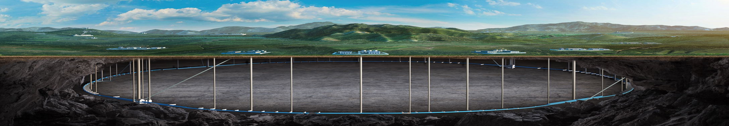

CEPC Alignment and Installation Studies in EDR
Wang xiaolong
On behalf of CEPC Alignment and Installation Group
HKUST IAS Program on Fundamental Physics
Jan. 13-17, 2025, Hongkong

Slide 2
Contents
  Introduction
  Alignment and installation study progress
  summary

Slide 3
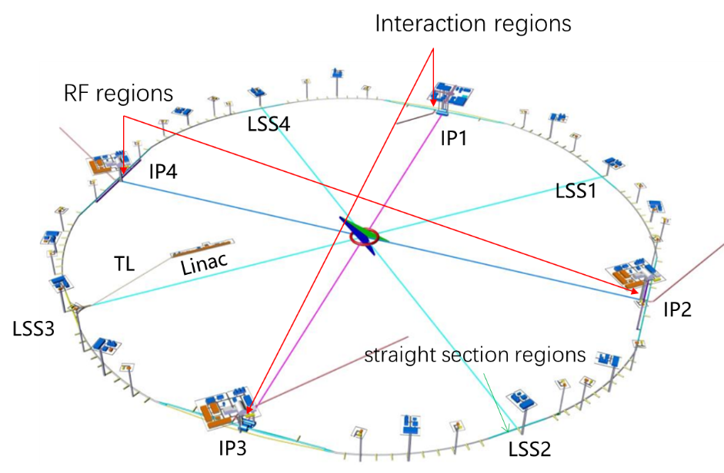
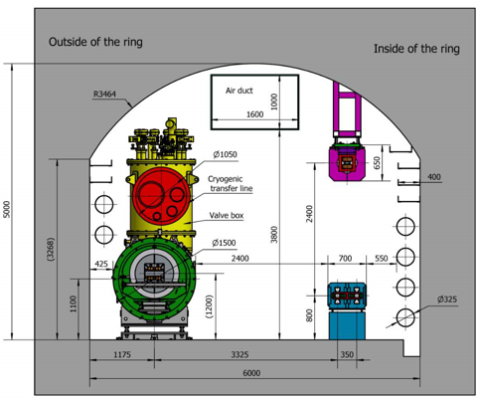
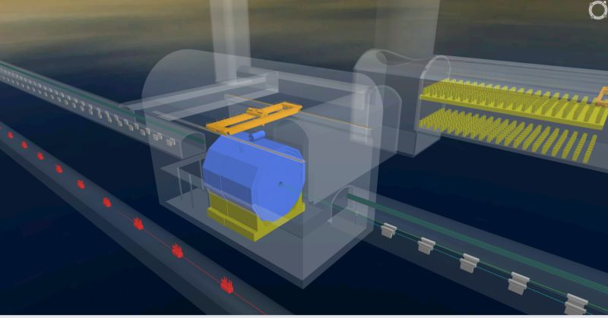

work scope
1、Introduction
Linac: 1.6km
TL:1.5km
Circumference of
ring tunnel:100km
  Collider：100km
  Booster：100km
Tunnel cross section：6X5m
booster
1.8m
4.2m
collider
Interaction
region
Ring
tunnel
SPPC
Tunnel cross section
3

Slide 4
1、Introduction
  Quantity of components
Component | Collider Ring | Booster | Linac, DR, TL | Total
Dipole | 13250（core） | 14866 | 135 | 28251
Quadrupole | 4148 | 3458 | 714 | 8320
Sextupole | 3176 | 100 | 72 | 3348
Corrector | 7088 | 1200 | 275 | 8563
BPM、PR、DCCT、kicker | 3544 | 2408 | 180 | 6132
Septum Magnet | 68 | 32 | 2 | 102
Kicker | 8 | 8 | 2 | 18
Cryomodule | 32 | 12 |  | 44
Electrostatic separator | 32 |  |  | 32
Collimator dump | 36 |  | 8 | 44
Superconducting Magnets | 4 |  |  | 4
Solenoid |  |  | 37 | 37
Accelerating structure |  |  | 577 | 577
Cavity |  |  | 4 | 4
Electron Source |  |  | 1 | 1
Positron Source |  |  | 1 | 1
Detector | 2 |  |  | 2
Total | 34396 | 23320 | 2008 | 56716
4

Slide 5
1、Introduction
  Alignment accuracy requirement
Relative position accuracy requirement of adjacent components（1 σ）
Component | Transversal/mm | Vertical /mm | Longitudinal/mm | Roll /mrad | Pitch /mrad | Yaw /mrad
Dipole | 0.1 | 0.1 | 0.2 | 0.1 | 0.2 | 0.2
Quadrupole | 0.1 | 0.1 | 0.2 | 0.1 | 0.2 | 0.2
Sextupole | 0.1 | 0.1 | 0.2 | 0.1 | 0.2 | 0.2
Corrector | 0.3 | 0.3 | 0.3 | 0.2 | 0.2 | 0.2
BPM | 0.2 | 0.2 | 0.3 | 0.2 | 0.2 | 0.2
Cryomodule | 0.5 | 0.5 | 1 | 0.3 | 0.3 | 0.3
Septum Magnet | 0.2 | 0.2 | 0.3 | 0.2 | 0.2 | 0.2
Kicker | 0.2 | 0.2 | 0.3 | 0.2 | 0.2 | 0.2
Electrostatic separator | 0.2 | 0.2 | 0.3 | 0.2 | 0.2 | 0.2
IR Quadrupole | 0.1 | 0.1 | - | 0.1 | 0.1 | 0.1
5

Slide 6
1、Introduction
  Key issues of CEPC alignment and installation
For large scale measurement, it must consider the irregular undulation of the geoid and needs to carry out geoid refinement.
To provide a positional reference frame for component alignment, it needs establish an accurate control network and control the error accumulation.
To improve alignment and installation efficiency, it is necessary to R&D high efficiency measurement method, and optimize the installation plan.
Challenge of MDI high accuracy alignment .

Slide 7
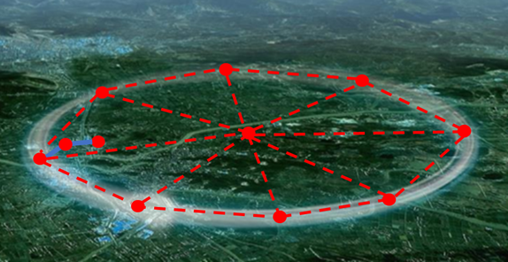
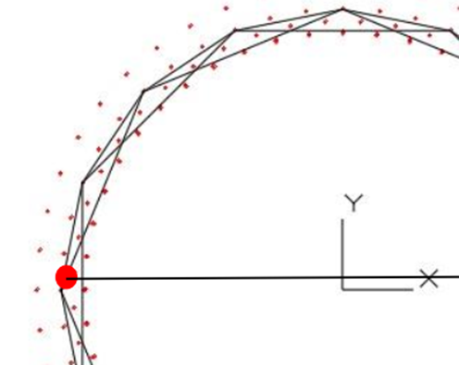
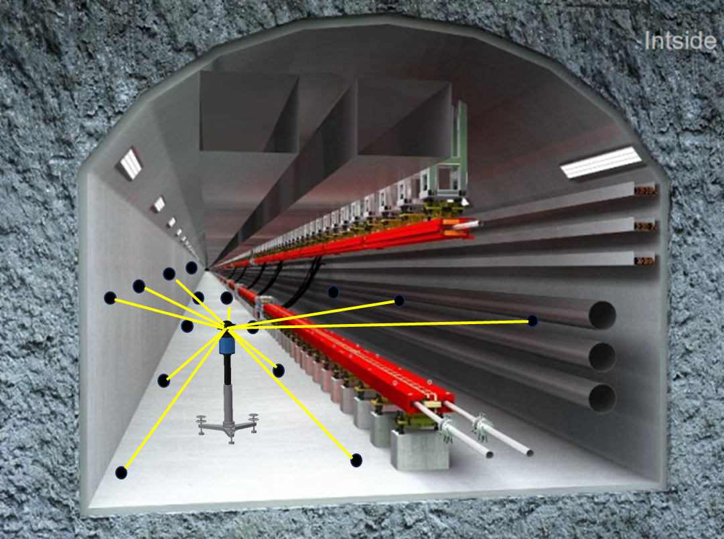
1、Introduction
  CEPC alignment technical route
    Build a high-precision quasi-geoid model as a global datum for the observations reduction;
    Establish a three-levels control network to provide a positional reference framework for component installation and control error accumulation;
Surface control network
Backbone control network
Tunnel control network
7

Slide 8
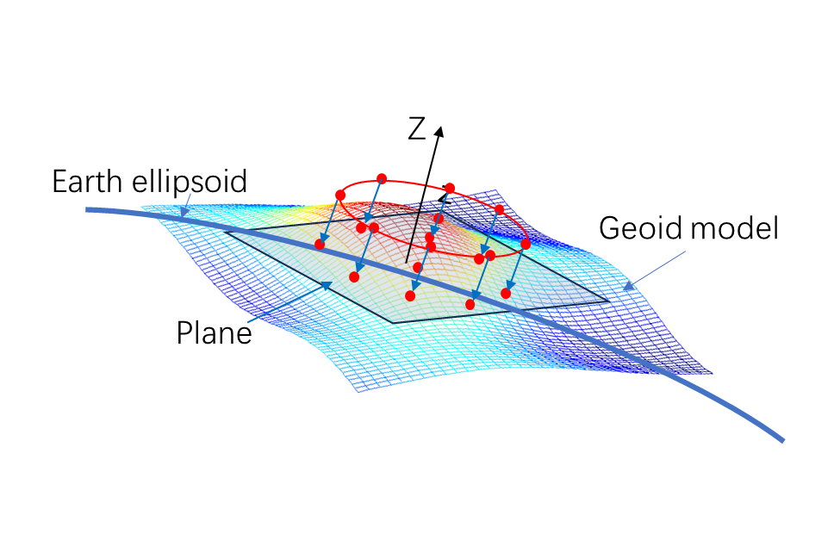
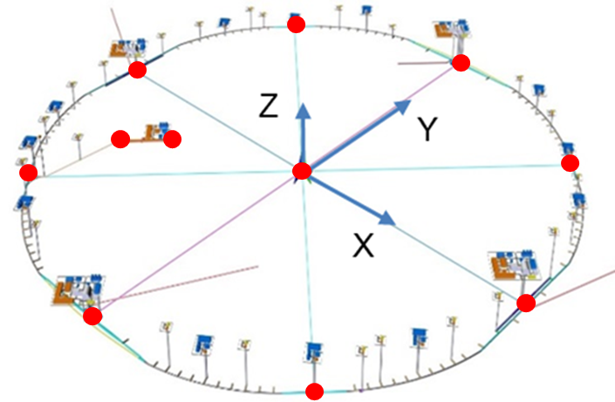
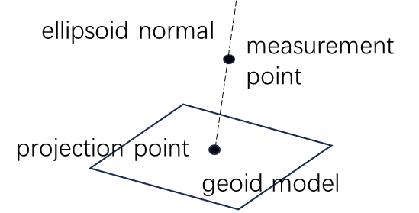
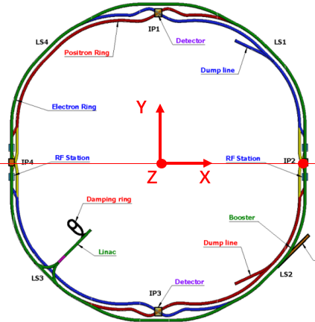
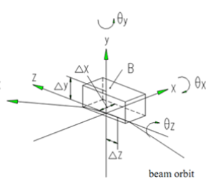
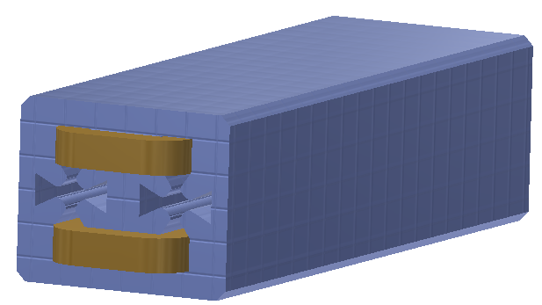
1、Introduction
    Use the surface network as a reference to establish CEPC coordinate system;
China Geodetic Coordinate System 2000 (CGCS2000)
    Through fiducialization and coordinate transformation to calculate the nominal coordinates of the component fiducials in CEPC coordinate system;
fiducialization
nominal coordinate calculation
fiducials
Z
Y
X
8

Slide 9
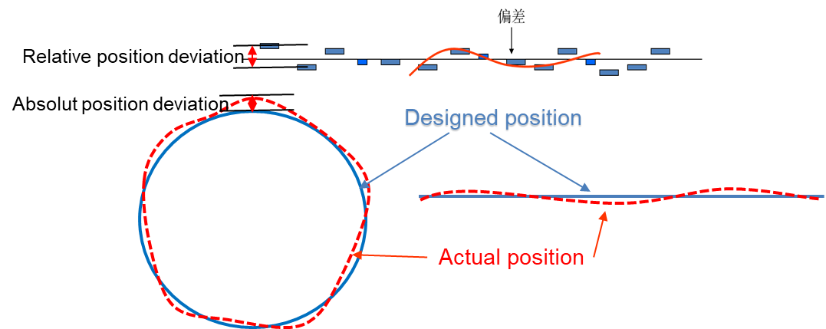
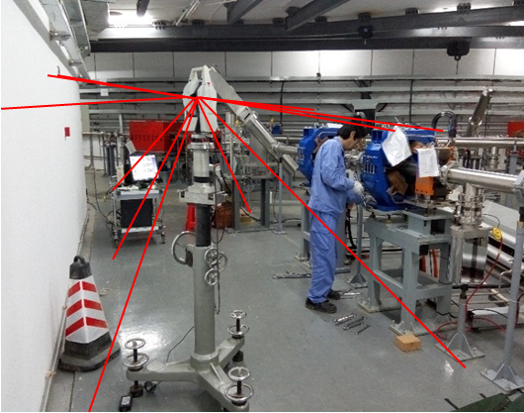
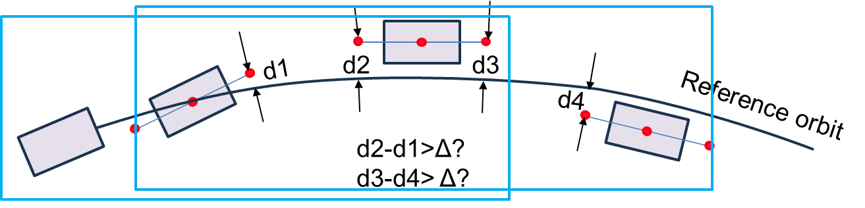
1、Introduction
    Use the control network as a positional reference, by measurement and adjustment to complete the component initial alignment.
    Through smooth alignment achieve the positional accuracy requirement.
Initial alignment
Smooth alignment
window
9

Slide 10
Alignment and installation study progress

Slide 11
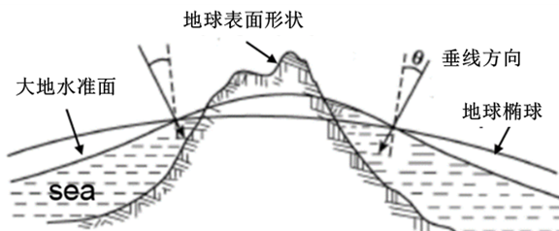
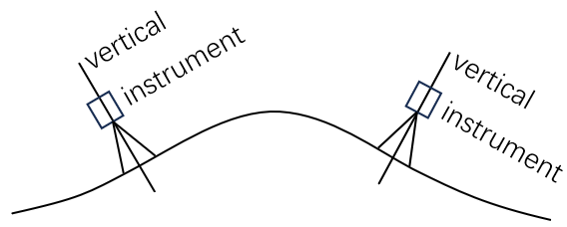
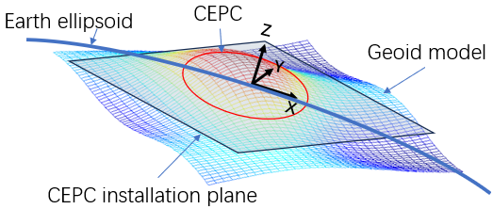
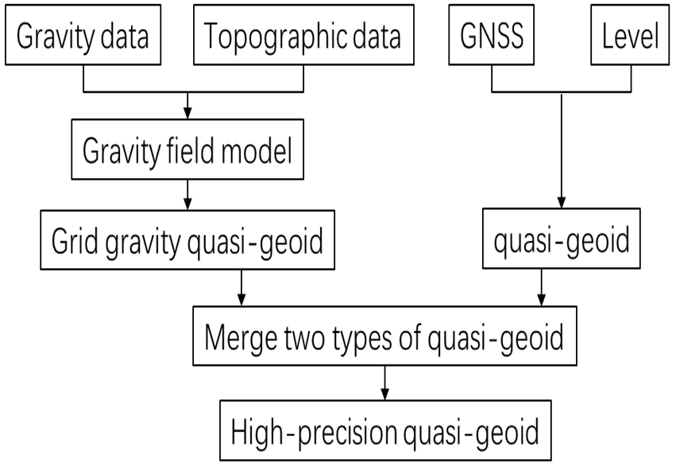
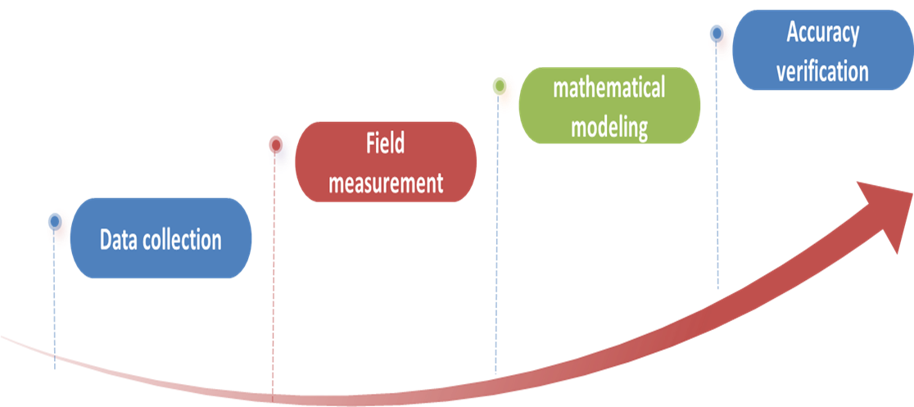
1、Geoid refinement
  Geoid refinement goal：To build a quasi-geoid model with 10mm elevation anomaly accuracy and 1″ vertical deflection accuracy.
  Geoid refinement plan

Slide 12
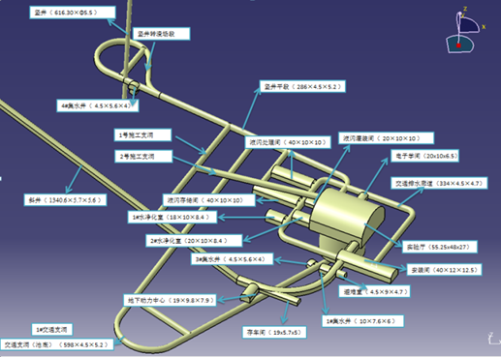
1、Geoid refinement
  The quasi-geoid model is based on the ground measurement data and needs to research how to transfer it to the tunnel elevation.
  We plan to select an underground space to conduct a modeling experiment.
Jiangmen Underground Neutrino Experiment
  The elevation from ground to the experimental hall is more than 550m. This big elevation is helpful to create an obvious difference between the ground model and underground model and is conductive to validate the modeling scheme.
(JUNO)

Slide 13
1、Geoid refinement
Technical route
    Use global gravity field model to determine the medium to long wavelength signals of the local gravity field;
    Use the ground and underground gravity data along with high resolution topographic data to determine the (very) shot wavelength signals of the local gravity field;
    Apply remove-restore method while considering the influence of the upper mass to study refined modeling technique for the underground gravity field.
    Utilize gravity and astronomical geodetic measuring data to verify the model accuracy.

Slide 14
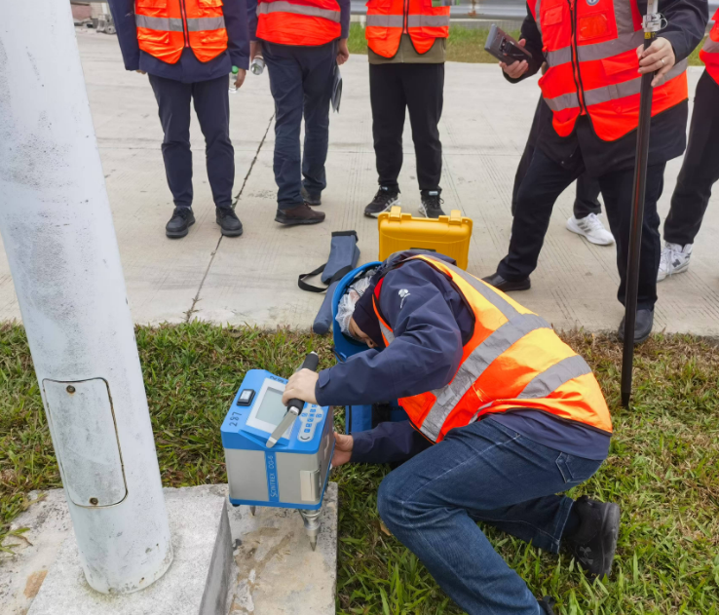
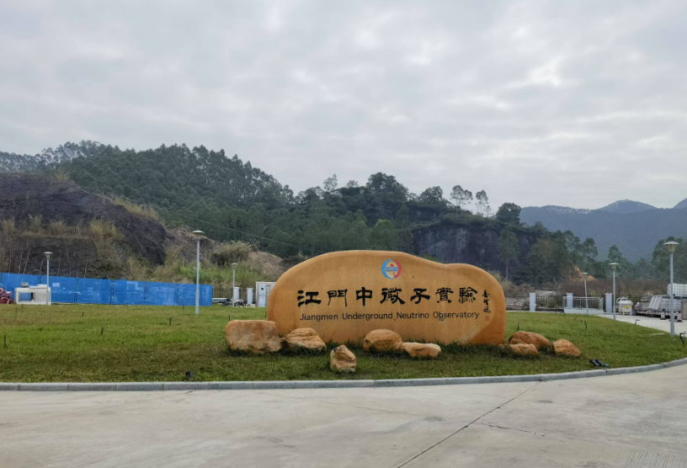
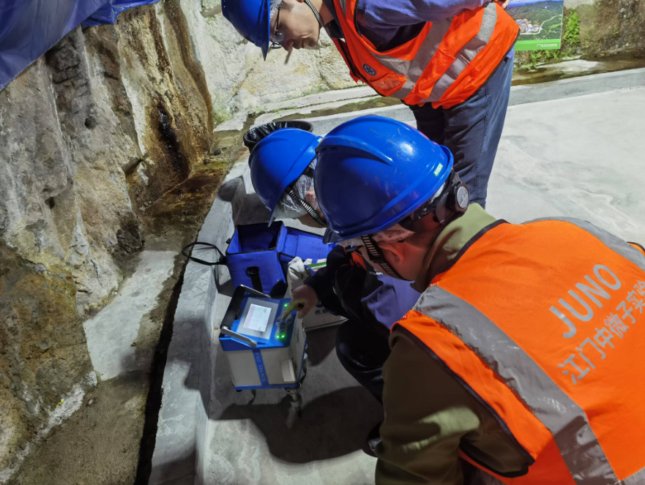
1、Geoid refinement
  Experimental site survey
    We have conducted an experimental site survey in Dec. 2024.
    The purpose includes: investigate the geological density; measure a few gravity data used for the geological density error correction; assess the feasibility of conducting gravity and astronomical geodetic measurement and prepare for make the experimental plan.

Slide 15
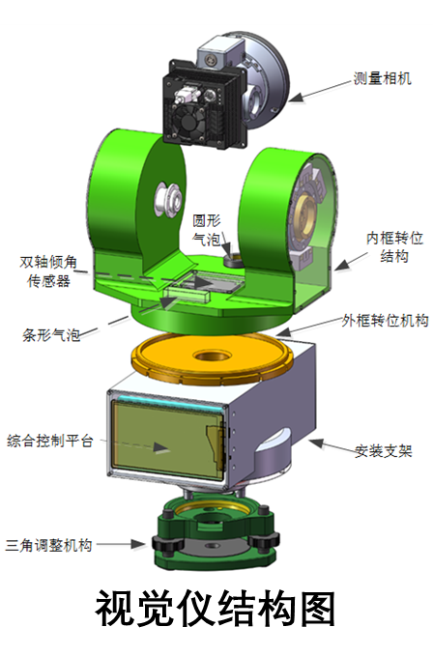
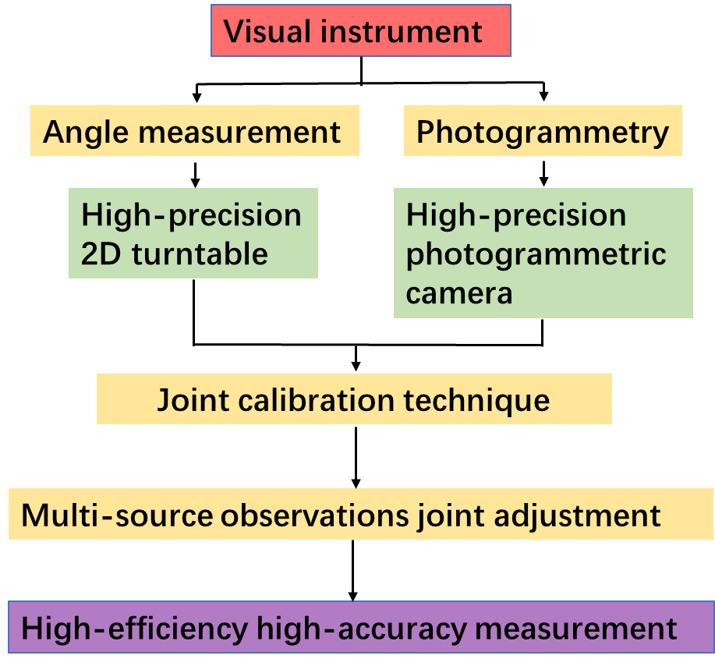
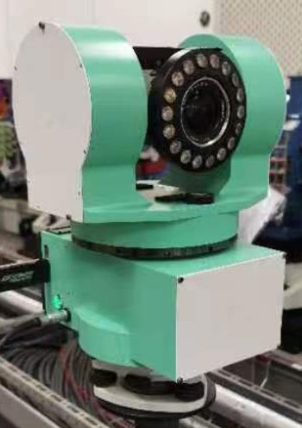
2、Visual instrument
  Visual instrument R&D
    The existing measurement plan (using laser tracker) will consume a lot of manpower and time. We hope to R&D more efficient measuring instruments.
camera
  Collaborating with PRODETEC company, a prototype has been developed.
turntable
Visual instrument structure
Technical route

Slide 16
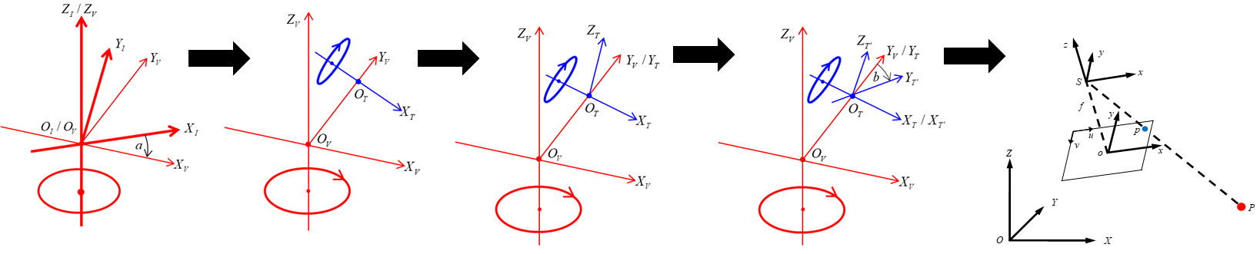
2、Visual instrument
  Visual instrument calibration progress
    In the assembly process, there will be non-orthogonality errors and offset errors among the turntable horizontal axis, vertical axis and the camera's optical axis. It is necessary to establish a mathematical model for the observations while taking these errors into account and calibrate these errors.
Instrument coordinate system
vertical axis coordinate system
horizontal axis static state coordinate system
horizontal axis dynamic state coordinate system
Camera coordinate system

Slide 17
2、Visual instrument
    Complete the observation error model establishment. (Wang tong)
Camera coordinate system
Instrument coordinate system
Matrix elements containing error parameters

Slide 18
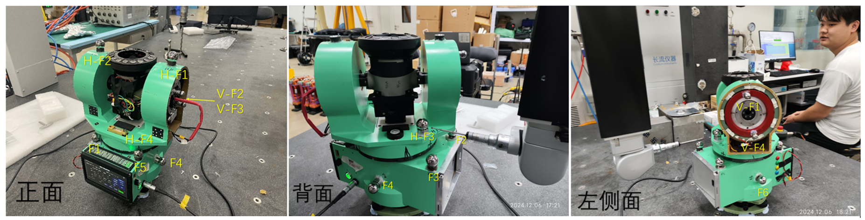
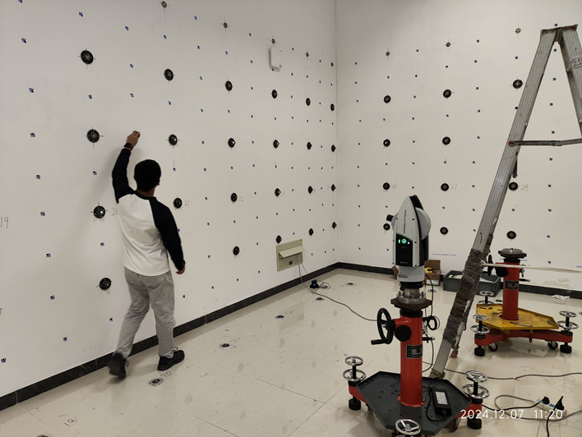
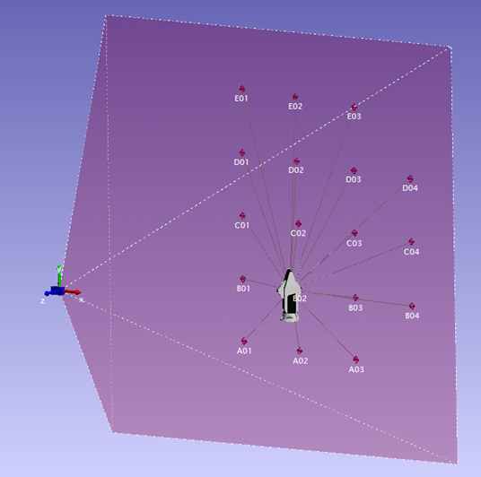
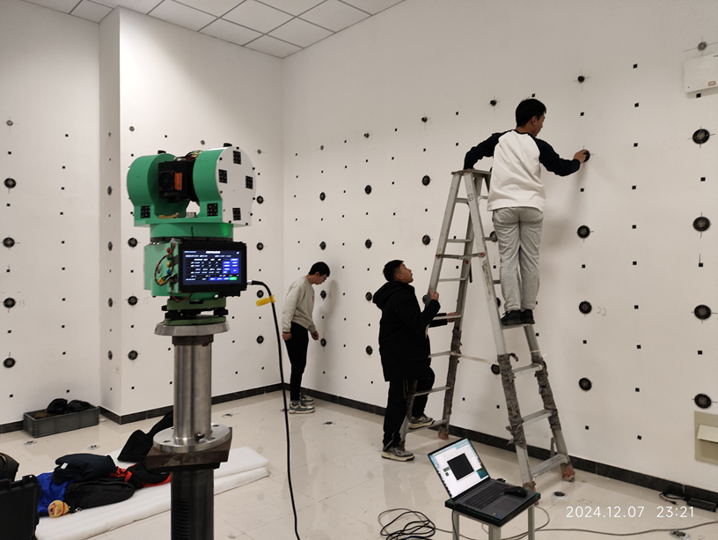
2、Visual instrument
    Performed the turntable axis system error calibration by a CMM .
    Conducted the camera and turntable axis system error calibration in a calibration room .

Slide 19
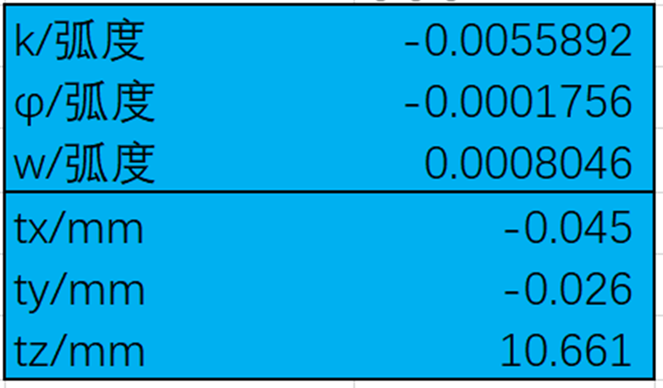
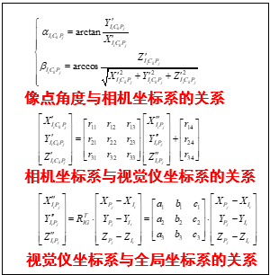
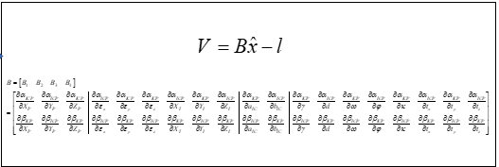
2、Visual instrument
    A preliminary calibration result has been obtained.
Camera pose parameters in the horizontal axis coordinate system
rad
The offset between the horizontal axis and the vertical axis is 0.0036mm, Orthogonality error is 36.4″
rad
rad
    Next we will try to use a total least-squares self-calibration model to conduct a more accurate calibration.

Slide 20
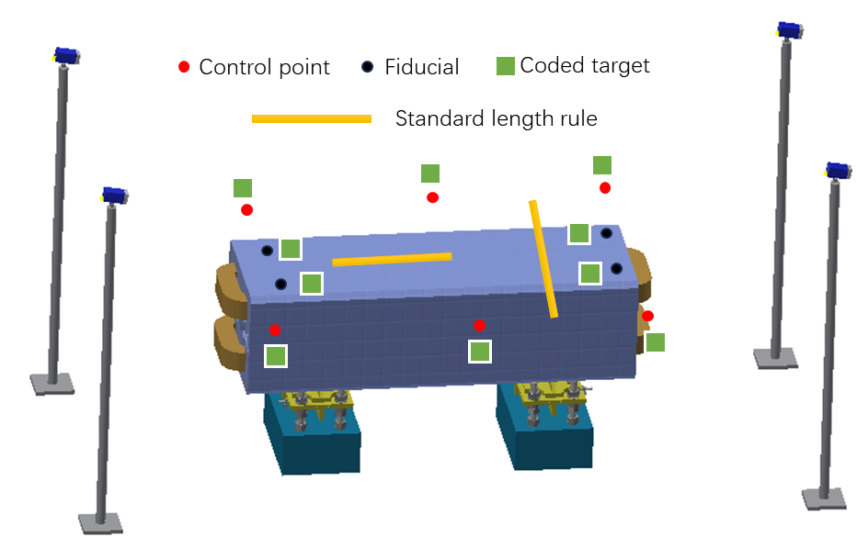
3、High-accuracy measurement field
  Automatic adjustment technology research
    CEPC has a large number of magnets need to be aligned. We hope to realize automatic adjustment to improve alignment efficiency.
    Alignment team collaborates with the mechanical team. Alignment team is responsible for developing a high-accuracy measurement field for measuring the component position, output the deviation between the actual and nominal position.
High-accuracy measurement field
  The main structure is a multi-camera photogrammetric system, combined with a synchronization control system, a software, some base part and auxiliary equipment.
camera
camera

Slide 21
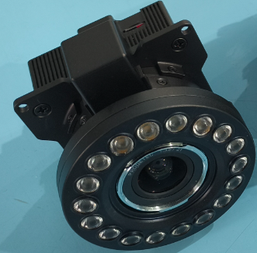
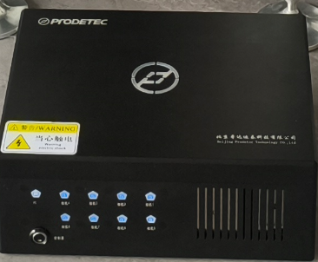
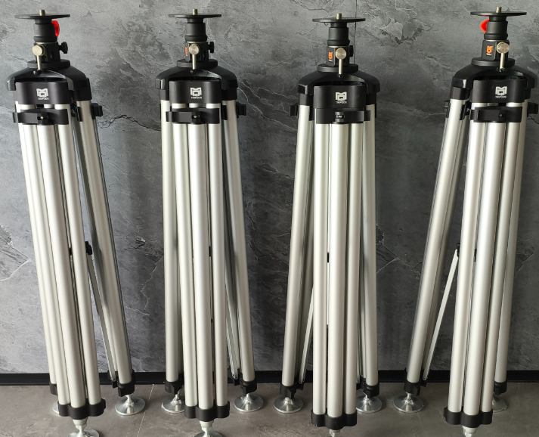
3、High-accuracy measurement field
  Development progress
    A camera was developed and the testing and calibration are ongoing.
Item | Parameter
Sensor | CMOS，NOIP1SE025KA-GDI25；
Resolution | 5120×5120；
Pixel size | 4.5μm×4.5μm；
Sensor size | 23.04mm×23.04mm；
Exposure | Exposure time1μs ～1s/frame rate；
Focus | 21mm；
Angle of view | 47.6°×47.6°；
Measuring range | 1~35m；
Precision | 3μm+3μm/m ；
    A multichannel synchronization controller was developed. Some auxiliary equipment were purchased

Slide 22
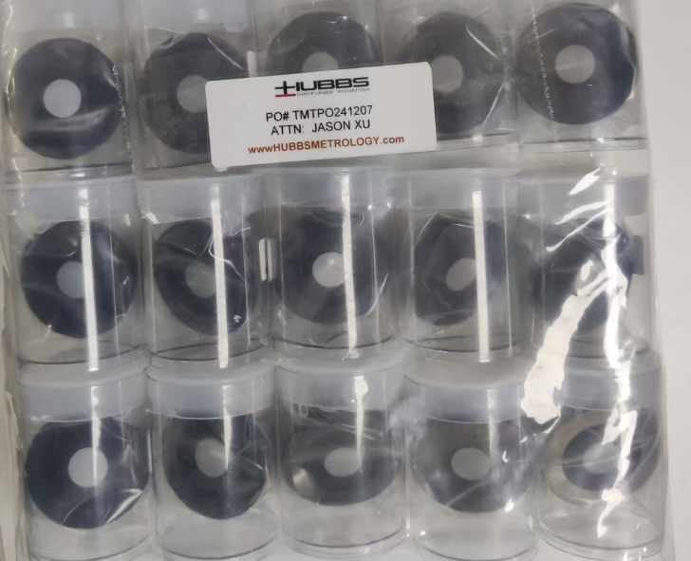
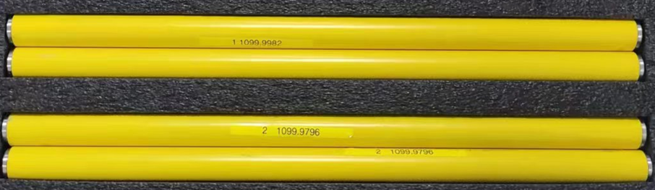
3、High-accuracy measurement field
    Procured a batch of benchmark scales and photogrammetric targets.
    A software which integrated photogrammetric function, communication function, data processing, display and output functions is under development, 70% programming work is completed.
    We plan to start the high-accuracy measurement field integration and testing work in March 2025.

Slide 23
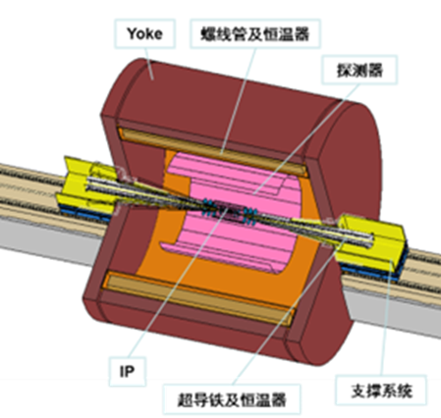
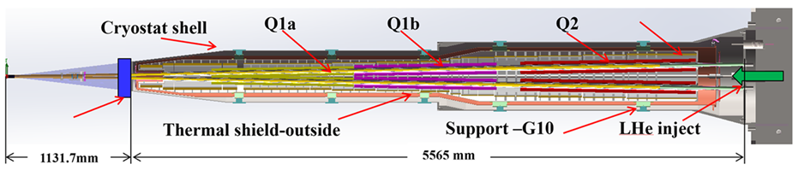
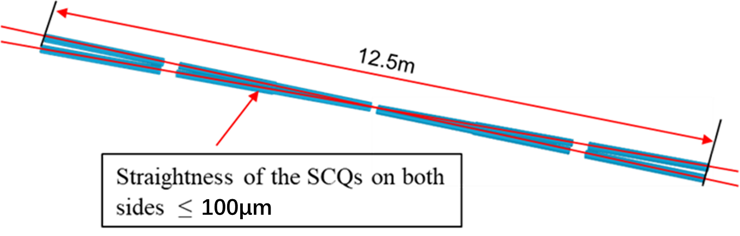
4、MDI alignment
  MDI alignment research
Alignment scheme
  LHe-tank module fiducialization
  Cryostat pre-alignment
  Cryostat installation alignment

Slide 24
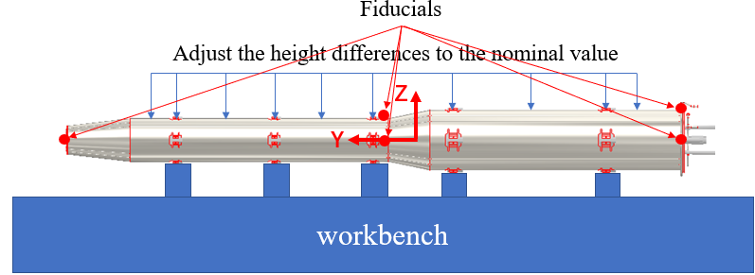
4、MDI alignment
  LHe-tank module fiducialization
    Q1a, Q1b, Q2, anti-solenoids are fixed together with the LHe-tank by a skeleton .
LHe-tank module
    The LHe-tank module should be placed on a workbench and properly supported to prevent deformation.
    Making a fiducialization of the module to record the coordinates of the fiducials in this state.

Slide 25
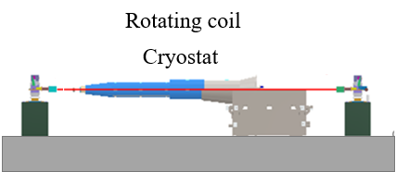
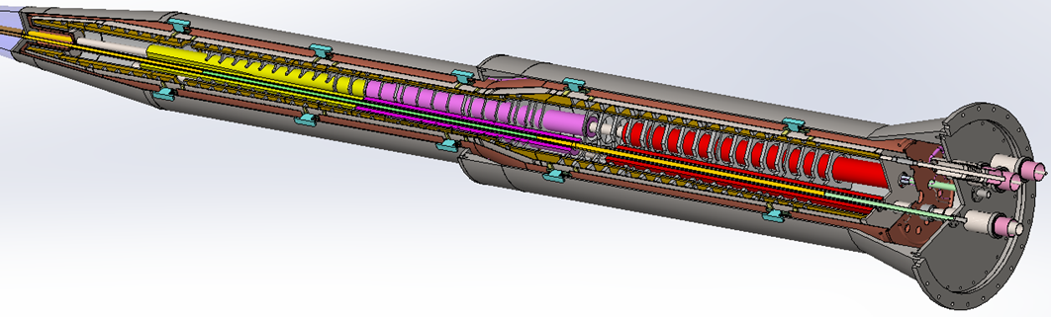
4、MDI alignment
  Cryostat pre-alignment
Support rods
    After the cryostat is installed on the support, due to the cantilever structure, the LHe-tank module will occur deformation. Restore the shape of the LHe-tank module according to the fiducialization coordinates of the fiducials by adjusting the support rods.
    After restore the shape of LHe-tank module, performing the SCQ magnetic center measurement by a rotating coil, and relate the magnetic center to the fiducials on the outside of the cryostat.

Slide 26
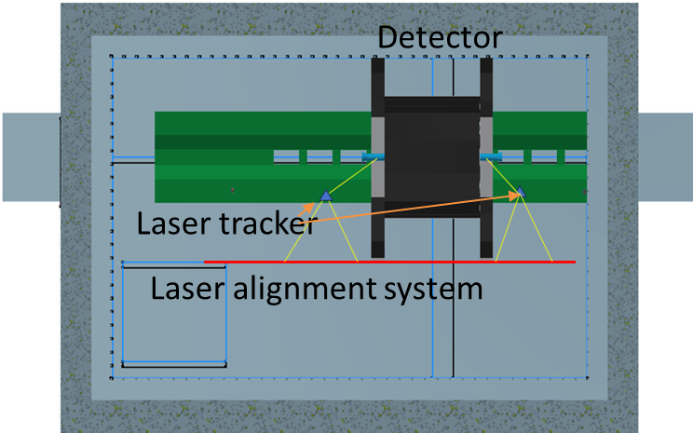
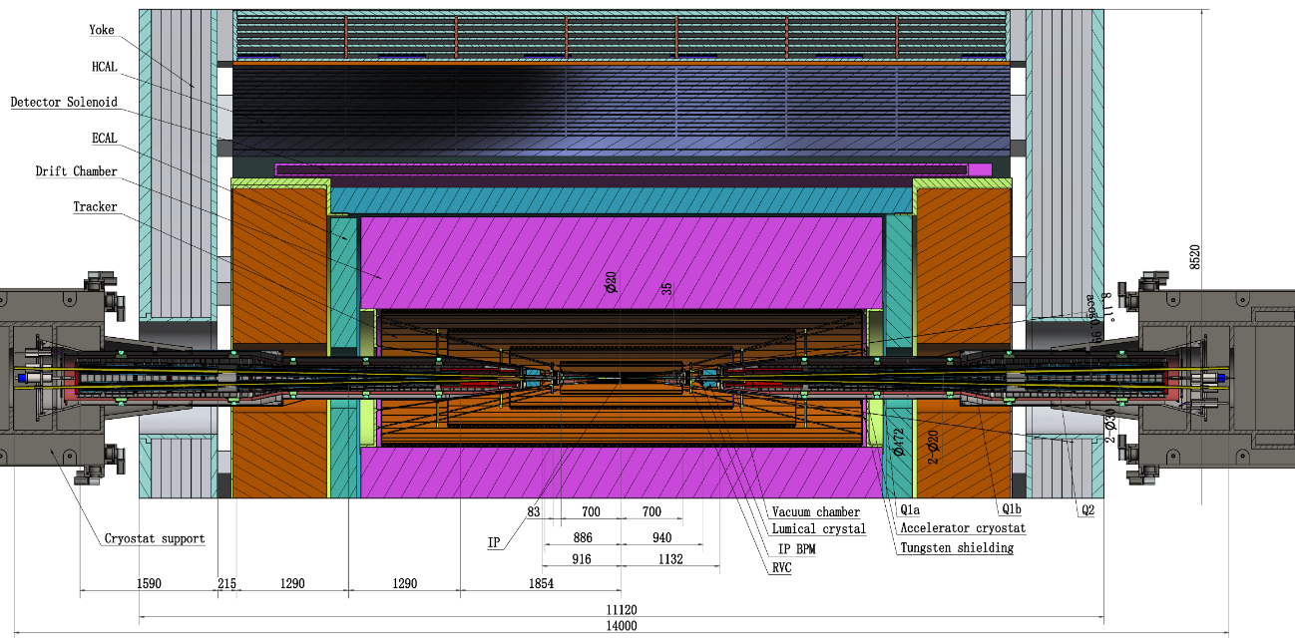
4、MDI alignment
  Cryostat installation alignment
    Install a laser alignment system beside the detector.
    Using this laser alignment system as a reference, adjust the rails and cryostats to the designed position in vertical and transversal.
    Push the cryostats into the detector along the rail.
  Difficulty
    How to measure the cryostat front end position?

Slide 27





4、MDI alignment
  Possible method
    Using a Multiline laser ranging system to monitor the cryostat front end position.
Multiline laser ranging system
Laser collimator
Laser collimator
High index glass target
High index glass target
Detector
Cryostat

Slide 28

4、MDI alignment
    Before the cryostat is pushed into the detector, use a laser tracker measure the coordinates of these points.
    Calculate the nominal coordinates of these glass targets when the cryostat is pushed to the design position in the detector.
    Thus, we can obtain the nominal distance values between these laser collimators and the nominal coordinates of their corresponding targets.

Slide 29

4、MDI alignment
    After the cryostat is pushed into the detector, jointly apply Multiline laser ranging system and laser trackers to measure its position and align it accurately.
Error analysis
Error item | Error /μm
SCQs installation in skeleton | 50
LHe-tank module fiducialization | 30
Cryostat module pre-alignment | 50
Laser alignment system | 20
Multiline & Laser tracker measurement | 30
Cryostat module adjustment | 30
Total | 90

Slide 30




5、 Installation shceme
  Surface test hall and warehouse layout
  Ring installation schedule: 3 years and 9 months

Slide 31
Summary
  As part of the geoid refinement study, we plan to conduct an underground modeling technique study. An experimental site has been selected, and field survey has been performed.
  To improve measurement efficiency, a visual instrument R&D is conducted. The calibration study is in progress.
  To achieve automated alignment adjustments of the magnets, a high-accuracy measurement field R&D is ongoing.
  A MDI alignment scheme is made.

Slide 32
Thank You !

