Slide 1



CEPC mechanics and mockups
Haijing Wang, on behalf of mechanics system staff
2025.1.13-2025.1.17
IAS Program on Fundamental Physics

Slide 2
Content
Introduction
EDR progress
  CEPC device layout
  Tunnel mockup
  High accuracy automatic adjusting and alignment system
  Vibration test
  Collimators
  MDI mechanics
Conclusion

Slide 3
Introduction
The mechanics system is aiming to carry out technically feasible engineering designs for the equipment it is responsible for during EDR stage.
Requirements on tunnel mockup
  Typical arc and RF section of 60 meters in total, with the TDR tunnel cross-section.
  Adjustment and alignment accuracy: mm-level
Requirements on high accuracy automatic adjusting and alignment system
  We take the dipole, quadrupole and sextupole supports in Collider as the first step in EDR stage.
Items | Requirements
Adjusting ranges | Y≥±30mm，X/Z≥20mm
Adjusting resolution | ≤10μm
Maximum load | ≥7ton
Calibration field range | 1m~20m
Sampling frequency | ≥15 Hz
Spatial single-point measurement error | ≤ 10μm+10μm/m

Slide 4
Introduction
The mechanics system is aiming to carry out technically feasible engineering designs for the equipment it is responsible for during EDR stage.
Requirements on vibration test
  Test the ground vibration with geological exploration
  Evaluate the vibration performance of the magnet-support assembly when operating
  Determine the support method of the Booster elements with geological exploration
Requirements on collimators
  Follow the accelerator physics stuff, design the collimator structure of the movable and unmovable collimators
  Safe jaw material for MPS

Slide 5
Introduction
The MDI group is aiming to carry out a technically feasible engineering design in EDR stage.
Main engineering requirements
Items | Requirements
MDI layout | The layout should fulfill the physics and technical requirement with all the devices included. A detailed installation and alignment schedule should be made.
SC magnets | Position accuracy: ≤100 μm Vibration as small as possible
RVC | A safe and reliable structure within the detective angle of acos 0.99. RF shielded. Leak rate: ≤2.7 ×10^{–11} Pa·m³/s
Relative position accuracy requirement of adjacent components（1 σ） From Xiaolong Wang
Component | Transversal/mm | Vertical/mm | Longitudinal/mm | Roll/mrad | Pitch/mrad | Yaw/mrad
IR Quadrupole | 0.1 | 0.1 | --- | 0.1 | 0.2 | 0.2

Slide 6
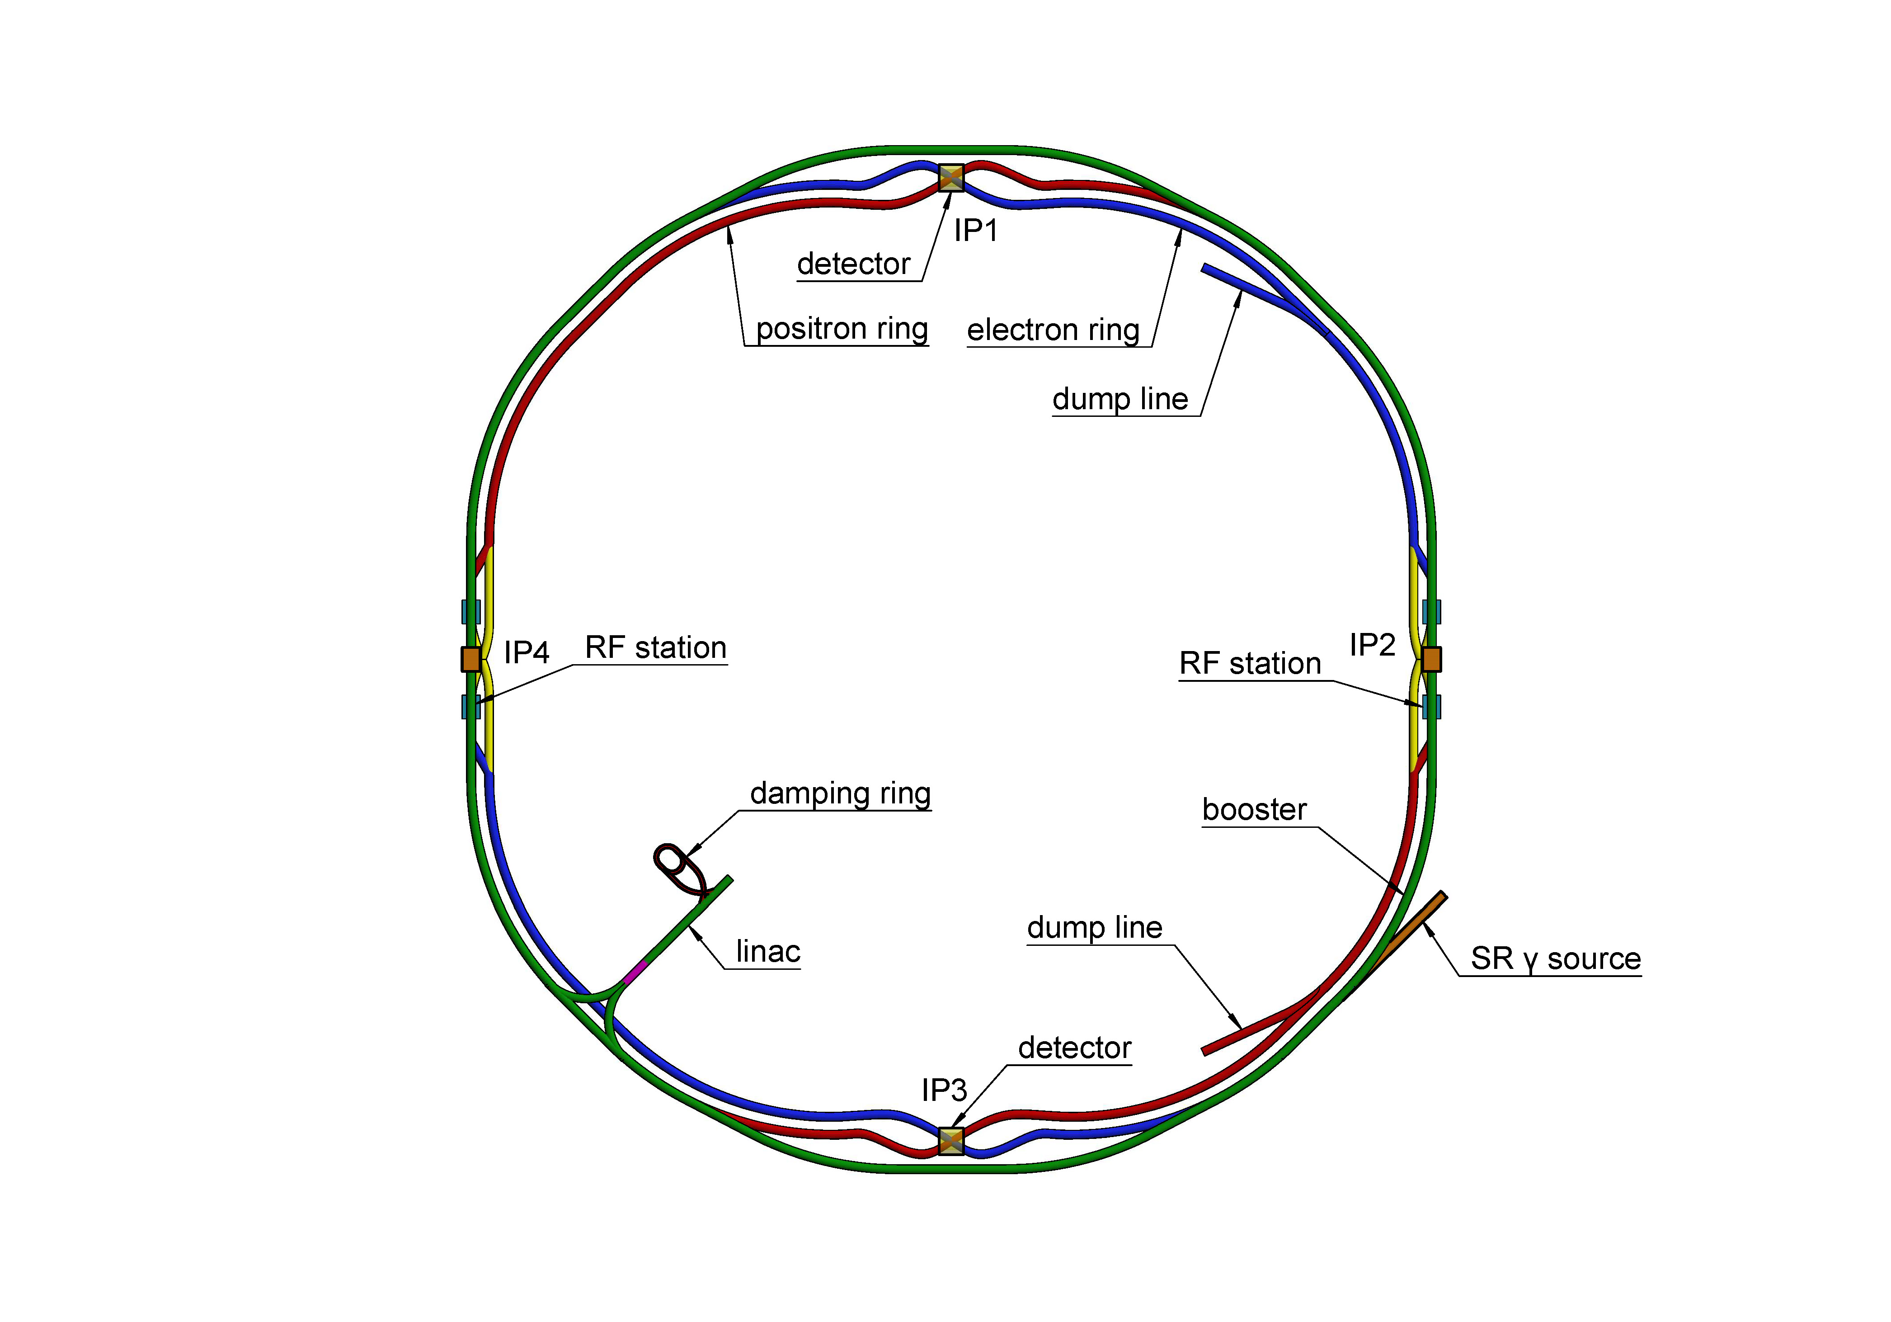
EDR progress-CEPC device layout
The layout is the basis for the engineering design of each equipment.
The constraints for layout design
  Quadrupole locations are fixed according to TDR lattice.
  The pumping spacing is less than 12.5 meter to fulfill the vacuum requirements for different operating modes.
  BPMs are next to quadrupoles.
  Dipoles as long as possible to decrease SR power.
  Reasonable space for installation and replacement.
We begin here

Slide 7
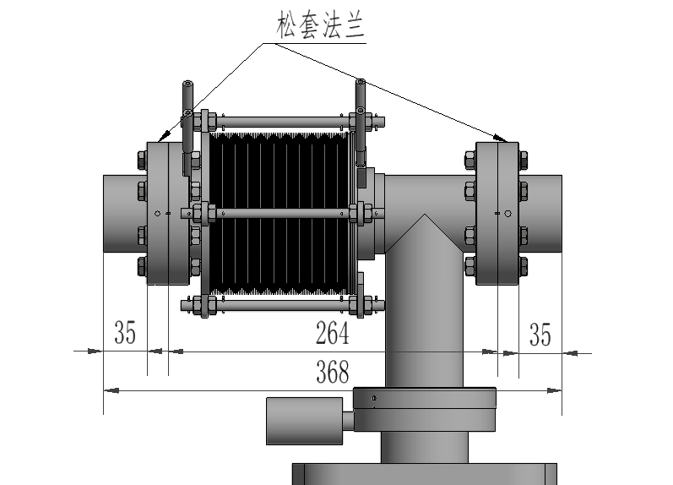
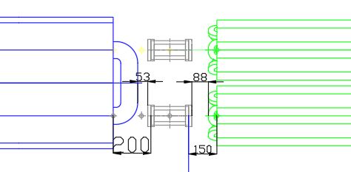
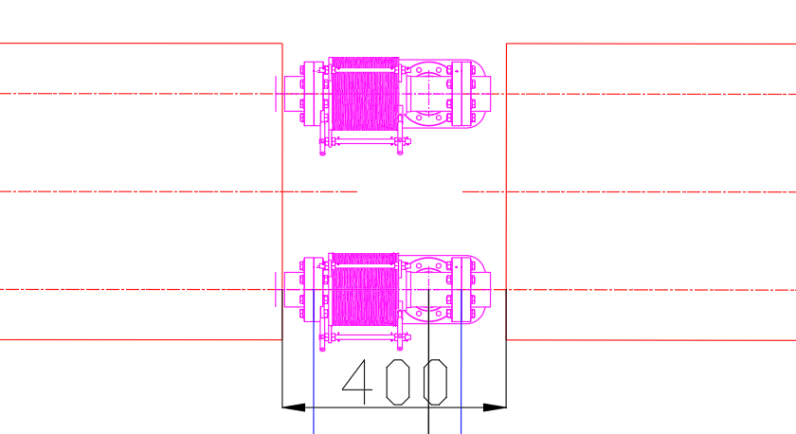
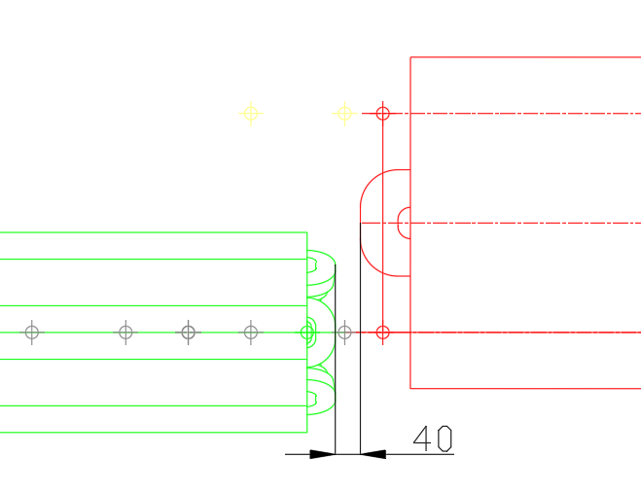
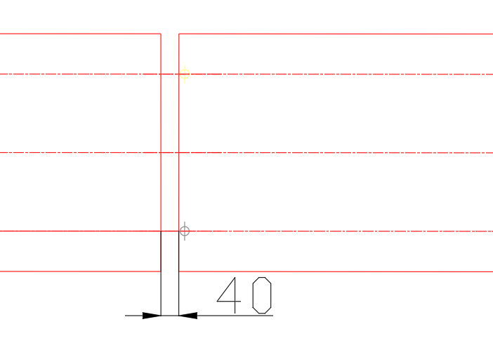
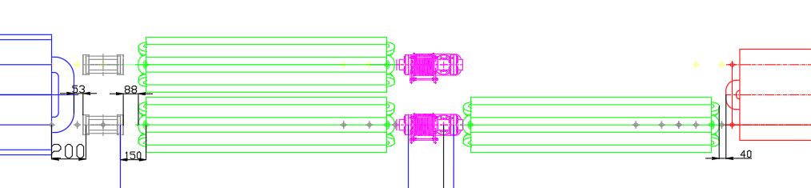
EDR progress-CEPC device layout
flanges
Arc section in Collider
  The vacuum connection part in Collider is optimized in longitudinal dimension. 400 mm is designed now.
Leaving bolts space at vacuum connection locations
Small spacing at non vacuum connection locations
To ensure the pump spacing, a vacuum connection part is set on the sextupole girder.

Slide 8
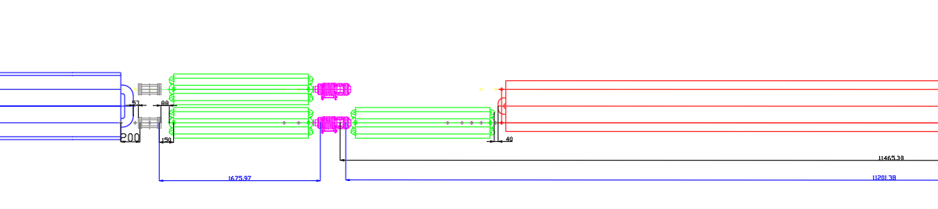
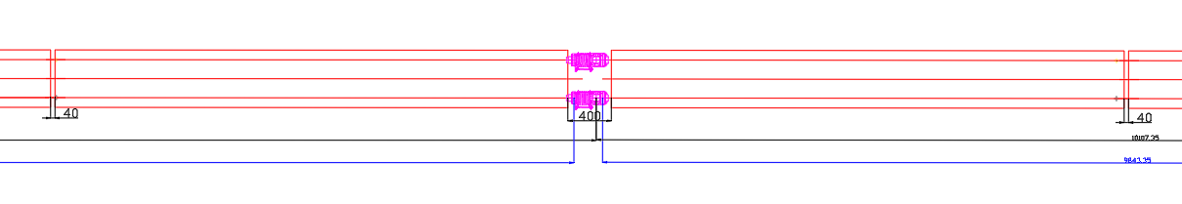
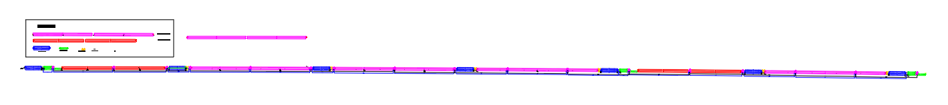
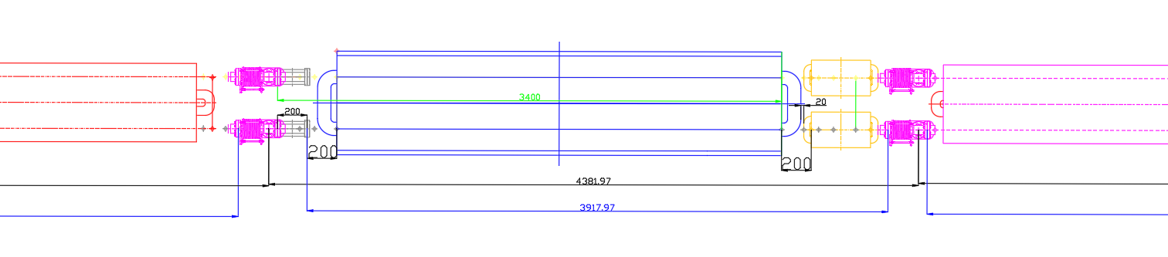
EDR progress-CEPC device layout
Quadrupole
BPM
sextupole
dipole
Vacuum connection part
dipole
Vacuum connection part
dipole
BPM
Vacuum connection part
dipole
Vacuum connection part
quadrupole
Corrector
Dipole

Slide 9
EDR progress-CEPC device layout
A new version with more details is under-going
  Quadrupoles fixed →A survey with all the magnets in/out coordinates
  Simplified device profiles → more detailed structure according to the EDR progress
  The layout of Booster, Linac, DR, transport lines…
2D/3D linkage design is under studying
Joint design of device layout, facility layout and architectural layout…

Slide 10
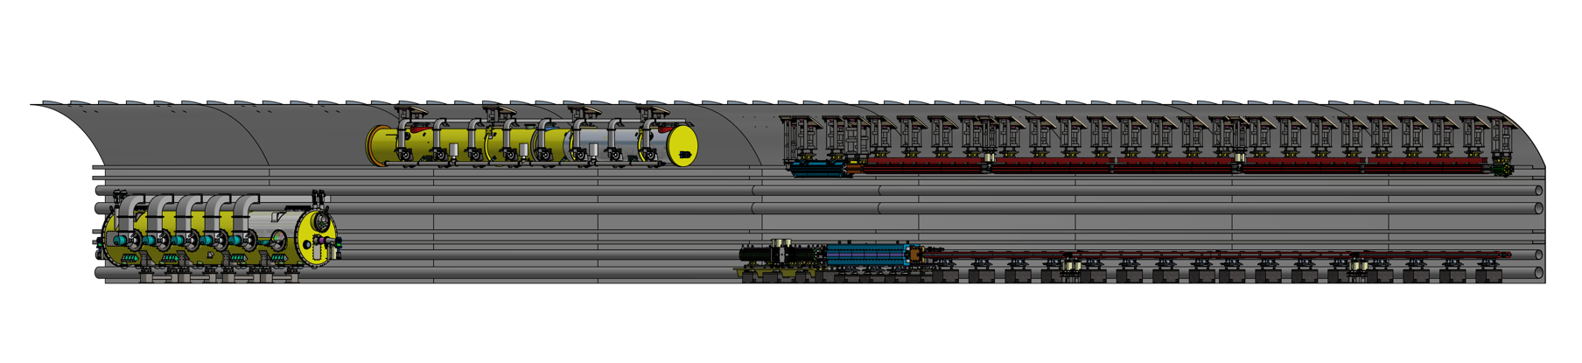
EDR progress-Tunnel mockup
A 60-meter tunnel with typical arc section and RF section
  Arc section：one FODO cell in both Collider and Booster（including dipole, quadrupole, sextupole, corrector and BPM）
  RF section：one RF module in both Collider and Booster
  Technical verification of installation and alignment for the above-mentioned equipment.

Slide 11
EDR progress-Tunnel mockup
The arc section
  Magnets ：ABS (Acrylonitrile Butadiene Styrene plastic) & steel，dimension tolerance ±2mm. The yoke can be opened and closed to simulate the vacuum tube installation.
  Vacuum devices and BPMs: ABS & steel，dimension tolerance ±4mm in longitudinal direction and ±1mm in radial direction.
  Vacuum support blocks are set in long magnets as necessary.
  Pedestals in Collider: reinforced concrete & steel plate as designed.
  Support frame in Booster: steel as designed.
  Adjusting mechanism: wedge adjustment or screw adjustment, having the interface to replaced by automatic ones after prototype tests.
  25 mm thick lead shielding for magnets in collider.
  RF modules：ABS & steel，dimension tolerance ±4mm.
  Modules supports: Steel.

Slide 12
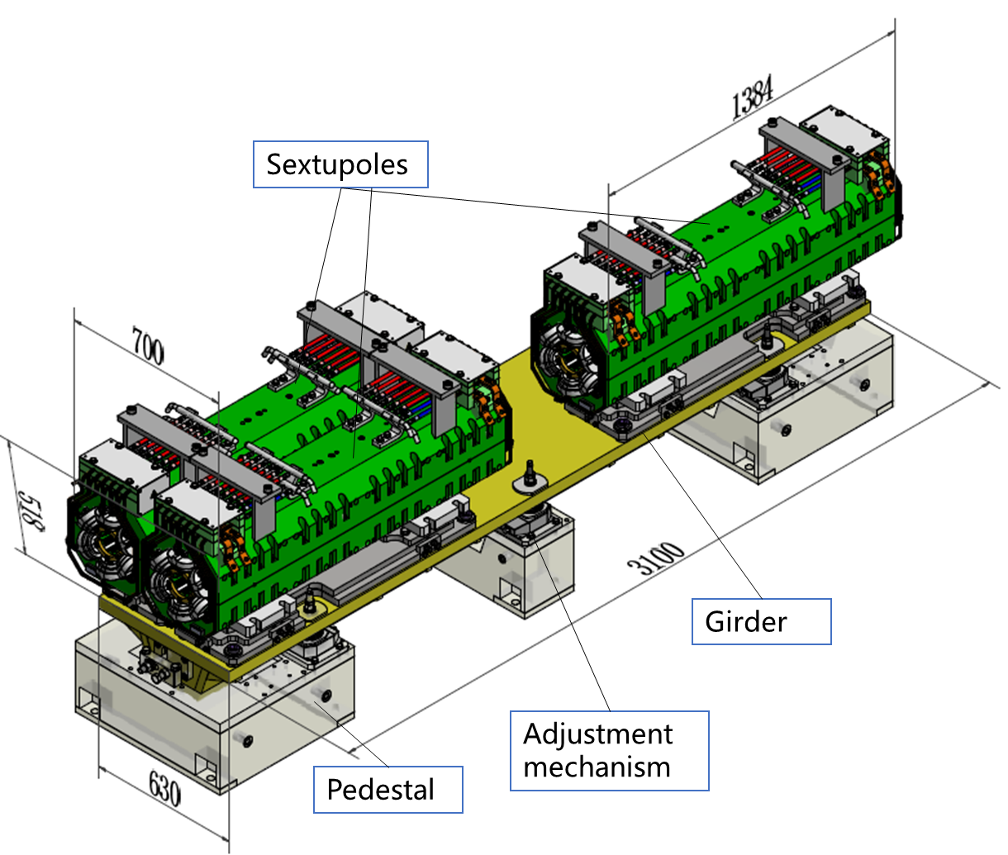
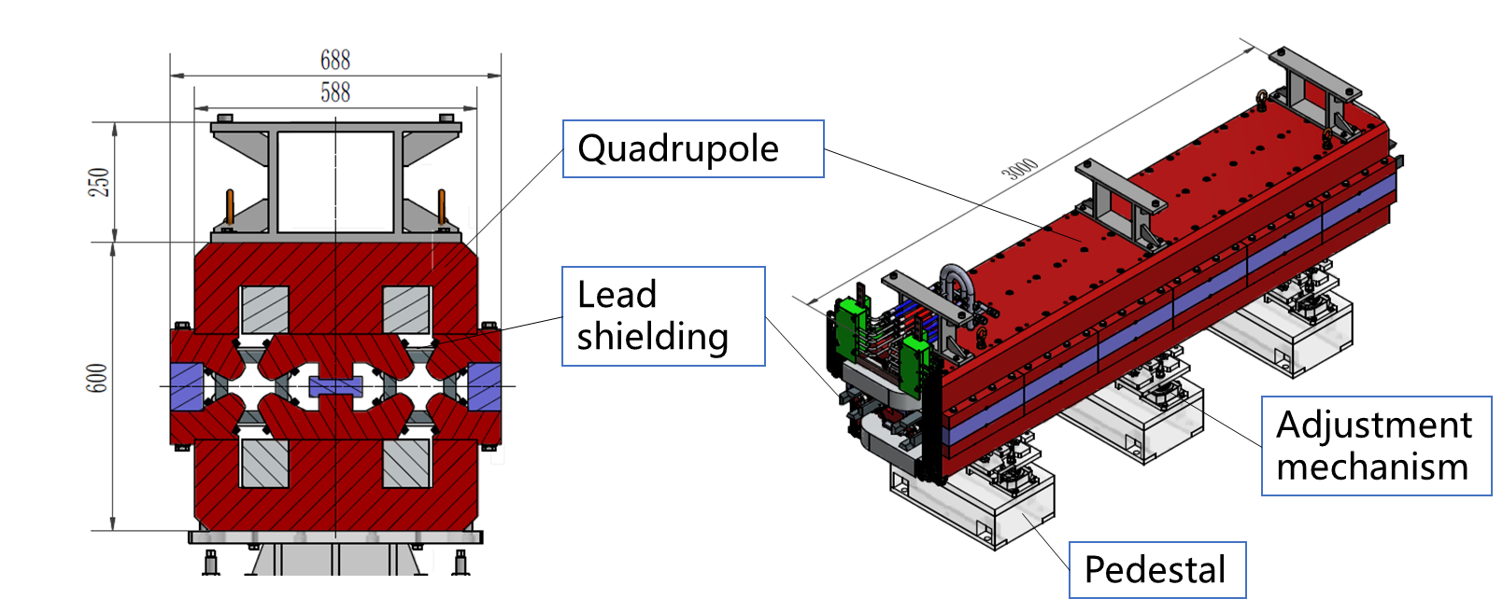
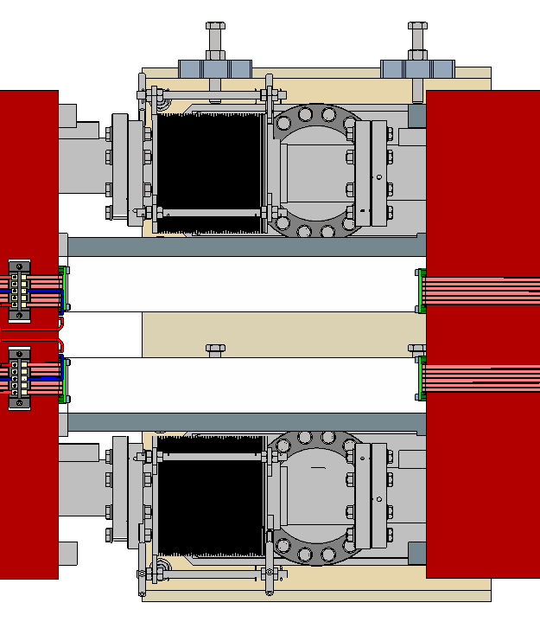
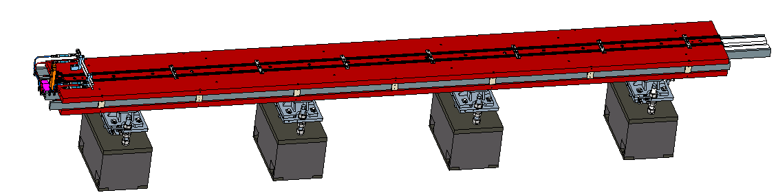
EDR progress-Tunnel mockup
Quadrupole assembly in Collider
  Yoke dimensions: 3000-734-600 mm。
Sextupole assembly in Collider
  Yoke dimensions: 1384-348-362mm
Dipole assembly in Collider
  Yoke dimensions：5450-530-160mm
Dipole
Lead shielding
Adjustment mechanism
Pedestal

Slide 13
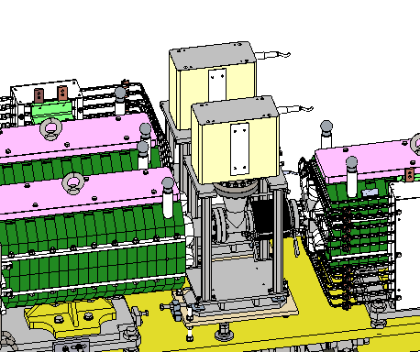
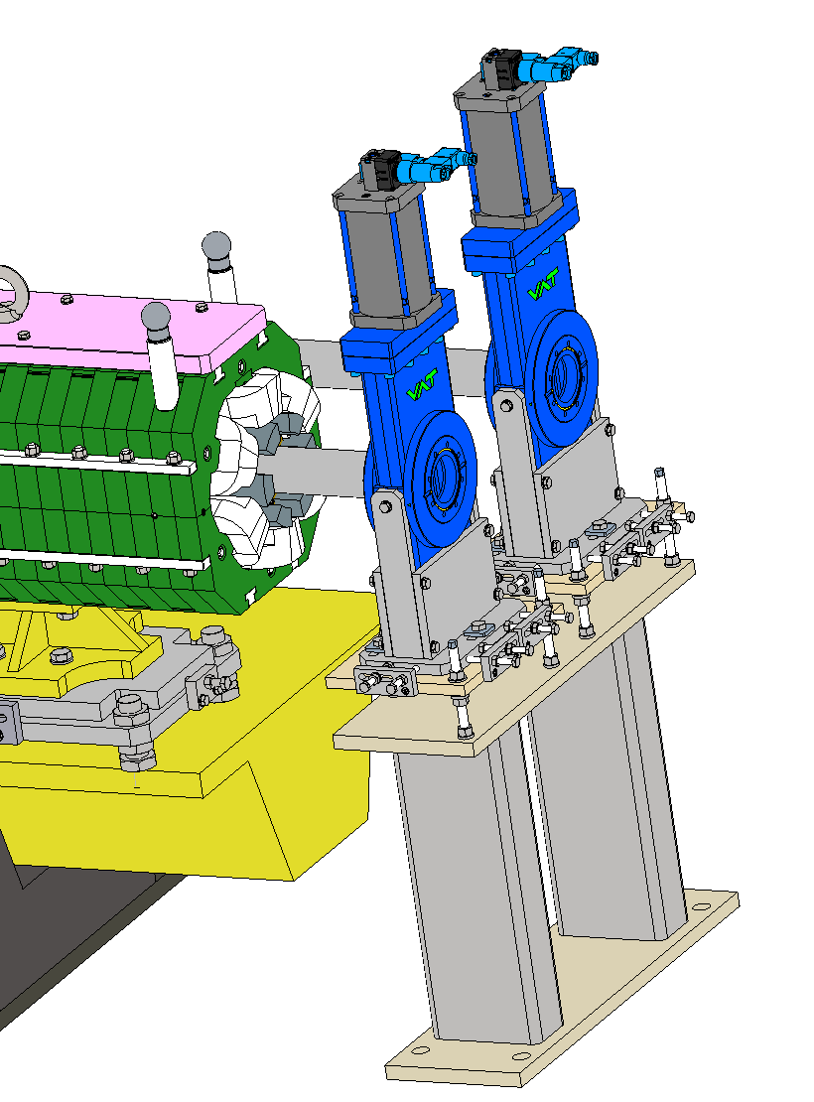
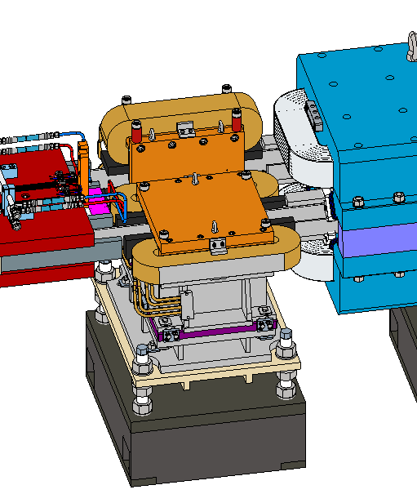
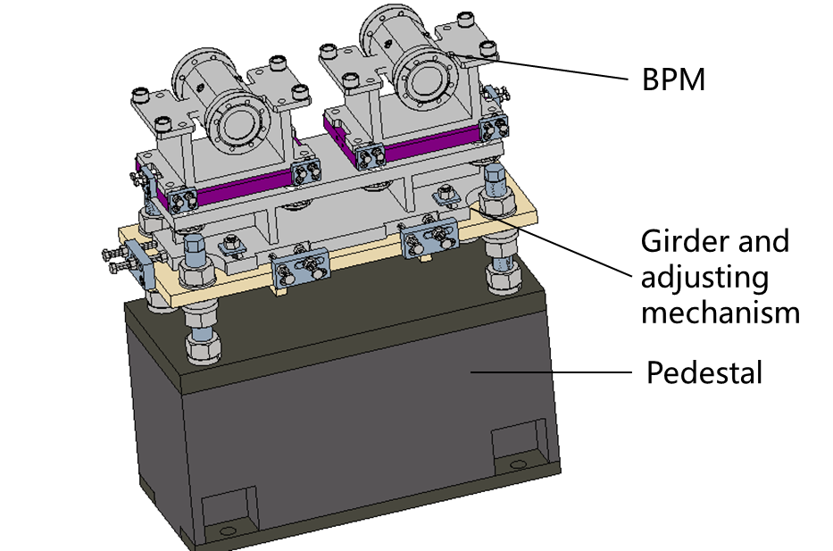
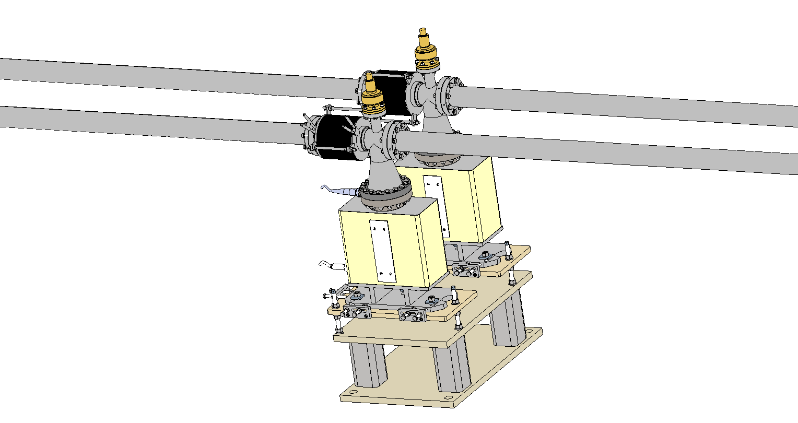
EDR progress-Tunnel mockup
BPM assembly in Collider
Vacuum devices in Collider
Corrector assembly in Collider
Girder and adjustment mechanism
CV
CH
Pedestal

Slide 14
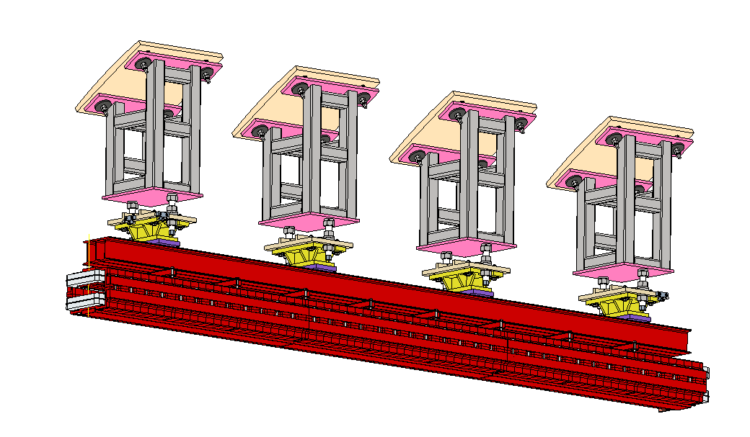
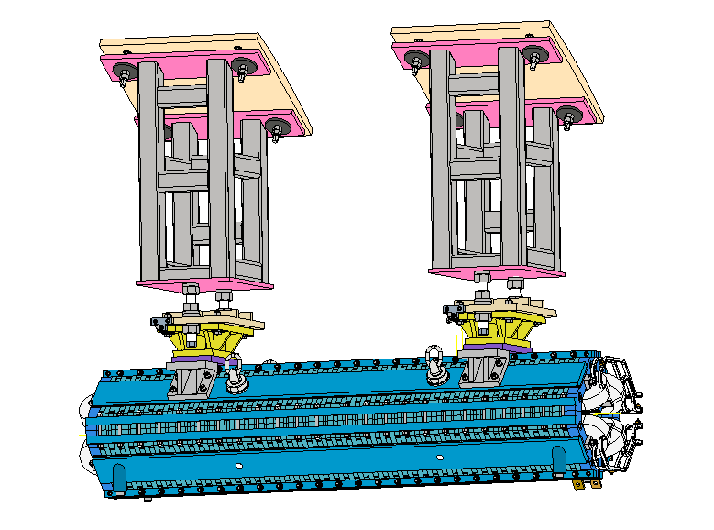
EDR progress-Tunnel mockup
Dipole assembly in Booster
  Yoke dimensions: 4608-392-272mm
Quadrupole assembly in Booster
  Yoke dimensions:1984-482-482mm
Steel frame
Adjustment mechanism
Coil
Yoke

Slide 15
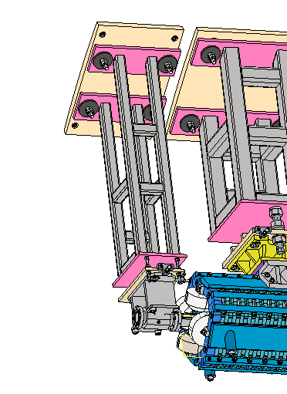
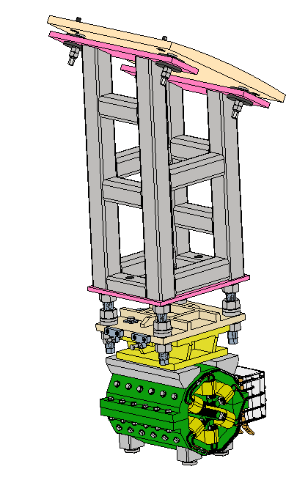
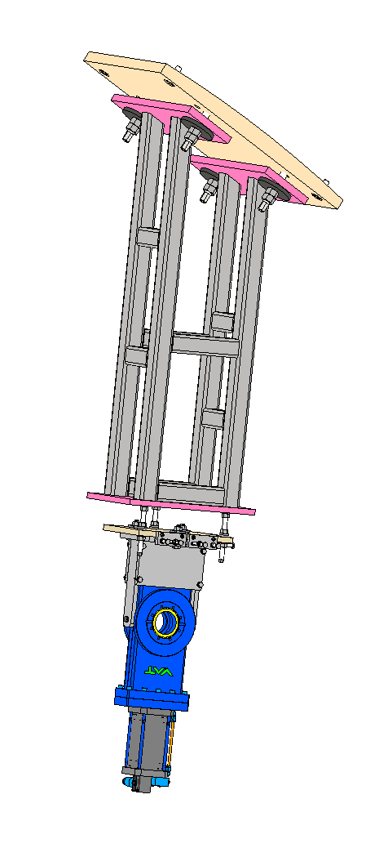
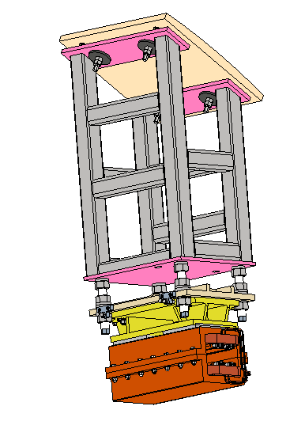
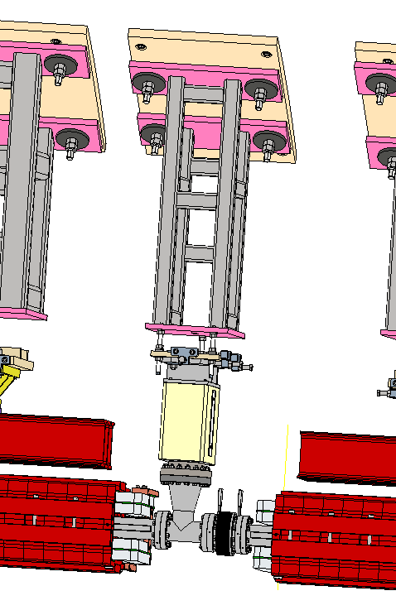
EDR progress-Tunnel mockup
BPM assembly in Booster
Sextuple assembly in Booster
Corrector assembly in Booster
Vacuum devices in Booster

Slide 16
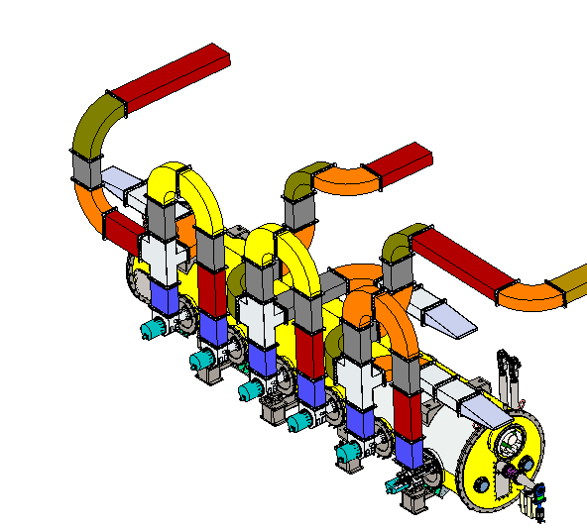
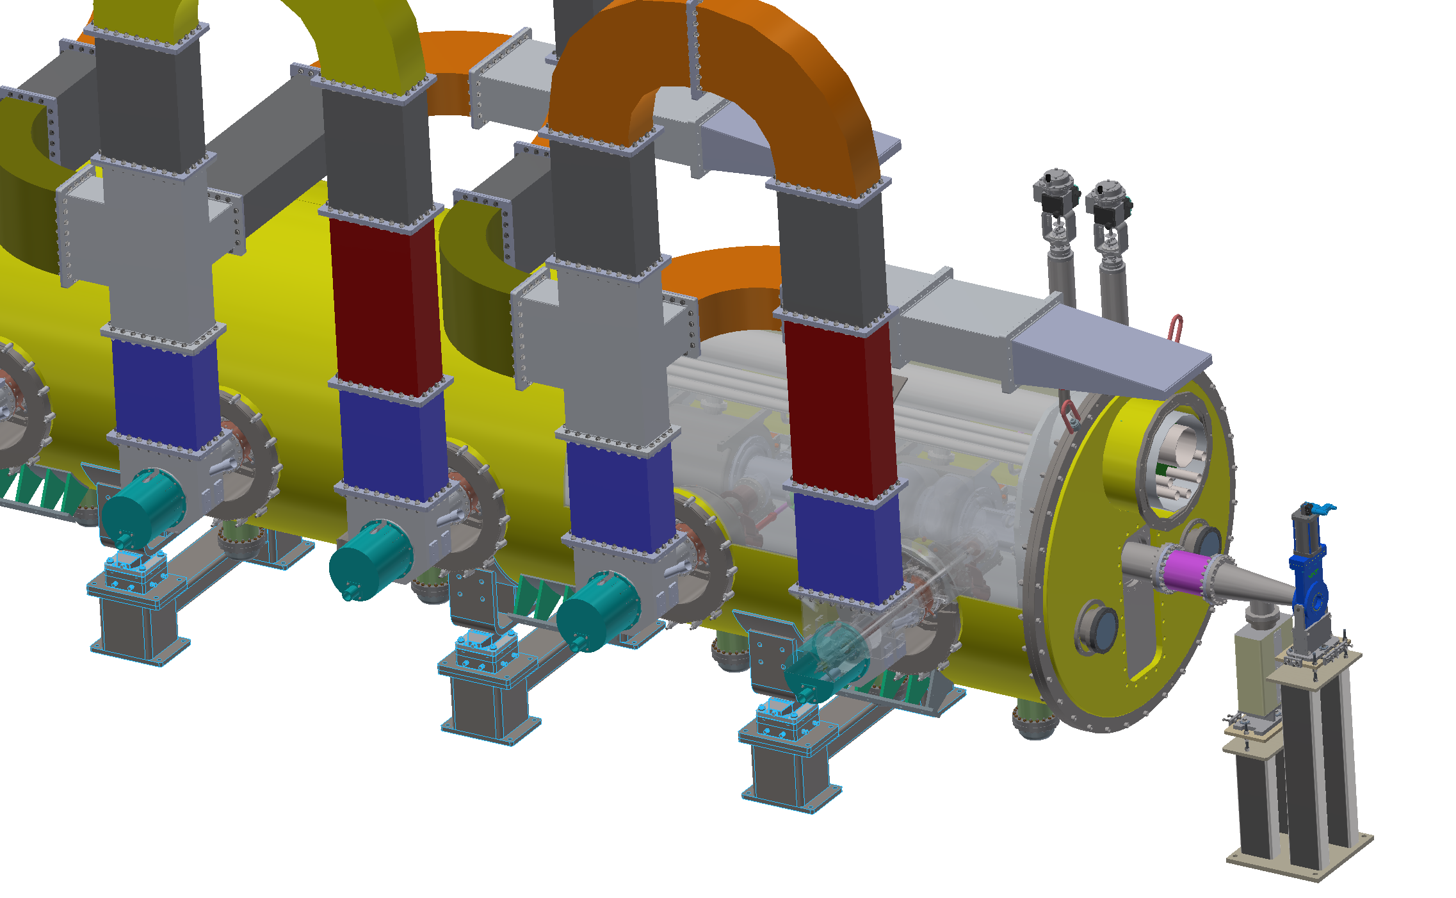
EDR progress-Tunnel mockup
Collider module
  Dimensions：9518-1644mm
  The vacuum vessel and thermal shield are partially transparent for inside structure displaying.

Slide 17
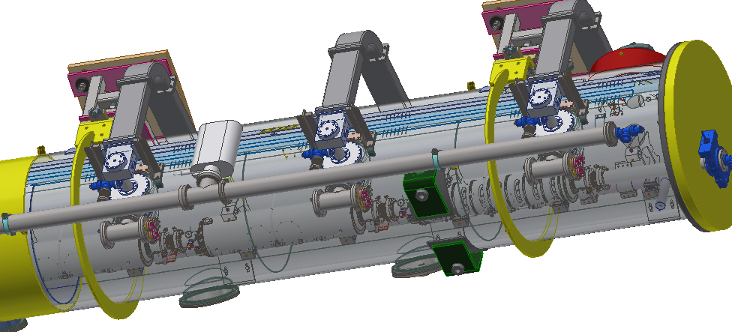
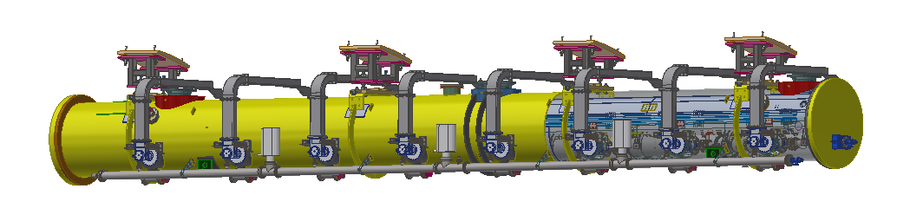
EDR progress-Tunnel mockup
Booster module
  Dimensions：12623-1160mm
  The vacuum vessel and thermal shield are partially transparent for inside structure displaying.

Slide 18
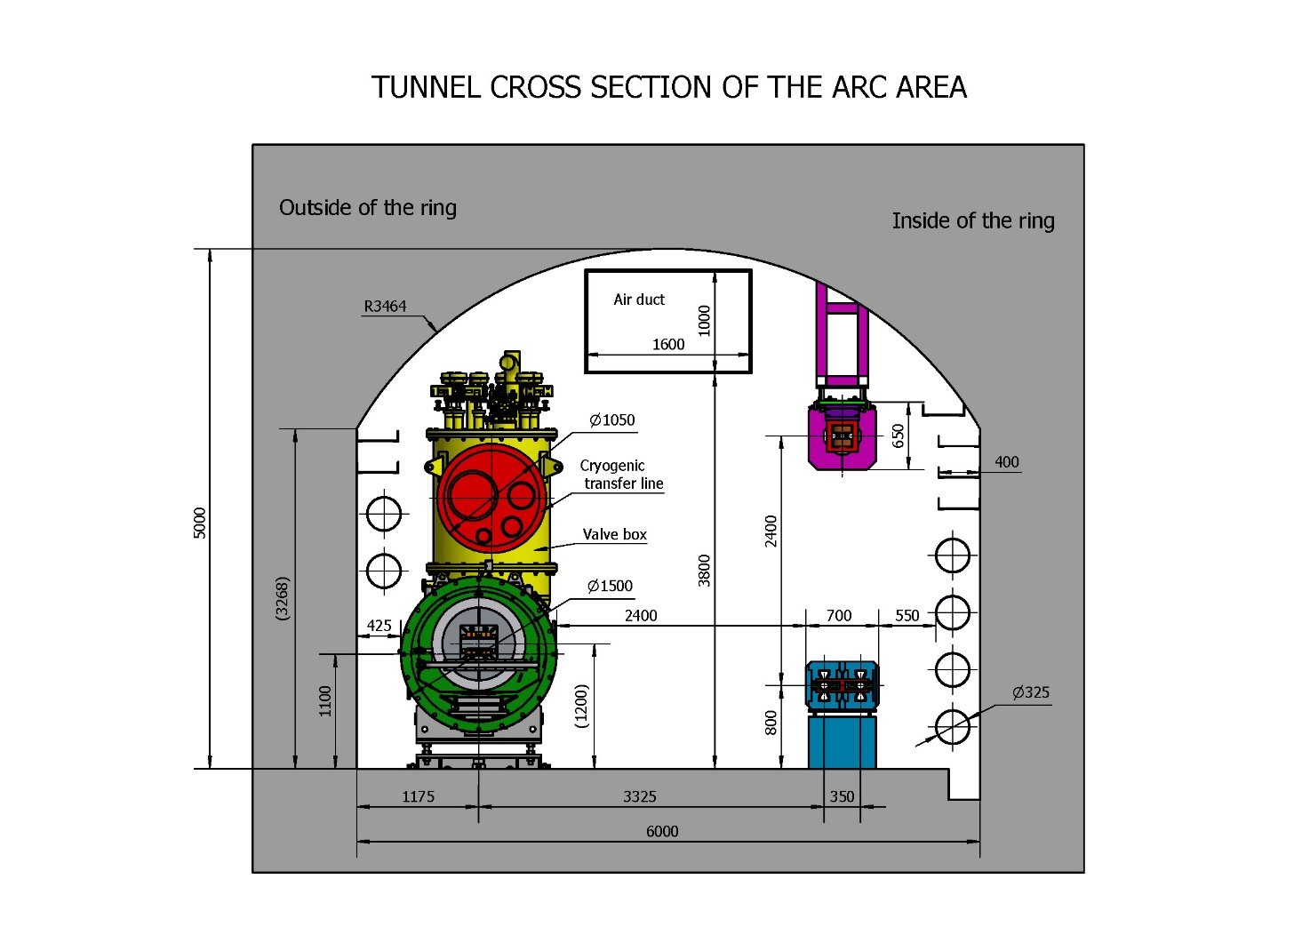
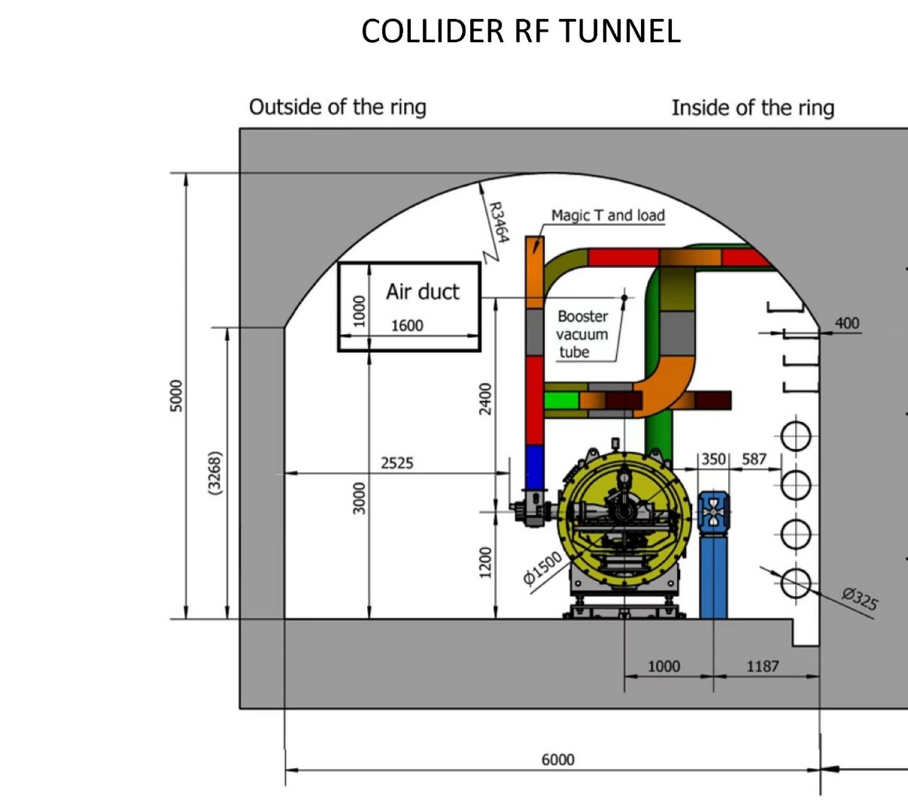
EDR progress-Tunnel mockup
Optimizing dimensions is one of the important tasks for EDR design.
The aim is to fulfill the space arrangement of TDR tunnel design.

Slide 19
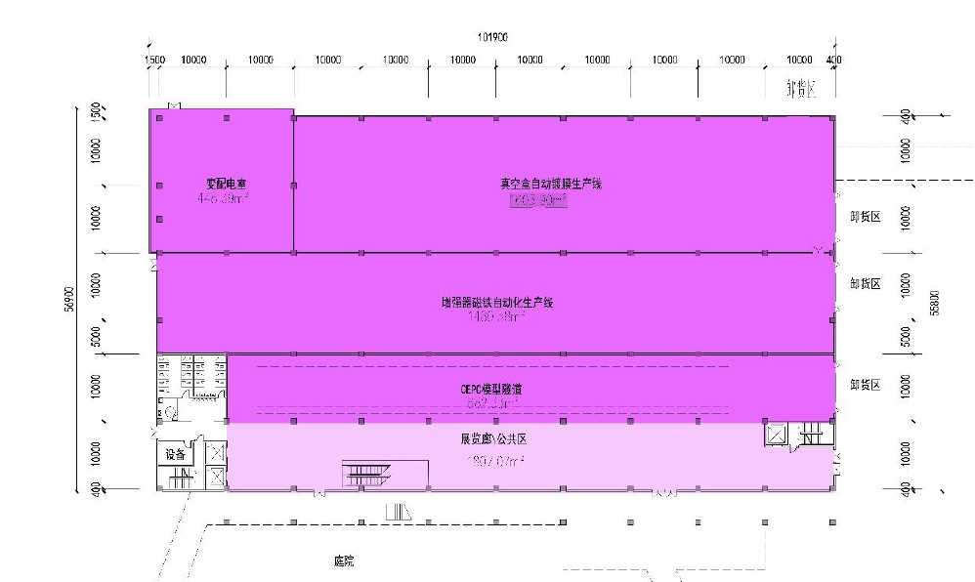
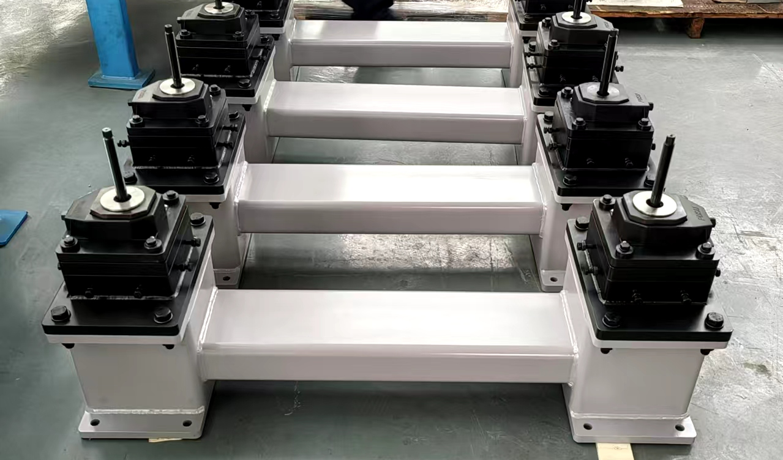
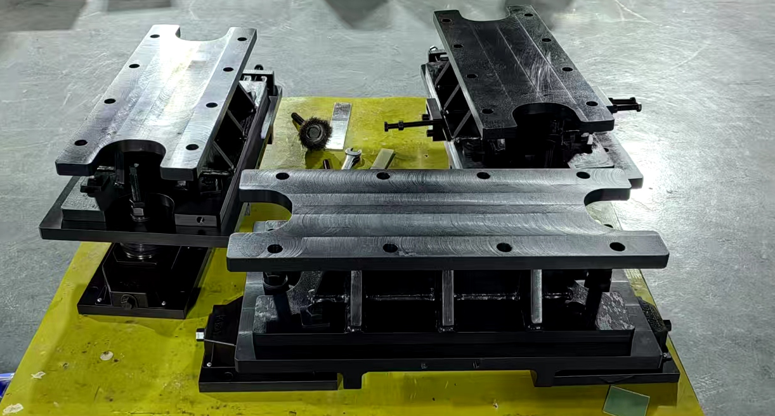
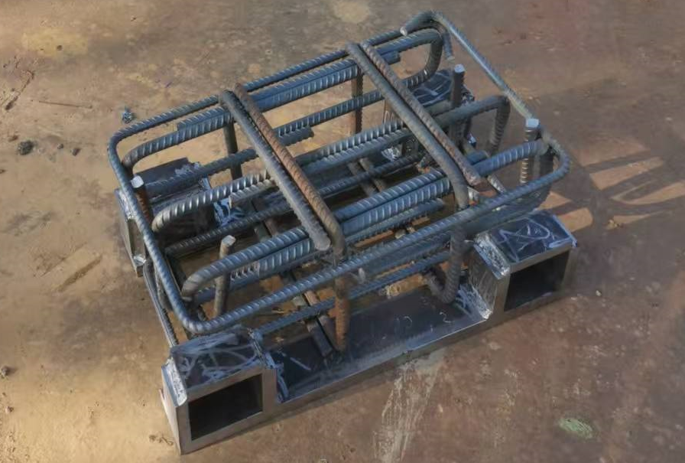
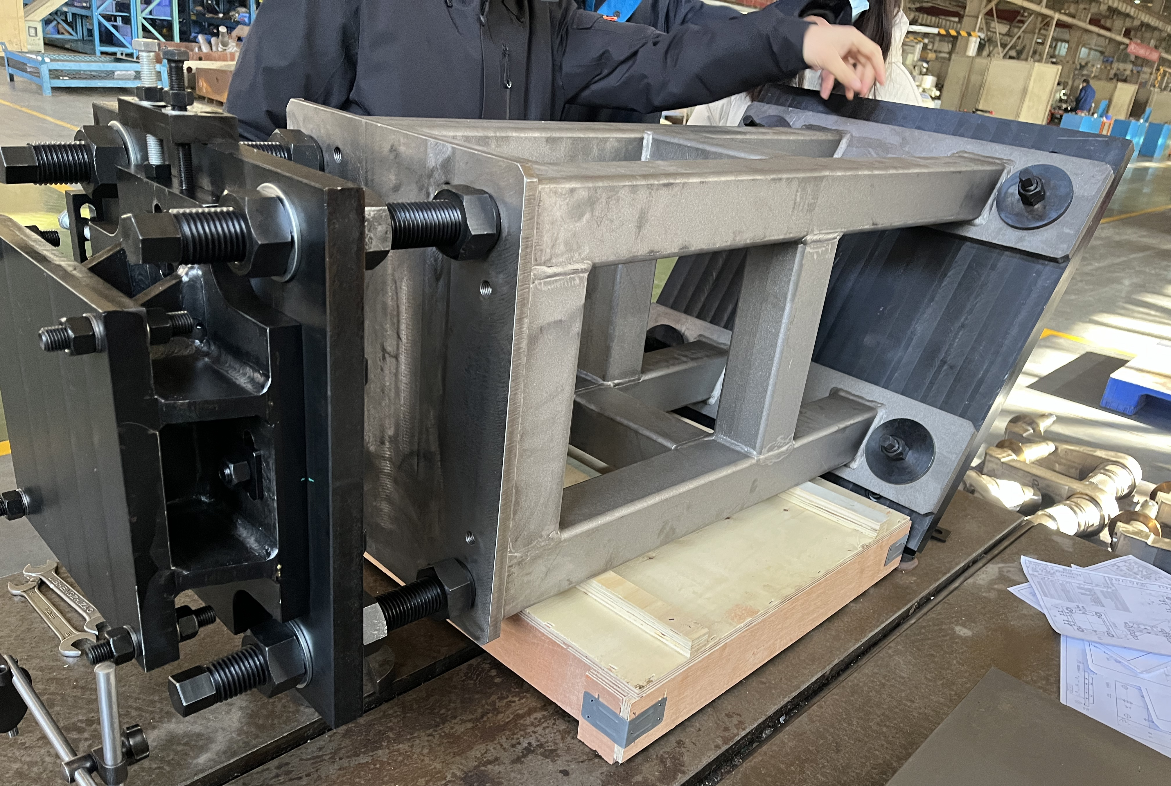
EDR progress-Tunnel mockup
The site construction design of the tunnel mockup is under-going.
The devices of the mockup is under developing.

Slide 20
EDR progress- high accuracy automatic adjusting and alignment system
The amount of CEPC equipment is huge. Therefore, improving alignment and adjusting efficiency while ensuring accuracy is one of the important aspects in EDR stage.
The high accuracy automatic adjusting and alignment system of CEPC
  High-accuracy measurement field: multi-camera photogrammetry, multi-point synchronous monitoring, high efficiency
  Automatic adjustment mechanism: movable drive, unified quick plug-and-play interface

Slide 21
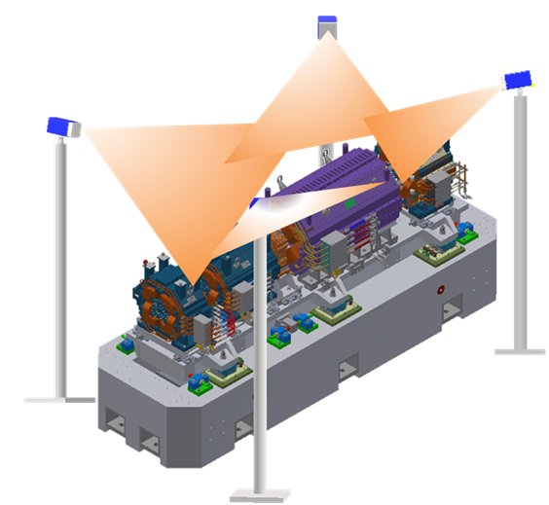
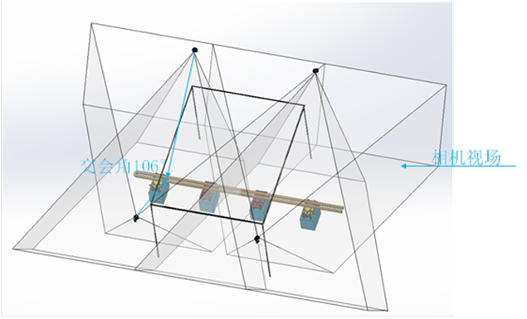
EDR progress- high accuracy automatic adjusting and alignment system
High-accuracy measurement field
  Select high-precision CMOS to improve the accuracy of pixel extraction.
  The intersection angle is within the optimal photogrammetric range (60°~120°).
  Select short focal length lenses to reduce the measurement field size.
  Using a 4-camera configuration to meet the measurement range requirements, measurement accuracy will be better than 45μm
From Xiaolong Wang
High-accuracy measurement field
Cameras layout and intersection angle

Slide 22
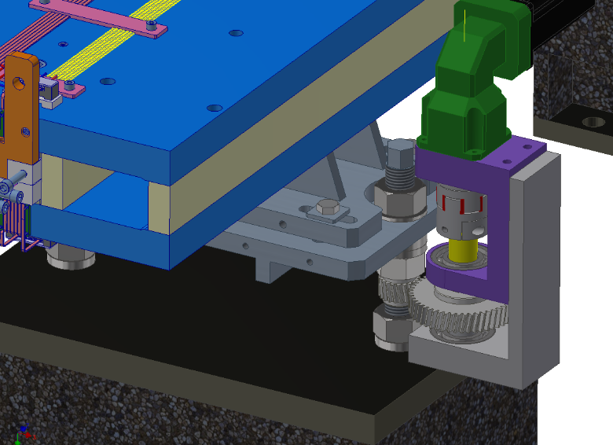
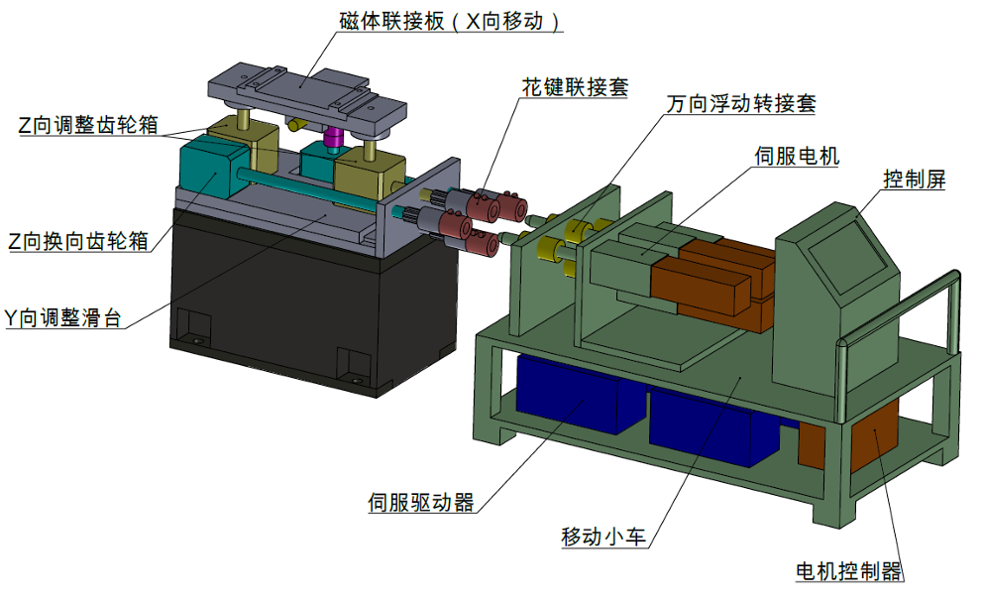
EDR progress- high accuracy automatic adjusting and alignment system
Automatic adjustment mechanism
  Dipole magnet: adjustment based on screws, simple structure, wide adjustment range, low cost, low load-bearing capacity
  Quadrupole/Sextupole magnet units: adjustment based on wedges, requiring additional shims to increase the adjustment range, high cost, high load-bearing capacity
  Considered three schemes, currently take the movable drive vehicle as the basic solution.
Three considered schemes

Slide 23
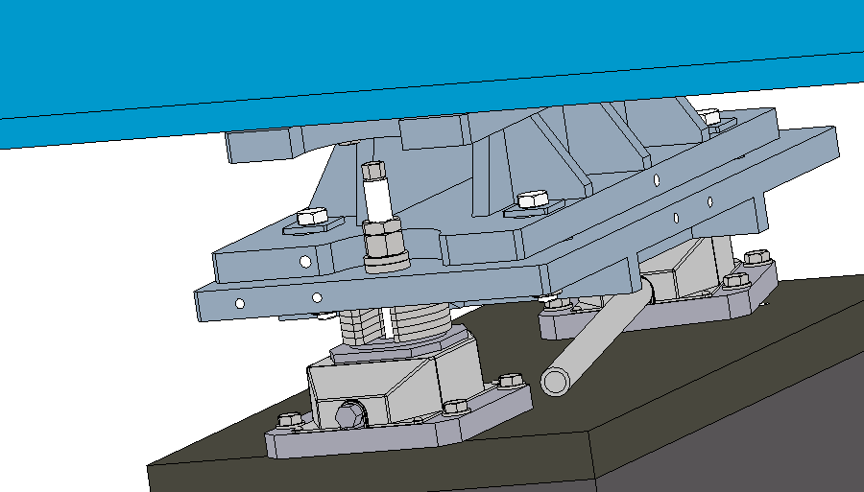
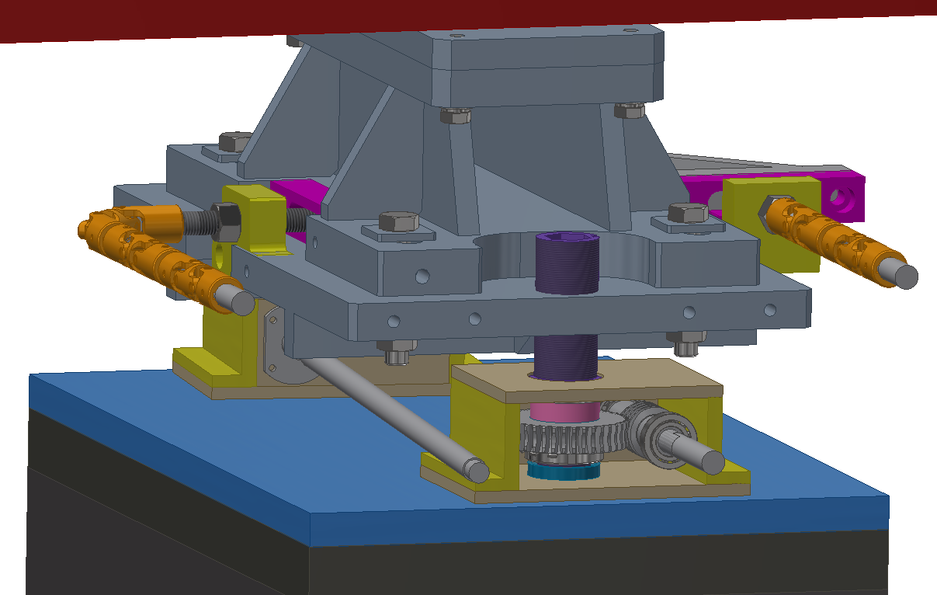
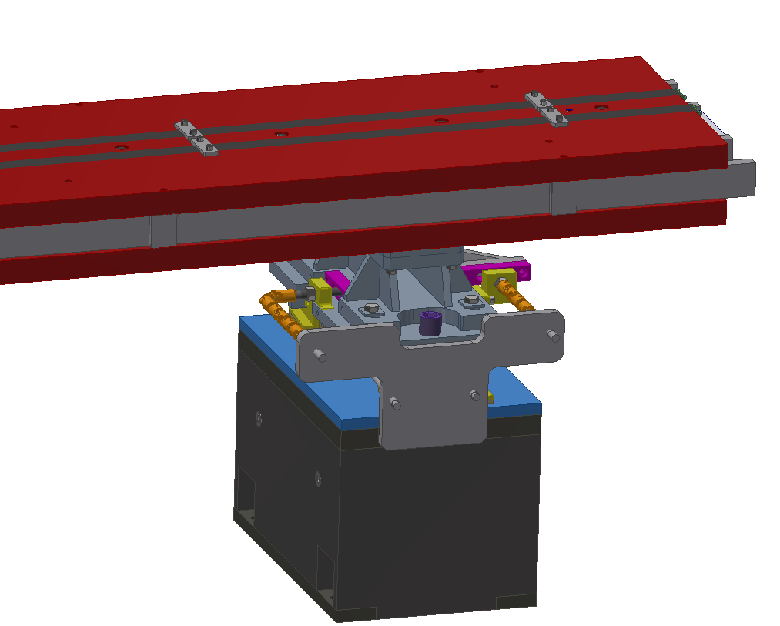
EDR progress- high accuracy automatic adjusting and alignment system
Adjustment mechanisms
  Dipole magnet: concentric screw in vertical
  Quadrupole/Sextupole magnet: wedge structure in vertical
  Horizontal: universal joints and connecting rods
  Output shafts at the aisle side
Wedge adjustment
Concentric screw

Slide 24
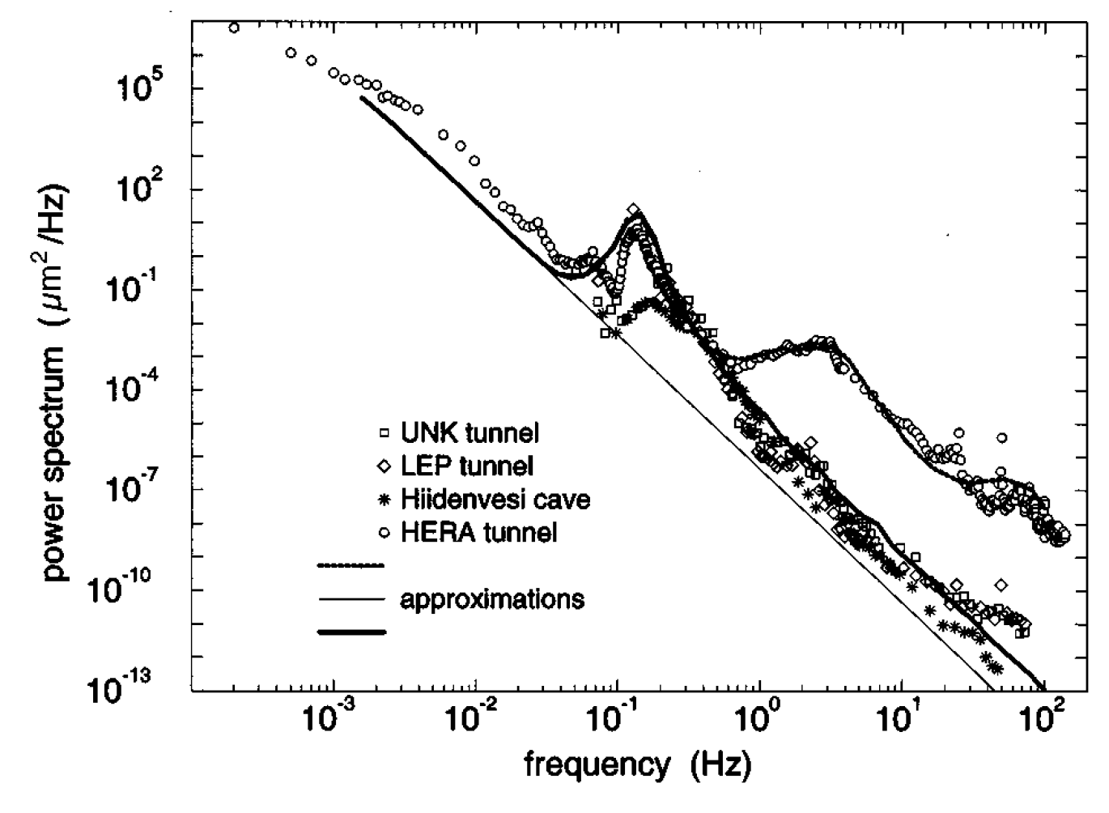
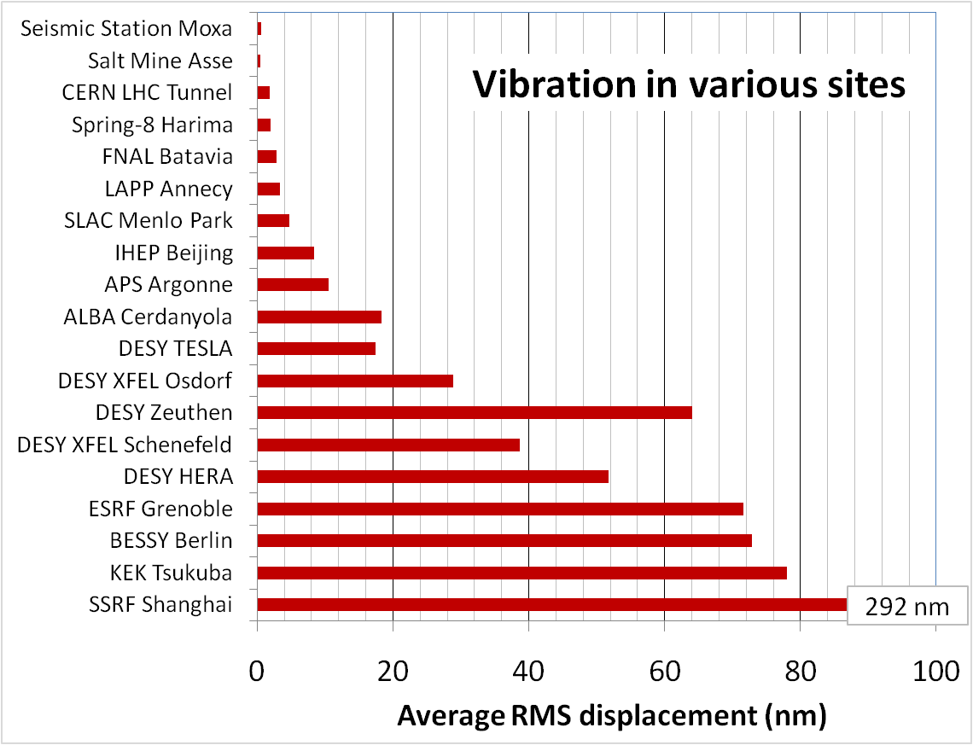
EDR progress- Vibration test
 | Ground motion requirements, RMS, 1-100 Hz displacement integral
MDI | ≤4 nm
Arc and straight section, and RF section in Collider | ≤24 nm
Linac | ≤50 nm
Mechanical dynamic stability (vibration)
  Ground vibration :
  Magnet-support assembly: natural frequency? Amplification factor?
  Damping devices: damping material? active vibration technology?
  Slab and pedestal
Enhancing the natural frequency is an effective method to decrease vibration.
HEPS site

Slide 25
EDR progress- Vibration test
Follow the geological exploration
  Establish a control group on a good foundation.
  Evaluate the vibration performance of the magnet-support system based on the stiffness of the adjustment mechanism and the vibration test.
  Optimize the support design.
  Determine the support method of the Booster elements with geological exploration→ stability, installation, water proof, tunnel construction…
Three schemes of booster support, the left is the baseline

Slide 26
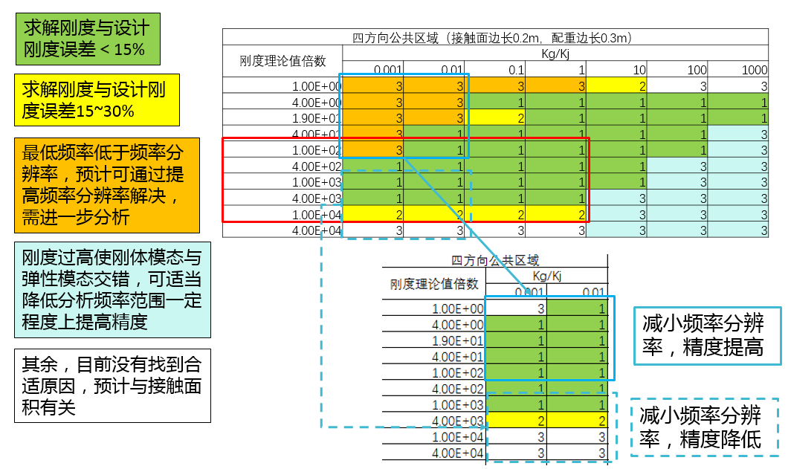
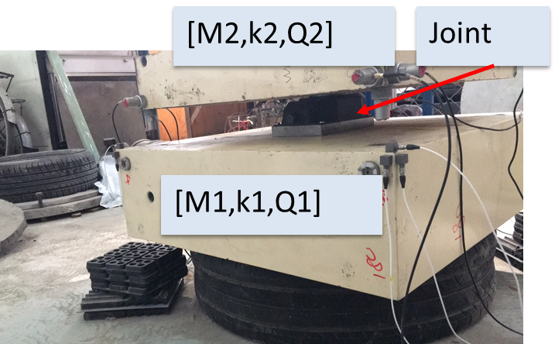

EDR progress- Vibration test
Our experience:
  The pedestal development and grouting experience from HEPS.
  The FEA guided hammer knocking method for stiffness test.
Modes | Tested /Hz | Simulated /Hz | Error
1 | 64.5 | 63.4 | 2%
2 | 74 | 70.6 | 5%
3 | 90.4 | 79.0 | 13%
The FEA guided stiffness test method, the green areas are ideal test conditions
Comparison of mode test and simulation
Joint stiffness test
HEPS Booster, which pedestal is similair to CEPC’s

Slide 27


EDR progress- Collimators
Horizontal movable collimator for background decreasing (TDR)
For the collimators used for MPS, low-Z, high-melting-point carbon-based materials need to be taken into consideration.
Jointing prototype of copper, graphite and graphene film
Jaw of HEPS collimator with copper body and graphite tip

Slide 28


EDR progress- Collimators
We have accumulated relevant experience from the HEPS.
  High shear strength: 38.7 Mpa between graphite and copper
  Copper coating to improve conductivity about one level.
  Endure more than 100 thermal shocks higher than 2000 ℃.
Before/after thermal shock
Microscopic observation of copper-graphite brazing
Copper coating on graphite

Slide 29



EDR progress- MDI mechanics
MDI layout
  Detective angle: acos0.99
  IP chamber：±700mm
  Yoke length：11750mm
Distance to detective angle
  IP chamber flange: 5.3mm RVC: 14.9mm (pressure tube)
  A auxiliary support is in consideration at about 3.3 m from IP

Slide 30


EDR progress- MDI mechanics
Cryostat support design
  Auto-tuning wedge adjustment at the end of the cryostat
  Auxiliary support at HCAL
  Skeleton support inside helium vessel for magnets
Key points
  Stability (static and dynamic)
  Accuracy
  Easy-operating
  Dimensions
SC quadrupole support
Anti solenoid support

Slide 31

EDR progress- MDI mechanics
From TDR to EDR
  TDR to EDR A1: Iron SC magnet → iron-free, support at cantilever end
  EDR A1 to EDR A2: skeleton support optimization
  EDR A2 to EDR A3: add rake-shaped cantilever support
Analyses | TDR | EDR A1 | EDR A2 | EDR A3
Max. displacement of SC magnet/mm | 1.934 | 1.634 ↓ | 1.282 ↓ | 0.893 ↑
Max. uneven deformation of SC magnet/um | 31 | 41 | 29 | 22
F1 /Hz | 12.7 | 13.29 | 15.0 | 17.9
F2 /Hz | 13.0 | 13.65 | 15.3 | 21.0
F3 /Hz | 44.6 | 51.0 | 55.6 | 40.8
  For all the FEA cases, gravity and Lorenz force are loaded.

Slide 32

EDR progress- MDI mechanics
From TDR to EDR
  EDR A4.1: based on EDR A3, add Lumical crystal, RVC and helium weight
  EDR A4.2: based on EDR A4.1, without Lorenz force
  EDR A 4.3 &4.3: based on EDR A4.1 & 4.2, add auxiliary support at 3.3 m from IP
Analyses | EDR A4.1 | EDR A4.2 | EDR A4.3 | EDR A4.4
Max. displacement of SC magnet/mm | 0.805 ↑ | 1.220 ↓ | 0.117 | 0.043
Max. uneven deformation of SC magnet/um | 24 | 25 | 11 | 7
F1 /Hz | 17.7 | 17.8 | 49.2 | 47.0
F2 /Hz | 20.8 | 20.9 | 58.8 | 57.1
F3 /Hz | 40.3 | 40.3 | 60.2 | 58.4

Slide 33





EDR progress- MDI mechanics
    RVC
  Leak rate requirement: 2.7 ×10–11 Pa·m3/s
  Leak rate: $Q=C∙∆P$
  Decrease $∆P$ (experience from CSNS)
  Single-layer → double layer, leak rate can be improved from 1e-6 Pa.m3/s to 8.5e-10 Pa.m3/s.
Inflatable seal
$$\left.C=34A^{2}（L/w）exp{[}−3F/(LwR)\right]$$
  For sealings with the same F/L
  Decrease roughness A, demonstrated by J-PARC
  Decease the perimeter L →almost determined by layout
  Decrease the hardness of gasket materials$R$→using copper
  Decrease the seal width $w$→knife-edge seal
Roughness and conductance, J-PARC

Slide 34


EDR progress- MDI mechanics
A prototype will be developed.
The influence of RVC displacement on the leakage rate will be simulated through an adjustment mechanism.
Fake model of vacuum vessel
Fake model of IP chamber, fixed
Adjustment mechanism
RVC

Slide 35
Conclusion
The mechanics system is aiming to carry out technically feasible engineering designs for the equipment it is responsible for during EDR stage.
The preliminary device layout has been done, based on which the CEPC tunnel mockup is designed and is under development.
A high accuracy automatic adjusting and alignment system is under studying, aiming at high efficiency alignment and adjustment of CEPC.
We will do the vibration test following the geological exploration, from which we can evaluate the vibration performance of the magnet-support system.
We are committed to the mechanical research of MDI, and have greatly improved the magnet displacement and vibration stability.

Slide 36
Thank you for your attention!

