Slide 1




CEPC high efficiency & high power RF sources
Zusheng Zhou
On behalf of CEPC klystron R&D team
IAS Program on Fundamental Physics (FP 2025), January 13-17, 2025

Slide 2
Content
System design consideration
  Collider ring
  Booster ring
  Linac injector
R&D
  High efficiency (P band 800kW CW klystron/Energy recovery klystron)
  High power (C band 80MW klystron)

Slide 3
Collider RF sources
Requirement list:
Klystron | 96 | 650MHz/800kW
PSM Power Supply | 96 | 130kV/16A and 60kV/22A
Circulator | 96 | 650MHz/800kW
Load | 96 | 650MHz/800kW
Phase shift | 96 | 650MHz/800kW
Waveguide | 96 | Power divider/directional coupler
LLRF | 96 | Phase stabilization <0.1 degree, Amplitude stabilization <0.1%
Pre-amplifier | 96 | 650MHz/100W

Slide 4
Collider RF sources
Requirement list:
Klystron | 96 | 650MHz/800kW | Higher efficiency
PSM Power Supply | 96 | 130kV/16A and 60kV/22A | Mature product
Circulator | 96 | 650MHz/800kW | Mature product
Load | 96 | 650MHz/800kW | Mature product
Phase shift | 96 | 650MHz/800kW | Mature product
Waveguide | 96 | Power divider/directional coupler | Mature product
LLRF | 96 | Phase stabilization <0.1 degree, Amplitude stabilization <0.1% | Mature product
Pre-amplifier | 96 | 650MHz/100W | Mature product

Slide 5
Booster RF sources
Requirement list:
SSA | 96 | 1300MHz/25kW
Circulator | 96 | 1300MHz/25kW
Load | 96 | 1300MHz/25kW
Waveguide | 96 | Directional coupler
LLRF | 96 | Phase stabilization <0.1 degree, Amplitude stabilization <0.1%

Slide 6
Booster RF sources
Requirement list:
SSA | 96 | 1300MHz/25kW | Mature product
Circulator | 96 | 1300MHz/25kW | Mature product
Load | 96 | 1300MHz/25kW | Mature product
Waveguide | 96 | Directional coupler | Mature product
LLRF | 96 | Phase stabilization <0.1 degree, Amplitude stabilization <0.1% | Mature product

Slide 7
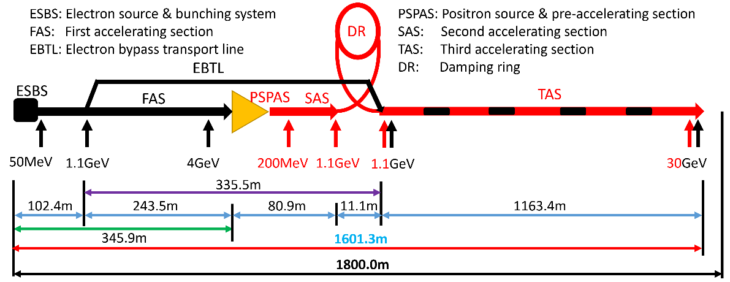
Linac RF sources
The main high power RF sources components are 33 units of 80MW S-band klystron, 236 units of 50MW C-band klystron and related modulators.
Type | QTY | Freq.(MHz) | Structure type
S-band klystron | 33 | 2860 | 1 1-to-1，standard-bunch 3 1-to-2，standard acc. structure. 8 1-to-2，large aperture acc. structure 21 1-to-4, standard acc. structure.
C-band klystron | 236 | 5720 | 1-to-2，standard acc. structure.

Slide 8
Linac RF sources
Requirement list:
S band klystron | 33 | 2860MHz/80MW
Modulator of S band klystron | 33 | 400kV/500A
C band klystron | 236 | 5720MHz/50MW
Modulator of C band klystron | 236 | 350kV/400A

Slide 9
Linac RF sources
Requirement list:
S band klystron | 33 | 2860MHz/80MW | Mature product
Modulator of S band klystron | 33 | 400kV/500A | Mature product
C band klystron | 236 | 5720MHz/50MW | Mature product
Modulator of C band klystron | 236 | 350kV/400A | Mature product

Slide 10
Why we need R&D?

Slide 11
1st-Collider RF sources
Higher efficiency
Less power consumption
CEPC annual electricity @6000 hours/year
Efficiency impact on operation electricity consumption (Only considering operation efficiency of klystrons)
Mature product

Slide 12
1st-Collider RF sources
Higher efficiency
Less power consumption
CEPC annual electricity @6000 hours/year
Efficiency impact on operation electricity consumption (Only considering operation efficiency of klystrons)
IHEP R&D

Slide 13
1st-Collider RF sources
Higher efficiency
Less power consumption
CEPC annual electricity @6000 hours/year
Efficiency impact on operation electricity consumption (Only considering operation efficiency of klystrons)
Near future

Slide 14
1st-Collider RF sources
Higher efficiency
Less power consumption
CEPC annual electricity @6000 hours/year
Efficiency impact on operation electricity consumption (Only considering operation efficiency of klystrons)
Future

Slide 15
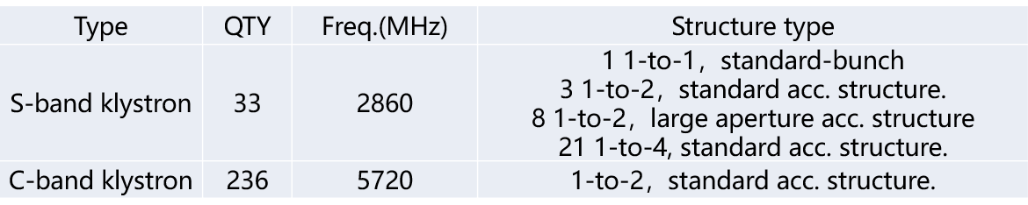
2nd-Linac RF sources
Higher power
Smaller number
Now
  Only C band of 50MW klystron is mature product in the world. 1 klystron only power to 2 accelerator structures (CEPC Linac baseline).
  Number of C band klystron is very large (236 set).
IF output power of C band klystron is up to 80MW, the number of klystron will be reduced by half. (1 klystron power to 4 accelerator structures). The cost of Linac RF sources will be decreased more than 30%.
CEPC Linac baseline

Slide 16
R&D Progress and Achievements

Slide 17
650MHz klystron R&D
3 or more klystron prototypes for klystron efficiency improvement
2016 | 2017 | 2018 | 2019 | 2020 | 2021
2022
2023
2024
Prototypes
Step1
1st
Step2
2nd
Step3
3rd
more
Efficiency: 60%
70%
80%

Slide 18
Design scheme
Scheme 1: Traditional way for >60% efficiency
Scheme 2: With high voltage gun (110 kV/9.1 A), low perveance (HE, >75%)
Scheme 3: MBK, 54 kV/20A electron gun (8 beams) (HE, >80%)
Parameter | Scheme1(1st prototype) | Scheme2(2nd) | Scheme3(3rd)
Freq. (MHz) | 650 | 650 | 650
Voltage (kV) | 82 | 110 | 54
Current (A) | 16 | 9.1 | 20(2.5×8)
Beam No. | 1 | 1 | 8
Perveance (µP) | 0.65 | 0.25 | 1.6(0.2×8)
Efficiency (%) | 65 | ~80 | >80
Power(kW) | 800 | 800 | 800(100×8)

Slide 19
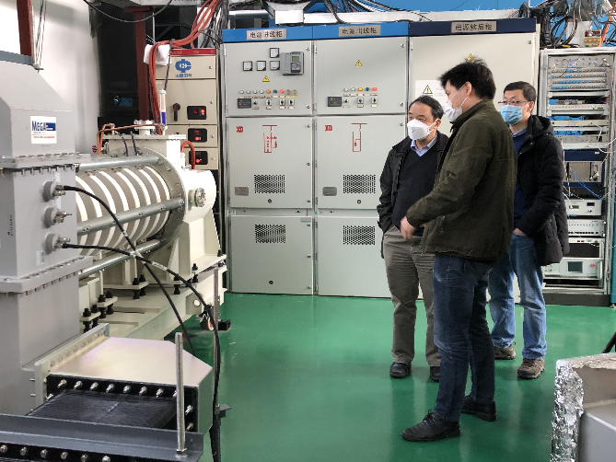
1st prototype
Oct. 2017 Prototype manufacture
Mar. 2020 High power test at IHEP
Parameters | Design | Test
Operating frequency (MHz) | 650 | 650
Beam Voltage (kV) | 81.5 | 80
Beam Perveance (μA/V^{3/2}) | 0.65 | 0.7
Efficiency(%) | 65 | 62
Saturation Gain(dB) | ≥45 | 47
Output power(kW) | 800 | 800
1 dB Bandwidth(MHz) | ≥1 | 1.8

Slide 20
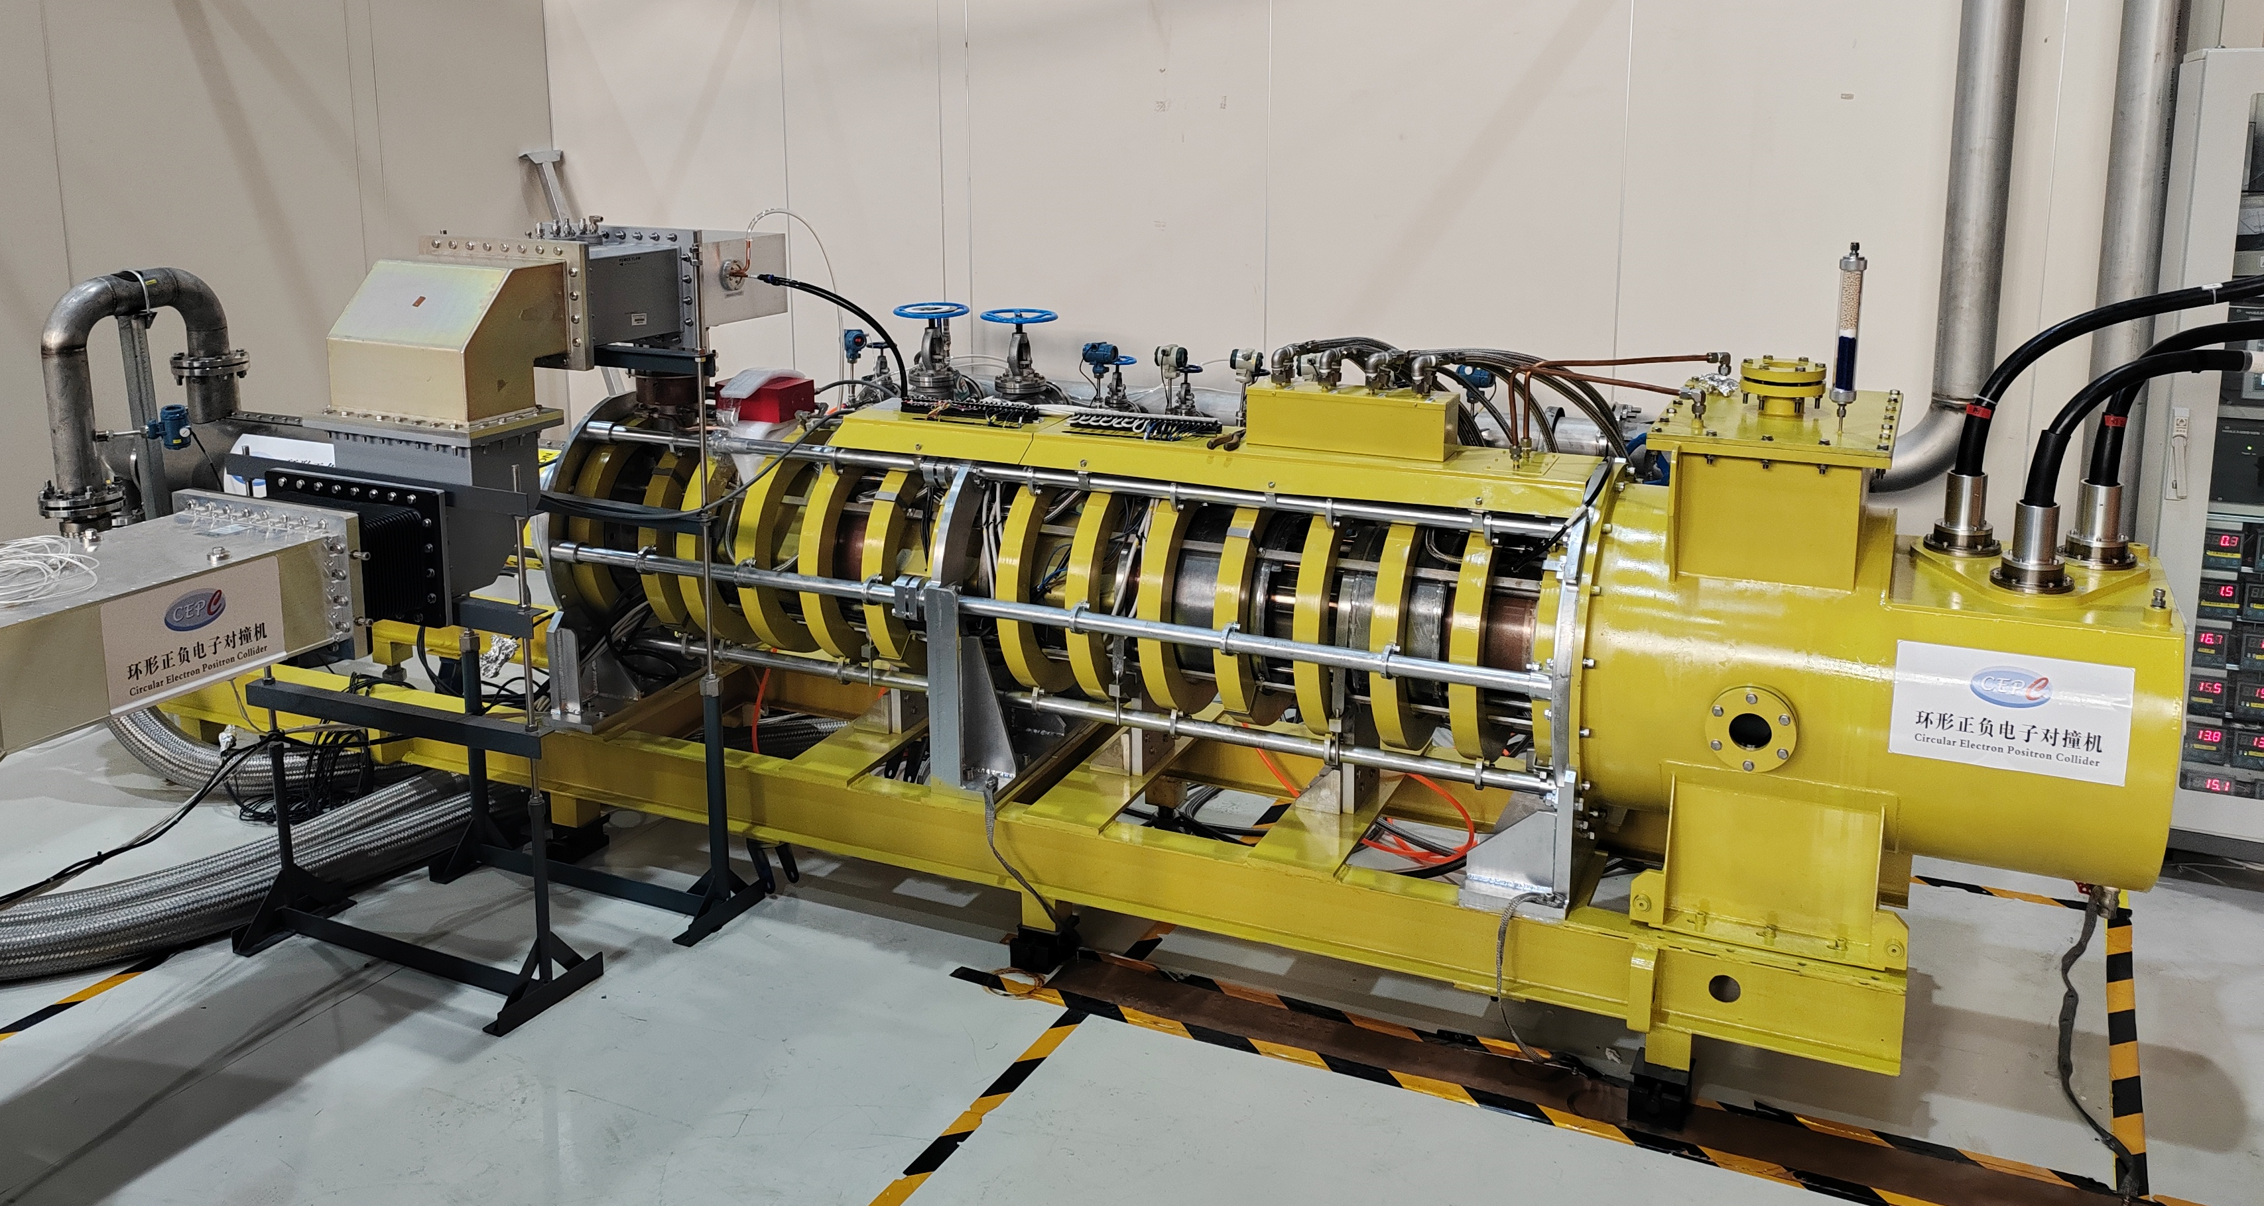
2nd prototype (HE design)
Jan. 2021: Prototype manufacture
Jul. 2022: CW 630kW with Eff. 70.5% (1st stage high power test)
Aug. 2024: CW 803kW with Eff. 78.5% (2nd stage high power test)

Slide 21
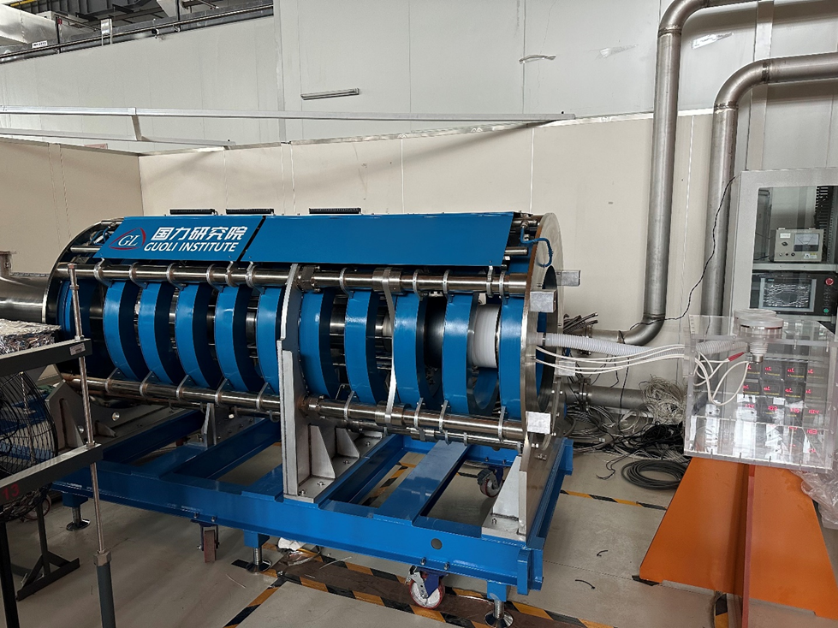
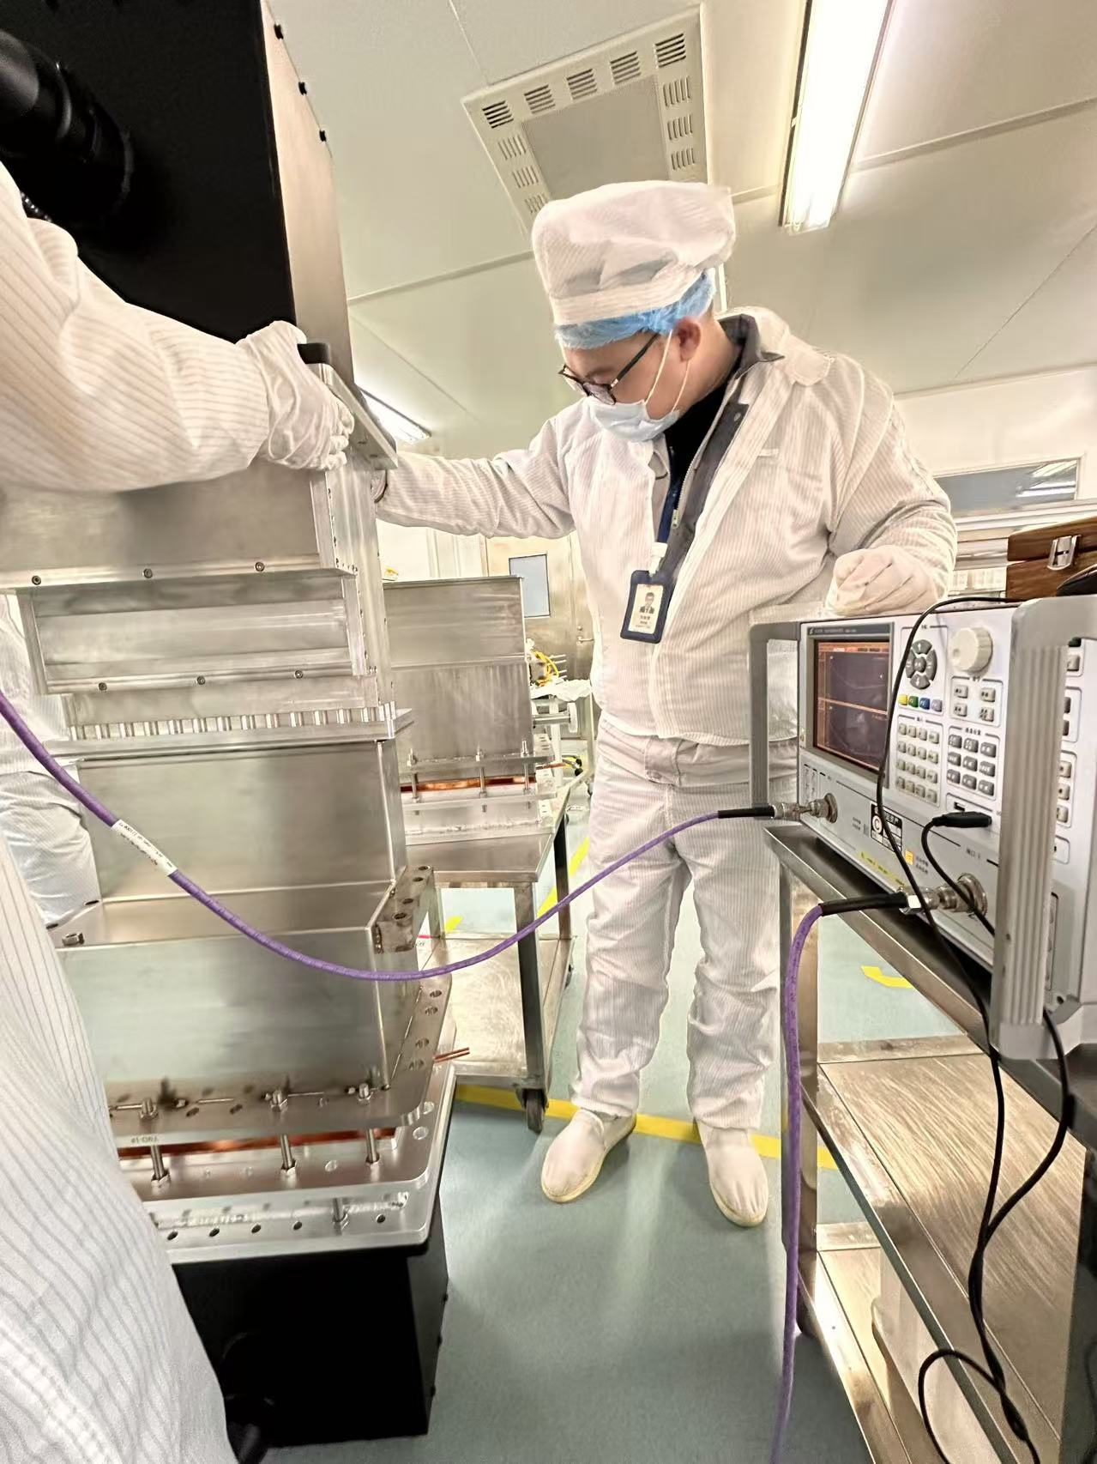
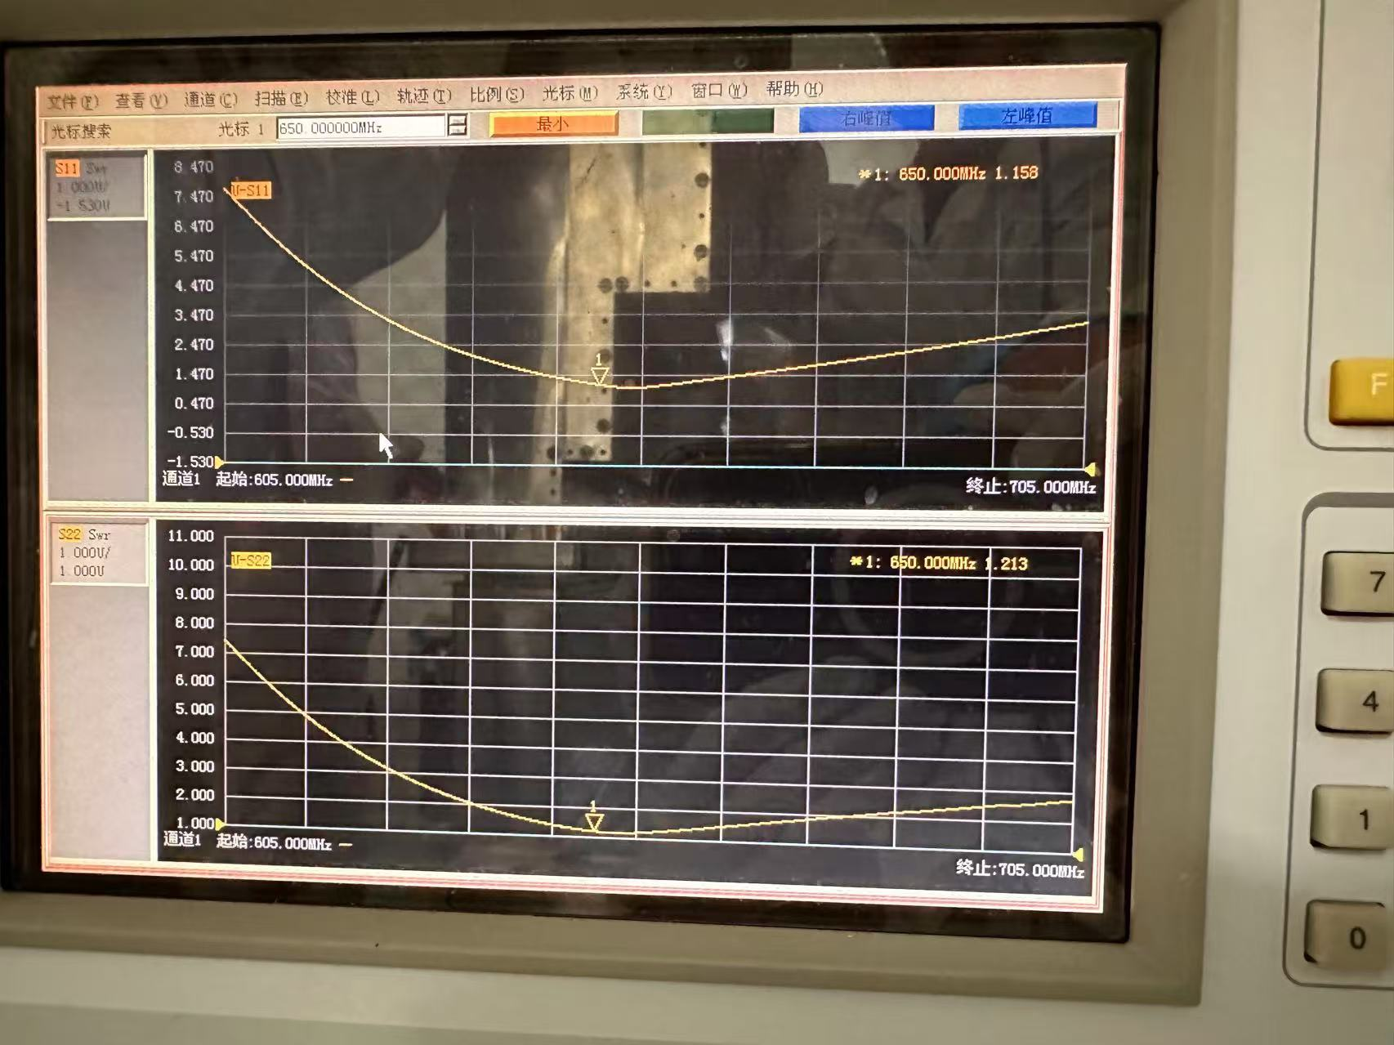
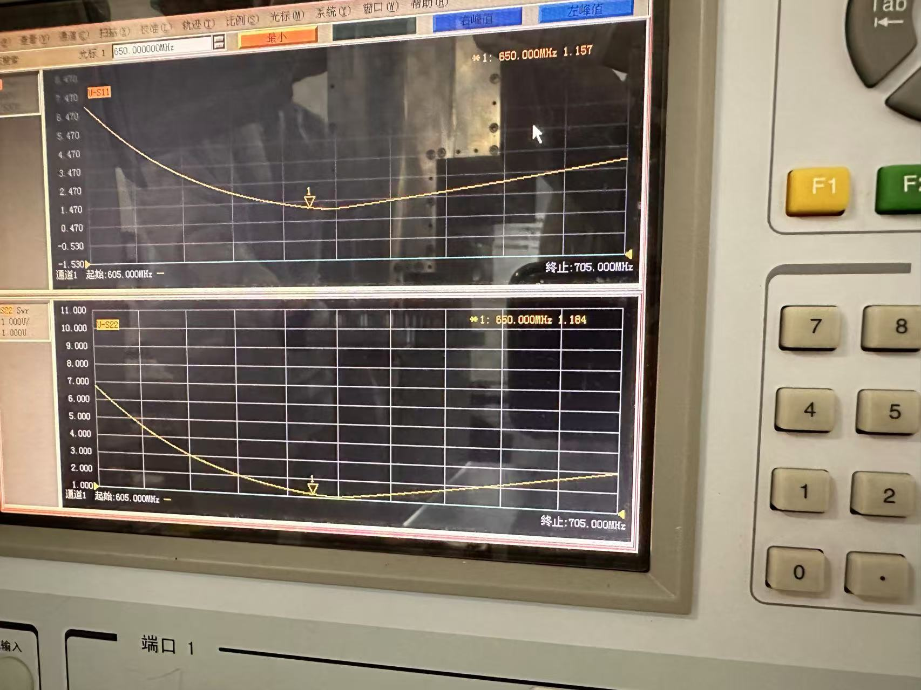
3rd prototype (MBK)
Dec. 2021: Klystron beam tester manufacture
Oct. 2023: Accomplishment of klystron beam tester high voltage conditioning and beam emission.
Now: Klystron prototype manufacture is in progress.

Slide 22
C band klystron

Slide 23
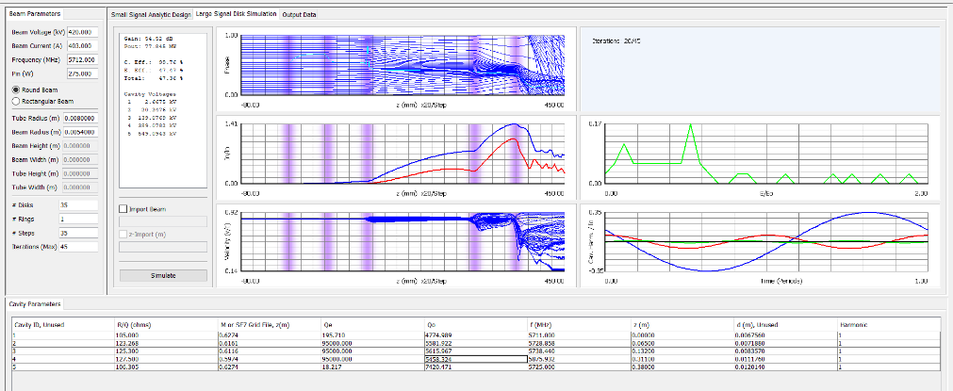
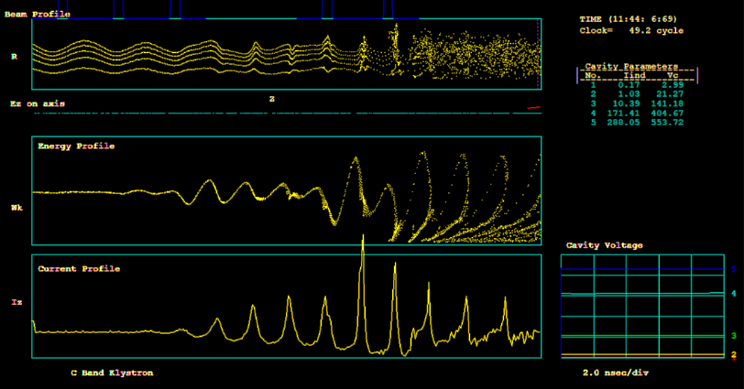
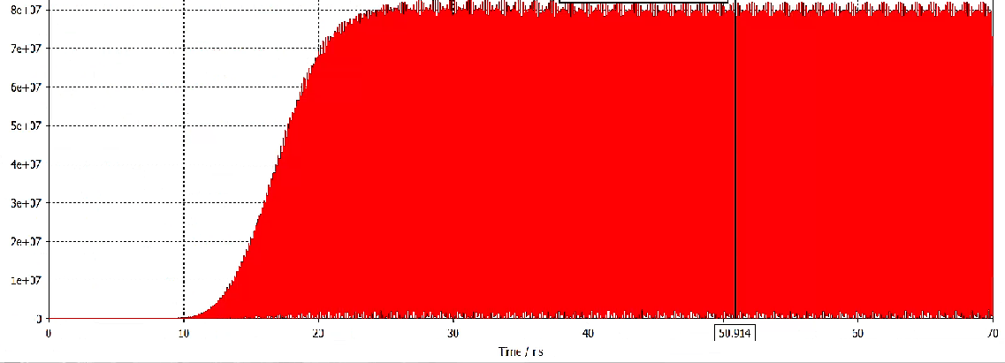
Design progress
Beam dynamics
Main parameters
Parameters | Value
Frequency | 5720 MHz
Output Power | 80MW
Pulsed width | 3us
Repetition rate | 100Hz
Gain | 54 dB
Efficiency | 47%
Beam voltage | 420 kV
Beam current | 403 A

Slide 24
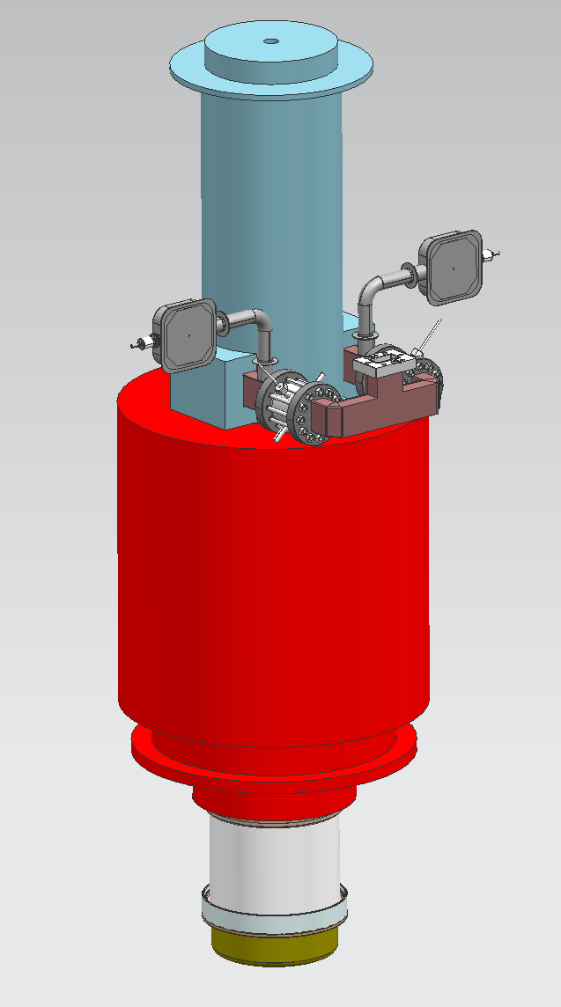
Fabrication progress
Prototype manufacture is started from August 2024.
The processing is scheduled to be completed in July this year.

Slide 25
Energy recovery klystron

Slide 26
3rd-Energy recovery
Higher efficiency
Less power consumption
CEPC annual electricity @6000 hours/year
Assuming klystron efficiency is up to 80%.

Slide 27
3rd-Energy recovery
Higher efficiency
Less power consumption
CEPC annual electricity @6000 hours/year
It is difficult to increase RF conversion efficiency of the klystron itself from 80% to 85 or 90%? So we need other methods to achieve a leap in efficiency.

Slide 28
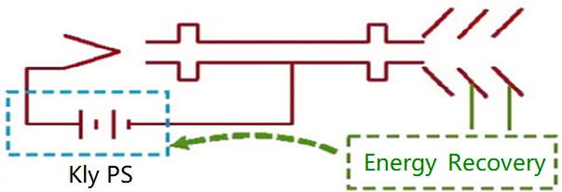
Energy recovery klystron(ERK)
The energy recovery klystron recovers energy from the spent electron beam by multi-depressed collector, thereby reducing the power demand from the grid and significantly lowering operation.
RF OUT
Typical klystron
Energy recovery klystron

Slide 29
Roughly theoretical analysis
Based on high efficiency klystron design
Final efficiency is the whole efficiency of ERK
Stage No. | Linear region | Saturation region
Without stage | 65% | 77.5%
Single stage | 72.9% | 84.3%
Two stages | 79.4% | 88.1%
Three stages | 83.0% | 90.1%

Slide 30
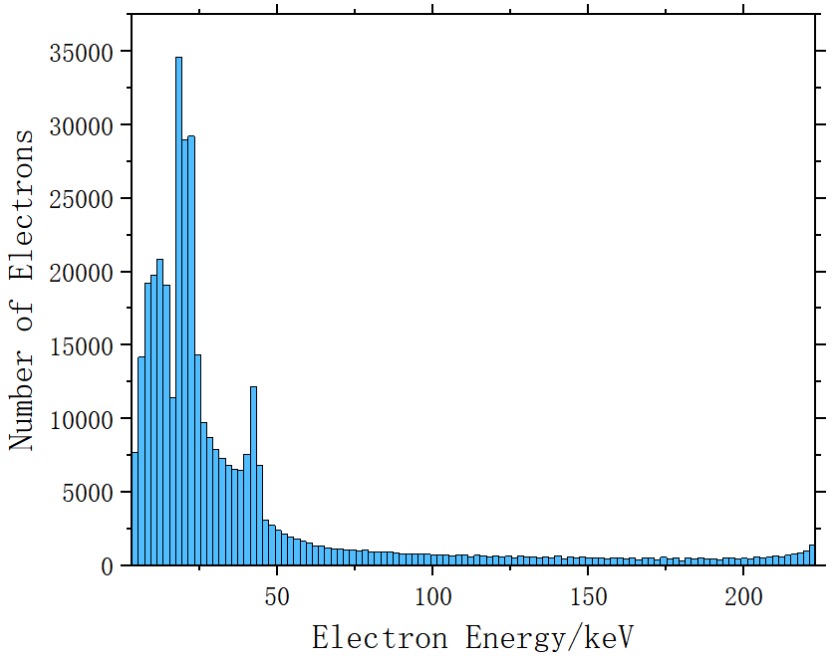
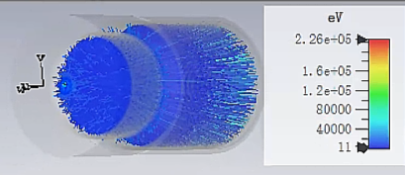
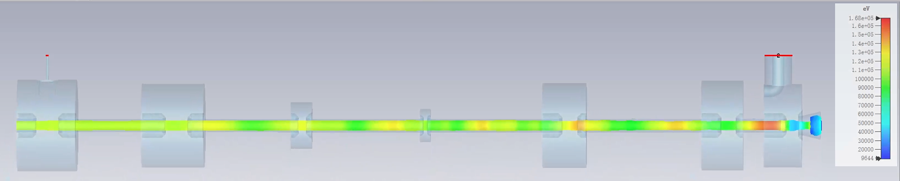
Design progress
Parameter | Value
Operating frequency | 650 MHz
Beam Voltage | 113 kV
Efficiency | 77.5%
Output power | 800 kW
Beam perveance | 0.25 μP
Beam current | 9.5A
Efficiency (one-stage depressed collector) | 84%
One-stage depressed collector
The energy distribution of spent electron beams
PIC (Particle-In-Cell) beam simulation

Slide 31
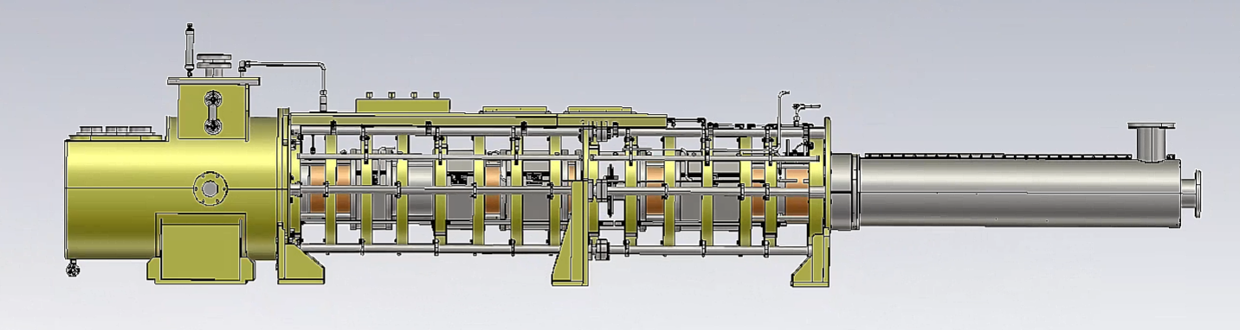
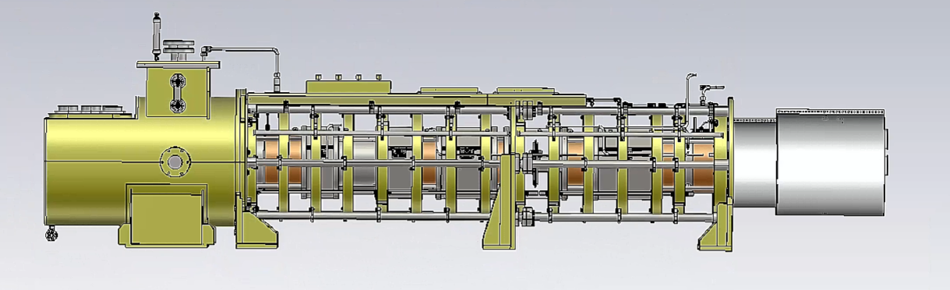
Preliminary mechanical design
5048mm
4200mm

Slide 32
Conclusion
The high power test of high-efficiency klystron prototype has been successfully completed, achieving a continuous wave (CW) output of 803 kW and an efficiency of 78.5%.
The processing of C band 80MW klystron is under progress.
Processing and high-power test of the MBK will be conducted in the near future.
Development of an energy recovery klystron based on high efficiency klystron technologies is progressing.

Slide 33
Thanks for your attention!

