Slide 1


CEPC Superconducting RF Progress
Jiyuan Zhai
IAS Program on Fundamental Physics, January 15, 2025, HKUST, Hongkong

Slide 2
Content
Introduction
CEPC SRF Progress
Summary

Slide 3
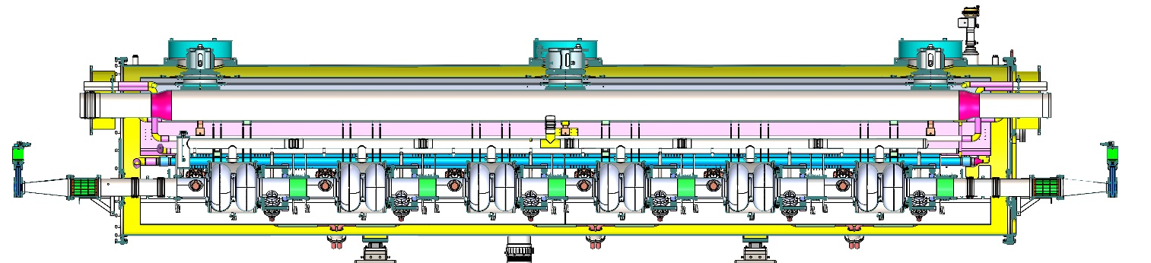
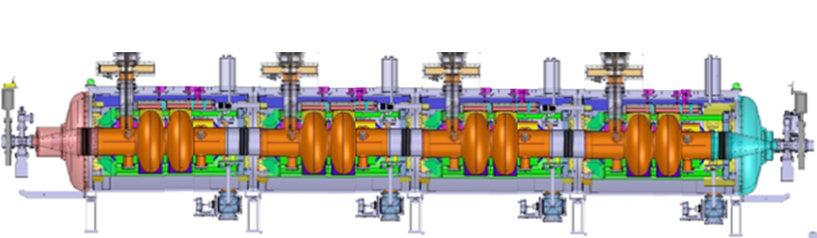
Collider SRF System of CEPC and FCC-ee
 | CEPC TDR 50 (30) MW | FCC-ee (new) 50 MW
RF freq. and cav. material | 650 MHz, high Q Nb | 400 MHz, Nb film on Cu
Cavity in cryomodule | 336 (192) 2-cell, 56 (32) CM | 264 2-cell, 66 CM
Cavity gradient and Q | 3E10 @ 14.5 (25) MV/m @ 2 K | 2.7E9 @ 10.6 MV/m @ 4.5 K
Cavity dynamic loss @ 4.5 K | 25 (72) W, total 8.4 (14) kW equiv. | 128 W, total 33 kW
Cavity max input / HOM power | 298 (313) kW / 12 (6 if 1-cell) kW | 378 kW / 10 (8 if 1-cell) kW
Operation (HL-Z) | Dedicated 1-cell cavity for Z (FCC-ee baseline before H, CEPC TDR > 10 MW Z after H) → Single 2-cell or 1-cell RF system with fast beam switch for Z/W/H (separate RF for Z/W). Z 2-cell problems: Qe range, HOM power in multi-cavity CM, HOM & FM CBI. H 1-cell problem: cavity gradient, FE, Z HOM …
CEPC
FCC-ee

Slide 4
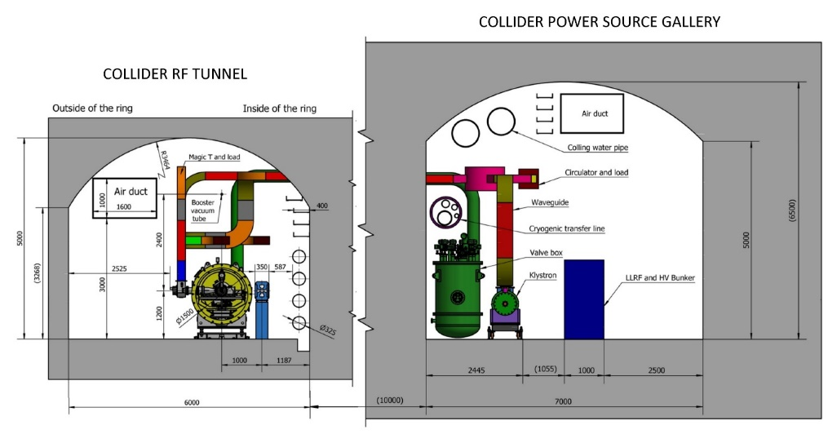
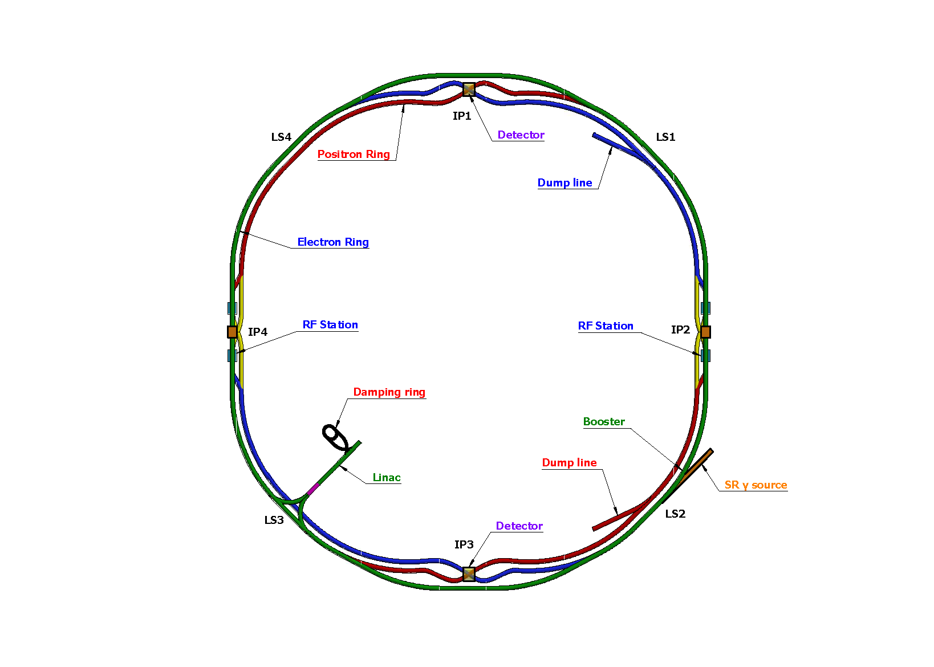
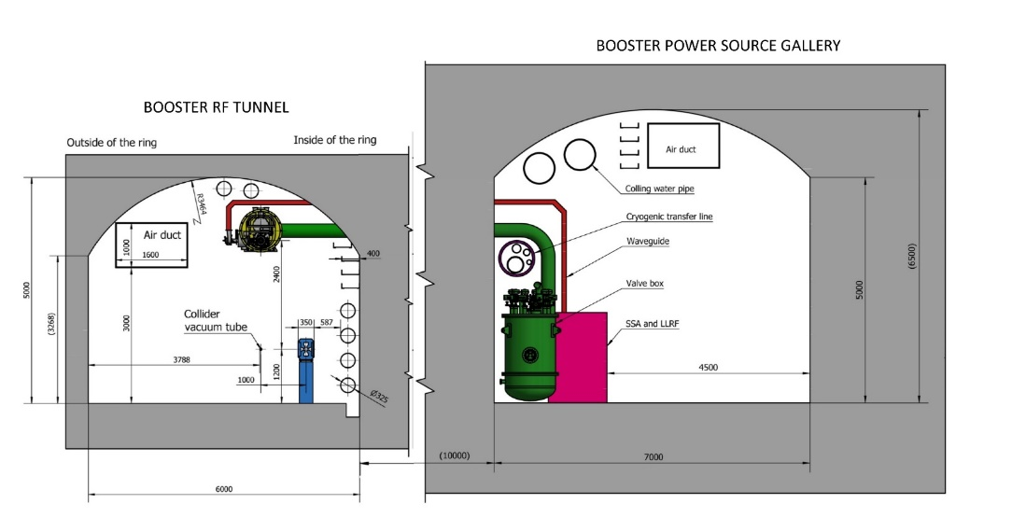
CEPC RF Layout
650 MHz cryomodules mounted on tunnel floor. Cavities operate in CW mode.
RF in two 3.7 km long straight sections
1.3 GHz cryomodules hung from ceiling at a different beamline height and in between collider cryomodule sections. Cavities operate in fast voltage ramp mode.

Slide 5
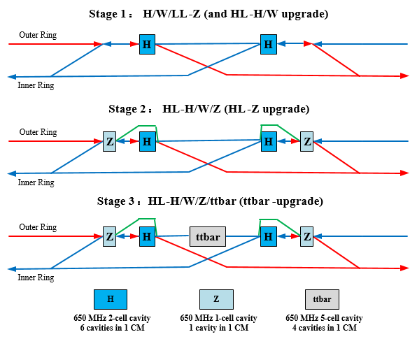
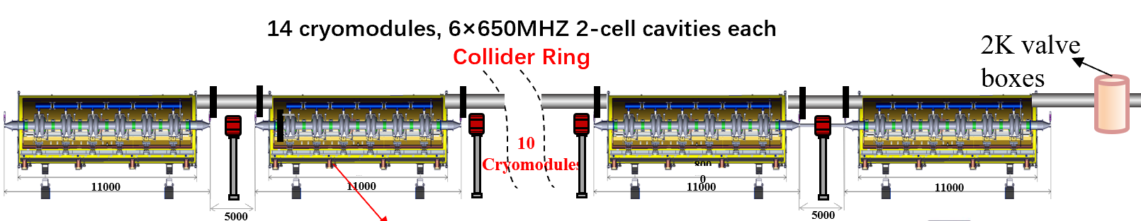
CEPC RF Layout
650 MHz 1-cell
650 MHz 2-cell
650 MHz 5-cell
30 MW: 15 CM
50 MW: 25 CM
30 MW: 8 CM (48 CAV)
50 MW: 14 CM (84 CAV)
12 CM (48 CAV)
1.3 GHz
9-cell
1 CM (8 CAV)
3 CM (24 CAV)
8 CM (64 CAV)
Center of IP2/4
Collider RF Staging and Bypass Scheme
2x1.8 km RF section, 3 km RF module footprint, 2 km RF module length
628 650 MHz cavities, 384 1.3 GHz cavities, total 1012 cavities, 5188 cells
Collider and booster RF bypass for mode switch.

Slide 6
EDR Plan of CEPC SRF System
EDR major goal is to prepare for the first stage construction of the CEPC SRF system (30 MW H/W & low-lumi Z):
Complete engineering design of the Collider 650 MHz and Booster 1.3 GHz cryomodule for Higgs 30/50 MW & Z 10 MW (3.8×10³⁵ cm⁻²s⁻¹).
Complete Higgs 650 MHz full-scale cryomodule prototyping to achieve TDR specification.
High Q high gradient cavity and high power RF components R&D.
Collider Higgs 650 MHz Cryomodule Parameters | Spec.
Module operating temperature | 2 K
Cavity vertical test gradient | 28 MV/m
Cavity vertical test Q₀ at 25 MV/m | 3.3E10
Module RF voltage (six 2-cell cavities) | 70 MV
Module average cavity gradient | 25 MV/m
Module average cavity Q₀ at 25 MV/m | 3.0E10
Module total 2 K heat load at 70 MV | 160 W
Input coupler conditioning power | 300 kW
Input coupler Q_{e} adjusting range | 1E5 ~ 1E7
HOM coupler power (cryogenic test) | 1 kW
HOM absorber power (test stand) | 5 kW
CEPC SRF Module EDR (2024-2027) | Preliminary Design | Engineering Design | Full-scale Prototyping | Industrial Preparation
Collider H/W (high Q / G 650 M) |  | √ | √ | √
Collider HL-Z (high current 650 M) | √
Collider ttbar (high G / Q 650 M) | √
Booster H/W (high Q / G 1.3 G) |  | √ | improve | √
Booster Z (high current 1.3 G) |  | √ | R&D

Slide 7
Content
Introduction
CEPC SRF Progress
Summary

Slide 8
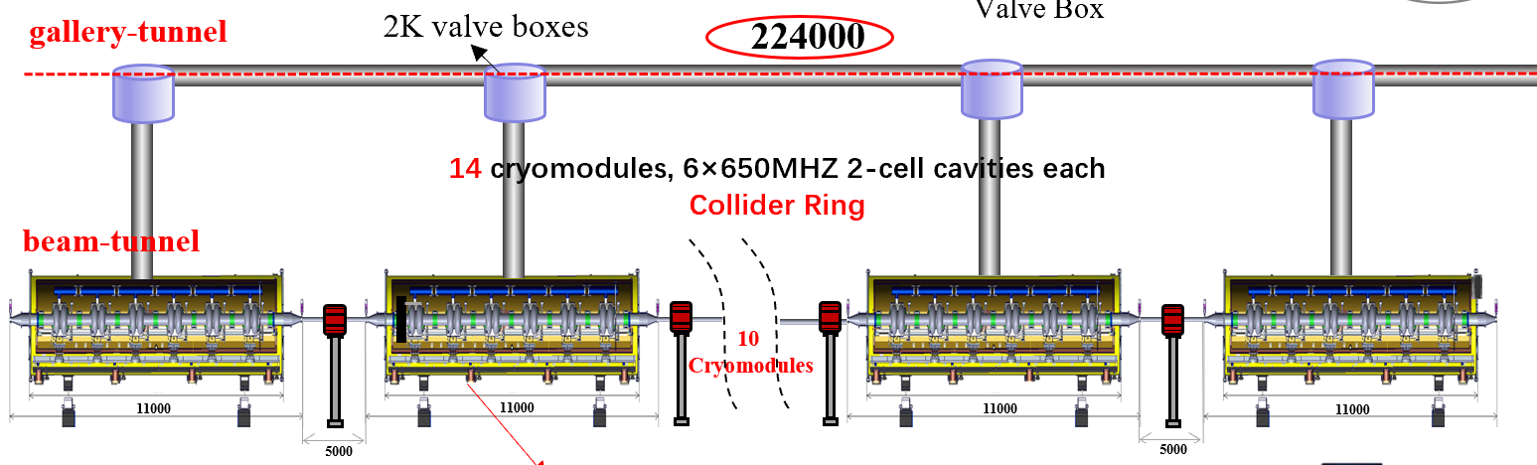
650 MHz Module Connection of CEPC Collider Ring
C
D
R
“Parallel”
cryogenic connection
TDR
“Series”
cryogenic connection
Multi-channel cryogenic transfer lines (CTL) inside cryomodule for TDR module connection scheme. Combines the features of cryomodule, valve box and cryogenic lines. Shared vacuum, make full use of space, low cost.
XFEL/ILC type module connection (all-cold beam line) not suitable for CEPC Collider cryomodules due to cooling requirement of huger HOM power (~ 5 kW per absorber). Water-cooling HOM absorbers in the two ends outside of the cryomodule at room-temperature, and normal conducting quadrupoles outside.

Slide 9
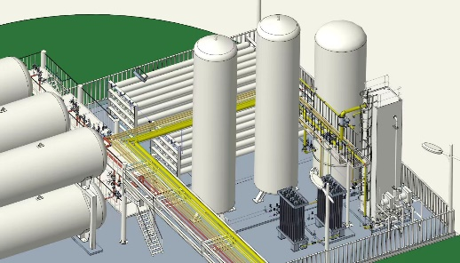
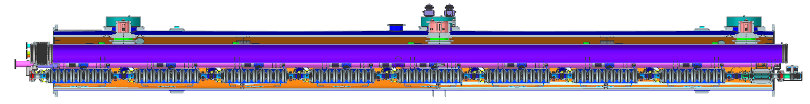
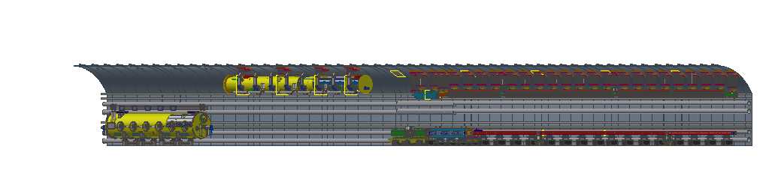
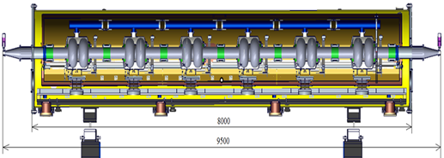
Flow Chart of SRF Module
Rui Ge, Mei Li
5 K @ 3 bara supercritical helium is subcooled to 4.5 K in the lower coldbox, and then further be cooled to 2.4 K @ 3 bara by a large heat exchanger ( ~ 90 g/s of each, total four HX)
2.4 K @ 3 bara helium is transferred to the beam tunnel, then is throttled by JT valve inside CM to produce the 2 K superfluid helium
Return GHe goes through 2 K HX and cold compressors to recover the cold quantity, then returns to CB and compressors LP side to finalize the whole cycle
40-80 K thermal shield is set to reduce the radiation loss
5-8 K circuit is set to cool down the coupler (conduction cooling)
Tanks zone
RF shaft
Upper Cold Box
（300K-80K）
Compressor group
Auxiliary tunnel
15kW@4.5K
100m shaft
Control cabinet
Lower Cold Box
（80K-4.5K）
10m
2K coldbox
3 cryomodules, 8 × 1.3 GHz 9-cell cavities each
Booster Ring
2KVB
10m
1
Cryomodules
20m
11000
11000
8000
32m
Beam tunnel
12
Cryomodules
From Haijing Wang
Phase seperator
8000
80m
Higgs 50MW
95000
224m
9500
14 cryomodules, 6 × 650 MHz 2-cell cavities each
Collider Ring

Slide 10
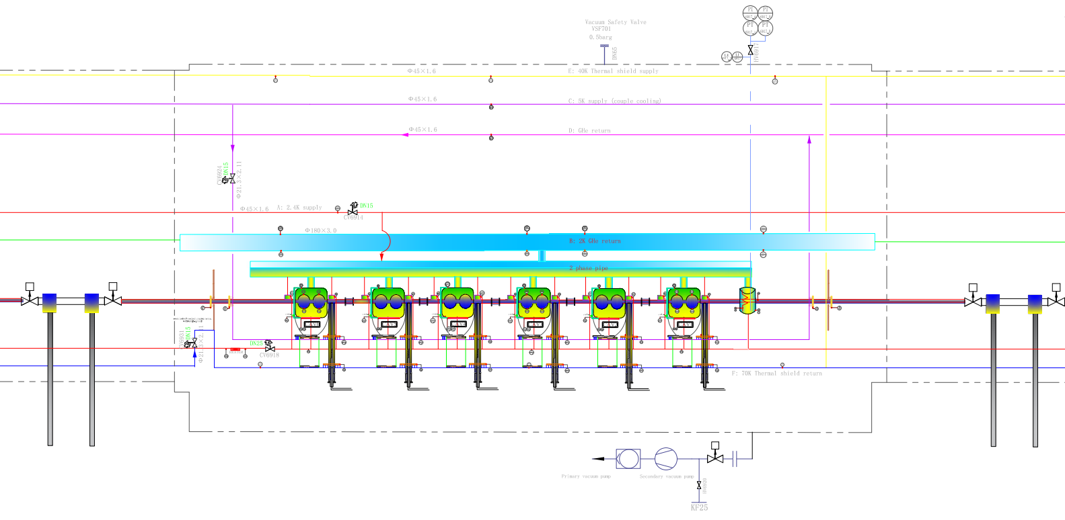
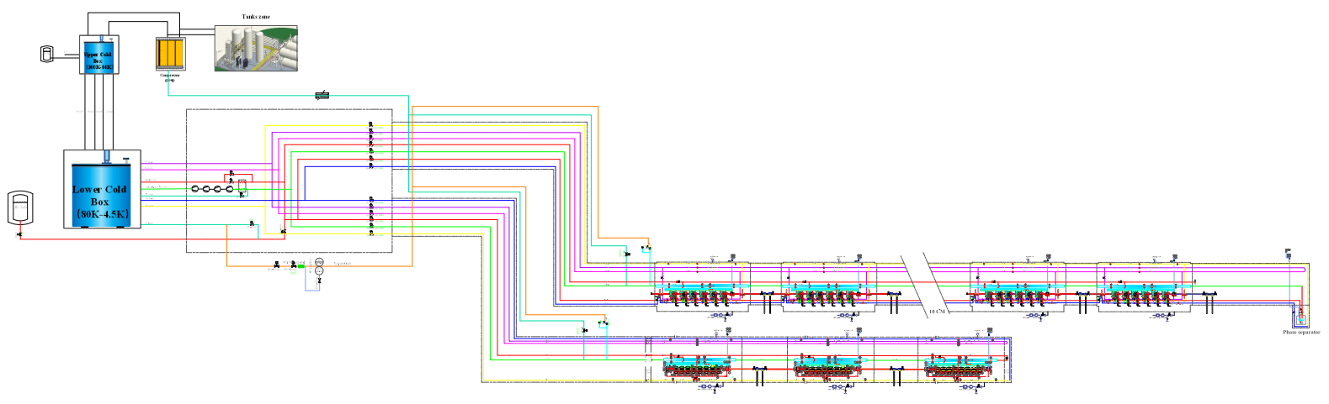
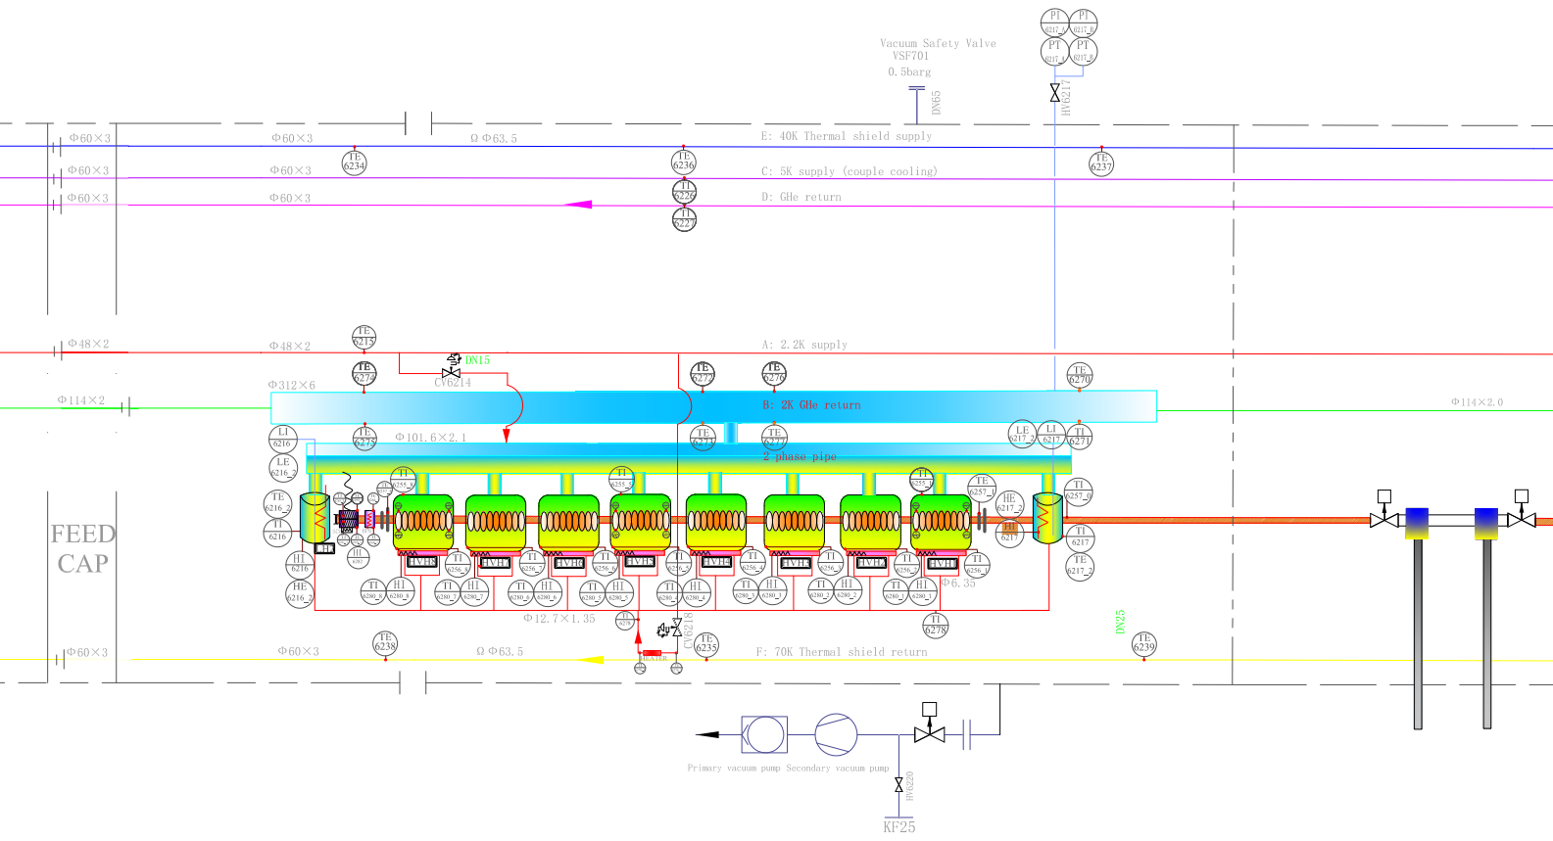
Process Flow Diagram of SRF Module
Rui Ge, Mei Li
End phase separator
Collider CM: 6×650MHZ 2-cell cavities each
Refrigerator
2K coldbox
14 cryomodules, 6×650MHZ 2-cell cavities each
Collider Ring
3 cryomodules, 8×1.3GHZ 9-cell cavities each
Booster Ring
Booster CM: 8×1.3GHZ 9-cell cavities each

Slide 11
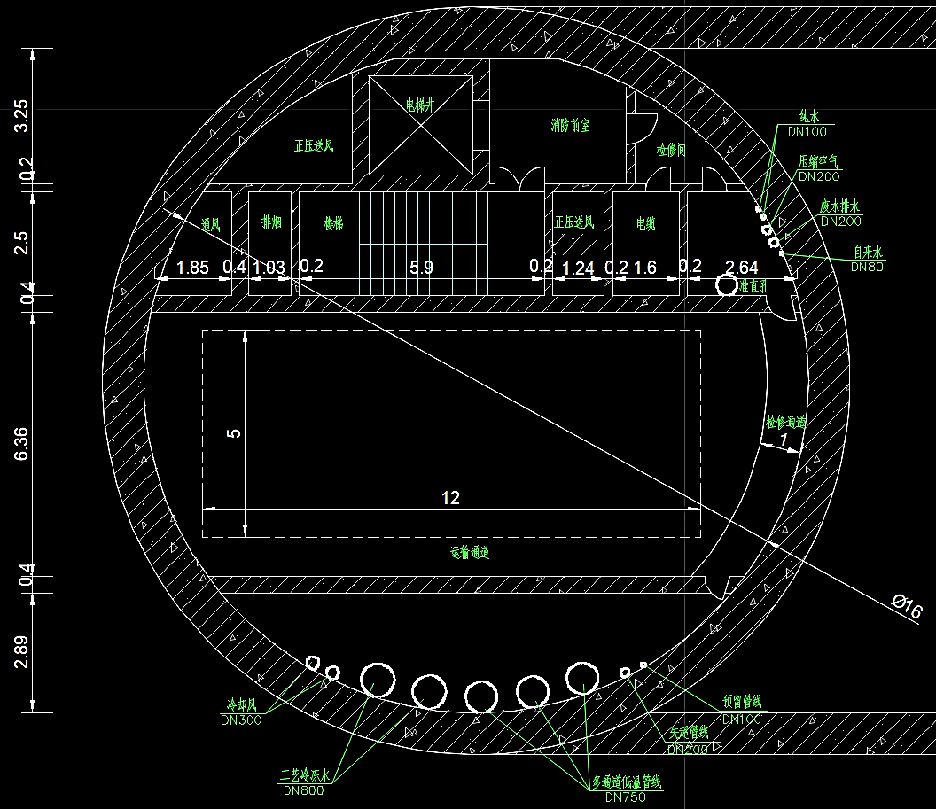
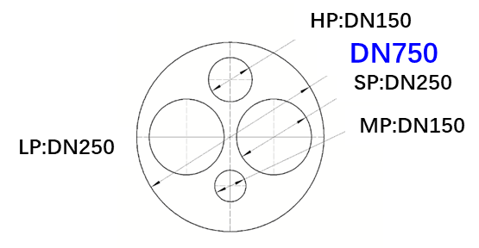
CEPC Cryogenic Layout at RF Section
Rui Ge, Mei Li
Higgs 30MW/50MW
Compressor system
RF
shaft
He Gas Tanks
LN2 system
Upper coldbox
H30MW:
4.83(Collider)+0.72(booster)=5.55kW@2K
3.54+0.95=4.49kW@5K~8K
15.8+5.6=21.4kW@40K~70K
Total (*1.54) 52.21kW@4.5K
4*15kW@4.5K large helium refrigerator
Ground surface
LHe
Dewar
Lower coldbox
Multiple TL: 1*DN750
(ttbar add 2*DN750)
Quench TL: 1*DN300
Reserve TL: 1*DN100
2K valve box
Auxiliary tunnel
DN420
Collider CM internal/external Multiple TL
Beam tunnel
Operating parameters | A | B | C | D | E | F
Pressure / [bara] | 3 | 0.031 | 3 | 2.5 | 13 | 10
Temperature / [K] | 2.4 | 2 | 5 | 8 | 40 | 70
Nominal Pipe Size Do × Thick. / [mm] | Φ45×1.6 | Φ219×3 | Φ45×1.6 | Φ45×1.6 | Φ45×1.6 | Φ45×1.6
Collider CM
(14 cryomodules, 6×650MHZ 2-cell/CM)
Phase seperator
C
B
A
D
F
E
90m
224m
Booster CM external Multiple TL
Booster CM
(3 cryomodules, 8×1.3GHZ 9-cell/CM)
DN400
Operating parameters | A | B | C | D | E | F
Pressure / [bara] | 3 | 0.031 | 3 | 2.5 | 13 | 10
Temperature / [K] | 2.2 | 2 | 5 | 8 | 40 | 70
Nominal Pipe Size Do × Thick. / [mm] | Φ34×1.6 | External Φ114×2 Internal DN300 | Φ34×1.6 | Φ48×1.6 | Φ34×1.6 | Φ34×1.6
C
A
C
A
B
D
B
D
30m
32m
F
E
F
E
Internal Multiple TL
External Multiple TL

Slide 12
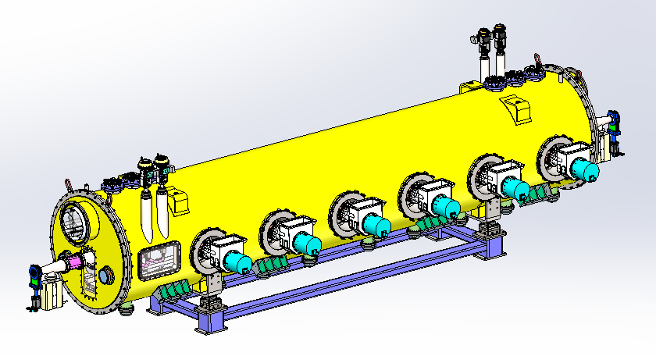
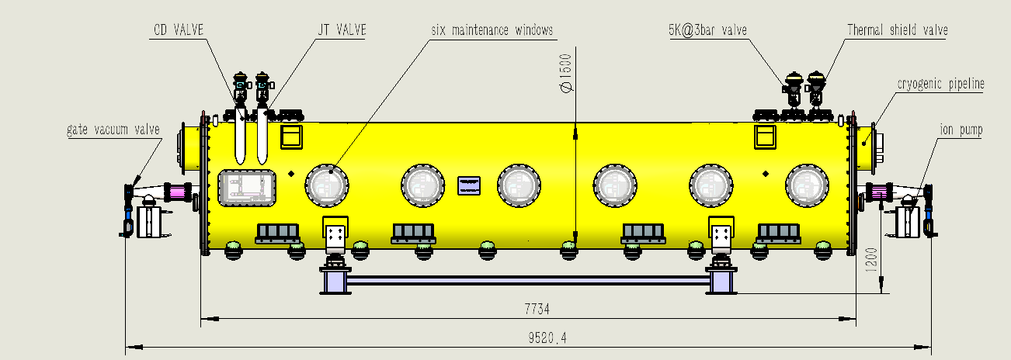
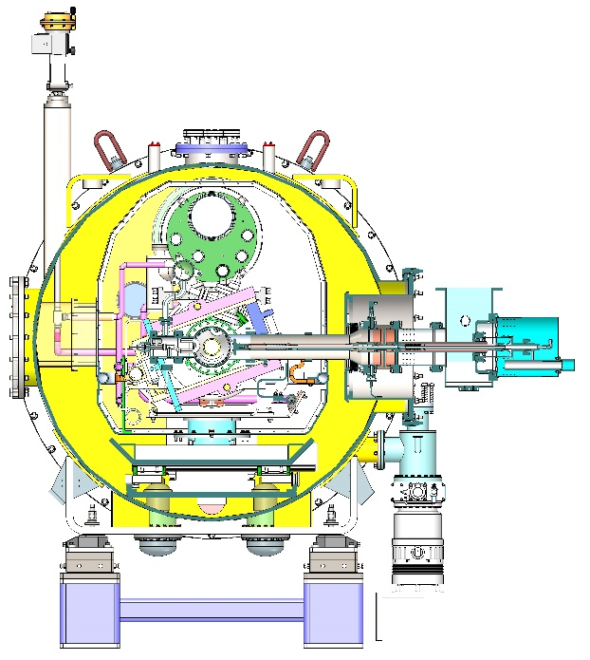
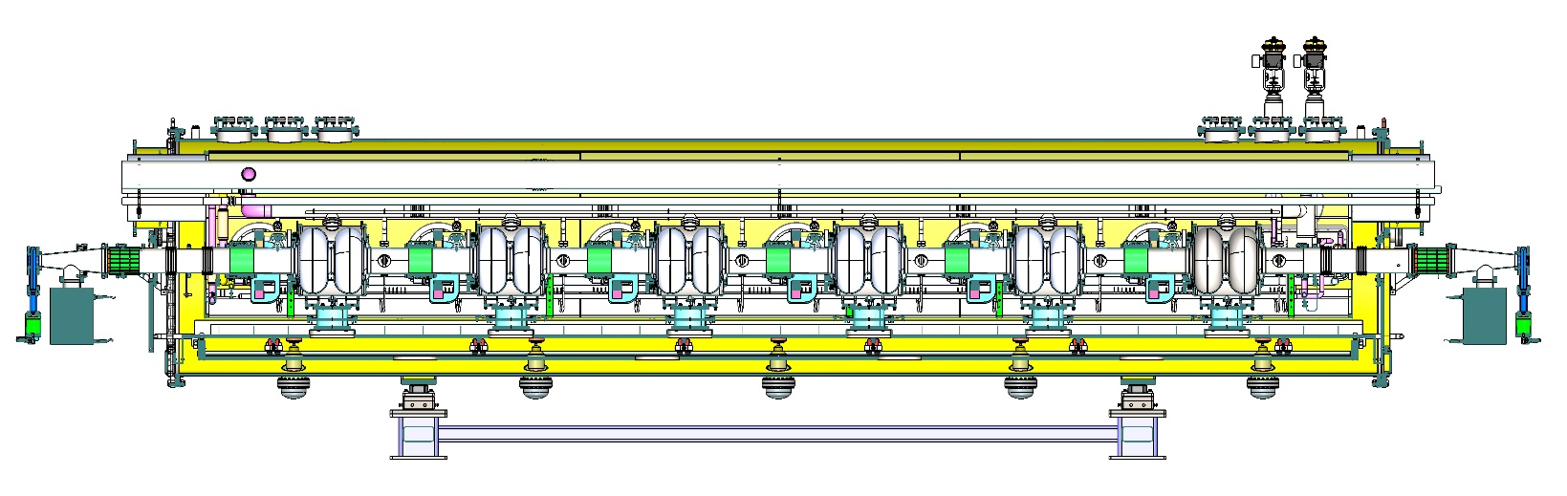
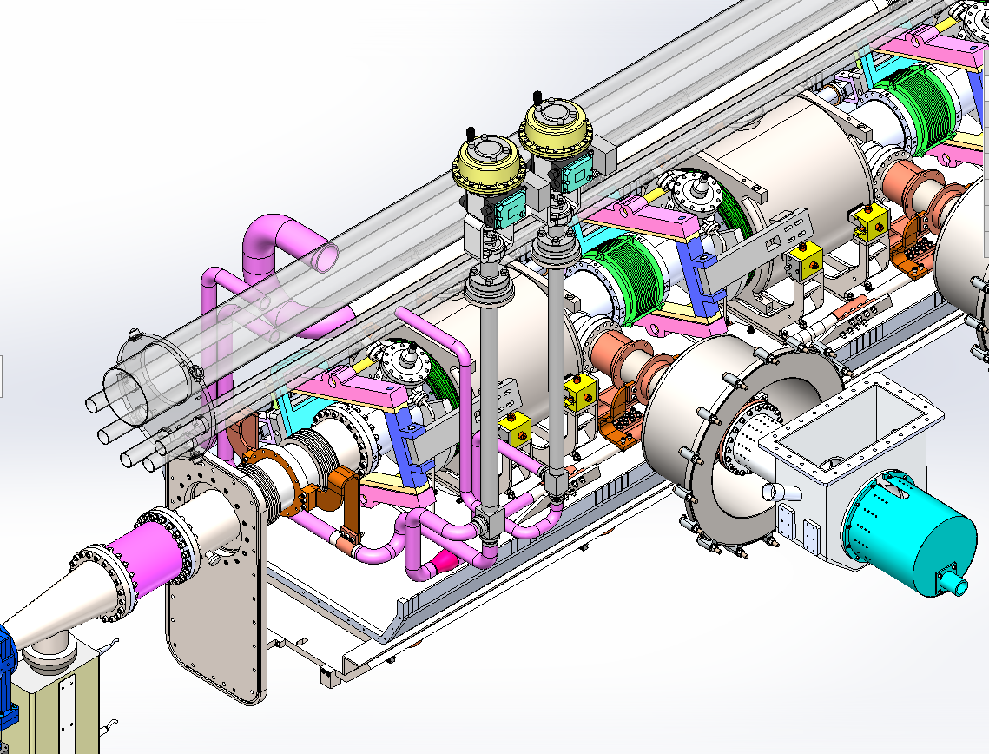
650 MHz Module Design (strongback support)
Strongback support similar to ADS 325 MHz and CSNS-II 648 MHz module.

Slide 13
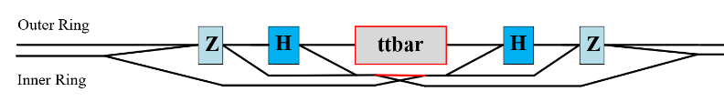
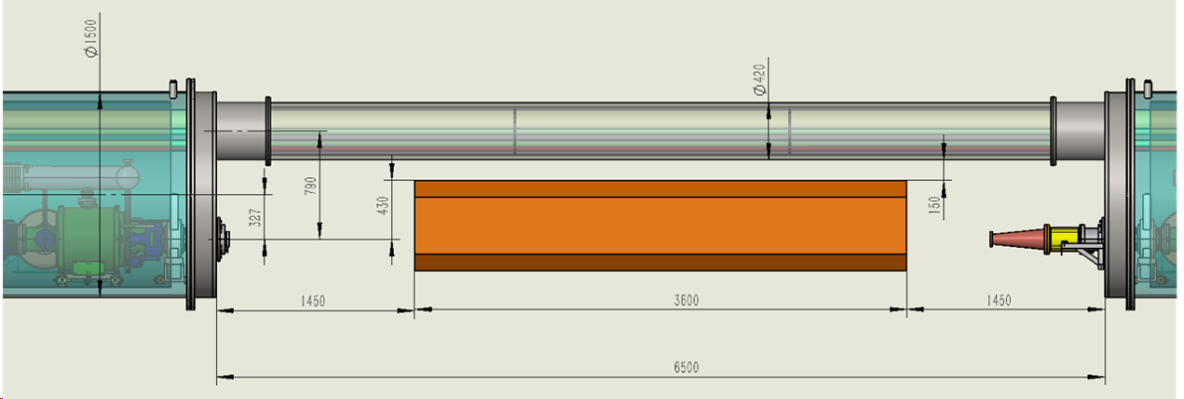
New Constraint on Module Structure
Quadrupole magnet between cryomodules is designed for different energies up to ttbar.
Beta function in RF section is determined by transverse cavity HOM CBI of various operation modes.
Distance between beam axis and CTL should be fit for the magnet and fiducials.
The current space requirement is > 450 mm (300 mm magnet + 150 mm fiducials).
Structure of the cryomodule should consider this constraint.
Calculated from transverse cavity HOM CBI | Beta function limit / m |  |  | 50 MW SR power per beam unless indicated
 | 1-cell | 2-cell | 5-cell | 50 MW SR power per beam unless indicated
Cavity number per beam | 50 | 336 | 192 | W & 10 MW Z: 168
45.5 GeV beam | 69 | 558 | / | 10 MW Z beam for H cavity, if transverse FB time is 1 ms.
80 GeV beam | 1455 | 30 (60) | / | need to reduce cavity Qe by 5 times. Can increase beta function with weak FB and include freq spread. W energy lower than H.
120 GeV beam | 2909 | 46 (60) | / | > 60 if include cavity HOM freq. spread
180 GeV beam | 7E5 | 1160 | 340

Slide 14
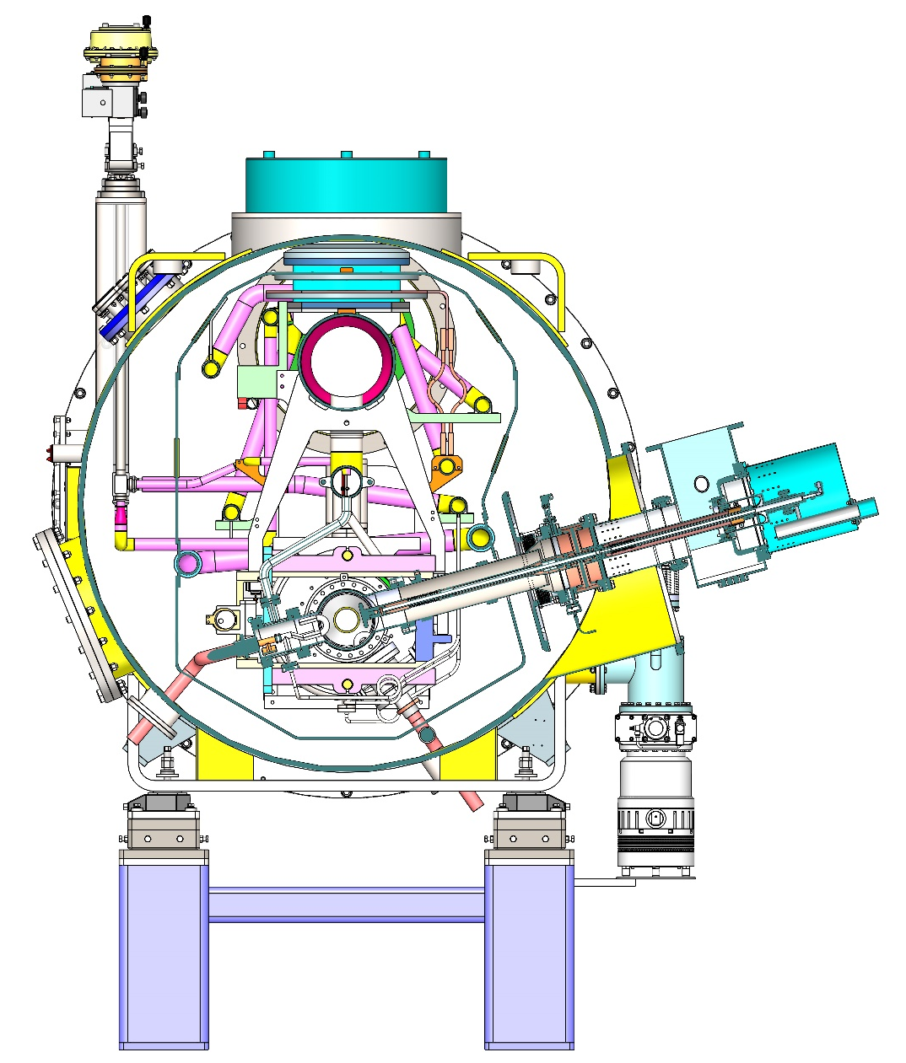

Change from Bottom Support to Top Suspension
Distance between beam axis and CTL: 206 mm (< 450 mm)
Beamline height: 1.2 m
Coupler side transverse dimension from the beam axis: 1.62 m.
Quadrupole spacing: distance between beam axis and CTL 510 mm (> 450 mm) (CTL OD 509 mm)
Beamline height: 1.2 m. Can be reduced to 0.8 m (same with arc section). Module height: 2.5 m (valve 2.9 m) reduce to 2.1 m.
Tunnel space
  Outside (transportation and HL-Z bypass line): coupler side transverse dimension from the beam axis 1.48 m (TDR 1.29 m)
  Inside (W/Z bypass line vacuum chamber, pipes and cables) : Module end flange OD 1.65 m (TDR 1.5 m). Tuner access port spacing.
Height: 2.1 m (valve 2.6 m)
Bottom Support
Top Suspension

Slide 15
RF Section Tunnel (TDR)

Slide 16
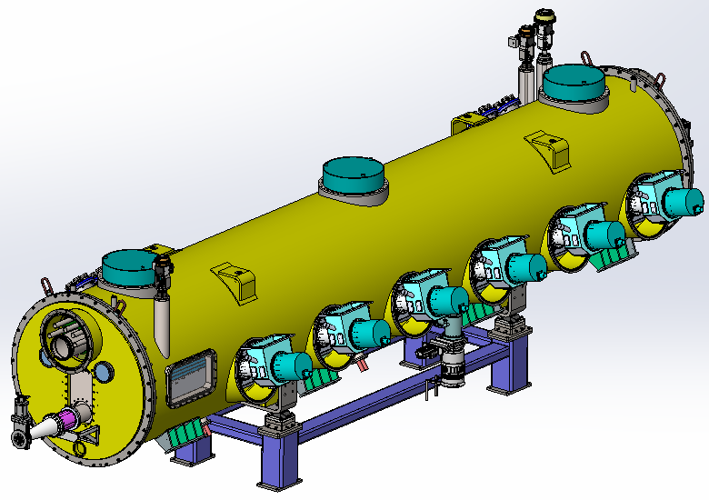
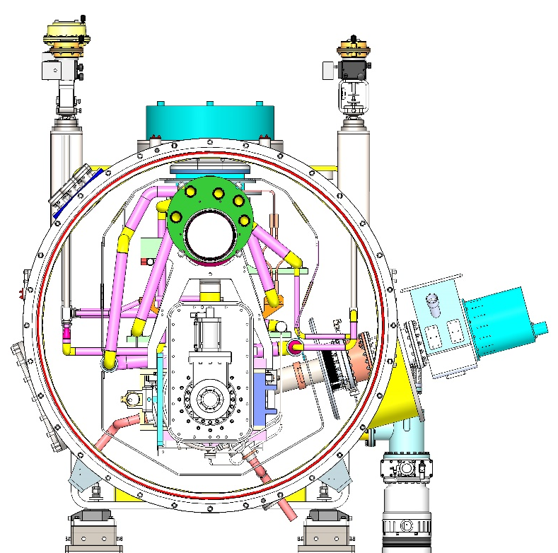

New 650 MHz Cryomodule Design
Two 5 ~ 8 K Ø45 pipes for coupler, two 40 ~ 70 K Ø45 pipes for thermal shield, one 2 K Ø273 (inside CM) Ø219 (outside CM) GRP, 3 Bara @ 2.4 K Ø45 pipe for subcooled supply.
Coupler change from horizontal to 15 deg tilt due to off-axis (move downward) and cold mass-vacuum vessel assembly requirement. Coupler length also reduced.
12 coaxial lines for power extraction of 12 HOM couplers (1 kW each).
Remove the ion pump inside the gate valve.
RF shielded bellow between cavities.
Impedance and heat load of cavity flange seal gap to be evaluated.

Slide 17
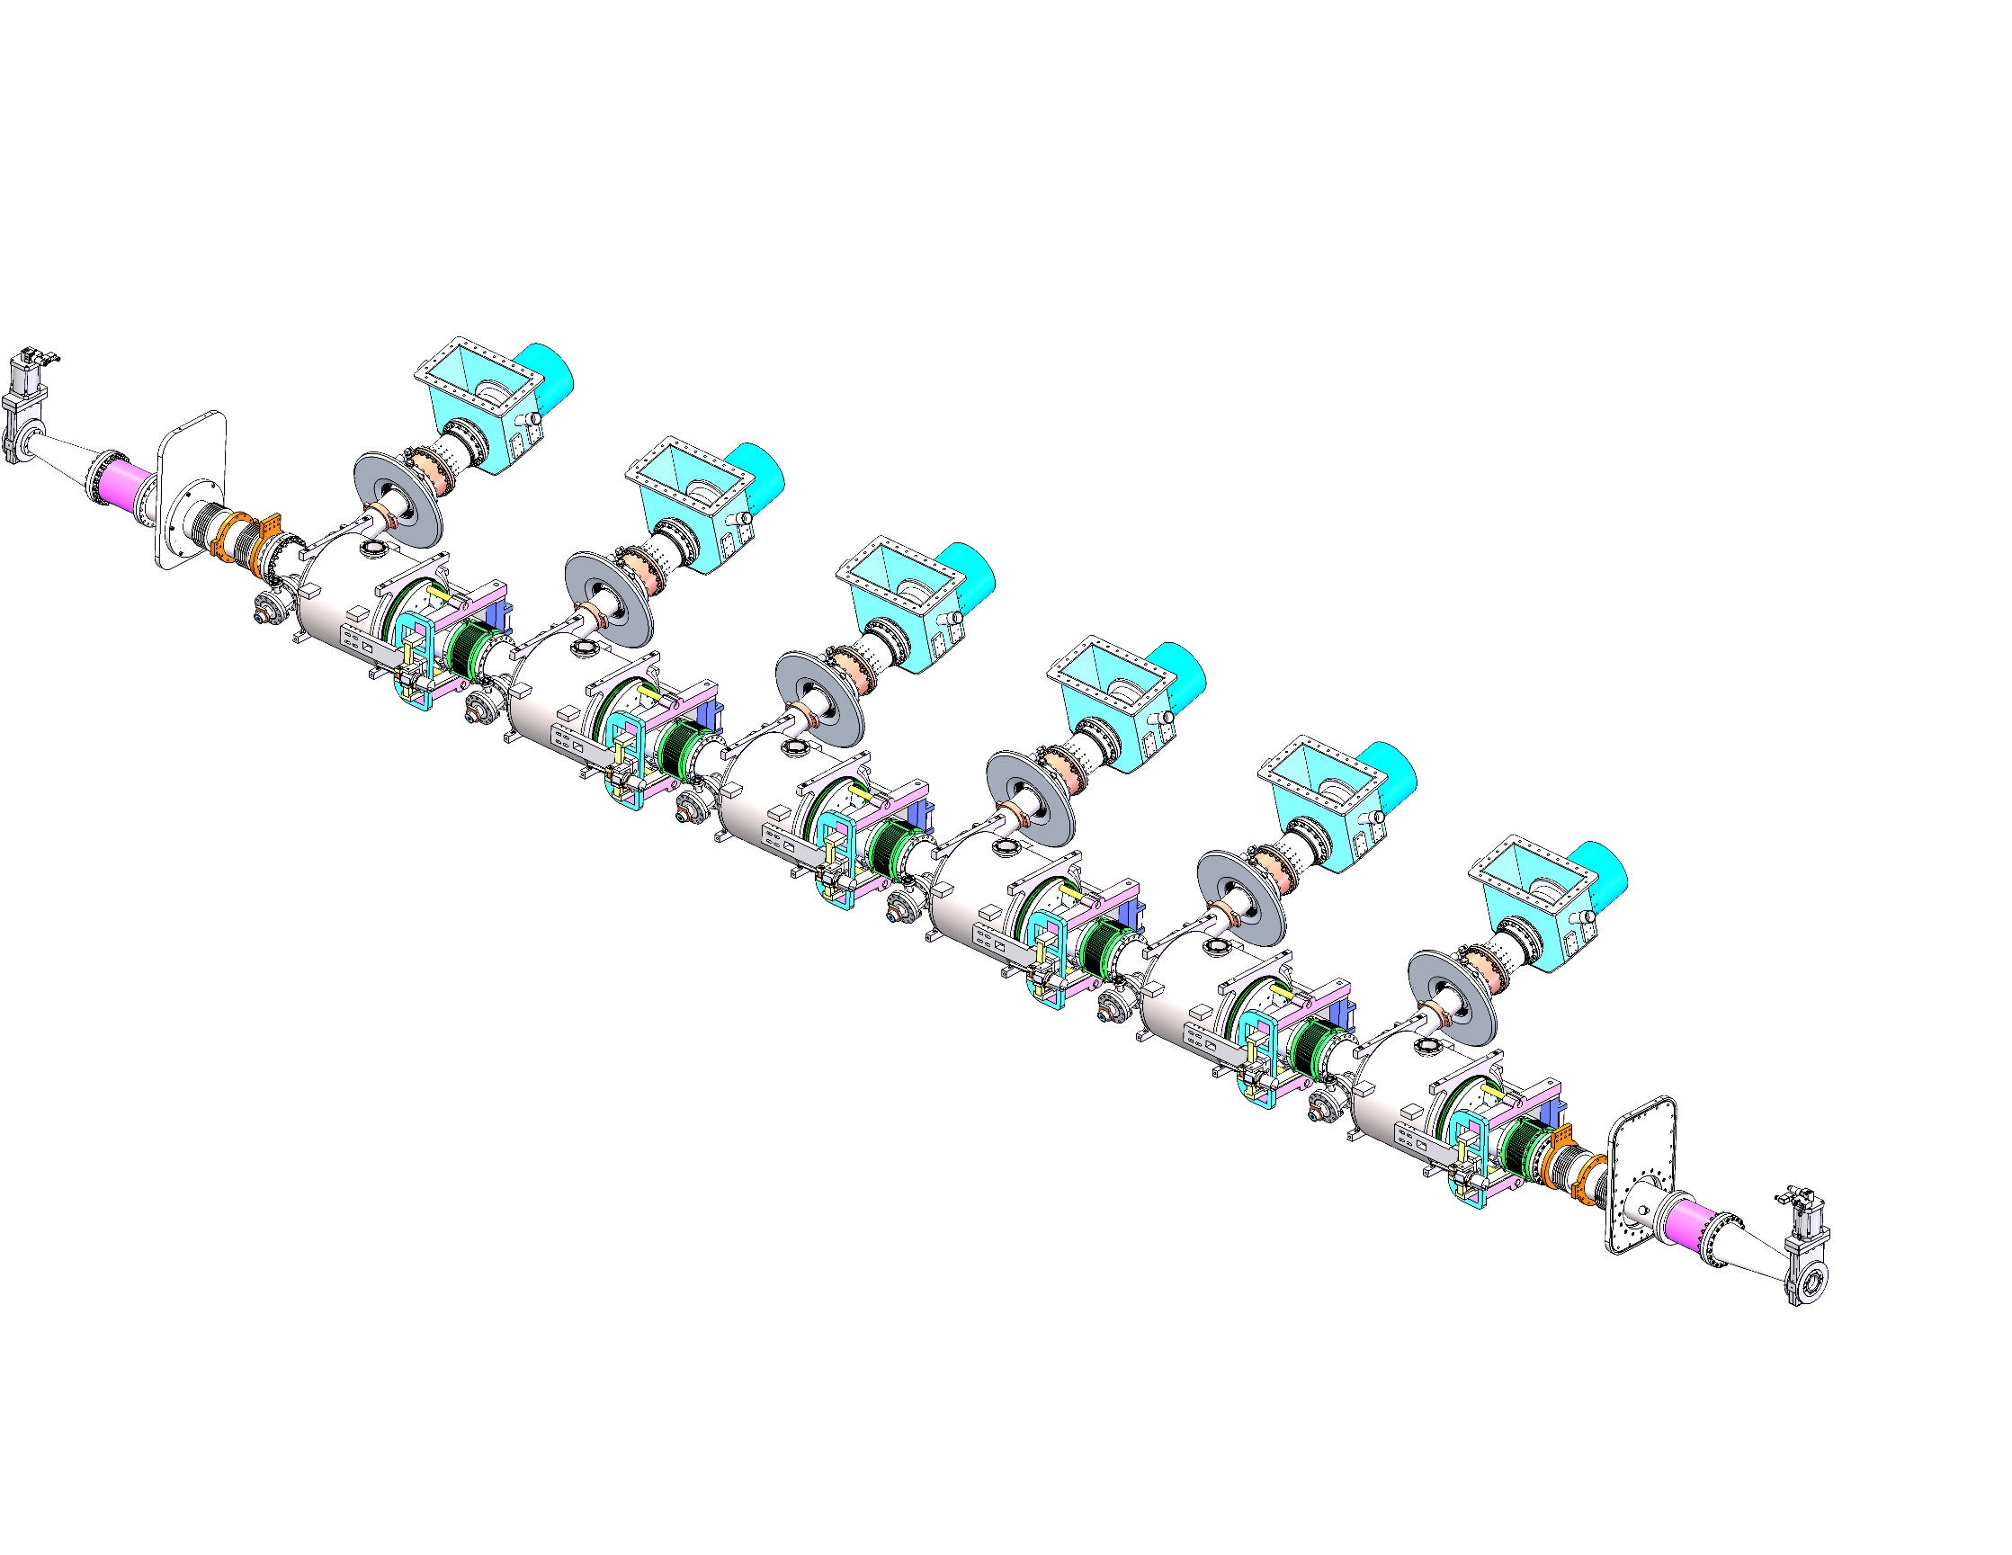
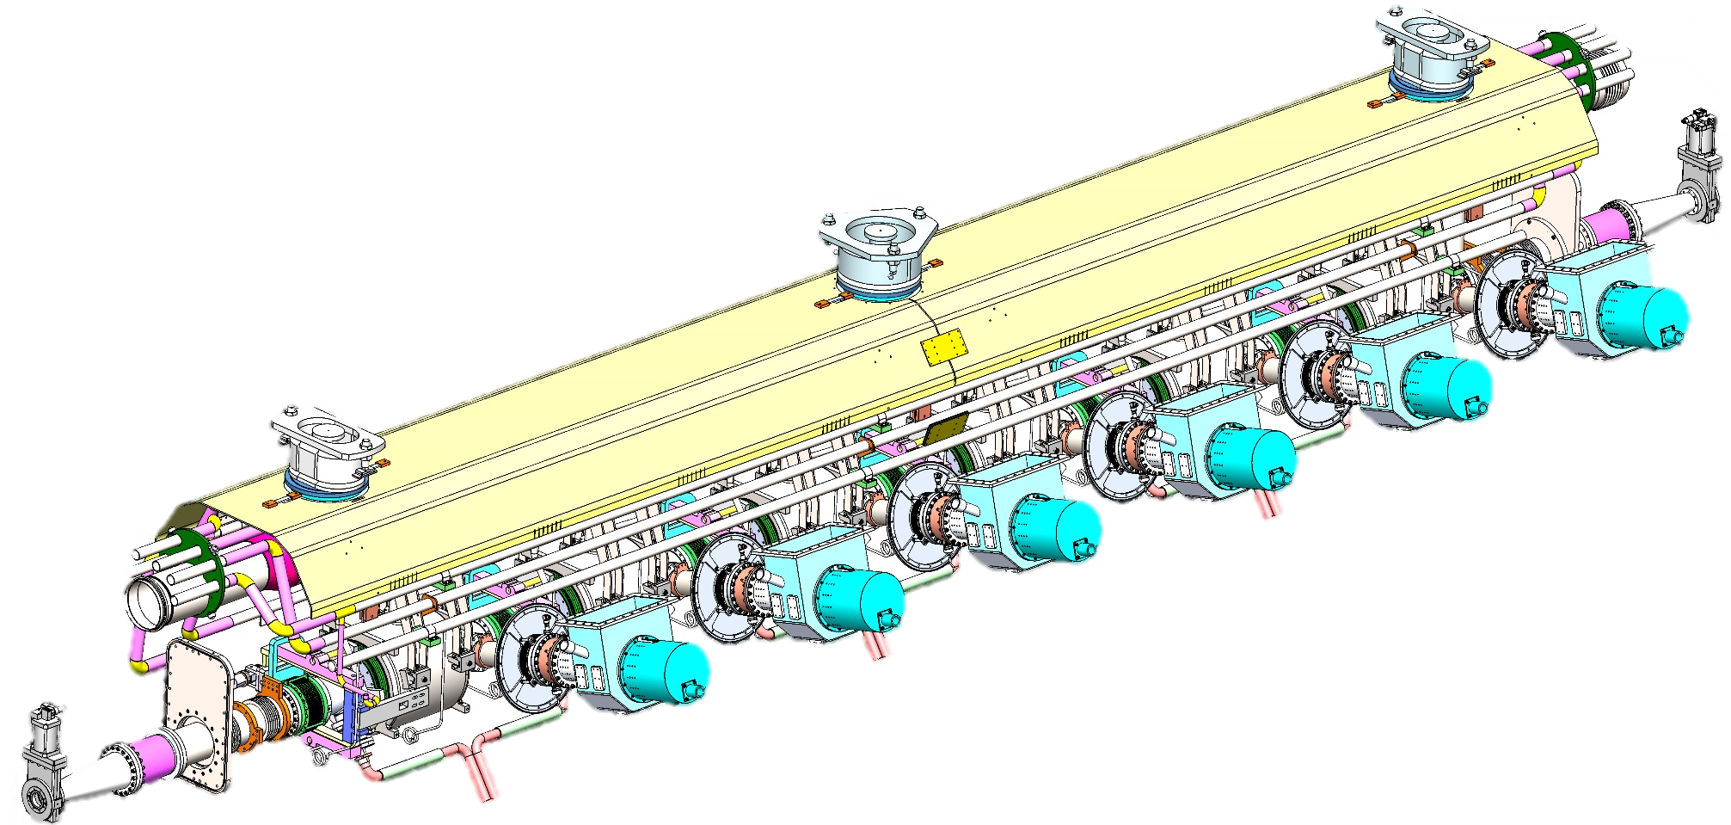
650 MHz Cavity String and Cold Mass

Slide 18
Vertical and Horizontal Test Stands in PAPS
Single cavity cryostat HT
166/500/1500 MHz CM HT
650 MHz CM HT with new VB
1.3 GHz CM HT
324 MHz DSR CM HT
Beam Test Stand
650 MHz 2x2-cell CM

Slide 19
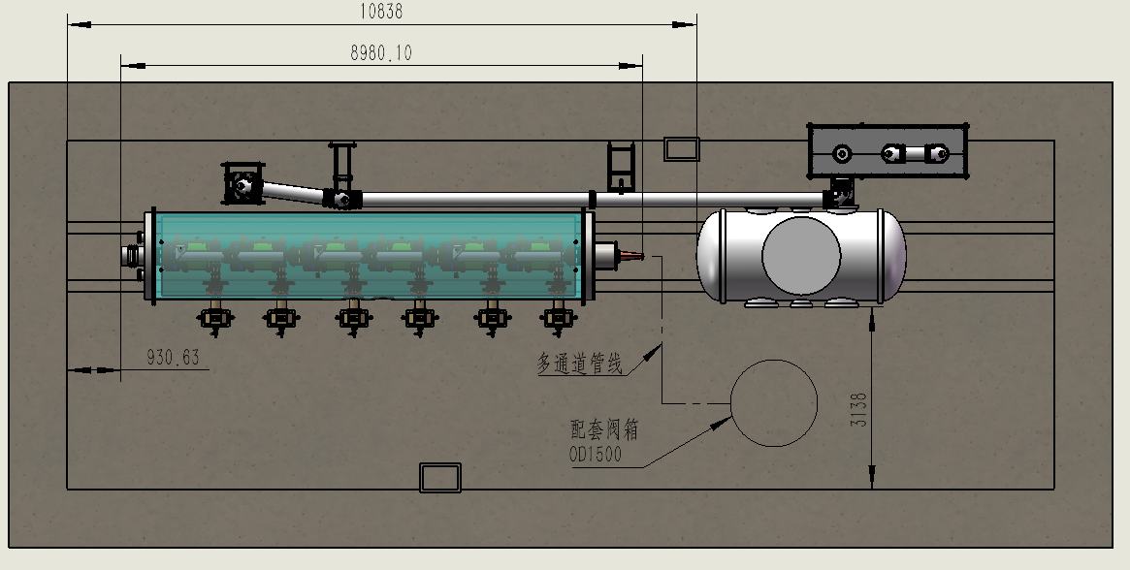
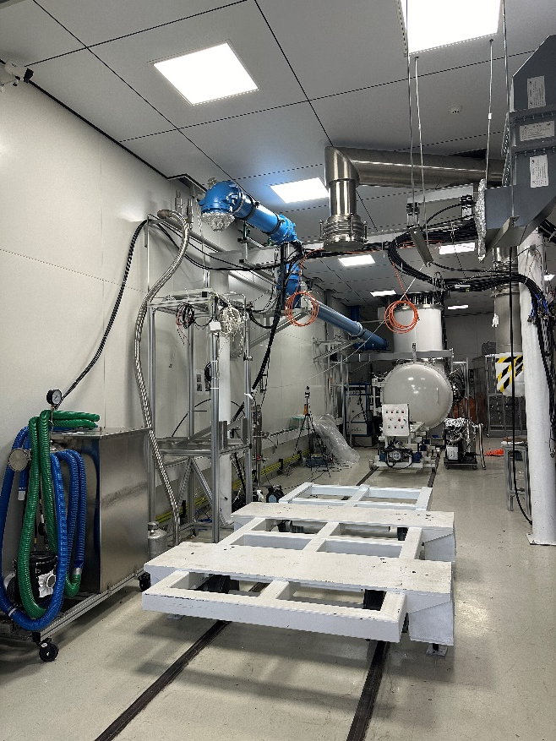
650 MHz Module Horizontal Test Stand
North HTS of PAPS SRF lab. New 2 K valve box.
Waveguide ports
New2K VB
4K
VB

Slide 20
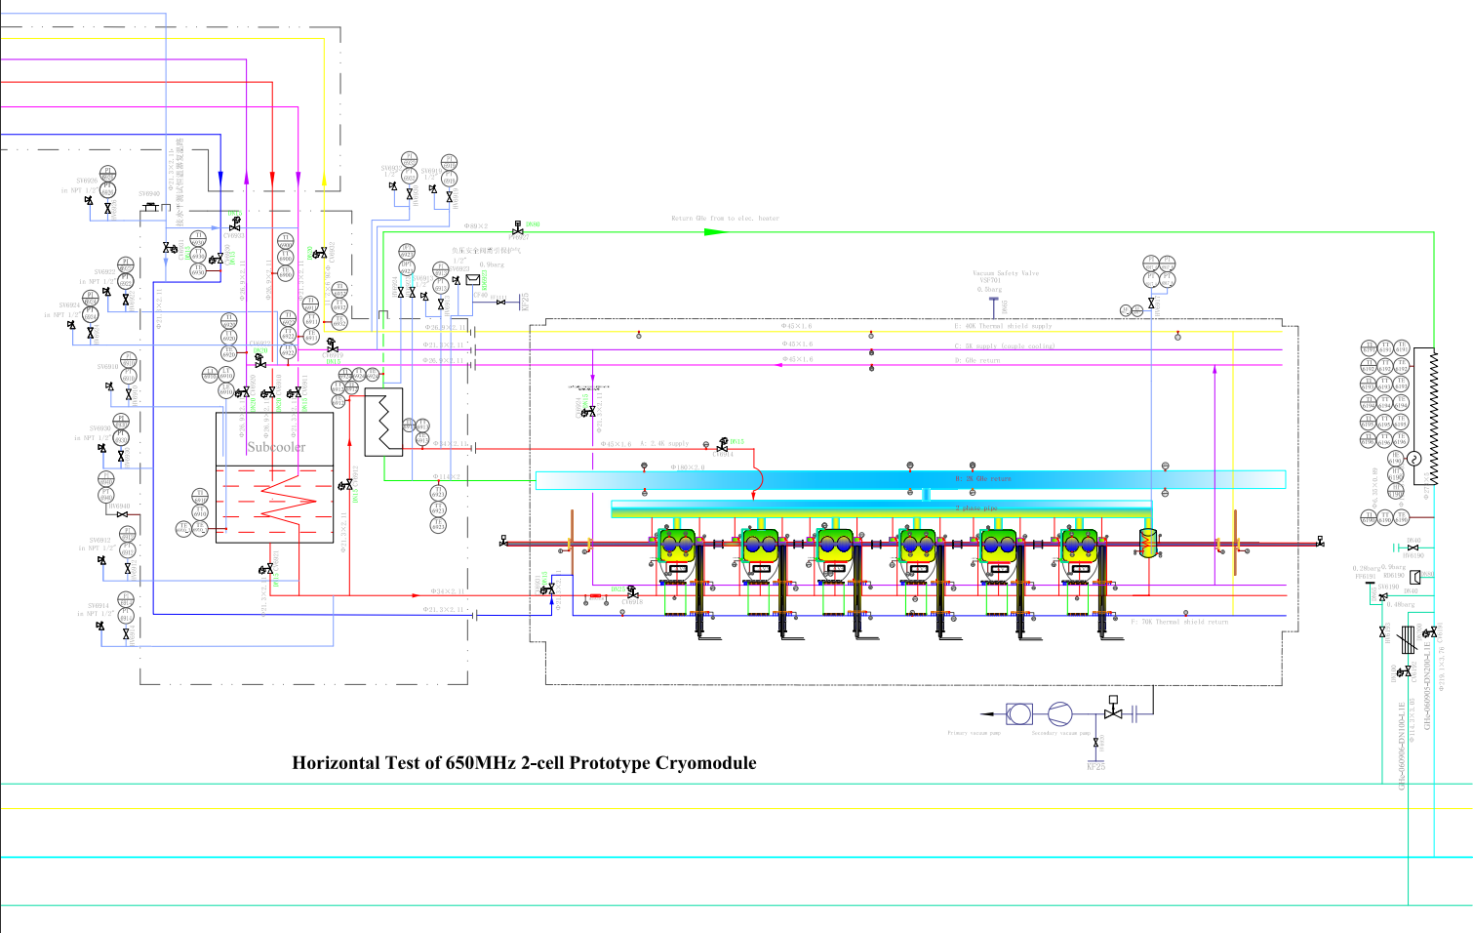
650 MHz Module PID Diagram

Slide 21
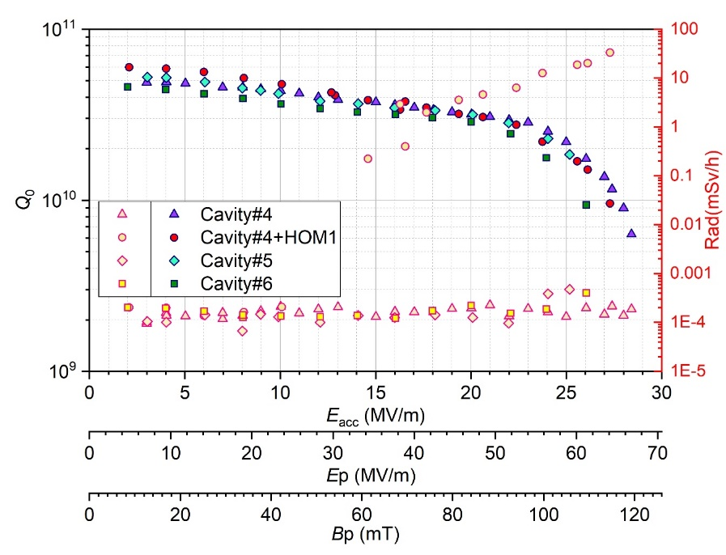
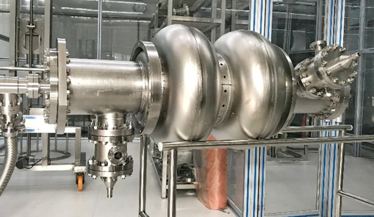
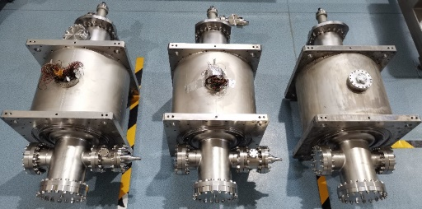
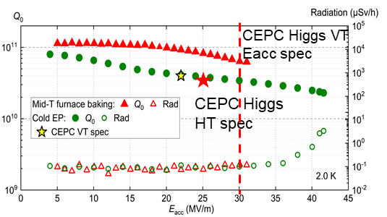
650 MHz 2-cell Cavity EDR R&D
CEPC 650 MHz CM |  | EDR Specification
650 MHz 2-cell cavity vertical test | E_{acc.max} | 30 MV/m
 | Q₀ | 3.6E10 @ 25 MV/m
Module horizontal test acceptance | E_{acc.max} | 28 MV/m
 | Q₀ | 3.3E10 @ 25 MV/m
Module long term operation | E_{acc.max} | 28 MV/m
 | Q₀ | 3.0E10 @ 25 MV/m
650 MHz 2-cell BCP
20 % margin from vertical test to operation spec.
BCP dressed 2-cell VT: 2E10 @ 25 MV/m, max ~ 26.5 MV/m
BCP 2-cell module test: 2E10 @ 8 MV/m (coupler cooling limited?)
EP + mid-T 1-cell VT: 8E10 @ 25 MV/m, max 31.5 MV/m
Apply 1-cell recipe to 2-cell
650 MHz 1-cell EP mid-T

Slide 22
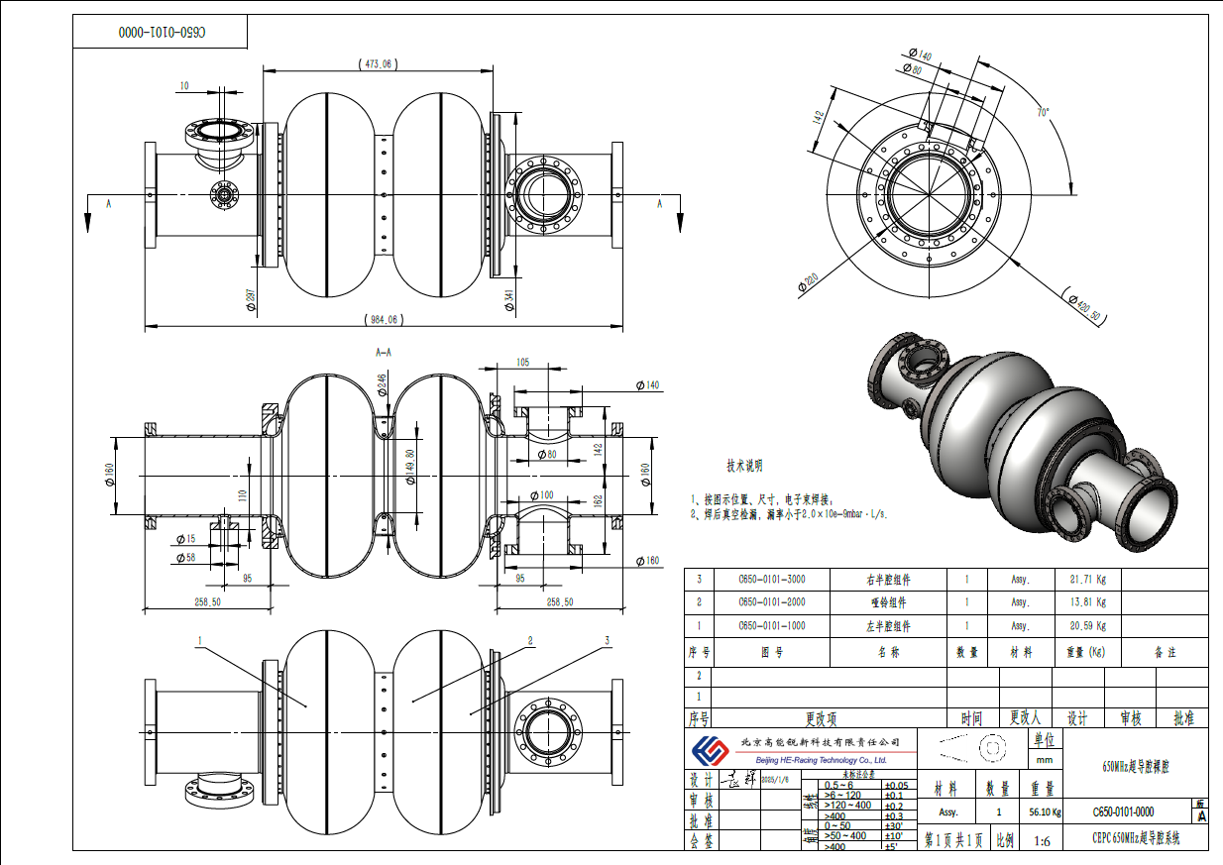
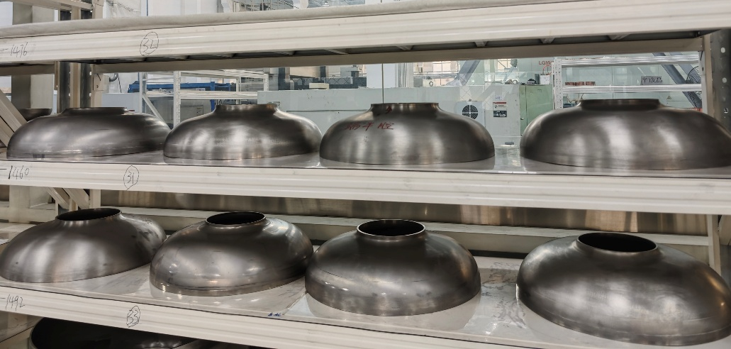
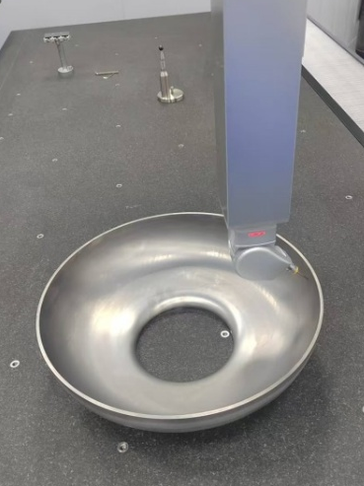
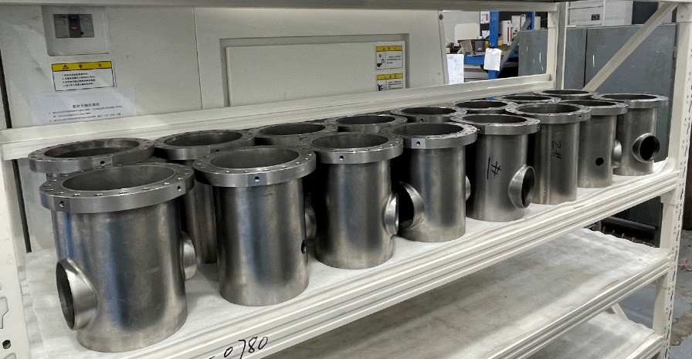
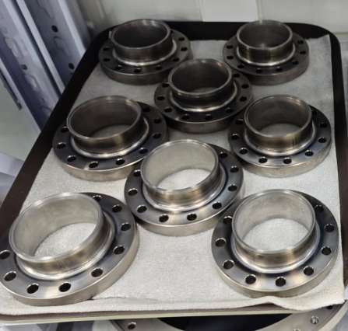
650 MHz 2-cell Cavity Fabrication
Will complete EBW of eight 2-cell cavities in March 2025.
Processing, dressing and vertical test until August 2025.

Slide 23
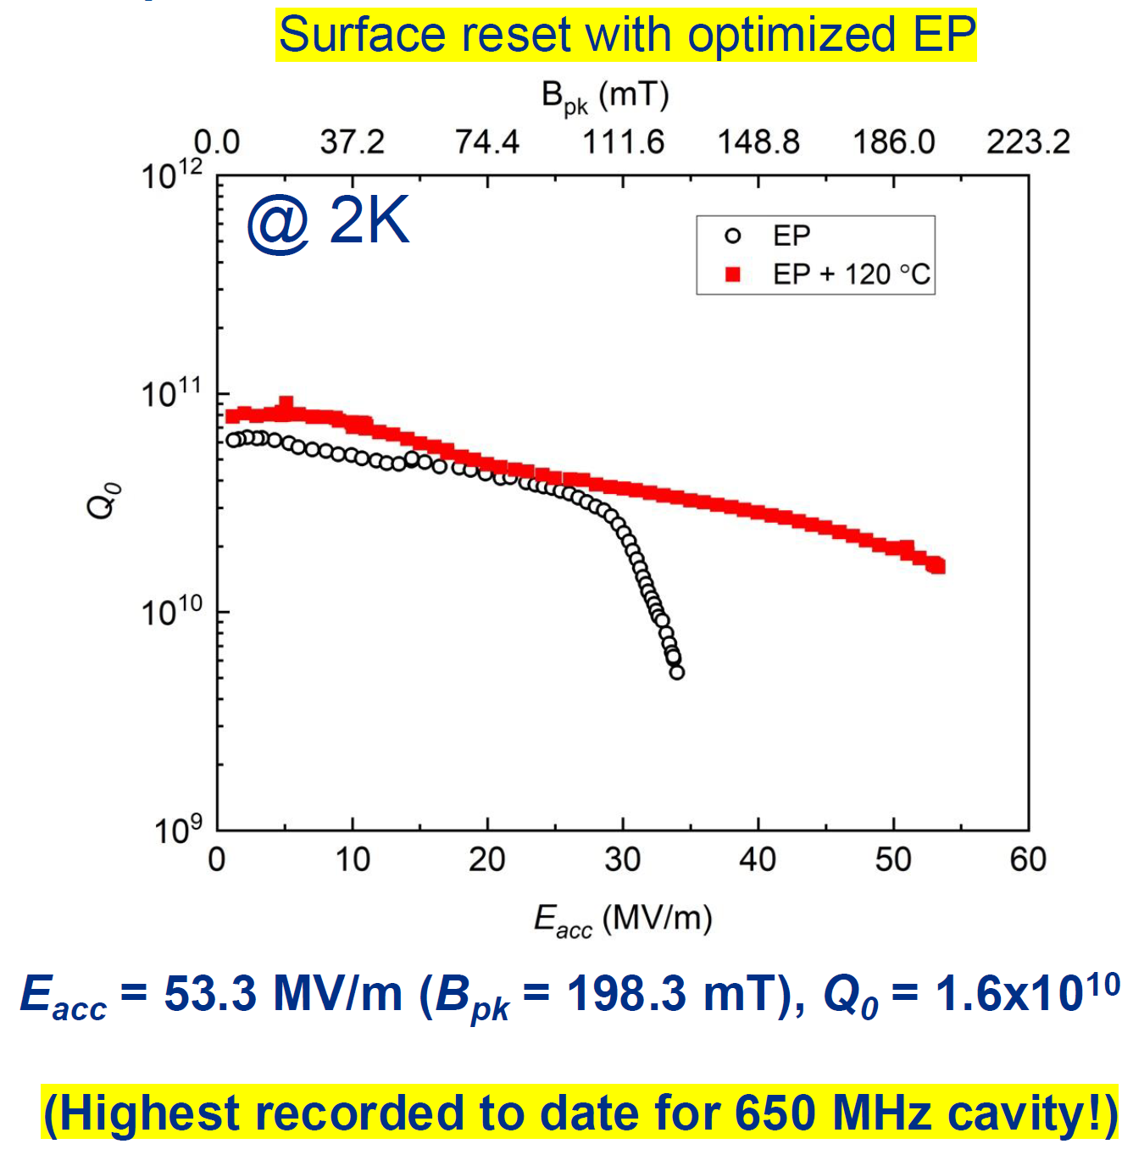
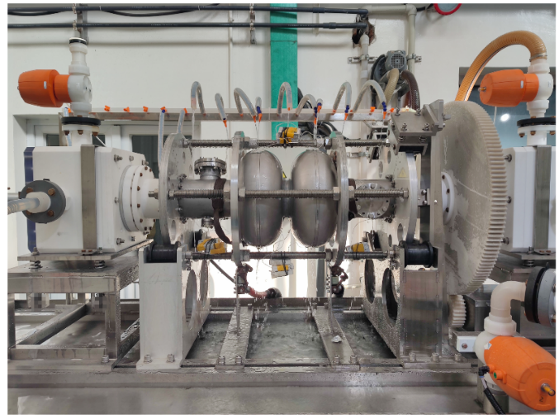
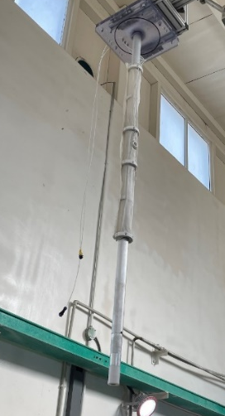
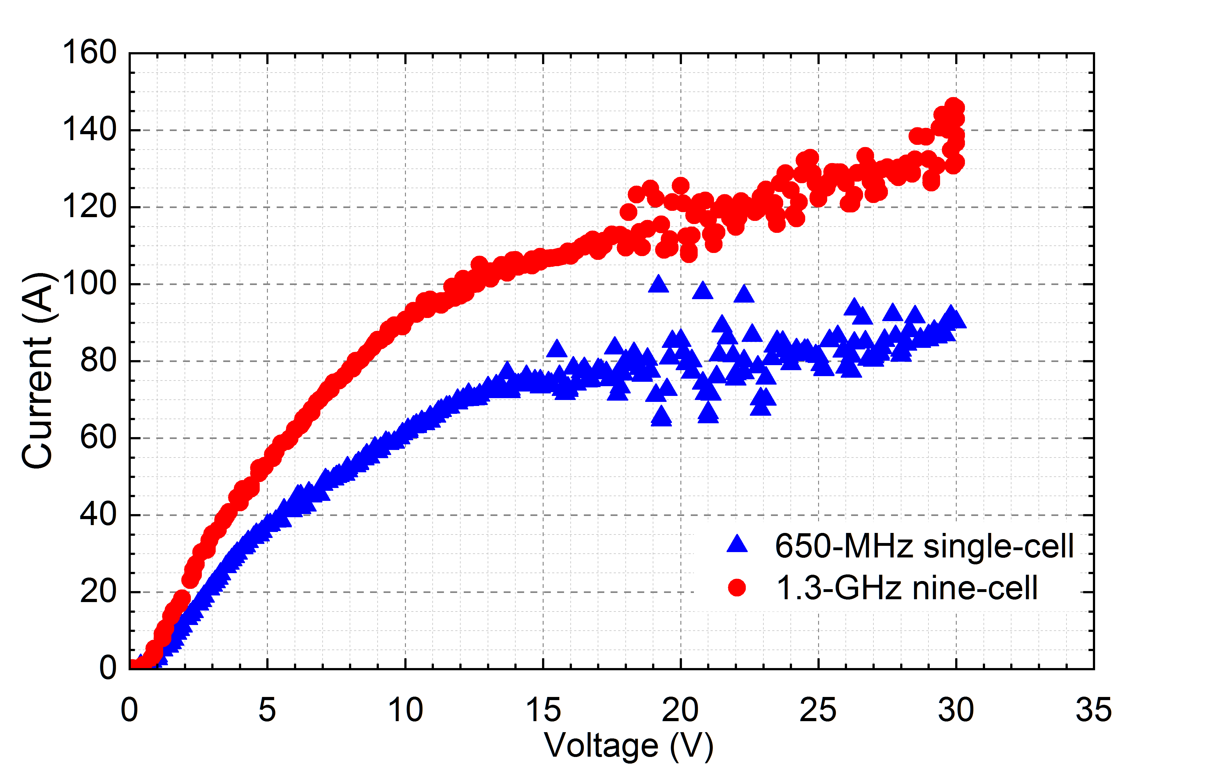
650 MHz 2-cell Cavity EP and Mid-T Bake
2-cell cavity EP optimization (cathode shape ...)
2-cell mid-T for high Q and high gradient
Vijay Chouhan (FNAL), TTC High-Q/ High-G WG meeting, 2024-09-12

Slide 24
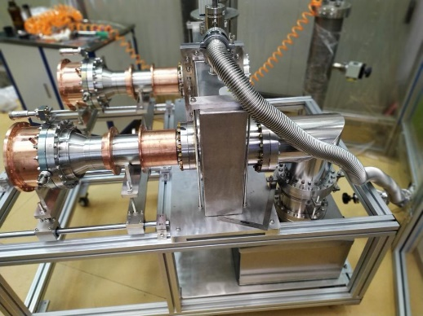
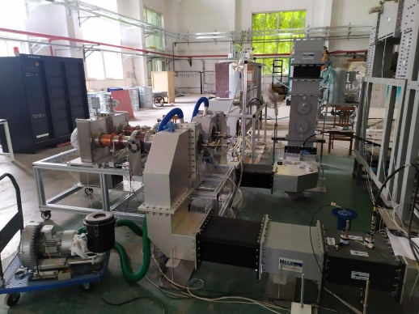
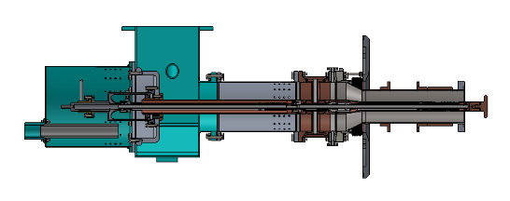
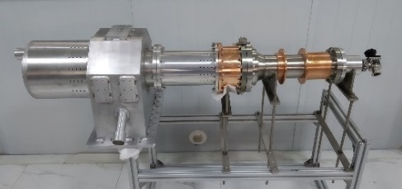
650 MHz High Power Input Coupler
CEPC Higgs mode requires variable 313 kW CW 650 MHz input coupler. In the CEPC TDR phase, both fixed and variable couplers are designed, fabricated and tested to CW TW 150 kW (SSA power limit), SW 100 kW (i.e. 400 kW TW power at the window).
EDR R&D:
Use six variable couplers in the full-size cryomodule instead of the fixed couplers in test cryomodule to meet green CEPC requirement for RF power saving in different operation modes.
Coupler cooling and heat load design optimization. Compare thermal anchor and helium gas cooling of the outer conductor. Six couplers to be fabricated in 2025.
High power conditioning with 800 kW 650 MHz klystron ( ~ 300 kW TW).

Slide 25
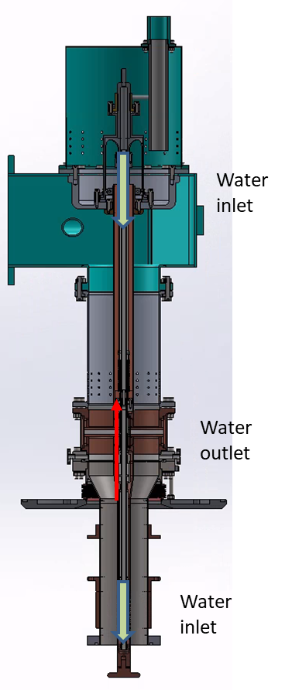









Cooling and Heat Load of 650 MHz Input Coupler
Evaluate cooling capacity of the thermal anchors on cryogenic lines, avoid cavity low field quench by coupler heating. Compare with helium gas cooling.
Avoid overheating of the bellow on the inner conductor.
Confirm air cooling capacity of the warm part and the window.
 | Heat Load at 313 kW, TW
298 K | 4.2 W
60 K | 29.2 W
7 K | 6.3 W
2 K | 2.7 W
NbTi flange@CW,313 kW
298K
7K
2K
SS flange @ CW,313 kW
60K
RF loss is large near the gap and the 2 K heat load increased
Copper plating of the flange surface is a must to reduce rf loss
gap
Air cooling of the outer window, 50 W/m²

Slide 26






Doorknob Cooling Design
The heat transfer effect of air cooling is not as good as that of water cooling, and water cooling is the most suitable way for cooling the inner conductor in this high-power situation.
However, the window components has been processed due to the time limit, the inner conductor can not be changed, that is water cooling design can not be carried out, so it is mainly optimized by air cooling.
The design evolves in three versions, while design III has the best effect, but the temperature of the inner conductor is still high, about 80 -105 C.
Results of Design III
doorknob
IC
Teflon sheet
Doorknob, IC, OC are all air cooled.
The highest temperature lies in IC and Teflon sheet.
The way to optimize is to reduce losses and let the cold air reach the hotter areas first.
Design I
Design II
Design III

Slide 27




Doorknob Cooling Simulation
Teflon sheet thickness is reduced from 10 mm to 5 mm, the maximum temperature dropped to 175 C； In order to avoid dirty air blowing to the surface of the ceramic, Teflon sheet is still adopted.
Dielectric loss tangent of teflon sheet used in this calculation is 0.001 (provided by HFSS), and the teflon temperature may be further reduced if 0.0004 is used.
In addition, Design I is suitable for operation at 150 kW, while Design III is possible to reach 313 kW.
Temperature in C | Design I | Design II | Design III
 | @313 kW, CW, Inlet flow: 150 L/min
OC | 80 - 90 | 57 - 63 | 53 - 68
IC | 70 - 200 | 86 -182 | 80 - 105
IC box | 70 | 78 | 75
Teflon sheet | 90 - 450 10 mm thickness | 127 - 415 10 mm thickness | 61 – 175 5 mm thickness
IC box
IC
aluminum 6061
copper
OC
teflon sheet
copper
PTFE
Simulated by HFSS-FLUENT
Main materials

Slide 28






650 MHz Input Coupler Fabrication

Slide 29
Summary
Design of SRF system for future circular lepton colliders (CEPC and FCC-ee) is converging, and facing similar technical challenges.
Engineering design and demonstration of SRF components and cryomodule (high Q, high gradient, high power) are very important.
EDR design and prototyping of the CEPC 650 MHz full-scale module are progressing well. Module structure is to be finalized taking into account many engineering issues. Fabrication and assembly of the module to be completed in end 2025.

Slide 30


