Slide 1

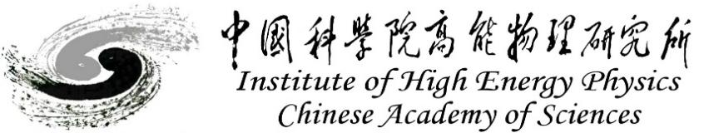
High Field Magnet R&D
for the Next-generation High Energy Particle Accelerators
Qingjin XU
for the Superconducting Magnet Group
Accelerator Division, IHEP-CAS
Jan 2025, HKUST

Slide 2


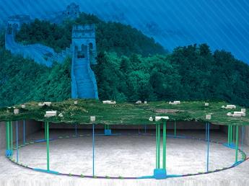
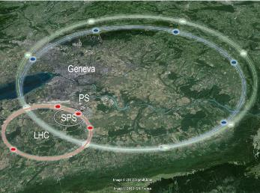
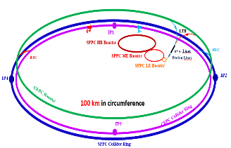
Design Scope for Next-generation Accelerators
High Energy Circular Colliders for next decades | SPPC | FCC
Proposed institution | IHEP-CAS, China | CERN, Europe
Proposed dates | 2012 | 2013
Site of the project | China | Europe
Baseline technology | IBS 20~24 T to reach 125-150 TeV, Nb₃Sn etc as options | Nb₃Sn 16 T to reach 100 TeV
Timeline | Construction at 2040s | Construction at 2050-60s
Cost | * | **

Slide 3
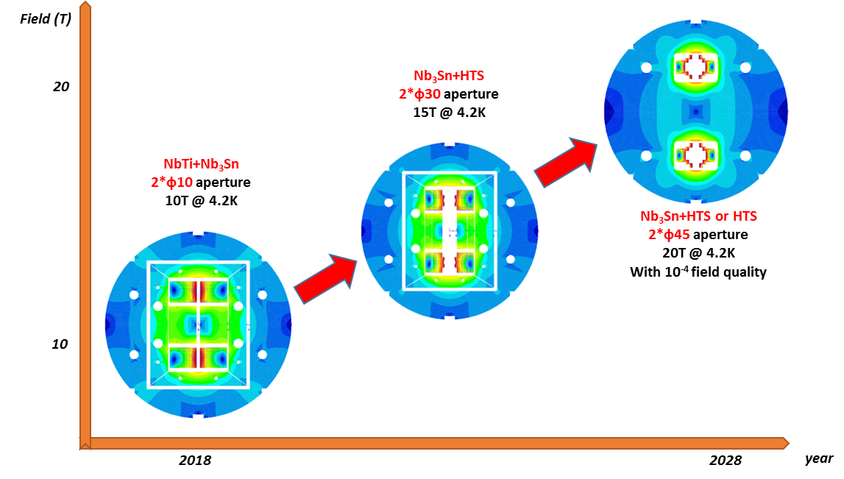
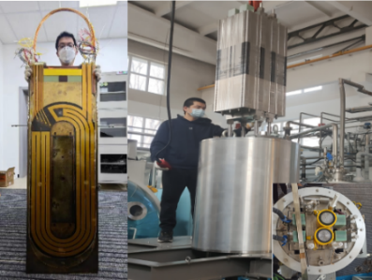
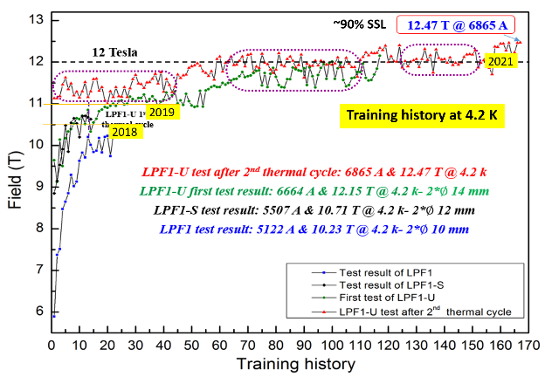
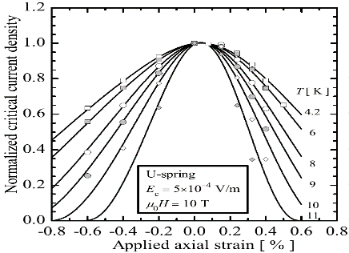
Roadmap of the High Field Magnet R&D at IHEP
2021-2025 16T @ 4.2K
Nb₃Sn + HTS
2018-2021, 12.47T @4.2K
NbTi + Nb₃Sn
Challenges: Stress control, quench protection, field quality control,……

Slide 4
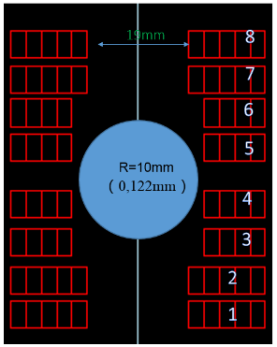
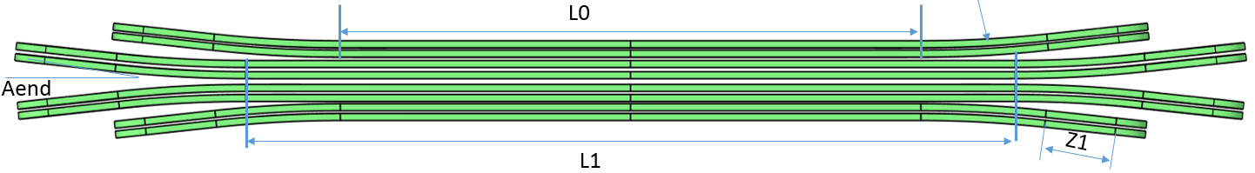
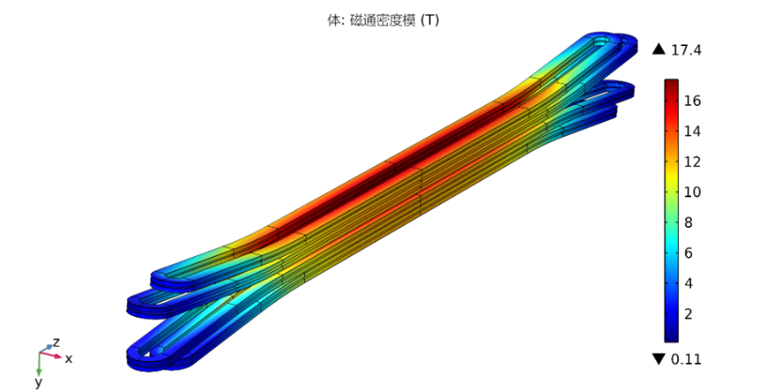
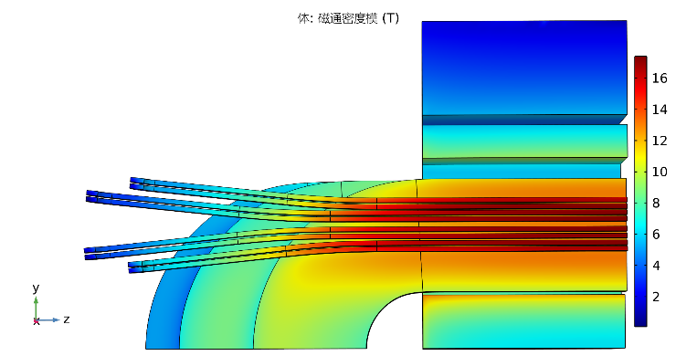
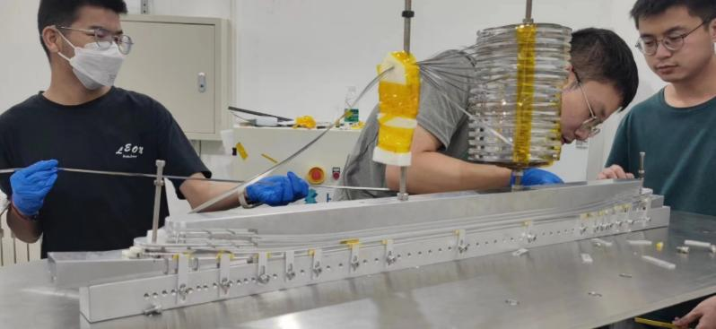
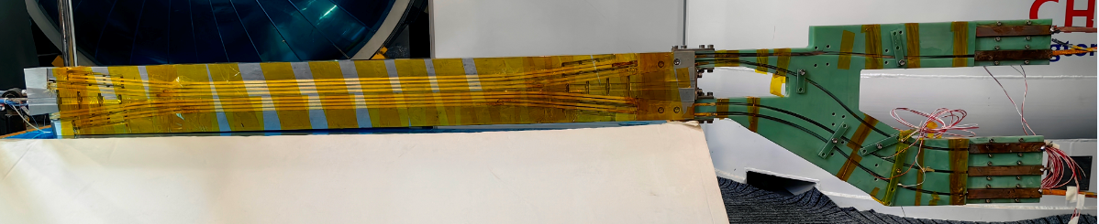
Development of the 16-T Model Dipole LPF3
The ReBCO block insert coils for LPF3
Ze Feng et al
Parameters | Values
L0 | 409.6 mm
L1 | 540.2 mm
Rhard | 800 mm
Aend | 6 °
R1 | 9.5 mm
Z1 | 120 mm

Slide 5
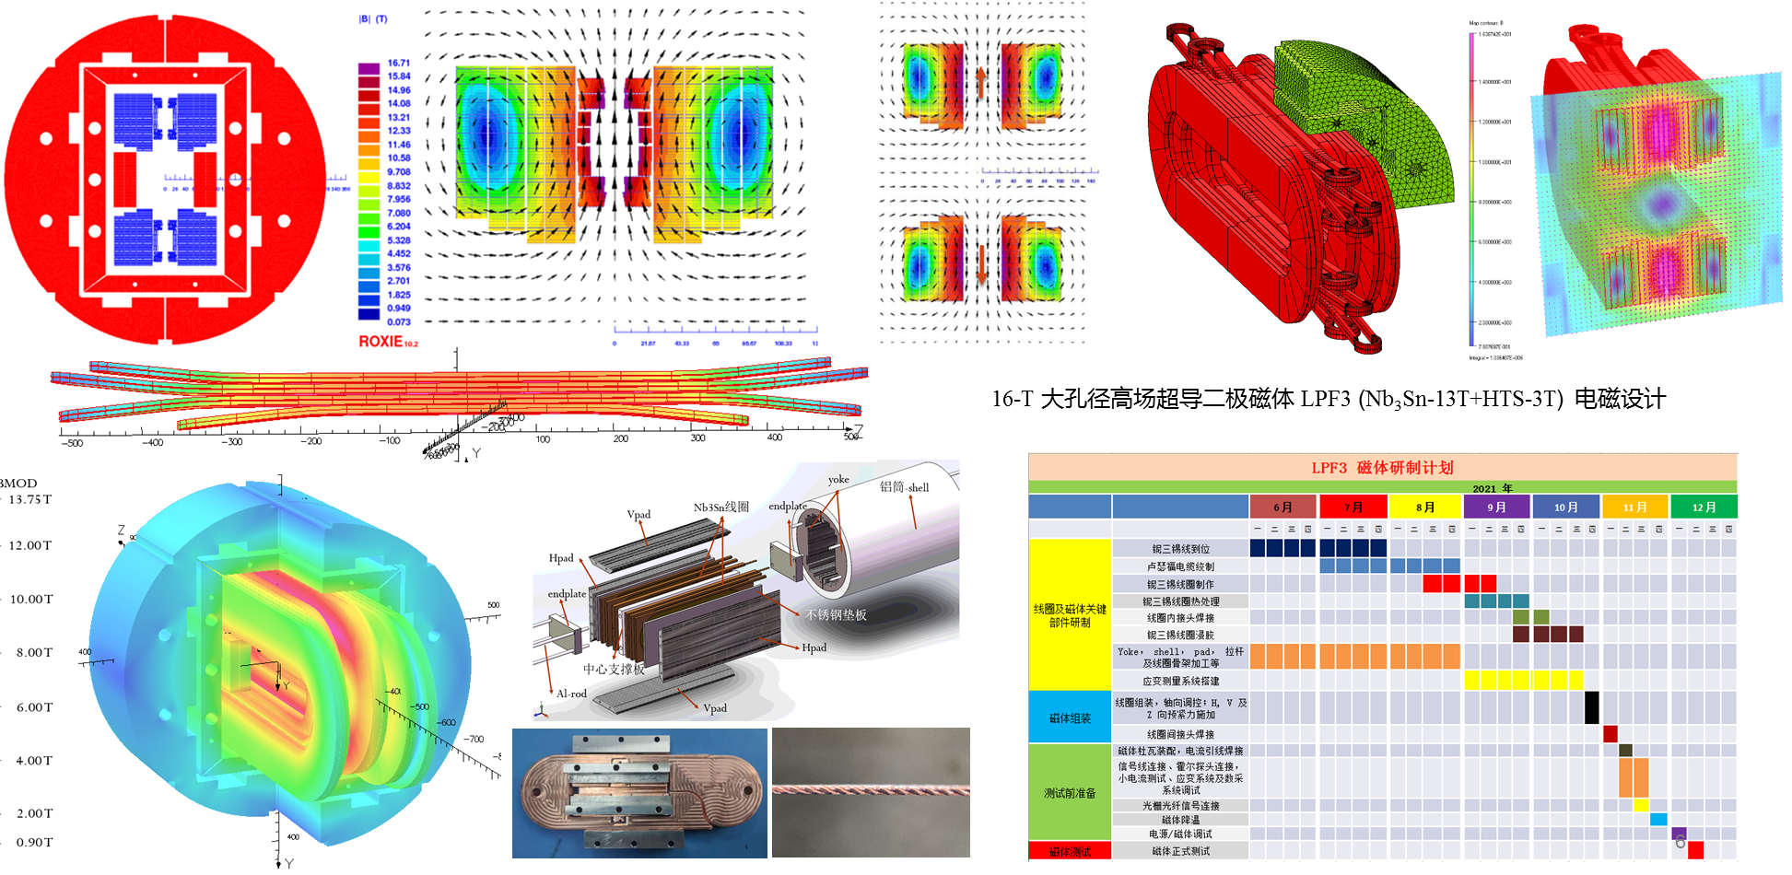
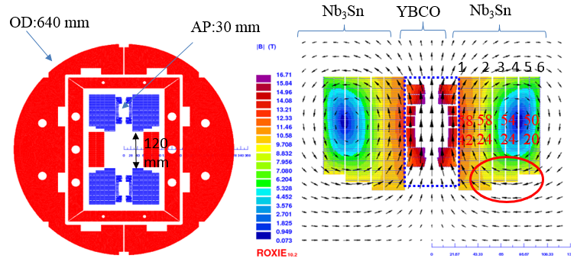
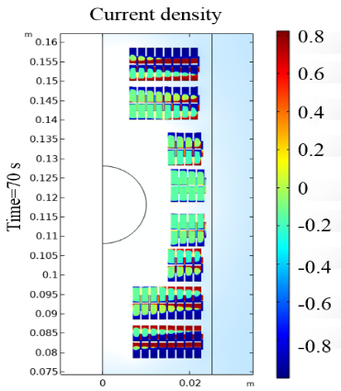
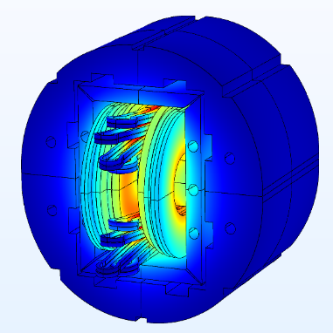
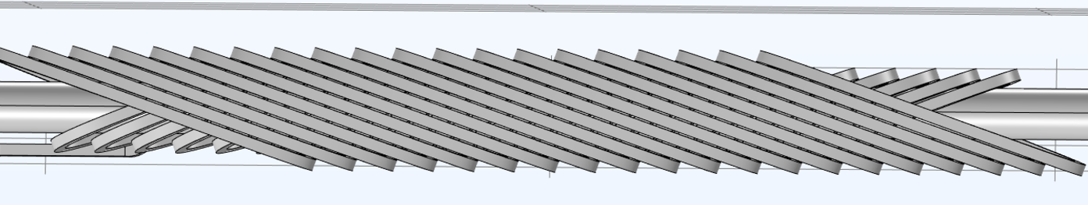

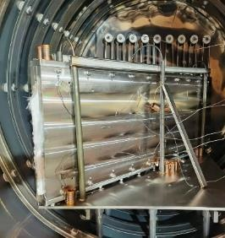
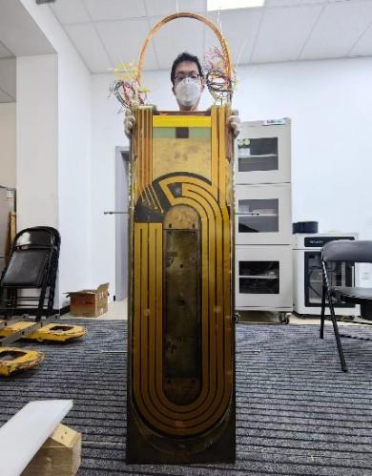
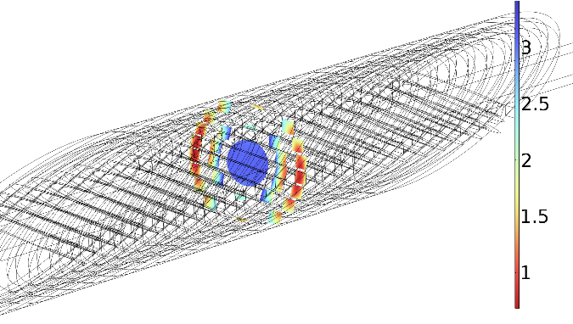
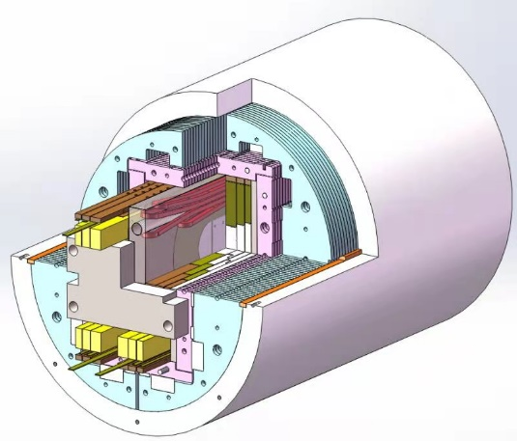
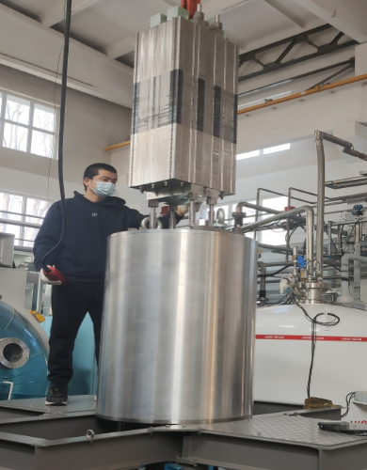
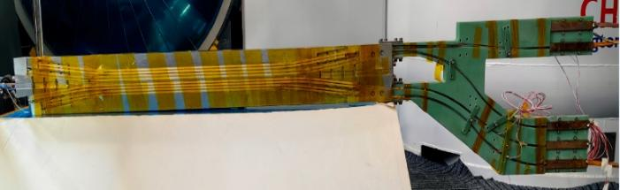
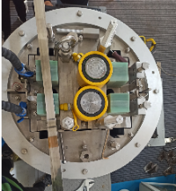
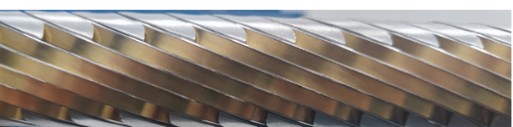
Development of the 16-T Model Dipole LPF3
16 T Model Dipole LPF3: Nb₃Sn 13 T (Common Coil with 55 mm gap) + HTS 3 T inserts (Block & CCT)

Slide 6
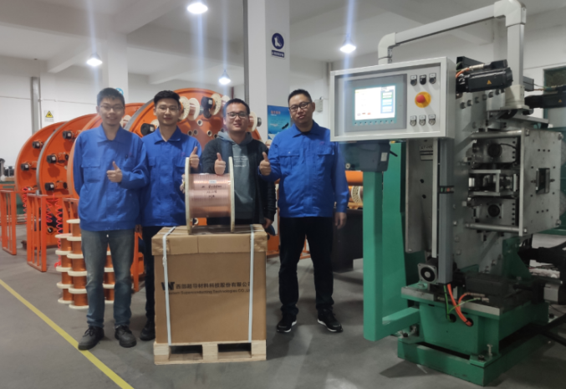

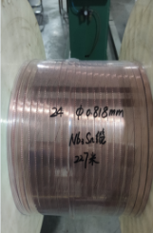
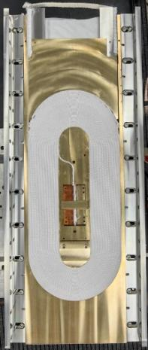
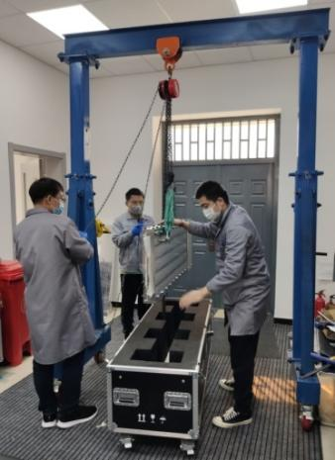
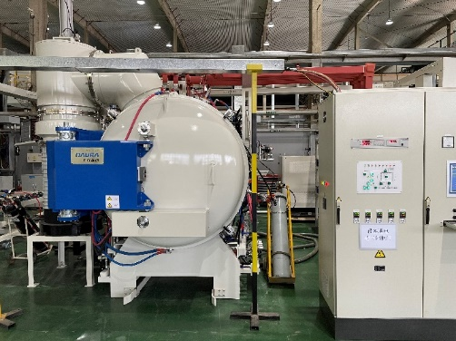
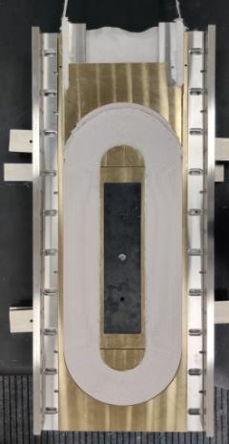
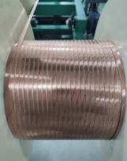
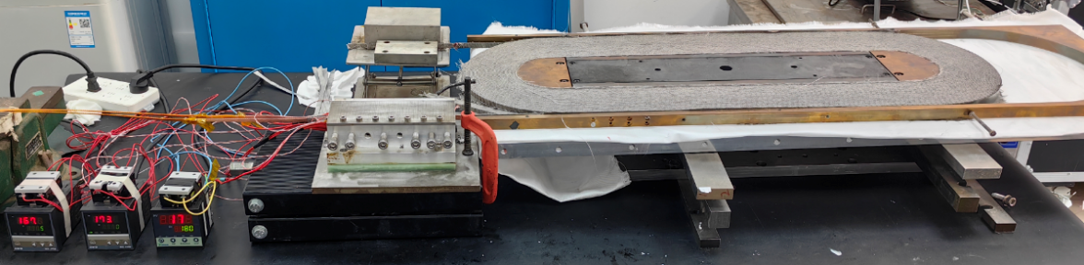
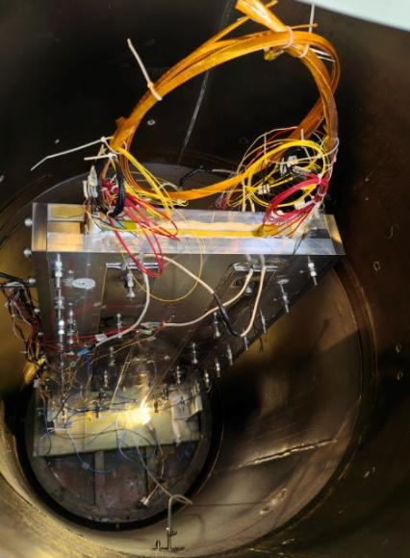
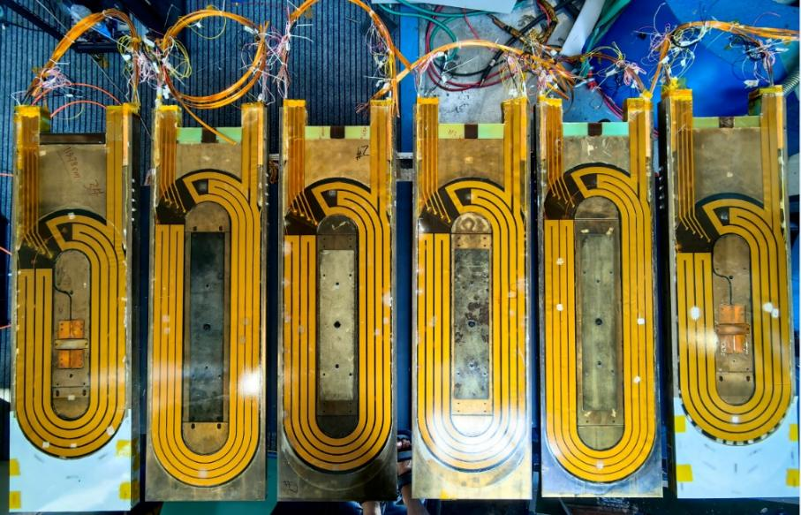
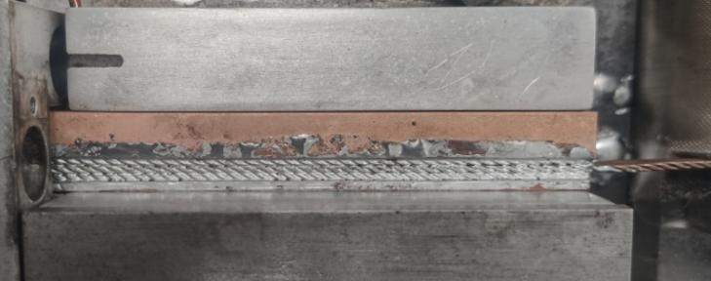
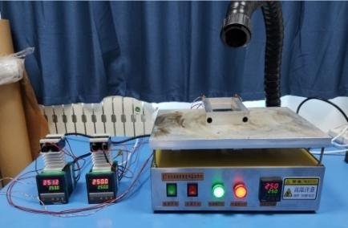
Development of the 16-T Model Dipole LPF3
The Nb₃Sn coils for LPF3
Chengtao Wang et al

Slide 7

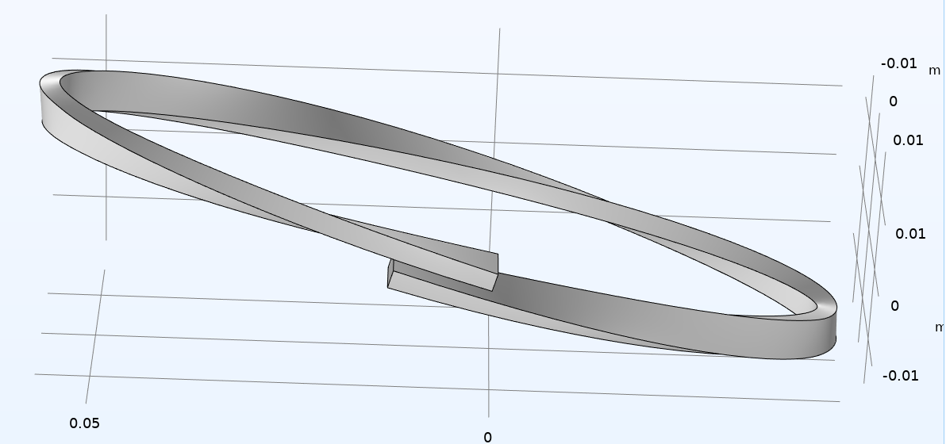
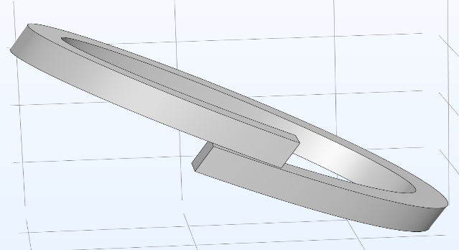
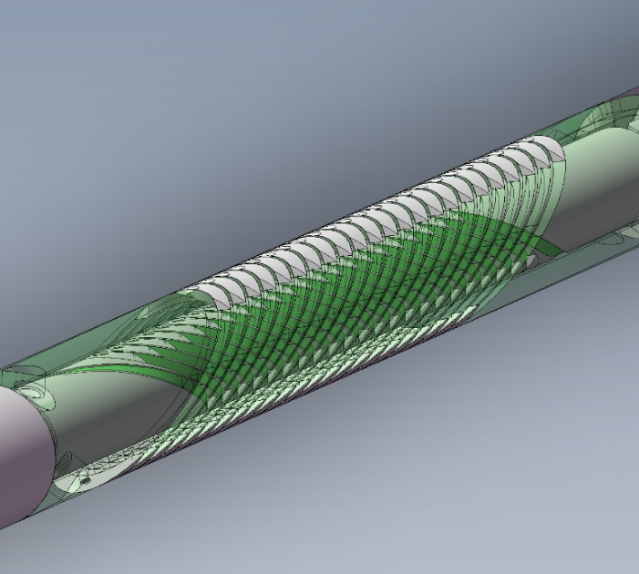
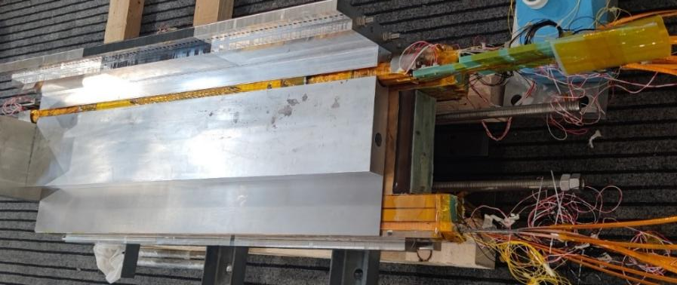
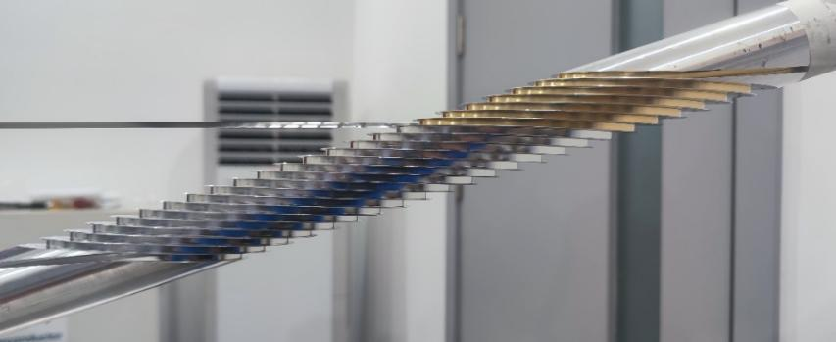
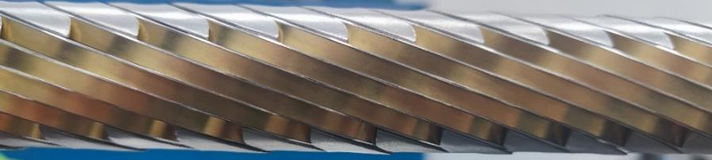
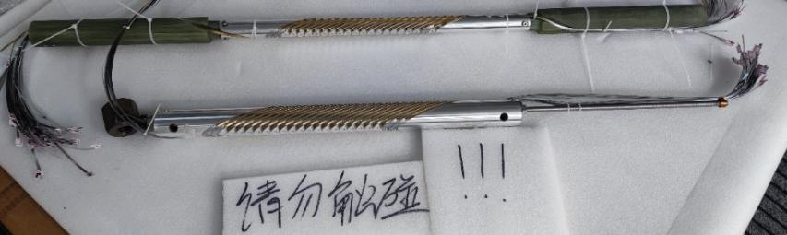
Development of the 16-T Model Dipole LPF3
The ReBCO CCT instert coils for LPF3
Rui Kang et al
典型CCT线圈结构示意
“斜螺线管”型CCT线圈结构示意

Slide 8
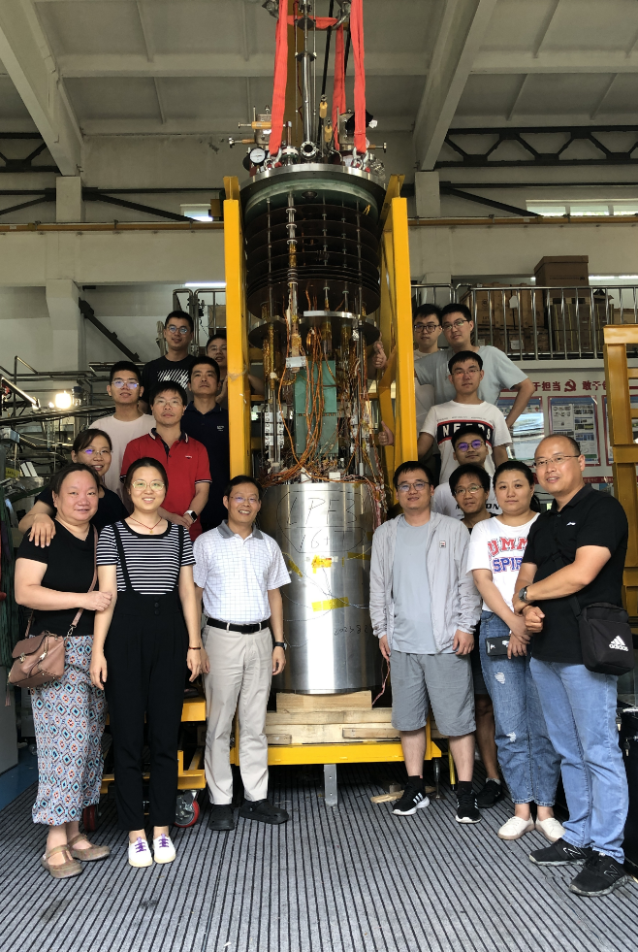
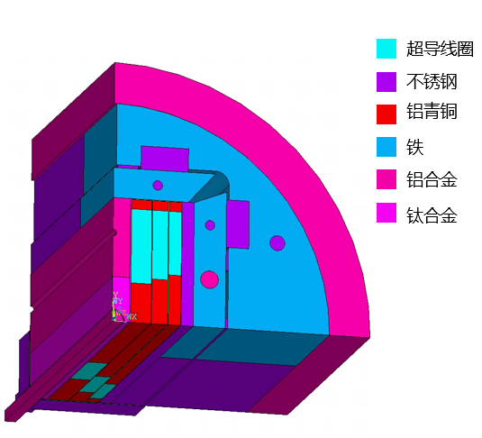
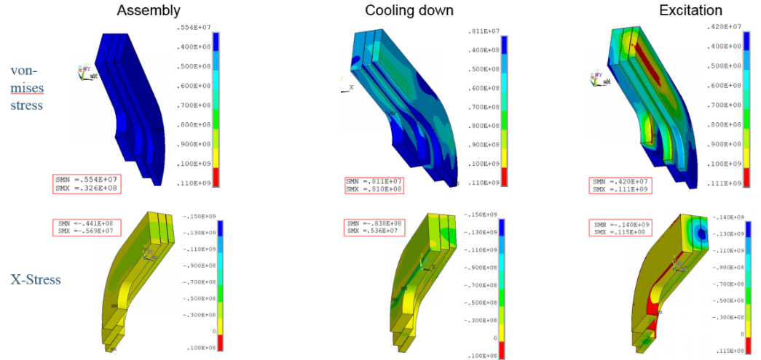
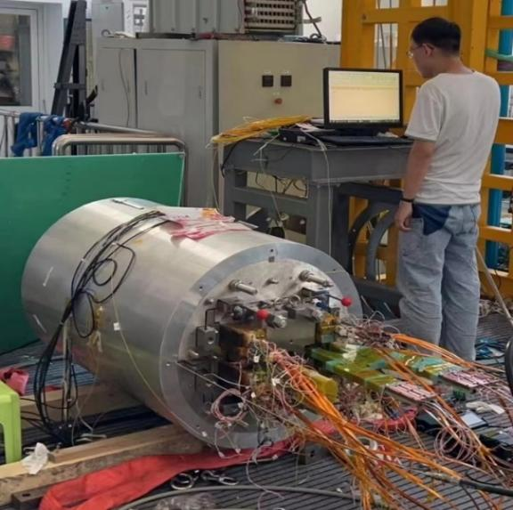



Development of the 16-T Model Dipole LPF3
Pre-stress and assembly of LPF3
Yingzhe Wang et al
Stress monitoring during
assembly with FBG
Pre-stress applied with commercial hydraulic jack
2023.8.29 Assembly completed

Slide 9




Development of the 16-T Model Dipole LPF3
Quench protection of LPF3
Jinrui Shi et al
Varistor plus CLIQ to protect the Nb₃Sn coils. The maximum hot spot is ~ 230 K
NI configuration plus dump resistor to protect the 2 HTS insert coils
Current decay curve at the operating current

Slide 10


Development of the 16-T Model Dipole LPF3
Performance test ongoing from Sep 2023
Wei Li et al
The Nb₃Sn coils were trained firstly, maximum current reached ~85% of I_{op} in Dec 2023, but showed an unstable plateau at 11 T due to one of the outmost Nb₃Sn coil, probably due to insufficient pre-stress during assembly
HTS block coil was ramped independently to 100% of I_{op} with negligible terminal voltage
55 mm 双孔径

Slide 11



Development of the 16-T Model Dipole LPF3
The 2nd Performance test in Feb 2024
The Nb₃Sn coils showed very unstable performance in the 6300-7000 A region due to one of the inner most coils, but finally passed this region and reached ~87% of I_{op} in the beginning of March 2024
HTS block coil was ramped independently to 120% of I_{op} to test its ultimate performance, but one of the lead was damaged due to the quench.

Slide 12





Development of the 16-T Model Dipole LPF3
Reassembly of the magnet with enhanced pre-stress
Xin Chen et al
2024 年 1 月
应变片监测磁体组装、降温、励磁过程
光栅光纤监测磁体组装及测试过程

Slide 13















Development of the 16-T Model Dipole LPF3
Fabrication of the new Nb₃Sn & HTS Coils Jun. to Oct. 2024
已完成新的铌三锡线圈所需的20芯、24芯、26芯及42芯卢瑟福缆的制作，线圈的绕制、热处理及固化
Wound in parallel in seven layers
已完成新HTS 线圈的制作，液氮测试结果达到设计值
AP: 20 mm
75 mm
2180 A
目标磁场：10 T (LTS) + 6 T (HTS)
加速器领域国内外尚无HTS高场(>10T)下成功应用先例：快速励磁、高能量密度、场质量…
HTS Coil 9+7 T design

Slide 14




Development of the 16-T Model Dipole LPF3
Accident in Mar 14 2024
The operator forgot to follow the most important step of the test manual: turn on the quench detection system, and powered the Nb₃Sn coils to high current directly. 2 of 6 Nb₃Sn coils were serious damaged during a quench
Plan for next months: establish a hardware interlock protection system, and re-fabricate 2 new Nb₃Sn coils and 2 HTS coils, to reach 16 T by the end of 2024

Slide 15







Development of the 16-T Model Dipole LPF3
LTS 线圈 + HTS 线圈桶外组装
线圈组件竖直吊装
线圈轴向找齐
LPF3-U 磁体组装
预紧力施加步骤及key片厚度 | 竖直方向 |  | 水平方向 |  | 轴向
 | 西 | 东 | 北 | 南 | 西北 | 东南 | 东北 | 西南 | 中
1.西打压，无示数：（7.6+2）+0.5 | 36 | 8 | -29 | -37
2.东打压，14Mpa：（4.6+2）+1+0.2 | 205 | 201 | -134 | -142
3.南打压，＜5MPa：4+2（中间3*2） | 155 | 168 | 8 | 114
4.北打压，＜50MPa：4+2（中间2*2+1+0.5） | 37 | 1 | 184 | 398
5.西打压，＜50MPa：7.6+2+1 | 105 | 353 | 241 | 457
6.西塞不锈钢块+2+1+0.5
7.东打压，60MPa：4.6+2+1+0.5 | 606 | 171 | 281 | 512
11.15 9：42 | 607 | 164 | 277 | 504
8.轴向打压： | 603 | 164 | 279 | 512 | 1288 | 1718 | 1584 | 1401
9.旋转90°（东朝上→南朝上） | 606 | 174 | 308 | 514 | 1281 | 1709 | 1541 | 1380
10.南打压：80MPa/66MPa 4+2+0.5-3*2-4+2+0.2*2 | 473 | 253 | 373 | 584 | 1281 | 1679 | 1609 | 1337
11.北打压:120MPa 4+2+0.5-3*2-4+2+0.5 | 511 | 432 | 576 | 773 | 1257 | 1712 | 1517 | 1372
12.轴向打压： | 515 | 430 | 580 | 776 | 3228 | 3353 | 3409 | 3210
13.南塞不锈钢片（yoke与pad间隙太小，塞不进不锈钢块）
14.东打压：100MPa：4.6+2+2 | 1229 | 597 | 672 | 863 | 3238 | 3277 | 3302 | 3276
15.东塞不锈钢片
16.北打压：150MPa 4+2+0.5+0.2-3*2-4+2+0.5 | 1061 | 789 | 705 | 886 | 3166 | 3287 | 3234 | 3243
17.西北单侧打压：150MPa 4+2+0.5+0.2-3*2-4+2+0.5+0.2 | 935 | 913 | 707 | 829 | 3166 | 3287 | 3234 | 3243
18.东北单侧打压：160MPa 4+2+0.5+0.2+0.2-3*2-4+2+0.5+0.2 | 1122 | 794 | 722 | 928 | 3163 | 3275 | 3284 | 3252
11.18 15：34 | 1079 | 762 | 681 | 901 | 3114 | 3234 | 3199 | 3216
19.西北单侧打压：170MPa 4+2+0.5+0.2+0.2-3*2-4+2+0.5+0.2+0.2 | 906 | 939 | 719 | 938 | 3113 | 3258 | 3162 | 3209
北塞不锈钢片
11.19 14:40 | 891 | 924 | 727 | 927 | 3090 | 3238 | 3166 | 3193
20.加轴向中间杆 |  |  |  |  | 3061 | 3214 | 3138 | 3163 | 3388
Reassembly of the LPF3-U magnet Oct. to Nov. 2024
铝筒和轴向拉杆上的应变水平均略高于0.7 mm 模拟结果，本次预紧力施加足够

Slide 16



Development of the 16-T Model Dipole LPF3
Test of the LPF3-U magnet Nov. 2024 to Jan. 2025
铌三锡线圈起始经历三次锻炼即励磁至 6905 A （~9.6 T）；最高电流达到 7080 A （设计电流的 97 %）
Main challenges: The LTS coils are strongly coupled with the HTS coils in magnetic field and stress during LTS training. the HTS induced current enhance the field strength and stress of the adjacent LTS coil, and the frequent training quench of LTS can easily cause irreversible degradation of the HTS coil.
受限于氦循环系统的产液速率，每轮测试最多进行 3 次 training tests，随后间隔 1-2 天等待产液；因此磁体总体测试时间较长，且由于磁体在产液等待期间存在温升，再次降温后励磁多数存在一定 detraining
铌三锡线圈与 HTS 线圈磁耦合较大，导致背场励磁时中心孔径内磁场延迟较大（~0.5h），同时 HTS 感生电流导致临近铌三锡（3#，4#）线圈场强增大；大部分失超发生在3# 线圈（失超典型电压曲线如下图所示）
Magnets still have great potential for performance improvement. More R&D needed on training tests……
2024.11.22
LPF3-U 磁体组装完成
LPF3-U 磁体 Nb₃Sn 线圈 training test

Slide 17

Development of the 16-T Model Dipole LPF3
Test of the LPF3-U magnet Nov. 2024 to Jan. 2025
The HTS coils subjected to several excitation tests in both self-field and 9 T background field, with a maximum excitation current of 2.5 kA (115 % of the design current) in 9 T background field. HTS coils provide a magnetic field significantly below the design value: long delay time? current short circuit inside the coil? irreversible degradation?
LTS：9 T
内插 HTS 无绝缘线圈在 77 K 下独立测试时磁场近无延迟，与背场磁体联合测试存在较大磁场响应时间；
9 T 背场下 HTS 首次励磁至 900 A， 实时场强1.8 T （随后电源误动作切断电源）；再次联合测试 HTS 励磁至 1700 A，实时场强2.6 T （LTS 失超致无稳定后磁场测试值）; 最后一次联合测试HTS 励磁至 2500 A，实时场强2.72 T，维持时LTS再次失超；其中HTS 1号线圈电压明显高于其他线圈；
计划磁体复温后进行 HTS 线圈检查及维修，同时研制一套新的 HTS 线圈，降低延迟时间，避免层间及骨架可能的分流。
Fabrication of the new HTS coil to be completed in mid-February, and a new round of test to be done in late February 2025

Slide 18



Development of the 16-T Model Dipole LPF3
R&D of the New CCT coil for LPF3-U magnet
切片-组装的设计，避免了复杂结构的连续加工，将骨架加工的成本降低至原来的1/10；
超导带带材全程在线槽中无侧弯绕制，并拟最终使用焊锡固化，极大提升机械性能；
利用加工好的骨架顺利试绕，马上开展测试，基于结果继续优化线圈结构；
不锈钢带试绕
线圈完成绕线

Slide 19


IBS Technology: Status and Outlook
90% Stainless-steel & 10% Sliver stabilized IBS tape achieved the highest J_{e} in 2022!
Significantly reduced the cost and raised the
mechanical properties.
IBS 2025
IBS 2022
IBS 2019
IBS 2016

Slide 20



IBS Technology: Status and Outlook
The First IBS Solenoid Coil at 35 T background field
Chunyan Li et al
I_{c} of Φ34mm-17 turns-DPC reached 49 A at 4.2 K and 35 T, world’s highest record up to now
2024 Supercond. Sci. Technol. 37 015001
Fabricated double pancake coils and a series-connected coil consisting of six DP coils and test at 35T

Slide 21




IBS Technology: Status and Outlook
Quench propagation study of the IBS tapes and coils
Chunyan Li et al

Slide 22


IBS Technology: Status and Outlook
Quench propagation study of the IBS tapes and coils
Chunyan Li et al
In 15~17K, when the transmission current of iron-based superconductor is 14-179A, the corresponding NZPV value is 0.4– 7cm/s

Slide 23

IBS Technology: Status and Outlook
Development of the kA class IBS transposed cable
Juan Wang et al
J. Wang et al, Superconductivity 3 (2022) 100019

Slide 24





IBS Technology: Status and Outlook
Juan Wang et al
Development of the world’s first 5kA class IBS transposed cable
World’s first IBS transposed cable reached 4660A at 4.2K、0.5T

Slide 25






IBS Technology: Status and Outlook
IBS solenoid at 32 T
Racetrack at 10 T
1.3 kA transposed cable
J_{e} > 450 A/mm²
@ 10 T, 4.2 K
100-m 7-core IBS tape fabricated
J_{e}= 100 A/mm²
@ 10 T, 4.2 K
Z. Zhao
IBS (T_{c} 55K)
2008.02
2008.04
2008.09
2016
2018
2020
2022
Discovery of IBS
Discovery of
122 phase IBS
IBS solenoid at 24 T
Racetrack at 8 T
J_{e}= 300 A/mm²
@ 10 T, 4.2 K
H. Hosono
IBS (T_{c} 26K)
J_{e} of IBS expected to be similar as ReBCO in 5 years with better mechanical properties and lower cost

Slide 26





Development of CCT Magnets for HL-LHC
Milestone of the HL-LHC CCT Magnet Project
Agreement signed
btw IHEP and CERN
The CCT magnet from China under test at CERN
Installation to tunnel
The qualified prototype delivered to CERN
All the 12 series CCT magnets delivered to CERN
HL-LHC commissioning

Slide 27






Development of CCT Magnets for HL-LHC
Successful design upgrade to solve the “long training problem”, significantly reduced the times of quench during training, ensured the project progress “on track”.

Slide 28







Training of MCBRD02 & MCBRD03
Development of CCT Magnets for HL-LHC
AP1(CB12，25 quenches 526A) reached ±422A after 11 quenches.
AP2(CB09, 33 quenches 530A; after thermal cycle ＞500A) reached ±422A without any quenches.

Slide 29


Training of MCBRD04
Development of CCT Magnets for HL-LHC
Satisfying performance at 4 K for both apertures, tested at IMP-CAS

Slide 30
Development of CCT Magnets for HL-LHC
7 series CCT magnets have been fabricated, successfully reached the design target and delivered to CERN
Production rate for the rest of series magnets: every 3 month per magnet; to be completed by Oct 2025
 | Nickname CERN | Manufacturer | Remarks | Status | Location
MCBRD05 |  |  |  |  | IMP
AP1 | MCBRD_CB18 | BAMA | 532A, 42 quenches | 394A (3 quenches); 422A (+6 quenches)
AP2 | MCBRD_CB19 | BAMA | 530A, 68 quenches | 394A (7 quenches); 422A (+10 quenches)
MCBRD06 |  |  |  | On the way to CERN
AP1 | MCBRD_CB14 | BAMA | 530 A (30+34 quenches)
AP2 | MCBRD_CB21 | BAMA | 530 A (119quenches)
MCBRD07
 | MCBRD_CB20 | BAMA | 530A (68 quenches) |  | BAMA
 | MCBRD_CB23 | BAMA | 530A (76 quenches) | 3.2KV-20.4GΩ | IHEP
 | MCBRD_CB22 | BAMA | 489A (124 quenches), put in quarantine | 3.2kV-71GΩ | IHEP
MCBRD08
 | MCBRD_CB24 | BAMA | VPIing |  | BAMA
 | MCBRD_CB25 | BAMA | Waiting for VPI |  | BAMA
MCBRD09
 | MCBRD_CB26 | BAMA | Outer former winding |  | BAMA
 | MCBRD_CB27
MCBRD10
 | MCBRD_CB28
 | MCBRD_CB29

Slide 31
Summary
Long-term advanced superconducting magnet R&D for future high-energy accelerators is ongoing at IHEP-CAS
16 T (Nb₃Sn+HTS) model dipole has been fabricated at IHEP-CAS and under performance test at 4.2 K. Re-fabrication of damaged coils completed in October 2024, reassembly and test from November 2024
Strong domestic collaboration for the advanced superconductor R&D (HTS & Nb₃Sn): Stainless-steel-Silver stabilized IBS tape achieved the highest J_{e} in 2022! IBS coil I_{c} reached 49A at 35 T. 5kA class transposed cable developed.
HL-LHC CCT magnets going well, to be installed in the tunnel from 2026
Thanks for your attention!

