Slide 1


CEPC Vacuum chamber NEG coating & heating spraying production line
Yongsheng Ma
Vacuum group, IHEP,CAS
Jan 15th 2025

Slide 2
Outline
- Preview of CEPC vacuum system
-Production line of vacuum chambers
-Prototype of cathode for NEG coating
-Spraying for heating film R&D
-Conclusion
-Acknowledgement

Slide 3

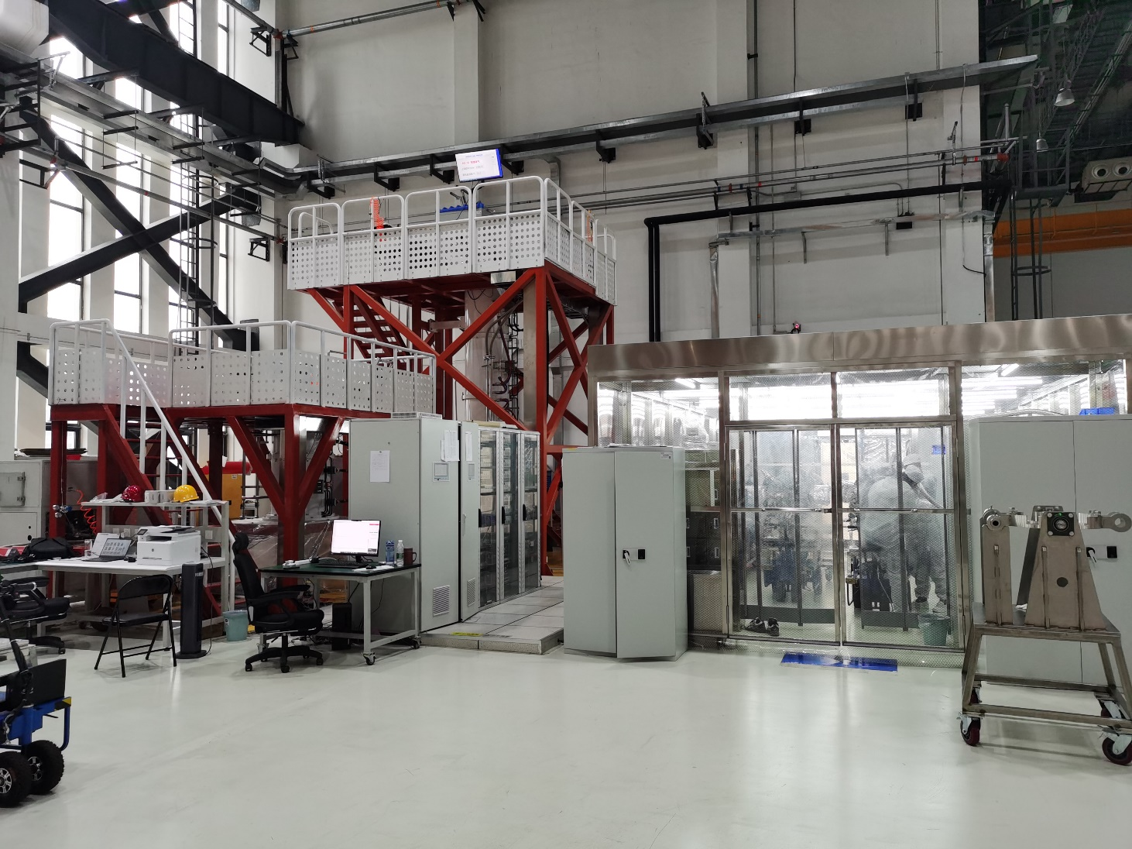
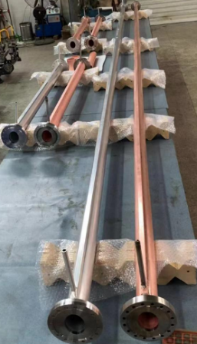
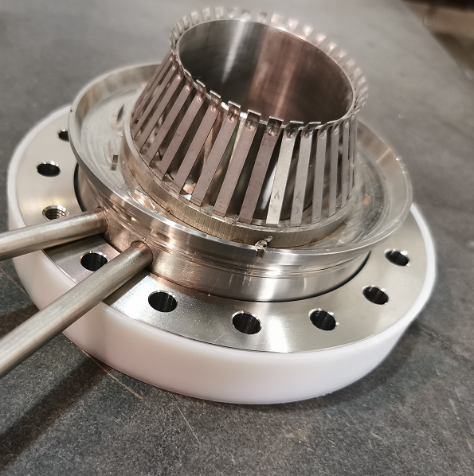
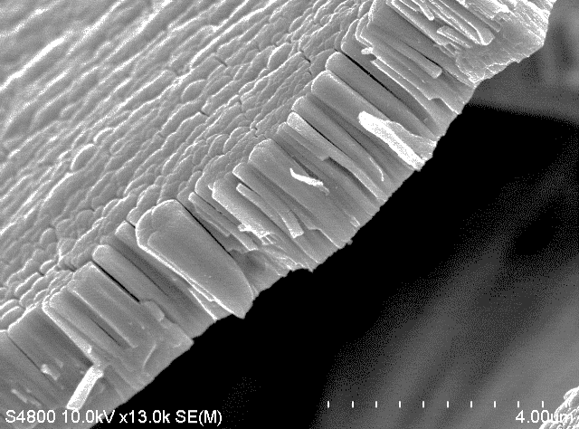
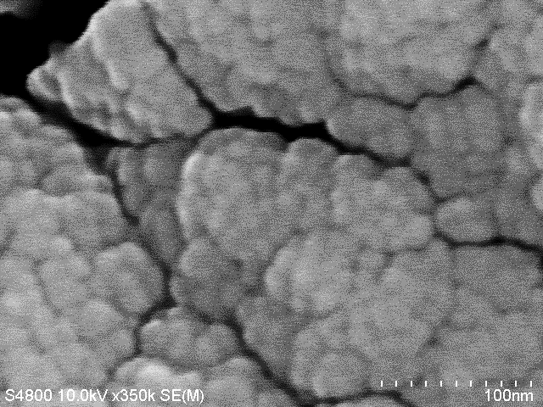
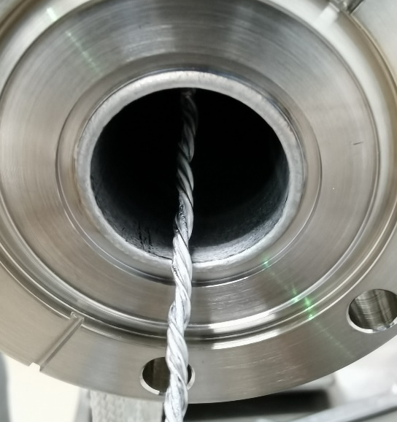
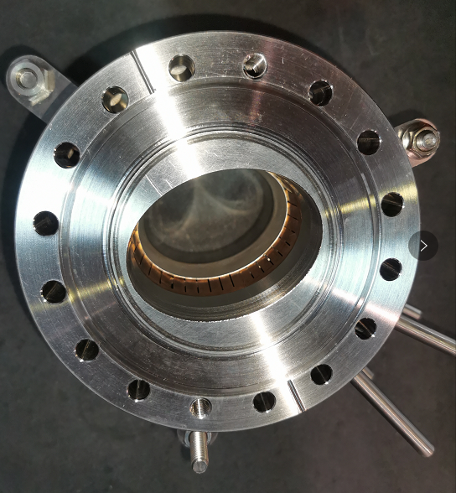
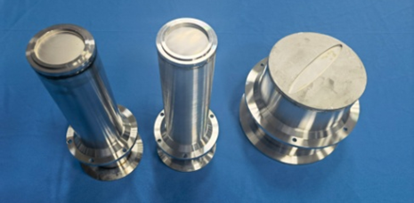
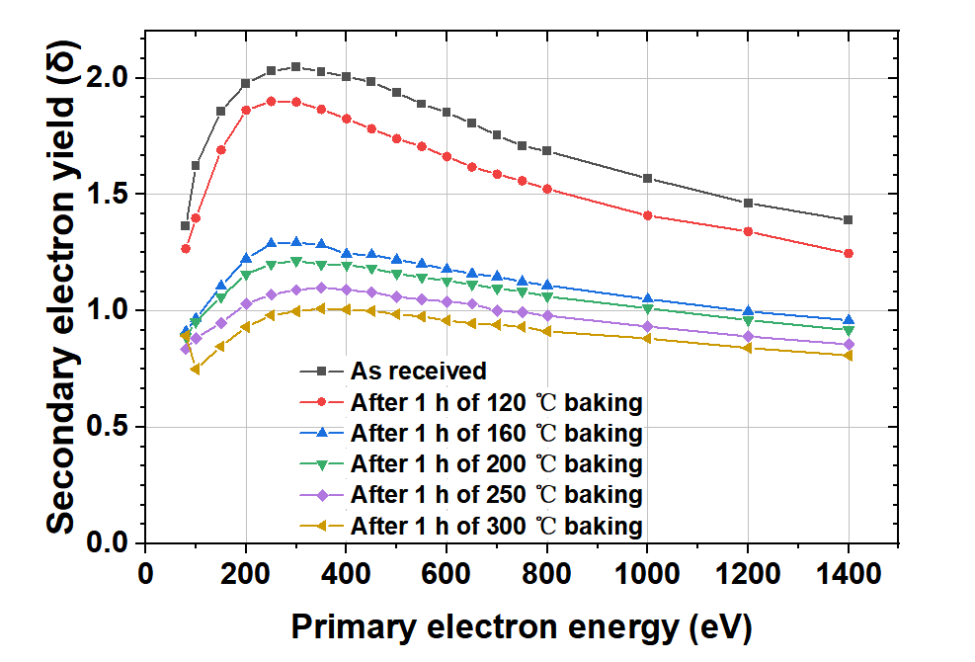
Preview of CEPC vacuum system
Technical developments in TDR
Machine and Vacuum Parameters
 | E | I | ρ
 | Gev | A | m
Higgs | 120 | 0.0167 | 10700
W | 80 | 0.084 | 10700
Z | 45.5 | 0.803 | 10700
tt | 180 | 0.0033 | 10700
Accelerator | length/m
LINAC | 1,601+335
Damping ring | 147
Booster | 100,000
Collider | 200,000
Transport line | 4,680
Total length/m | 306,763

Slide 4
Vacuum requirements and configuration
 | Energy | Material | Cross Section/mm | Length/m | Dynamic pressure /Torr
LINAC | 30 GeV | Stainless steel, copper | Φ20~30 | 1,601+ 335 (BTL) | Acc <2×10⁻⁷ E-gun<2×10⁻⁸
Damping ring | 1.1 GeV | Extruded aluminum 6061 | Φ30/Al 6061 | 147 | <2×10⁻⁸
Booster | 30 to 180 GeV | Extruded aluminum 6061 | Φ56/thickness of 2mm | 100,000 | <3×10⁻⁸ tt<4×10⁻⁸
Collider | 45.5~180 GeV | Extruded copper, NEG film SEY<1.2 | Φ56/thickness of 2mm | 100,000×2 | Z<8×10⁻¹⁰ tt<1×10⁻⁸
MDI | 45.5~180 GeV | Copper/tungsten alloy, NEG film | Φ20 | 12 | <3×10⁻⁹
LTB | 30 GeV | Stainless steel | Φ56 | 3,000 | <1×10⁻⁷
BTC(CTB) | 6 GeV | Stainless steel | Φ56 | 240×6 | <1×10⁻⁷
DL | 1.1 GeV | Stainless steel | Φ30 | 240 | <1×10⁻⁷

Slide 5
EDR goal, scope and plan
1. Vacuum chambers massive NEG coating and heating spraying production line development
The conventional NEG coating method is not suitable for the CEPC project, as there is a need to coat a total length of 190km of vacuum chambers within a 5-year timeframe. Implementing a production line can enhance stability, ensure timely production, and reduce labor costs. Therefore, a production line incorporating NEG coating and heating spraying will be developed to explore a new method for constructing vacuum chambers for the CEPC.
The construction of the vacuum chambers for the collider rings will be completed in 5 years with the use of 2 production lines, each equipped with 1 welding oven, 7 and 2 NEG coating and spraying setups.
2024: The whole production line design and biding. key components and processing like flanges sealing automatically, heating spraying will be developed.
2025: the production line construction and debugging.
2. Optimization of NEG coating:
NEG coating is used to sustain the vacuum of beam pipe and suppress the e-clouds of positron ring. Because the resistance of NEG coating increases with the thickness increases, but the life of the NEG coating decreases significantly when the thickness is less than 200nm, it is necessary to optimize the thickness and impedance of NEG coating.
2024: Optimization the thickness of NEG coating distribution along the vacuum chamber.
2024~2025: The new composition and construction development to increase the pumping properties of NEG coating, especially increase its reactivation times (life-times).
2026~2027: Optimization the resistance of NEG coating.
Composition of 2025 CEPC proposal.

Slide 6
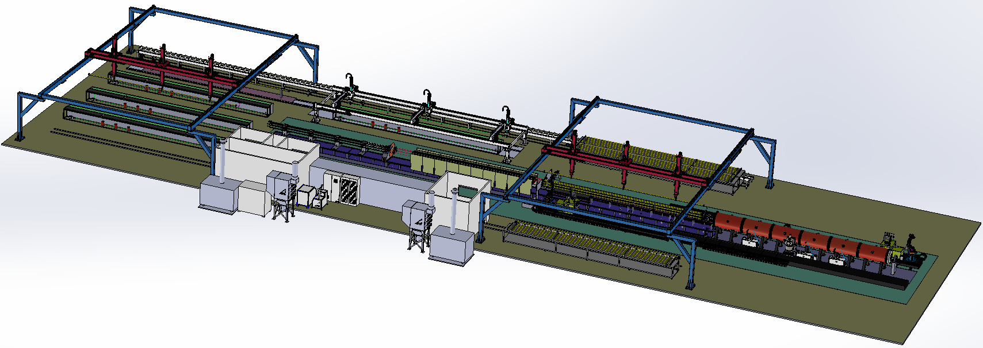
CEPC vacuum chamber production line
Requirement
Due to the difference in length, two production lines will be used to complete the production of vacuum chambers for the CEPC collider. The quantity of NEG coating and spraying facilities for the two lines varies to match the production speed.
With two production lines, the all vacuum chambers of collider will be finished in 5 years.
Advantages
More stable process, less manpower, less NEG coating facility, more adaptive capacity in production, etc.
Important nodes and progress
Technical scheme review
Procurement bidding
2024.10
2024.12
Items | Specifications
Dimension | L 11400-d56-D62
Weight | 50~100kg
NEG coating | Thickness：200nm±30% SEY<1.1 S、Q、life-times
Spraying heating | Thickness<0.5mm Heating temperature <300℃

Slide 7
Production line composition
Classification | Sub-devices | Parameters | Note
Electron-beam welder | Electron-beam gun Power supply Vacuum chamber | Meets the Length of 11.4m vacuum chamber 6 working position | Design and manufacturing
Brazing | Mechanical holder Power supply | 350℃ 11.4m long | Low temperature brazing in air by conductivity heating, expecting stead by double hole copper tube
Heating film spraying facility | Electron-beam gun Power supply Controller Mechanical Structure | Meets the Length of 11.4m vacuum chamber Multilayer Spray Ceramic and conductivity layer | R&D
NEG coating tower | Pumping system Vacuum measurement Power supply Vacuum chambers Discharge Gas Cathode、controller | Meets the Length of 11.4m vacuum chamber 6 working position Background vacuum <5e-7Pa Baking temperature 200℃ | Developing to be more fitted the production line
Measurement and testing | Dimension measurement Leakage testing | Dimension measurement 11.5m/0.1mm Leakage testing 1e-10 mbar·L/s | Design and manufacturing
Cleaning | rinsing | deionized water rinsing | Design and manufacturing
Production line auxiliary equipment | Moving band robot arm system controller | Meets the Length of 11.4m vacuum chamber | Design and manufacturing

Slide 8
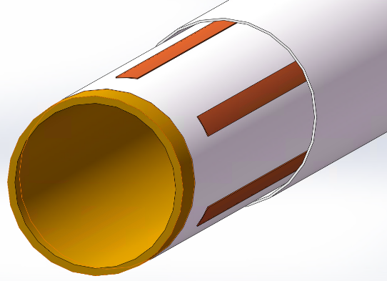
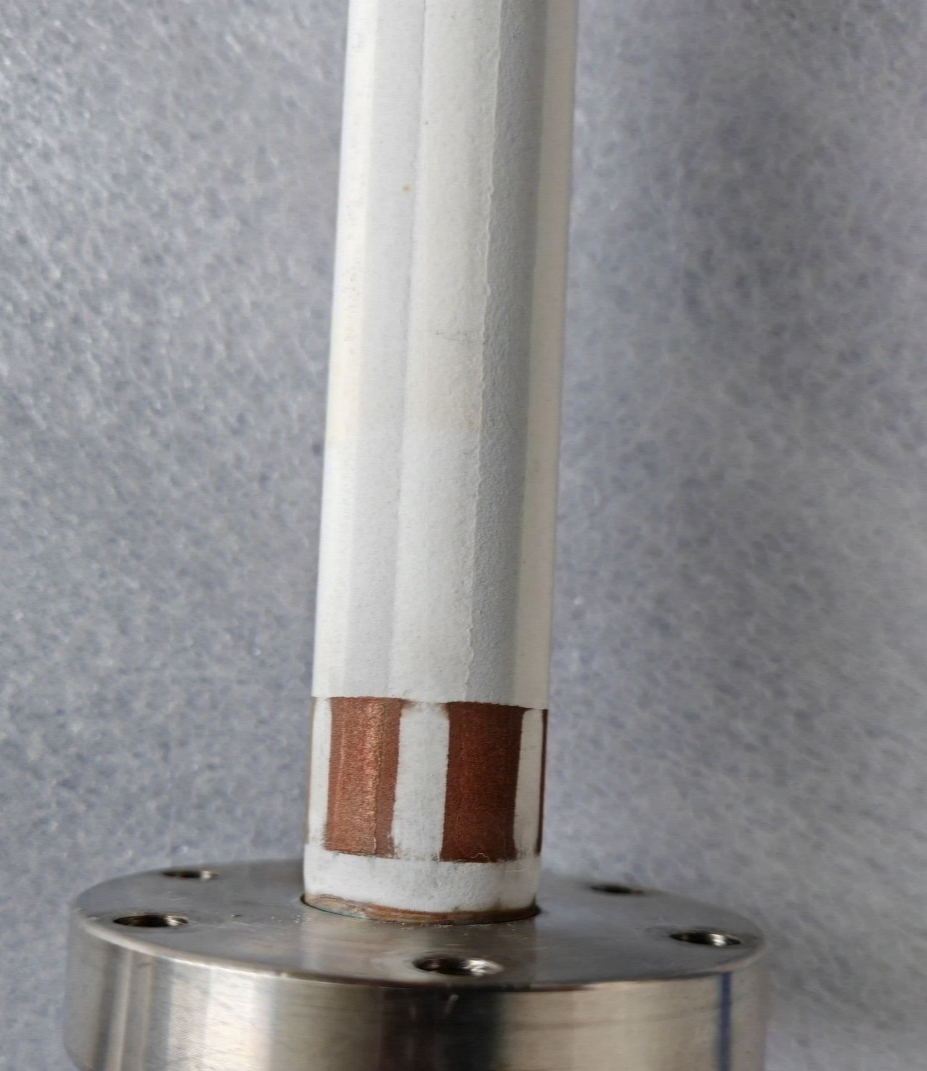
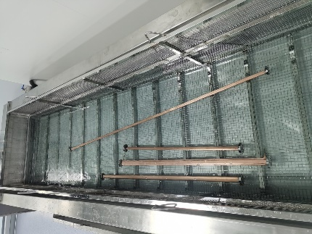
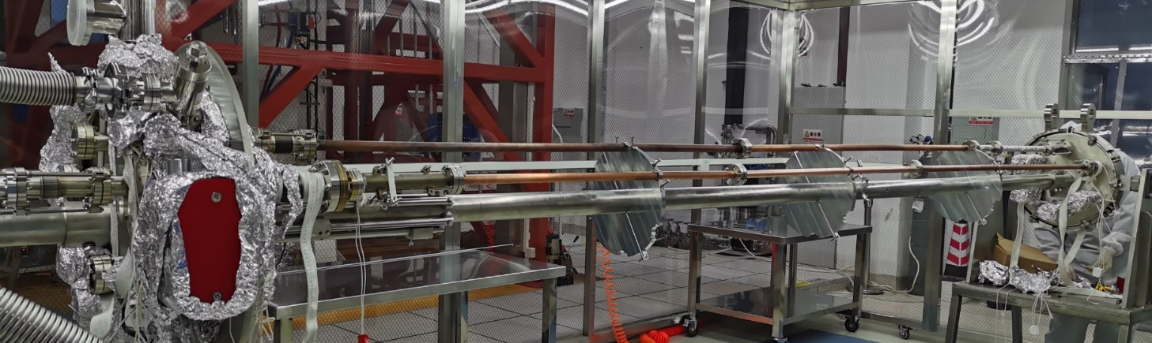
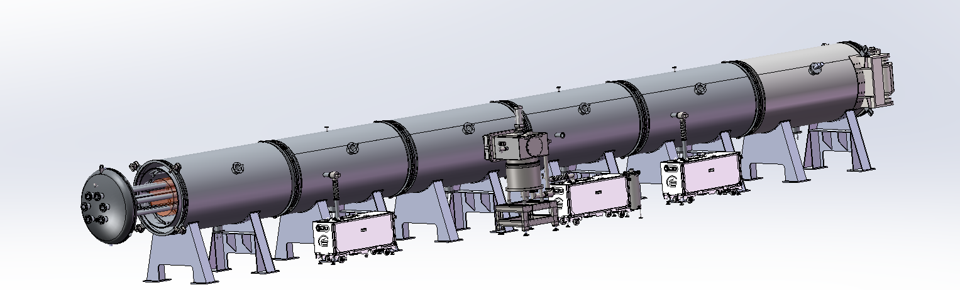
Procedure of NEG coating, spraying
Spraying
Sandblasting
Spraying_Isolation_layer
Spraying_Conductivity-layer
Spraying_Isolation-layer
Spraying_Contactor-layer
Cleaning
Outside
Inside
NEG coating
vacuum chambers, cathodes assembling by mechanical arms (flanges sealing).
Leakage testing.
Deliver the assembles to vacuum oven/ baking/ NEG coating;
Disassembly the vacuum chambers
Function | Materials | Thichness/um
Transition-layer | MCrAlY alloy | 50~100
Isolation-layer | Al2O3 cermic | ~150
Conductivity-layer | NiCr alloy | ~100~200
Isolation-layer | Al2O3 cermic | ~150
Contactor-layer | Copper | ~50

Slide 9
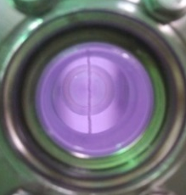
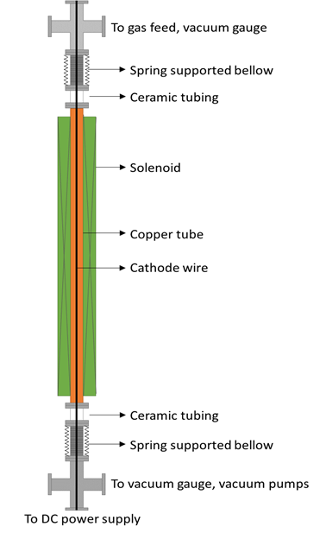
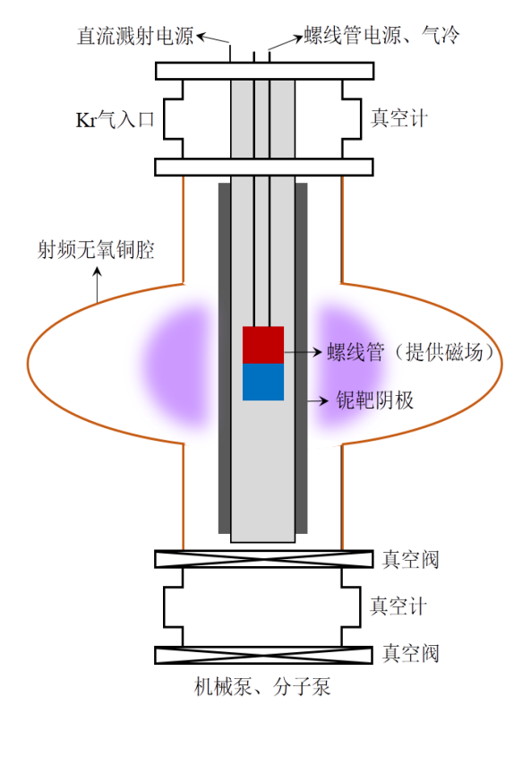
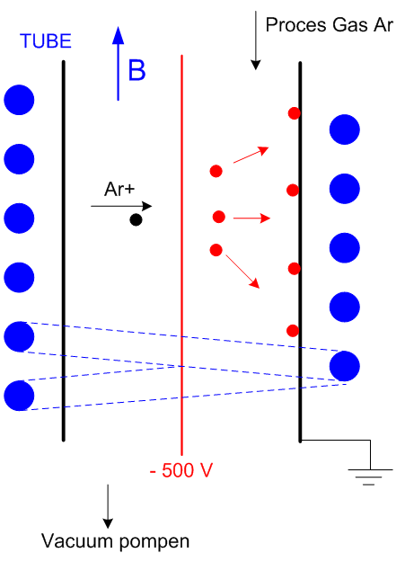
NEG coating mechanism & method
HEPS, LHC, MAX IV, SIRIUS, APS_U etc.
CSNS, BEPCII vacuum chambers;
Nb coating;
磁环
Kr+
Outside magnet （solenoid）
Inside magnet
Cathode wire
Magnetron sputtering cathode
Notes:
在磁场的约束下，形成等离子体。Kr原子被等离子体电离形成Kr+，在电场加速作用下打向阴极靶，从而形成溅射作用。TiZrV原子沉积到铜基底表面形成NEG薄膜

Slide 10
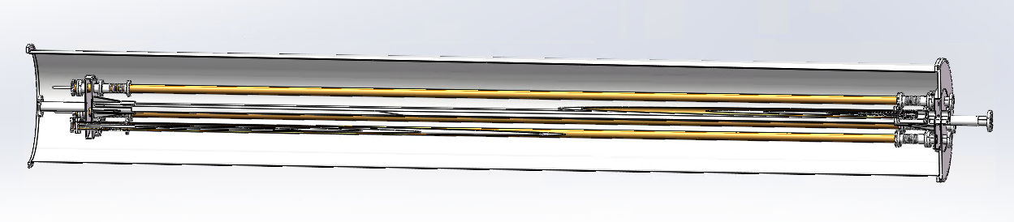
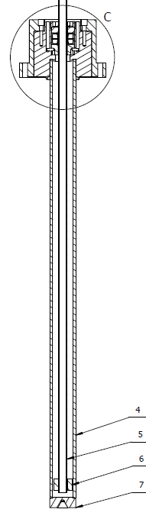
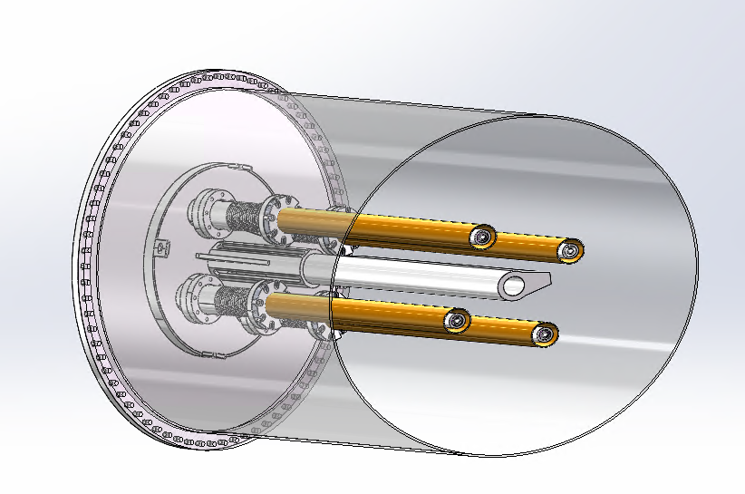
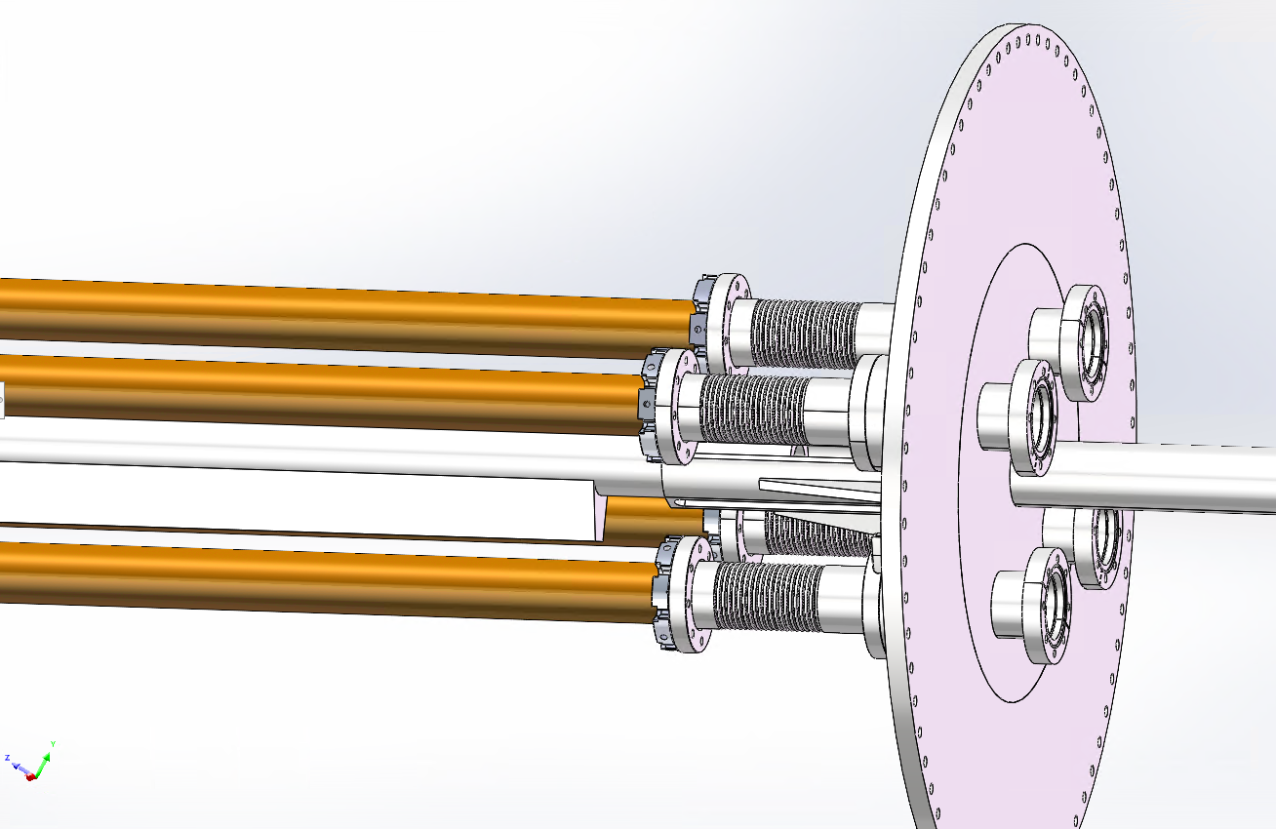
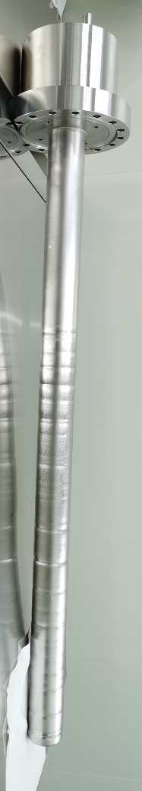
Massive production of NEG coating for CEPC——Upgrade plan
Due to the diameter of CEPC is D56, we plan to replace the cathode wire with a magnetron sputtering cathode
Permanent magnet instead of the solenoid which supplies magnetic field for DCMS;
By combining the low vacuum chamber outside of the vacuum chambers to be coated with NEG, the high vacuum process is simplified;

Slide 11
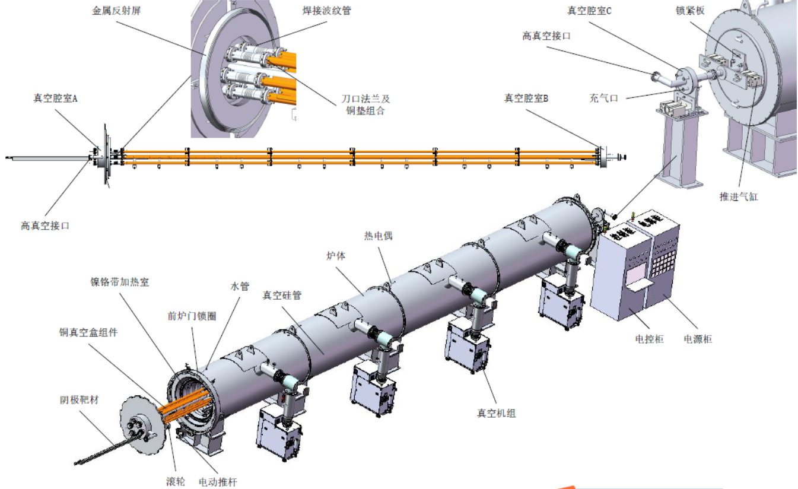
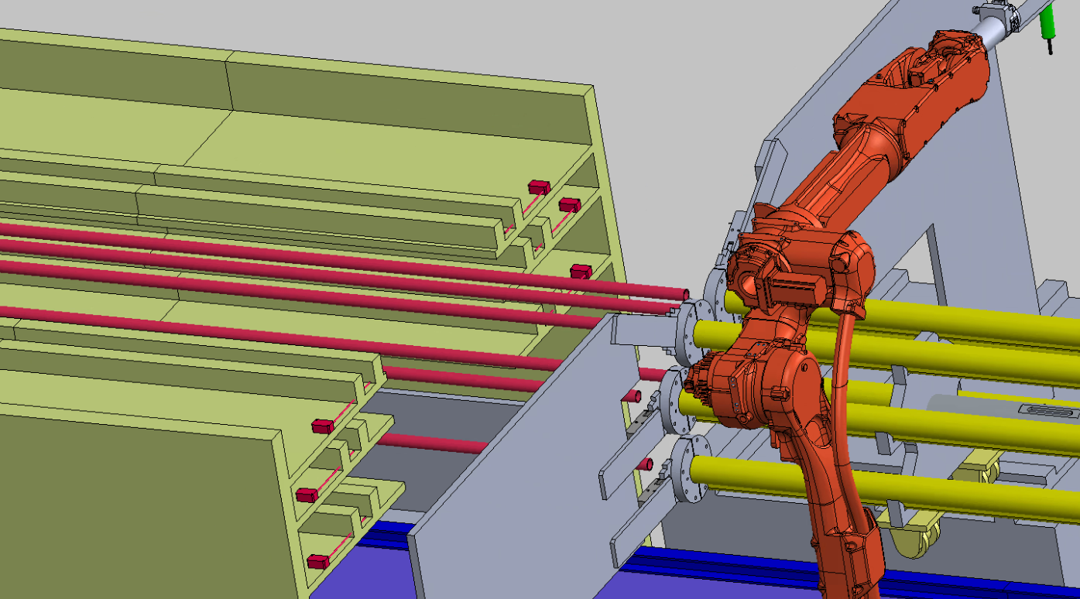
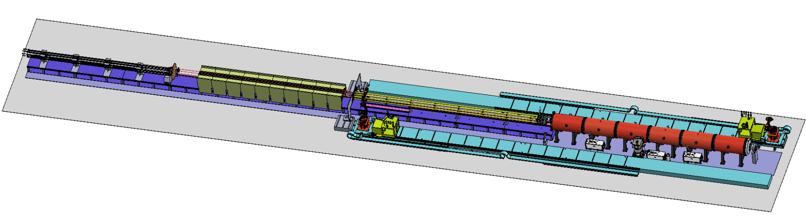
layout & composition of NEG coating facility
NEG coating, VC assembly and disassembly with automatic robot arms.
Cathodes driven
Cathodes
VC assembly
Vacuum oven

Slide 12
Prototype of vacuum chambers assembly

Slide 13
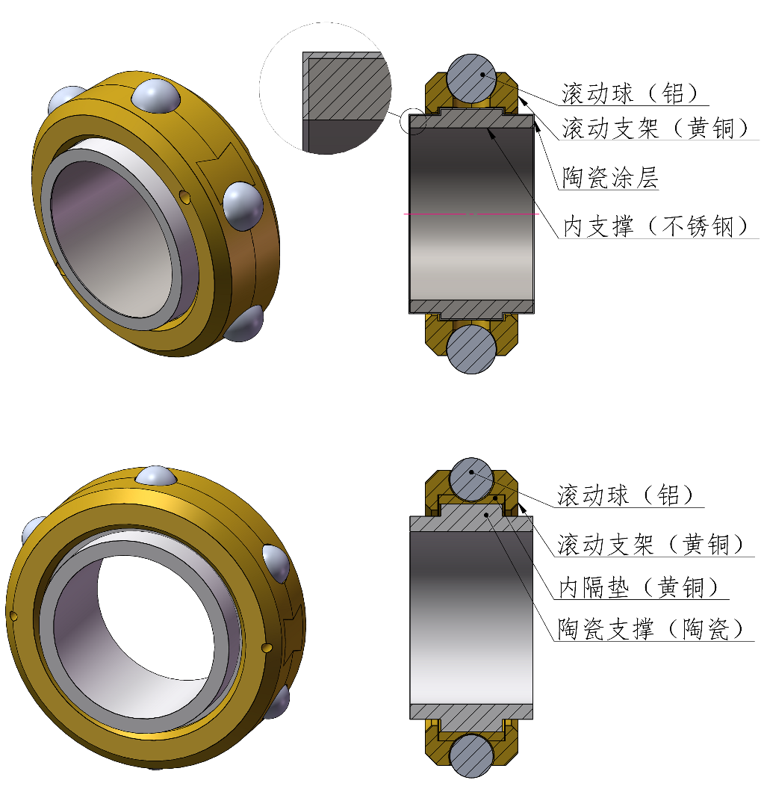
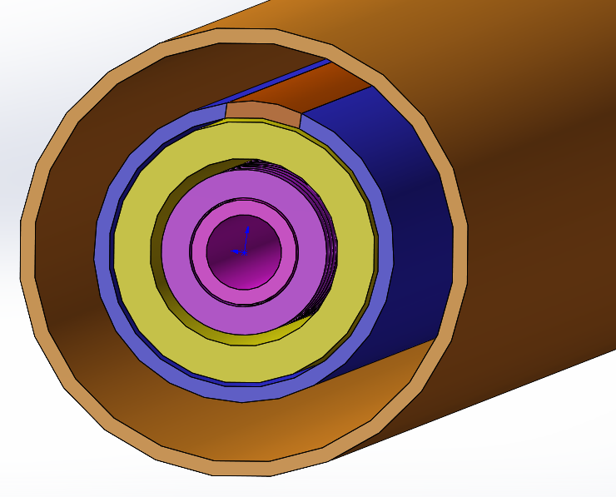
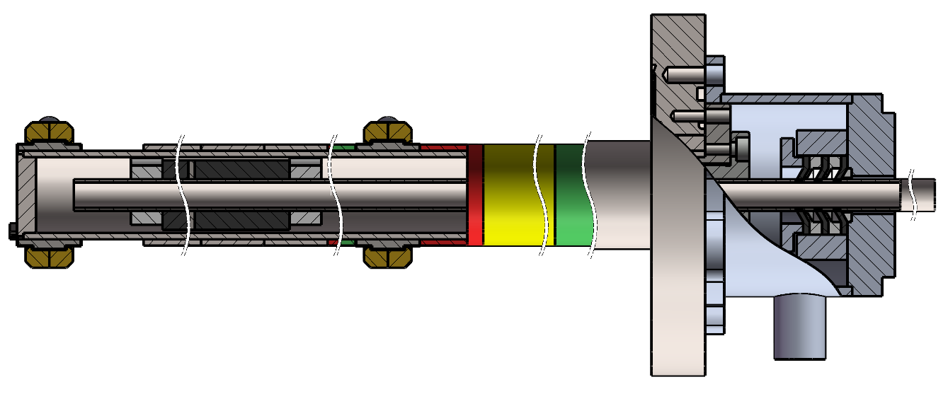
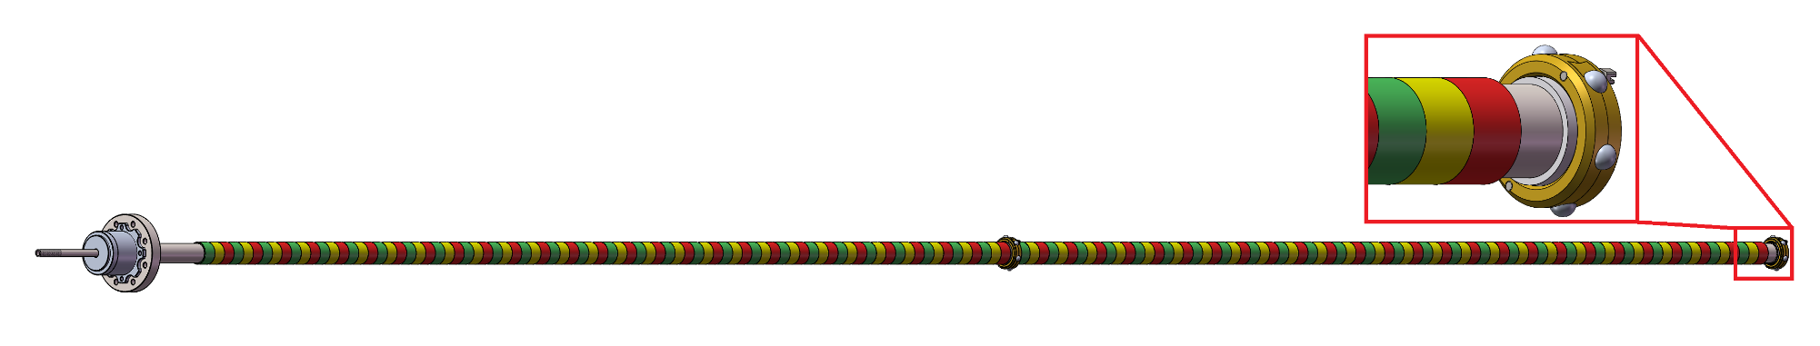
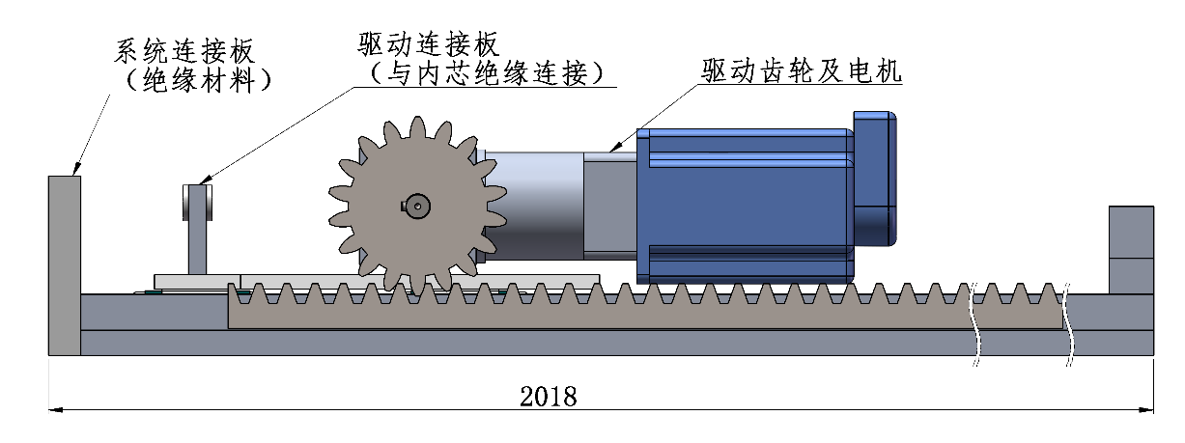
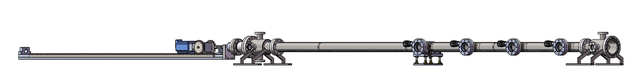
Prototype of cathode for NEG coating
dynamic sealing for water pipe
Magnets
Isolating and supporting ring
Water cooling pipe
~12000mm(12 meters)
Magnetron Cathode
The magnets will be driven by motor when NEG coating
Motor for magnets driven
23000mm(23 meters)

Slide 14
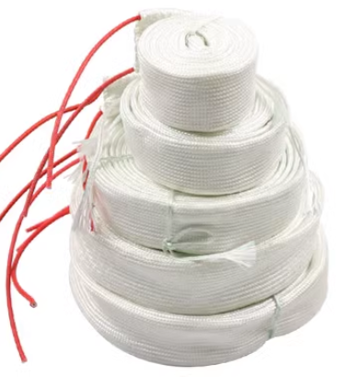
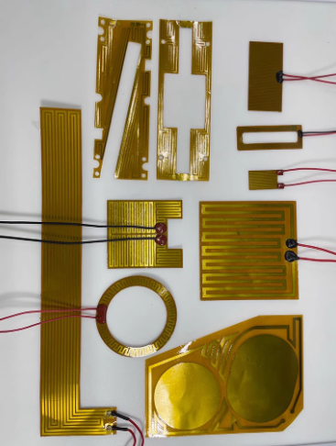
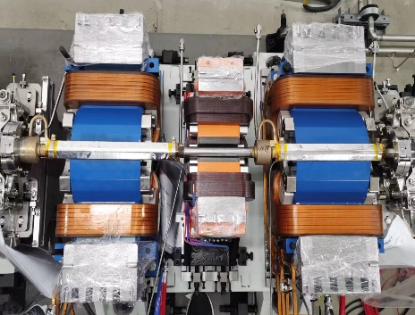
VC baking & Why spray heating film
The baking is the most crucial procedure in achieving ultra-high vacuum
Necessity:
In order to meet the ultra-high vacuum requirement of achieving a dynamic vacuum level of 3.0E-10 mbar.
NEG coating reactivation
Too thick
Lifetime is very short under SR of CEPC
N₂
N₂
H₂
H₂
O₂
MO
O₂
Heat
O
High
vacuum
or
inert gas
H₂O
C
MC
CO
H₂O
CO₂
CO₂

Slide 15
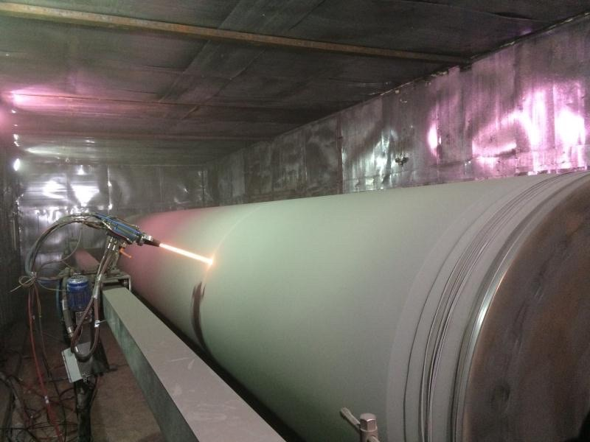
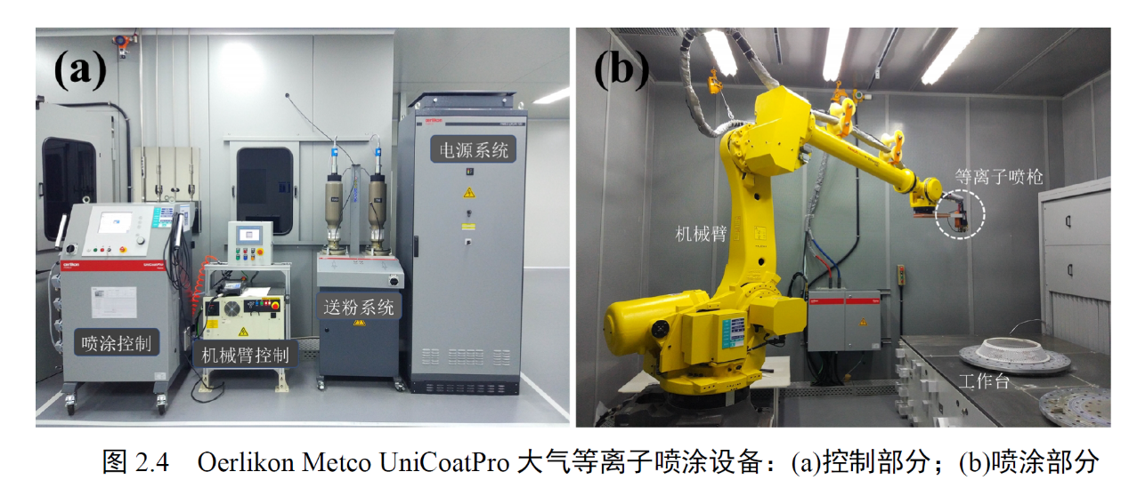
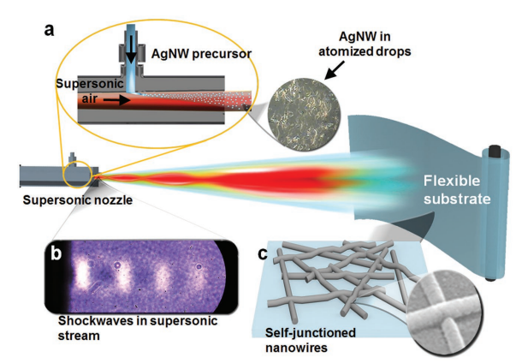
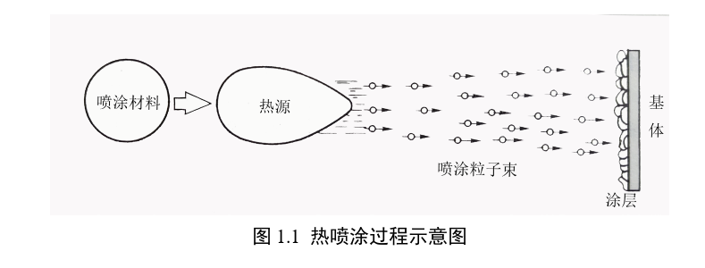
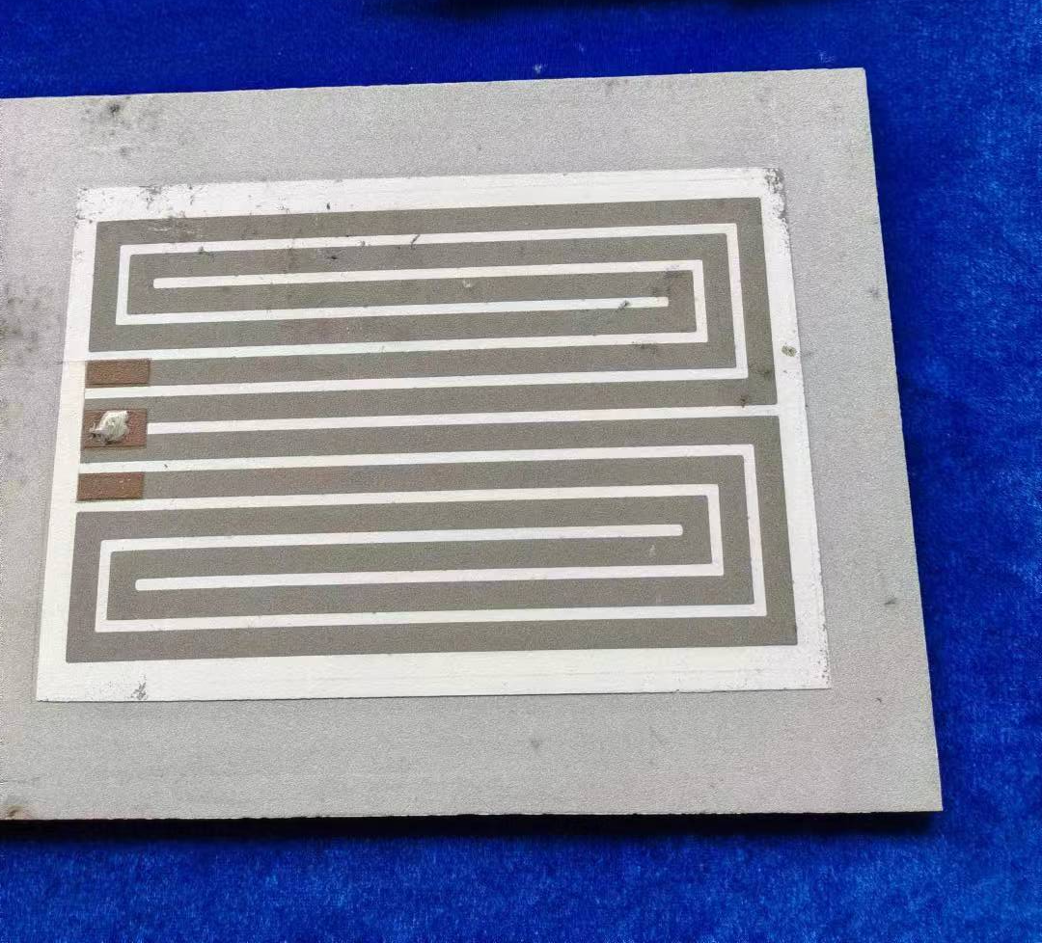
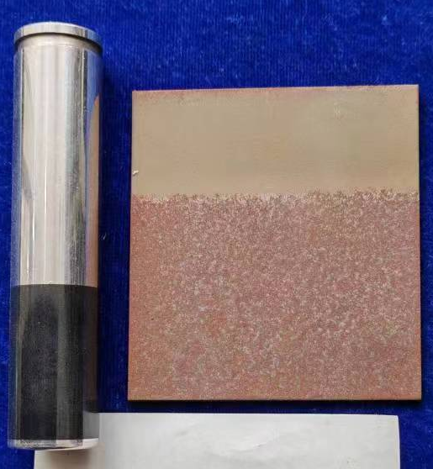
Spray for heating film
Multilayer heating film will be coated outside of the vacuum chamber which composited by ceramic and conductivity layer
The heating temperature could reach 250℃
Heating layer
Thickness： 0.5mm
Ceramic layer
Convection
Radiation
Conductivity layer
I
solution
Conduction
Ceramic layer
Cu/ceramic transition layer
Vacuum chamber
Related commercial products
Cu/Ag NW
Processing of spray
Plasma spraying
Electric heating circuit
De-icing for airplane

Slide 16
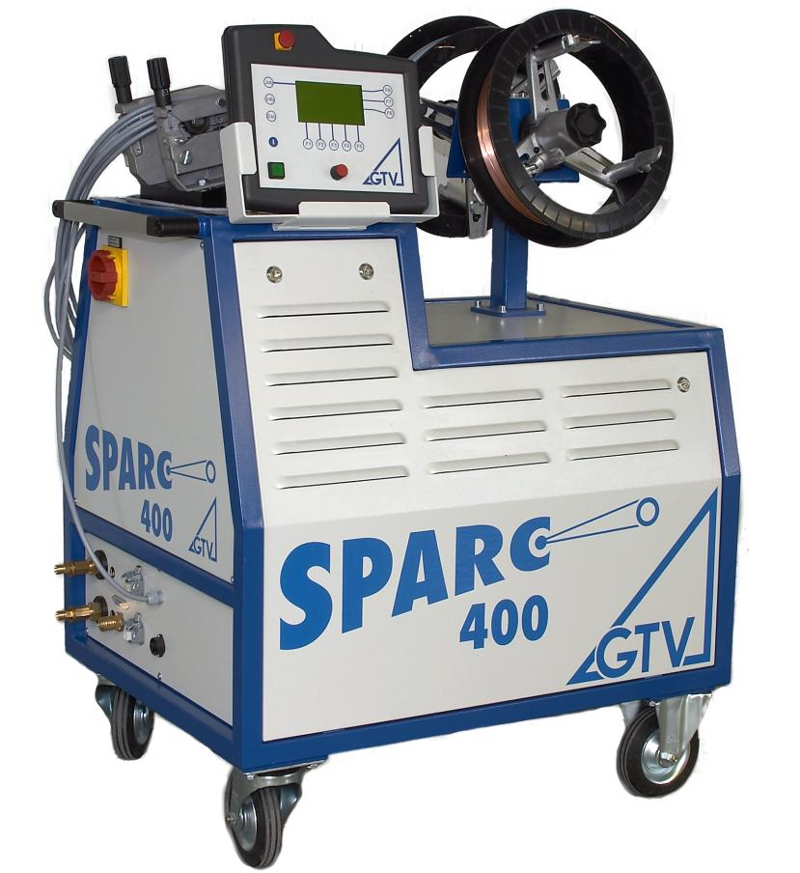
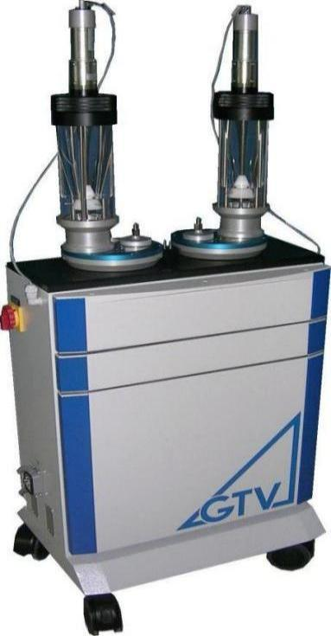
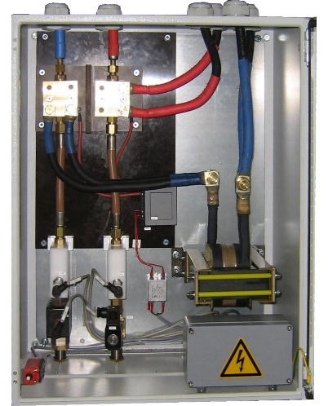
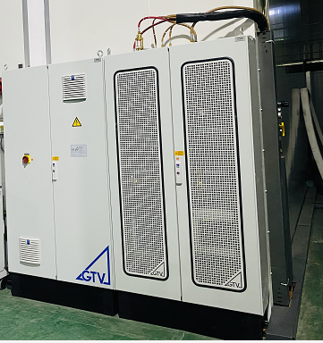
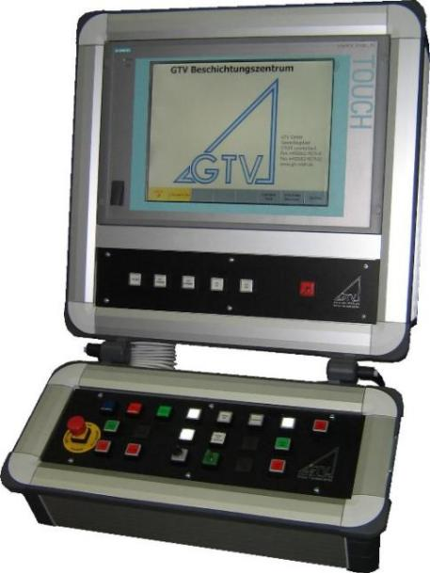
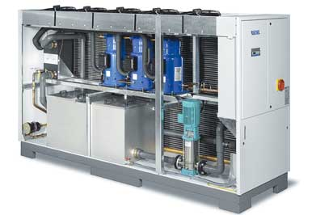
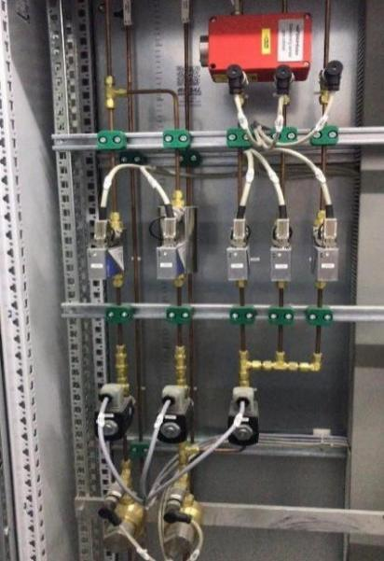
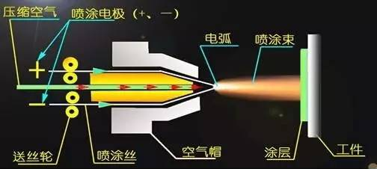



Multiple-layers spraying
Plasma spraying
Electric arc spraying
Gun power： 22 KW
Efficiency：0.98
Current：max. 400 A
Voltage：max. 10 - 70 V
Gun power：≤55KW
Process gases：Ar/N2、Ar/H2、N2/H2、Ar/He
Current：200A-800A

Slide 17




Prototype of Spraying heating film and tests
Reheating test more than 12 times
Adhesion test in ultrasonic resining
Dimension: L400*D24 Substrate: copper
Function | Materials | Thichness/um
Transition-layer | MCrAlY alloy | 50~100
Isolation-layer | Al2O3 cermic | ~150
Conductivity-layer | NiCr alloy | ~100~200
Isolation-layer | Al2O3 cermic | ~150
Contactor-layer | Copper | ~50
管外温度/℃
功率面密度W/cm2

Slide 18
Conclusion
Production line of vacuum chambers NEG coating and spraying heating will be R&D in 2 years;
NEG coating by magnetron sputtering cathode method R&D will be carried out to adapt the production line;
Prototype of Spraying heating film and tests have been carried out, which shows a good results;
NEG coating optimization for low impedance film, Spraying for heating film plan to be carried out ;

Slide 19
Acknowledgement
A significant amount of work has been completed in the CDR and TDR, and I would like to thank all those who have contributed to these efforts.
Thanks for the HEPS, FCC-ee project;
Thanks for your attention

