Slide 1


Progress of CEPC Booster
and Collider prototype magnets
Wen Kang, Mei Yang
HKUST, Hong Kong
2025-01-15
IAS Program on Fundamental Physics 2025

Slide 2
Contents
Key specifications of the CEPC main magnets
Dipole magnets of the Booster
Automatic magnet production line
Dual aperture dipole magnets of the Collider
Dual aperture quadrupole magnets of the Collider
Sextupole magnets of the Collider
Summary

Slide 3
Key specifications of the CEPC main magnets
Booster | Number | Length | Min. field | Max. field
Dipoles | 14866 | 4.7m/2.4m | 95Gs | 564Gs
Quad. | 3458 | 2m/1m | 2.0T/m | 15.9T/m
Sext. | 100 | 0.4m | 18T/m² | 217T/m²
Corr. | 1200 | 0.58m | 20Gs | 200Gs
Collider | Dipole | Quad. | Sext. | Corr.
Number of DA | 3008 | 3012 | - | -
Number of SA | 162 | 1128 | 3176 | 7088
Length(m) | 19.7/23.1 | 3 | 1.4 | 0.44
Max. field | 600Gs | 12.4T/m | 847T/m² | 300Gs
The total length of all magnets is about 160 km, so magnets cost is a significant concern in the design of the magnets, particularly the dipole magnets.
The field of Booster magnets will change with the beam energy, the cores of the magnets will be produced by laminations not solid iron.
Most dipole and quadrupole magnets of the collider are dual aperture magnets, the distance between two apertures is only 350 mm.
All magnets of the Collider work at four energies (Higgs, W, Z and ttbar mode).

Slide 4
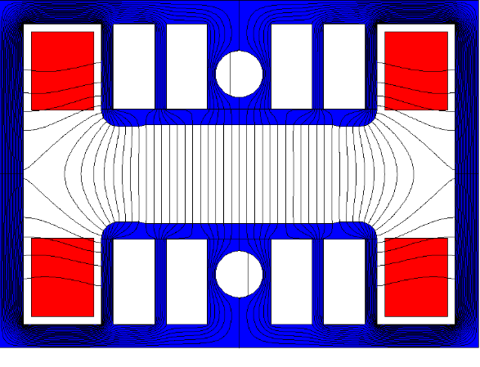
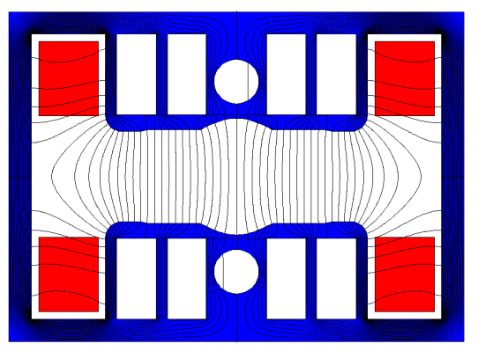
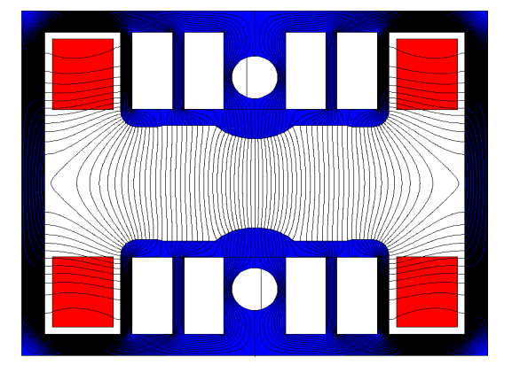
Dipole magnets of the Booster
There are three types of dipole magnets in the Booster. One is the pure dipoles, the others are the dipole-sextupole combined magnets.
  To achieve better shielding of the earth's field, a closed H-type core was chosen.
  To reduce cost of the magnets,
  The cores will be made by steel and plastic or aluminium sheets with thickness ratio of 1:2.
  The return yokes of the cores are made as thin as possible.
  Some holes are punched in the pole areas of the laminations.

Slide 5
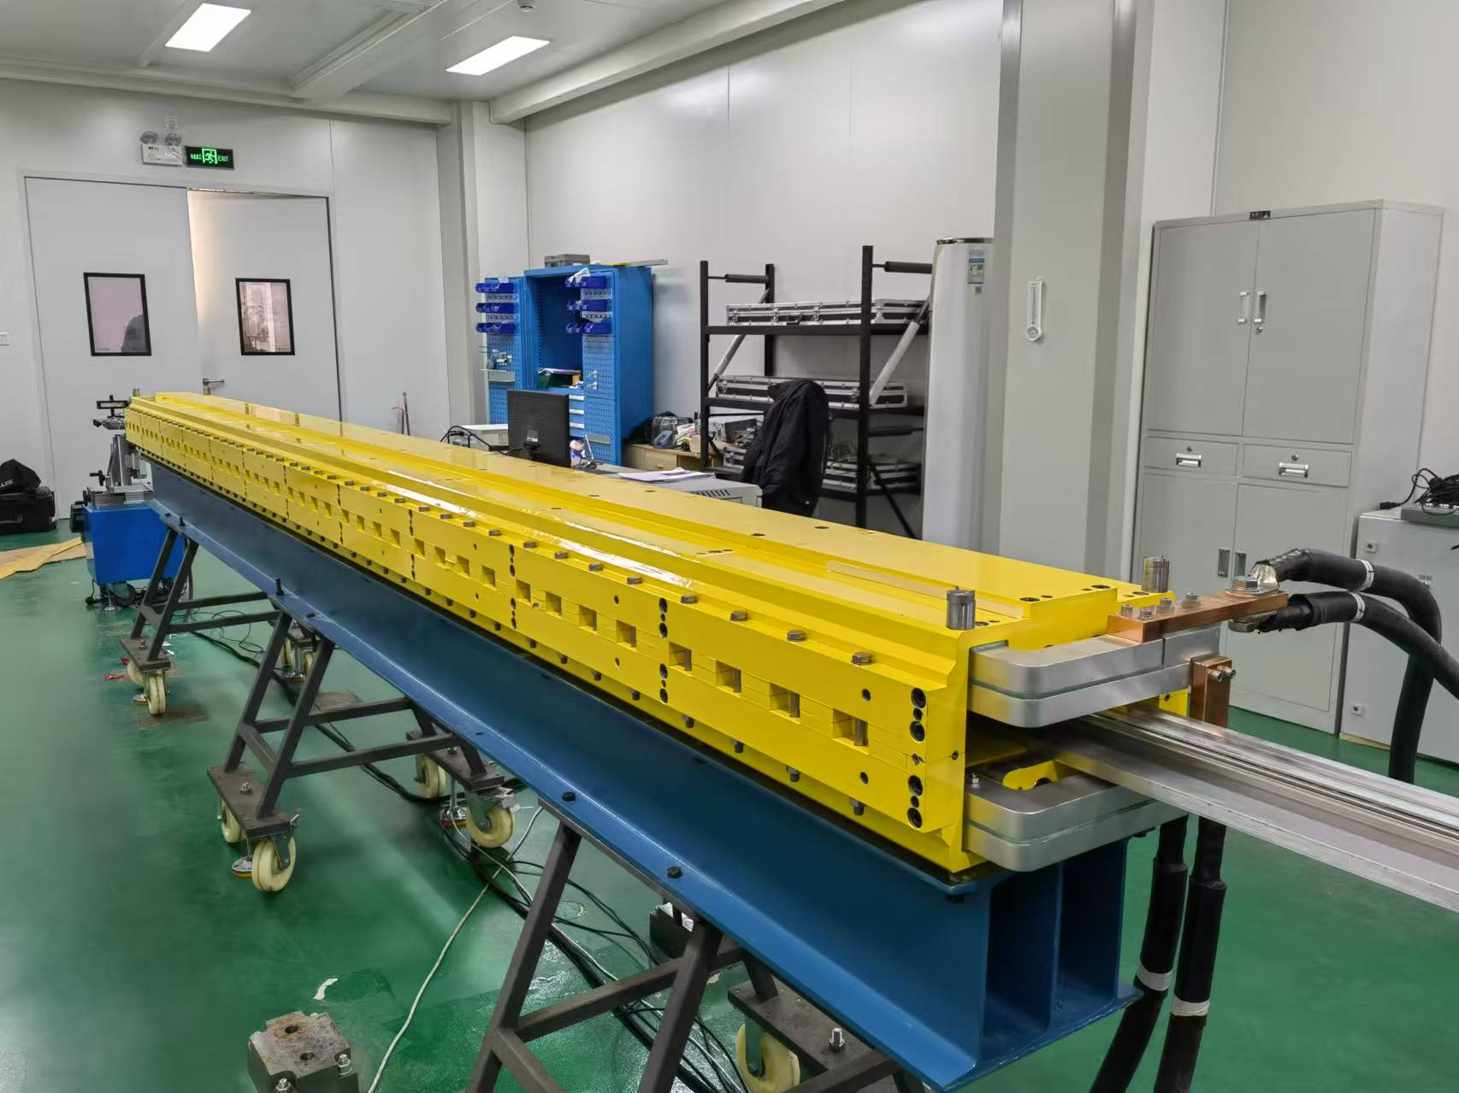
Dipole magnets of the Booster
In TDR stage, a full length (4.7m) pure dipole magnet was developed and researched, the field performance was satisfied with the physical requirements.

Slide 6
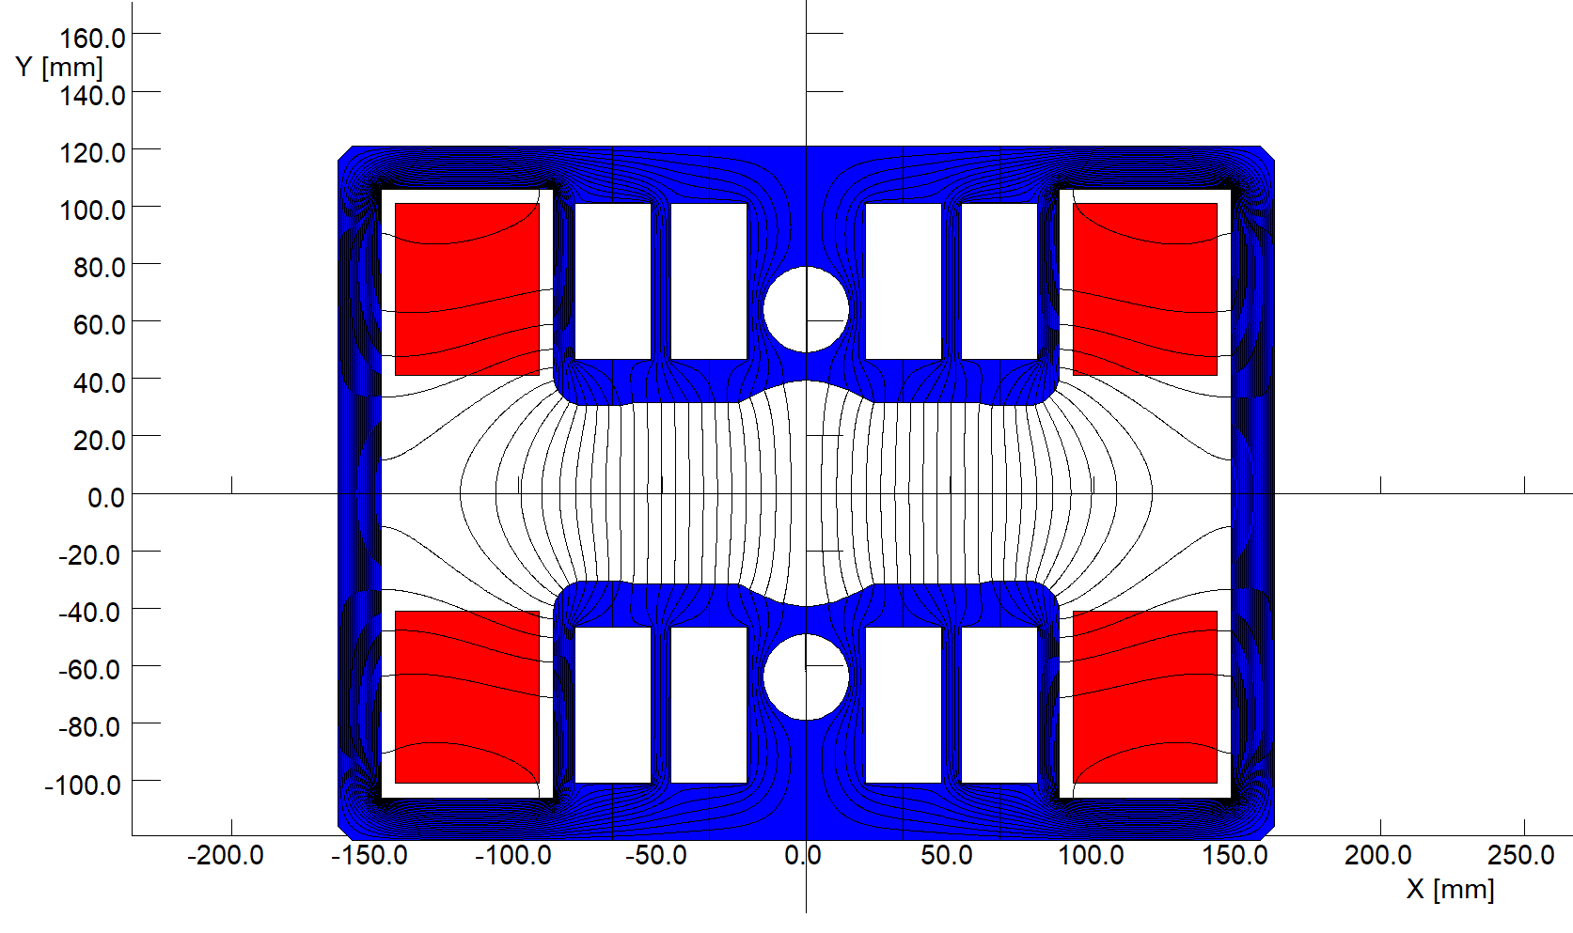
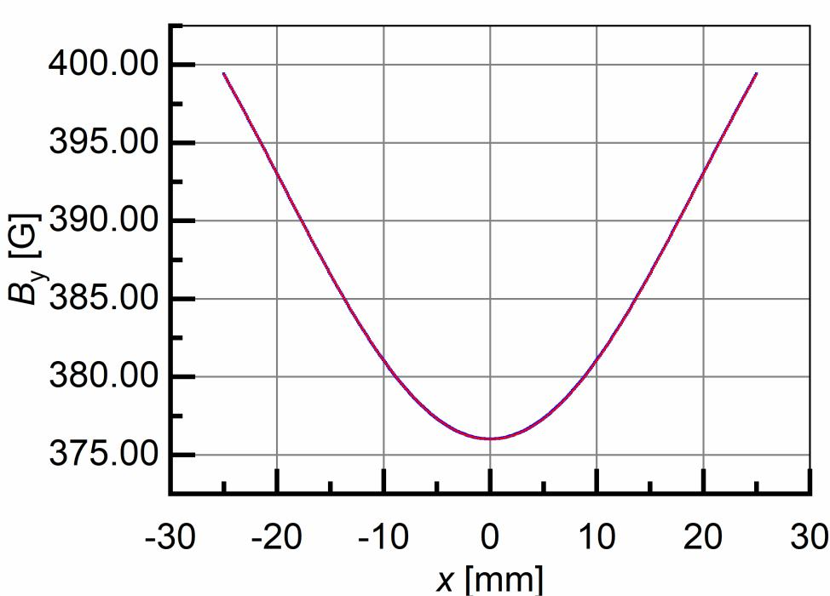

Dipole magnets of the Booster
In EDR stage, a full length (4.7m) dipole-sextupole combined magnet is designed and being developed.
requirements |  |  |  | simulated
B0[T] | 0.0376 | B0[Gs] | 376 | 376.004
S[T/m^2] | 10.6925 | S[Gs/mm^2] | 0.106925 | 0.106928
h[m] | ≥0.0315 | h[mm] | ≥31.5 | 31.5
Optimized results
$$y=376.0041+5.2734×{10}^{−6}x+5.3464×{10}^{−2}x^{2}$$
$−4.6946×{10}^{−8}x^{3}−3.0196×{10}^{−5}x^{4}$
$+7.6261×{10}^{−11}x^{5}+7.2944×{10}^{−9}x^{6}$
dipole
sextupole

Slide 7
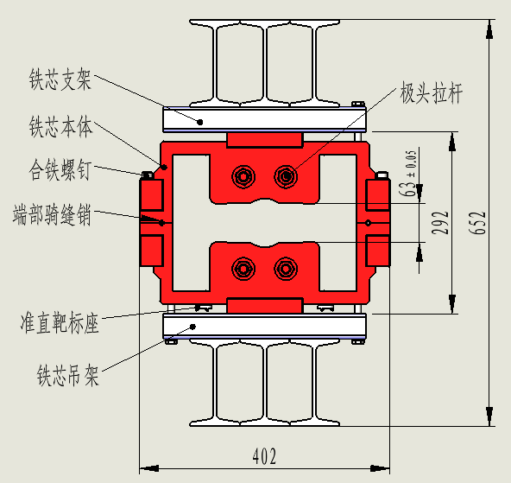
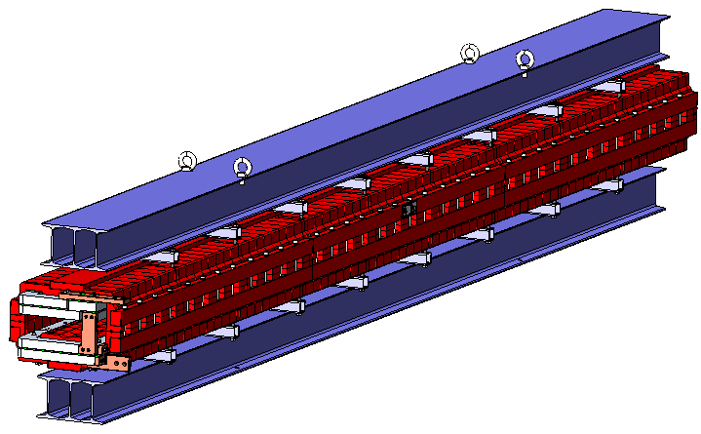
Dipole magnets of the Booster
The magnet has a two-in-one H-type structure, the length 4608mm, the gap 63mm.
The cores of the magnet are composed of steel and plastic or aluminum sheets, end plates, central and surrounding draw bars.
Because the mechanical strength of the stacked cores is not strong enough for lift and delivery, two ‘I’ type beams on the top and bottom are tightly assembled with the magnet.

Slide 8
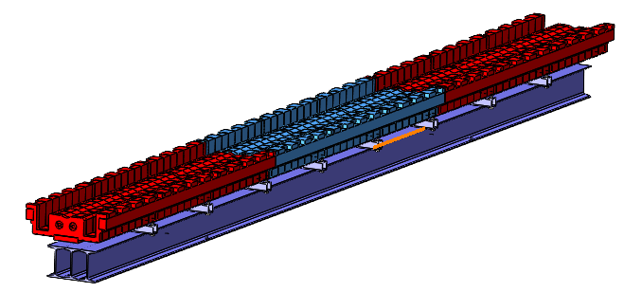
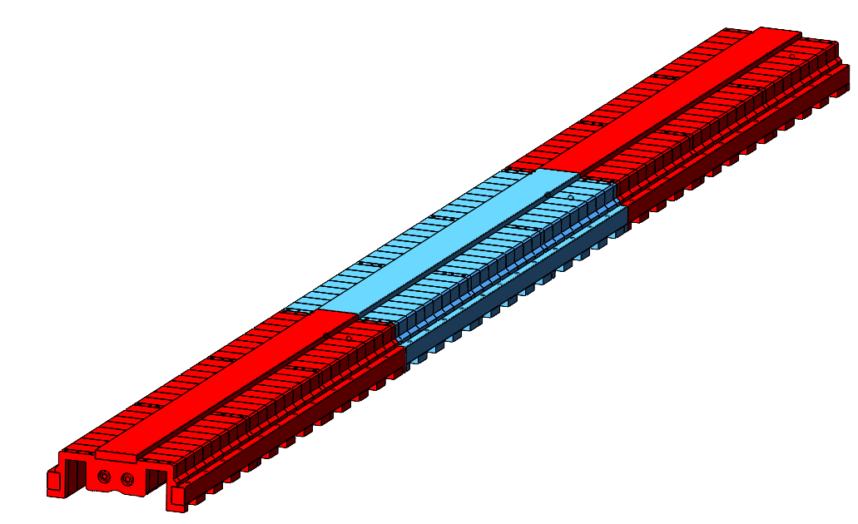
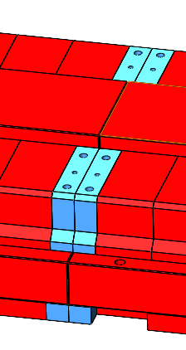
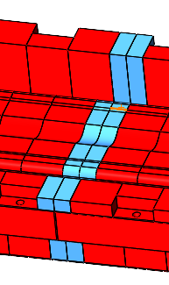
Dipole magnets of the Booster
Since the cores are too long to be produced easily, the long cores will split into three short ones to be produced, then assembled and welded together, so the actual length of the stacked cores is shortened from 4608mm to 1536mm.

Slide 9
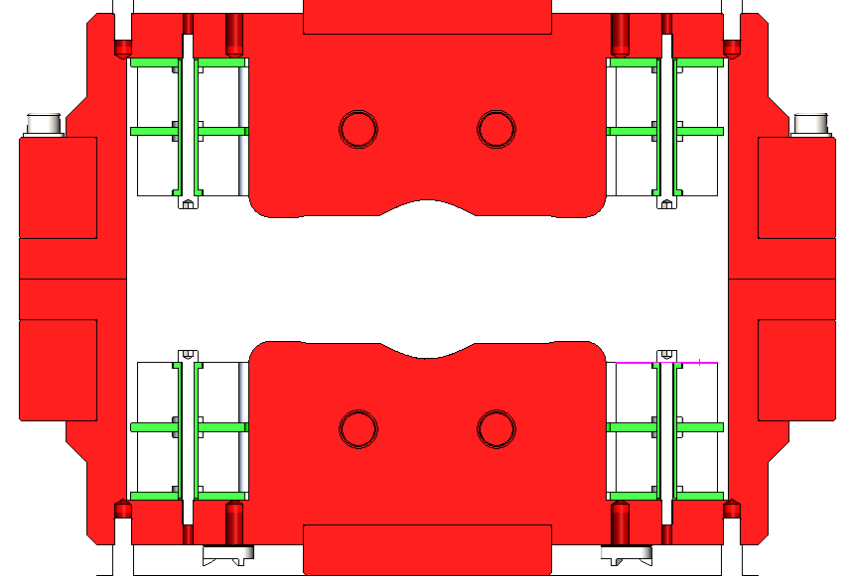
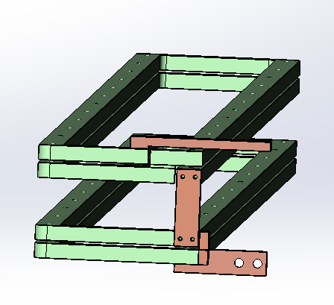
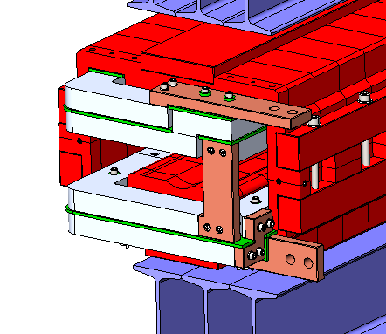
Dipole magnets of the Booster
The magnet has two coils, each coil has two turns, which are pieced together by the aluminum bars.
G10 plates are used for insulation from turn to turn as well as between the coils and cores. The withstand voltage could be higher than 1000V.
By using a special structure, the coils are fixed on the cores by anti-loosening bolts.
After two half magnets are assembled together, two coils are connected by the pass bars at the end of the magnet.
N
“+”
S
“一”

Slide 10
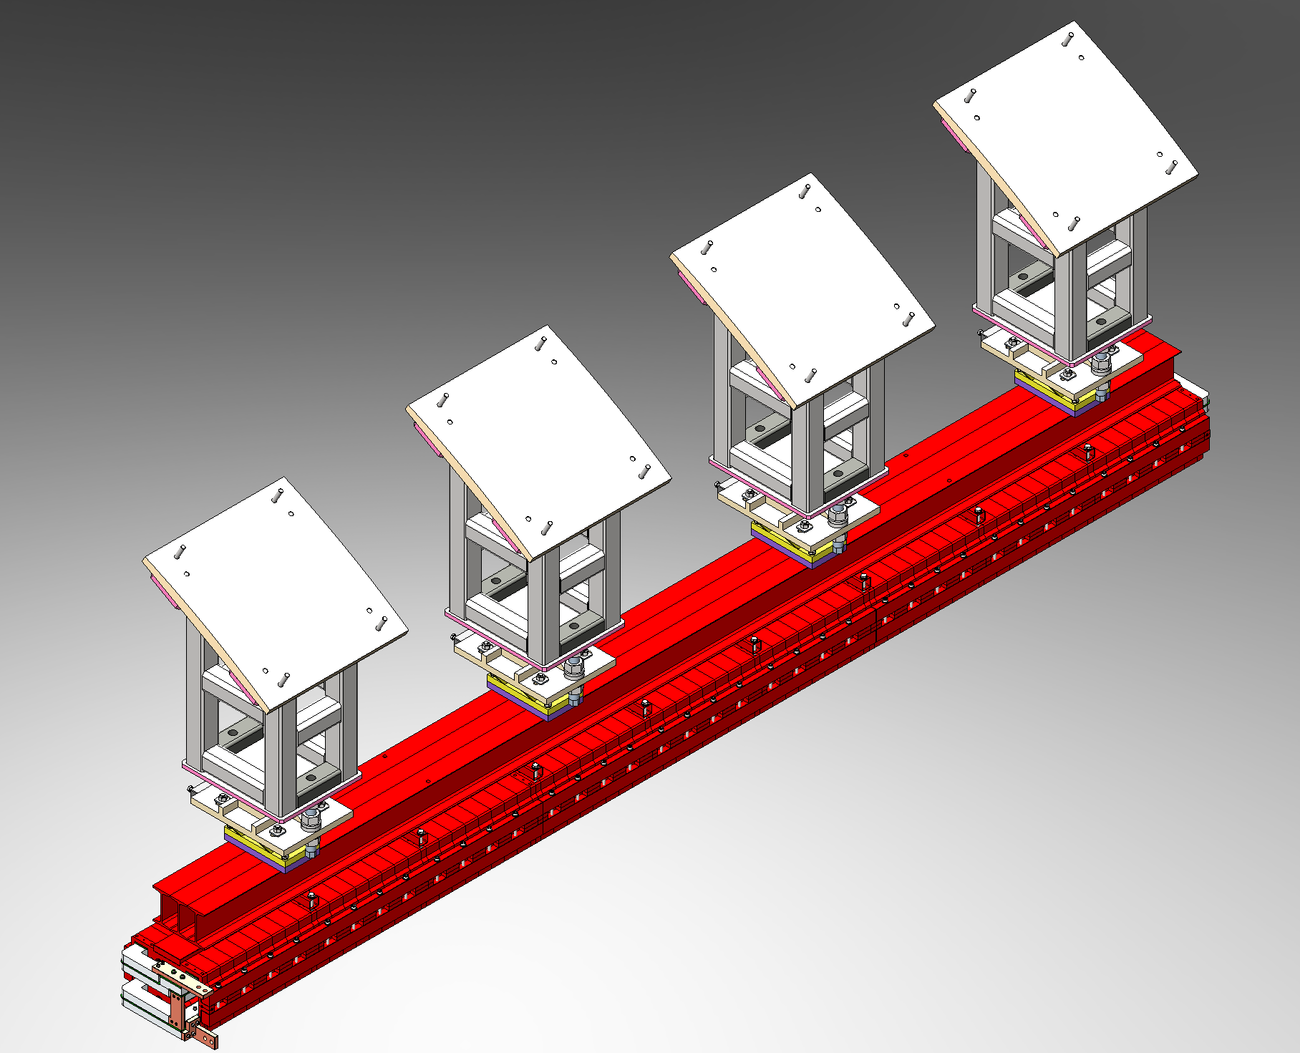
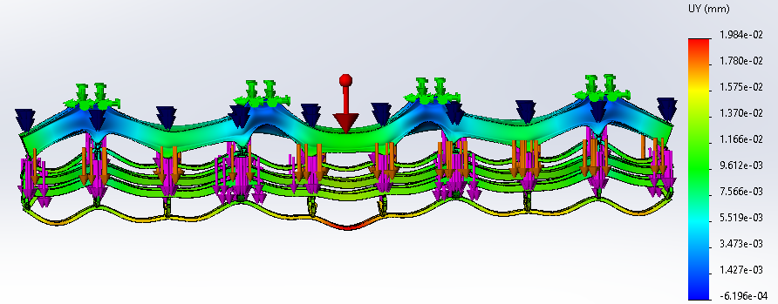
Dipole magnets of the Booster
Because all the magnets of the Booster are installed on the top of the CEPC tunnel, the deformation of the dipole magnet as hanged is analyzed.
The simulation results show that the max. deformation is about 20um when the magnet is hanged by four points.

Slide 11
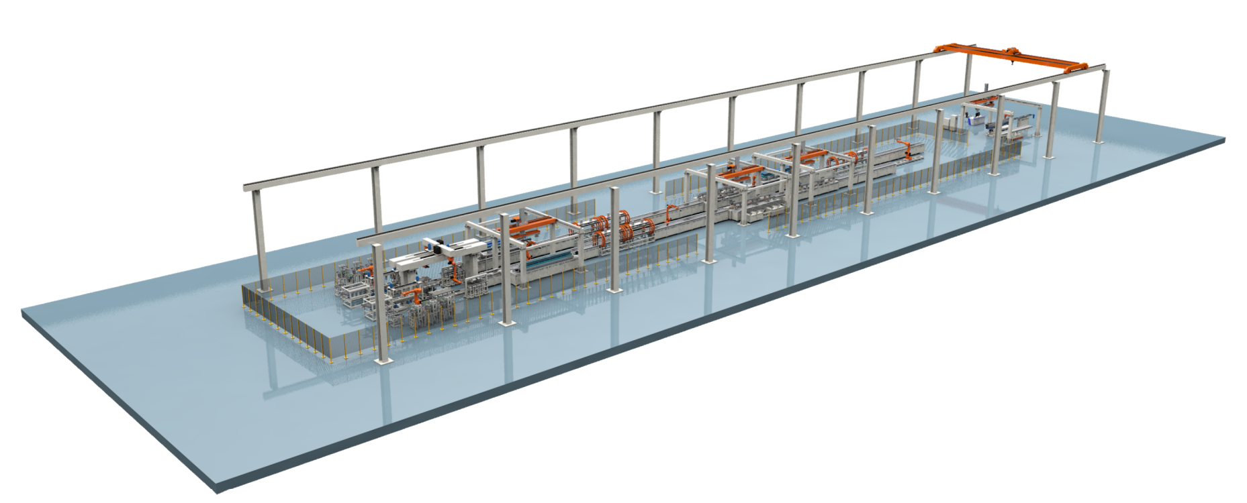
Automatic magnet production line
To decrease cost and increase efficiency of the magnet production, an automatic magnet production line for the Booster dipole magnets is designed and developed.
It is composed of four sub-systems, which are stacking of 1/3 length core, integration of full length core, assembly of the magnet and field measurement.
Production capability: 4 magnets/day
Mass production period: 5 years
So three production lines are needed for mass production of dipoles.

Slide 12
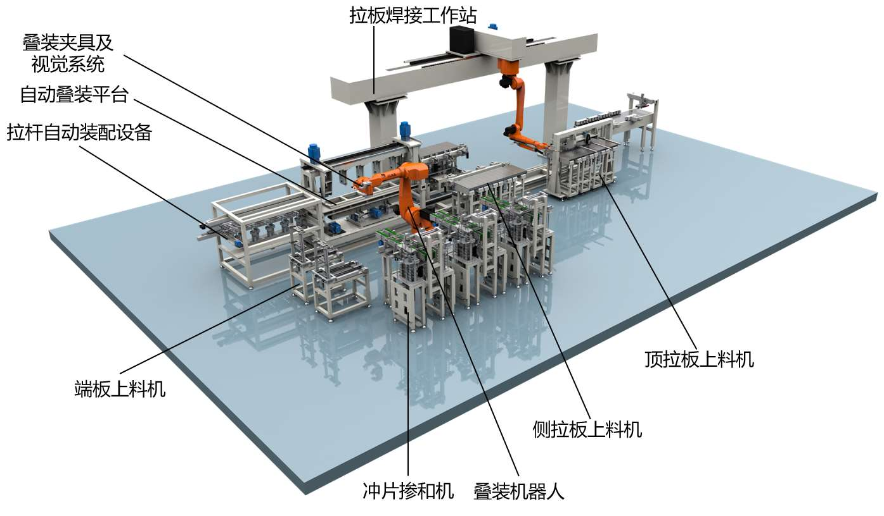
Automatic magnet production line
Automatic stacking of 1/3 length core
Stacking of the steel and plastic laminations.
Installation of the central and surrounding bars.
Welding of the laminations and bars together.
Inspection of the dimensional tolerance.

Slide 13
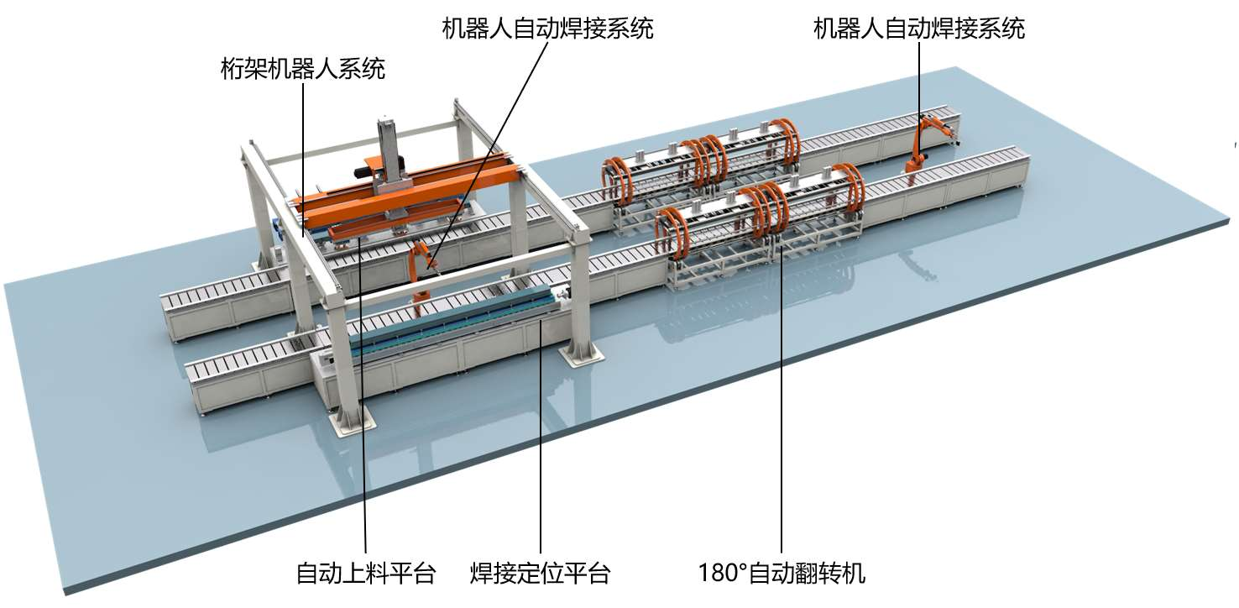
Automatic magnet production line
Automatic integration of the three 1/3 length cores
Three cores are precisely assembled on a tooling and tightly pressed.
The end plates between each core are welded together.
The dimensional tolerance is inspected.

Slide 14
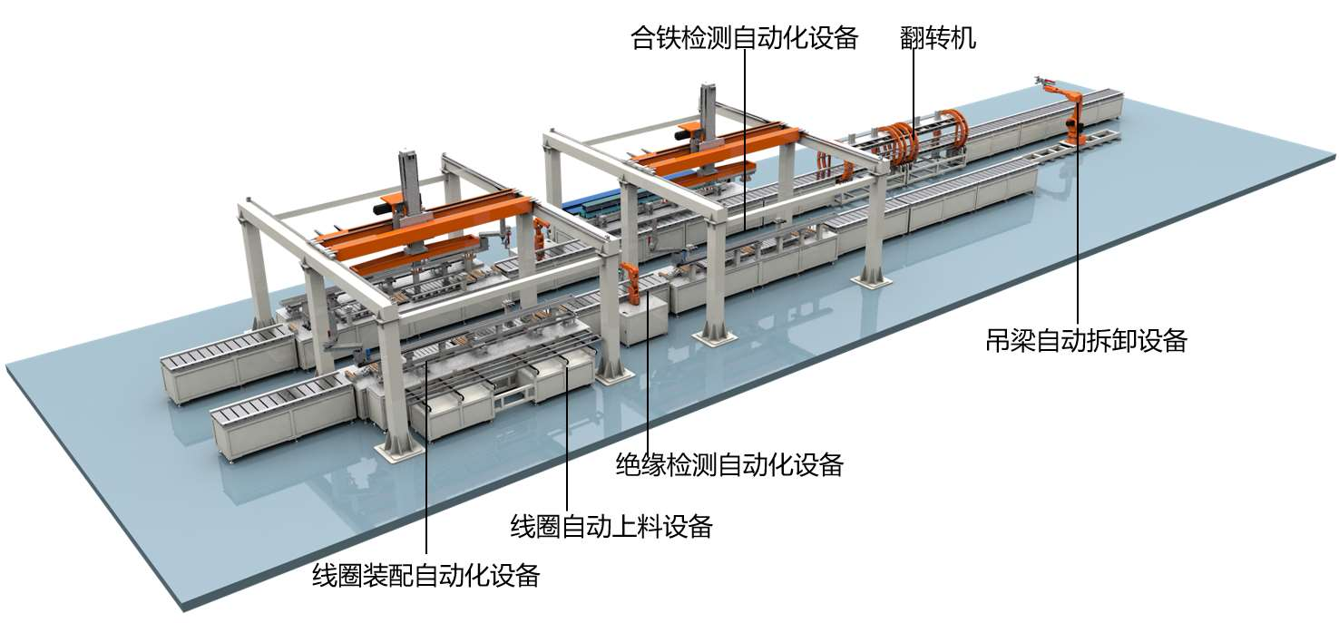
Automatic magnet production line
Automatic assembly of the magnet
The half cores are rotated 180 degree and the coils are installed and fixed by the anti-loosening bolts.
Assemble two half magnets at their right position, install and fix the side bolts.
Install the connection bars between upper and lower coils
Inspect insulation strength between coils and cores.

Slide 15
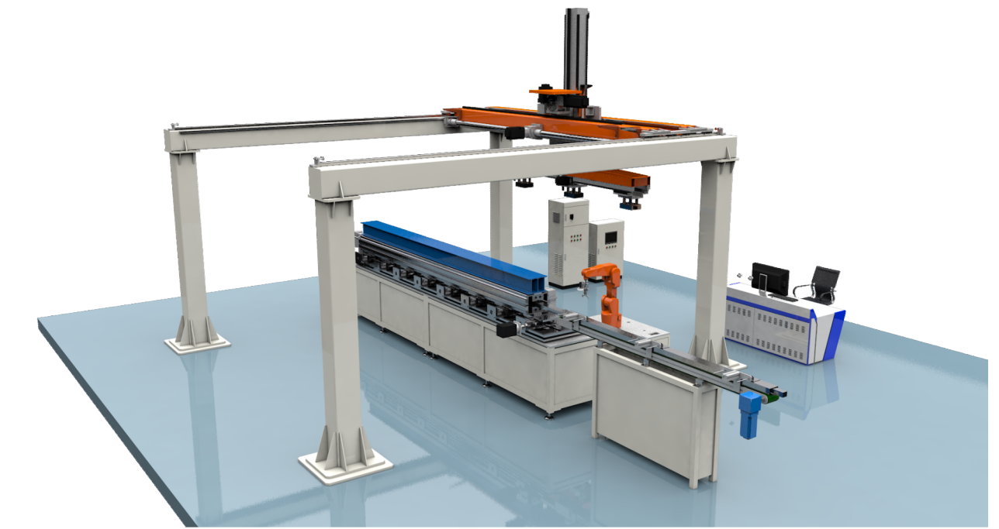
Automatic magnet production line
Automatic field measurement
Put the magnet on the test bench.
Connect power supply with the magnet.
Install the rotating coil into the magnet.
Turn on the program and finish the field measurement.
Uninstall the rotating coil.
Disconnect the power supply.
Take away the magnet.

Slide 16
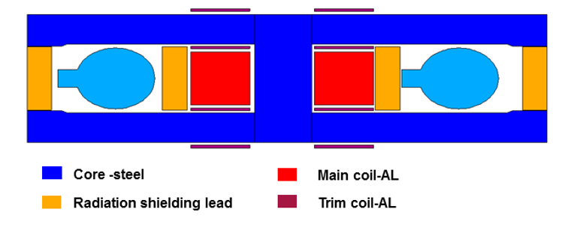
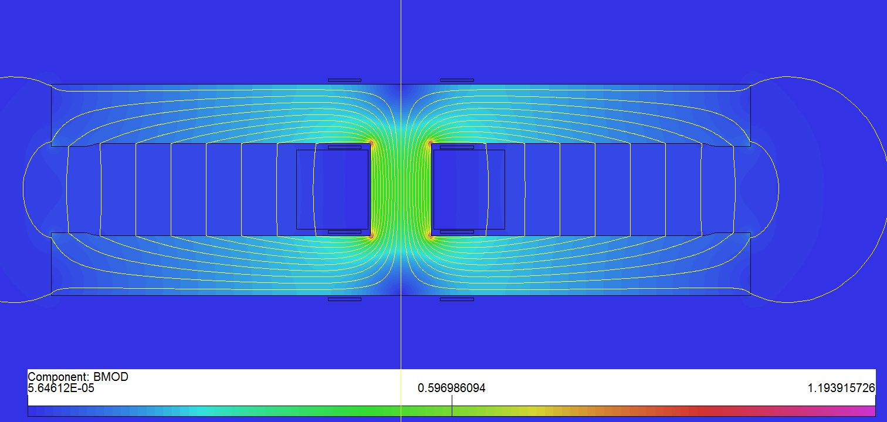
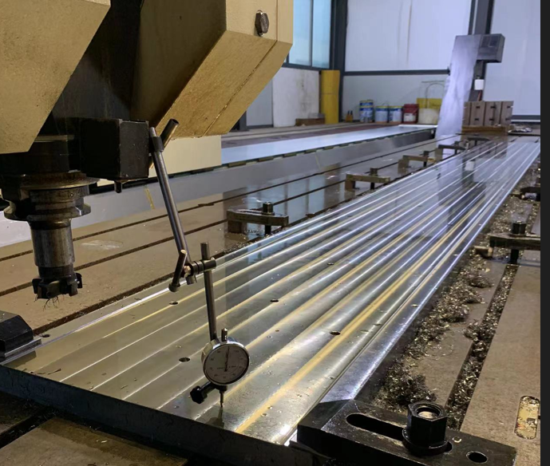
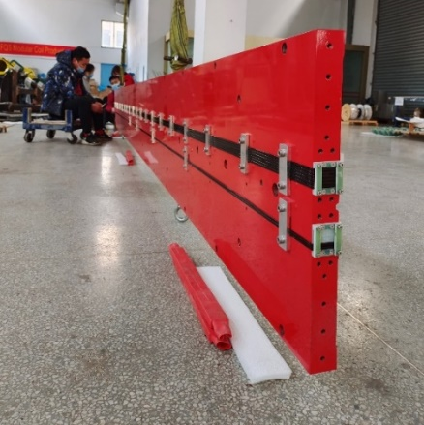
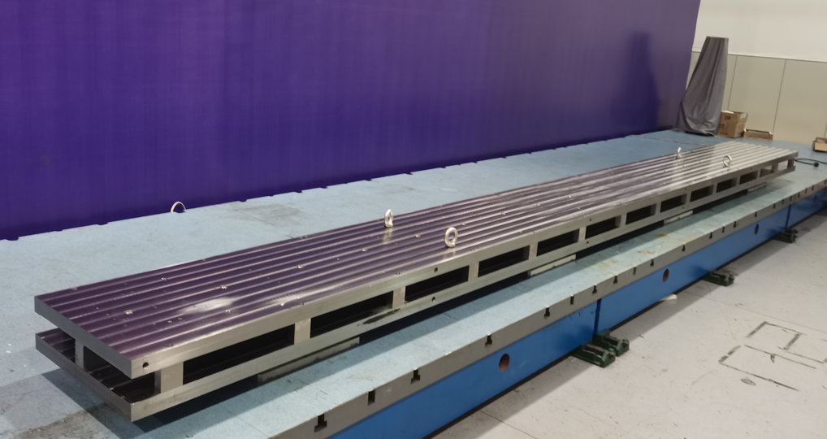
Dual Aperture Dipole(DAD) of the Collider
A full length dual aperture dipole magnet was developed in TDR stage
Type | Gap(mm) | Leff. (m) | Field(Gs) | Quant. | Core structure
B0A | 66 | 19.74 | 150~600 | 1024 | 4* 4.9m
B0B | 66 | 23.14 | 150~600 | 1984 | 4* 5.7m
  To long to be easily produced, it is divided into 4 cores
    ~ 5 meters/core, ~12000 cores in total
  A simple structure of I type solid iron cores are adopted for reduction of cost and power loss.
  The aluminum water cooled bars are used for the coils.

Slide 17
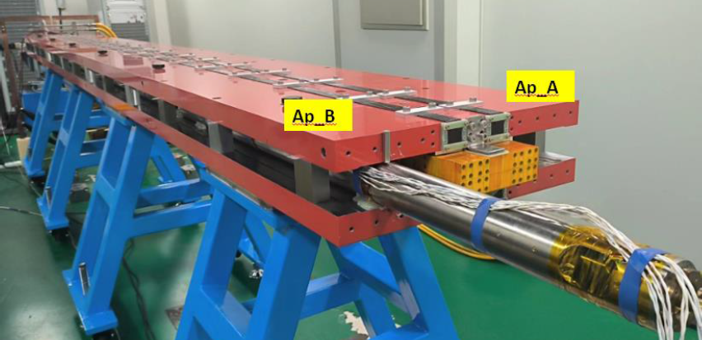
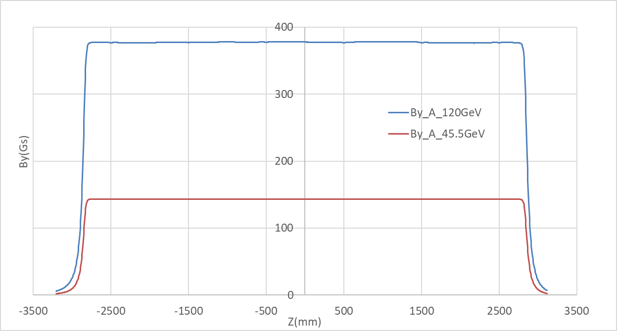
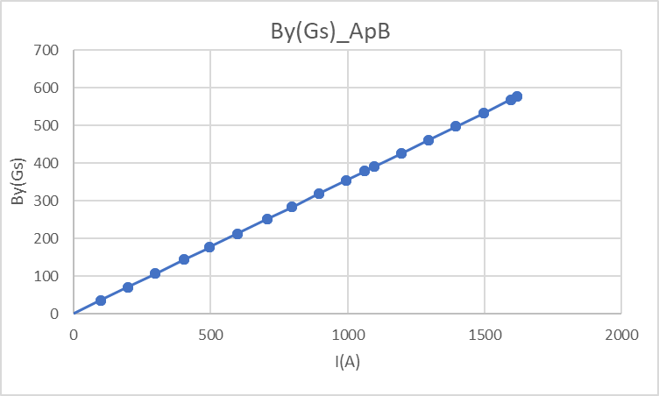
Dual Aperture Dipole(DAD) of the Collider
Field performance tested by a hall probe and rotating coil measurement system
  Integral field difference in two apertures <0.1%
  Excitation efficiency ~ 99.2%
  By=378.3Gs@120GeV, Leff= 5746.8mm
  High field harmonics<5×10^{–4}

Slide 18
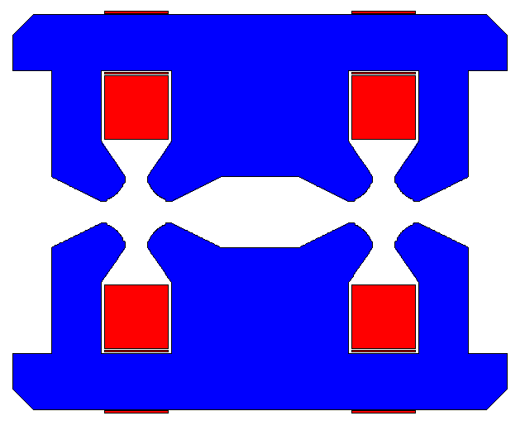
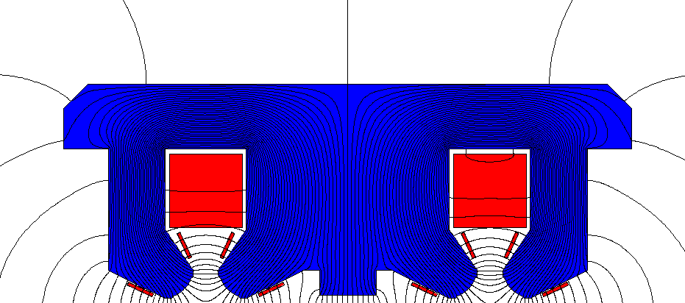
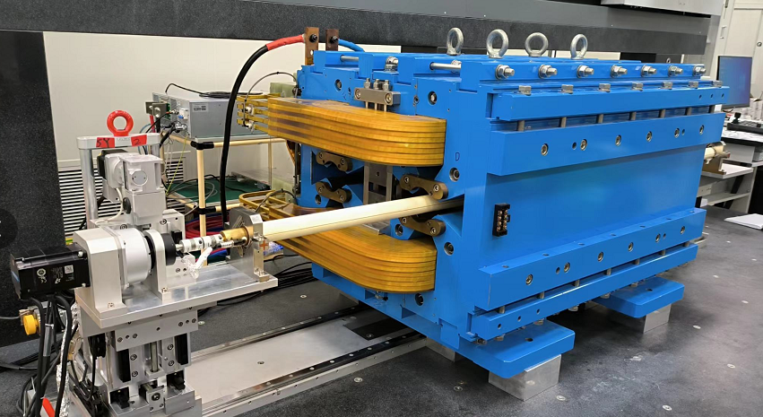
Dual Aperture Quadrupole(DAQ) of the Collider
In TDR stage, a short prototype DAQ magnet was developed.
  G=3.2T/m~12.4T/m, D=76mm, L=1m.
  The magnet had laminated cores with complex structure.
  Hollow aluminum conductors were used for coil winding.
  To decrease the field cross talk between two aperture, bumps in the center of the yokes were added and the trim coils were moved from the back yokes to poles.
  GL difference in two apertures <0.2%
  The transfer functions in two apertures were similar.
  Field harmonics< 5×10^{–4}

Slide 19
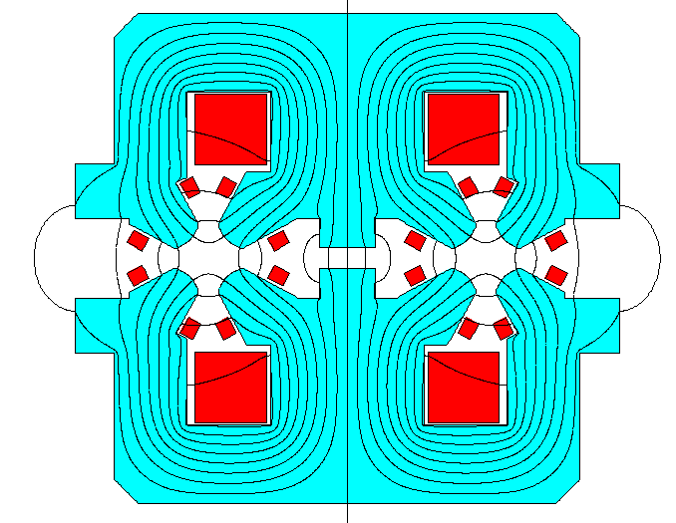
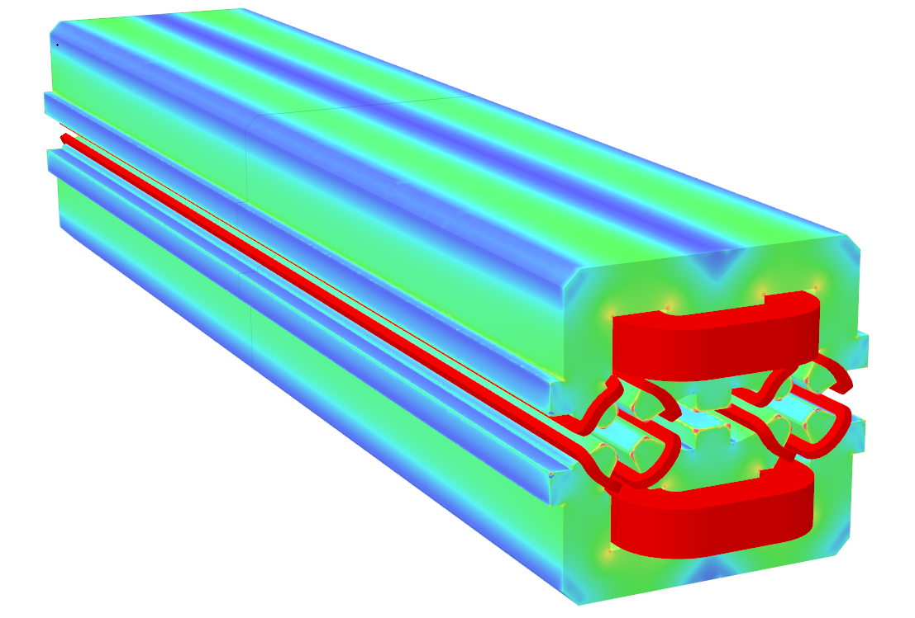
Dual Aperture Quadrupole(DAQ) of the Collider
In EDR stage, a full length dual aperture quadrupole (DAQ) magnet is designed and will be developed
  D=66mm, Leff=3m, G=1.9~10.6T/m (E=45.5~180GeV)
  Cross section updated and optimized to consist with vacuum chamber and lead blocks.
  Center yoke shim is still used for field interference compensation.
  Trim coil (4%) is considered to taper the field gradient.
  The field quality is verified by 3D simulation.

Slide 20
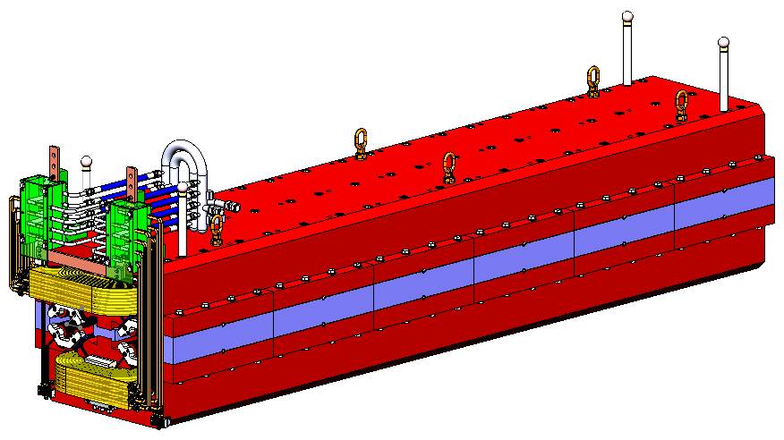
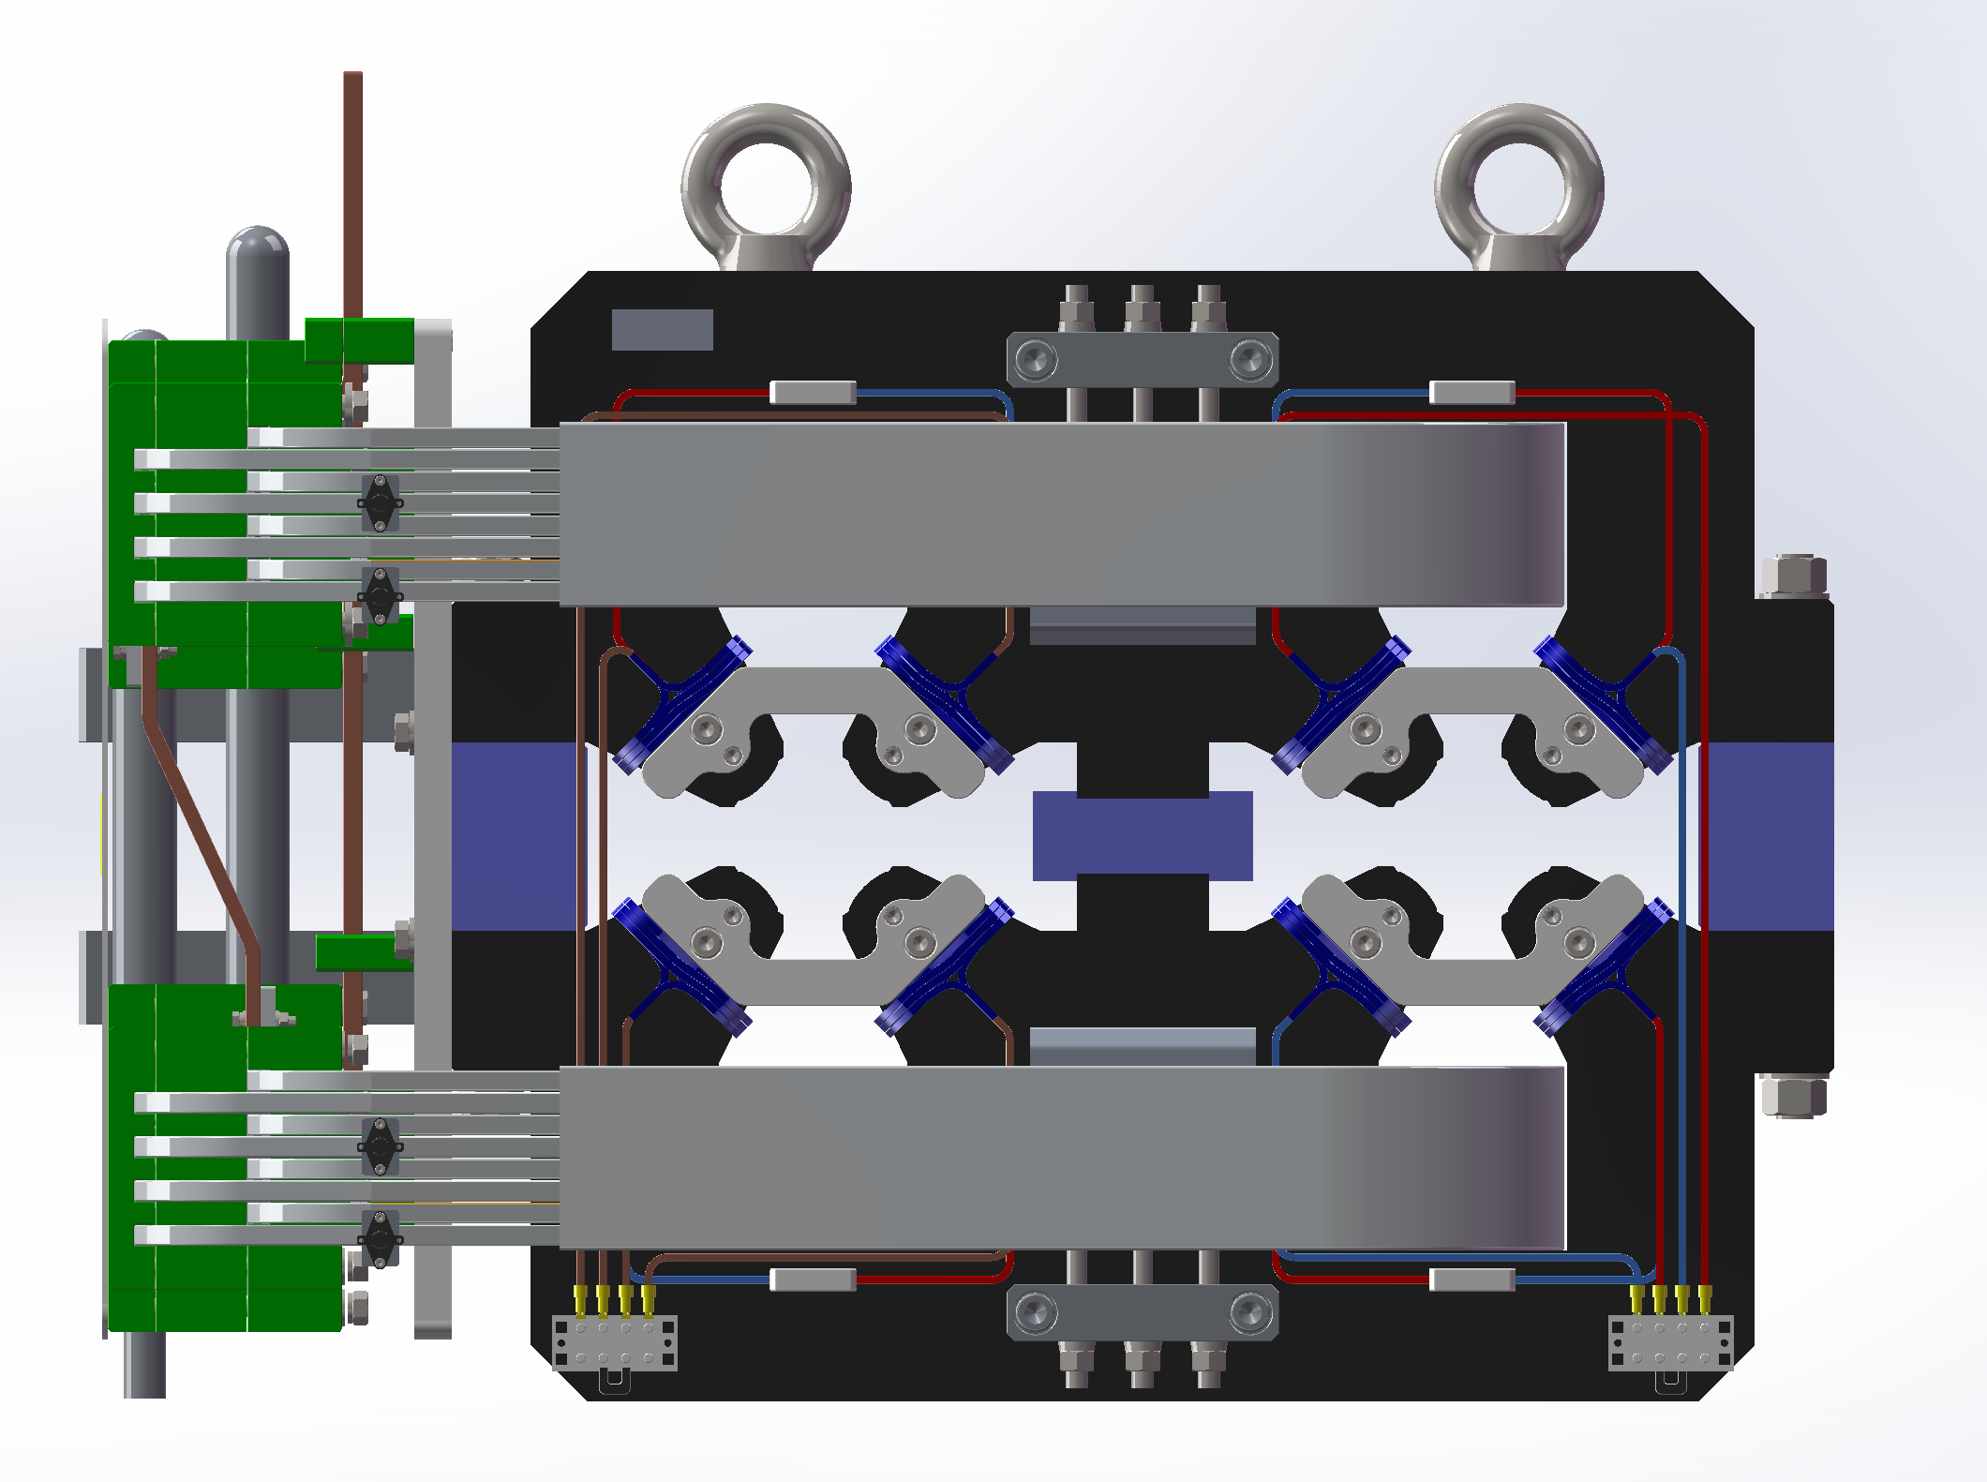
Dual Aperture Quadrupole(DAQ) of the Collider
  Based on TDR design, the mechanical design of 3m long magnet is finished.
  The up and bottom yokes are machined separately.
  The poles are bolted with the yokes, which are convenient to install the main coils.
  Three stainless steel blocks are used to support the upper and lower yokes.
  Both the main coil and trim coils are wound by the aluminum wires.

Slide 21
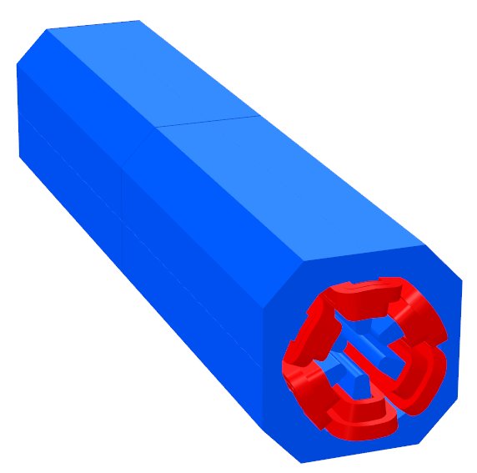
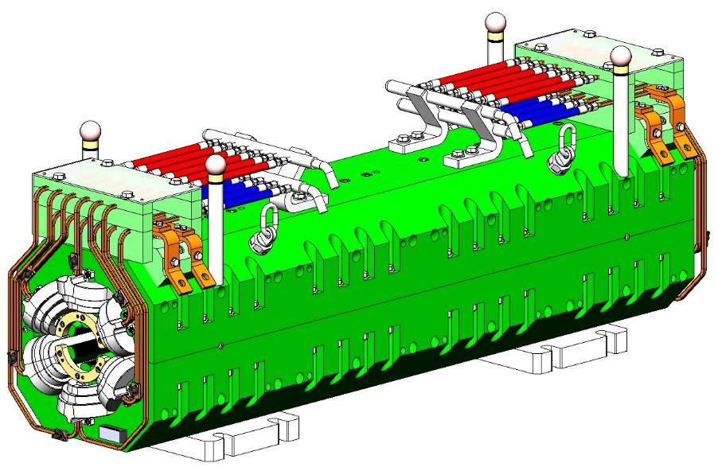
Sextupole magnet of the Collider
Requirements of sextupoles of the collider
Item | Units | Value
Number of magnets |  | 3072
Aperture diameter | mm | 66
Gradient at 45.5GeV | T/m² | 209
Gradient at 182.5GeV | T/m² | 847
Effective length | m | 1.4
Good field region | mm | 11.6
Harmonics |  | 5×10⁻⁴
  The sextupole magnets of two ring are installed side by side, the beam separation of 350 mm strictly restricts their width.
  To reduce the cross section of the magnet, hollow copper conductors instead of aluminum conductors are used for coils.
  The leads of the cooling water and electrical conductors have to be put on the top not by sides of the magnets.

Slide 22
Summary
Total length of all magnets for the CEPC is about 160 km, the magnets cost is a significant concern in the design of the magnets, particularly the dipole magnets.
A prototype full-scale pure dipole magnet for the Booster was produced and studied in TDR stage, the development of a full-scale dipole-sextupole magnet is under way.
To reduce the production cost and improve production efficiency, au automatic magnet production lines for the Booster dipole magnets is designed and will be developed.
The most of dipole and quadrupole magnets for the CEPC Collider are dual aperture magnets, some prototype magnets were developed in TDR stage and some will be developed in EDR stage.

Slide 23
Thank you very much!

