Slide 1



CEPC MDI
Sha Bai
On behalf of CEPC MDI group
IAS Program on Fundamental Physics (FP 2025)
Jan 13-17, 2025

Slide 2
Outline
Introduction
  MDI layout and IR design
  MDI EDR goal, scope and plan
SC magnets and cryostat
Background estimation
Mitigation design efforts
  Masks
  Collimators
  Shielding
Thermal Analysis
  HOM heating
  Synchrotron radiation
  Beam loss backgrounds
  Beam pipe thermal analysis
IR BPMs
SC magnet support system
Mechanical and assembly
Summary

Slide 3
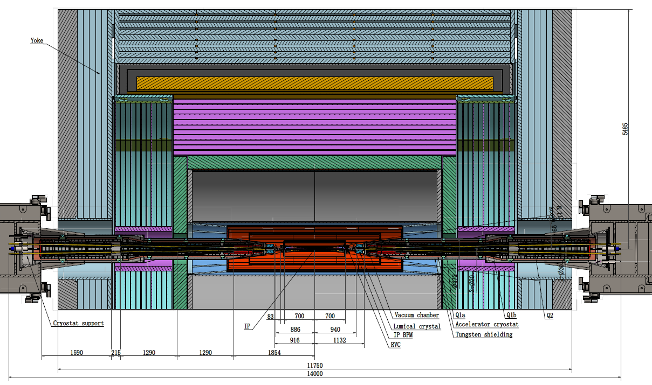
MDI layout and IR design
The Machine Detector Interface (MDI) of CEPC double ring scheme is about ±7m long from the IP.
The CEPC detector superconducting solenoid with 3T magnetic field (2T in Z).
The accelerator components inside the detector are within a conical space with an opening angle ~detective angle: acos0.99
The e+e- beams collide at the IP with a horizontal angle of 33mrad and the final focusing length is to 1.9m.

Slide 4
MDI EDR goal, scope and plan
IR magnet system & Cryostats
  FF Quads & Correctors
  Solenoid compensation & anti-solenoid design update
  Cryomodule design update, thermal and mechanical analysis of the structure, optimization of heat and mass transfer of the helium, design of current leads. PI&D scheme determination, assembly process design and alignment considerations.
Beam induced backgrounds
  The MDI region is now improved as more realistic, and software model developed. Narrow the difference with future experiments.
  Backgrounds, collimators, IR beam losses, SR, IR radiation level & fluences
Heat loads in IR region
  HOM heating, SR, Beam loss backgrounds, Beam pipe thermal analysis
IR Mechanical model, including vertex and lumical integration, and assembly concept
  Cooling for vertex and vacuum chambers
  Remote Vacuum connection, IR BPMs, Supporting system
  Integrate in the design an alignment system
  Overall integration and installation for all components in the MDI. Specific installation procedure.

Slide 5
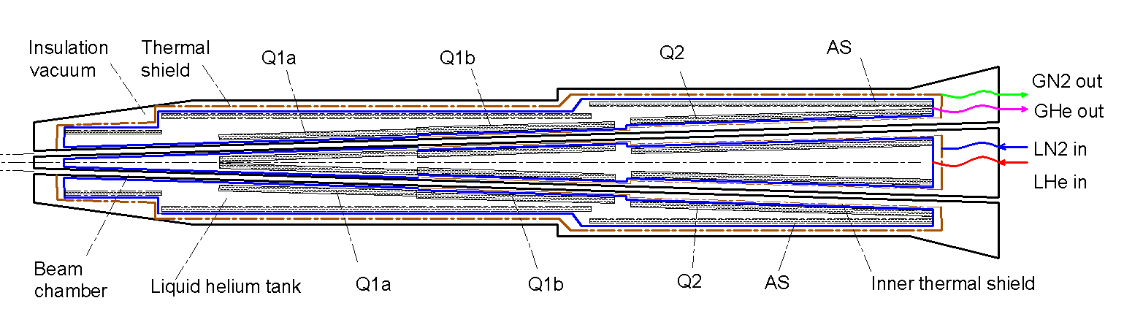
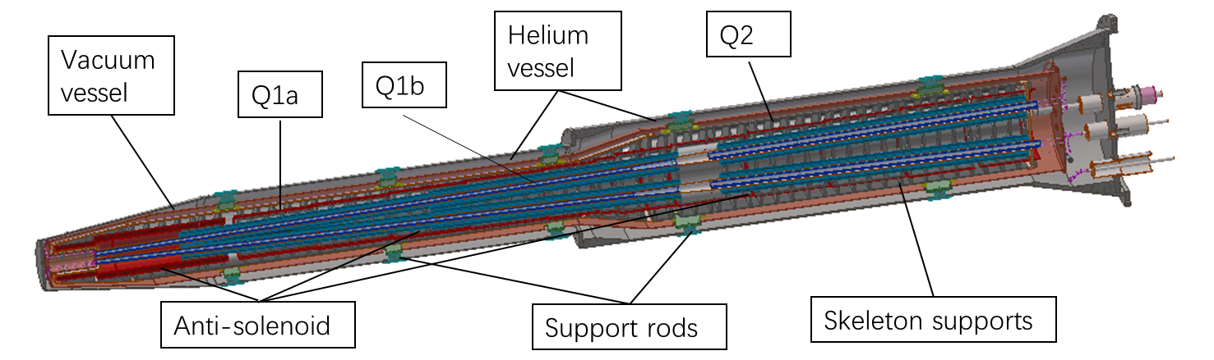
SC magnets and cryostat
In CEPC, there are two combined-function Superconducting magnets in MDI
Each combined-function magnet includes double aperture high gradient quadrupole (Q1a, Q1b, Q2) and anti-solenoid, around each side of the IP point, placed on a cantilever support.
Iron-free structure is selected for CEPC IR SC magnets
The cryostat is used to provide the cryogenic environment for SC magnets, which is below 5.0 K.
Superconducting magnets are immersed in the helium tank for the low temperature.
One thermal shield is set for the heat interruption from the ambient temperature.
The shield is extended between the helium tank and the beam chamber.
The 4K cold mass is cooled by supercritical or subcooled helium, and the shield is by liquid nitrogen.

Slide 6
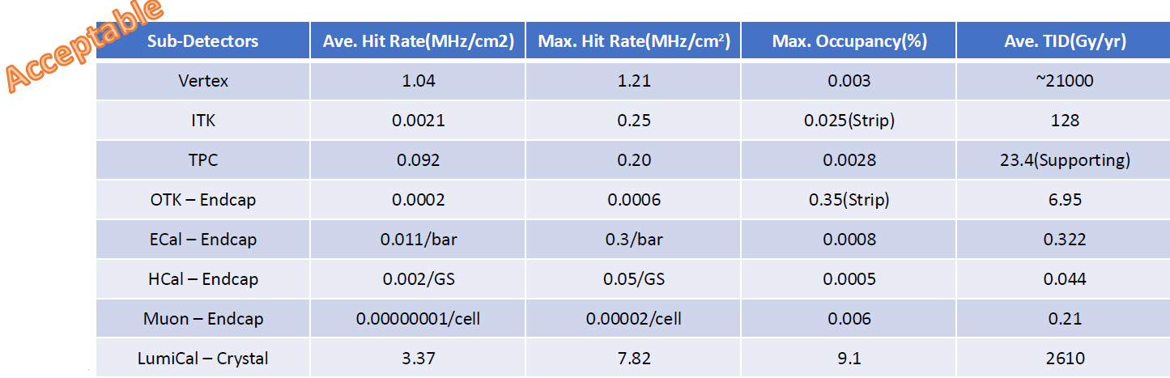
Radiation background
  Background sources:
  Photon backgrounds: SR, Pair production
  Beam loss backgrounds
    Radiative Bhabha scattering
    Beam Gas scattering
    Beam Thermal photon scattering
  Injection background
Collimators were implemented to reduce IR loss caused by single beam.
  16 sets of collimators were implemented for MDI purpose, ~20 sets of collimators were installed for passive machine protection and will also contribute to mitigating beam background.
With the implementation of collimators, multi-turn beamstrahlung and radiative Bhabha loss particles have been effectively shielded outside the interaction region.

Slide 7
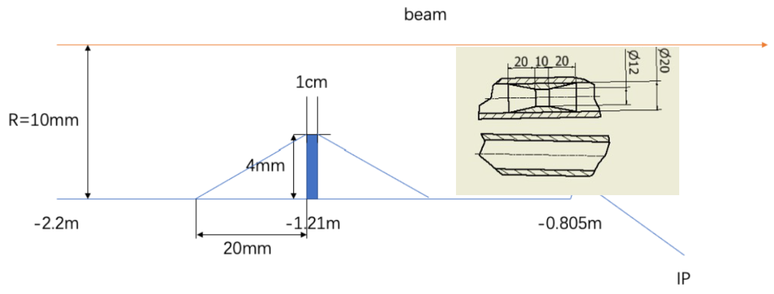
SR mitigation – mask and gold plating
The central beam pipe was carefully designed to avoid the direct hitting of the SR photons.
The masks are implemented to further mitigate the secondaries, the design is still on going.
  Several ways has been attempted, including the shrinking of the incoming beam pipe and different position/material/design of the mask.
Masks design(two masks/IP/ring) :
  Tungsten
  One locates at -1.21m with 4mm height and 10mm long
  The other at -4.2m with 0.6mm height
Methods | Photon hitting number on Be/BX | Deposition power on Be(W)
No mask | 39400.0 | 30.57*e-5
1.21-mask-Cu | 1736.0 | 1.45*e-5
1.21-mask-W | 1698.0 | 1.36*e-5
2.2-mask-Cu | 1147.0 | 0.94*e-5
1.21-mask-Cu-5㎛Au | 216.0 | 0.273*e-5
Photons hitting number on Be/BX reduced by two orders of magnitude
Deposition power on Be pipe suppressed to acceptable level by vertex detector

Slide 8
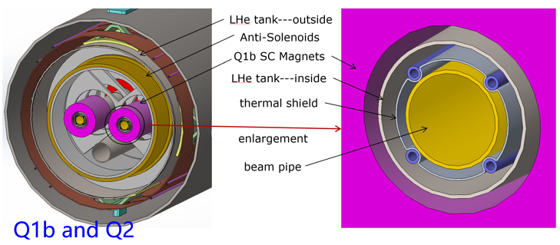
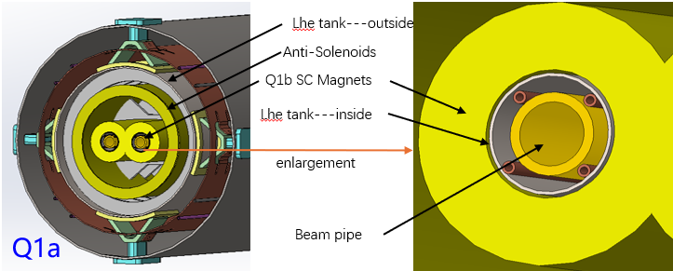
Shielding
To mitigate the beam background, Shielding has been implemented at both ends of the yoke using the 10 cm of paraffin, and also 10mm W outside of the cryo-module. It will continue with the optimization of BG and maybe more tungsten shielding inside & outside of the cryostat.
Gold plating on beryllium pipe (~5µm) to mitigate the SR.
Shielding for detector hall
The very tight space of IR beam pipe layer ~Tungsten IR beam pipe
To protect SC magnets: cumulative dose should be less than 100MGy
To avoid quench of SC magnets: heat load density should be less than 100mJ/cm³
Analysis is on-going to decide if tungsten alloy IR beam pipe is necessary or not

Slide 9
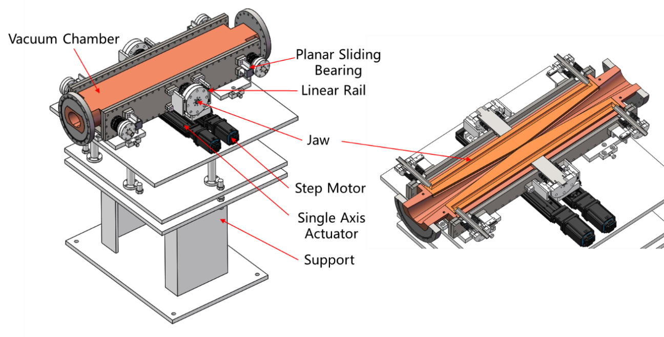
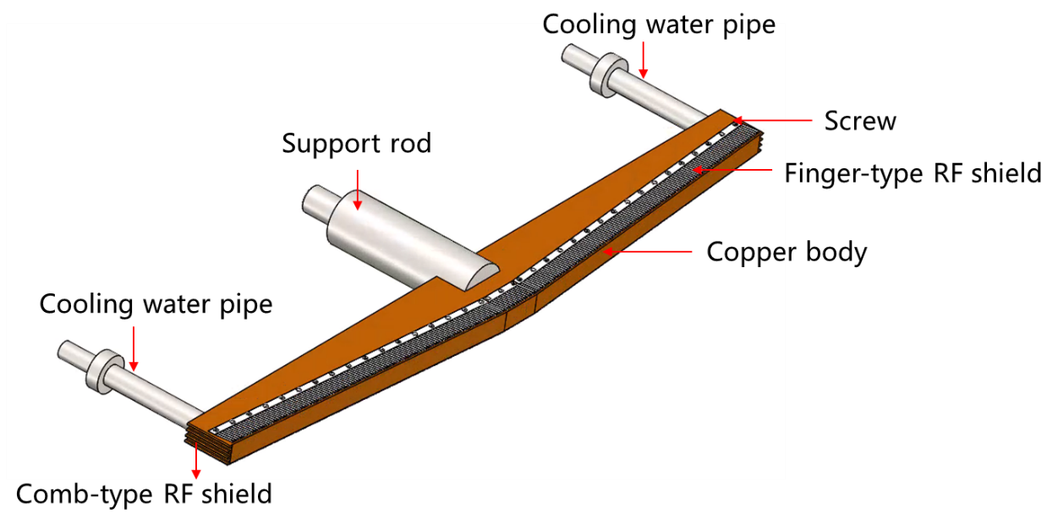
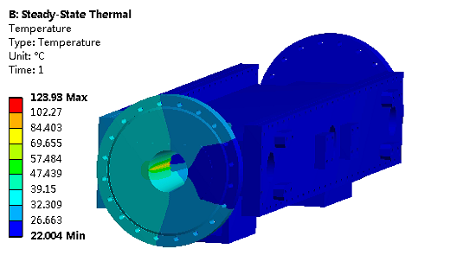
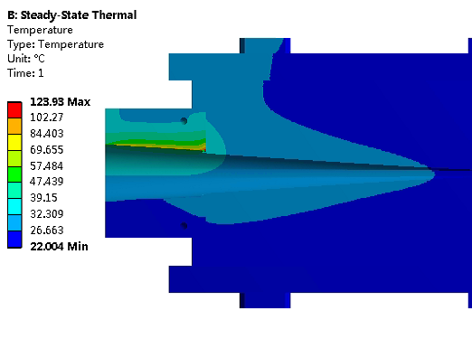
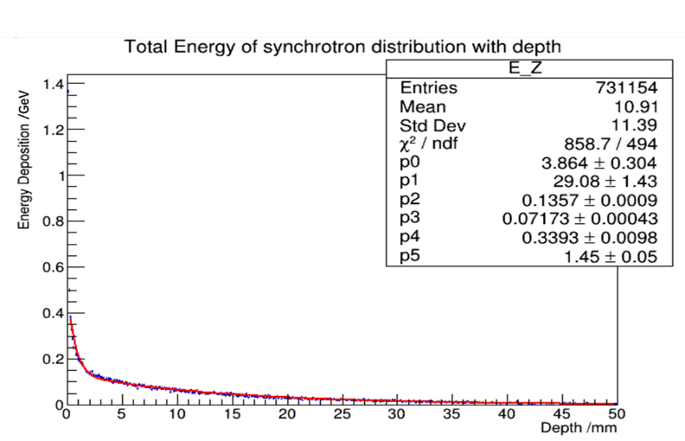
Movable collimators
  Movable collimators are designed for beam background mitigation.
  Jaw and vacuum vessel material: Glidcop Al-15, can endure the SR and HOM power in normal operation.
Structure of the jaw
Highest temperature: 124 ℃

Slide 10
Thermal analyses – Synchrotron radiation
Synchrotron radiation
Region | ttbar |  | Higgs |  | Z
 | SR heat load | SR average power density | SR heat load | SR average power density | SR heat load | SR average power density
0~780mm | 0 | 0 | 0 | 0 | 0 | 0
780mm~805mm | 11.88W | 132W/cm² | 23.04W | 256W/cm² | 11.8W | 131.1W/cm²
805mm~855mm | 27.53W | 152.9W/cm² | 53.39W | 296.6W/cm² | 27.4W | 152.2W/cm²
855mm~1.9m(Q1a entrance） | 2.22W | 0.59W/cm² | 4.32W | 1.15W/cm² | 2.2W | 0.59W/cm²
Q1a（1900-3110）1210 | 1.69W | 0.38Wcm² | 3.28W | 0.75W/cm² | 1.68W | 0.38W/cm²
Q1a~Q1b（3110-3190） | 11.8W | 40.97W/cm² | 22.92W | 79.58W/cm² | 11.75W | 40.8W/cm²
Q1b（3190-4400） | 2.04W | 0.47W/cm² | 3.96W | 0.91W/cm² | 2.03W | 0.47W/cm²
Q1b~Q2(4400-4700) | 36.6W | 33.9W/cm² | 71.04W | 65.8W/cm² | 36.4W | 33.7W/cm²
Q2(4700-5900) | 3.74W | 0.69W/cm² | 7.26W | 1.34W/cm² | 3.72W | 0.69W/cm²
Notes:
标注尺寸

Slide 11
Thermal analyses – HOM & Resistance wall
HOM & Resistance wall
Position | Position Start-end（mm） | material | Length (mm) | Higgs(w) & (w/cm²) | W (w) & (w/cm²) | Z(w) & (w/cm²) | ttbar（w） & (w/cm²)
Be pipe (w) | 0-85 | Be | 85 | 1.13 & 0.021 | 5.587 & 0.105 | 55.295 & 1.35 | 0.31 & 0.005
Be pipe transition(w) | 85-180 | Al | 95 | 0.61 & 0.01 | 2.950 & 0.049 | 29.280 & 0.491 | 0.172 & 0.007
Transition pipe (w) | 180-655 | Al | 475 | 6.99 & 0.017 | 34.48 & 0.085 | 341.562 & 0.83 | 1.958 & 0.005
Transition （w） | 655-700 | Al | 45 | 0.62 & 0.015 | 2.95 & 0.071 | 29.28 & 0.701 | 0.172 & 0.004
RVC bellow（w） | 700-780 | Cu | 80 | 0.52 & 0.007 | 2.532 & 0.034 | 25.002 & 0.337 | 0.14 & 0.002
Transition on Y-crotch | 780-805 | Cu | 25 | 0.16 & 0.007 | 0.785 & 0.032 | 7.822 & 0.316 | 0.05 & 0.002
Y- crotch (w) | 805-855 | Cu | 50 | 0.33 & 0.005 | 1.572 & 0.024 | 15.626 & 0.241 | 0.091 & 0.002
Quadrupole pipe(w) | 855-1100 | Cu | 245 | 1.58 & 0.005 | 7.735 & 0.024 | 75.594& 0.24 | 0.434 & 0.002
Total | 0-1100 | - | 1100 | 12.0 &0.011 | 58.594 &0.056 | 580.46 & 0.56 | 3.331 & 0.003
Notes:
标注尺寸

Slide 12
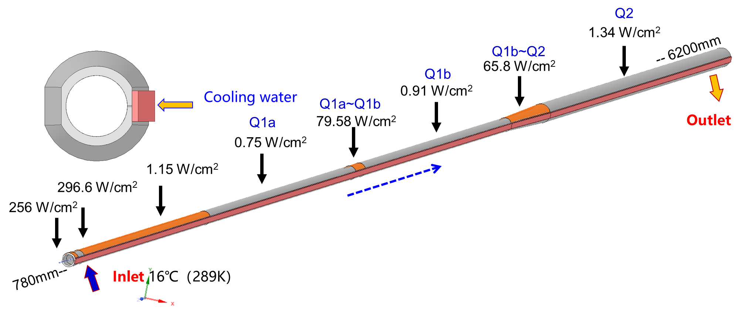
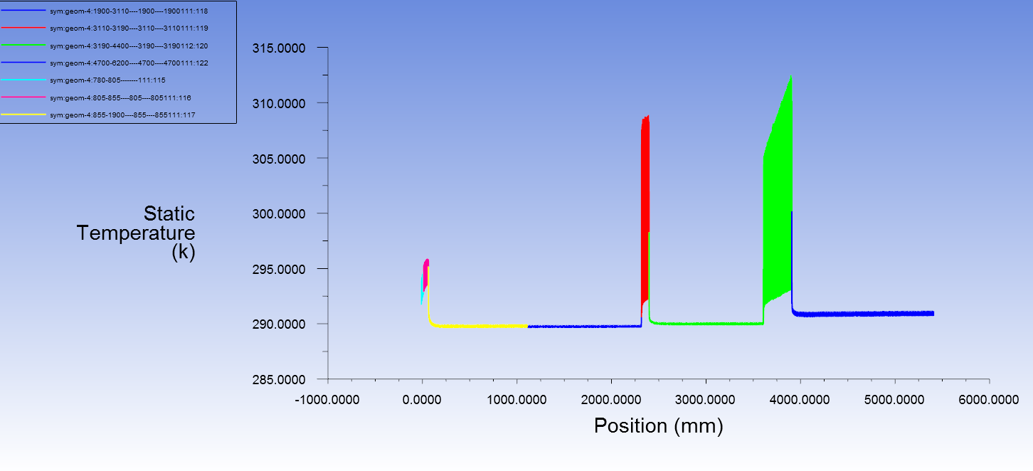
Thermal analyses of IR beam pipe
Thermal analyses of beam pipe at cryostat @Higgs, 30MW
  Total SR power: 189W
  Total HOM power: 12W
  Cooling water temperature: 16 ℃ (289K)
  Maximum temperature on beam pipe: 40 ℃ (313K)
The detailed structure design including the space arrangement is under-going.

Slide 13
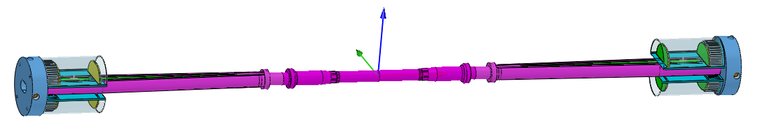
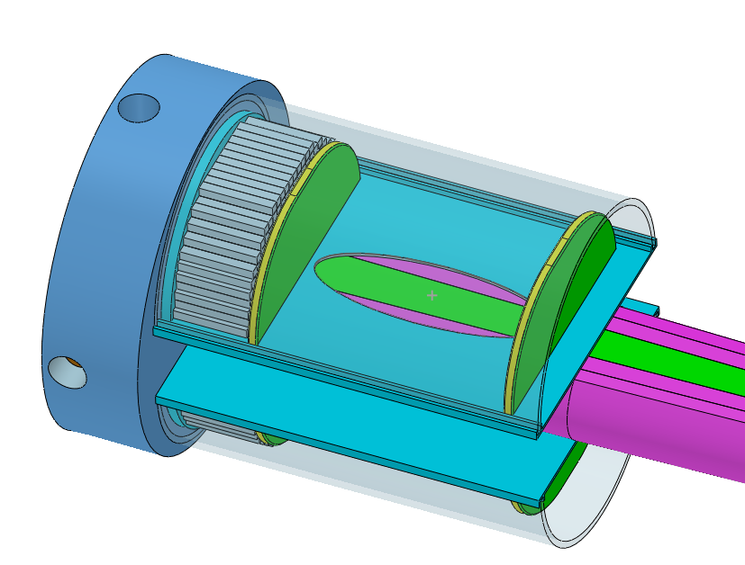
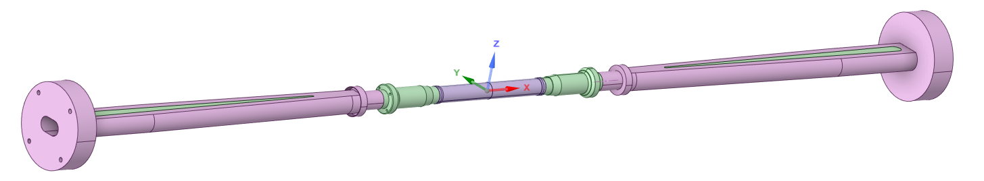
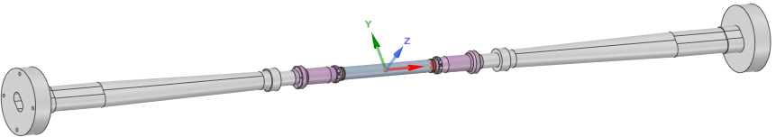
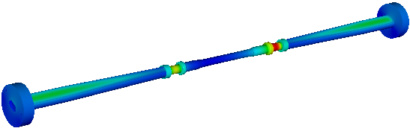

The central beampipe design
Central Be pipe segment: 380mm, the inner diameter: 20mm
The inner Be layer: 0.2mm
Outer Be layer: 0.15mm (to improve the accuracy of vertex)
the cooling gap: 0.35mm, Coolant
Si wafer
LYSO bars
Highest temperature position
Water or Paraffin could be used as the coolant
Dynamic temperature/pressure could meet the requirements.
Highest temperature: 26.7℃

Slide 14
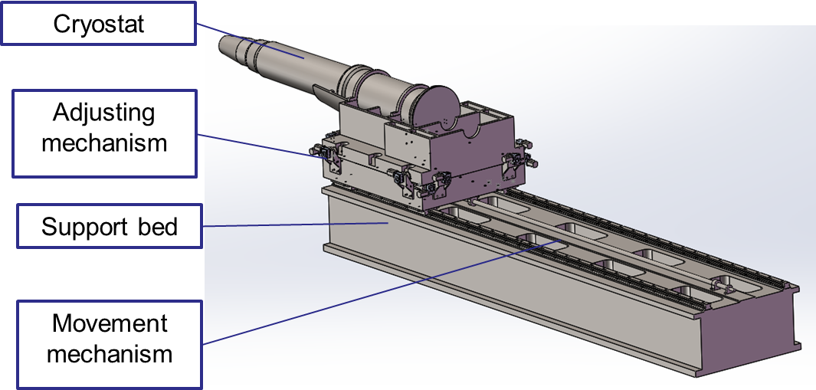
SC magnet support system
  After the optimization of the supports in the cryostat, the total weight of the cryostat and the devices inside is ~1.1 ton.
  The cryostat is about 5.7m long. The cantilever length is ~5.2m.
  The resolution requirement of the adjusting mechanism < 5 μm.

Slide 15
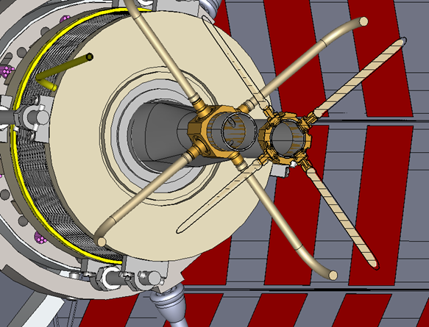
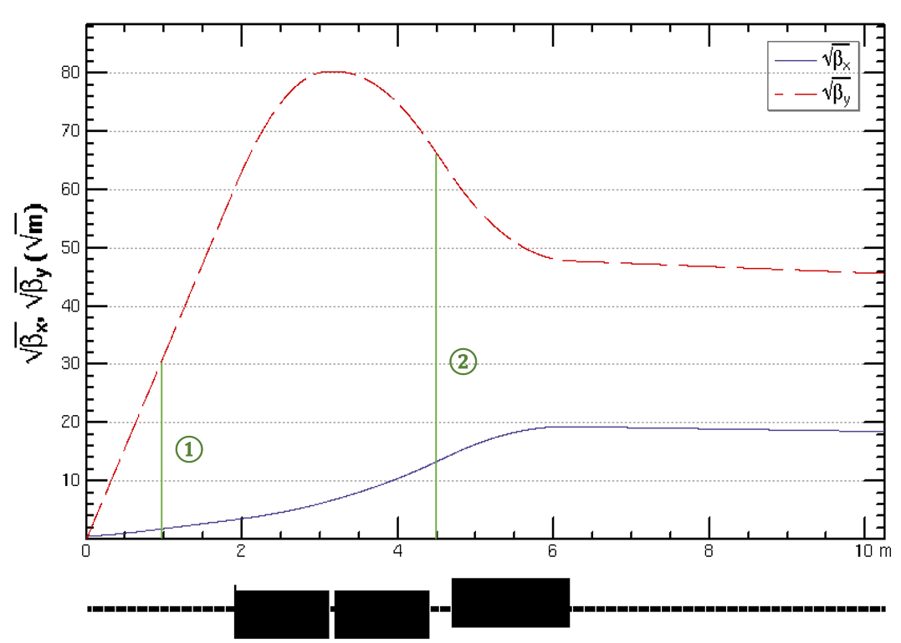
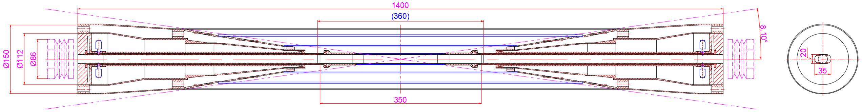
IR BPMs
Considering response time and calibration difficulty, two 4 button electrodes BPM in double pipe and one 2 button electrodes BPM in single pipe at each side of CEPC IR are adopted.
2 button electrodes BPM for measuring the arrival time.
Utilize a pair of BPMs for vertical beam orbit feedback (fast lumi monitor for horizontal), placed at symmetric positions on each side of the IP, located at distance of 0.9m.

Slide 16
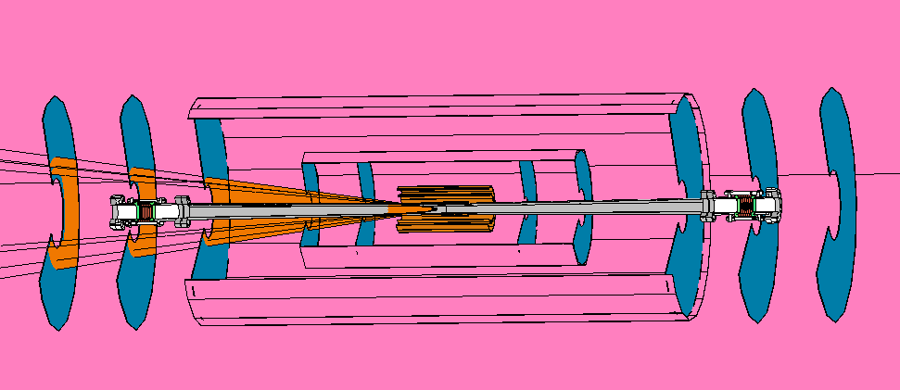
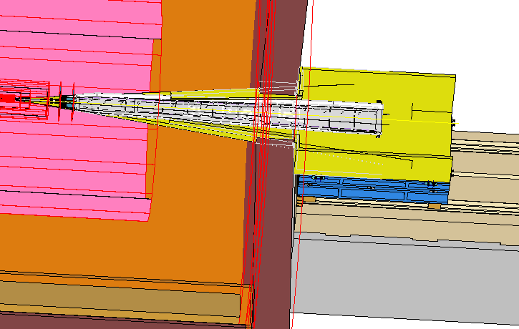
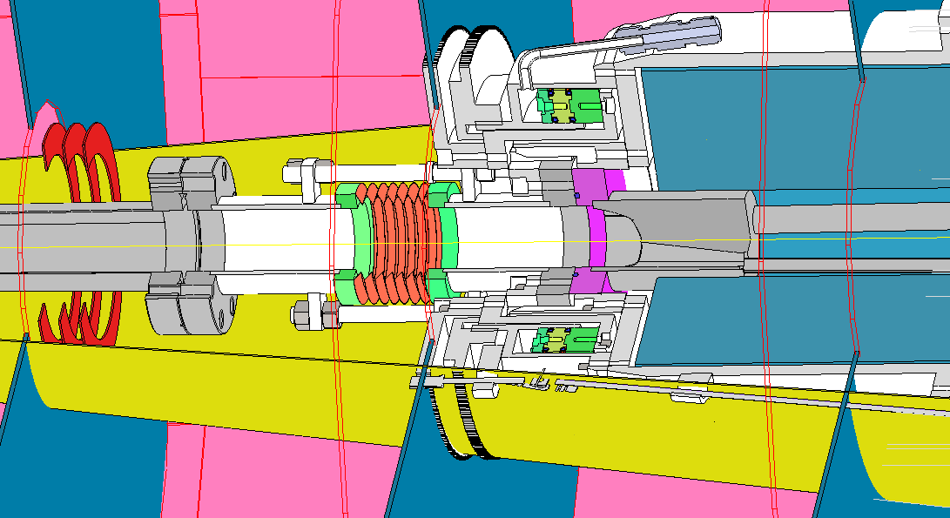
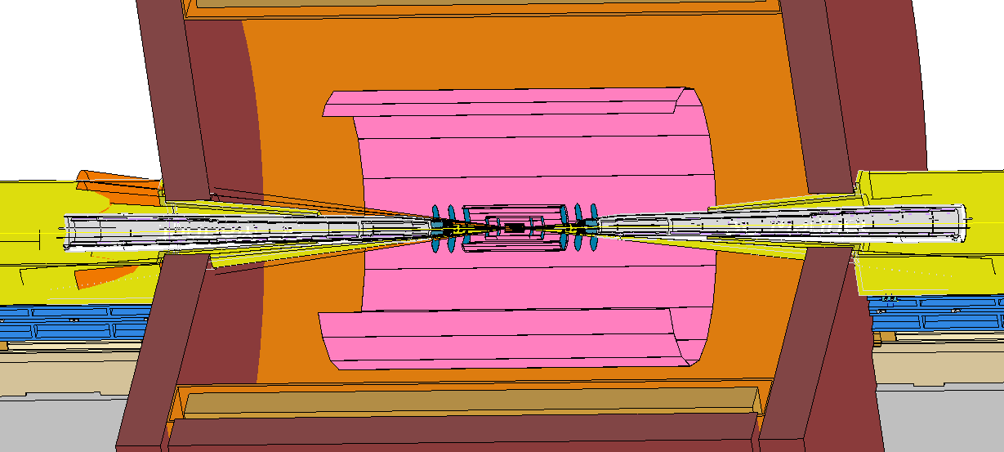
Integration and Assembly
The integration and installation procedure of accelerator in MDI is specified supposing that detector part already installed and aligned.
Cryostat including Final doublet installation alignment under laboratory.
Part of Lumical installed and aligned with cryostat.
In future, the integration and assembly will be more specified along with detector designed in detail.

Slide 17
Summary
  The MDI layout is compatible and no interference for the design.
  SC magnets and cryostat are designed and improved.
  Φ20mm~ Φ20mm IR beam pipe is well designed.
  The estimation of the radiative background has been estimated with real beam.
  The mitigation efforts of every kinds of background dedicated to the mask, collimator and shielding has been designed.
  The thermal analysis including HOM heating, synchrotron radiation, beam loss background and beam pipe thermal analysis meet the requirement.
  IR BPMs are designed.
  The SC magnet supports inside the cryostat are designed and optimized.
  Preliminary integration and assembly is assumed.

Slide 18
Thanks

