Slide 1


Circular Electron Positron Collider
Polarization progress
Zhe Duan
On behalf of the CEPC Polarization Working Group
January 14, 2025, IAS Program on Fumdamental Physics 2025, HongKong, email: duanz@ihep.ac.cn

Slide 2
Outline
Polarized beam studies at CEPC
R&D progress in the EDR phase
Summary

Slide 3
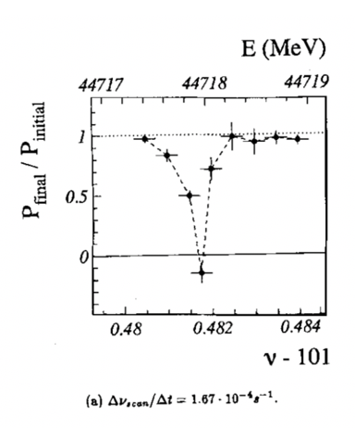
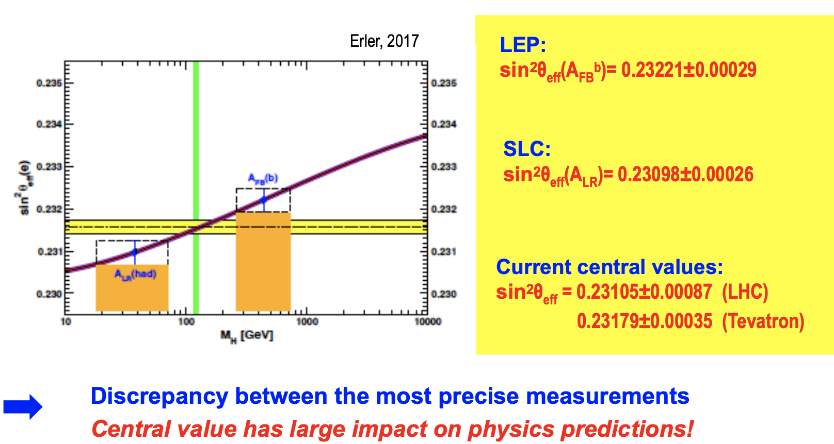
Physics motivation of polarized beams @ CEPC
Precision beam energy calibration @ Z, W (~100keV)
  resonant depolarization with vertically polarized beams
Precision measurement of weak mixing angle @ Z
  Longitudinally polarized colliding beams for measuring A_{LR}
  could resolve the tension between A_{FB} & A_{LR}, by measuring both in the same experiement
CPV with polarized beams in e+e- → HZ. H → ττ etc
ECFA meeting on e+e- to ZH angular measurements
Polarized beam applications @ ILC,
arXiv:2105.09691, 2111.06687, 2202.07385
L. Arnaudon, et al., Z. Phys. C 66, 45-62 (1995).
G. Moortgat-Pick’s talk on CEPC Workshop EU @ Marseille, 2024 April

Slide 4
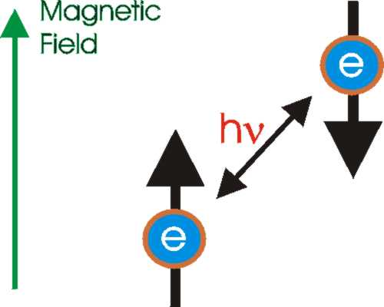
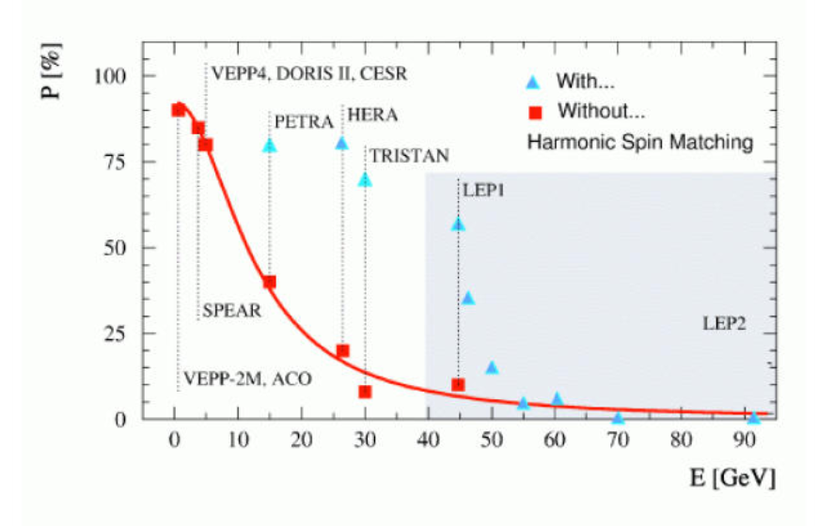
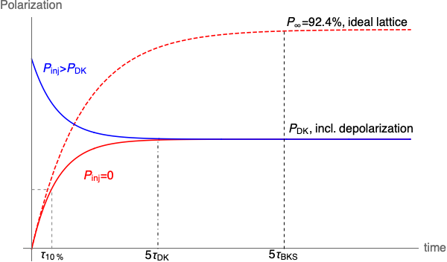
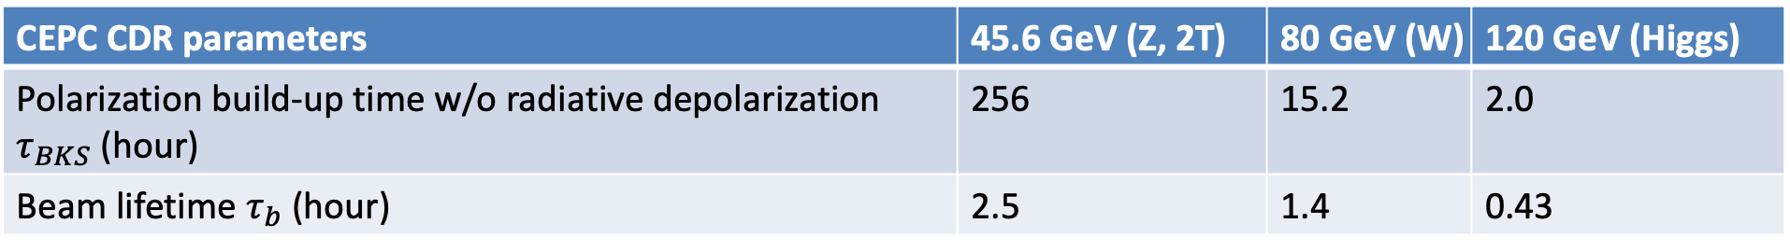
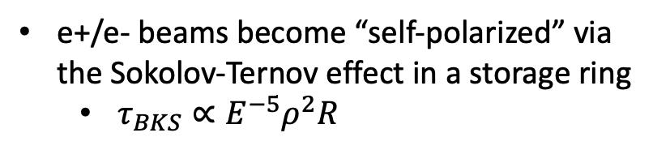
Self-polarization in the CEPC
e+/e- beams become “self-polarized” via the Sokolov-Ternov effect in a storage ring
  $τ_{BKS}∝E^{−5}ρ^{2}R$
Polarization build-up rate << beam decay rate @ Z
  Asymmetric wigglers in the Collider (FCC EPOL)
  Hard to achieve a high-level polarization
  In conflict with a high luminosity
R. Assmann, et al, AIP Conference Proceeding, 570, 169 (2001).
CEPC CDR parameters | 45.6 GeV (Z, 2T) | 80 GeV (W) | 120 GeV (Higgs)
Polarization build-up time w/o radiative depolarization $τ_{BKS}$ (hour) | 256 | 15.2 | 2.0
Beam lifetime $τ_{b}$ (hour) | 2.5 | 1.4 | 0.43

Slide 5
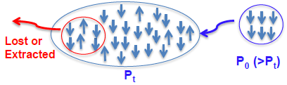
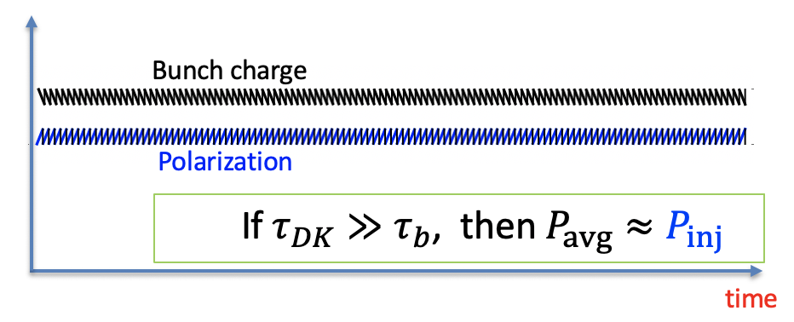
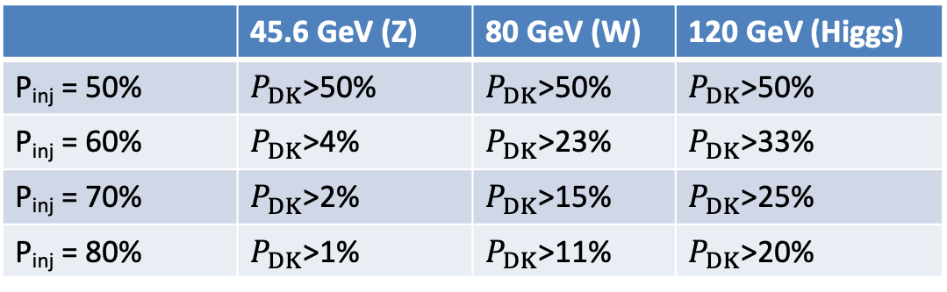
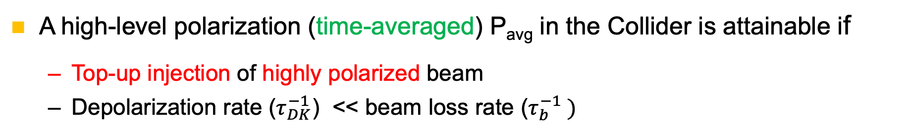
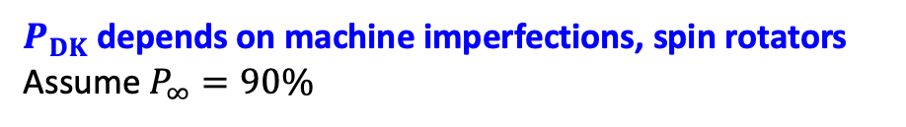

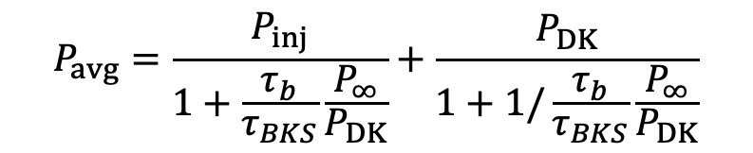

How to achieve a high-level polarization?
A high-level polarization (time-averaged) P_{avg} in the Collider is attainable if
  Top-up injection of highly polarized beam
  Depolarization rate ($τ_{DK}^{−1}$) << beam loss rate ($τ_{b}^{−1} )$
$$P_{avg}=\frac{P_{inj}}{1+\frac{τ_{b}}{τ_{BKS}}\frac{P_{∞}}{P_{DK}}}+\frac{P_{DK}}{1+1/\frac{τ_{b}}{τ_{BKS}}\frac{P_{∞}}{P_{DK}}}$$
Injected beam
P_{inj} > P_{DK}
$P_{DK}$depends on machine imperfections, spin rotators
Assume $P_{∞}=90\%$
$P_{avg}$> 50% requires a minimum value of $P_{DK}$
Sawtooth-shape evolution during top-up injection
 | 45.6 GeV (Z) | 80 GeV (W) | 120 GeV (Higgs)
P_{inj} = 50% | $P_{DK}$>50% | $P_{DK}$>50% | $P_{DK}$>50%
P_{inj} = 60% | $P_{DK}$>4% | $P_{DK}$>23% | $P_{DK}$>33%
P_{inj} = 70% | $P_{DK}$>2% | $P_{DK}$>15% | $P_{DK}$>25%
P_{inj} = 80% | $P_{DK}$>1% | $P_{DK}$>11% | $P_{DK}$>20%
$$\frac{|P_{inj}−P_{DK}|}{{(τ}_{b}+τ_{DK})/dt}$$
Amplitude of sawtooth ~

Slide 6
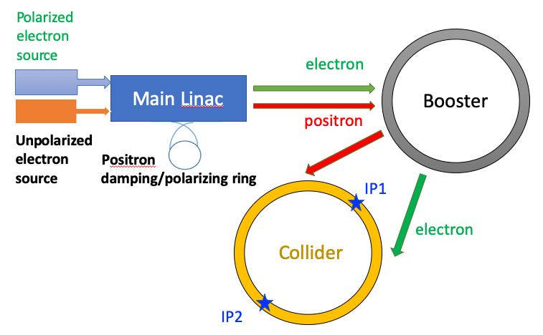
Polarized injector for CEPC
Polarized source
  Polarized electron gun
  Positron damping/polarizing ring
Linac & Transport lines
  spin direction matching @ injection/extraction
  helicity adjustment for e+
Booster
  free from intrinsic spin resonances
T. Chen, Z. Duan, D. H. Ji, D. Wang, Phys. Rev. Accel. Beams, 26, 051003 (2023).
Collider
  solenoid spin rotators @ 45.6 GeV
> 70% polarization transmission in the injector chain for Z & W operation.
W. Xia et al., Investigation of spin rotators in CEPC at the Z-pole,
Radiat. Det. Tech. Meth. 6:490 (2022).

Slide 7
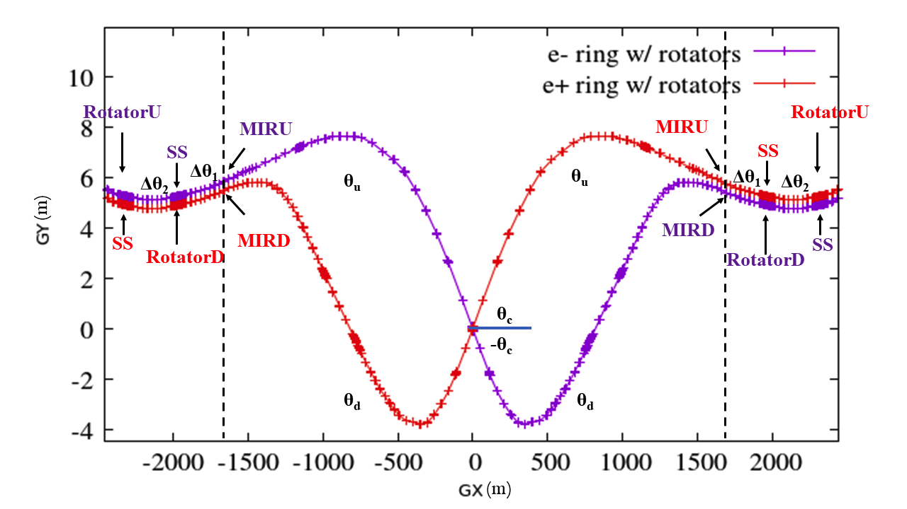
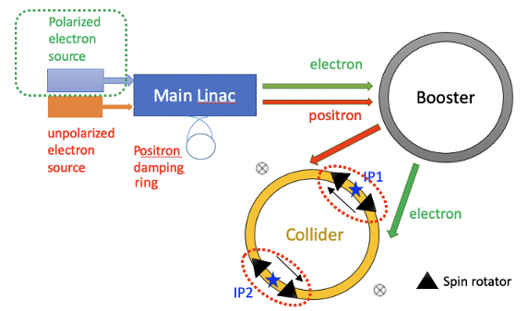
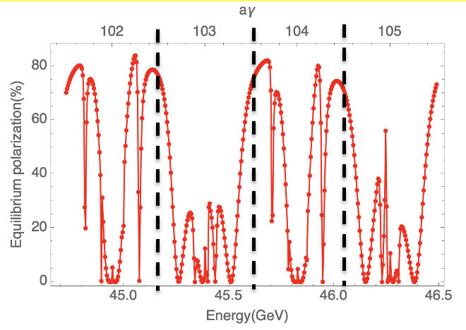
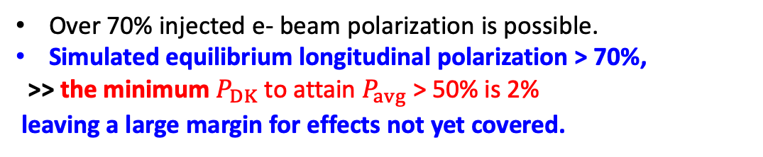
A high-level longitudinal polarization @ Z-pole
50%-70% longitudinal polarization for e- bunches is a reasonable goal
Implementation of the spin rotators adjacent to the IR
Over 70% injected e- beam polarization is possible.
Simulated equilibrium longitudinal polarization > 70%,
>> the minimum $P_{DK}$ to attain $P_{avg}$> 50% is 2%
leaving a large margin for effects not yet covered.
Simulated equilibrium polarization for an imperfect lattice w/ rotators after closed orbit correction
Topics to study
Useful polarization level @ Higgs
Spin rotators at higher energies

Slide 8
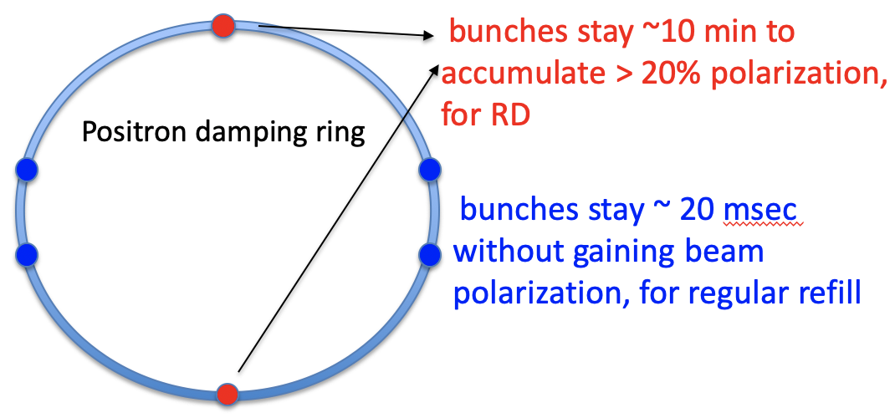
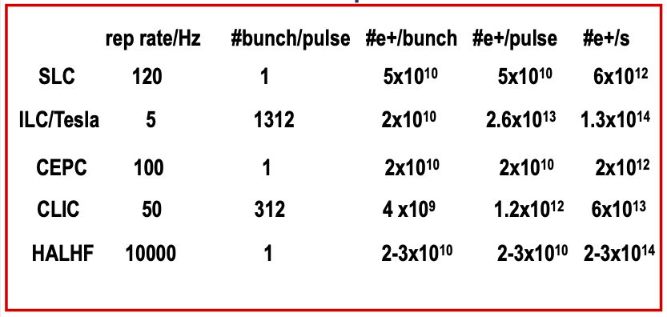
Polarized e+ generation
For resonance depolarization:
  e+ damping/polarizing ring
  extracted beam polarization @ 10min ~ 44%
For polarized colliding beams
  more demanding polarizing ring design
  plan to revisit the schemes for ILC/CLIC
DR V4.0 | unpolarized e+ | polarized e+
Energy (Gev) | 1.983
Circumference (m) | 144.2
Number of trains | 2(4)
Number of bunches/trian | 1(2)
Total current (mA) | 12.4
Dipole strength B₀ (T) | 1.92
U₀ (kev/turn) | 397.9
Damping time x/y/z (ms) | 4.8/4.8/2.4
Momentum compaction | 0.0078
Storage time | 20 ms | 10 min
δ₀ (%) | 0.0917
ε₀ (mm.mrad) | 132
injection σ_{z} (mm) | 6
Extract σ_{z} (mm) | 6.7 | 6.6
ε_{inj} (mm.mrad) | 2500
ε_{ext x/y} (mm.mrad) | 133/13 | 132/13
δ_{inj} /δ_{ext} (%) | 0.18 /0.092
RF acceptance (%) | 1.85
Longitudinal tune | 0.025

Slide 9
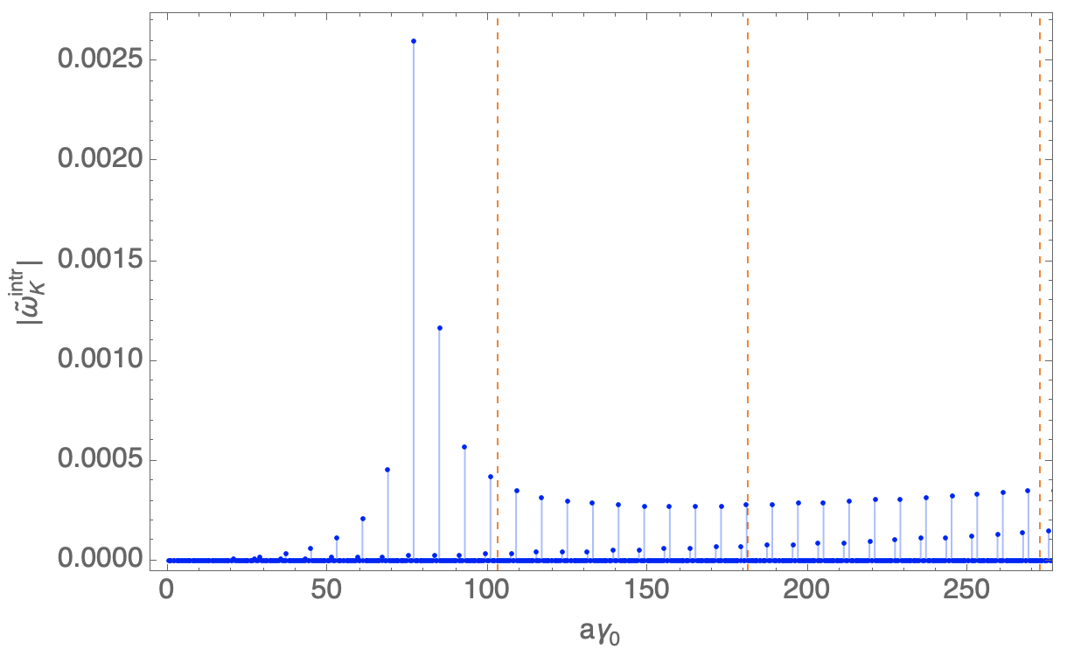
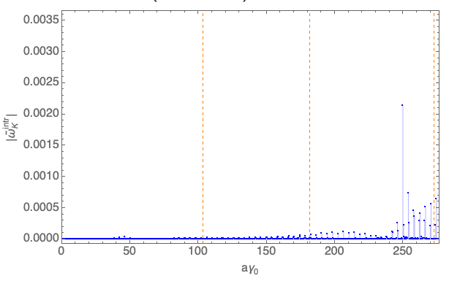
Updates on booster polarization maintenance
Optimization for better polarization transmission
  Vertical betatron tune changed by ~ -11 units
  W/o change of layout & beam emittance
  Promising for Z &W
  Optimization for Higgs is under way
TDR lattice
30 GeV
injection energy
45.6 GeV
80 GeV
120 GeV
 | TDR lattice | New lattice
ν_{y} | 116.83 | 105.18
ν_{B}/η_{arc} | 79 | 50
Polarization transmission to Z | ~50% | ~99%
Polarization transmission to W | ~50% | ~95%
Polarization transmission to H | ~20% | ~0%
New lattice

Slide 10
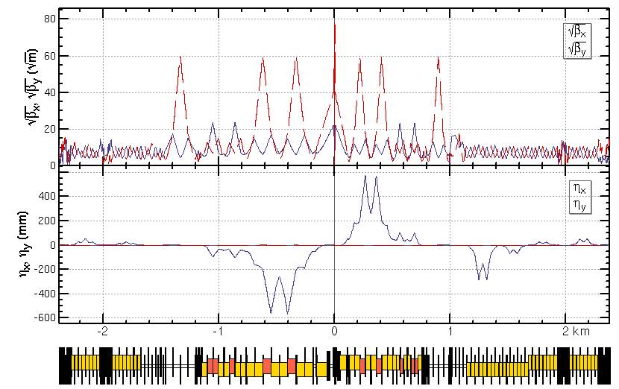
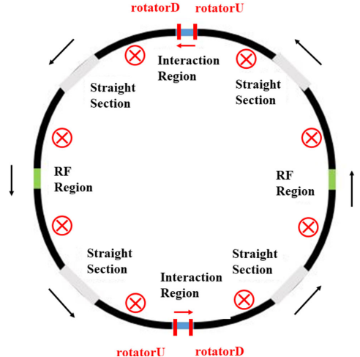
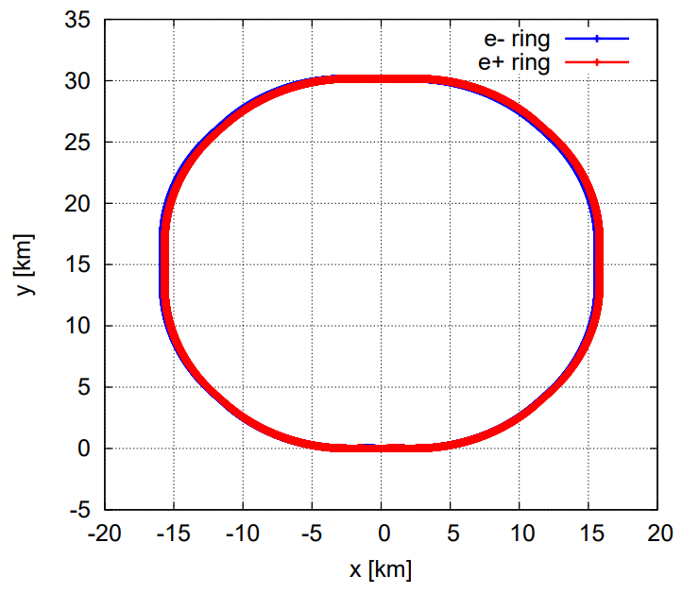
Updates on spin rotator implementation in Colliders
Spin rotators have been implemented into the TDR lattice
  Inserted into the regions between IR and ARC
  The deflection angles and lengths of ARC dipoles are reduced
  The circumference of the whole ring is 99.913km
  More detailed optics matching & optimization is under way

Slide 11
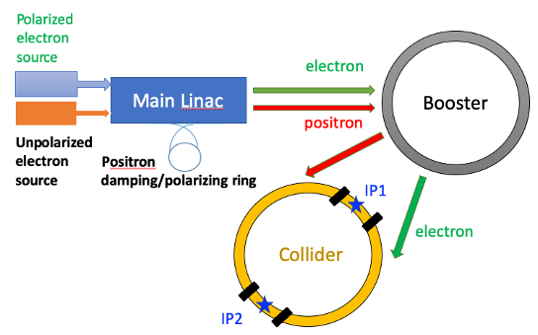
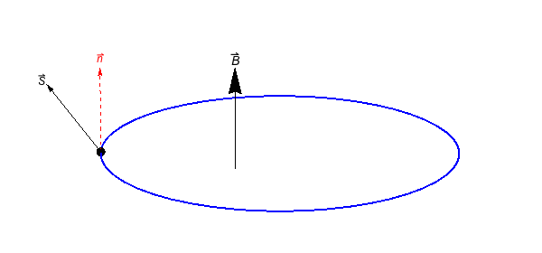
Key aspects of polarization R&D in the EDR phase
Key aspects | Figure of merit | R&D goal
Design study | > 50% polarization for both beams | improve pol e- design, study pol e+ scheme
Polarized electron source | polarization > 85% | polarized DC gun @ PAPS, polarization > 85%
Compton polarimeter | 3D measurements ~ 0.1% | vertical polarization measurement @ BEPCII, ~1%
Resonant depolarization-based beam energy calibration | ~1e-6 for Z & W | demonstration @ BEPCII
Solenoid spin rotator for longitudinal polarization @ Z-pole | Solenid integral field ~ 1000 T.m per IP | YBCO SC solenoid, B ~ 12 T, BL > 10 T.m
Hardware R&D and beam tests
Enable
IP/detector
Experimental studies
Verify
IP/detector
polarimeter
Physics design

Slide 12
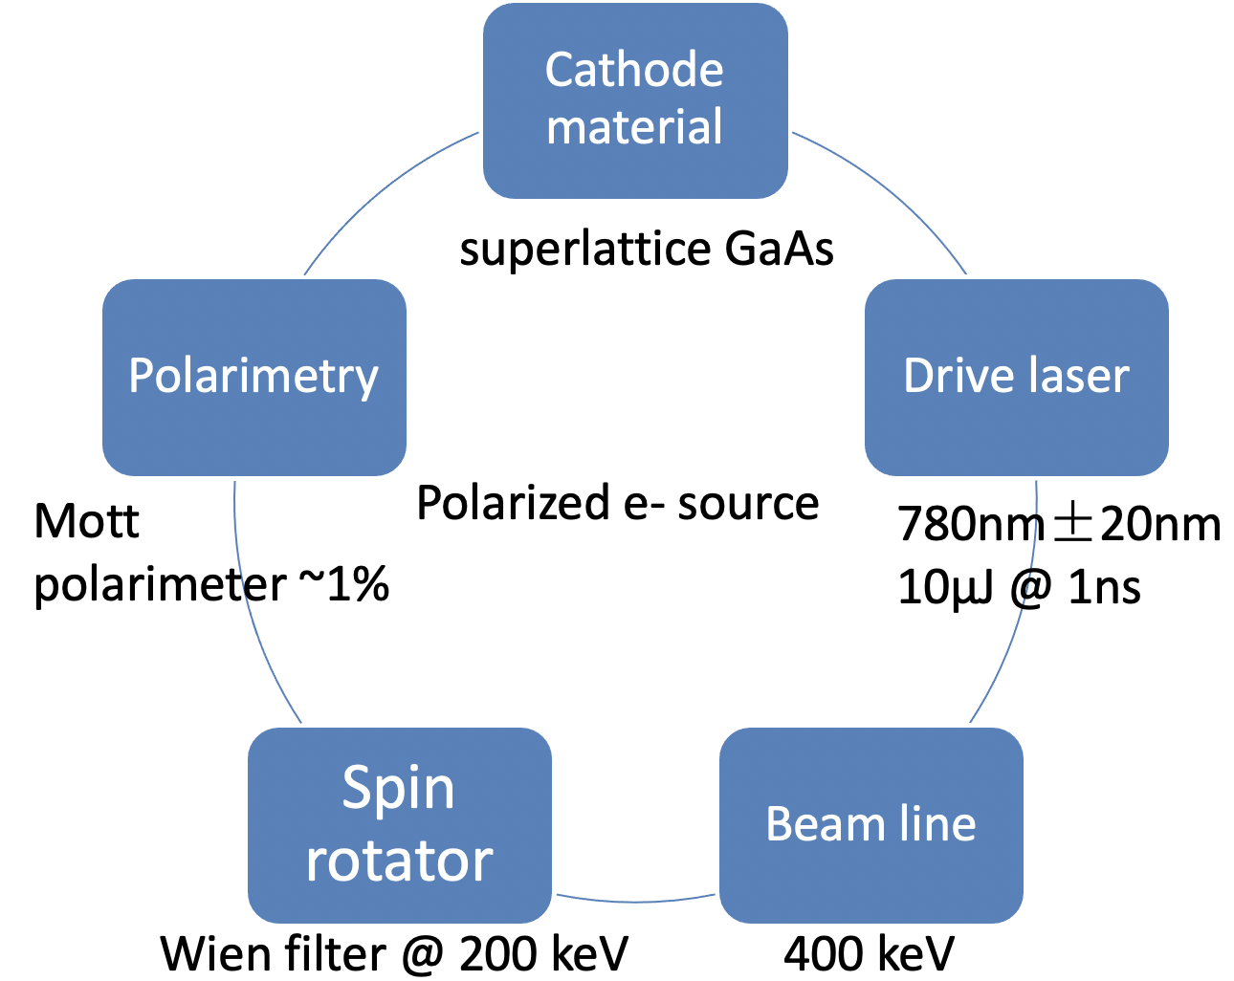
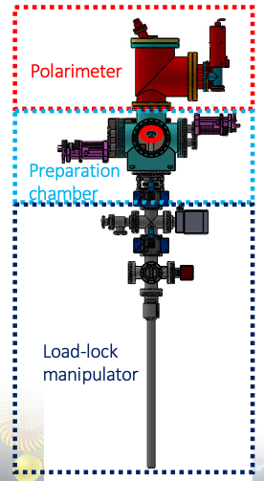
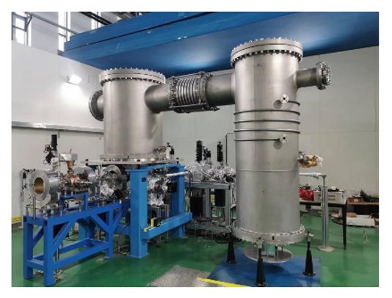
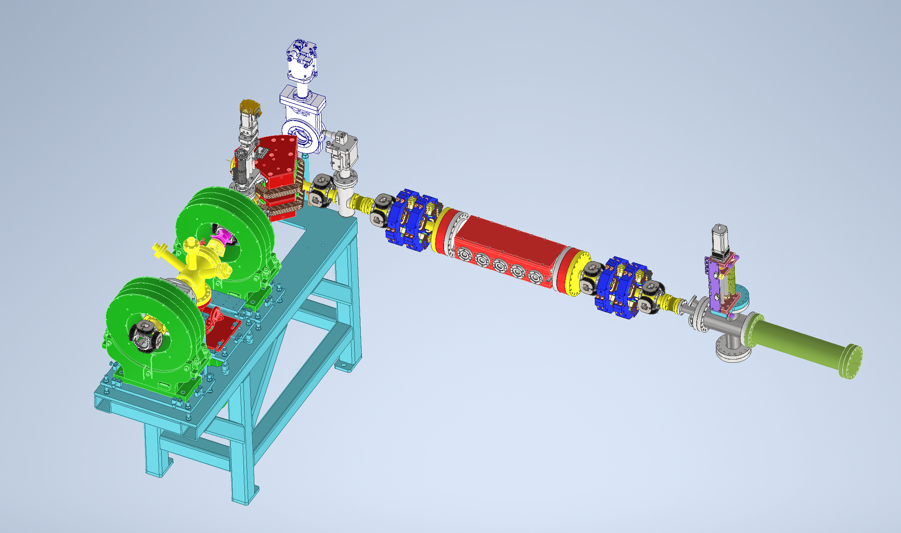
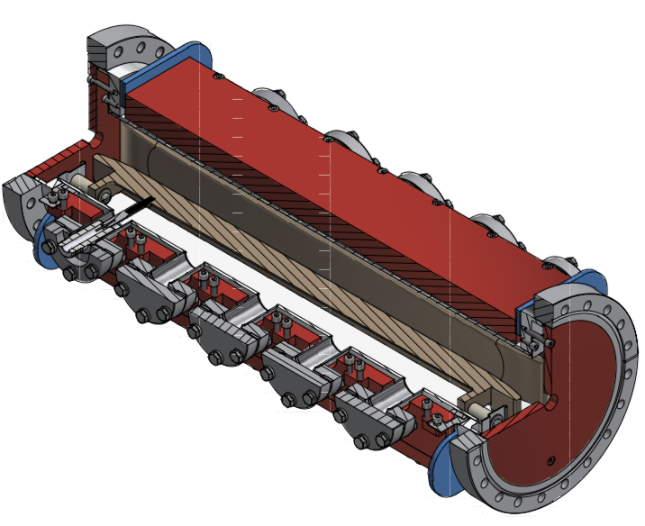
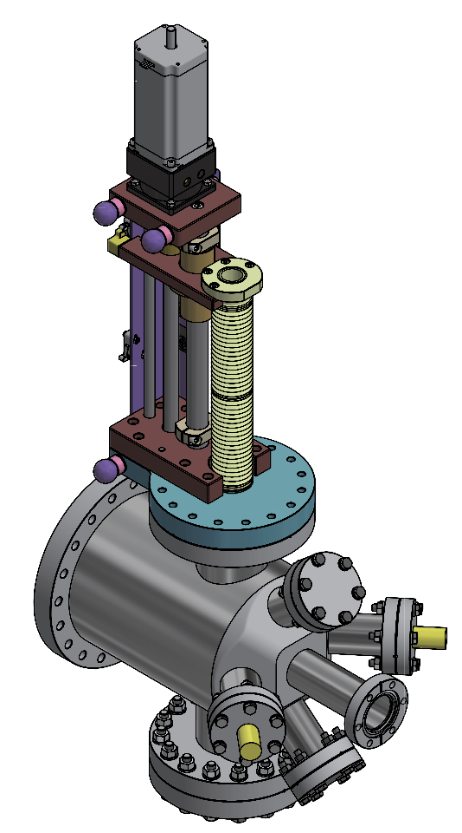
A test facility for polarized electron source
Convert a HV DC gun to a polarized electron source
  Domestic R&D on superlattice GaAs cathode, goal: polarization > 85%, QE > 0.8%
  First design of Wien filter & Mott polarimeter and the beamline modification, in collaboration with V. Tyukin (JGU-Mainz) supported by PIFI
  Beam commissioning scheduled in 2026-2027
500kV photocathode DC gun @ PAPS
Wien filter
Mott polarimeter
Li Xiaoping, Liu Wei, Meng Cai, Wang Jianli, Wang Haijing, Liu Jindong, Liang Zhijun, Zhang Shu etc

Slide 13
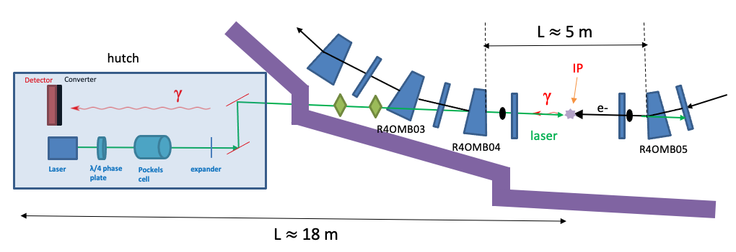
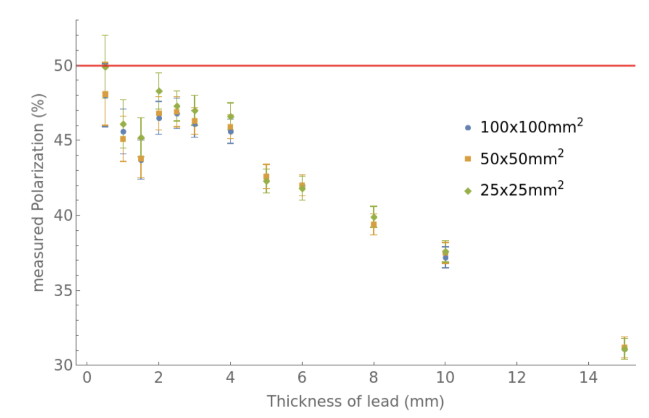
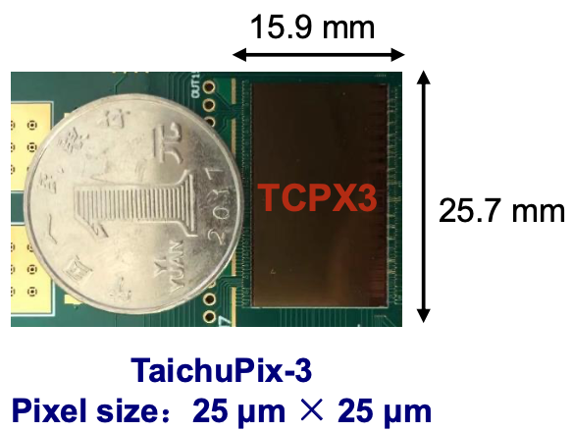
Compton polarimeter @ BEPCII
Design
  Reuse the beamline and hutch of a dismantled wiggler 4W2
  Laser source & detector in the hutch
  Use a lead converter + CEPC vertex detector prototype for detection of backscattered γ
In collaboration with A. Martens (IJCLab) etc with support from FCPPN/L.
Performance simulations (by Guangyi Tang, A. Martens etc)
Asymmetry
Assume 50% vertical polarization
Measured polarization (%)
~1% stats uncertainty in ~ 1 min.
vertical coordinate on detector(mm)
Thickness of lead (mm)
Liang Zhijun etc

Slide 14
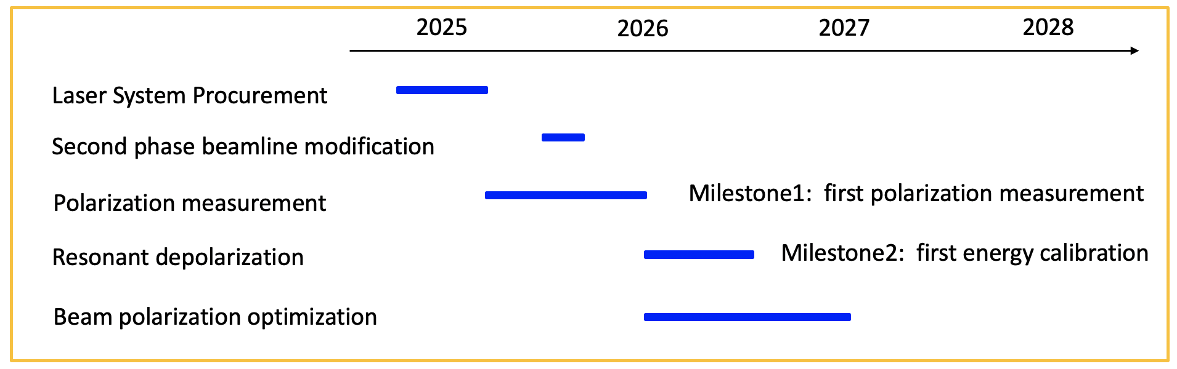
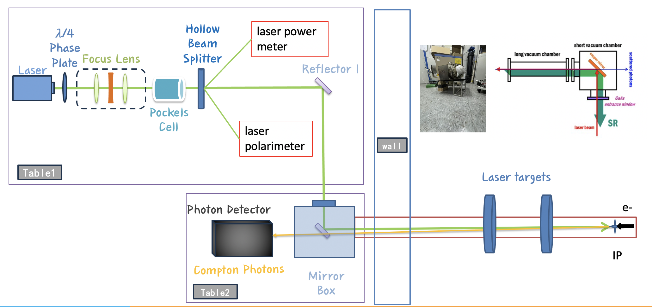
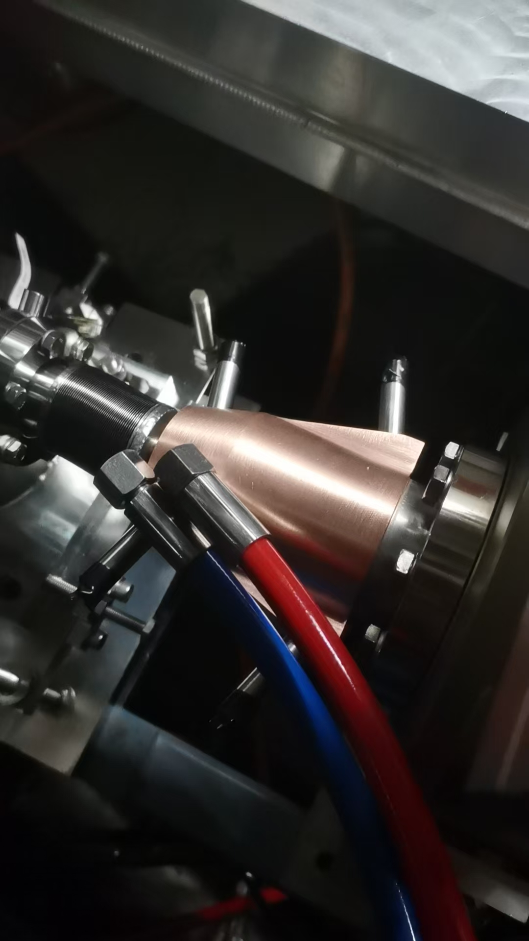
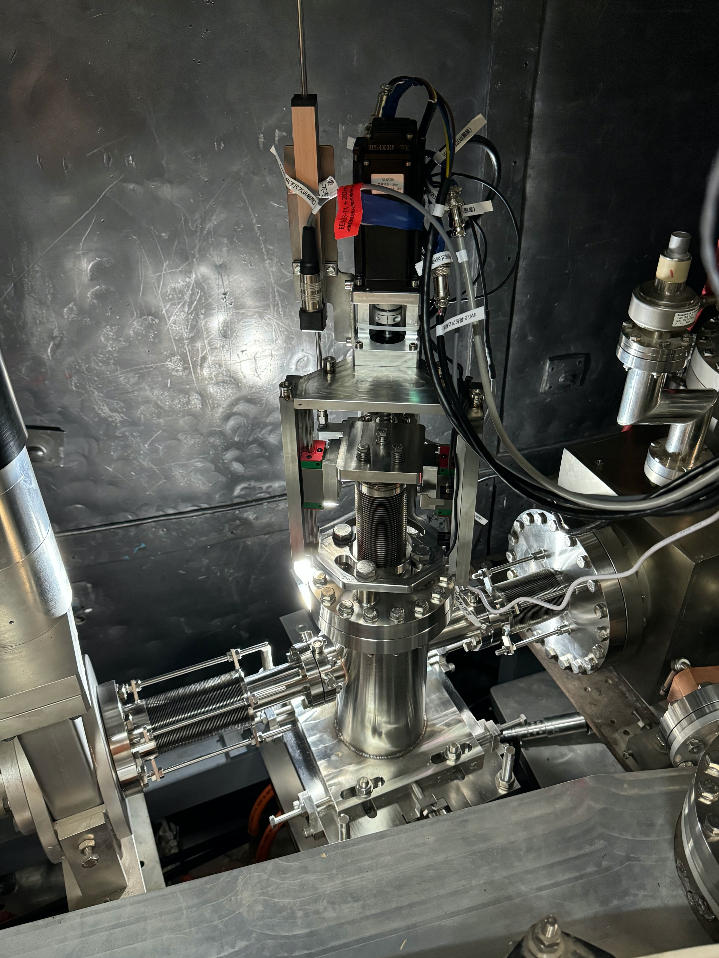
Compton polarimeter @ BEPCII
Progress
  Phase 1 beamline modification finished
  Laser system in procurement
  First polarization measurements in this year
Laser optics in the hutch
Laser targets
Bellow with X-ray collimation
mirror box borrowed from BEMS
By Su Mengyu, Aurelien Martens, Zhang Jianyong etc
Wang Jianli, Zhu Dechong, Zhou Ningchuang, etc

Slide 15
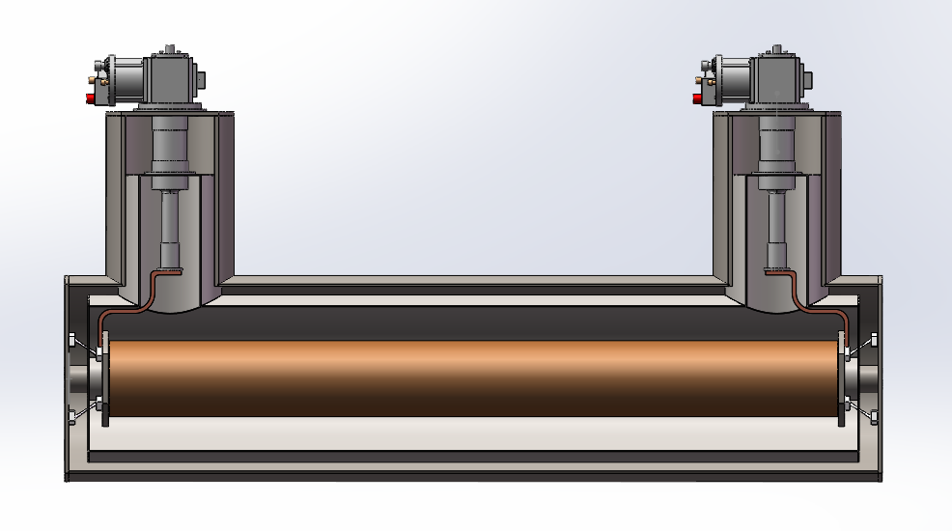
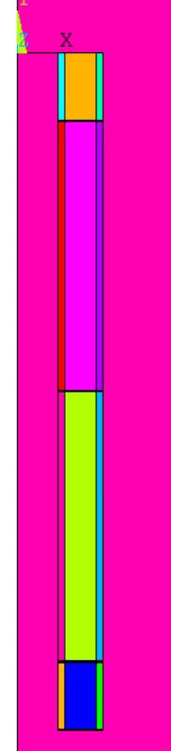
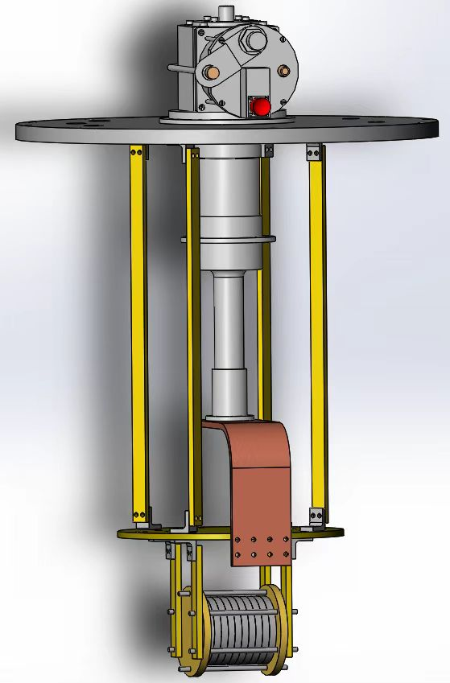
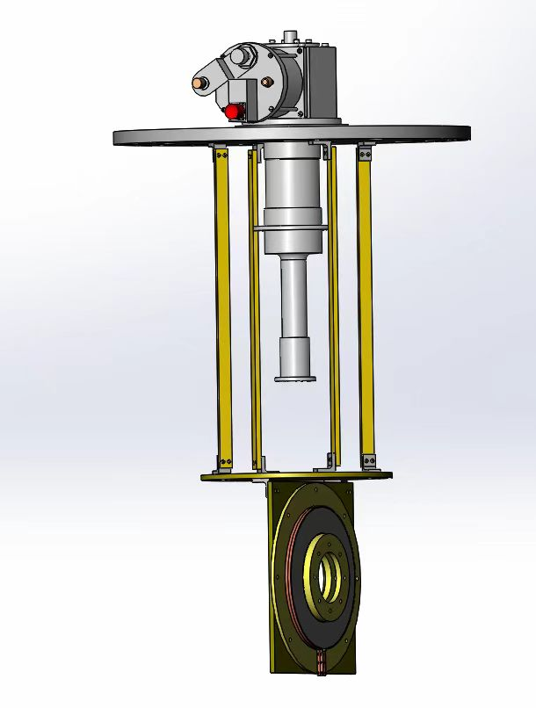
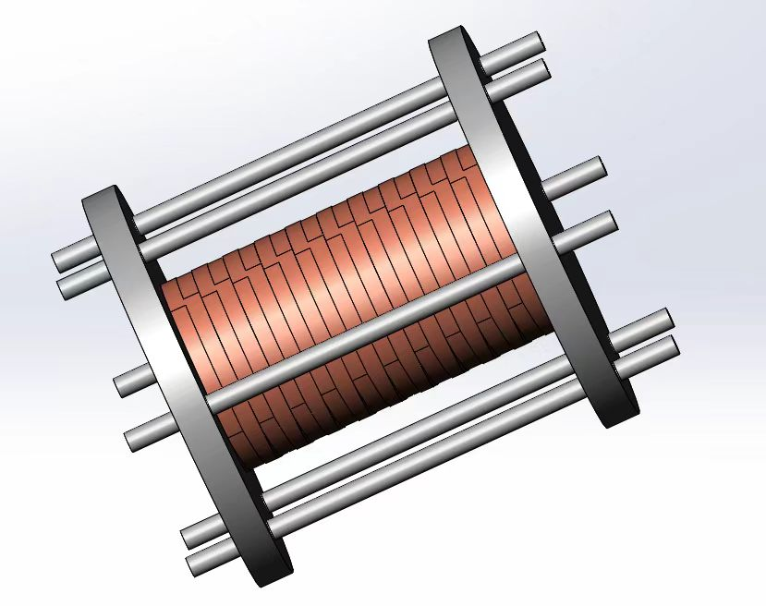
YBCO Superconducting solenoid spin rotator R&D
Concept
  Application of HTS with conduction-cooling
Coil design and optimization
  integral field meets spec
  max strain lower than limit
Experiment studies
  Temperature homogeniety
  Stability of YBCO coils
Measurements & tests scheduled in 2027
Design specs：
integral filed：10.26T.m
Length：1.018m
Working current：300A
Coil aperture：140mm
magnet aperture > 64mm
Cryo-cooler
Vacuum Dewar
Solenoid
10 Double-winding（12mm宽）
80 Double-winding（4.8mm宽）
10 Double-winding（12mm宽）
Zhao Ling, Xu Qingjin, Hou Zhilong, Zhou Jin, Liu Zhongxiu etc
Experiment studies of key issues with the conduction cooling and YBCO coils

Slide 16
Summary
A scheme with polarized lepton injector is promising for polarized beam applications at CEPC.
A Compton polarimeter is under development at BEPCII
The HV DC photocathode gun @ PAPS will be converted to a TF for polarized electron source.
A prototype of a HTS solenoid spin rotator is under design.
Thank you for your attention!

Slide 18
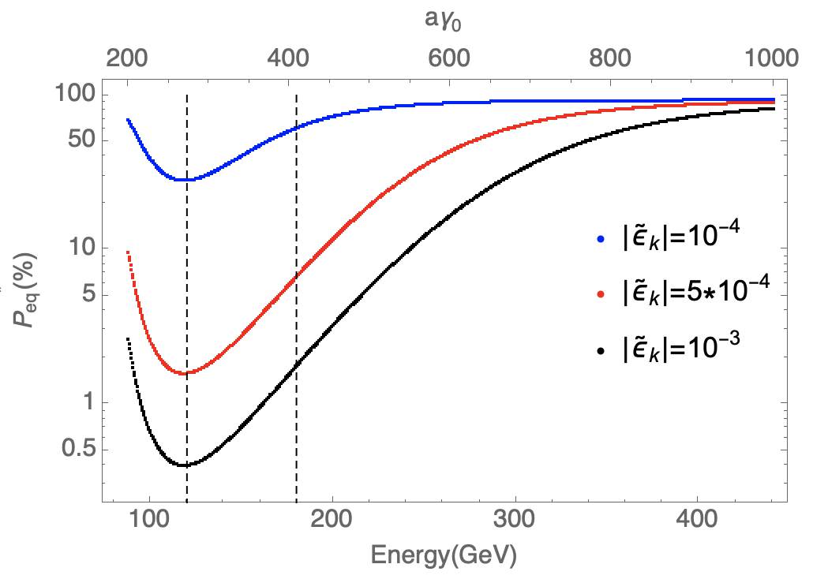
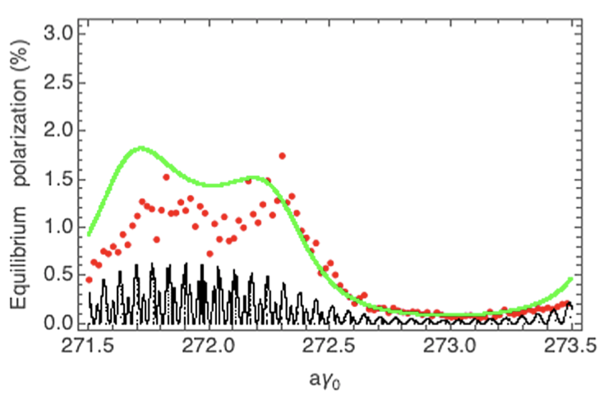
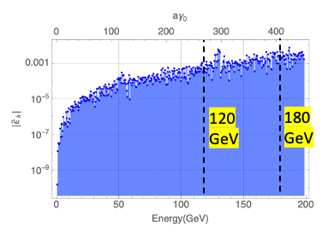
Useful polarization level at Higgs?
More challenging but possible at Higgs (Under study)
  Simulated injected polarization < 30% -> improvements in Booster lattice design & mitigation to machine imperfections
  Simulated equilibrium polarization ~ 1% -> mitigate depolarization by harmonic spin matching, cancellation of Sokolov-Ternov effect
Interleaved solenoid +dipole spin rotators to cover a larger energy range (under study)
Prediction of resonant spin diffusion theory at ultra-high energies
Simulated polarization transmission in Booster to Higgs
Simulated equilibrium polarization of Collider at Higgs
The key is to reduce the spin
resonance strength by a factor of 10
W. H. Xia, et al, Evaluation of radiative depolarization in the future circular electron-positron collider, Phys. Rev. Accel. Beams, 26, 091001, (2023).

