Slide 1
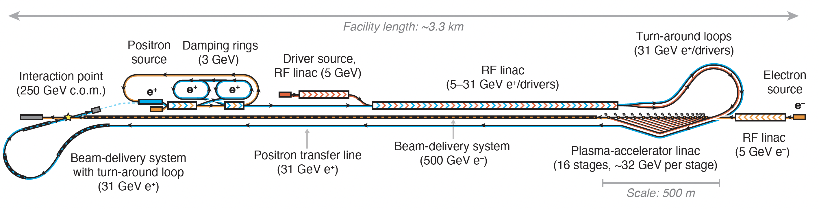
Hybrid Asymmetric Linear Higgs
Factory (HALHF)
Brian Foster for the HALHF Collaboration
Foster, D’Arcy and Lindstrøm, New J. Phys. 25, 093037 (2023)
Lindstrøm, D’Arcy and Foster, arXiv:2312.04975

Slide 2
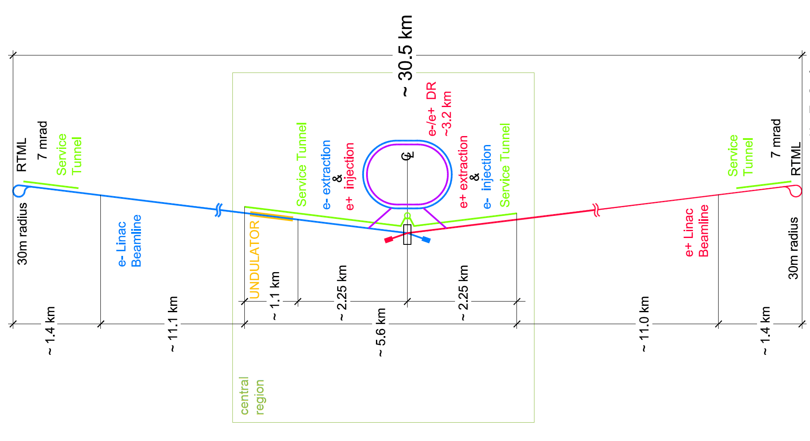

Hybrid Asymmetric Linear Higgs
Factory (HALHF)
ILC
CEPC
https://arxiv.org/2303.10150

Slide 3
Hybrid Asymmetric Linear Higgs
Factory (HALHF)
For decades plasma acceleration has promised very high gradients => cheap LCs. HALHF for first time tries to make this a reality.
The basic idea is – there are enough problems with a PWFA e⁻ accelerator; e⁺ is even more difficult. Bypass this for e⁺e⁻ collider by using conventional linac for e⁺.
For this to be attractive financially, conventional linac must be low energy => asymmetric energy machine (31 x 500 GeV).
This requirement led to (at least for us) unexpected directions – the more asymmetric the machine became, the better!

Slide 4
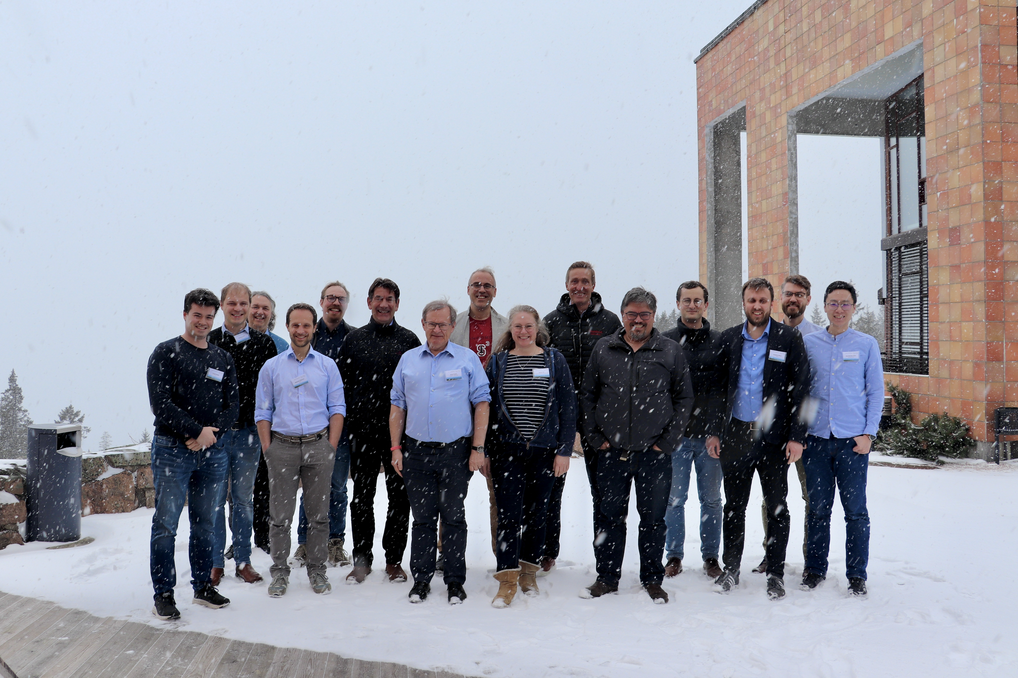


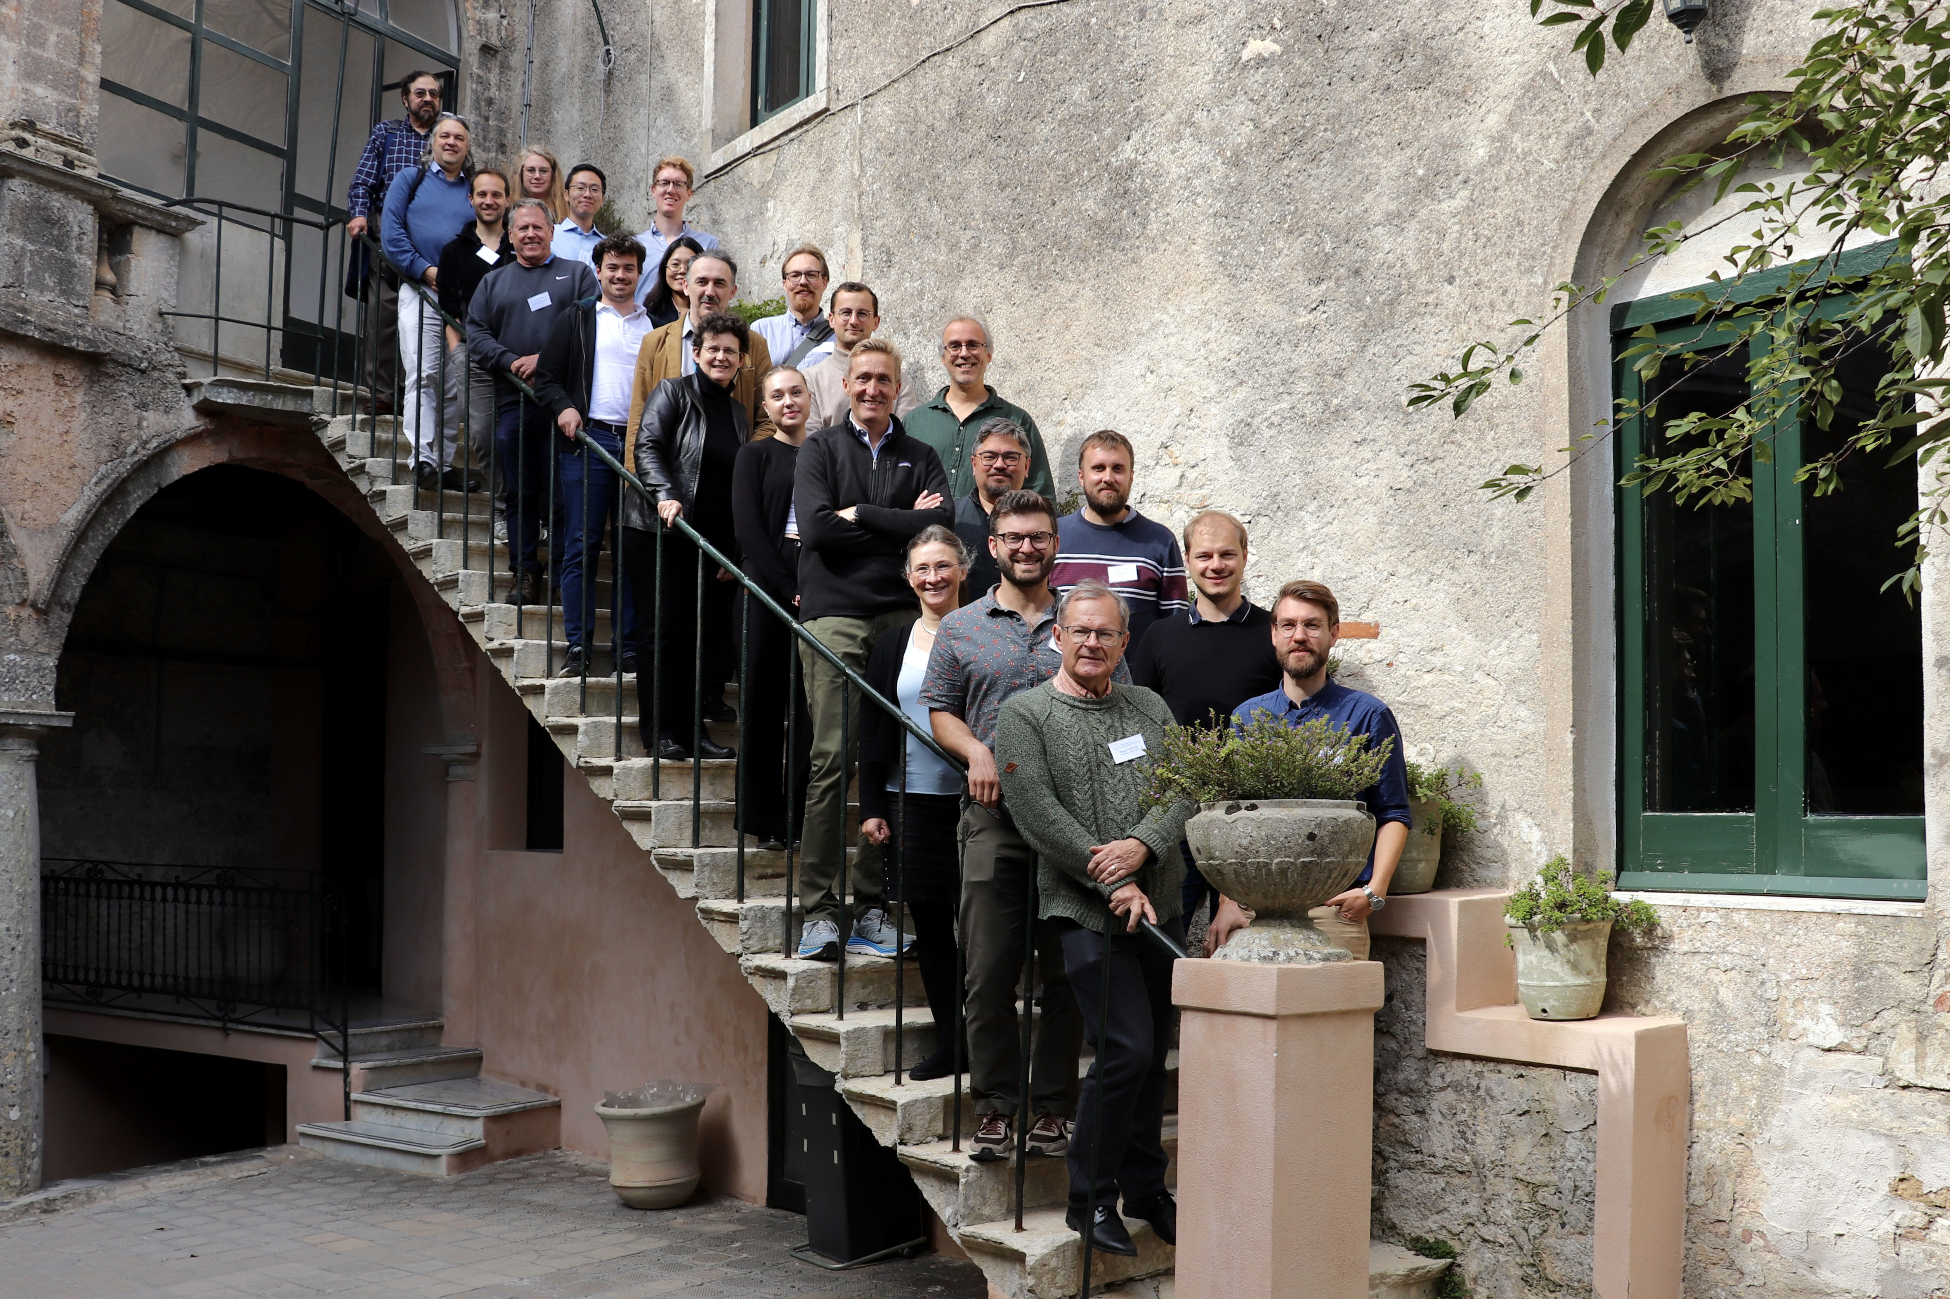
Recent Progress
Workshops in Oslo (April) and Erice (October)

Slide 5

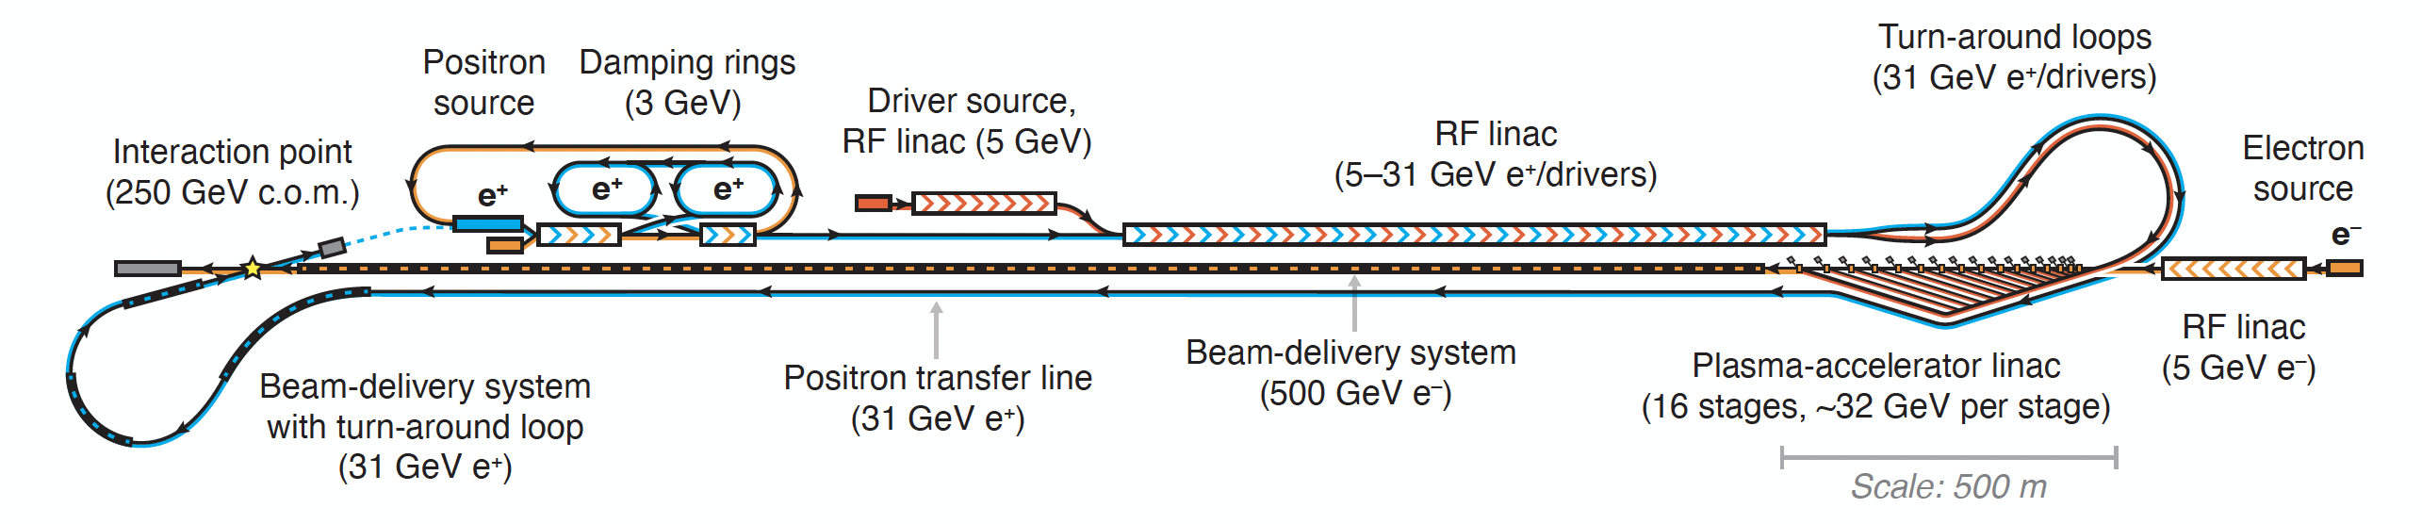
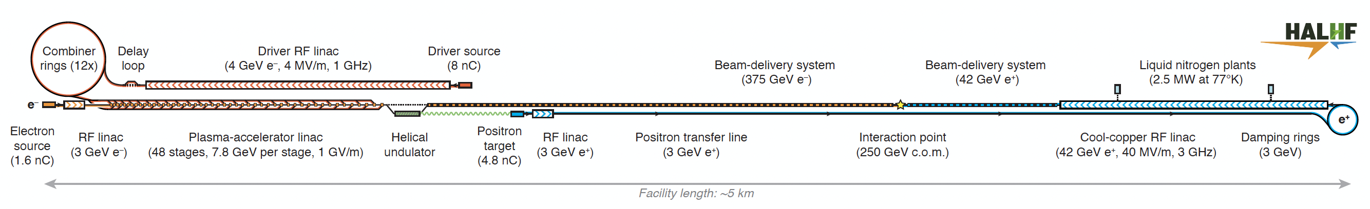
HALHF Status
HALHF workshop 3 – 8.10, Erice dedicated to reassessing baseline in light of comments
from colleagues and progress in design.
Original Baseline:
Principal problems:
“Turn-around” too small to retain required beam quality & scales badly with energy;
“Dual-Purpose” linac difficult to design and inflexible.
New Baseline (not yet official):

Slide 6
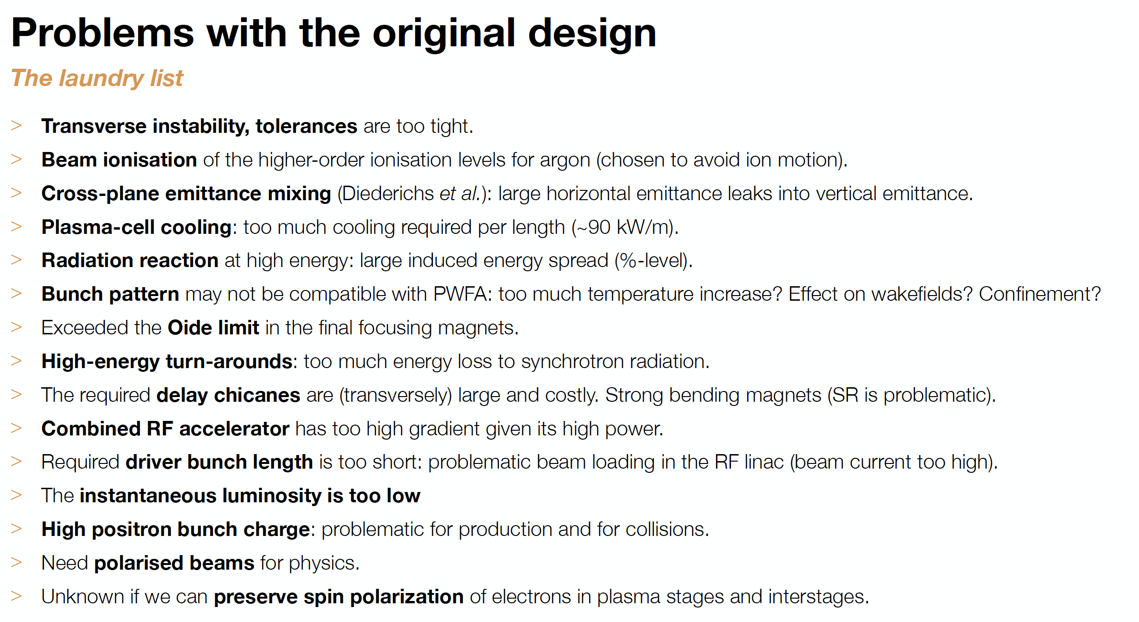
Recent Progress

Slide 7
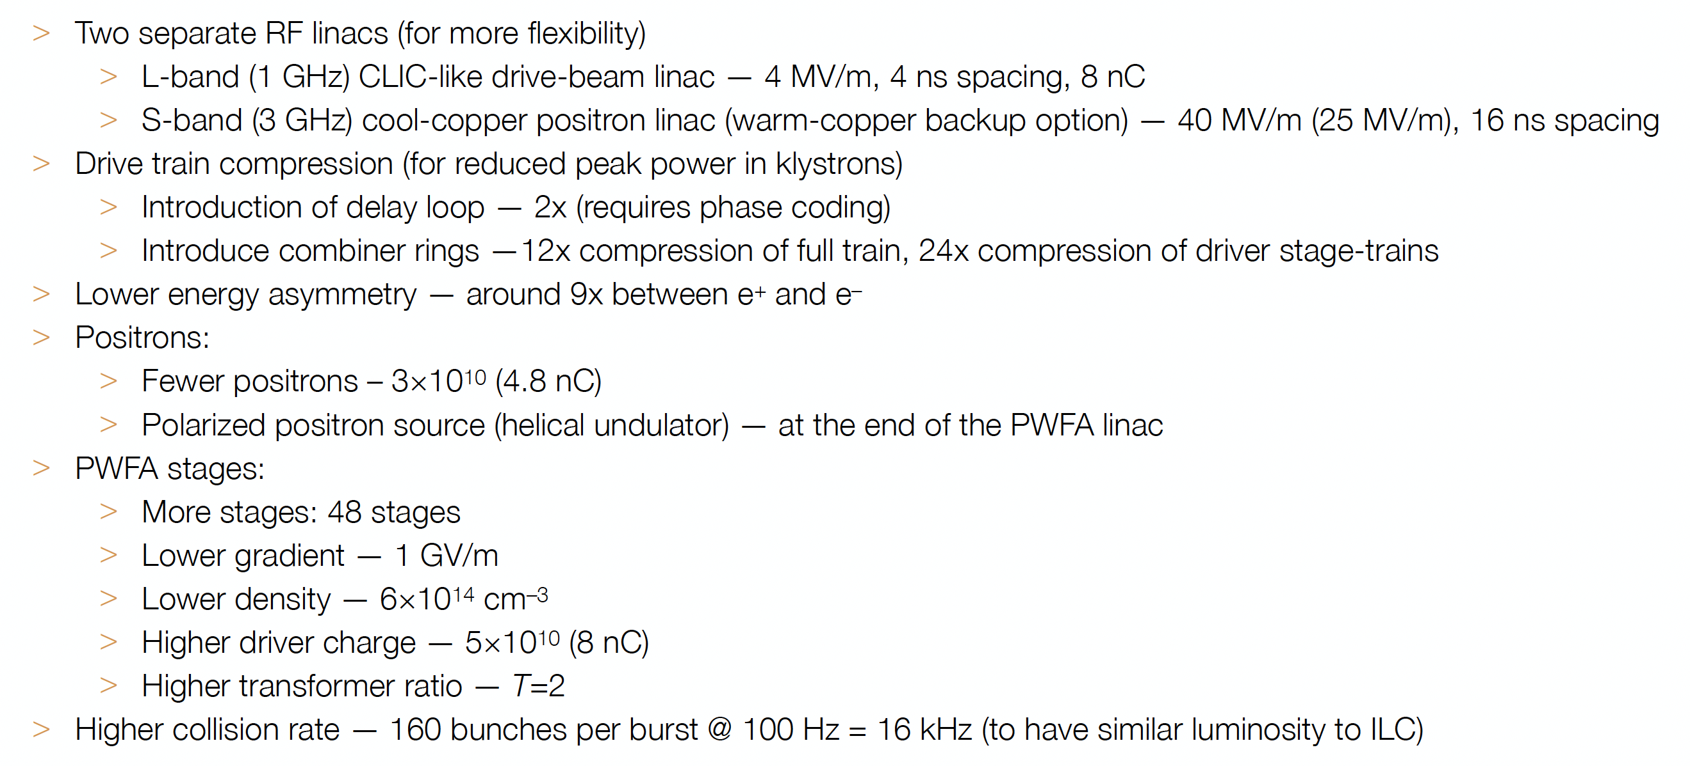
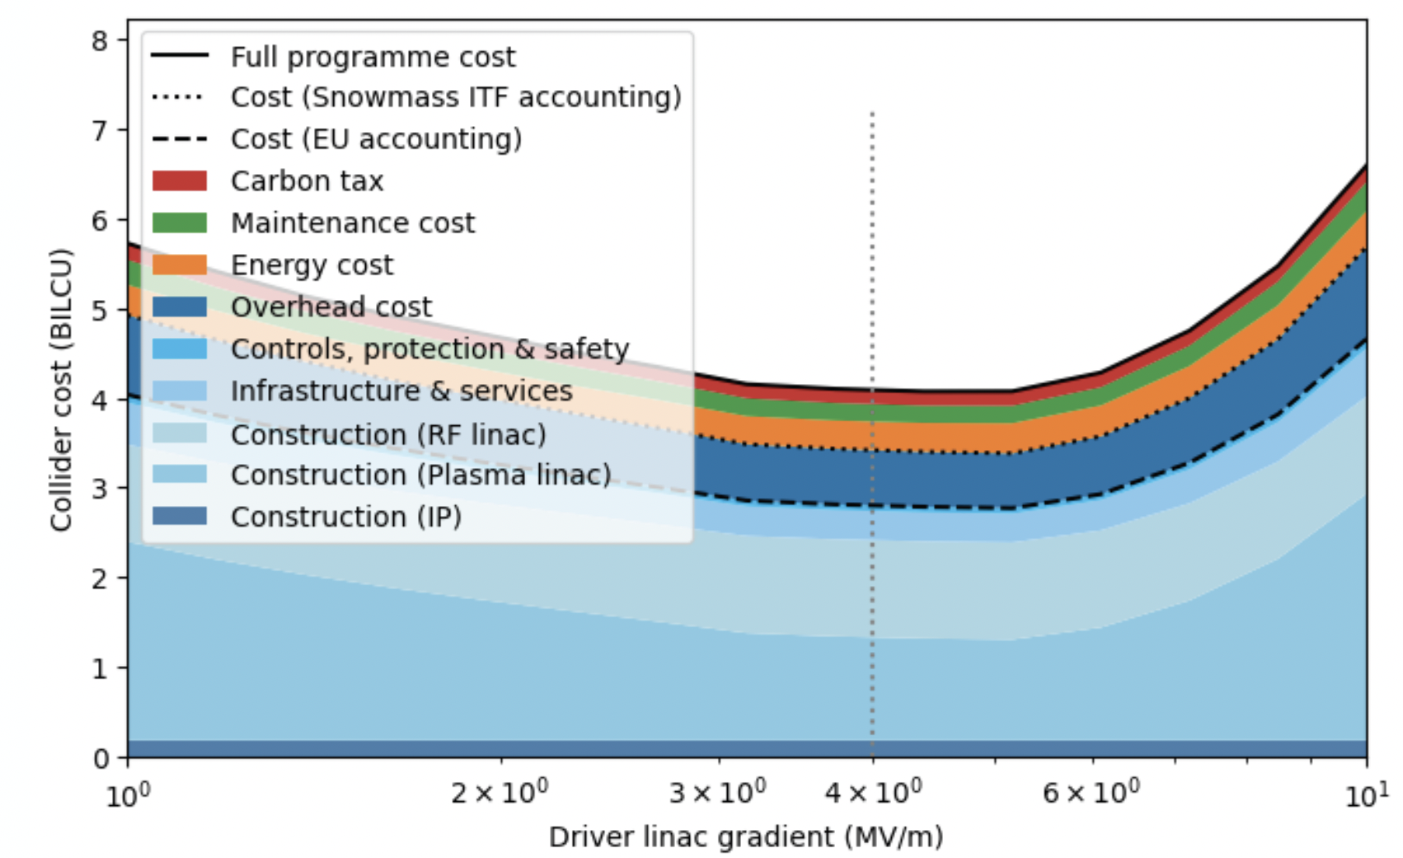
HALHF Status
Summary of changes in new baseline – not yet official:

Slide 8
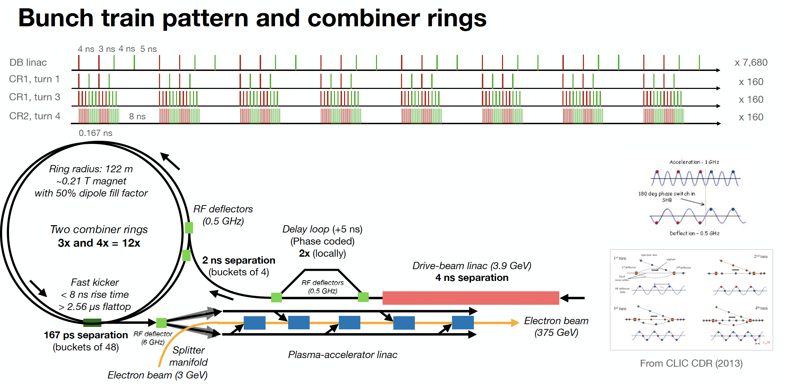
Bunch pattern

Slide 9
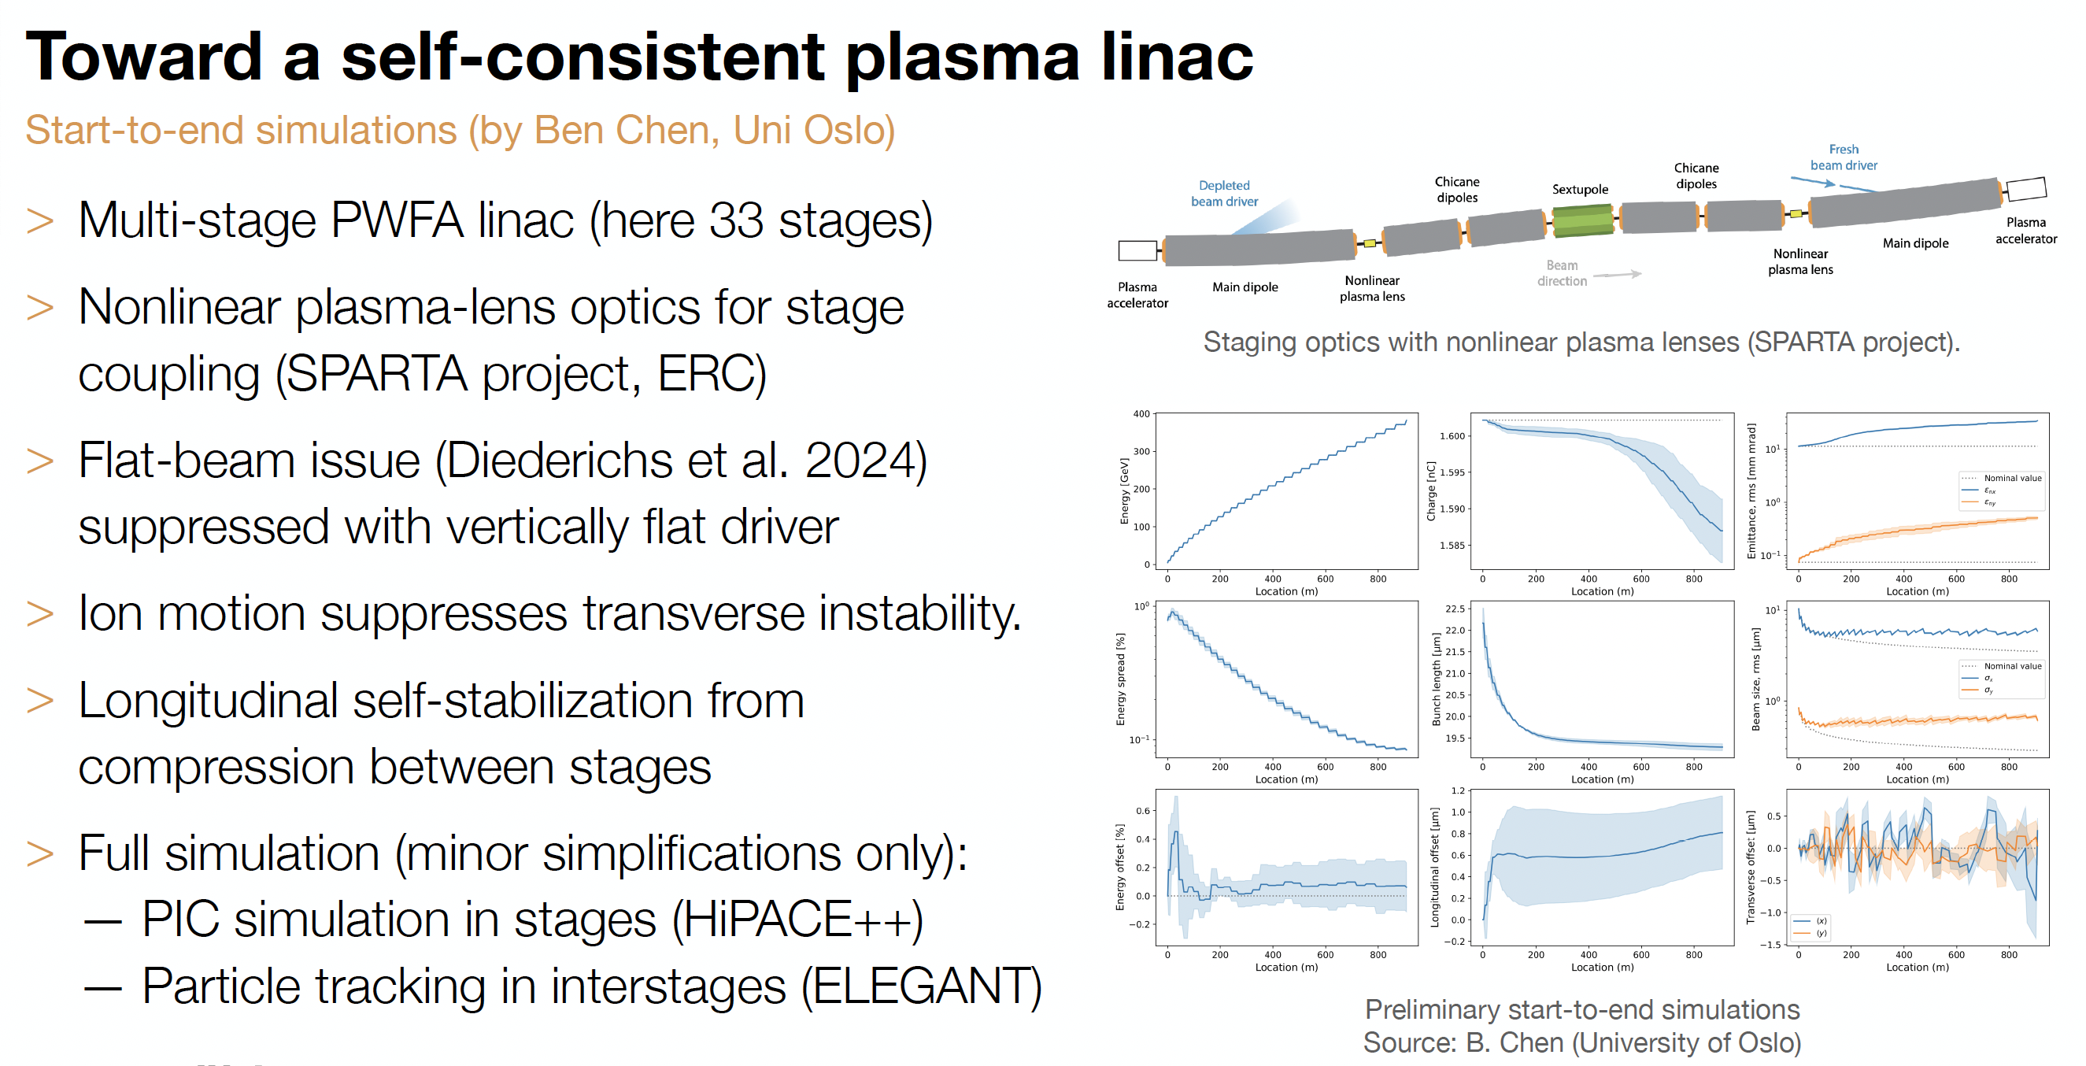
Recent Progress

Slide 10
Bunch pattern
PIC simulation with HiPACE++, He @ 6 × 10¹⁴ cm⁻³ ; driver and main beam (orange) 8 & 1.6 nC. Excess ion density
on axis (green)
Corresponding current profile has peak current ~ 4–5 kA, with a ramped driver current and an initially Gaussian witness (colliding) beam.

Slide 11
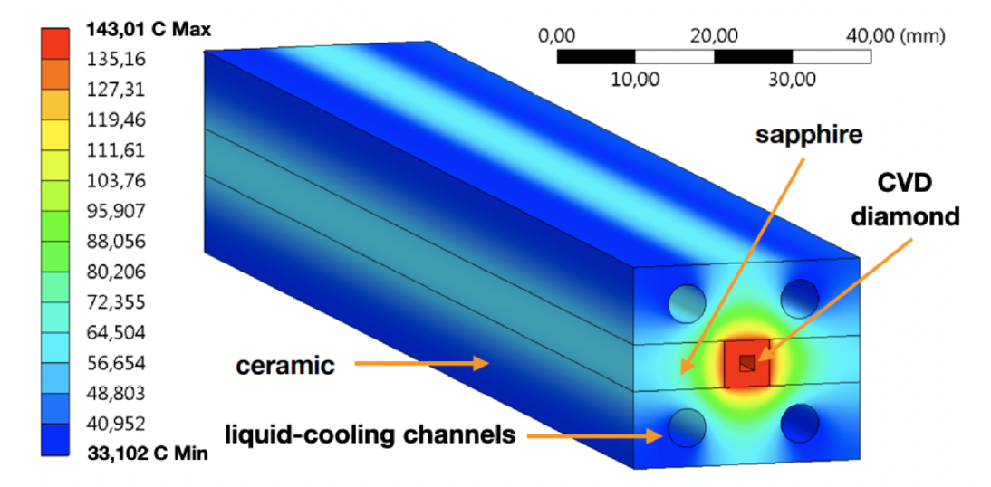
Plasma Cell
Getting the heat out of the plasma cells given the
power required for colliders is a BIG problem;
Very little is known
about plasmas at these
temperatures in PWFA -
T > 100 keV - although
rather a lot at ITER!
Depending on details of
bunch structure,
extreme cooling is
needed – ~ 100 kW/m –
10* higher than CLIC -> urgent R&D required!

Slide 12
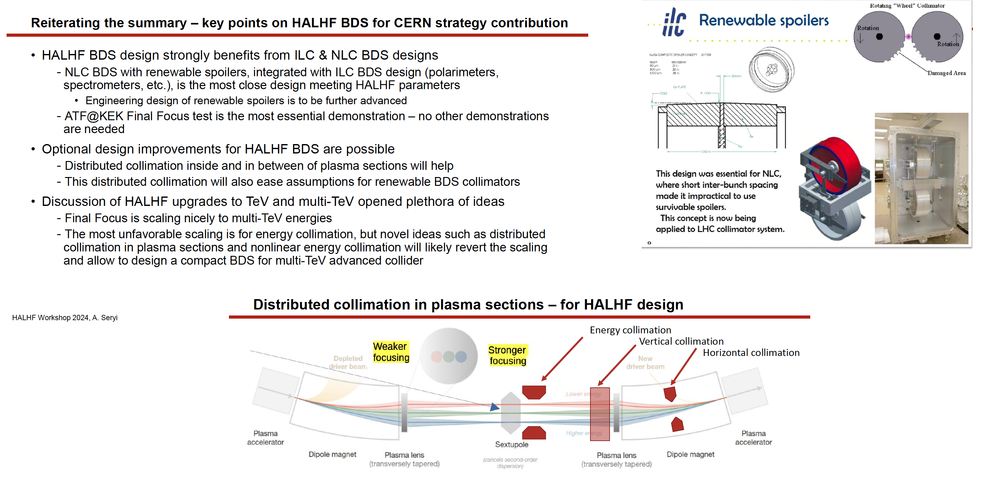
Beam-Delivery System

Slide 13
Towards an advanced LC
Technology being developed for HALHF could also enhance a “conventional” LC design – part of “LCVision”:
Assume: ILC has been built,
-> 2x125GeV linacs available
Goal: upgrade electron arm to 500GeV with plasma
-> 125x500GeV -> 500GeV COM; γ ~ 1.2
-> upgrade a Higgs factory to a tth / Zhh factory
Use electron linac for drive and witness beam:
run a lower gradient but higher current, upgrade RF on electron arm
Use space for undulator source between electron ML and BDS to install plasma booster
Feed boosted electrons into existing BDS (laid out for 500GeV)
Space for
plasma booster
(B. List)

Slide 14
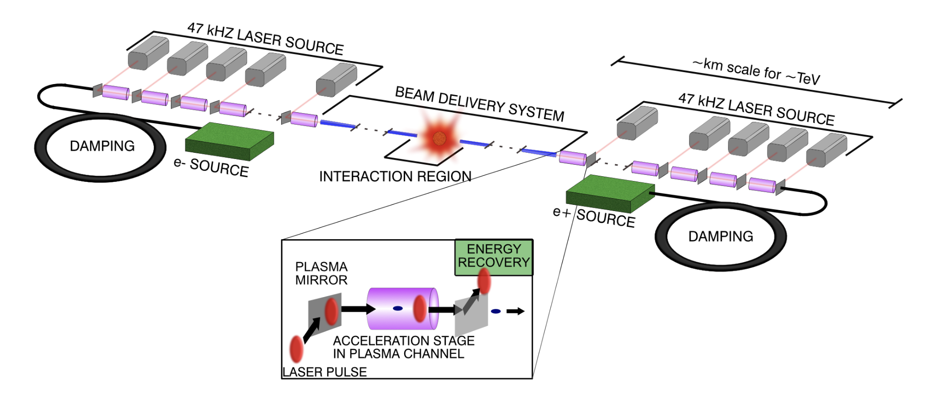
10 TeV Wakefield Collider Summary
Working Groups
System integration and optimization
Beam sources (incl. damping rings)
Drivers
  Laser
  Beams - SWFA
  Beams - PWFA
Linacs
  LWFA
  SWFA
  PWFA
Beam delivery system
Beam-beam interactions
Beam diagnostics
Machine-detector interface
HEP detector
HEP physics case
Environmental impact
Simulations/computing/AI
Green = Broader accelerator community
Orange/blue/purple = AAC specific
Red = HEP and broader community

Slide 15
10 TeV Wakefield Collider Summary
Challenges
Inefficient acceleration of positrons in plasma
  Proposed solution: Take advantage of large VBF cross-section and utilize gamma-gamma or e⁻e⁻ collisions instead.
Extreme beamstrahlung at high collision energies and beam densities
  Proposed solution: 1) Collide ultrashort bunches to mitigate beamstrahlung and 2) Embrace the broad luminosity spectrum so long as significant fraction of the colliding particles are close to 10 TeV CM.
Detector design and background modeling for high energy collisions
  Proposed solution: Development of new Particle-in-Cell codes, benchmarked against GUINEA-PIG and CAIN, to accurately model backgrounds for high-energy gamma-gamma, e⁻e⁻, and e⁻e⁺ collisions.

Slide 16
Summary & Outlook
Despite ~ 0 funding, HALHF is making rapid progress;
Hope to finalise new baseline tomorrow;
Regular monthly HALHF accelerator meetings;
In parallel, physics & detector studies continue (J. List, coord.)
first indications boost does not impact physics reach;
Next workshop in DESY, 27-28.2.25;
Short-term goal: input to European Strategy and
to comprehensive global LC plan, LCVision;
Longer-term goal: pre-CDR & funding to start R&D programme;
Contribute to 10 TeV design.

