Slide 1



CEPC Booster, Damping Ring and Timing
Dou Wang (IHEP)
on behalf of CEPC AP group
HONG KONG, Jan 14-17, IAS Program on Fundamental Physics HKUST (FP 2025)

Slide 2
Content
EDR progress of CEPC Booster
  Progress of error study
  Strong beam-beam simulation with on-axis injection for Higgs
  Progress of beam loading study
  Progress of polarization study
EDR progress of CEPC positron damping ring
  DR TDR design status
  Polarized DR study
  TF design status -- LPA multi-function ring
CEPC timing issue and detector performance
Summary

Slide 3
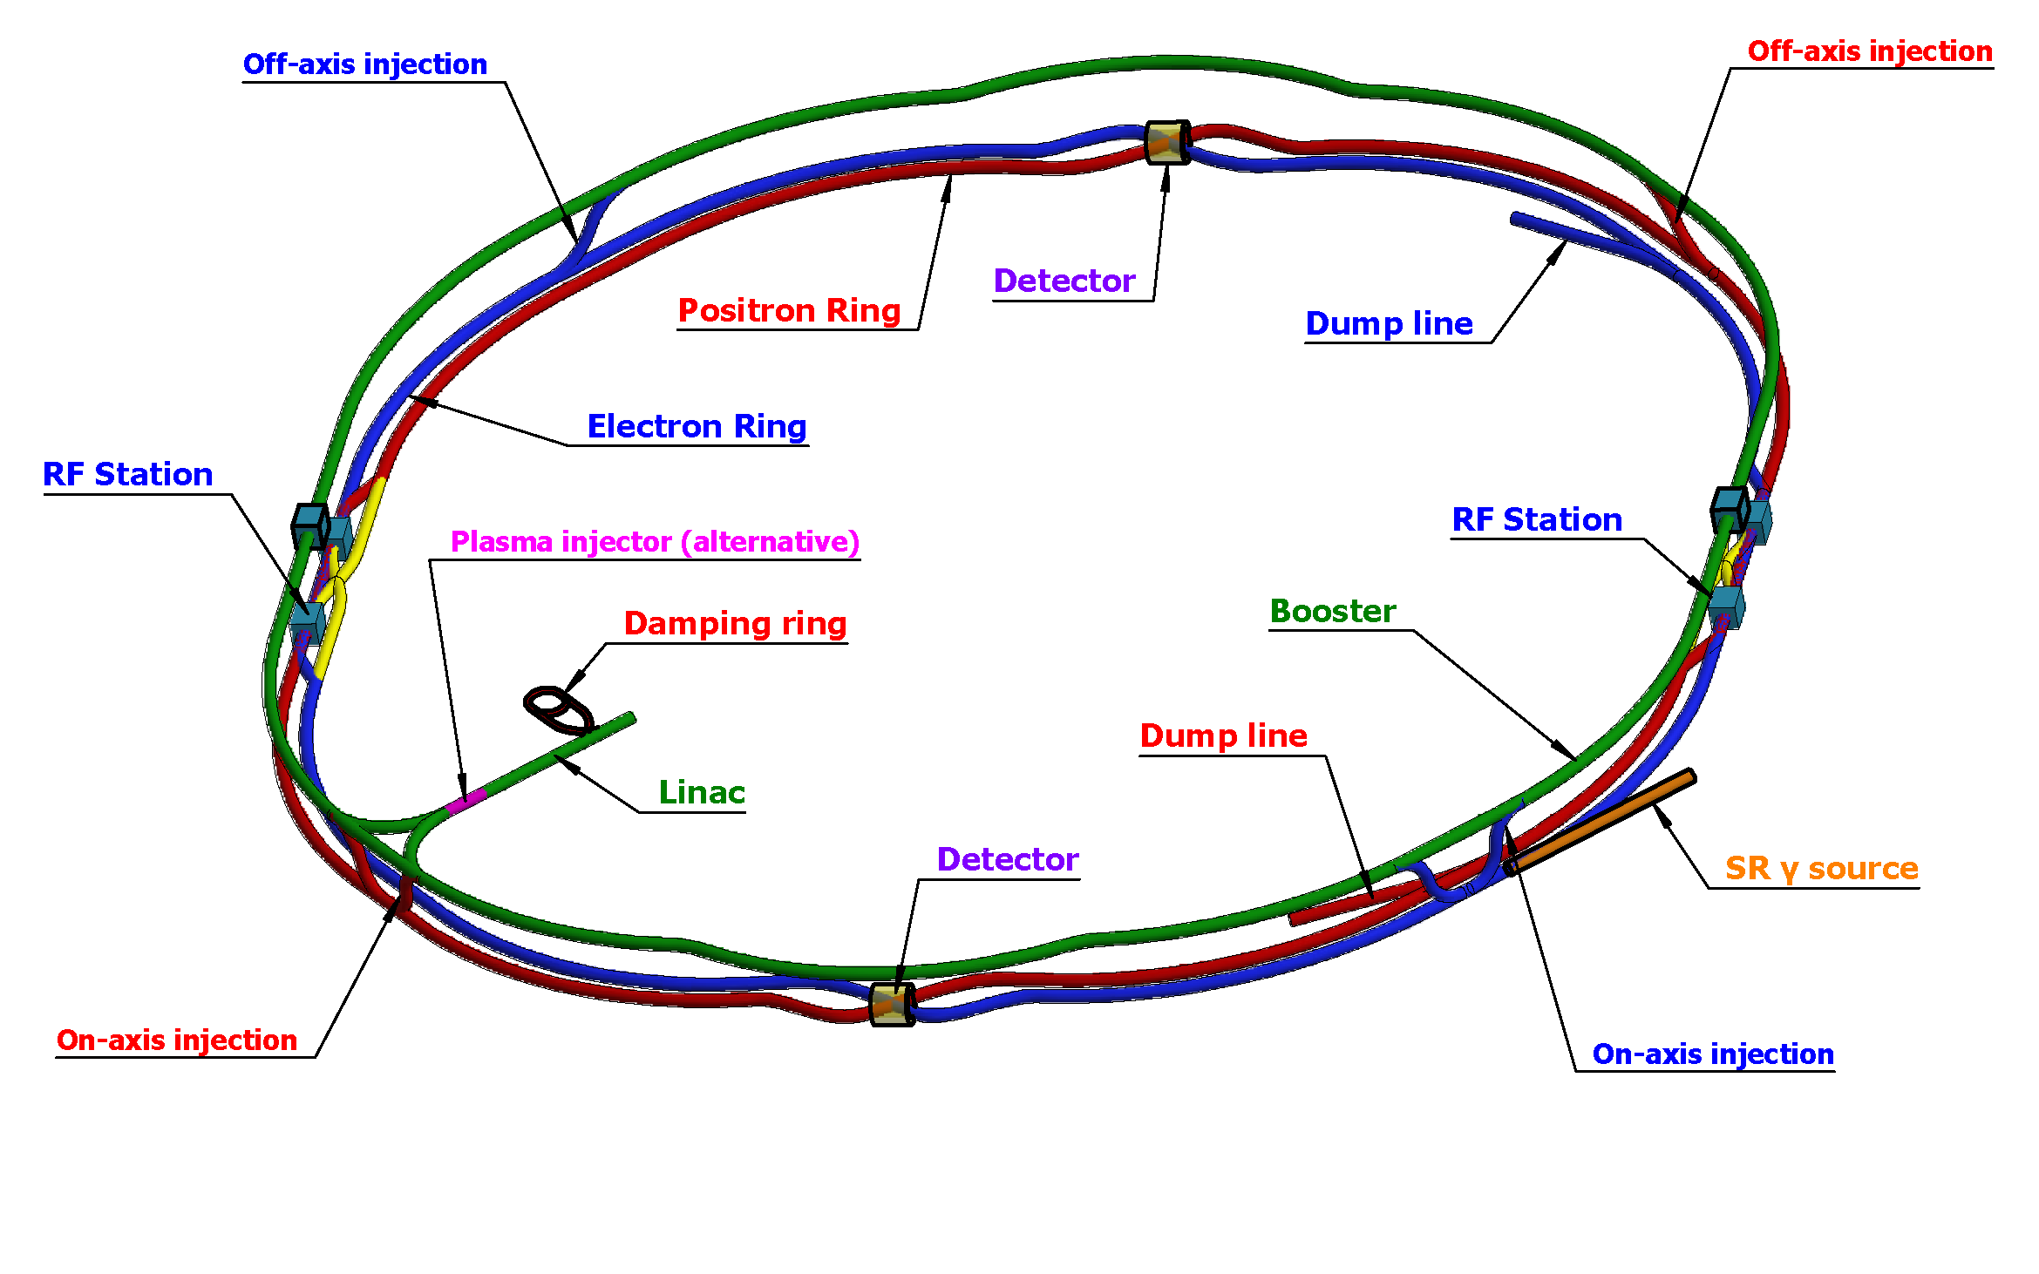
CEPC injector chain
30→180GeV
30GeV
2 RF stations
2 Inj. (Linac to Booster)
2 Inj. (Collider to Booster)
4 Ext. (Booster to Collider)
2 Ext. (Booster to Dump)
100km
30 GeV linac provides electron and positron beams for booster.
Top up injection for collider ring ~ 3% current decay
Booster is in the same tunnel as collider ring, above the collider ring, bypass in IRs (same circumference).
Budget for transfer efficiency 90%: 95% for booster + 95% for transport lines (inj. to collider).
Beam current threshold in booster is limited by RF system.
Feedback systems (Transverse & longitudinal) are need to damp the instability at low energy.

Slide 4
Booster TDR parameters
Injection energy: 10GeV → 20GeV → 30GeV
Max energy: 120GeV → 180GeV
Lower emittance ─ new lattice (TME)
Extraction
Injection
*Diameter of beam pipe is 56mm for re-injection with high single bunch current @120GeV.

Slide 5
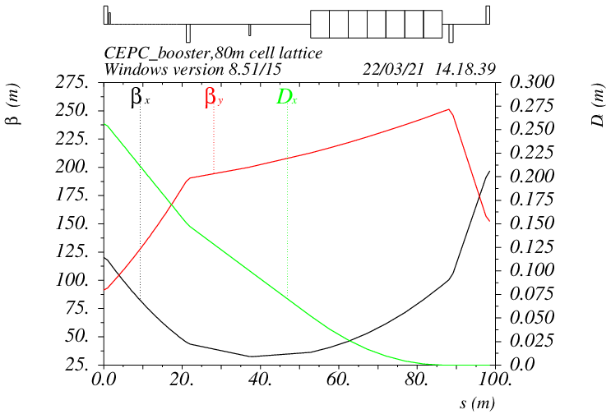
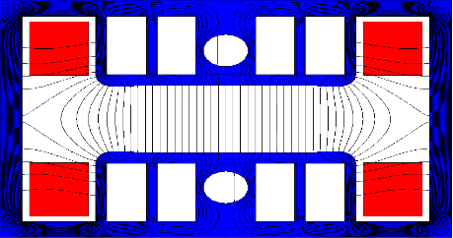
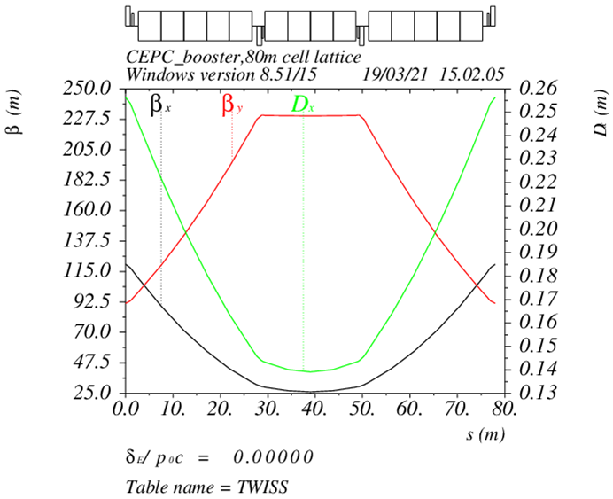
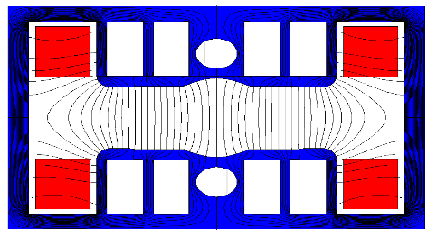
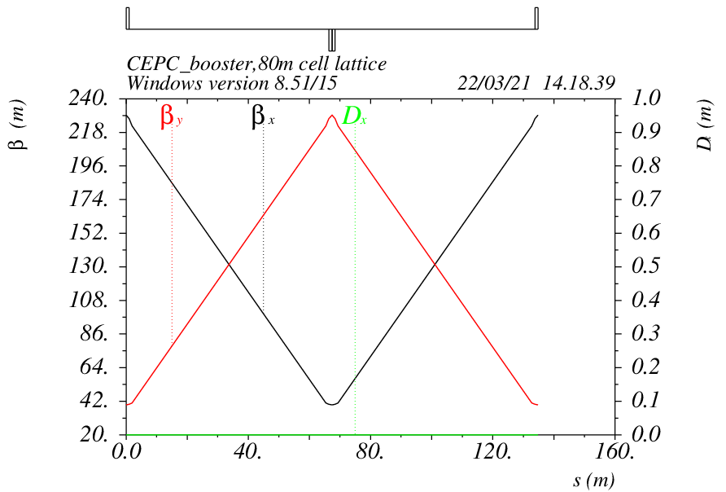
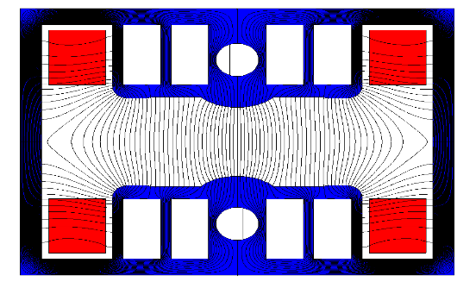
Booster TDR optics
D. Wang, C. H. Yu, D. H. Ji, Y. M. Peng, X. H. Cui,…
Arc: TME like structure (cell length=78m)
Interleave sextupole scheme
Emittance@120GeV=1.26nm
Overall idea: uniform distribution for the Q
Combined magnet (B+S) scheme + 100 sextupoles
Phase advance/cell: 100° (H) / 28° (V)
Dispersion sup.
Arc cell
Straight cell
Ref: D. Wang, et al., “Low emittance optics design for CEPC booster”, NIMA, 1062 (2024) 169159.

Slide 6
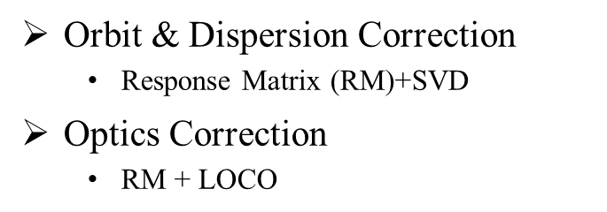
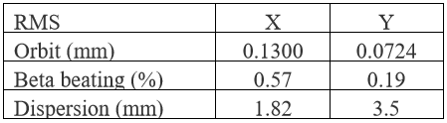
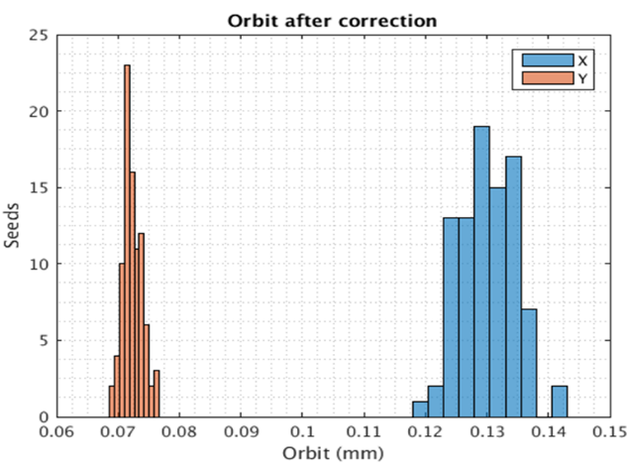
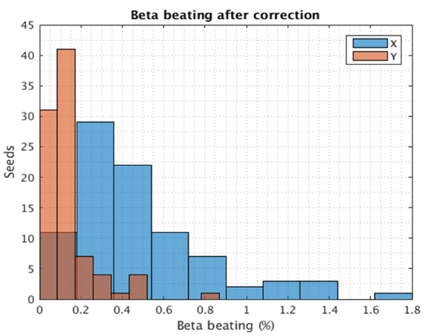
Error setting in TDR
Gaussian distributions are used for the errors, and they are truncated at 3σ.
D. H. Ji
 | Dipole | Quadrupole | Sextupole
Transverse shift X/Y (μm) | 100 | 100 | -
Longitudinal shift Z (μm) | 100 | 150 | -
Tilt about X/Y (mrad) | 0.2 | 0.2 | -
Tilt about Z (mrad) | 0.1 | 0.2 | -
Nominal field | 1e-3 | 2e-4 | 1e-3
 | Accuracy (um) | Tilt (mrad) | Gain | Offset w/ BBA(um)
BPM(10Hz) | 0.1 | 10 | 5% | 30
(100 seeds)
(93 seeds)
DA track in AT w/o SR
Include multipole errors
Residual errors after correction with 100 random seeds
dipole | quadrupole
B1/B0 ≤ 2×10⁻⁴
B2/B0 ≤ 5×10⁻⁴ | B2/B1 ≤ 3×10⁻⁴
B3/B0 ≤ 2×10⁻⁵ | B3/B1 ≤ 2×10⁻⁴
B4/B0 ≤ 8×10⁻⁵ | B4/B1 ≤ 1×10⁻⁴
B5/B0 ≤ 2×10⁻⁵ | B5/B1 ≤ 1×10⁻⁴
B6/B0 ≤ 8×10⁻⁵ | B6/B1 ≤ 5×10⁻⁵
B7/B0 ≤ 2×10⁻⁵ | B7/B1 ≤ 5×10⁻⁵
B8/B0 ≤ 8×10⁻⁵ | B8/B1 ≤ 5×10⁻⁵
B9/B0 ≤ 2×10⁻⁵ | B9/B1 ≤ 5×10⁻⁵
B10/B0 ≤ 8×10⁻⁵ | B10/B1 ≤ 5×10⁻⁵

Slide 7
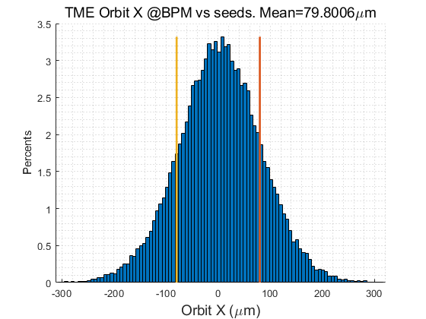
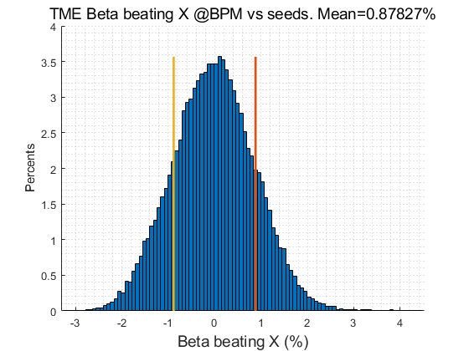
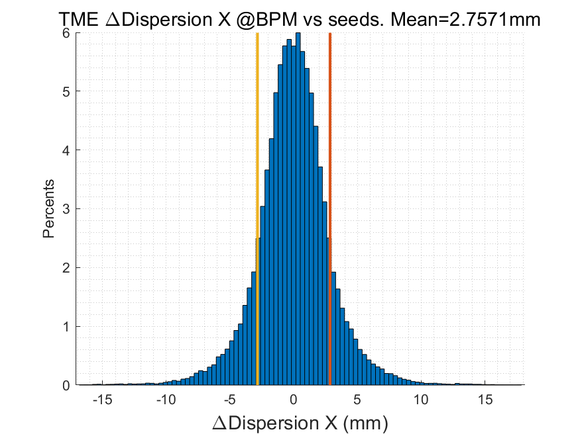
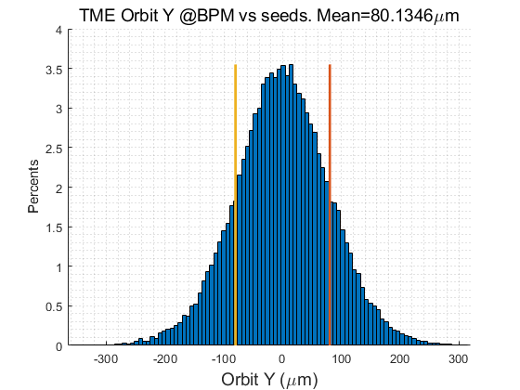
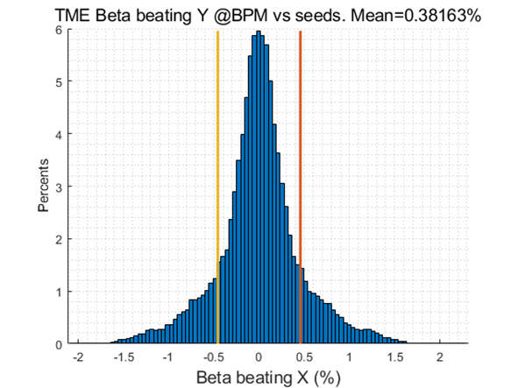
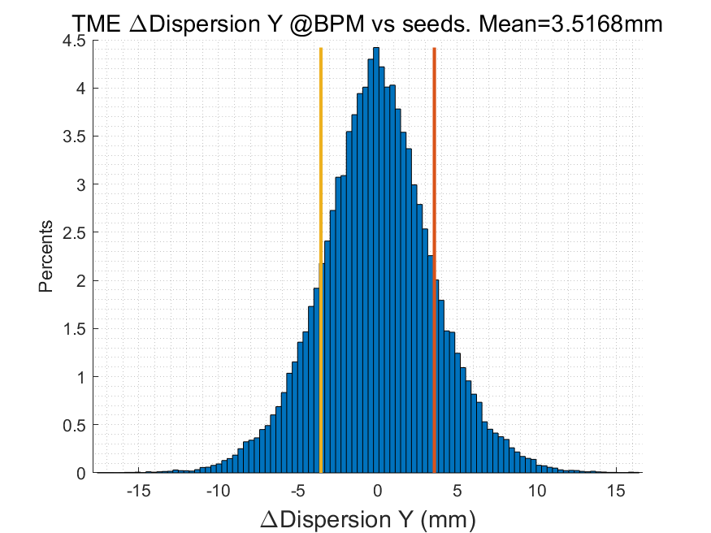
Error study update in EDR
Daheng Ji
Orbit Correction + Horizontal dispersion
  Response Matrix
  2-level iteration：
    1st Loop: 20%~100% Corrector
    2nd Loop：30%~80% Singular Value
  Dispersion correction
  Energy adjustment by corrector
  80um RMS in both plan
Optics correction
  RM + LOCO
  Based on 30GeV simulation
  All quadrupole independent
  Dispersion correction included
Coupling and vertical dispersion correction
  Mainly used for the simulation of beam polarization. (Z. Duan)
  Skew quadrupole magnets are arranged in both the dispersion free section and the arc section to correct coupling and vertical dispersion independently.
  the coupling control target being better than 0.5%
RMS@30GeV | X | Y
Orbit (mm) | 0.080 | 0.080
Beta Beating(%) | 0.8 | 0.38
Δ Dispersion(mm) | 2.7 | 3.5
  #BPM~2400
  #Corrector~1200

Slide 8
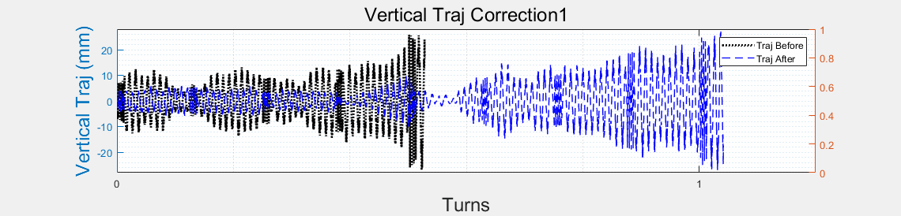
First Turn Commissioning
  Multi-turn Trajectory Correction, Injection Beam Trajectory Correction
D. H. Ji
  Single-turn Trajectory Correction
0
10
100
500
1000
10000
storaged
RF on
  Tune tuning,
  RF Phase tuning
TBT Optics Correction
 | Accuracy (um) | Offset w/o BBA(um)
BPM | 100 | 100
Physical aperture: 56mm
Other error settings are same as ordinary error correction simulation
The injection beam jitter and beam distribution is taken into account
Based on the AT program
Using the response matrices of orbit, trajectory, working point, and injection beam from theoretical models.

Slide 9
First Turn Commissioning
  Multi-turn Trajectory Correction, Injection Beam Trajectory Correction
D. H. Ji
  Single-turn Trajectory Correction
0
10
100
500
1000
10000
storaged
RF on
  Tune tuning,
  RF Phase tuning
TBT Optics Correction
Single-turn trajectory correction: Minimize the trajectory of the beam for the first 5 turns.
Multi-turn trajectory correction: Average the beam trajectory over more than 5 turns to obtain an approximate closed orbit and correct it.
Injection beam trajectory correction: Correct the coordinates of the injection beam at the injection point to reduce the oscillation of the injected beam.
Tune adjustment: Calculate (Phased-CFT) and adjust the working point using the beam over 50 turns.
RF parameters adjustment: Evaluate the beam energy variation with the average of the horizontal trajectory over each turn and adjust the RF parameters to reduce oscillation.
Optics correction: Based on ICA, PCA.

Slide 10
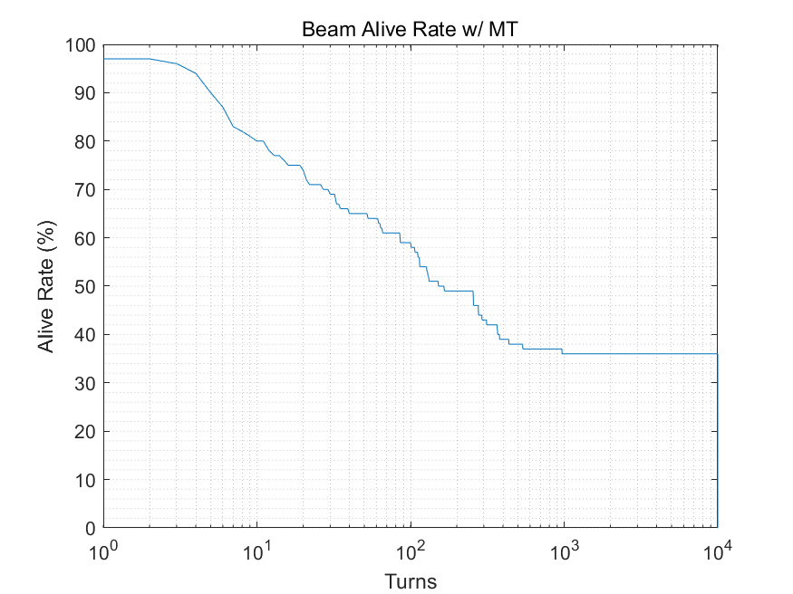
First Turn Commissioning
  Multi-turn Trajectory Correction, Injection Beam Trajectory Correction
D. H. Ji
  Single-turn Trajectory Correction
0
10
100
500
1000
10000
storaged
RF on
  Tune tuning,
  RF Phase tuning
TBT Optics Correction
Results indicate that after correction, approximately 40% of the particles survive for more than 10,000 turns.
  This can meet the needs of subsequent more detailed corrections, forming a complete process with previous simulation correction results.
  The algorithm is still undergoing optimization.
The research still lacks many details, with some conditions such as the quality of the injection beam and more detailed physical apertures being updated and iterated.

Slide 11
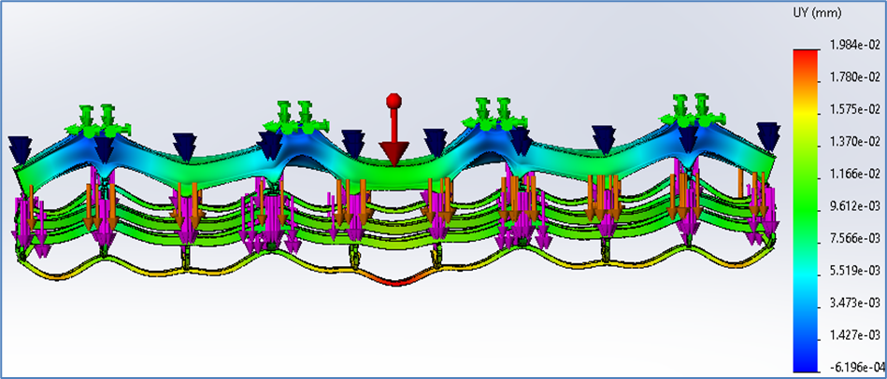
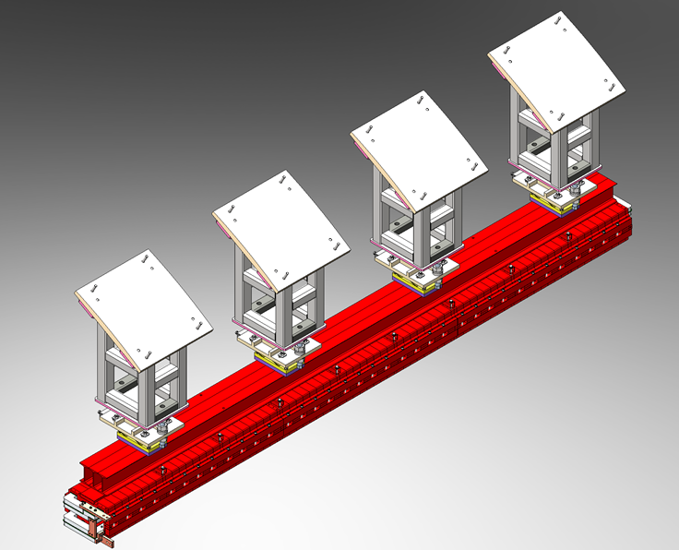
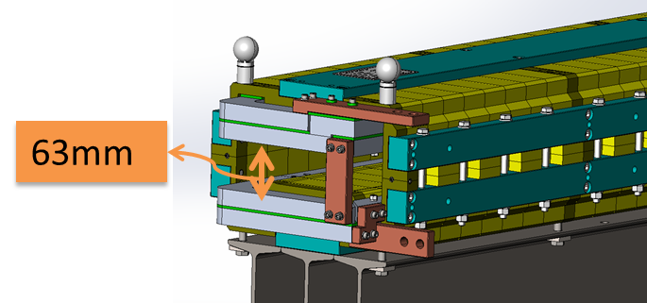
Error estimation for the combined dipoles
Max. mechanical error (deformation, part dimensions, assembly, welding…)
-- Horizontal：0.30mm, Vertical：0.10mm
Max. trans. error of the sextupole center (alignment based on the sextupole center)
-- Horizontal：0.20mm, Vertical：0.20mm
Design value |  | Error simulation |  |  | Relative error | ΔB3/B | requirement | status
 |  | Bx | By | Bmod
B[Gs] | 376 | -0.1879 | 376.0000 | 376.0000 | 2.58E-07 | / | <±1E-03 | √
S[Gs/mm²] | 0.106925 | 0.0013 | 0.1063 | 0.106349 | 5.39E-03 | 3.88E-4 | <±5E-04 | √
TDR error setting meet the requirement of beam dynamics.
TDR error setting has covered the estimated error of combined dipoles.

Slide 12
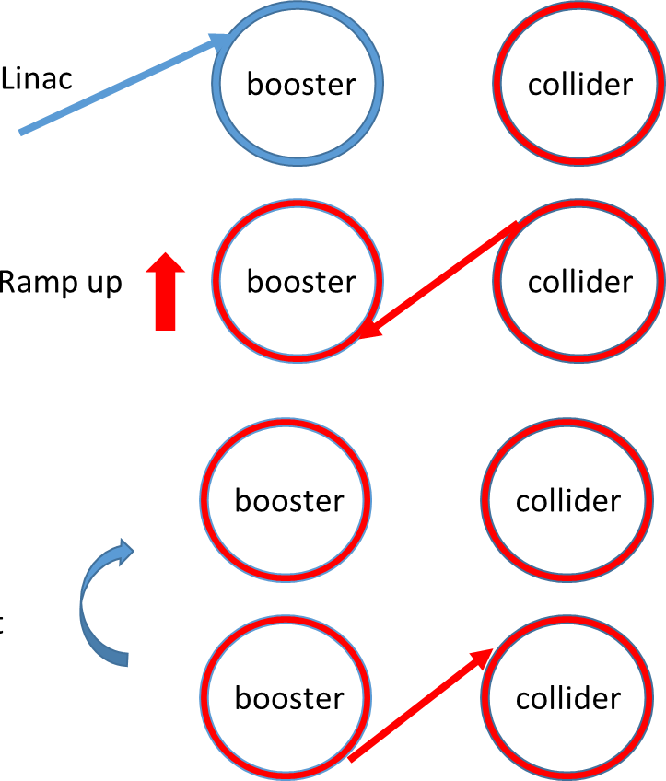

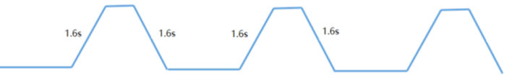
Booster ramping scheme
Dou Wang, Xiaohao Cui
0.035s
On-axis injection @Higgs
tt
7.1s
7.1s
0.35s+7.1s+0.035s+7.1s=14.6s
1 cycles/beam
0.35s
0.27s
4.7s damping
Higgs
4.3s
4.3s
4.3s
4.3s
1 cycles/beam
2.7s
off-axis
2.7s
on-axis
2.7s+4.3s+4.7s+4.3s=16.0s
1.3s
W
2.4s
2.4s
1 cycles/beam
12.97s+2.4s+1.3s+2.4s=19.1s
12.97s
0.05s
Z
1.0s
1.0s
1.0s
(19.9s+1.0s+0.05s+1.0s)*3=65.9s
1.0s
19.9s
19.9s
3 cycles/beam
19.9s

Slide 13
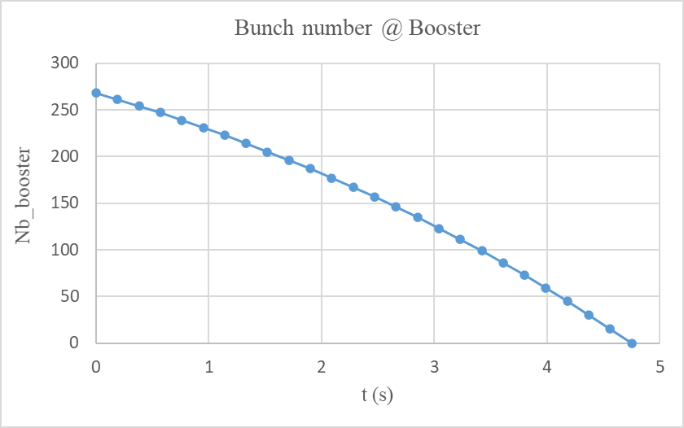
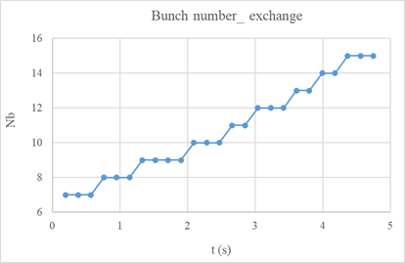
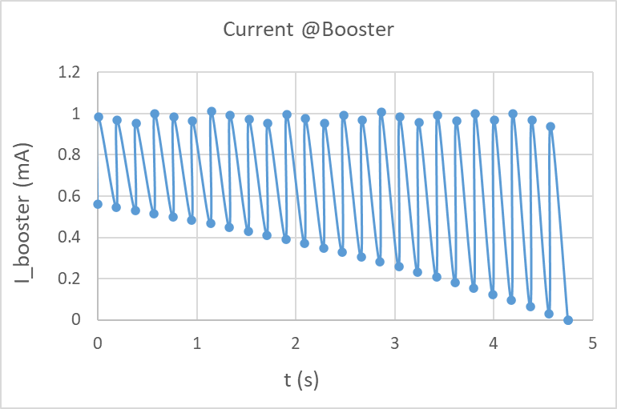
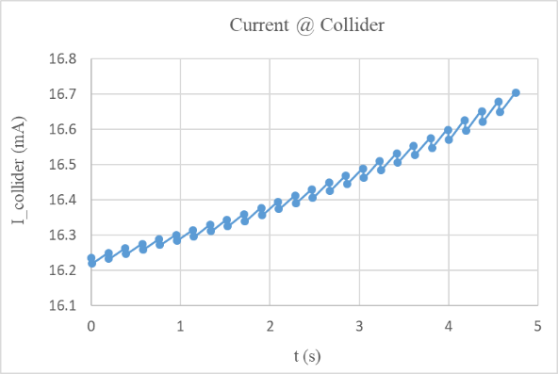
On-axis injection at Higgs energy (30MW)
Swap-out injection
Current threshold in booster: 1mA
Current decay for collider: 3% (top up mode)
4 damping times to merge the bunches in booster

Slide 14
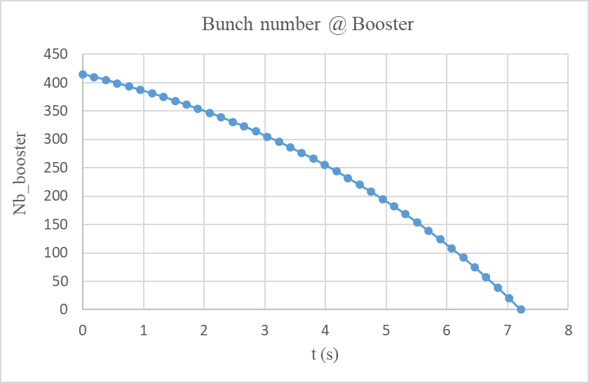
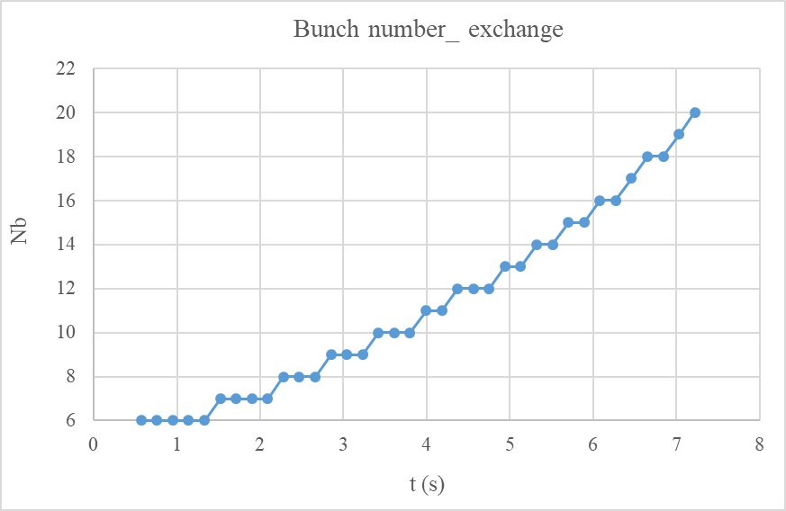
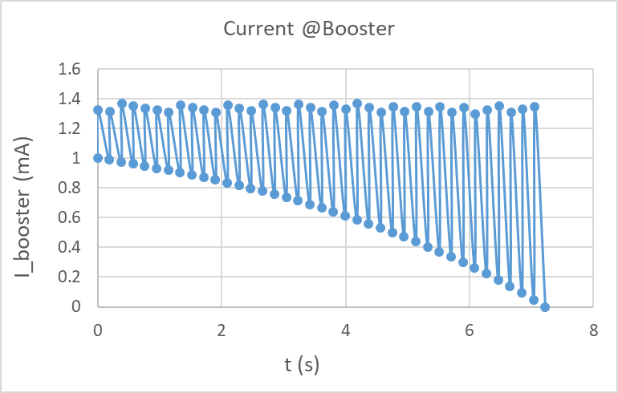
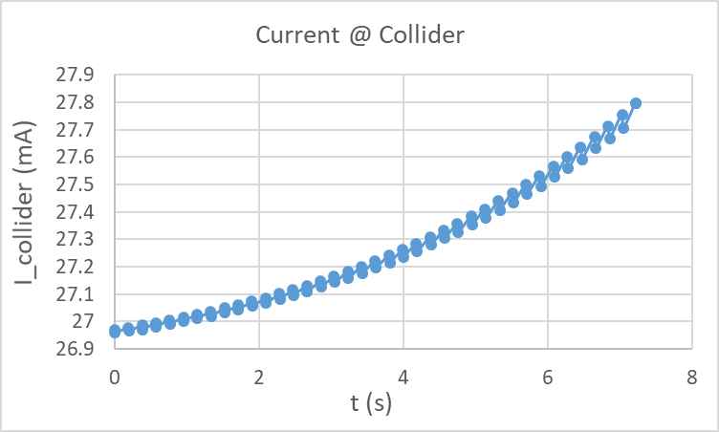
On-axis injection at Higgs energy (50MW upgrade)
Swap-out injection
Current threshold in booster: 1.4 mA
Current decay for collider: 3% (top up mode)
Small upgrade for the RF power source

Slide 15
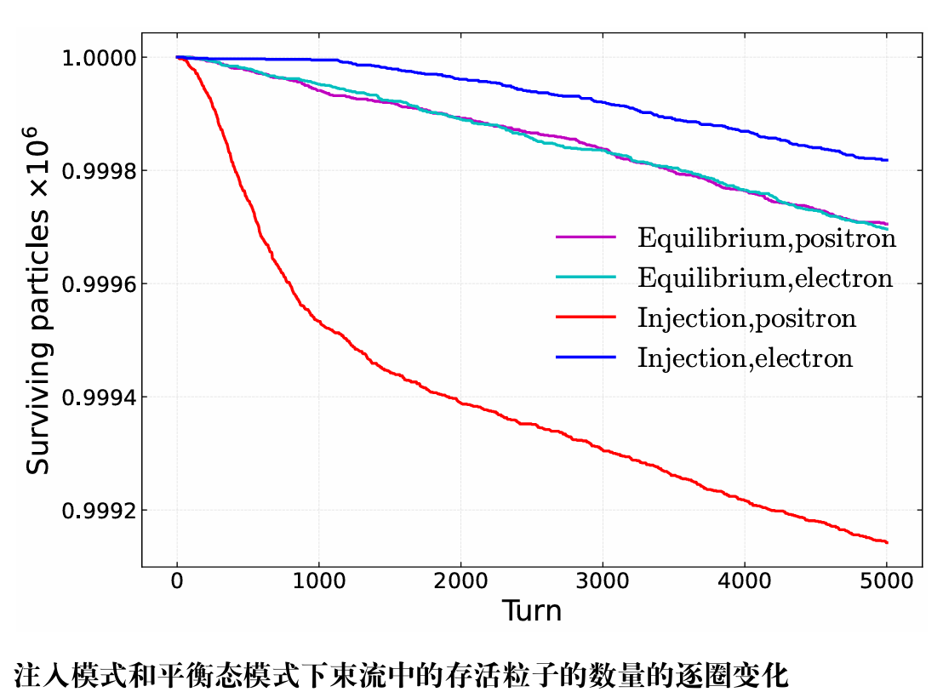
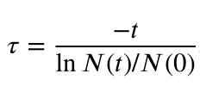
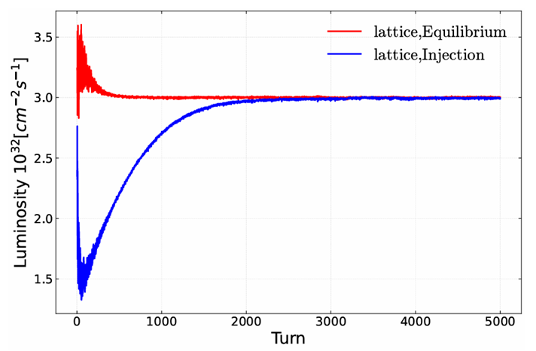
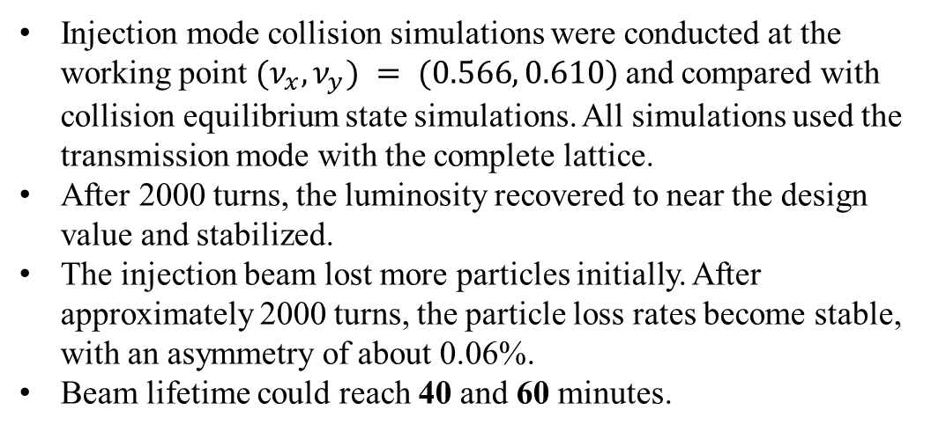
Beam beam instability for on-axis injection
Yuan Zhang, Zhiyuan Li
Strong-strong simulation including both e+ & e- lattice (APES-T)
Collision is stable at design bunch population
Lifetime (bb) requirement: > 40 min
e+ (Ne=14×10¹⁰)
injected beam
e- (Ne=14×10¹⁰) Circulating beam
• Emittance X = 1.26nm
• Energy spread = 0.1%
• Bunch length=1.85mm
• Coupling=1.0%
• Emittance X = 0.64nm
• Energy spread = 0.1%
• Bunch length=2.20mm
• Coupling=0.2%
Injection mode collision simulations were conducted at the working point $(ν_{x},ν_{y}) = (0.566, 0.610)$and compared with collision equilibrium state simulations. All simulations used the transmission mode with the complete lattice.
After 2000 turns, the luminosity recovered to near the design value and stabilized.
The injection beam lost more particles initially. After approximately 2000 turns, the particle loss rates become stable, with an asymmetry of about 0.06%.
Beam lifetime could reach 40 and 60 minutes.

Slide 16
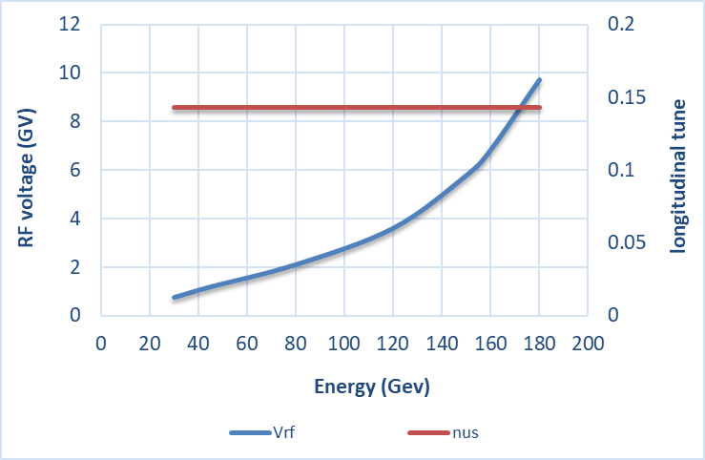
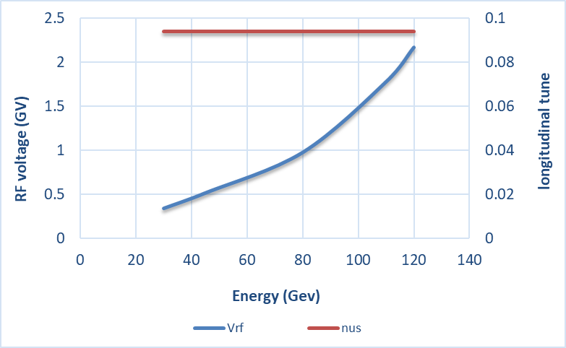
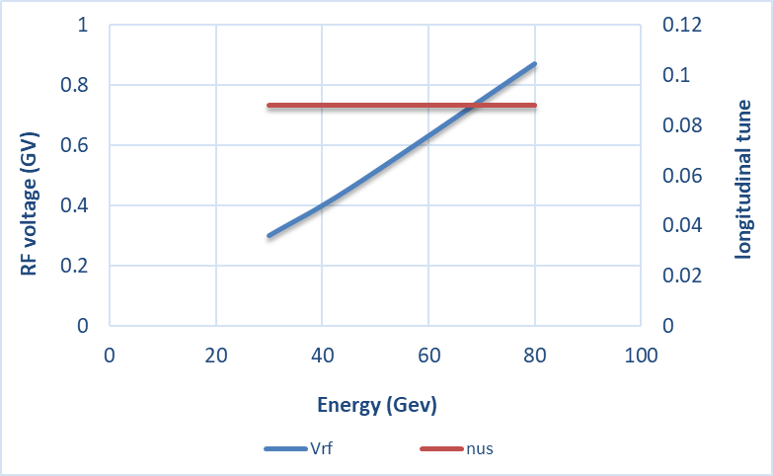
RF ramping curve
D. Wang, J.Y. Zhai
Different RF ramping curve for each energy mode (constant νs )
νs for tt: 0.14
νs for Higgs: 0.094
νs for W & Z: 0.088
tt
Max RF voltage @tt determined by longitudinal quantum lifetime & DA.
η_{RF}: ~ 12 ×δ
VRF (180GeV)=9.8GV
Higgs
W &Z

Slide 17
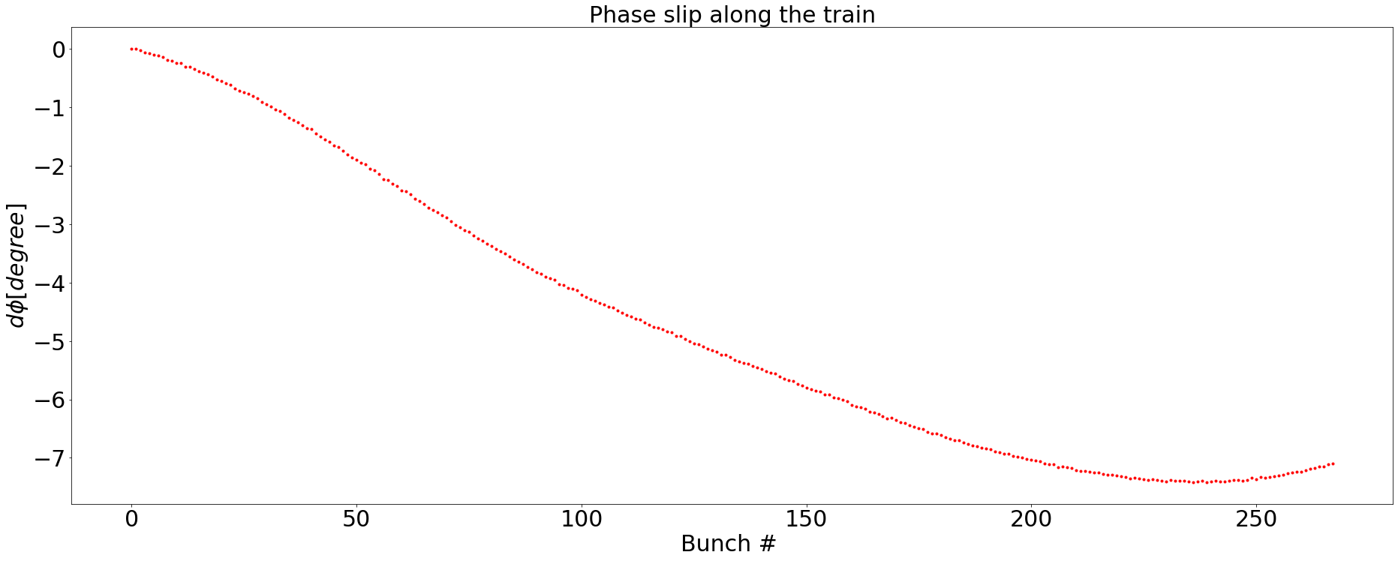
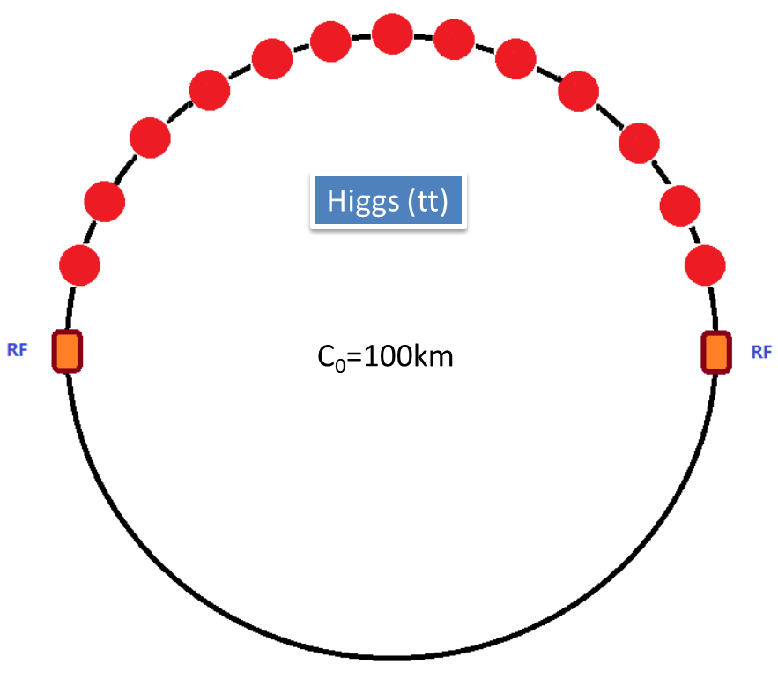
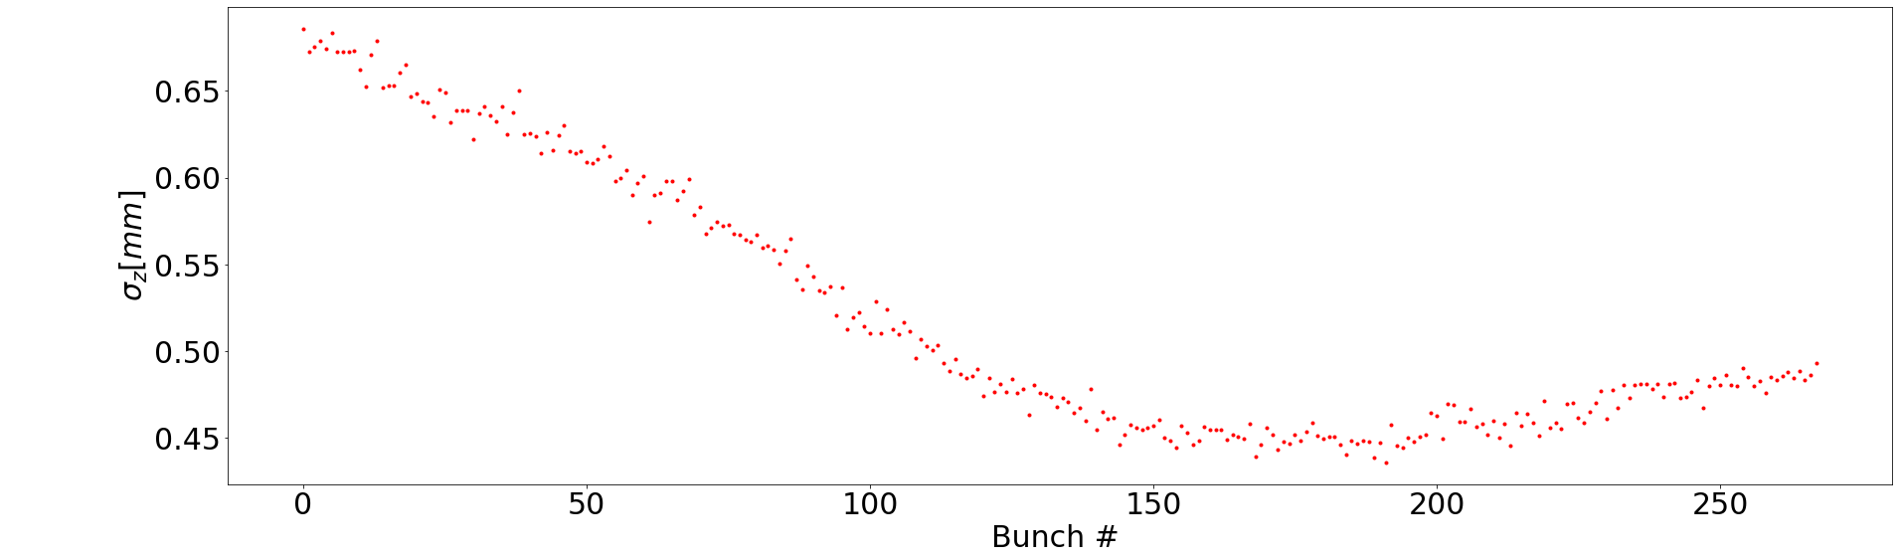
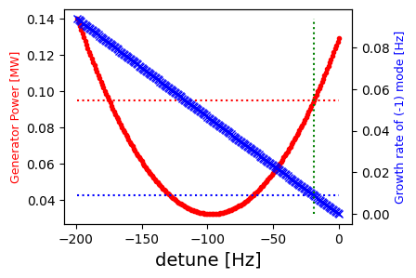
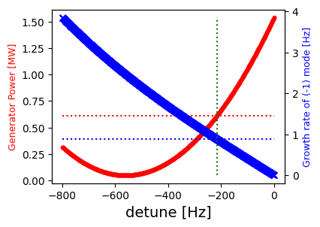
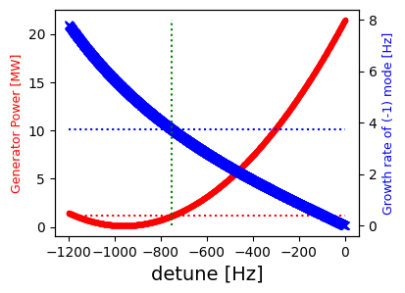
RF beam loading effect @ 30 GeV
T. M. Xin, J. Y. Zhai
Transient beam loading due to half filled ring in Higgs mode.
The radiation dampping rate at 30 GeV is only 0.67 Hz.
The dampping rate with bunch by bunch feedback is 8 Hz.
We are looking at two figures of merit at detune freuquency optimized for top energy:
  The growth rate of -1 mode;
  The power requirement at given detune.
Higgs
Higgs
Mode | Growth rate [Hz] | Power required [MW] | Power Available [MW]
Higgs | < 0.01 | 0.095 | 2.40
W | 0.88 | 0.61 | 1.15
Z | 3.7 | 1.14 | 0.64
Z with df = -840 Hz | 4.6 | 0.60
Higgs
W
Z
df = -19.4 Hz
df = -216 Hz
df = -752 Hz
Pg = 0.095 MW
Growth rate = 3.7 Hz
Pg = 0.61 MW
Pg = 1.14 MW
Growth rate < 0.01 Hz
Growth rate = 0.88 Hz

Slide 18
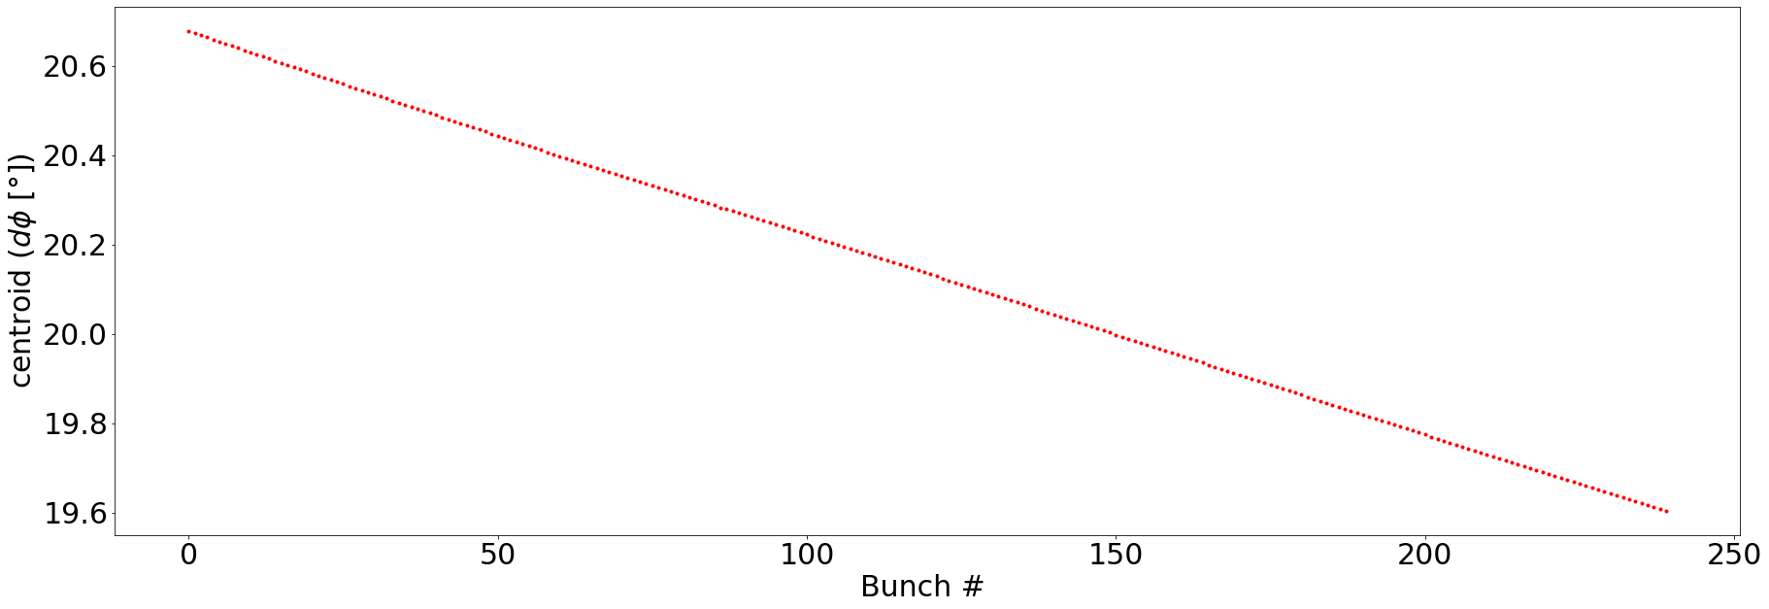
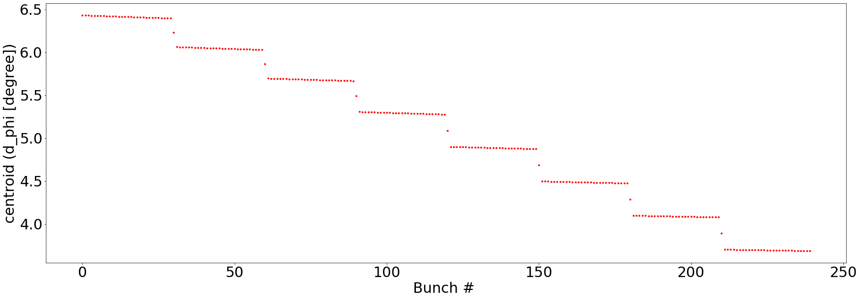
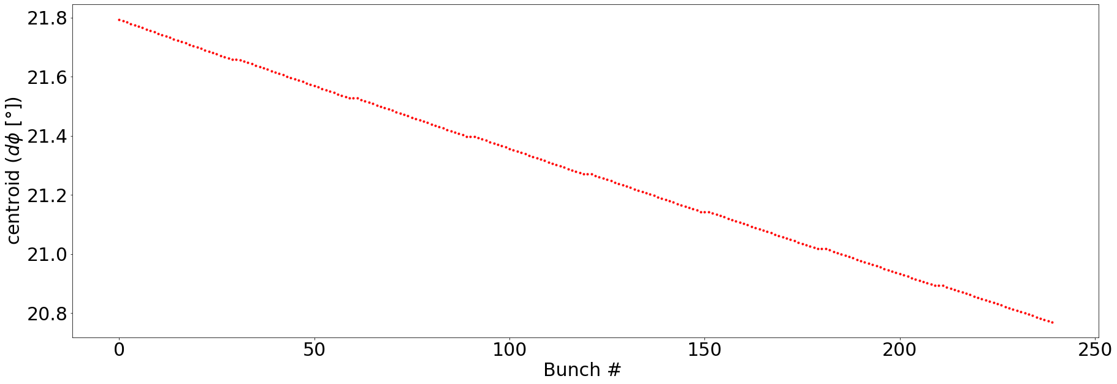
Transient Beam Loading during the on-axis Injection @ H
T. M. Xin, J. Y. Zhai
During the on-axis injection process in Higgs mode, 7 to 13 large bunches will be back injected from the Storage ring;
The change of beam pattern will cause different transient phase slip compare to the normal half fill pattern (Doubled total phase slip between head and tail and jumps between the small trains);
After several synchrotron oscillations, the large bunch will be completely merged with the small existing bunches. Then the large bunches will be injected into the storage ring again;
The bunch pattern again will change because of the vacancies and a new transient phase pattern will occur.
No apparent instability detected during the whole process.
Before
During
After

Slide 19
Beam Loading Study Plan in EDR
T. M. Xin, J. Y. Zhai
Check rest of the parts in the full cycle:
  Confirm the phase stability during the rampping process;
  Estimate the thermal load and tuning requirement;
  Investigate the solution for the possible power shortage in Z mode;
Run the full cycle simulation
Legend:
checked
Injection from the LINAC
not yet
Energy rampping
Injection into the Storage Ring
Back injection from the Storage Ring
Replenish the Storage Ring.

Slide 20
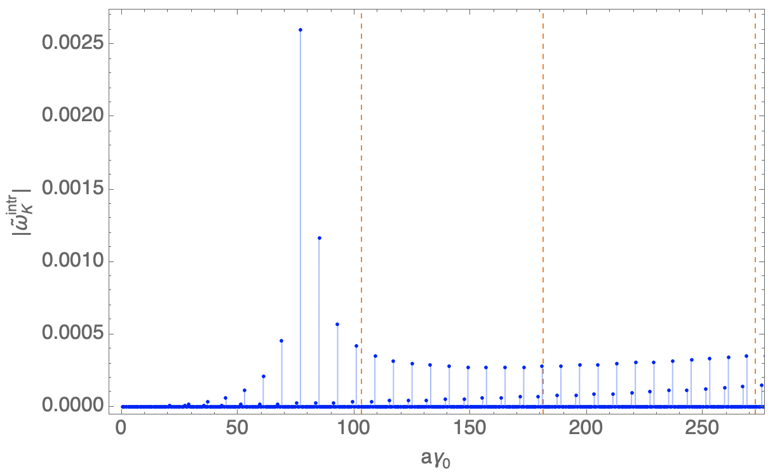
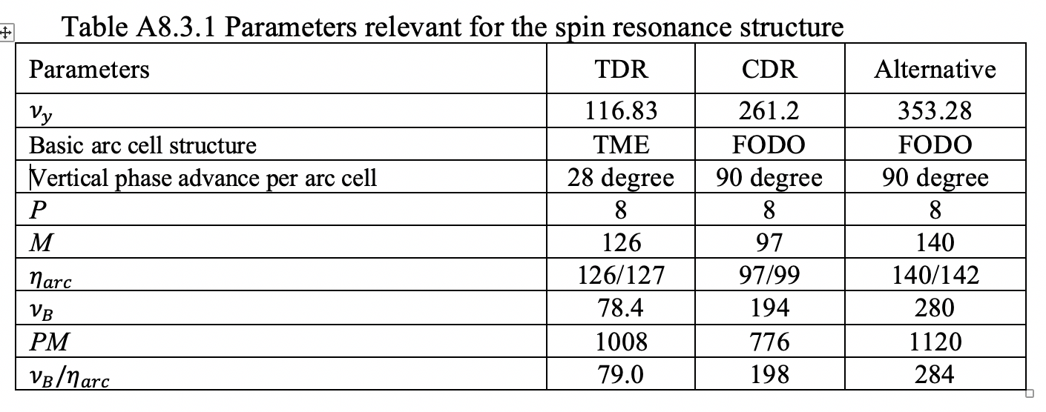

Progress of polarization study in EDR
The TDR lattice suffers from superstrong resonances before Z energy
  Injected vertical emittance 6.5nm -> Polarization trans. ~ 50% @ Z & W, 20% @ Higgs
  Injected vertical emittance 1.5 nm -> Polarization trans. ~ 80% @ Z & W, 30% @ Higgs
Potential optimization:
  Move the location of superstrong resonances
  Mitigation of imperfection resonances
    Reduce lattice sensitivity
    Harmonic spin matching & partial snakes
Z. Duan
TDR bare lattice
Intrinsic resonance
TDR lattice (one seed)
Imperfection resonance

Slide 21
Content
EDR progress of CEPC Booster
  Progress of error study
  Strong beam-beam simulation with on-axis injection for Higgs
  Progress of beam loading study
  Progress of polarization study
EDR progress of CEPC positron damping ring
  DR TDR design status
  Polarized DR study
  TF design status -- LPA multi-function ring
CEPC timing issue and detector performance
Summary

Slide 22
DR parameters in TDR
Damping with reversed bending magnet
4 (max. 8)-bunch storage, storage time:20 (40) ms
Emittance: 2500→ 166/75 (97/3) mm.mrad
Flexibility for extr. emittance
 | DR V3.0
Energy (Gev) | 1.1
Circumference (m) | 147
Number of trains | 2 (4)
Number of bunches/trian | 2
Total current (mA) | 12.4 (24.8)
Bending radius (m) | 2.87
Dipole strength B₀ (T) | 1.28
U₀ (kev/turn) | 94.6
Damping time x/y/z (ms) | 11.4/11.4/5.7
Phase/cell (degree) | 60/60
Momentum compaction | 0.013
Storage time (ms) | 20 (40)
δ₀ (%) | 0.056
ε₀ (mm.mrad) | 94.4
injection σ_{z} (mm) | 4.4
Extract σ_{z} (mm) | 4.4
ε_{inj} (mm.mrad) | 2500
ε_{ext x/y} (mm.mrad) | 166(97)/75(3)
δ_{inj} /δ_{ext} (%) | 0.18 /0.056
Energy acceptance by RF(%) | 1.8
f_{RF} (MHz) | 650
V_{RF} (MV) | 2.5
Longitudinal tune | 0.0387

Slide 23




DR optics and error study
Cell length: 3m
B=1.28T
θ_{r} /θ₀=0.355
Phase/cell: 60°/60°
Interleave sextupole scheme
2 sex. families
-θ_{r}
B=1.28T
θ₀
Error study
Arc

Slide 24




Alternative design for the DR with polarization
Z. Duan, D. Wang
Produce polarized positron beam for the purpose of energy calibration @ Z & W*.
DR V4.0 | unpolarized e+ | polarized e+
Energy (Gev) | 1.542
Circumference (m) | 145
Number of trains | 2(4)
Number of bunches/trian | 1(2)
Total current (mA) | 12.4
Bending radius (m) | 3.44
Dipole strength B₀ (T) | 1.5
Wiggler strength B₊ (T) | 1.8
Wiggler cell length (m) | 1.5
U₀ (kev/turn) | 190.9
Damping time x/y/z (ms) | 7.77/7.77/3.89
Momentum compaction | 0.015
Storage time | 20 ms | 10 min
δ₀ (%) | 0.072
ε₀ (mm.mrad) | 138
injection σ_{z} (mm) | 6
Extract σ_{z} (mm) | 5.7 | 5.6
ε_{inj} (mm.mrad) | 2500
ε_{ext x/y} (mm.mrad) | 150/15 | 138/14
δ_{inj} /δ_{ext} (%) | 0.18 /0.072
RF acceptance (%) | 1.8
f_{RF} (MHz) | 650
V_{RF} (MV) | 3.95
Longitudinal tune | 0.044
10 min storage → ~20% polarization
arc
Compatible with standard top up operation
Asymmetric wigglers
B₊=1.8T=5 B₋
cell length=1.5m
wiggler
Wiedemann, Particle Accelerator Physics, 4 Edition
16 wigglers

Slide 25


Positron damping/polarizing ring
Optimization of a dual-purpose design
  Bunches stay ~ 20 msec for regular refill
  Bunches stay ~ 10 min to accumulate > 20% polarization for resonant depolarization in the Colliders
Cost and benefit comparison between two schemes
  Higher beam energy without asymmetric wigglers
  Lower beam energy with asymmetric wigglers
Z. Duan
Asymmetric wigglers

Slide 26


PBA TF based on LPA + Storage Ring
A proposed TF
e+/e- injection @200MeV
~ 1nC in the ring for e+ and e- → off-axis injection
Multi bunch storage
Ring circumference: ~ 100 m
A demonstration for CEPC DR

Slide 27





Design status of the multi-function ring
60°/60° FODO
Off-axis injection with two kickers
Undulator parameter
Undulator
B_{max}: 1 T
L_cell: 25 mm
L_total: 1.6 m
DA @ 200MeV
Spin rotator→ longitudinal polarization
8 skew quads

Slide 28
Parameters of the multi-function ring
Plan & schedule:
DR V2.0 | 200MeV | 500MeV | 1.2GeV
Circumference (m) | 100.3
Number of bunches | 1 ~ 4
Bunch charge (nC) | 0.001~ 1.0 | 0.1~2 | 1~ 2
Bending radius (m) | 2.65
Dipole strength B₀ (T) | 0.2517 | 0.629 | 1.51
U₀ (kev/turn) | 0.053 | 2.09 | 69.3
Damping time x/y/z (s) | 2.4/2.4/1.2 | 0.157/0.157/0.079 | 0.011/0.011/0.0056
Injection time (min) | 83 (positron) | 0.3 (electron)
Polarization build-up time (h) | 9421 | 96.5 | 1.21
Momentum compaction | 0.04
Storage time (s) | >8 | >0.6 | >0.04
δ₀ (%) | 0.011 | 0.027 | 0.064
γε₀ (mm.mrad) | 2.147 | 33.6 | 463.8
ε₀ (nm) | 5.49 | 34.3 | 197.5
injection σ_{z} (um) | 2000 | 5
Natural σ_{z} (mm) | 0.6 | 2.05 | 7.27
γε_{inj} (mm.mrad) | 2500 | 10
γε_{ext x/y} (mm.mrad) | 2.2/0.2 | 34/3.4 | 464/46
δ_{inj} /δ_{ext} (%) | 2.0 /0.01 | 1/0.03 | 0.064
RF acceptance (%) | 3.27 | 2.45 | 1.63
f_{RF} (MHz) | 500 (650)
V_{RF} (MV) | 2.16 | 2.97 | 3.24
Longitudinal tune | 0.105 | 0.077 | 0.052
Feb. 2025: acc physics design finish
Dec. 2025: construction start
Dec. 2026: construction finish
Jul. 2027: electron accumulating
Dec. 2027: see the first light
Jul. 2028: positron accumulating
Dec. 2028: polarization study

Slide 29
Content
EDR progress of CEPC Booster
  Progress of error study
  Strong beam-beam simulation with on-axis injection for Higgs
  Progress of beam loading study
  Progress of polarization study
EDR progress of CEPC positron damping ring
  DR TDR design status
  Polarized DR study
  TF design status -- LPA multi-function ring
CEPC timing issue and detector performance
Summary

Slide 30
CEPC frequency choice
f (MHz) |  | SHB1 | SHB2 | Linac_S | DR | Linac_C | Booster | Collider
CEPC | Baseline (thermal cathode gun) | 158.89 | 476.76 | 2860 | 650 | 5720 | 1300 | 650
 | Alternative (RF gun) | ⎯ | ⎯ | 2860 | 650 | 5720 | 1300 | 650
CEPC: greatest common divisor=130 MHz
Min bunch spacing @ rings: 7.6923ns
Bunch spacing @ Z: 7.6923×3=23.0769 ns
FCC: greatest common divisor=400 MHz
Min bunch spacing @ rings: 2.5 ns
*D. Wang, et al, “Problems and considerations about the injection philosophy and timing structure for CEPC”, International Journal of Modern Physics A， Vol. 37, (2022) 2246006.

Slide 31


Bunch structure in Booster
tt
H
35 bunches
268 bunches
Train structure @Z
51 train
78 bunch/train
W
Z
1297 bunches
3978 bunches

Slide 32
Bunch structure in Collider
tt
H
35 bunches
268 bunches
Train structure @Z
153 train
78 bunch/train
W
Z
1297 bunches
11934 bunches

Slide 33


TDR Bunch Structures and Circumference
D. Wang, X. H. Cui, C. Meng, G. Lei, G. Li, J. H. Chen, J. C. Wang, W. Wei…
The spacings between adjacent bunches in any CEPC operation mode are integer numbers of 23.08 ns..
The master CEPC clock will be provided by the accelerator to the detector system(s), synchronous to the beam. The CEPC detector system relies on the clock to sample physics signal at the right time.
It is agreed to have the detector frequency of 43.3 MHz = 130 MHz / 3 = 1 / 23.08 ns, which is reasonably good from the detector point of view.
The CEPC collider ring have possible 14,442 bunch positions (14,442 × 23.0769 ns × c = 99.914 km).
SR 30 / 10 MW | H | Z |  | W | $t\overline{t}$
SR power per beam [MW] | 30 | 30 | 10 | 30 | 30
Bunch number | 268 | 11,934 | 3,978 | 1,297 | 35
Bunch spacing* [ns] | 576.9 | 23.1 | 69.2 | 253.8 | 4523.1
[ × 23.08 ns ] | 25 | 1 | 3 | 11 | 196
Train gap [%] | 54 | 17 | 17 | 1 | 53
Luminosity/IP [×10³⁴cm⁻²s⁻¹] | 5.0 | 115 | 38 | 16 | 0.5
SR 50 MW | H | Z | W | $t\overline{t}$
SR power per beam [MW] | 50
Bunch number | 446 | 13,104 | 2,162 | 58
Bunch spacing* [ns] | 346.2 | 23.1 | 138.5 | 2700.0
[ ×23.08 ns ] | 15 | 1 | 6 | 117
Train gap [%] | 54 | 9 | 10 | 53
Luminosity/IP [×10³⁴cm⁻²s⁻¹] | 8.3 | 192 | 26.7 | 0.8
14,442 = 2 × 3 × 29 × 83
It is important that beam collisions are synchronized with a 43.33 MHz clock.

Slide 34


Circumference finetuning and detector performance improvement
D. Wang, J. Gao, X. H. Cui, C. Meng, Y. W. Wang, D. P. Jin, G. Lei, J. H. Chen, Y. H. Li, J. C. Wang, W. Wei, J. B. Ye, J. Y. Zhai, S. S. Sun, …
CEPC will operate in the Higgs and the LL Z modes in the first 10 years.
The bunch spacing for the LL Z mode is 3×23.08 ns. If the bunching spacing for the Higgs mode is an integer number of 3×23.08 ns, e.g. 24×23.08 ns, the detector system could benefit more.
An estimation of the vertex detector using 65nm CMOS sensor shows that the power consumption per sensor chip is reduced from 310 to 165 mW, about 47% reduction. This significantly reduces the material budget, hence improve the physics performance.
14,448 = 24 × 3 × 7 × 43
$14448×23.08ns×c=99955.418m$
SR 30 / 10 MW | H | Z |  | W | $t\overline{t}$
SR power per beam [MW] | 30 | 30 | 10 | 30 | 30
Bunch number | 268 | 11,934 | 3,978 | 1,297 | 35
Bunch spacing* [ns] | 553.85 | 23.08 | 69.23 | 184.62 | 3969.23
Case 14448 [ × 23.08 ns ] | 24 | 1 | 3 | 8 | 172
SR 50 MW | H | Z | W | $t\overline{t}$
SR power per beam [MW] | 50
Bunch number | 446 | 13,104 | 2,162 | 58
Bunch spacing* [ns] | 276.92 | 23.08 | 138.46 | 2584.62
Case 14448 [ ×23.08 ns ] | 12 | 1 | 6 | 112

Slide 35
Key milestones in EDR phase
Complete the CEPC proposal by the end of 2025
2027 (June), finish the study in EDR plan

Slide 36
Summary
The CEPC booster/DR TDR parameter and design optimizations for all four energies (Higgs, W/Z and ttbar) have been studied. The results demonstrate that the physics design satisfies the scientific goals.
CEPC booster/DR development was reported on the TDR international review meeting (June 2023 ), cost review meeting (Sept. 2023) and 1st EDR IARC review meeting (Sept. 2024)
R&D plan for EDR phase (2024-2027) before construction have been established, with the aim of starting the construction in “15th five-year-plan” (2026-2030) .
The timing issue of CEPC has been studied between the accelerator team and the detector team. The circumference of CEPC is slightly changed to 99955.418m to improve the detector performance.

Slide 37
Thanks for your attention!
Welcome to suggestions and comments!

