Slide 1



CEPC collider lattice with energy switch, ground motion and updates
Yiwei Wang
14 Jan 2025, HKUST, The conference of the IAS Program on High Energy Physics (HEP) 2025

Slide 2
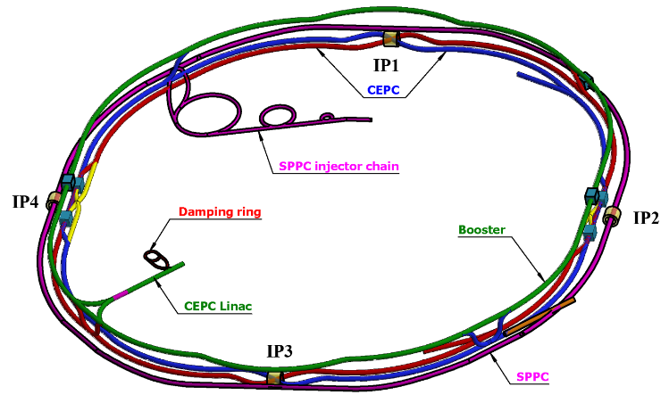
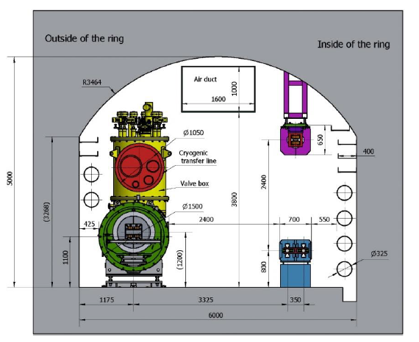
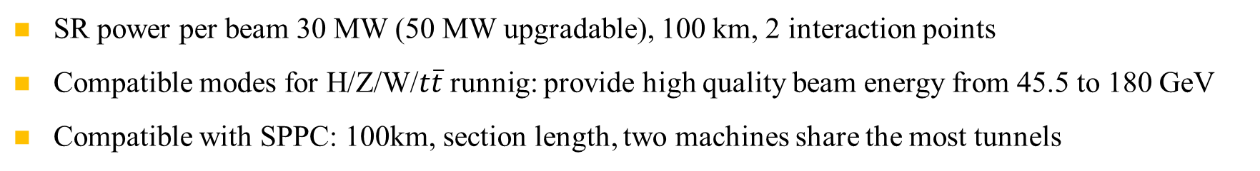
Overall design requirement of the CEPC collider ring
SR power per beam 30 MW (50 MW upgradable), 100 km, 2 interaction points
Compatible modes for H/Z/W/$t\overline{t}$runnig: provide high quality beam energy from 45.5 to 180 GeV
Compatible with SPPC: 100km, section length, two machines share the most tunnels
CEPC+SPPC complex
Tunnel in the arc regions
CEPC detectors

Slide 3
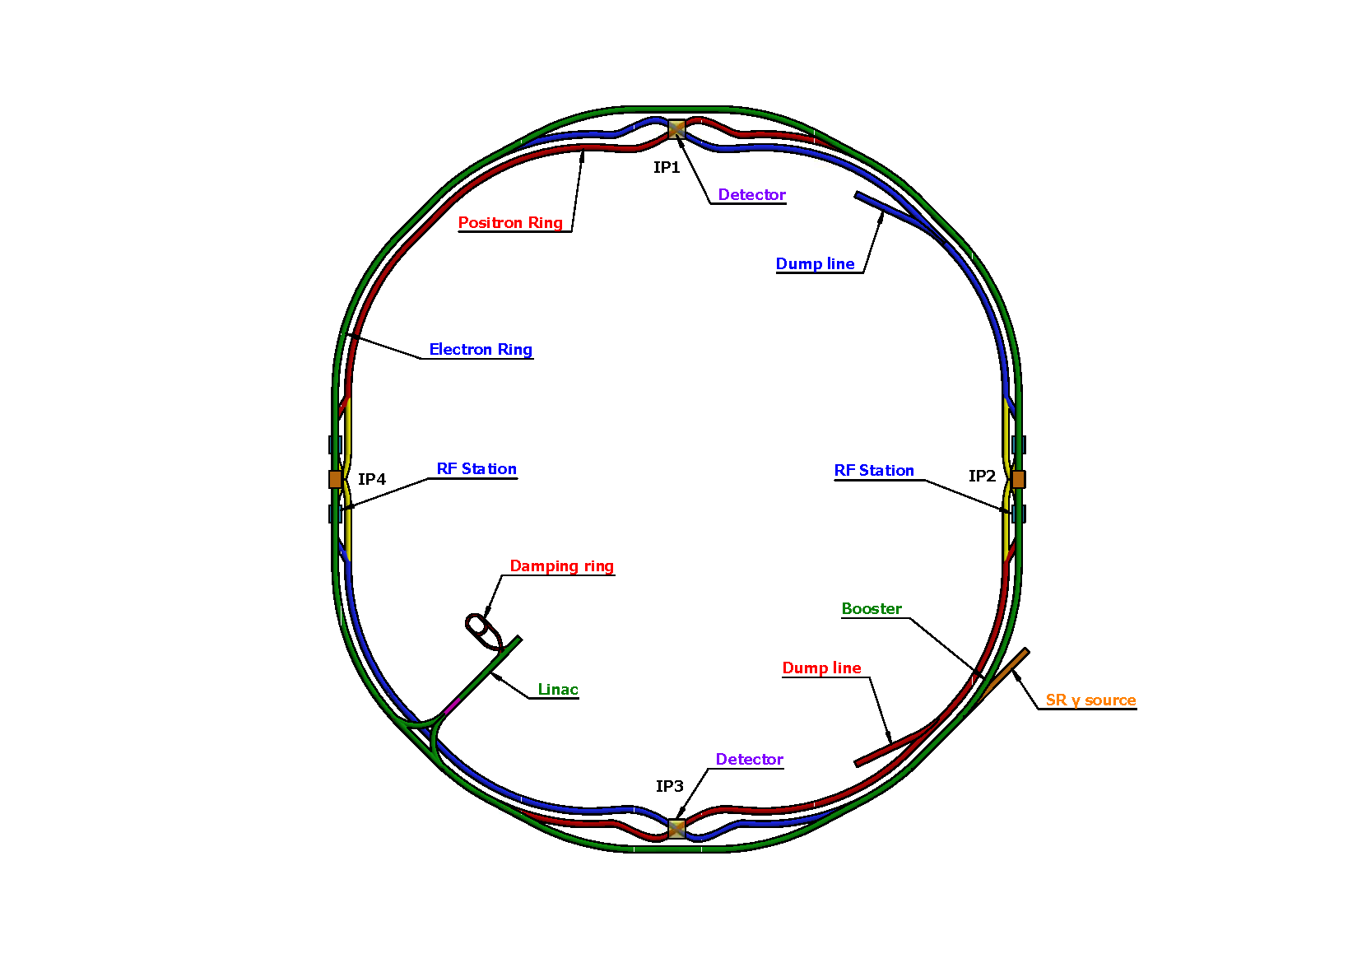
Lattice design requirement of the CEPC collider ring
Basically 2 folded symmetry
2 interaction regions @ IP1 and IP3
  crab waist collision
  local chromaticity correction for the interaction region
  asymmetric interaction region
2 RF acceleration regions @ IP2 and IP4
  shared cavities for two beam @ ttbar, Higgs
  flexible switching between compatible modes
8 arc sections
  dual aperture dipole and quadrupole magnets
4 short straight section
  on/off axis injection regions for different modes
  beam dumping
SS4
SS1
SS3
SS2
Ref: CEPC TDR; Radiation Detection Technology and Methods (2024) 8:1–1105, https://doi.org/10.1007/s41605-024-00463-y
SS: short straight section

Slide 4
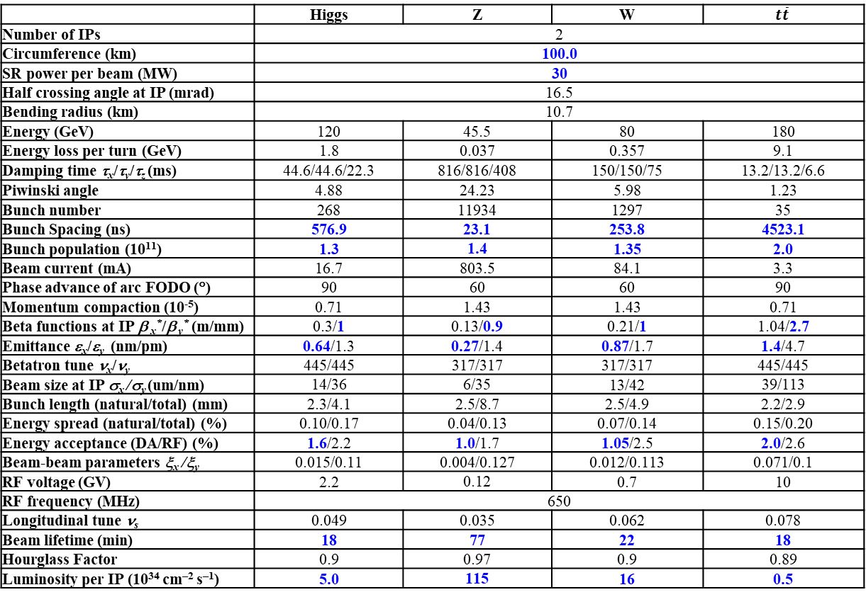
CEPC Design Parameters
 | Higgs | Z | W | $$t\overline{t}$$
Number of IPs | 2
Circumference (km) | 100.0
SR power per beam (MW) | 30
Half crossing angle at IP (mrad) | 16.5
Bending radius (km) | 10.7
Energy (GeV) | 120 | 45.5 | 80 | 180
Energy loss per turn (GeV) | 1.8 | 0.037 | 0.357 | 9.1
Damping time τ_{x}/τ_{y}/τ_{z} (ms) | 44.6/44.6/22.3 | 816/816/408 | 150/150/75 | 13.2/13.2/6.6
Piwinski angle | 4.88 | 24.23 | 5.98 | 1.23
Bunch number | 268 | 11934 | 1297 | 35
Bunch Spacing (ns) | 576.9 | 23.1 | 253.8 | 4523.1
Bunch population (10¹¹) | 1.3 | 1.4 | 1.35 | 2.0
Beam current (mA) | 16.7 | 803.5 | 84.1 | 3.3
Phase advance of arc FODO (°) | 90 | 60 | 60 | 90
Momentum compaction (10⁻⁵) | 0.71 | 1.43 | 1.43 | 0.71
Beta functions at IP β _{x}*/β _{y}* (m/mm) | 0.3/1 | 0.13/0.9 | 0.21/1 | 1.04/2.7
Emittance ε_{x}/ε_{y} (nm/pm) | 0.64/1.3 | 0.27/1.4 | 0.87/1.7 | 1.4/4.7
Betatron tune ν_{x}/ν_{y} | 445/445 | 317/317 | 317/317 | 445/445
Beam size at IP σ_{x} /σ_{y} (um/nm) | 14/36 | 6/35 | 13/42 | 39/113
Bunch length (natural/total) (mm) | 2.3/4.1 | 2.5/8.7 | 2.5/4.9 | 2.2/2.9
Energy spread (natural/total) (%) | 0.10/0.17 | 0.04/0.13 | 0.07/0.14 | 0.15/0.20
Energy acceptance (DA/RF) (%) | 1.6/2.2 | 1.0/1.7 | 1.05/2.5 | 2.0/2.6
Beam-beam parameters ξ_{x} /ξ_{y} | 0.015/0.11 | 0.004/0.127 | 0.012/0.113 | 0.071/0.1
RF voltage (GV) | 2.2 | 0.12 | 0.7 | 10
RF frequency (MHz) | 650
Longitudinal tune ν_{s} | 0.049 | 0.035 | 0.062 | 0.078
Beam lifetime (min) | 18 | 77 | 22 | 18
Hourglass Factor | 0.9 | 0.97 | 0.9 | 0.89
Luminosity per IP (10³⁴ cm^{–2} s^{–1}) | 5.0 | 115 | 16 | 0.5
𝛽y∗ and emittance chosen for luminosity
adequate bunch population Ne for the luminosity and the achievable energy acceptance for lattice design
Number of bunches Nb is adjusted to keep the beam current
Updated bunch spacing for the requirement from detector (D. Wang, Aug 2024, CEPC day)
Ref: CEPC TDR; Radiation Detection Technology and Methods (2024) 8:1–1105, https://doi.org/10.1007/s41605-024-00463-y;

Slide 5
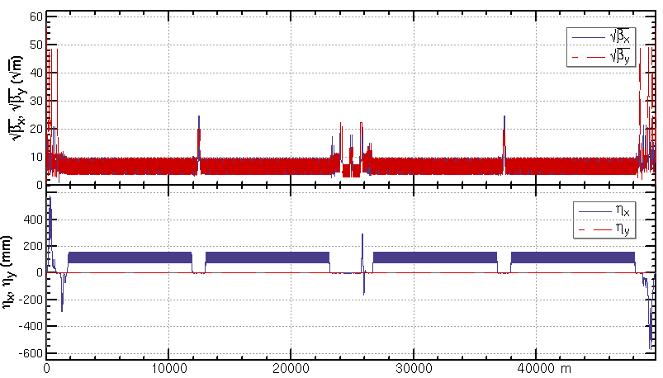
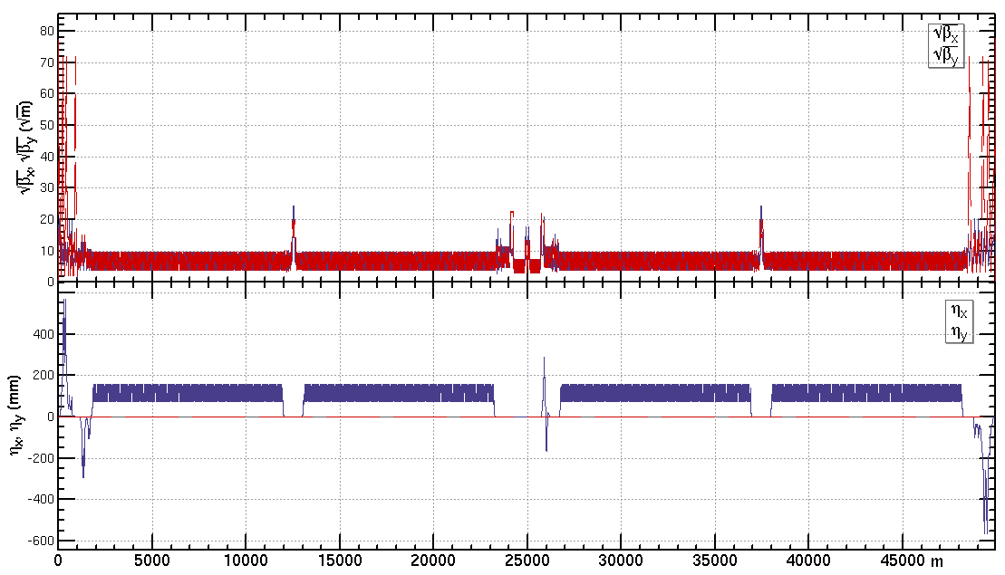
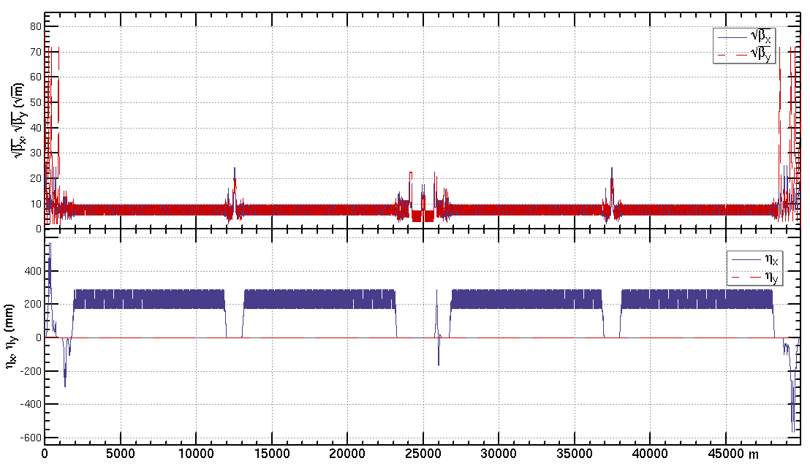
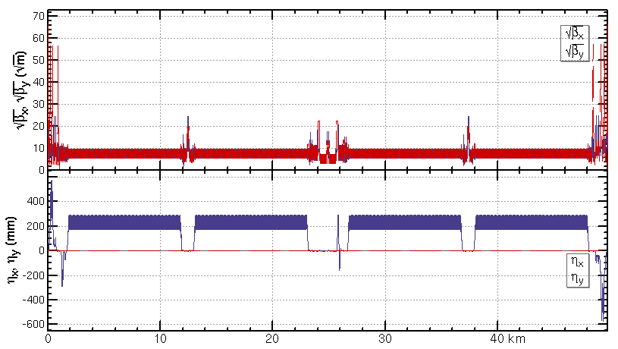
Lattice design of the CEPC half ring
ttbar: εx=1.4nm, β=1.04m/2.7mm
Higgs: εx=0.64nm, β=0.30m/1mm
W: εx=0.87nm, β=0.21m/1mm
Z: εx=0.27nm, β=0.13m/0.9mm

Slide 6
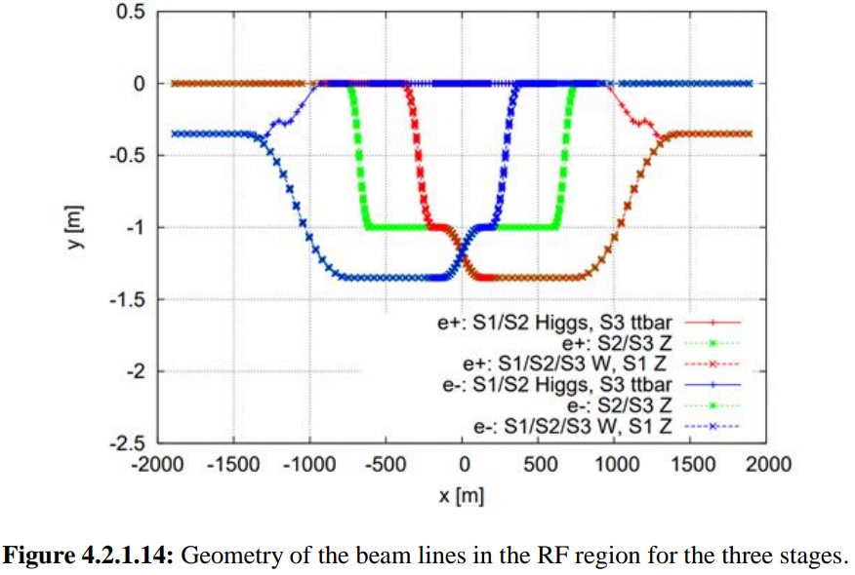
Remind of the RF region layout in TDR
1st priority of the Higgs running and switching between different modes
Shared cavities for two beam @ Higgs, ttbar; Bunches filled in each half rings
  Independent cavities; bunches filled in each whole rings for the W and Z
Maximize the performance and flexibility of future circular electron positron collider
Stage 1
H/W/LL
-
Z (and HL
-
：
H/W upgrade)
Outer Ring
H
H
Inner Ring
Stage 2
HL
-
H/W/Z (HL
-
：
Z upgrade)
Outer Ring
Z
H
H
Z
Inner Ring
Stage 3
HL
-
H/W/Z/ttbar (ttbar
-
：
upgrade)
Outer Ring
Z
H
ttbar
H
Z
Peak luminosity at different stages with SR power for 30/50MW per beam
Inner Ring
Luminosity/IP [10^34/cm^2/s] | Higgs | Z | W | ttbar
Stage 1 | 5/8.3 | 38 (2T solenoid, beam power limit) | 16/26.7 | -
Stage 2 | 5/8.3 | 115/192 | 16/26.7 | -
Stage 3 | - | 115/192 | 16/26.7 | 0.5/0.83
H
Z
ttbar
650 MHz 2
-
cell cavity
650 MHz 5
-
650 MHz 1
cell cavity
-
6 cavities in 1 CM
cell cavity
4 cavities in 1 CM
1 cavity in 1 CM

Slide 7
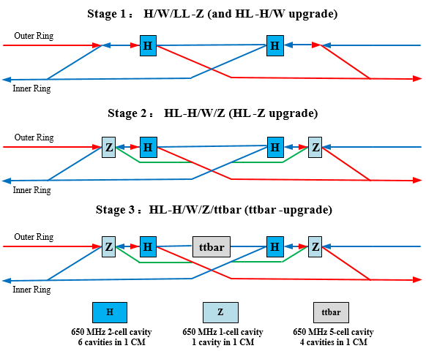
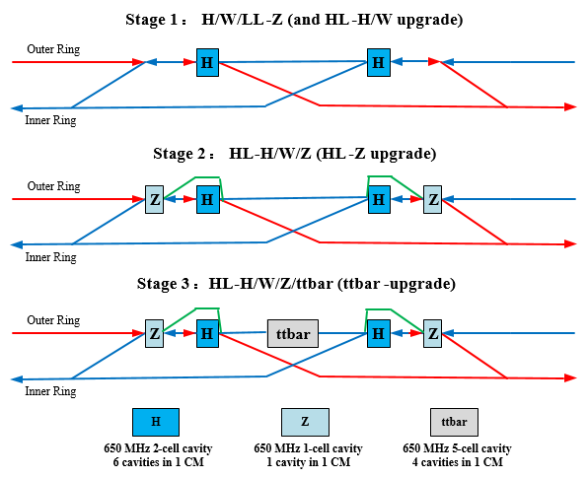
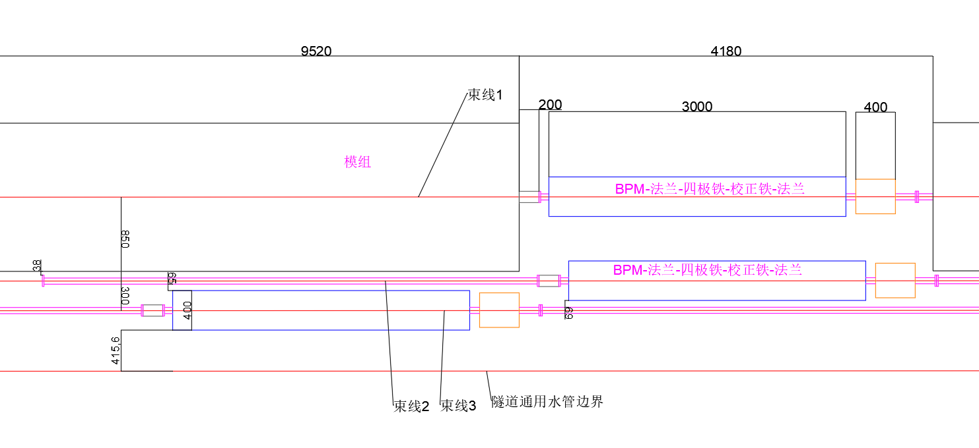
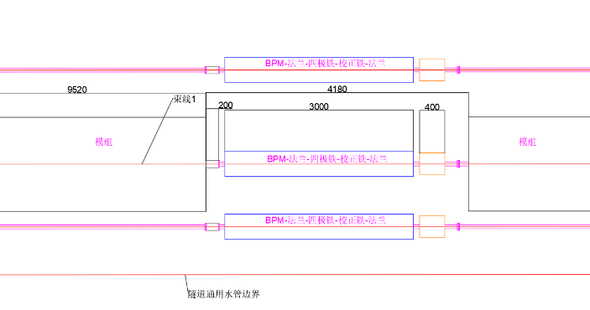
Modification of the RF region layout
Move the high-luminosity Z bypass beamline (green) to the outside, for the following reasons:
Placement on the inside is tight in the transverse space, and the low-luminosity Z (first phase) bypass beamline is very close to the wall-mounted water pipes.
Construction during 2nd stage, but not 1st stage
Line 2
Line 1
Line 1
Line 2
Line 3
Line 3

Slide 8
Magnet parameters of the RF region beam lines
Reduce the transverse size of the magnet in the bypass line as lower running energy and not necessary to limit the maximum beta function
Distance between the module beamline and the inner bypass beamline will be determined by the transverse size of the magnets.
Line 2
By J. Zhai, H. Zheng and N. Wang
 | Beta lower limit/m
 | Z 1-cell cavity | H 2-cell cavity | ttbar 5-cell cavity
Cavity number per beam | 50 | 336 | 192
45.5 GeV beam | 69 | 558 | /
80 GeV beam | 1455 | 30 | /
120 GeV beam | 2909 | 46 | /
180 GeV beam | 698241 | 1160 | 340
Line 1
Line 3
 | G[T/m] | Diameter of the beam stay clear region [mm] | Inner diameter of vacuum chamber [mm] | Effective length L[m]
line 1 (RF module ) | 11 | 21 | 56 | 3
Line 2 (High lumi-Z bypass) | 3.2 | 15
Line 3 (H/W/low lumi-Z bypass) | 8.3 | 21
ARC dual-aperture quadrupole* | 10.6 | 23.2 | 56 | 3

Slide 9
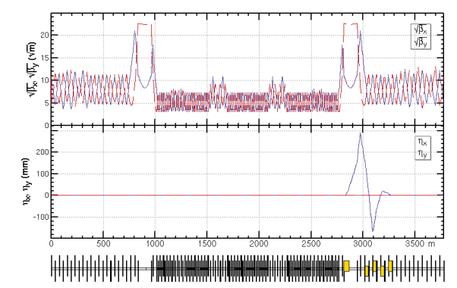
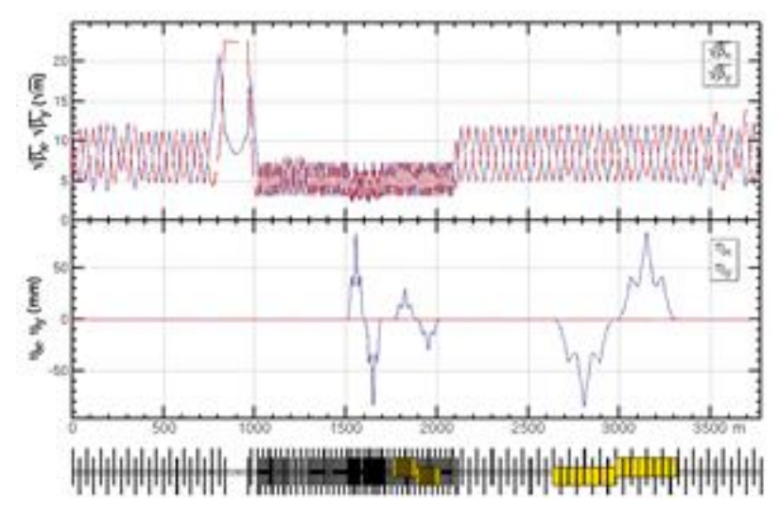
RF region lattice
Optics of the RF region for Higgs at stage 1/2 and 𝑡t𝑡̅at stage 3.
Optics of the RF region for W at stage 1/2/3 and Z at stage 1.
*Design of the optics of the RF region for Z at stage 2/3 is under going

Slide 10
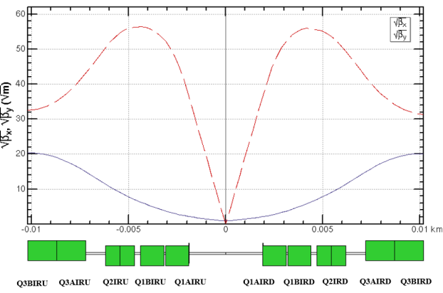
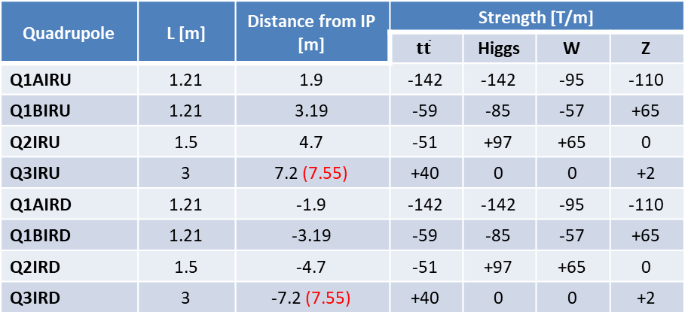
  Super conducting final quadrupoles for all modes
Dipole field aberration due to cross talk of the two aperture
  Three types of SCQ design were designed
  Beam dynamics: integrated dipole field should be corrected
  Radiation and particle loss: maximum 450/300/200/100 gs in the good field region along the SCQs for ttbar/Higgs/W/Z modes (the requirement will be updated with simulation of an integrated model of the quadrupoles, dipole error and solenoid)
    This is also the max field allowed for the correctors in SCQ
  The normal conducting quadrupole of Q3 for ttar running was moved outward (outer end from 7.2m to 7.55m) due to conflict between the cryomodule and the Q3
Layout of the dual aperture SCQ final quadrupoles
Parameters of the twin-aperture SCQs between the IP
Quadrupole | L [m] | Distance from IP [m] | Strength [T/m]
 |  |  | $$t\overline{t}$$ | Higgs | W | Z
Q1AIRU | 1.21 | 1.9 | -142 | -142 | -95 | -110
Q1BIRU | 1.21 | 3.19 | -59 | -85 | -57 | +65
Q2IRU | 1.5 | 4.7 | -51 | +97 | +65 | 0
Q3IRU | 3 | 7.2 (7.55) | +40 | 0 | 0 | +2
Q1AIRD | 1.21 | -1.9 | -142 | -142 | -95 | -110
Q1BIRD | 1.21 | -3.19 | -59 | -85 | -57 | +65
Q2IRD | 1.5 | -4.7 | -51 | +97 | +65 | 0
Q3IRD | 3 | -7.2 (7.55) | +40 | 0 | 0 | +2

Slide 11
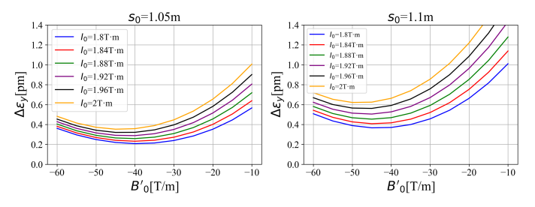
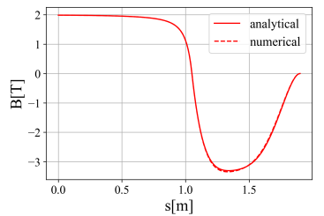
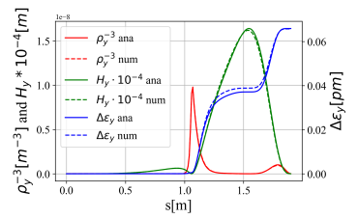
  Vertical emittance generated by solenoid field
Ande MA, Yiwei Wang, Yingshun Zhu et al
The detector solenoid are compensated locally with anti-solenoids
From IP to the entrance of Q1A (0 to 1.9m):
  ∫Bzdz cancled between the IP and the entrance of final quadrupole with strong anti-solenoid field in 1.1m to 1.9m.
  Field configuration optimized to get emittance minimum and iterate with anti-solenoid technical constraints
I0
s0

Slide 12
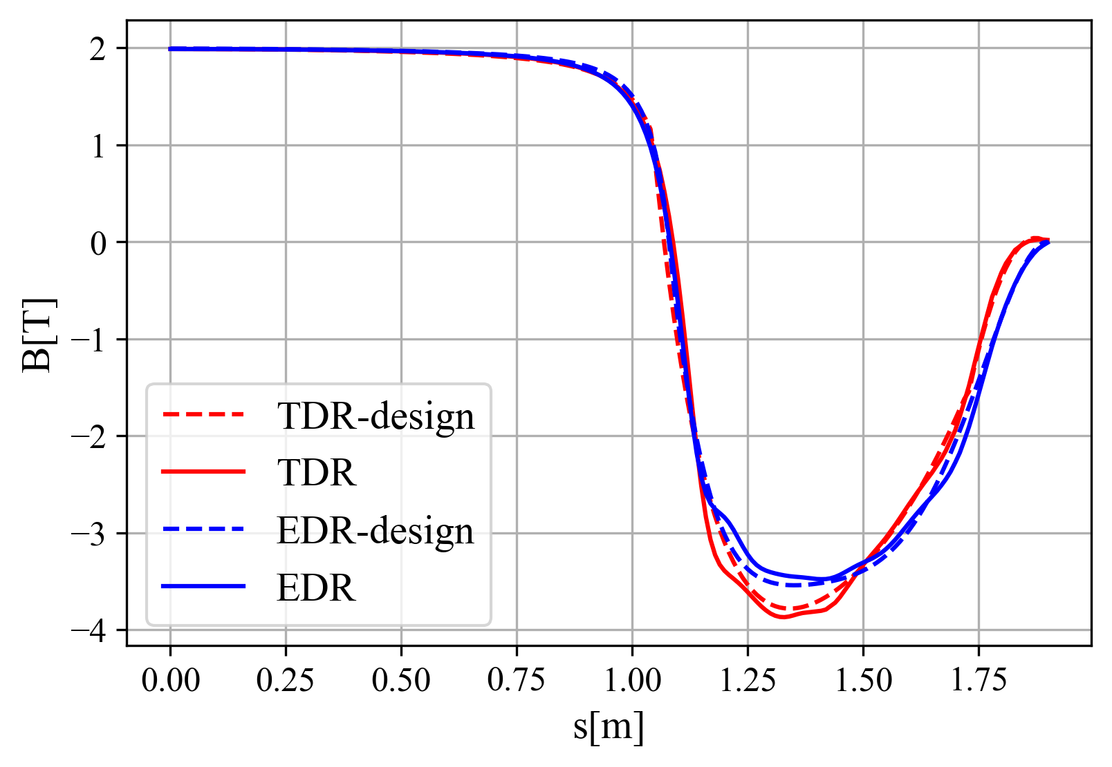
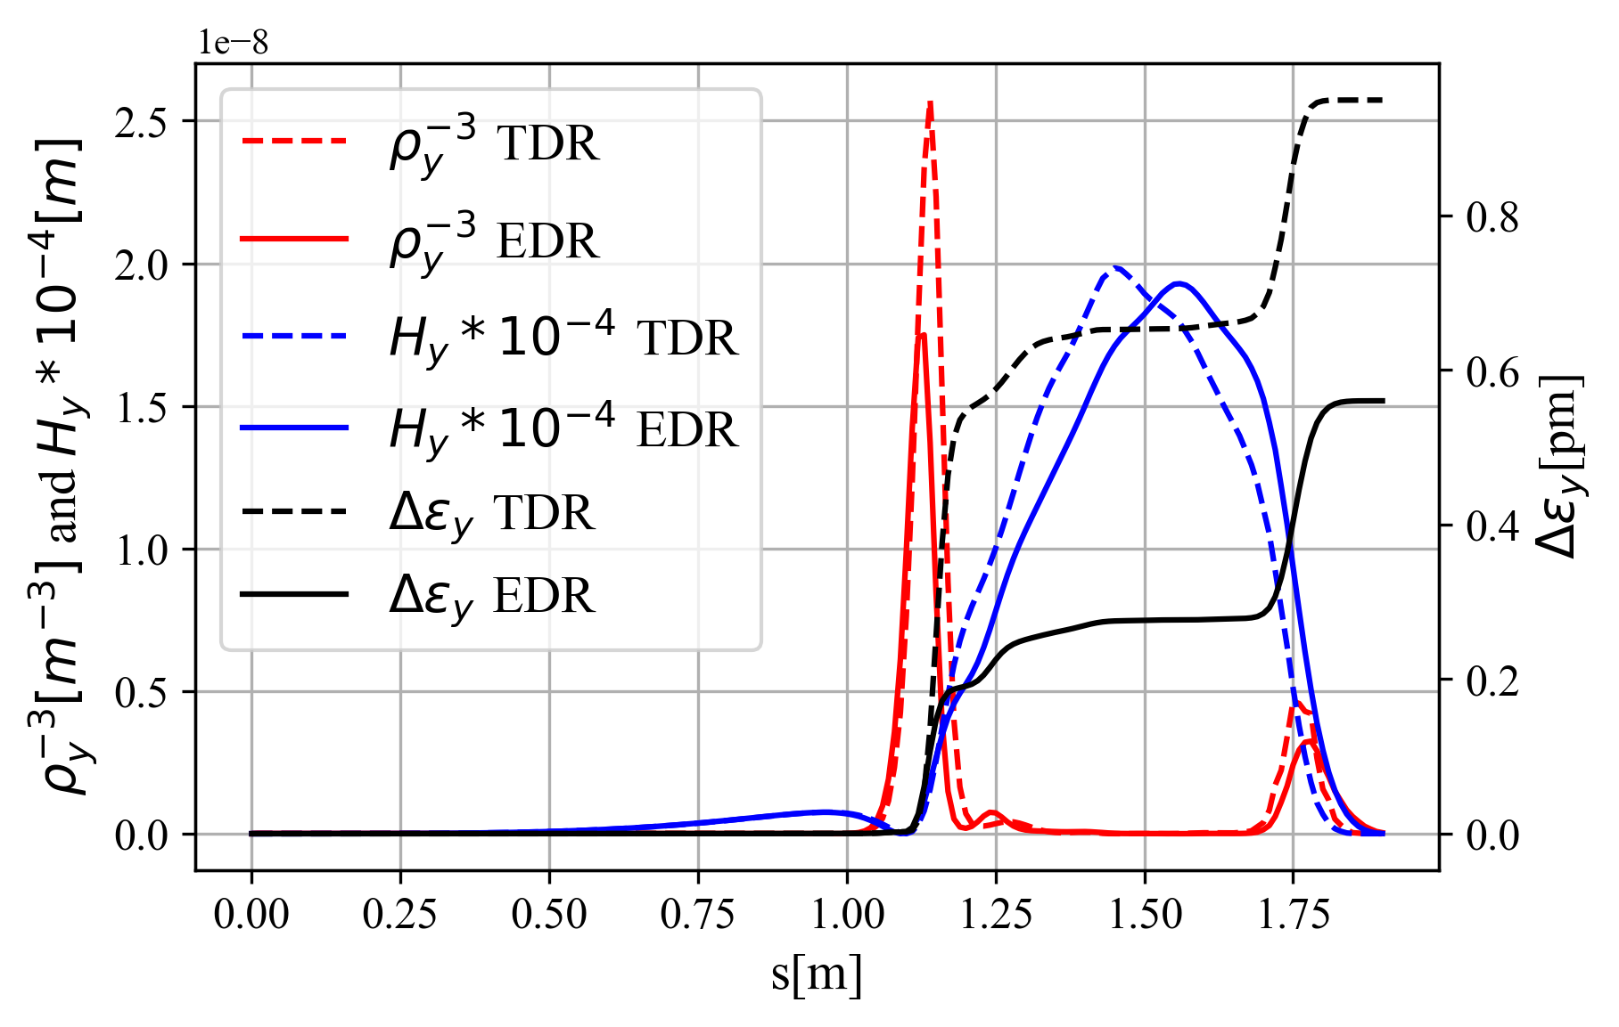
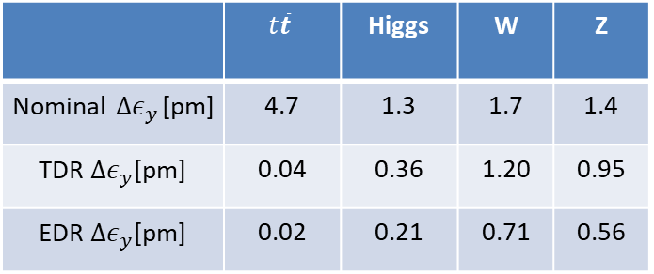
  Vertical emittance generated by solenoid field
Ande MA, Yiwei Wang, Yingshun Zhu et al
The detector solenoid are compensated locally with anti-solenoids
From IP to the entrance of Q1A (0 to 1.9m):
  ∫Bzdz cancled between the IP and the entrance of final quadrupole with strong anti-solenoid field in 1.1m to 1.9m.
  Field configuration optimized to get emittance minimum and iterate with anti-solenoid technical constraints
Combined field @ Z
Emittance contribution from the from IP to the entrance of Q1A
Updated detector solenoid field @ W/Higgs/ttbar
(Scaled to 2T at IP @ Z)
 | $$t\overline{t}$$ | Higgs | W | Z
Nominal $∆ε_{y}$[pm] | 4.7 | 1.3 | 1.7 | 1.4
TDR $∆ε_{y}$[pm] | 0.04 | 0.36 | 1.20 | 0.95
EDR $∆ε_{y}$[pm] | 0.02 | 0.21 | 0.71 | 0.56
Data from Feipeng Ning
Z(m)

Slide 13
  Vertical emittance generated by solenoid field
Updated detector solenoid field @ W/Higgs/ttbar
(Scaled to 2T at IP @ Z)
From the entrance of Q1A to Q3(1.9m to 10.55m)
  Bz keep fully cancellation along this region
  Torlerance of the cancellation: amplitude ≤±200 Gs in a region L≥2 cm to limit the emittance growth less than 1% nominal value
From the Q3 to the last bend (farer than 10.55m)
  ∫Bzdz from detector only < 0.5 T*m.
  Along beam line (not z), fully cancelation in Q3 and pre-cancelation in some extension region (with length of 1m) for the long tail of the detector solenoid field
Data from Feipeng Ning
Z(m)

Slide 14
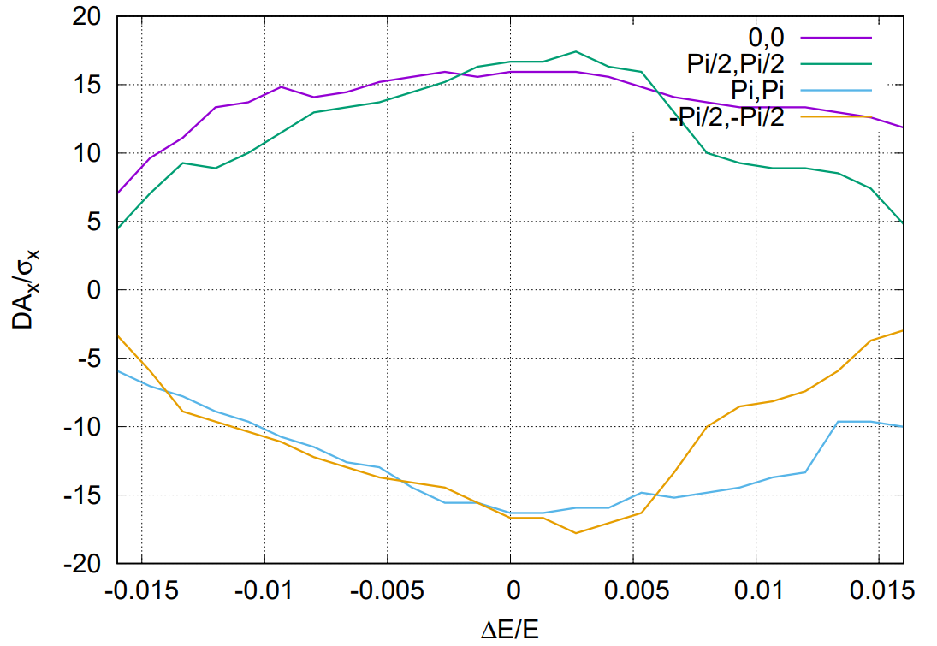
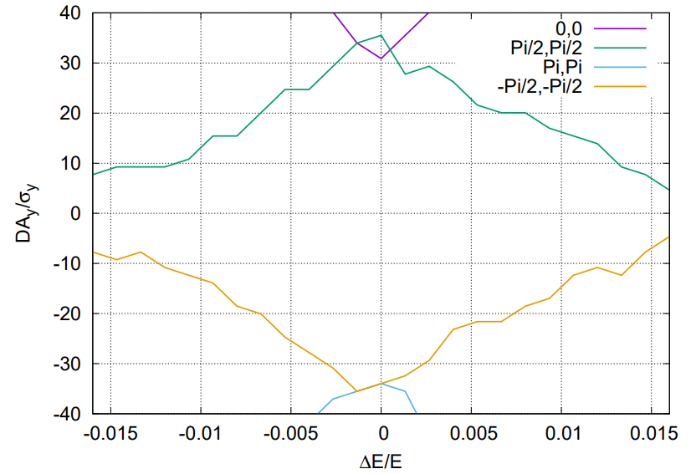
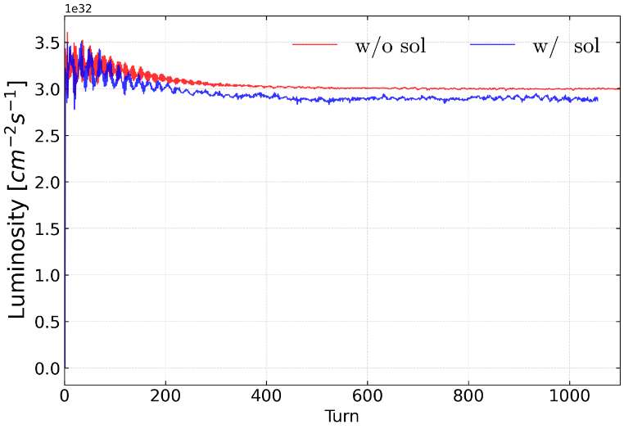
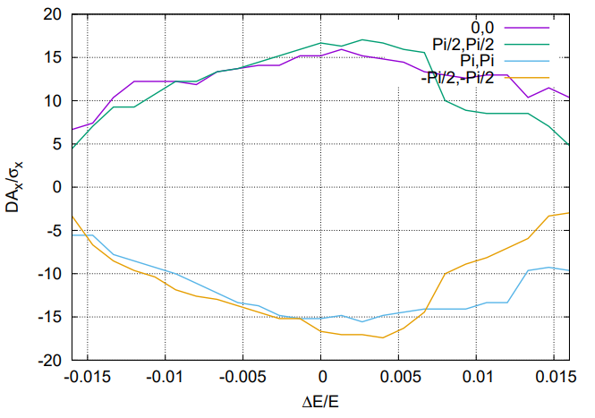
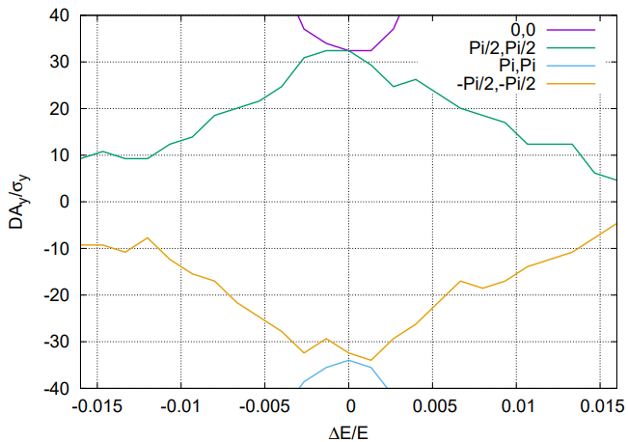
Solenoid effect on Dynamic aperture
  The anti-solenoid cancel the ∫Bzdz between the IP and the faces of the final quadrupole.
The Twiss function distortion due to solenoid field was corrected with final quadrupoles.
The solenoid effect on the dynamic aperture is small.
Preliminary result show the luminosity decreased a little bit; fine tuning is needed.
Effects included in tracking
Synchrotron motion
Radiation loss in all magnets
Tapering
Crab waist sextupole
Maxwellian fringes
Kinematic terms
Finite length of sextupole
Solenoid
Higgs without solenoid
By Zhiyuan Li
Higgs with
solenoid

Slide 15
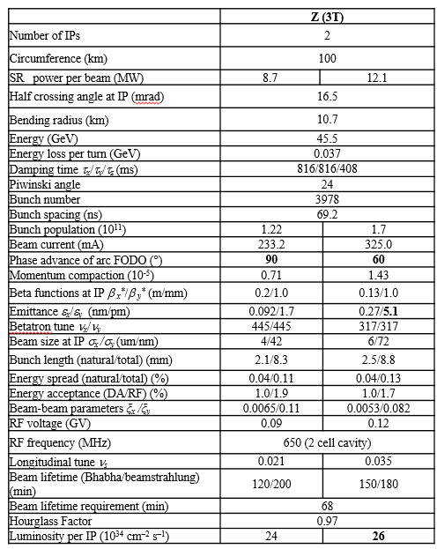
Possibility studies of 3T solenoid detector field for CEPC Z pole operation
Para table by D. Wang, Nov 2024
If keep local compensation scheme
  Bz0 2T => 3 T
  vertical emittance 0.56pm => 5.1pm
The study with non-local scheme is undergoing (If needed, probably installed during the High luminosity Z stage)
Lumi may be a bit lower due to coupling in other regions
High lumi Z: 115*10^34/cm^2/s

Slide 16
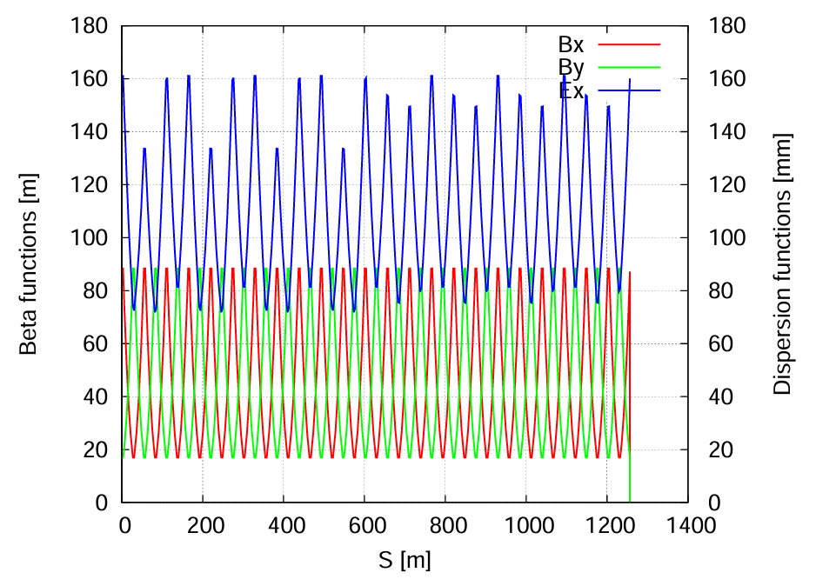
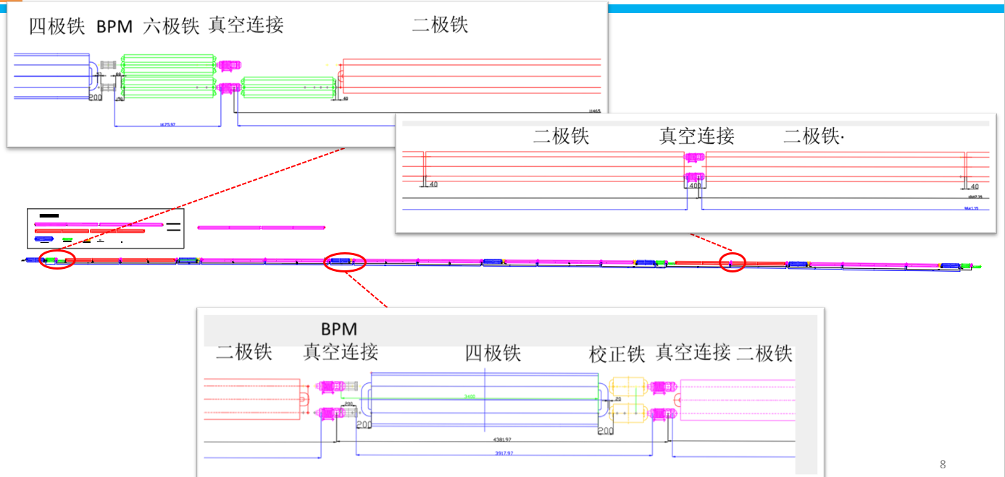
  Update of the ARC lattice
FODO cells in the arc to provide a large filling factor of dipole
  Dual-aperture dipoles and quadrupoles in the arc to save magnet power
  Single-aperture sextupoles for independent nonlinearity optimization of e+ e- rings
  Two kind of dipole length to use the space where no sextupoles
Single aperture magnets in the RF, injection and interaction regions
Correction of the energy sawtooth effects require adjusting range of magnets strength ±2.5% with the trim coils
Running at energy up to 180 GeV
The layout of the lattice in the arc area were updated based on the space required for vacuum, BPM, magnets, and mechanical equipment.
Qaud BPM Sext VCconection Dipole
Dipole VCconection Dipole
BPM
Dipole VCconection Quad Corr VCconection Dipole

Slide 17
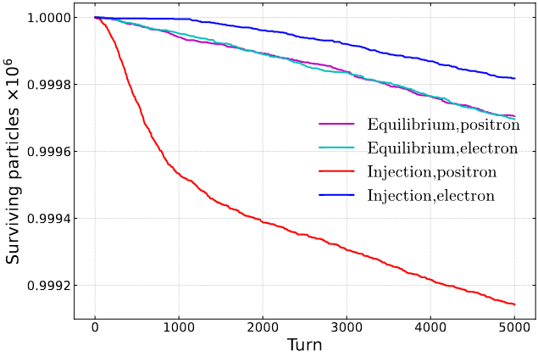
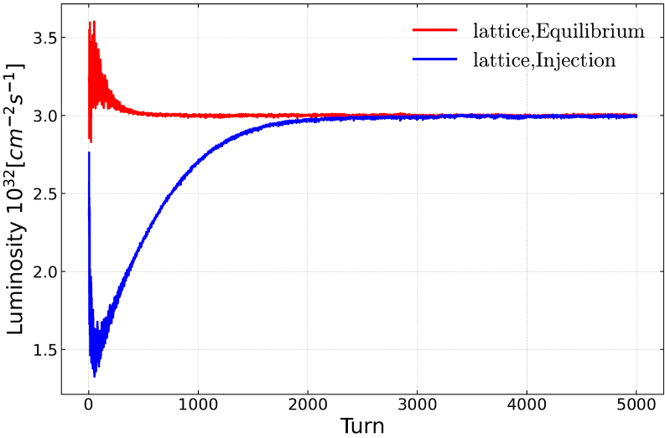
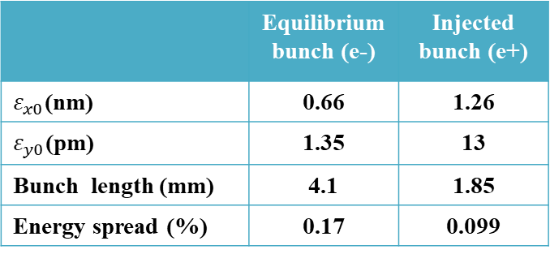
Beam lifetime of lattice + beam beam(s-s) + beamstrahlung
Zhiyuan Li etal., NIMA 1064 (2024) 169386
In collaboration with KEK team
Using an integrated simulation code in APES-T (IHEP homemade, in progress) which can implement element-by-element tracking with strong-strong beam-beam interaction and lattice
 | Equilibrium bunch (e-) | Injected bunch (e+)
$ε_{x0}$(nm) | 0.66 | 1.26
$ε_{y0}$(pm) | 1.35 | 13
Bunch length (mm) | 4.1 | 1.85
Energy spread (%) | 0.17 | 0.099
The injection pattern reaches a stable state equivalent to the equilibrium collision after 2000 turns, with a lifetime of approximately 40-60 minutes (33 min required). The particle loss before stability is about 0.06%.

Slide 18
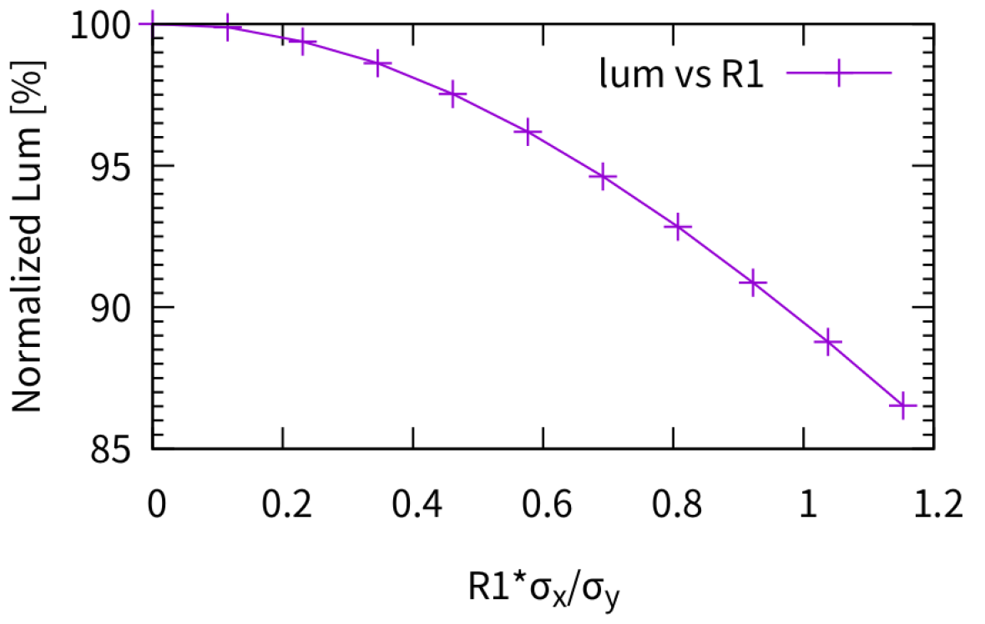
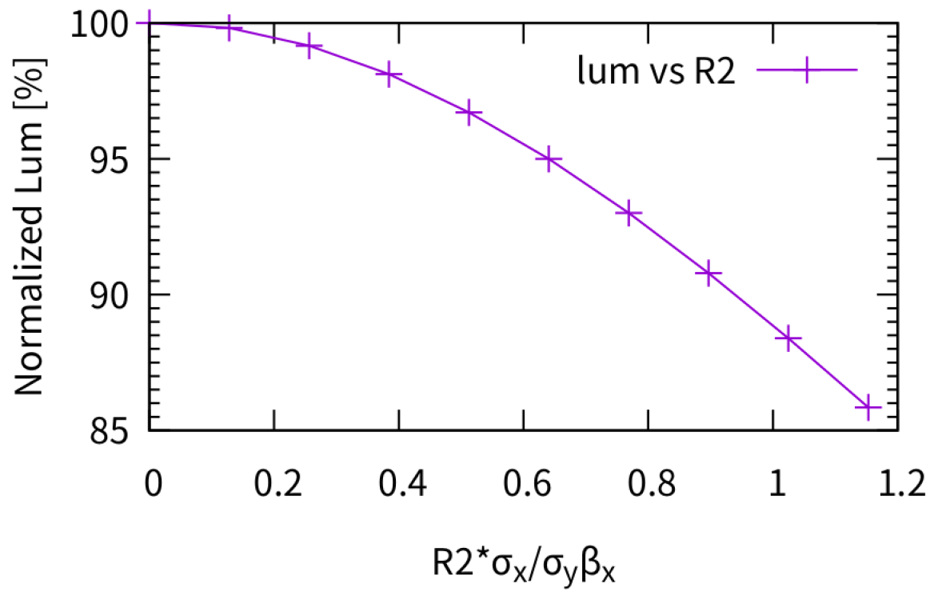
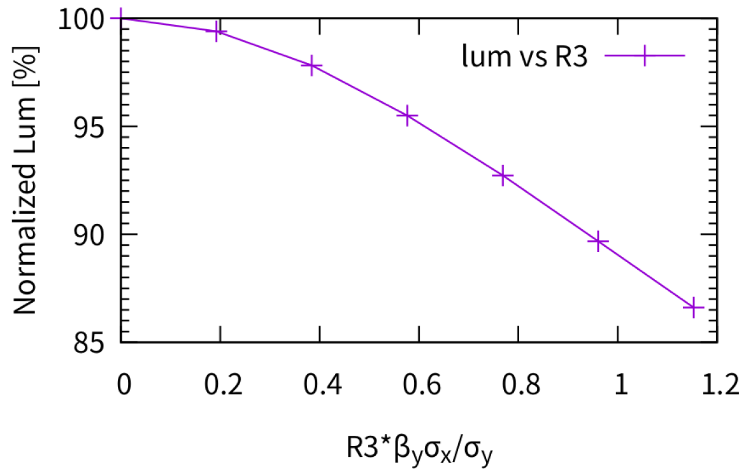
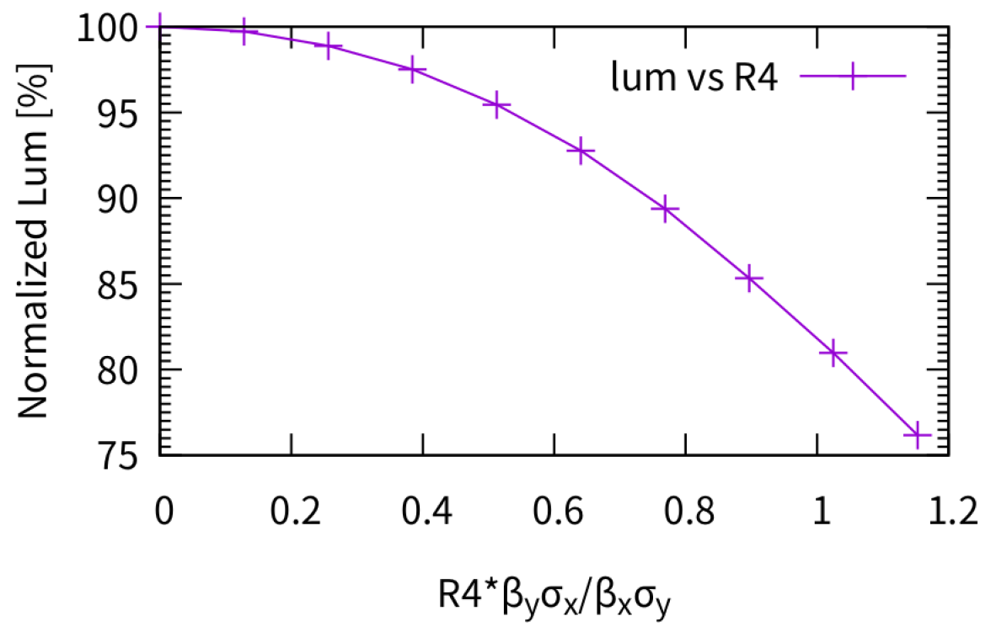
Luminosity with local coupling error at IP
by Yuan ZHANG et al.
Sensitivity study of the luminosity with local coupling error only in one beam (ring); for Higgs energy
The scaled coupling parameters R1/R2/R3/R4 have similar effects, where the scaled parameters should < ~1 to keep luminosity loss < 10%
Next step: IP tuning and get the corrector requirement to fulfill scaled parameters < ~1
$$σ_{y}^{2}\left(s\right)∼ε_{x}\left[β_{x}{\left(−R_{1}+R_{3}s\right)}^{2}+\frac{1}{β_{x}}{\left(R_{2}+R_{4}s\right)}^{2}\right]+ε_{y}\left[β_{y}+\frac{s^{2}}{β_{y}}\right]$$
R1, R2, R3 and R4 are the components of the x-y coupling matrix

Slide 19
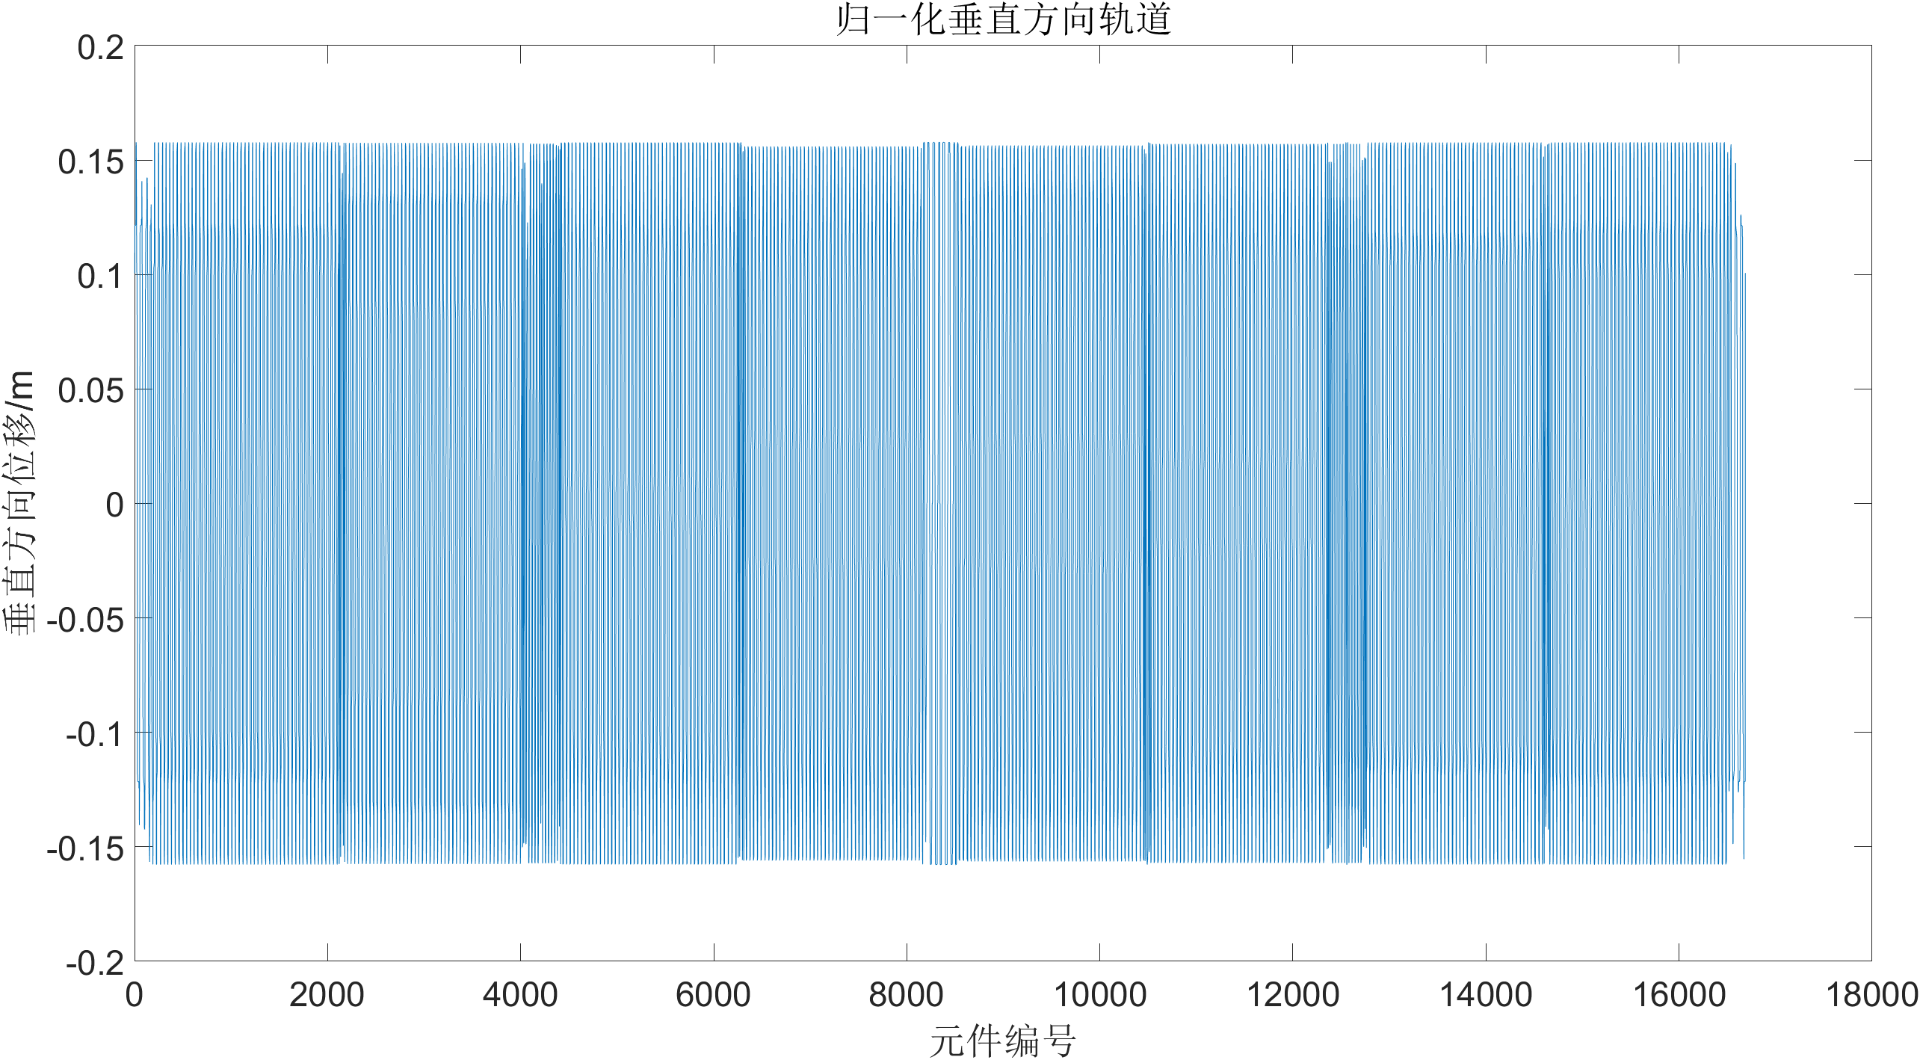
Preliminary ground motion result
Xiangyu Tan, Fang Yan, Yiwei Wang
Sensitivity study of the quadrupoles
  With Higgs lattice
  with 1um vertical error for the final doublets at the downstream of IP (P1), final doublets at upstream of IP (P2) and a regular quadrupole in the ARC (P3)
  To check the closed orbit distortion at the IPs in order to check the luminosity sensitivity
  No surprise, the final doublets is most sensitive to the ground motion
IP1
 | 1um @P1 | 1um @P2 | 1um @P3
orbit displacement at IP1 | 0.509μm | 0.506μm | -9.52nm
orbit displacement at IP2 | -0.470nm | -0.351nm | 2.061nm
P2
P1
P3
Normalized COD for the case P1
 | 3.5nm @P1 | 3.5nm @P2 | 25nm @All other quads
orbit displacement at IP1 | 3.6 nm | 3.6 nm | 10 nm
IP2
●the first set of quadrupoles
●the second set of quadrupoles
●the third quadrupole

Slide 20
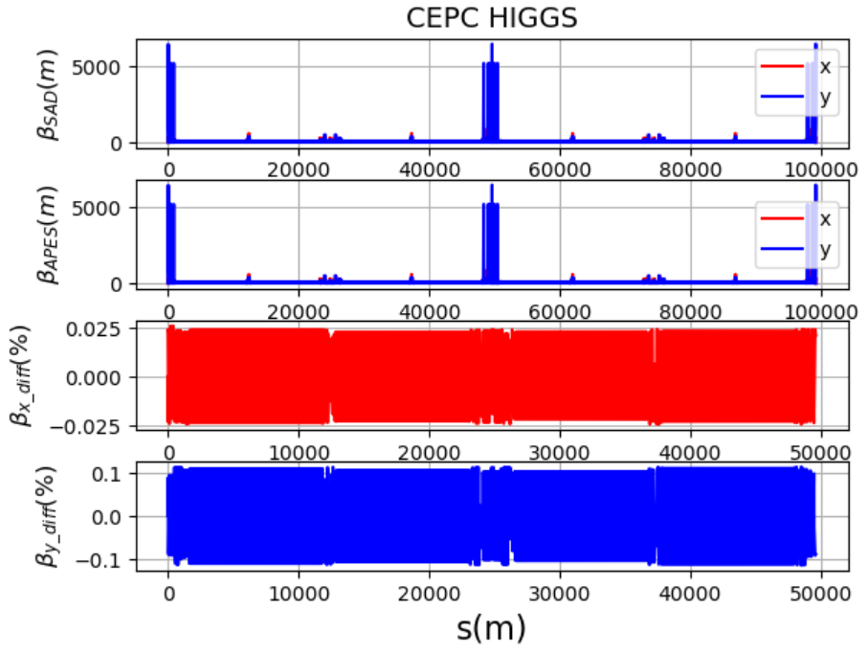
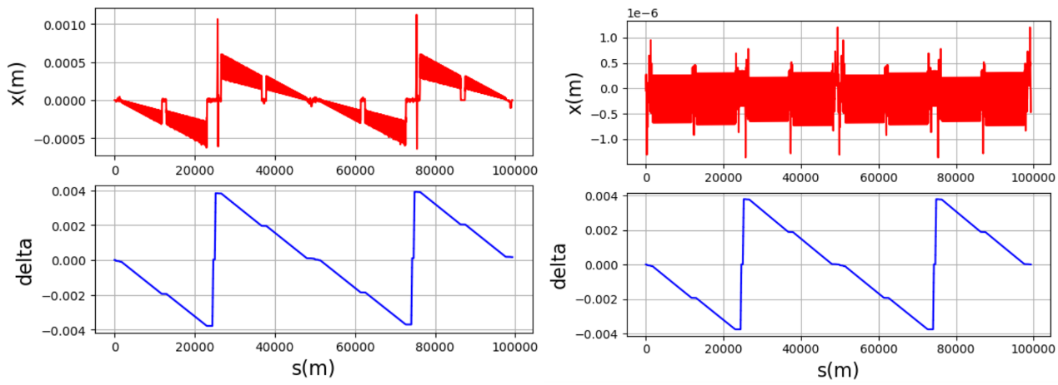
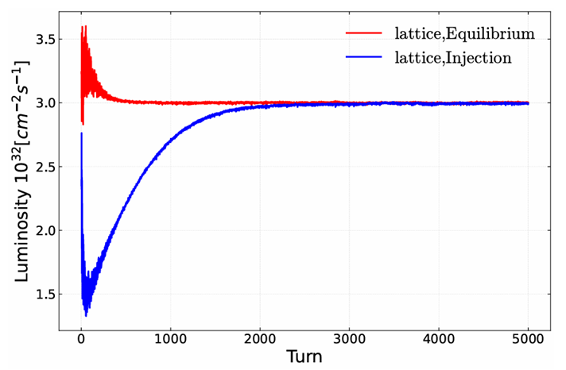
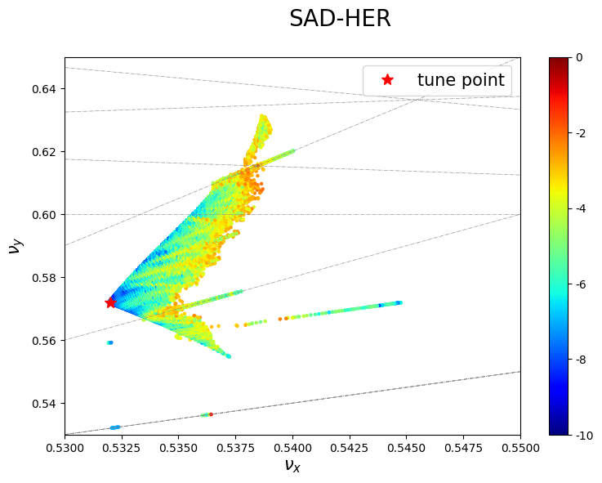
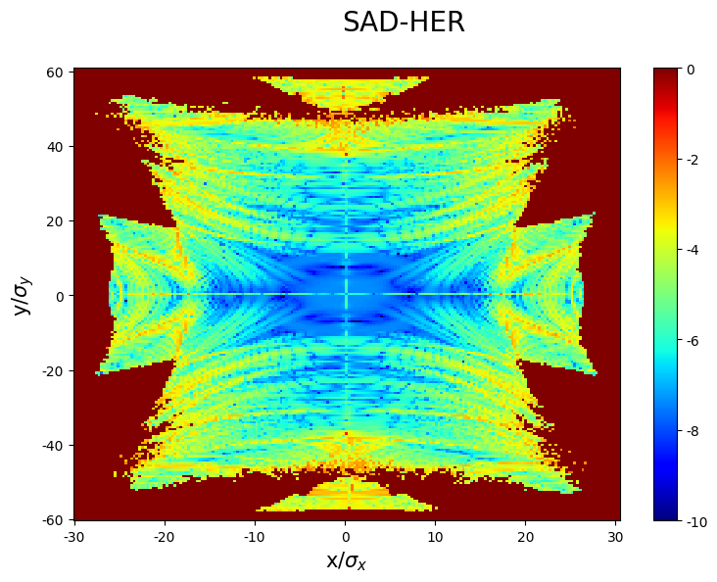
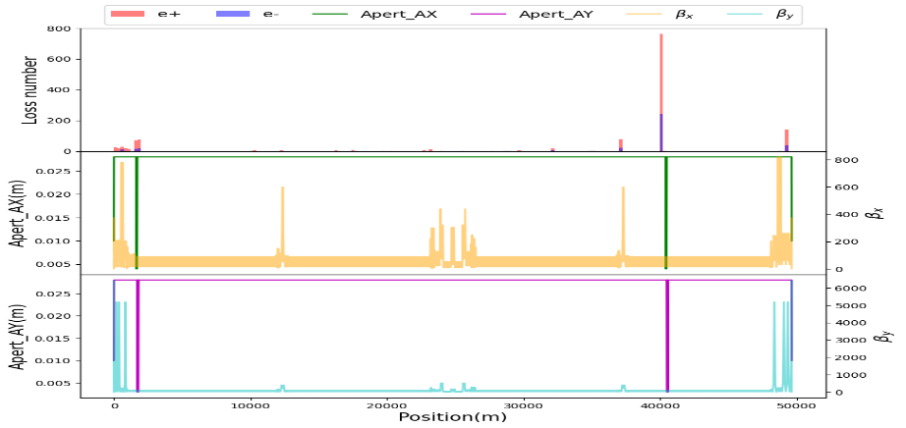
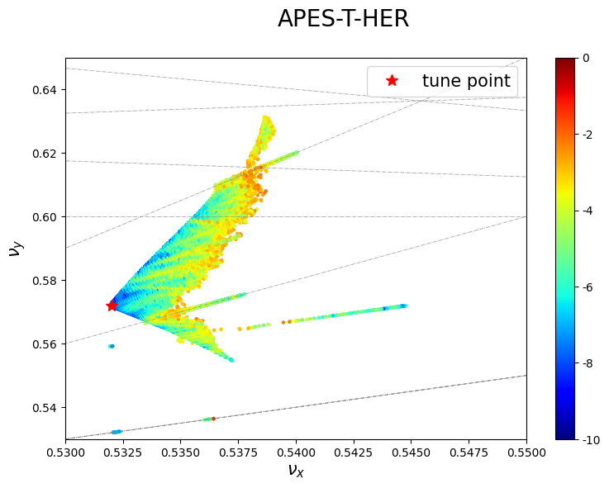
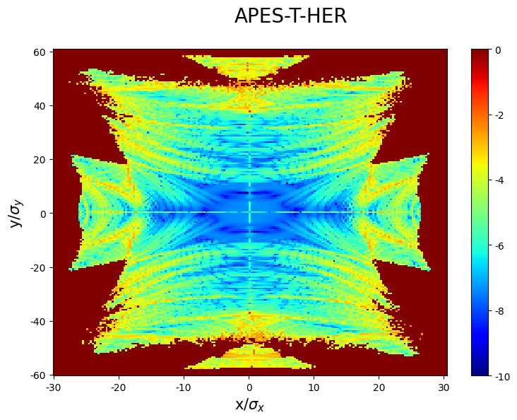
Beam dynamics code development: APES
APES working group
Some results for CEPC Higgs lattice
Lattice modeling and optics calculation
Sawtooth orbit deviates from energy loss due to synchrotron radiation
Orbit deviates after rad-taper
FMA
Beam-beam simulations
Collimators in the ring
Benchmark with SAD

Slide 21
Conclusions and further work
Progress of the collider ring beam dynamics toward EDR are presented.
    The lattice were updated due to the trade off with the engineering constraints
    RF region bypass layout updated
    Solenoid induced vertical emittance was further optimized
    Preliminary sensitivity study of the quadrupoles due to ground motion are made
To be done
  DA re-optimized with updates in the lattice
  Optimize Luminosity with solenoid
  More analysis of ground motion

Slide 22
Backup

Slide 23
Work under going for the error corrections
Error simulation with the long range alignment data and first turn tuning is ongoing.
  A large beta* lattice (3mm, 45GeV) and long range alignment data (rms ~7mm) were prepared.
  The existing first turn commission program has been developed for HEPS, part of the program has already been modified according to the CEPC lattice.
Preliminary result show the integrated RMS offset of the ground motion around the IP should less than some nanometers for the frequency of 1-100Hz
  Magnify factor for ground to magnet 1, magnify factor for magnet to beam 3
  (∆𝑦_𝐼𝑃/𝜎𝑦_IP)𝑟𝑚𝑠 <0.2 , if limit the luminosity decrease < 1%

