Slide 1

IAS Program on HEP 2024
PERLE Status at IJCLab
Walid Kaabi (IJCLab-CNRS)

Slide 2
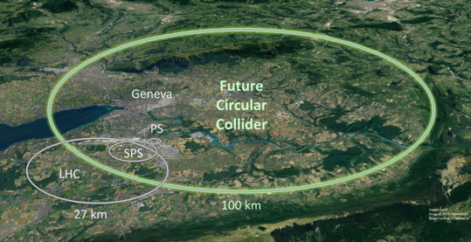

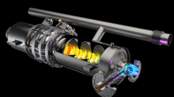

Introduction: Average power needs for future HEP projects
Example: FCC-ee (ZH) @250 GeV, CW, (0.4 & 0.8) GHz
60% efficiency
Grid to DC: 90%
RF power generation!
RF distribution!
losses in cavities
RF to beam
The power consumption for a e+ e- Higgs factory is 300 MW, Nearly 2 TWh for a typical yearly operating cycle.
This represent 2 to 3% of the annual consumption of some European countries as Belgium, Finland and Netherland.
For this facility, the power needs is distributed as the following:
  RF for beam acceleration 51% (145 MW)
  Cryogenic cooling 5% (14 MW)
  Magnets 9% (26 MW)
  Others 35% (98 MW)
Sankey diagram (Exp: FCC-ee ($t\overline{t}$))
FCC CDR, Eur. Phys. J. Special Topics 228, 261–623 (2019)

Slide 3
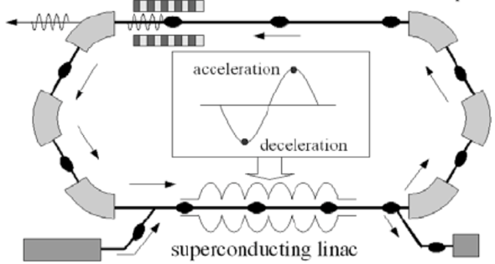
Introduction- ERL Concept
Acceleration:
RF power provided to cavities
The idea:
ERL Loop
(1’)
(1)
New beam injected in ERL loop
Acceleration to the top energy
(2’)…
(2)
acceleration
deceleration
ERL Loop
Kinetic energy of used beam recycled to re-excite cavities
Superconducting Linac
(4)
Beam used in IP
(3)
Injector
Beam dump
The benefits:
Reduce accelerator power consumption
Dumping the beam at injection power
Fresh beam in IP with the same characteristics
Deceleration:
180° RF Phase shift
More advantages:
Linac-like beam quality with extremely flexible time structure
High operating efficiency
Multi-pass configuration: High average current carrying capability (no more RF power limit) + High average beam power in a compact machine

Slide 4
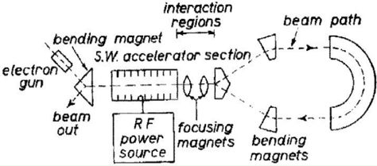
ERL History and achievements
1987 Los Alamos
FEL-operation, nc,
coupled acc/dec cavities
1987 High Energy Physics Lab
Stanford University
SRF cavities, proof of principal experiment
1965 M. Tigner
“A possible apparatus for electron clashing-beam experiments”
2000
Jefferson Lab
“Front End Test”
SRF, first CW
recovery
2017 Darmstadt Univ, Germany
“S-DALINAC”, SRF, single pass 22.5MeV,
2021
2 pass demonstration
2002 JEARI, Japan
FEL, SRF, 700kW beam power
2005 Daresbury Lab, GB
“Alice”, SRF, 26MeV, versatile
10-year user program
under construction:
MESA, Germany
particle physics application
PERLE, France
Technology test facility (LHeC/FCC-eh) + eRIB test facility
bERLinPro, Germany
SRF/ERL technology test facility
CeC, BNL, USA
Coherent electron cooling for EIC
2002
Jefferson Lab
“IR-Demo”
SRF, 5mA, 48MeV,
2.1kW beam power IR
2003
CEBAF, 1 GeV, single turn
2007 Upgrade:
9mA, 150MeV
1.1MW beam power with ~300kW total power
2004 BINP, Russia
FEL-operation
normal conducting RF,
30 mA
2007: 4-passes
2013 KEK, Japan
“cERL”, prototype
ERL light source
Industrial applications
2020, Cornell/BNL
cbeta, FFA-arc
4-pass ERL
(80mA injector, e = 0.3mm mrad)
Courtesy to Bettina Kuske

Slide 5
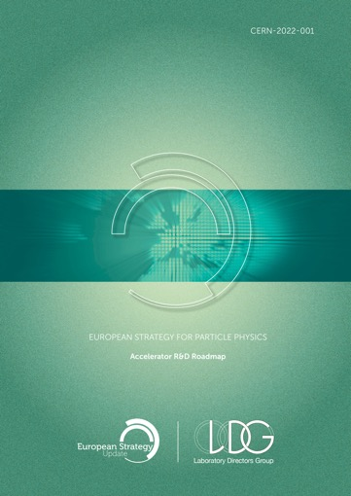
ERLs in the European Accelerator R&D Roadmap
ERL development has been recognized as one of the five main axis of accelerators R&D in support of the European Strategy for Particle Physics (ESPP):
  High-field magnets
  High-gradient RF structures and systems
  High-gradient plasma and laser accelerators
  Bright muon beams and muon colliders
  Energy Recovery Linacs
The ERL Roadmap Panel, chaired by Max Klein and Andrew Hutton, has done a tremendous job with broad and active participation. PERLE & bERLinPro projects were recognized as one of the "essential pillars of the ERL development," with milestones to be achieved by the next ESPP in 2026.
ESPP R&D Accelerator Roadmap: https://arxiv.org/ftp/arxiv/papers/2201/2201.07895.pdf

Slide 6
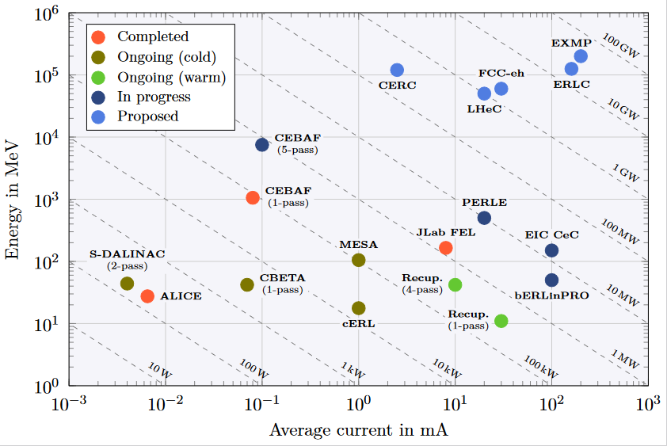
ERL - The global landscape
Funding Limited
Technology Limited

Slide 7
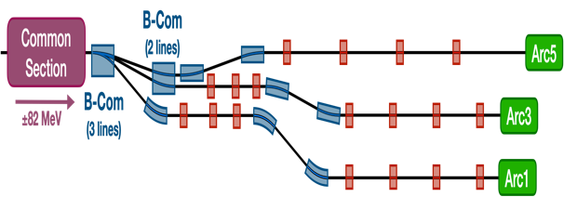
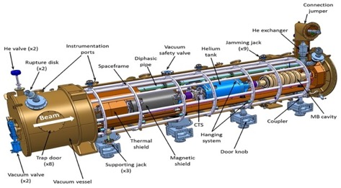
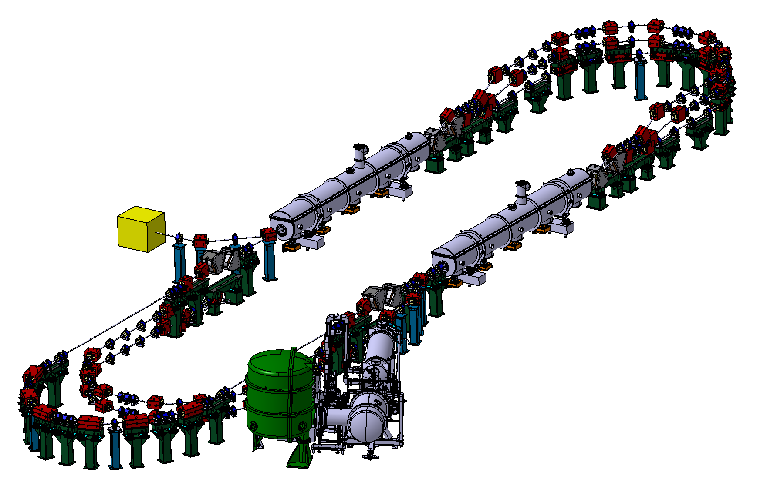
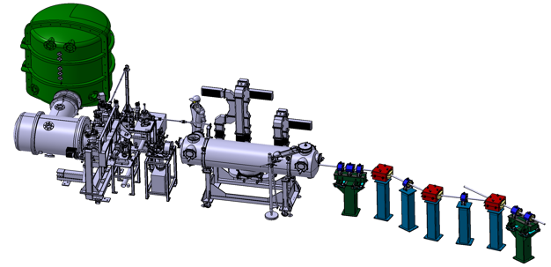








PERLE @ IJCLab-Orsay
PERLE: first multi-turn ERL, based on SRF technology, designed to operate at 10MW (20 mA, 500 MeV) power regime
→ A hub to explore a broad range of accelerator phenomena and to validate technical choices improving accelerators efficiency in an unexplored operational power regime on the pathway of the ERL technology development for future energy and intensity frontier machines.
Cryomodule with 4 five-Cell cavities
Total gradient 82 MeV
3 acc & 3 decc beams at different energies travelling in the CM.
Switchyard: vertical separation/recombination of beams at different energies
Target Parameter | Unit | Value
Injection energy | MeV | 7
Electron beam energy | MeV | 500
Normalised Emittance γε_{x,y} | mm mrad | 6
Average beam current | mA | 20
Bunch charge | pC | 500
Bunch length | mm | 3
Bunch spacing | ns | 25
RF frequency | MHz | 801.58
Duty factor |  | CW
Beam dump
3 staked isochronous recirculation arcs for beams at different energies (Arcs 1, 3, 5).
Interaction Points
HV tank
Photocathodes loading chamber (Sb-based photocathodes)
Buncher
350-500 kV
DC gun
Merger
3 staked (& inversed) isochronous recirculation arcs for beams at different energies (Arcs 2, 4, 6)
Light box
Green laser 40 MHz
Booster: 5 single-cell cavities (802MHz) individually powered
Injection line delivering 500pC bunches at 7 MeV.

Slide 8
Challenges toward PERLE realisation
Development of high current electron sources:
DC gun: high charge production at high repetition rate, high cathode field & high vacuum
New photocathode materials with high quantum efficiency and long life time
Beam dynamics & instrumentation:
Specific simulation tools for ERL adapted to high-power beams at different energies and currents
Development of high dynamic range instrumentation allowing high beam control at different functioning phases (commissioning, ramping-up and operation), and also to decern beams from “undesired” one (halo):
  Non-invasive diagnostics: optical system for beam imaging
  BPMs and BAMs adapted to multi-turn
  Sensitive BLMs for the monitoring of beam loss and beam halo
SRF Cavity and High Order Mode (HOM) damping:
For operation in CW mode with the minimum dynamic loss, cavity should have the highest Q₀: Thermal treatment (Doping, infusion, medium temperature annealing) or R&D on SRF material for 4,2K operation (Nb3Sn or others…)
Development of Fast Reactive Tuners (FRTs) adapted to cavity and cryomodule to mitigate cavity detuning by microphonics.
Efficient HOM extraction w/o increasing cryoload, to preserve beam quality & avoid its disruption by wakefields
  Cavity design choices should integrate the HOM extraction issue: frequency optimisation, large aperture, few cells, optimised end group)
  Design of specific HOM couplers & optimisation of the damping scheme
  Study the need of additional absorber in the beam line

Slide 9
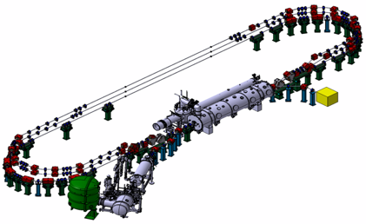
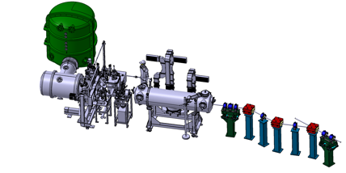
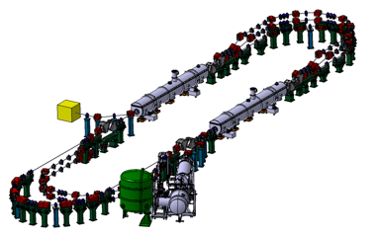
PERLE Timeline for TDR phase and beyond
Prepare to Build phase (P2B): TDR and prototyping
Installation phases
Phase 1: Injection line Installation
Phase 2: PERLE 250 MeV version
Phase 3: PERLE 500 MeV version
2020
2021
2022
2023
2024
2025
2026
2027
2028
2029
2030
2031

Slide 10
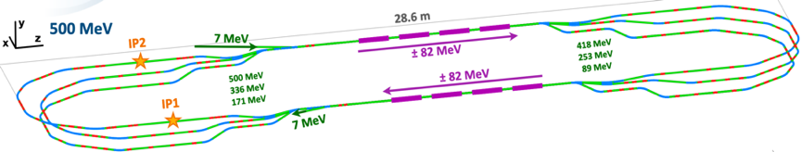
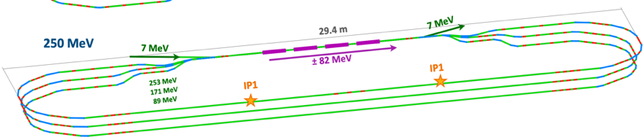
PERLE Lattice optimization
Lattices and optics for the 500 MeV and 250MeV PERLE versions were studied and optimised:
A full 1st order calculation were finished and a complete 250 and 500 MeV lattice is now available.
The stability of the lattice was crosscheck with different codes (OPTIM6, MADX & BMAD).
First specifications of quadrupoles and dipoles in switchyards & arc sections are obtained.
→ Further studies are ongoing/to be done: correction of nonlinear aberrations with multipoles, momentum acceptance, longitudinal match…
→ In addition to beam dynamics studies: Start to end simulations with CSR and microbunching, Multiparticle tracking, BBU, Impedance analysis and Wakefield effect mitigation …

Slide 11
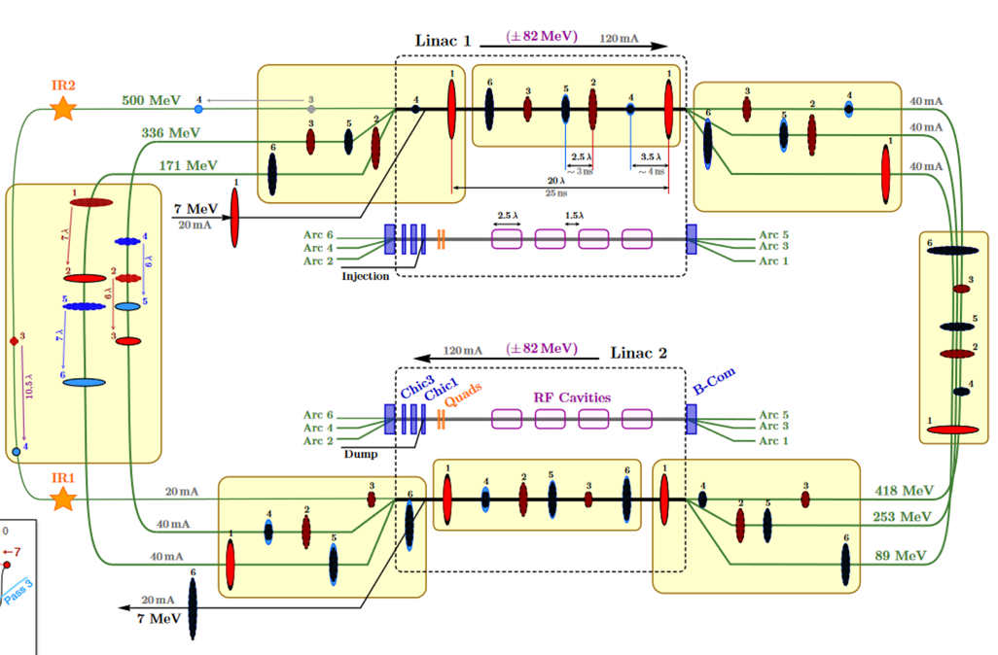
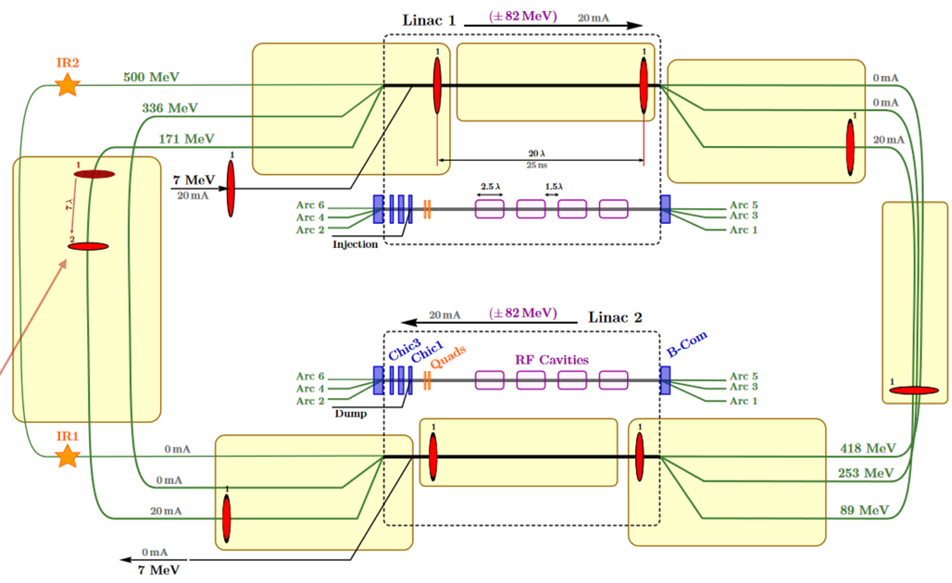
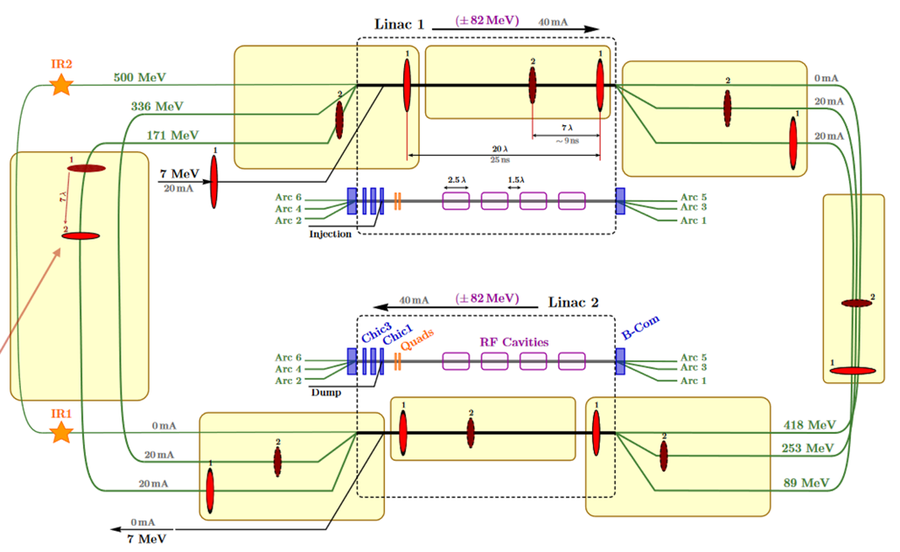
Bunch Filling Pattern studies
Pass 1
Pass 1-2
In the injection line:
500 pC e- bunchs generated at f_{inj}= 40 MHz
  time spacing between bunches: 25 ns
  average current: 20 mA
Bunches accelerated to 7 MeV in the injector then injected into the ERL loop
ERL Loop:
Cavity frequency: f_{RF}= 801,58 MHz (λ_{RF}= 34.7 cm)
f_{RF}/f_{inj =} 20
Length spacing between bunches: 20 λ_{RF}
During the 1st Pass:
Linac 1 → Arc 1 → Linac 2 → Arc2
7 → 89 MeV 89 → 171 MeV
1st Pass length= 167 λ_{RF}
8 bunchs injected in the 1st pass.
The 9th bunch Injected is followed by the 1st accelerated bunch in pass 1 that start pass 2 (spaced by 7 λ_{RF}).
Pass 1-6

Slide 12
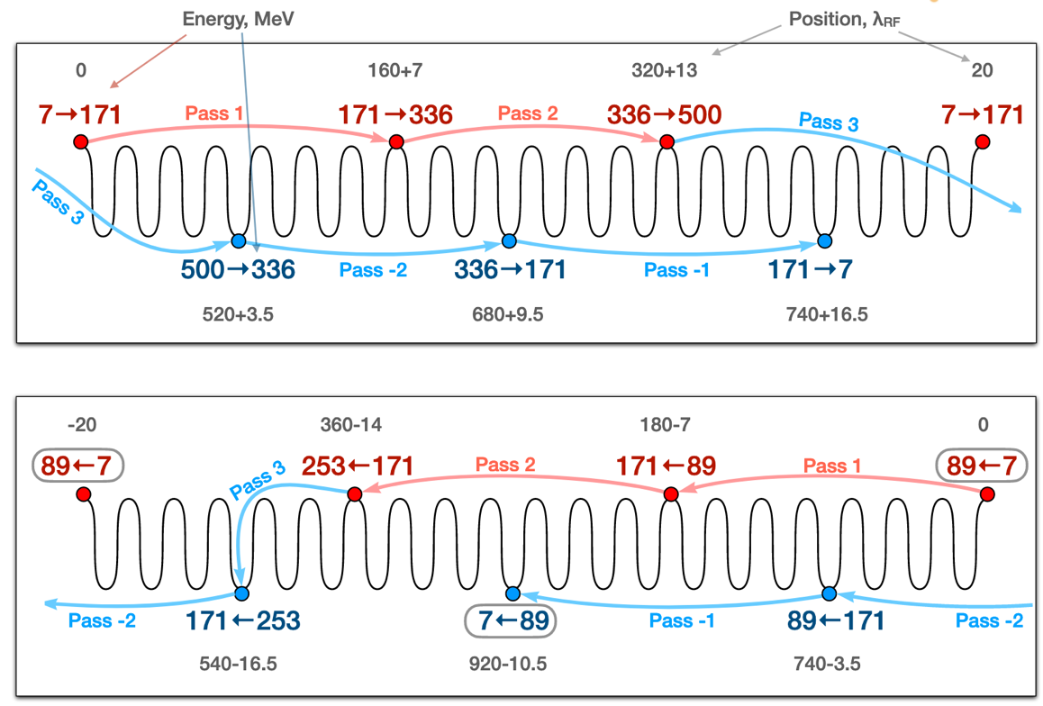
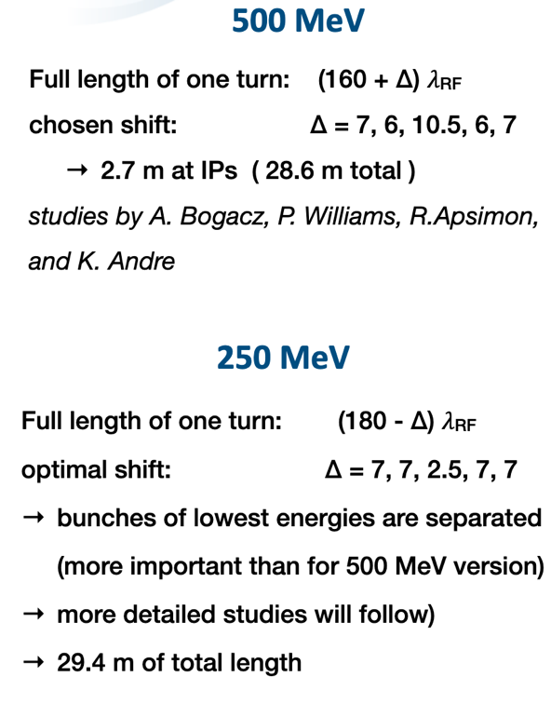
Bunch Filling Pattern 250 MeV Vs. 500 MeV version

Slide 13
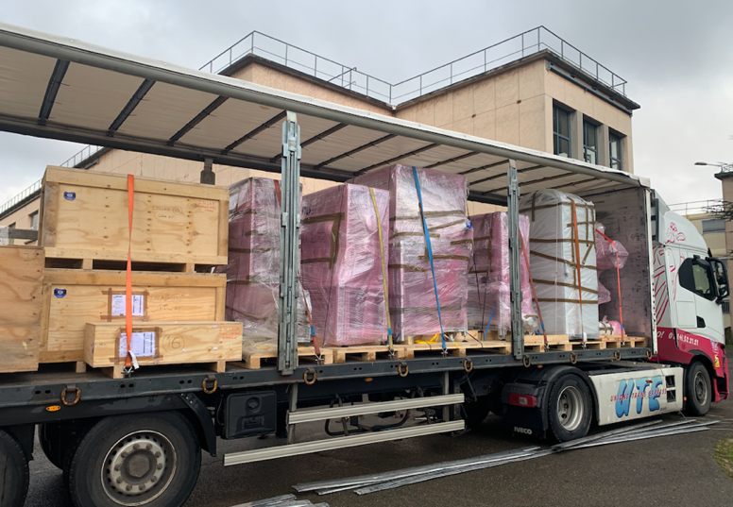
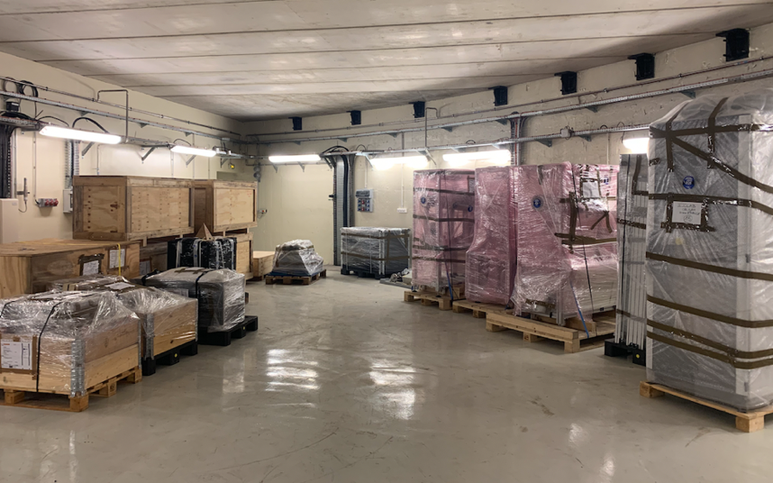
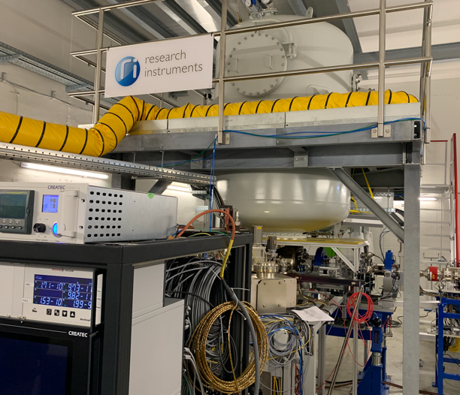
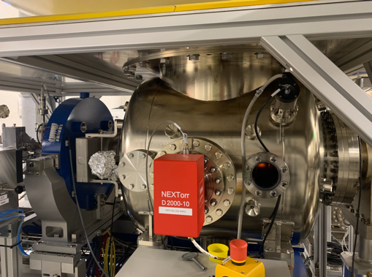
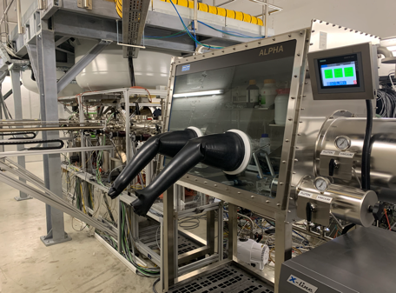
PERLE e- Source
Acquisition of a DC gun from Research Instruments GmbH (RI).
→ A Gun with Cornell design (400 pC, 50 MHz demonstrated), fully equipped, in load-lock version
Equipped with a Photocathode preparation facility
HV power supply suited for high bunch charge (designed for 40 mA, 450 kV)
The gun was commissioned and tested at high rep rate, at a limited bunch charge
The equipment were received at Orsay end of December.

Slide 14
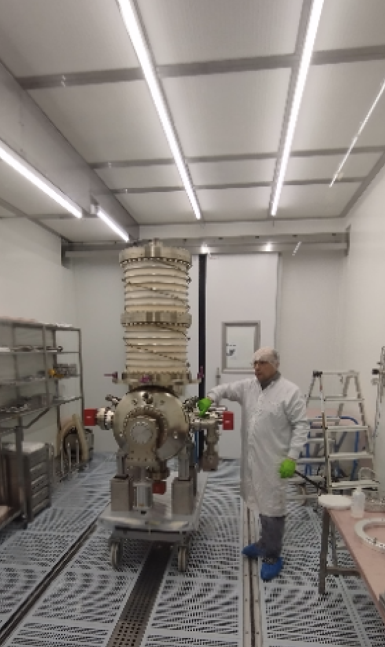
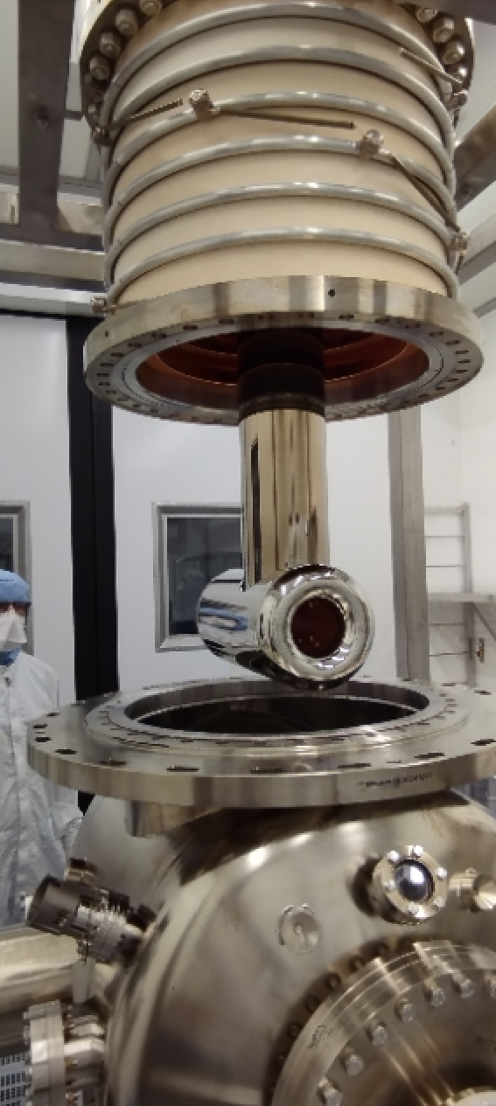
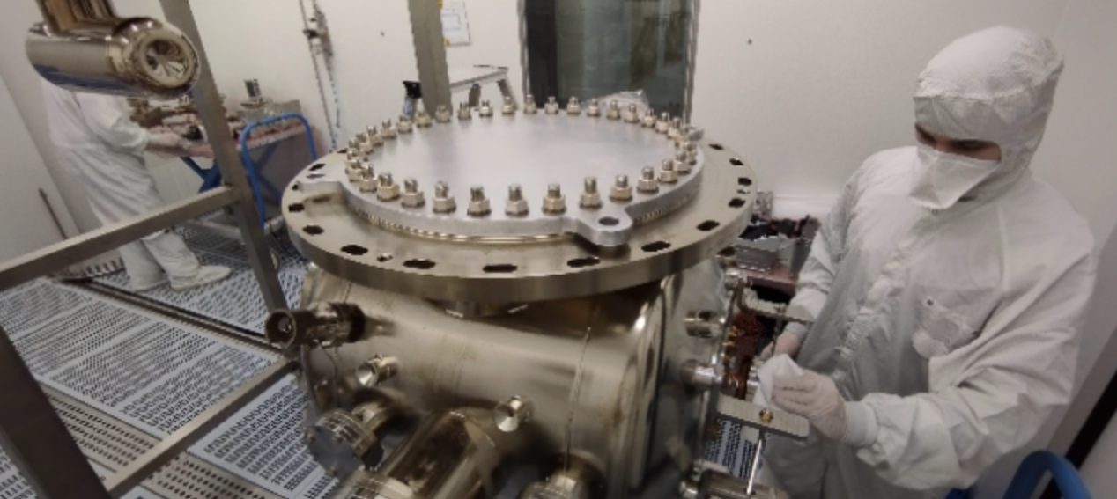
PERLE e- Source
The e- Gun: Main piece of the puzzle (and most fragile one) was dismounted last week in cleanroom @ RI. Shipment to IJCLab is foreseen on Friday this week.
Installation of the e- source at IJCLab will start next week.
First e- beam is foreseen for end 2024.

Slide 15
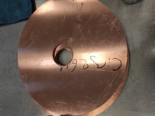
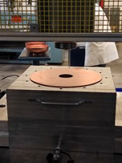
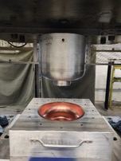
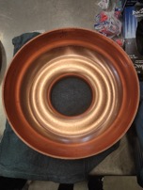
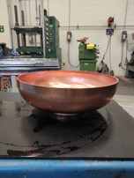
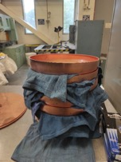
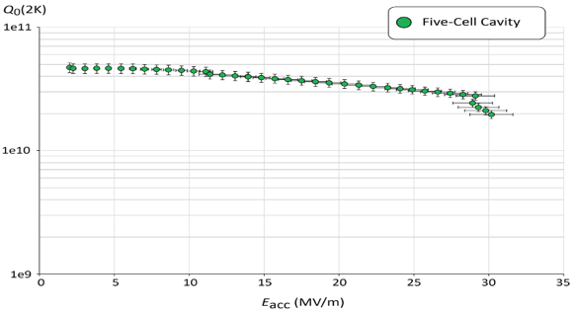
PERLE SRF cavity
PERLE Requirements | Impacts | Challenges | Possible Solutions
CW operation (RF) | High dynamic losses | The highest cavity Q₀ | Cavity post-treatment (Doping, infusion…)
High current operation | High HOMs excitation | Efficient HOMs extraction & damping | Act on cavity design: low frequency cavity choice (< 1GHz), larger cavity aperture, fewer cells for the a given gradient, optimisation of end-cell design.
Muti-bunches operation | Increase beam instabilities | The highest BBU threshold | Regular spacing of bunches: optimisation of the bunch filling pattern during Lattice design + BBU study after HOM optimisation (including collective effects).
A 5-Cell copper cavity of the same design was fabrication @Jlab to allow end group design optimisation and to test several HOM couplers combinations to assess the best HOM damping scheme.
Q₀ (2k) = 3 e10 @ ~27 MV/m
Quench @ E_{acc} ~ 30 MV/m
PERLE requirements
First Nb 802 MHz 5-Cell cavity fabricated @ JLAB
F. Marhauser et al. “802 MHz ERL cavity design and development”- IPAC2018 (Vancouver, BC, Canada)- doi:10.18429/JACoW-IPAC2018-THPAL146

Slide 16

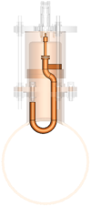
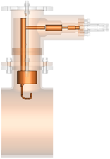
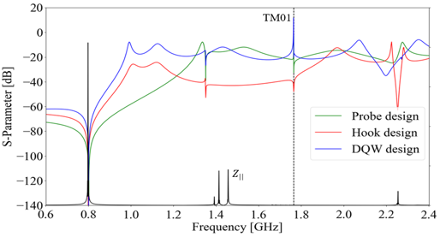
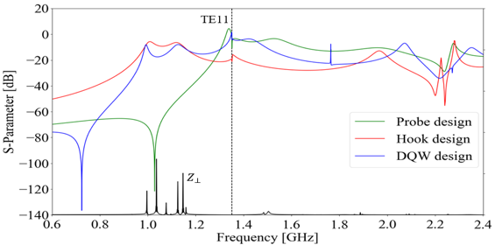
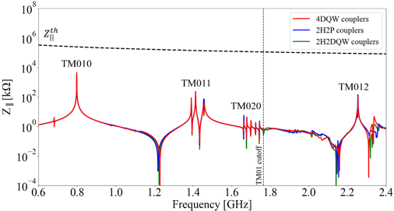
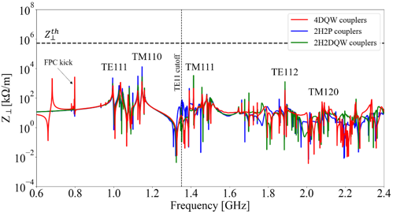
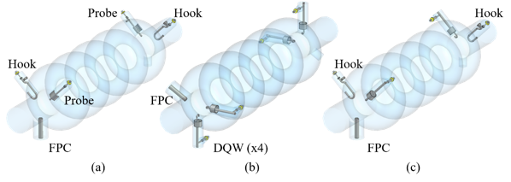
Status of HOM studies :
HOM coupler optimization of 3 different designs
Monopole transmission
Dipole transmission
TM010
Optimized region
Probe Coupler
Hook Coupler
DQW Coupler
Optimized region
TM011
TM110
TM012
TE111
TM111
Couplers were geometrically optimized according to HOM spectrum ($Z_{||}$and $Z_{⊥}$) & S-parameters btw port 1 (beam pipe) & port 2 (coupler output) were studied.
The hook coupler provides higher damping of the first two dipole passbands (TE111 and TM110)
The DQW coupler exhibits a better monopole coupling for TM010 mode than the probe design.
Study of 2 damping schemes with 4 HOM couplers (Especially for dipole HOM extraction)
Longitudinal impedance spectra of the cavity
Transverse impedance spectra of the cavity
beam
beam
→ Promising results of the 4 DQW scheme: It allows damping both monopole and dipole HOMs below the analytically-computed beam-stability limits

Slide 17
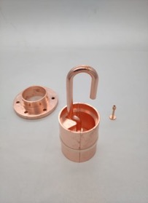
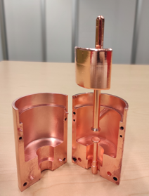
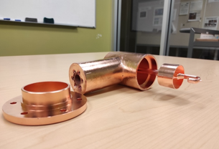
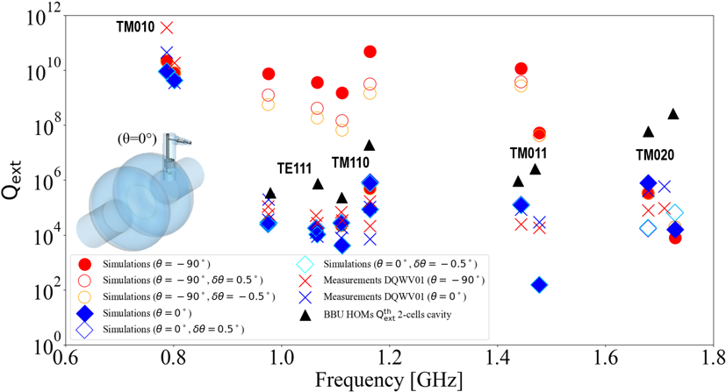
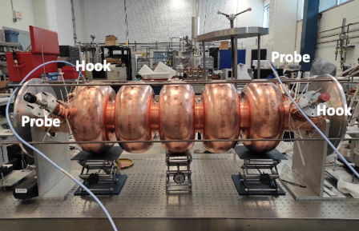
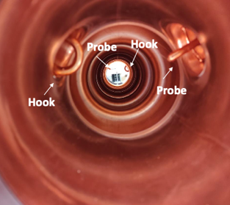
Status of HOM studies :
From RF design to performance measurements: Successful collaborative effort between IJCLab, Jefferson Lab & CERN
Probe coupler
DQW coupler
Hook coupler
3D-printed prototype (Epoxy Accura 48) copper-coated @CERN
Ultimately, we aim to produce Nb HOM couplers with optimised design and to install them on a new Nb 5-cell PERLE cavity with optimised end groups. The Production of 4 cavity scheduled within the ISAS program (Starting from 2024).
C. Barbagallo et al. “First RF measurements of coaxial HOM coupler prototypes in a copper cavity for the PERLE project”- IPAC’23- MOPA025

Slide 18
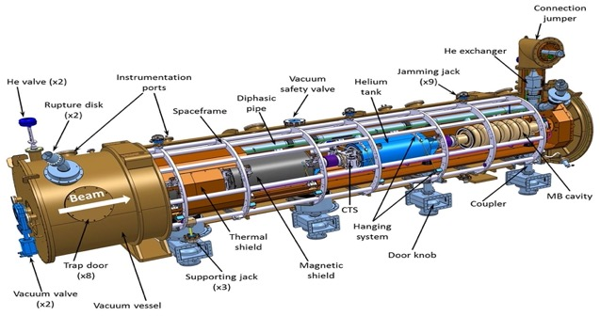
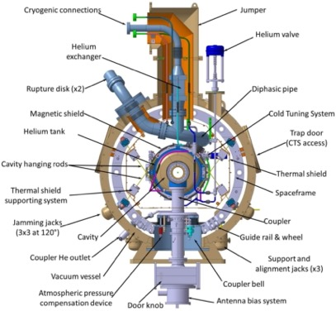
Cryomodule design:
ESS Cryomodule design was selected:
Intermediate supporting structure (spaceframe)
Cavity string hung by rods
Insertion of the cavity string by the extremity (rollers)
Trap doors for tuner access
Connexion to the valve box on the top of the vacuum vessel
Important space available inside
Design validated: series fab. & tests ongoing (Qty 30)
1st Cryomodule: Foreseen for 2027
Adapted from ESS design, it will be optimised for efficient high current ERL operation within the European Infra-Tech program iSAS*. It will host cavities equipped with HOM couplers and FPC optimised and developed within the same program.
2nd Cryomodule: Foreseen for 2030
May include some/all the technologies studied within iSAS program to improve the efficiency of Cryomodules: Fast Reactive Tuner (FRT) for microphonics mitigation, LLRF managed by AI and 4.2 K Cavities operating.
* More information on iSAS program: https://indico.ijclab.in2p3.fr/event/9521/

Slide 19
Thank you for your attention!

