Slide 1



From CEPC Lattice Design to Hardware Requirements in EDR
Yiwei Wang
for the CEPC Accelerator Physics Group
18 Jan 2024, HKUST, The conference of the IAS Program on High Energy Physics (HEP) 2024

Slide 2
Outline
This talk aiming to present the CEPC collider ring lattice design, progress and lattice related hardware requirements for EDR to give start points of the EDR iteration between the engineering design and the accelerator physics.

Slide 3
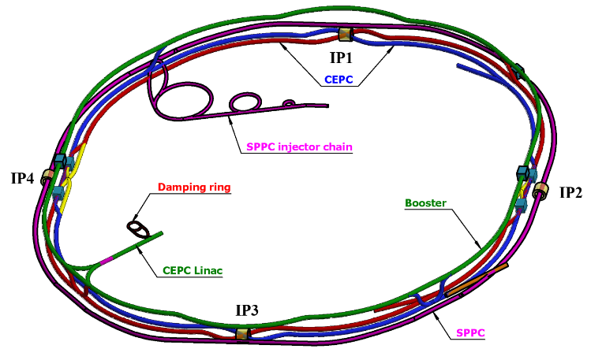
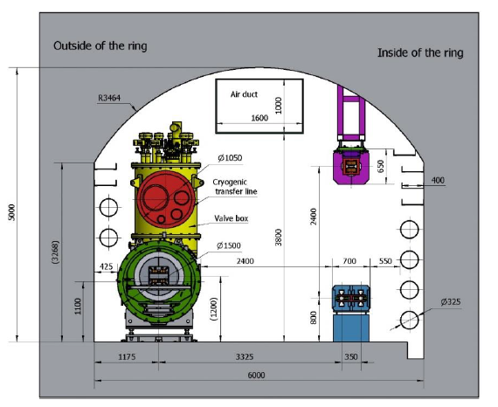
Overall design requirement of the CEPC collider ring
SR power per beam 30 MW (50 MW upgradable), 100 km, 2 interaction points
Higgs mode hold the 1st priority and compatible with the ttbar/W/Z modes.
Compatible with SPPC: 100km, section length, two machines share the most tunnels
CEPC+SPPC complex
Tunnel in the arc regions
CEPC detectors

Slide 4
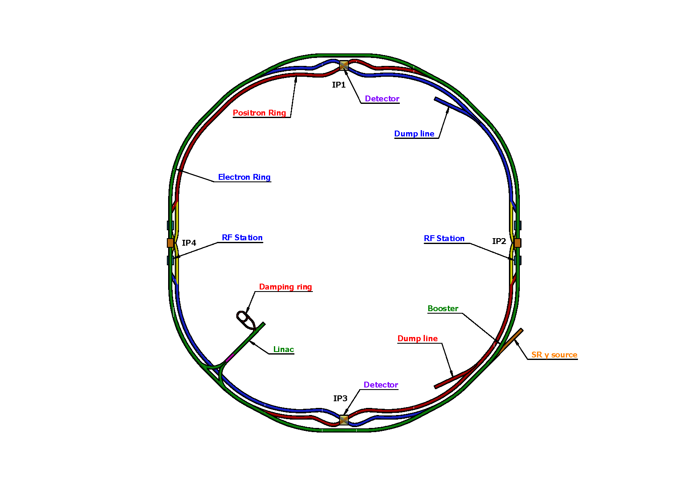
Lattice design requirement of the CEPC collider ring
Basically 2 folded symmetry
2 interaction regions @ IP1 and IP3
  crab waist collision
  local chromaticity correction for the interaction region
2 RF acceleration regions @ IP2 and IP4
  shared cavities for two beam @ ttbar, Higgs
  flexible switching between compatible modes
8 arc sections
  dual aperture dipole and quadrupole magnets
4 short straight section
  on/off axis injection regions for different modes
  beam dumping, gamma source
Providing polarized beam
SS4
SS1
SS: short straight section
SS3
SS2
one short auxiliary tunnel per km
Ref: CEPC TDR, arXiv 2312.14363

Slide 5
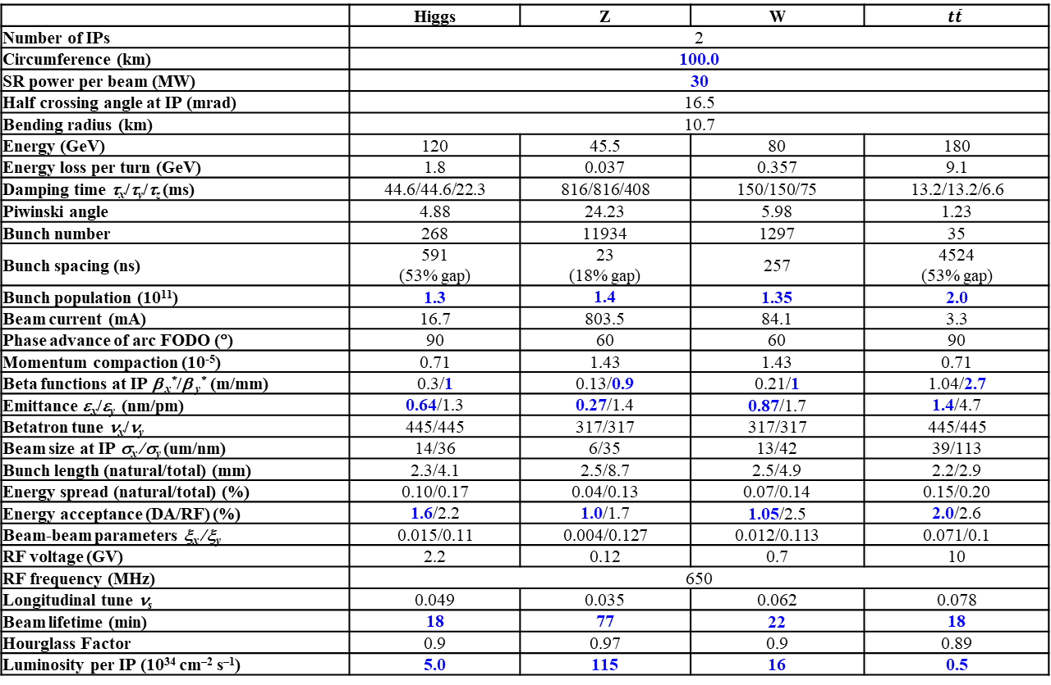
Design Parameters
 | Higgs | Z | W | $$t\overline{t}$$
Number of IPs | 2
Circumference (km) | 100.0
SR power per beam (MW) | 30
Half crossing angle at IP (mrad) | 16.5
Bending radius (km) | 10.7
Energy (GeV) | 120 | 45.5 | 80 | 180
Energy loss per turn (GeV) | 1.8 | 0.037 | 0.357 | 9.1
Damping time τ_{x}/τ_{y}/τ_{z} (ms) | 44.6/44.6/22.3 | 816/816/408 | 150/150/75 | 13.2/13.2/6.6
Piwinski angle | 4.88 | 24.23 | 5.98 | 1.23
Bunch number | 268 | 11934 | 1297 | 35
Bunch spacing (ns) | 591 (53% gap) | 23 (18% gap) | 257 | 4524 (53% gap)
Bunch population (10¹¹) | 1.3 | 1.4 | 1.35 | 2.0
Beam current (mA) | 16.7 | 803.5 | 84.1 | 3.3
Phase advance of arc FODO (°) | 90 | 60 | 60 | 90
Momentum compaction (10⁻⁵) | 0.71 | 1.43 | 1.43 | 0.71
Beta functions at IP β _{x}*/β _{y}* (m/mm) | 0.3/1 | 0.13/0.9 | 0.21/1 | 1.04/2.7
Emittance ε_{x}/ε_{y} (nm/pm) | 0.64/1.3 | 0.27/1.4 | 0.87/1.7 | 1.4/4.7
Betatron tune ν_{x}/ν_{y} | 445/445 | 317/317 | 317/317 | 445/445
Beam size at IP σ_{x} /σ_{y} (um/nm) | 14/36 | 6/35 | 13/42 | 39/113
Bunch length (natural/total) (mm) | 2.3/4.1 | 2.5/8.7 | 2.5/4.9 | 2.2/2.9
Energy spread (natural/total) (%) | 0.10/0.17 | 0.04/0.13 | 0.07/0.14 | 0.15/0.20
Energy acceptance (DA/RF) (%) | 1.6/2.2 | 1.0/1.7 | 1.05/2.5 | 2.0/2.6
Beam-beam parameters ξ_{x} /ξ_{y} | 0.015/0.11 | 0.004/0.127 | 0.012/0.113 | 0.071/0.1
RF voltage (GV) | 2.2 | 0.12 | 0.7 | 10
RF frequency (MHz) | 650
Longitudinal tune ν_{s} | 0.049 | 0.035 | 0.062 | 0.078
Beam lifetime (min) | 18 | 77 | 22 | 18
Hourglass Factor | 0.9 | 0.97 | 0.9 | 0.89
Luminosity per IP (10³⁴ cm^{–2} s^{–1}) | 5.0 | 115 | 16 | 0.5
- 𝛽y∗ and emittance chosen for luminosity
- adequate bunch population Ne for the luminosity and the achievable energy acceptance for lattice design
Ref: CEPC TDR, arXiv 2312.14363

Slide 6
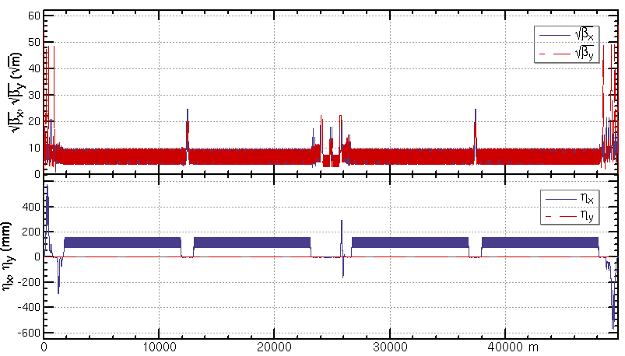
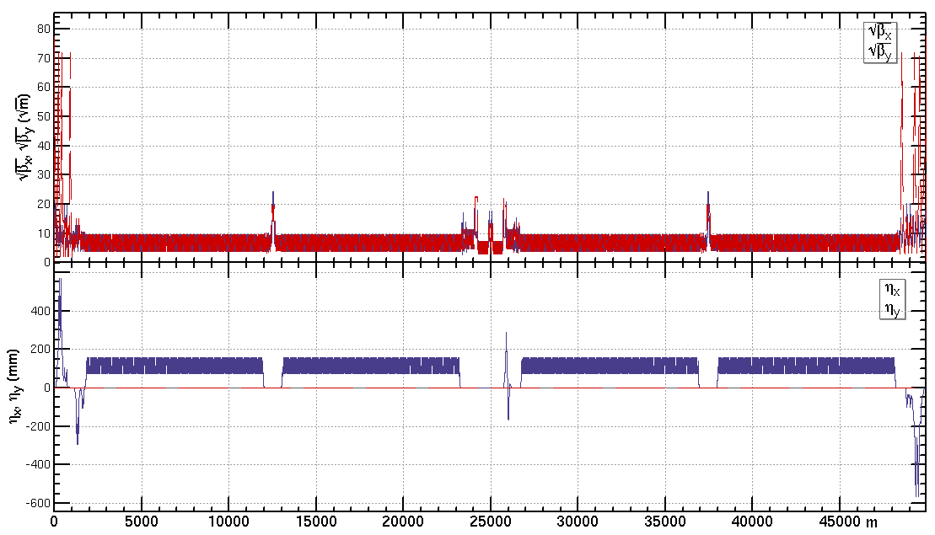
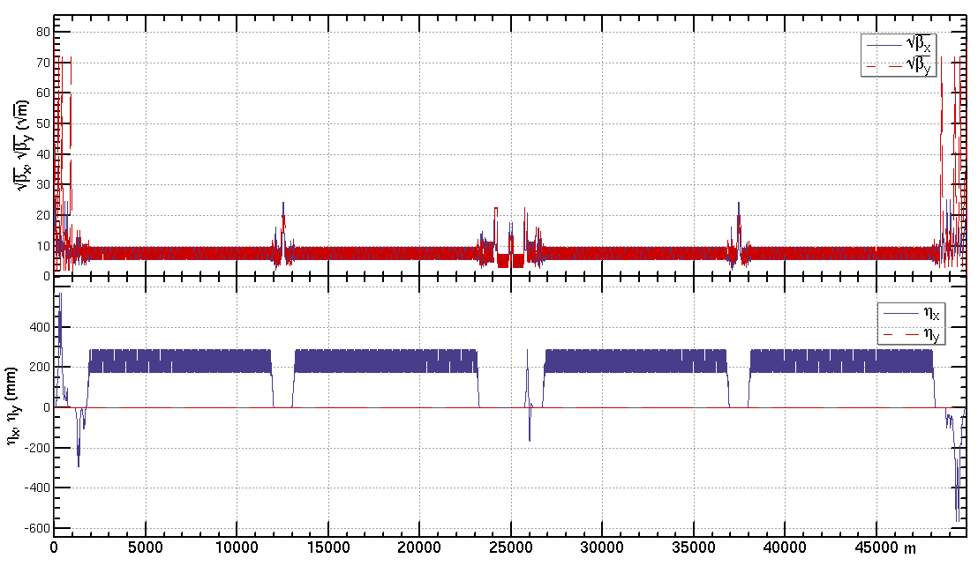
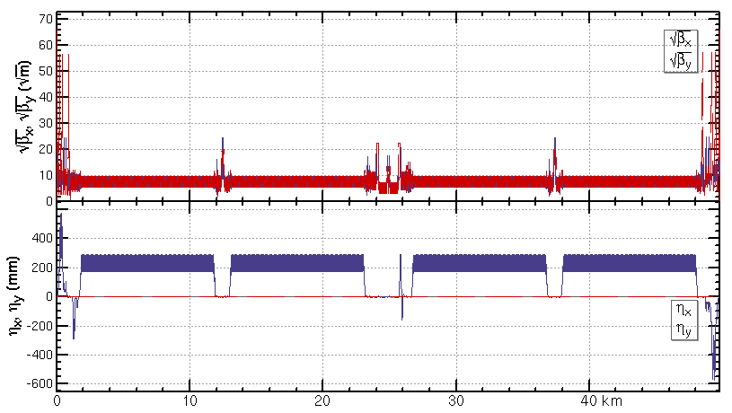
Lattice of the CEPC collider ring
ttbar: β=1.04m/2.7mm, εx=1.4nm, μ=90/90 deg
Higgs: β=0.30m/1mm, εx=0.64nm,
μ=90/90 deg
W: β=0.21m/1mm, εx=0.87nm, μ=60/60 deg
Z: β=0.13m/0.9mm, εx=0.27nm, μ=60/60 deg

Slide 7
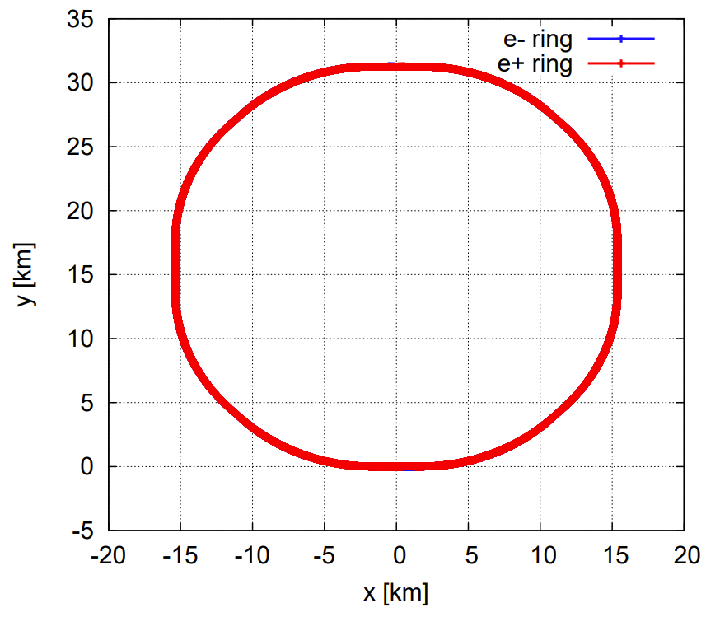
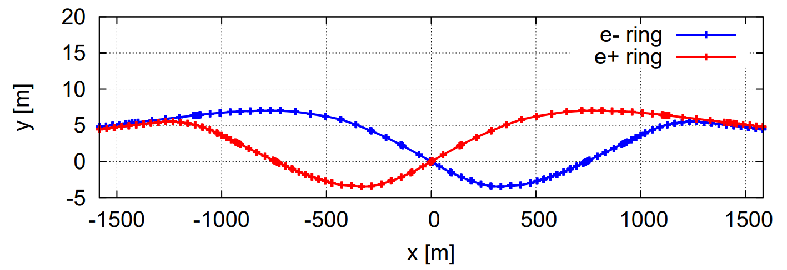
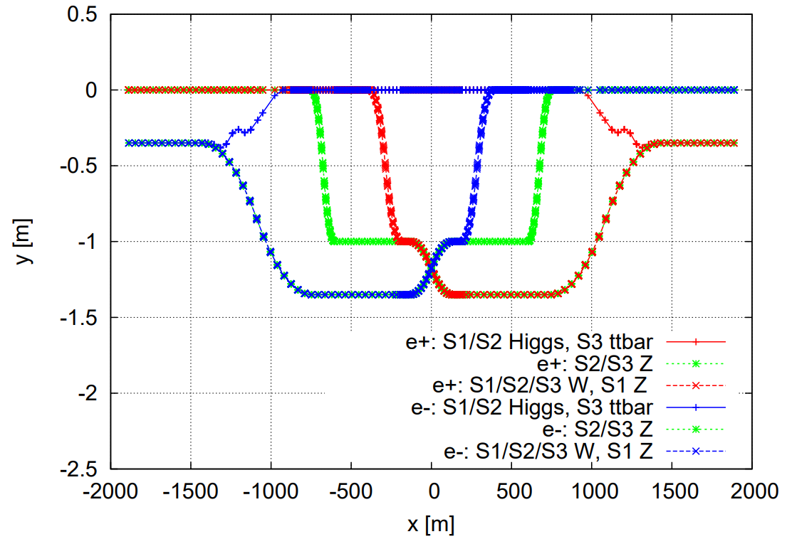
Geometry of the collider ring
4 curved arc sections, each with a length of 10270.44 m
4 curved arc sections, each with a length of 10185.70 m
2 interaction regions (IRs), IP1/IP3, each with a length of 3337.13 m
2 linear sections for RF, IP2/IP4, each with a length of 3776.90 m
4 linear sections, each with a length of 986.84 m
SS4
SS1
SS3
SS2

Slide 8
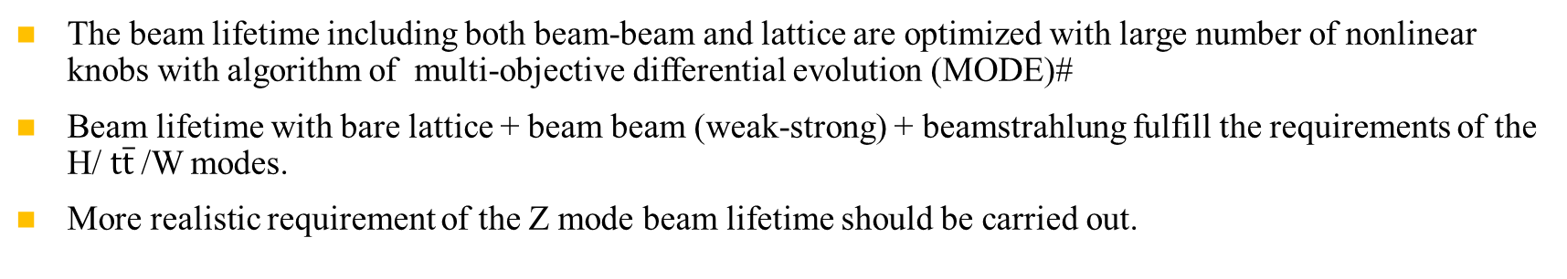
Beam lifetime of lattice + beam beam(w-s) + Beamstrahlung
Y. Zhang, Y. Wang, D. Wang, H. Geng, Z. Duan
The beam lifetime including both beam-beam and lattice are optimized with large number of nonlinear knobs with algorithm of multi-objective differential evolution (MODE)#
  Beam lifetime with bare lattice + beam beam (weak-strong) + beamstrahlung fulfill the requirements of the H/ $t\overline{t}$/W modes.
  More realistic requirement of the Z mode beam lifetime should be carried out.
 | Higgs | ttbar | W
Beam lifetime requirement for top-up injection [min] | 18 | 18 | 22
Bhabha lifetime [min] | 40 | 80 | 60
Required lattice + beambeam + beamstrahlung beam lifetime [min] | 33 | 24 | 35
Simulated lattice + beambeam + beamstrahlung beam lifetime [min] | 139 | 278 | 139
Crab sextupole strength [%] | 80 | 49 | 80
#J. Wu, Y. Zhang, Q. Qin, Y. Wang, C. Yu, D. Zhou, NIMA 959 (2020) 163517.
J. Wu, Y. Zhang, Q. Qin, doi:10.18429/JACoW-IPAC2019-MOPGW051, IPAC19.
Y. Zhang et al, doi:10.18429/JACoW-eeFACT2018-TUYBA04, eeFACT2018.
K. Oide, FCCIS 2022 workshop, Dec. 06, 2022.
Notes:
详细描述优化过程

Slide 9
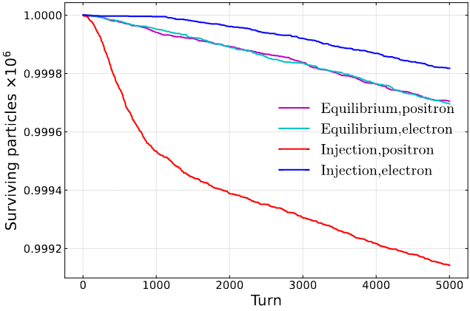
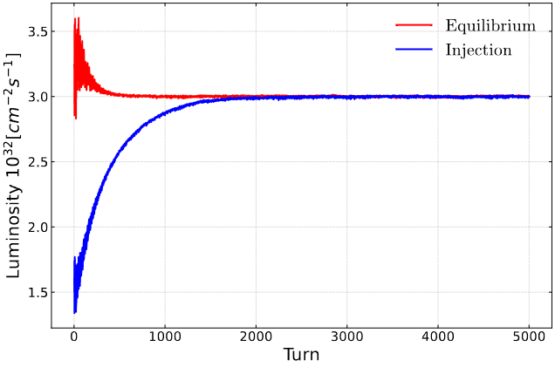
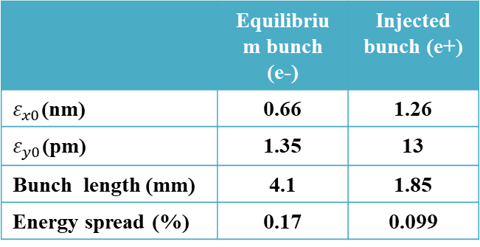
Beam lifetime of lattice + beam beam(s-s) + Beamstrahlung
Ref: Z. Li, Y. Zhang, K. Ohmi, D. Zhou, Y. Wang, G. Xu, strong-strong beam-beam simulations with realistic lattices of circular e+e- colliders, paper submitted
Using an integrated simulation code in APES-T (IHEP homemade, in progress) which can implement element-by-element tracking with strong-strong beam-beam interaction and lattice*
 | Equilibrium bunch (e-) | Injected bunch (e+)
$ε_{x0}$(nm) | 0.66 | 1.26
$ε_{y0}$(pm) | 1.35 | 13
Bunch length (mm) | 4.1 | 1.85
Energy spread (%) | 0.17 | 0.099
The injection pattern reaches a stable state equivalent to the equilibrium collision after 2000 turns, with a lifetime of approximately 40-50 minutes. The particle loss before stability is about 0.06%.

Slide 10
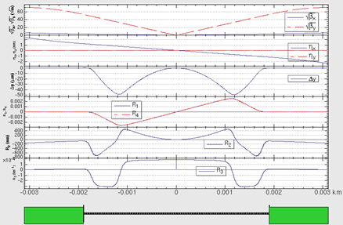
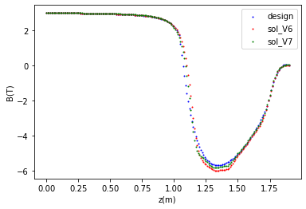
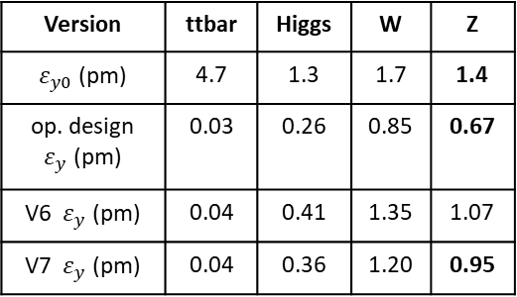
Vertical emittance generated by solenoid field
The detector solenoid are compensated locally with anti-solenoids
  ∫Bzdz cancled between the IP and the entrance of final quadrupole
  The vertical emittance generated by the vertical bending
    due to the fringe field of the anti-solenoid combined with the horizontal crossing angle.
  3T for 𝑡𝑡 ̅/Higgs/W, 2T for the Z as smaller nominal emittance and larger induced emittance with lower beam energy
  Field configuration optimized to get emittance minimum and iterate with anti-solenoid technical constraints
By Ande MA, Yiwei Wang, Yingshun Zhu
IR optics with solenoid for Higgs energy
Version | ttbar | Higgs | W | Z
$ε_{y0}$ (pm) | 4.7 | 1.3 | 1.7 | 1.4
op. design $ε_{y}$ (pm) | 0.03 | 0.26 | 0.85 | 0.67
V6 $ε_{y}$ (pm) | 0.04 | 0.41 | 1.35 | 1.07
V7 $ε_{y}$ (pm) | 0.04 | 0.36 | 1.20 | 0.95

Slide 11
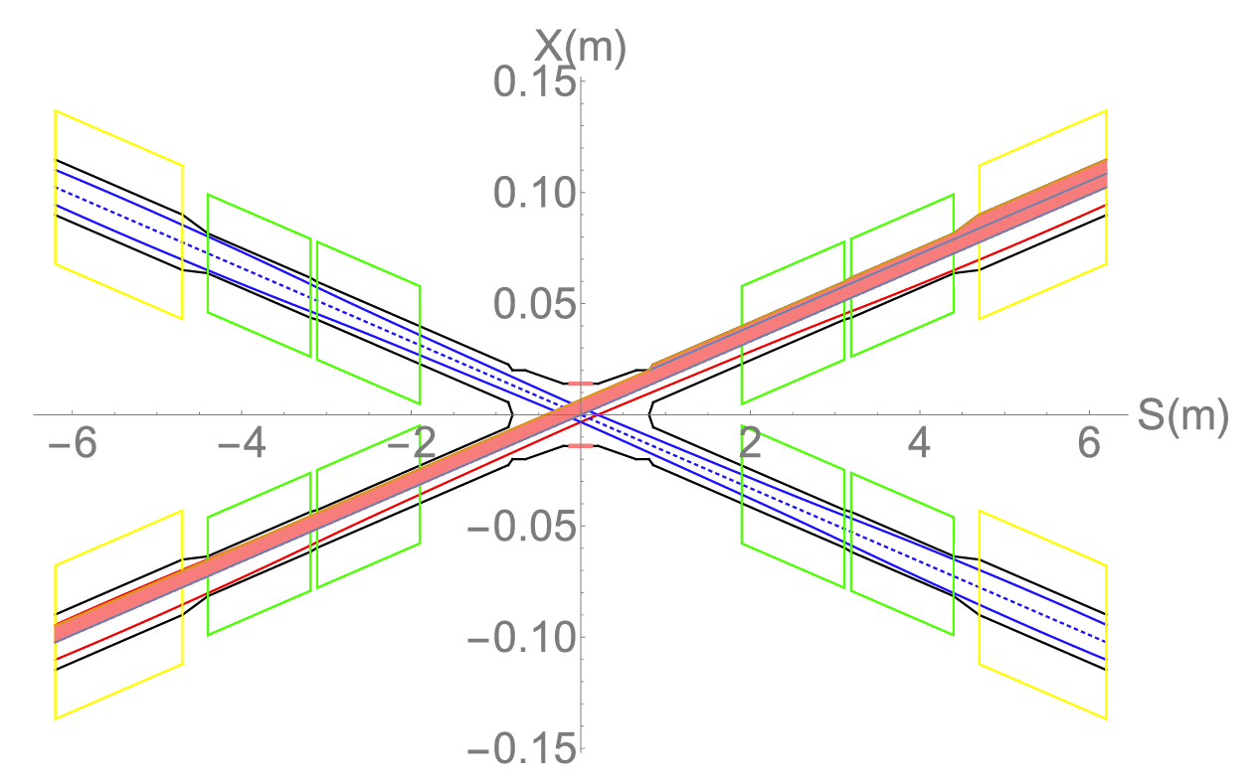
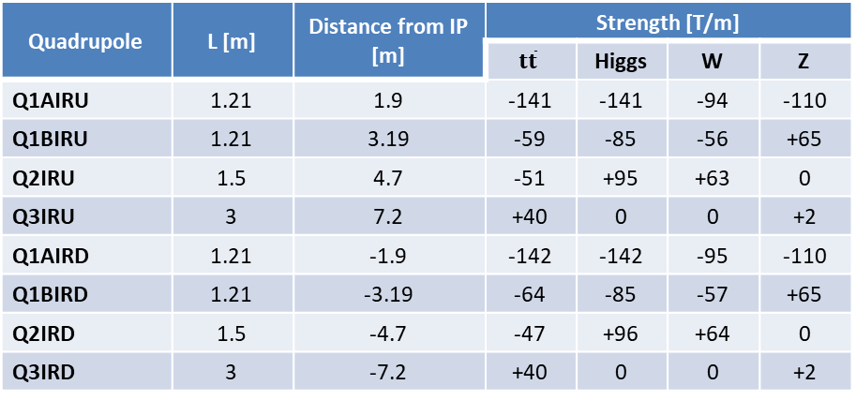
  Super conducting final quadrupoles for all modes
Y. Zhu, C. Shen, J. Geng, H. Shi, S. Bai, Y. Wei, Y. Wang
The final quadrupole parameters near the IP are chosen based on a trade-off between the beam dynamics and the machine detector interface.
Dipole field aberration due to cross talk of the two aperture
  Three types of SCQ design are undergoing.
  Beam dynamics: integrated dipole field should be corrected
  Radiation and particle loss: maximum 300 gs as start point of iteration between quadrupole technical design and MDI simulation
    Radiation and 2nd ordinary particles loss will be simulated with an integrated model of the quadrupoles, dipole error and solenoid
Requirements of the correction coils are undergoing with the IP tuning simulation.
Layout of the dual aperture SCQ final quadrupoles
Q2IRD
Q2IRD
Q1BIRD
Q1BIRD
Q1AIRD
Q1AIRD
 | QD | QF
Z | Q1A | Q1B
W/H | Q1A+Q1B | Q2
ttbar | Q1A+Q1B+Q2 | add quad Q3A and Q3B
Q1BIRU
Q1AIRU
Q1AIRU
Q1BIRU
Q2IRU
Q2IRU
Quadrupole | L [m] | Distance from IP [m] | Strength [T/m]
 |  |  | $$t\overline{t}$$ | Higgs | W | Z
Q1AIRU | 1.21 | 1.9 | -141 | -141 | -94 | -110
Q1BIRU | 1.21 | 3.19 | -59 | -85 | -56 | +65
Q2IRU | 1.5 | 4.7 | -51 | +95 | +63 | 0
Q3IRU | 3 | 7.2 | +40 | 0 | 0 | +2
Q1AIRD | 1.21 | -1.9 | -142 | -142 | -95 | -110
Q1BIRD | 1.21 | -3.19 | -64 | -85 | -57 | +65
Q2IRD | 1.5 | -4.7 | -47 | +96 | +64 | 0
Q3IRD | 3 | -7.2 | +40 | 0 | 0 | +2
Notes:
加清晰区等

Slide 12
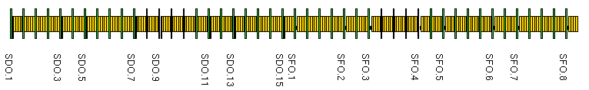
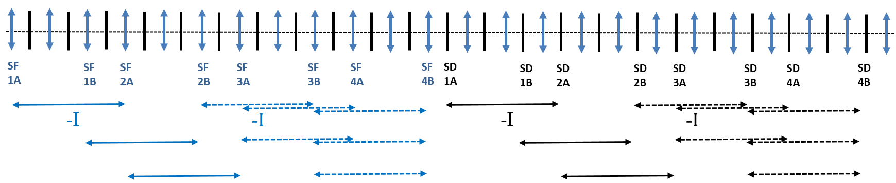
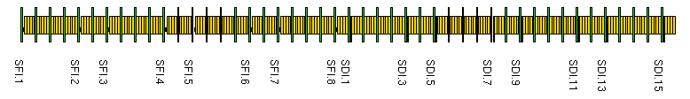
  Lattice design of the ARC region
FODO cell to provide a large filling factor of dipole.
90/90 degrees’ phase advances for the Higgs and ttbar modes due to the emittance and nonlinearity cancelation.
60/60 degrees’ phase advances for the W and Z modes to fulfil the collective instability requirement.
The distance 0.35m and opposite polarity between two beams fulfill the requirement technical design of the twin-aperture of dipoles and quadrupoles.
The distribution of sextupoles for Higgs & ttbar mode allowed to select –I sextupole pairs for W &Z modes.
0.35m
Dual aperture quadrupole and bend with opposite polarity in two ring
Distribution of sextupoles

Slide 13
Normal conducting magnets
FODO cells in the arc to provide a large filling factor of dipole
  Dual-aperture dipoles and quadrupoles in the arc to save magnet power
  Single-aperture sextupoles for independent nonlinearity optimization of e+ e- rings
  Two kind of dipole length to use the space where no sextupoles
Single aperture magnets in the RF, injection and interaction regions
Correction of the energy sawtooth effects require adjusting range of magnets strength ±2.5% with the trim coils
Running at energy up to 180 GeV
Work to be done
Exploring less alignment sensitivity arc lattice and estm. magnet papa.
Dual-aperture dipole | B0A | B0B
Core number | 1024*4 | 1984*4
Core length[m] | 4.9 | 5.7
Aperture [mm] | 66 | 66
Field strength [Gs] @45.5 GeV | 150.9 | 150.9
Field strength [Gs] @180 GeV | 597 | 597
Good field region [mm] | 11.6 | 11.6
Dual-aperture quadrupole | DAQ
Quantity | 3008
Aperture diameter[mm] | 72
Max. field [T/m] | 10.6
Core length[mm] | 3000
 | Number
Dipoles
Dual aperture dipole (L= 19.743 m) | 1024
Dual aperture dipole (L= 23.14 m) | 1984
Single aperture dipole | 162
Quadrupoles
Dual aperture quadrupole | 3008
Single aperture quadrupole (L= 2.65 m) | 212
Single aperture quadrupole (L= 2 m) | 364
Single aperture quadrupole (L= 0.8 m) | 408
Other quadrupoles | 148
Sextupoles
Sextupole | 3072
Other sextupole | 104
Correctors | 7088
Sextupole | SFI/SFO | SDI/SDO
Quantity | 512/512 | 1024/1024
Aperture diameter[mm] | 76 | 76
Max. field [T/m²] | 825 | 846.75
Core length[mm] | 1400 | 1400
Correctors | CH/CV
Quantity | 3544/3544
Aperture diameter[mm] | 66
Max. field [Gs] | 225
Core length[mm] | 875

Slide 14
Magnet Power Supplies
Arc regions
  In principle, the dual-aperture dipoles and quadrupoles can be connected in series as same FODO cells in the arc. Actually powered by many power supplies due to the large scale of CEPC.
  Correctors, trim coils for the tapering, each pair of sextupoles for nonlinearity optimization should be powered independently (single-aperture)
RF, injection and interaction regions
  most magnets should be powered independently (single-aperture)
The stability requirement of magnet PS
  from the stability of the collision energy, working point, beta* and the beam lifetime.
Magnet Power Supplies | Quantity | Stability /8hours
Dipole-D-aperture | 32 | 10ppm
Dipole-S-aperture | 38 | 10ppm
Quadrupole-D-aperture | 328 | 10ppm
Quadrupole-S-aperture | 600 | 10ppm
Sextupole | 1096 | 20ppm
Corrector-H & V | 7088 | 100ppm
Trim | 11904 | 100ppm
Superconducting magnets | 88 | 10ppm
Total | 21174
  Preliminary calculation show that
  the accuracy of the collision energy measurement from the HEP experiment would require better dipole stability esp. at Z pole
  The working point and beta* stability would require better quadrupole stability
Ref: Yiwei Wang, Note on the stability of power supply, 20230814, v2.1

Slide 15
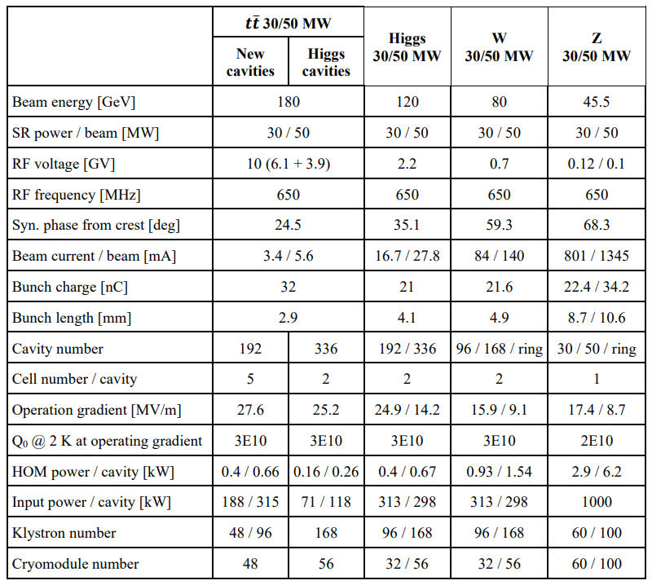
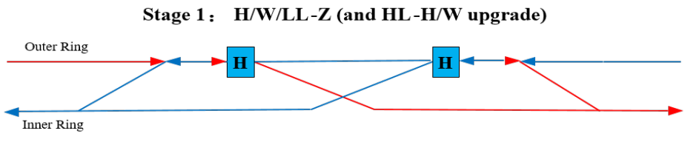
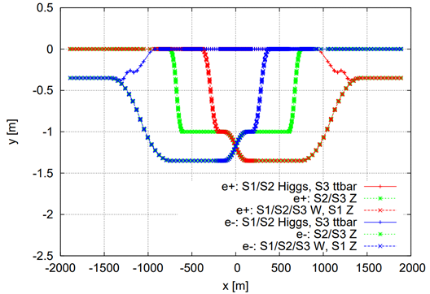
Superconducting RF System and RF Power Source
1st priority of the Higgs running and flexible switching
Stage 1: High luminosity Higgs and W; medium or low luminosity at Z
  2-cell SC RF cavities are shared by two rings for the Higgs running; Half the number of H cavities are bypassed for W and Z running.
The RF power source number is determined by the synchrotron radiation power and klystron power.
Work to be done: engineering design of the beamlines in different stages; synchrotron radiation due to errors and so on

Slide 16
Mechanical Systems
Independent support for dual aperture dipole as long length (~5m)
Independent support for dual aperture quadrupole as long length (3m)
One support per 3 adjacent sextupoles
The resolution of the support should be better than 10 um due to the sensitivity of the closed orbit to the magnets
 | Number
Mechanical Systems
Dipole support | 13314
Quadrupole support | 4128
Sextupole support | 1128
Corrector support | 3544
Vacuum device support | 98979
BI Support | 4254
Collimators | 120
MDI mechanical devices | 8
RF support | 100
Adjustment range and resolution of supports
Direction | Range of adjustment | Direction | Resolution
X | ≥±20 mm | X | ≤10μm
Y | ≥±30 mm | Y | ≤10μm
Z | ≥±20 mm | Z | ≤10μm

Slide 17
Alignment requirement
More details can be found in talk by
Bin WANG, this conference
Requirement of the relative alignment accuracy of the adjacent equipment is basically 100um based on the current error correction simulation.
Requirement of the absolute alignment accuracy need to be carried out.
Accuracy of the collider circumference due to alignment doesn’t pose an issue as the RF frequency and timing can be change slightly.
Requirement of the relative difference of the two-ring circumferences need investigation as the adjustment limited very high magnetic rigidity
  Contribution form the ARC would be limited due to the application of dual aperture dipole and quadrupole ( with order(2Pi*10s um) )
  Possible approaches: soft and long alternating bending in straight sections (prop. by G. Xu), closed orbit correction

Slide 18
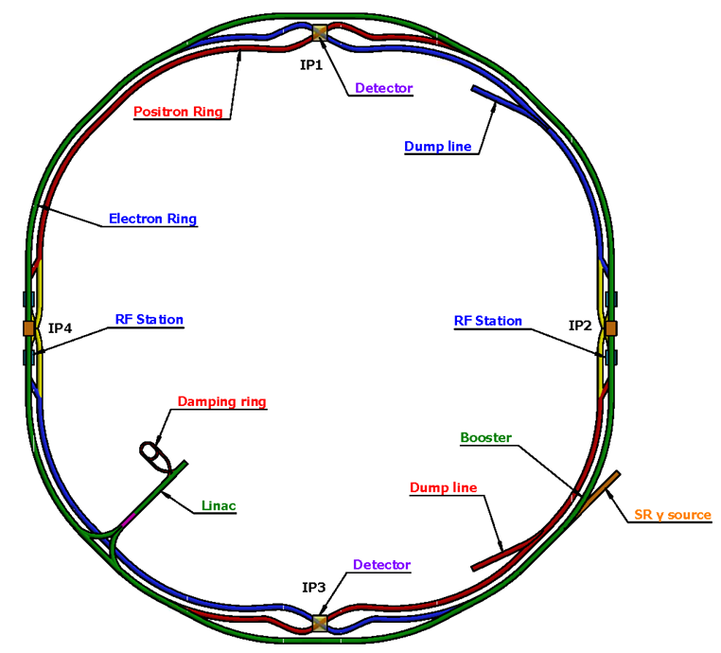
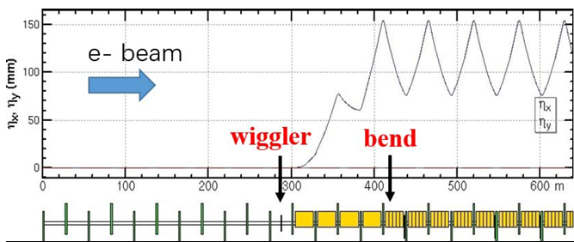
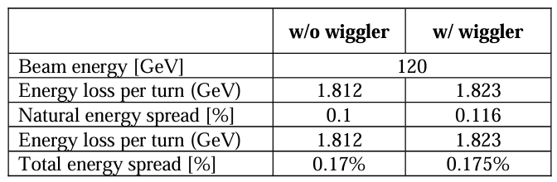
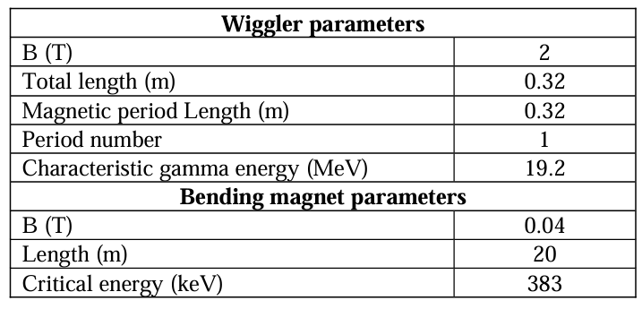
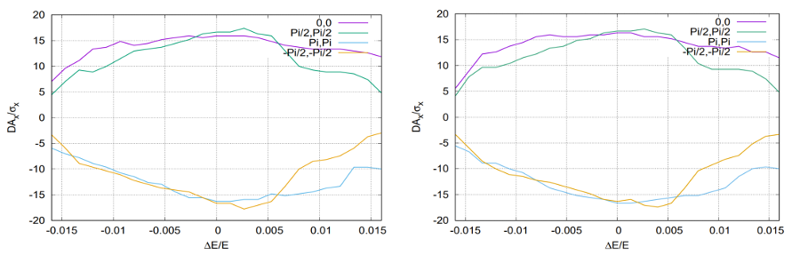
Wiggler and bends for gamma source
The strength of wiggler is required by the experiment and its length is limited by the beam performance for collision.
The introduction of an additional wiggler for the SR γ-ray source leads to a slight increase in energy loss per turn ∆U0/U0 increment of 0.6%.
Synchrotron radiation effects of wiggler on beam dynamics can be mitigated by adjusting the magnet strength to accommodate the beam (COD 2um)
The reduction in luminosity due to the SR from the wiggler is ~3% as the total bunch length increasing is ~3%.
  further investigation to restore luminosity will be done
Comparison of the dynamic aperture with (left) and without (right) wiggler at Higgs energy.

Slide 19
EDR plans for the collider ring lattice
Further tradeoff between the collider lattice, MDI, booster to get a more adequate machine design and further improve the dynamic aperture for the bare machine.
Establish the more realistic lattice with polarization systems, energy measurement systems, the complex interaction region components, realistic finite length fringe field and so on.
Face to the engineering design, trade off the accelerator physics requirements and the technology to establish parameters for future engineering.
Improve the global corrections and emittance tuning with errors.
Investigate more static errors including effect of BPM errors and multi-field errors, the long range alignment errors and the beam-based alignment for the main magnets et al.
Investigate on the dynamic error effects and possible feedback, including the injection jitter, the power source jitter, the ground motion with realistic data from the candidate sites.
Perform tracking simulations with a realistic lattice and strong-strong beam-beam interaction, to study the effects of machine errors on the beam-beam performance and the interplay with the luminosity-tuning knobs.
Establish the detailed procedures for the first turn injection, tuning, operation, different modes switching et al. Establish the tools and soft wares for tuning and operation.

Slide 20
Summary
The collider ring lattice design, progress and lattice related hardware requirements for EDR to give start points are presented.
Work progress and plan toward the EDR is proposed.
The lattice design will also evolve with the iteration between beam physics simulation and hardware engineering design.
Thanks to beneficial discussion with colleague of CEPC Accelerator Physics Group!

Slide 21
backup

Slide 22
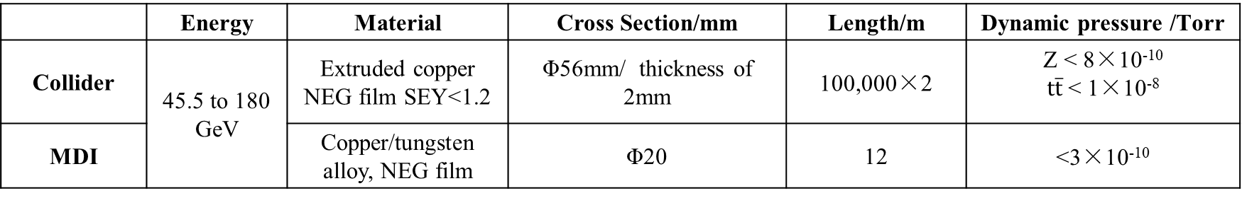
Vacuum System
Very low pressure must be attained to get enough beam-gas scattering lifetime
NEG coating to control secondary electron yield to suppress electron cloud effect: SEY < 1.2
Resistive wall impedance: copper, Φ56 mm, thickness 2mm, NEG coating <200nm
Modes | E (Gev) | Beam gas scattering lifetime (hours) | Vacuum Requirement (Torr)
Higgs | 120 | 10 | 2 × 10⁻⁹
W | 80 | 5 | 1.5 × 10⁻⁹
Z | 45.5 | 3 | 8 × 10⁻¹⁰
tt | 180 | 15 | 1 × 10⁻⁸
 | Energy | Material | Cross Section/mm | Length/m | Dynamic pressure /Torr
Collider | 45.5 to 180 GeV | Extruded copper NEG film SEY<1.2 | Φ56mm/ thickness of 2mm | 100,000×2 | Z < 8×10⁻¹⁰ $t\overline{t}$ < 1×10⁻⁸
MDI |  | Copper/tungsten alloy, NEG film | Φ20 | 12 | <3×10⁻¹⁰
CDR | TDR
75×56 mm | Φ56 mm | Mitigate quadrupolar wake and its induced betatron tune shift
NEG coating on e+ ring Cu e+ ring, Al e- ring | NEG coating on e+/e- ring Cu e+/e- ring | Reach high vacuum requirements in both rings

Slide 23
Instrumentation
Beam position monitor
  More than four per 2 Pi phase advances
Beam loss monitor
  Locate at the positon where the beam particle more likely lost
Synchronous light extraction area
  one/IP/ring
  X-ray for measuring transverse beam size and visible light for bunch length
 | Number
Instrumentation (Ch 4.3.7)
Beam position monitor
Pick-ups | 4252
Cable | 21260
Electronics | 4252
Beam current monitor (AC)
Pick-ups and front end electronics | 2
Read out electronics | 2
Beam current monitor (DC)
Detector | 4
Read out electronics | 4
Cable | 4
Bunch length monitor
Streak camera | 2
Optical platform | 4
Beam profile monitor
X ray camera | 2
Optical path and components | 2
Beam loss monitor
Pin diodes | 5800
Read out electronics | 1450
Tune monitor
Electronics | 2
Power amplifier | 8
Kicker | 2
Transverse feedback
Electronics | 8
Kicker | 8
Longitudinal feedback
Electronics | 8
Kicker | 4
Synchronous light extraction area | 4

