Slide 1
Mechanical Model of the
FCC e+e- MDI

Slide 2
Table of content
Spatial constraint | 5 | Support tube | 14
MDI Mechanical Model | 4 | Assembly procedure | 19
Central Chamber | 7 | Conclusion | 20
Trapezoidal chamber | 8
Structural analysis – chamber | 9
Bellows | 11
Crotch chamber | 12

Slide 3
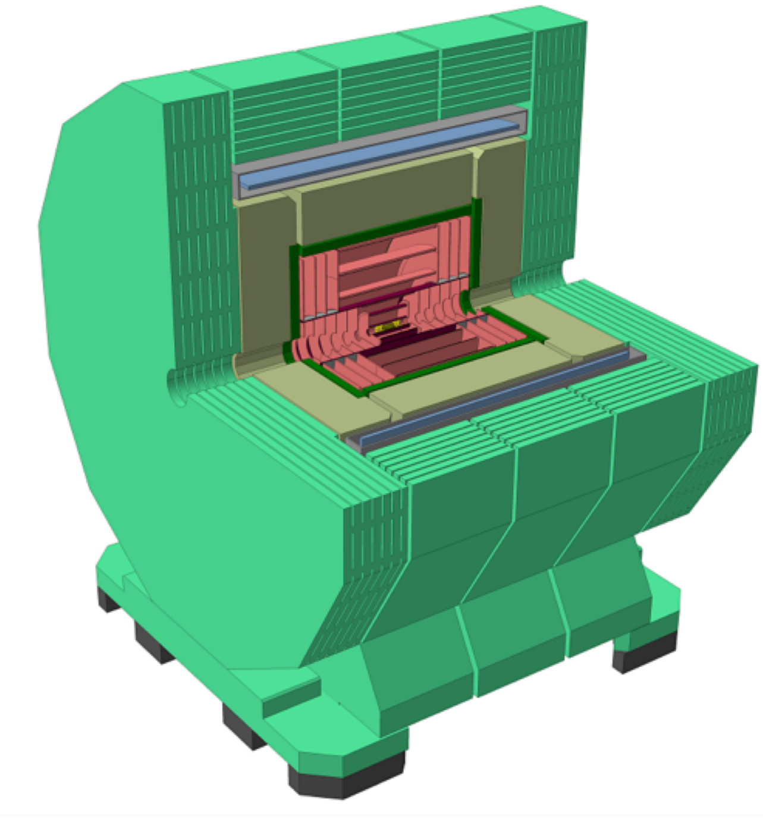
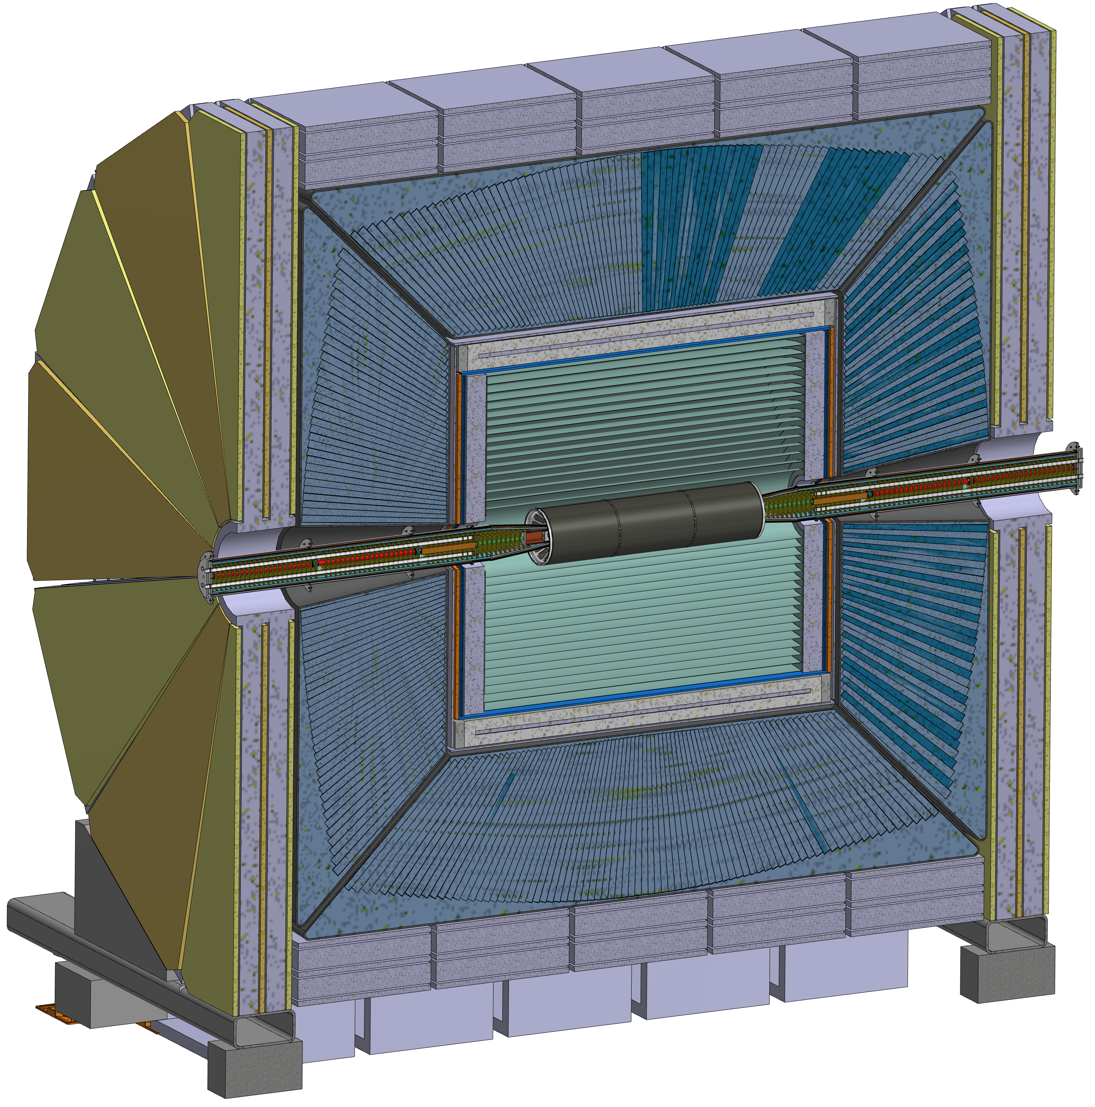
At the moment a detector concept has not been defined. The two main philosophy are based on the IDEA concept and the CLD concept,
Any design shown in this presentation for now is based on IDEA detector.
IDEA
CLD
12 m
11 m
10.6m
13 m

Slide 4
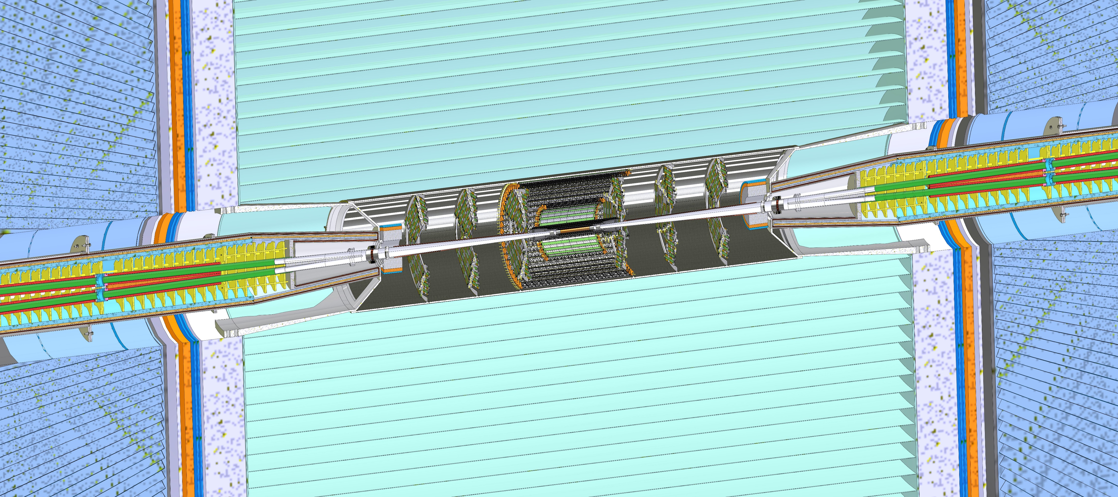
Support tube
Central chamber
Outer and medium tracker
Bellows
Cryomagnet
Cooling
IDEA detector
Conical chamber
LumiCal
Outer and medium tracker
Disks

Slide 5
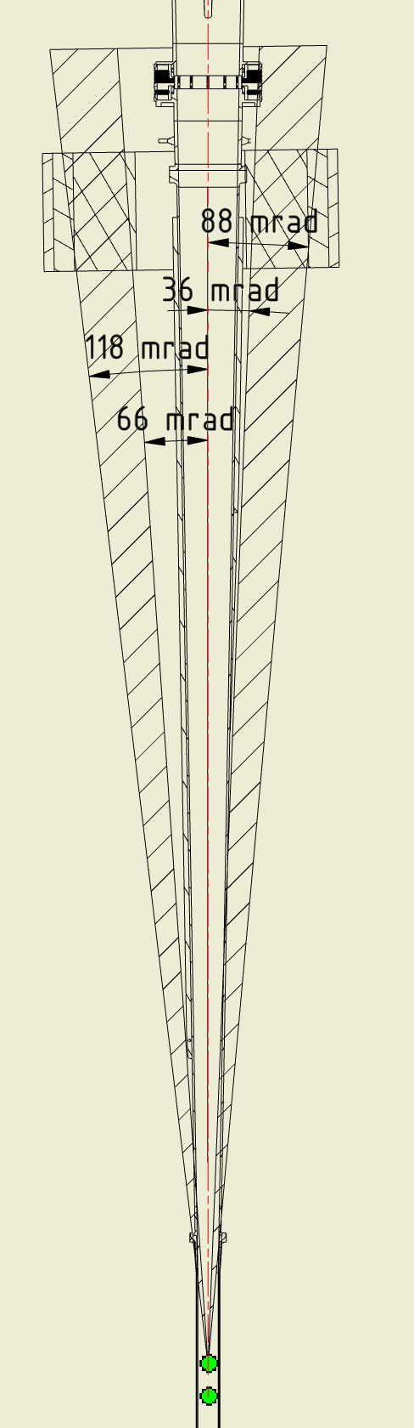
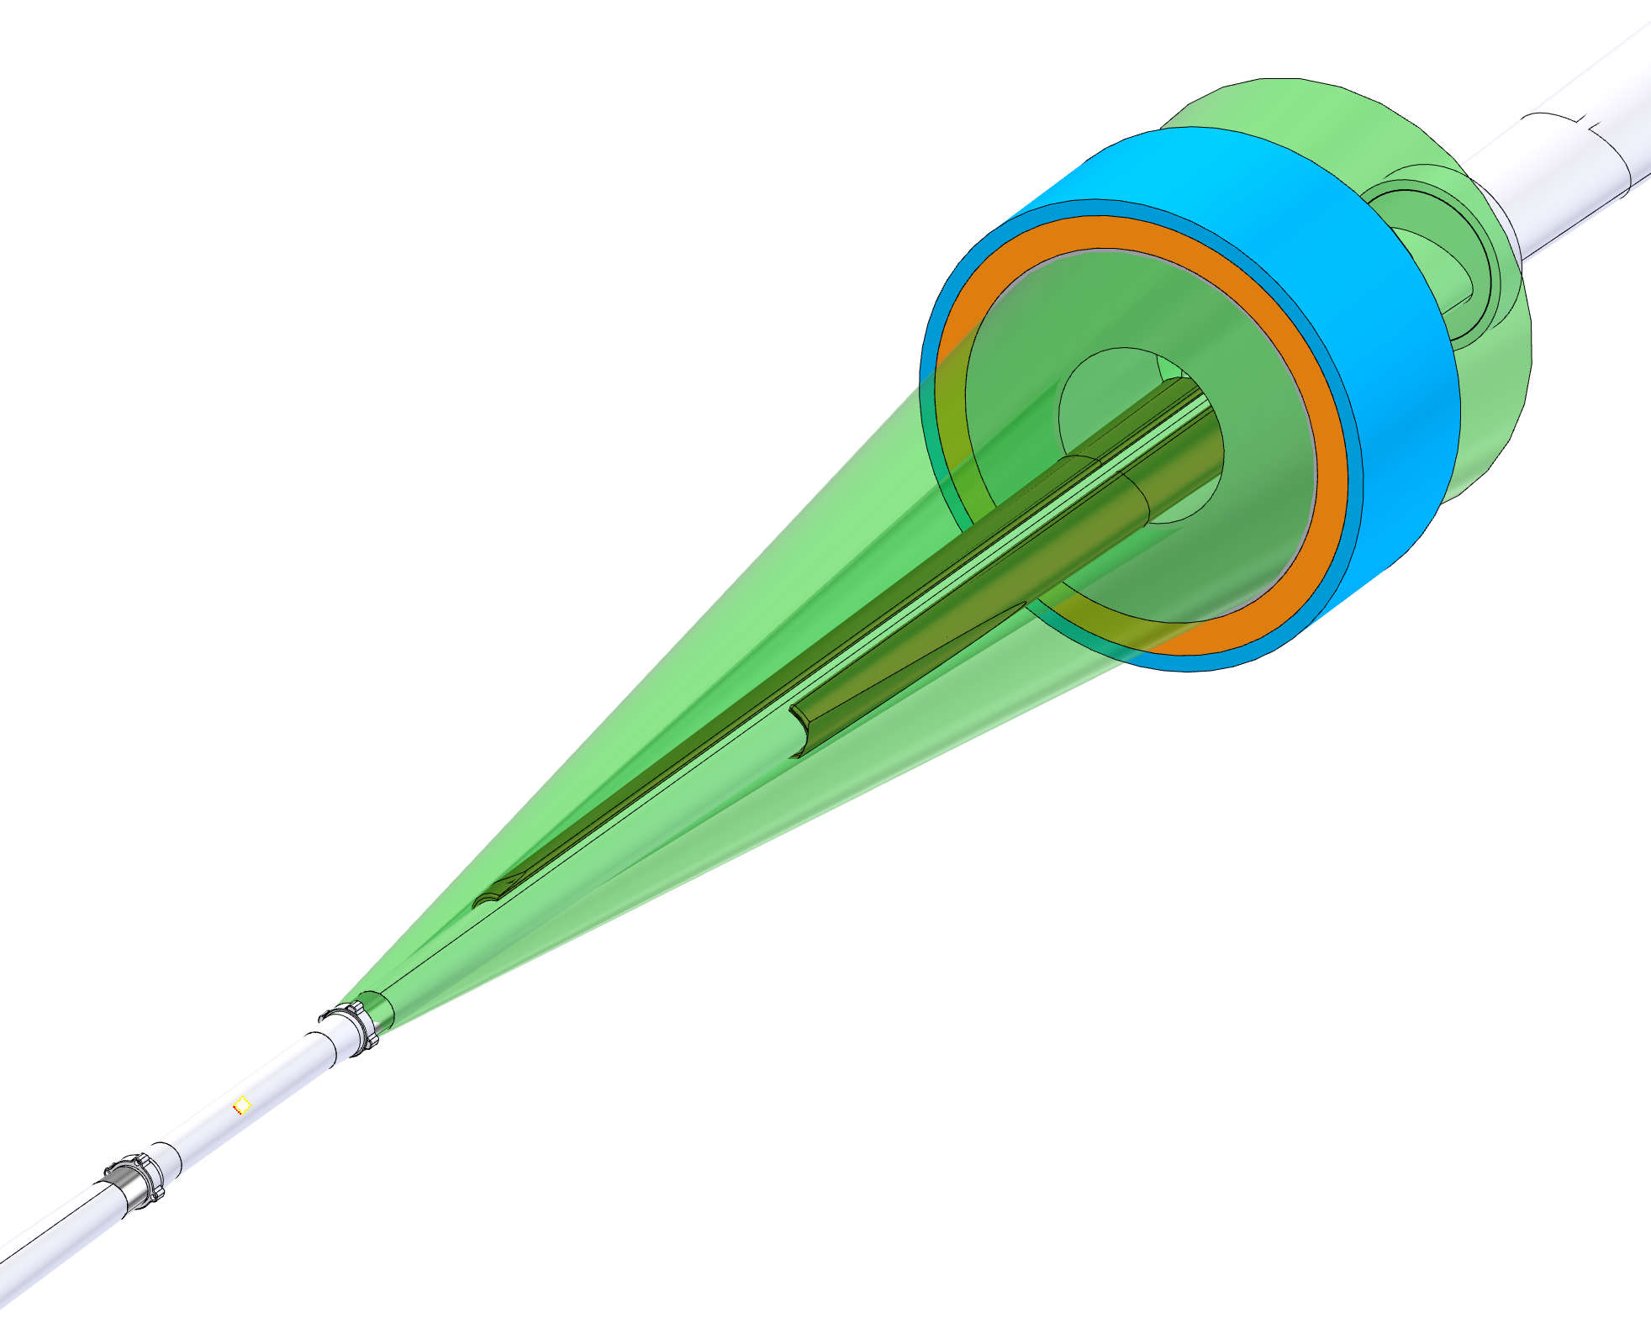
Spatial constraints - LumiCal Cones
The Lumical is centred on the outgoing beam pipe.
The device to perform properly needs an empty space between two cones, the 50 mrad cones and the 105 mrad cone.
105 mrad
50 mrad
The components integration and each component (i.e. the conical chamber) have been designed to keep everything out of this range, or the thickness has been optimized to achieve the maximum transparency possible.
Asymmetric spatial constraint

Slide 6
Spatial constraints – Detector Cone
Another important constraint imposed over the IR from the detector is the respect of a 100 mrad cone, centered on the detector axis.
This constraint is symmetric and, therefore, is less problematic if compared with the Lumical Constraint

Slide 7
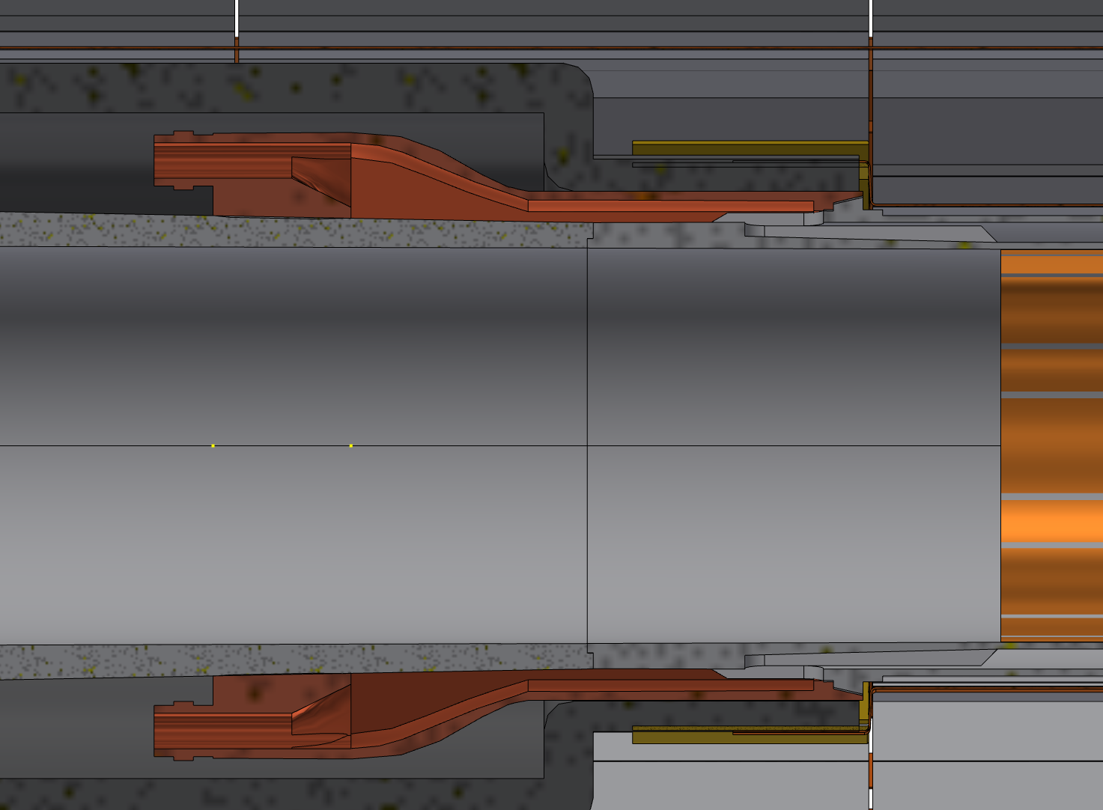
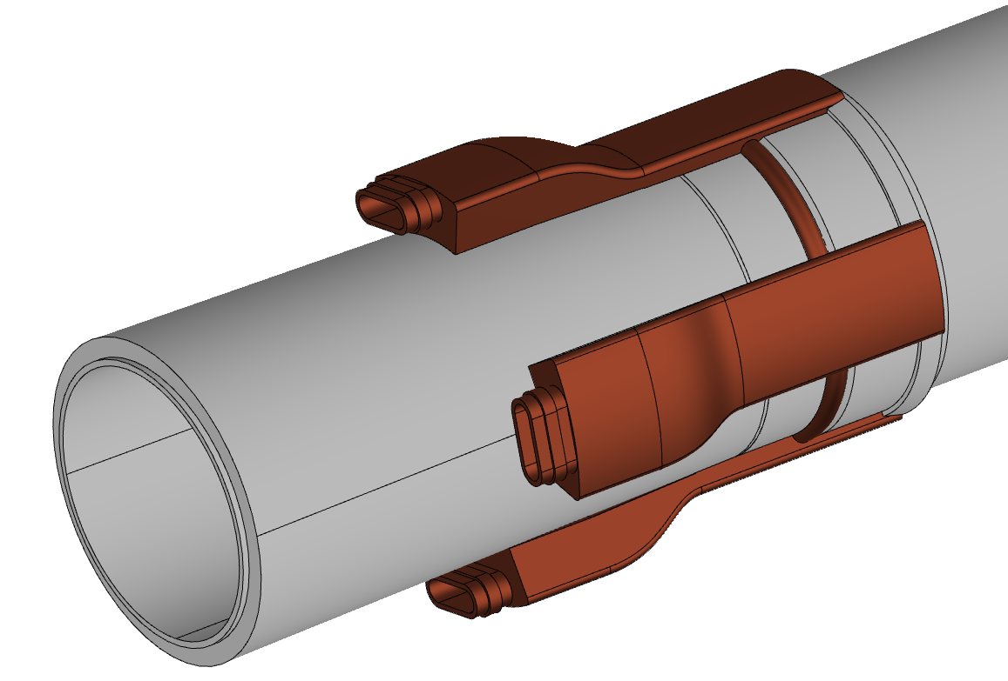
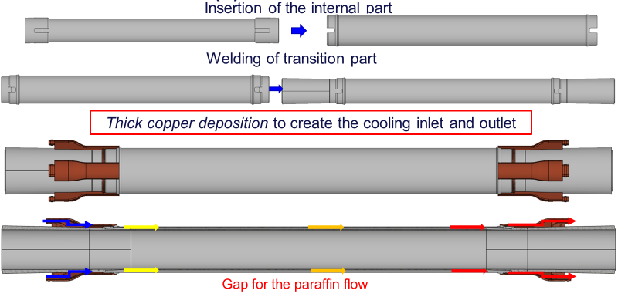
Central chamber
1st layer Inner Vertex
The central has the following characteristics:
AlBeMet 162 as main material
Three layers from 0-90 mm from IP
0.35 mm of AlBeMet162
1 mm gap for Paraffin
0.35 mm of AlBeMet162
Paraffin as coolant
Geometry studied to integrate the central chamber with the Inner Vertex (200 µm of clearance between central chamber and Inner Vertex support)
Central chamber
Inlet/outlet
Inlet/outlet for paraffin cooling

Slide 8
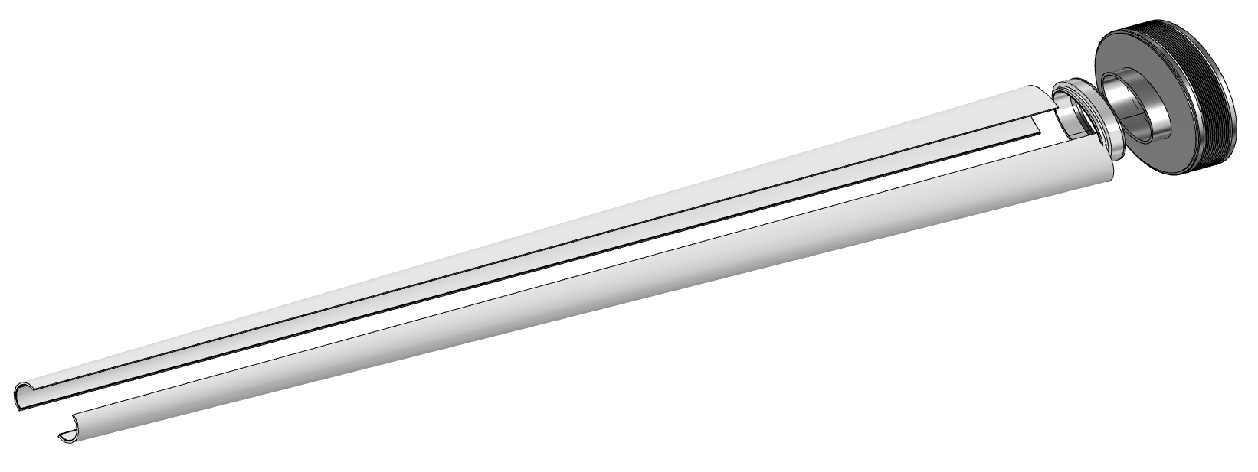
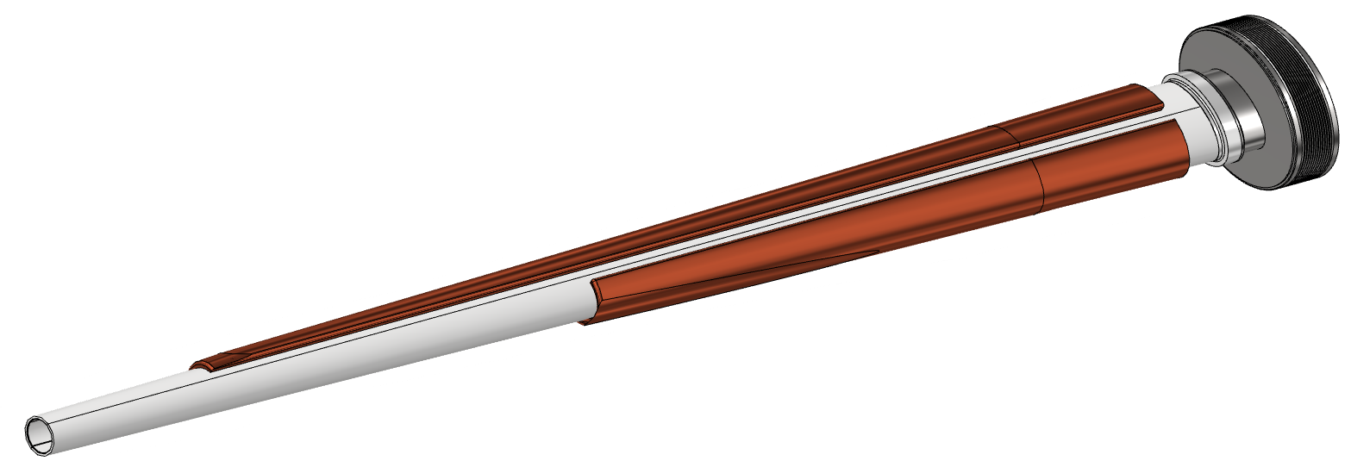
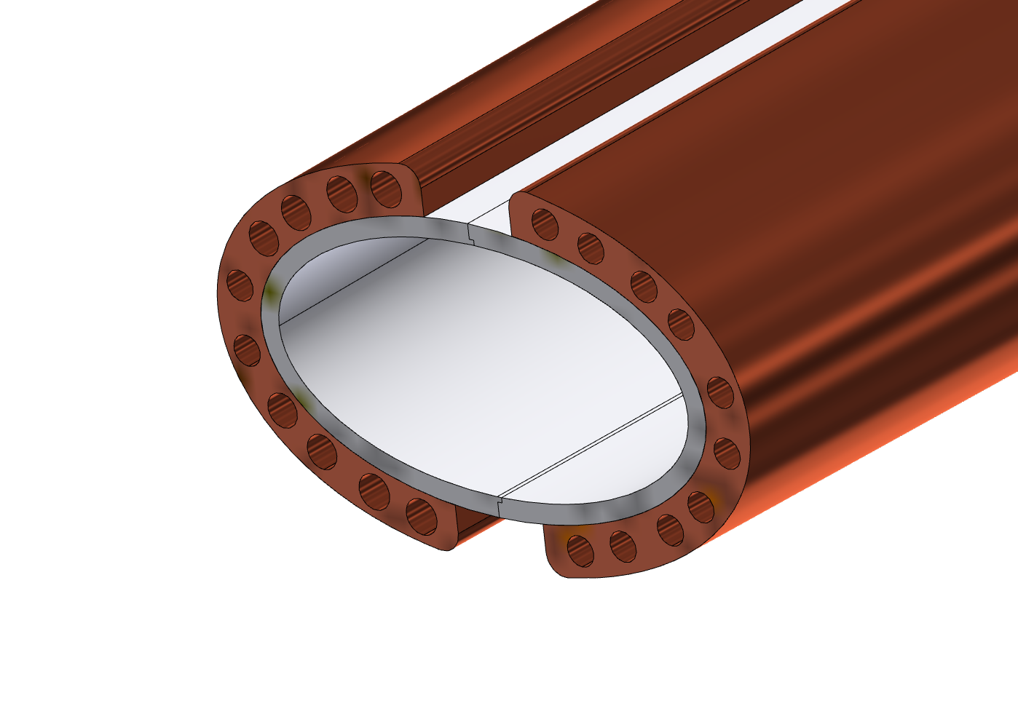
Trapezoidal chamber
Main characteristics:
AlBeMet162 as main material
Chamber in two halves and assembled using EBW
Copper cooling system
Bellows
Transition
Two halves AlBeMet pipe
EBW
A-A
A
EBW
Thick copper deposition
A
The cooling is based on an asymmetric solution, using the 50 mrad cone as the cutting profile, to assure the respect of the spatial constraint due to the LumiCal requirment.
To reduce the cooling material, the design provides five couples of channels for each side; in this way is possible to use the needed quantity of coolant and reduce the material, creating a light structure.

Slide 9
Structural analysis – chamber
Loads, constraints, characteristic parameters, design
FEA (Ansys)
Temperature distribution, stress and displacement along the pipe
Paraffin flow (central chamber)
Flow rate
Section
Velocity
Inlet temperature
Convective coefficient
Water flow (trapezoidal chamber)
Flow rate
Section
Velocity
Inlet temperature
Convective coefficient
Heat load
From CST calculations (Alexander Novokhatski (SLAC))
Weight
chamber
Inner Vertex first layer
Constraint
Cantilevered, simply supported configuration
Hypothesis:
Perfect thermal contact between the materials
Chamber design (until the bellows)
RESULTS

Slide 10
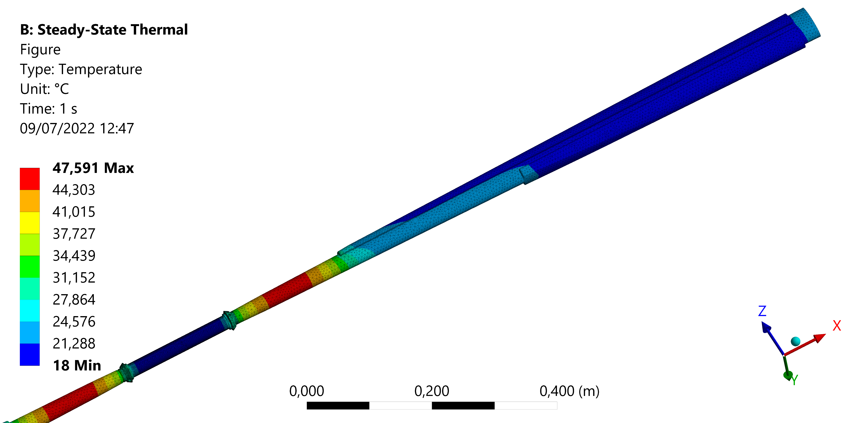
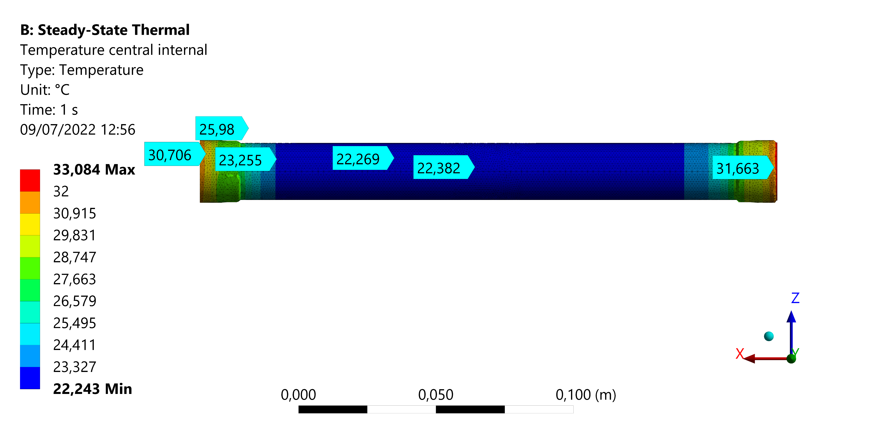
Structural analysis - chamber - results
 | Trapezoidal chamber | Central chamber
Coolant | Water | Paraffin
Maximum chamber temperature [°C] | 47,6 | 33,1
T_out coolant [°C] | 20,5 | 20,1
Von Mises stress [MPa]
 |  | Trapezoidal SX | Trapezoidal DX | Central IN | Central EX
BEAM | Fixed ends | 22,07 | 21,86 | 46,8 | 38,9
 | Fixed+displ | 14,65 | 10,63 | 9,69 | 17
Maximum displacement [mm]
 |  | X | Y
BEAM | Fixed ends | 0,031 | 0,07
 | Fixed+displ | 0,1 | 0,29

Slide 11
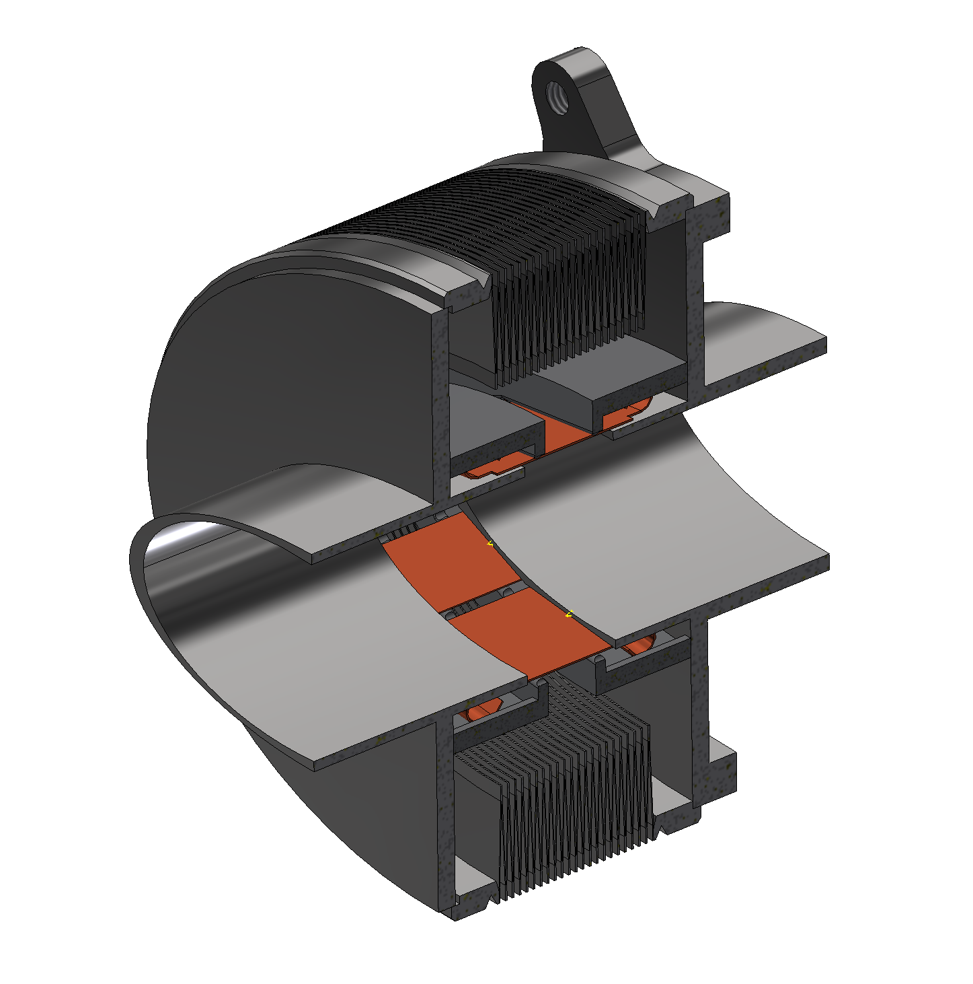
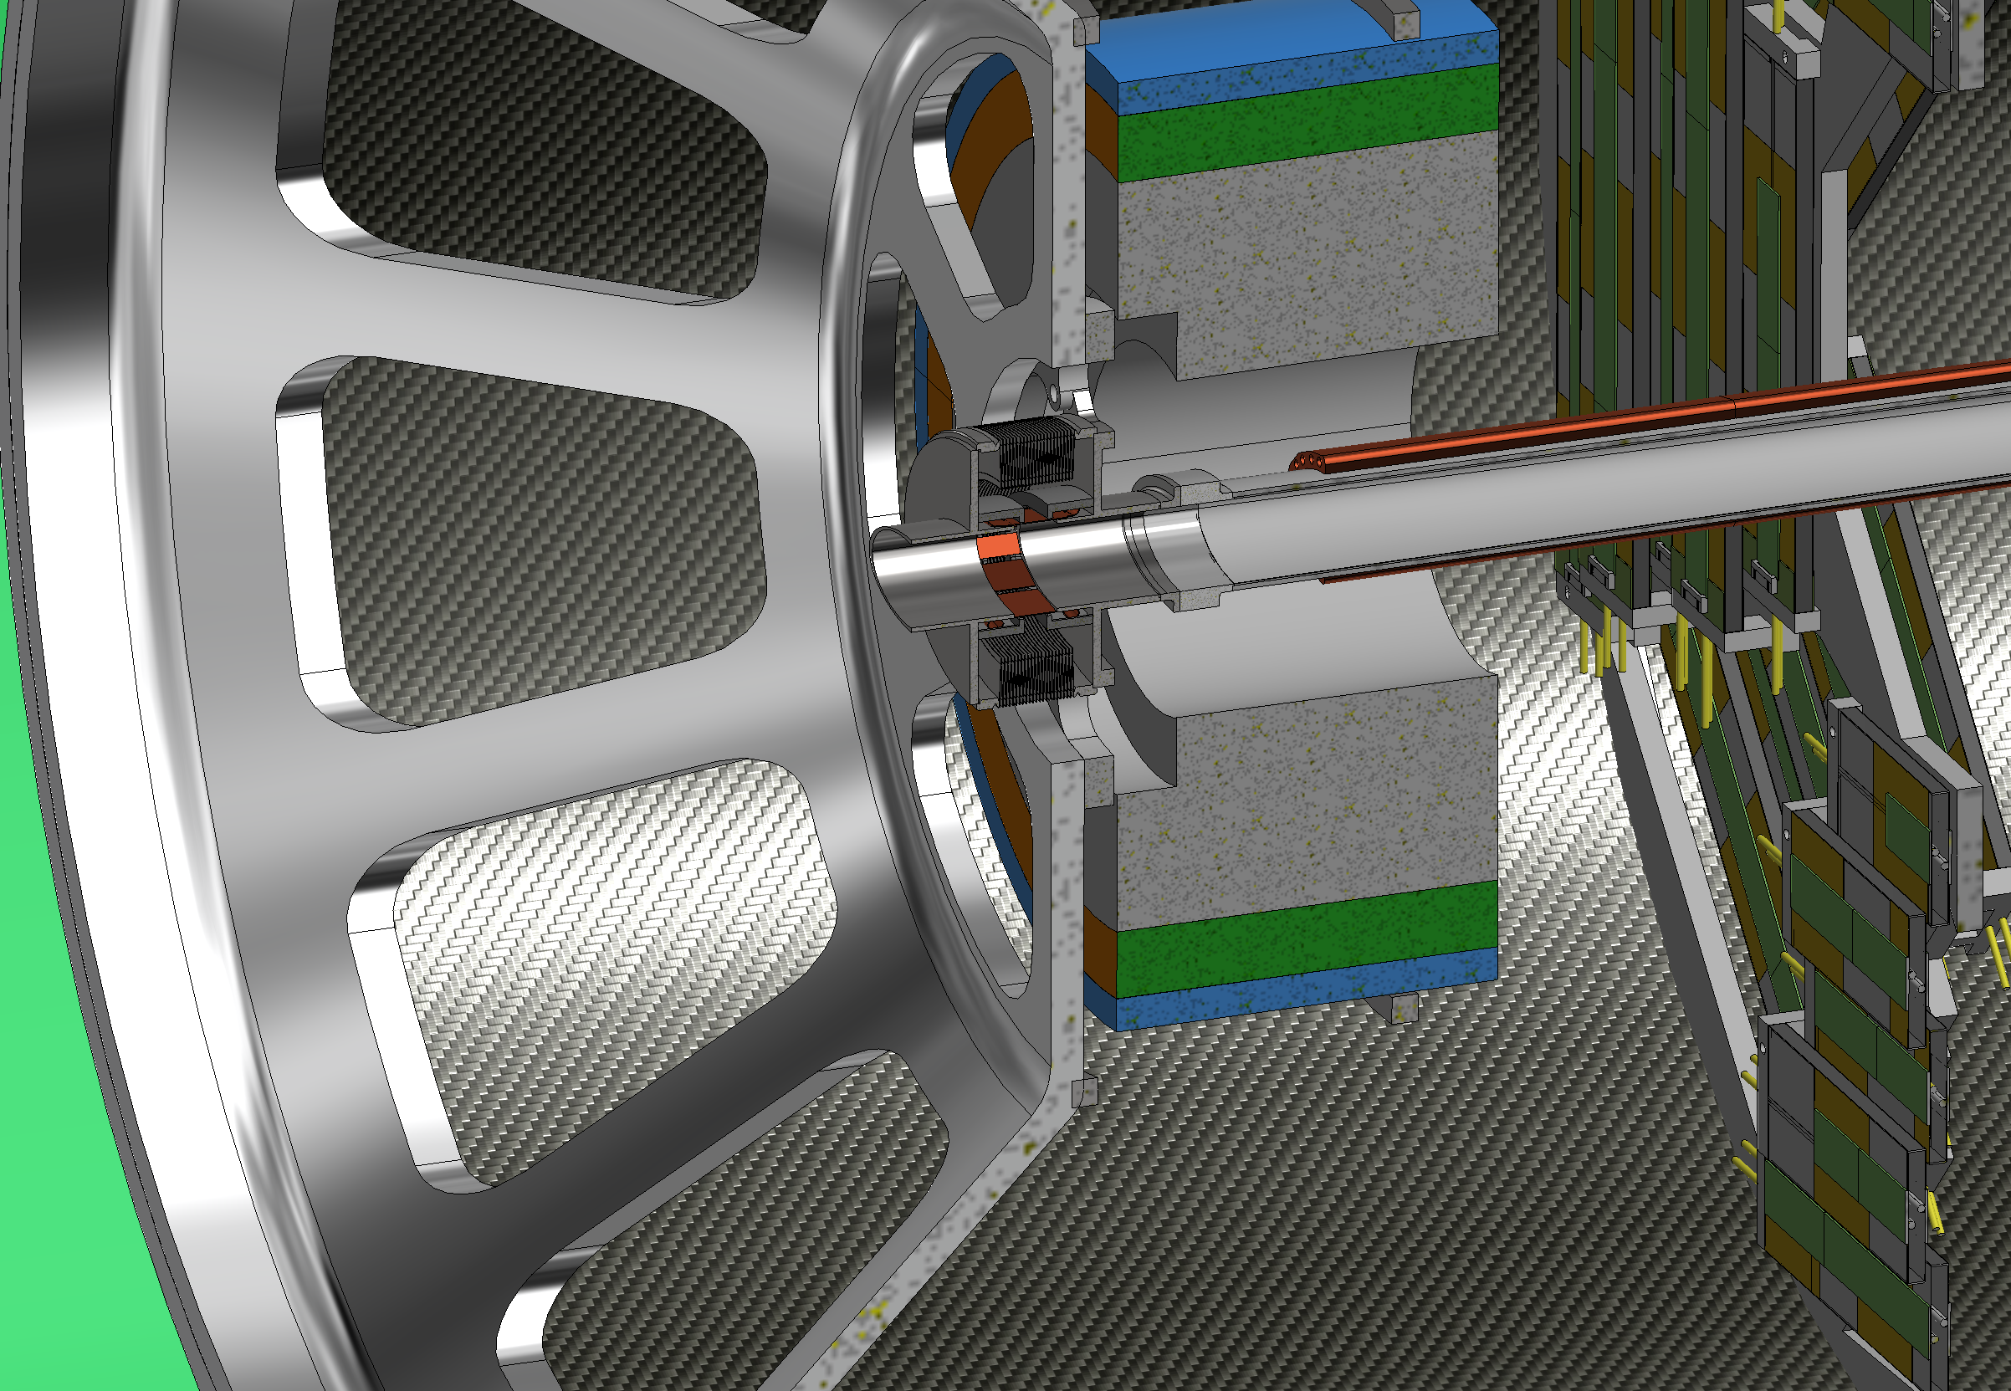
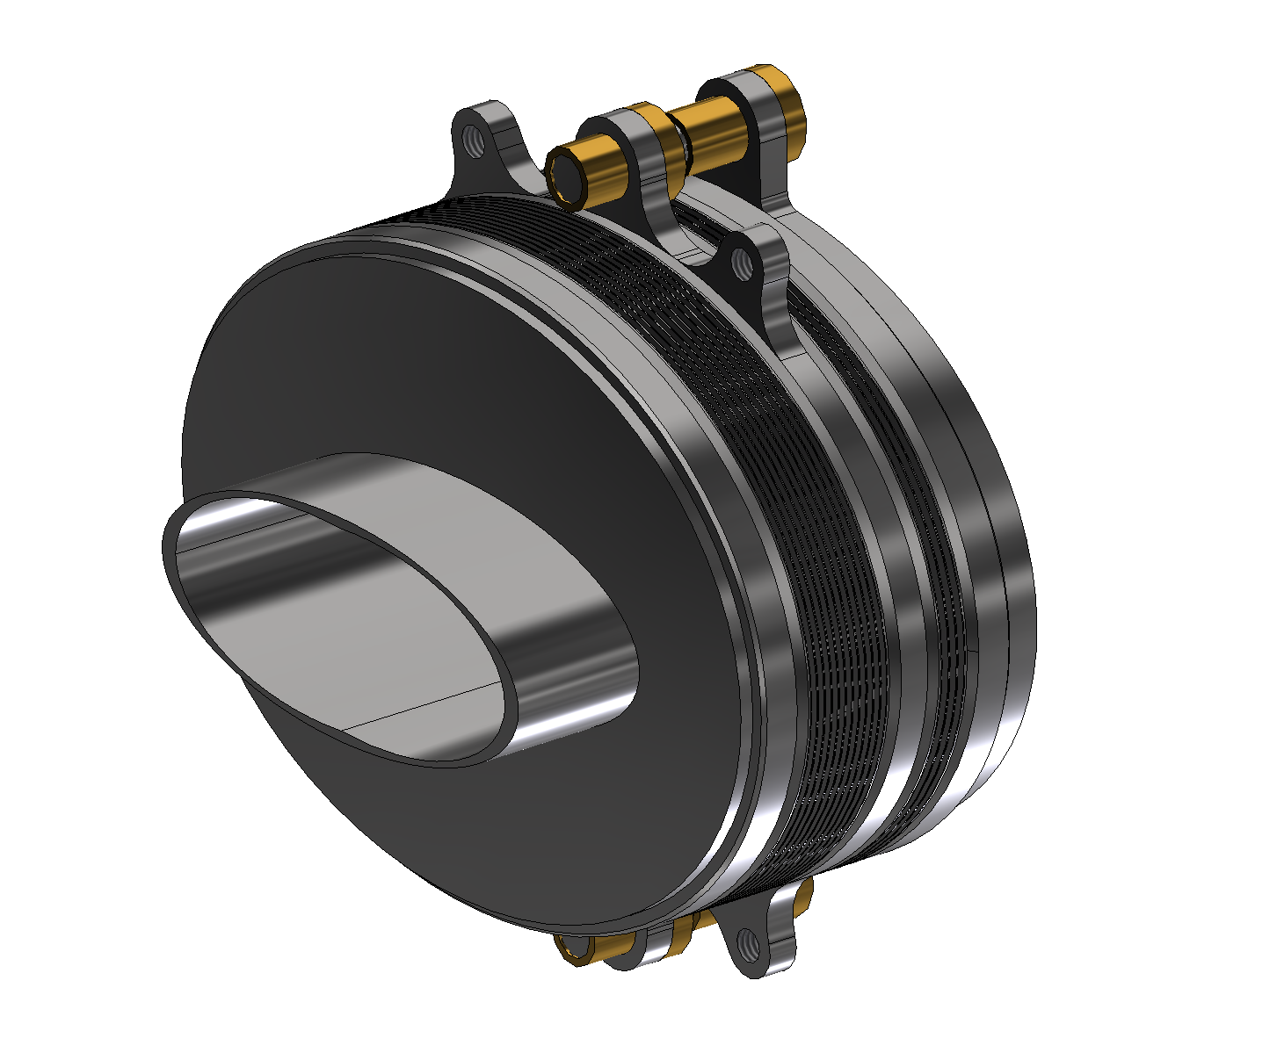
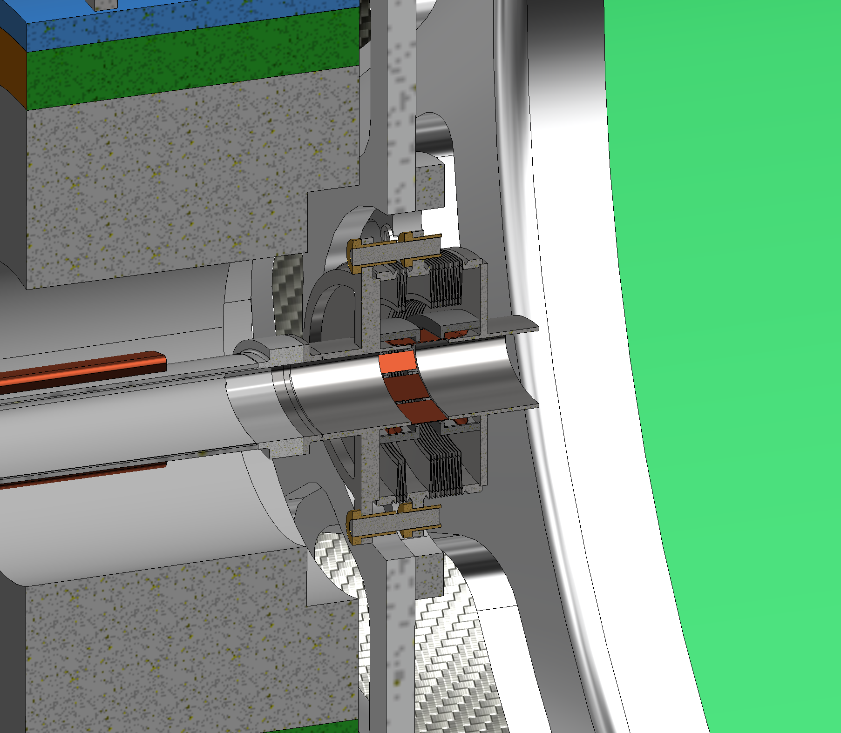
2nd Bellows (Double bellows)
Bellows
The use of Support Tube is designed to avoid overloads on central chamber during assembly and operation (thermal expansion). This solution has been obtained using two kind of bellows for the two sides of the support tube.
In short, in this way we can:
Protect the central chamber during the assembly procedure
Support properly the chamber bellows-to-bellows, containing the deformation
Allow the thermal deformation without compromising the chamber
1st Bellows (Single bellows)
Anchoring flange
IP SIDE
IP SIDE
IP SIDE
CRYOSTAT SIDE
CRYOSTAT SIDE
CRYOSTAT SIDE
CRYOSTAT SIDE
IP SIDE

Slide 12
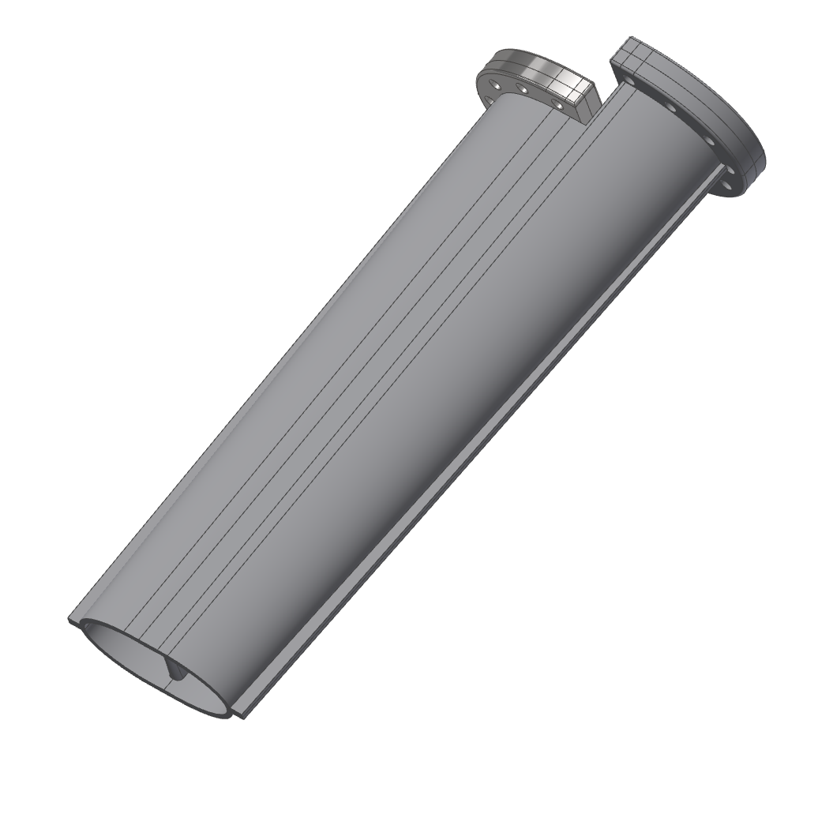
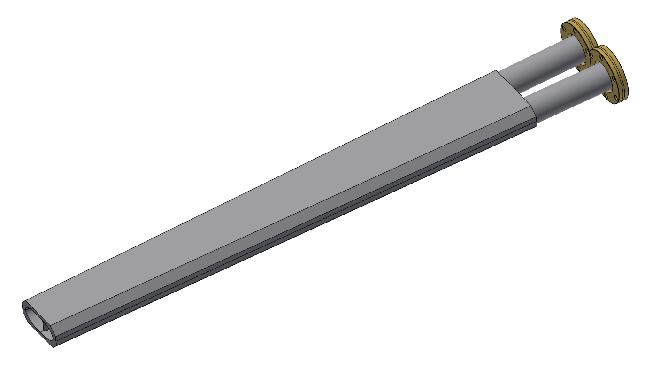
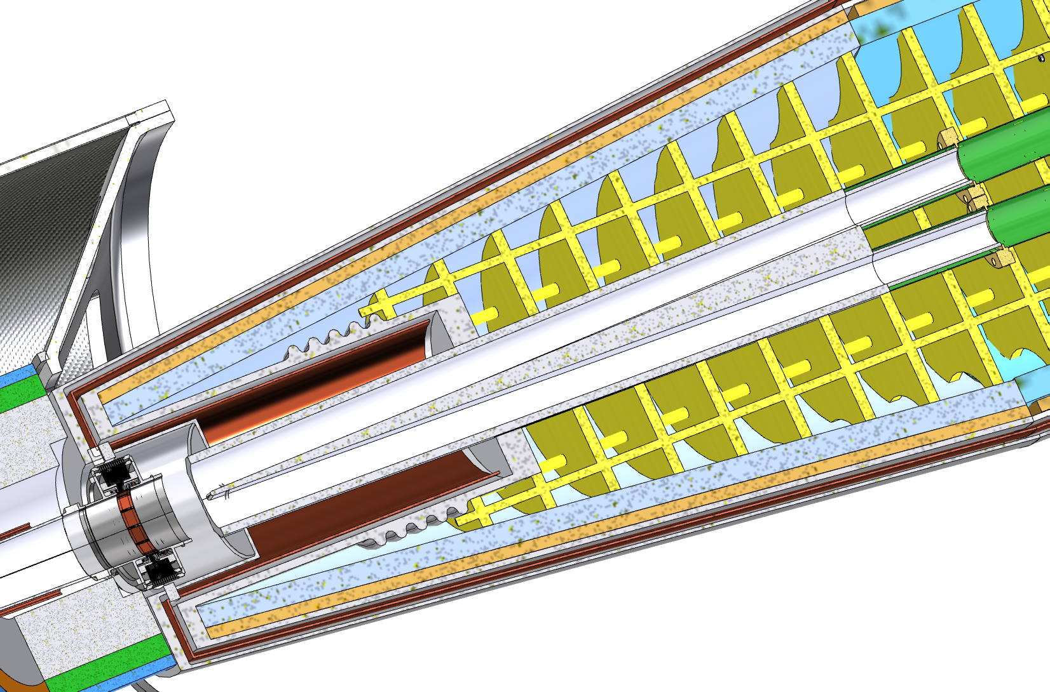
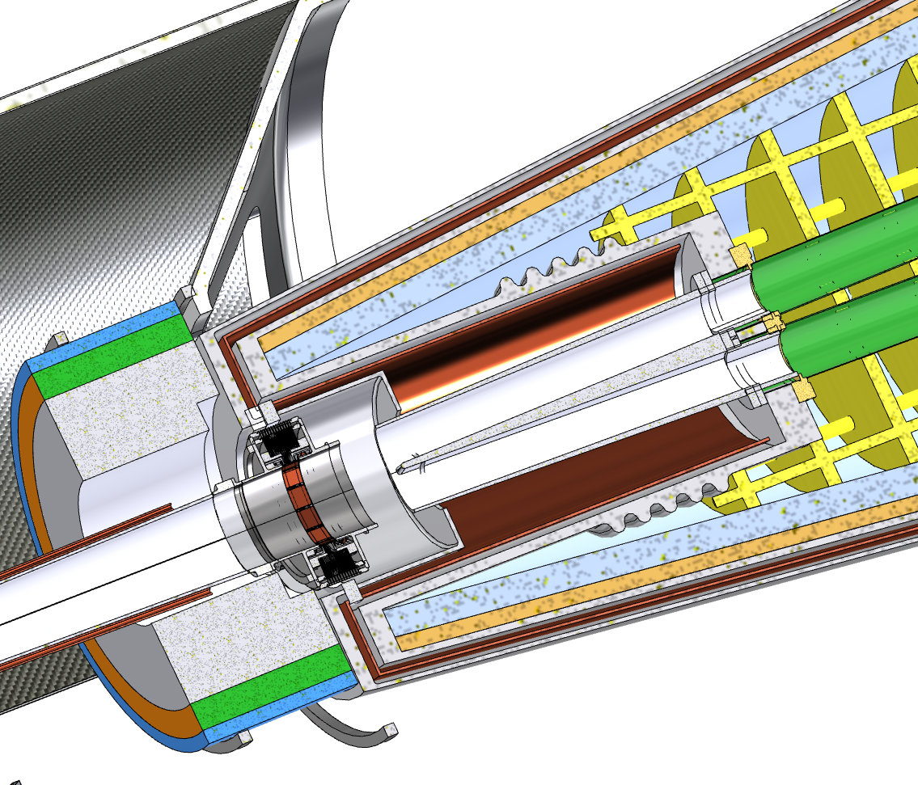
Crotch chamber
-1175 mm
Work in progress
Solution A
Solution B
Solution A:
Standard flanges
More space available for the crotch
Flanges in Helium
Solution B:
Flanges not in contact with Helium
Shorter chamber than solution A
Non standard flanges
Remote vacuum connection

Slide 13
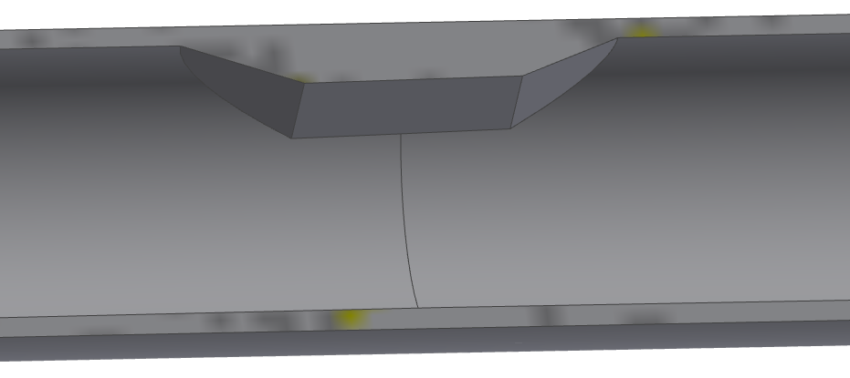
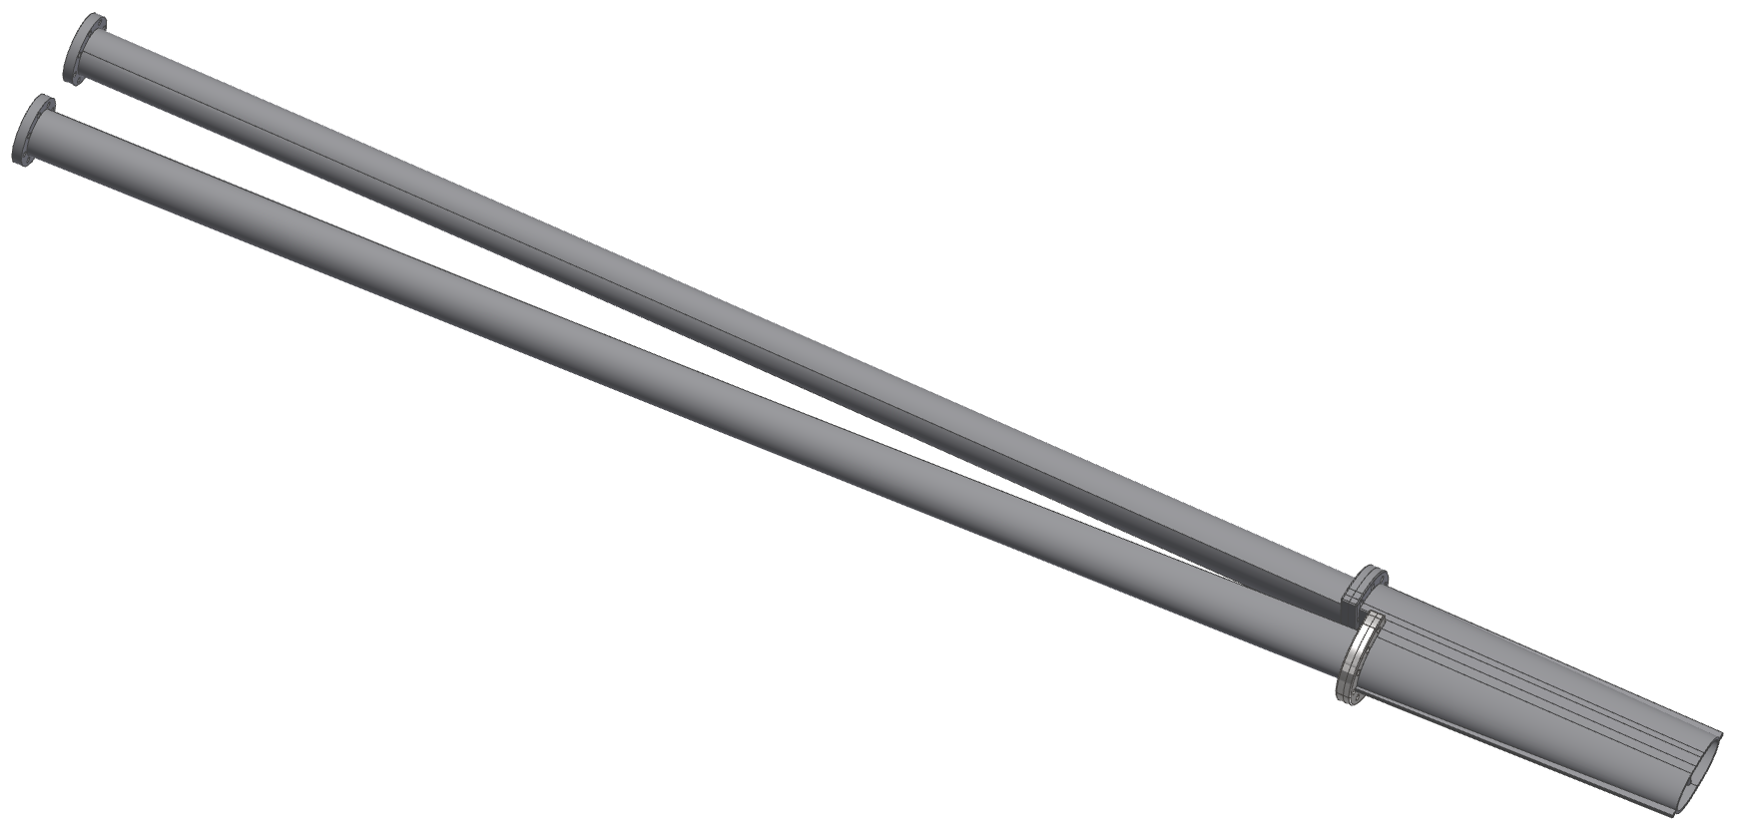
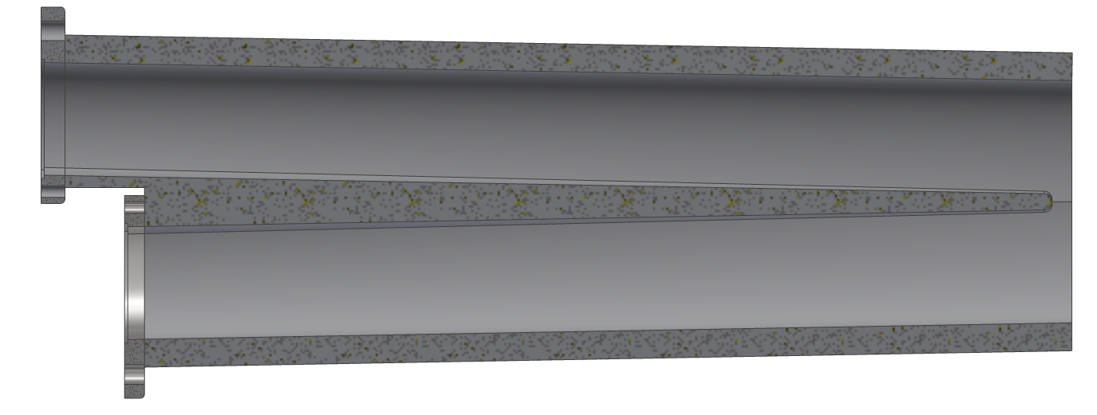
Start of circular pipe at 2550 mm from IP
SR MASK
2550 mm
Very preliminary design
Not regular shape
Custom flanges
It is a work in progress:
Shape
Flanges geometry
Interface with Remote vacuum connection
REMOTE VACUUM CONNECTION BLOCK
Shifted flanges
IP

Slide 14
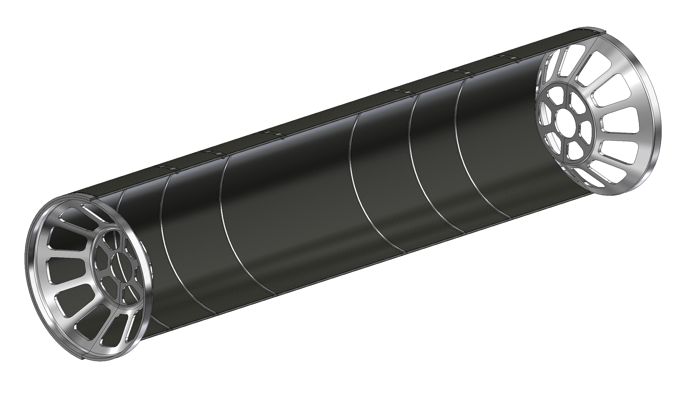
Support tube – description
The support tube aims to :
Provide a cantilevered support for the pipe.
Avoid loads on thin-walled central chamber during assembly or due to its own weight
Support LumiCal.
Support the Medium, Outer Vertex and Vertex Disks.
The structure is made with a multiple layer structure:
CF + HC + CF
To allow the support of the disks are necessary reinforcement ribs.
The cylinder is split in two halves to simplify the assembly procedure
The Aluminium endcaps support the LumiCal and the beampipe
Aluminium endcaps
CF=carbon fibre
HC=honeycomb
Aluminium ribs

Slide 15
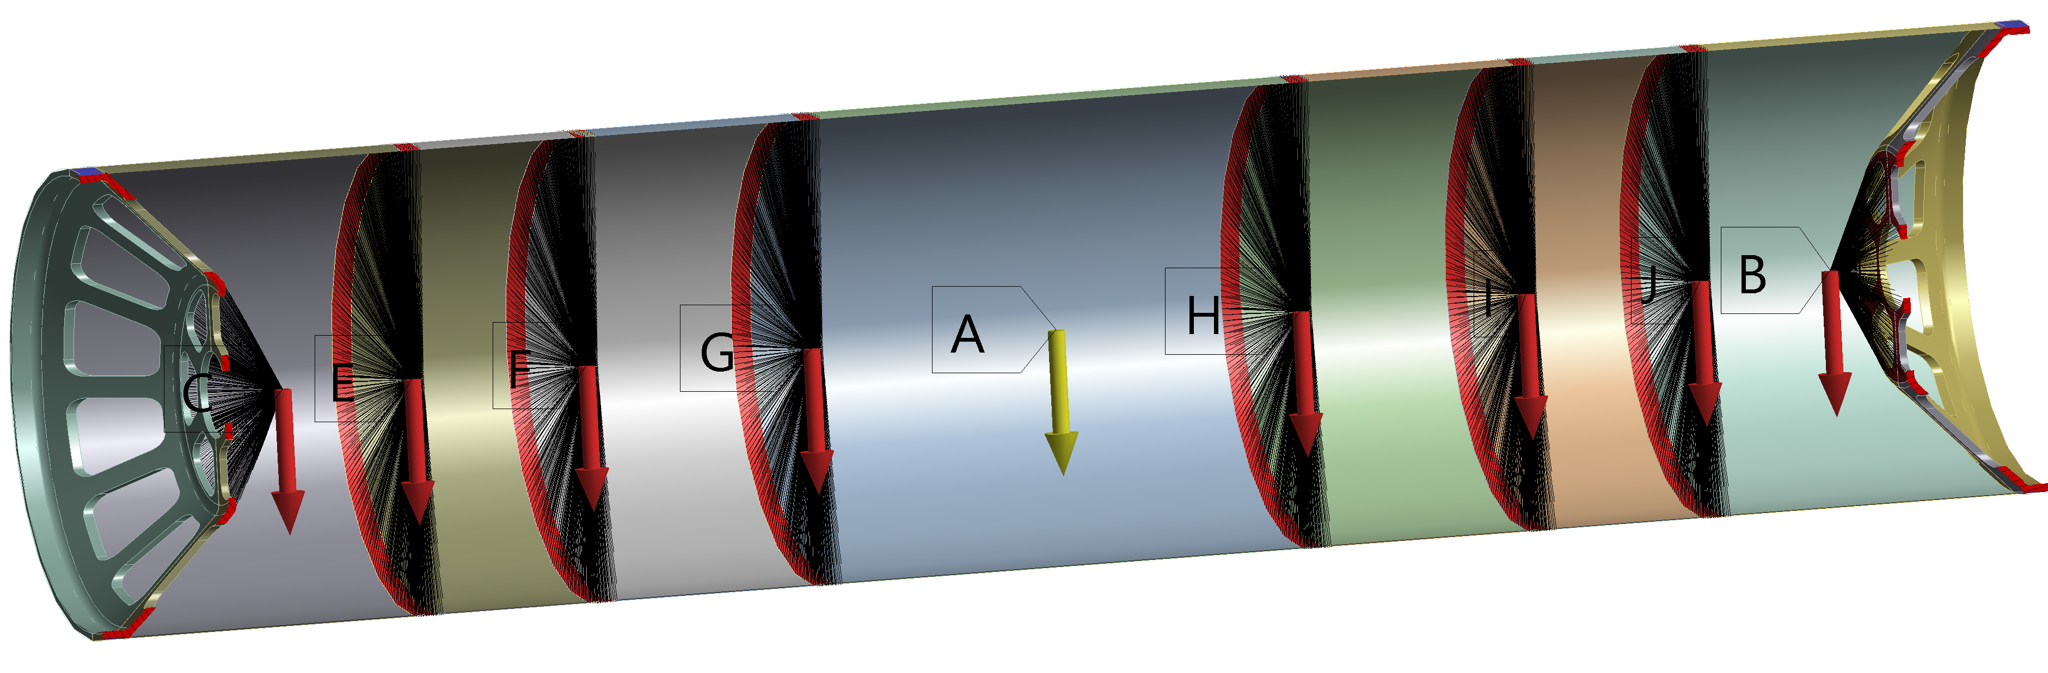
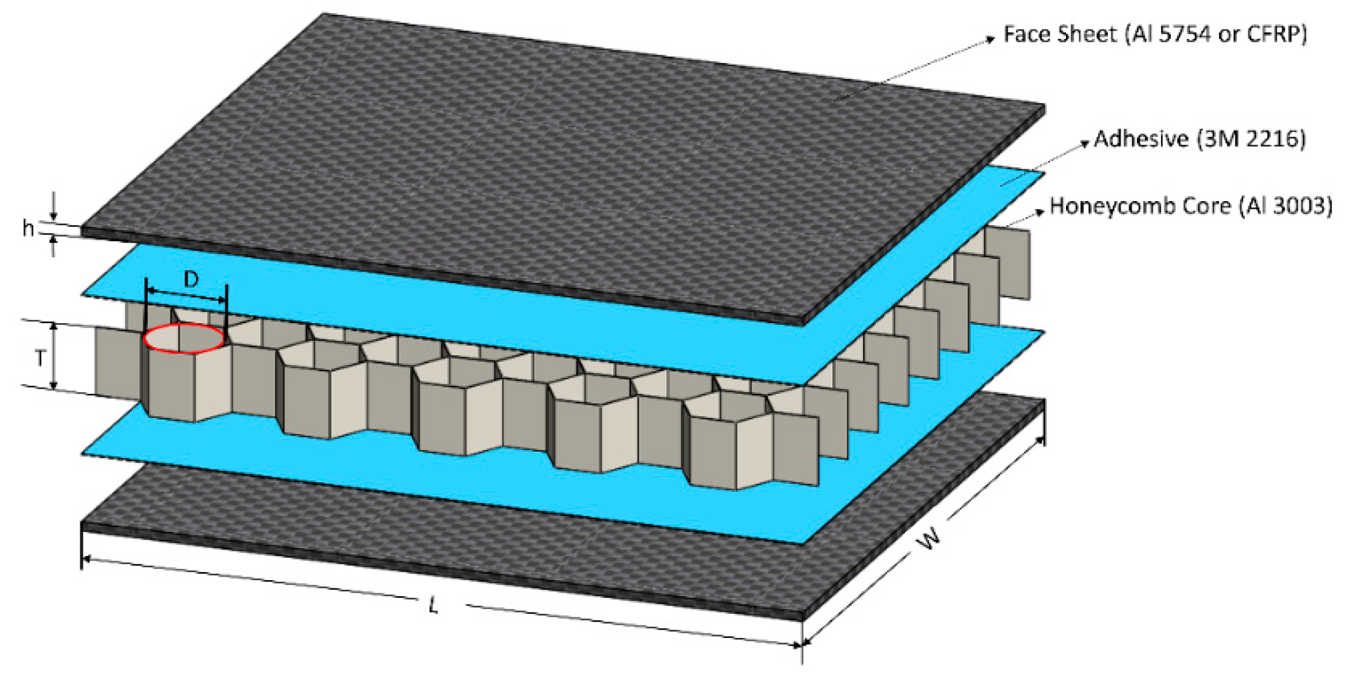
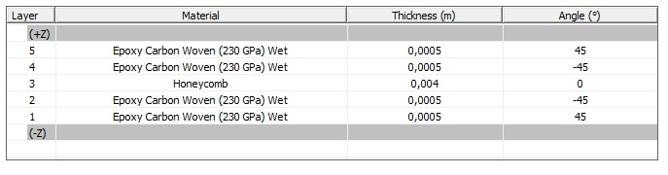
Support tube – loads and constraints
The aim of this analysis is to calculate the stress and displacement in each part of the cylinder (Al reinforcement, carbon fiber, honeycomb).
It is necessary to set:
Chamber | 50 kg
LumiCal | 70 kg + 70 kg
Vertex Disks | 6*10 kg
Outer Vertex | 15 kg
Medium Vertex | 7 kg
First guess loads (overestimated)
Constraint configuration → double fixed ends
Loads configuration
Carbon fiber/ honeycomb creation → layered section

Slide 16
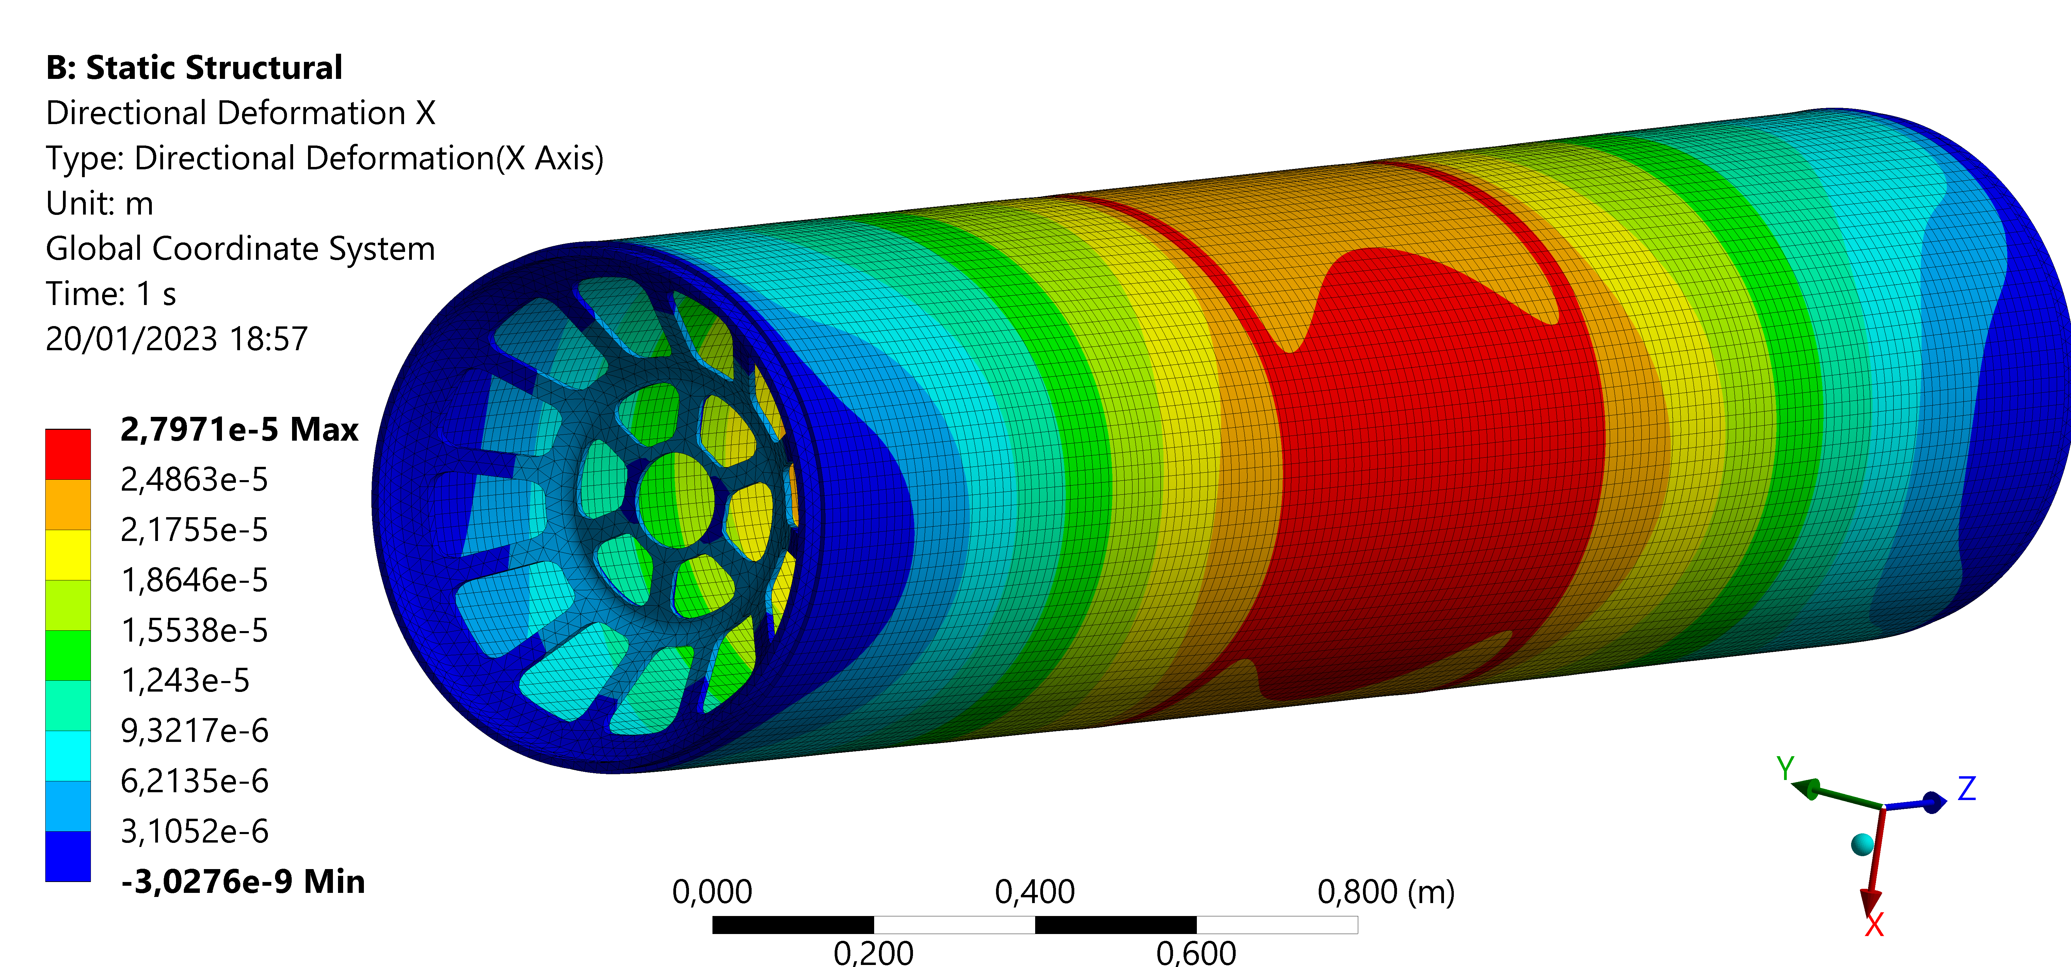
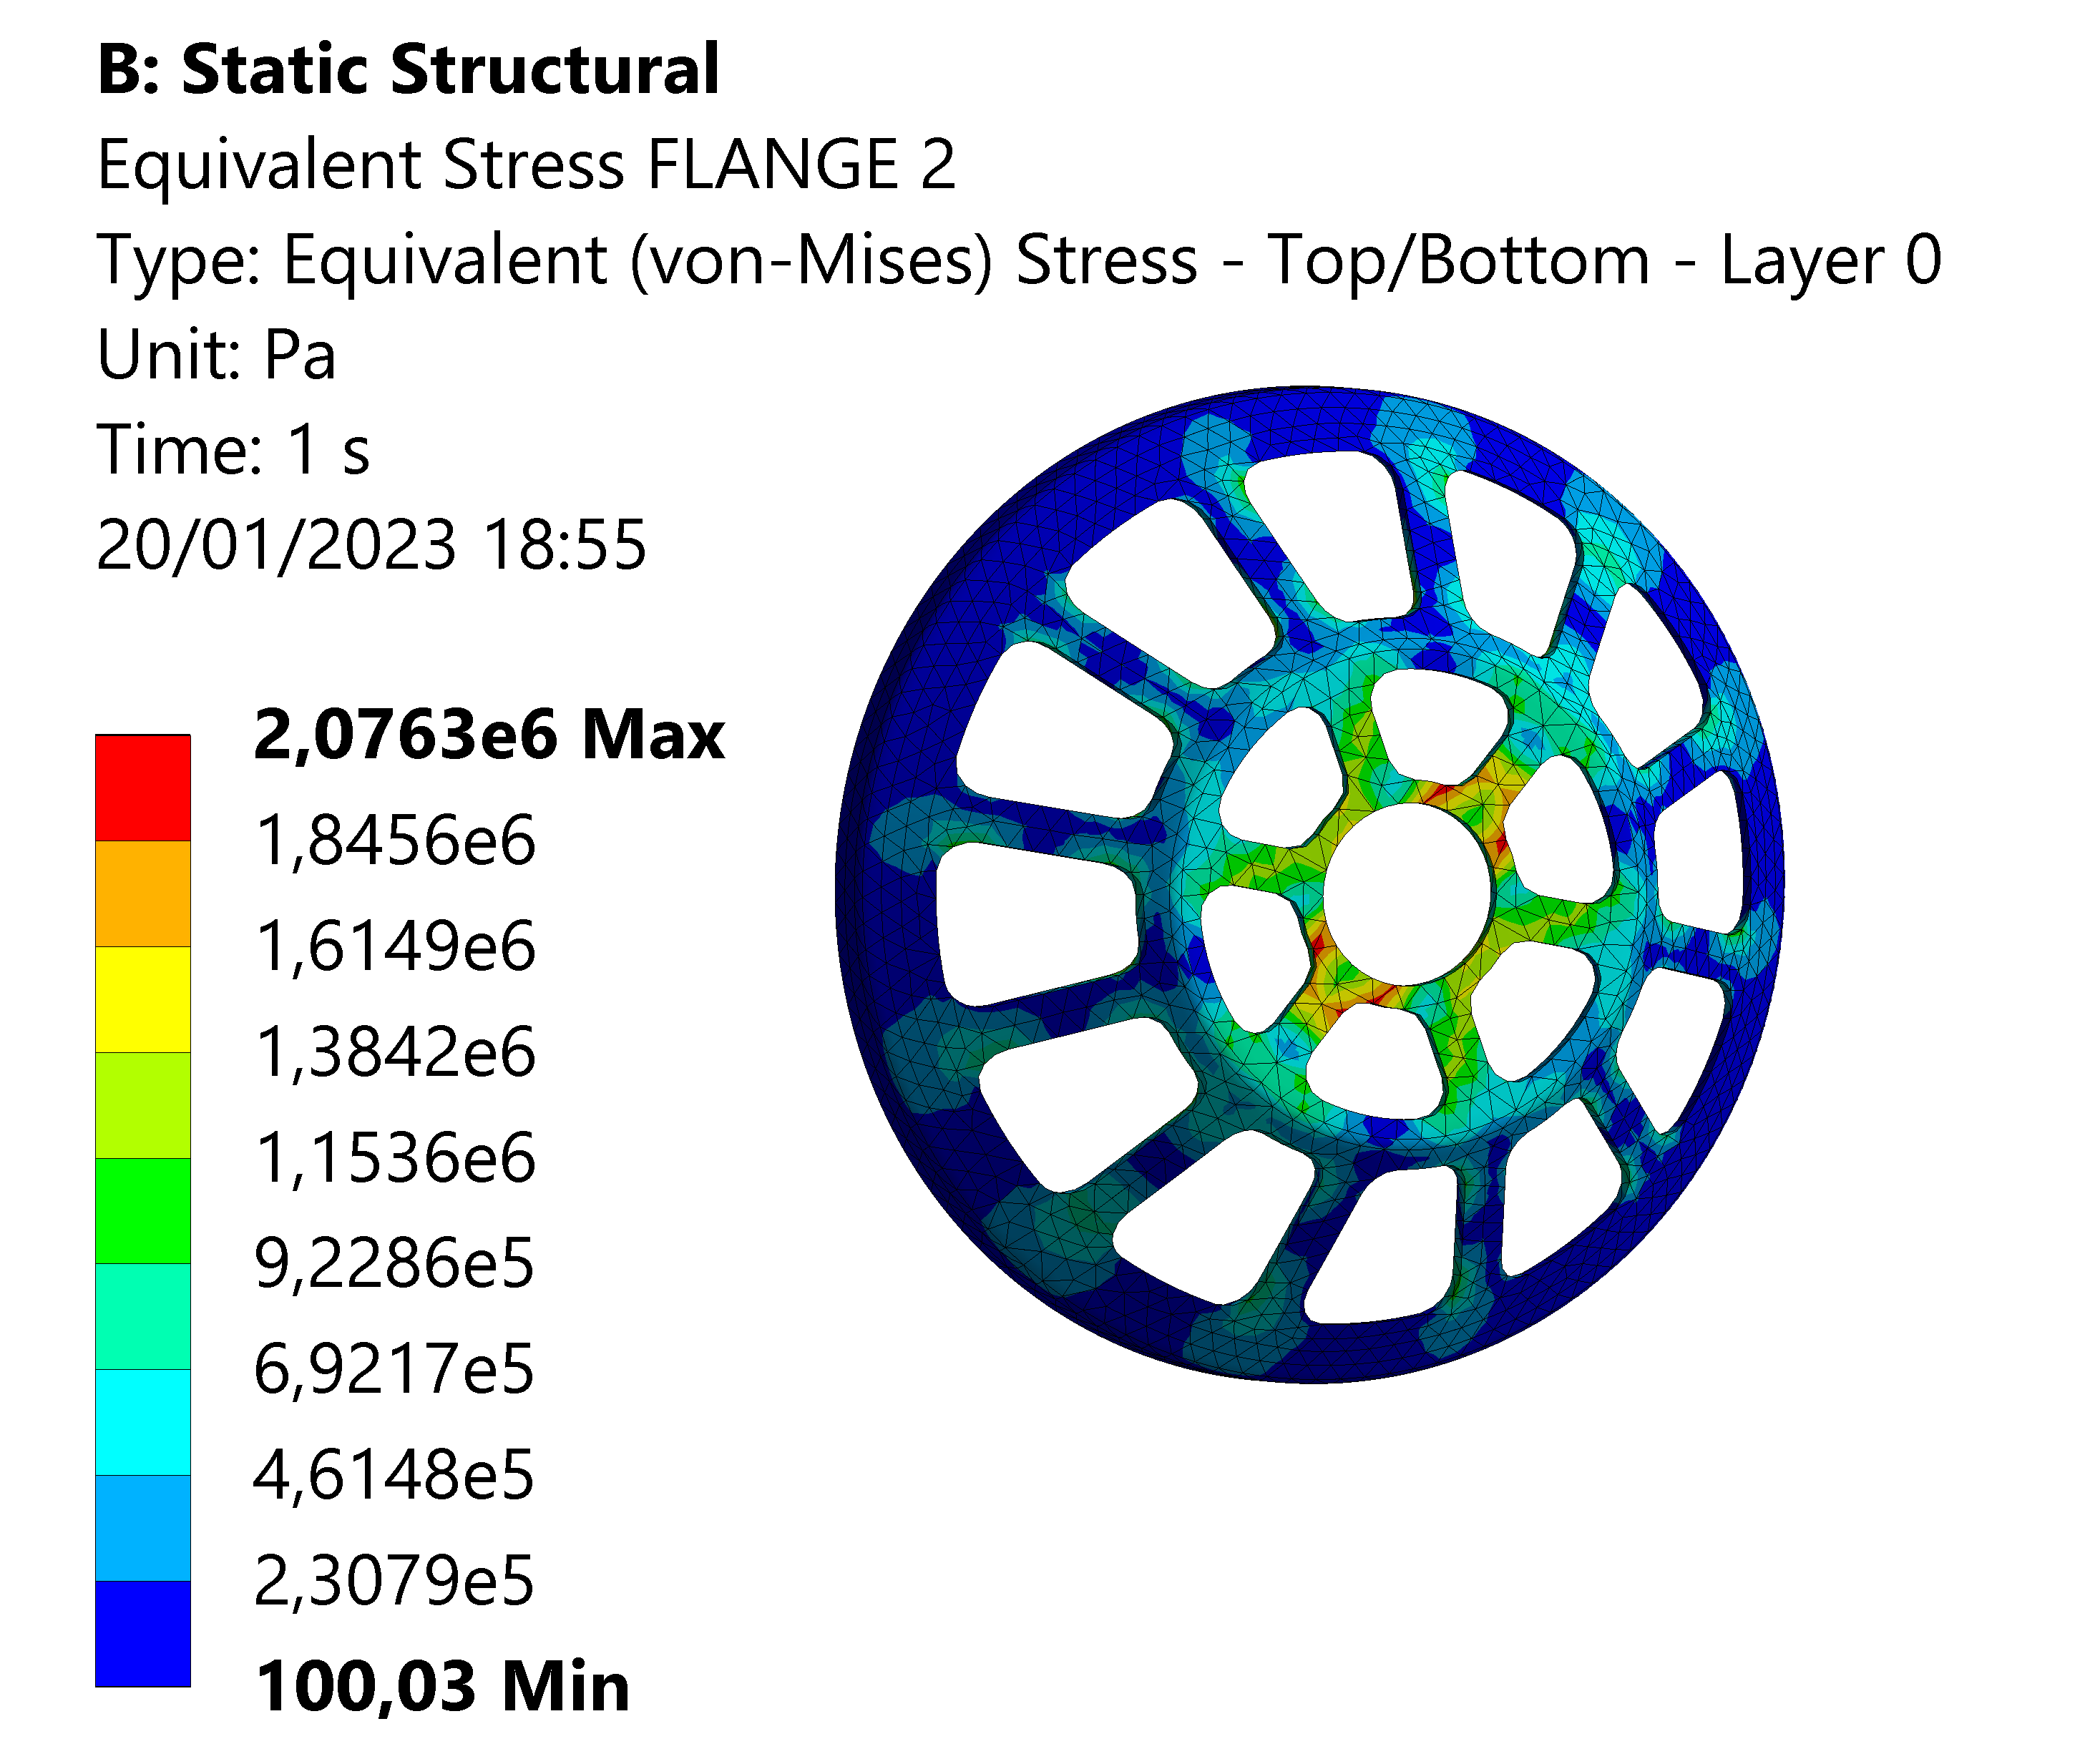
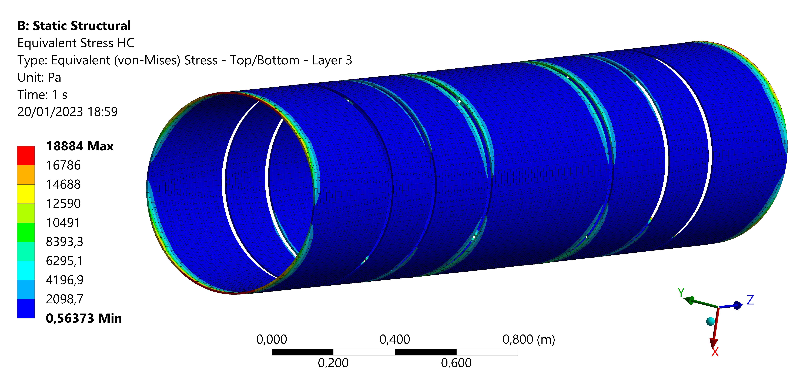
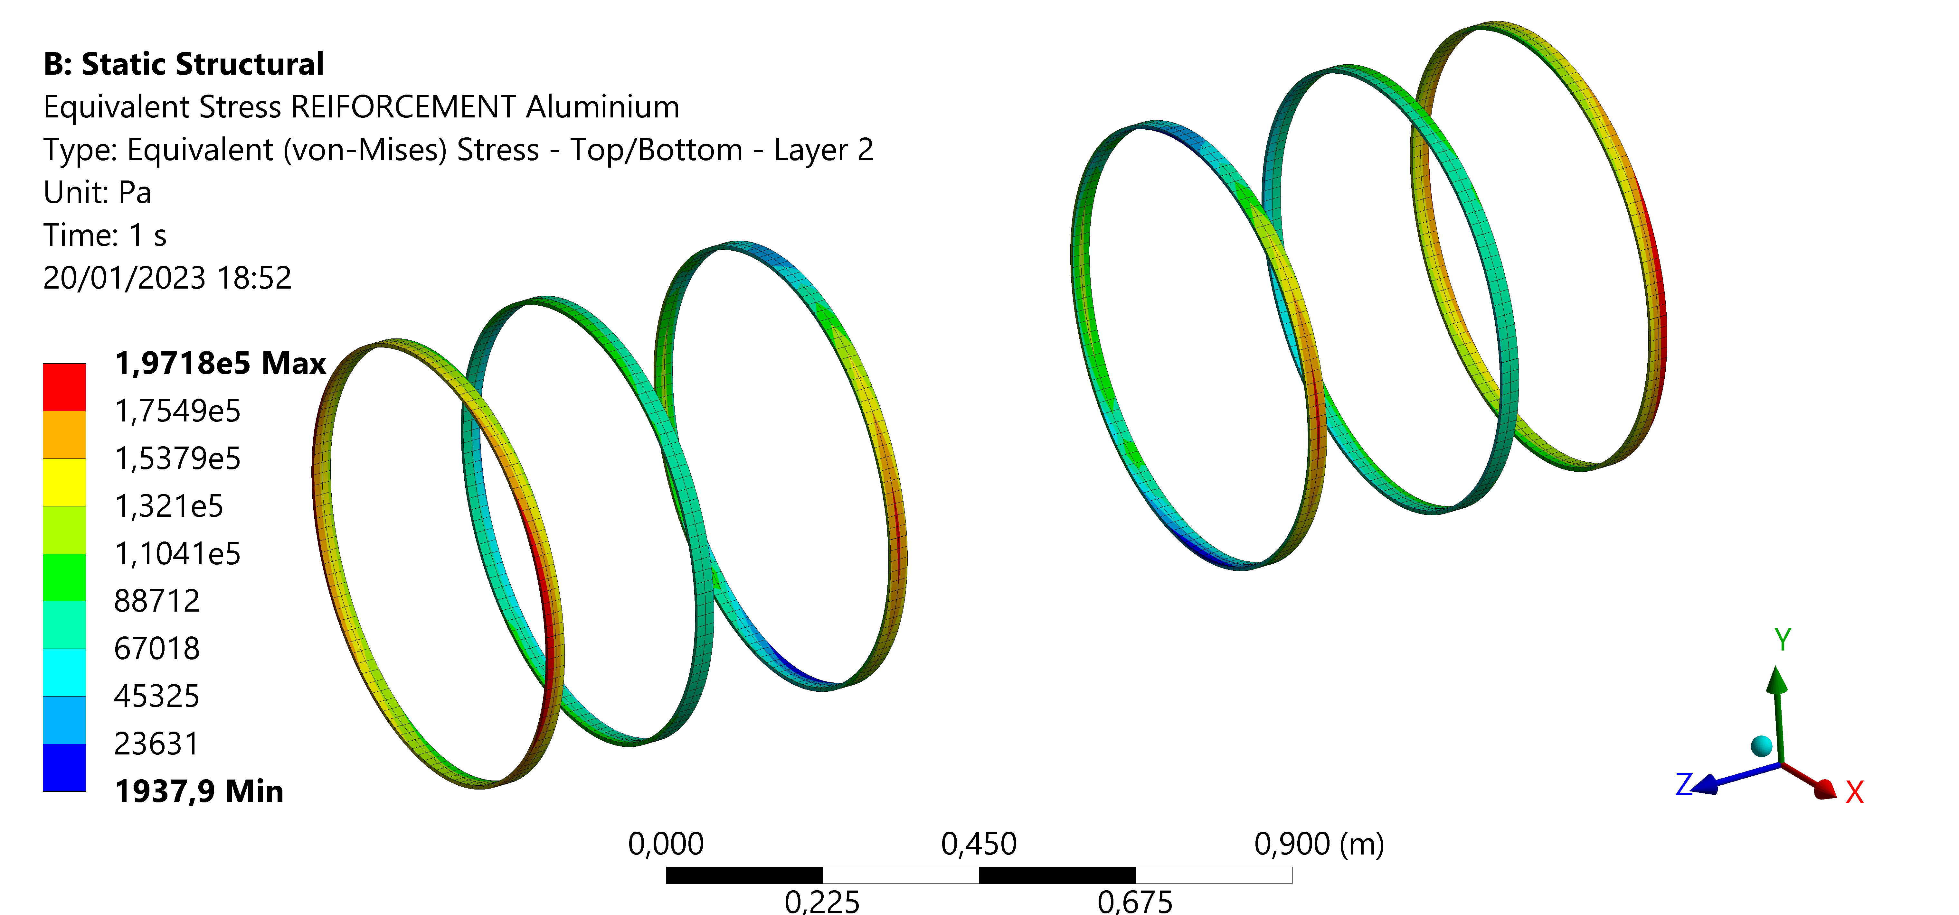
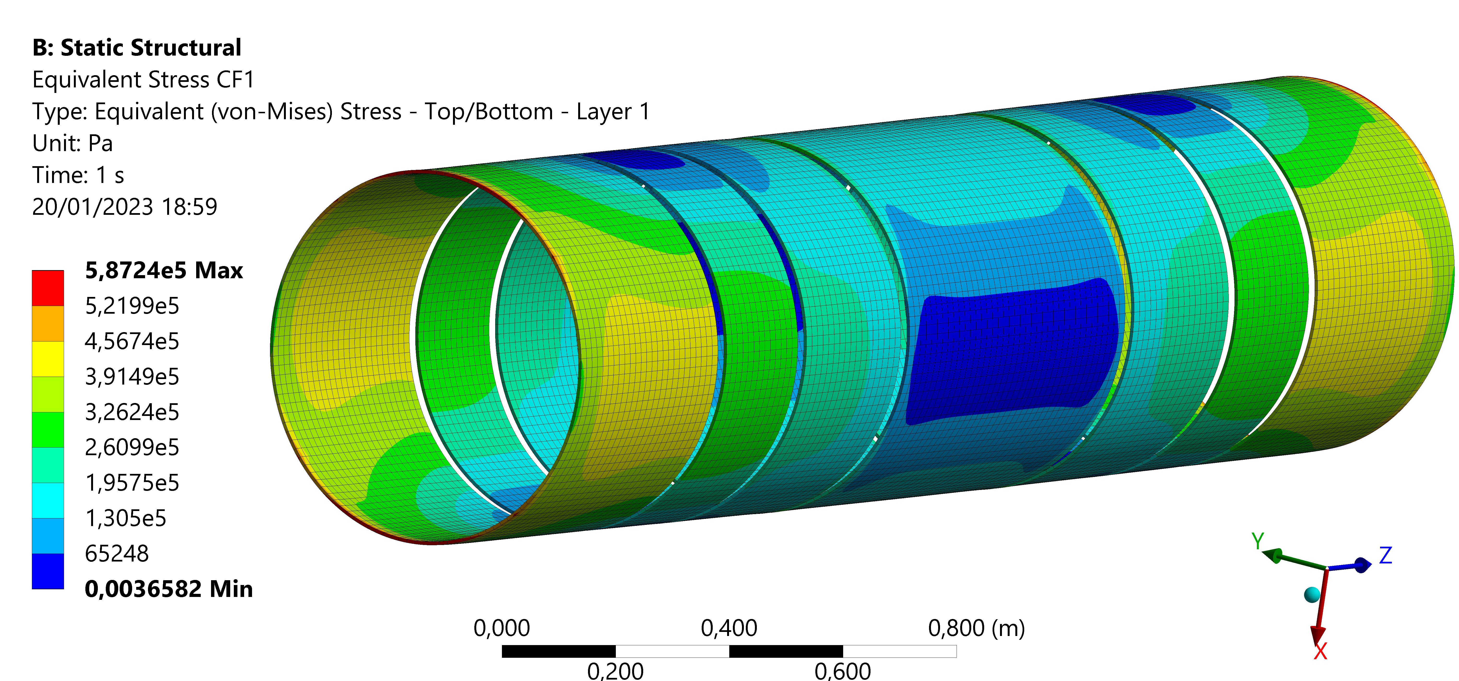
Support tube – Structural analysis – results
 | Maximum stress [MPa]
Aluminium flanges | 2.08
Aluminium ribs | 0.20
Honeycomb | 0.02
Carbon fiber | 0.60
 | Maximum displacement X [mm]
Aluminium flanges | 1.34 e-2
Aluminium ribs | 2.62 e-2
Composite | 2.80 e-2

Slide 17
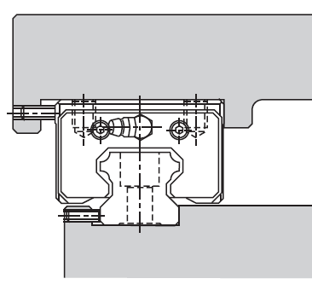
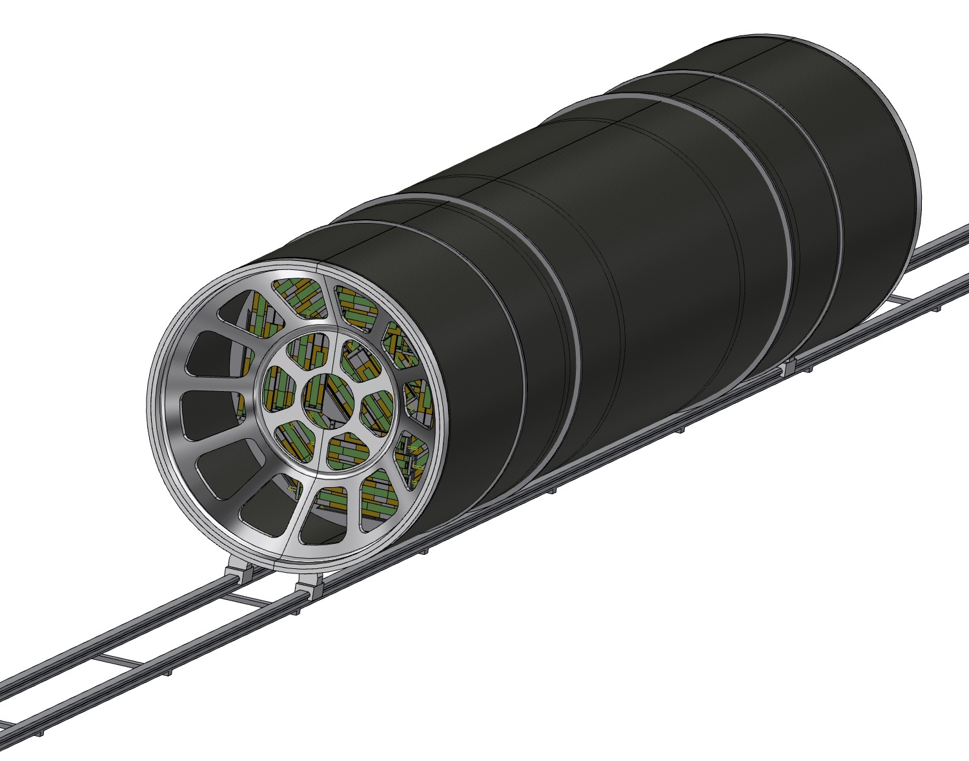
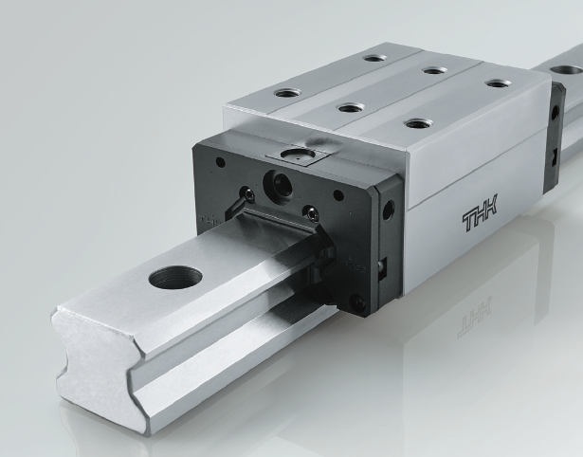
Support tube – Rail
SECTION
The support tube needs to be inserted into the main detector; the idea is to use a rail, starting from the outside of the detector to allow the sliding of the cylinder.
To assure a good precision and appropriate support it is necessary to use the linear bearings; different types are available, the choice has to be made considering:
Required positioning precision
Weight of the whole structure
Necessary degrees of freedom
After the positioning the rail will be removed, and the support tube attached to the detector

Slide 18
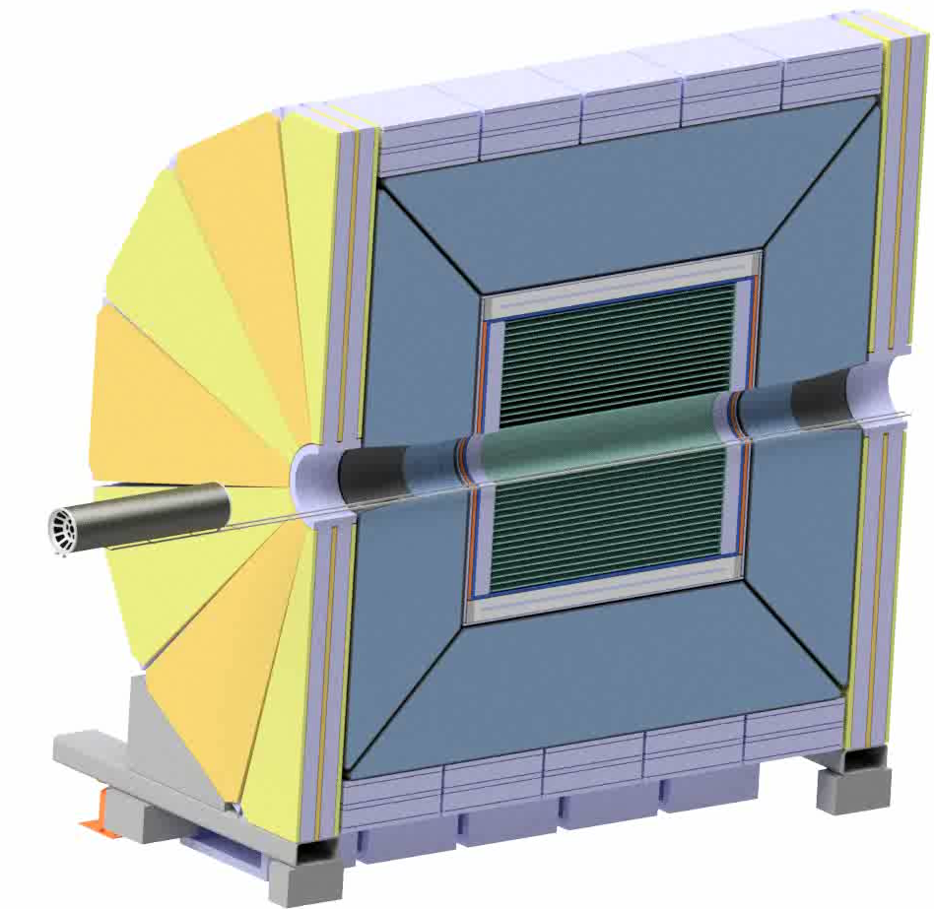
Under study:
Rail support
Rail anchoring
Rails length
Geometry of the rail section
Linear bearing type
Positioning system
Hypothesized anchoring point
To continue the design, it is necessary to know:
Allowable anchoring point from detector side
Allowable space (internal detector diameter and geometry)

Slide 19
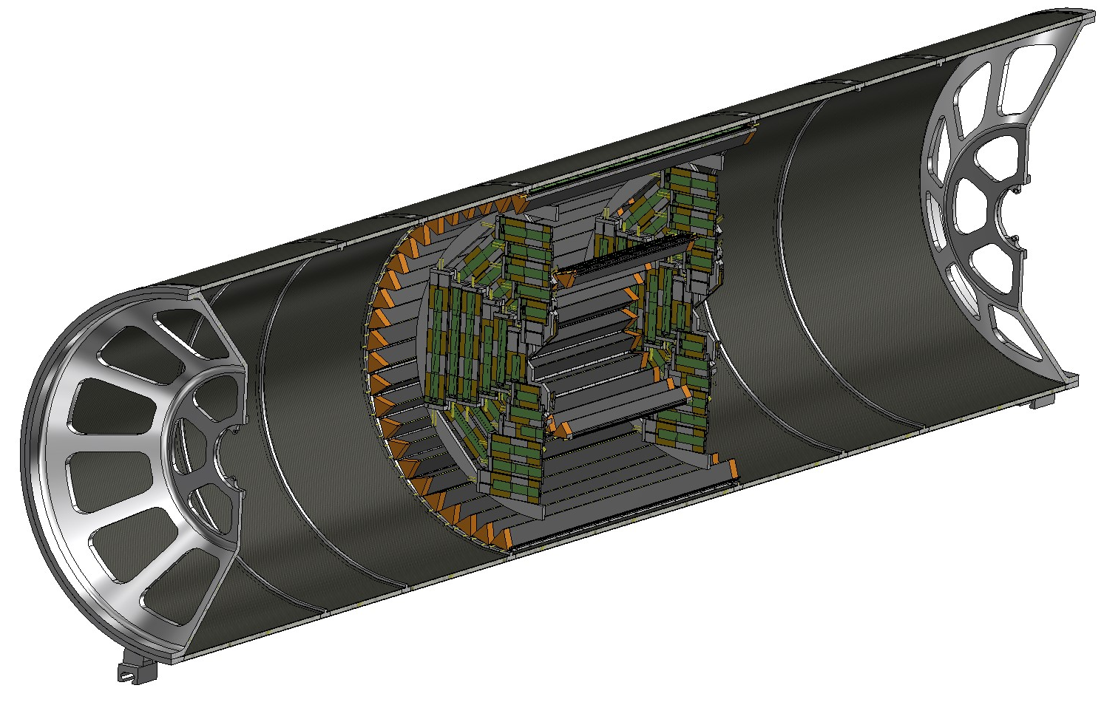
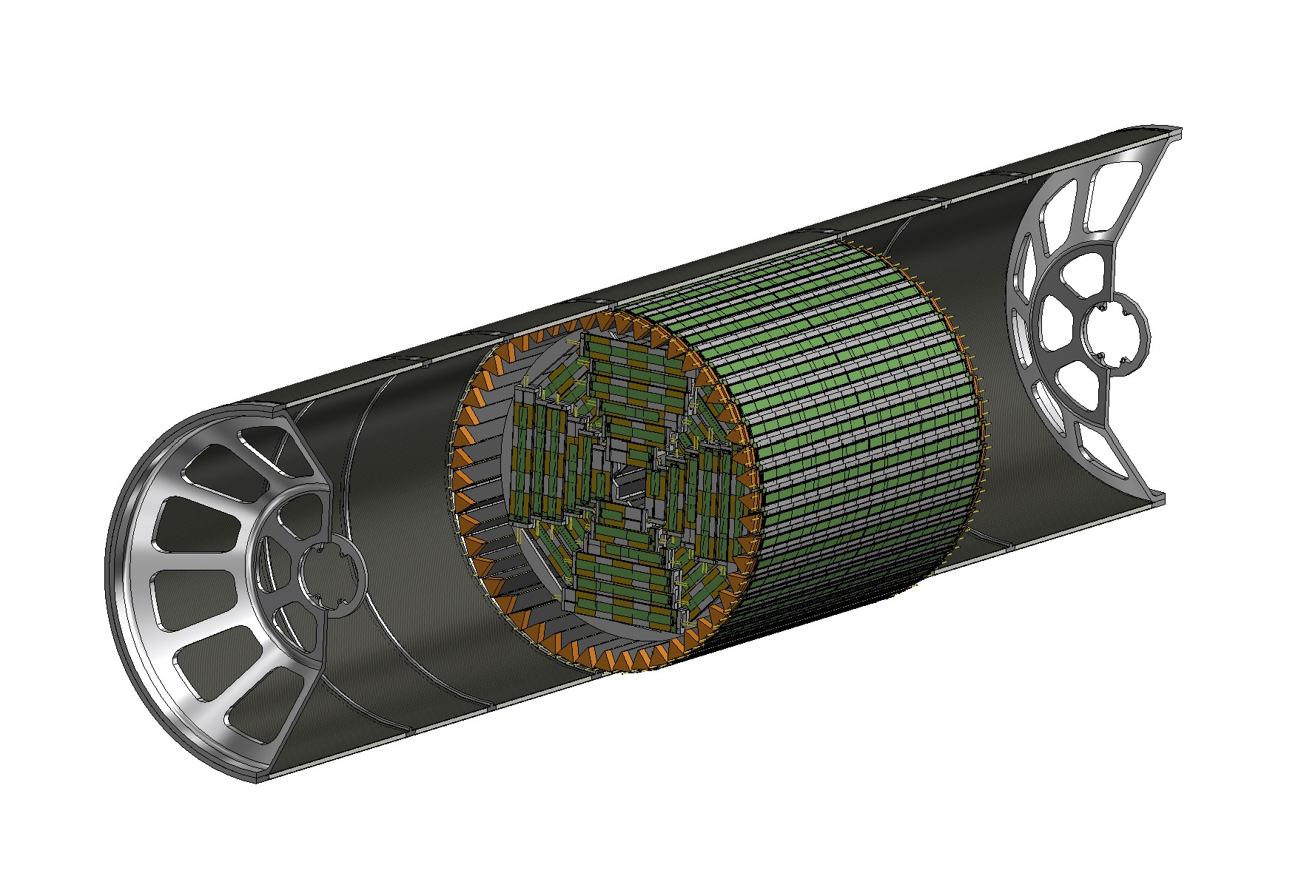
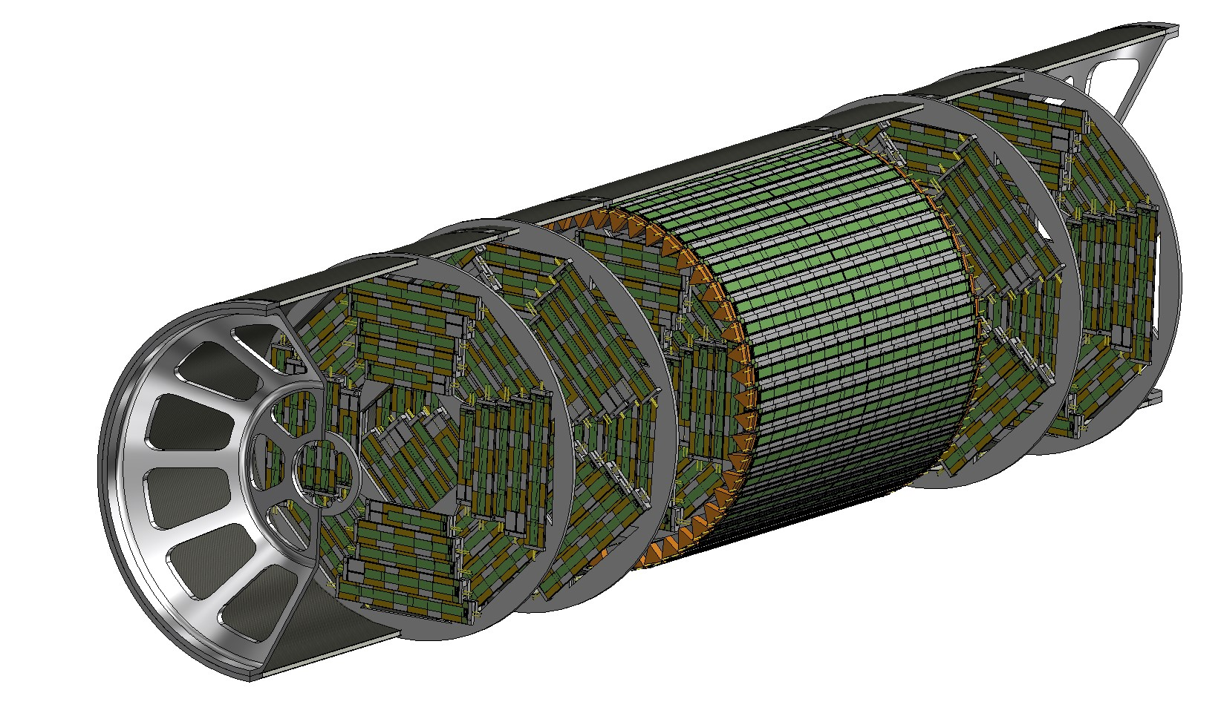
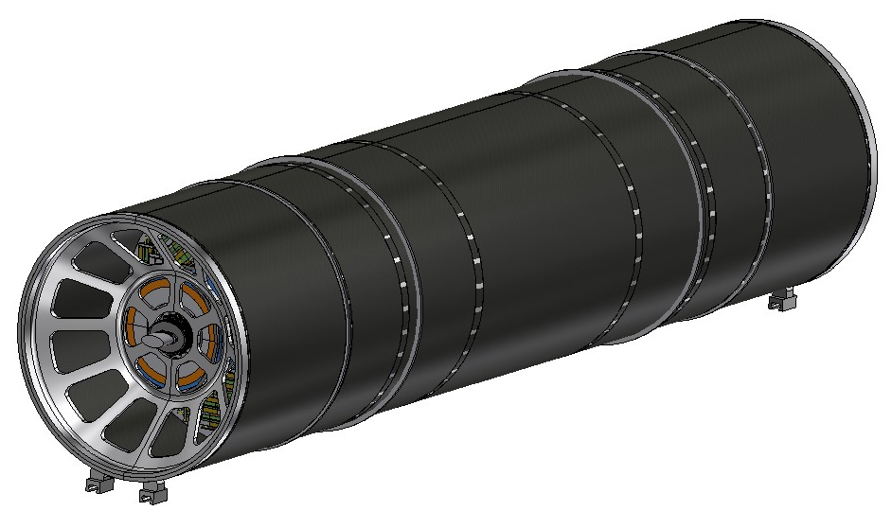
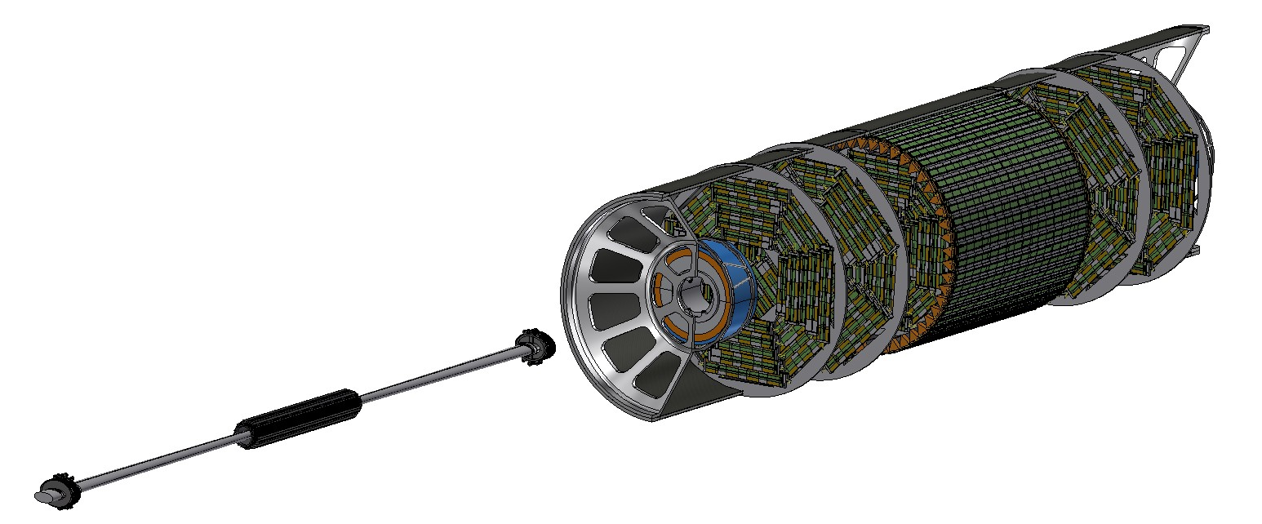
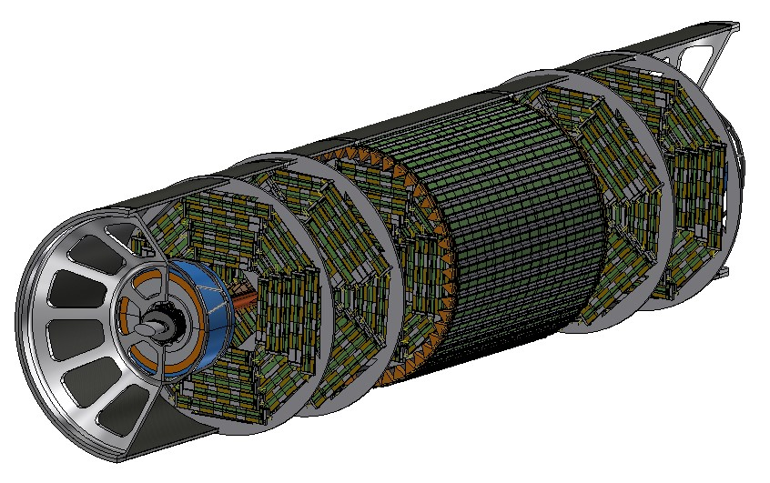
Assembly procedure
Section view
2) Disks 2 and 3 are installed inside the support tube
1) Outer tracker, Medium tracker and disks 1 are installed as a rigid structure inside the support tube
3) LumiCal is installed in centered position, then beam pipe with vertex detector is inserted with a dedicated tool inside disks and outer tracker, then fixed to both endcaps
4) LumiCal can be aligned in the correct position on the outgoing beams
5) Support tube can be closed

Slide 20
Conclusion
The current central chamber design has been proposed and is compatible with the Inner Vertex design.
The design of conical chamber has been developed and is compatible with LumiCal requirements.
The preliminary design of crotch chamber has been proposed.
The concept of Support Tube has been introduced and the proposal of an assembly strategy as well.
The preliminary structural analyses have been performed and the results are compatible with the requirement in terms of allowable maximum stress and displacement.

Slide 21
\

